Slide 1

Economics
THE AGGREGATE DEMAND/AGGREGATE SUPPLY MODEL

Slide 2
Ch.24 OUTLINE
24.1: Macroeconomic Perspectives on Demand and Supply
24.2: Building a Model of Aggregate Demand and Aggregate Supply
24.3: Shifts in Aggregate Supply
24.4: Shifts in Aggregate Demand
24.5: How the AD/AS Model Incorporates Growth, Unemployment, and Inflation
24.6: Keynes’ Law and Say’s Law in the AD/AS Model

Slide 3
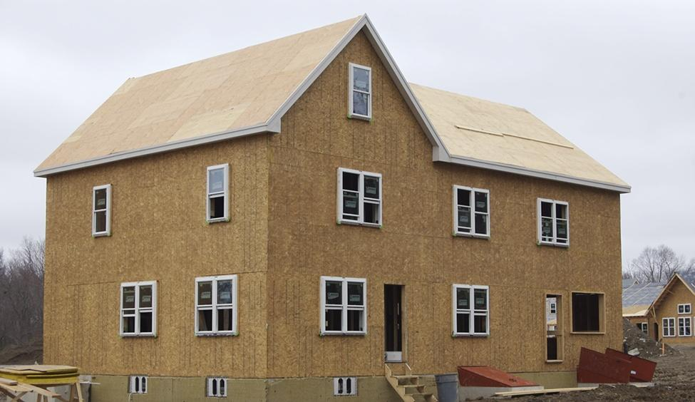
New Home Construction
At the peak of the housing bubble, many people across the country were able to secure the loans necessary to build new houses. (Credit: modification of "our house! Again!" by Tim Pierce/Flickr Creative Commons, CC BY 2.0)

Slide 4
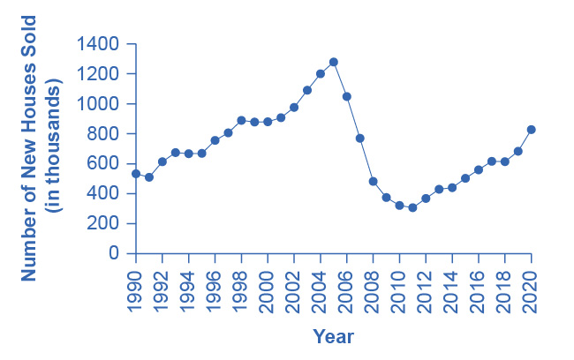
New Single Family Houses Sold
From the early 1990s up through 2005, the number of new single family houses sold rose steadily.
In 2006, the number dropped dramatically and this dramatic decline continued through 2011.
Beginning in 2012, the number of new houses sold began to climb back up, but the levels are still lower than those of 1990. (Source: U.S. Census Bureau)

Slide 5
24.1 Macroeconomic Perspectives on Demand and Supply
Macroeconomists are sometimes divided into two groups:
Supply is the most important determinant of the size of the macroeconomy while demand just tags along.
-or-
Demand is the most important factor in the size of the macroeconomy while supply just tags along.
A successful economic approach needs to take into account both supply and demand.

Slide 6
Say’s Law and the Macroeconomics of Supply
Say’s law is: “Supply creates its own demand.”
Each time a good or service is produced and sold, it represents income to someone.
Neoclassical economists - economists who generally emphasize the importance of aggregate supply in determining the size of the macroeconomy over the long run.
Say’s law that supply creates its own demand does seem a good approximation for the long run.
Over periods of years or decades, as the productive power of an economy to supply goods and services increases, total demand in the economy grows at roughly the same pace.
However, over shorter time horizons of a few months or years, recessions or depressions can occur in which firms, as a group, seem to face a lack of demand for their products.

Slide 7
Keynes’ Law and the Macroeconomics of Demand
Keynes’ law: “Demand creates its own supply.”
The level of GDP in the economy is not primarily determined by the potential of what the economy can supply, but rather by the amount of total demand.
Keynes’ law can apply well in the short run of months to years, when many firms experience either a drop in demand for their output during a recession, or so much demand that they have trouble producing enough during an economic boom.
However, if demand was all that mattered, then government could make the economy larger through increases in government spending or large tax cuts to push up consumption.
Economies do face genuine limits to how much they can produce.

Slide 8
24.2 Building a Model of Aggregate Demand and Aggregate Supply
Aggregate demand/aggregate supply model - a model that shows what determines total supply or total demand for the economy, and how total demand and total supply interact at the macroeconomic level.
Aggregate supply (AS) - the total quantity of output (i.e., real GDP) firms will produce and sell.
Aggregate supply (AS) curve - shows the total quantity of output (i.e., real GDP) that firms will produce and sell at each price level.
Potential GDP - the maximum quantity that an economy can produce given full employment of its existing levels of labor, physical capital, technology, and institutions.
Full-employment GDP - another name for potential GDP, when the economy is producing at its potential and unemployment is at the natural rate of unemployment.

Slide 9
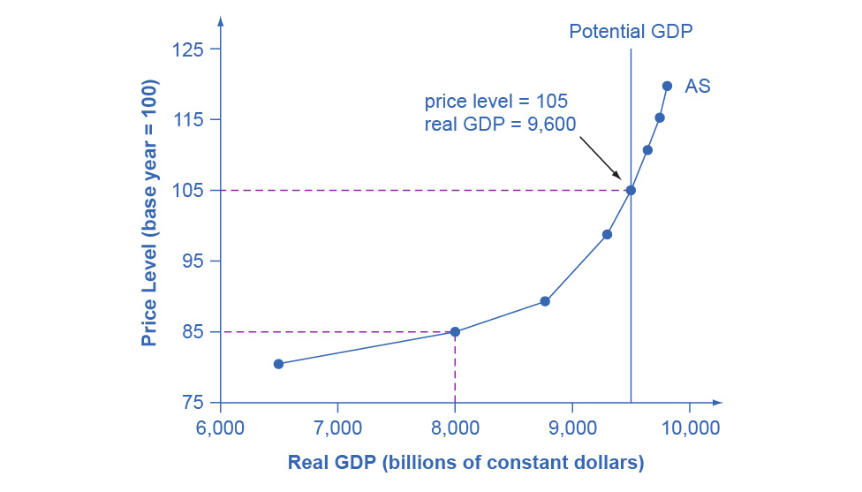
The Aggregate Supply Curve
Aggregate supply (AS) slopes up, because as the price level for outputs rises, with the price of inputs remaining fixed, firms have an incentive to produce more to earn higher profits.
The potential GDP line shows the maximum that the economy can produce with full employment of workers and physical capital.
Discussion Question: How can the AS cross Potential GDP?

Slide 10
The Aggregate Demand Curve
Aggregate demand (AD) - the amount of total spending on domestic goods and services in an economy.
It includes all four components of demand: consumption, investment, government spending, and net exports (exports minus imports).
Aggregate demand (AD) curve - shows the total spending on domestic goods and services at each price level.

Slide 11
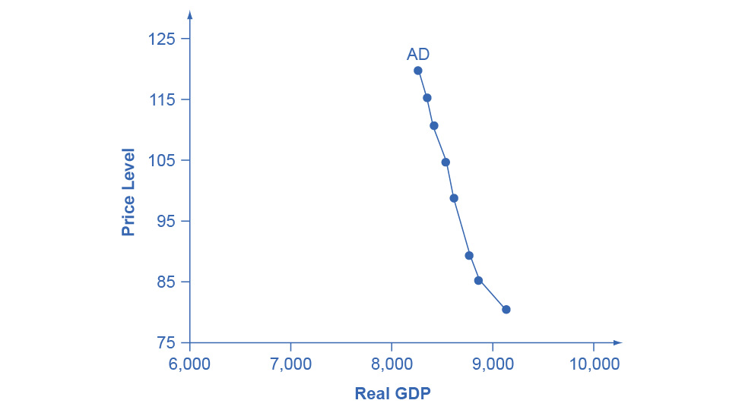
The Aggregate Demand Curve, Continued
Aggregate demand (AD) slopes down, showing that, as the price level rises, the amount of total spending on domestic goods and services declines.

Slide 12
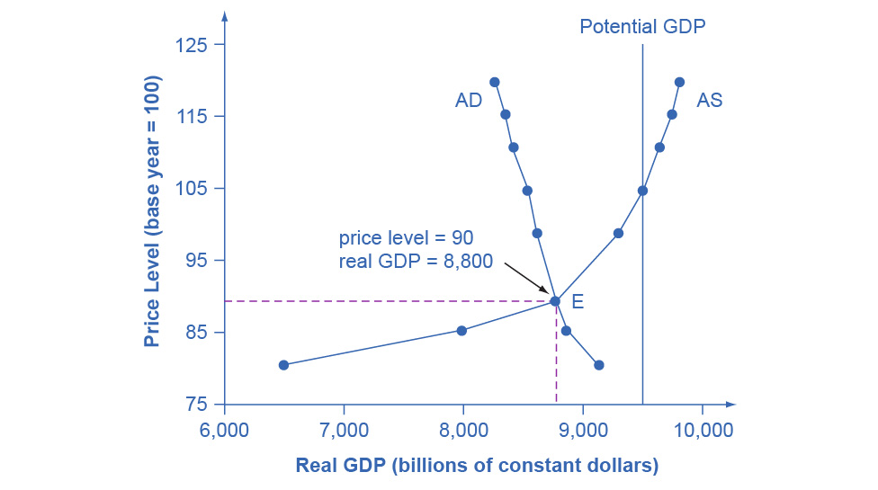
Combining the Aggregate Supply and Aggregate Demand Curves
The intersection of the aggregate supply and aggregate demand curves shows the equilibrium level of real GDP and the equilibrium price level in the economy.
The equilibrium, where aggregate supply (AS) equals aggregate demand (AD), occurs at a price level of 90 and an output level of 8,800.

Slide 13
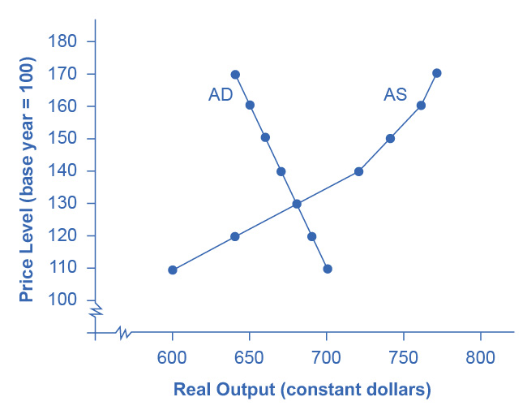
Interpreting the AD/AS Model
Using a hypothetical equilibrium, with price level at 130 and real GDP at $680, what information can we infer about the state of this country’s economy?
Is this country risking inflationary pressures or facing high unemployment? How can you tell?

Slide 14
Defining SRAS and LRAS
Short run aggregate supply (SRAS) curve - positive short run relationship between the price level for output and real GDP, holding the prices of inputs fixed
Long run aggregate supply (LRAS) curve - vertical line at potential GDP showing no relationship between the price level for output and real GDP in the long run.

Slide 15
24.3 Shifts in Aggregate Supply
Two of the most important factors that can lead to shifts in the AS curve:
productivity growth
changes in input prices
The aggregate supply curve can also shift due to unexpected shocks to input goods or labor.
Examples: large weather events affecting crops or an overseas war that requires a large number people to fight instead of work.
Stagflation - an economy experiences stagnant growth and high inflation at the same time.

Slide 16
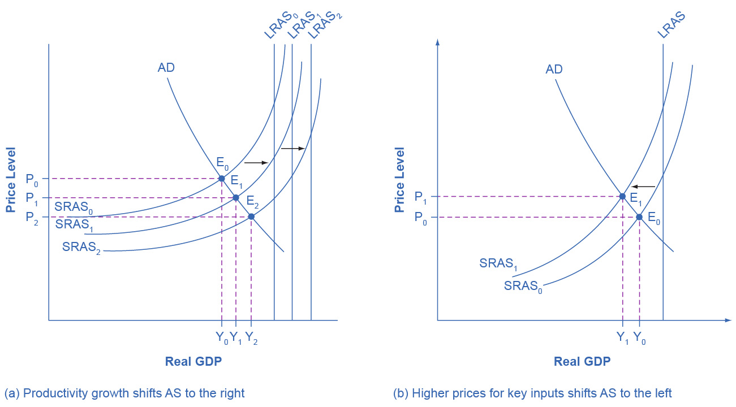
Illustrated: Shifts in Aggregate Supply
For graph (a): The rise in productivity causes the SRAS curve to shift to the right. The original equilibrium E₀ is at the intersection of AD and SRAS₀.
When SRAS shifts right, then the new equilibrium E₁ is at the intersection of AD and SRAS₁, and then yet another equilibrium, E₂, is at the intersection of AD and SRAS₂.
Shifts in SRAS to the right, lead to a greater level of output and to downward pressure on the price level.

Slide 17
Illustrated: Shifts in Aggregate Supply, Continued
For graph (b): A higher price for inputs means that at any given price level for outputs, a lower real GDP will be produced so aggregate supply will shift to the left from SRAS₀ to SRAS₁.
The new equilibrium, E₁, has a reduced quantity of output and a higher price level than the original equilibrium (E₀).

Slide 18
24.4 Shifts in Aggregate Demand
Remember that the components of aggregate demand are:
consumption spending
investment spending
government spending
spending on exports minus imports.
A shift of the AD curve to the right means that at least one of these components increased so that a greater amount of total spending would occur at every price level.
A shift of the AD curve to the left means that at least one of these components decreased so that a lesser amount of total spending would occur at every price level.

Slide 19
How Changes by Consumers and Firms Can Affect AD
When consumers feel more confident about the future of the economy, they tend to consume more.
If business confidence is high, then firms tend to spend more on investment, believing that the future payoff will be substantial.
Conversely, if consumer or business confidence drops, then consumption and investment spending declines.

Slide 20
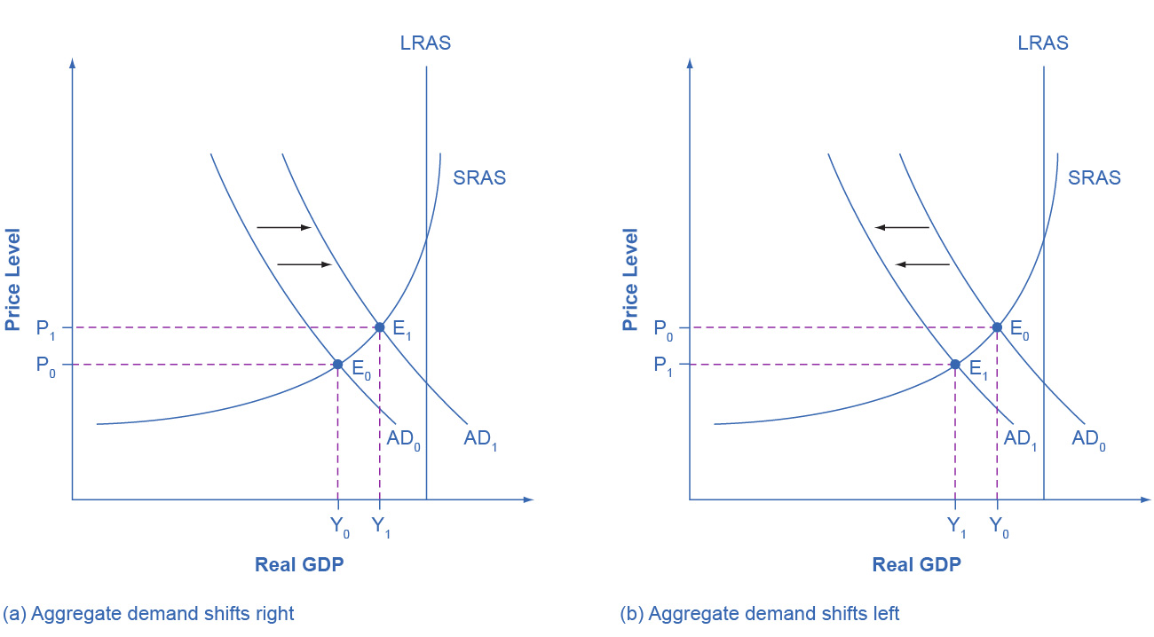
Illustrated: Shifts in Aggregate Demand
For graph (a) :An increase in consumer confidence or business confidence can shift AD to the right, from AD₀ to AD₁.
When AD shifts to the right, the new equilibrium (E₁) will have a higher quantity of output and also a higher price level compared with the original equilibrium (E₀).
In this example, the new equilibrium (E₁) is also closer to potential GDP.
An increase in government spending or a cut in taxes that leads to a rise in consumer spending can also shift AD to the right.

Slide 21
Illustrated: Shifts in Aggregate Demand, Continued
For graph (b): A decrease in consumer confidence or business confidence can shift AD to the left, from AD₀ to AD₁.
When AD shifts to the left, the new equilibrium (E₁) will have a lower quantity of output and also a lower price level compared with the original equilibrium (E₀).
In this example, the new equilibrium (E₁) is also farther below potential GDP.
A decrease in government spending or higher taxes that leads to a fall in consumer spending can also shift AD to the left.

Slide 22
How Government Macroeconomic Policy Choices Can Shift AD
Higher government spending will cause AD to shift to the right, while lower government spending will cause AD to shift to the left.
Tax cuts for individuals will tend to increase consumption demand, while tax increases will tend to diminish it.
Tax policy can also pump up investment demand by offering lower tax rates for corporations or tax reductions that benefit specific kinds of investment.
During a recession, when unemployment is high and many businesses are suffering low profits or even losses, the U.S. often passes tax cuts.

Slide 23
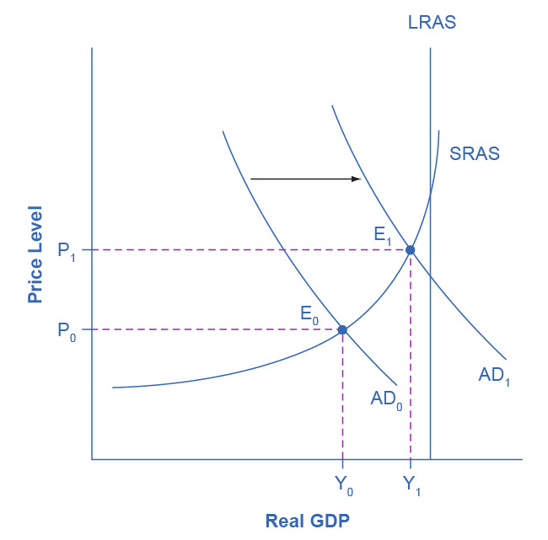
Recession and Full Employment in the AD/AS Model
Whether the economy is in a recession is illustrated in the AD/AS model by how close the equilibrium is to the potential GDP line as indicated by the vertical LRAS line.
In this example, the level of output Y₀ at the equilibrium E₀ is relatively far from the potential GDP line, so it can represent an economy in recession, well below the full employment level of GDP.
In contrast, the level of output Y₁ at the equilibrium E₁ is relatively close to potential GDP, and so it would represent an economy with a lower unemployment rate.

Slide 24
24.5 How the AD/AS Model Incorporates Growth, Unemployment, and Inflation
Growth and Recession in the AD/AS Diagram:
In the AD/AS diagram, long-run economic growth due to productivity increases over time will be represented by a gradual shift to the right of aggregate supply.
The vertical line representing potential GDP (or the “full employment level of GDP”) will gradually shift to the right over time as well.
The AD/AS diagram illustrates recessions when the equilibrium level of real GDP is substantially below potential GDP.
In years of resurgent economic growth the equilibrium will typically be close to potential GDP.

Slide 25
Unemployment in the AD/AS Diagram
Remember, there are two types of unemployment:
Short run variations in unemployment (cyclical unemployment) caused by the business cycle as economy expands and contracts.
Long run unemployment rate (typically hovers around 5% in U.S.) when the economy is healthy.
The AD/AS diagram shows cyclical unemployment by how close the economy is to the potential or full GDP employment level.
Low cyclical unemployment for an economy occurs when the level of output is close to potential GDP.
High cyclical unemployment arises when the output is substantially to the left of potential GDP.

Slide 26
Inflationary Pressures in the AD/AS Diagram
Inflation fluctuates in the short run.
Higher inflation rates have typically occurred either during or just after economic booms.
Rates of inflation generally decline during recessions.
The AD/AS framework implies two ways that inflationary pressures may arise:
If the aggregate demand continues to shift to the right when the economy is already at or near potential GDP and full employment, thus pushing the equilibrium into the AS curve's steep portion.
A rise in input prices that affects many or most firms across the economy (e.g., oil or labor) and causes the aggregate supply curve to shift back to the left.

Slide 27
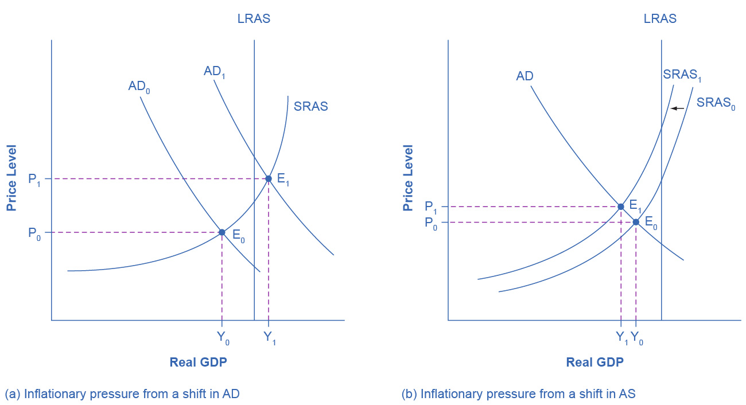
Sources of Inflationary Pressure in the AD/AS Model
In graph (a):
A shift in aggregate demand, from AD₀ to AD₁, when it happens in the area of the SRAS curve that is near potential GDP, will lead to a higher price level, leading to inflation.
The new equilibrium (E₁) is at a higher price level (P₁) than the original equilibrium.

Slide 28
Sources of Inflationary Pressure in the AD/AS Model, Continued
In graph (b):
A shift in aggregate supply, from SRAS₀ to SRAS₁, will lead to a lower real GDP and to pressure for a higher price level and inflation.
The new equilibrium (E₁) is at a higher price level (P₁), while the original equilibrium (E₀) is at the lower price level (P₀).

Slide 29
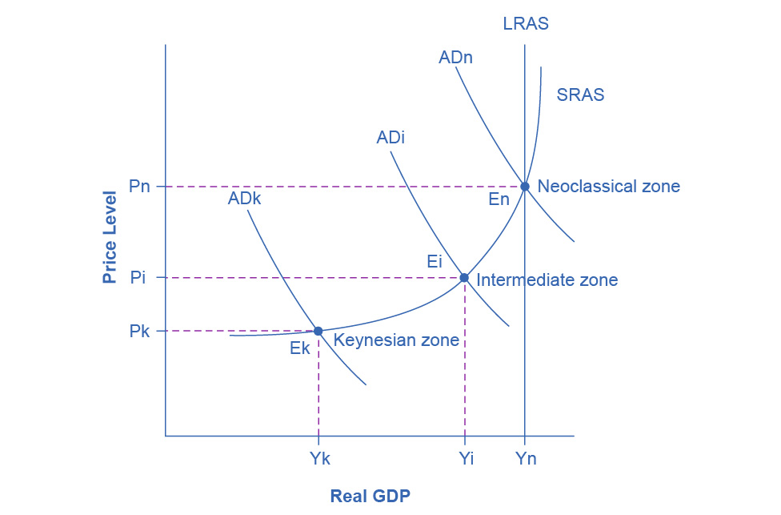
24.6 Keynes’ Law and Say’s Law in the AD/AS Model
We can use the AD/AS model to illustrate both Say’s law and Keynes’ law.
This approach of dividing the SRAS curve into different zones works as a diagnostic test that we can apply to an economy.

Slide 30
The Keynesian Zone
Keynesian zone - portion of the SRAS curve where GDP is far below potential and the SRAS curve is flat
If the AD curve crosses a portion of the SRAS curve in the Keynesian zone, the equilibrium level of real GDP is far below potential GDP, so:
the economy is in recession,
cyclical unemployment is high,
inflationary price pressure is not much of a worry

Slide 31
The Neoclassical Zone
Neoclassical zone - portion of the SRAS curve where GDP is at or near potential output where the SRAS curve is steep.
If the AD curve crosses a portion of the SRAS curve in the neoclassical zone, the equilibrium is near potential GDP, so:
cyclical unemployment is low (structural unemployment may remain an issue),
the only way to increase the size of the real GDP is for AS to shift to the right,
shifts in AD will create pressures to change the price level.

Slide 32
The Intermediate Zone
Intermediate zone - portion of the SRAS curve where GDP is below potential but not so far below as in the Keynesian zone; the SRAS curve is upward-sloping, but not vertical in the intermediate zone.
If the AD curve crosses a portion of the SRAS curve in the intermediate zone, we expect unemployment and inflation to move in opposing directions.
A shift of AD to the right will move output closer to potential GDP:
Reduce unemployment
Higher price level and upward pressure on inflation.
A shift of AD to the left will move output further from potential GDP:
Raise unemployment
Lower price level and downward pressure on inflation.

