Slide 1

Economics
THE KEYNESIAN PERSPECTIVE

Slide 2
Ch.25 OUTLINE
25.1: Aggregate Demand in Keynesian Analysis
25.2: The Building Blocks of Keynesian Analysis
25.3: The Phillips Curve
25.4: The Keynesian Perspective on Market Forces

Slide 3
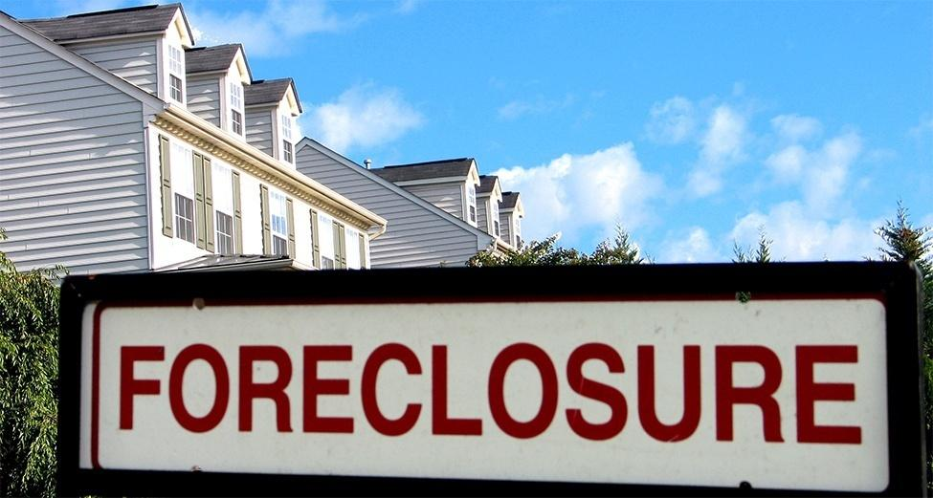
Signs of a Recession
Home foreclosures were just one of the many signs and symptoms of the recent Great Recession. During that time, many businesses closed and many people lost their jobs. (Credit: modification of "Foreclosure" by Taber Andrew Bain/Flickr Creative Commons, CC BY 2.0)

Slide 4
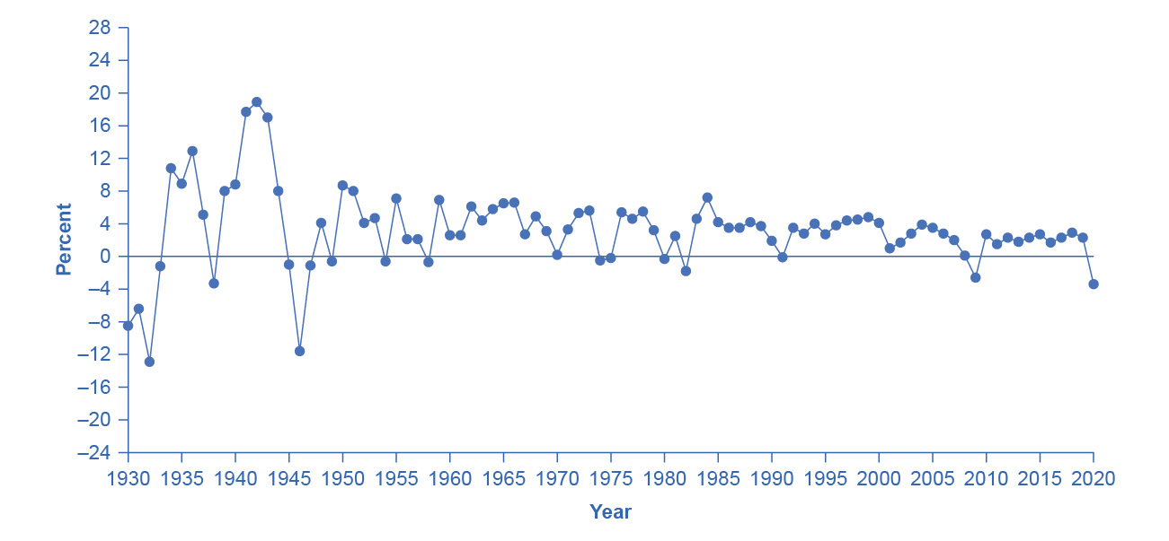
U.S. Real Domestic Product, Percent Changes 1930–2020
The chart tracks the percent change in Real GDP since 1930.
The magnitude of both recessions and peaks was quite large between 1930 and 1945. (Source: Bureau of Economic Analysis, “National Economic Accounts," https://apps.bea.gov/itable/index.cfm)

Slide 5
25.1 Aggregate Demand in Keynesian Analysis
The Keynesian perspective focuses on the idea that firms produce output only if they expect it to sell.
Real GDP - the amount of goods and services actually sold in a nation.
Keynes argued that aggregate demand is not stable - that it can change unexpectedly.
Recessionary gap - equilibrium at a level of output below potential GDP.
Inflationary gap - equilibrium at a level of output above potential GDP.

Slide 6
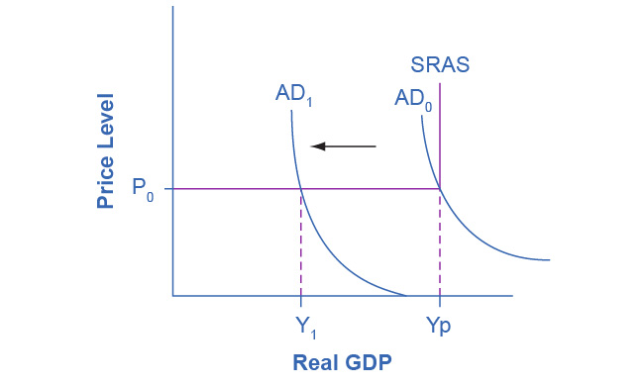
The Keynesian AD/AS Model
The Keynesian View of the AD/AS Model uses an SRAS curve, which is horizontal at levels of output below potential and vertical at potential output.
Thus, when beginning from potential output, any decrease in AD affects only output, but not prices.
Any increase in AD affects only prices, not output.

Slide 7
What Determines Consumption Expenditure?
Consumption expenditure is spending by households and individuals on durable goods, nondurable goods, and services.
Keynes identified three factors that affect consumption:
Disposable income - income after taxes.
Expected future income
Wealth or credit

Slide 8
What Determines Investment Expenditure?
Spending on new capital goods is called investment expenditure.
These fall into four categories:
producer’s durable equipment and software
nonresidential structures (such as factories, offices, and retail locations)
changes in inventories
residential structures (such as single-family homes, townhouses, and apartment buildings)
When a business decides to make an investment in physical or intangible assets, the firm considers both:
the expected investment benefits (future profit expectations)
the investment costs (interest rates)

Slide 9
What Determines Government Spending?
Federal, state, and local government spending provides important public services such as national defense, transportation infrastructure, and education.
Keynes recognized that the government budget offered a powerful tool for influencing aggregate demand.
More government spending could stimulate AD (or less government spending reduce it).
Lowering or raising tax rates could influence consumption and investment spending.
Keynes concluded that during extreme times like deep recessions, only the government had the power and resources to move aggregate demand.

Slide 10
What Determines Net Exports?
Since we define aggregate demand as spending on domestic goods and services, export expenditures add to AD, while import expenditures subtract from AD.
Two sets of factors can cause shifts in export and import demand:
changes in relative growth rates between countries
changes in relative prices between countries

Slide 11
25.2 The Building Blocks of Keynesian Analysis
Keynesian economics focuses on explaining why recessions and depressions occur and offering a policy prescription for minimizing their effects.
The Keynesian view of recession is based on two key building blocks.
Aggregate demand is not always automatically high enough to provide firms with an incentive to hire enough workers to reach full employment.
The macroeconomy may adjust only slowly to shifts in aggregate demand because of sticky wages and prices.
Sticky wages and prices - a situation where wages and prices do not fall in response to a decrease in demand, or do not rise in response to an increase in demand.

Slide 12
Wage and Price Stickiness
Keynes pointed out that although AD fluctuated, prices and wages did not immediately respond as economists often expected.
Instead, prices and wages are “sticky,” making it difficult to restore the economy to full employment and potential GDP.
Keynes emphasized one particular reason why wages were sticky: the coordination argument.
Coordination argument - downward wage and price flexibility requires perfect information about the level of lower compensation acceptable to other laborers and market participants.

Slide 13
Wage and Price Stickiness, Continued
Some modern economists have argued that along with wages, other prices may be sticky too.
When a firm considers changing prices, it must consider two sets of costs.
changing prices uses company resources
frequent price changes may leave customers confused or angry
Menu costs - costs firms face in changing prices.

Slide 14
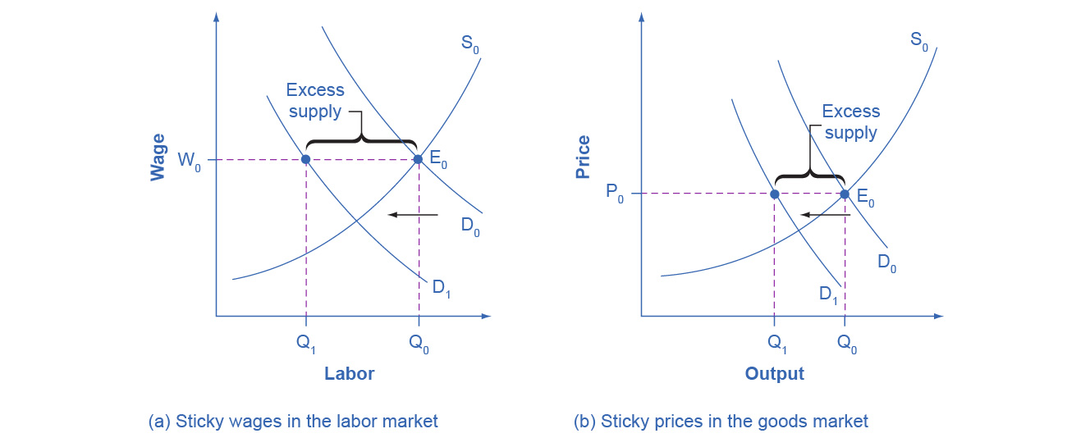
Sticky Prices and Falling Demand in the Labor and Goods Market
In both (a) and (b), demand shifts left from D₀ to D₁.
However, the wage in (a) and the price in (b) do not immediately decline.
In (a), the quantity demanded of labor at the original wage (W₀) is Q₀, but with the new demand curve for labor (D₁), it will be Q₁.
Similarly, in (b), the quantity demanded of goods at the original price (P₀) is Q₀, but at the new demand curve (D₁) it will be Q₁.

Slide 15
Sticky Prices and Falling Demand in the Labor and Goods Market, Continued
An excess supply of labor will exist, which we call unemployment.
An excess supply of goods will also exist, where the quantity demanded is substantially less than the quantity supplied.
Thus, sticky wages and sticky prices, combined with a drop in demand, bring about unemployment and recession.

Slide 16
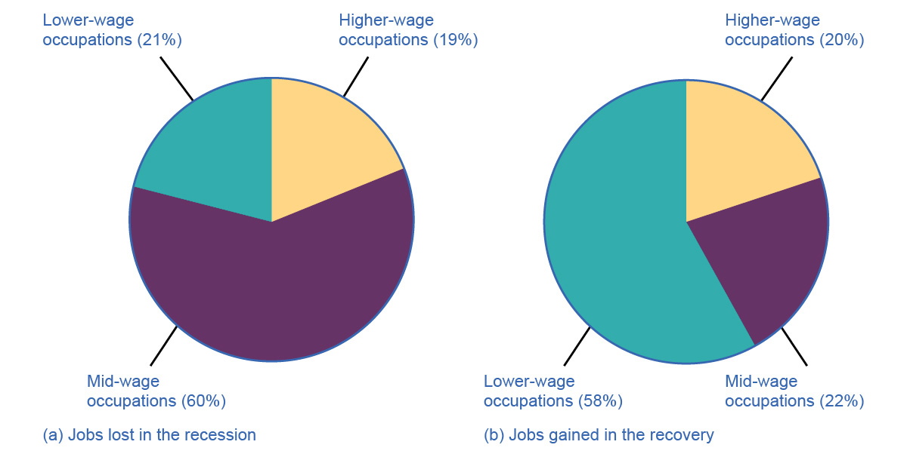
Jobs Lost/Gained in the Recession/Recovery
Discussion Questions:
Why was the pace of wage adjustments slow?
What does the data in the charts above suggest about jobs lost and gained since the Great Recession in the U.S.?

Slide 17
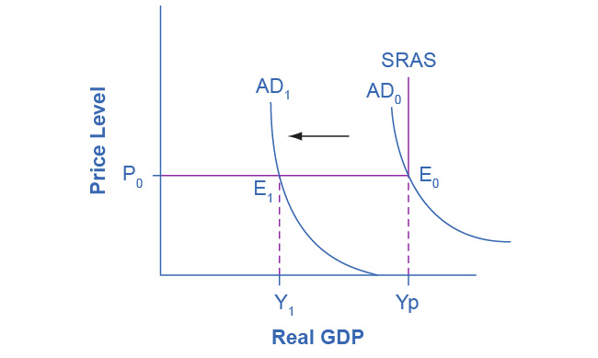
A Keynesian Perspective of Recession
The figure illustrates the two key assumptions behind Keynesian economics.
A recession begins when aggregate demand declines from AD₀ to AD₁.

Slide 18
A Keynesian Perspective of Recession, Continued
The recession persists because of the assumption of fixed wages and prices, which makes the SRAS flat below potential GDP.
If that were not the case, the price level would fall also, raising GDP and limiting the recession.
Instead the intersection E₁ occurs in the flat portion of the SRAS curve where GDP is less than potential.

Slide 19
The Expenditure Multiplier
Macroeconomic externality - occurs when what happens at the macro level is different from and inferior to what happens at the micro level.
Expenditure multiplier - Keynesian concept that asserts that a change in autonomous spending causes a more than proportionate change in real GDP.
The idea that not only does spending affect the equilibrium level of GDP, but that spending is powerful.
Δ Y > 1
Δ Spending
The reason for the expenditure multiplier is that one person’s spending becomes another person’s income, which leads to additional spending and additional income
The cumulative impact on GDP is larger than the initial increase in spending.

Slide 20
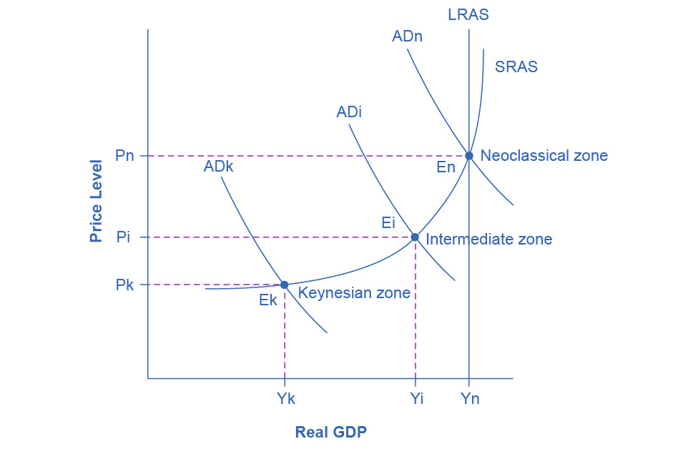
25.3 The Phillips Curve
Recall the different zones in the AS curve.
Phillips curve - the tradeoff between unemployment and inflation.

Slide 21
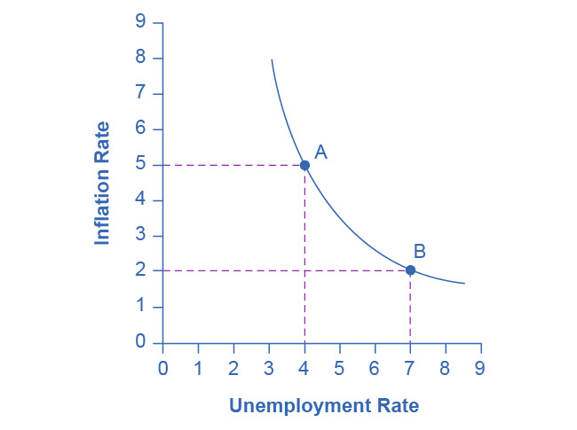
A Keynesian Phillips Curve Tradeoff between Unemployment and Inflation
A Phillips curve illustrates a tradeoff between the unemployment rate and the inflation rate.
If one is higher, the other must be lower.
For example, point A illustrates a 5% inflation rate and a 4% unemployment.
If the government attempts to reduce inflation to 2%, then it will experience a rise in unemployment to 7%, as point B shows.

Slide 22
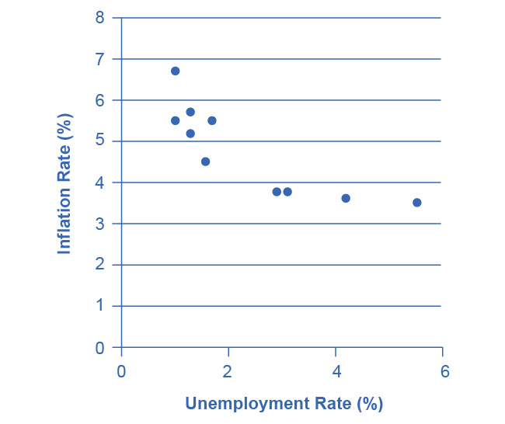
The Phillips Curve from 1960–1969
This chart shows the negative relationship between unemployment and inflation.

Slide 23
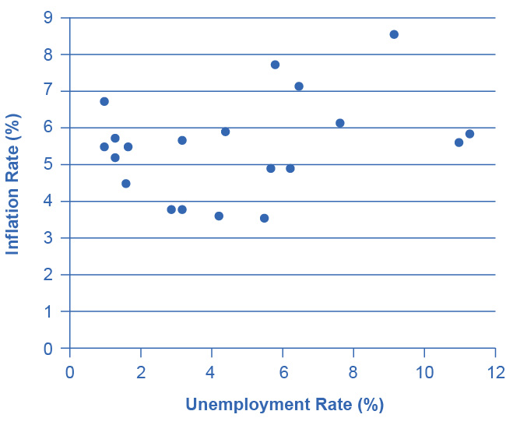
U.S. Phillips Curve, 1960–1979
The tradeoff between unemployment and inflation appeared to break down during the 1970s as the Phillips Curve shifted out to the right.

Slide 24
Keynesian Policy for Fighting Unemployment and Inflation
Keynesian macroeconomics argues that the solution to a recession is expansionary fiscal policy.
Expansionary fiscal policy - tax cuts or increases in government spending designed to stimulate aggregate demand and move the economy out of recession.
When the economy is operating above potential GDP, unemployment is low, but inflationary rises in the price level are a concern.
The Keynesian response would be contractionary fiscal policy, using tax increases or government spending cuts to shift AD to the left.
The result would be downward pressure on the price level, but very little reduction in output or very little rise in unemployment.
Contractionary fiscal policy - tax increases or cuts in government spending designed to decrease aggregate demand and reduce inflationary pressures

Slide 25
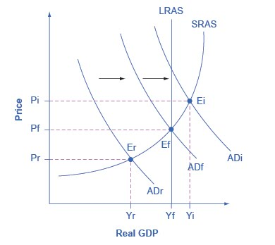
Fighting Recession and Inflation with Keynesian Policy
If an economy is in recession, with an equilibrium at E_{r}, then the Keynesian response would be to enact a policy to shift aggregate demand to the right from AD_{r} toward AD_{f}.
If an economy is experiencing inflationary pressures with an equilibrium at E_{i}, then the Keynesian response would be to enact a policy response to shift aggregate demand to the left, from AD_{i} toward AD_{f}.

Slide 26
25.4 The Keynesian Perspective on Market Forces
Controversy has simmered over the extent to which government should play an active role in managing the economy.
Some supporters of Keynesian economics advocated a high degree of government planning in all parts of the economy.
However, Keynes was careful to separate the issue of aggregate demand from the issue of how well individual markets worked.

Slide 27
The Keynesian Perspective on Market Forces, Continued
He argued that individual markets for goods and services were appropriate and useful, but that sometimes that level of aggregate demand was just too low.
He also believed that, while government should ensure that overall level of aggregate demand is sufficient for an economy to reach full employment, this task did not imply that the government should attempt to set prices and wages, nor to take over and manage large corporations or entire industries directly.

