Slide 1
NCCMP3
Paul Fahey
Oliver Huck
David Zaharee

Slide 2
Introduction
NCCMP3 is a new music player and library manager application.
It is meant to be a lightweight replacement of mainstream music library options.
It is going to have many of the same features found in other music applications, without being bloated or slow.

Slide 3
Functional Requirements
Music player interface should include:
Display of current track info
Play
Skip Song
Skip Back

Slide 4
Functional Requirements (con’t)
Library interface should include:
Filtering by:
Artist
Album
Organizing by:
Track name
Track number
Artist
Album

Slide 5
Functional Requirements (con’t)
Interfaces should be graphical to facilitate ease-of-use
The music library should be sorted by the mp3 metadata and not dependent on folder structure
Multiple folders in different locations should be able to be added to the library
The application should be fast and responsive
To play songs they should be added from the library to the current playlist
Users should be able to save the current playlist, and be able to load saved playlists

Slide 6
Non-Functional Requirements
The application will not move music files/folders added to the library
The application will not include a “visualization” mode
The application will not include an equalizer
The application will not display or store album covers
The application will not play videos
The application will not play internet radio
The application will not have an online store

Slide 7
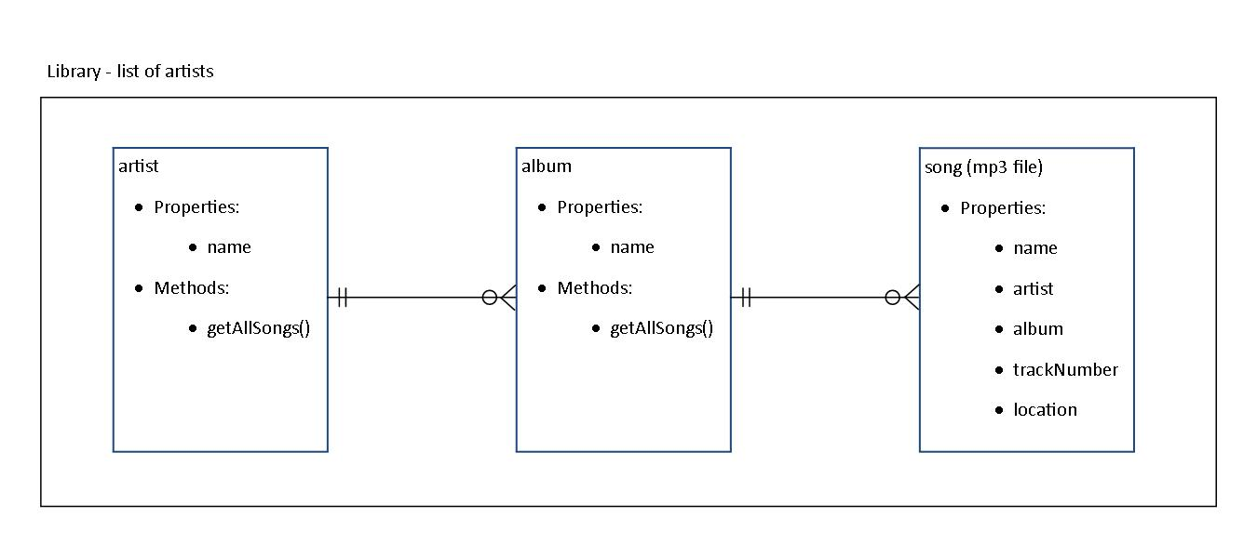
Design: Library
Hierarchical design of the objects with inheritance

Slide 8
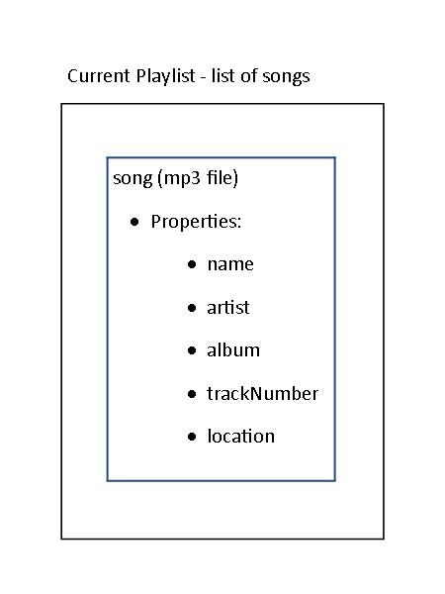
Design: Playlist
Contains list of song names
This list does not persist from one use of the player to the next

Slide 9
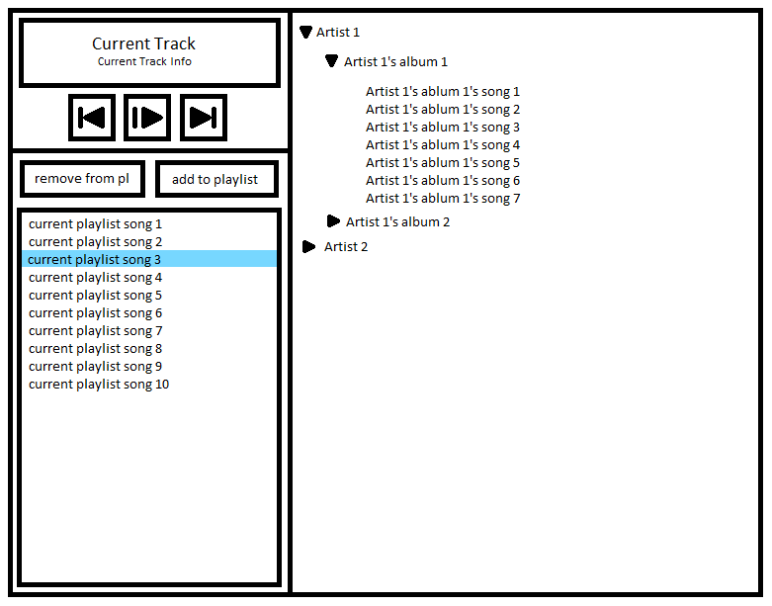
Design: Interface

Slide 10
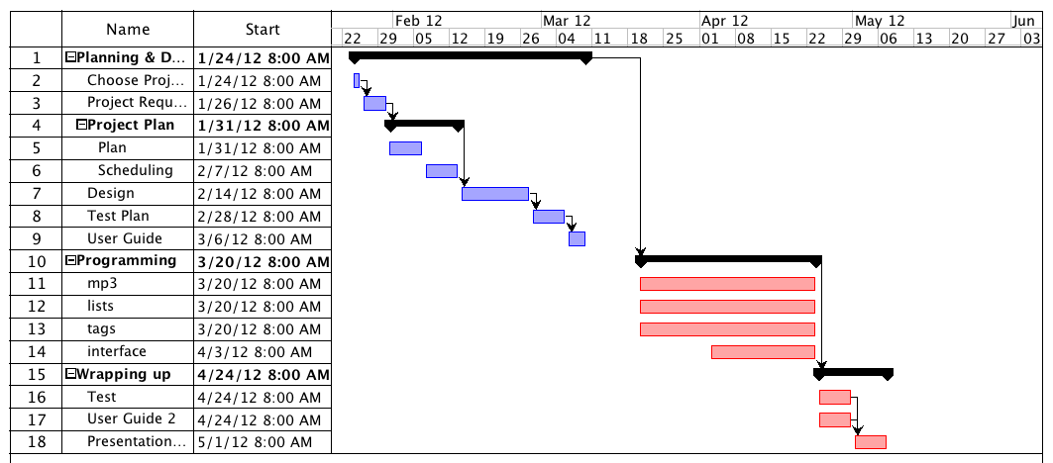
Schedule

