Slide 1
Scripturable Android
By Paul Fahey
Advisor: Dr. Shen

Slide 2
What is the Need?
Common Features
Most Used Features
Reading Plans
Highlights
Favorites
Video Lectures
Note Taking
Daily Verse
Sharing
Search
Note Taking
Favorites
Search
Sharing

Slide 3
Product Deliverables
Easy Verse Search with Enhanced Suggesting
Simple Navigation
Note Customization with Tablet Optimization
In app Internet browsing
Text Sharing
Text Customization

Slide 4
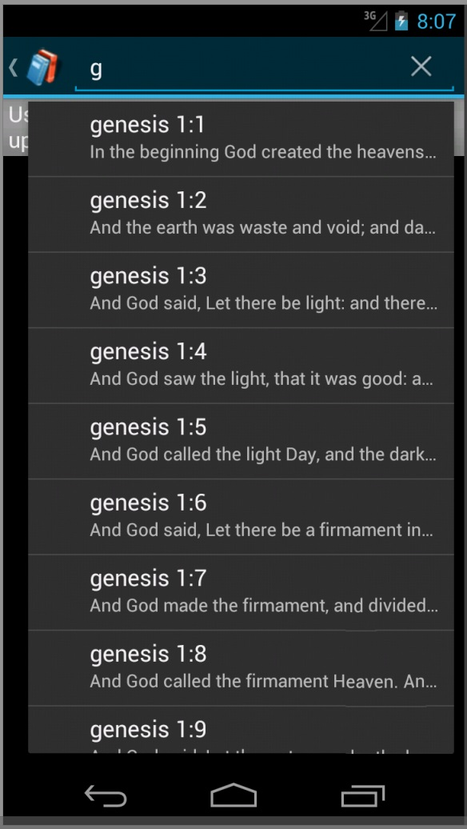
Search Feature
Accessible from the main navigation
Search Suggestions as you search your verse
**Verse Preview**
Not case sensitive
Works with voice recognition

Slide 5
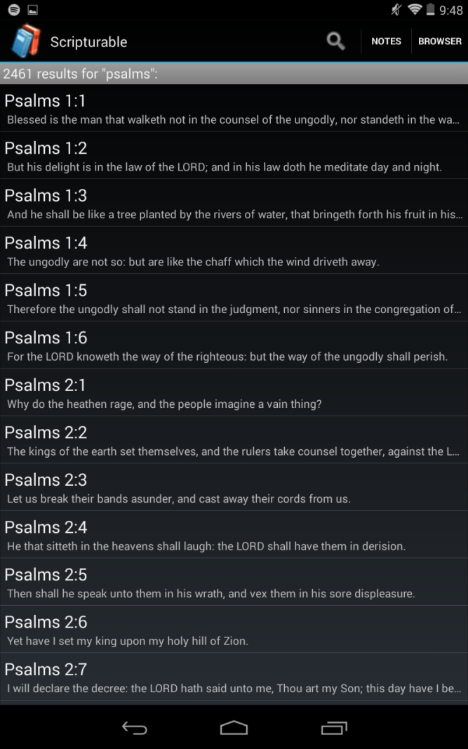
Contextual Search Results
List of results based on your search query
Gives a total result value based on your query
Text is visible beforehand
Clicking on a result brings you to the full verse view

Slide 6
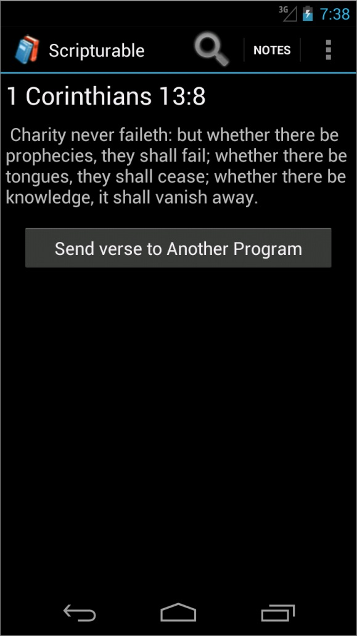
Verse View
Shows the full verse you searched
Font Size customization available from main navigation
Copy your verse to an outside source

Slide 7
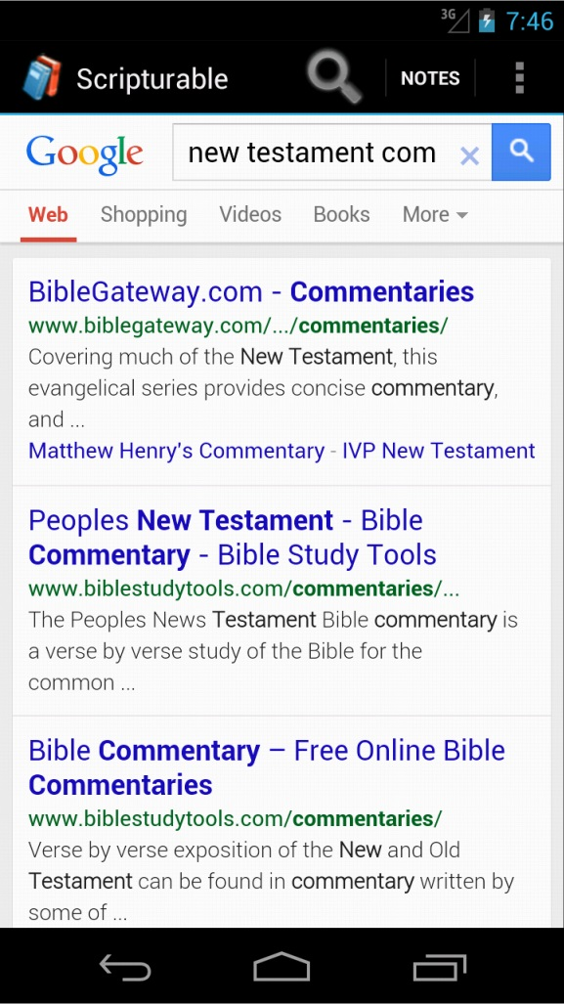
In-app browser
No other bible app on the market has this feature
Convenient Refreshing
No need to exit application
Convenient for more in depth verse study

Slide 8
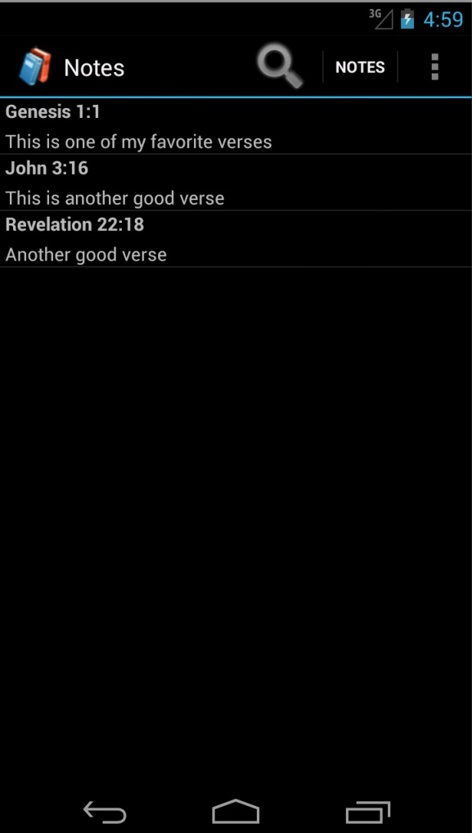
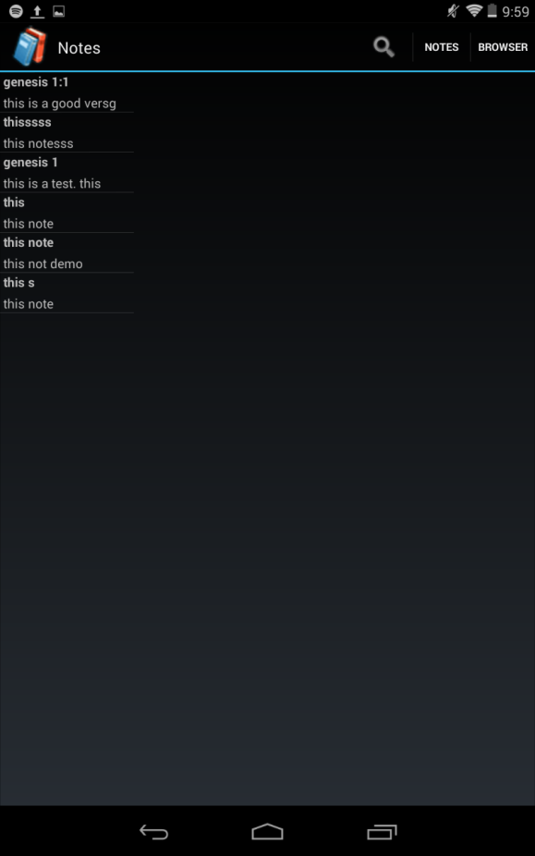
Note Visual Concept
Smart Phone
Tablet

Slide 9
Demos
Note Demo
Full feature Demo: Type “Scripturable Demo” on YouTube

Slide 10
Note Feature Summary
Unlimited Note Storage
Title & Details are visible from list
Convenient Editing
Notes Can be Deleted
Accessible anywhere within the application
Tablet optimization for better usage of space
Notes Can be sent to outside applications

Slide 11
Future Releases
**In app favorites storage**
Google Play Store
Multiple verse Search
Switch between verses sequentially
More Verse customization features (Add a note, web search)
Tablet Optimization for Verse View with in app web browser

Slide 12
Audience Panel
Any Questions or Comments?

