Slide 1

Introdução a Redes Neurais (Deep Learning)

Slide 2
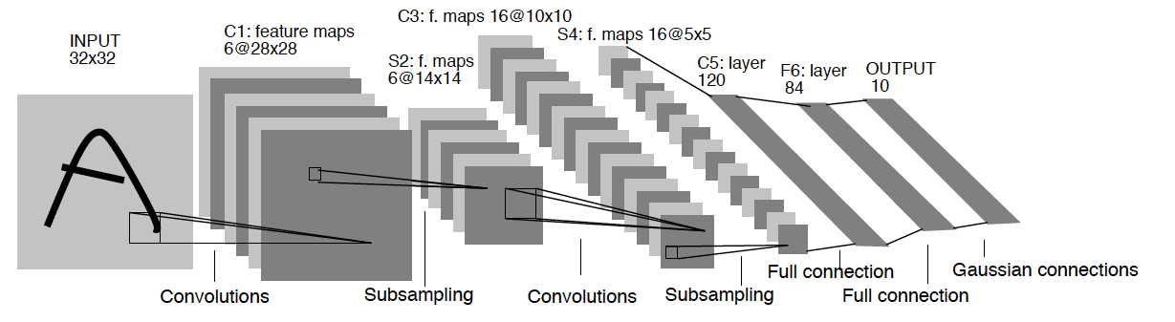
What is Deep Learning?
Sub-area of Machine Learning
Not really something new
Handwriting recognition paper (1998)
Img-Source: http://yann.lecun.com/exdb/publis/pdf/lecun-01a.pdf

Slide 3
What is new?
New training strategies: able to train deep networks
  Hinton et al. (2006) presented a new, stacked training method which applies the concept of pre-training
More data has been available
Computer infrastructure (hardware and software) has improved- > bigger models

Slide 4
Supervised Learning
Goal: to infer a function from examples to predict classes on new examples
  Example of classification tasks: sentiment analysis, image detection, text categorization etc
Two steps:
  Training: learn the function
  Test: apply the function on new examples

Slide 5
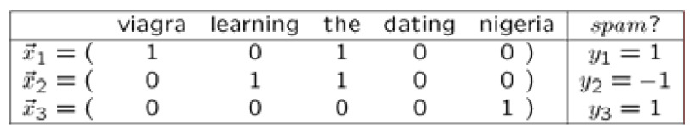
Supervised Learning
Categorical
Training set: instances and labels
Instance represented by its features’ vector: x
Goal: to learn f(x)=y that better predicts y given x
Label y
  Categorical -> classification
  Numerical -> regression
Training set

Slide 6
Features
Very important for good classification results
Good feature: high correlation with the classification outcome
  Ex₁: weather prediction: temperature, humidity
  Ex₂: sentiment analysis: words with polarity (positive/negative)
Usually human-generated
The training task becomes optimizing weights of the features for prediction

Slide 7
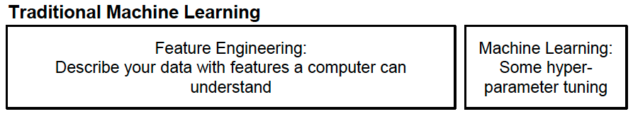
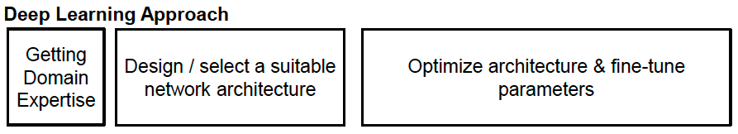
Traditional ML vs. Deep Learning

Slide 8
Deep Learning
Automatically learns good features or representations (instead of feature engineering)
Multiple levels of representation from raw data
Usually needs large amounts of data
  Not necessarily labeled
For small datasets: hand-designed features can still be included

Slide 9





Basics: Artificial Neuron
x₁
w₁
Given inputs:
and weights:
and a bias value:
A neuron produces a single output:
Function s: activation function
The weights and bias values
  Initialized randomly
  Learned during training
x₂
w₂
Output
w₃
s
x₃
.
.
.
w_{n}
Activation
Function
b
x_{n}
Features’
vector
of instance

Slide 10
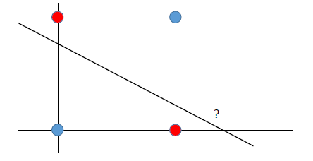
Activation Function & Non-linearity
Motivation: linear classifier can not solve some problems
Example: learning the XOR function
Goal of activation function: to add non-linearity
[1,0]
[1,1]
[0,0]
[0,1]

Slide 11
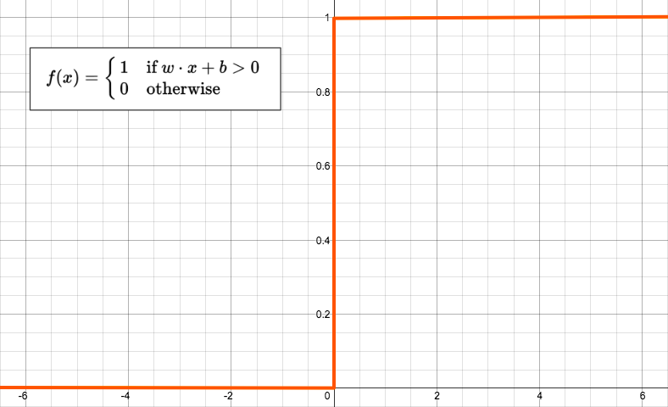
Typical Activation Function
Step function scales between 0 and 1
Img-Source: https://appliedgo.net/perceptron/

Slide 12
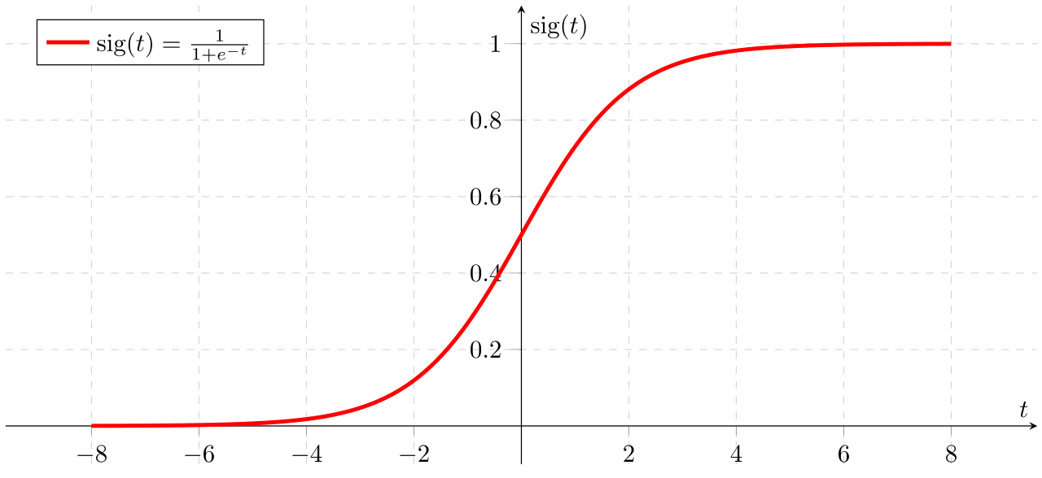
Typical Activation Function
Sigmoid Function scales between 0 and 1
Img-Source: Wikipedia

Slide 13
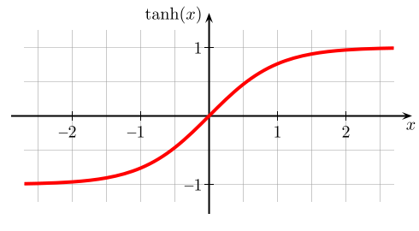
Typical Activation Function
Hyperbolic tangent scales between -1 and 1
Img-Source: Wikipedia

Slide 14
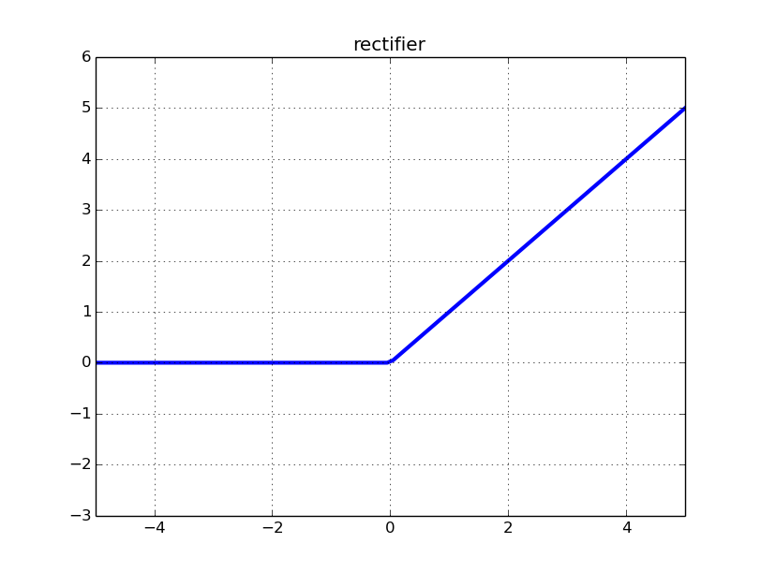

Typical Activation Function
Rectifier:
A unit using the rectifier
function is called rectified linear unit (ReLU)
Img-Source: http://datascience.stackexchange.com/questions/5706/what-is-the-dying-relu-problem-in-neural-networks

Slide 15
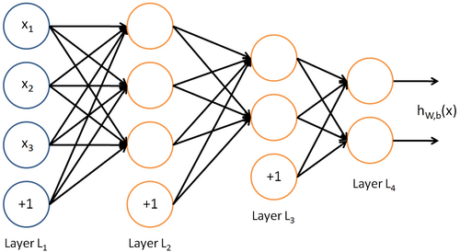
Feed Forward Neural Networks
Layers of neurons
Information flows forward
First layer: input data
Last layer: output of the model
Img-Source: http://ufldl.stanford.edu/wiki/

Slide 16
Feed Forward Neural Networks
The hidden layers (L₂, L₃) represent learned non-linear combination of input data
  Project the input to a (usually) low dimensional space
Img-Source: http://ufldl.stanford.edu/wiki/

Slide 17
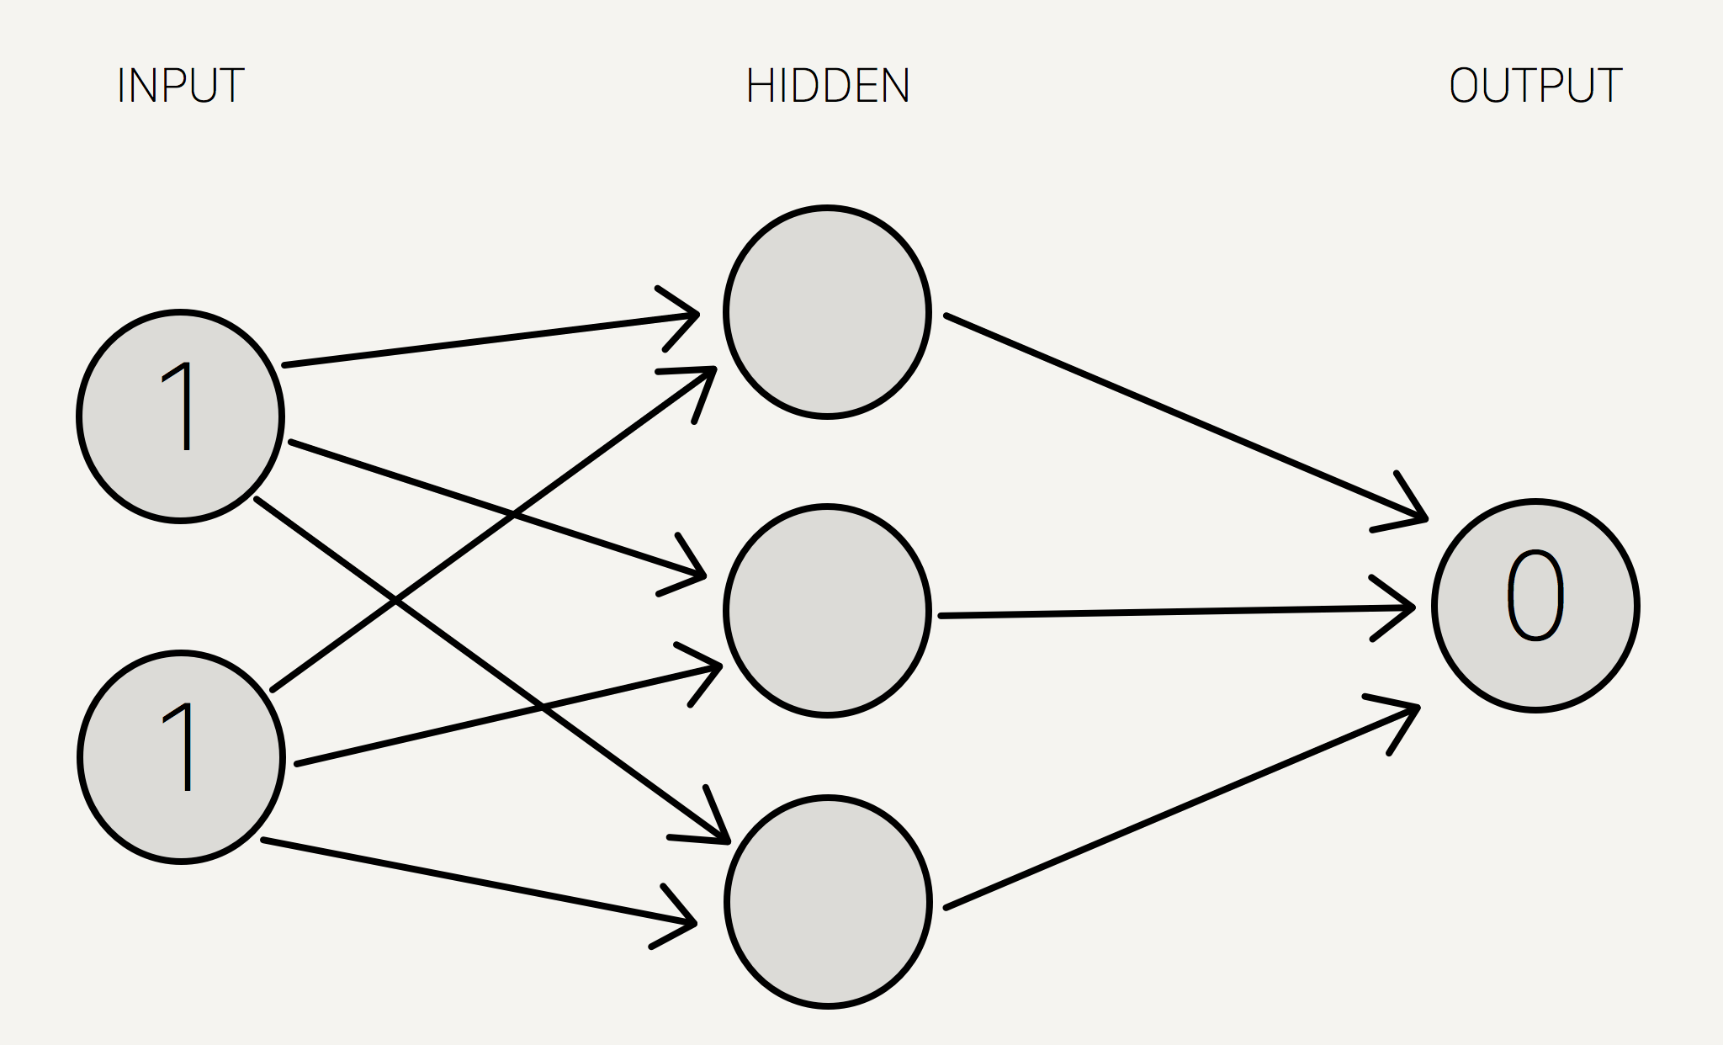
Computation: XOR Example
Img-Source: http://stevenmiller888.github.io/mind-how-to-build-a-neural-network/

Slide 18
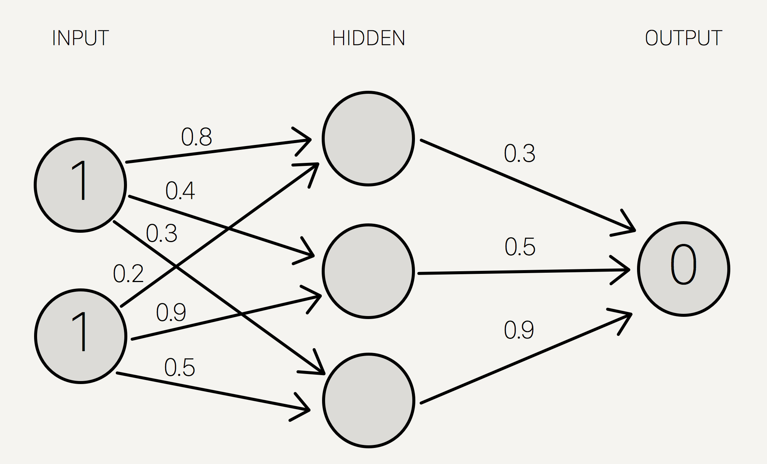
Computation: XOR Example
Img-Source: http://stevenmiller888.github.io/mind-how-to-build-a-neural-network/

Slide 19
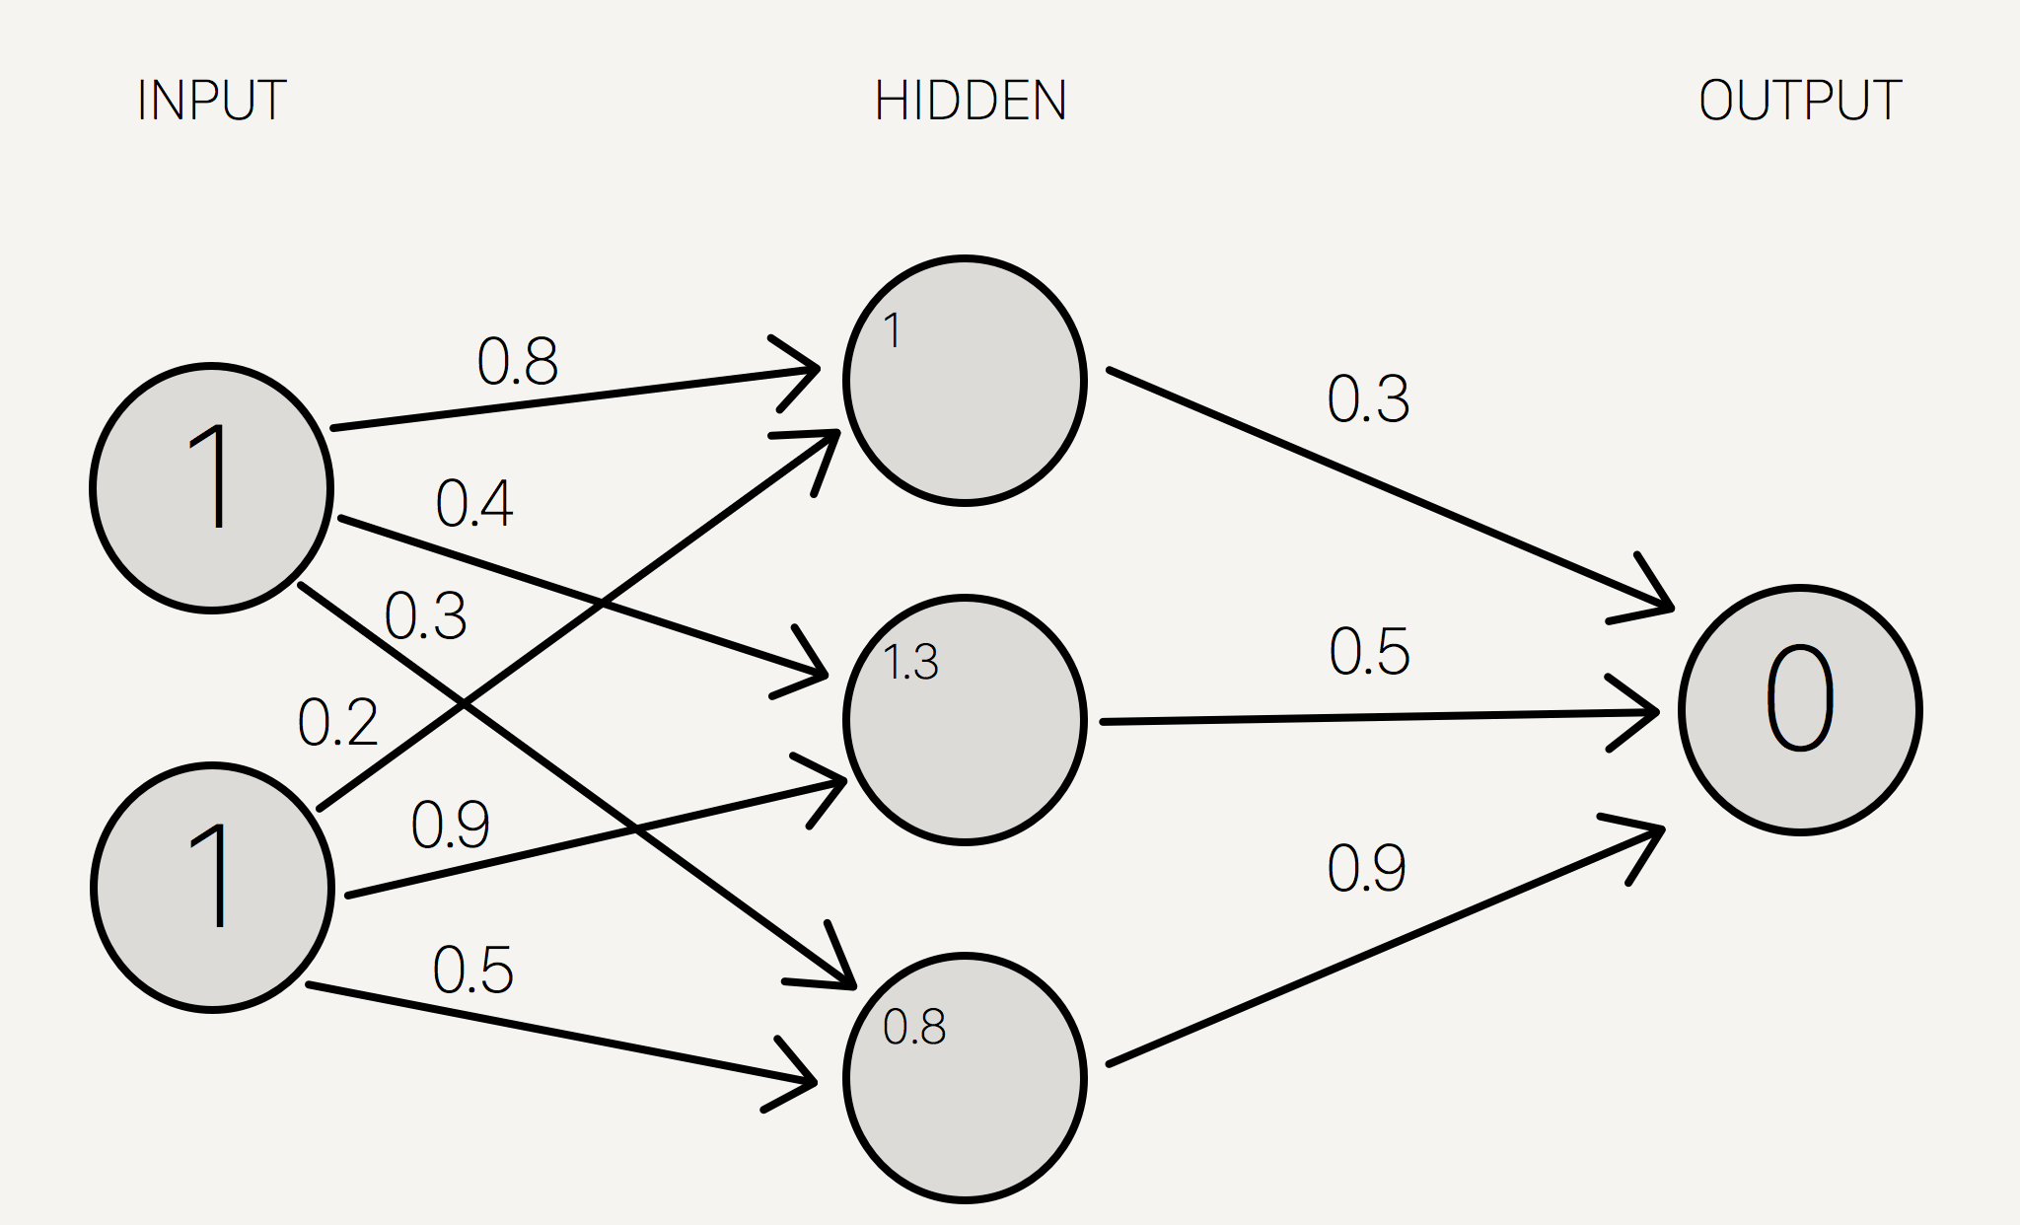
Computation: XOR Example
Matrix Operation
[1,1]*
0.8
0.2
0.4
0.9
0.3
0.5
Input
W_{H}
Img-Source: http://stevenmiller888.github.io/mind-how-to-build-a-neural-network/

Slide 20
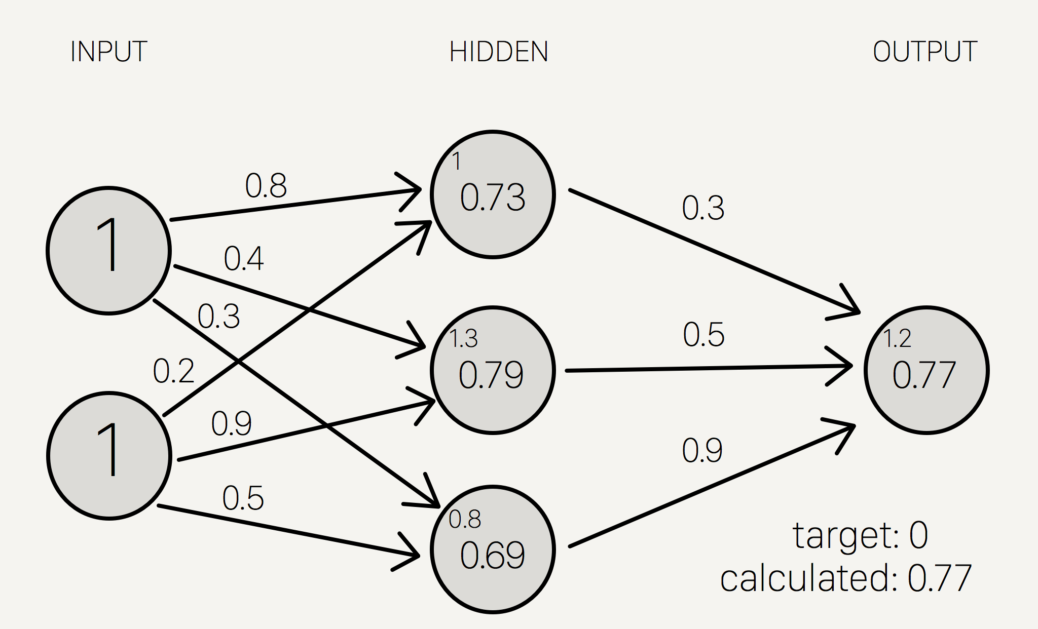
Computation: XOR Example
Img-Source: http://stevenmiller888.github.io/mind-how-to-build-a-neural-network/

Slide 21
Computation: XOR Example
Summing the weights and applying the activation function in the output layer
Matrix Operation
0.3
0.5
0.9
[0.73,0.79,0.69]*
I_{O}
W_{O}
Img-Source: http://stevenmiller888.github.io/mind-how-to-build-a-neural-network/

Slide 22
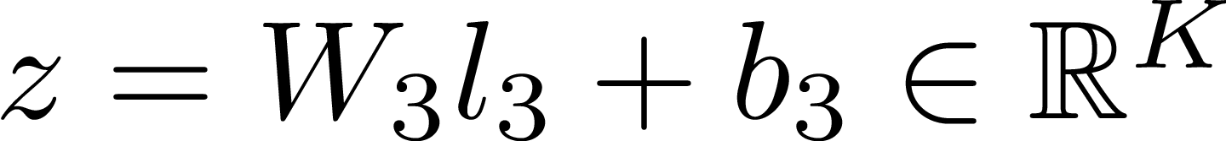
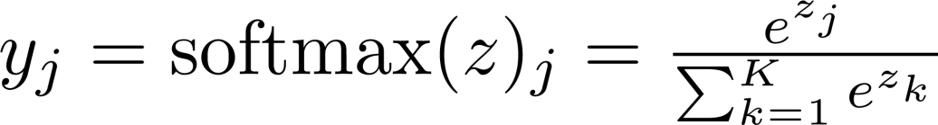
Output Layer: Softmax-Classifier
Multi-class classification
Given K classes (K = number of output units), compute the activation z for the last layer:
Compute the final output y:
y_{j} can have values between 0 and 1
y_{j} sums up to 1 -> it can be interpreted as probability distribution

Slide 23
Neural Network as One Long Function
Long function of vector and matrix operations
Img-Source: http://ufldl.stanford.edu/wiki/

Slide 24
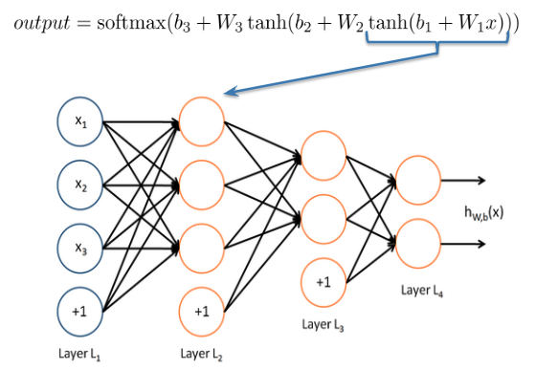
Neural Network as One Long Function
Long function of vector and matrix operations
Img-Source: http://ufldl.stanford.edu/wiki/

Slide 25
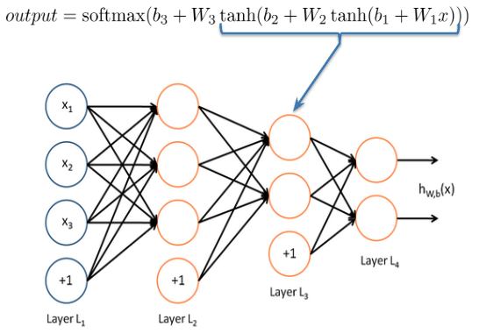
Neural Network as One Long Function
Long function of vector and matrix operations
Img-Source: http://ufldl.stanford.edu/wiki/

Slide 26
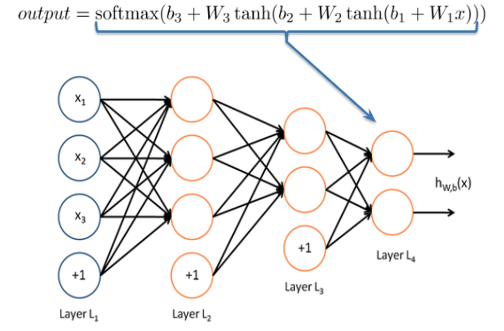
Neural Network as One Long Function
Long function of vector and matrix operations
Compose linear combinations and activation functions
Img-Source: http://ufldl.stanford.edu/wiki/

Slide 27
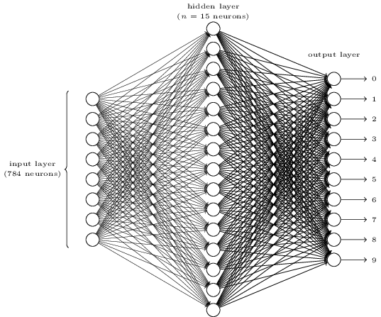
Feed-Forward Network for Handwritten Digit Recognition
Img-Source: http://neuralnetworksanddeeplearning.com

Slide 28
Hidden Layers: Rules of Thumb
The number and the size of the hidden layers can have a large impact on the performance
More hidden layers  more parameters to learn  more data you need
Start with a small number of hidden layers, i.e. with 1
Increase number of hidden layers stepwise until you find an optimum

Slide 29
Learning the Weights
Img-Source: http://stevenmiller888.github.io/mind-how-to-build-a-neural-network/

Slide 30

Training
Goal: to minimize the error over the training data
Error: difference between the output of the network and the expected output (true label)
Mean-squared error:
where y_{i} : the expected value of instance i and o the network’s output of i

Slide 31

Error Function: Negative log-likelihood
Negative log-likelihood:
P(Y=y*|x): probability of x belonging to the true class y*
Ex: given the true label of a sentence s is negative
  The probability of s being negative returned by the network is 0.5
  Error = - log(1/2) = 1
Error = 0 if p = 1
Error increases as p << 0

Slide 32
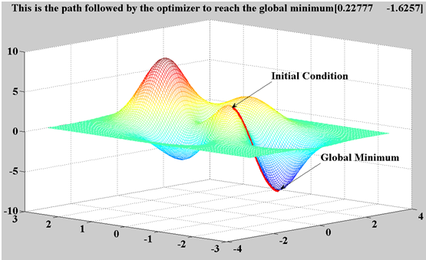
Example of Error Function
Error Curve
Img source: mathworks.de

Slide 33
Training: Back Propagation
Tuning parameters (weights and biases) to minimize the error: optimization problem
Analytical solution doesn’t work: huge number of parameters
Gradient descent:
  The gradient of the error curve points towards a local minima
Source: mathworks.de

Slide 34

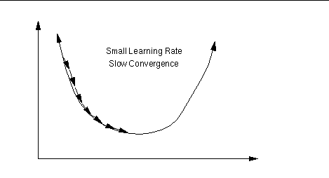
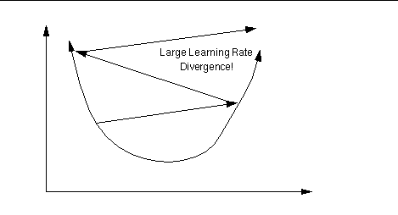
Training with Back Propagation
Initialize the weights and biases randomly
Given the input data, compute the values for the output neurons
Compare the output to the gold labels – compute error function
Compute the derivative for all tunable parameters (weights and parameters)
Update the parameters:
is denoting the learning rate
Img-Source: https://www.willamette.edu/~gorr/classes/cs449/linear2.html

Slide 35
Training with Back Propagation
Each iteration of backpropagation is called an epoch
  After each epoch, the error function decreases,
  converging to a local minima
  Mini-batches:
    Compute derivatives for few instances
    Accumulate them
    Update the parameters based on them

Slide 36
Back Propagation: Example
Img-Source: http://stevenmiller888.github.io/mind-how-to-build-a-neural-network/

Slide 37
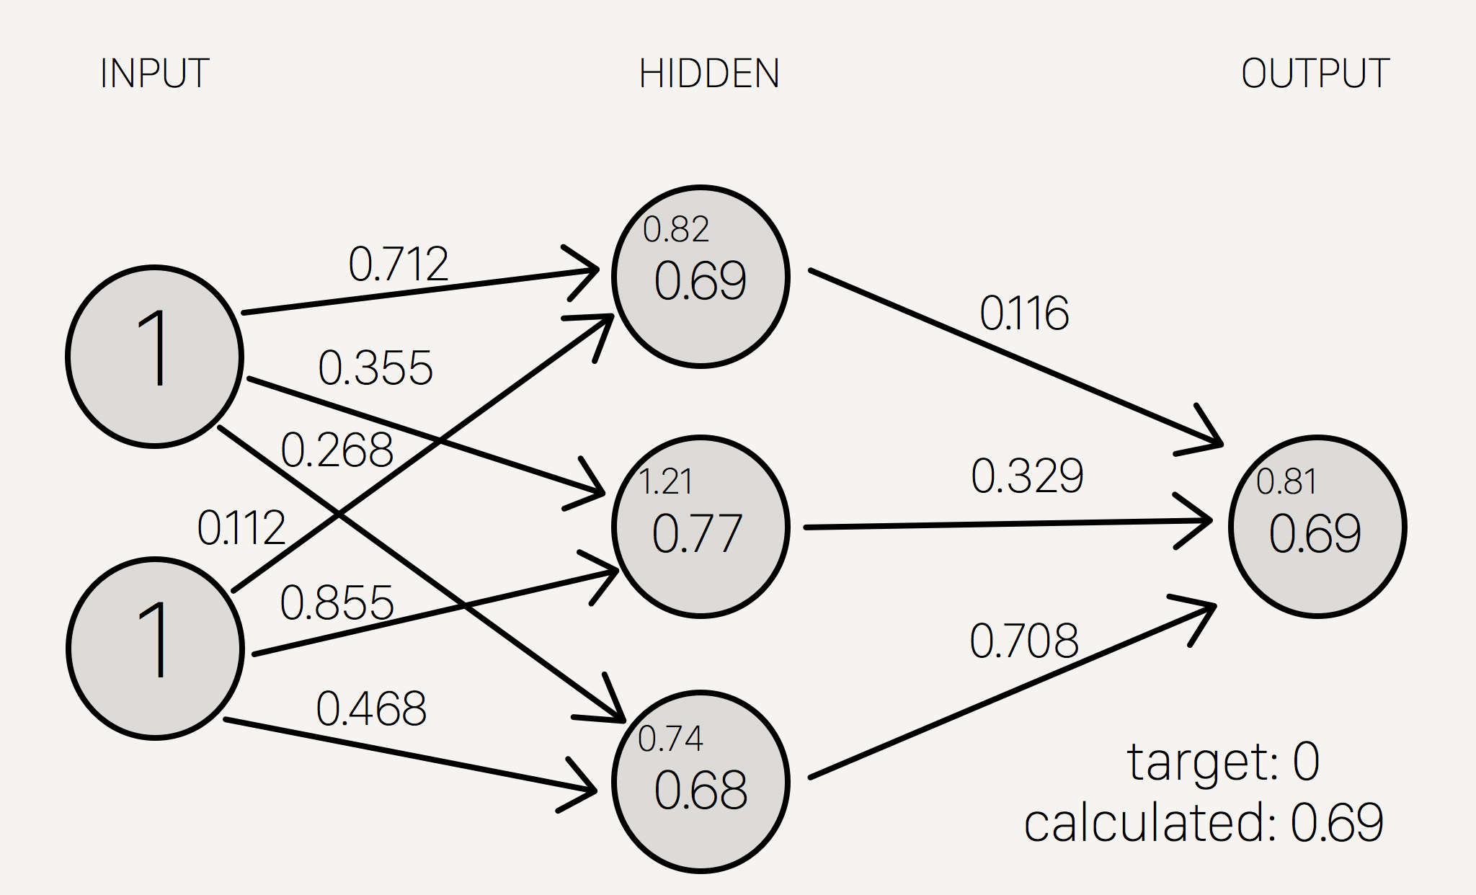
Back Propagation: Example
After 1 epoch:
old new
----------------------------
w1: 0.8 w1: 0.712
w2: 0.4 w2: 0.3548
w3: 0.3 w3: 0.2681
w4: 0.2 w4: 0.112
w5: 0.9 w5: 0.8548
w6: 0.5 w6: 0.4681
w7: 0.3 w7: 0.1162
w8: 0.5 w8: 0.329
w9: 0.9 w9: 0.708
Img-Source: http://stevenmiller888.github.io/mind-how-to-build-a-neural-network/

Slide 38
Computation of Gradients
Computation of the gradient (the derivative of a multi dimensional function) can be cumbersome
  Billions of computations
DL frameworks provide us automatic gradient computation
  We don’t need to compute the derivative
  And we don’t need to implement it into our program code

Slide 39
Motivation for Deep Learning
In theory, feed forward networks with a single hidden layer can compute any function: no need for deep architectures
However, learning shallow architectures is not always efficient
Some problems require an exponential number of hidden units

Slide 40
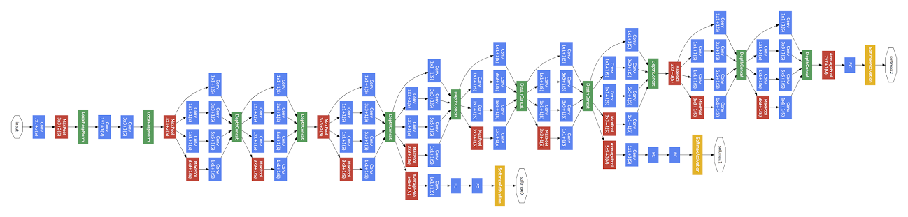
What does a Deep Network can look like?
Source: Szegedy et al., 2014, Going Deeper with Convolutions
Convolution
Pooling
Softmax
Other
Google’s Entry for the 2014 ImageNet Challenge
5 million parameters – 20MB model size

Slide 41
Requirements for Training
Deal with billions of operations
  Google had trained some models on up to 16000 cores
Fast: performance in training time is crucial
Nearly all operations are matrix operations (multiplications, additions)
  Optimizing matrix multiplication for speed is hard
Run on multiple CPUs and on GPUs

