Slide 1
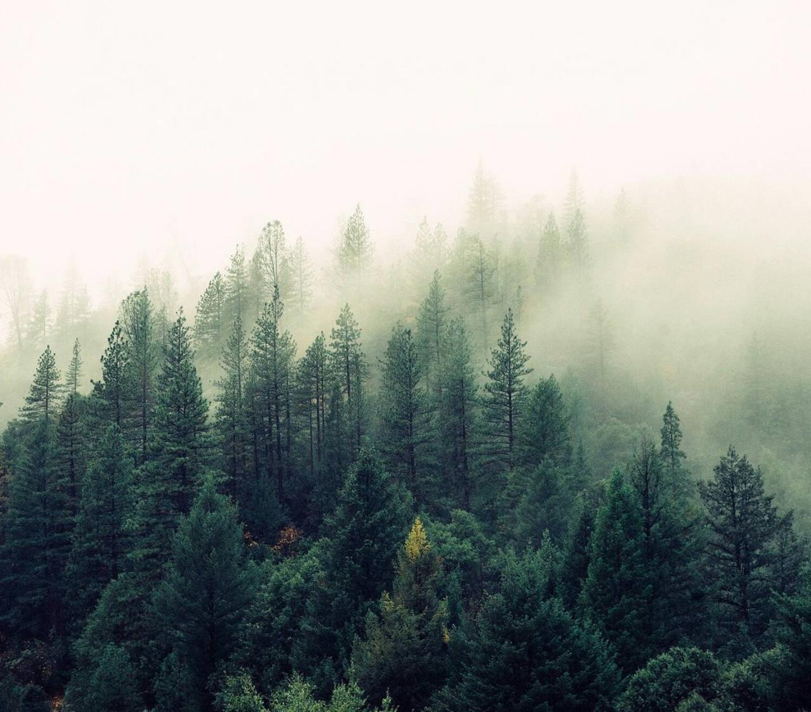
Forest Cover Type Prediction with Machine Learning
Joel Pangilinan
Daniel Carrasco
Poonam FANDAN
Ra-cee Lucas
David Levy
Notes:
POONAM
Hello everyone! For our project, we decided to tackle a forestry classification task using a data set provided by Colorado State University and accessed through the UC Irvine Machine Learning Repository.
Essentially, we are using supervised learning techniques to build a model that can accurately predict what the primary type of tree is in any given 30x30 meter square in the Roosevelt National Forest in Northern Colorado.
Now that may seem a little niche, but we promise we’ll bring it around and give it some real-world meaning once we give you a sense of how we put this all together.

Slide 2
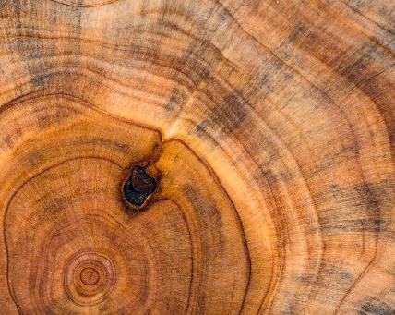
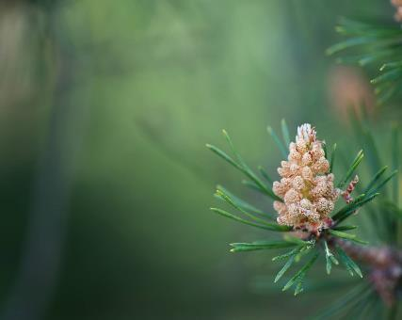
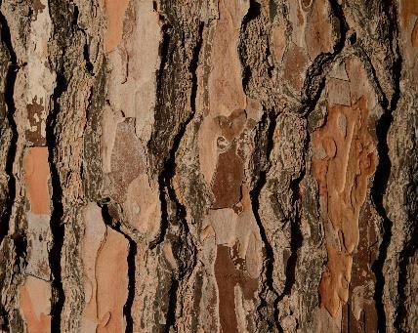

Presentation Overview
Objective & Data Set
Exploratory Data Analysis
Supervised Classification Trials
ML Model & Prediction Results
Applications & Conclusion
Notes:
POONAM
We’ll start by shedding a little more light on our motivations and explaining the nature of our data set without getting too bogged down in details. Obviously we don’t want to get into a situation where you can’t see the forest for the trees, as it were (haha).
Then we’ll give you a sense for what our data looks like through the output of our exploratory data analysis efforts.
Once we all know what we’re looking at, we can dive into the classification trials we ran and some intuition as to what each algorithm does.
We’ll tell you a bit about the best performance we were able to get from the models we tried—spoiler alert, the algorithms have a sense of humor on this topic. I’ll leave you to think about what we might mean by that.
And we’ll finish with an overview of the ways in which this model might be put to use in the real world.

Slide 3
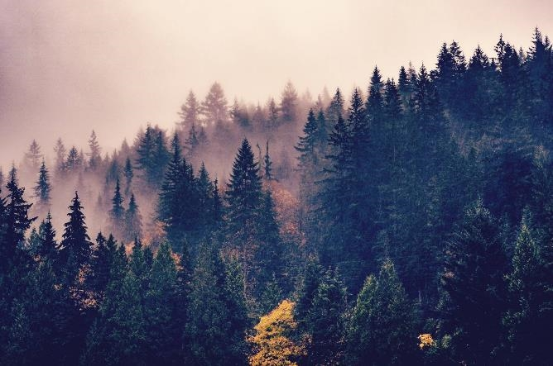


Forest Cover Types — Why?
If we understand what tree species predominate in relatively pristine wilderness areas, we can make better decisions about reforestation efforts as more nations, corporations and individuals set out to reintroduce forest into our landscapes.
Benefits
Carbon sinks
Flood and fire control
Improve livability of urban areas
Challenges
Cost
Time
Ecological health
Notes:
POONAM
Now we have some intuition as to what kinds of information are included in this data set, but it might not be immediately clear why we should care about the ability to predict forest cover types from cartographic variables. After all, ultimately if we can just go out and take pictures of the forest with drones or something, couldn’t we more easily classify that way?
Well sure, but what about areas where we have the cartographic information… but not the labeled data pertaining to cover type?
If we were to understand what tree species currently predominate in relatively pristine wilderness areas like the Roosevelt National Forest, that could help us figure out what types of trees used or could someday cover deforested areas where we’re seeing the most dramatic effects of the Anthropocene era.
Reforestation efforts have become a major aspect of national, corporate and individual responsibility, but ultimately if you don’t understand the land those efforts can be for naught.
That doesn’t mean reforestation is not important, though. Reforested areas act as carbon sinks, they aid in flood and fire control, and they can even improve the livability of urban areas. That said, if people are going to throw money and time at reforestation efforts, we want to make sure that the cost and time to effect are minimal, and that the ecological benefits are maximal.
And that’s why ML models like the one we’ve constructed here matter.

Slide 4
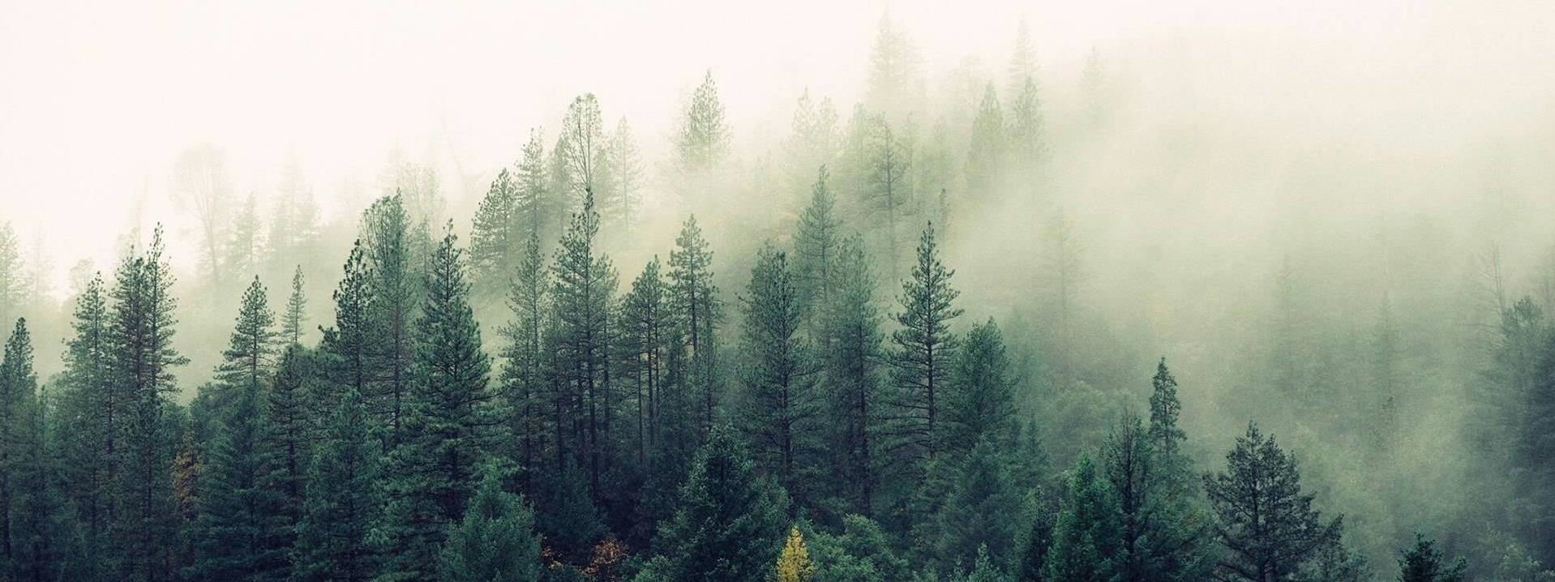
Data Set Overview
Features
Target
Elevation (m)
Aspect (º azimuth)
Slope (º)
Horizontal Distance to Hydrology
Vertical Distance to Hydrology
Horizontal Distance to Roadways
Hillshade 9am
Hillshade 12pm
Hillshade 3pm
Horizontal Distance to Fire Point
Wilderness Area
Soil Type
Cover Type:
1 – Spruce/Fir
2 – Lodgepole Pine
3 – Ponderosa Pine
4 – Cottonwood / Willow
5 – Aspen
6 – Douglas-Fir
7 – Krummholz
Notes:
RA-CEE
Okay, like I said, we are dealing with a supervised learning classification task here. How do we know? Well, we have labeled data, where the target attribute is the predominant type of tree growing in a 30x30 m patch of forest. All of the non-target attributes fall into one of the categories listed on the left side of this slide.
So clearly, we have a discrete target variable and then both continuous and categorical data.
For instance, elevation would be continuous where Wilderness Area and Soil Type fields are binary categorical indicating which of 4 wilderness areas the patch is in and which of 40 soil types are present.
One important thing to note here, all of these variables are what we call cartographic variables, so they’re all information that can be gleaned from maps – either topographical maps that help us understand features of the land, or specialty maps constructed by the U.S. Geological Survey to keep track of things like the wilderness area and soil types over forested land in the U.S.
The second important thing is that the cover type target attribute was determined using U.S. Forest Service Resource Information System data.

Slide 5

Tools We Used
Preprocessing
PostgreSQL
Numpy
Pandas
Visualizations
Seaborn
Matplotlib
Machine Learning
Sci-Kit Learn
TensorFlow
Spark
PyTorch
Notes:
Racee

Slide 6
Exploratory Data Analysis
Notes:
David

Slide 7

ML Algorithms We Chose
Logistic Regression
Random
Forest
Gaussian
NB
Bagging Classifier
Notes:
David

Slide 8
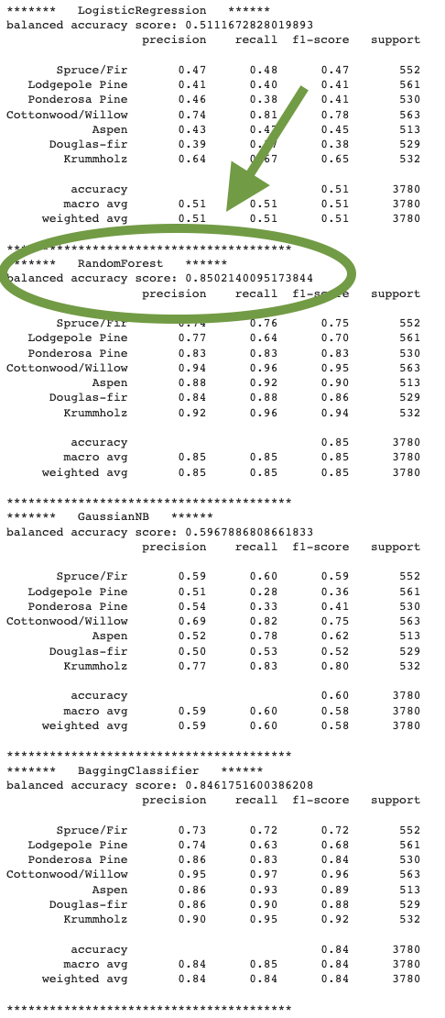
Results
Algorithm | Accuracy
Random Forest | 85.02%
Bagging Classifier | 84.62%
GaussianNB | 59.68%
Logistic Regression | 51.11%
Notes:
Daniel

Slide 9
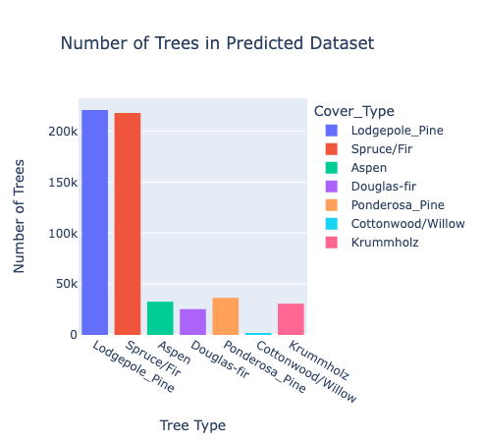
Results
Machine Learning type 2
Results
Notes:
Joel

Slide 10
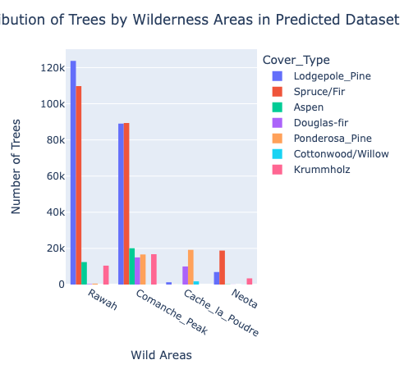
Results
Machine Learning type 2
Results
Notes:
Joel

Slide 11
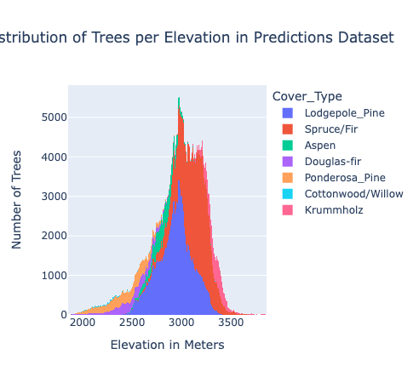
Results
Machine Learning type 2
Results
Notes:
Joel

Slide 12
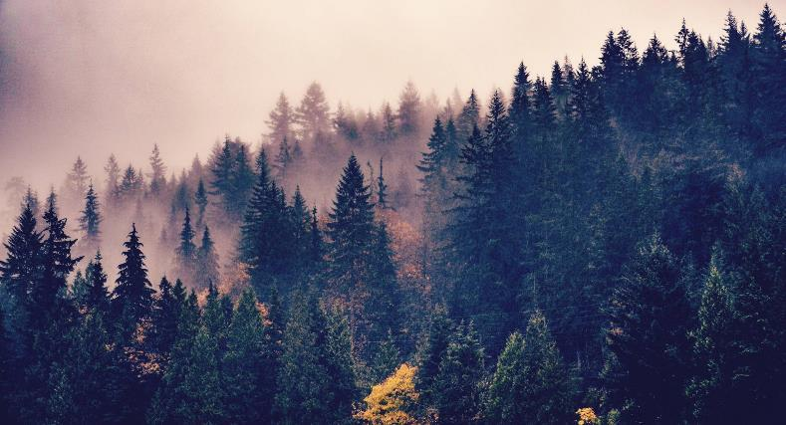
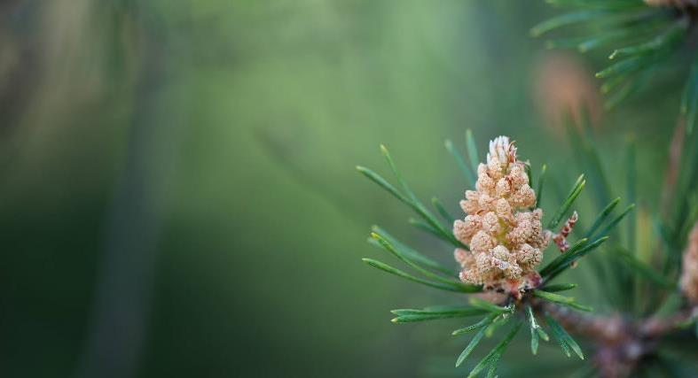
Summary
A random forest approach proved to maximize the accuracy of our supervised learning classification task of predicting forest cover type with cartographic variable inputs that could easily be obtained for currently deforested areas. We hope to
Notes:
Daniel

Slide 13
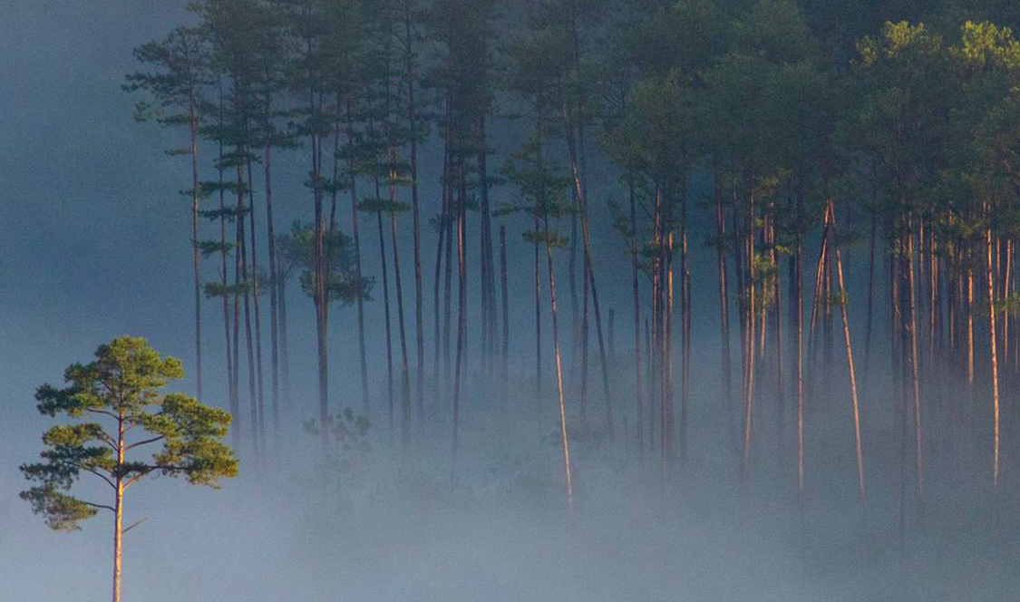
Thank you
Joel Palinginan
Daniel Carrasco
Poonam Fandan
Ra-cee Lucas
David Levy

