Slide 1
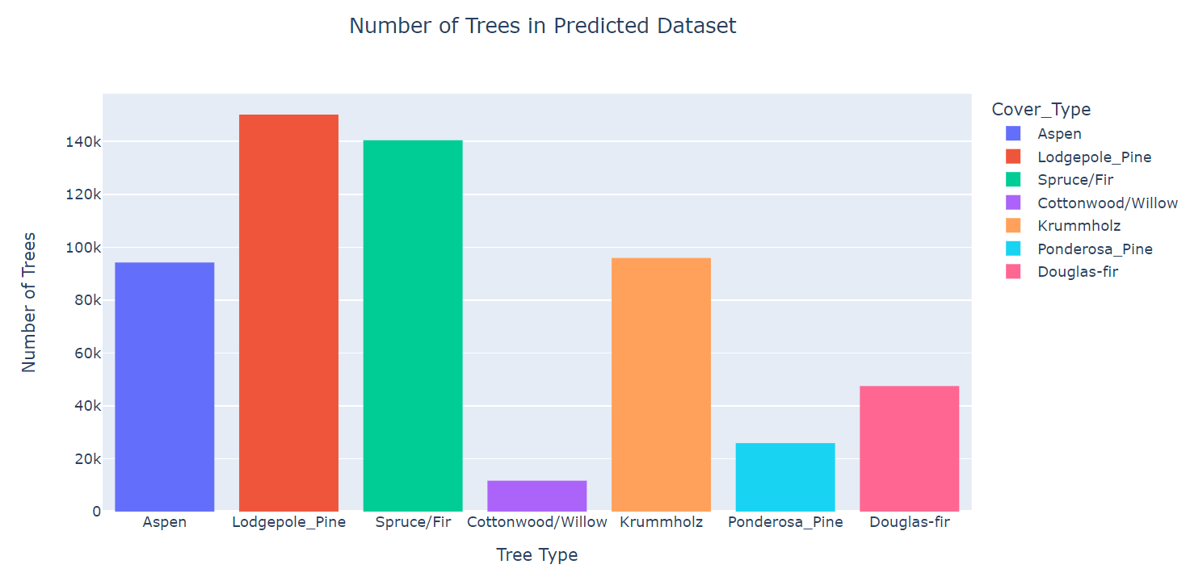
Results – Number of Trees by Cover Type
Notes:
Explanation: This visualization displays the distribution of tree cover types found in our predicted dataset. By analyzing this distribution, we can gain insights into the dominant tree cover types present in the dataset.
Lodgepole_Pine as the predominant cover type in the study area and Cottonwood/Willow as being the smallest.
Key Takeaway: The distribution of tree cover types provides valuable insights into the composition of the dataset and can aid in understanding the vegetation patterns and characteristics of the study area.
******************************************************
Slide 1: Number of Trees by Cover Type
Title: Distribution of Tree Cover Types
Explanation: This visualization displays the distribution of tree cover types found in our predicted dataset. By analyzing this distribution, we can gain insights into the dominant tree cover types present in the dataset.
Key Observations:
Cover Type 2: Lodgepole Pine - This cover type appears to be the most abundant in the dataset, as it has the highest count among all cover types.
Cover Type 1: Spruce/Fir - Spruce/Fir also represents a significant portion of the tree cover in the dataset.
Cover Type 7: Krummholz and Aspen - Krummholz another prominent cover type, although it is less prevalent compared to Spruce/Fir and Lodgepole Pine.
Cover Types 3, 4 and 6: These cover types exhibit relatively lower counts compared to the aforementioned types, suggesting they are less common in the dataset.
Understanding the distribution of tree cover types is crucial for further analysis and decision-making in areas such as forestry management, ecological studies, and land-use planning.
Key Takeaway: The distribution of tree cover types provides valuable insights into the composition of the dataset and can aid in understanding the vegetation patterns and characteristics of the study area.
On our first visualization, I’m showing here the number of cover types across all four wilderness areas.
***********************************

Slide 2
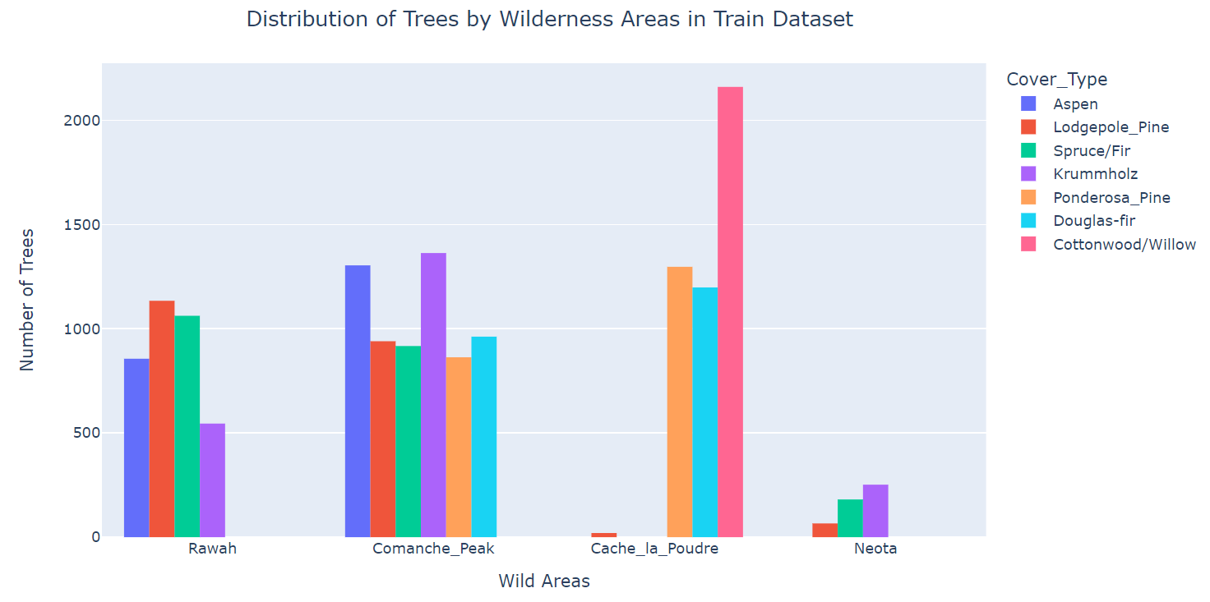
Results – Distribution of Cover Types by Wilderness Areas
Notes:
Slide 2: Distribution of Cover Types by Wilderness Areas
Title: Cover Types Across Wilderness Areas
Explanation: This visualization explores the relationship between the wilderness areas and the distribution of cover types. Wilderness areas are specific regions characterized by their unique environmental and geographical features.
Key Observations:
Wilderness Area 1 (Rawah): This area shows a diverse range of cover types, including Spruce/Fir, Lodgepole Pine, Ponderosa Pine, Cottonwood/Willow, Aspen, and Douglas-fir. It has a relatively higher count of Spruce/Fir and Lodgepole Pine compared to other cover types.
Wilderness Area 2 (Neota) : The dominant cover type in this area is Spruce/Fir, followed by Lodgepole Pine and Aspen. Other cover types appear to have lower representation.
Wilderness Area 3 (Comanche) : Spruce/Fir and Lodgepole Pine are the prominent cover types in this area, with Spruce/Fir being more abundant. The other cover types are less prevalent.
Wilderness Area 4 (Cache_la_Poudre) : This area primarily consists of Spruce/Fir and Lodgepole Pine cover types, with Spruce/Fir being the more dominant of the two.
This visualization provides insights into the relationship between wilderness areas and the composition of tree cover types within each area. Understanding this distribution can assist in ecosystem analysis, conservation efforts, and determining suitable management strategies for different wilderness areas.
Key Takeaway: The distribution of cover types across different wilderness areas provides valuable information about the vegetation characteristics specific to each area. Understanding these patterns can aid in assessing the ecological diversity and management needs of different wilderness areas.

Slide 3
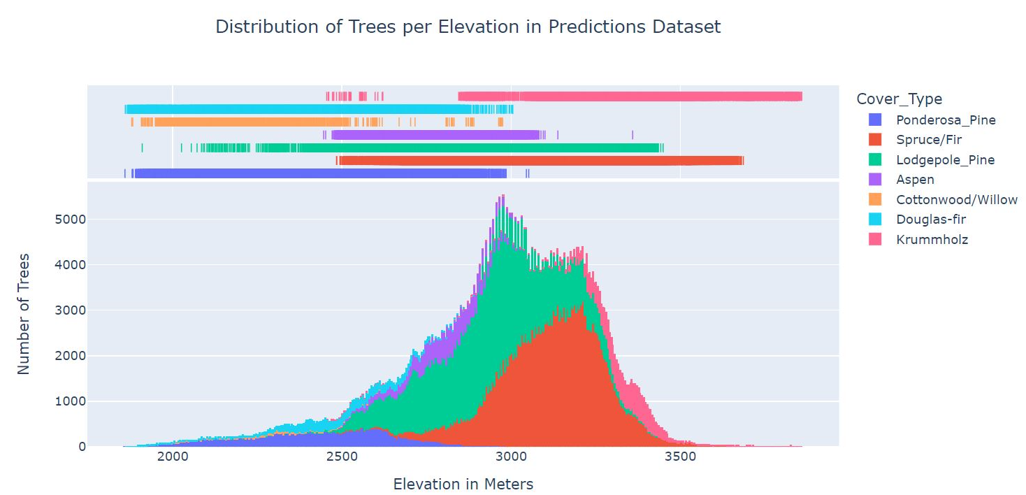
Results – Distribution of Cover Types by Elevation
Notes:
Slide 3: Distribution of Cover Types by Elevation
Title: Cover Types Across Elevation Levels
Explanation: This visualization examines the distribution of tree cover types across different elevation levels. The x-axis represents the elevation values, while the y-axis represents the count of each cover type corresponding to the respective elevation range.
Key Observations:
Lower Elevation Ranges: At lower elevation levels, the dominant cover types are Cottonwood/Willow, Aspen, and Douglas-fir. These cover types are typically associated with lower-lying areas.
Mid to High Elevation Ranges: As the elevation increases, the dominant cover types transition to Spruce/Fir, Lodgepole Pine, Ponderosa Pine, and other coniferous species. These cover types thrive at higher altitudes and exhibit a significant presence in the dataset.
Transition Zones: In certain elevation ranges, there may be overlap or coexistence of different cover types, indicating ecotones or transitional areas between distinct vegetation zones.
Analyzing the distribution of cover types with respect to.
Key Takeaway: The distribution of cover types with respect to elevation provides insights into the preferences and adaptability of different tree species to specific altitude ranges. Understanding these relationships is crucial for studying ecological patterns and predicting vegetation changes across varying elevations.

