Slide 1
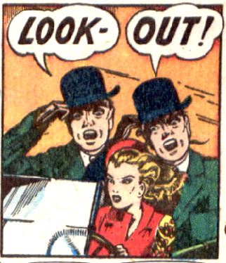
teach me py. test
Haecksen miniconf | LCA 2013 | Brianna Laugher & Mary Gardiner

Slide 2
Our mission:
Teach Mary how to use py.test
  in this session
  with no prior knowledge or experience
Write tests for (a fraction of) zookeepr

Slide 3
py.test – all the good stuff
Python test runner/testing library
all test styles possible: unittest, doctest, nose
boilerplate-free style – natural asserts
support for running tests distributed, boxed
generate JUnit-style XML for Jenkins CI
informative error reporting
extensible plugins, useful builtins
skip, xfail, custom test markers
parametrize, generate tests, funcargs!

Slide 4
Installing
pip install pytest (recommended method)
May be installable from your distro, e.g. apt-get / python-pytest
Call on the command-line as py.test

Slide 5
Now to the code!

Slide 6
For more on py.test
http://codespeak.net/mailman/listinfo/py-dev
testing-in-python mailing list
Stack Overflow
lead developer Holger Krekel is very responsive

Slide 7
credits, thanks, contact
Comic panels from comicallyvintage.tumblr.com
Mary for the idea (from Steve Holden/PyCon US)
Check out the more detailed intro to py.test I gave at PyConAU 2012.
Video: http://youtu.be/DTNejE9EraI
Code examples: gist.github.com/3386951
brianna@modernthings.org

Slide 8

pytest.org

