Slide 1
面向海洋时空模型的可重构 FPGA 加速器
学术分享 · 研究论文
让卷积、循环与逐元素运算共享计算资源
Energy-efficient reconfigurable FPGA accelerator for marine
convolutional neural network-long short-term memory applications
Qiuyu Wang · Qi Wen · Zhiqiang Wei · Haiyang Mao
Ruitao Tao · Hao Zhang
Intelligent Marine Technology and Systems · 4:9 · 2026
DOI 10.1007/s44295-026-00098-3
Wang et al. · IMTS (2026) · 文献汇报
01
Notes:
Wang et al. (2026). Energy-efficient reconfigurable FPGA accelerator for marine convolutional neural network-long short-term memory applications. Intelligent Marine Technology and Systems 4:9. DOI:10.1007/s44295-026-00098-3；摘要、§1
Layout: L16
Palette: P6
Scenario: academic
讲解提示：本研究核心是统一硬件架构，海表温度预测是验证场景。关注计算、存储与控制如何协同，以及报告结果是否足以支持部署。
EVIDENCE_MANIFEST: {"materials": {"papers": [{"id": "wang2026", "path": "materials/paper.pdf", "figure_status": "relevant"}]}, "figures": []}

Slide 2
研究问题来自海洋边缘设备的资源约束
01 / 背景与贡献
应用需求
硬件矛盾
本文方案
海表温度等数据具有时空关联
通信链路与设备能量受限
希望在观测终端就地推理
CNN 强调空间卷积与数据复用
LSTM 包含时序依赖与门控
单一计算阵列容易利用不足
异构 PE / SPE / EW 计算阵列
可配置数据流与整数精度
用统一指令组织异构计算
Wang et al. · IMTS (2026) · 文献汇报
02
Notes:
Wang et al. (2026). Energy-efficient reconfigurable FPGA accelerator for marine convolutional neural network-long short-term memory applications. Intelligent Marine Technology and Systems 4:9. DOI:10.1007/s44295-026-00098-3；§1–2
Layout: L16
Palette: P6
Scenario: academic
讲解提示：贡献在架构与映射，不是提出新的海洋预测算法。FPGA的适用性需要结合目标设备功耗、成本与时延约束判断。
EVIDENCE_MANIFEST: {"materials": {"papers": [{"id": "wang2026", "path": "materials/paper.pdf", "figure_status": "relevant"}]}, "figures": []}

Slide 3
串联 CNN–LSTM 与 ConvLSTM 需要区分
01 / 模型与工作负载
串联式结构
ConvLSTM
本文实验
CNN 先提取每帧空间特征
LSTM 再处理特征时间序列
两阶段连接形成混合模型
将门控中的全连接变换
替换成二维卷积操作
空间结构在递归过程中保留
使用 ConvLSTM 海温预测模型
不能将其直接等同于
任意 CNN + LSTM 串联网络
Wang et al. · IMTS (2026) · 文献汇报
03
Notes:
Wang et al. (2026). Energy-efficient reconfigurable FPGA accelerator for marine convolutional neural network-long short-term memory applications. Intelligent Marine Technology and Systems 4:9. DOI:10.1007/s44295-026-00098-3；§1、§4.1
Layout: L16
Palette: P6
Scenario: academic
讲解提示：原文Fig.1说明串联式混合网络，实际验证模型则是ConvLSTM。这一区别决定门控映射与运算量的解释。
EVIDENCE_MANIFEST: {"materials": {"papers": [{"id": "wang2026", "path": "materials/paper.pdf", "figure_status": "relevant"}]}, "figures": []}

Slide 4
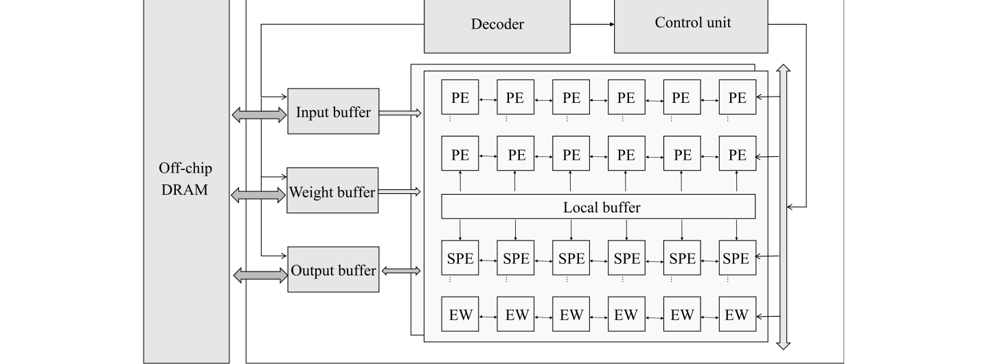
统一架构连接计算、存储与指令控制
02 / 总体设计
Fig.3 统一架构连接计算、存储与指令控制
来源：Wang et al. (2026), Fig.3, p.7
Wang et al. · IMTS (2026) · 文献汇报
04
Notes:
Wang et al. (2026). Energy-efficient reconfigurable FPGA accelerator for marine convolutional neural network-long short-term memory applications. Intelligent Marine Technology and Systems 4:9. DOI:10.1007/s44295-026-00098-3；Fig.3, p.7
Layout: L16
Palette: P6
Scenario: academic
讲解提示：片外DRAM通过缓存与FIFO向计算阵列供数；解码与控制模块配置PE、SPE和EW。重点沿数据流向说明计算与搬运如何配合。
EVIDENCE_MANIFEST: {"materials": {"papers": [{"id": "wang2026", "path": "materials/paper.pdf", "figure_status": "relevant"}]}, "figures": [{"kind": "paper_crop", "path": "/workspace/output/fpga-report/figures/Fig.3.png", "caption": "Fig.3 统一架构连接计算、存储与指令控制", "source": "来源：Wang et al. (2026), Fig.3, p.7", "provenance": {"paper_id": "wang2026", "figure": "Fig.3", "page": 7, "crop_bbox": [58, 100, 538, 277], "pdf_sha256": "ad9ccffe7f1244881c7e0ae65342ca0d813ef961ea0bbdb481fd19838a2e4361", "png_sha256": "5064950ba39509863f560081d90337e6d3f076b5836e6a6bceb61d42fa18c0df", "render_method": "pdf_clip", "dpi": 216, "verified_complete": true}}]}

Slide 5
三类处理单元承担互补的运算任务
02 / 计算阵列
PE：乘加基础
SPE：可配置单元
EW：逐元素计算
完成核心 MAC 运算
多方向输入与输出路由
支持卷积及部分矩阵运算
在 PE 类与 EW 类模式间切换
参与卷积或门控等计算
使资源随工作阶段重新分配
支持 ReLU、Sigmoid、tanh
处理门控乘法与状态更新
用本地寄存器和 RAM 缓存
Wang et al. · IMTS (2026) · 文献汇报
05
Notes:
Wang et al. (2026). Energy-efficient reconfigurable FPGA accelerator for marine convolutional neural network-long short-term memory applications. Intelligent Marine Technology and Systems 4:9. DOI:10.1007/s44295-026-00098-3；§3.1、Fig.4–6
Layout: L16
Palette: P6
Scenario: academic
讲解提示：动态可重构在本文主要指指令驱动的数据通路与模式配置；不应自动理解为运行时重新加载FPGA位流。
EVIDENCE_MANIFEST: {"materials": {"papers": [{"id": "wang2026", "path": "materials/paper.pdf", "figure_status": "relevant"}]}, "figures": []}

Slide 6
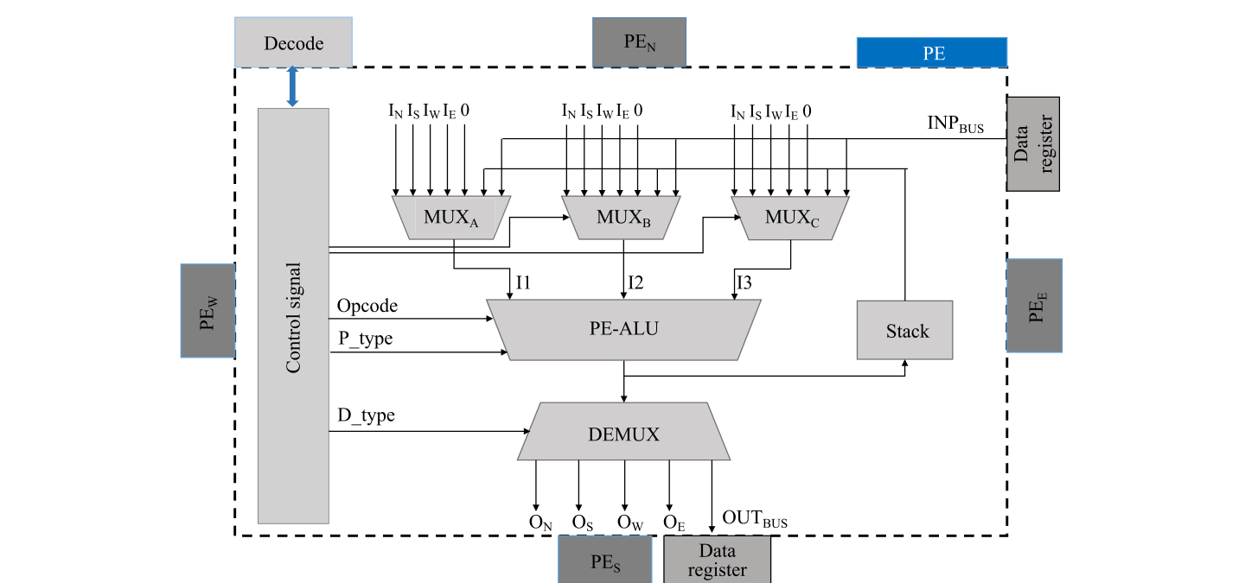
PE 的多路选择器与路由支持模式切换
02 / 处理单元原图
Fig.4 PE 的多路选择器与路由支持模式切换
来源：Wang et al. (2026), Fig.4, p.7
Wang et al. · IMTS (2026) · 文献汇报
06
Notes:
Wang et al. (2026). Energy-efficient reconfigurable FPGA accelerator for marine convolutional neural network-long short-term memory applications. Intelligent Marine Technology and Systems 4:9. DOI:10.1007/s44295-026-00098-3；Fig.4, p.7
Layout: L16
Palette: P6
Scenario: academic
讲解提示：按输入MUX、PE-ALU、输出DEMUX讲解；精度与操作码来自中央解码器，局部存储支撑数据复用。
EVIDENCE_MANIFEST: {"materials": {"papers": [{"id": "wang2026", "path": "materials/paper.pdf", "figure_status": "relevant"}]}, "figures": [{"kind": "paper_crop", "path": "/workspace/output/fpga-report/figures/Fig.4.png", "caption": "Fig.4 PE 的多路选择器与路由支持模式切换", "source": "来源：Wang et al. (2026), Fig.4, p.7", "provenance": {"paper_id": "wang2026", "figure": "Fig.4", "page": 7, "crop_bbox": [58, 462, 538, 687], "pdf_sha256": "ad9ccffe7f1244881c7e0ae65342ca0d813ef961ea0bbdb481fd19838a2e4361", "png_sha256": "abf1294aa452585698a91c08803801c190fbbc1607929ec0e0df737f6547892e", "render_method": "pdf_clip", "dpi": 216, "verified_complete": true}}]}

Slide 7
数据流选择围绕不同的数据复用机会
02 / WS、OS 与 RS
OS：输出驻留
WS：权重驻留
RS：行驻留
部分和保存在本地累加寄存器
减少输出结果的反复搬运
适合输出通道累加密集的卷积
权重预加载至 PE 寄存器
输入激活流经阵列
适合跨时间步反复使用的权重
缓存连续输入特征行
复用输入、卷积核与部分和
利用二维卷积的空间局部性
Wang et al. · IMTS (2026) · 文献汇报
07
Notes:
Wang et al. (2026). Energy-efficient reconfigurable FPGA accelerator for marine convolutional neural network-long short-term memory applications. Intelligent Marine Technology and Systems 4:9. DOI:10.1007/s44295-026-00098-3；§3.3–3.4
Layout: L16
Palette: P6
Scenario: academic
讲解提示：三种数据流并非固定绑定某一种网络，而是根据层结构、尺寸和复用需求选择。
EVIDENCE_MANIFEST: {"materials": {"papers": [{"id": "wang2026", "path": "materials/paper.pdf", "figure_status": "relevant"}]}, "figures": []}

Slide 8
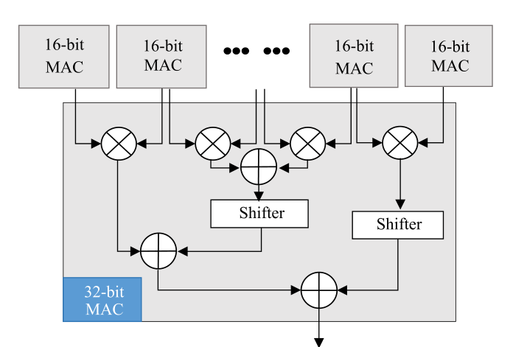
低位宽乘法器通过级联支持多精度
02 / 混合精度原图
Fig.7 低位宽乘法器通过级联支持多精度
来源：Wang et al. (2026), Fig.7, p.10
Wang et al. · IMTS (2026) · 文献汇报
08
Notes:
Wang et al. (2026). Energy-efficient reconfigurable FPGA accelerator for marine convolutional neural network-long short-term memory applications. Intelligent Marine Technology and Systems 4:9. DOI:10.1007/s44295-026-00098-3；Fig.7, p.10
Layout: L16
Palette: P6
Scenario: academic
讲解提示：原文支持8、16与32位整数模式。低精度时独立并行，高精度时组合级联；需区分硬件支持精度切换与已验证的精度策略。
EVIDENCE_MANIFEST: {"materials": {"papers": [{"id": "wang2026", "path": "materials/paper.pdf", "figure_status": "relevant"}]}, "figures": [{"kind": "paper_crop", "path": "/workspace/output/fpga-report/figures/Fig.7.png", "caption": "Fig.7 低位宽乘法器通过级联支持多精度", "source": "来源：Wang et al. (2026), Fig.7, p.10", "provenance": {"paper_id": "wang2026", "figure": "Fig.7", "page": 10, "crop_bbox": [58, 520, 290, 677], "pdf_sha256": "ad9ccffe7f1244881c7e0ae65342ca0d813ef961ea0bbdb481fd19838a2e4361", "png_sha256": "5bcb063871677219fb7acf5994f5aa9fac5244ba53d918c18cf2585405dd3abe", "render_method": "pdf_clip", "dpi": 216, "verified_complete": true}}]}

Slide 9
三层存储减少反复访问片外数据
02 / 存储与控制
片外存储
片上缓存
本地寄存器
保存输入、权重与中间结果
容量大但访问代价较高
由 DMA 组织块数据传输
保存当前计算所需数据块
FIFO 向阵列持续供数
结合层参数选择数据流
保存权重、状态及临时结果
尽量在处理单元内部复用
降低片外带宽压力
Wang et al. · IMTS (2026) · 文献汇报
09
Notes:
Wang et al. (2026). Energy-efficient reconfigurable FPGA accelerator for marine convolutional neural network-long short-term memory applications. Intelligent Marine Technology and Systems 4:9. DOI:10.1007/s44295-026-00098-3；§3.3–3.5
Layout: L16
Palette: P6
Scenario: academic
讲解提示：正文阐述了减少片外访问的设计动机；没有给出统一的带宽下降消融数据，不应补造具体节省比例。
EVIDENCE_MANIFEST: {"materials": {"papers": [{"id": "wang2026", "path": "materials/paper.pdf", "figure_status": "relevant"}]}, "figures": []}

Slide 10

64 位指令编码层类型与运行配置
02 / 指令驱动控制
Fig.8 64 位指令编码层类型与运行配置
来源：Wang et al. (2026), Fig.8, p.11
Wang et al. · IMTS (2026) · 文献汇报
10
Notes:
Wang et al. (2026). Energy-efficient reconfigurable FPGA accelerator for marine convolutional neural network-long short-term memory applications. Intelligent Marine Technology and Systems 4:9. DOI:10.1007/s44295-026-00098-3；Fig.8, p.11
Layout: L16
Palette: P6
Scenario: academic
讲解提示：CIW编码层类型、数据流、精度、卷积核、步幅与通道参数；4位操作码为扩展保留编码空间。
EVIDENCE_MANIFEST: {"materials": {"papers": [{"id": "wang2026", "path": "materials/paper.pdf", "figure_status": "relevant"}]}, "figures": [{"kind": "paper_crop", "path": "/workspace/output/fpga-report/figures/Fig.8.png", "caption": "Fig.8 64 位指令编码层类型与运行配置", "source": "来源：Wang et al. (2026), Fig.8, p.11", "provenance": {"paper_id": "wang2026", "figure": "Fig.8", "page": 11, "crop_bbox": [58, 635, 539, 698], "pdf_sha256": "ad9ccffe7f1244881c7e0ae65342ca0d813ef961ea0bbdb481fd19838a2e4361", "png_sha256": "1b1a376081d9f8fca89d73e221af0b766515e43efb74a74f7cb8f411126b4258", "render_method": "pdf_clip", "dpi": 216, "verified_complete": true}}]}

Slide 11
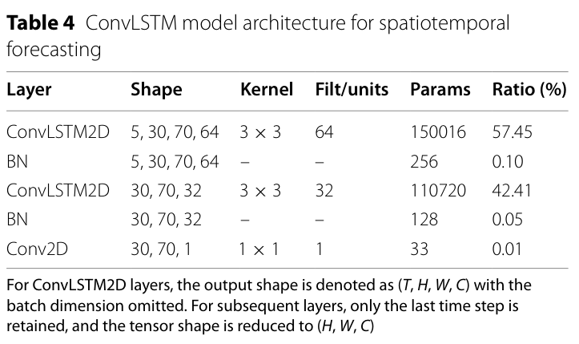
验证模型以两层 ConvLSTM 进行海温预测
03 / 模型与实验
Table4 验证模型以两层 ConvLSTM 进行海温预测
来源：Wang et al. (2026), Table4, p.13
Wang et al. · IMTS (2026) · 文献汇报
11
Notes:
Wang et al. (2026). Energy-efficient reconfigurable FPGA accelerator for marine convolutional neural network-long short-term memory applications. Intelligent Marine Technology and Systems 4:9. DOI:10.1007/s44295-026-00098-3；Table4, p.13
Layout: L16
Palette: P6
Scenario: academic
讲解提示：模型为ConvLSTM2D、BN、ConvLSTM2D、BN、1×1 Conv2D。张量包括5个时间步、30×70空间网格，通道数为64与32。原文未充分交代数据集来源、划分与预测误差定义，复现信息需要补充。
EVIDENCE_MANIFEST: {"materials": {"papers": [{"id": "wang2026", "path": "materials/paper.pdf", "figure_status": "relevant"}]}, "figures": [{"kind": "paper_crop", "path": "/workspace/output/fpga-report/figures/Table4.png", "caption": "Table4 验证模型以两层 ConvLSTM 进行海温预测", "source": "来源：Wang et al. (2026), Table4, p.13", "provenance": {"paper_id": "wang2026", "figure": "Table4", "page": 13, "crop_bbox": [54, 83, 295, 226], "pdf_sha256": "ad9ccffe7f1244881c7e0ae65342ca0d813ef961ea0bbdb481fd19838a2e4361", "png_sha256": "e2379c441e502027e8c0e7119f3bb577b4a841911bd5a92d9de7f7d9b17867df", "render_method": "pdf_clip", "dpi": 216, "verified_complete": true}}]}

Slide 12
实验平台与主要报告结果
03 / 硬件实现
实现条件
作者报告
资源占用
Xilinx ZCU102
Vivado 2023.2
实现后时序分析：200 MHz
吞吐率：18.5 GOPS
功耗：1.2 W
能效：15.4 GOPS/W
LUT：53,113（19.3%）
FF：107,328（19.5%）
DSP：834（33.0%）
BRAM：322（17.6%）
Wang et al. · IMTS (2026) · 文献汇报
12
Notes:
Wang et al. (2026). Energy-efficient reconfigurable FPGA accelerator for marine convolutional neural network-long short-term memory applications. Intelligent Marine Technology and Systems 4:9. DOI:10.1007/s44295-026-00098-3；§4、Table5–8
Layout: L16
Palette: P6
Scenario: academic
讲解提示：18.5/1.2≈15.4，数值关系自洽。但功耗测量范围、精度模式与吞吐统计条件需结合完整实现说明核实。
EVIDENCE_MANIFEST: {"materials": {"papers": [{"id": "wang2026", "path": "materials/paper.pdf", "figure_status": "relevant"}]}, "figures": []}

Slide 13
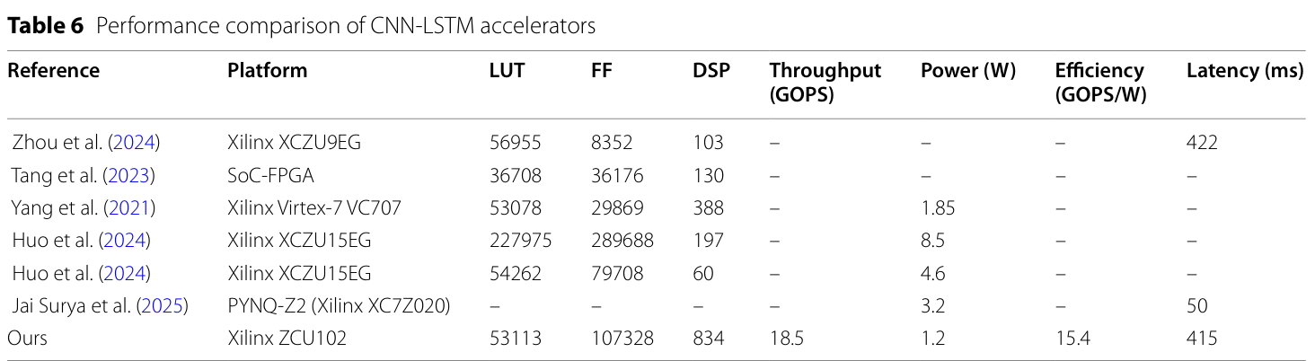
混合模型比较显示低功耗与更高 DSP 使用
03 / 性能比较原表
Table6 混合模型比较显示低功耗与更高 DSP 使用
来源：Wang et al. (2026), Table6, p.14
Wang et al. · IMTS (2026) · 文献汇报
13
Notes:
Wang et al. (2026). Energy-efficient reconfigurable FPGA accelerator for marine convolutional neural network-long short-term memory applications. Intelligent Marine Technology and Systems 4:9. DOI:10.1007/s44295-026-00098-3；Table6, p.14
Layout: L16
Palette: P6
Scenario: academic
讲解提示：本方案相对Yang的功耗为1.2对1.85 W，使用834 DSP；相对Zhou时延为415对422 ms。多个比较项缺失，不可据此建立统一性能排名；不同模型与器件也限制直接比较。
EVIDENCE_MANIFEST: {"materials": {"papers": [{"id": "wang2026", "path": "materials/paper.pdf", "figure_status": "relevant"}]}, "figures": [{"kind": "paper_crop", "path": "/workspace/output/fpga-report/figures/Table6.png", "caption": "Table6 混合模型比较显示低功耗与更高 DSP 使用", "source": "来源：Wang et al. (2026), Table6, p.14", "provenance": {"paper_id": "wang2026", "figure": "Table6", "page": 14, "crop_bbox": [54, 83, 542, 217], "pdf_sha256": "ad9ccffe7f1244881c7e0ae65342ca0d813ef961ea0bbdb481fd19838a2e4361", "png_sha256": "f23a22ea5a168f590ecdc37d68f9693c8b3cdf7e895635777f64e4e318ec790f", "render_method": "pdf_clip", "dpi": 216, "verified_complete": true}}]}

Slide 14
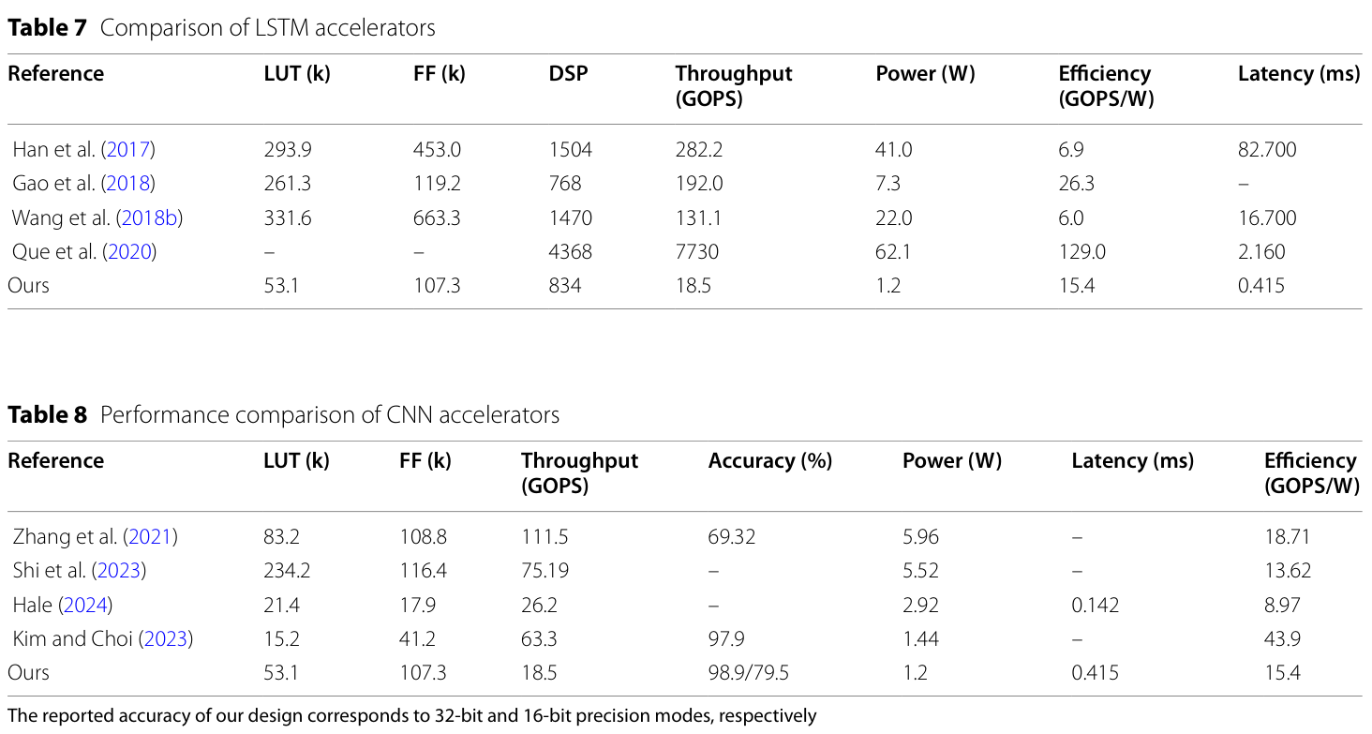
LSTM 与 CNN 的结果需要按任务分别读
03 / 性能与精度原表
Tables7-8 LSTM 与 CNN 的结果需要按任务分别读
来源：Wang et al. (2026), Tables7-8, p.14
Wang et al. · IMTS (2026) · 文献汇报
14
Notes:
Wang et al. (2026). Energy-efficient reconfigurable FPGA accelerator for marine convolutional neural network-long short-term memory applications. Intelligent Marine Technology and Systems 4:9. DOI:10.1007/s44295-026-00098-3；Tables7-8, p.14
Layout: L16
Palette: P6
Scenario: academic
讲解提示：完整保留两张原表。Table7和8列出本方案0.415 ms，而Table6及结论列415 ms，相差1000倍。Table8的32/16位Accuracy为98.9/79.5%，但并非清楚定义的海温预测误差，不宜直接称为海温预测准确率。
EVIDENCE_MANIFEST: {"materials": {"papers": [{"id": "wang2026", "path": "materials/paper.pdf", "figure_status": "relevant"}]}, "figures": [{"kind": "paper_crop", "path": "/workspace/output/fpga-report/figures/Tables7-8.png", "caption": "Tables7-8 LSTM 与 CNN 的结果需要按任务分别读", "source": "来源：Wang et al. (2026), Tables7-8, p.14", "provenance": {"paper_id": "wang2026", "figure": "Tables7-8", "page": 14, "crop_bbox": [54, 233, 542, 494], "pdf_sha256": "ad9ccffe7f1244881c7e0ae65342ca0d813ef961ea0bbdb481fd19838a2e4361", "png_sha256": "dac7f00adb7118da5856fb8d0cb548de31ab5eb203d58494f562f77ba46d89f2", "render_method": "pdf_clip", "dpi": 216, "verified_complete": true}}]}

Slide 15
两处结果定义影响性能结论的可信度
04 / 局限与核查
时延口径不一致
精度指标不清晰
比较与消融不足
Table6 与结论：415 ms
Table7 / Table8：0.415 ms
相差 1000 倍，需要作者澄清
32 / 16 位：98.9% / 79.5%
未清楚定义 Accuracy 的计算
不等同于明确的 SST 误差指标
器件、模型与精度条件不统一
缺少各模块独立贡献的消融
尚需端到端功耗与切换开销
Wang et al. · IMTS (2026) · 文献汇报
15
Notes:
Wang et al. (2026). Energy-efficient reconfigurable FPGA accelerator for marine convolutional neural network-long short-term memory applications. Intelligent Marine Technology and Systems 4:9. DOI:10.1007/s44295-026-00098-3；Table6–8、§4–5；评价为汇报者判断
Layout: L16
Palette: P6
Scenario: academic
讲解提示：这些问题应保留在一页集中讨论。不能自行猜测并修正原文单位，也不能声称本方案在所有指标上最好。
EVIDENCE_MANIFEST: {"materials": {"papers": [{"id": "wang2026", "path": "materials/paper.pdf", "figure_status": "relevant"}]}, "figures": []}

Slide 16
本文提供了可复用的硬件协同设计思路
04 / 总结与研究启发
核心贡献
下一步验证
讨论问题
用统一阵列承载异构工作负载
将精度、数据流和存储联动
强调海洋边缘设备的能耗约束
固定同一模型与数据集
对比固定 / 自适应数据流
分别测量精度、能耗和总时延
精度下降与能耗下降如何权衡？
切换与存储开销会抵消收益吗？
在真实观测设备上是否可持续？
Wang et al. · IMTS (2026) · 文献汇报
16
Notes:
Wang et al. (2026). Energy-efficient reconfigurable FPGA accelerator for marine convolutional neural network-long short-term memory applications. Intelligent Marine Technology and Systems 4:9. DOI:10.1007/s44295-026-00098-3；§5；研究建议为汇报者提出
Layout: L16
Palette: P6
Scenario: academic
讲解提示：可借鉴的是任务与数据复用共同决定架构配置的思路。部署前必须补全任务指标和实测端到端证据。
EVIDENCE_MANIFEST: {"materials": {"papers": [{"id": "wang2026", "path": "materials/paper.pdf", "figure_status": "relevant"}]}, "figures": []}

Slide 17
文献信息与汇报结论
参考与结束
Wang, Q., Wen, Q., Wei, Z., Mao, H., Tao, R., & Zhang, H. (2026).
Energy-efficient reconfigurable FPGA accelerator for marine
convolutional neural network-long short-term memory applications.
Intelligent Marine Technology and Systems, 4:9.
DOI: 10.1007/s44295-026-00098-3
原图与原表：所上传论文；仅裁去外围正文与空白，未改绘结果。
Wang et al. · IMTS (2026) · 文献汇报
17
Notes:
Wang et al. (2026). Energy-efficient reconfigurable FPGA accelerator for marine convolutional neural network-long short-term memory applications. Intelligent Marine Technology and Systems 4:9. DOI:10.1007/s44295-026-00098-3；全文
Layout: L16
Palette: P6
Scenario: academic
讲解提示：研究是可配置FPGA架构与映射的探索。汇报的主要结论为统一异构计算、混合精度与可变数据流具有潜力，但性能比较和复现仍需澄清。
EVIDENCE_MANIFEST: {"materials": {"papers": [{"id": "wang2026", "path": "materials/paper.pdf", "figure_status": "relevant"}]}, "figures": []}

