Slide 1
Introduction to Computers and C++
Chapter 1 of C++ How to Program, 10/e

Slide 2
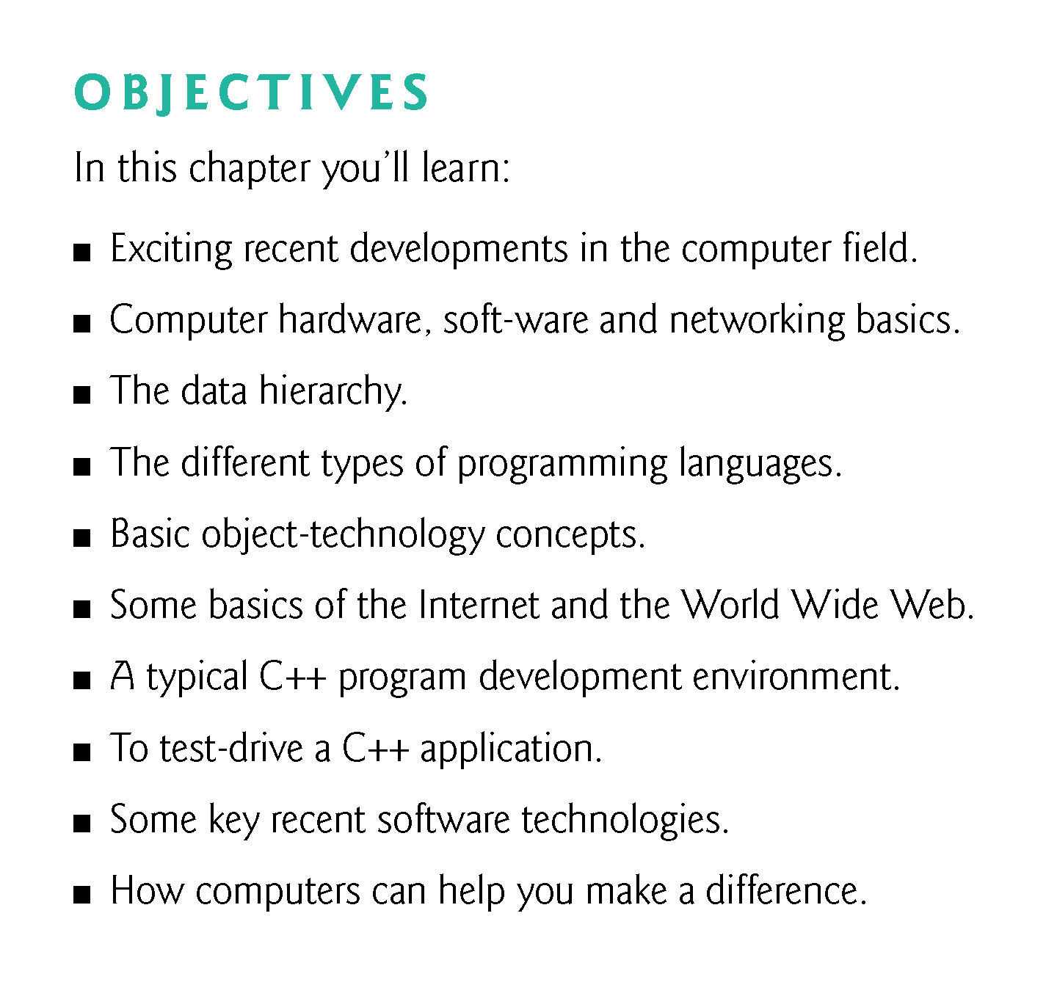

Slide 3
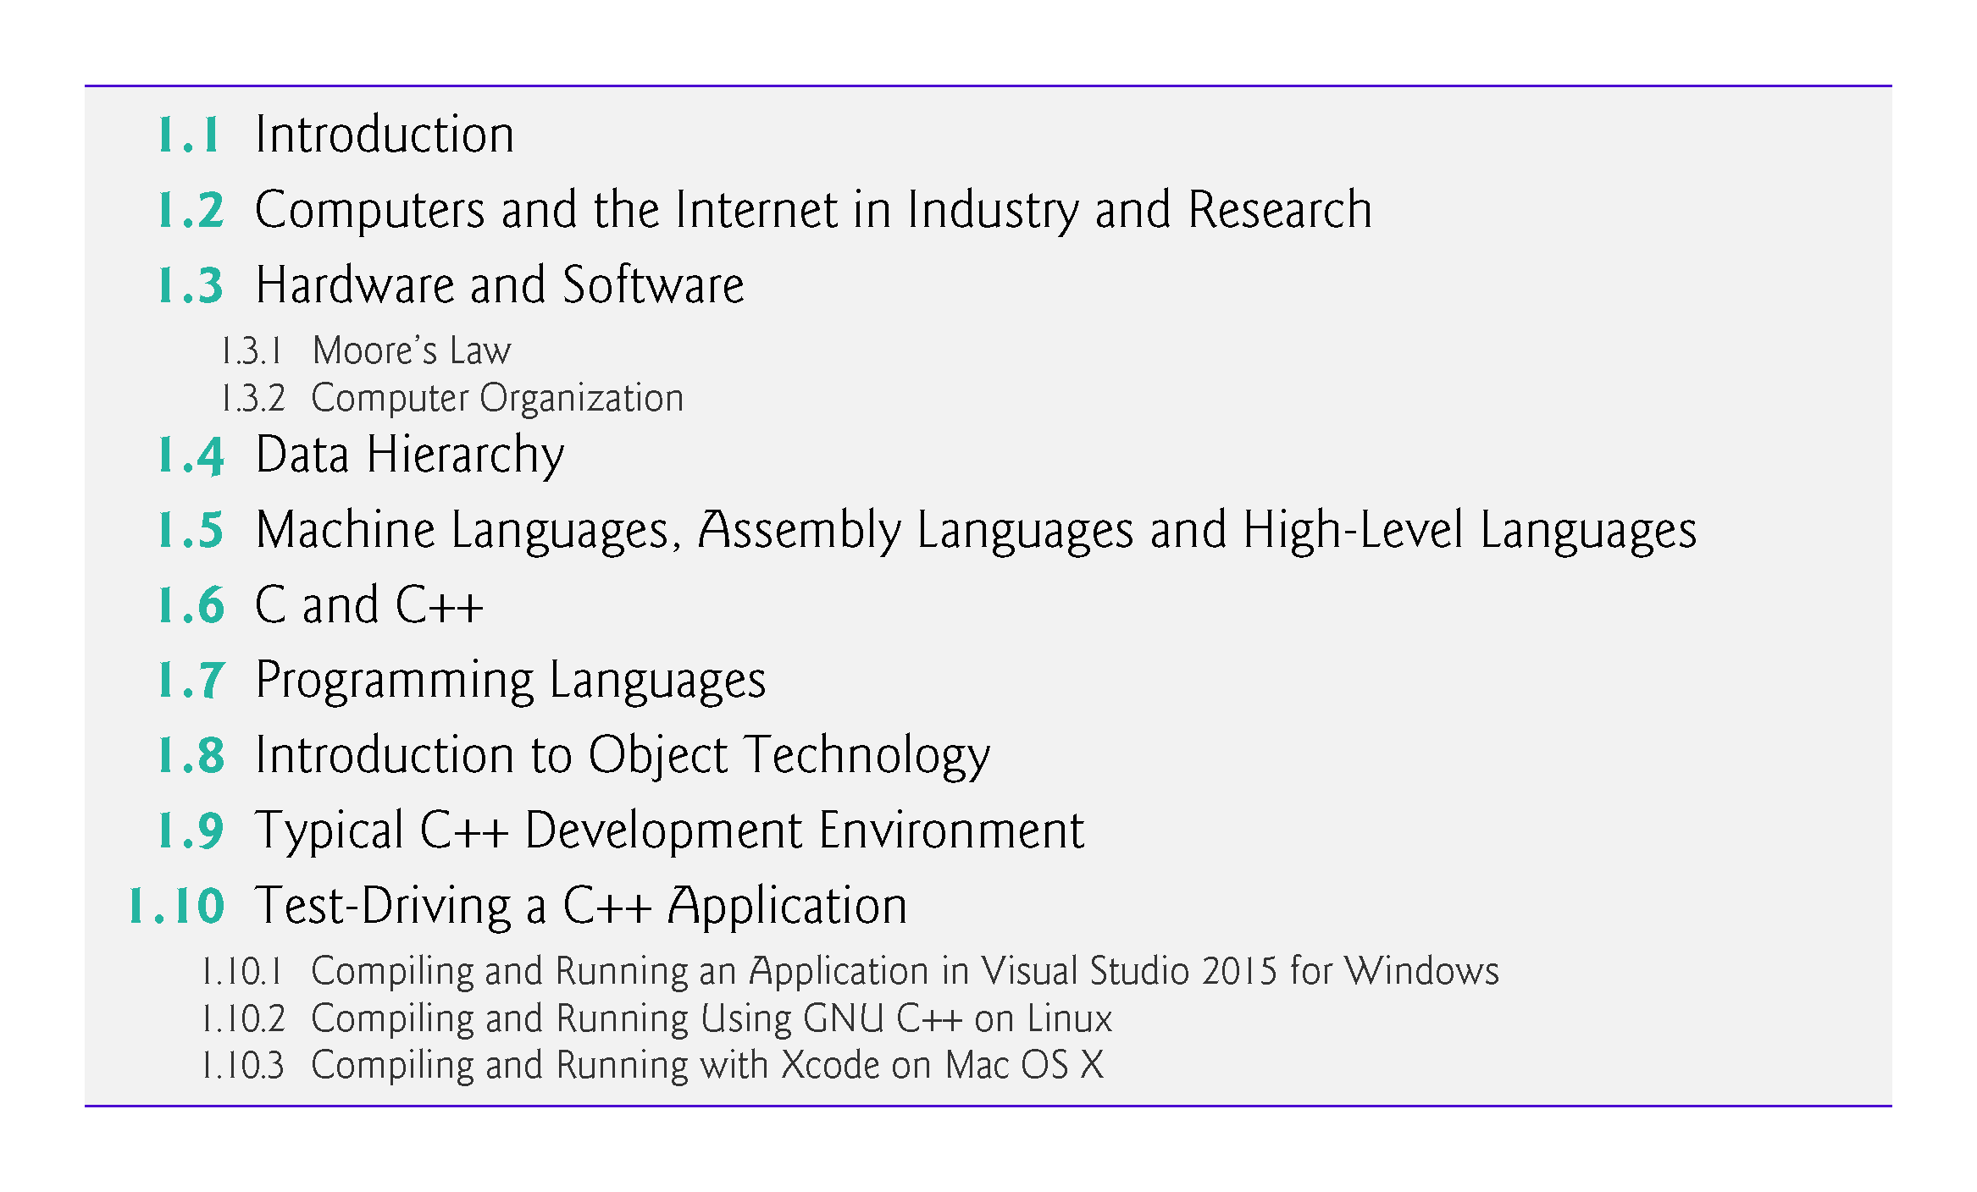

Slide 4
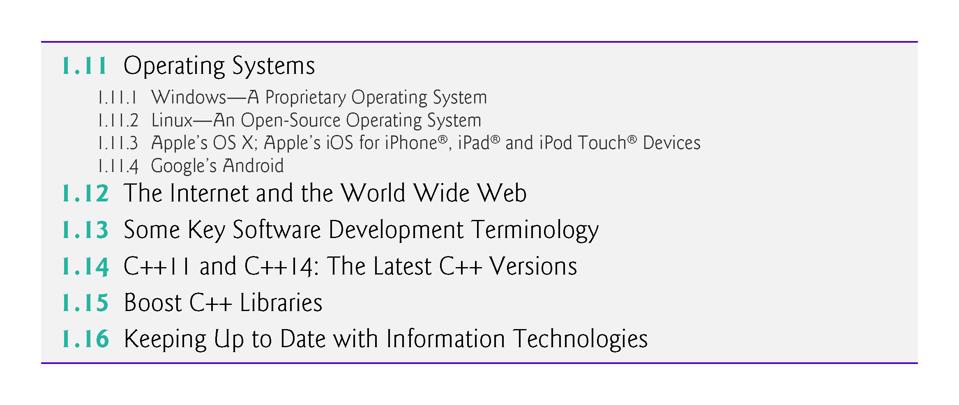

Slide 5
1.1 Introduction
C++—a powerful computer programming language that’s appropriate for technically oriented people with little or no programming experience, and for experienced programmers to use in building substantial information systems.
You’ll write instructions commanding computers to perform those kinds of tasks.
Software (i.e., the instructions you write) controls hardware (i.e., computers).
You’ll learn object-oriented programming—today’s key programming methodology.
You’ll create many software objects in the real world.

Slide 6
1.1 Introduction (Cont.)
C++ is one of today’s most popular software development languages.
C++ is one of today’s most popular software development languages.
C++11 and C++14 are the latest versions standardized through the International Organization for Standardization (ISO) and the International Electrotechnical Commission (IEC).

Slide 7
1.2 Computers and the Internet in Industry and Research
Many of the most influential and successful businesses of the last two decades are technology companies, including Apple, IBM, Hewlett Packard, Dell, Intel, Motorola, Cisco, Microsoft, Google, Amazon, Facebook, Twitter, eBay and many more.
These companies are major employers of people who study computer science, computer engineering, information systems or related disciplines.

Slide 8
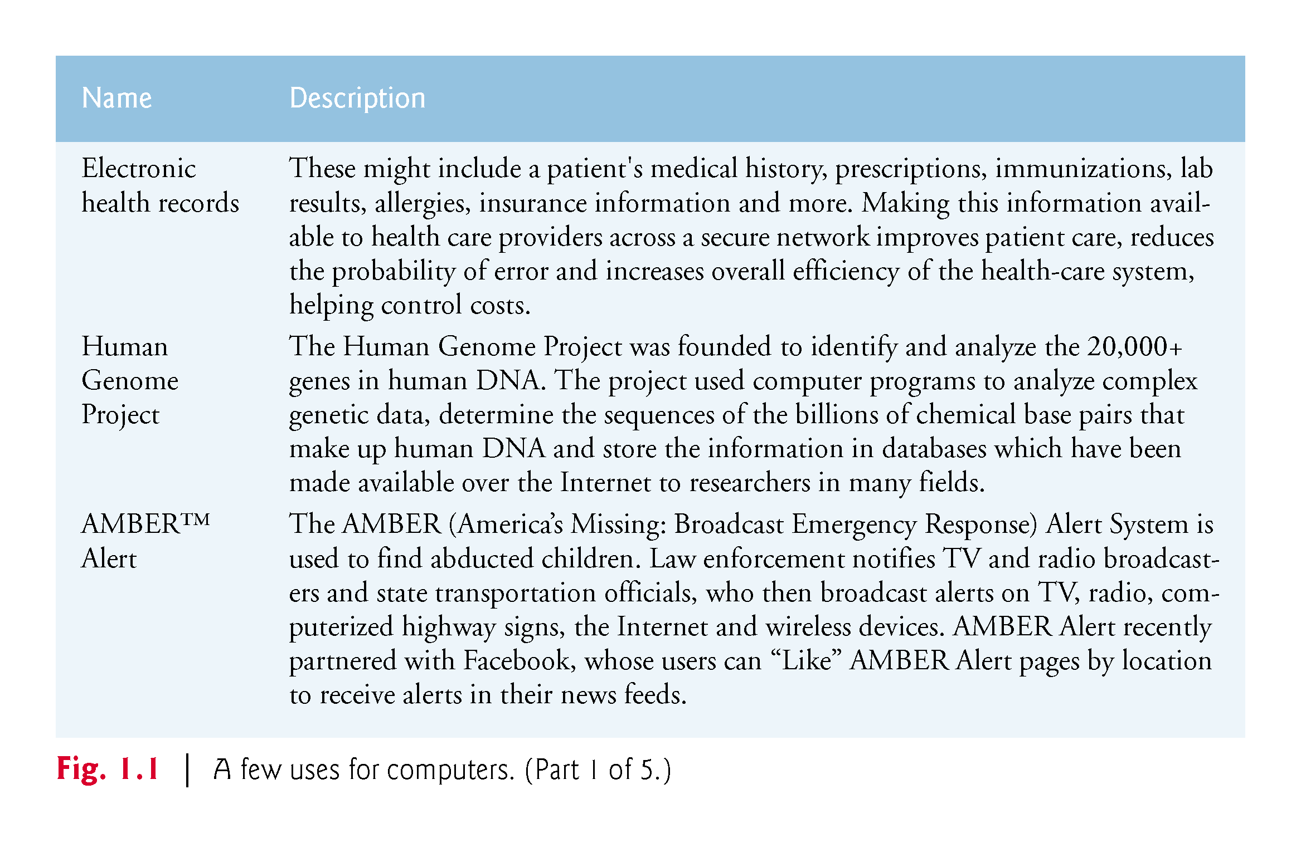

Slide 9
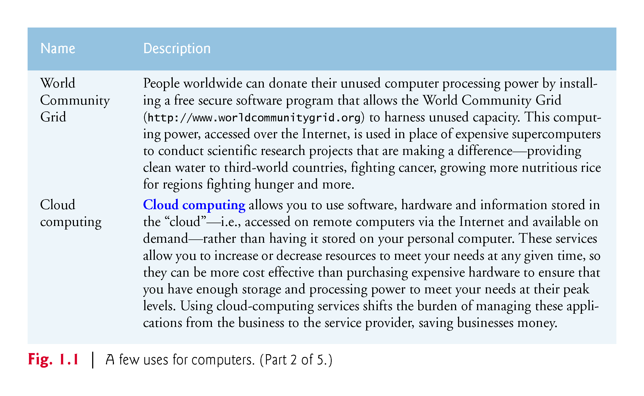

Slide 10
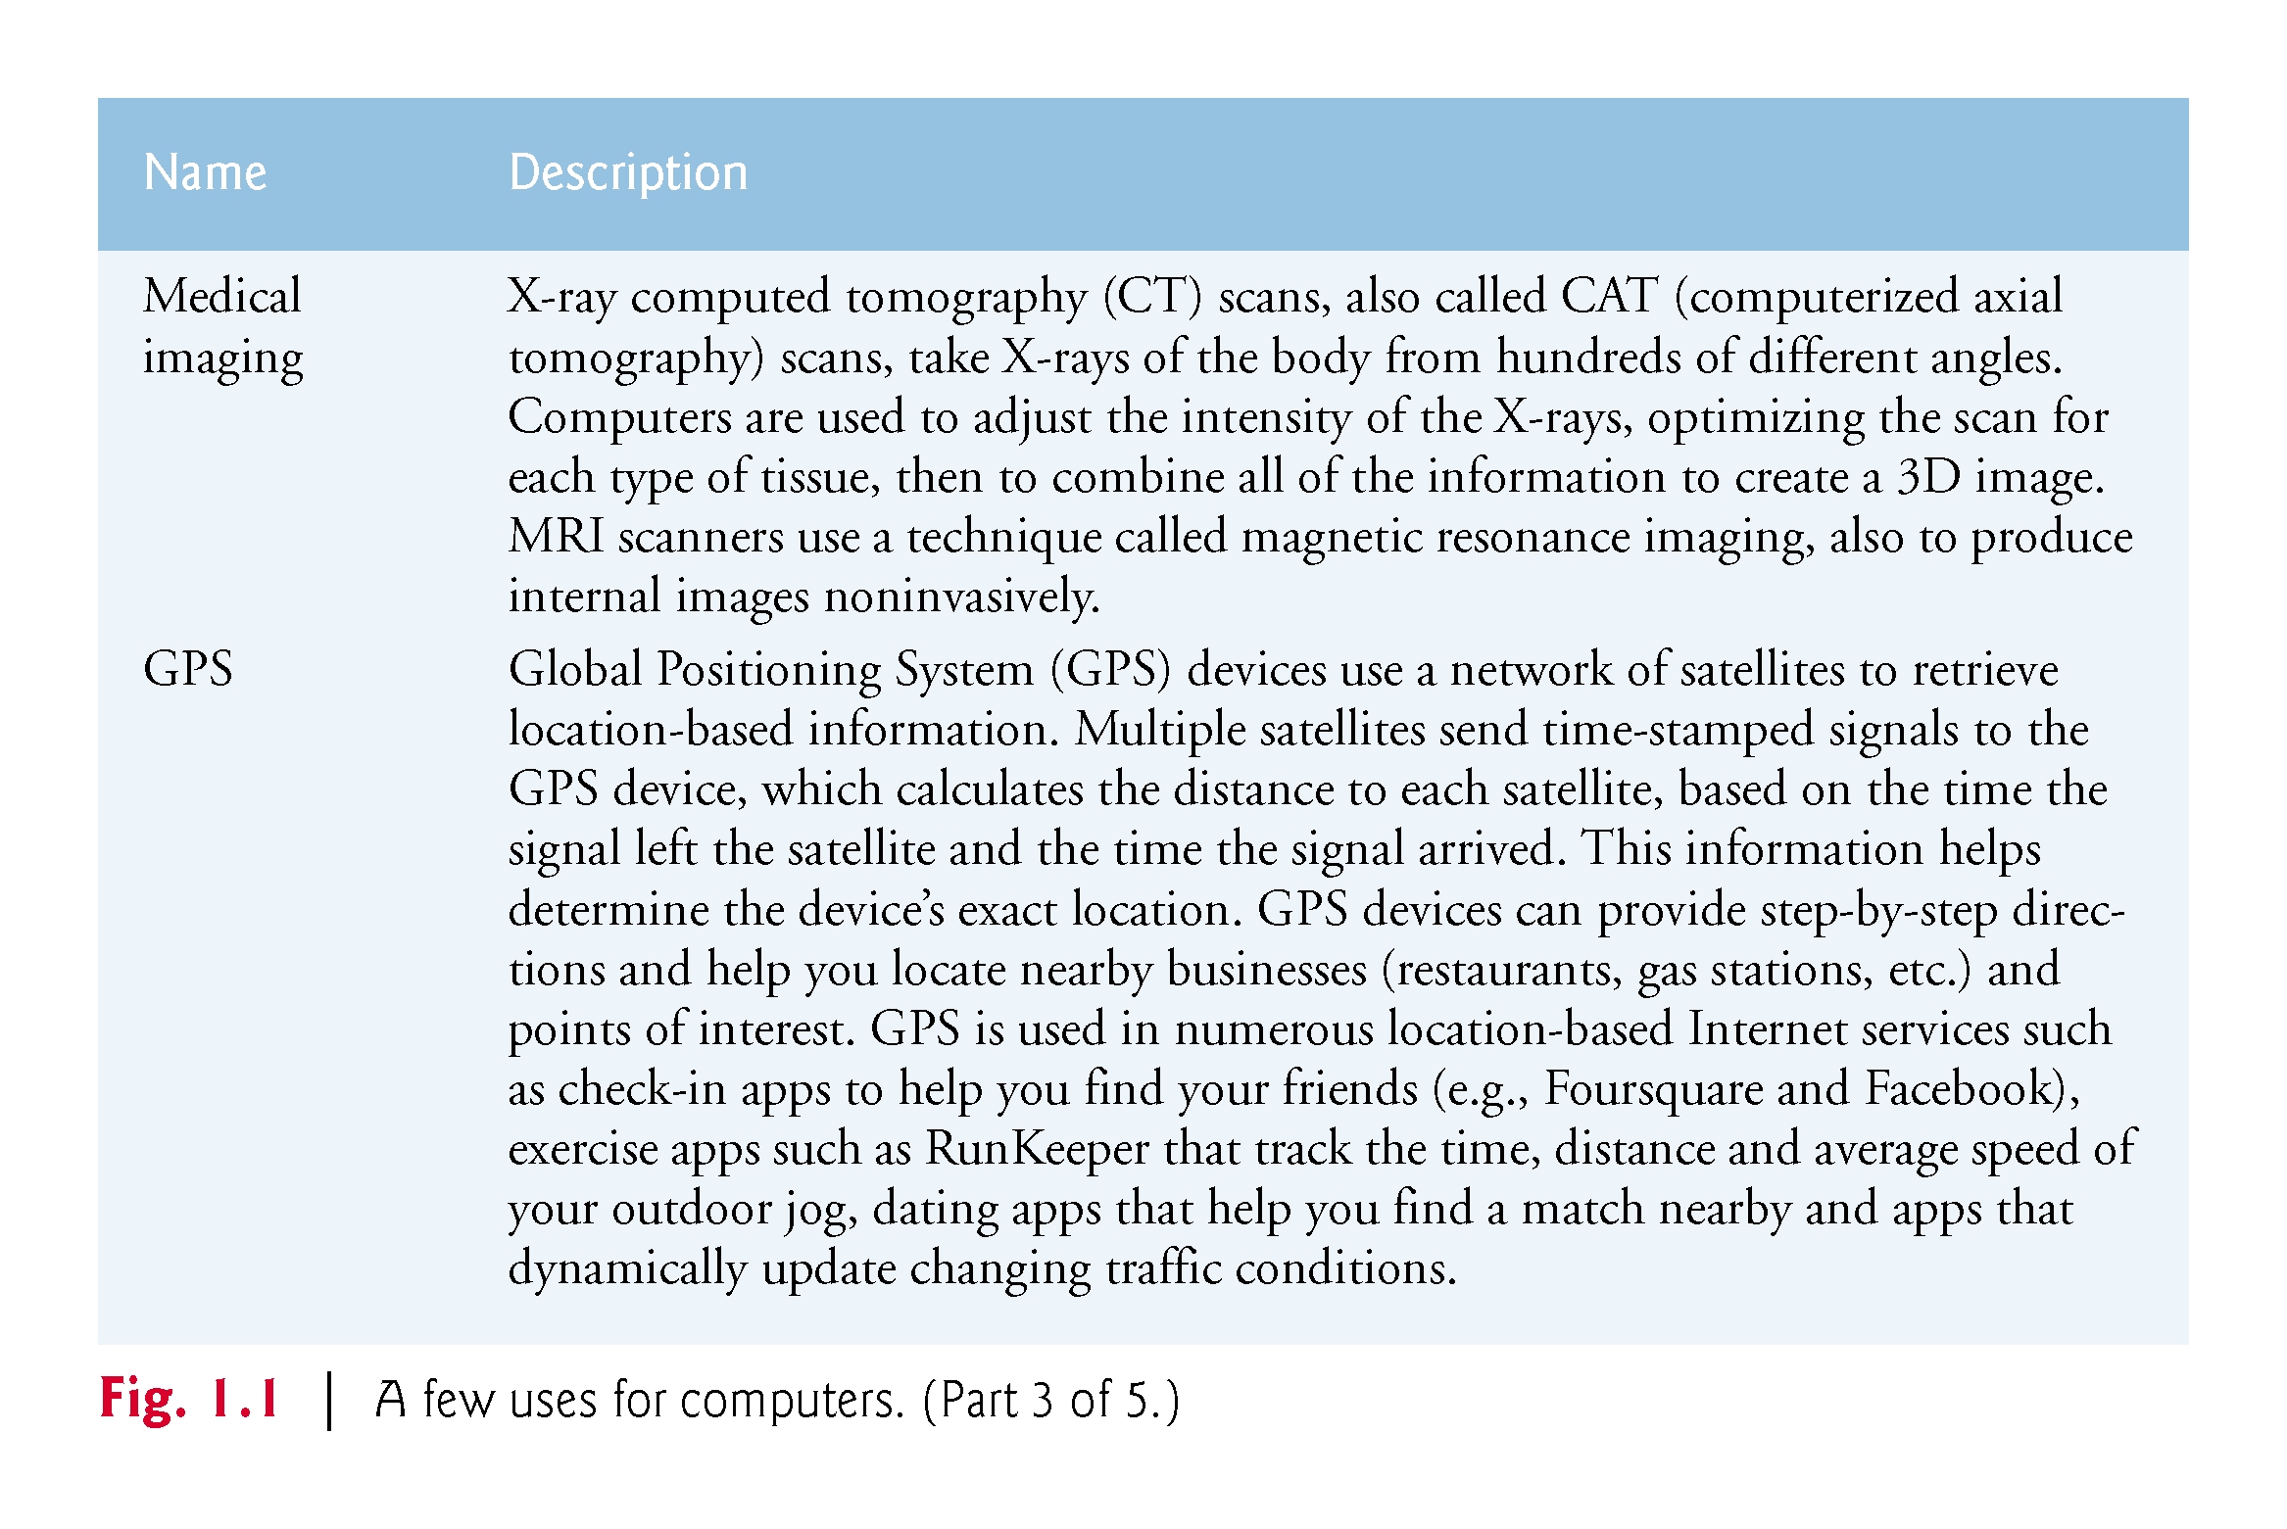

Slide 11
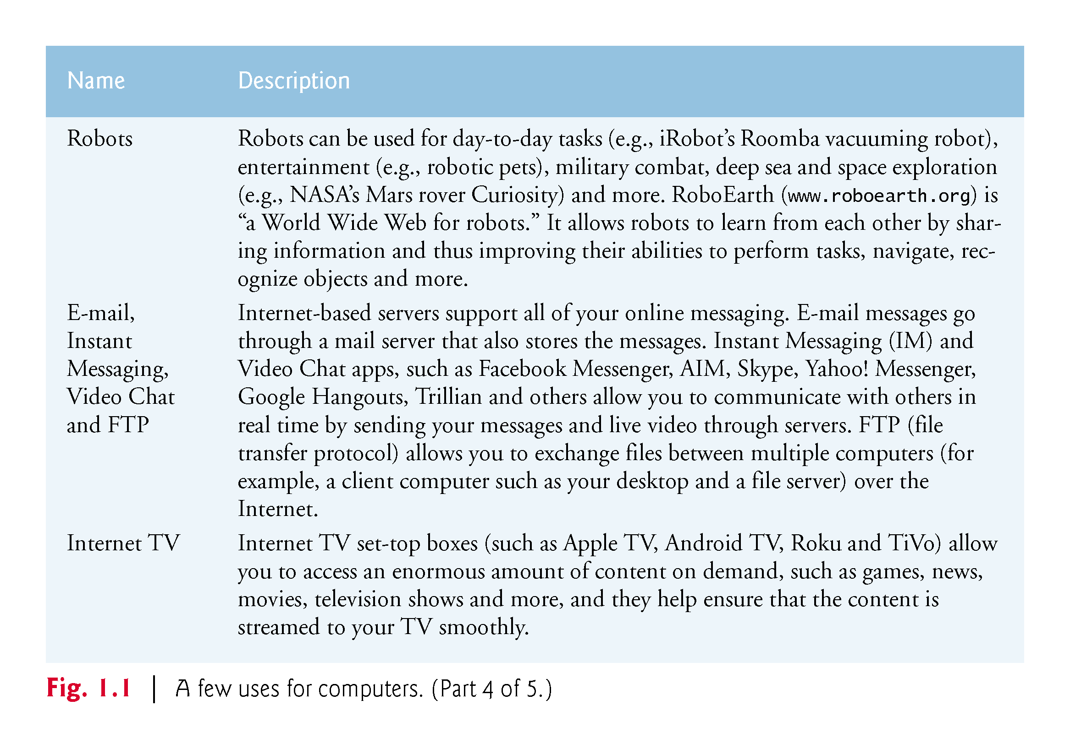

Slide 12
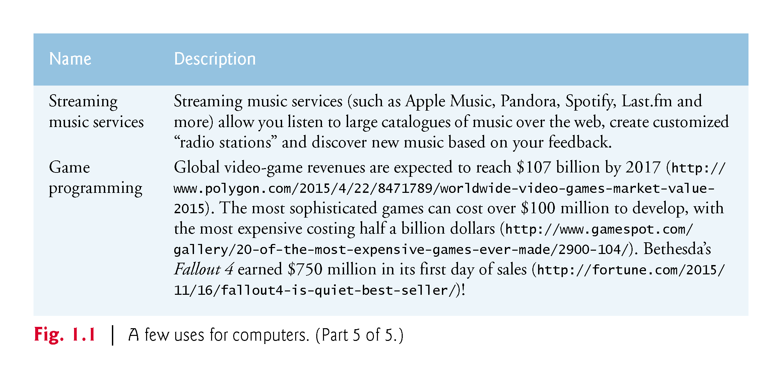

Slide 13
1.3 Hardware and Software
Computers can perform calculations and make logical decisions phenomenally faster than human beings can.
Today’s personal computers can perform billions of calculations in one second—more than a human can perform in a lifetime.
Supercomputers are already performing thousands of trillions (quadrillions) of instructions per second!

Slide 14
1.3 Hardware and Software
Computers process data under the control of sequences of instructions called computer programs.
These programs guide the computer through ordered actions specified by people called computer programmers.
The programs that run on a computer are referred to as software.
You’ll learn a key programming methodology that’s enhancing programmer productivity, thereby reducing software-development costs—object-oriented programming.

Slide 15
1.3 Hardware and Software (Cont.)
A computer consists of various devices referred to as hardware
(e.g., the keyboard, screen, mouse, hard disks, memory, DVD drives and processing units).
Computing costs are dropping dramatically, due to rapid developments in hardware and software technologies.
Computers that might have filled large rooms and cost millions of dollars decades ago are now inscribed on silicon chips smaller than a fingernail, costing perhaps a few dollars each.
Silicon-chip technology has made computing so economical that computers have become commodity.

Slide 16
1.3.1 Moore’s Law
For many decades, hardware costs have fallen rapidly.
Every year or two, the capacities of computers have approximately doubled inexpensively.
This trend often is called Moore’s Law, named for the person who identified it in the 1960s, Gordon Moore, co-founder of Intel.

Slide 17
1.3.1 Moore’s Law (Cont.)
Moore’s Law and related observations apply especially to the amount of memory that computers have for programs, the amount of secondary storage (such as disk storage) they have to hold programs and data over longer periods of time, and their processor speeds—the speeds at which they execute their programs (i.e., do their work).
These increases make computers more capable
puts greater demands on programming language designers to innovate

Slide 18
1.3.1 Moore’s Law (Cont.)
Similar growth has occurred in the communications field.
Costs have plummeted as enormous demand for communications bandwidth (i.e., information-carrying capacity) has attracted intense competition
We know of no other fields in which technology improves so quickly and costs fall so rapidly.
Such phenomenal improvement is truly fostering the Information Revolution.

Slide 19
1.3.2 Computer Organization
Regardless of differences in physical appearance, computers can be envisioned as divided into various logical units or sections (Fig. 1.2)

Slide 20
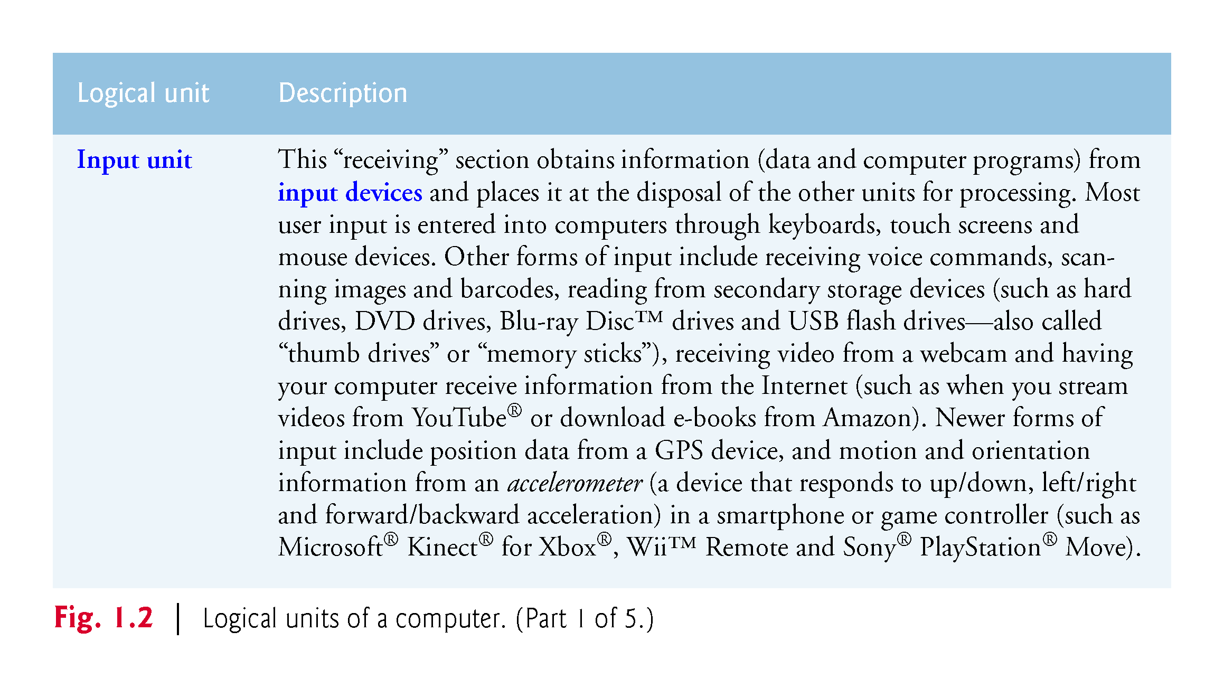

Slide 21
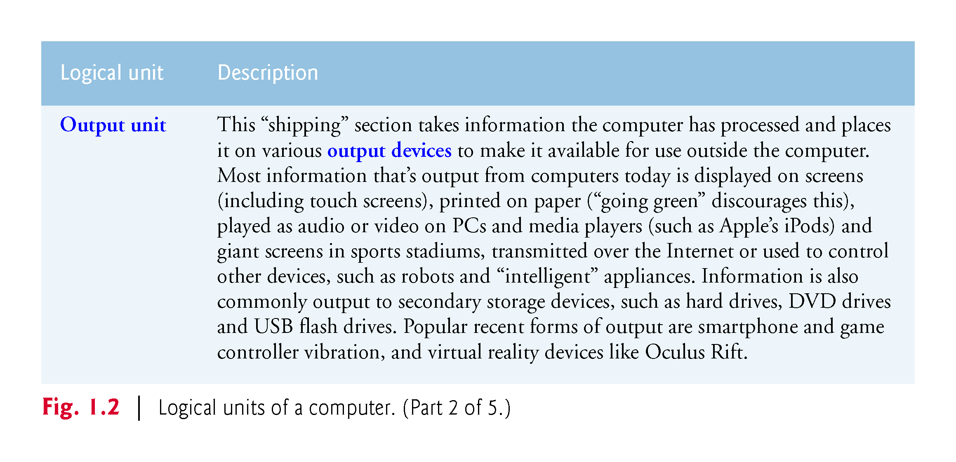

Slide 22
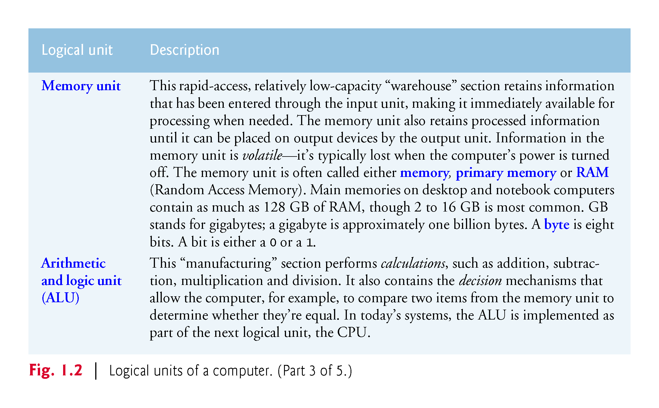

Slide 23
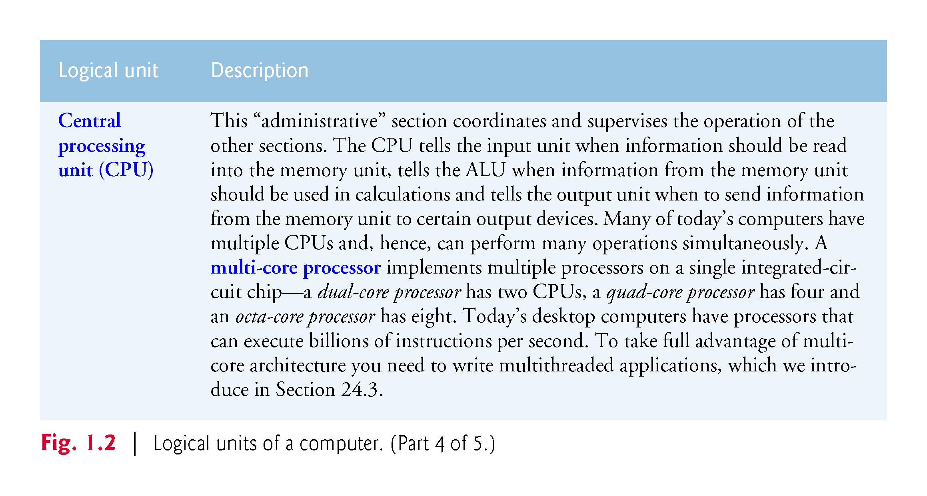

Slide 24
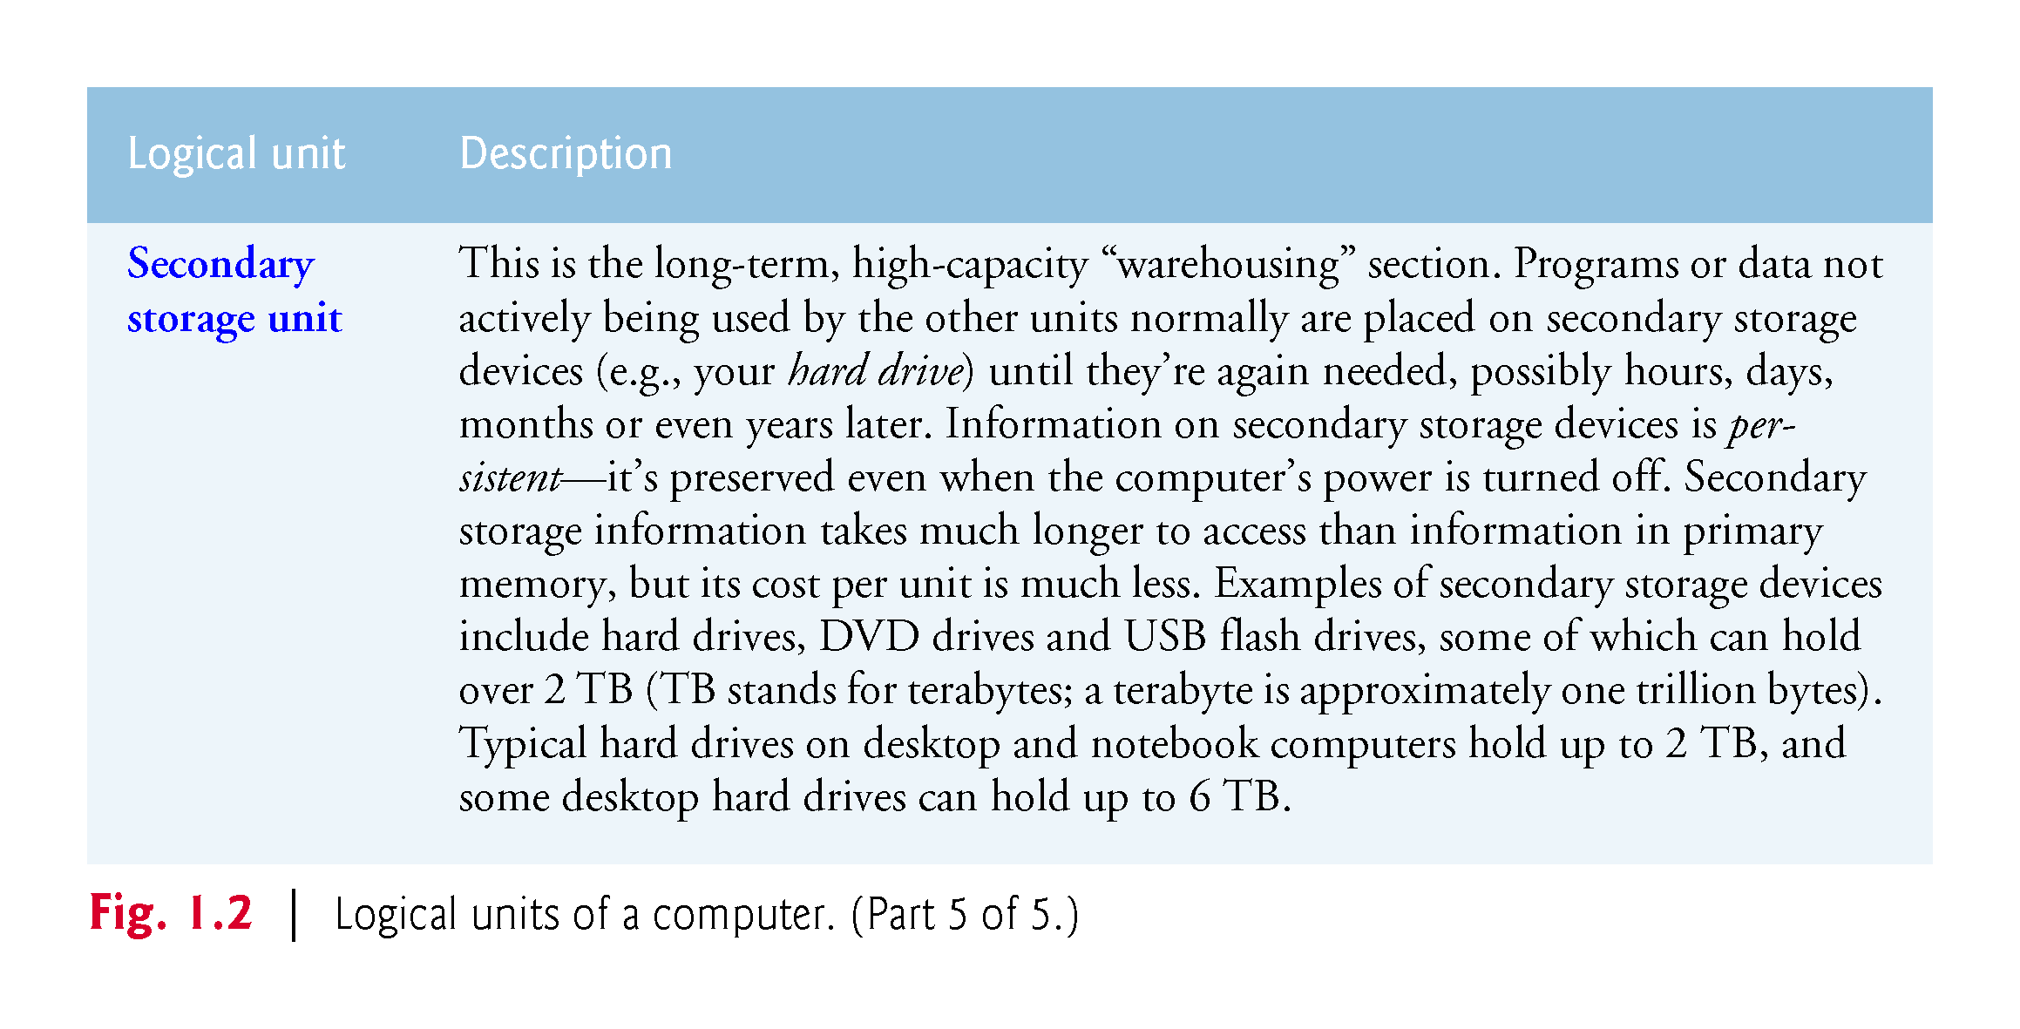

Slide 25
1.4 Data Hierarchy
Data items processed by computers form a data hierarchy that becomes larger and more complex in structure as we progress from bits to characters to fields, and so on.

Slide 26
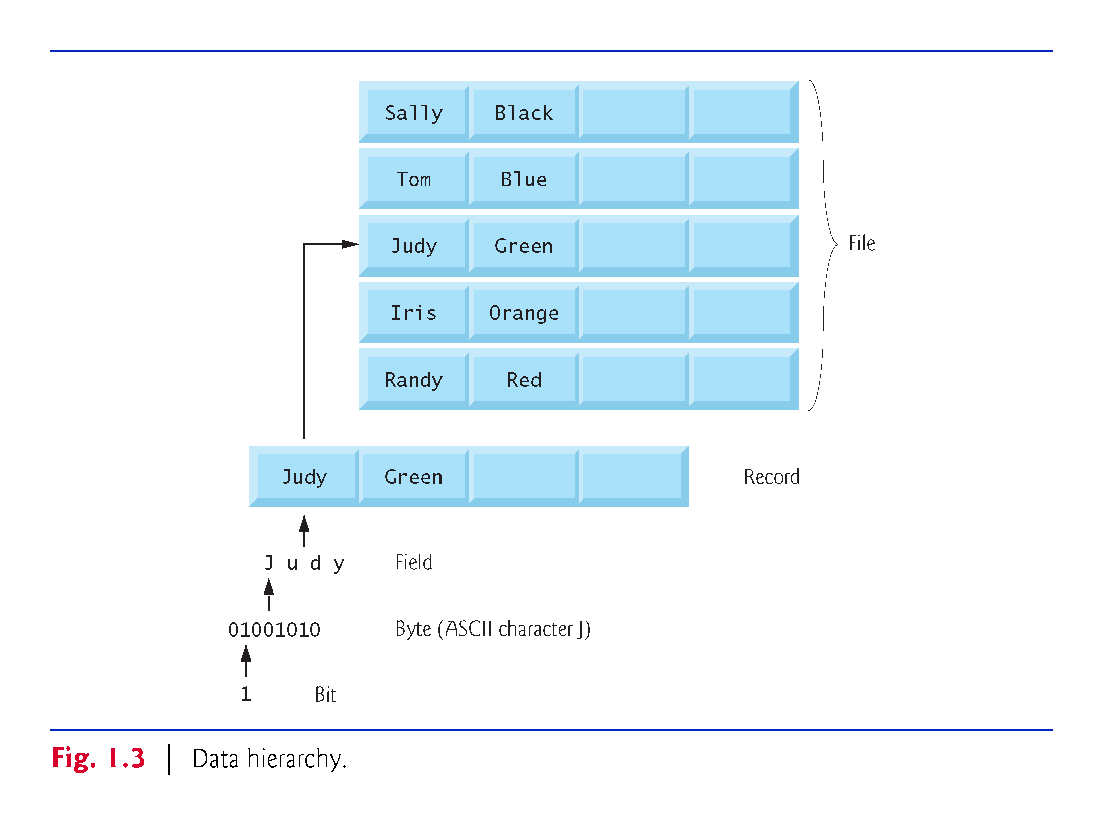

Slide 27
1.4 Data Hierarchy
Bits
The smallest data item in a computer can assume the value 0 or the value 1.
Called a bit (short for “binary digit”—a digit that can assume one of two values)

Slide 28
1.4 Data Hierarchy
Characters
Tedious to work with data in the low-level form of bits.
People prefer to work with decimal digits (0–9), letters (A–Z and a–z), and special symbols (e.g., $, @, %, &, *, (, ), –, +, ", :, ? and /)
Known as characters.
The computer’s character set is the set of all the characters used to write programs and represent data items.
Computers process only 1s and 0s, so a computer’s character set represents every character as a pattern of 1s and 0s.

Slide 29
1.4 Data Hierarchy
Fields
Just as characters are composed of bits, fields are composed of characters or bytes.
A field is a group of characters or bytes that conveys meaning.
A field consisting of uppercase and lowercase letters can be used to represent a person’s name
A field consisting of decimal digits could represent a person’s age.

Slide 30
1.4 Data Hierarchy
Records
Several related fields can be used to compose a record.
In a payroll system, for example, the record for an employee might consist of the following fields
Employee identification number (a whole number)
Name (a string of characters)
Address (a string of characters)
Hourly pay rate (a number with a decimal point)
Year-to-date earnings (a number with a decimal point)
Amount of taxes withheld (a number with a decimal point).
A company might have many employees and a payroll record for each.

Slide 31
1.4 Data Hierarchy
Files
A file is a group of related records.
[Note: More generally, a file contains arbitrary data in arbitrary formats. In some operating systems, a file is viewed simply as a sequence of bytes—any organization of the bytes in a file, such as organizing the data into records, is a view created by the application programmer.]
It’s not unusual for an organization to have many files, some containing billions, or even trillions, of characters of information.

Slide 32
1.4 Data Hierarchy
Database
A database is a collection of data organized for easy access and manipulation.
The most popular model is the relational database
Data is stored in simple tables.
A table includes records and fields.
You can search, sort and otherwise manipulate the data based on its relationship to multiple tables or databases.

Slide 33
1.4 Data Hierarchy
Big Data
The amount of data being produced worldwide is enormous and growing quickly.
According to IBM, approximately 2.5 quintillion bytes (2.5 exabytes) of data are created daily
According to Salesforce.com, 90% of the world’s data was created in just the past 12 months!
According to an IDC study, the global data supply will reach 40 zettabytes (equal to 40 trillion gigabytes) annually by 2020.
Figure 1.4 shows some common byte measurements.
Big data applications deal with massive amounts of data.

Slide 34
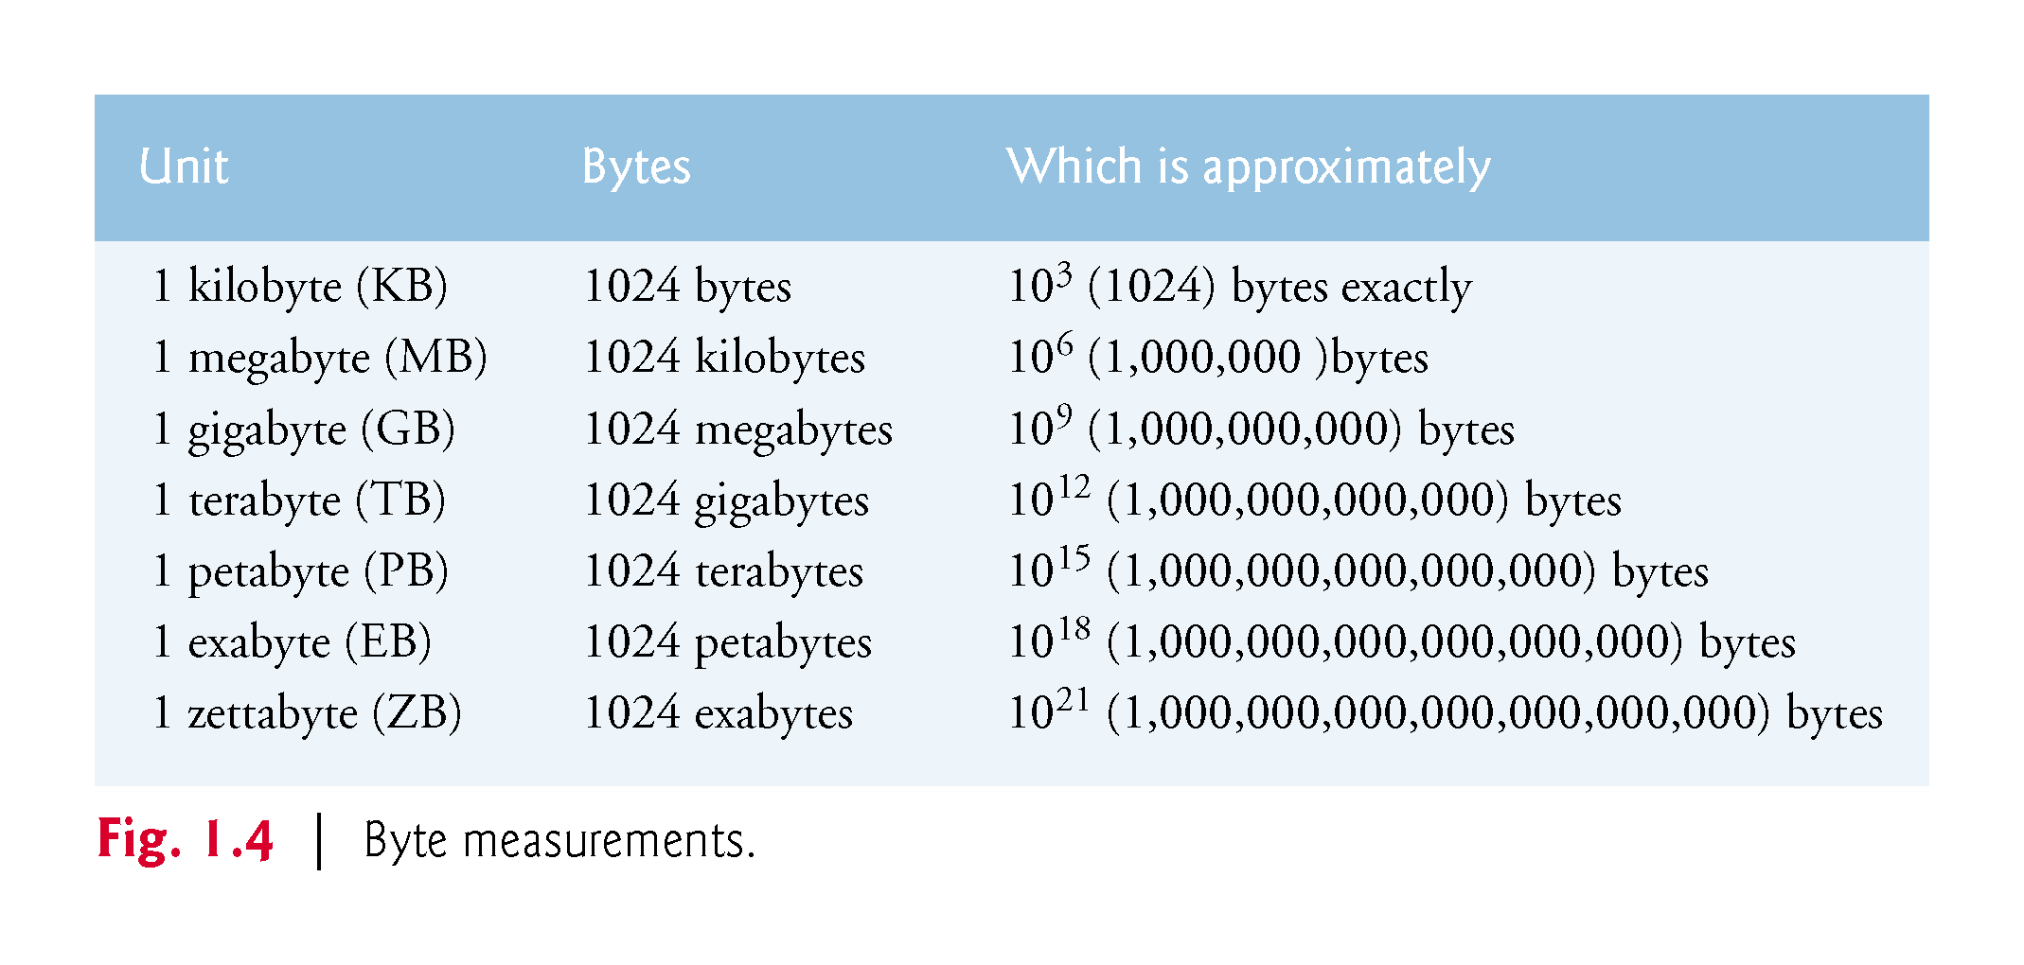

Slide 35
1.5 Machine Languages, Assembly Languages and High-Level Languages
Programmers write instructions in various programming languages, some directly understandable by computers and others requiring intermediate translation steps.
These may be divided into three general types:
Machine languages
Assembly languages
High-level languages

Slide 36
1.5 Machine Languages, Assembly Languages and High-Level Languages
Machine Languages
Any computer can directly understand only its own machine language (also called machine code), defined by its hardware architecture.
Machine languages generally consist of numbers (ultimately reduced to 1s and 0s). Such languages are cumbersome for humans.

Slide 37
1.5 Machine Languages, Assembly Languages and High-Level Languages
Assembly Languages
English-like abbreviations to represent elementary operations. These abbreviations formed the basis of assembly languages.
Translator programs called assemblers were developed to convert early assembly-language programs to machine language.

Slide 38
1.5 Machine Languages, Assembly Languages and High-Level Languages
High-Level Languages
To speed up the programming process further, high-level languages were developed in which single statements could be written to accomplish substantial tasks.
Translator programs called compilers convert high-level language programs into machine language.
Allow you to write instructions that look more like everyday English and contain commonly used mathematical expressions.

Slide 39
1.5 Machine Languages, Assembly Languages and High-Level Languages
Compiling a high-level language program into machine language can take a considerable amount of computer time.
Interpreter programs were developed to execute high-level language programs directly (without the need for compilation), although more slowly than compiled programs.
Scripting languages such as the popular web languages JavaScript and PHP are processed by interpreters.

Slide 40
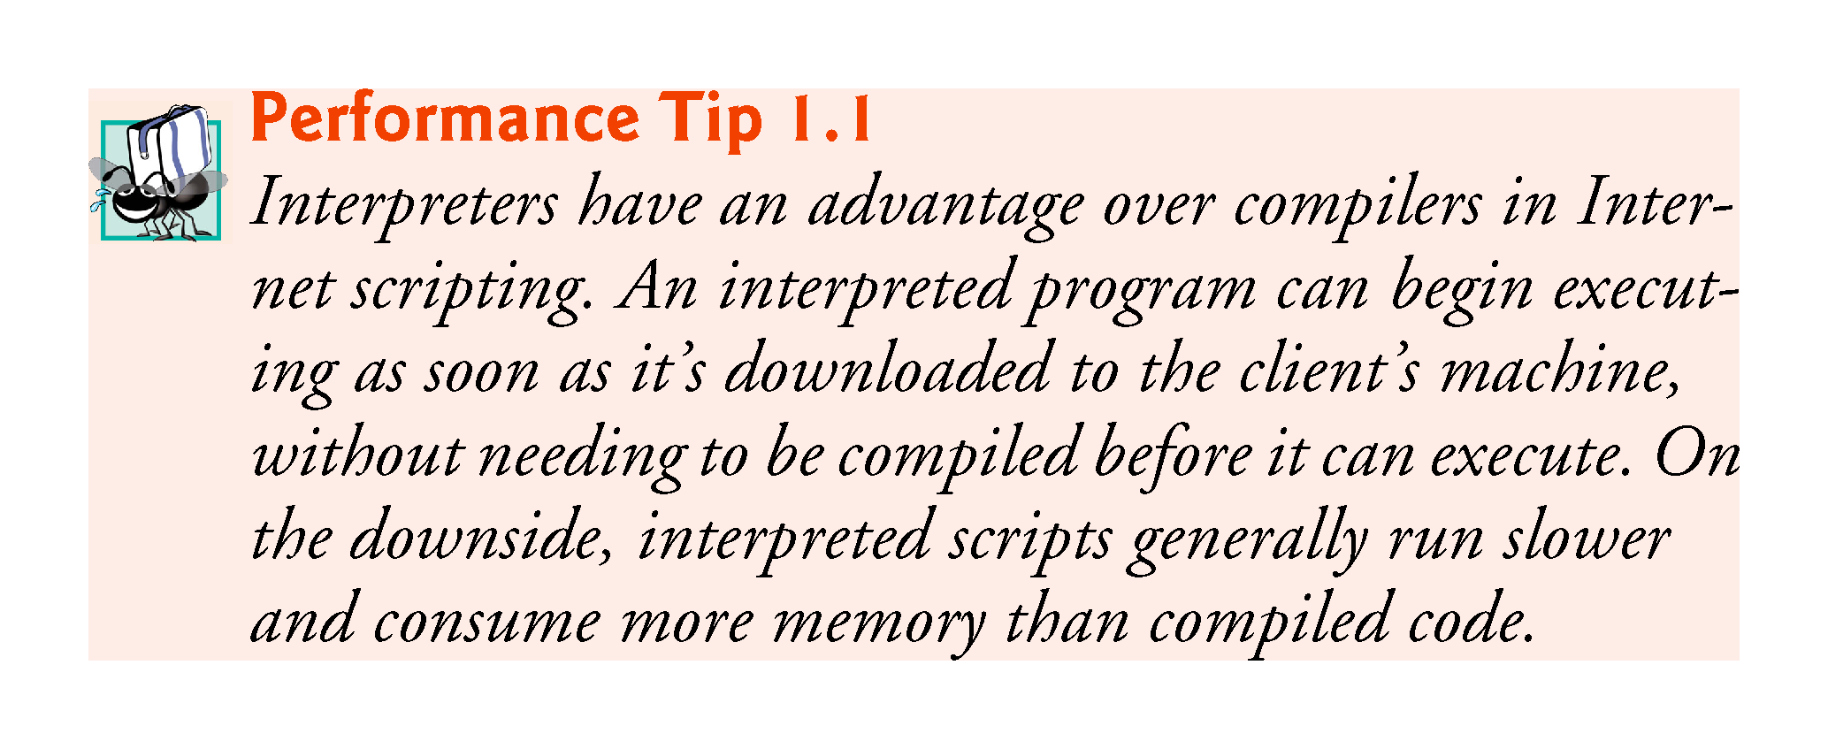

Slide 41
1.6 C and C++
C was implemented in 1972 by Dennis Ritchie at Bell Laboratories.
Initially became widely known as the UNIX operating system’s development language.
Today, most of the code for general-purpose operating systems is written in C or C++.
C++ evolved from C, which is available for most computers and is hardware independent.

Slide 42
1.6 C and C++
The widespread use of C with various kinds of computers (sometimes called hardware platforms) led to many variations.
American National Standards Institute (ANSI) cooperated with the International Organization for Standardization (ISO) to standardize C worldwide.
Joint standard document was published in 1990.

Slide 43
1.6 C++ (Cont.)
C11
Latest ANSI standard for the language.
Developed to evolve the C language to keep pace with increasingly powerful hardware and ever more demanding user requirements.
Makes C more consistent with C++.
C++, an extension of C, was developed by Bjarne Stroustrup in 1979 at Bell Laboratories.
C++ provides a number of features that “spruce up” the C language.
C++ also provides capabilities for object-oriented programming that were inspired by the Simula simulation programming language.

Slide 44
1.6 C++ (Cont.)
C++ Standard Library
C++ programs consist of pieces called classes and functions.
Most C++ programmers take advantage of the rich collections of classes and functions in the C++ Standard Library.
Two parts to learning the C++ “world.”
The C++ language itself (the core language), and
How to use the classes and functions in the C++ Standard Library.
Many special-purpose class libraries are supplied by independent software vendors.

Slide 45
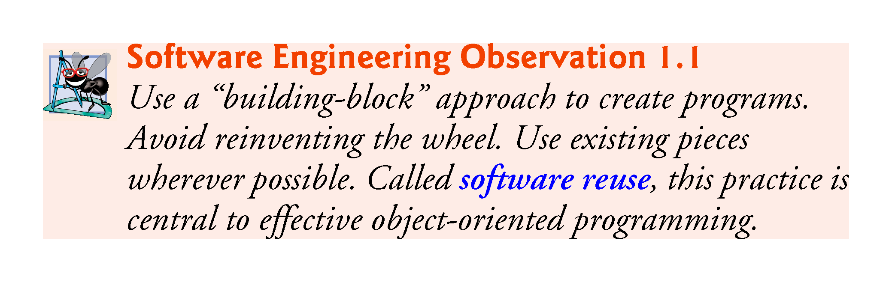

Slide 46
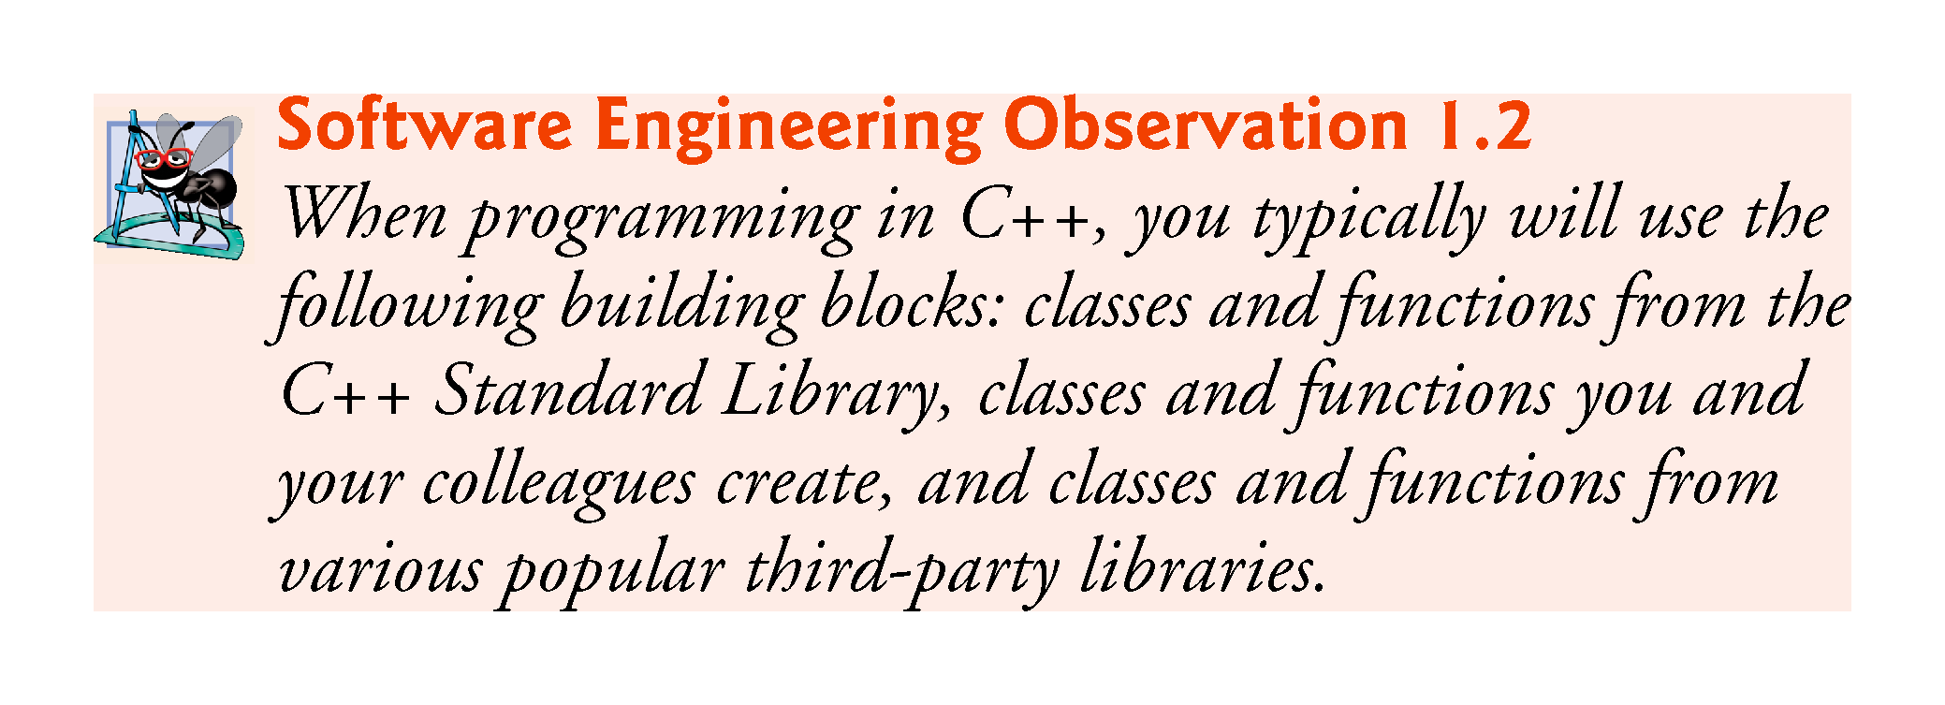

Slide 47
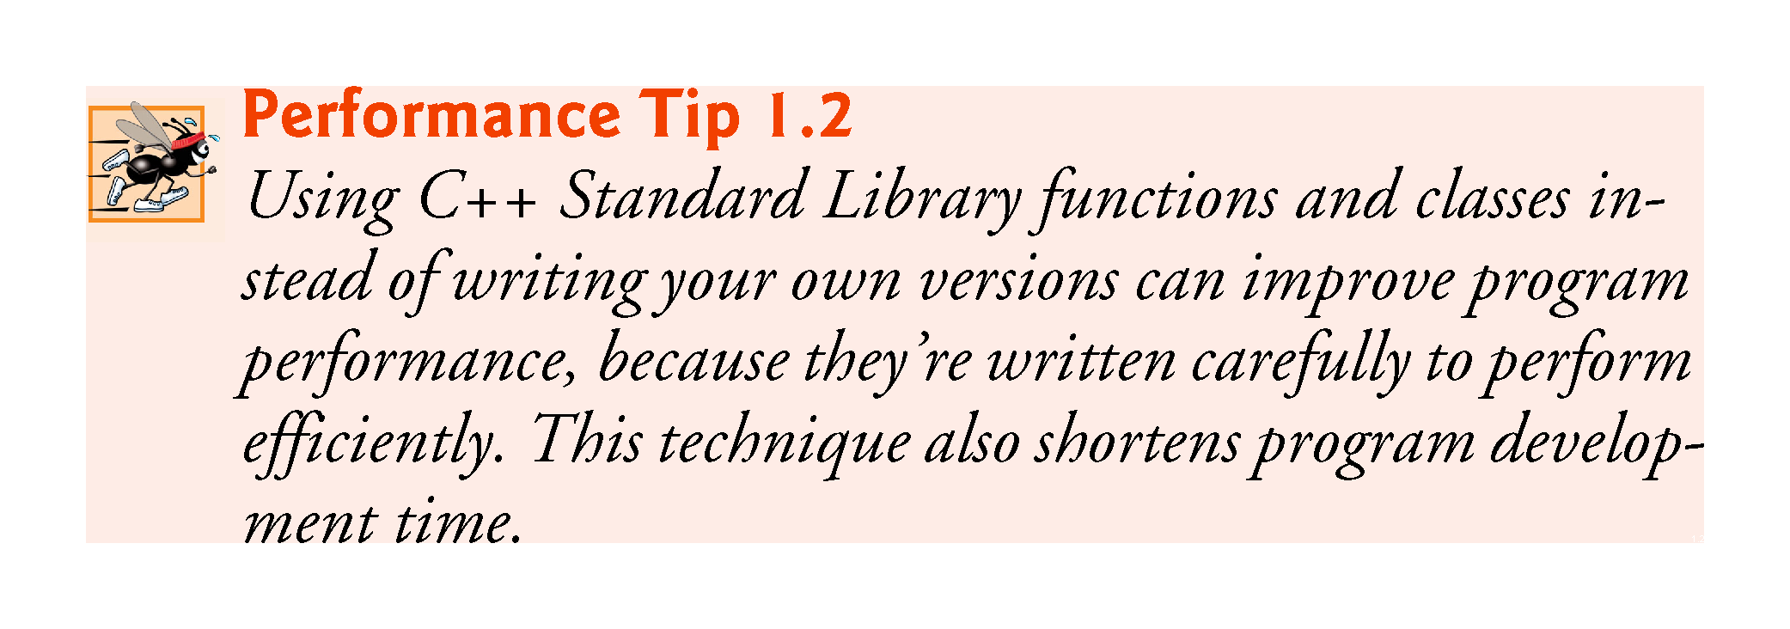

Slide 48
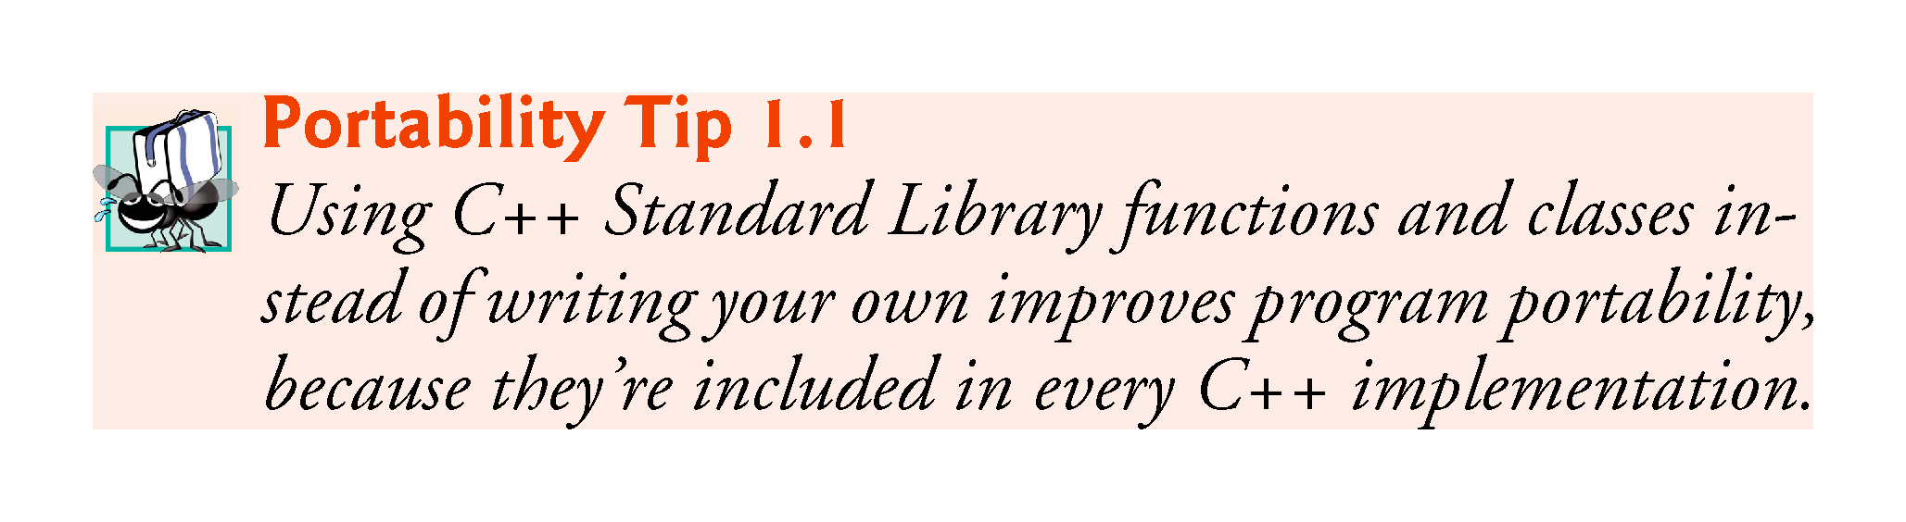

Slide 49
1.7 Programming Languages
In this section, we provide brief comments on several popular programming languages (Fig. 1.5).

Slide 50
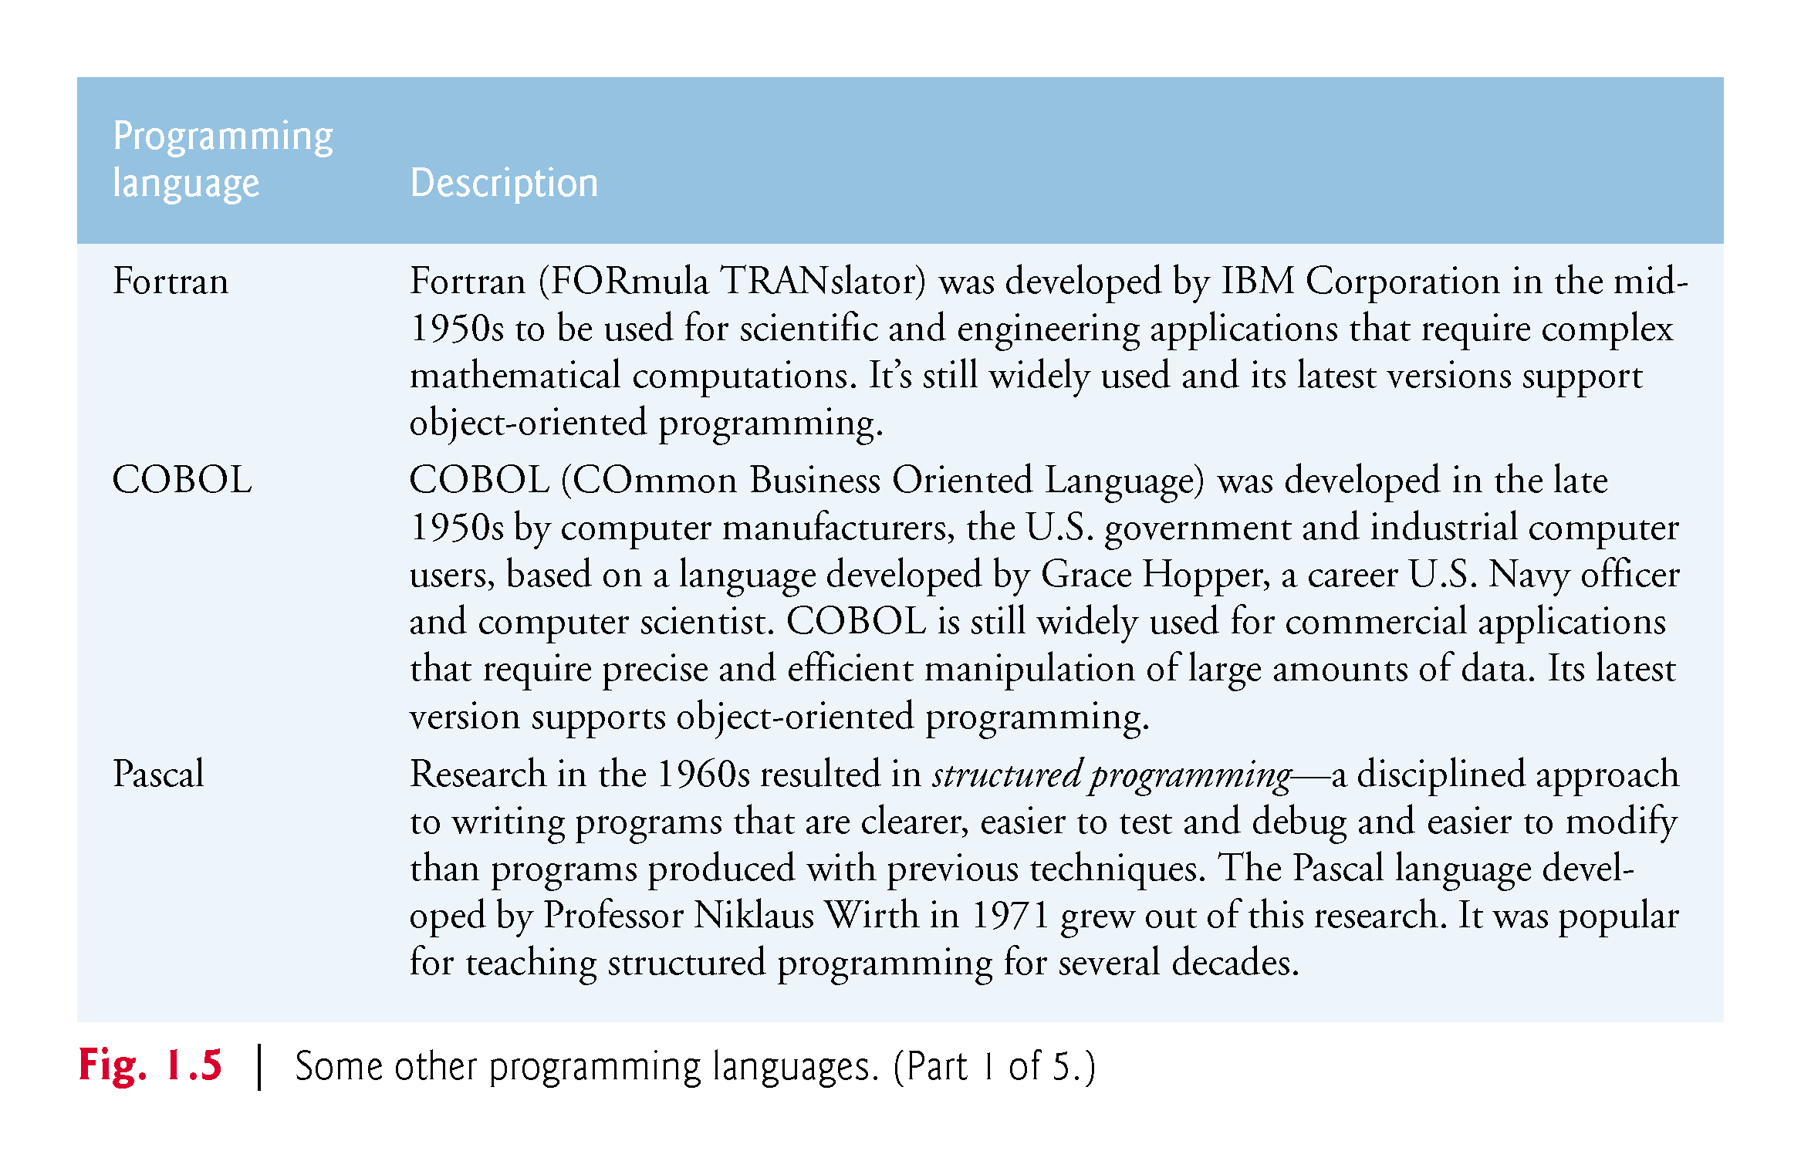

Slide 51
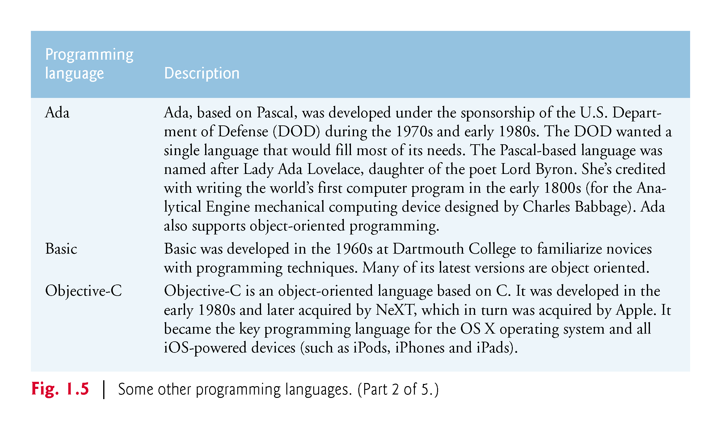

Slide 52
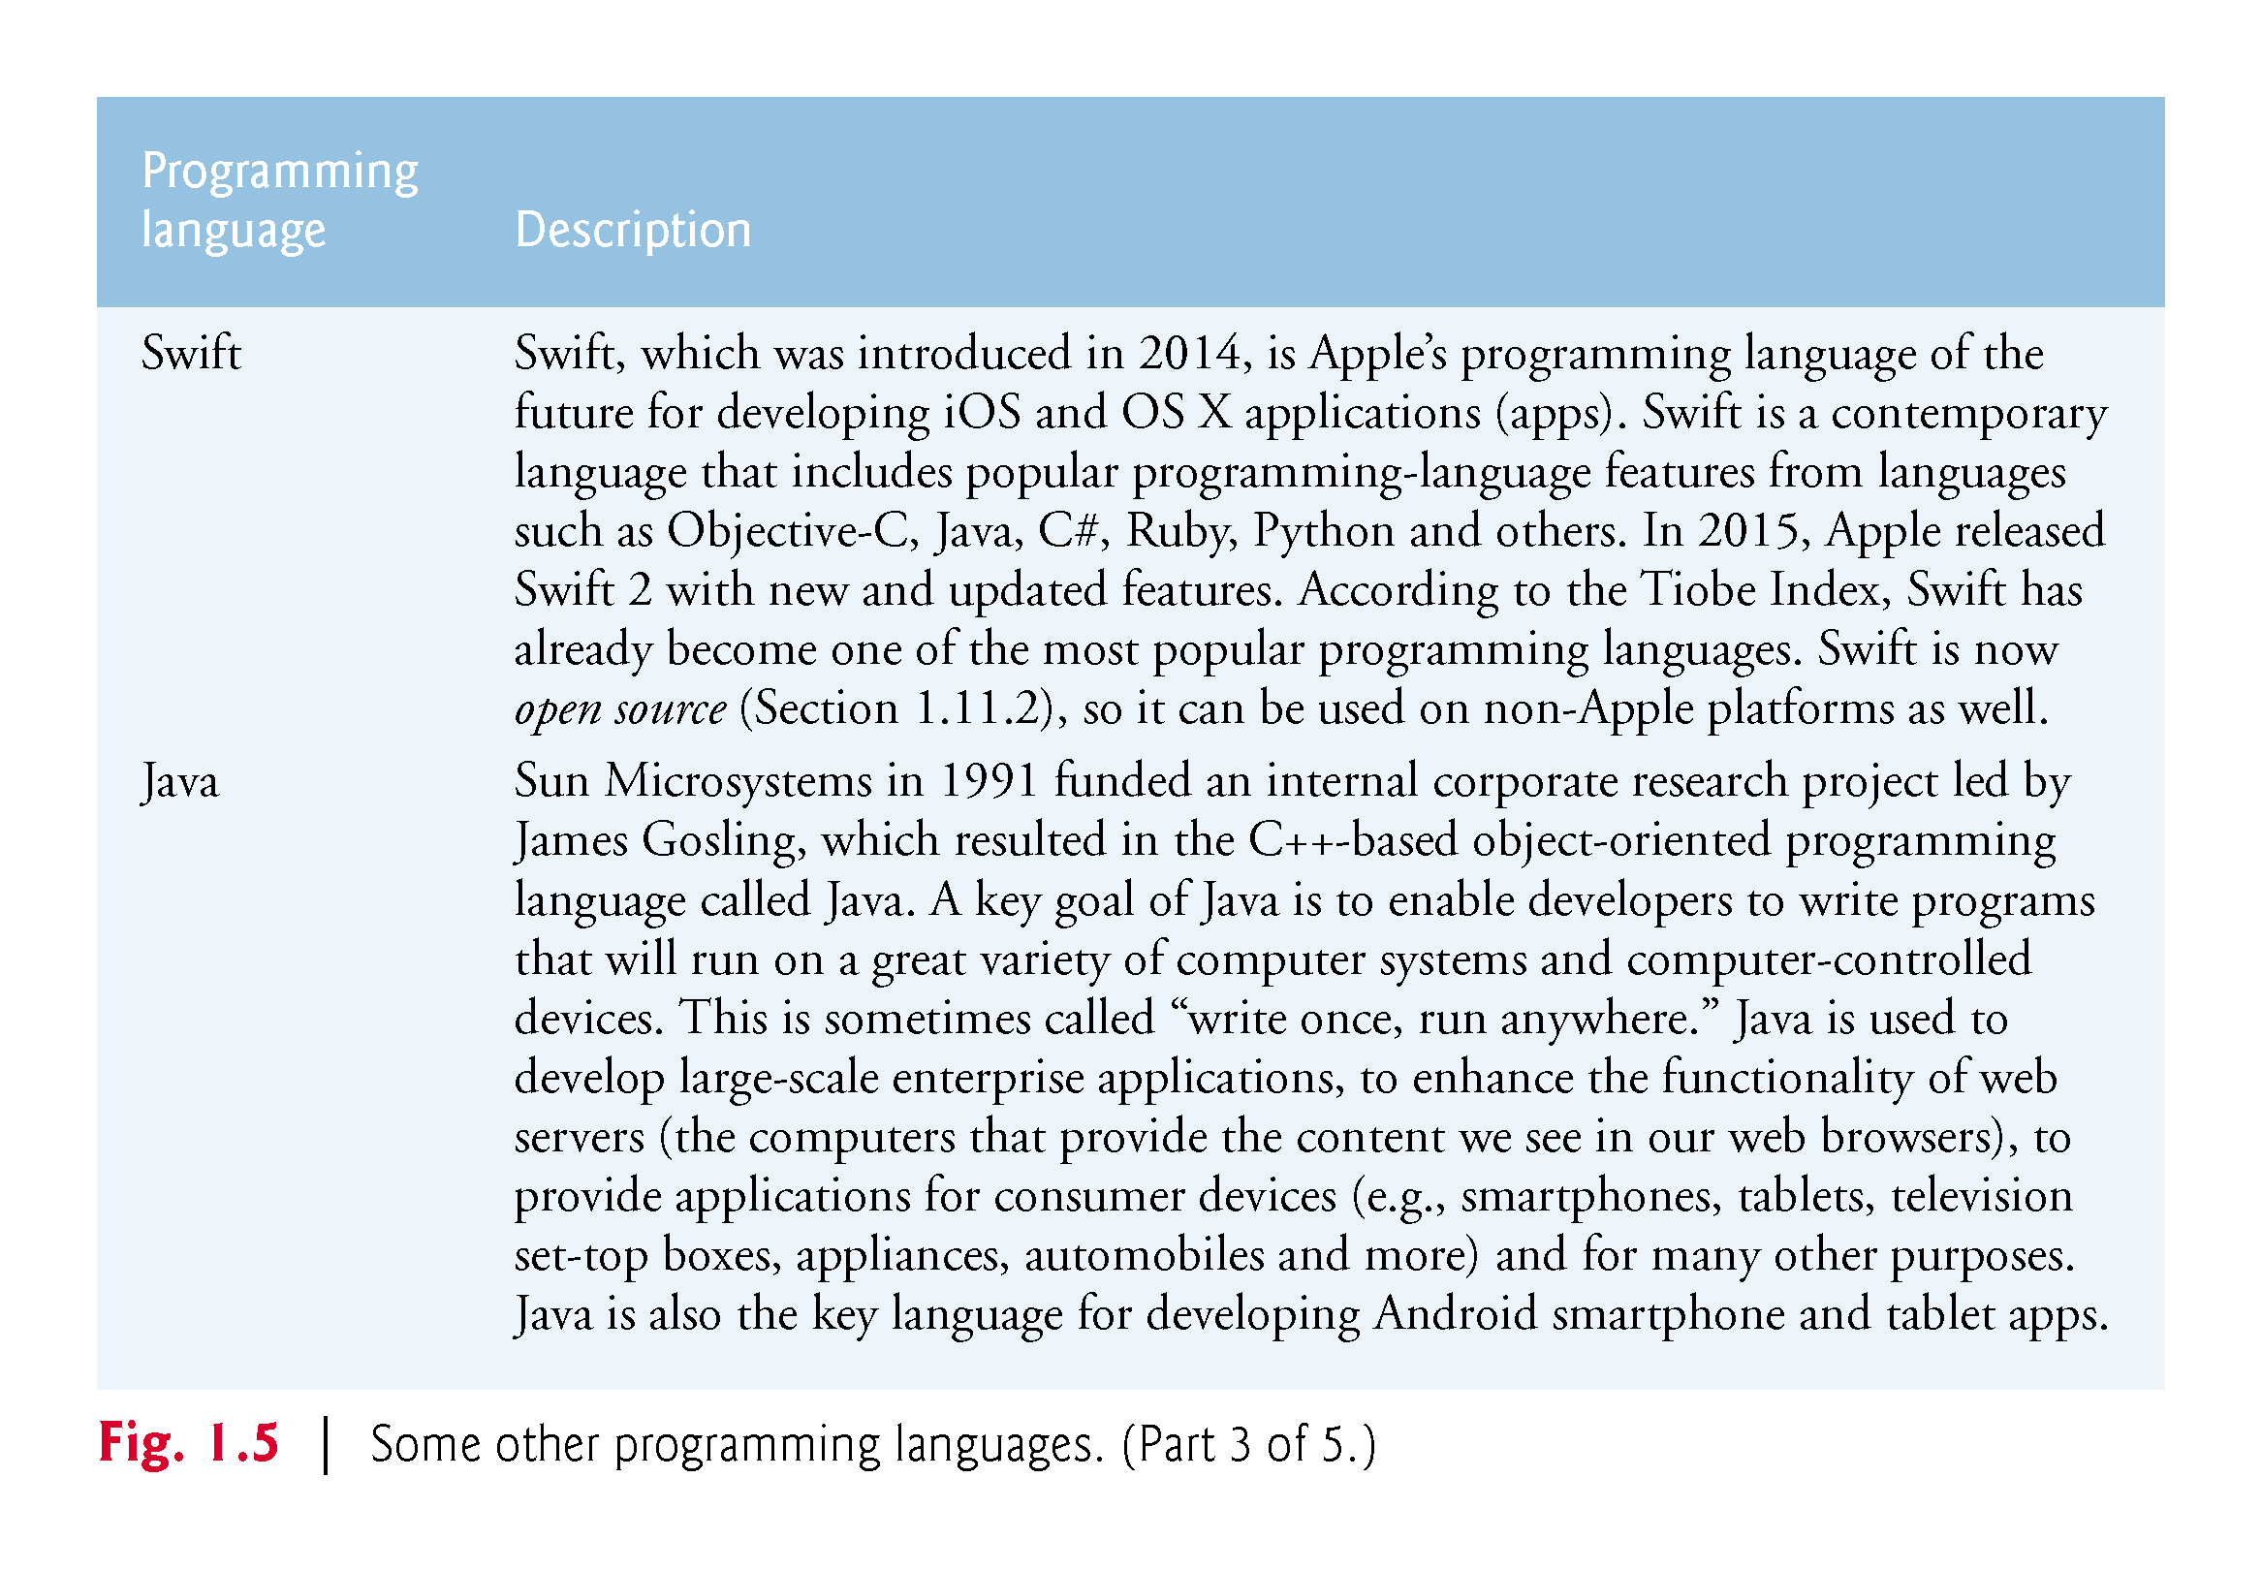

Slide 53
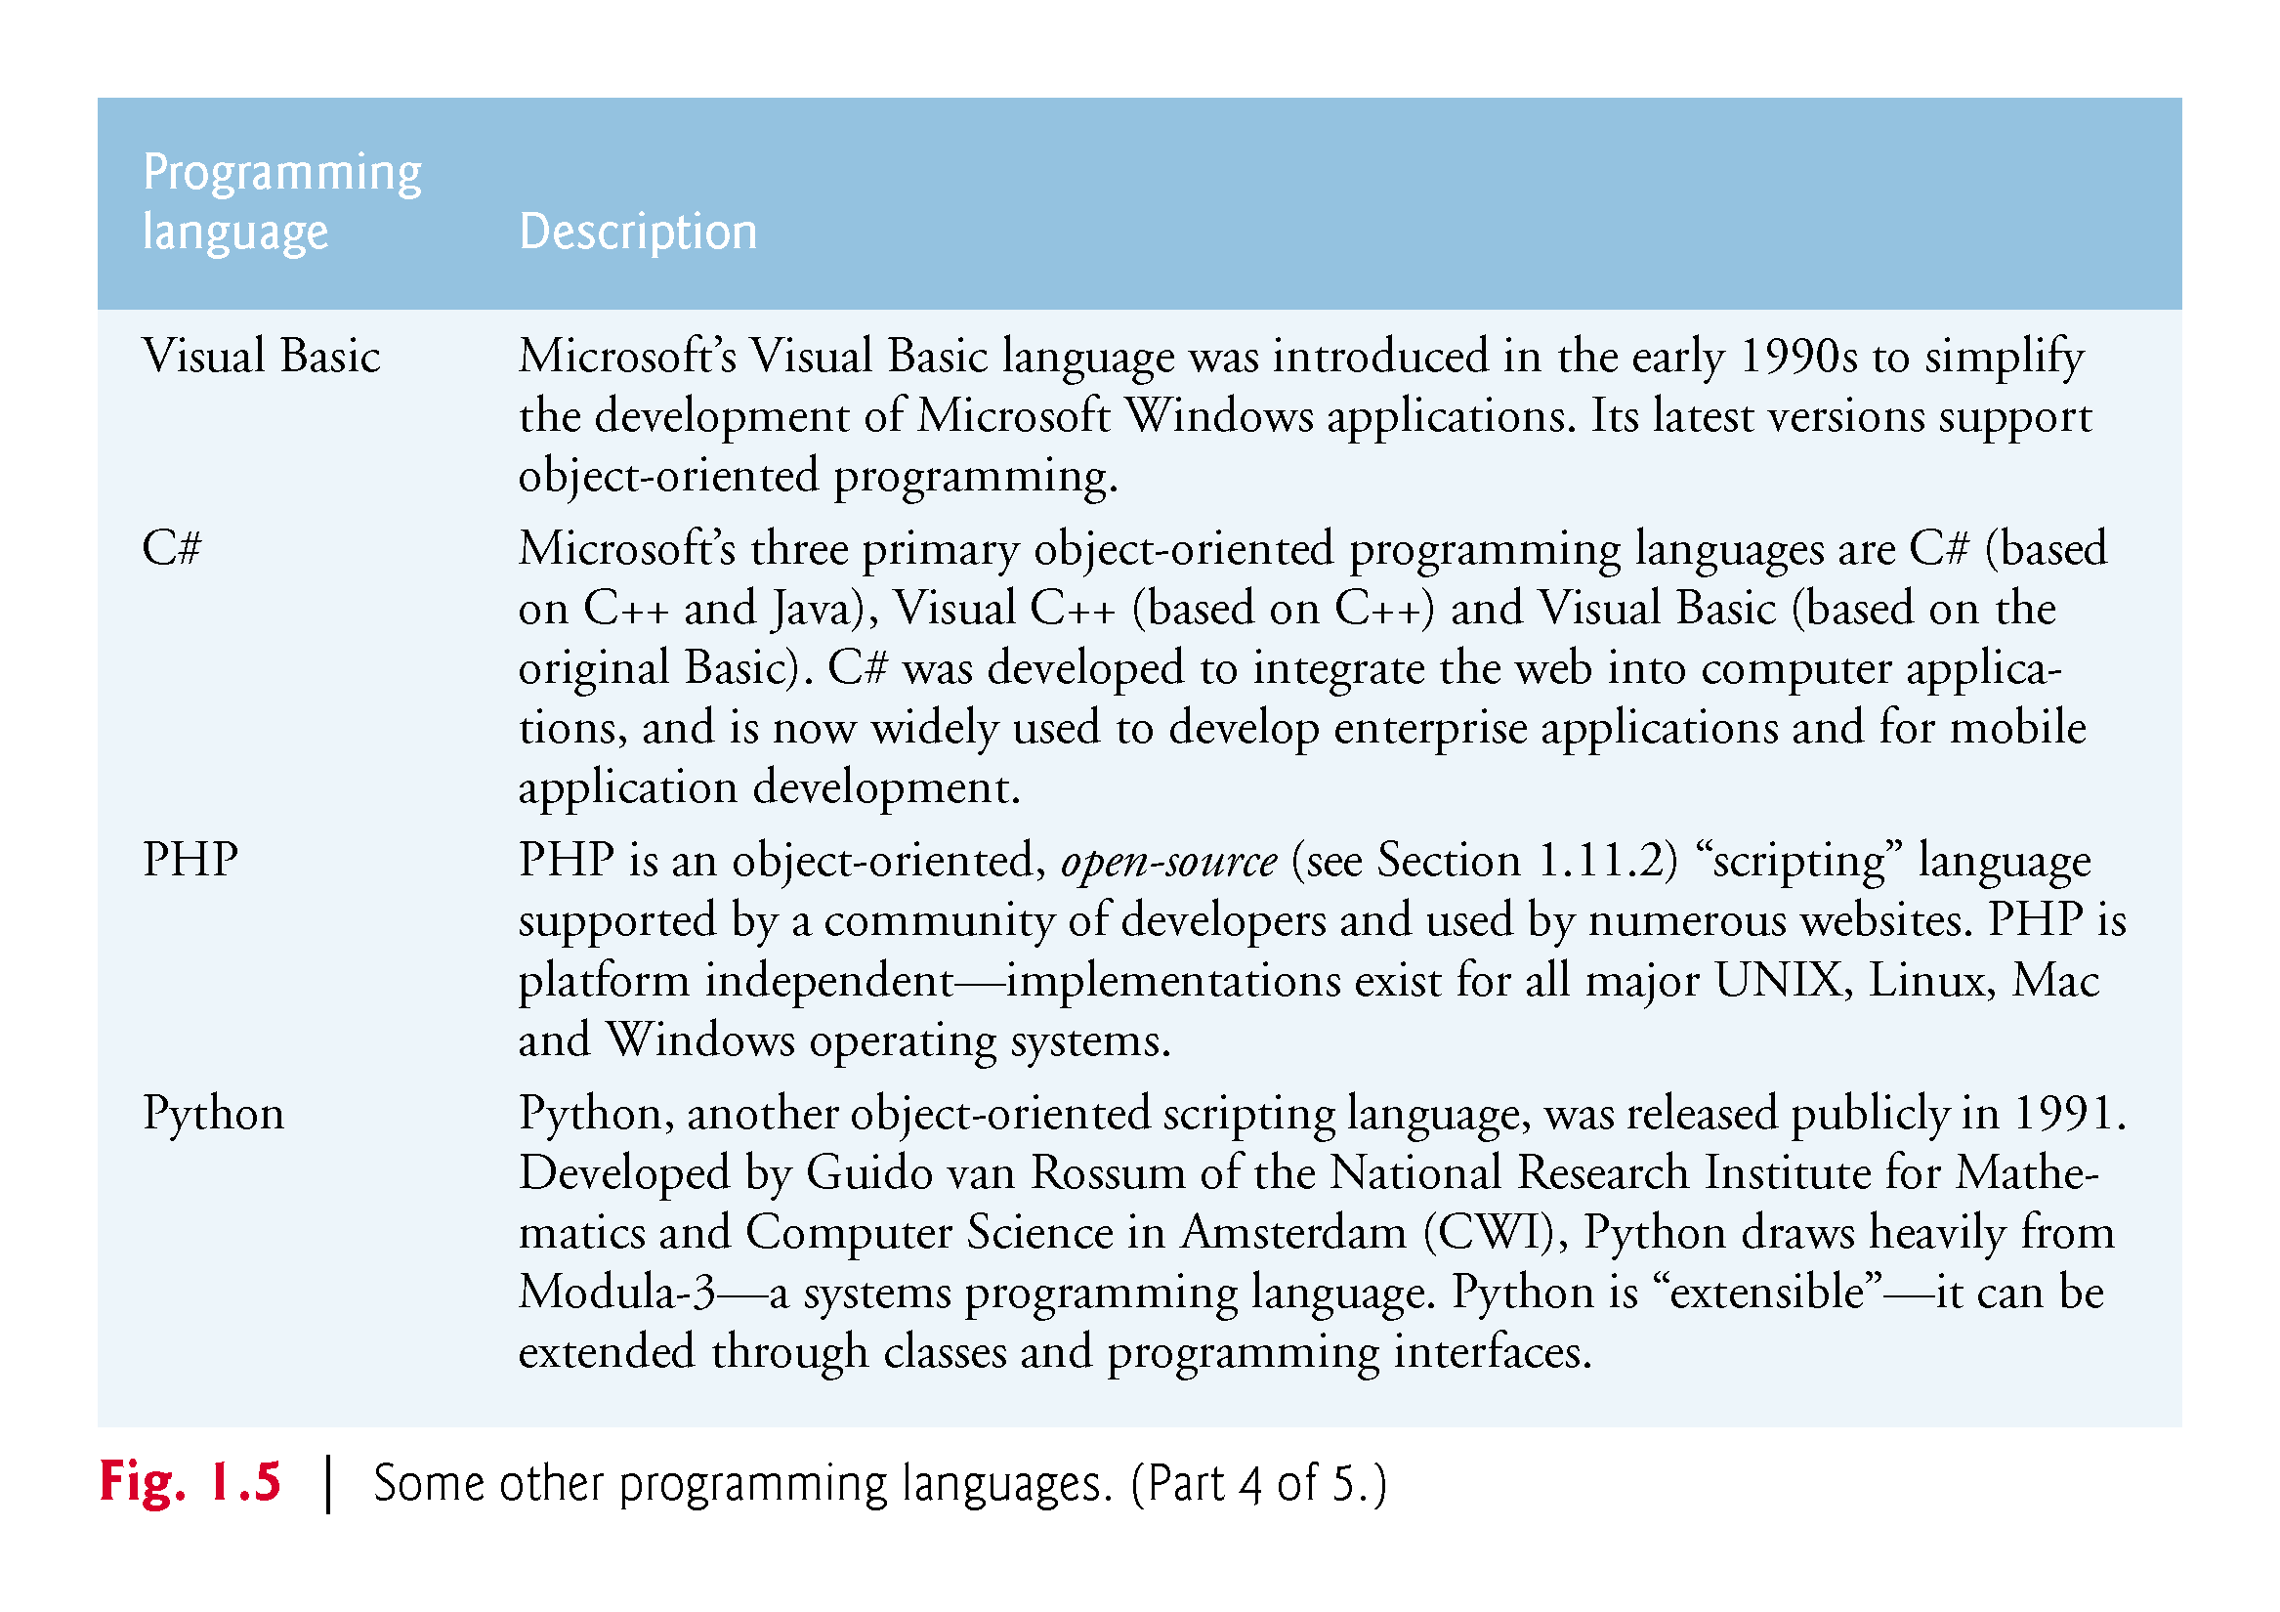

Slide 54
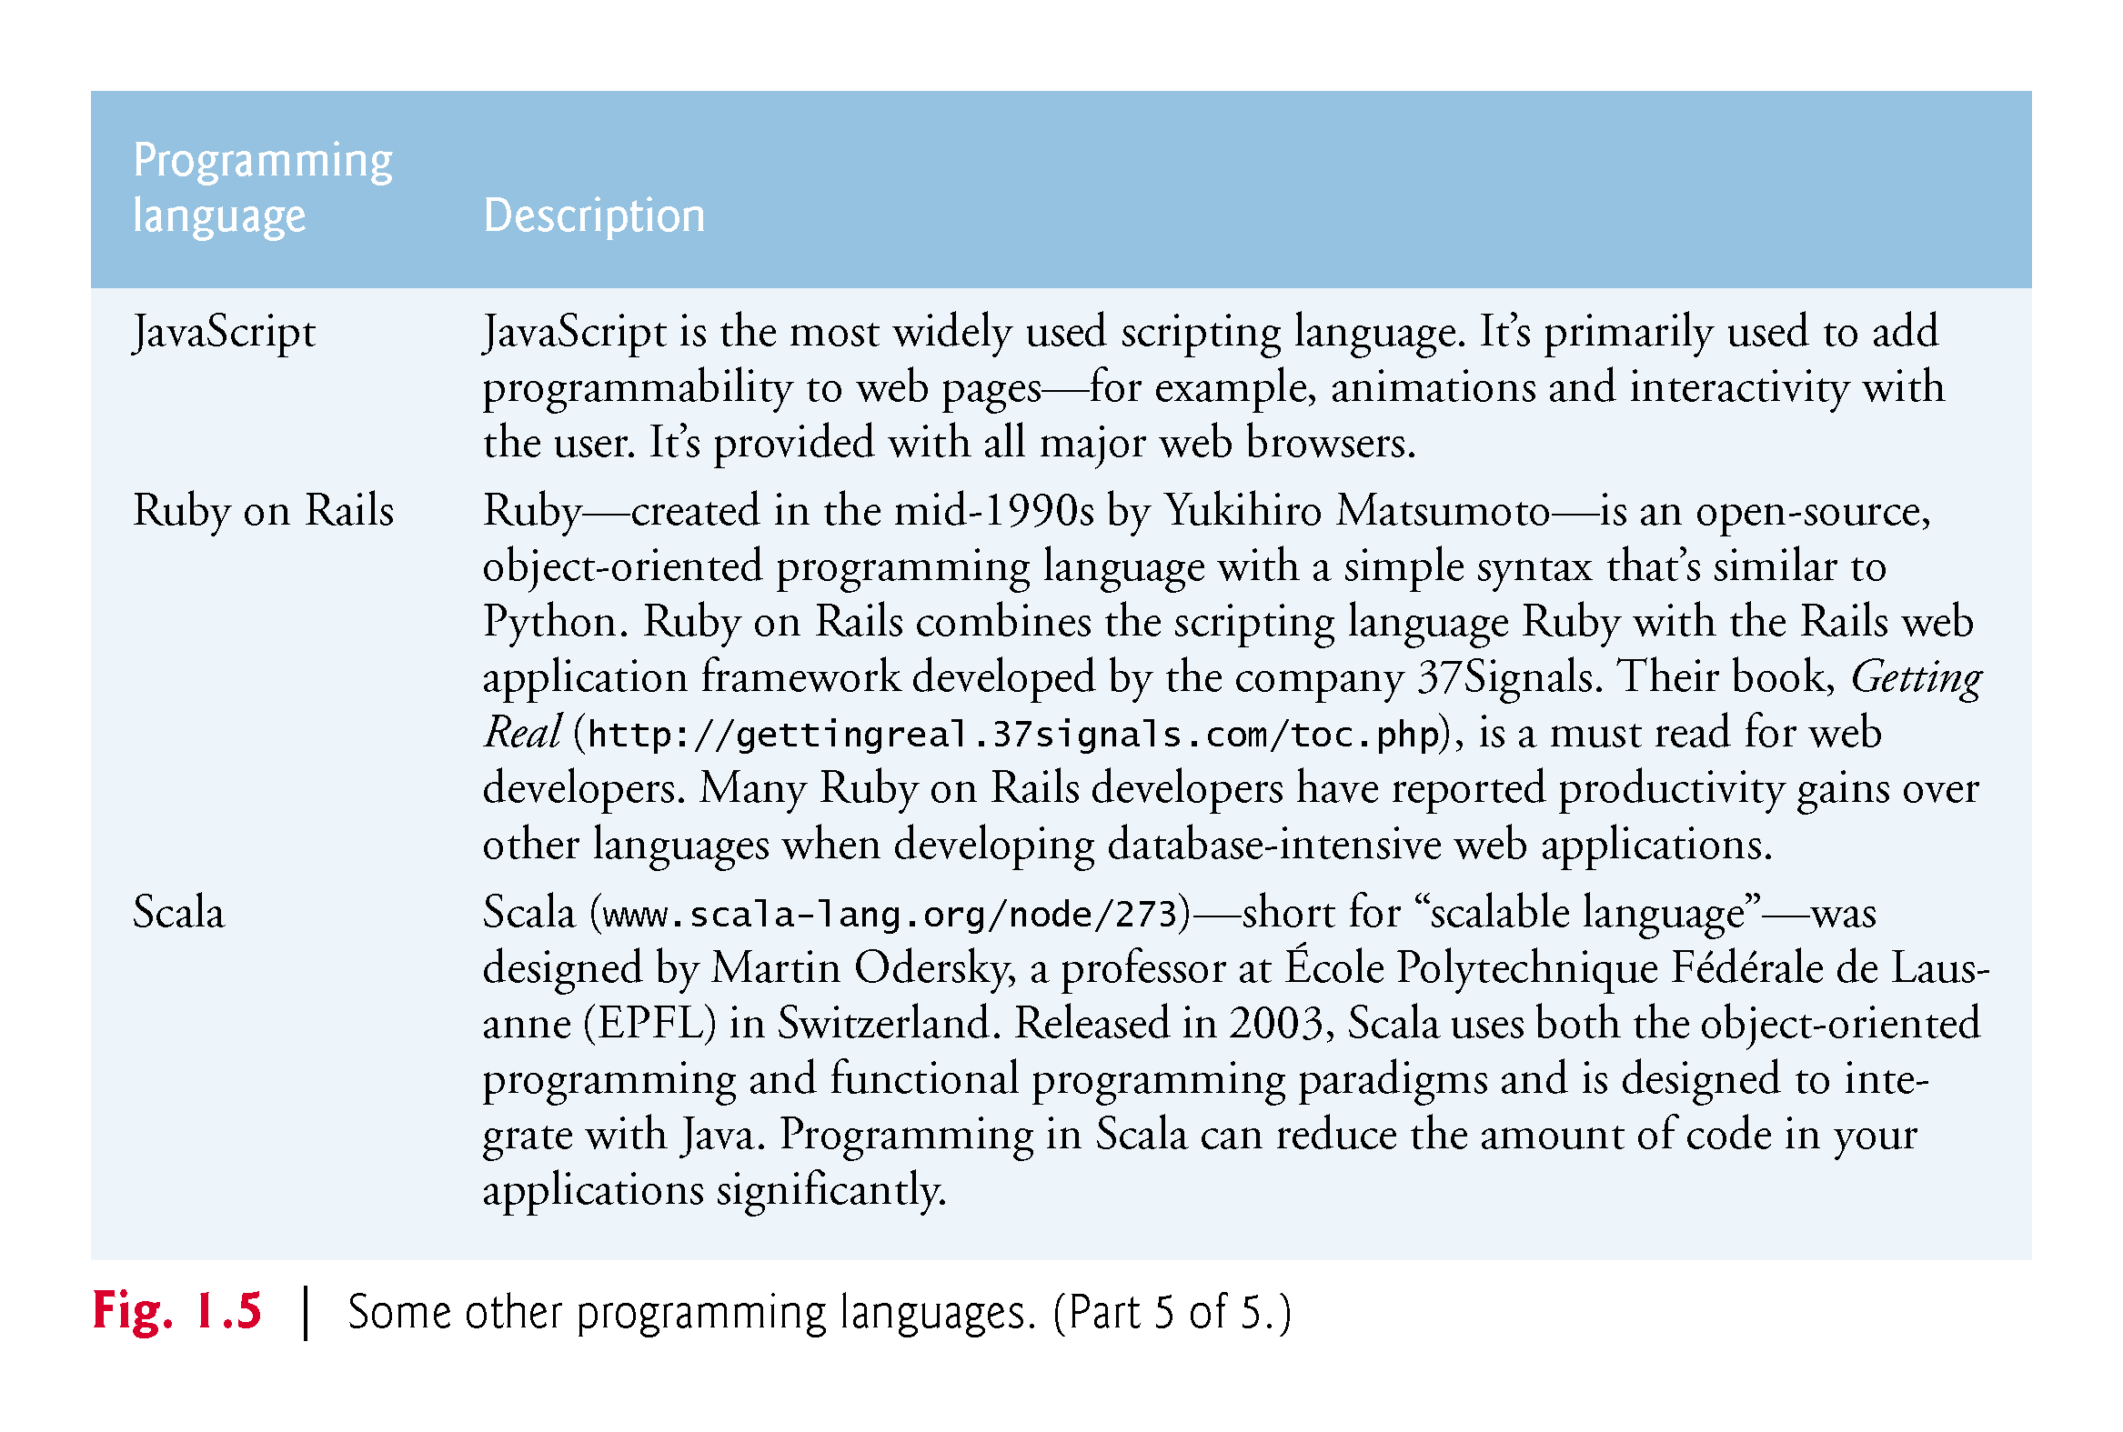

Slide 55
1.8 Introduction to Object Technology
Objects, or more precisely—as we’ll see in Chapter 3—the classes objects come from, are essentially reusable software components.
There are date objects, time objects, audio objects, video objects, automobile objects, people objects, etc.
Almost any noun can be reasonably represented as a software object in terms of attributes (e.g., name, color and size) and behaviors (e.g., calculating, moving and communicating).
Using a modular, object-oriented design-and-implementation approach can make software-development groups much more productive than was possible with earlier techniques—object-oriented programs are often easier to understand, correct and modify.

Slide 56
1.8 Introduction to Object Technology (Cont.)
The Automobile as an Object
Let’s begin with a simple analogy.
Suppose you want to drive a car and make it go faster by pressing its accelerator pedal.
Before you can drive a car, someone has to design it.
A car typically begins as engineering drawings, similar to the blueprints that describe the design of a house.
Drawings include the design for an accelerator pedal.
Pedal hides from the driver the complex mechanisms that actually make the car go faster, just as the brake pedal hides the mechanisms that slow the car, and the steering wheel hides the mechanisms that turn the car.

Slide 57
1.8 Introduction to Object Technology (Cont.)
Enables people with little or no knowledge of how engines, braking and steering mechanisms work to drive a car easily.
Before you can drive a car, it must be built from the engineering drawings that describe it.
A completed car has an actual accelerator pedal to make the car go faster, but even that’s not enough—the car won’t accelerate on its own (hopefully!), so the driver must press the pedal to accelerate the car.

Slide 58
1.8 Introduction to Object Technology (Cont.)
Functions, Member Functions and Classes
Performing a task in a program requires a member function
Houses the program statements that actually perform its task.
Hides these statements from its user, just as the accelerator pedal of a car hides from the driver the mechanisms of making the car go faster.

Slide 59
1.8 Introduction to Object Technology (Cont.)
In C++, we create a program unit called a class to house the set of functions that perform the class’s tasks—these are the class’s member functions.
A class is similar in concept to a car’s engineering drawings, which house the design of an accelerator pedal, steering wheel, and so on.

Slide 60
1.8 Introduction to Object Technology (Cont.)
Instantiation
Just as someone has to build a car from its engineering drawings before you can actually drive a car, you must build an object from a class before a program can perform the tasks that the class’s member functions define.
An object is then referred to as an instance of its class.

Slide 61
1.8 Introduction to Object Technology (Cont.)
Reuse
Just as a car’s engineering drawings can be reused many times to build many cars, you can reuse a class many times to build many objects.
Reuse of existing classes when building new classes and programs saves time and effort.

Slide 62
1.8 Introduction to Object Technology (Cont.)
Reuse also helps you build more reliable and effective systems, because existing classes and components often have gone through extensive testing, debugging and performance tuning.
Just as the notion of interchangeable parts was crucial to the Industrial Revolution, reusable classes are crucial to the software revolution that has been spurred by object technology.

Slide 63
1.8 Introduction to Object Technology (Cont.)
Messages and Member-Function Calls
When you drive a car, pressing its gas pedal sends a message to the car to perform a task—that is, to go faster.
Similarly, you send messages to an object.
Each message is implemented as a member-function call that tells a member function of the object to perform its task.

Slide 64
1.8 Introduction to Object Technology (Cont.)
Attributes and Data Members
A car has attributes
Color, its number of doors, the amount of gas in its tank, its current speed and its record of total miles driven (i.e., its odometer reading).
The car’s attributes are represented as part of its design in its engineering diagrams.
Every car maintains its own attributes.
Each car knows how much gas is in its own gas tank, but not how much is in the tanks of other cars.

Slide 65
1.8 Introduction to Object Technology (Cont.)
An object has attributes that it carries along as it’s used in a program.
Specified as part of the object’s class.
A bank account object has a balance attribute that represents the amount of money in the account.
Each bank account object knows the balance in the account it represents, but not the balances of the other accounts in the bank.
Attributes are specified by the class’s data members.

Slide 66
1.8 Introduction to Object Technology (Cont.)
Encapsulation
Classes encapsulate (i.e., wrap) attributes and member functions into objects created from those classes
An object’s attributes and member functions are intimately related.
Objects may communicate with one another
They’re normally not allowed to know how other objects are implemented—implementation details are hidden.
Information hiding is crucial to good software engineering.

Slide 67
1.8 Introduction to Object Technology (Cont.)
Inheritance
A new class of objects can be created quickly and conveniently by inheritance—the new class absorbs the characteristics of an existing class, possibly customizing them and adding unique characteristics of its own.
In our car analogy, an object of class “convertible” certainly is an object of the more general class “automobile,” but more specifically, the roof can be raised or lowered.

Slide 68
1.8 Introduction to Object Technology (Cont.)
Object-Oriented Analysis and Design (OOAD)
How will you create the code (i.e., the program instructions) for your programs?
Follow a detailed analysis process for determining your project’s requirements (i.e., defining what the system is supposed to do)
Develop a design that satisfies them (i.e., deciding how the system should do it).
Carefully review the design (and have your design reviewed by other software professionals) before writing any code.

Slide 69
1.8 Introduction to Object Technology (Cont.)
If this process involves analyzing and designing your system from an object-oriented point of view, it’s called an object-oriented analysis and design (OOAD) process.
Languages like C++ are object oriented.
Object-oriented programming (OOP) allows you to implement an object-oriented design as a working system.

Slide 70
1.8 Introduction to Object Technology (Cont.)
The UML (Unified Modeling Language)
The Unified Modeling Language (UML) is now the most widely used graphical scheme for modeling object-oriented systems.

Slide 71
1.9 Typical C++ Development Environment (Cont.)
C++ systems generally consist of three parts: a program development environment, the language and the C++ Standard Library.
C++ programs typically go through six phases: edit, preprocess, compile, link, load and execute.

Slide 72
1.9 Typical C++ Development Environment (Cont.)
Phase 1 consists of editing a file with an editor program, normally known simply as an editor.
Type a C++ program (source code) using the editor.
Make any necessary corrections.
Save the program.
C++ source code filenames often end with the .cpp, .cxx, .cc or .C extensions, which indicate that a file contains C++ source code.

Slide 73
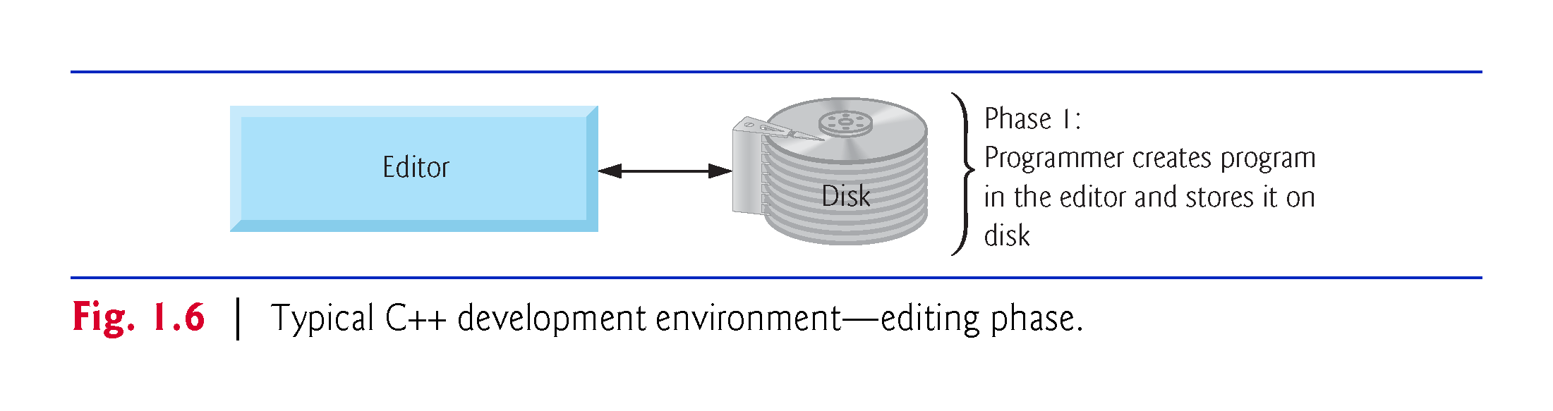

Slide 74
1.9 Typical C++ Development Environment (Cont.)
Linux editors: vi and emacs.
You can also use a simple text editor, such as Notepad in Windows, to write your C++ code.
integrated development environments (IDEs)
Provide tools that support the software-development process, including editors for writing and editing programs and debuggers for locating logic errors—errors that cause programs to execute incorrectly.

Slide 75
1.9 Typical C++ Development Environment (Cont.)
Popular IDEs
Microsoft® Visual Studio 2015 Community Edition
NetBeans
Eclipse
Apple’s Xcode
CodeLite
Clion

Slide 76
1.9 Typical C++ Development Environment (Cont.)
In phase 2, you give the command to compile the program.
A preprocessor program executes automatically before the compiler’s translation phase begins (so we call preprocessing Phase 2 and compiling Phase 3).
The C++ preprocessor obeys commands called preprocessing directives, which indicate that certain manipulations are to be performed on the program before compilation.
These manipulations usually include (copy into the program file) other text files to be compiled, and perform various text replacements.

Slide 77
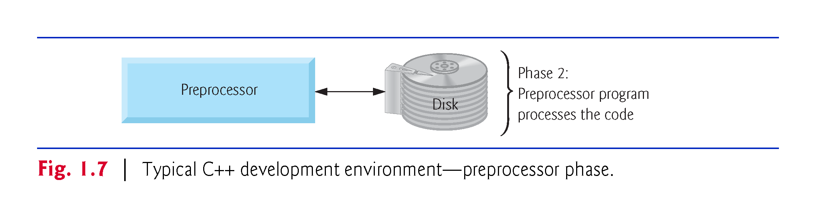

Slide 78
1.9 Typical C++ Development Environment (Cont.)
In Phase 3, the compiler translates the C++ program into machine-language code—also referred to as object code.

Slide 79
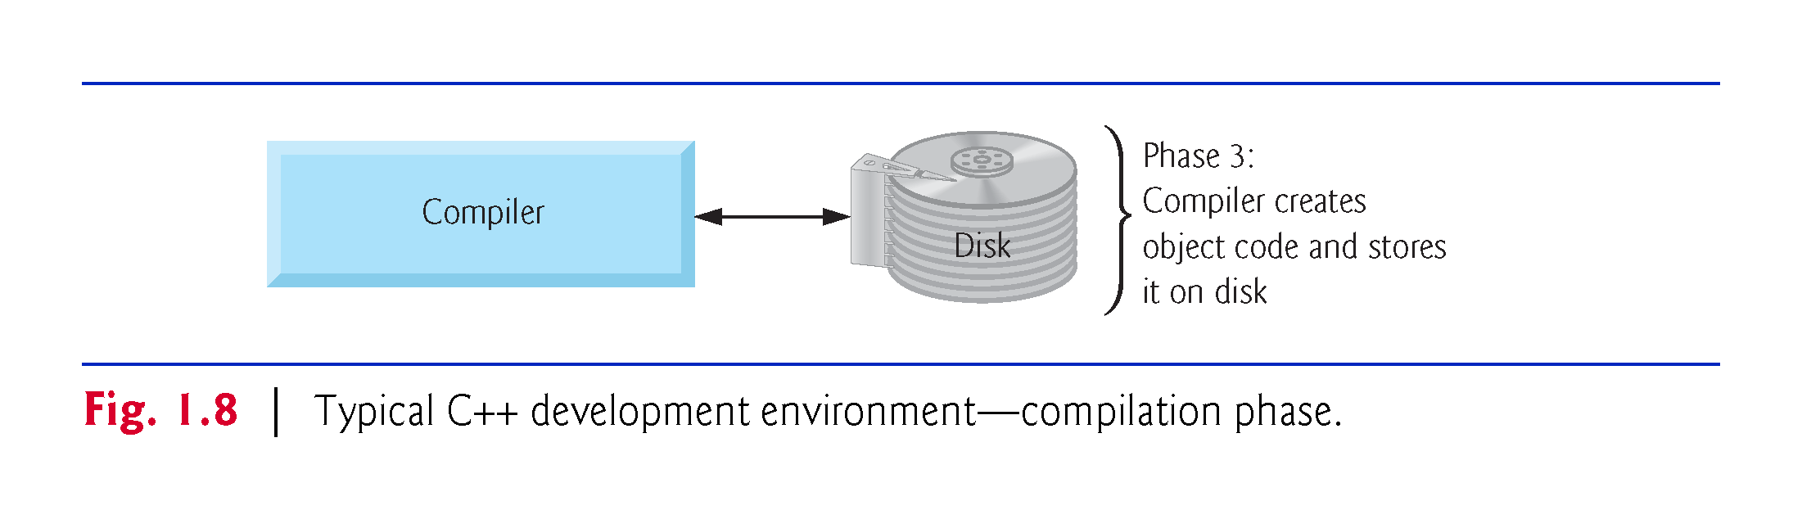

Slide 80
1.9 Typical C++ Development Environment (Cont.)
Phase 4 is called linking.
The object code produced by the C++ compiler typically contains “holes” due to these missing parts.
A linker links the object code with the code for the missing functions to produce an executable program.
If the program compiles and links correctly, an executable image is produced.

Slide 81
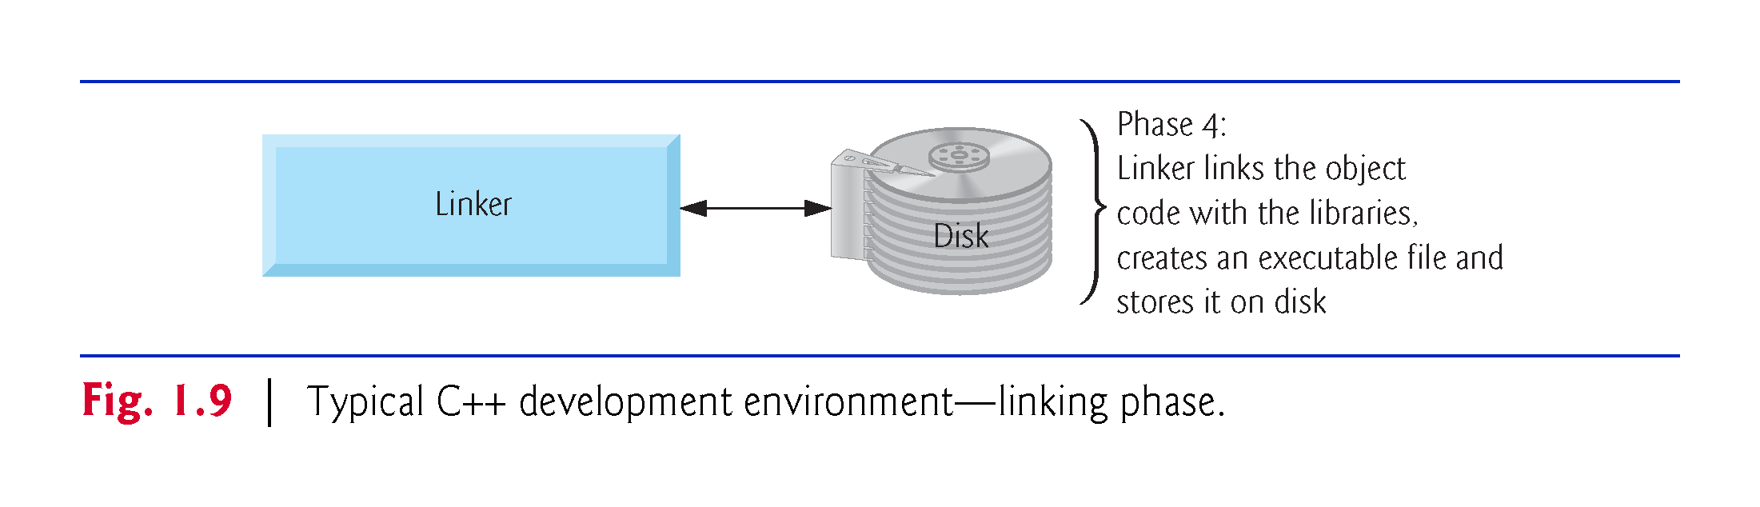

Slide 82
1.9 Typical C++ Development Environment (Cont.)
Phase 5 is called loading.
Before a program can be executed, it must first be placed in memory. T
his is done by the loader, which takes the executable image from disk and transfers it to memory.
Additional components from shared libraries that support the program are also loaded.

Slide 83
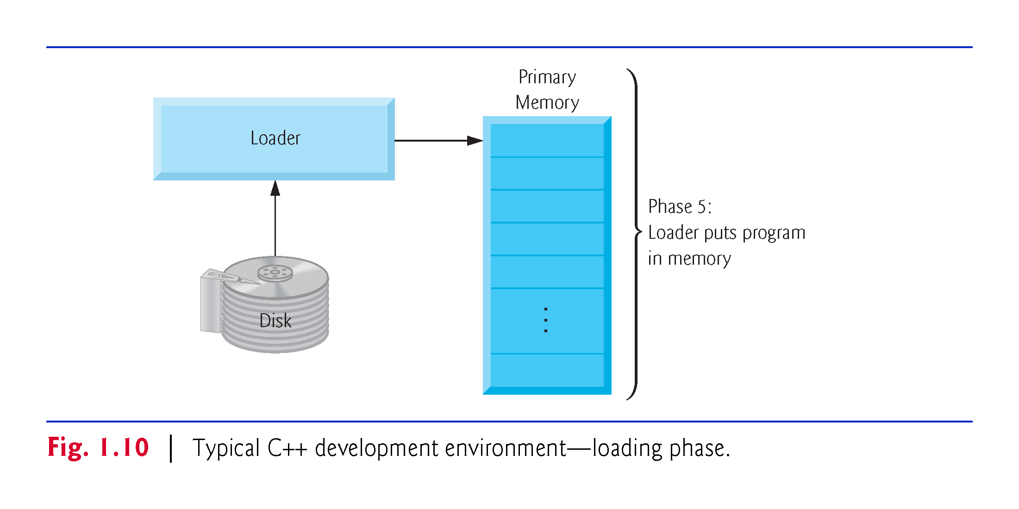

Slide 84
1.9 Typical C++ Development Environment (Cont.)
Phase 6: Execution
Finally, the computer, under the control of its CPU, executes the program one instruction at a time.
Some modern computer architectures often execute several instructions in parallel.

Slide 85
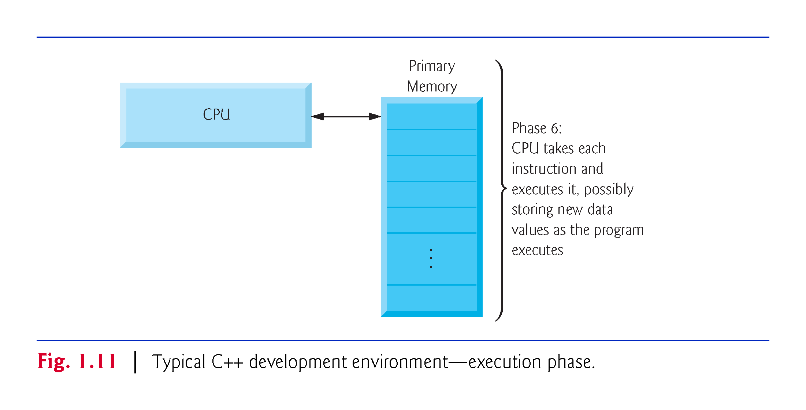

Slide 86
1.9 Typical C++ Development Environment (Cont.)
Problems That May Occur at Execution Time
Programs might not work on the first try.
Each of the preceding phases can fail because of various errors that we’ll discuss throughout this book.
If this occurred, you’d have to return to the edit phase, make the necessary corrections and proceed through the remaining phases again to determine that the corrections fixed the problem(s).
Most programs in C++ input or output data.

Slide 87
1.9 Typical C++ Development Environment (Cont.)
Certain C++ functions take their input from cin (the standard input stream; pronounced “see-in”), which is normally the keyboard, but cin can be redirected to another device.
Data is often output to cout (the standard output stream; pronounced “see-out”), which is normally the computer screen, but cout can be redirected to another device.
When we say that a program prints a result, we normally mean that the result is displayed on a screen.

Slide 88
1.9 Typical C++ Development Environment (Cont.)
Data may be output to other devices, such as disks, hardcopy printers or even transmitted over the Internet.
There is also a standard error stream referred to as cerr. The cerr stream is used for displaying error messages.

Slide 89
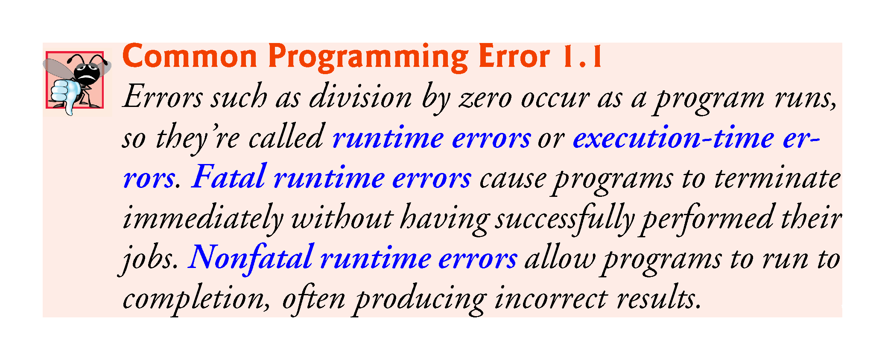

Slide 90
1.10 Test-Driving a C++ Application
In this section, you’ll compile, run and interact with your first C++ application.
Guess-the-number game, which picks a number from 1 to 1000 and prompts you to guess it.
If your guess is correct, the game ends.
If your guess is not correct, the application indicates whether your guess is higher or lower than the correct number. There is no limit on the number of guesses you can make.

Slide 91
1.10 Test-Driving a C++ Application
[Note: For this test drive only, we’ve modified this application from the exercise you’ll be asked to create in Chapter 6, Functions and an Introduction to Recursion. Normally this application randomly selects the correct answer as you execute the program. The modified application uses the same correct answer every time the program executes (though this may vary by compiler), so you can use the same guesses we use in this section and see the same results as we walk you through interacting with your first C++ application.]

Slide 92
1.10.1 Compiling and Running an Application in Visual Studio 2015 for Windows
In this section, you’ll run a C++ program on Windows using Microsoft Visual Studio 2015 Community Edition.
There are several versions of Visual Studio available—on some versions, the options, menus and instructions we present might differ slightly. From this point forward, we’ll refer to Visual Studio 2015 Community Edition simply as “Visual Studio” or “the IDE.”

Slide 93
1.10.1 Compiling and Running an Application in Visual Studio 2015 for Windows
Step 1: Checking Your Setup
It’s important to read this book’s Before You Begin section to make sure that you’ve installed Visual Studio and copied the book’s examples to your hard drive correctly.

Slide 94
1.10.1 Compiling and Running an Application in Visual Studio 2015 for Windows
Step 2: Launching Visual Studio
Open Visual Studio from the Start menu.
The IDE displays the Start Page (Fig. 1.12), which provides links for creating new programs, opening existing programs and learning about the IDE and various programming topics.
Close this window for now by clicking the X in its tab—you can access this window any time by selecting View > Start Page.
We use the > character to indicate selecting a menu item from a menu. For example, the notation File > Open indicates that you should select the Open menu item from the File menu.

Slide 95
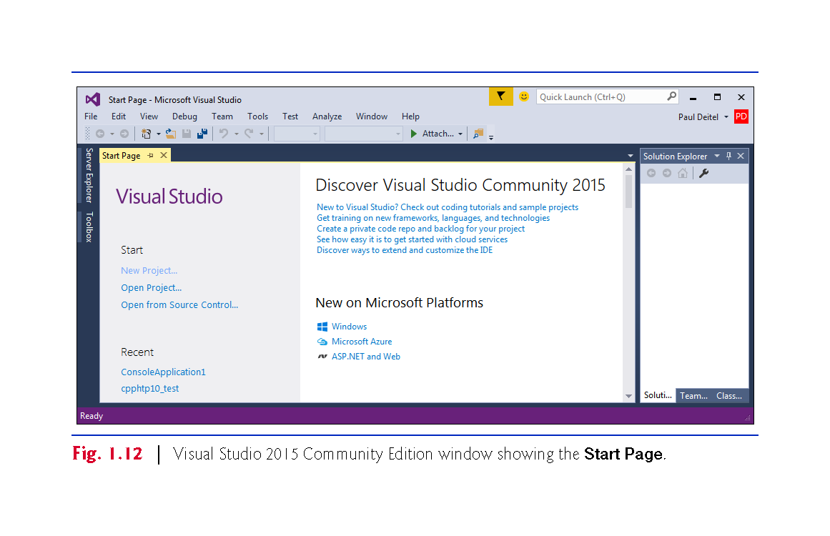

Slide 96
1.10.1 Compiling and Running an Application in Visual Studio 2015 for Windows
Step 3: Creating a Project
A project is a group of related files, such as the C++ source-code files that compose an application.
Visual Studio organizes applications into projects and solutions, which contain one or more projects.
Multiple-project solutions are used to create large-scale applications.
Each application in this book will be a solution containing a single project.

Slide 97
1.10.1 Compiling and Running an Application in Visual Studio 2015 for Windows
Step 3: Creating a Project
This book’s examples are Win32 Console Application projects that you’ll execute from the IDE.
Select File > New > Project….
At the New Project dialog’s left side, select the category Installed > Templates > Visual C++ > Win32 (Fig. 1.13).

Slide 98
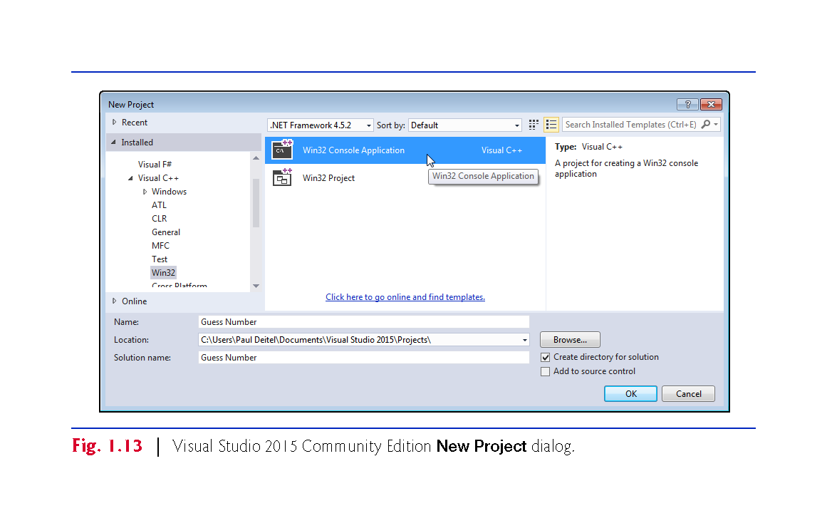

Slide 99
1.10.1 Compiling and Running an Application in Visual Studio 2015 for Windows
Step 3: Creating a Project
In the New Project dialog’s middle section, select Win32 Console Application.
Provide a name for your project in the Name field—we specified Guess Number—then click OK to display the Win32 Application Wizard window, then click Next > to display the Application Settings step.
Configure the settings as shown in Fig. 1.14 to create a solution containing an empty project, then click Finish.

Slide 100
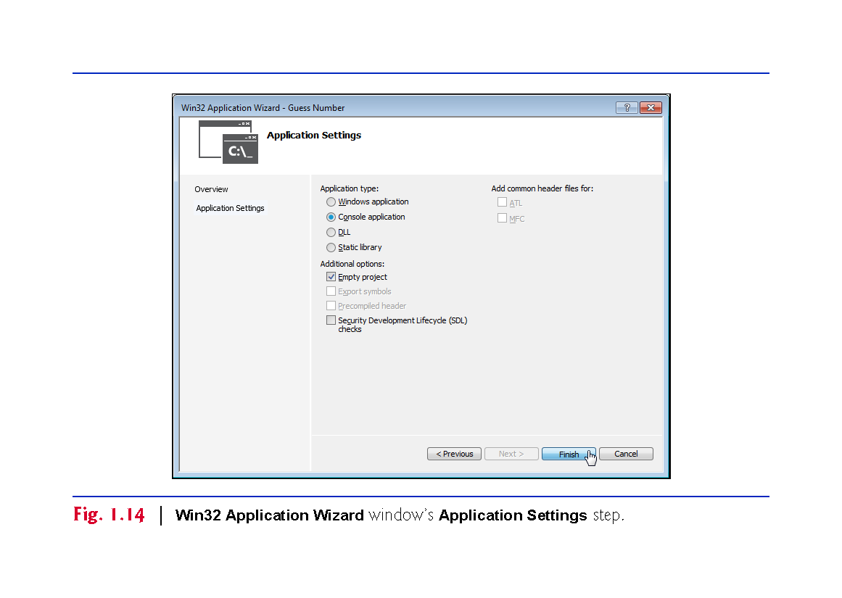

Slide 101
1.10.1 Compiling and Running an Application in Visual Studio 2015 for Windows
Step 3: Creating a Project
At this point, the IDE opens the window in Fig. 1.15 and creates your project and places its folder in
C:\Users\YourUserAccount\Documents\Visual Studio 2015\Projects
This window displays editors as tabbed windows (one for each file) when you’re editing code.
Also displayed is the Solution Explorer in which you can view and manage your application’s files. You’ll typically place each program’s code files in the Source Files folder.
If the Solution Explorer is not displayed, you can display it by selecting View > Solution Explorer.

Slide 102
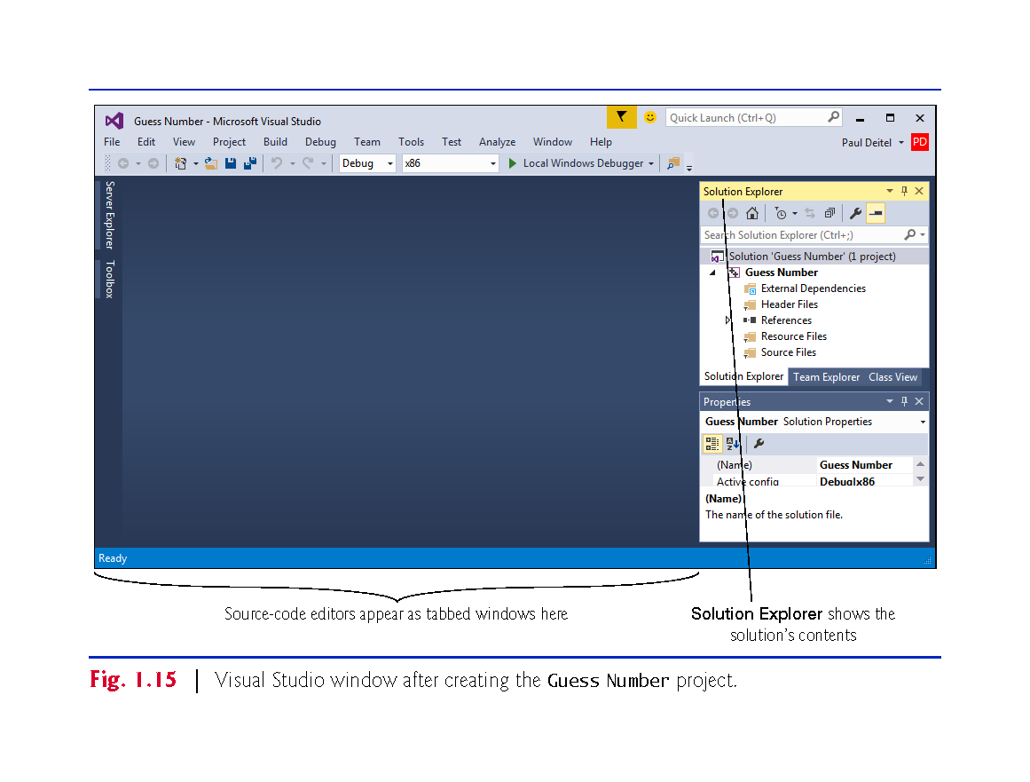

Slide 103
1.10.1 Compiling and Running an Application in Visual Studio 2015 for Windows
Step 4: Adding the GuessNumber.cpp File into the Project
Next, add GuessNumber.cpp to the project you created in Step 3.
In Windows Explorer (Windows 7) or File Explorer (Windows 8 and 10), open the ch01 folder in the book’s examples folder, then drag GuessNumber.cpp onto the Source Files folder in the Solution Explorer.

Slide 104
1.10.1 Compiling and Running an Application in Visual Studio 2015 for Windows
Step 5: Compiling and Running the Project
To compile and run the project so you can test-drive the application, select Debug > Start without debugging or simply type Ctrl + F5.
If the program compiles correctly, the IDE opens a Command Prompt window and executes the program (Fig. 1.16)
We changed the Command Prompt’s color scheme to make the screen captures more readable.
The application displays "Please type your first guess.", then displays a question mark (?) as a prompt on the next line.

Slide 105
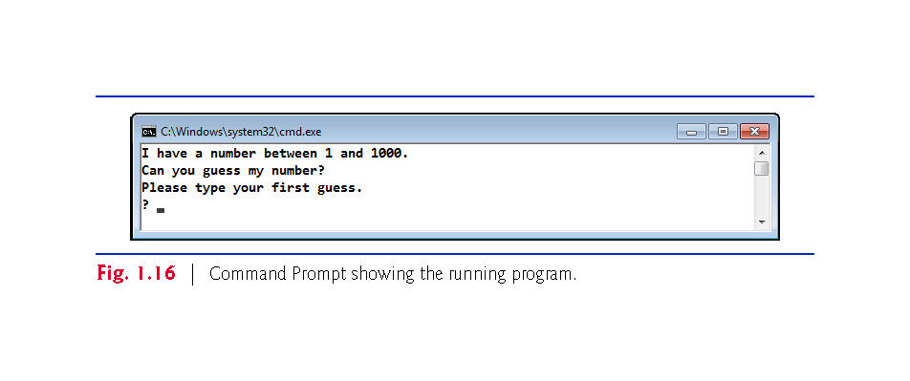

Slide 106
1.10.1 Compiling and Running an Application in Visual Studio 2015 for Windows
Step 6: Entering Your First Guess
Type 500 and press Enter.
The application displays "Too high. Try again." (Fig. 1.17), meaning that the value you entered is greater than the number the application chose as the correct guess.

Slide 107
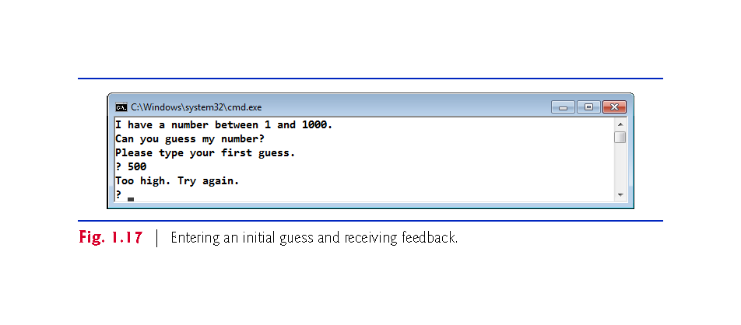

Slide 108
1.10.1 Compiling and Running an Application in Visual Studio 2015 for Windows
Step 7: Entering Another Guess
At the next prompt, enter 250 (Fig. 1.18).
The application displays "Too high. Try again.", because the value you entered once again is greater than the correct guess.

Slide 109
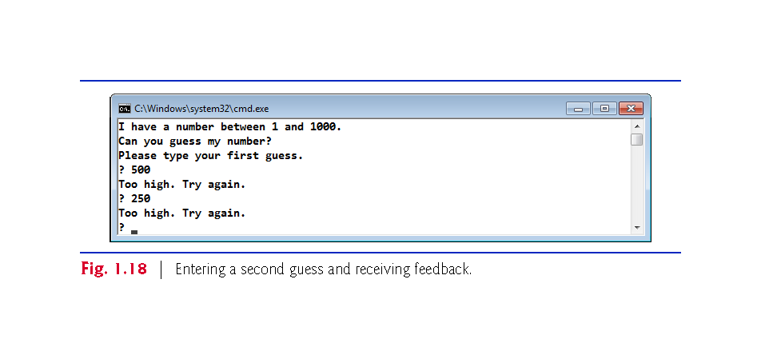

Slide 110
1.10.1 Compiling and Running an Application in Visual Studio 2015 for Windows
Step 8: Entering Additional Guesses
Continue to play the game (Fig. 1.19) by entering values until you guess the correct number.
When you guess correctly, the application displays "Excellent! You guessed the number."

Slide 111
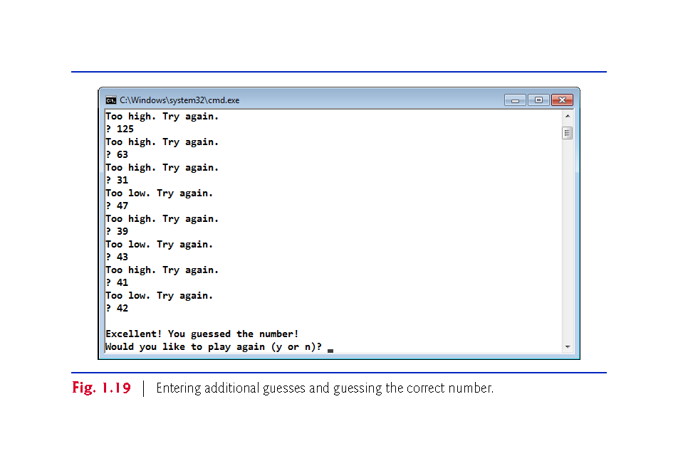

Slide 112
1.10.1 Compiling and Running an Application in Visual Studio 2015 for Windows
Step 9: Playing the Game Again or Exiting the Application
After you guess the correct number, the application asks if you’d like to play another game.
At the "Would you like to play again (y or n)?" prompt, entering the one character y causes the application to choose a new number and displays the message "Please type your first guess." followed by a question-mark prompt so you can make your first guess in the new game.
Entering the character n terminates the application.
Each time you execute this application from the beginning (Step 5), it will choose the same numbers for you to guess.

Slide 113
1.10.2 Compiling and Running Using GNU C++ on Linux
For this test drive, we assume that you read the Before You Begin section and that you placed the downloaded examples in your home directory on your Linux system.
The prompt in the shell on our system uses the tilde (~) character to represent the home directory, and each prompt ends with the dollar sign ($) character. The prompt will vary among Linux systems.

Slide 114
1.10.2 Compiling and Running Using GNU C++ on Linux
Step 1: Locating the Completed Application
From a Linux shell, use the command cd to change to the completed application directory (Fig. 1.20) by typing
cd examples/ch01
then pressing Enter.

Slide 115
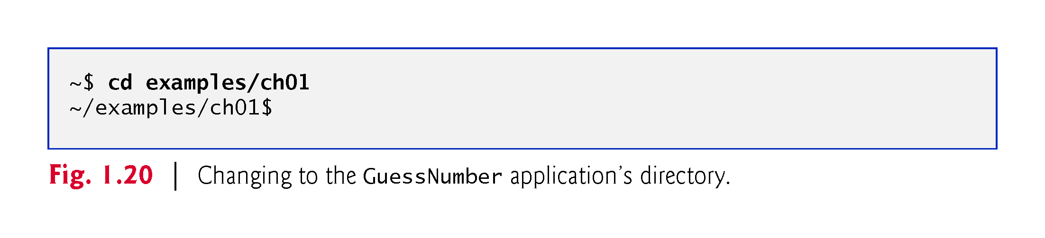

Slide 116
1.10.2 Compiling and Running Using GNU C++ on Linux
Step 2: Compiling the Application
Before running the application, you must first compile it (Fig. 1.21) by typing
g++ -std=c++14 GuessNumber.cpp -o GuessNumber
This command compiles the application for C++14 (the current C++ version) and produces an executable file called GuessNumber.

Slide 117
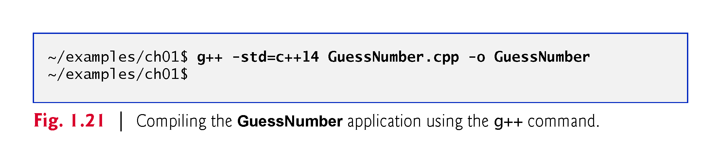

Slide 118
1.10.2 Compiling and Running Using GNU C++ on Linux
Step 3: Running the Application
To run the executable file GuessNumber, type ./GuessNumber at the next prompt, then press Enter (Fig. 1.22).
The ./ tells Linux to run from the current directory and is required to indicate that GuessNumber is an executable file.

Slide 119
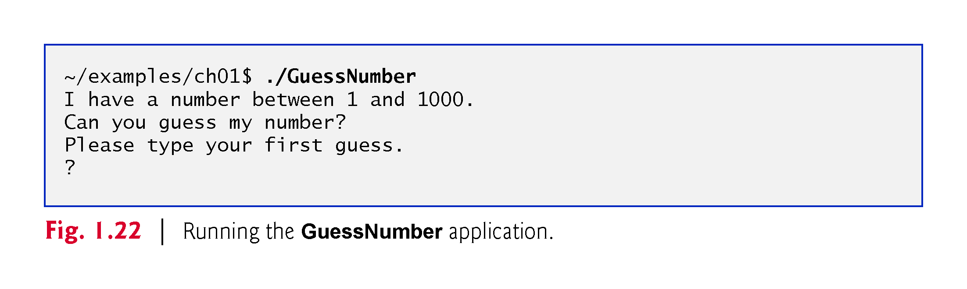

Slide 120
1.10.2 Compiling and Running Using GNU C++ on Linux
Step 4: Entering Your First Guess
The application displays "Please type your first guess.", then displays a question mark (?) as a prompt on the next line (Fig. 1.22).
At the prompt, enter 500 (Fig. 1.23). [Note that the outputs may vary based on the compiler you’re using.]

Slide 121
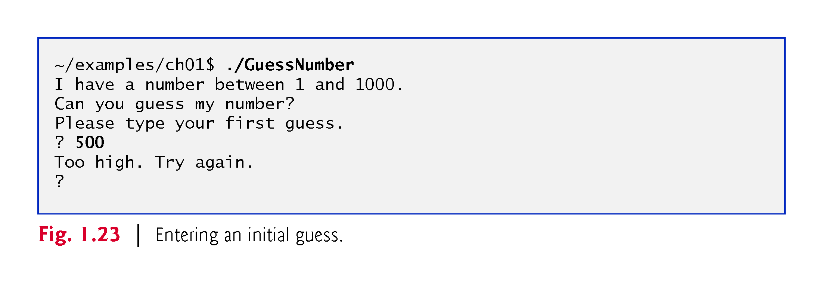

Slide 122
1.10.2 Compiling and Running Using GNU C++ on Linux
Step 5: Entering Another Guess
The application displays "Too high. Try again.", meaning that the value you entered is greater than the number the application chose as the correct guess (Fig. 1.23).
At the next prompt, enter 250 (Fig. 1.24).
This time the application displays "Too low. Try again.", because the value you entered is less than the correct guess.

Slide 123
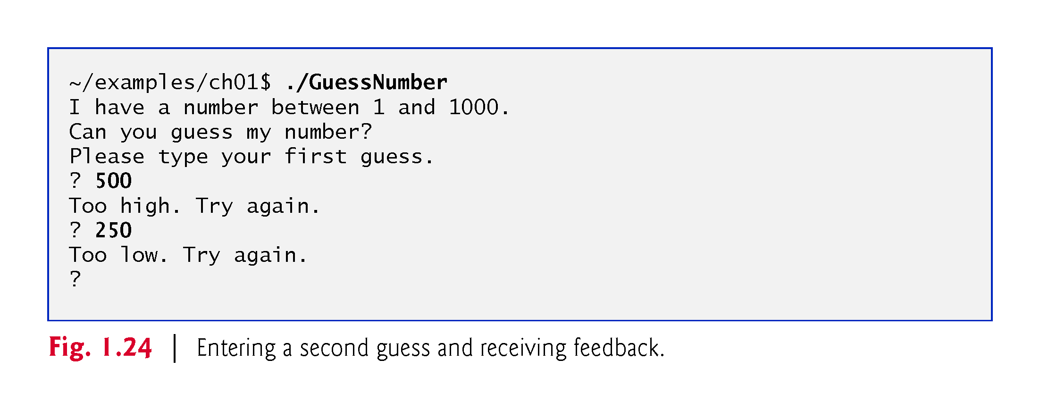

Slide 124
1.10.2 Compiling and Running Using GNU C++ on Linux
Step 6: Entering Additional Guesses
Continue to play the game (Fig. 1.25) by entering values until you guess the correct number.
When you guess correctly, the application displays "Excellent! You guessed the number."

Slide 125
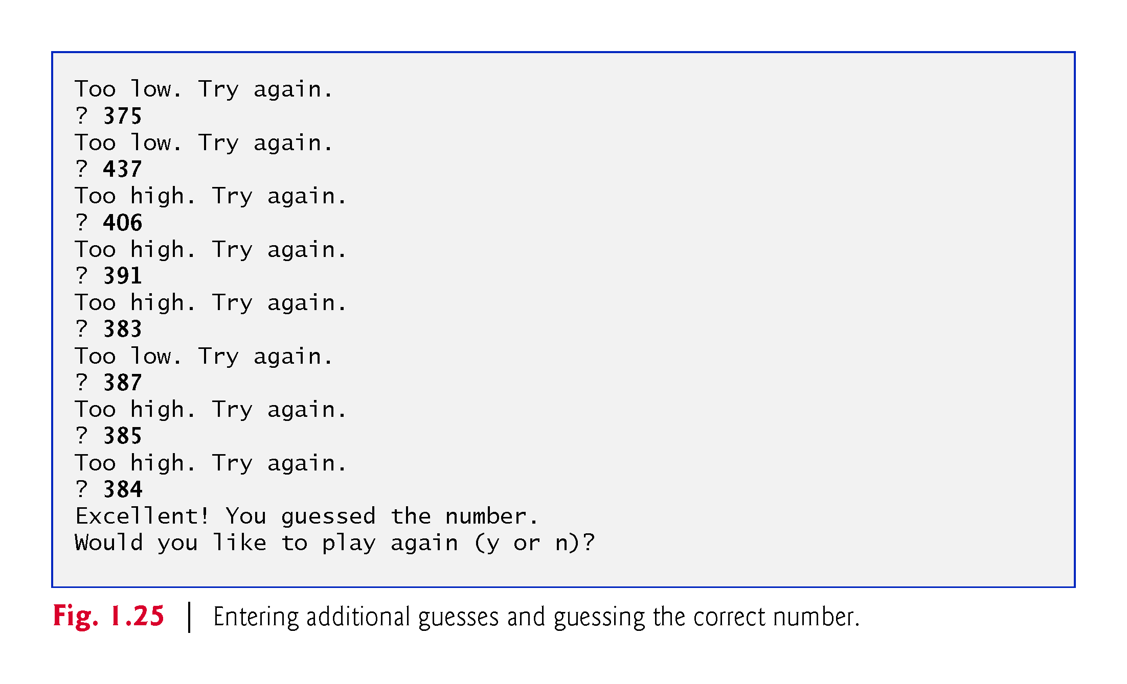

Slide 126
1.10.2 Compiling and Running Using GNU C++ on Linux
Step 7: Playing the Game Again or Exiting the Application
After you guess the correct number, the application asks if you’d like to play another game.
At the "Would you like to play again (y or n)?" prompt, entering the one character y causes the application to choose a new number and displays the message "Please type your first guess." followed by a question-mark prompt so you can make your first guess in the new game.
Entering the character n ends the application, returns you to the shell and awaits your next command.

Slide 127
1.10.3 Compiling and Running with Xcode on Mac OS X
Step 1: Checking Your Setup
It’s important to read this book’s Before You Begin section to make sure that you’ve installed Apple’s Xcode IDE and copied the book’s examples to your hard drive correctly.

Slide 128
1.10.3 Compiling and Running with Xcode on Mac OS X
Step 2: Launching Xcode
Open a Finder window, select Applications and double click the Xcode icon.
If this is your first time running Xcode, the Welcome to Xcode window will appear (Fig. 1.26).
Close this window for now—you can access it any time by selecting Window > Welcome to Xcode.

Slide 129
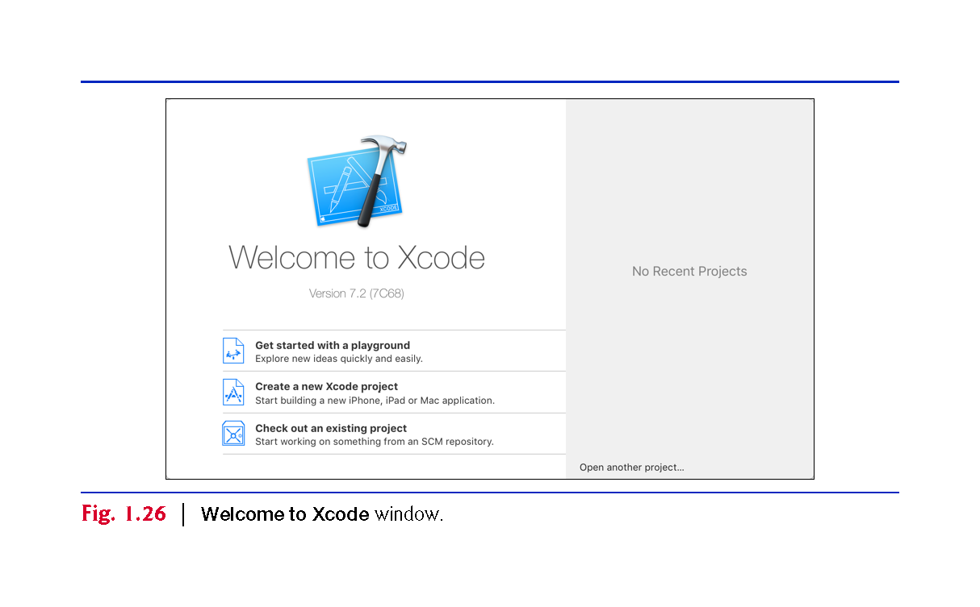

Slide 130
1.10.3 Compiling and Running with Xcode on Mac OS X
Step 3: Creating a Project
A project is a group of related files, such as the C++ source-code files that compose an application.
The Xcode projects we created for this book’s examples are OS X Command Line Tool projects that you’ll execute directly in the IDE. To create a project:

Slide 131
1.10.3 Compiling and Running with Xcode on Mac OS X
Step 3: Creating a Project
Select File > New > Project….
In the OS X subcategory Application, select Command Line Tool and click Next.
Provide a name for your project in the Product Name field—we specified Guess Number.
Ensure that the selected Language is C++ and click Next.
Specify where you want to store your project, then click Create. (See the Before You Begin section for information on configuring a project to use C++14.)

Slide 132
1.10.3 Compiling and Running with Xcode on Mac OS X
Step 3: Creating a Project
Figure 1.27 shows the workspace window that appears after you create the project.
By default, Xcode creates a main.cpp source-code file containing a simple program that displays "Hello, World!".
The window is divided into four main areas below the toolbar: the Navigator area, Editor area and Utilities area are displayed initially. We’ll explain momentarily how to display the Debug area in which you’ll run and interact with the program.

Slide 133
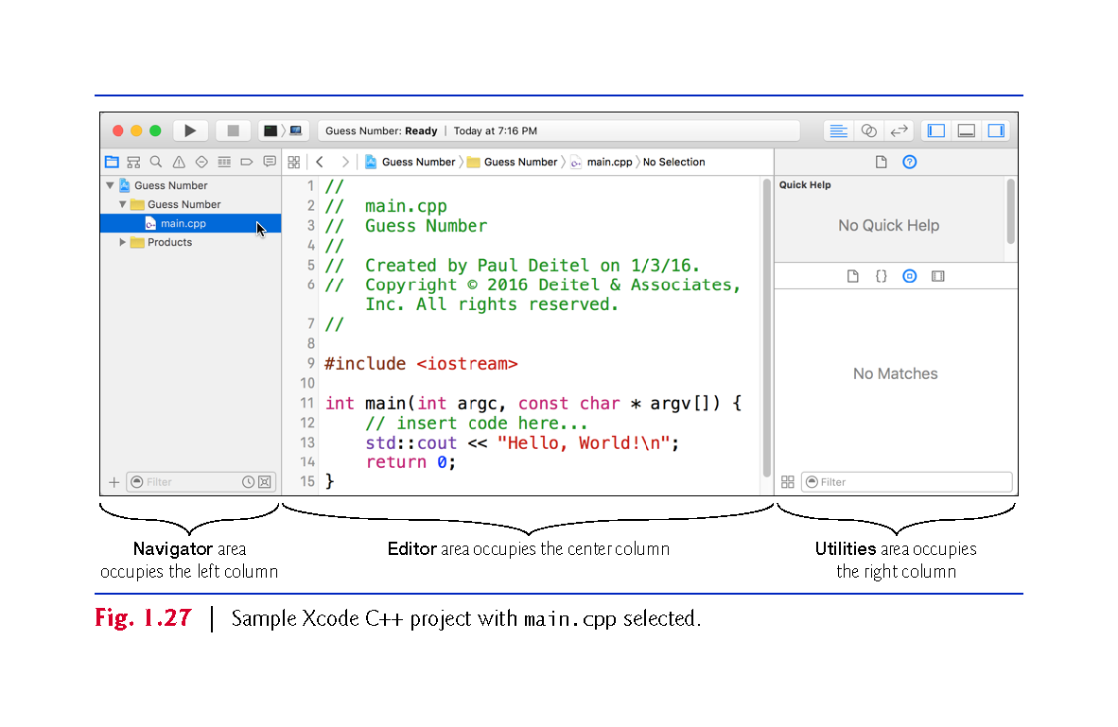

Slide 134
1.10.3 Compiling and Running with Xcode on Mac OS X
At the left of the workspace window is the Navigator area.
The Project navigator shows all the files and folders in your project.
The Issue navigator shows you warnings and errors generated by the compiler.
You choose which navigator to display by clicking the corresponding button above the Navigator area of the window.

Slide 135
1.10.3 Compiling and Running with Xcode on Mac OS X
To the right of the Navigator area is the Editor area for editing source code.
When you select a file in the Project navigator, the file’s contents are displayed in the Editor area.
At the right side of the workspace window is the Utilities area, which you will not use in this book.
The Debug area, when displayed, appears below the Editor area.

Slide 136
1.10.3 Compiling and Running with Xcode on Mac OS X
The toolbar contains options for executing a program (Fig. 1.28(a)), a display area (Fig. 1.28(b)) to shows the progress of tasks executing in Xcode (such as the compilation status) and buttons (Fig. 1.28(c)) for hiding and showing areas in the workspace window.

Slide 137
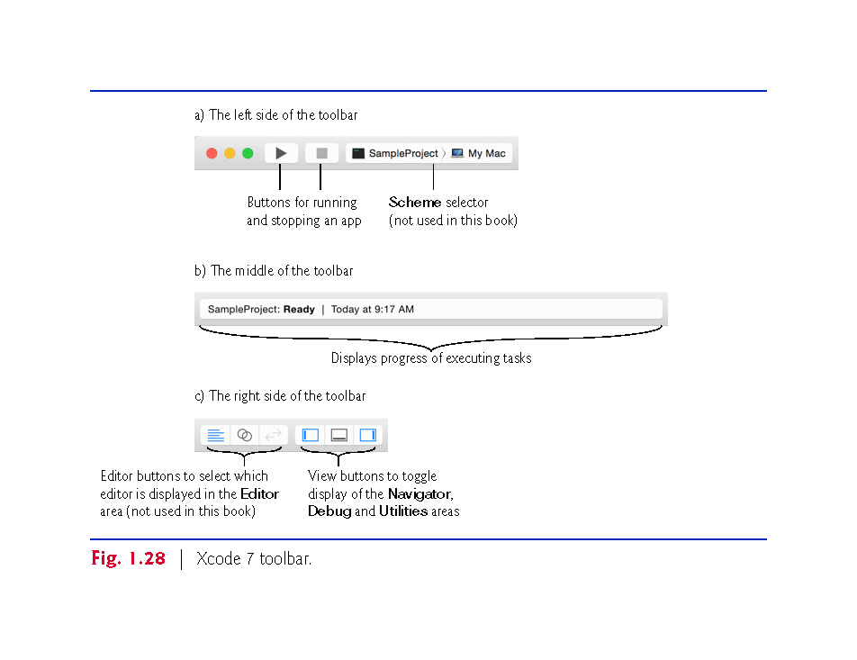

Slide 138
1.10.3 Compiling and Running with Xcode on Mac OS X
Step 4: Deleting the main.cpp File from the Project
You won’t use main.cpp in this test-drive, so you should delete the file.
In the Project navigator, right click the main.cpp file and select Delete.
In the dialog that appears, select Move to Trash to delete the file.

Slide 139
1.10.3 Compiling and Running with Xcode on Mac OS X
Step 5: Adding the GuessNumber.cpp File into the Project
Add GuessNumber.cpp to the project.
In a Finder window, open the ch01 folder in the book’s examples folder, then drag GuessNumber.cpp onto the Guess Number folder in the Project navigator.
In the dialog that appears, ensure that Copy items if needed is checked, then click Finish.

Slide 140
1.10.3 Compiling and Running with Xcode on Mac OS X
Step 6: Compiling and Running the Project
To compile and run the project so you can test-drive the application, click the run button at the left side of Xcode’s toolbar.
If the program compiles correctly, Xcode opens the Debug area (at the bottom of the Editor area) and executes the program in the right half of the Debug area (Fig. 1.29).
The application displays "Please type your first guess.", then displays a question mark (?) as a prompt on the next line.

Slide 141
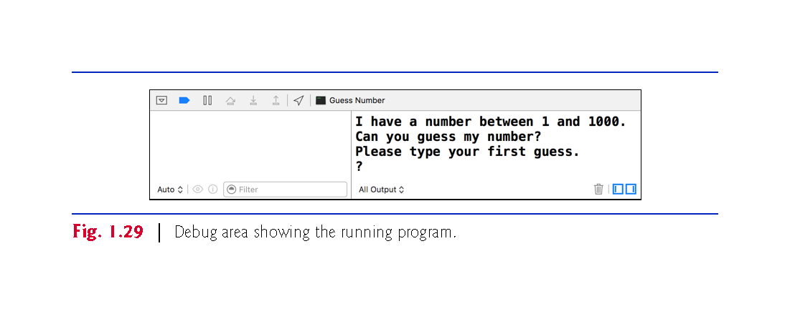

Slide 142
1.10.3 Compiling and Running with Xcode on Mac OS X
Step 7: Entering Your First Guess
Click in the Debug area, then type 500 and press Return.
The application displays "Too low. Try again." (Fig. 1.30), meaning that the value you entered is less than the number the application chose as the correct guess.

Slide 143


Slide 144
1.10.3 Compiling and Running with Xcode on Mac OS X
Step 8: Entering Another Guess
At the next prompt, enter 750 (Fig. 1.31).
The application displays "Too low. Try again.", because the value you entered once again is less than the correct guess.

Slide 145


Slide 146
1.10.3 Compiling and Running with Xcode on Mac OS X
Step 9: Entering Additional Guesses
Continue to play the game (Fig. 1.32) by entering values until you guess the correct number.
When you guess correctly, the application displays "Excellent! You guessed the number."

Slide 147


Slide 148
1.10.3 Compiling and Running with Xcode on Mac OS X
Playing the Game Again or Exiting the Application
After you guess the correct number, the application asks if you’d like to play another game.
At the "Would you like to play again (y or n)?" prompt, entering the character y causes the application to choose a new number and displays the message "Please type your first guess." followed by a question-mark prompt so you can make your first guess in the new game.
Entering the character n terminates the application. Each time you execute this application from the beginning (Step 6), it will choose the same numbers for you to guess.

Slide 149
1.11 Operating Systems
Operating systems
Software systems that make using computers more convenient for users, application developers and system administrators.
Provide services that allow each application to execute safely, efficiently and concurrently (i.e., in parallel) with other applications.
The software that contains the core components of the operating system is called the kernel.
Popular desktop operating systems include Linux, Windows and OS X (formerly called Mac OS X).
Popular mobile operating systems used in smartphones and tablets include Google’s Android, Apple’s iOS and Windows 10 Mobile.

Slide 150
1.11.1 Windows—A Proprietary Operating System
Mid-1980s, Microsoft developed the Windows operating system, consisting of a graphical user interface built on top of DOS—an enormously popular personal-computer operating system of the time that users interacted with by typing commands.
Windows borrowed from many concepts (such as icons, menus and windows) developed by Xerox PARC and popularized by early Apple Macintosh operating systems.

Slide 151
1.11.1 Windows—A Proprietary Operating System (Cont.)
Windows 10 is Microsoft’s latest operating system—its features include enhancements to the Start menu and user interface, Cortana personal assistant for voice interactions, Action Center for receiving notifications, Microsoft’s new Edge web browser, and more.
Windows is a proprietary operating system—it’s controlled by Microsoft exclusively.
Windows is by far the world’s most widely used desktop operating system

Slide 152
1.11.2 Linux—An Open-Source Operating System
Open-source software
A software development style that departs from the proprietary development that dominated software’s early years.
Individuals and companies contribute their efforts in developing, maintaining and evolving software in exchange for the right to use that software for their own purposes, typically at no charge.

Slide 153
1.11.2 Linux—An Open-Source Operating System (Cont.)
Some key organizations in the open-source community are
the Eclipse Foundation (the Eclipse Integrated Development Environment helps programmers conveniently develop software)
the Mozilla Foundation (creators of the Firefox web browser)
the Apache Software Foundation (creators of the Apache web server used to develop web-based applications)
GitHub (which provides tools for managing open-source projects—it has millions of them under development).
Facebook, which was launched from a college dorm room and built with open-source software.

Slide 154
1.11.2 Linux—An Open-Source Operating System (Cont.)
Linux
The most popular open-source operating system.
Developed by volunteers
Popular in servers, personal computers and embedded systems.
Source code is available to the public for examination and modification
Free to download and install.
Ability to completely customize the operating system to meet specific needs.

Slide 155
1.11.3 Apple’s OS X; Apple’s iOS for iPhone ®, iPad® and iPod Touch ® Devices
In 1979, Steve Jobs and several Apple employees visited Xerox PARC (Palo Alto Research Center) to learn about Xerox’s desktop computer that featured a graphical user interface (GUI).
That GUI served as the inspiration for the Apple Macintosh, launched with much fanfare in a memorable Super Bowl ad in 1984.

Slide 156
1.11.3 Apple’s OS X; Apple’s iOS for iPhone ®, iPad® and iPod Touch ® Devices (Cont.)
Objective-C Programming Language
Created by Brad Cox and Tom Love at Stepstone in the early 1980s, added capabilities for object-oriented programming (OOP) to the C programming language.
Steve Jobs left Apple in 1985 and founded NeXT Inc.
In 1988, NeXT licensed Objective-C from StepStone and developed an Objective-C compiler and libraries which were used as the platform for the NeXTSTEP operating system’s user interface and Interface Builder—used to construct graphical user interfaces.

Slide 157
1.11.3 Apple’s OS X; Apple’s iOS for iPhone ®, iPad® and iPod Touch ® Devices (Cont.)
Jobs returned to Apple in 1996 when Apple bought NeXT.
Apple’s OS X operating system is a descendant of NeXTSTEP.
Apple’s proprietary operating system, iOS, is derived from Apple’s OS X and is used in the iPhone, iPad and iPod Touch devices.
In 2014, Apple introduced its new Swift programming language, which became open source in 2015.
The iOS app-development community is gradually shifting from Objective-C to Swift.

Slide 158
1.11.4 Google’s Android
Android
Fastest growing mobile and smartphone operating system
Based on the Linux kernel and Java.
Open source and free.
Developed by Android, Inc., which was acquired by Google in 2005.
According to IDC, after the first six months of 2015, Android had 82.8% of the global smartphone market share, compared to 13.9% for Apple, 2.6% for Microsoft and 0.3% for Blackberry.
Used in numerous smartphones, e-reader devices, tablets, in-store touch-screen kiosks, cars, robots, multimedia players and more.
At the time of this writing there were more than 1.4 billion Android users.

Slide 159
1.12 The Internet and the World Wide Web
In the late 1960s, ARPA—the Advanced Research Projects Agency of the United States Department of Defense—rolled out plans for networking the main computer systems of approximately a dozen ARPA-funded universities and research institutions.
The computers were to be connected with communications lines operating at speeds on the order of 50,000 bits per second, a stunning rate at a time when most people were connecting over telephone lines to computers at a rate of 110 bits per second.
ARPA proceeded to implement what quickly became known as the ARPANET, the precursor to today’s Internet. Today’s fastest Internet speeds are on the order of billions of bits per second with trillion-bits-per-second speeds on the horizon!

Slide 160
1.12 The Internet and the World Wide Web
Although the ARPANET enabled researchers to network their computers, its main benefit proved to be the capability for quick and easy communication via what came to be known as electronic mail (e-mail).
This is true even on today’s Internet, with e-mail, instant messaging, file transfer and social media such as Facebook and Twitter enabling billions of people worldwide to communicate quickly and easily.
The protocol (set of rules) for communicating over the ARPANET became known as the Transmission Control Protocol (TCP).
TCP ensured that messages, consisting of sequentially numbered pieces called packets, were properly routed from sender to receiver, arrived intact and were assembled in the correct order.

Slide 161
1.12 The Internet and the World Wide Web
The Internet: A Network of Networks
In parallel with the early evolution of the Internet, organizations worldwide were implementing their own networks for both intraorganization and interorganization communication.
A huge variety of networking hardware and software appeared.
One challenge was to enable these different networks to communicate with each other.
ARPA accomplished this by developing the Internet Protocol (IP), which created a “network of networks,” the current architecture of the Internet.
The combined set of protocols is now called TCP/IP.
As a result of business investement, bandwidth—the information-carrying capacity of communications lines—on the Internet has increased tremendously, while hardware costs have plummeted.

Slide 162
1.12 The Internet and the World Wide Web
The World Wide Web (simply called “the web”) is a collection of hardware and software associated with the Internet that allows computer users to locate and view multimedia-based documents (documents with various combinations of text, graphics, animations, audios and videos) on almost any subject.
In 1989, Tim Berners-Lee of CERN (the European Organization for Nuclear Research) began to develop a technology for sharing information via “hyperlinked” text documents.

Slide 163
1.12 The Internet and the World Wide Web
Berners-Lee called his invention the HyperText Markup Language (HTML).
He also wrote communication protocols such as HyperText Transfer Protocol (HTTP) to form the backbone of his new hypertext information system—the World Wide Web.
In 1994, Berners-Lee founded the World Wide Web Consortium (W3C, http://www.w3.org), devoted to developing web technologies.
One of the W3C’s primary goals is to make the web universally accessible to everyone regardless of disabilities, language or culture.

Slide 164
1.12 The Internet and the World Wide Web
Web services are software components stored on one computer that can be accessed by an app (or other software component) on another computer over the Internet.
With web services, you can create mashups, which enable you to rapidly develop apps by combining complementary web services, often from multiple organizations and possibly other forms of information feeds.
Programmableweb (http://www.programmableweb.com/) provides a directory of over 11,150 APIs and 7,300 mashups, plus how-to guides and sample code for creating your own mashups.

Slide 165
1.12 The Internet and the World Wide Web
Ajax technology helps Internet-based applications perform like desktop applications.
Using Ajax, applications like Google Maps have achieved excellent performance and approach the look-and-feel of desktop applications.

Slide 166
1.12 The Internet and the World Wide Web
The Internet is no longer just a network of computers—it’s an Internet of Things.
A thing is any object with an IP address and the ability to send data automatically over the Internet
Examples
a car with a transponder for paying tolls
a heart monitor implanted in a human
a smart meter that reports energy usage
mobile apps that can track your movement and location
smart thermostats that adjust room temperatures based on weather forecasts and activity in the home.

Slide 167
1.13 Some Key Software Development Terminology
Figure 1.27 lists a number of buzzwords that you’ll hear in the software development community.

Slide 168


Slide 169


Slide 170


Slide 171


Slide 172
1.13 Some Key Software Development Terminology (Cont.)
Figure 1.28 describes software product-release categories.

Slide 173


Slide 174
1.14 C++11 and C++14: The Latest C++ Versions
C++11 (formerly called C++0x) was published by ISO/IEC in 2011.
The main goals were to
make C++ easier to learn,
improve library building capabilities
increase compatibility with the C programming language.
This version of the standard extended the C++ Standard Library and includes several features and enhancements to improve performance and security.

Slide 175
1.14 C++11 and C++14: The Latest C++ Versions
The current C++ standard, C++14, was published by ISO/IEC in 2014.
Added several language features and C++ Standard Library enhancements, and fixed bugs from C++11.
For a list of C++11 and C++14 features and the compilers that support them, visit
http://en.cppreference.com/w/cpp/compiler_support
The next version of the C++ standard, C++17, is currently under development.
https://en.wikipedia.org/wiki/C%2B%2B17

Slide 176
1.15 Boost C++ Libraries
The Boost C++ Libraries are free, open-source libraries created by members of the C++ community.
Boost has grown to over 100 libraries, with more being added regularly.

Slide 177
1.15 Boost C++ Libraries
Regular expressions are used to match specific character patterns in text. They can be used to validate data to ensure that it’s in a particular format, to replace parts of one string with another, or to split a string.
Many common bugs in C and C++ code are related to pointers, a powerful programming capability that C++ absorbed from C.
Smart pointers help you avoid errors associated with traditional pointers.

Slide 178
1.16 Keeping Up-to-Date with Information Technologies
Figure 1.35 lists key technical and business publications that will help you stay up-to-date with the latest news, trends and technology.

Slide 179


Slide 180


