Slide 1
Introduction to Classes, Objects, Member Functions and Strings
Chapter 3 of C++ How to Program, 10/e

Slide 2
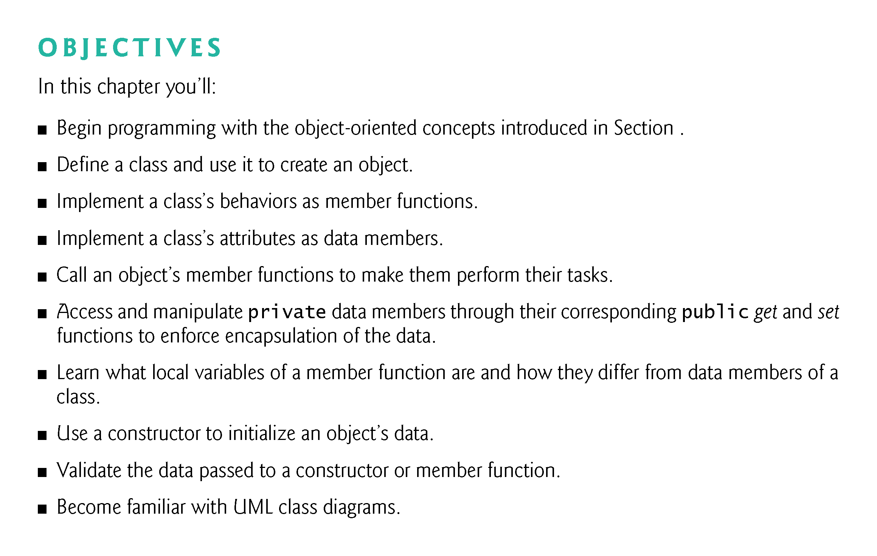

Slide 3
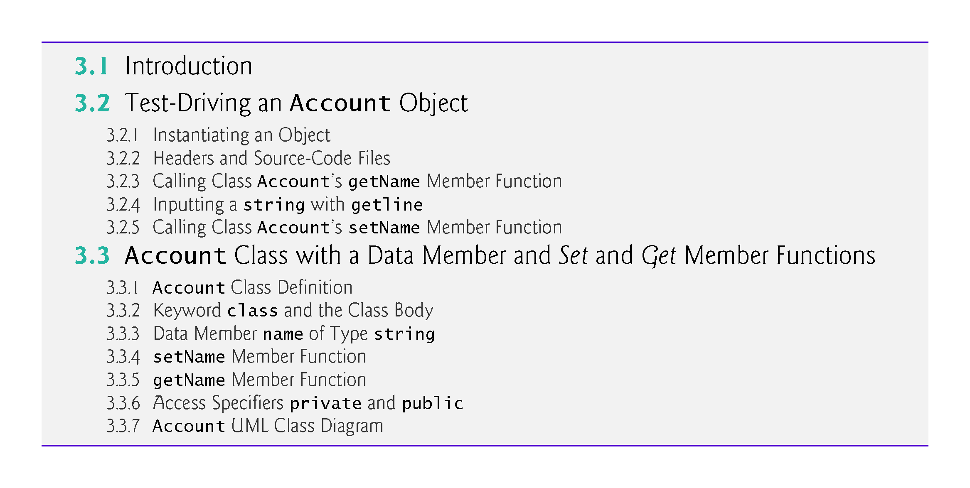

Slide 4
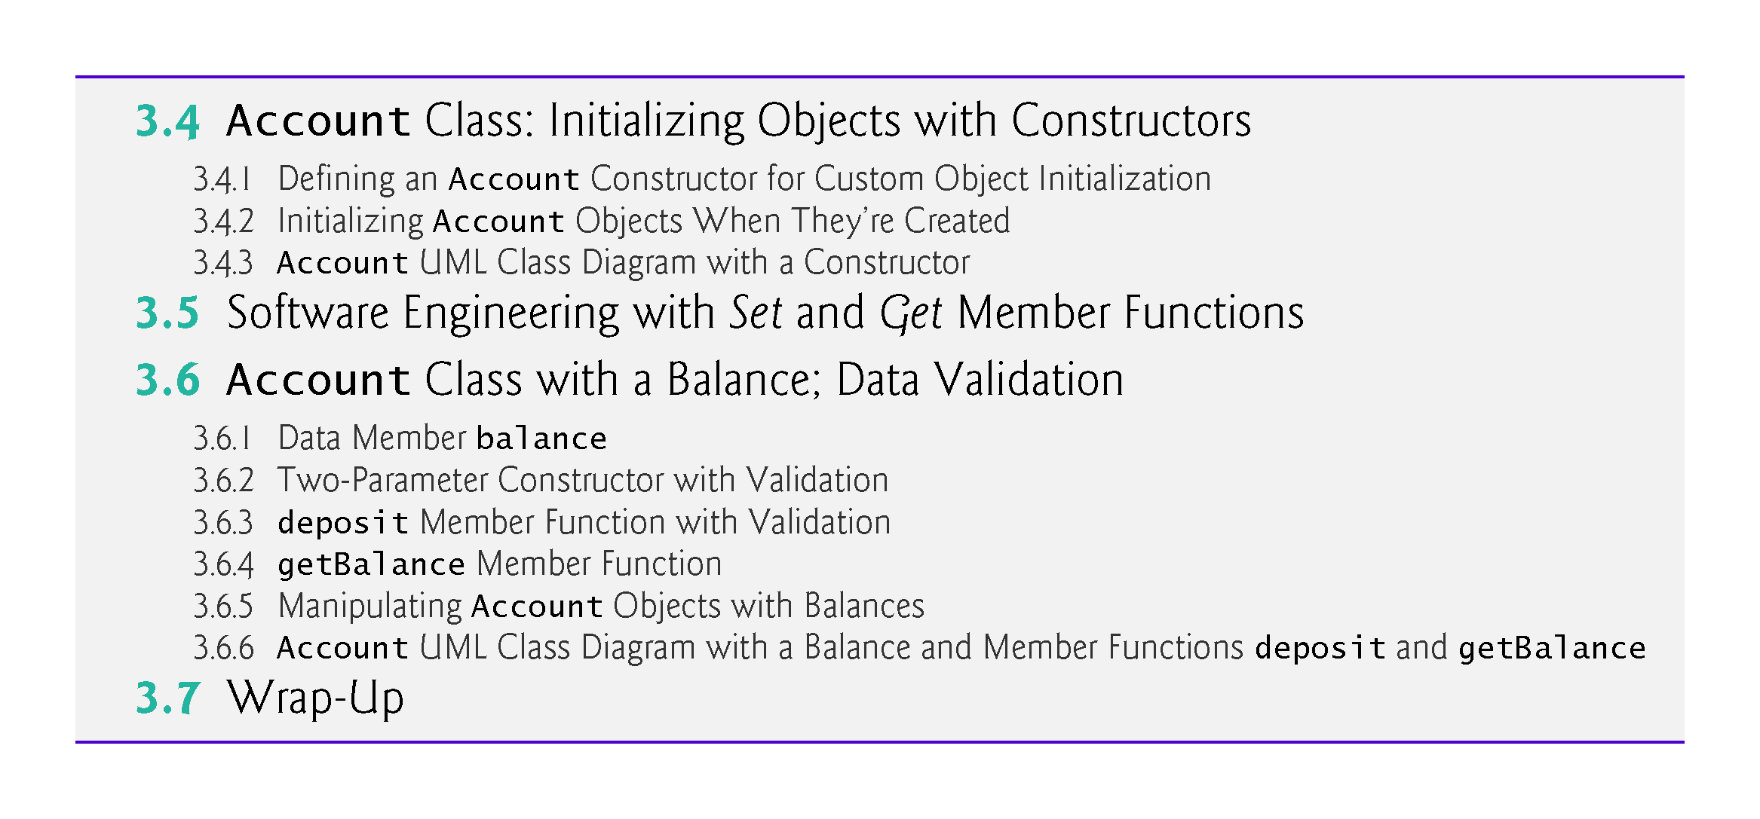

Slide 5
3.1 Introduction
Simple bank-account class.
Maintains as data members the attributes name and balance, and provides member functions for behaviors including
querying the balance (getBalance),
making a deposit that increases the balance (deposit) and
making a withdrawal that decreases the balance (withdraw).
We’ll build the getBalance and deposit member functions into the chapter’s examples.
You’ll add the withdraw member function in Exercise 3.9.

Slide 6
3.1 Introduction (cont.)
Each class you create becomes a new type you can use to create objects, so C++ is an extensible programming language.
If you become part of a development team in industry, you might work on applications that contain hundreds, or even thousands, of custom classes.

Slide 7
3.2 Test-Driving an Account Object
Classes cannot execute by themselves.
A Person object can drive a Car object by telling it what to do (go faster, go slower, turn left, turn right, etc.)—without knowing how the car’s internal mechanisms work.
Similarly, the main function can “drive” an Account object by calling its member functions—without knowing how the class is implemented.
In this sense, main (Fig. 3.1) is referred to as a driver program.

Slide 8
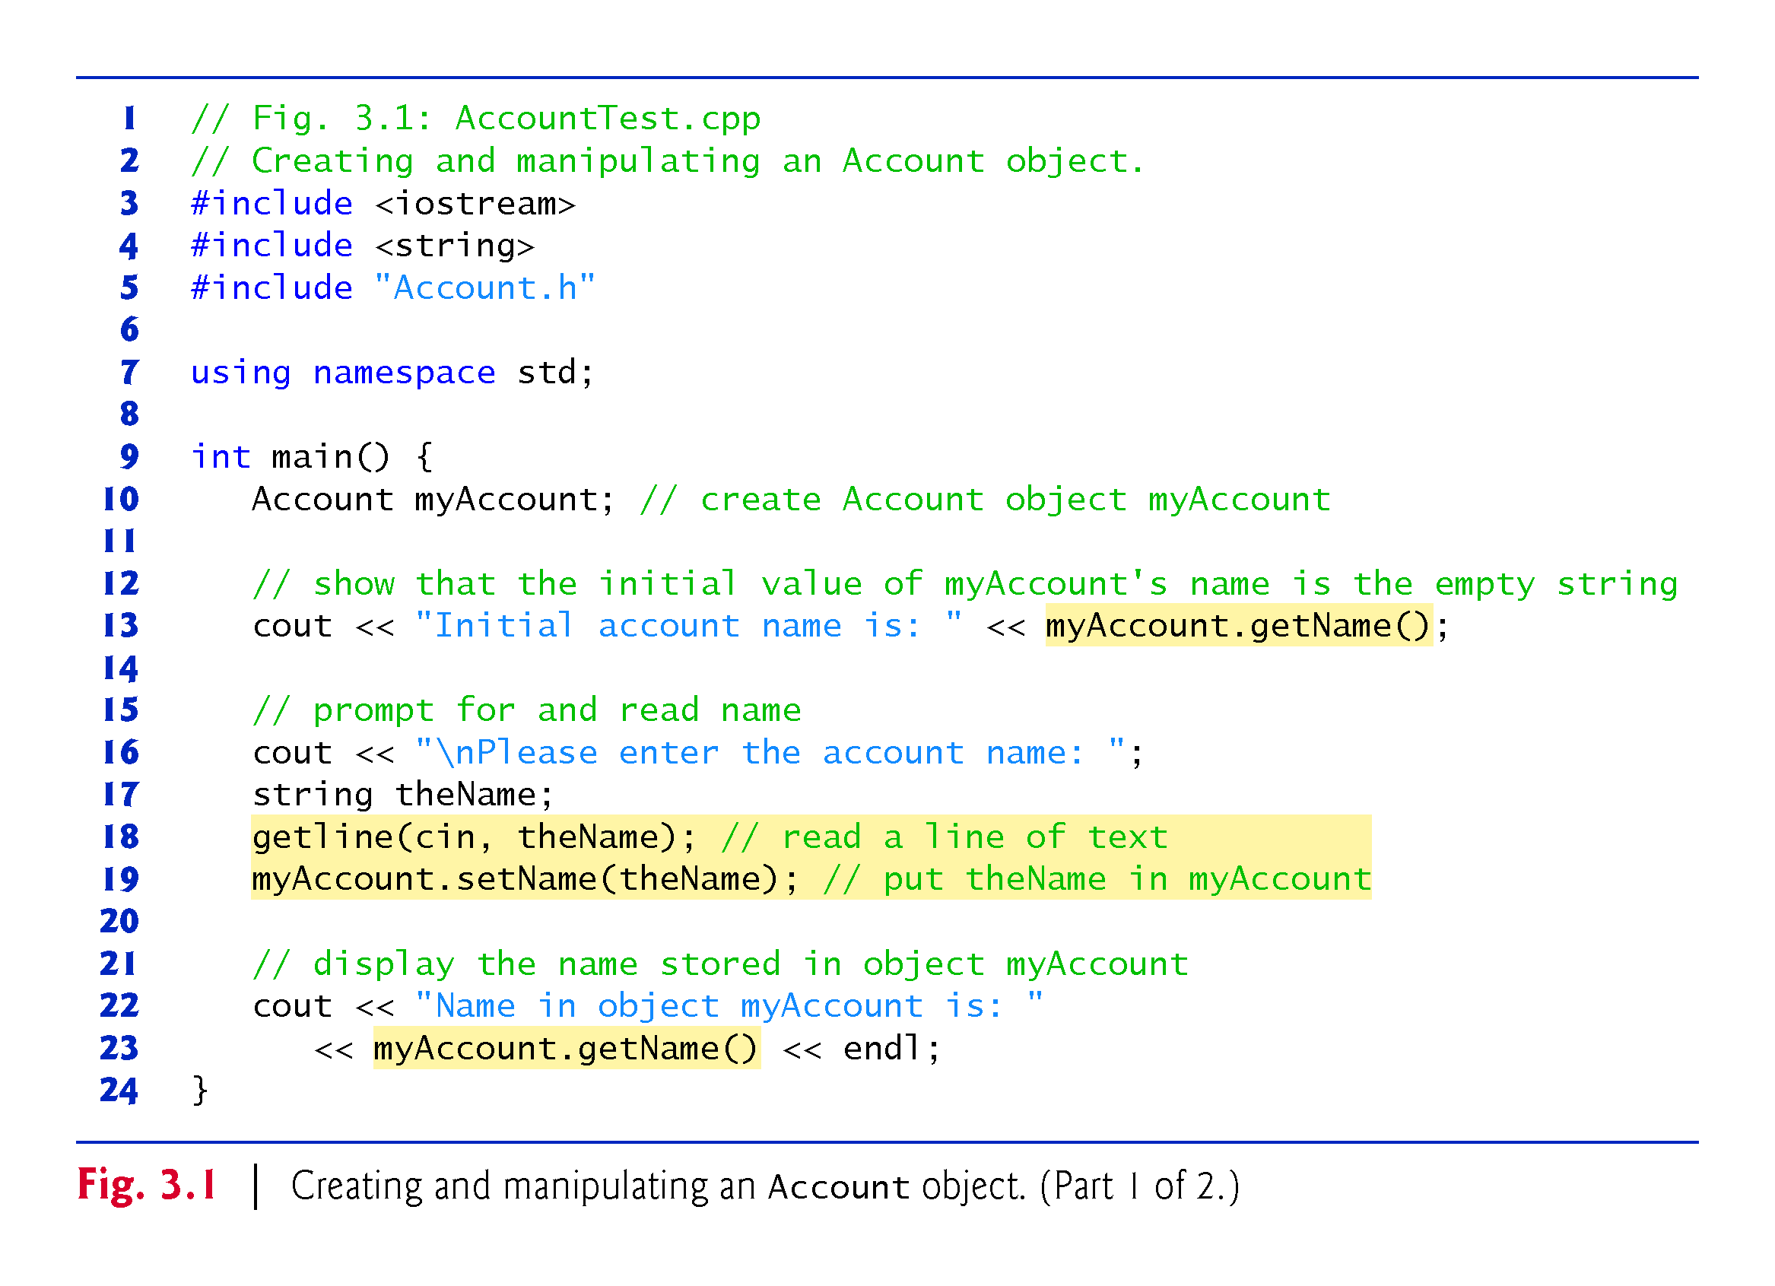
Notes:
Ex: Test indeed if the first get name call gives the empty string. If not initialise explicitly

Slide 9
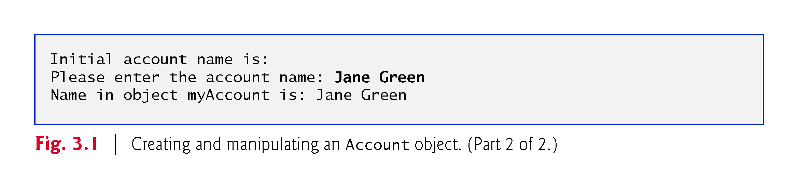

Slide 10
3.2.1 Instantiating an Object
Typically, you cannot call a member function of a class until you create an object of that class.
Line 10
Account myAccount; // create Account object myAccount
creates myAccount object of class Account.
The variable’s type is Account (Fig. 3.2).
Notes:
Obs: We say that a member function binds an object of a class to a member function

Slide 11
3.2.2 Headers and Source-Code Files
The compiler knows what int is—it’s a fundamental type that’s “built into” C++.
The compiler does not know in advance what type Account is—it’s a user-defined type.
When packaged properly, new classes can be reused by other programmers.
It’s customary to place a reusable class definition in a file known as a header with a .h filename extension.
You include (via #include) that header wherever you need to use the class.
For example, you can reuse the C++ Standard Library’s classes in any program by including the appropriate headers.
Notes:
Obs: Give an example of the last bullet point

Slide 12
3.2.2 Headers and Source-Code Files (cont.)
Class Account is defined in the header Account.h (Fig. 3.2).
We tell the compiler what an Account is by including its header, as in:
#include "Account.h"
If we omit this, the compiler issues error messages wherever we use class Account and any of its capabilities.
In an #include directive, a header that you define in your program is placed in double quotes (""), rather than the angle brackets (<>) used for C++ Standard Library headers like <iostream>.
The double quotes in this example tell the compiler that header is in the same folder as Fig. 3.1, rather than with the C++ Standard Library headers.
Notes:
Ob: How would you tell the complier that your header files are one directory higher in the file system?

Slide 13
3.2.2 Headers and Source-Code Files (cont.)
Files ending with the .cpp filename extension are source-code files.
These define a program’s main function, other functions and more, as you’ll see in later chapters.
You include headers into source-code files, though you also may include them in other headers.

Slide 14
3.2.3 Calling Class Account’s getName Member Function
The Account class’s getName member function returns the account name stored in a particular Account object.
Can get myAccount’s name by calling the object’s getName member function with the expression myAccount.getName().
To call this member function for a specific object, you specify the object’s name (myAccount), followed by the dot operator (.), then the member function name (getName) and a set of parentheses.
The empty parentheses indicate that getName does not require any additional information to perform its task.
Notes:
Ex: What would happen if you tried to access a class attribute directly from your main program?

Slide 15
3.2.3 Calling Class Account’s getName Member Function (cont.)
From main’s view, when the getName member function is called:
The program transfers execution from the call to member function getName.
Because getName was called via the myAccount object, getName “knows” which object’s data to manipulate.
Next, member function getName performs its task—that is, it returns (i.e., gives back) myAccount’s name to where the function was called.
The main function does not know the details of how getName performs its task.
The cout object displays the name returned by member function getName, then the program continues executing with the next statement.
Notes:
Ob: Objects are also uniquely identifiable through the this pointer – we will discuss later

Slide 16
3.2.4 Inputting a string with getline
string variables can hold character string values such as "Jane Green".
A string is actually an object of the C++ Standard Library class string, which is defined in the header <string>.
The class name string, like the name cout, belongs to namespace std.

Slide 17
3.2.4 Inputting a string with getline (cont.)
Sometimes functions are not members of a class.
Such functions are called global functions.
Standard Library global function getline reads a line of text.
Like class string, function getline requires the <string> header and belongs to namespace std.
Notes:
Ex: Why the function getline requires the <string> header?

Slide 18
3.2.4 Inputting a string with getline (cont.)
Consider why we cannot simply obtain a full name with
cin >> theName;
We entered the name “Jane Green,” which contains multiple words separated by a space.
When reading a string, cin stops at the first white-space character (such as a space, tab or newline).
The preceding statement would read only "Jane".
The information after "Jane" is not lost—it can be read by subsequent input statements later in the program.
Notes:
Ex: How would you read “Green” through the cin function?

Slide 19
3.2.4 Inputting a string with getline (cont.)
When you press Enter (or Return) after typing data, the system inserts a newline in the input stream.
Function getline reads from the standard input stream object cin the characters the user enters, up to, but not including, the newline, which is discarded
getline places the characters in its second argument.

Slide 20
3.2.5 Calling Class Account’s setName Member Function
Line 19
myAccount.setName(theName); // put theName in myAccount
calls myAccounts’s setName member function.
A member-function call can supply arguments that help the function perform its task.
You place the arguments in the function call’s parentheses.
Here, theName’s value is the argument that’s passed to setName, which stores theName’s value in the object myAccount.
Notes:
Ob: Call by value for theName as compared to call by reference

Slide 21
3.2.5 Calling Class Account’s setName Member Function (cont.)
From main’s view, when setName is called:
The program transfers execution from the call in main to the setName member function’s definition.
The call passes to the function the argument value in the call’s parentheses—that is, theName object’s value.
Because setName was called via the myAccount object, setName “knows” the exact object to manipulate.
Next, member function setName stores the argument’s value in the myAccount object.
When setName completes execution, program execution returns to where setName was called, then continues with the next statement.

Slide 22
3.3 Account Class with a Data Member and Set and Get Member Functions
This section presents class Account’s details and a UML diagram that summarizes class Account’s attributes and operations in a concise graphical representation.

Slide 23
3.3.1 Account Class Definition
Class Account (Fig. 3.2) contains a name data member that stores the account holder’s name.
A class’s data members maintain data for each object of the class.
Class Account also contains member function setName that a program can call to store a name in an Account object, and member function getName that a program can call to obtain a name from an Account object.

Slide 24
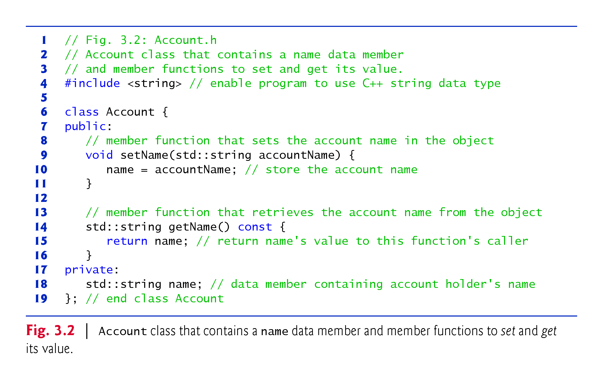

Slide 25
3.3.2 Keyword class and the Class Body
The class definition begins with
class Account {
Keyword class is followed immediately by the class’s name.
Every class’s body is enclosed in an opening left brace and a closing right brace.
The class definition terminates with a required semicolon.
For reusability, place each class definition in a separate header with the .h filename extension.

Slide 26


Slide 27
3.3.2 Keyword class and the Class Body (cont.)
Identifiers and Camel-Case Naming
Class names, member-function names and data-member names are all identifiers.
By convention, variable-name identifiers begin with a lowercase letter, and every word in the name after the first word begins with a capital letter—e.g., firstNumber starts its second word, Number, with a capital N.
This naming convention is known as camel case, because the uppercase letters stand out like a camel’s humps.
Also by convention, class names begin with an initial uppercase letter, and member-function and data-member names begin with an initial lowercase letter.

Slide 28
3.3.3 Data Member name of Type string
An object has attributes, implemented as data members—the object carries these with it throughout its lifetime.
Each object has its own copy of the class’s data members.
Normally, a class also contains one or more member functions that manipulate the data members belonging to particular objects of the class.

Slide 29
3.3.3 Data Member name of Type string (cont.)
Data members are declared inside a class definition but outside the bodies of the class’s member functions.
The following declares data member name of type string.
std::string name; // data member containing account holder's name
A data member can be manipulated by each of the class’s member functions.
The default value for a string is the empty string (i.e., "").

Slide 30
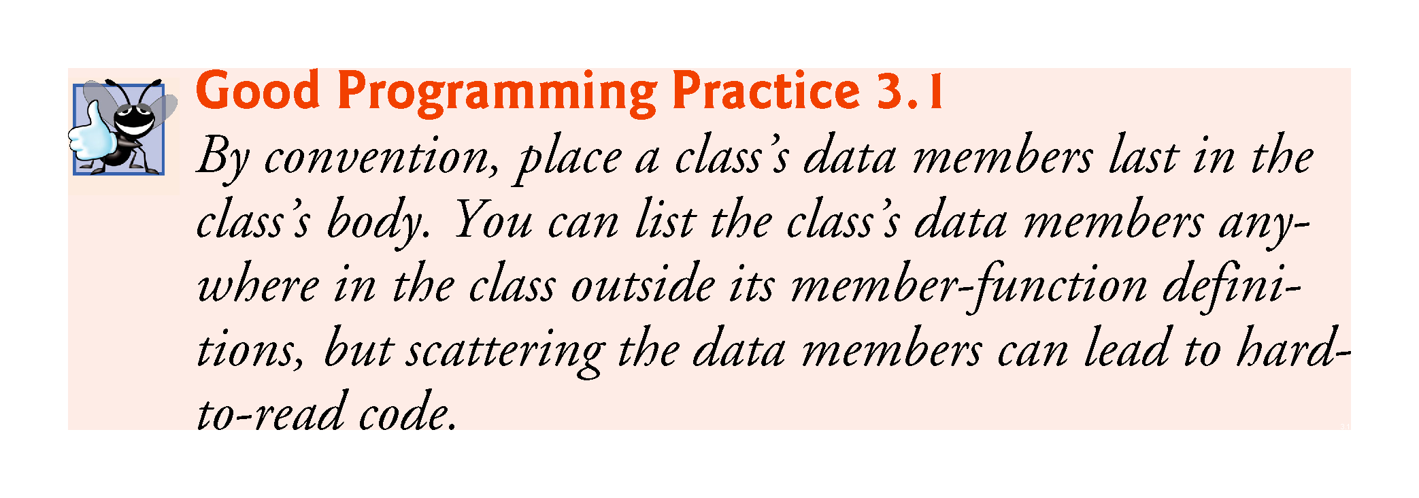

Slide 31
3.3.3 Data Member name of Type string (cont.)
Throughout the Account.h header (Fig. 3.2), we use std:: when referring to string (lines 9, 14 and 18).
For subtle reasons that we explain in Section 23.4, headers should not contain using directives or using declarations.

Slide 32
3.3.4 setName Member Function
The first line of each function definition is the function header.
The member function’s return type (which appears to the left of the function’s name) specifies the type of data the member function returns to its caller after performing its task.
The return type void indicates that a function does not return (i.e., give back) any information to its calling function.

Slide 33
3.3.4 setName Member Function (cont.)
Car analogy mentioned that pressing a car’s gas pedal sends a message to the car to perform a task—make the car go faster.
How fast should the car accelerate?
The farther down you press the pedal, the faster the car accelerates.
So the message to the car includes both the task to perform and information that helps the car perform that task.
This information is known as a parameter—the parameter’s value helps the car determine how fast to accelerate.
A member function can require one or more parameters that represent the data it needs to perform its task.
When the following statement executes, the argument value in the call’s parentheses (i.e., the value stored in theName) is copied into the corresponding parameter (accountName) in the member function’s header
myAccount.setName(theName); // put theName in myAccount

Slide 34
3.3.4 setName Member Function (cont.)
Parameters are declared in a parameter list located in the required parentheses following the member function’s name.
Each parameter must specify a type followed by a parameter name.
Parameters are separated by a comma, as in
(type1 name1, type2 name2, …)
The number/order of arguments in a function call must match the number/order of parameters in the function definition’s parameter list.
Notes:
GPP: Always make sure that the order you pass arguments in a called function is the intended one – easy to confuse with long parameter lists containing a single data type for example

Slide 35
3.3.4 setName Member Function (cont.)
Every member function body is delimited by an opening left brace and a closing right brace.
Within the braces are one or more statements that perform the member function’s task(s).
When program execution reaches the member function’s closing brace, the function returns to its caller.

Slide 36
3.3.4 setName Member Function (cont.)
Variables declared in a particular function’s body are local variables which can be used only in that function.
When a function terminates, the values of its local variables are lost.
A function’s parameters also are local variables of that function.

Slide 37
3.3.5 getName Member Function
When a member function with a return type other than void is called and completes its task, it must return a result to its caller.
The return statement passes a value back to the caller, which then can use the returned value.
We declared member function getName as const (after the parameter list) because the function does not, and should not, modify the Account object on which it’s called
std::string getName() const {
Notes:
Obs: What does the return statement do in terms of computer architectures?

Slide 38
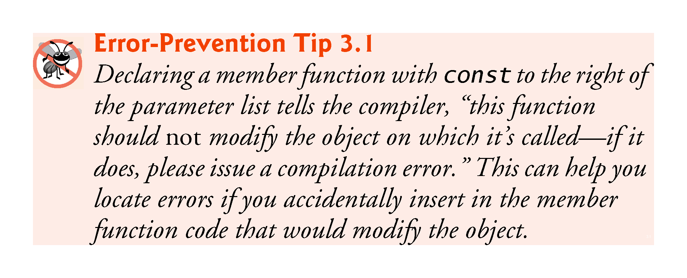

Slide 39
3.3.6 Access Specifiers private and public
private is an access specifier.
Access specifiers are always followed by a colon (:).
Data member name’s declaration (line 18) appears after access specifier private: to indicate that name is accessible only to class Account’s member functions.
This is known as data hiding—the data member name is encapsulated (hidden) and can be used only in class Account’s setName and getName member functions.
Most data-member declarations appear after the private: access specifier.
Data members or member functions listed after the public access specifier (and before the next access specifier if there is one) are “available to the public.”
They can be used by other functions in the program, and by member functions of other classes.

Slide 40
3.3.6 Access Specifiers private and public (cont.)
By default, everything in a class is private, unless you specify otherwise.
Once you list an access specifier, everything from that point has that access until you list another access specifier.
The access specifiers public and private may be repeated, but this is unnecessary and can be confusing.

Slide 41
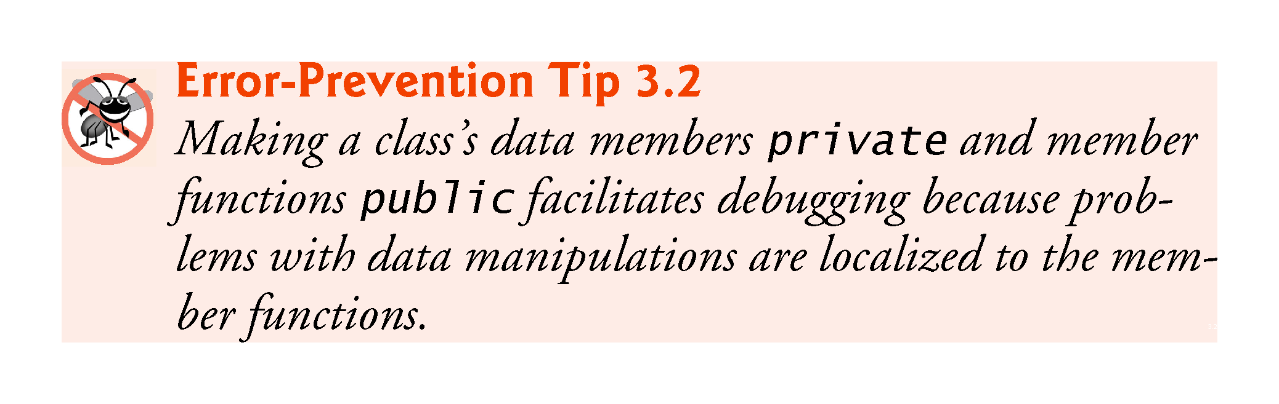

Slide 42
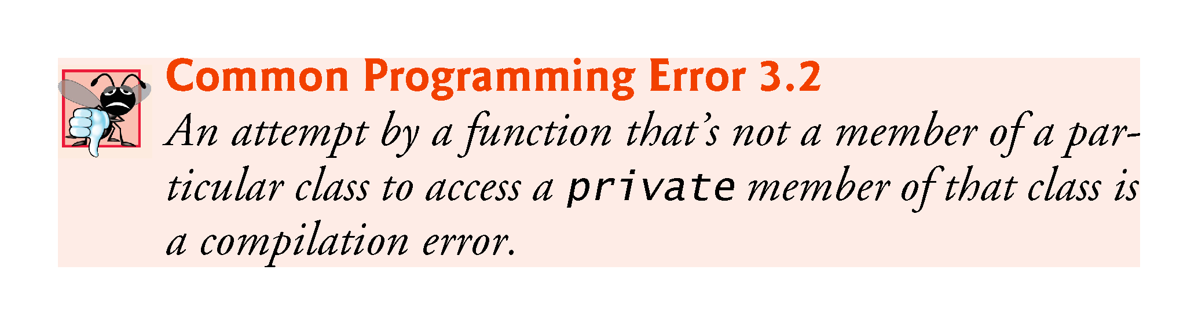

Slide 43
3.3.7 Account UML Class Diagram
UML class diagrams summarize a class’s attributes and operations.
In industry, UML diagrams help systems designers specify systems in a concise, graphical, programming-language-independent manner, before programmers implement the systems in specific programming languages.
Figure 3.3 presents a UML class diagram for class Account.

Slide 44
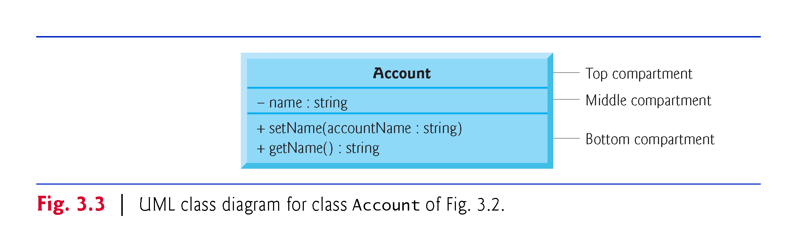

Slide 45
3.3.7 Account UML Class Diagram (cont.)
In the UML, each class is modeled in a class diagram as a rectangle with three compartments.
The top compartment contains the class name centered horizontally in boldface type
The middle compartment contains the class’s attributes, which correspond to the data members of the same name in C++.
The UML class diagram lists a minus sign (–) access modifier before the attribute name for private attributes (or other private members).
Following the attribute name are a colon and the attribute type.

Slide 46
3.3.7 Account UML Class Diagram (cont.)
The bottom compartment contains the class’s operations, which correspond to the member functions of the same names in C++.
The UML models operations by listing the operation name preceded by an access modifier.
A plus sign (+) indicates public in the UML.
The UML indicates the return type of an operation by placing a colon and the return type after the parentheses following the operation name.

Slide 47
3.3.7 Account UML Class Diagram (cont.)
The UML models a parameter by listing the parameter name, followed by a colon and the parameter type in the parentheses after the operation name.
The UML has its own data types similar to those of C++—for simplicity, we use the C++ types.

Slide 48
3.4 Account Class: Initializing Objects with Constructors
Each class can define a constructor that specifies custom initialization for objects of that class.
Special member function that must have the same name as the class.
C++ requires a constructor call when each object is created—ideal point to initialize an object’s data members.
A constructor can have parameters—the corresponding argument values help initialize the object’s data members.

Slide 49
3.4.1 Defining an Account Constructor for Custom Object Initialization
Figure 3.4 shows class Account with a constructor that receives an accountName parameter and uses it to initialize data member name when an Account object is created.
Account’s constructor definition
explicit Account(std::string accountName) : name{accountName} { // member initializer // empty body }
Normally, constructors are public.
A constructor’s parameter list specifies pieces of data required to initialize an object.

Slide 50
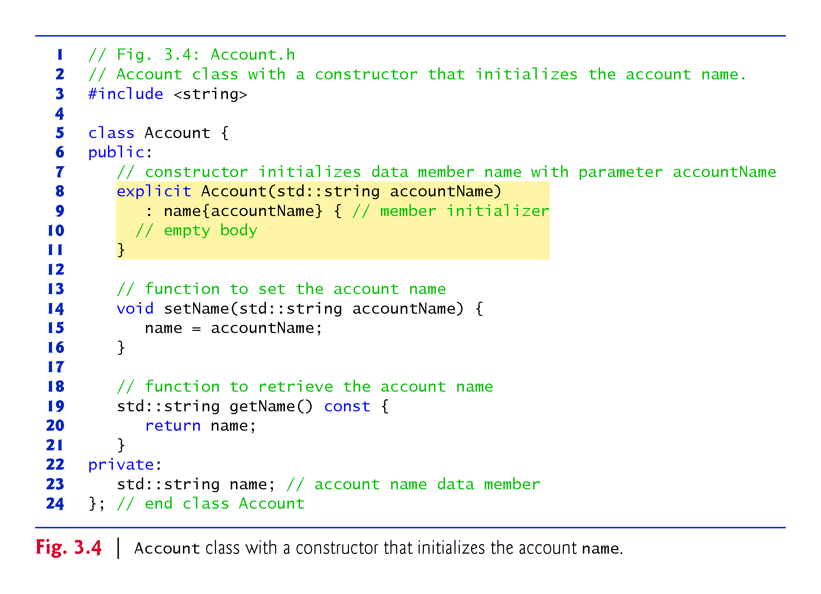

Slide 51
3.4.1 Defining an Account Constructor for Custom Object Initialization (cont.)
A member-initializer list initializes data members (typically with argument values):
: name{accountName}
Member initializers appear between a constructor’s parameter list and the left brace that begins the constructor’s body.
Separated from the parameter list with a colon (:).
Each member initializer consists of a data member’s variable name followed by parentheses containing the member’s initial value.
If a class contains more than one data member, each member initializer is separated from the next by a comma.
The member initializer list executes before the constructor’s body executes.

Slide 52


Slide 53
3.4.1 Defining an Account Constructor for Custom Object Initialization (cont.)
We declared this constructor explicit, because it takes a single parameter—important for subtle reasons that you’ll learn in later chapters.
For now, declare all single-parameter constructors explicit.
Constructors cannot specify return types
not even void.
Constructors cannot be declared const
Initializing an object modifies it.

Slide 54
3.4.1 Defining an Account Constructor for Custom Object Initialization (cont.)
Fig. 3.4: Constructor and setName both have a parameter called accountName.
Though their identifiers are identical, the parameter in line 8 is a local variable of the constructor that’s not visible to member function setName.
Similarly, the parameter in line 14 is a local variable of setName that’s not visible to the constructor.
Such visibility is called scope.
Notes:
Ob: Can use the same variable names in parameter lists of different function definitions

Slide 55
3.4.2 Initializing Account Objects When They’re Created
When you create an object, C++ implicitly calls the class’s constructor to initialize that object.
If the constructor has parameters, you place the corresponding arguments in braces, { and }, to the right of the object’s variable name.
Lines 15–16 use each object’s getName member function to obtain the names and show that they were initialized when the objects were created.
The output shows different names, confirming that each Account maintains its own name.

Slide 56
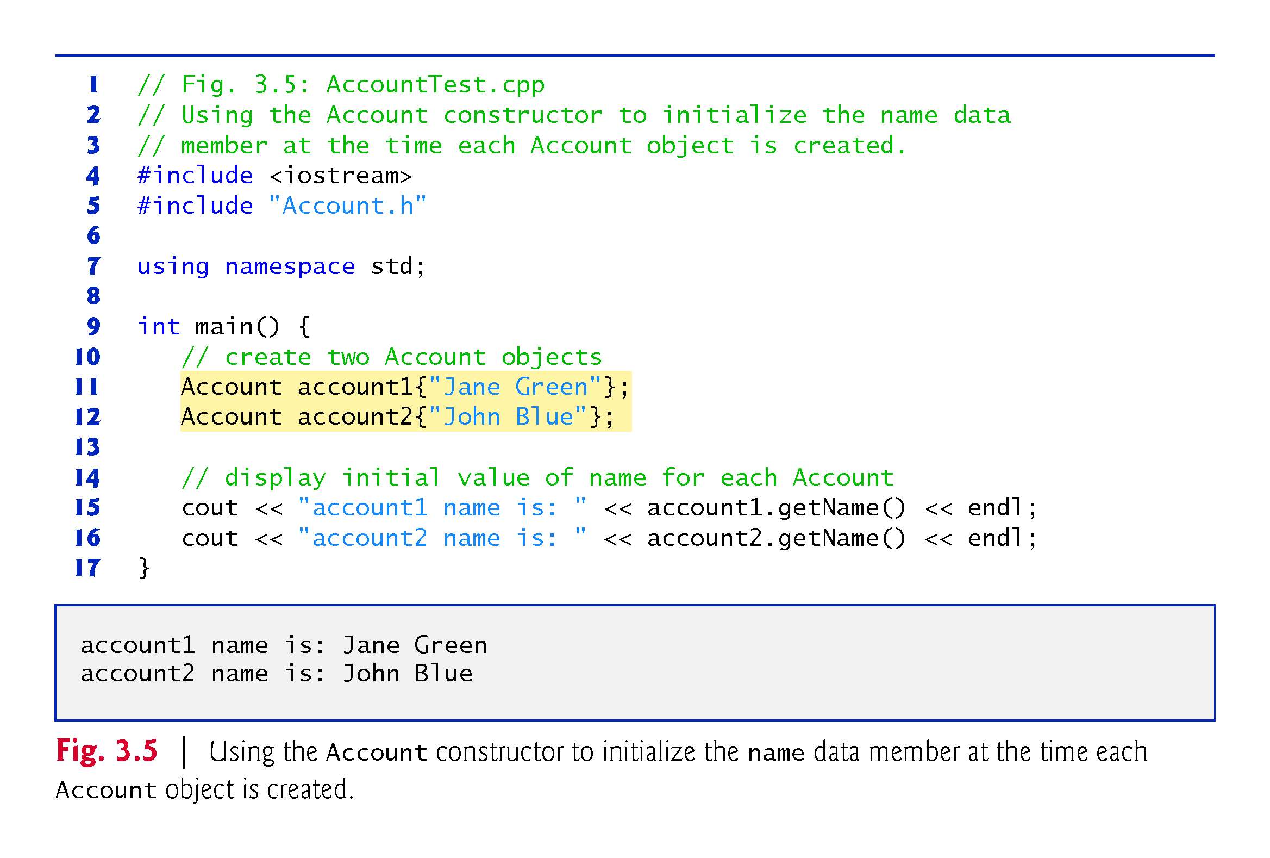

Slide 57
3.4.2 Initializing Account Objects When They’re Created (cont.)
Recall that line 10 of Fig. 3.1
Account myAccount;
creates an Account object without placing braces to the right of the object’s variable name.
In this case, C++ implicitly calls the class’s default constructor.
In any class that does not explicitly define a constructor, the compiler provides a default constructor with no parameters.
The default constructor does not initialize the class’s fundamental-type data members, but does call the default constructor for each data member that’s an object of another class.
In the Account class of Fig. 3.2, the class’s default constructor calls class string’s default constructor to initialize the data member name to the empty string.
An uninitialized fundamental-type variable contains an undefined (“garbage”) value.

Slide 58
3.4.2 Initializing Account Objects When They’re Created (cont.)
There’s no default constructor in a class that defines a constructor
If you define a custom constructor for a class, the compiler will not create a default constructor for that class.
We’ll show later that C++11 allows you to force the compiler to create the default constructor even if you’ve defined non-default constructors.

Slide 59
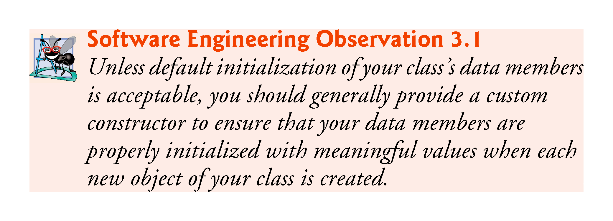

Slide 60
3.4.3 Account UML Class Diagram with a Constructor
The UML class diagram of Fig. 3.6 models class Account of Fig. 3.4, which has a constructor with a string accountName parameter.
Like operations, the UML models constructors in the third compartment of a class diagram.
To distinguish a constructor from the class’s operations, the UML requires that the word “constructor” be enclosed in guillemets (« and ») and placed before the constructor’s name.
It’s customary to list constructors before other operations in the third compartment.

Slide 61
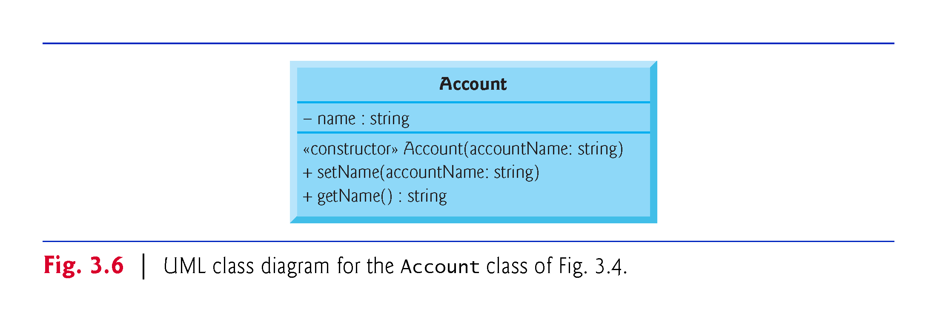

Slide 62
3.5 Software Engineering with Set and Get Member Functions
Set and get member functions can validate attempts to modify private data and control how that data is presented to the caller, respectively—compelling software engineering benefits.
If a data member were public, any client of the class—that is, any other code that calls the class’s member functions—could see the data and do whatever it wanted with it, including setting it to an invalid value.

Slide 63
3.5 Software Engineering with Set and Get Member Functions (cont.)
Set functions can be programmed to validate their arguments and reject any attempts to set the data to bad values, such as
a negative body temperature
a day in March outside the range 1 through 31
a product code not in the company’s product catalog, etc.

Slide 64
3.5 Software Engineering with Set and Get Member Functions (cont.)
A get function can present the data in a different form, while the actual data representation remains hidden from the user.
A Grade class might store a grade data member as an int between 0 and 100, but a getGrade member function might return a letter grade as a string, such as "A" for grades between 90 and 100, "B" for grades between 80 and 89, etc.
Tightly controlling the access to and presentation of private data can greatly reduce errors, while increasing the robustness, security and usability of your programs.

Slide 65
3.5 Software Engineering with Set and Get Member Functions (cont.)
You can think of an Account object as shown in Fig. 3.7.
The private data member name is hidden inside the object (represented by the inner circle containing name) and protected by an outer layer of public member functions (represented by the outer circle containing getName and setName).
Any client code that needs to interact with the Account object can do so only by calling the public member functions of the protective outer layer.

Slide 66
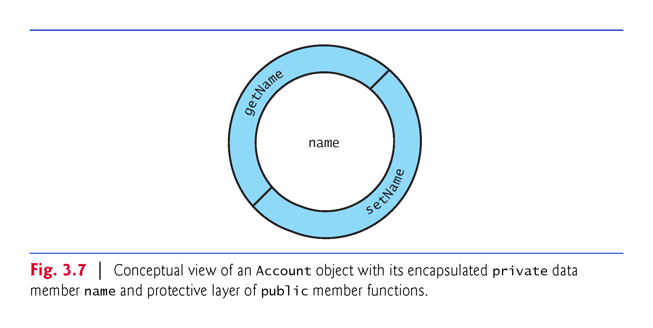
Notes:
Ob: Especially important when you have teams around the world working on the same class code

Slide 67
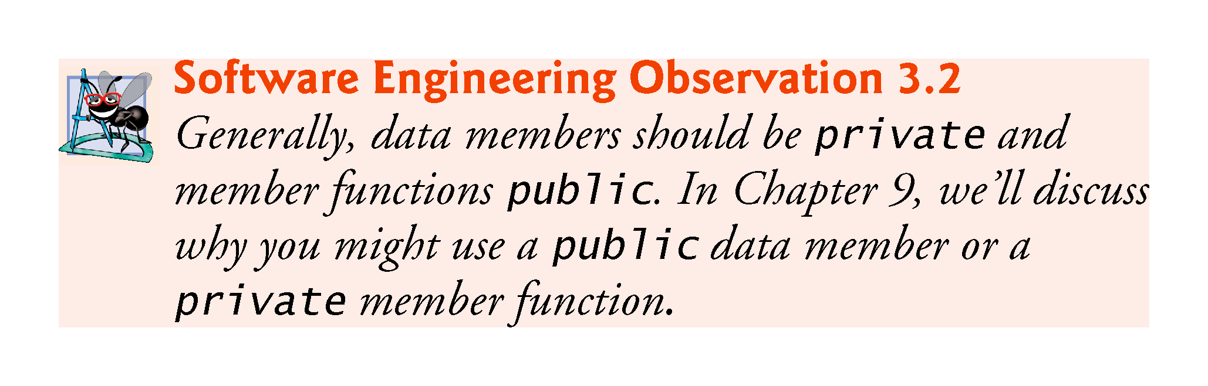

Slide 68
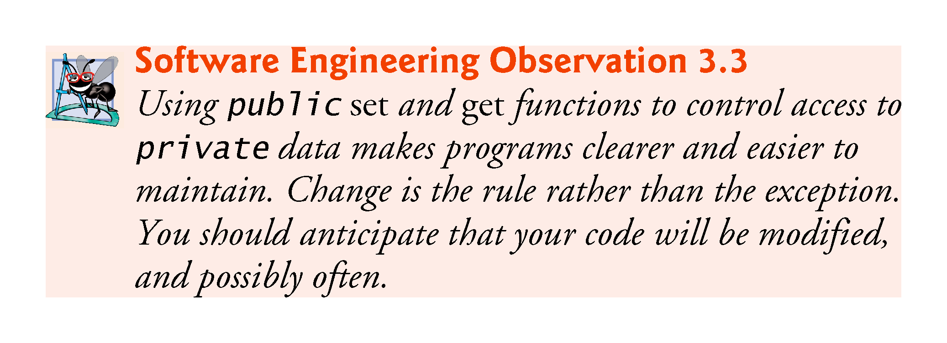
Notes:
Ob: The last 2 sentences are especially true

Slide 69
3.6 Account Class with a Balance; Data Validation
We now define an Account class that maintains a bank account’s balance in addition to the name.
For simplicity, we’ll use data type int to represent the account balance.
In Chapter 4, you’ll see how to represent numbers with decimal points.

Slide 70
3.6.1 Data Member balance
A typical bank services many accounts, each with its own balance.
In this updated Account class (Fig. 3.8), line 42 declares a data member balance of type int and initializes its value to 0
int balance{0}; // data member with default initial value
This is known as an in-class initializer and was introduced in C++11.
Notes:
Ob: Again potential mismatch with lab version of C++

Slide 71
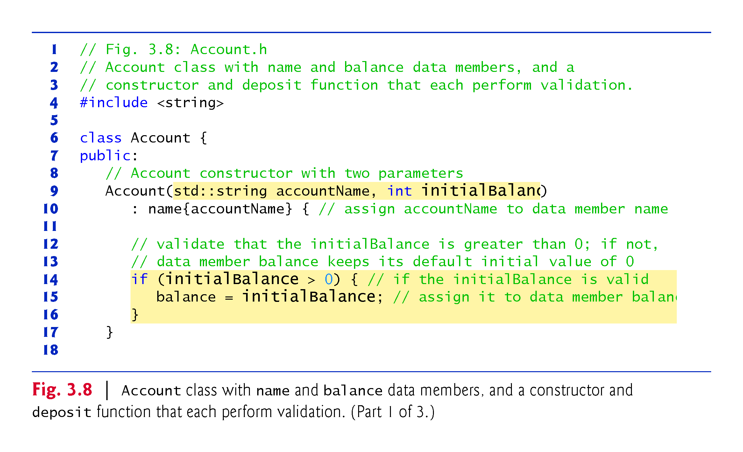

Slide 72
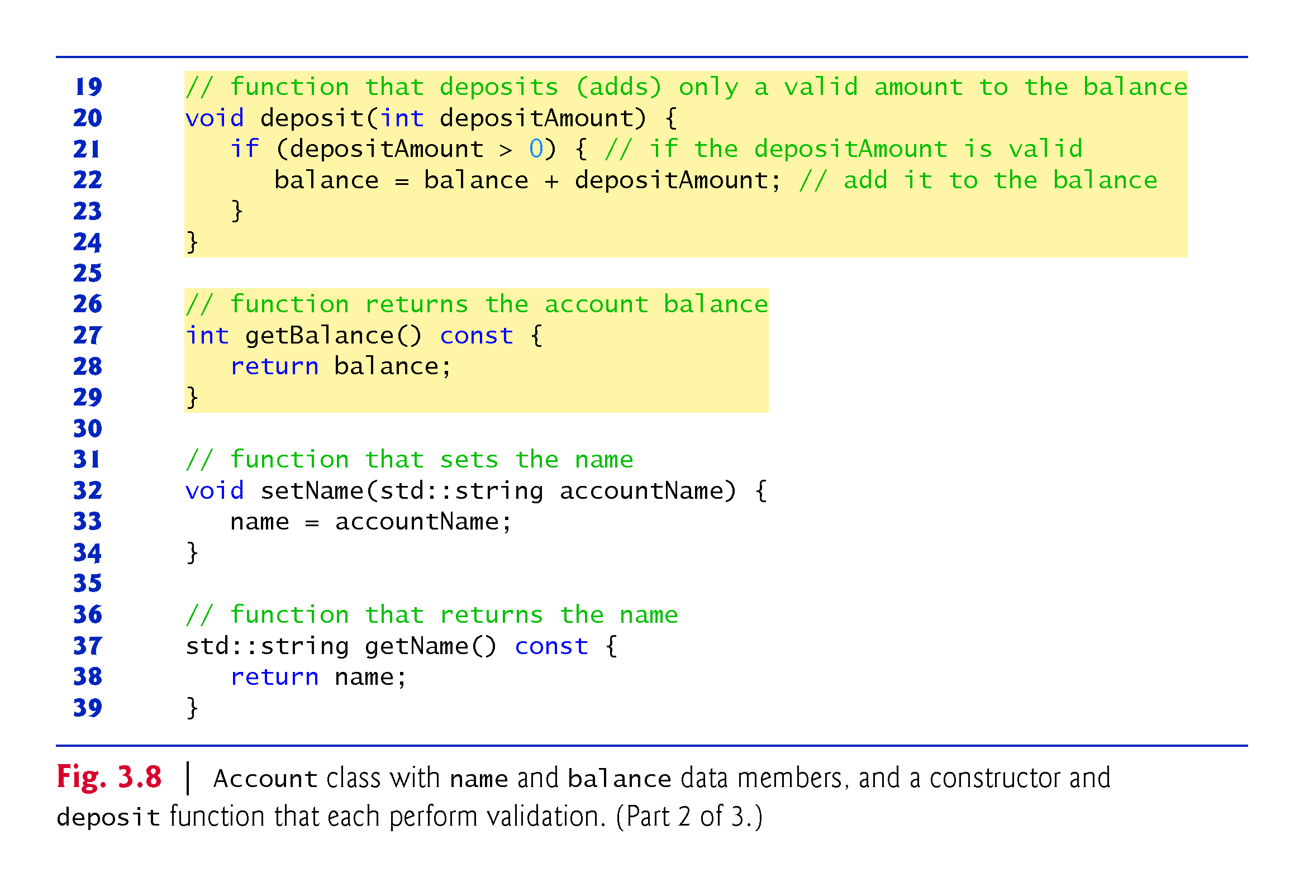
Notes:
Ob: Note that getBalance and getName functions can not modify attributes of the calling object

Slide 73
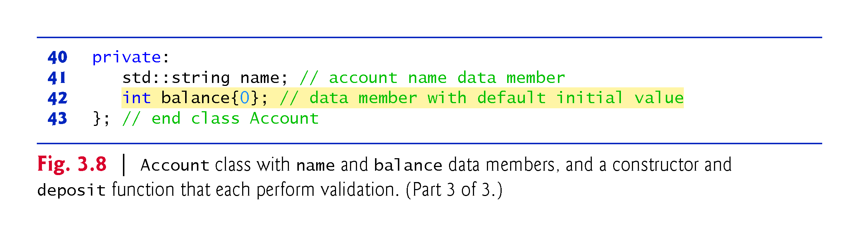
Notes:
Ob: Many not be able to do assignment statements on private attributes. If this is the case, you do assignments inside constructors

Slide 74
3.6.1 Data Member balance (cont.)
The statements in lines 15, 22 and 28 use the variable balance even though it was not declared in any of the member functions.
We can use balance in these member functions because it’s a data member in the same class definition.

Slide 75
3.6.2 Two-Parameter Constructor with Validation
It’s common for someone opening an account to deposit money immediately, so the constructor (lines 9–17) now receives a second parameter—initialBalance of type int that represents the starting balance.
We did not declare this constructor explicit (as in Fig. 3.4), because this constructor has more than one parameter.

Slide 76
3.6.2 Two-Parameter Constructor with Validation (cont.)
Lines 14–16 of Fig. 3.8 ensure that data member balance is assigned parameter initialBalance’s value only if that value is greater than 0—this is known as validation or validity checking
if (initialBalance > 0) { // if the initialBalance is valid balance = initialBalance; // assign it to data member balance }
Otherwise, balance remains at 0—its default initial value that was set at line 42 in class Account’s definition.

Slide 77
3.6.3 deposit Member Function with Validation
Member function deposit (lines 20–24) does not return any data when it completes its task, so its return type is void.
The member function receives one int parameter named depositAmount.
Lines 21–23 ensure that parameter depositAmount’s value is added to the balance only if the parameter value is valid (i.e., greater than zero)—another example of validity checking.
if (depositAmount > 0) { // if the depositAmount is valid balance = balance + depositAmount; // add it to the balance }
Notes:
Ob: Too many checks in Set, Deposit and constructor functions. Constructors usually check class attributes and items from parameter lists (if they have), other checking functions items from parameter lists

Slide 78
3.6.3 deposit Member Function with Validation (cont.)
Line 22 first adds the current balance and depositAmount, forming a temporary sum which is then assigned to balance, replacing its prior value
It’s important to understand that the calculation balance + depositAmount on the right side of the assignment operator does not modify the balance—that’s why the assignment is necessary.

Slide 79
3.6.4 getBalance Member Function
Member function getBalance (lines 27–29) allows the class’s clients to obtain the value of a particular Account object’s balance.
The member function specifies return type int and an empty parameter list.
getBalance is declared const, because the function does not, and should not, modify the Account object on which it’s called.
Notes:
Comment: Tell the story about hackers removing decimals from deposit accounts

Slide 80
3.6.5 Manipulating Account Objects with Balances
The balance of account2 is initially 0, because the constructor rejected the attempt to start account2 with a negative balance, so the data member balance retains its default initial value.
The six statements at lines 14–15, 16–17, 26–27, 28–29, 37–38 and 39–40 are almost identical.
Each outputs an Account’s name and balance, and differs only in the Account object’s name—account1 or account2.
Duplicate code can create code maintenance problems
For example, if six copies of the same code all have the same error to fix or the same update to be made, you must make that change six times, without making errors.
Exercise 3.13 asks you to include function displayAccount that takes as a parameter an Account object and outputs the object’s name and balance. You’ll then replace main’s duplicated statements with six calls to displayAccount.
Notes:
Ob: Important – much less code to change with a displayAccount function

Slide 81
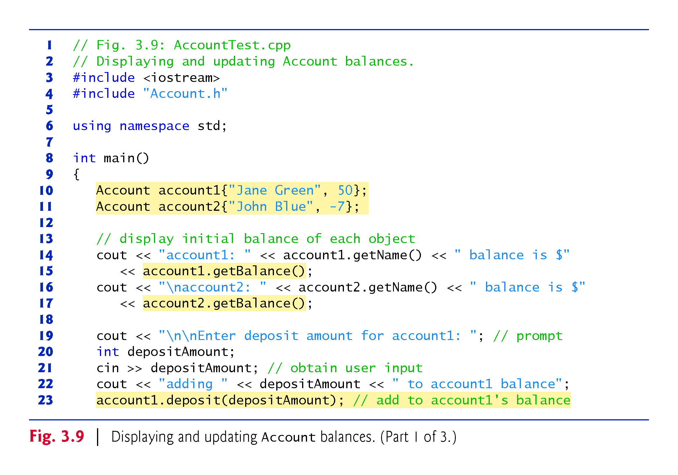

Slide 82
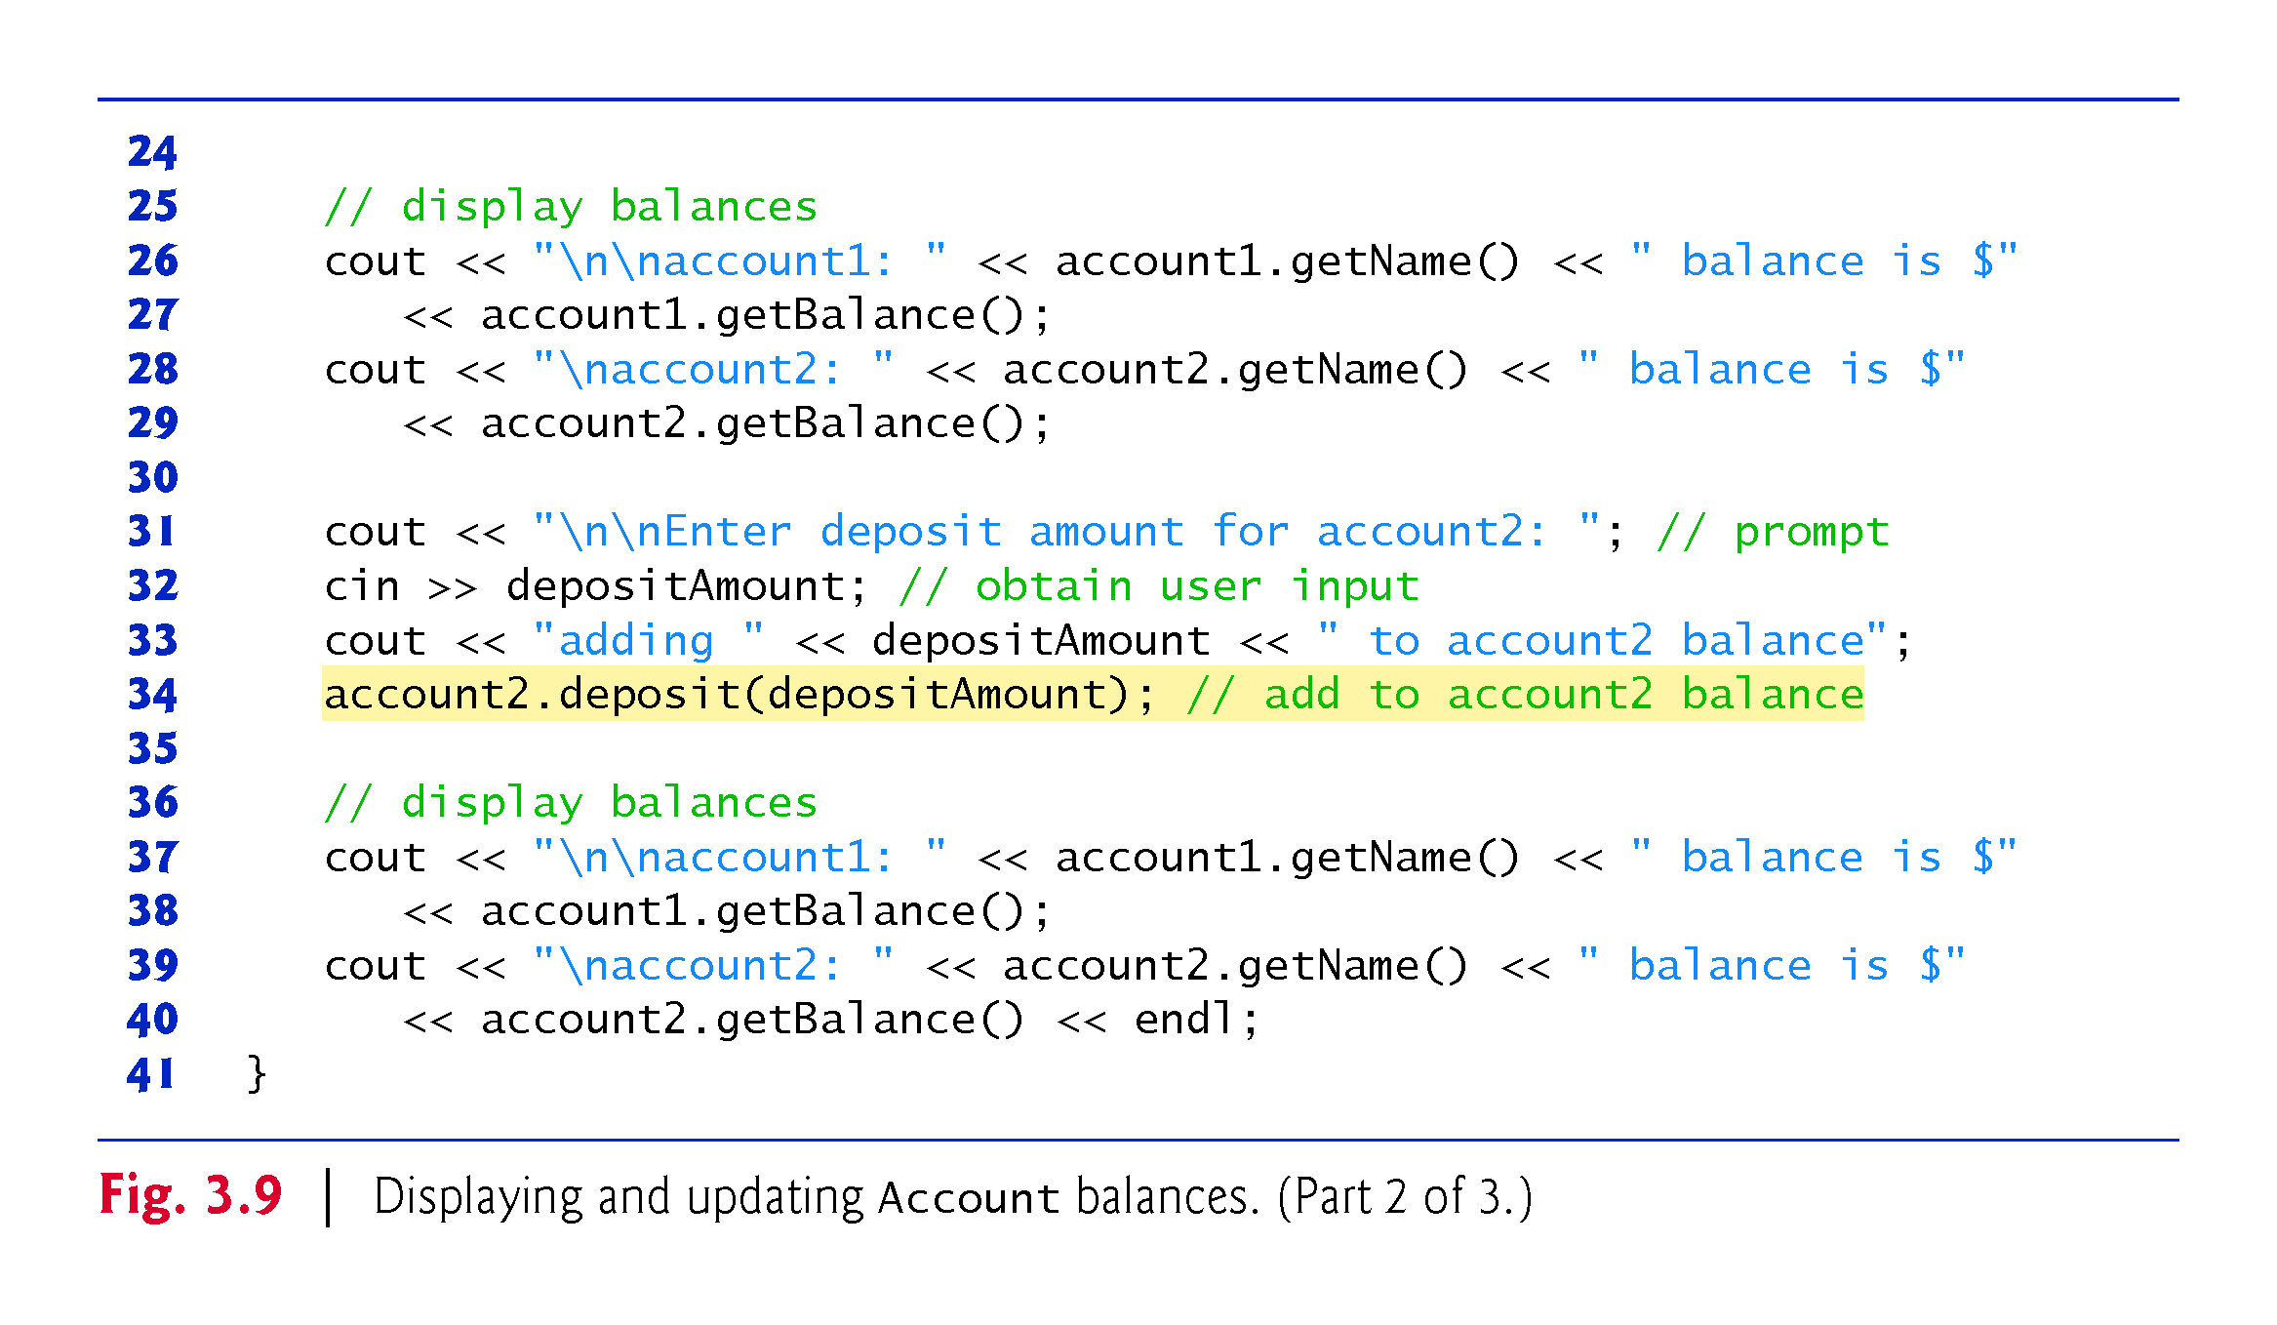

Slide 83
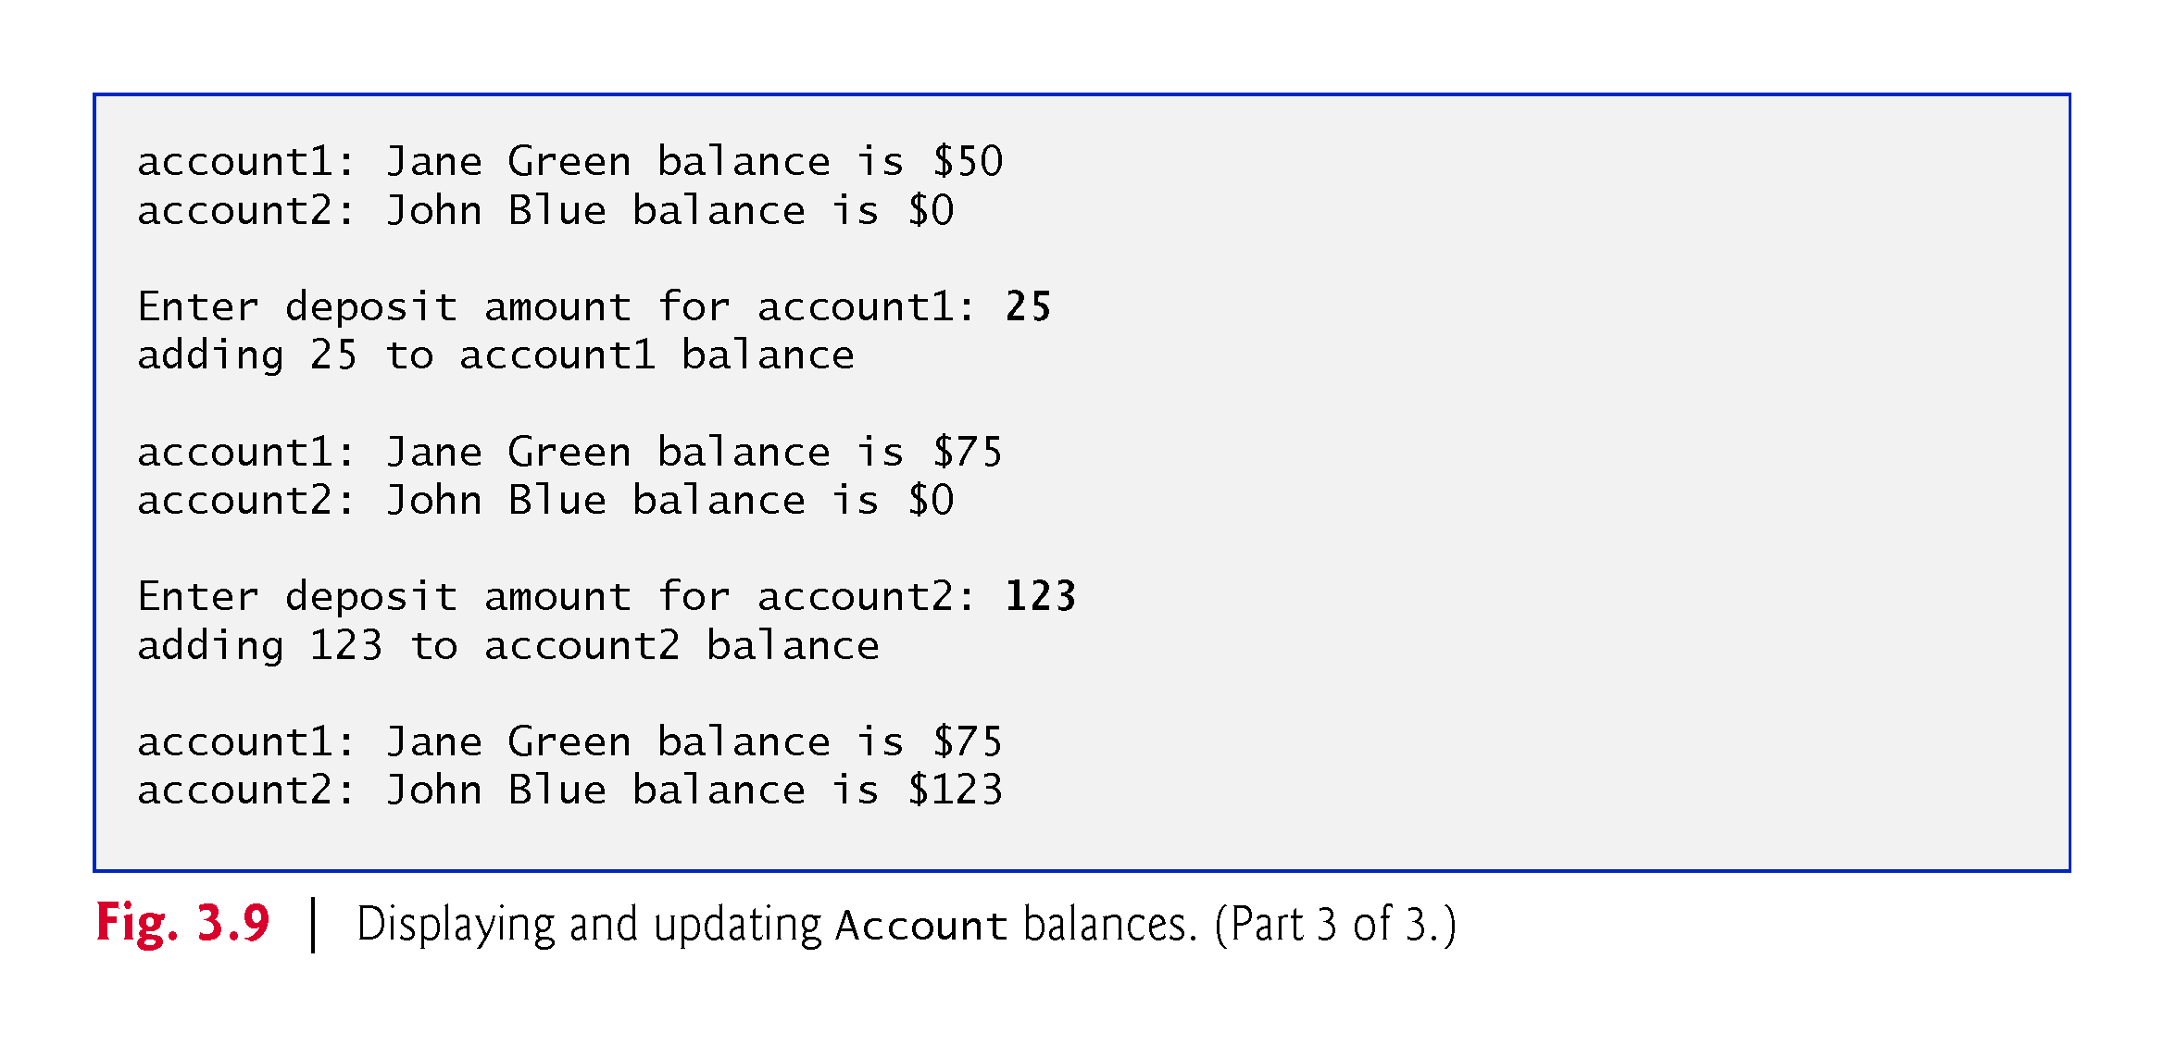

Slide 84
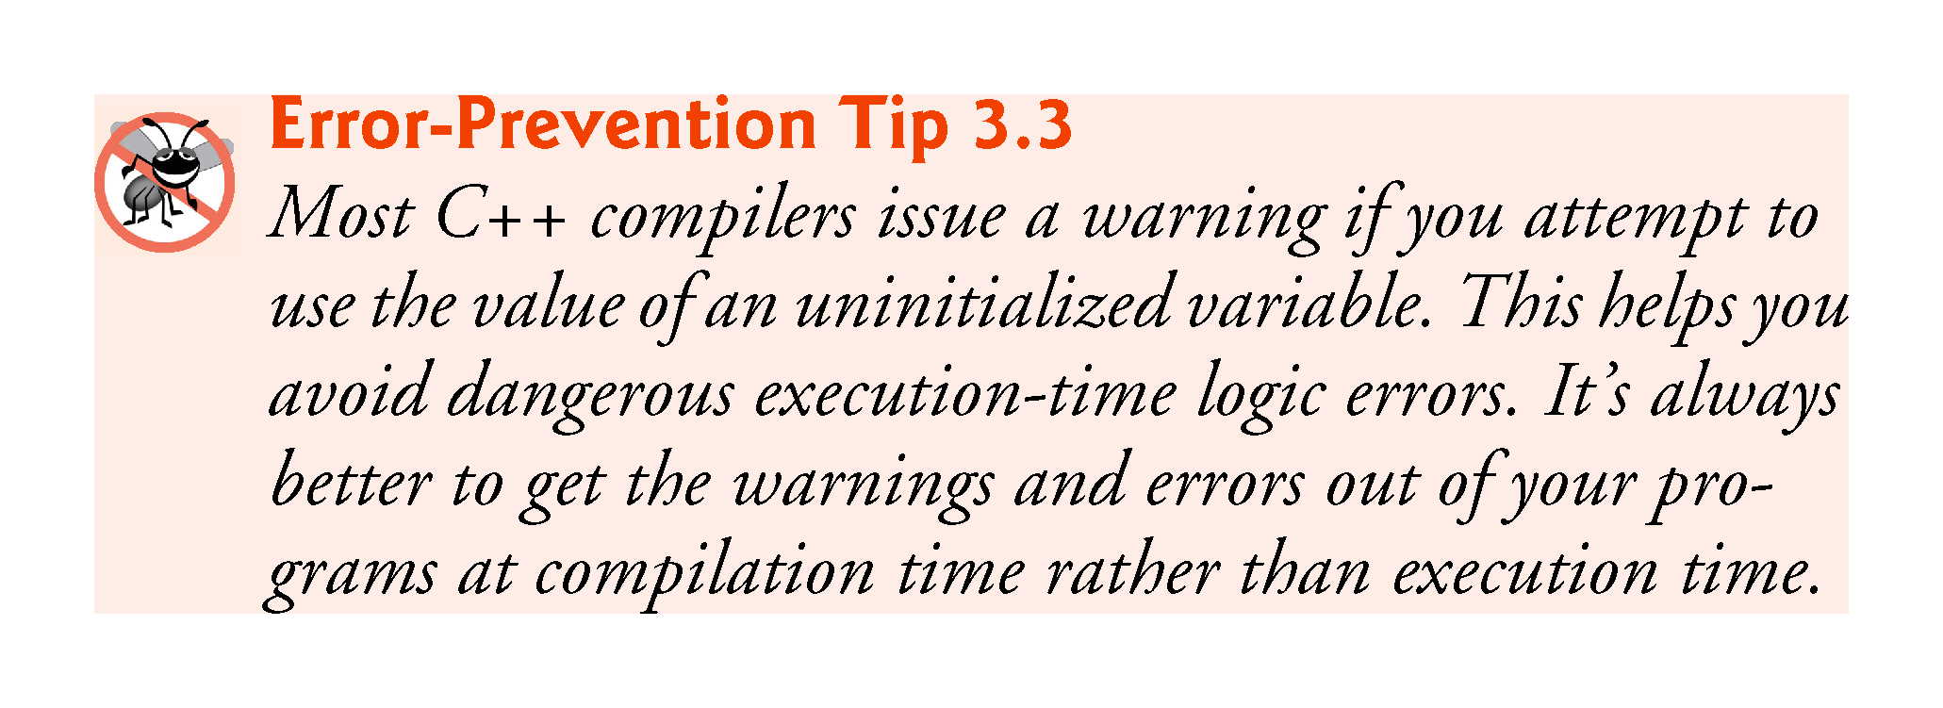

Slide 85


Slide 86
3.6.6 Account UML Class Diagram with a Balance and Member Functions deposit and getBalance
The UML class diagram in Fig. 3.10 concisely models class Account of Fig. 3.8.
Second compartment contains the private attributes
name of type string
balance of type double.
Constructor is modeled in the third compartment
With parameters accountName of type string and initialBalance of type double
The class’s public member functions also are modeled in the third compartment
operation deposit with a depositAmount parameter of type double,
operation getBalance with a return type of double,
operation setName with an accountName parameter of type string
operation getName with a return type of string.
Notes:
Ob: Usually balances and deposits have decimals so are double data types

Slide 87
