Slide 1
Algorithm Development and Control Statements: Part 1
Chapter 4 of C++ How to Program, 10/e

Slide 2
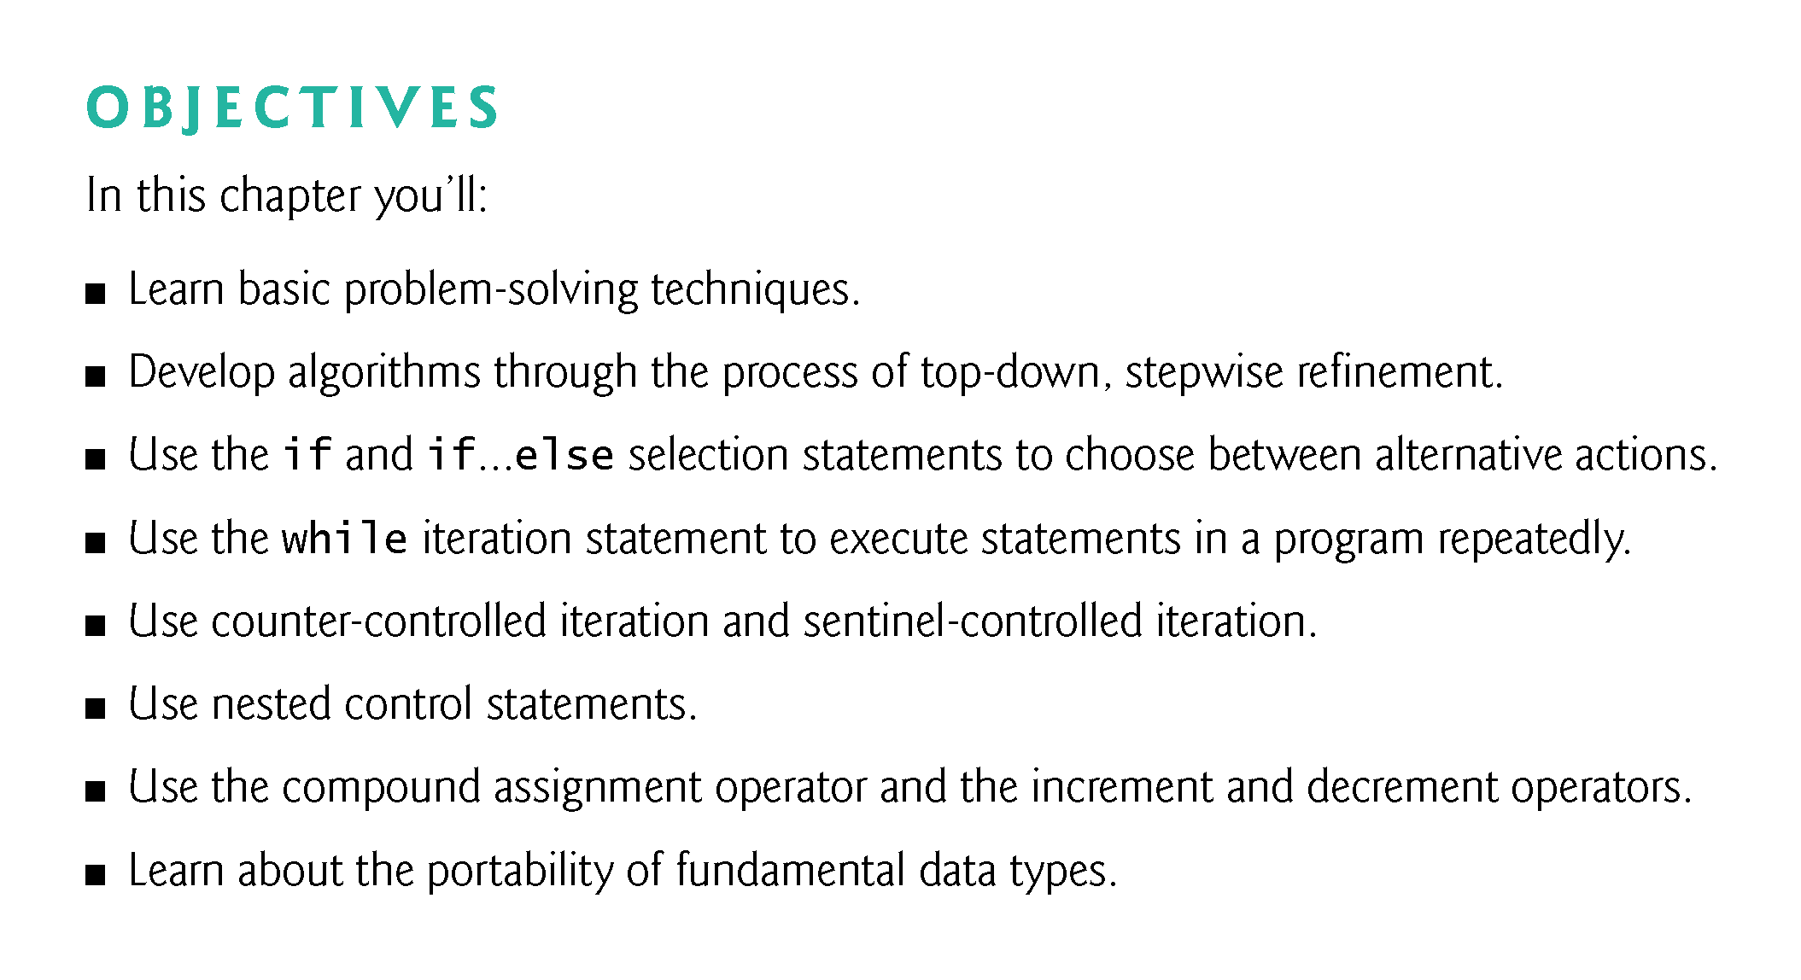

Slide 3
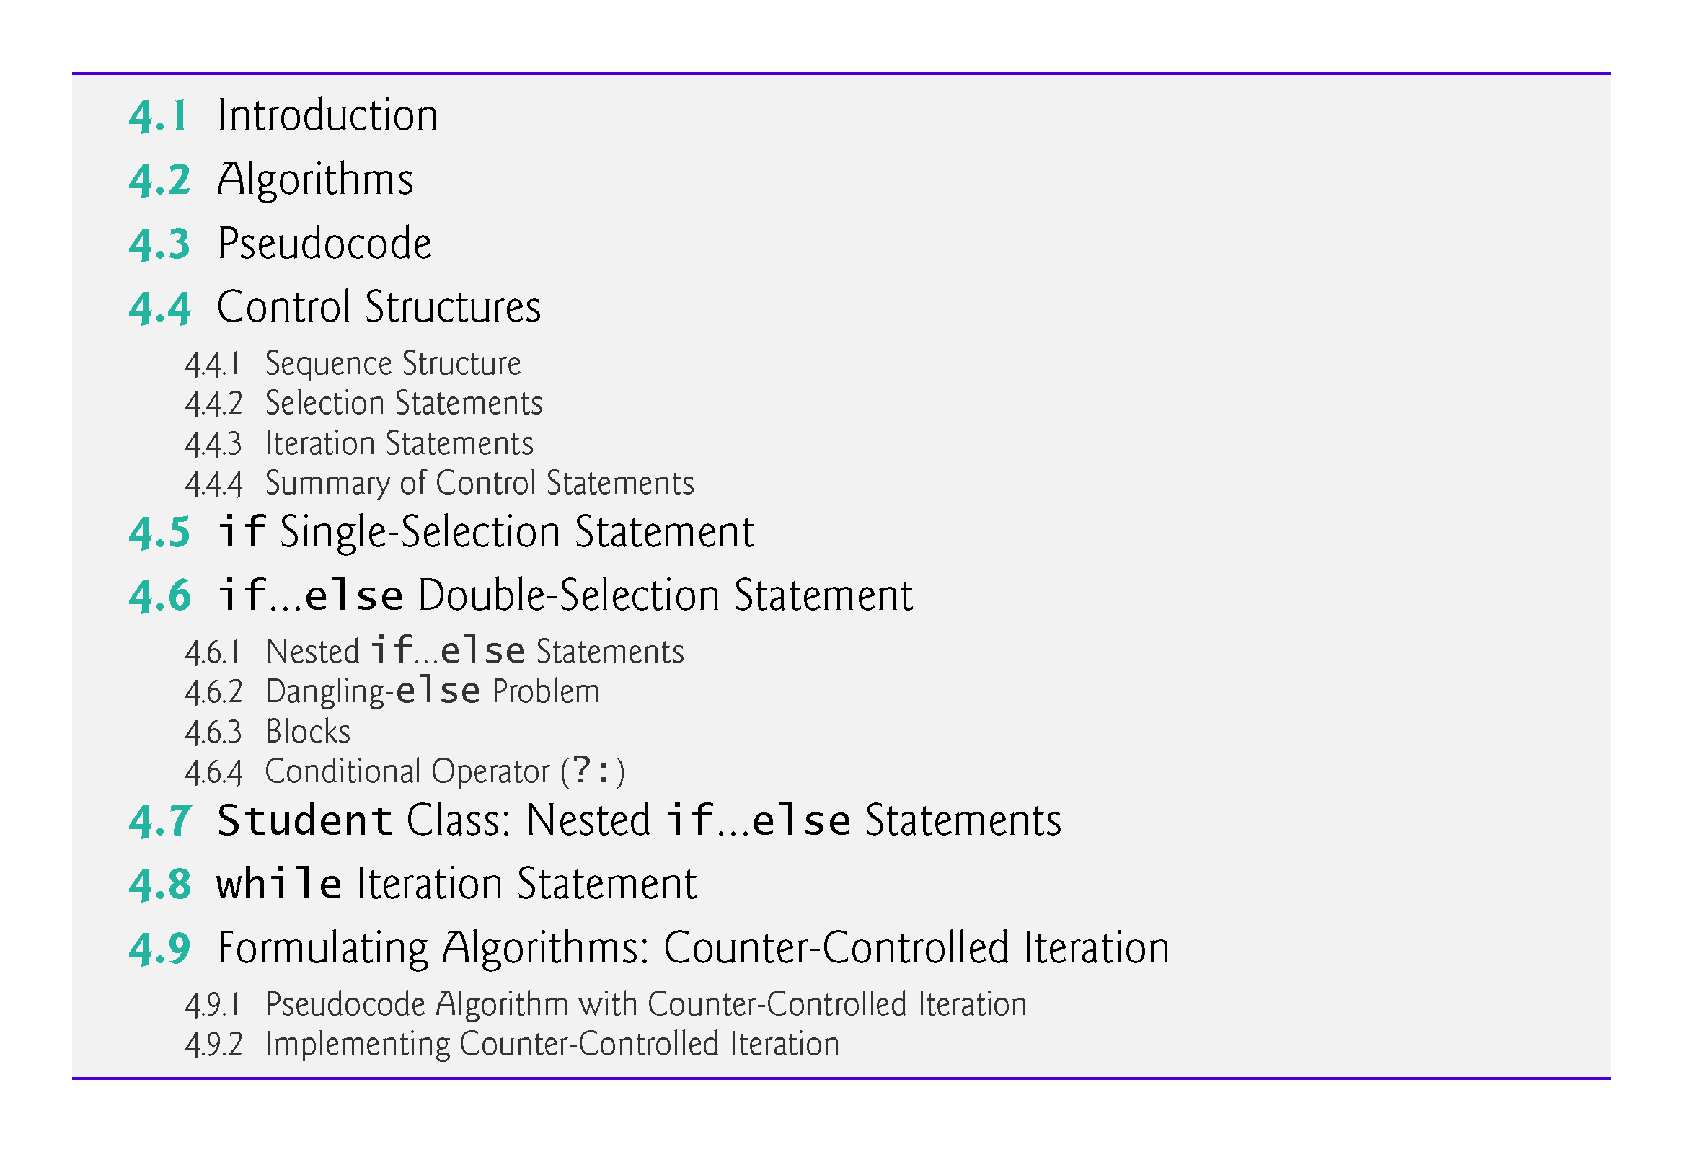

Slide 4
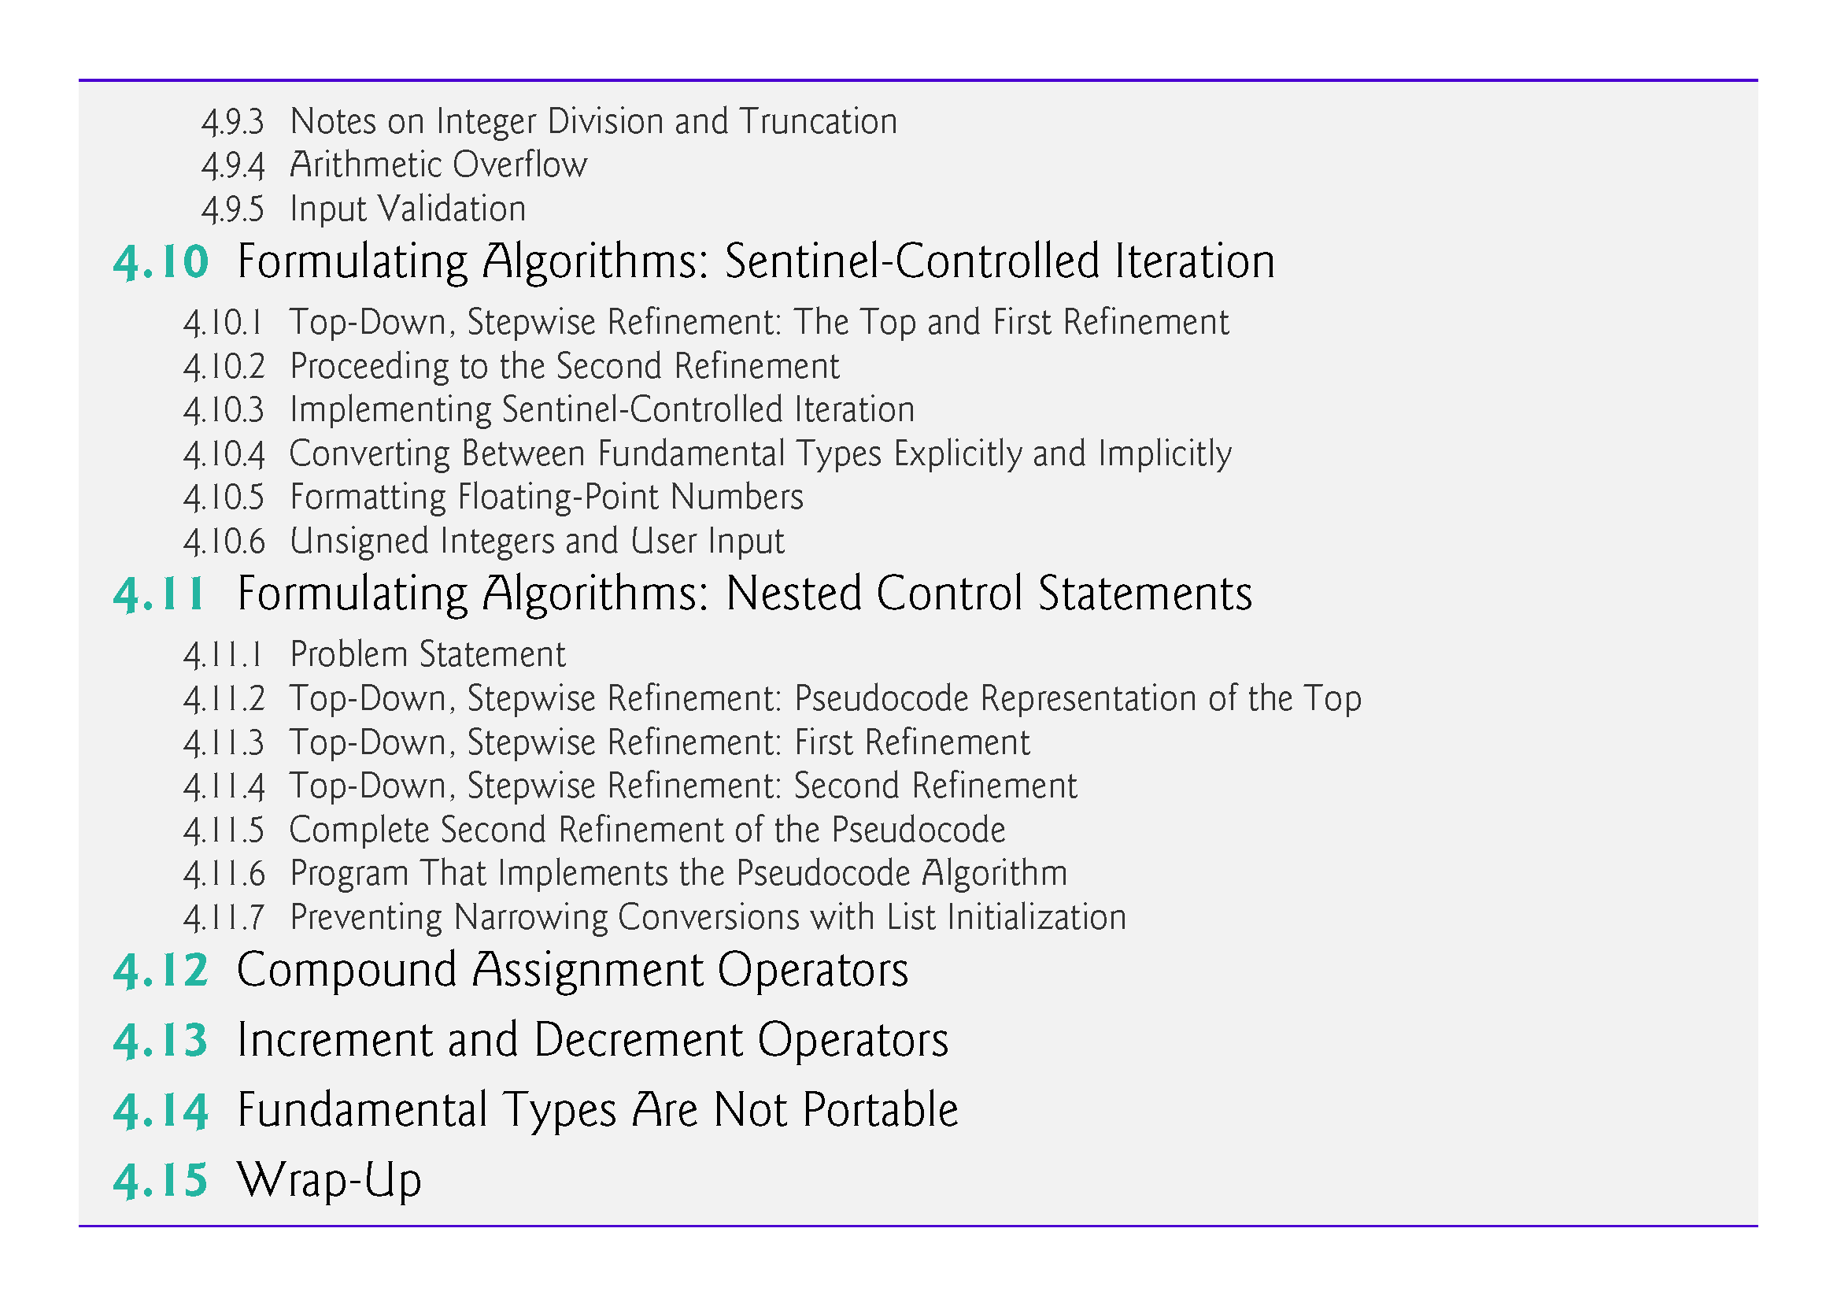

Slide 5
4.1 Introduction
Before writing a program to solve a problem, have a thorough understanding of the problem and a carefully planned approach to solving it.
Understand the available building blocks and employ proven program-construction techniques.

Slide 6
4.2 Algorithms
Any solvable computing problem can be solved by the execution a series of actions in a specific order.
An algorithm is a procedure for solving a problem in terms of
the actions to execute and
the order in which these actions execute
Specifying the order in which statements (actions) execute in a computer program is called program control.
This chapter investigates program control using C++’s control statements.

Slide 7
4.3 Pseudocode
Pseudocode (or “fake” code) is an artificial and informal language that helps you develop algorithms.
Similar to everyday English
Convenient and user friendly.
Helps you “think out” a program before attempting to write it.
Carefully prepared pseudocode can easily be converted to structured portions of C++ programs.
Normally describes only executable statements.
Declarations (that do not have initializers or do not involve constructor calls) are not executable statements.
Fig. 4.1 corresponds to the algorithm that inputs two integers from the user, adds these integers and displays their sum.

Slide 8
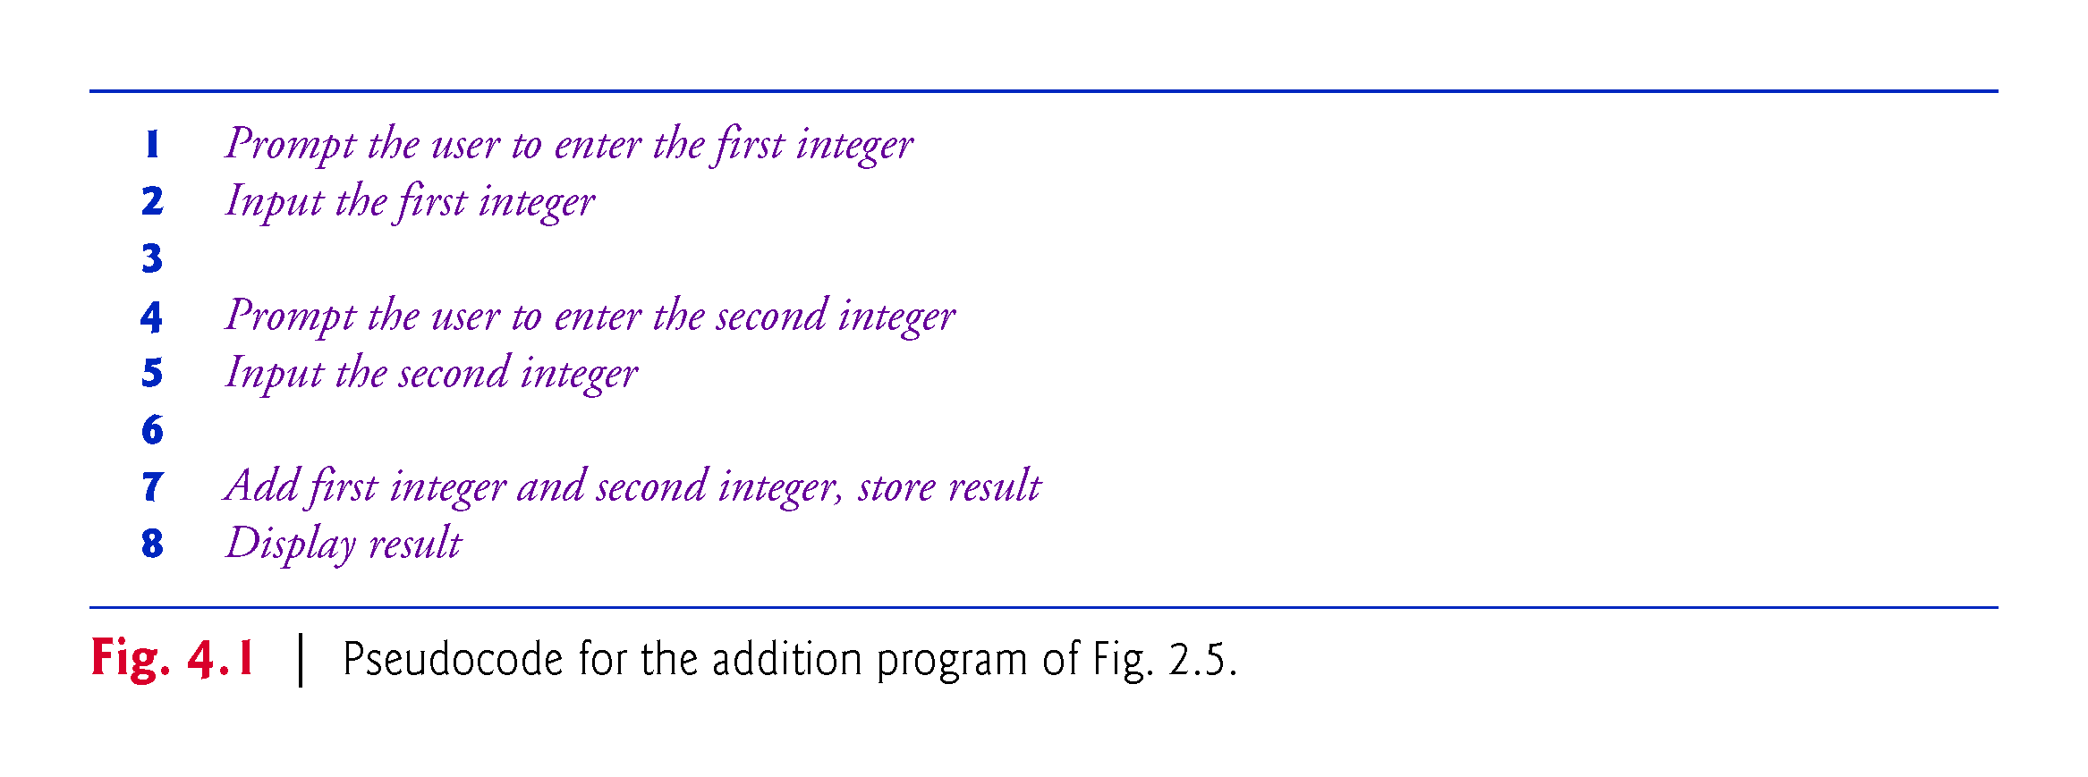

Slide 9
4.4 Control Structures
Normally, statements in a program are executed one after the other in the order in which they’re written.
Called sequential execution.
Various C++ statements enable you to specify that the next statement to execute may be other than the next one in sequence.
Called transfer of control.
All programs could be written in terms of only three control structures
the sequence structure
the selection structure and
the iteration structure
When we introduce C++’s implementations of control structures, we’ll refer to them in the terminology of the C++ standard document as “control statements.”

Slide 10
4.4.1 Sequence Structure
Unless directed otherwise, the computer executes C++ statements one after the other in the order in which they’re written—that is, in sequence.
The Unified Modeling Language (UML) activity diagram of Fig. 4.2 illustrates a typical sequence structure in which two calculations are performed in order.
C++ lets you have as many actions as you want in a sequence structure.
Anywhere a single action may be placed, we may place several actions in sequence.

Slide 11
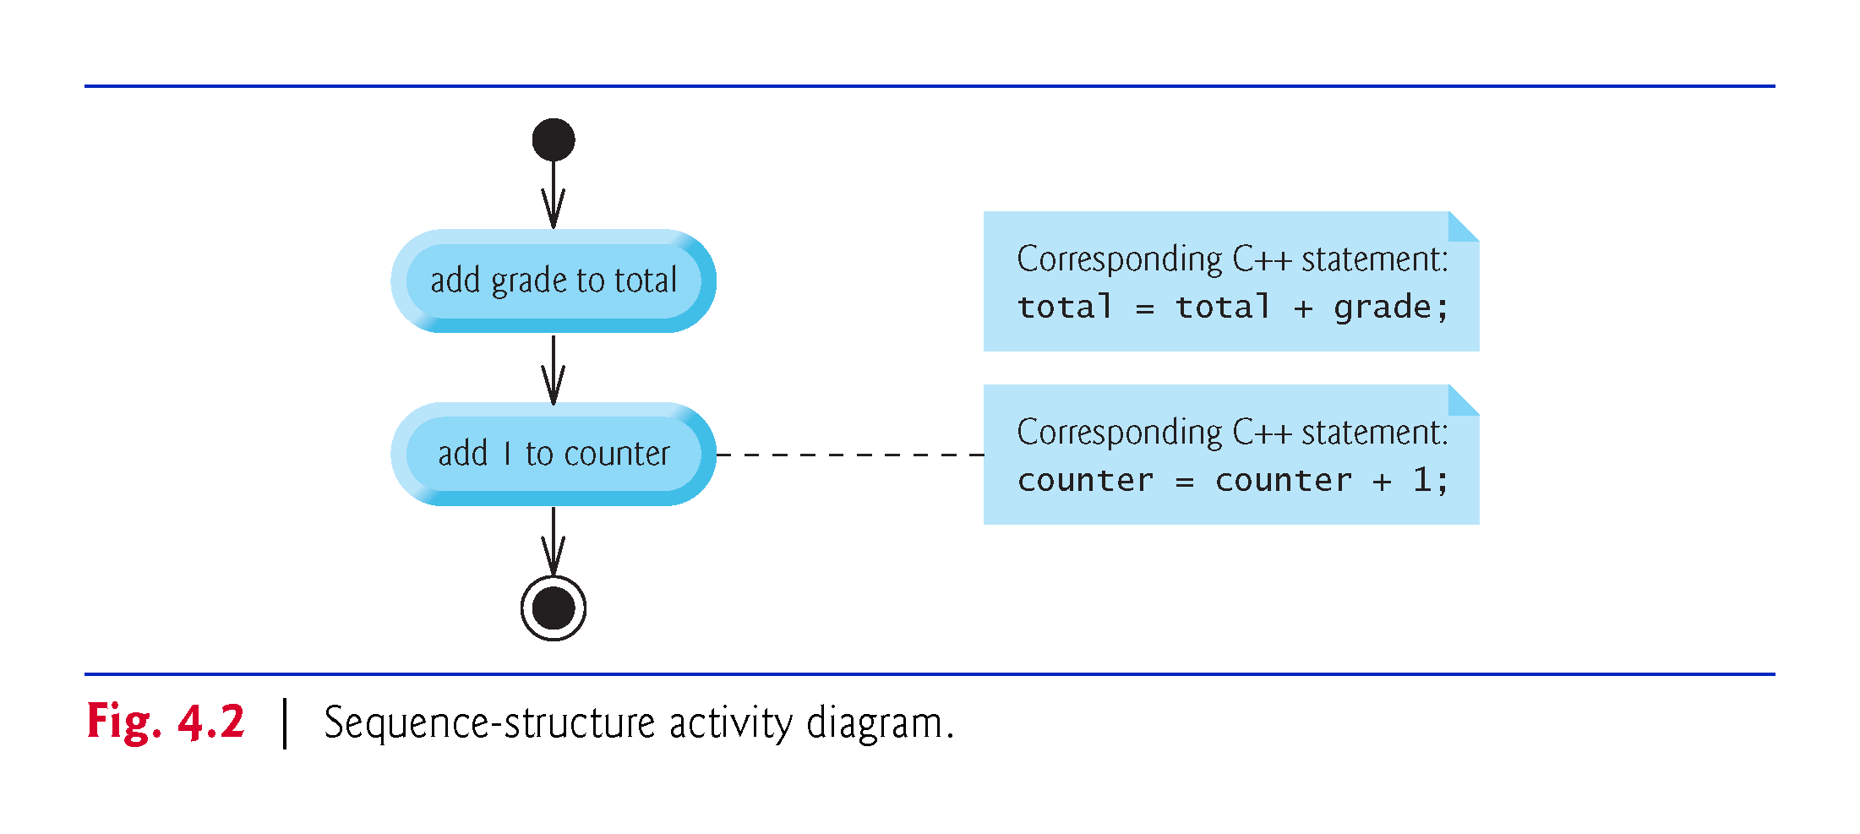

Slide 12
4.4.1 Sequence Structure
An activity diagram models the workflow (also called the activity) of a portion of a software system.
Such workflows may include a portion of an algorithm, such as the sequence structure in Fig. 4.2.
Activity diagrams are composed of special-purpose symbols, such as action state symbols (rectangles with their left and right sides replaced with arcs curving outward), diamonds and small circles; these symbols are connected by transition arrows, which represent the flow of the activity.

Slide 13
4.4.1 Sequence Structure
Activity diagrams help you develop and represent algorithms, but many programmers prefer pseudocode.
Activity diagrams clearly show how control structures operate.
Action states represent actions to perform.
Each contains an action expression that specifies a particular action to perform.

Slide 14
4.4.1 Sequence Structure
The arrows in the activity diagram are called transition arrows.
Represent transitions, which indicate the order in which the actions represented by the action states occur.
The solid circle at the top of the diagram represents the activity’s initial- state—the beginning of the workflow before the program performs the modeled activities.
The solid circle surrounded by a hollow circle that appears at the bottom of the activity diagram represents the final state—the end of the workflow after the program performs its activities.

Slide 15
4.4.1 Sequence Structure
Rectangles with the upper-right corners folded over are called notes in the UML.
Explanatory remarks that describe the purpose of symbols in the diagram.
Notes can be used in any UML diagram.
Figure 4.2 uses UML notes to show the C++ code associated with each action state in the activity diagram.
A dotted line connects each note with the element that the note describes.

Slide 16
4.4.2 Selection Statements
C++ has three types of selection statements (discussed in this chapter and Chapter 5).
The if selection statement either performs (selects) an action (or group of actions) if a condition (predicate) is true or skips the action (or group of actions) if the condition is false.
The if…else selection statement performs an action (or group of actions) if a condition is true or performs a different action (or group of actions) if the condition is false.
The switch selection statement (Chapter 5) performs one of many different actions (or groups of actions), depending on the value of an integer expression.

Slide 17
4.4.2 Selection Statements
The if selection statement is a single-selection statement because it selects or ignores a single action (or group of actions).
The if…else statement is called a double-selection statement because it selects between two different actions (or groups of actions).
The switch selection statement is called a multiple-selection statement because it selects among many different actions (or groups of actions).

Slide 18
4.4.3 Iteration Statements
C++ provides three types of iteration statements (also called looping statements or loops) for performing statements repeatedly while a condition (called the loop-continuation condition) remains true—while, do…while and for.
The while and for statements perform the action (or group of actions) in their bodies zero or more times.
The do…while statement performs the action (or group of actions) in its body at least once.

Slide 19
4.4.3 Iteration Statements
Each of the words if, else, switch, while, do and for is a C++ keyword.
These words are reserved by the C++ programming language to implement various features, such as C++’s control statements.
Keywords cannot be used as identifiers, such as variable names.
Figure 4.3 provides a complete list of C++ keywords-.

Slide 20
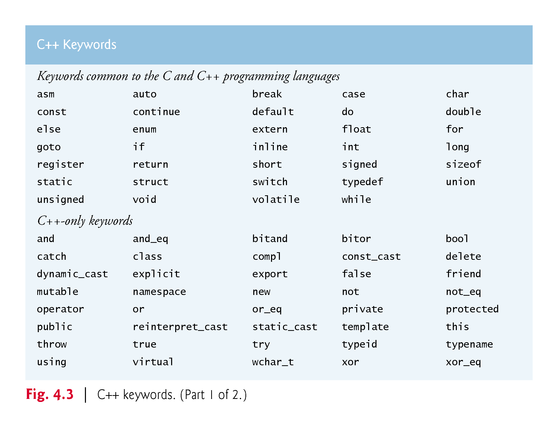

Slide 21
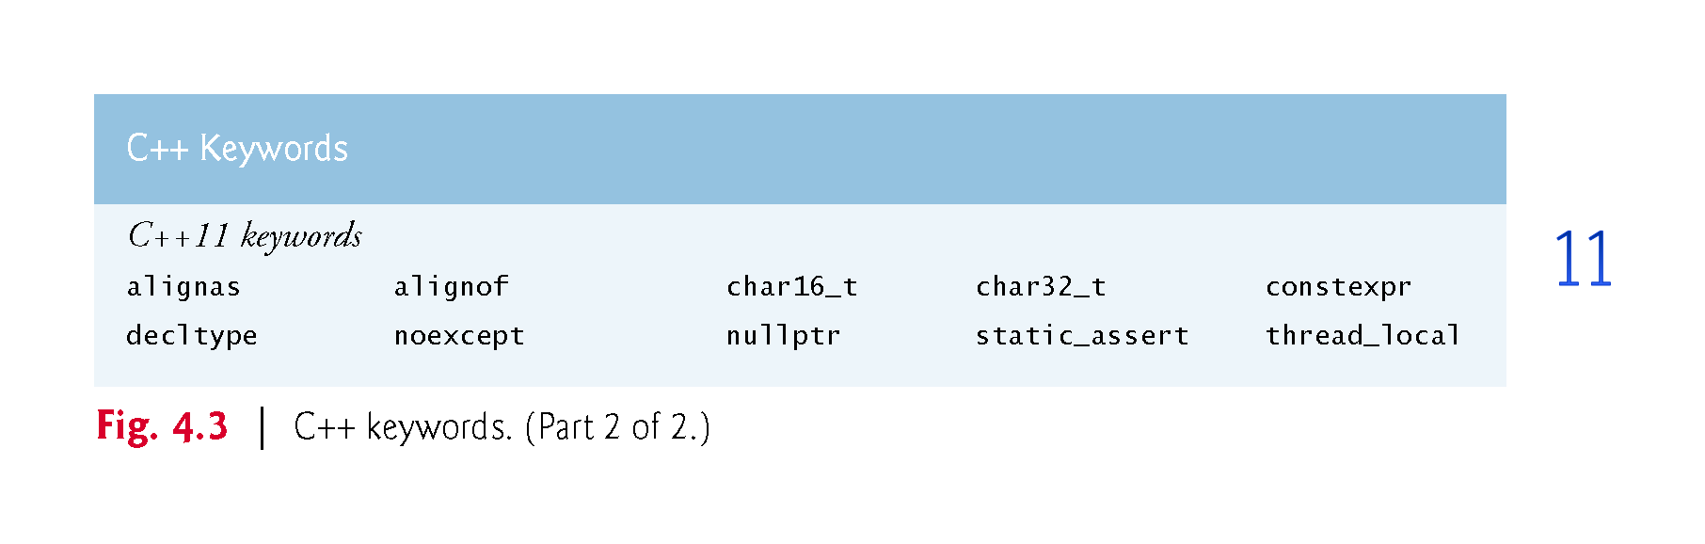

Slide 22
4.4.4 Summary of Control Statements
Each program is formed by combining as many of each of these control statements as appropriate for the algorithm the program implements.
We can model each control statement as an activity diagram with initial and final states representing that control statement’s entry and exit points, respectively.
Single-entry/single-exit control statements
Connecting the exit point of one control statement to the entry point of the next.
Called control-statement stacking.
Only one other way to connect control statements—called control-statement nesting, in which one control statement is contained inside another.
Notes:
Ob: if { } else followed by another if { } else is a single entry statement

Slide 23
4.5 if Single-Selection Statement
Programs use selection statements to choose among alternative courses of action.
Pseudocode to determine whether “student’s grade is greater than or equal to 60” is true.
If student’s grade is greater than or equal to 60 Print “Passed”
If true, “Passed” is printed and the next pseudocode statement in order is “performed” (remember that pseudocode is not a real programming language).
If false, the print statement is ignored and the next pseudocode statement in order is performed.
The indentation of the second line is optional, but it’s recommended because it emphasizes the inherent structure of structured programs.

Slide 24
4.5 if Selection Statement (cont.)
The preceding pseudocode If statement can be written in C++ as
if (studentGrade >= 60) { cout << "Passed"; }
In C++, a decision can be based on any expression that evaluates to zero or nonzero
If the expression evaluates to zero, it’s treated as false; if the expression evaluates to nonzero, it’s treated as true.
C++ also provides the data type bool for Boolean variables that can hold only the values true and false.
Notes:
Ob: Be very careful about control statements testing non-initialised values. Eg. Int size declared and then if (size) { } - flow depends on if the size default is zero or not!

Slide 25
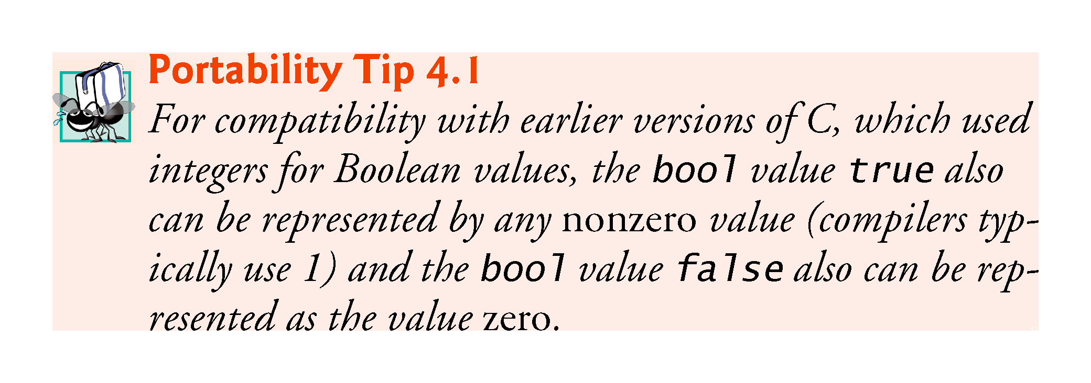

Slide 26
4.5 if Selection Statement (cont.)
Figure 4.4 illustrates the single-selection if statement.
The diamond or decision symbol indicates that a decision is to be made.
The workflow will continue along a path determined by the symbol’s associated guard conditions, which can be true or false.
Each transition arrow emerging from a decision symbol has a guard condition in square brackets above or next to the arrow.
If a guard condition is true, the workflow enters the action state to which that transition arrow points.

Slide 27
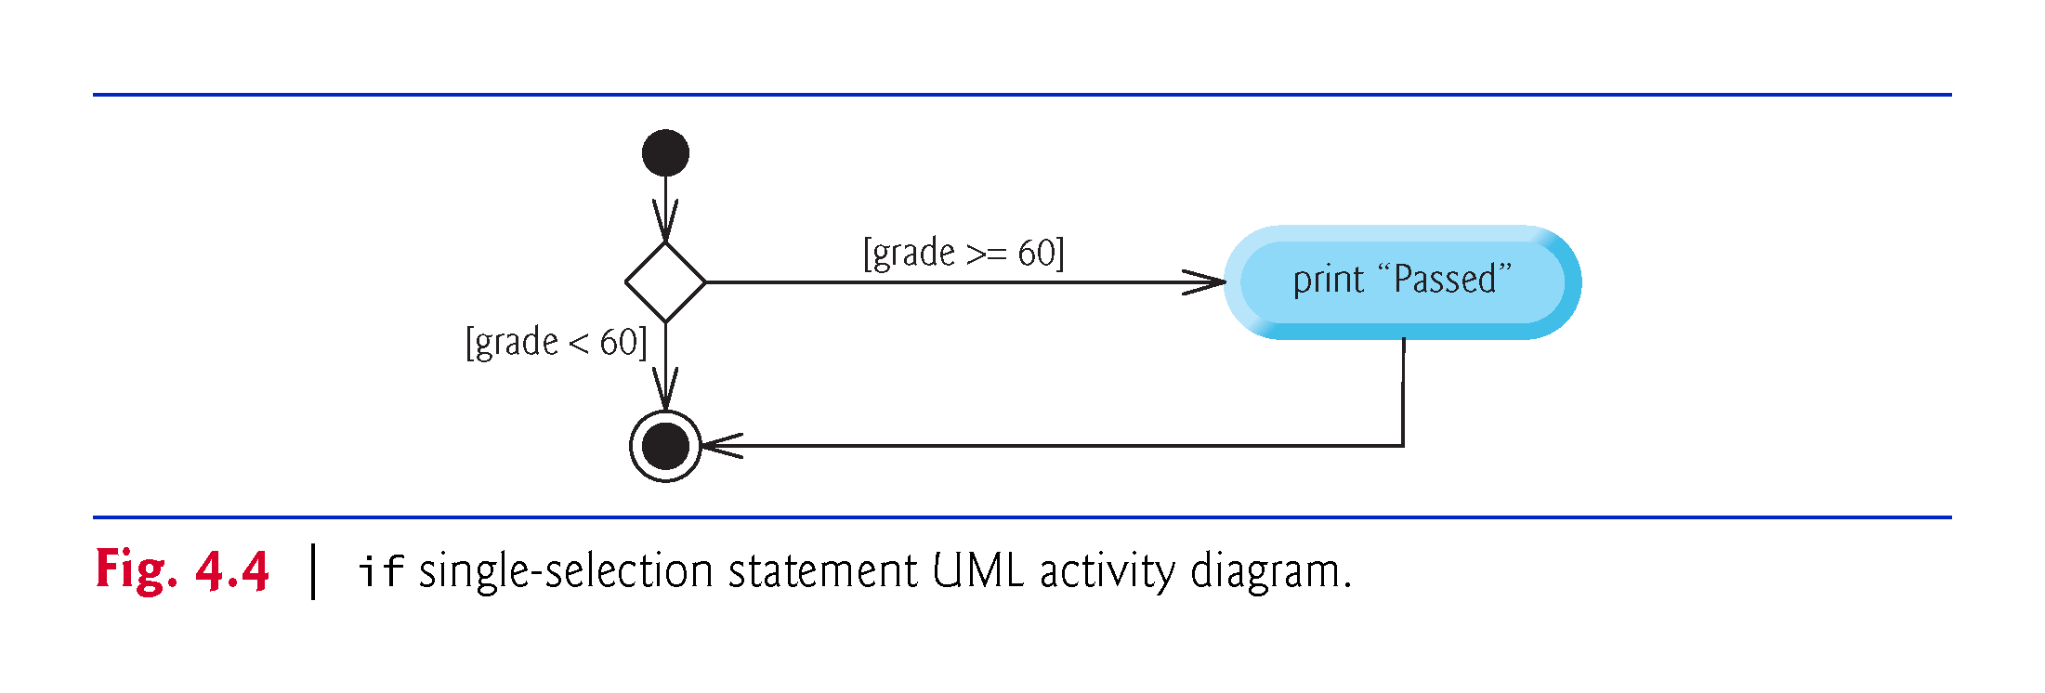

Slide 28
4.6 if…else Double-Selection Statement
if…else double-selection statement
specifies an action (or group of actions) to perform when the condition is true and a different action to perform when the condition is false.
Pseudocode that prints “Passed” if the student’s grade is greater than or equal to 60, or “Failed” otherwise.
If student’s grade is greater than or equal to 60 Print “Passed” Else Print “Failed”

Slide 29
4.6 if…else Double-Selection Statement
The preceding If…Else pseudocode can be written in C++ as
if (grade >= 60) { cout << "Passed"; } else { cout << "Failed"; }

Slide 30
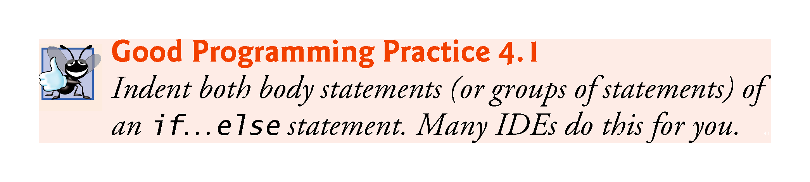

Slide 31
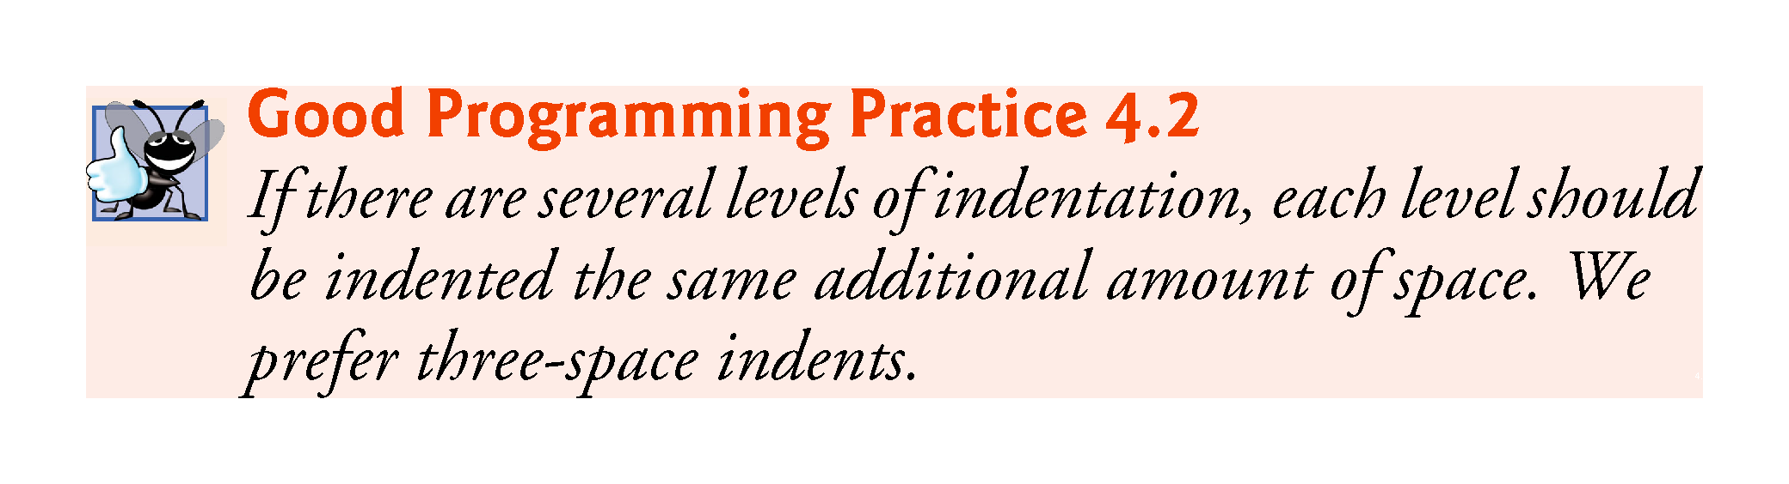

Slide 32
4.6 if…else Double-Selection Statement (cont.)
Figure 4.5 illustrates the if…else statement’s flow of control.

Slide 33
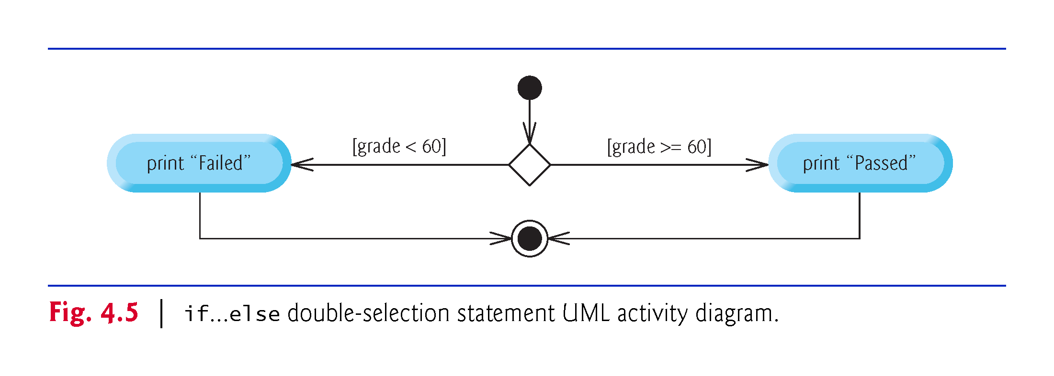

Slide 34
4.6.1 Nested if…else Statements
Nested if…else statements test for multiple cases by placing if…else selection statements inside other if…else selection statements.
If student’s grade is greater than or equal to 90 Print “A” Else If student’s grade is greater than or equal to 80 Print “B” Else If student’s grade is greater than or equal to 70 Print “C” Else If student’s grade is greater than or equal to 60 Print “D” Else Print “F”

Slide 35
4.6.1 Nested if…else Statements
This pseudocode can be written in C++ as
if (studentGrade >= 90) { cout << "A"; } else { if (studentGrade >= 80) { cout << "B"; } else { if (studentGrade >= 70) { cout << "C"; } else { if (studentGrade >= 60 { cout << "D"; } else { cout << "F"; } } } }
If variable studentGrade is greater than or equal to 90, the first four conditions in the nested if…else will be true, but only the statement in the if part of the first if…else will execute. After that, the else part of the “outermost” if…else statement is skipped.
Notes:
Ob: if statements inside the outermost else block were executing based on the initial if condition all grades would trivially be assigned – a logic error

Slide 36
4.6.1 Nested if…else Statements
Most programmers write the preceding statement as
if (studentGrade >= 90) { cout << "A"; } else if (studentGrade >= 80) { cout << "B"; } else if (studentGrade >= 70) { cout << "C"; } else if (studentGrade >= 60) { cout << "D"; } else { cout << "F"; }
The two forms are identical except for the spacing and indentation, which the compiler ignores.
The latter form is popular because it avoids deep indentation of the code to the right, which can force lines to wrap.
Notes:
Test: What happens if the user accidentally enters a negative grade? Ambiguity since the student may have earned a grade other than F and it was simply a clerical error.

Slide 37


Slide 38
4.6.2 Dangling-else Problem
Throughout the text, we always enclose control statement bodies in braces ({ and }).
This avoids a logic error called the “dangling-else” problem.
We investigate this problem in Exercises 4.23–4.25.

Slide 39
4.6.3 Blocks
The if statement normally expects only one statement in its body.
To include several statements in an if (or the body of an else for an if…else statement), enclose the statements in braces.
Good practice to always use the braces.
Statements contained in a pair of braces form a block.
A block can be placed anywhere in a function that a single statement can be placed.

Slide 40
4.6.3 Blocks
Syntax errors (such as when one brace in a block is left out of the program) are caught by the compiler.
A logic error (such as an incorrect calculation) has its effect at execution time.
A fatal logic error causes a program to fail and terminate prematurely.
A nonfatal logic error allows a program to continue executing but causes it to produce incorrect results.

Slide 41
4.6.3 Blocks
Just as a block can be placed anywhere a single statement can be placed, it’s also possible to have no statement at all—called a null statement (or an empty statement).
The null statement is represented by placing a semicolon (;) where a statement would normally be.

Slide 42
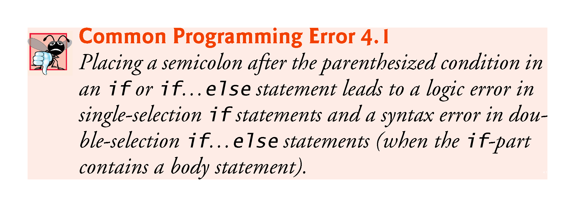
Notes:
Ob: Easier to spot syntax errors rather than logic errors, so prefer if {else }to if – even if {else} body within braces is empty

Slide 43
4.6.4 Conditional Operator (?:)
Conditional operator (?:)
Closely related to the if…else statement.
C++’s only ternary operator—it takes three operands.
The operands, together with the conditional operator, form a conditional expression.
The first operand is a condition
The second operand is the value for the entire conditional expression if the condition is true
The third operand is the value for the entire conditional expression if the condition is false.
The “values” also can be actions to execute.

Slide 44
4.7 Student Class: Nested if…else Statements
The example of Figs. 4.6–4.7 demonstrates a nested if…else statement that determines a student’s letter grade based on the student’s average in a course.
Class Student (Fig. 4.6) stores a student’s name and average and provides member functions for manipulating these values.
Data member name of type string (line 65) to store a Student’s name.
Data member average of type int (line 66) to store a Student’s average in a course.
A constructor (lines 8–13) that initializes the name and average.
Member functions setName and getName (lines 16–23) to set and get name.
Member functions setAverage and getAverage (lines 26–39) to set and get average.
Member function getLetterGrade (lines 42–63), which uses nested if…else statements to determine the Student’s letter grade based on the Student’s average.

Slide 45
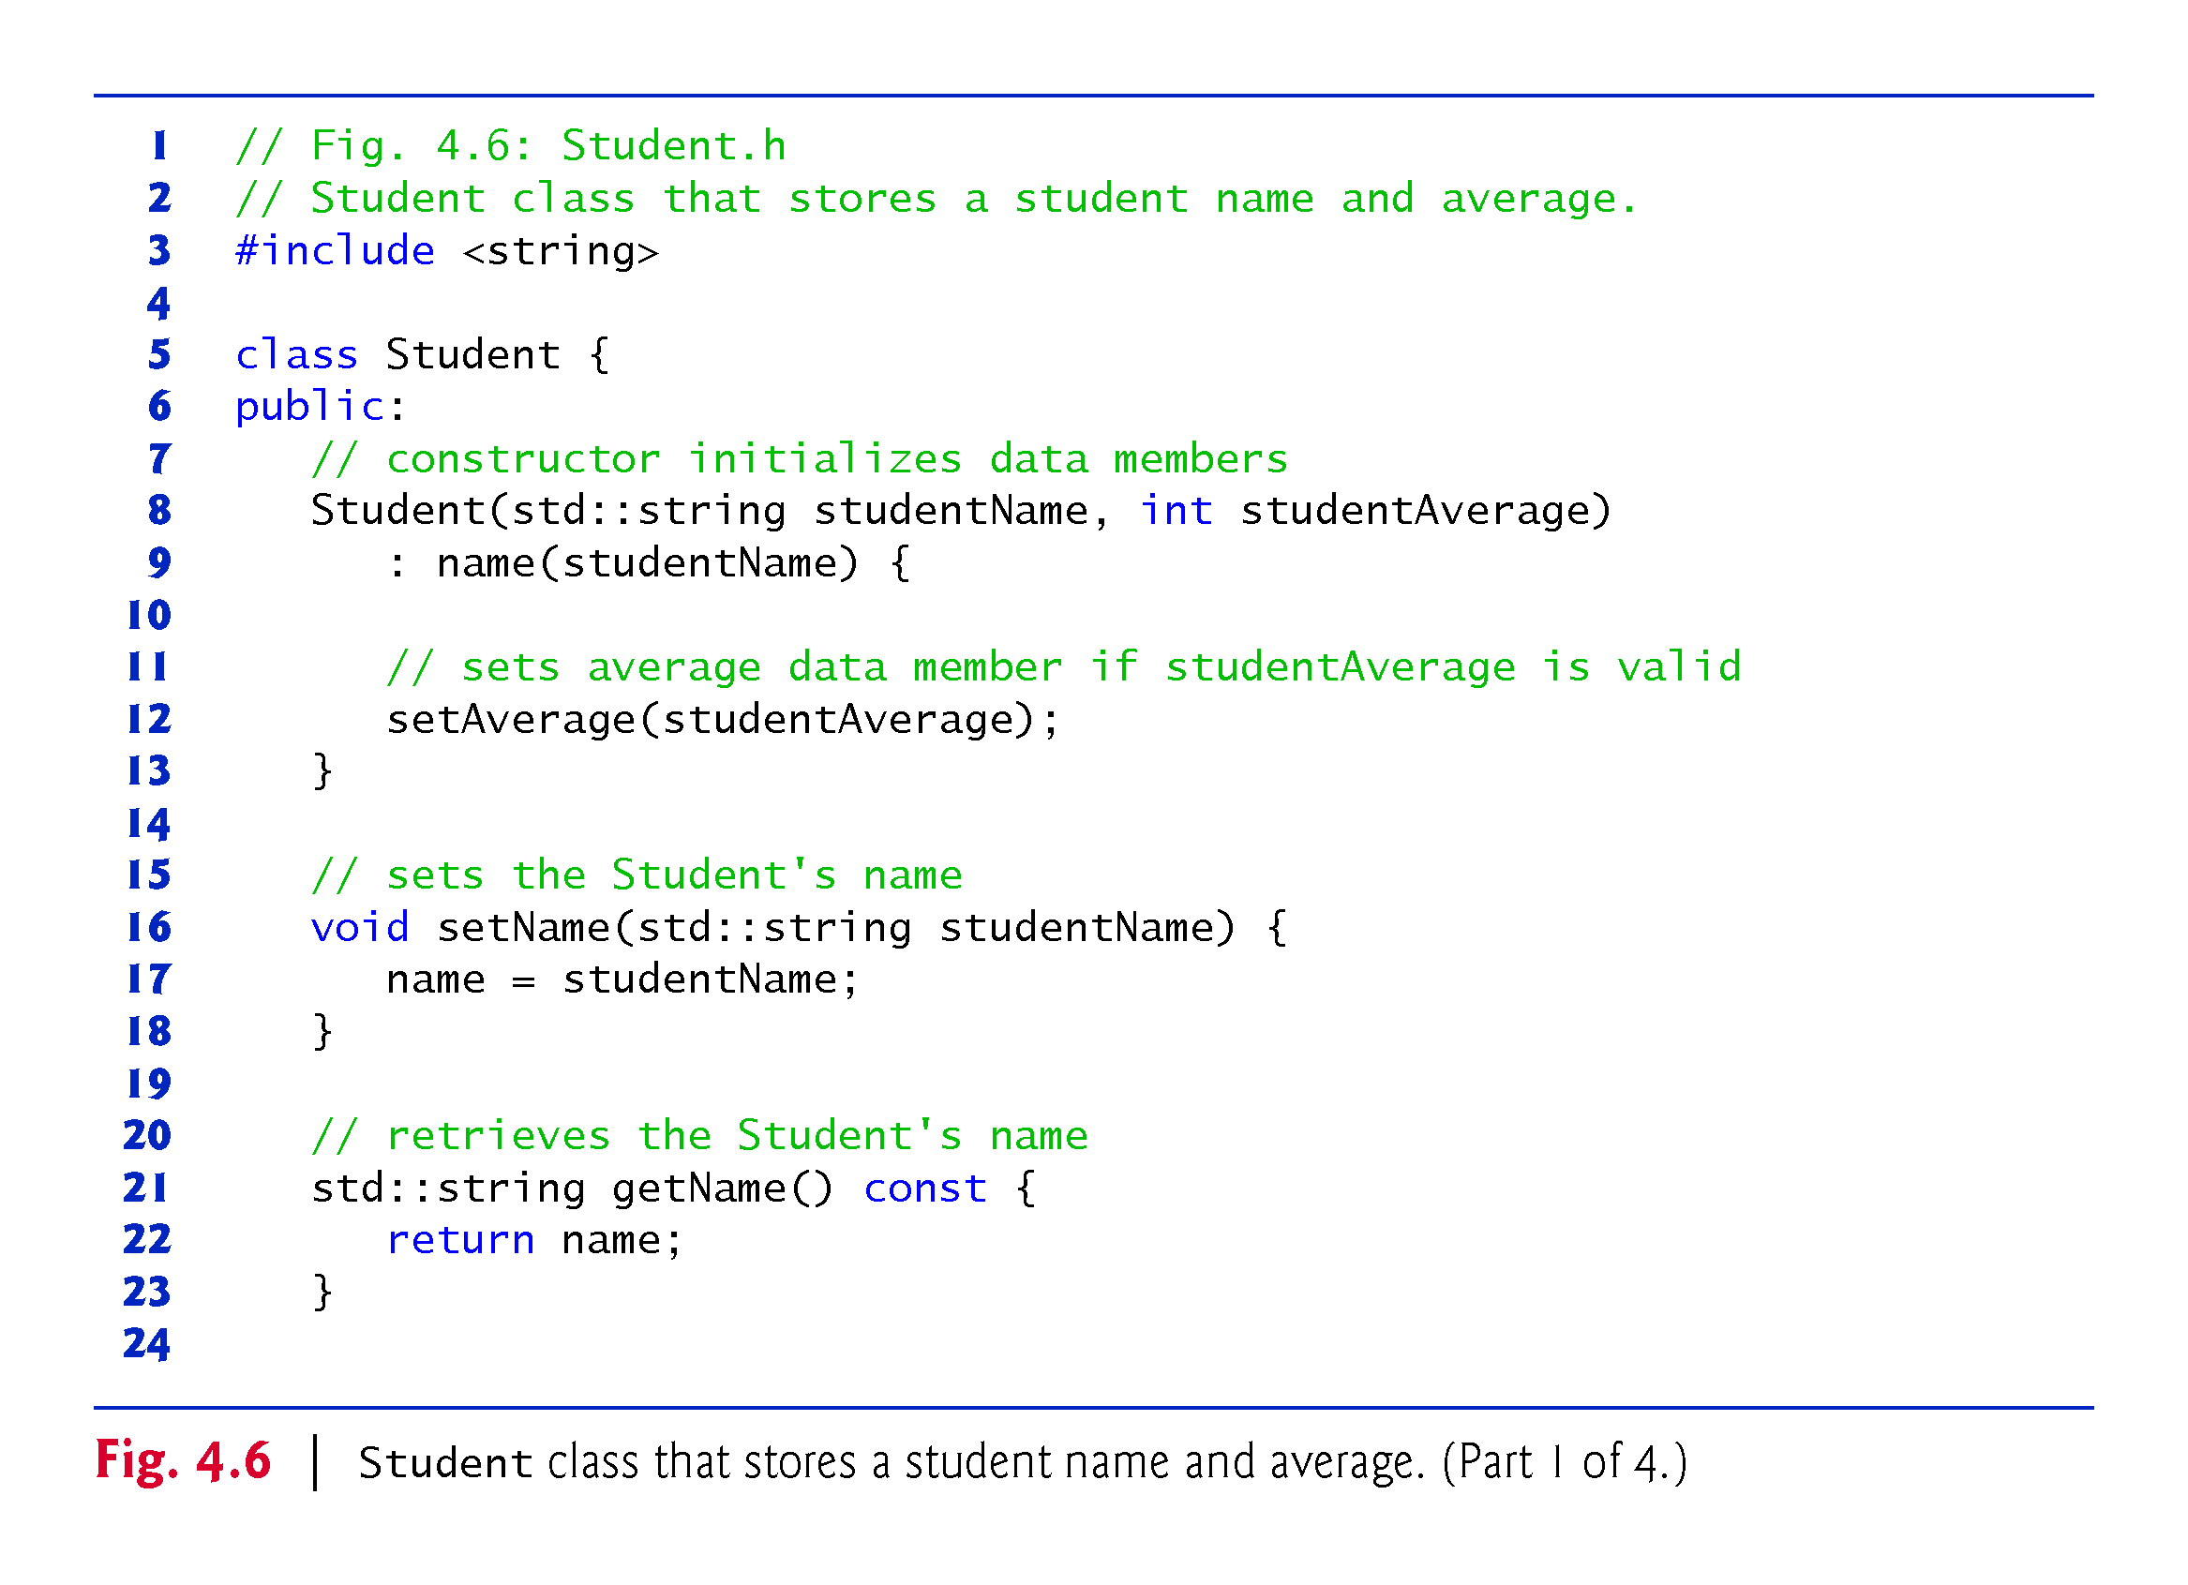
Notes:
Ob: Note constructor is calling another member function – setaverage with parameters

Slide 46
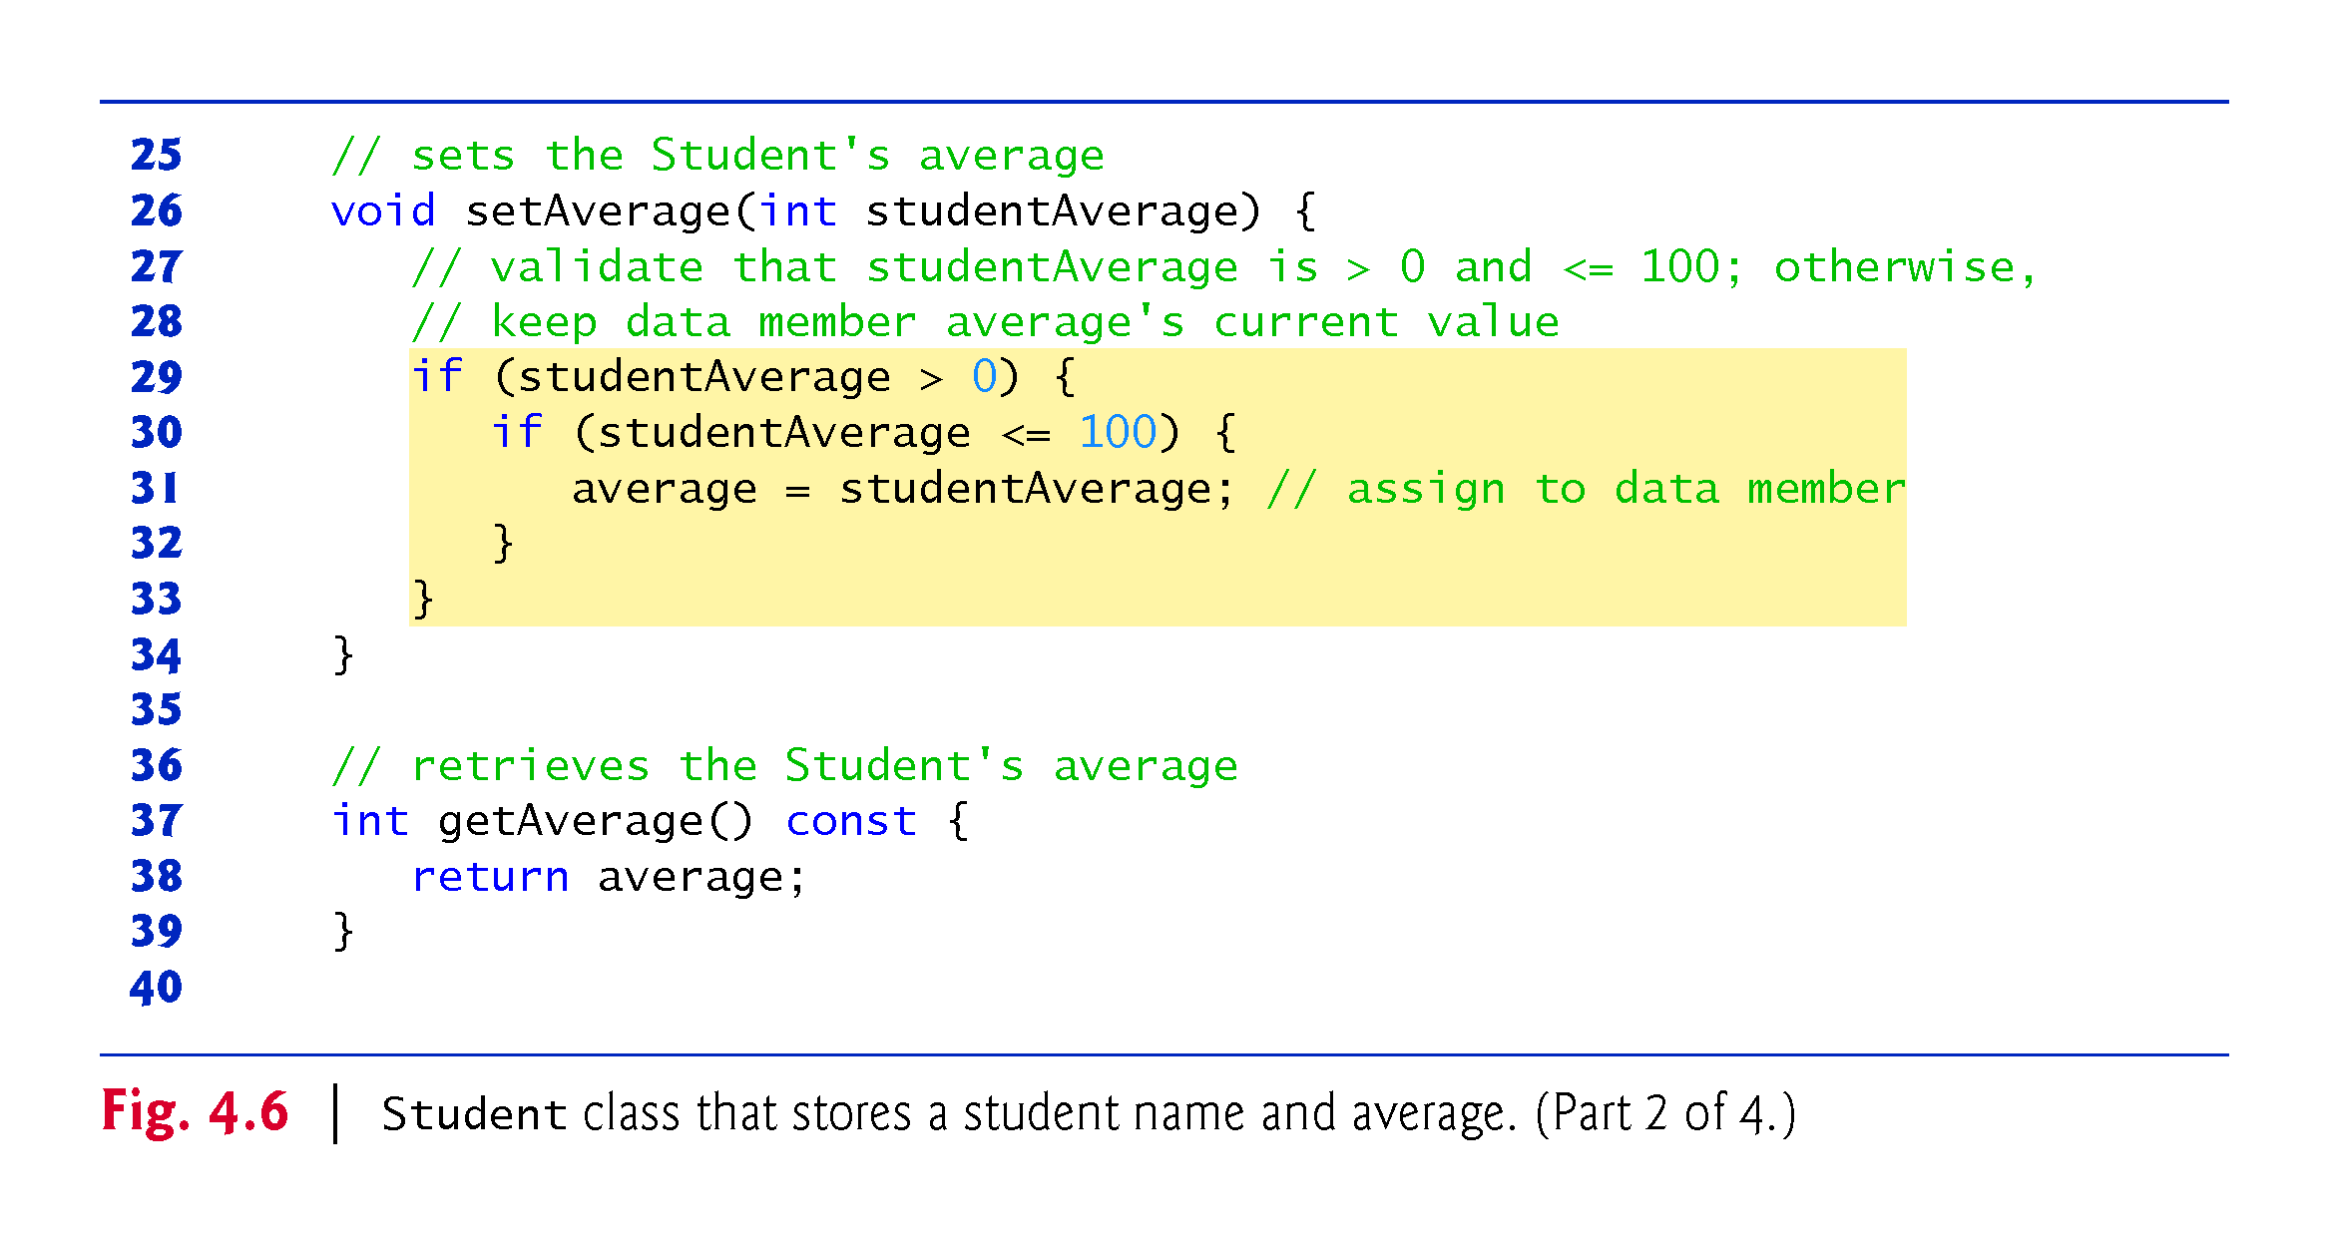

Slide 47
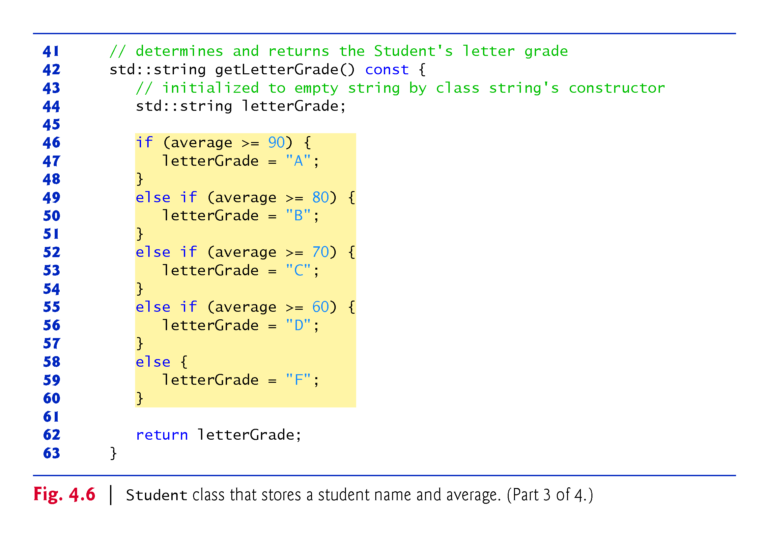
Notes:
Ob: Note the const nature of the getletetrgrade function – marking scheme is fixed

Slide 48
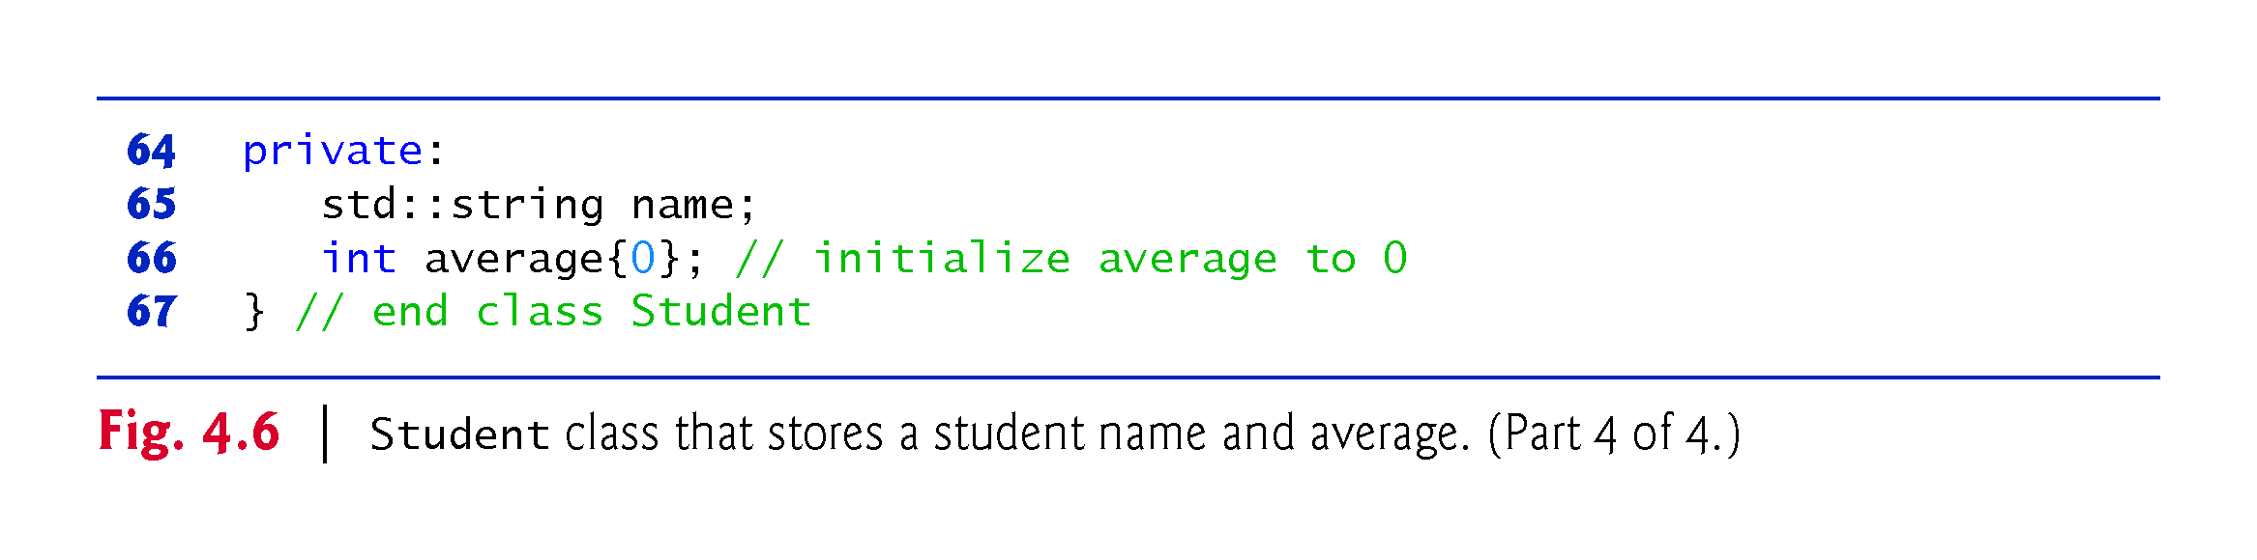

Slide 49
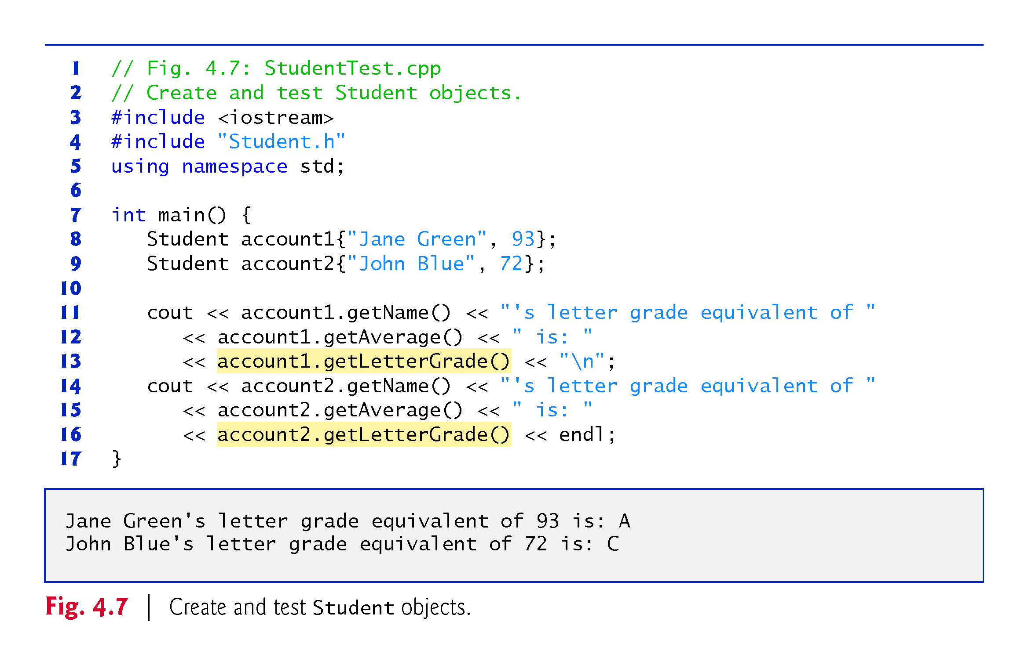

Slide 50
4.8 while Iteration Statement
An iteration statement (also called a looping statement or a loop) allows you to specify that a program should repeat an action while some condition remains true.
While there are more items on my shopping list Purchase next item and cross it off my list
“There are more items on my shopping list” is true or false.
If true, “Purchase next item and cross it off my list” is performed.
Performed repeatedly while the condition remains true.
The statement contained in the While iteration statement constitutes the body of the While
Eventually, the condition will become false, the iteration will terminate, and the first pseudocode statement after the iteration statement will execute.
Notes:
Obs: You need to change the condition while is checking inside the while loop

Slide 51
4.8 while Iteration Statement (cont.)
Consider a program segment that finds the first power of 3 larger than 100. When the following while iteration statement finishes executing, product contains the result:
int product = 3; while (product <= 100) { product = 3 * product; }

Slide 52
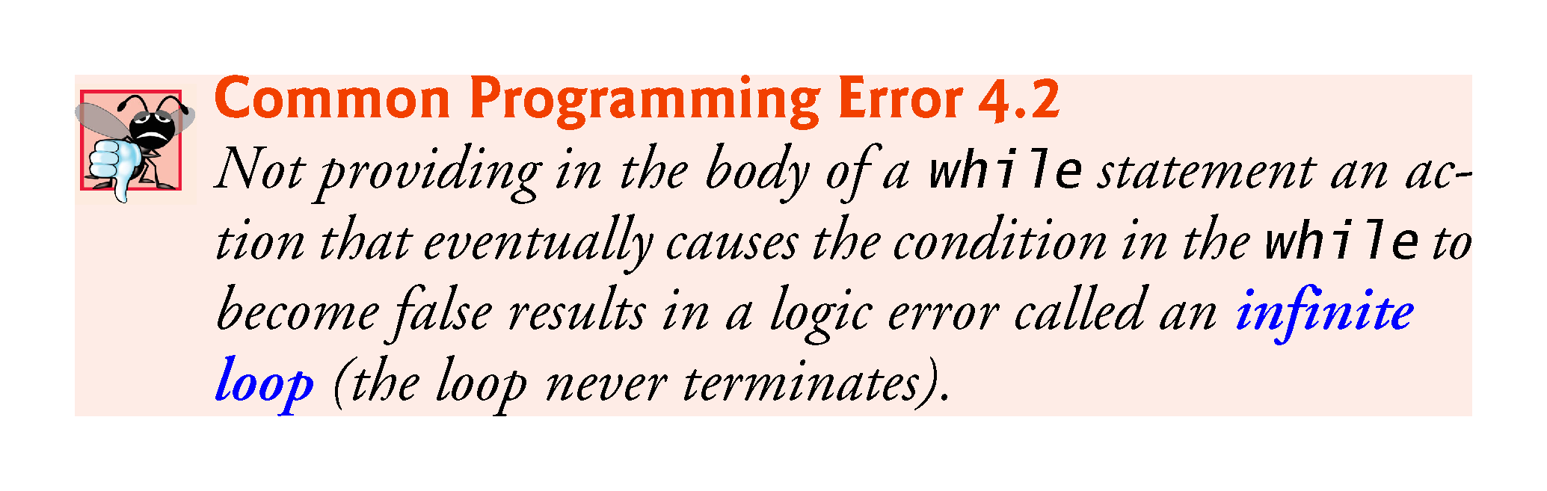

Slide 53
4.8 while Iteration Statement (cont.)
The UML activity diagram of Fig. 4.8 illustrates the flow of control that corresponds to the preceding while statement.
Introduces the UML’s merge symbol, which joins two flows of activity into one flow of activity.
The UML represents both the merge symbol and the decision symbol as diamonds.
The merge symbol joins the transitions from the initial state and from the action state, so they both flow into the decision that determines whether the loop should begin (or continue) executing.

Slide 54
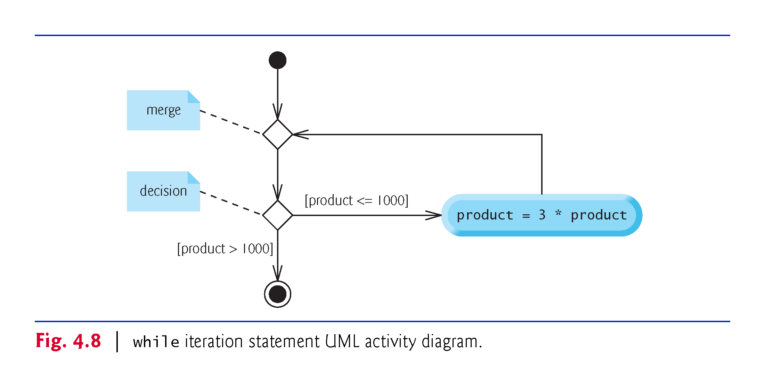

Slide 55
4.8 while Iteration Statement (cont.)
The decision and merge symbols can be distinguished by the number of “incoming” and “outgoing” transition arrows.
A decision symbol has one transition arrow pointing to the diamond and two or more transition arrows pointing out from the diamond to indicate possible transitions from that point.
Each transition arrow has a guard condition next to it.
A merge symbol has two or more transition arrows pointing to the diamond and only one transition arrow pointing from the diamond, to indicate multiple activity flows merging to continue the activity.
Unlike the decision symbol, the merge symbol does not have a counterpart in C++ code.

Slide 56
4.9 Formulating Algorithms: Counter-Controlled Iteration
Consider the following problem statement:
A class of ten students took a quiz. The grades (integers in the range 0-100) for this quiz are available to you. Determine the class average on the quiz.
The class average is equal to the sum of the grades divided by the number of students.
The algorithm for solving this problem on a computer must input each grade, keep track of the total of all grades entered, perform the averaging calculation and print the result.

Slide 57
4.9.1 Pseudocode Algorithm with Counter Controlled Iteration
We use counter-controlled iteration to input the grades one at a time.
This technique uses a variable called a counter (or control variable) to control the number of times a group of statements will execute.
Often called definite iteration because the number of iterations is known before the loop begins executing.

Slide 58
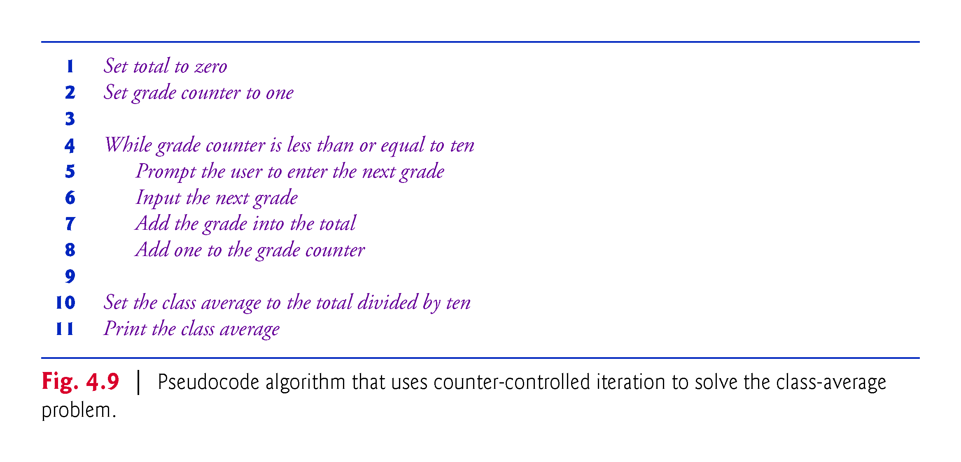

Slide 59
4.9.1 Pseudocode Algorithm with Counter Controlled Iteration
A total is a variable used to accumulate the sum of several values.
A counter is a variable used to count—in this case, the grade counter indicates which of the 10 grades is about to be entered by the user.
Variables that are used to store totals are normally initialized to zero before being used in a program; otherwise, the sum would include the previous value stored in the total’s memory location.

Slide 60
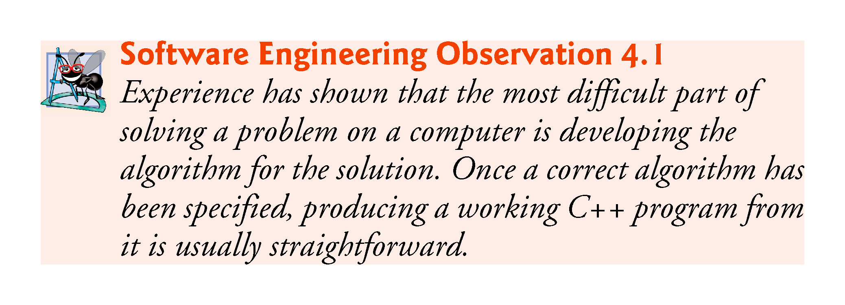

Slide 61
4.9.2 Implementing Counter-Controlled Iteration
Fig. 4.10 implements the class-average problem using counter-controlled iteration.

Slide 62
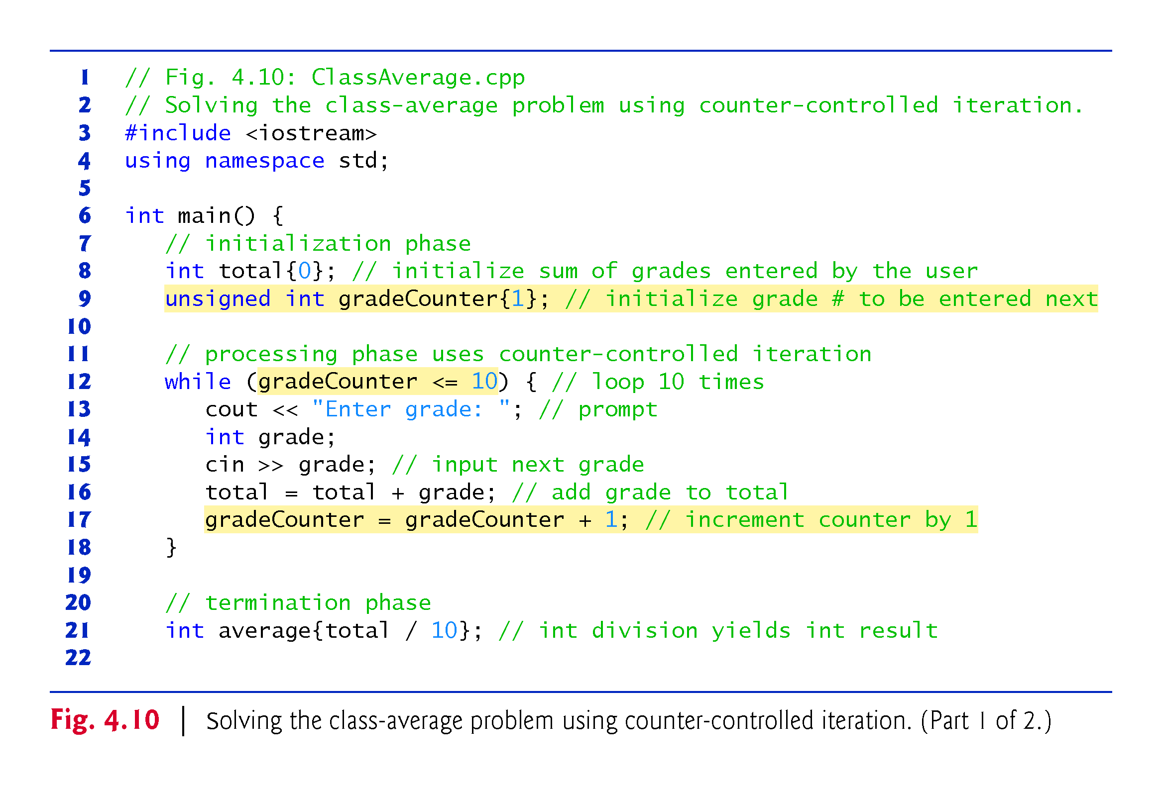
Notes:
Ob: Again list initialisations may not work in the version of c++ we have in labs,. The variable grade has block of statements scope, the variable average has main routine scope

Slide 63
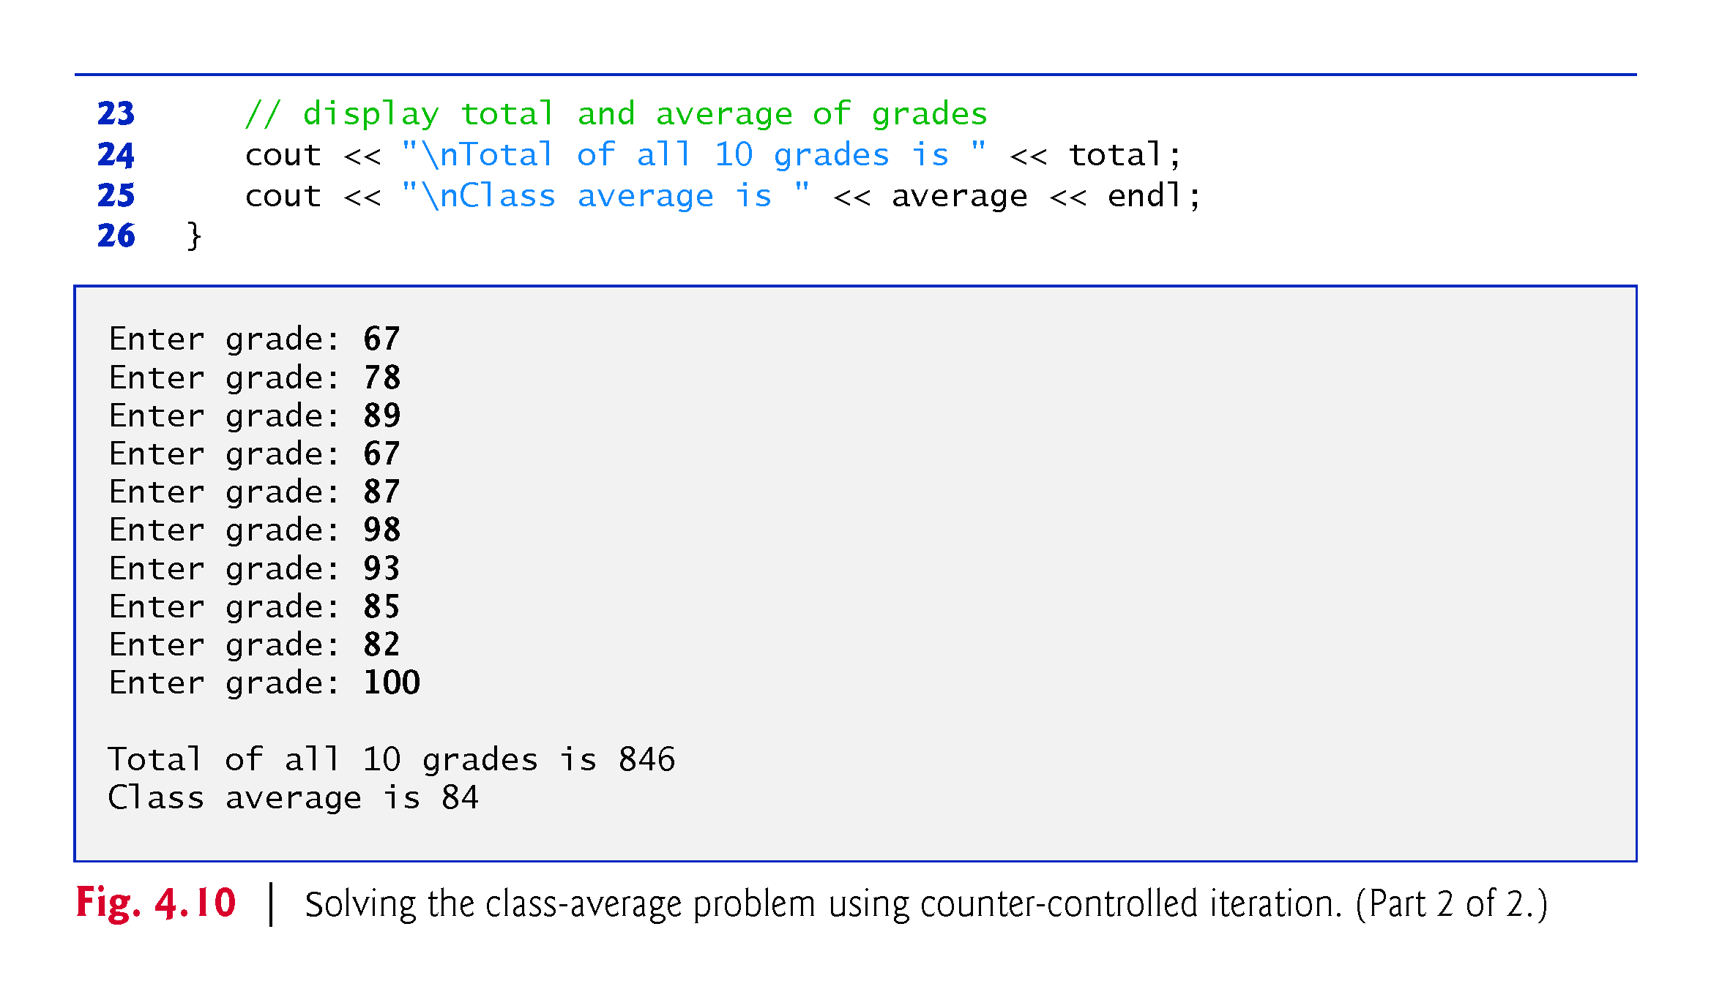

Slide 64
4.9.2 Implementing Counter-Controlled Iteration
Variable gradeCounter is of type unsigned int, because it can assume only the values from 1 through 11 (11 terminates the loop), which are all positive values.
In general, counters that should store only nonnegative values should be declared with unsigned types.
Variables of unsigned integer types can represent values from 0 to approximately twice the positive range of the corresponding signed integer types.

Slide 65
4.9.2 Implementing Counter-Controlled Iteration
A variable declared in a function body is a local variable and can be used only from the line of its declaration to the closing right brace of the block in which the variable is declared.
A local variable’s declaration must appear before the variable is used; otherwise, a compilation error occurs.
Variable grade—declared in the body of the while loop—can be used only in that block.

Slide 66
4.9.2 Implementing Counter-Controlled Iteration
You’ll normally initialize counter variables to zero or one, depending on how they are used in an algorithm.

Slide 67
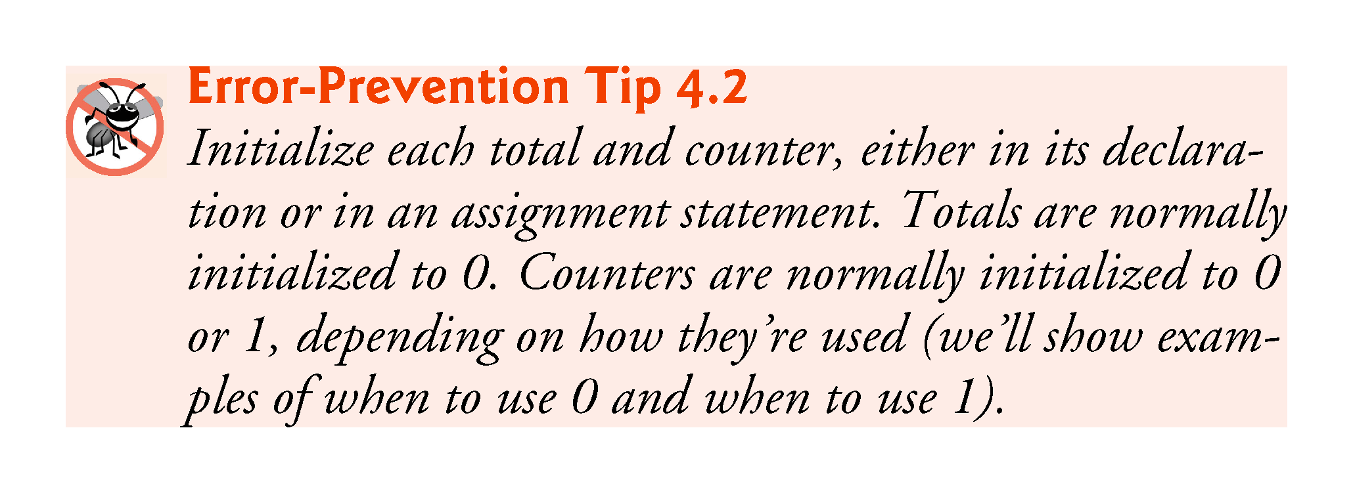

Slide 68
4.9.3 Notes on Integer Division and Truncation
Dividing two integers results in integer division—any fractional part of the calculation is truncated (discarded).

Slide 69
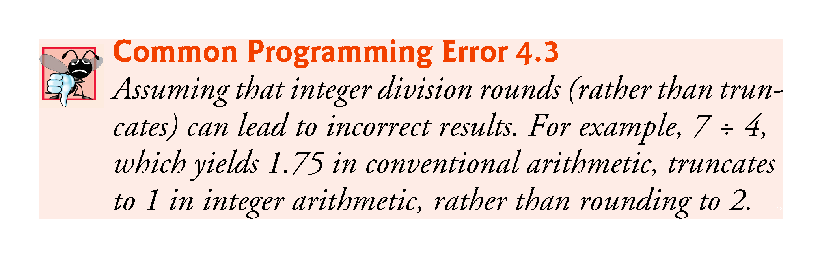

Slide 70
4.9.3 Arithmetic Overflow
In Fig. 4.10, line 16
total = total + grade; // add grade to total
added each grade entered by the user to the total.
Even this simple statement has a potential problem—adding the integers could result in a value that’s too large to store in an int variable.
This is known as arithmetic overflow and causes undefined behavior, which can lead to security problems or unintended results
http://en.wikipedia.org/wiki/Integer_overflow #Security_ramifications

Slide 71
4.9.3 Arithmetic Overflow
Figure 2.5’s addition program had the same issue in line 19, which calculated the sum of two int values entered by the user:
sum = number1 + number2;
The maximum and minimum values that can be stored in an int variable are represented by the constants INT_MAX and INT_MIN, respectively, which are defined in the header <climits>.

Slide 72
4.9.3 Arithmetic Overflow
There are similar constants for the other integral types and for floating-point types.
You can see your platform’s values for these constants by opening the headers <climits> and <cfloat> in a text editor.
It’s considered a good practice to ensure that before you perform arithmetic calculations like the ones in line 16 of Fig. 4.10 and line 19 of Fig. 2.5, they will not overflow.
The code for doing this is shown on the CERT website www.securecoding.cert.org—just search for guideline “INT32-CPP.” (Uses operators defined in next chapter.)

Slide 73
4.9.4 Input Validation
To ensure that inputs are valid, industrial-strength programs must test for all possible erroneous cases.
A program that inputs grades should validate the grades by using range checking to ensure that they’re values from 0 to 100.
You can then ask the user to reenter any value that’s out of range.
If a program requires inputs from a specific set of values (e.g., non-sequential product codes), you can ensure that each input matches a value in the set.

Slide 74
4.10 Formulating Algorithms: Sentinel-Controlled Iteration
Let’s generalize the class average problem.
Develop a class average program that processes grades for an arbitrary number of students each time it’s run.
Must process an arbitrary number of grades.
How can the program determine when to stop the input?
Sentinel value (also called a signal value, a dummy value or a flag value) can be used for “end of data entry.”
Sentinel-controlled iteration is often called indefinite iteration
the number of iterations is not known in advance.
Sentinel value must not be an acceptable input value.

Slide 75
4.10.1 Top-Down, Stepwise Refinement: The Top and First Refinement
We approach the class average program with a technique called top-down, stepwise refinement
Begin with a pseudocode representation of the top—a single statement that conveys program’s overall function
Determine the class average for the quiz for an arbitrary number of students
The top is, in effect, a complete representation of a program.
Rarely conveys sufficient detail from which to write a pro-gram.

Slide 76
4.10.1 Top-Down, Stepwise Refinement: The Top and First Refinement
We divide the top into a series of smaller tasks and list these in the order in which they need to be performed.
This results in the following first refinement.
Initialize variables
Input, sum and count the quiz grades
Calculate and print the class average
This refinement uses only the sequence structure—these steps execute in order.

Slide 77
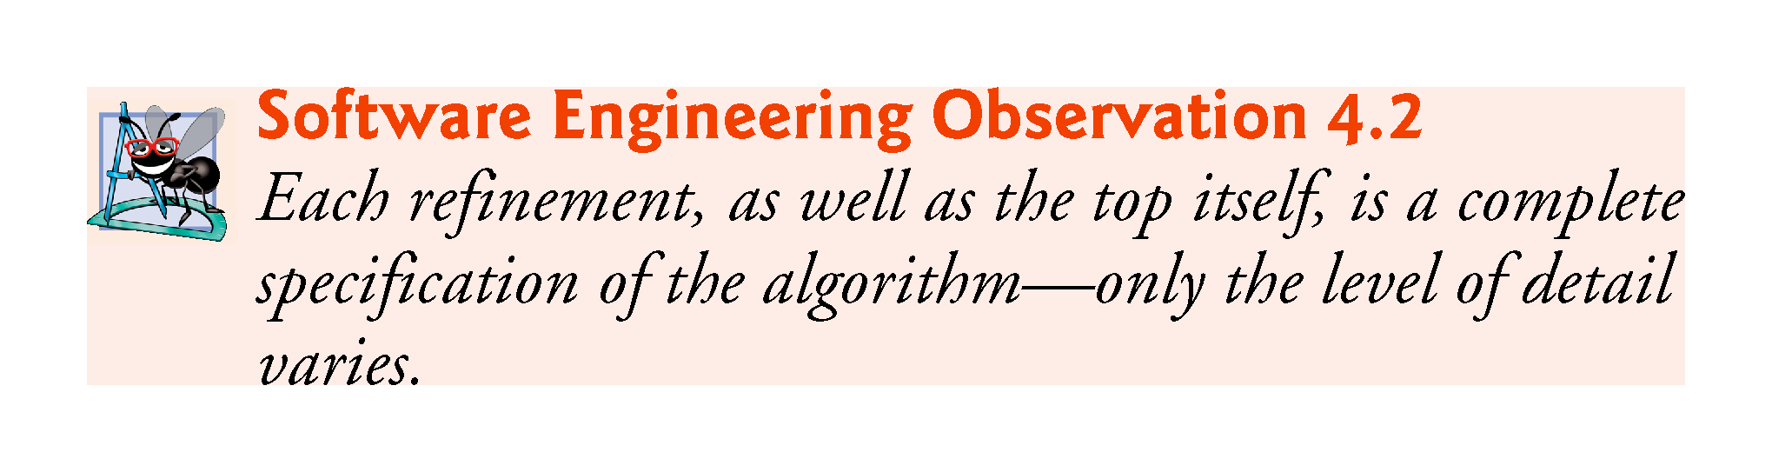

Slide 78
4.10.2 Proceeding to the Second Refinement
In the second refinement, we commit to specific variables.
The pseudocode statement
Input, sum and count the quiz grades
requires an iteration statement (i.e., a loop) that successively inputs each grade.

Slide 79
4.10.2 Proceeding to the Second Refinement
We don’t know in advance how many grades are to be processed, so we’ll use sentinel-controlled iteration.
The user enters legitimate grades one at a time.
After entering the last legitimate grade, the user enters the sentinel value.
The program tests for the sentinel value after each grade is input and terminates the loop when the user enters the sentinel value.

Slide 80
4.10.2 Proceeding to the Second Refinement
The second refinement of the preceding pseudocode statement is then
Prompt the user to enter the first grade
Input the first grade (possibly the sentinel)
While the user has not yet entered the sentinel
Add this grade into the running total
Add one to the grade counter
Prompt the user to enter the next grade
Input the next grade (possibly the sentinel)

Slide 81
4.10.2 Proceeding to the Second Refinement
The pseudocode statement
Calculate and print the total of all student grades and the class average
can be refined as follows:
If the counter is not equal to zero
Set the average to the total divided by the counter
Print the average
else
Print “No grades were entered”
Test for the possibility of division by zero
Normally a fatal logic error that, if undetected, would cause the program to fail (often called “crashing”).

Slide 82
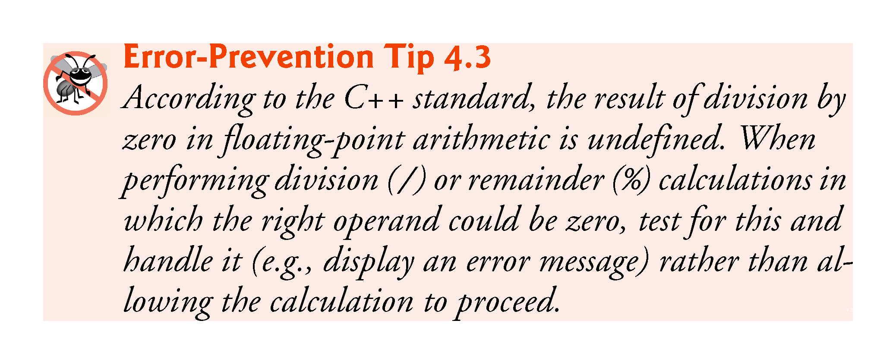

Slide 83
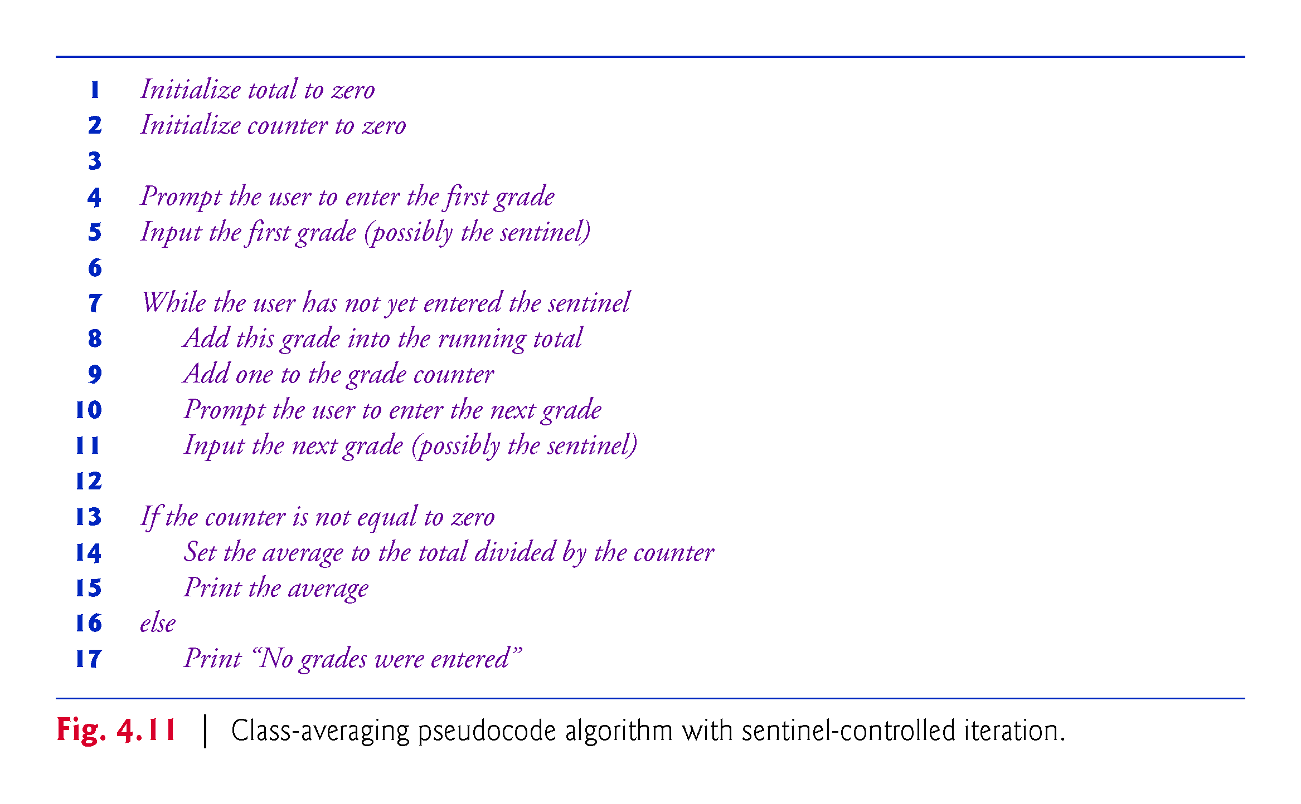

Slide 84
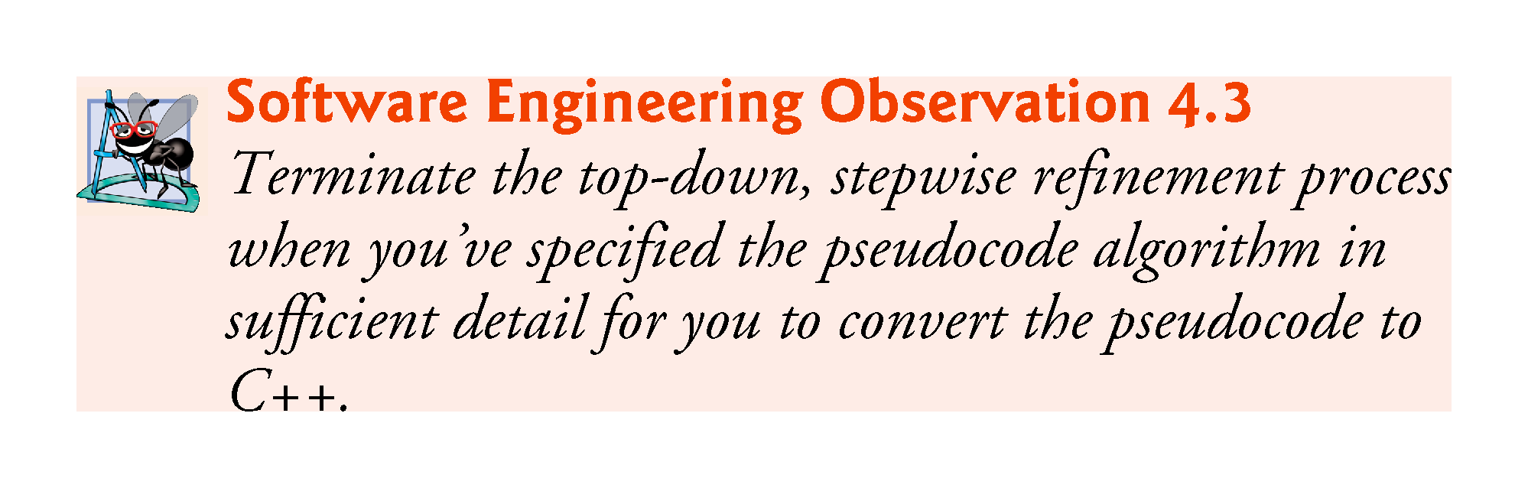

Slide 85
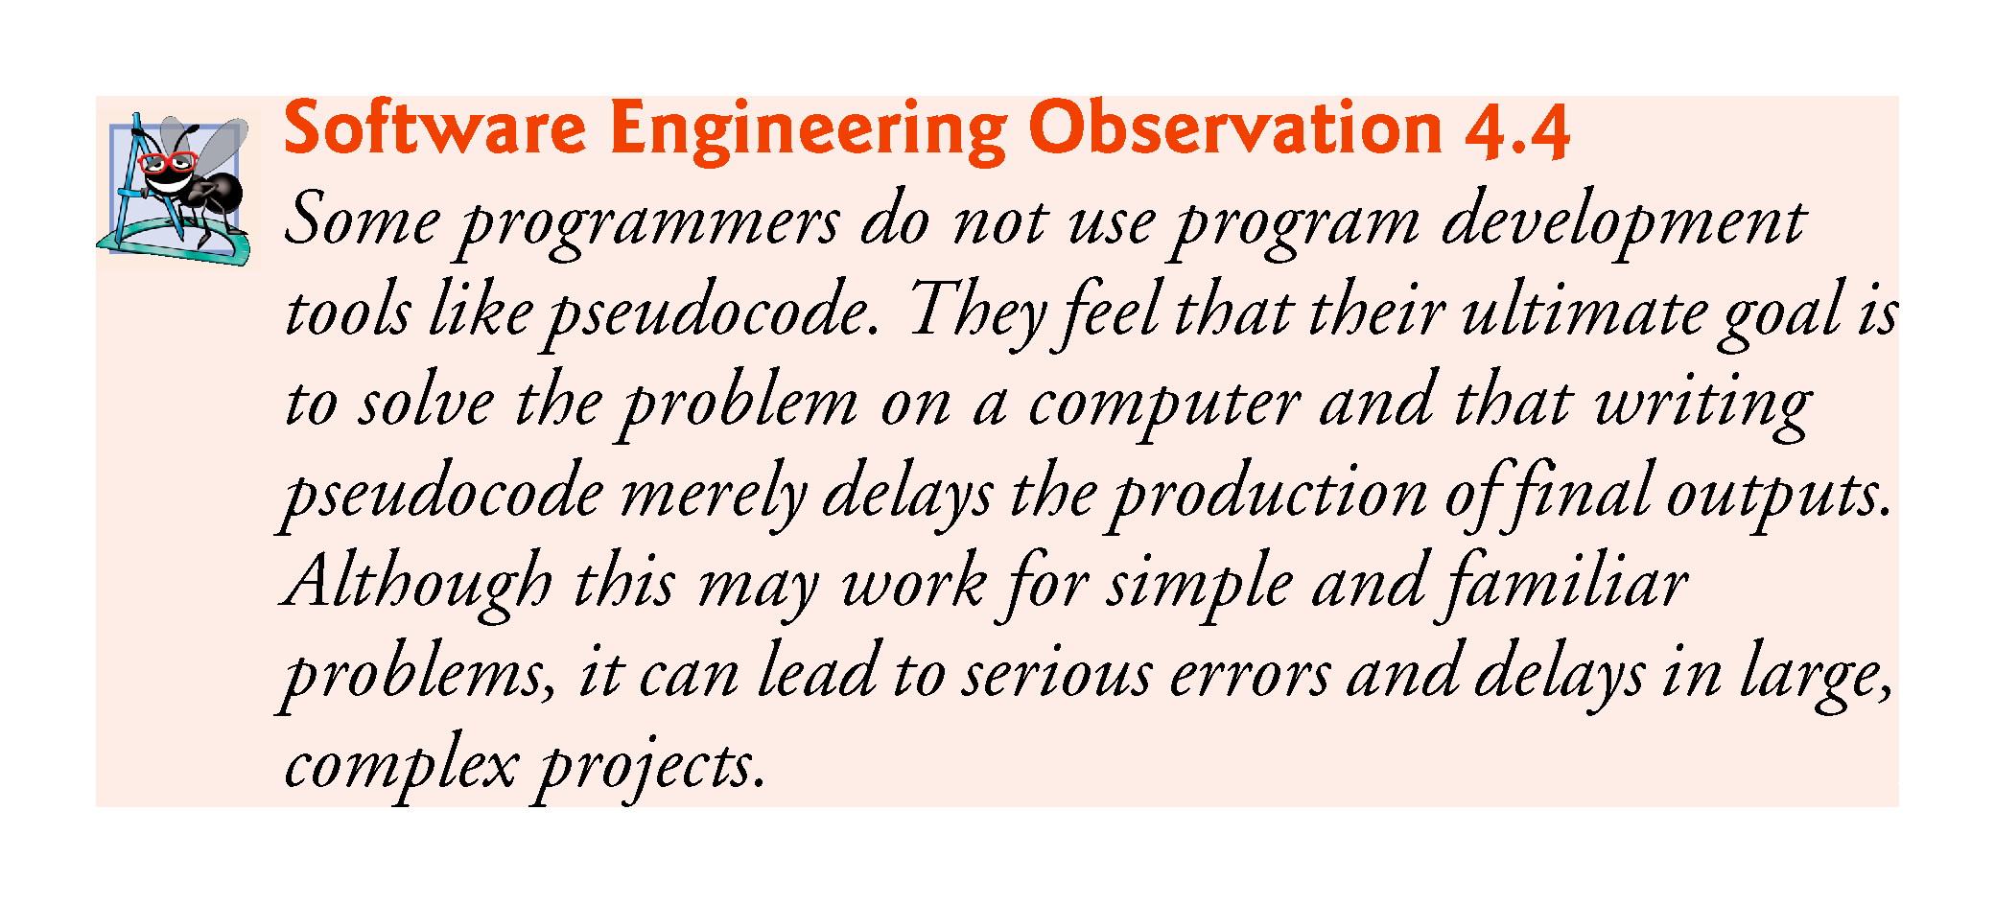

Slide 86
4.10.3 Implementing Sentinel-Controlled Iteration
An averaging calculation is likely to produce a number with a decimal point—a real number or floating-point number (e.g., 7.33, 0.0975 or 1000.12345).
Type int cannot represent such a number.
C++ provides several data types for storing floating-point numbers in memory, including float and double.
Compared to float variables, double variables can typically store numbers with larger magnitude and finer detail
more digits to the right of the decimal point—also known as the number’s precision.
Cast operator can be used to force the averaging calculation to produce a floating-point numeric result.

Slide 87
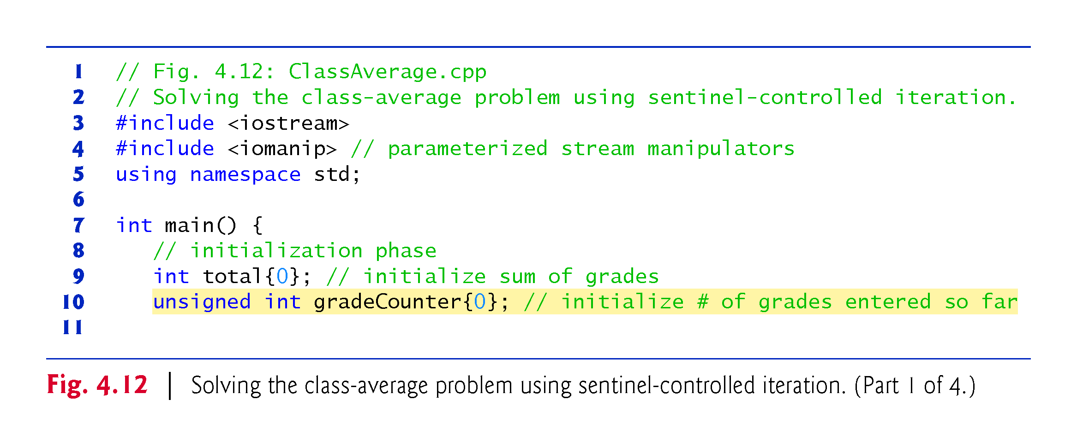

Slide 88
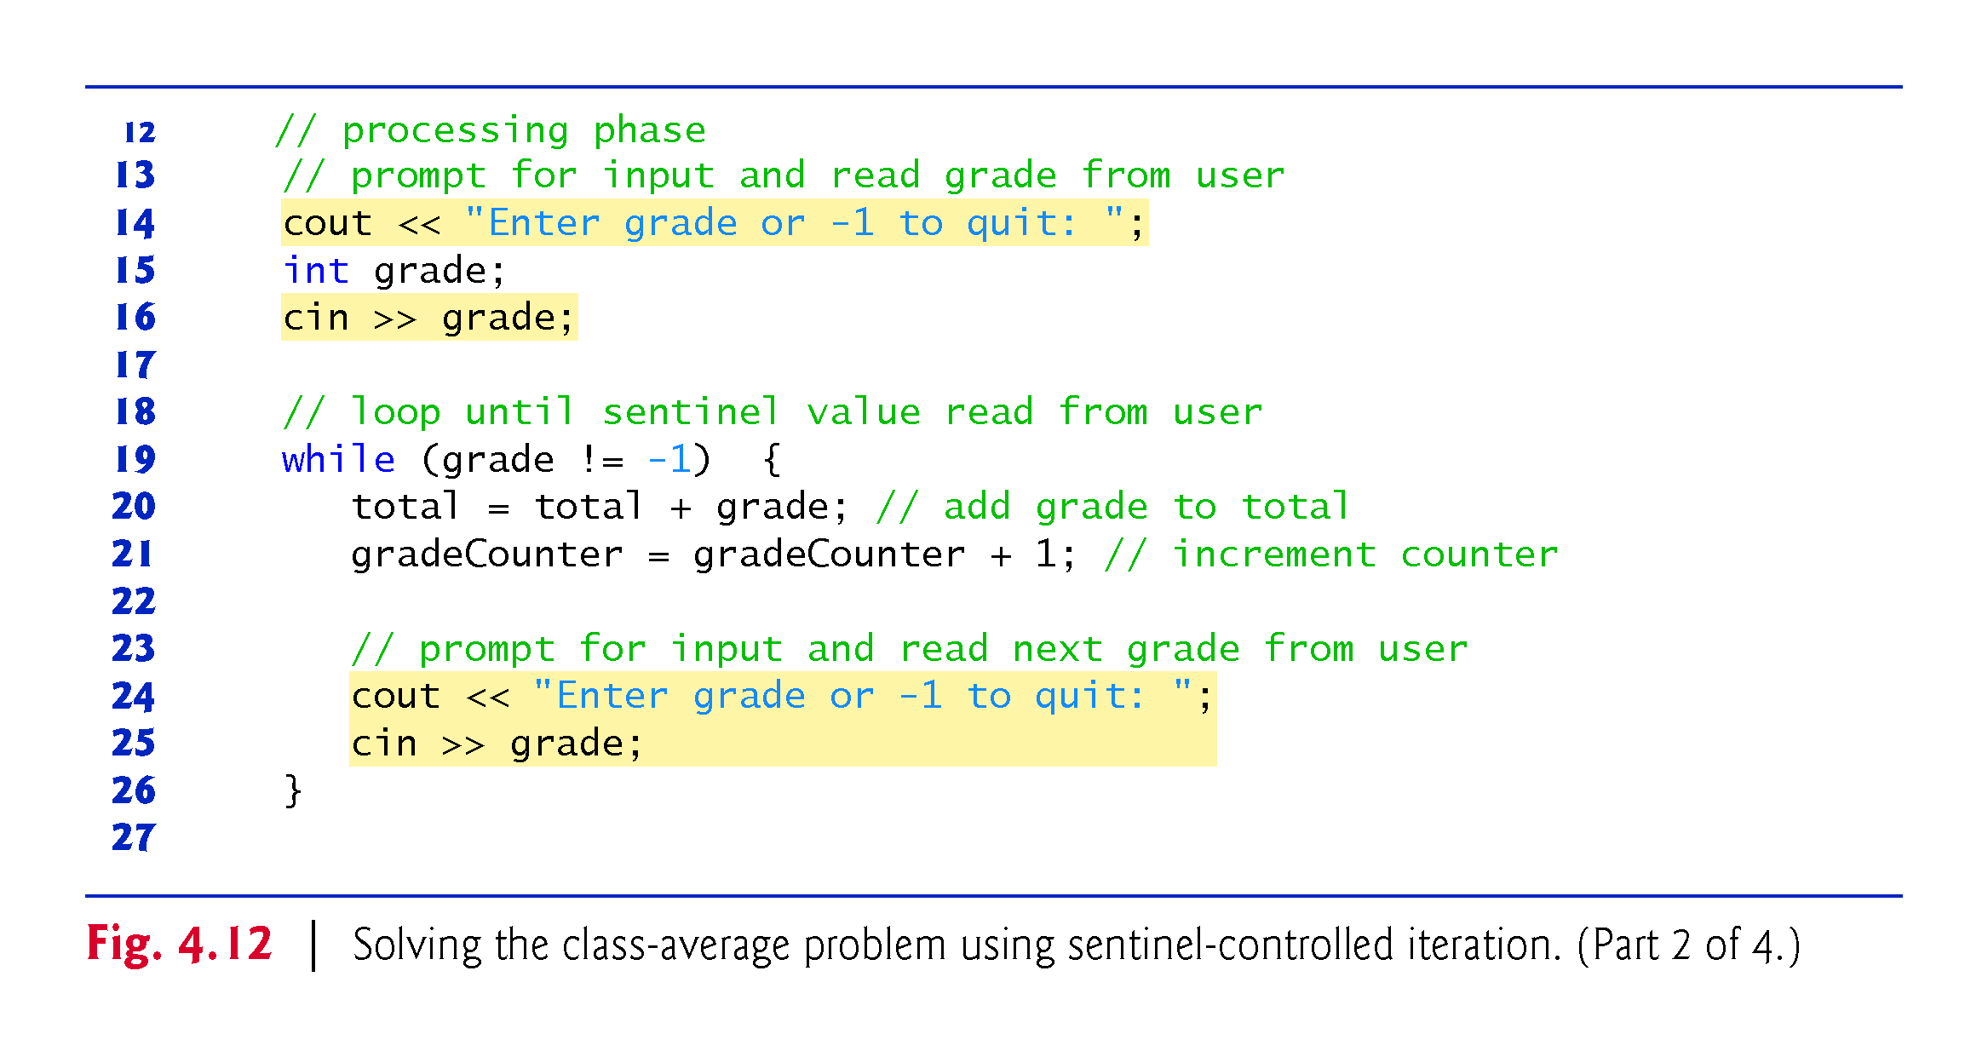

Slide 89
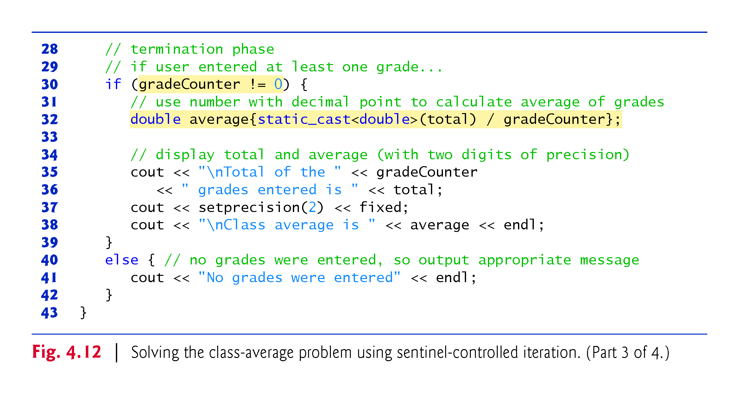
Notes:
Ob: fixed forces 2 decimal digits precision even in the case of whole numbers – i.e 88 is shown as 88.00
Ob: setprecision(x) forces numbers to be shown with a number of decimals and in NOT scientific notation – i.e powers of 10

Slide 90
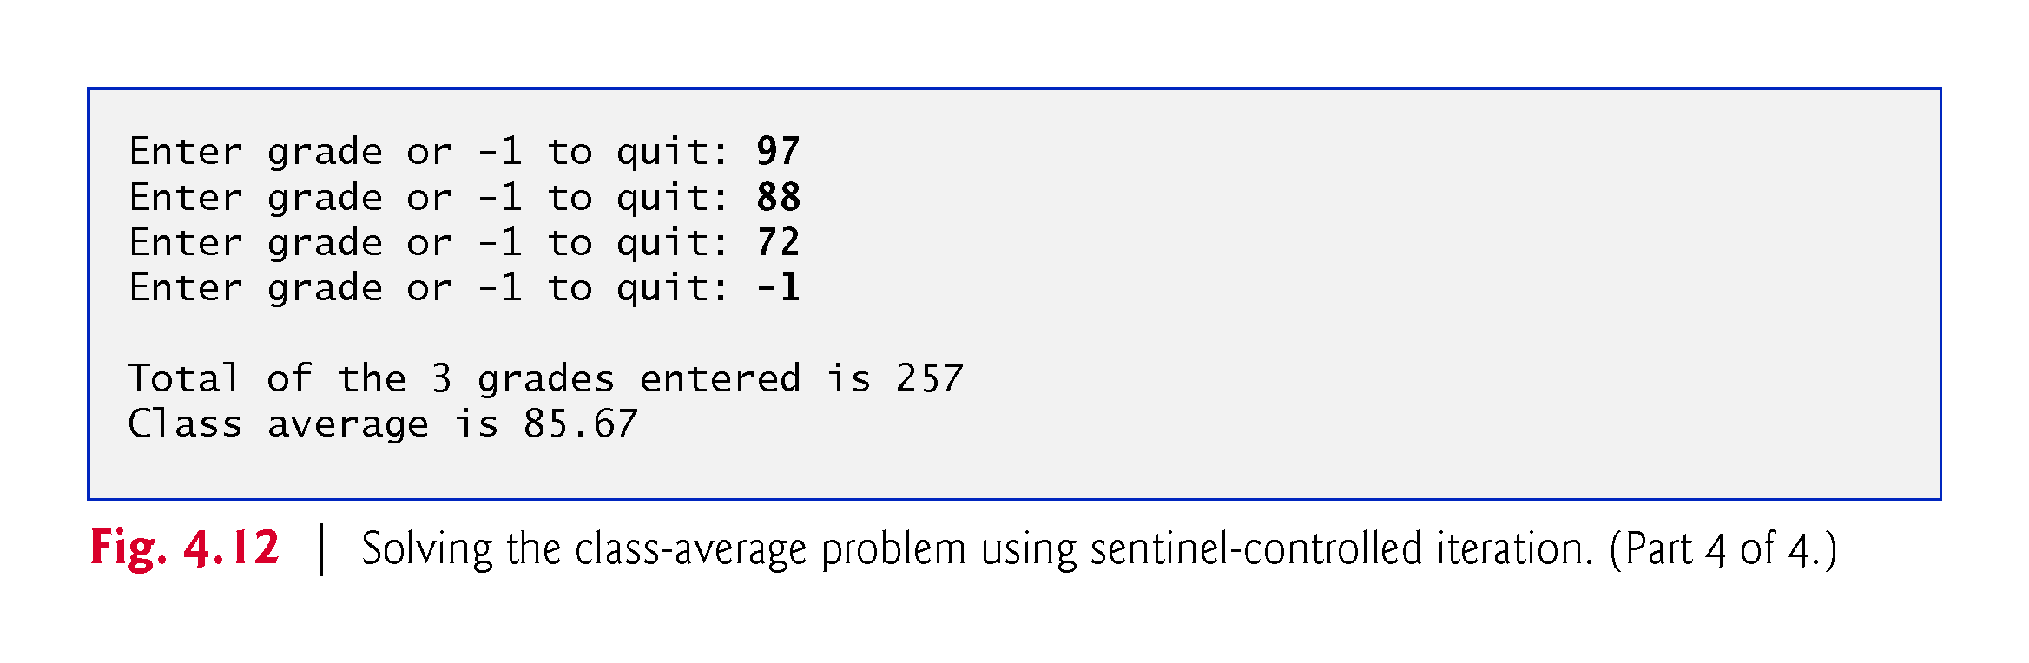

Slide 91
4.10.3 Implementing Sentinel-Controlled Iteration
Notice the block in the while loop.
Without the braces, the last three statements in the loop would fall outside its body, as follows:
// loop until sentinel value read from user while (grade != -1) total = total + grade; // add grade to total gradeCounter = gradeCounter + 1; // increment counter // prompt for input and read next grade from user cout << "Enter grade or -1 to quit: "; cin >> grade;
Would cause an infinite loop in the program if the user did not input –1 for the first grade.
Notes:
Ob: The last bullet point is especially true

Slide 92
4.10.4 Converting Between Fundamental Types Explicitly and Implicitly
The variable average is declared to be of type double to capture the fractional result of our calculation.
total and gradeCounter are both integer variables.
Recall that dividing two integers results in integer division, in which any fractional part of the calculation is lost (i.e., truncated).
In the following statement the division occurs first—the result’s fractional part is lost before it’s assigned to average:
double average{total / gradeCounter};
Notes:
Ob: if cout << average with total 7 and gradeCounter 4, the outputted average would be 1 due to truncation. How would you output 1.000 – with setprecision(3) and the fixed keyword.

Slide 93
4.10.4 Converting Between Fundamental Types Explicitly and Implicitly
To perform a floating-point calculation with integers, create temporary floating-point values.
static_cast operator accomplishes this task.
The cast operator static_cast<double>(total) creates a temporary floating-point copy of its operand in parentheses.
Known as explicit conversion.
The value stored in total is still an integer.

Slide 94
4.10.4 Converting Between Fundamental Types Explicitly and Implicitly
The calculation now consists of a floating-point value divided by the integer gradeCounter.
The compiler knows how to evaluate only expressions in which the operand types of are identical.
Compiler performs promotion (also called implicit conversion) on selected operands.
In an expression containing values of data types int and double, C++ promotes int operands to double values.
Cast operators are available for use with every data type and with class types as well.
Notes:
Ob: The last statement is especially true – it applies to user defined class types. If you casr double to int , you will get a compiler warning – potential loss of data

Slide 95


Slide 96
4.10.5 Formatting Floating-Point Numbers
The call to setprecision (with an argument of 2) indicates that double values should be printed with two digits of precision to the right of the decimal point (e.g., 92.37).
Parameterized stream manipulator (argument in parentheses).
Programs that use these must include the header <iomanip>.
endl is a nonparameterized stream manipulator and does not require the <iomanip> header file.
If the precision is not specified, floating-point values are normally output with six digits of precision.

Slide 97
4.10.5 Formatting Floating-Point Numbers
Stream manipulator fixed indicates that floating-point values should be output in fixed-point format, as opposed to scientific notation.
Fixed-point formatting is used to force a floating-point number to display a specific number of digits.
Specifying fixed-point formatting also forces the decimal point and trailing zeros to print, even if the value is a whole number amount, such as 88.00.
Without the fixed-point formatting option, such a value prints in C++ as 88 without the trailing zeros and decimal point.

Slide 98
4.10.5 Formatting Floating-Point Numbers
When the stream manipulators fixed and setprecision are used in a program, the printed value is rounded to the number of decimal positions indicated by the value passed to setprecision (e.g., the value 2), although the value in memory re-mains unaltered.
It’s also possible to force a decimal point to appear by using stream manipulator showpoint.
If showpoint is specified without fixed, then trailing zeros will not print.
Both can be found in header <iostream>.
Notes:
Ob: The first bullet point very important – the internal representation of a number remains unaltered.
Ob: showpoint without fixed – equivalent to cout

Slide 99
4.10.6 Unsigned Integers and User Input
Fig. 4.10 declared the variable gradeCounter as an unsigned int because it can assume only the values from 1 through 11 (11 terminates the loop), which are all non-negative values.
Could have also declared as unsigned int the variables grade, total and average. Grades are normally values from 0 to 100, so the total and average should each be greater than or equal to 0.
We declared those variables as ints because we can’t control what the user actually enters—the user could enter negative values.
Worse yet, the user could enter a value that’s not even a number.

Slide 100
4.10.6 Unsigned Integers and User Input
Sometimes sentinel-controlled loops use intentionally invalid values to terminate a loop.
We terminate the loop when the user enters the sentinel -1 (an invalid grade), so it would be improper to declare variable grade as an unsigned int.
As you’ll see, the end-of-file (EOF) indicator is also normally implemented internally in the compiler as a negative number.
Notes:
Ob: Last bullet point useful when reading characters for example – EOF is usually -1

Slide 101
4.11 Formulating Algorithms: Nested Control Statements
For the next example, we once again formulate an algorithm by using pseudocode and top-down, stepwise refinement, and write a corresponding C++ program.
In this case study, we examine the only other structured way control statements can be connected—namely, by nesting one control statement within another.

Slide 102
4.11.1 Problem Statement
Consider the following problem statement:
A college offers a course that prepares students for the state licensing exam for real estate brokers. Last year, ten of the students who completed this course took the exam. The college wants to know how well its students did on the exam. You’ve been asked to write a program to summarize the results. You’ve been given a list of these 10 students. Next to each name is written a 1 if the student passed the exam or a 2 if the student failed.
Your program should analyze the results of the exam as follows:
1.Input each test result (i.e., a 1 or a 2). Display the prompting message “Enter result” on the screen each time the program requests another test result.
2.Count the number of test results of each type.
3.Display a summary of the test results indicating the number of students who passed and the number who failed.
4.If more than eight students passed the exam, print “Bonus to instructor!”

Slide 103
4.11.1 Problem Statement
After reading the problem statement carefully, we make the following observations:
Must process test results for 10 students. A counter-controlled loop can be used because the number of test results is known in advance.
Each test result is either a 1 or a 2. Each time the program reads a test result, the program must determine whether the number is a 1 or a 2. For simplicity, we test only for a 1 in our algorithm. If the number is not a 1, we assume that it’s a 2.
Two counters keep track of the exam results—one to count the number of students who passed and one to count the number of students who failed.
After the program has processed all the results, it must decide whether more than eight students passed the exam.

Slide 104
4.11.2 Top-Down Stepwise Refinement: Pseudocode Representation of the Top
Pseudocode representation of the top:
Analyze exam results and decide whether tuition should be raised

Slide 105
4.11.3 Top-Down Stepwise Refinement: First Refinement
First refinement
Initialize variables
Input the 10 exam results, and count passes and failures
Print a summary of the exam results and decide whether a bonus should be paid
Further refinement is necessary.
Counters are needed to record the passes and failures, a counter will be used to control the looping process and a variable is needed to store the user input.

Slide 106
4.11.4 Top-Down Stepwise Refinement: Second Refinement
The pseudocode statement
Initialize variables
can be refined as follows:
Initialize passes to zero
Initialize failures to zero
Initialize student counter to one

Slide 107
4.11.4 Top-Down Stepwise Refinement: Second Refinement
The following pseudocode statement requires a loop that successively inputs the result of each exam
Input the 10 exam results, and count passes and failures
10 exam results, so counter-controlled looping is appropriate.
Nested inside the loop, an if…else statement will determine whether each exam result is a pass or a failure and will increment the appropriate counter.
The refinement of the preceding pseudocode statement is then
While student counter is less than or equal to 10
Prompt the user to enter the next exam result
Input the next exam result
If the student passed
Add one to passes
Else Add one to failures
Add one to student counter

Slide 108
4.11.4 Top-Down Stepwise Refinement: Second Refinement
The pseudocode statement
Print a summary of the exam results and decide whether bonus should be paid
can be refined as follows:
Print the number of passes
Print the number of failures
If more than eight students passed
Print “Bonus to instructor!”
The complete second refinement appears in Fig. 4.13.

Slide 109
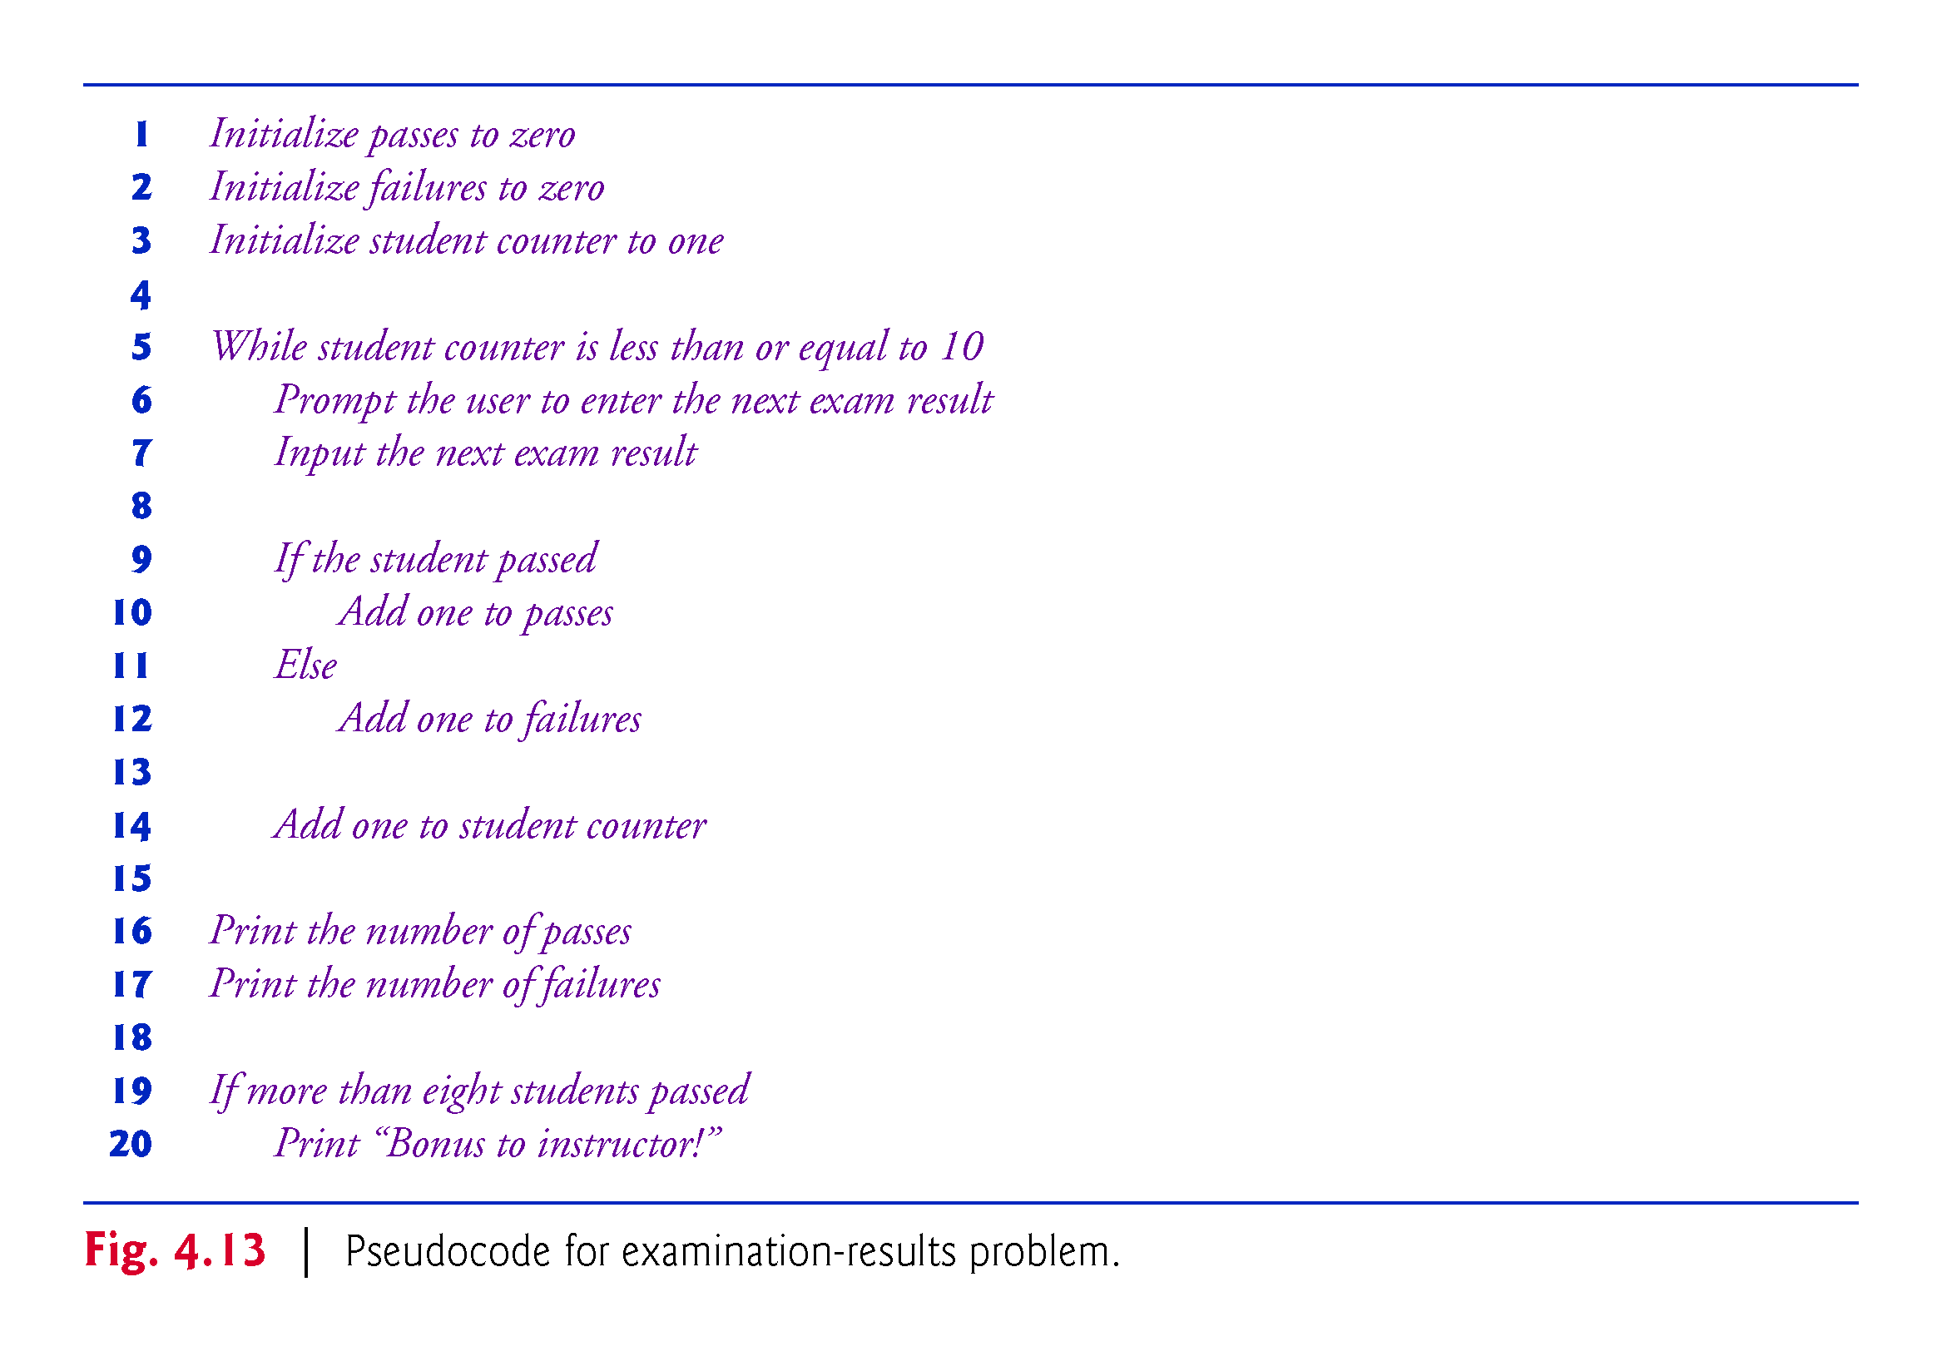

Slide 110
4.11.6 Program That Implements the Pseudocode Algoritm
The program that implements the pseudocode algorithm and two sample executions are shown in Fig. 4.14.

Slide 111
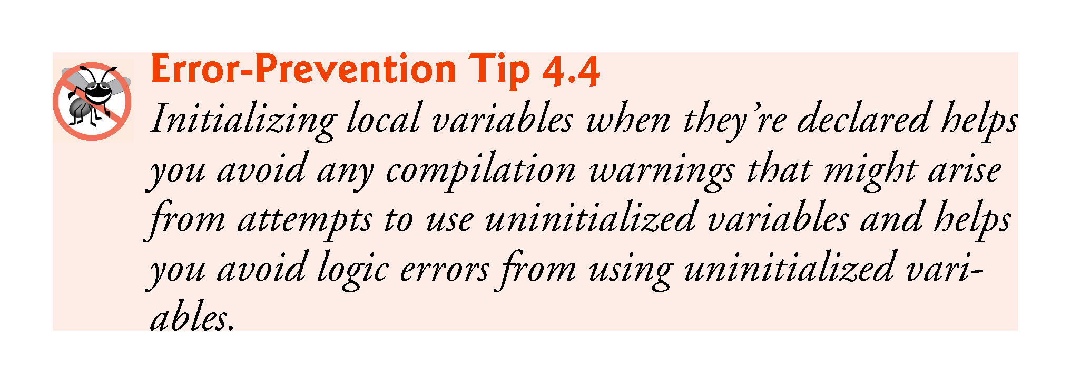

Slide 112
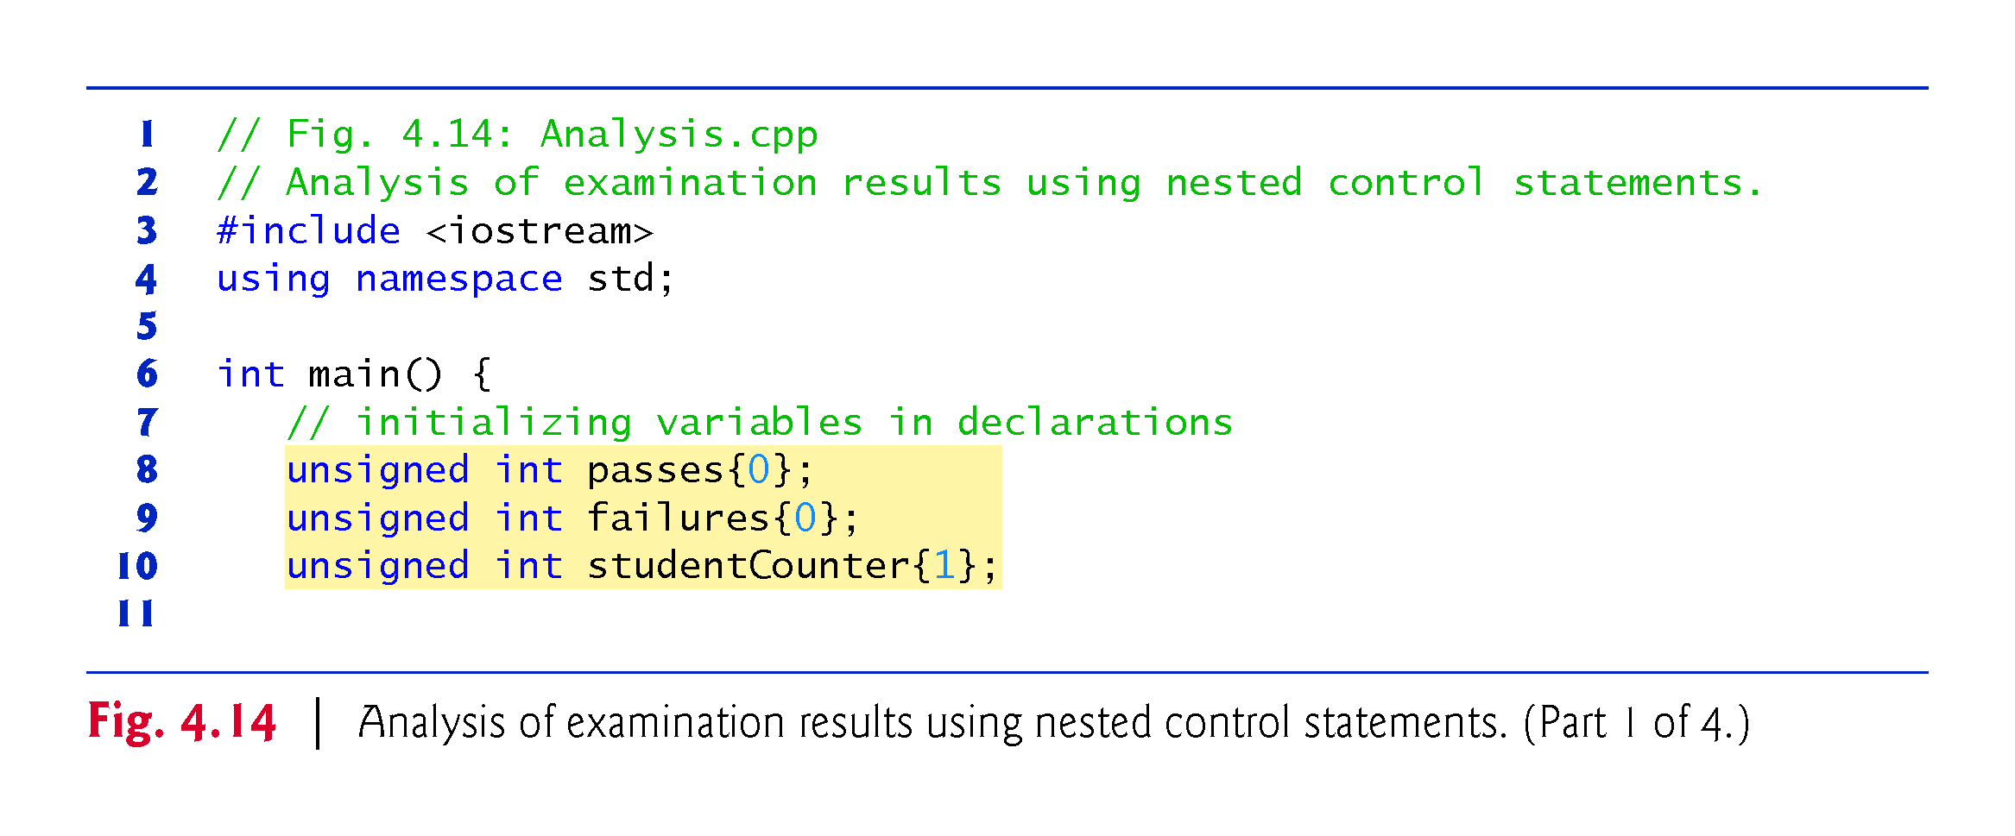

Slide 113
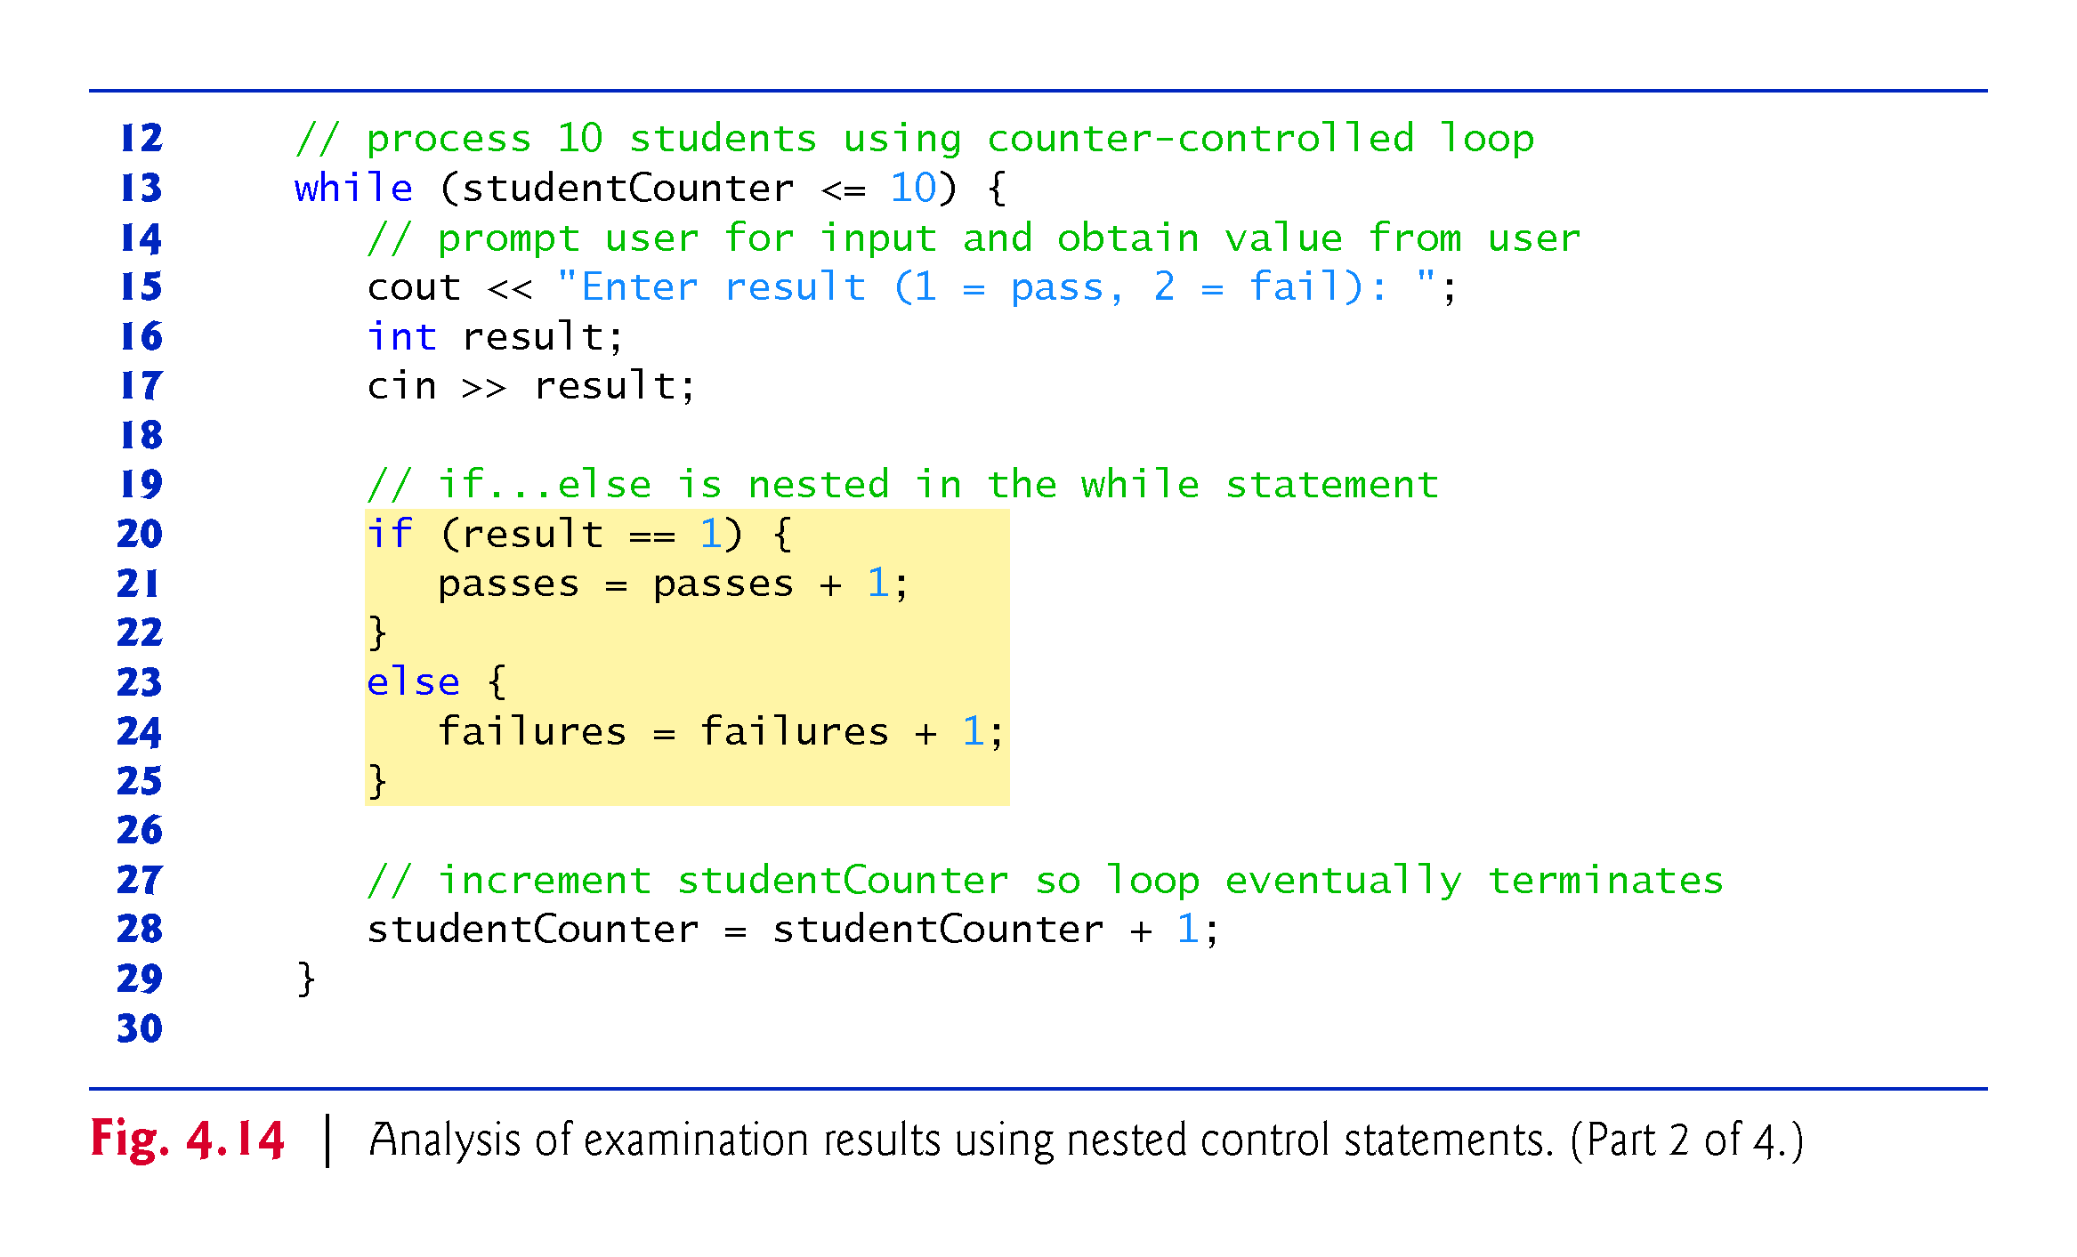
Notes:
Ob: important to guide the user on inputting the correct values – cout in line 15. Still the program not safe – safer with an inner while loop forcing the 1 or 2 choices. Inside this while you will have to input result again

Slide 114
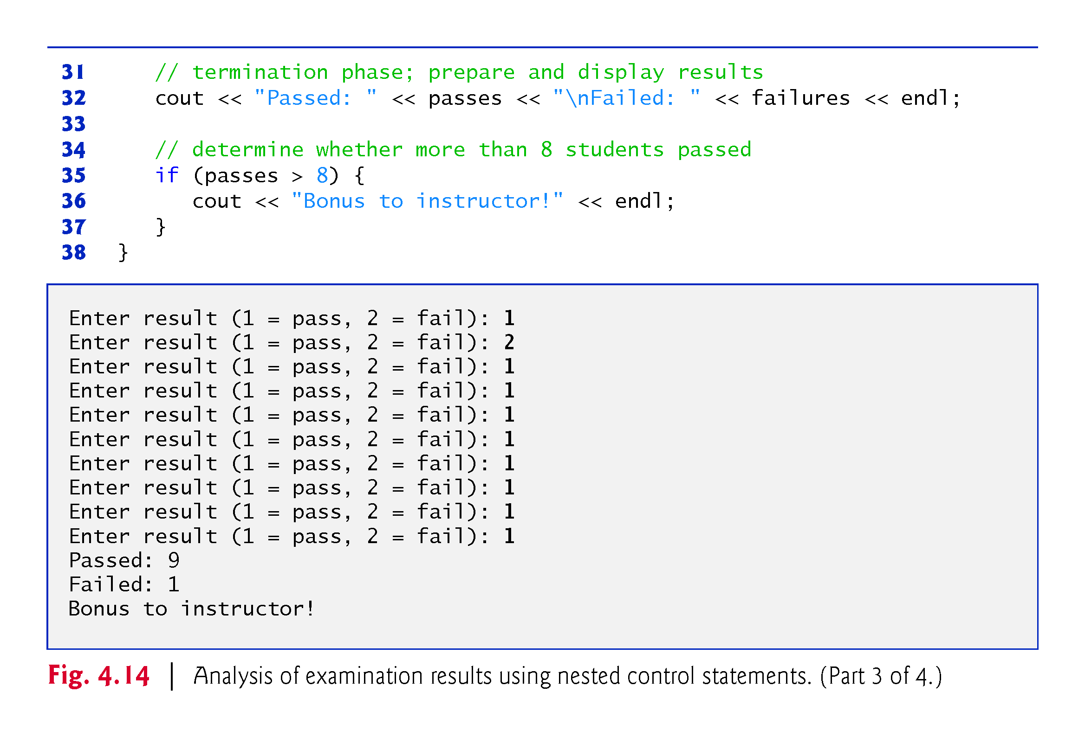

Slide 115
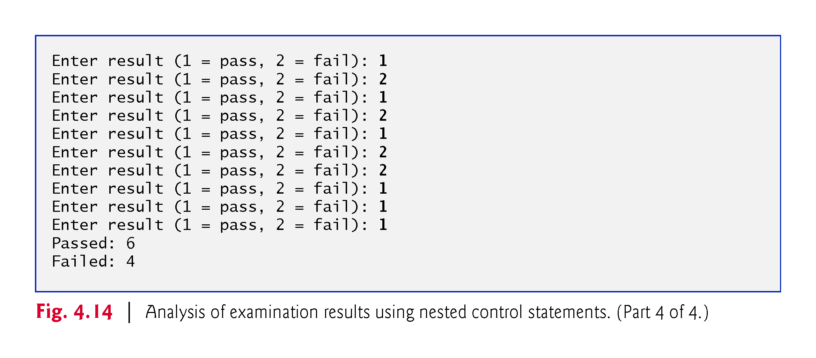

Slide 116
4.11.6 Program That Implements the Pseudocode Algoritm
The if…else statement for processing each result is nested in the while statement.
The if statement after the loop determines whether more than eight students passed the exam and, if so, outputs the message "Bonus to instructor!".

Slide 117
4.11.7 Preventing Narrowing Conversions with List Initialization
Consider from Fig. 4.14
unsigned int studentCounter{1};
Can also write as
unsigned int studentCounter = {1};
or
unsigned int studentCounter = 1;

Slide 118
4.11.7 Preventing Narrowing Conversions with List Initialization
For fundamental-type variables, list-initialization syntax also prevents so-called narrowing conversions that could result in data loss.
For example, previously you could write
int x = 12.7;
which attempts to assign the double value 12.7 to the int variable x.
A double value is converted to an int, by truncating the floating-point part (.7), which results in a loss of information—a narrowing conversion.

Slide 119
4.11.7 Preventing Narrowing Conversions with List Initialization
The actual value assigned to x is 12.
Many compilers generate a warning for this statement, but still allow it to compile.
However, using list initialization, as in
int x = {12.7};
or
int x{ 12.7 };
yields a compilation error.

Slide 120
4.12 Compound Assignment Operators
The compound assignment operators abbreviate assignment expressions.
The += operator adds the value of the expression on the right of the operator to the value of the variable on the left of the operator and stores the result in the variable on the left of the operator.
Any statement of the form
variable = variable operator expression;
in which the same variable appears on both sides of the assignment operator and operator is one of the binary operators +, -, *, /, or % (or others we’ll discuss later in the text), can be written in the form
variable operator= expression;
Thus the assignment c += 3 adds 3 to c.
Figure 4.15 shows the arithmetic assignment operators, sample expressions using these operators and explanations.
Notes:
Ob: That’s how the compiler understands these grammar rules - usual operations on grammars are substitutions and rewriting

Slide 121
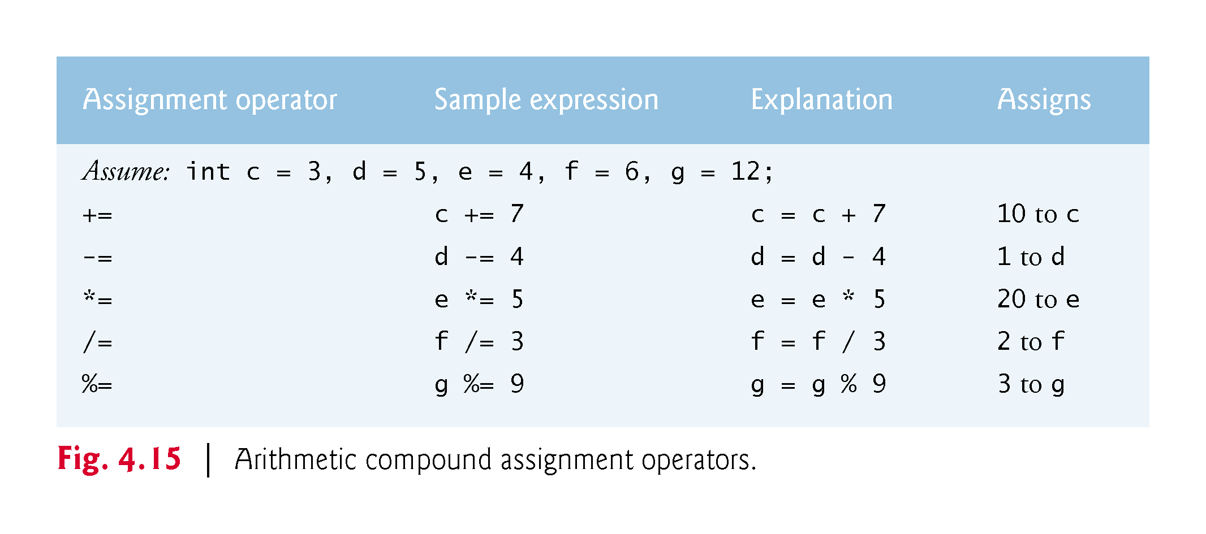

Slide 122
4.13 Increment and Decrement Operators
C++ also provides two unary operators for adding 1 to or subtracting 1 from the value of a numeric variable.
These are the unary increment operator, ++, and the unary decrement operator, --, which are summarized in Fig. 4.16.

Slide 123
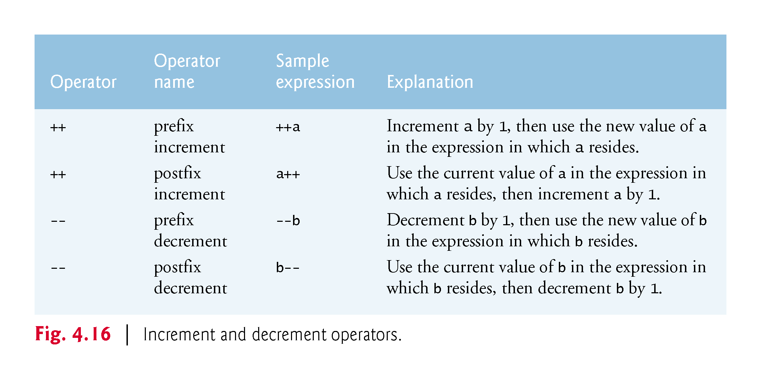

Slide 124
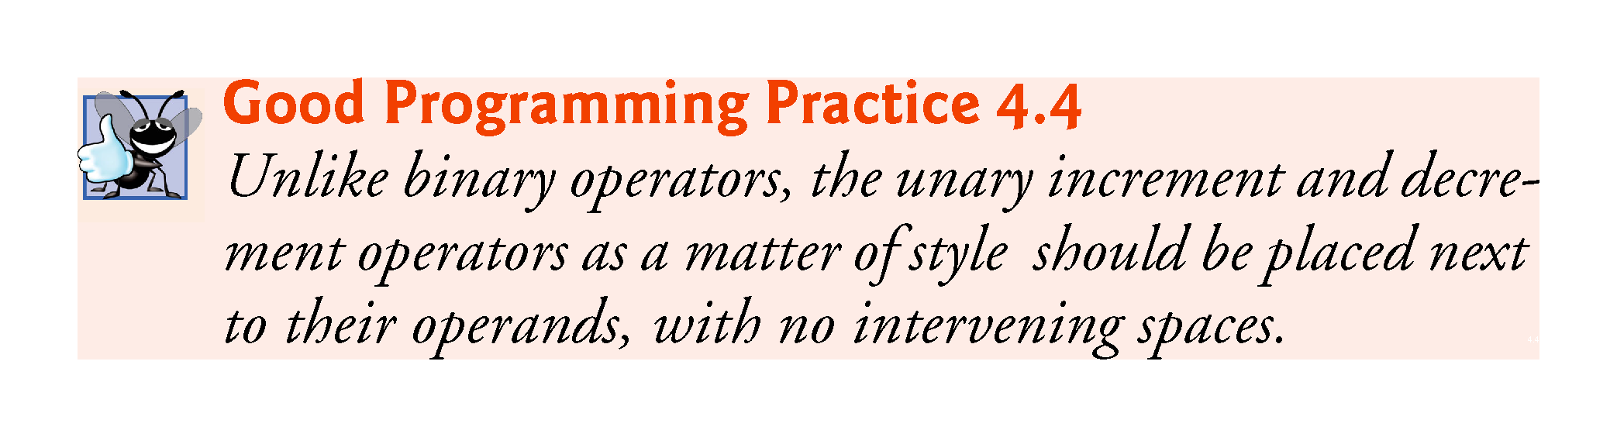

Slide 125
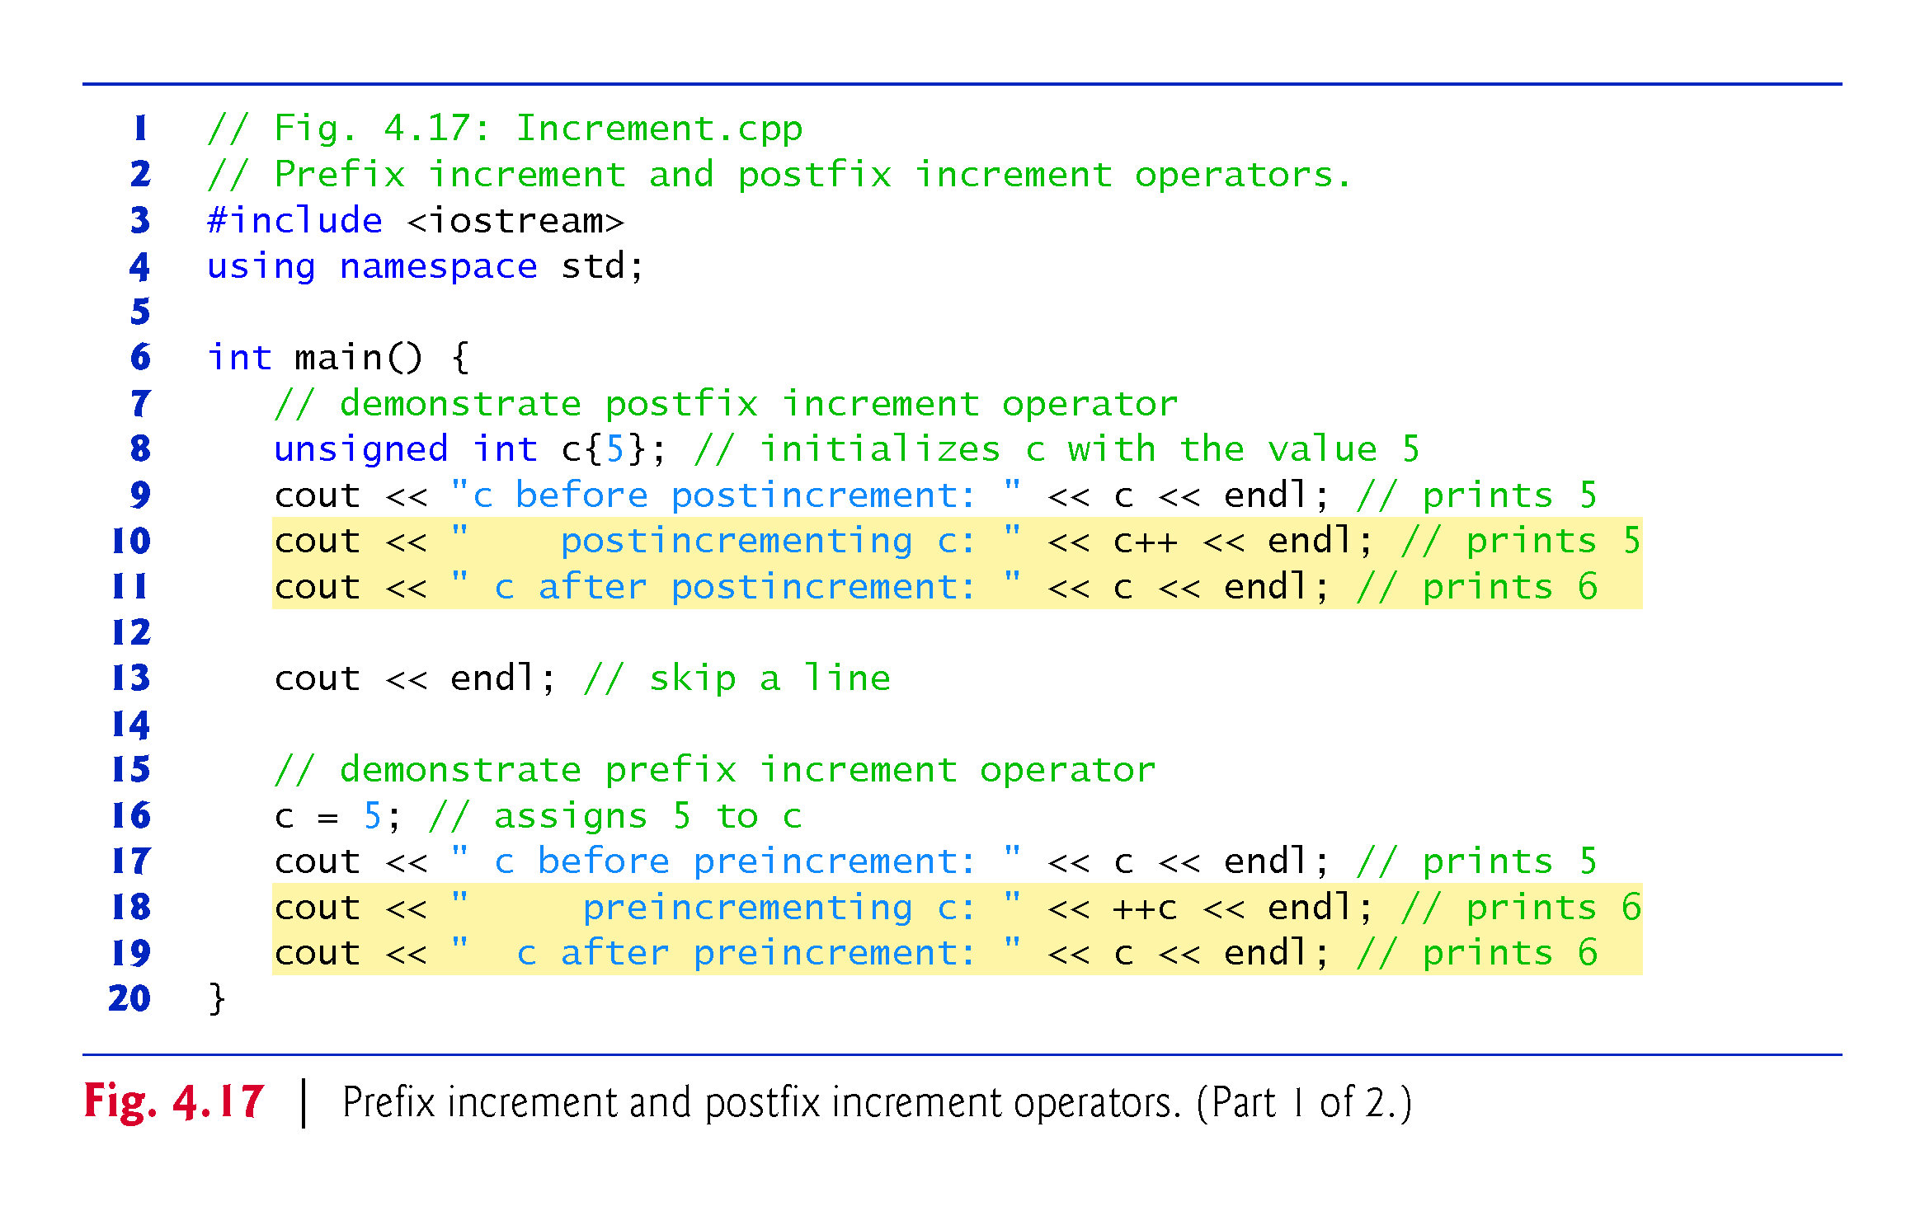

Slide 126
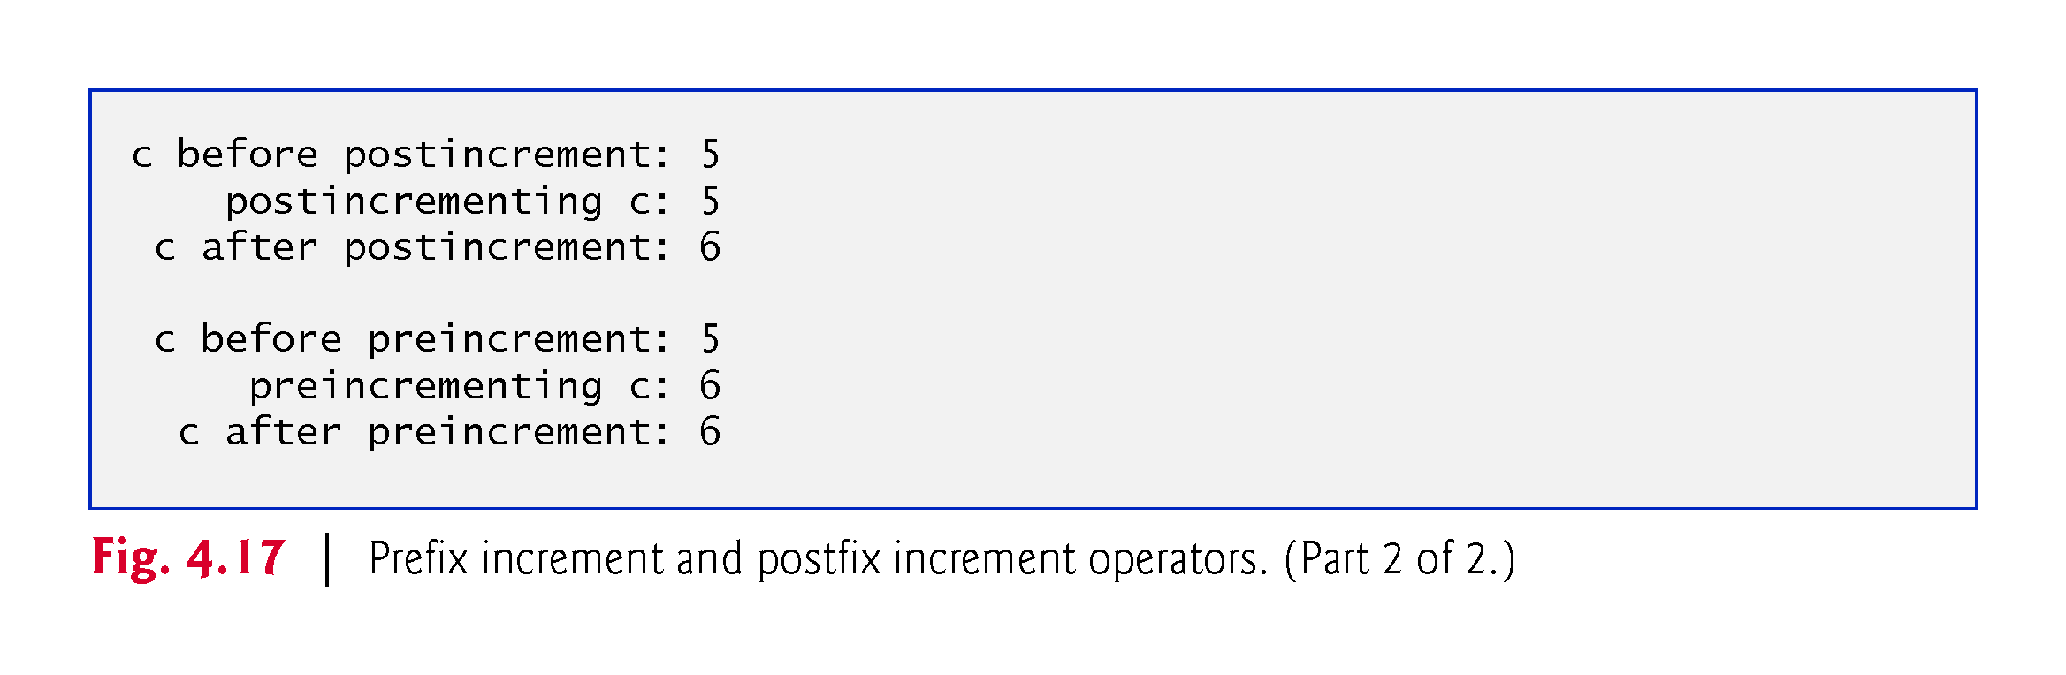

Slide 127
4.13 Increment and Decrement Operators (cont.)
When you increment (++) or decrement (--) a variable in a statement by itself, the preincrement and postincrement forms have the same effect, and the predecrement and postdecrement forms have the same effect.
In the context of a larger expression preincrementing a variable and postincrementing a variable have different effects (and similarly for predecrementing and post-decrementing).
Notes:
Ob: from the first bullet point atomic statements such as c++; ++c; --c; c–; all have the same effect

Slide 128
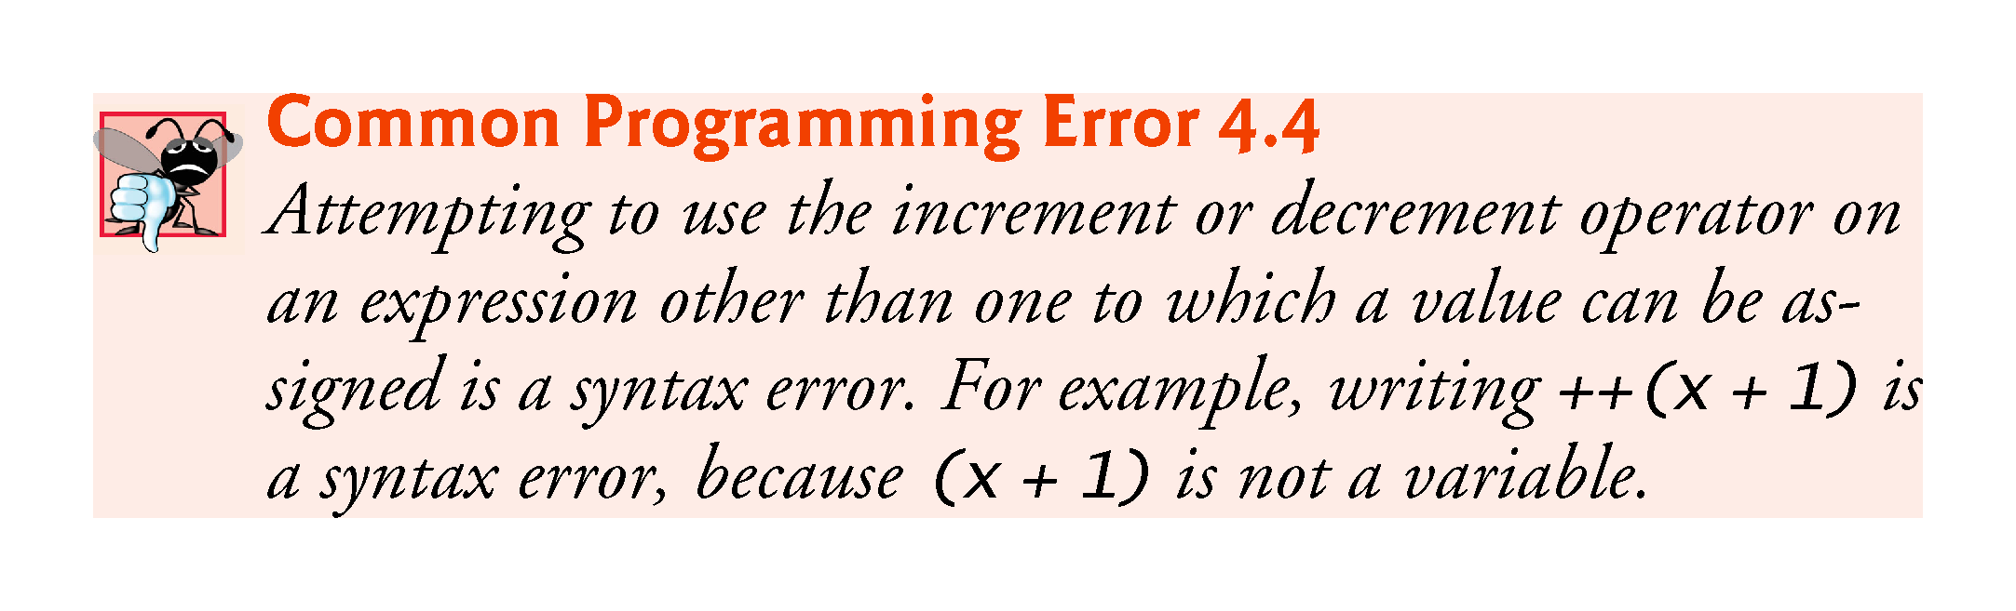

Slide 129
4.13 Increment and Decrement Operators (cont.)
Figure 4.18 shows the precedence and associativity of the operators introduced to this point.

Slide 130
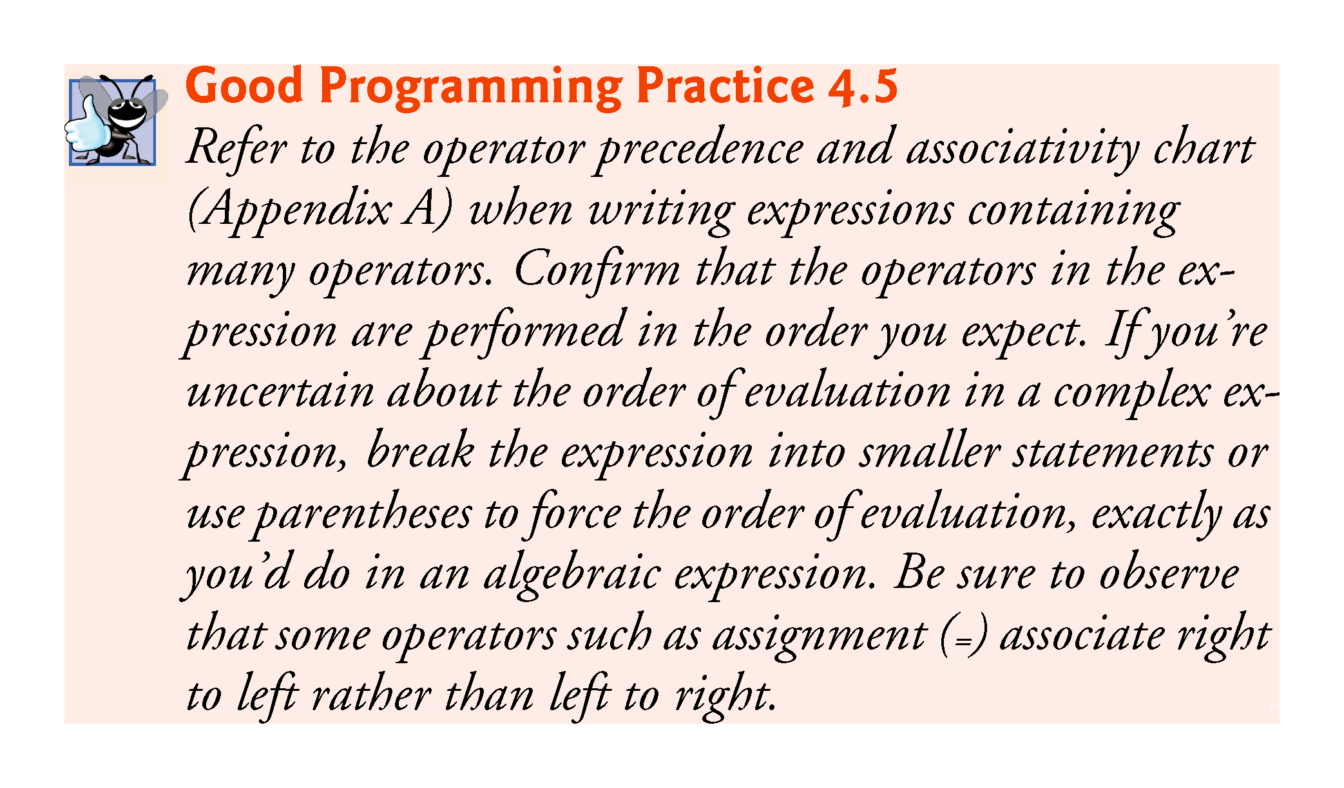

Slide 131
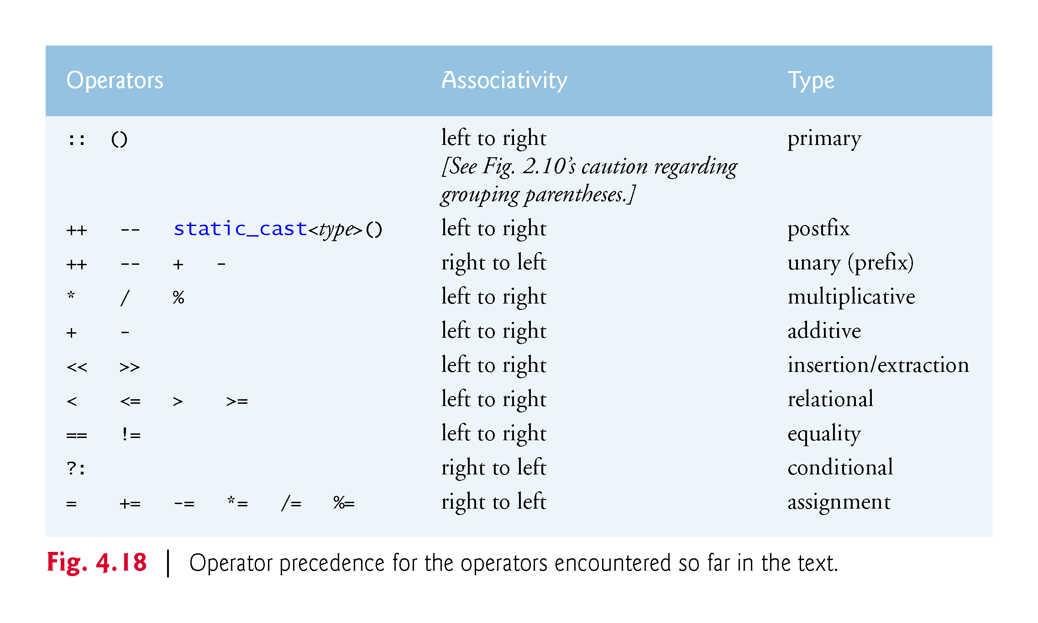

Slide 132
4.14 Fundamental Types Are Not Portable
The table in Appendix C lists C++’s fundamental types.
C++ requires all variables to have a type.
In C and C++, programmers frequently have to write separate versions of programs to support different computer platforms, because the fundamental types are not guaranteed to be identical from computer to computer.
An int on one machine might be represented by 16 bits (2 bytes) of memory, on a second machine by 32 bits (4 bytes), and on another machine by 64 bits (8 bytes).

Slide 133


