Slide 1
Operator Overloading; Class string
Based on Chapter 10 of C++ How to Program, 10/e

Slide 2
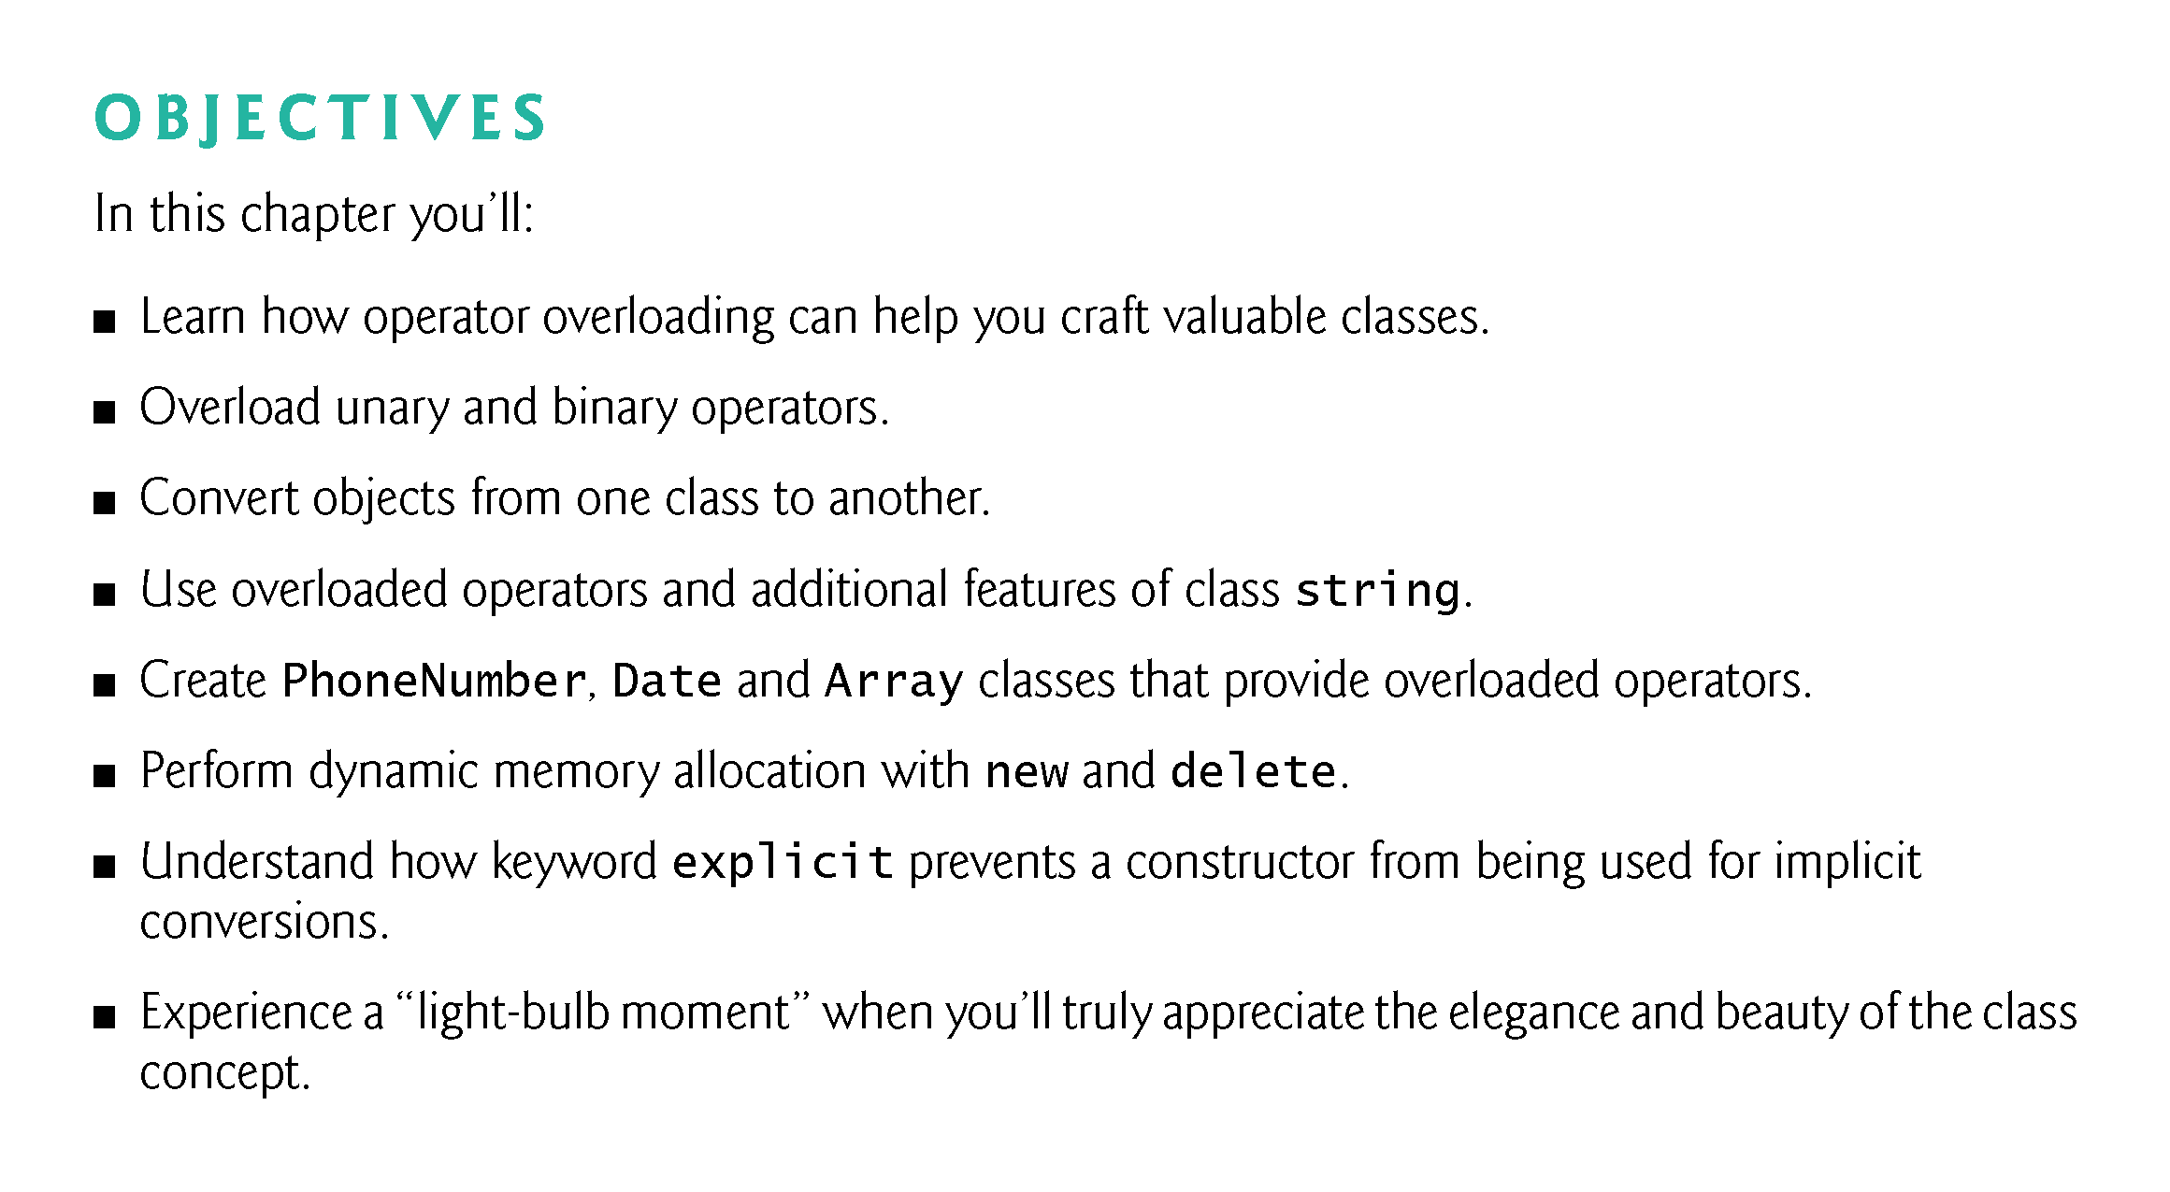

Slide 3
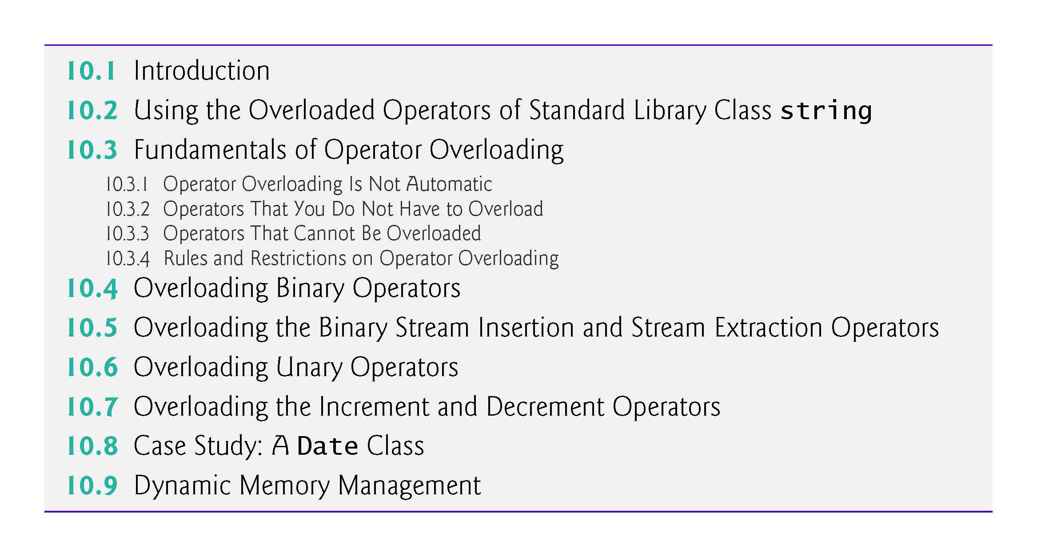

Slide 4
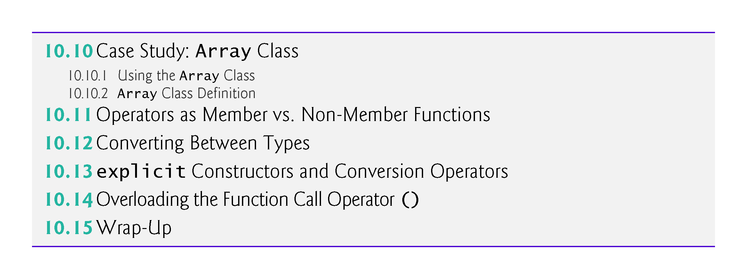

Slide 5
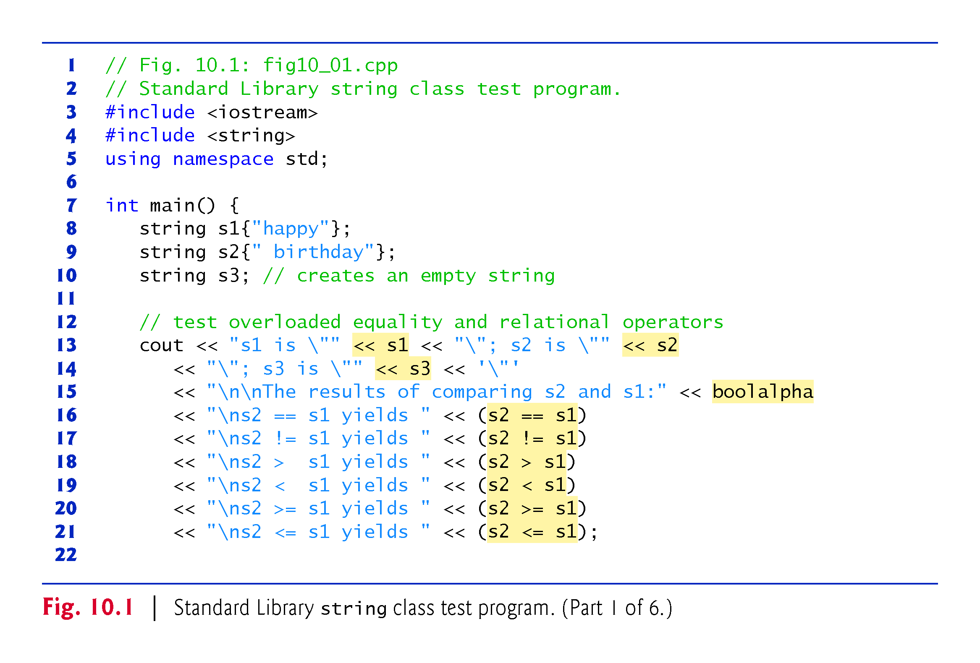
Notes:
Ob: Observe how we append strings. Boolalpha is defined in <iostream>

Slide 6
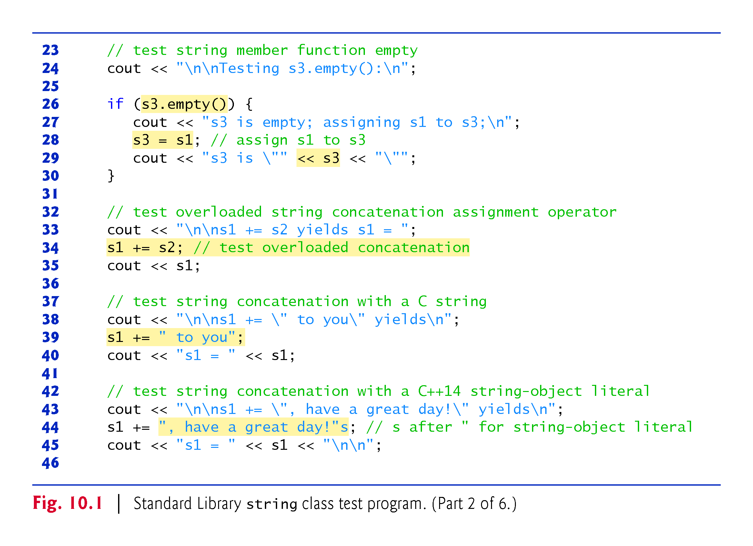
Notes:
Ob: line 44 “, have a great day!”s actually calls a C++ function that stores this string to s. Then s is concatenated with s1

Slide 7
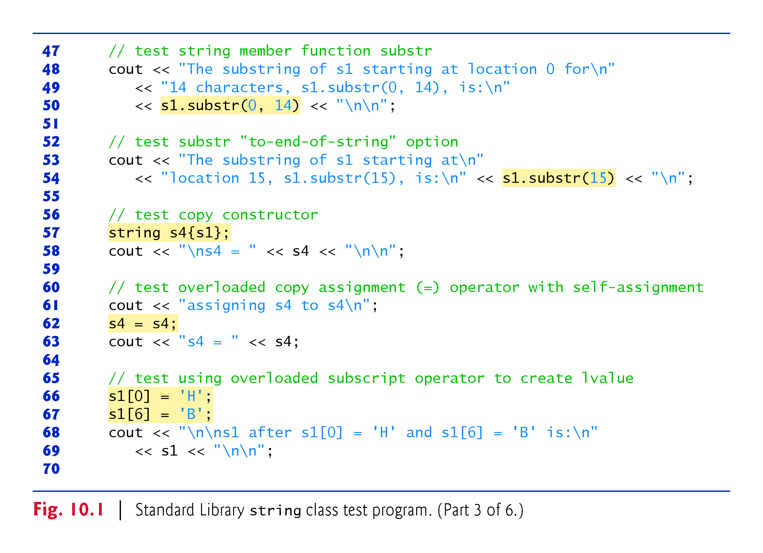
Notes:
Ob: In line 57 the constructor of the string class is called. Self assignment can be dangerous for array template classes.

Slide 8
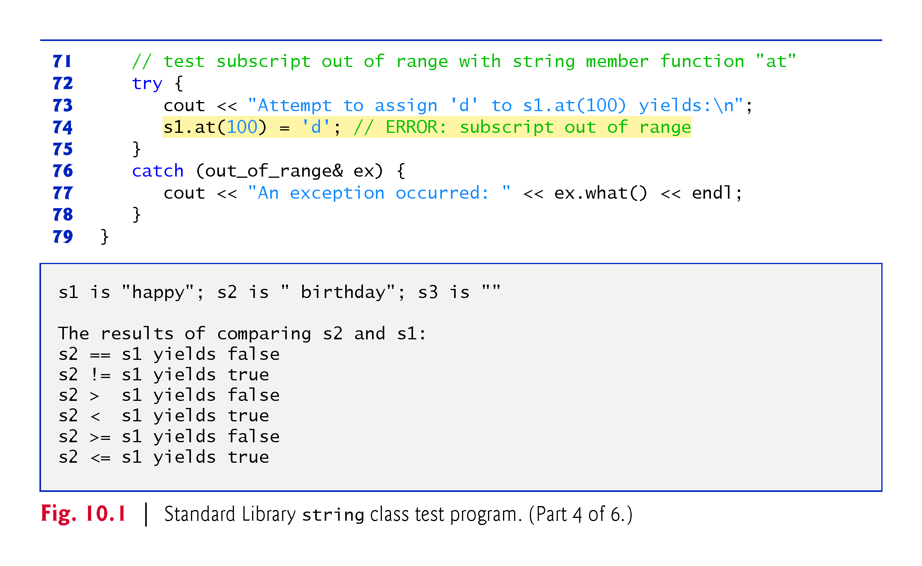

Slide 9
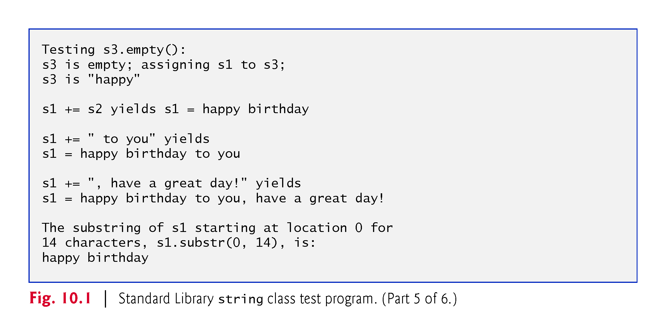

Slide 10
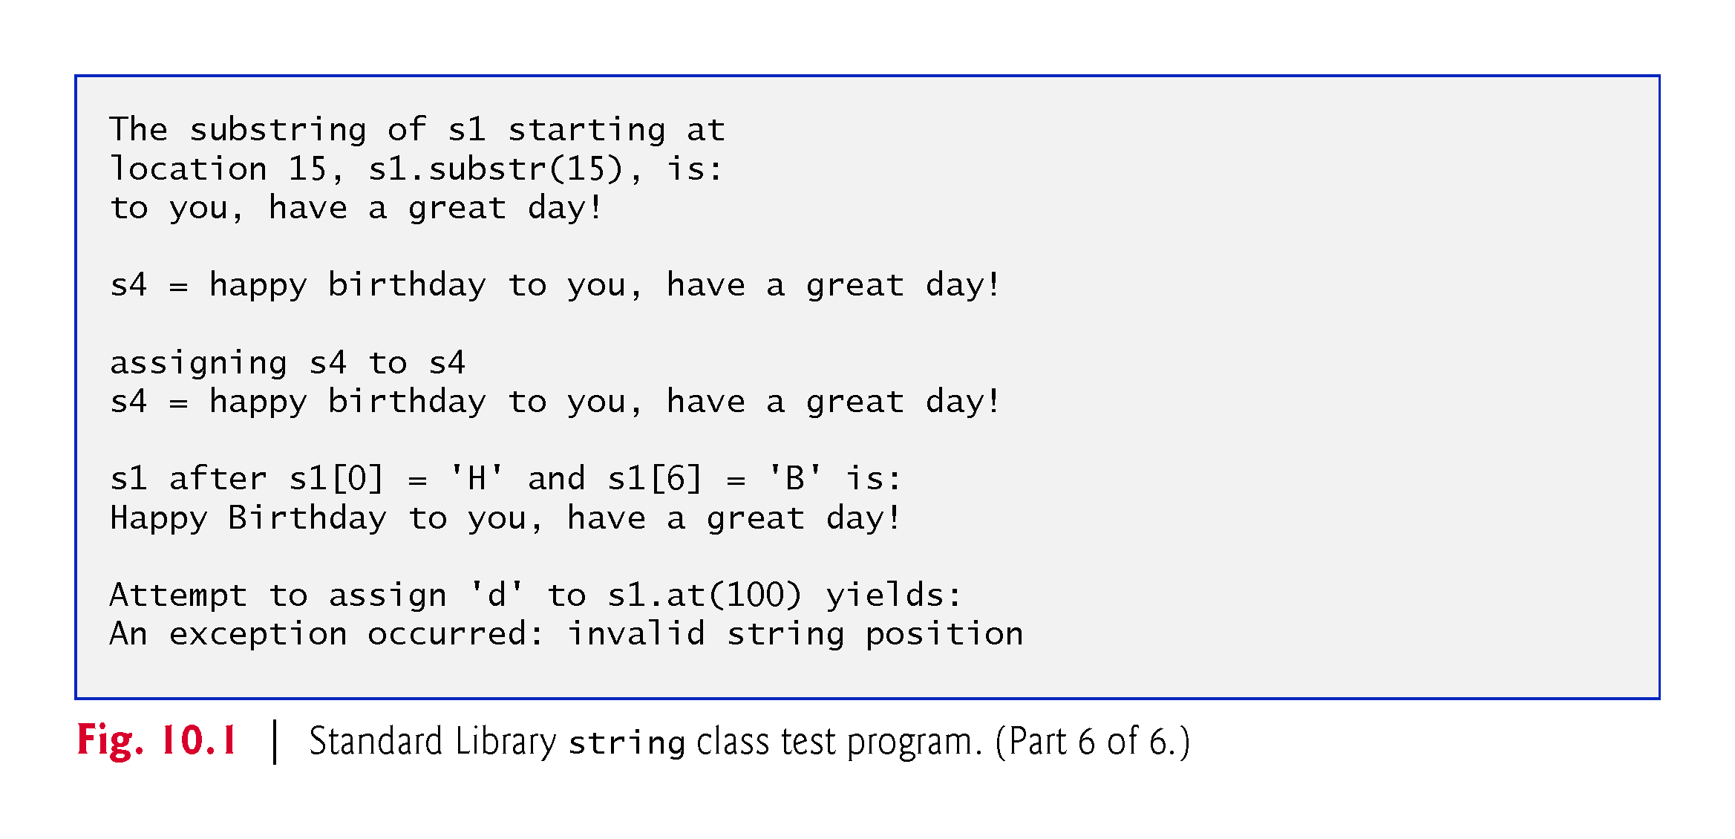

Slide 11
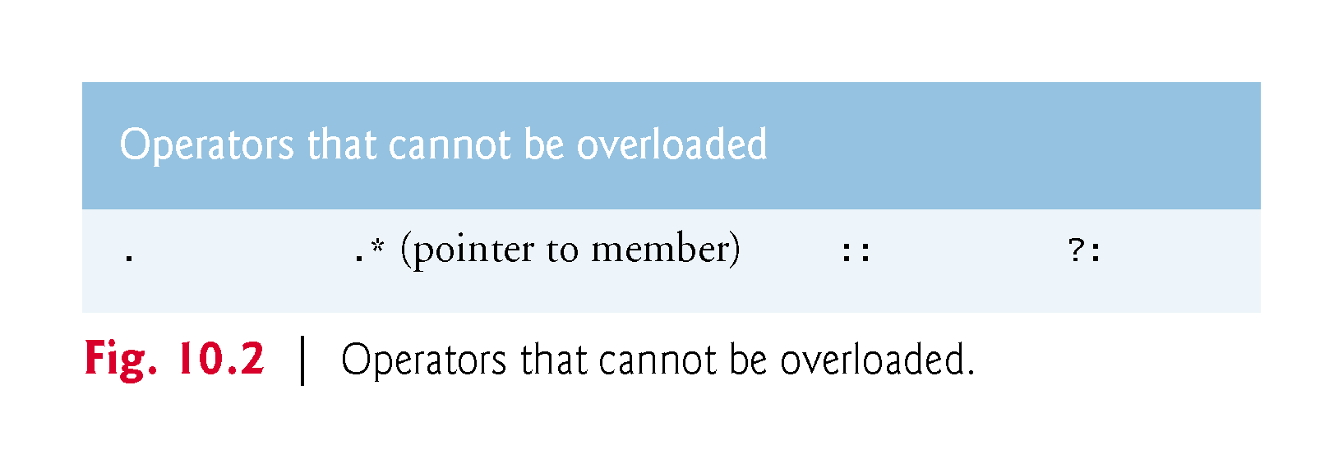
Notes:
Ob: If these operators could be overloaded you would have semantic issues

Slide 12
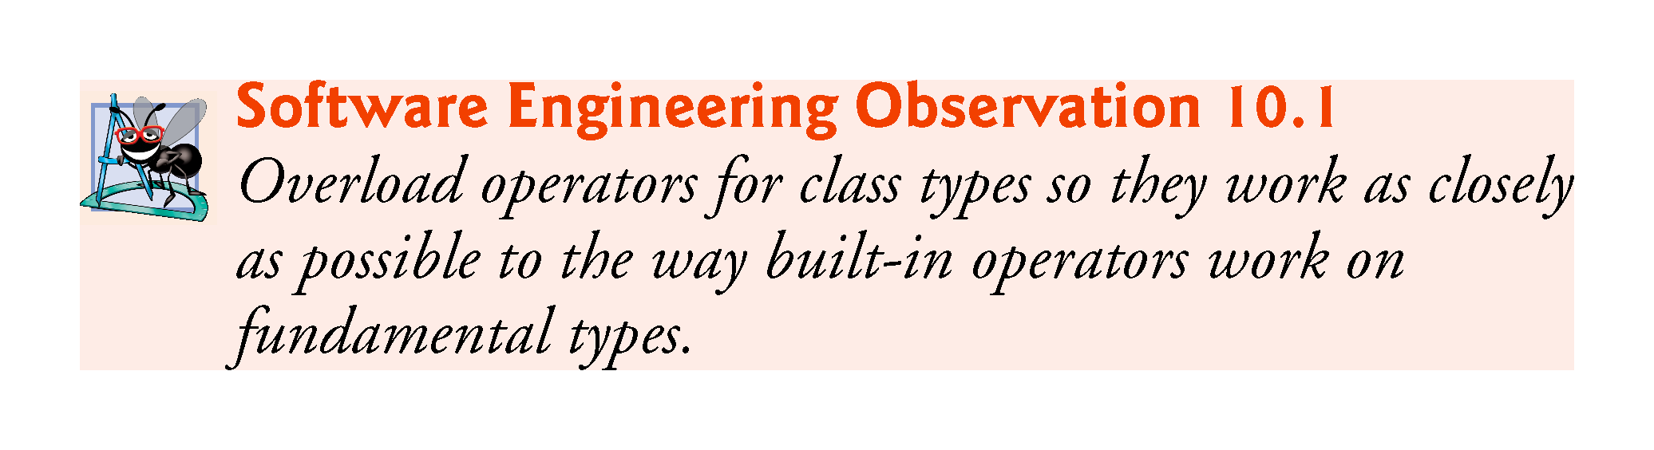

Slide 13
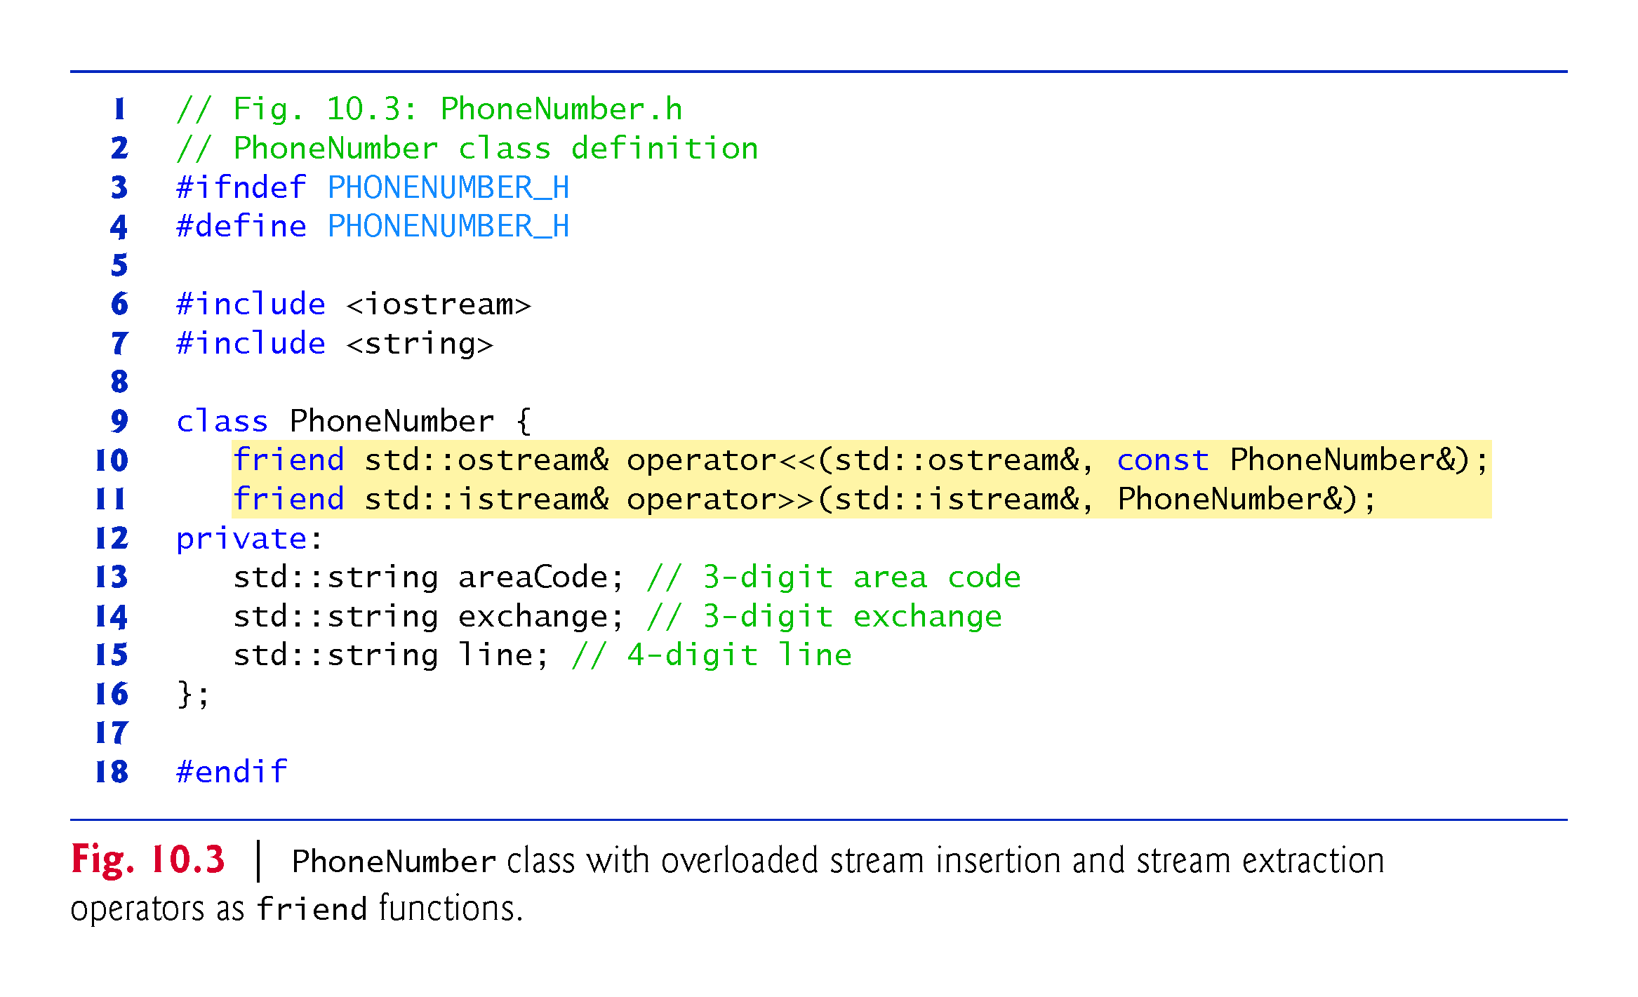

Slide 14
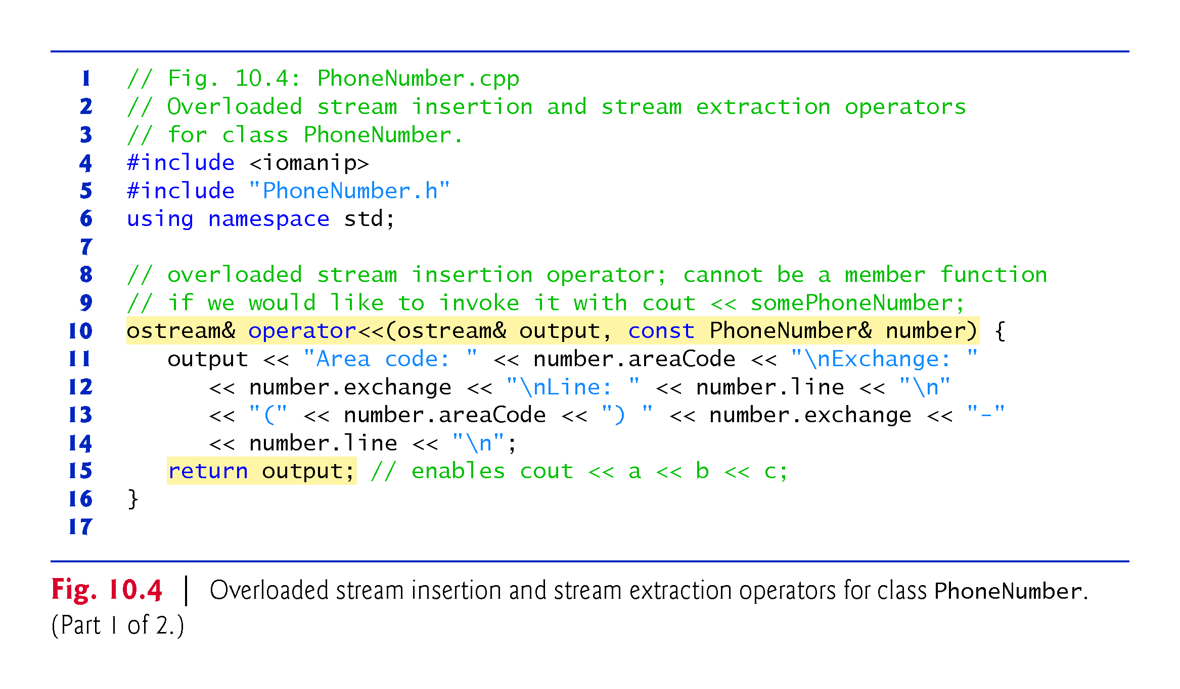

Slide 15
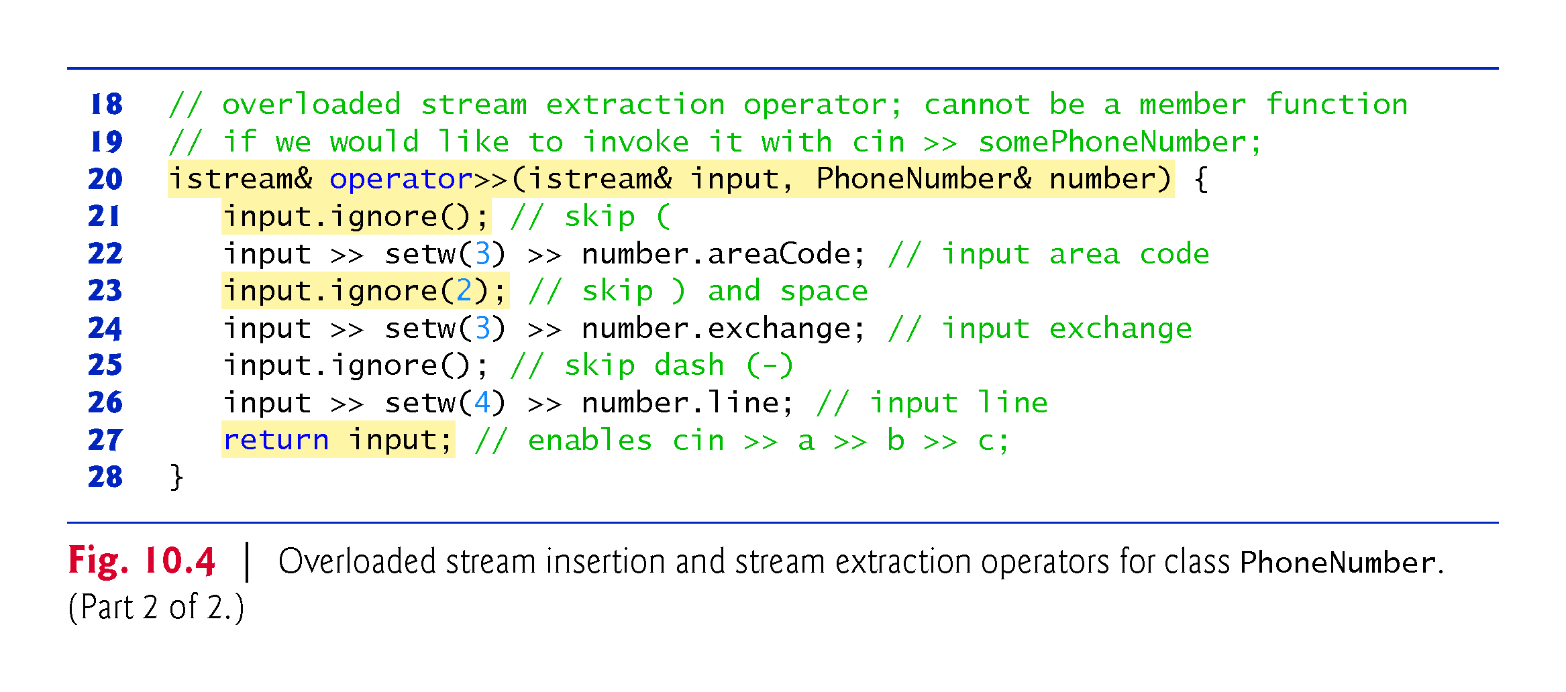

Slide 16
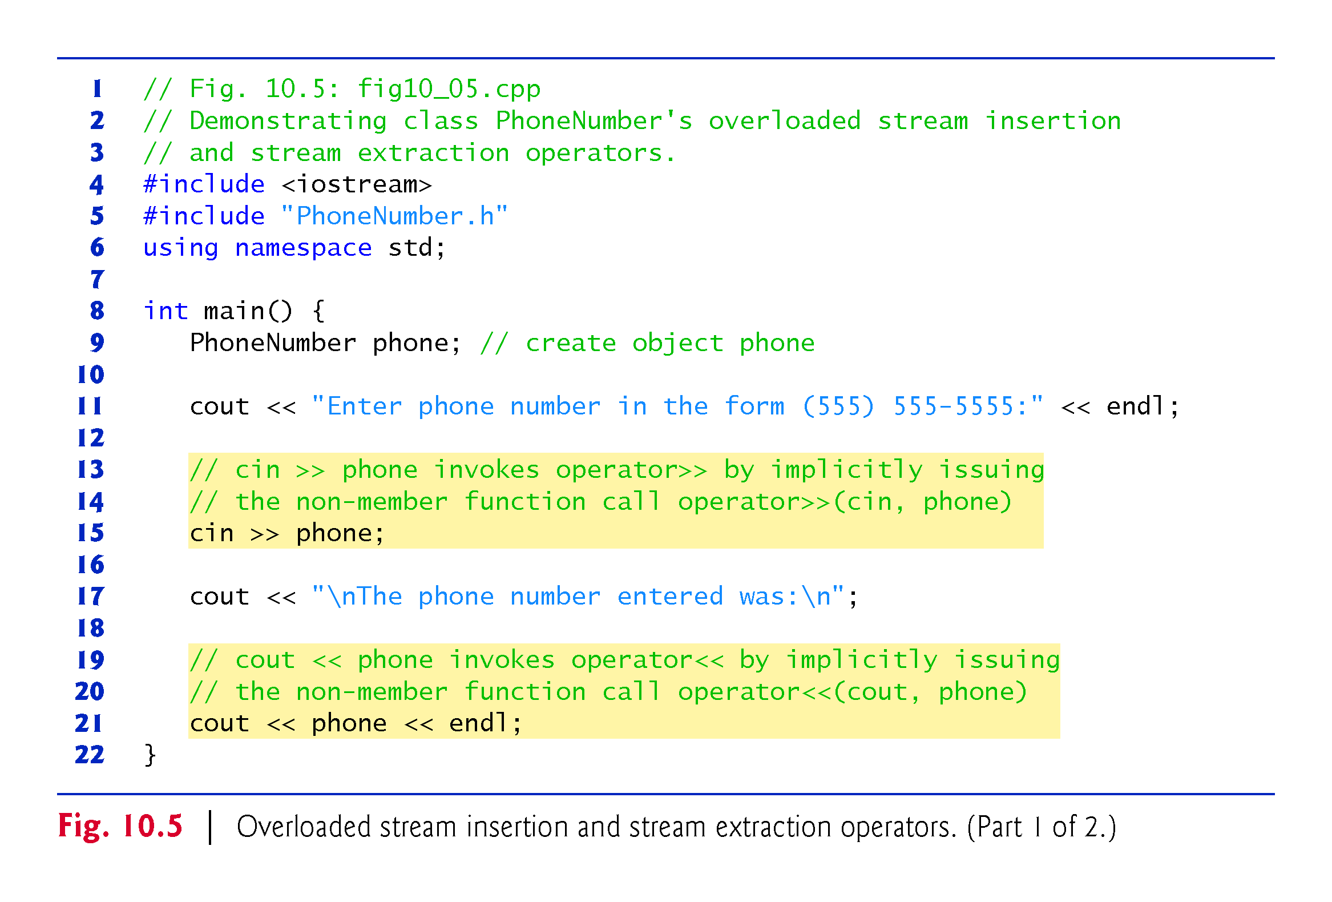
Notes:
Ob: cin, phone become aliases to the input and phone number objects of the previous slide. Likewise for cout, phone – they become aliases to output and phone number objects 2 slides before

Slide 17
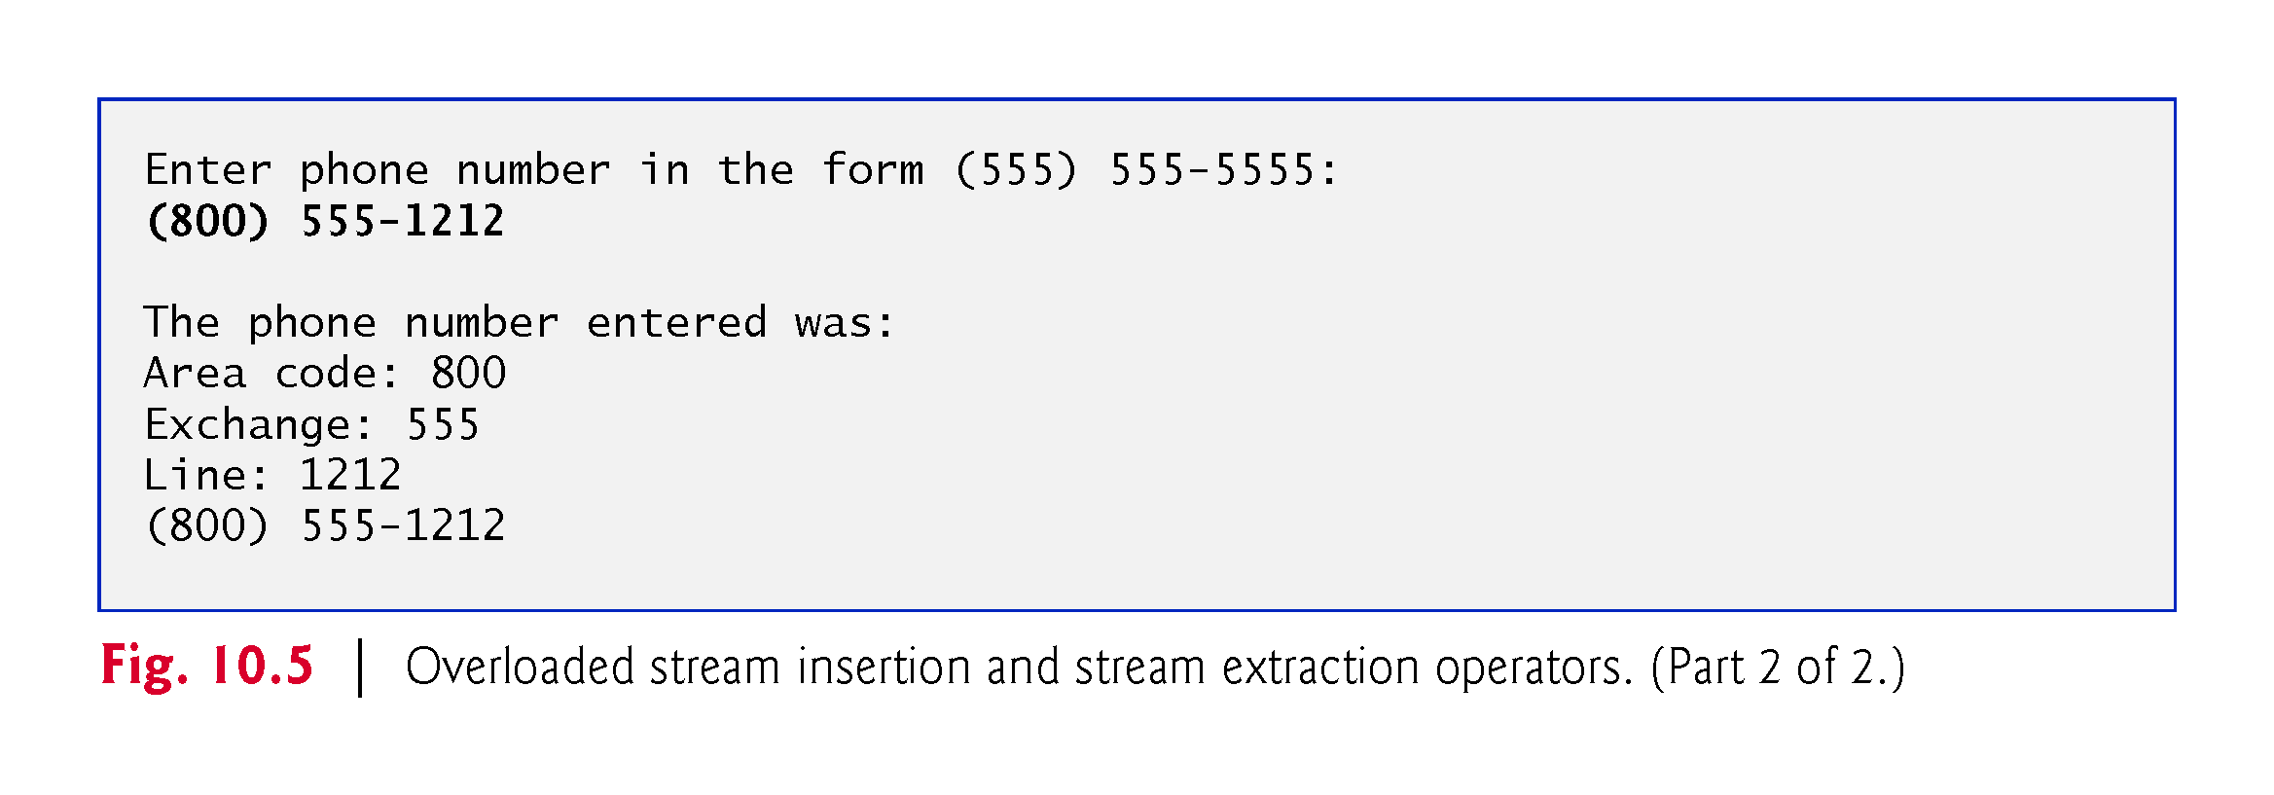

Slide 18
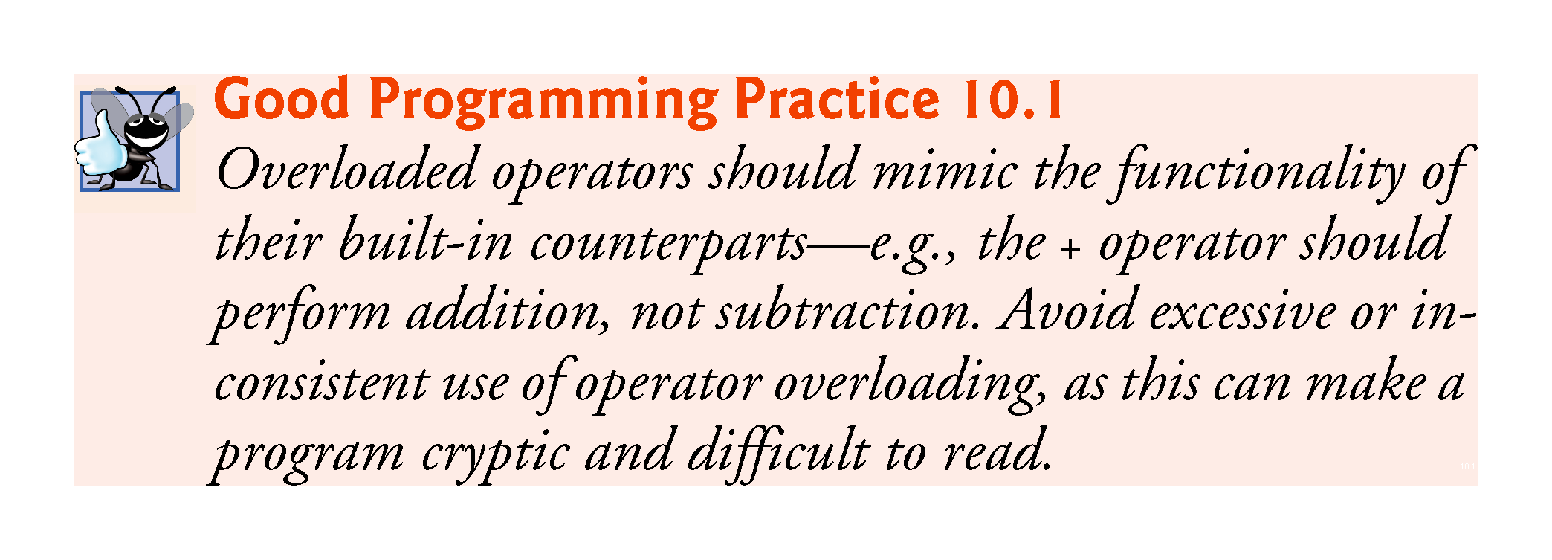

Slide 19
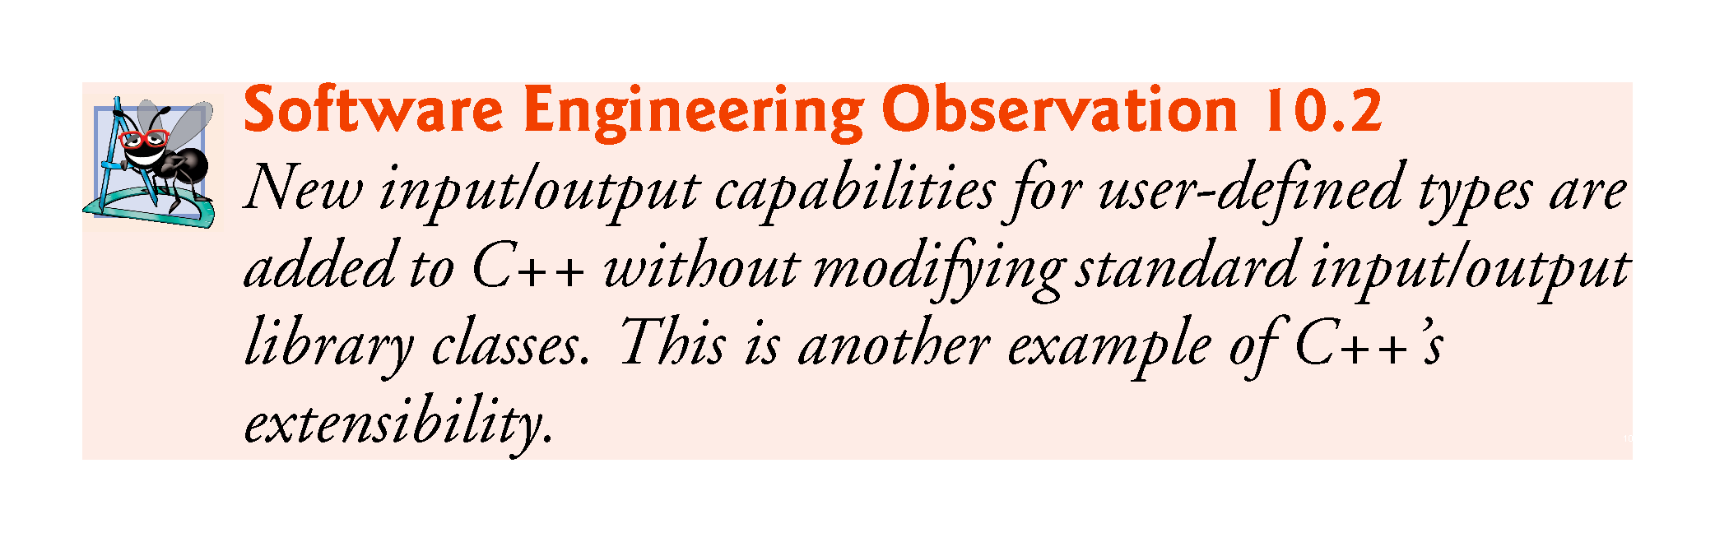

Slide 20
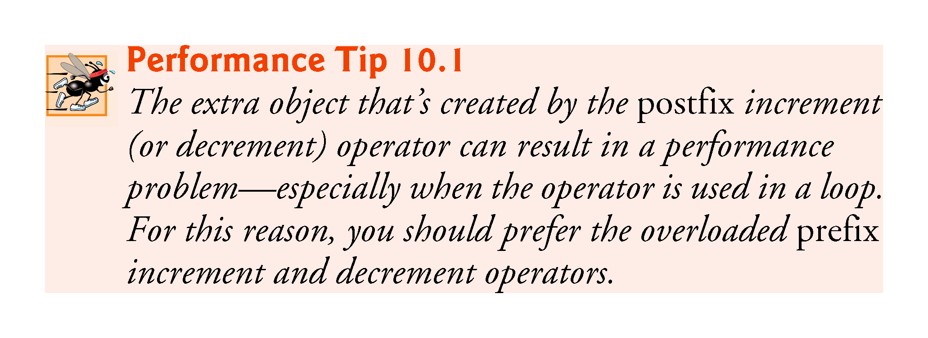

Slide 21
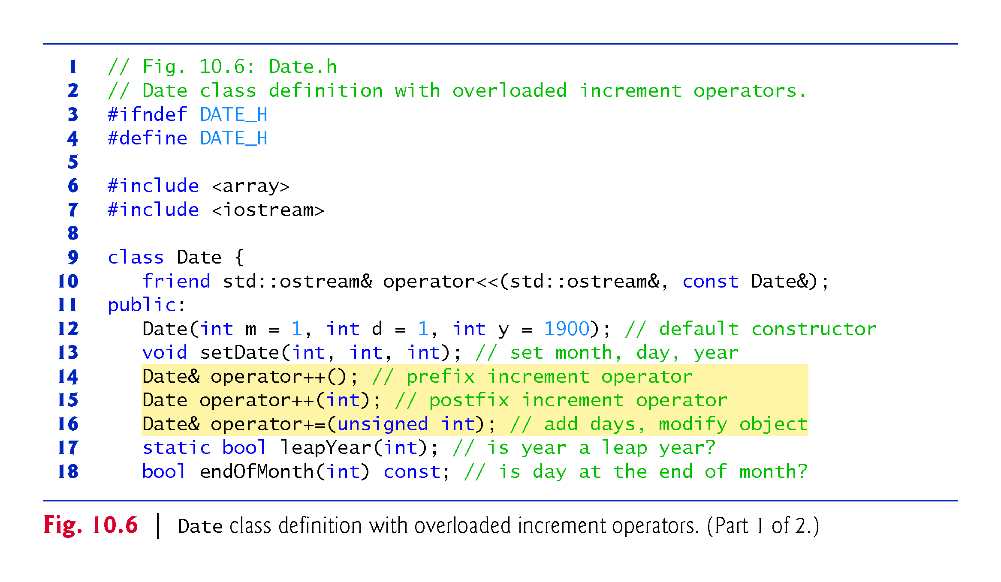

Slide 22
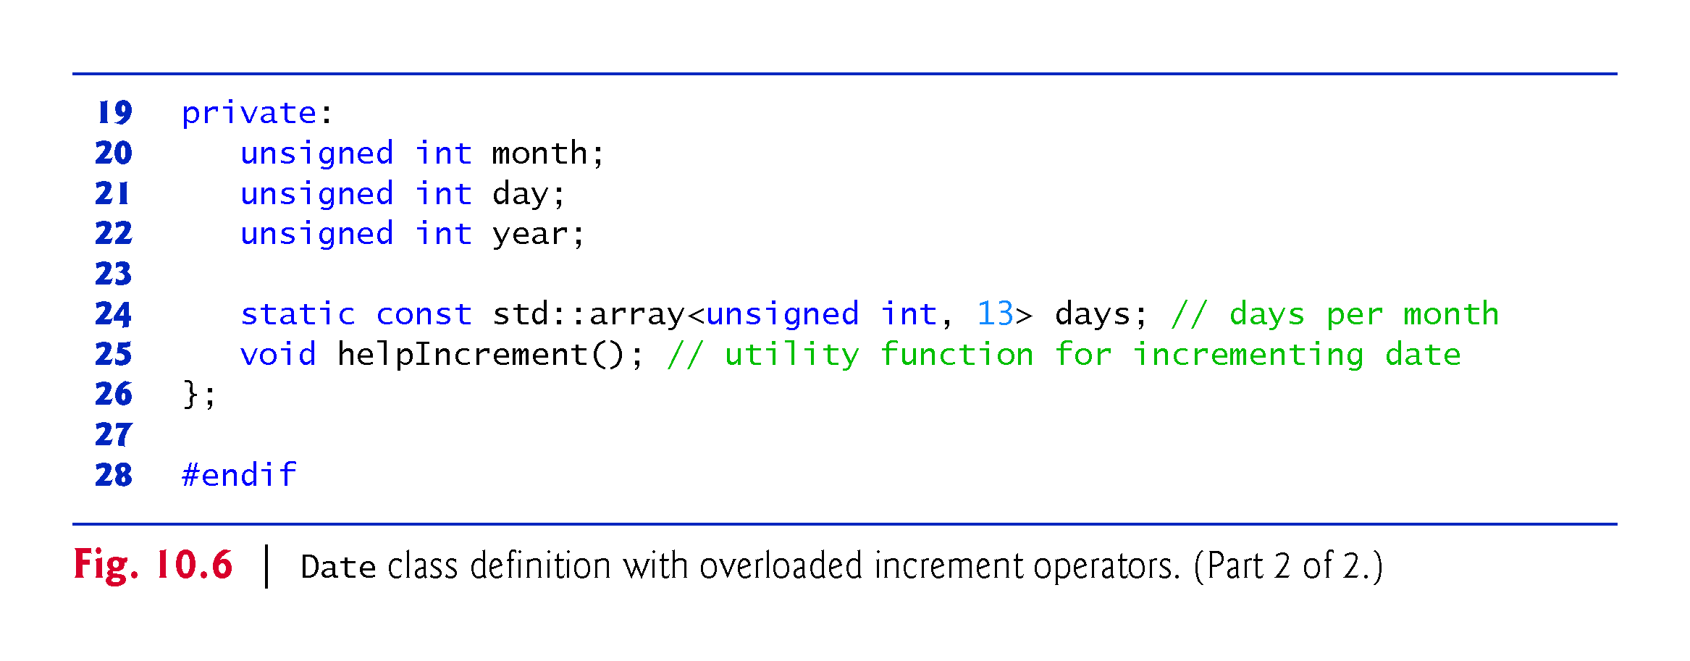

Slide 23
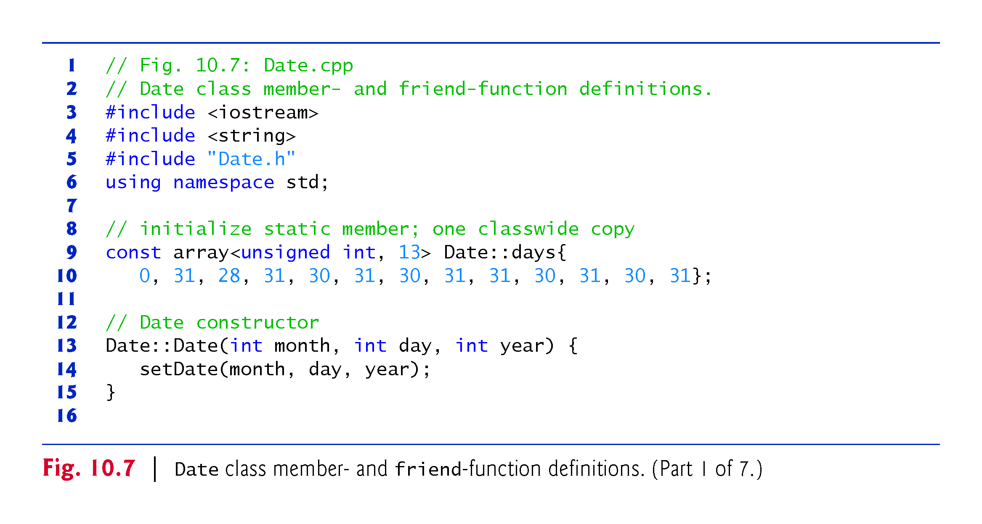

Slide 24
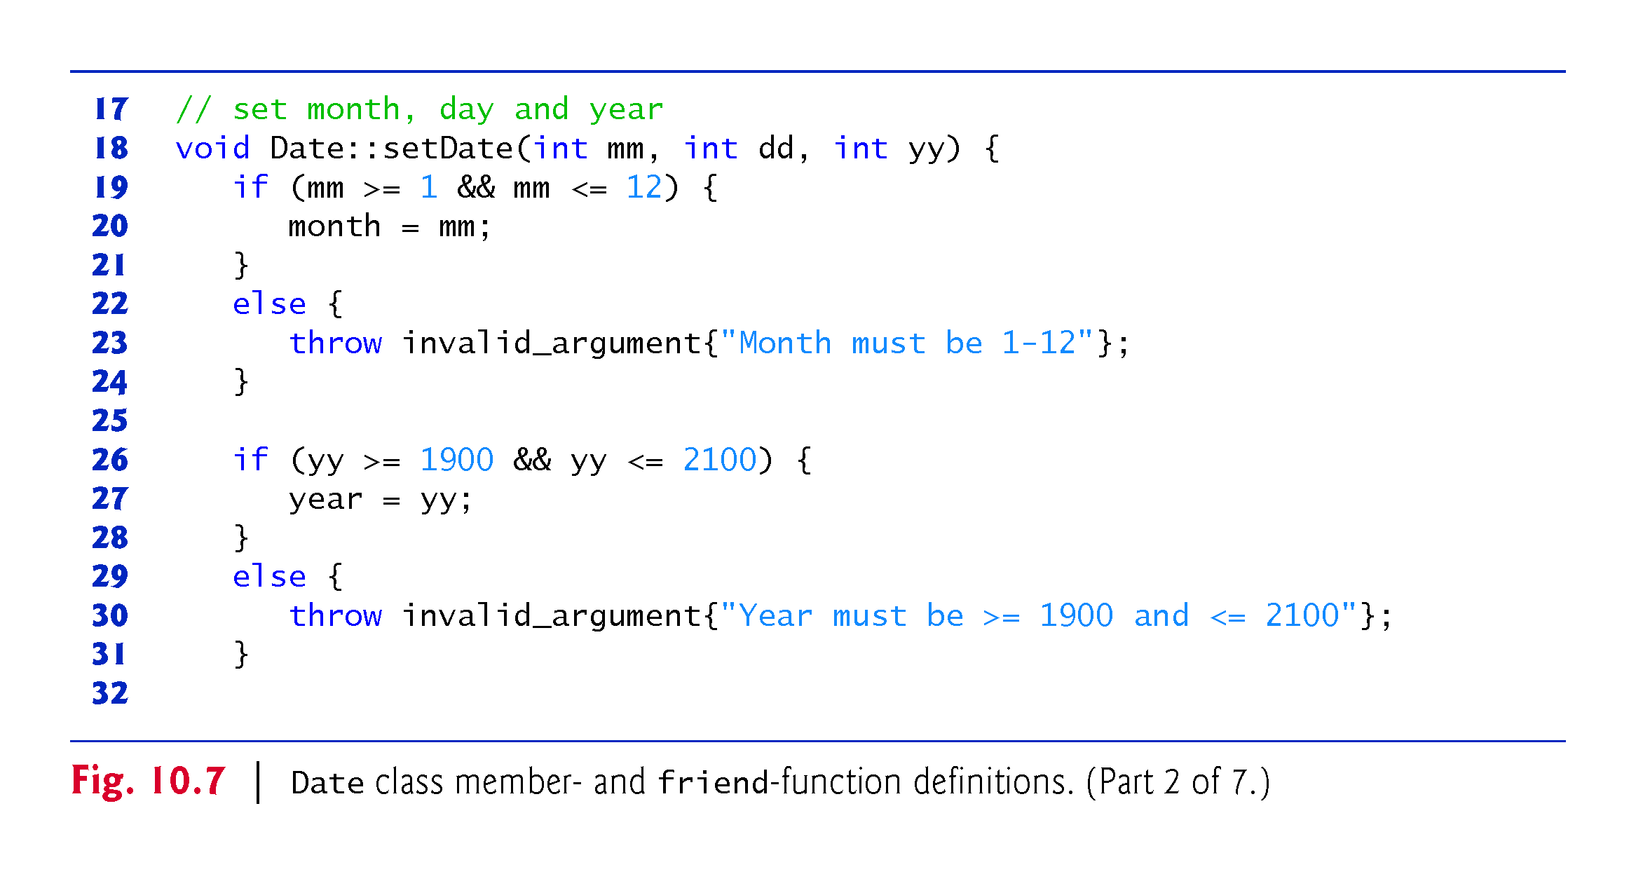

Slide 25
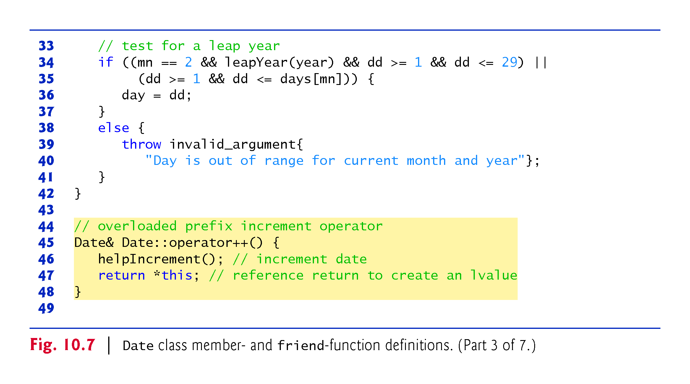
Notes:
Ob: mistake its mm not mn

Slide 26
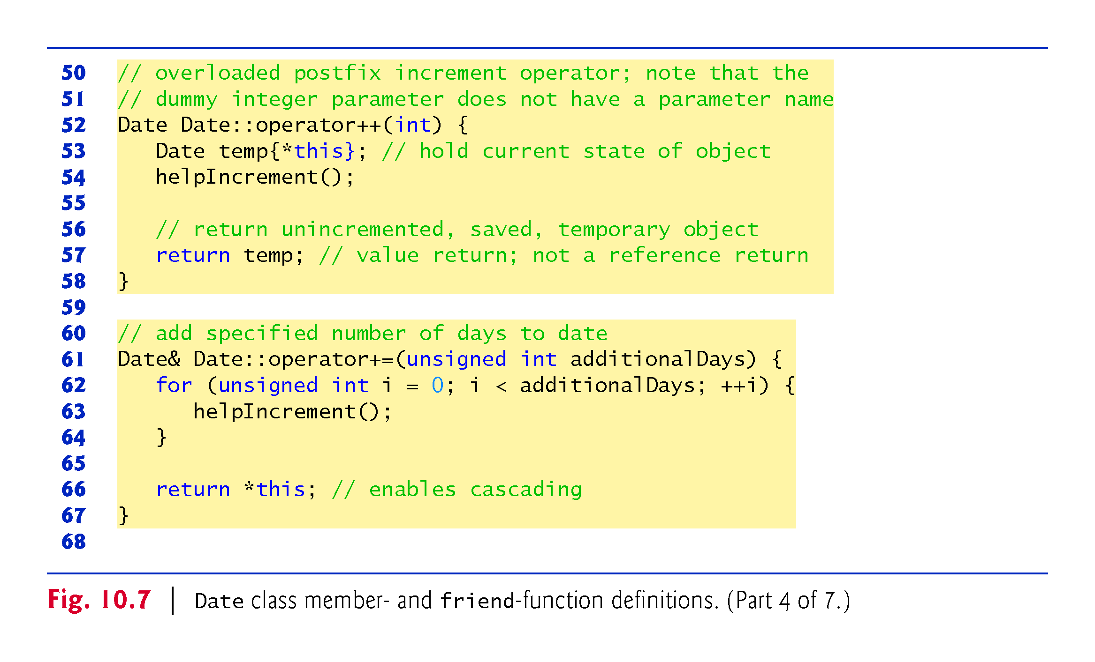
Notes:
Ob: Make (*this) hold the contents of temp.

Slide 27
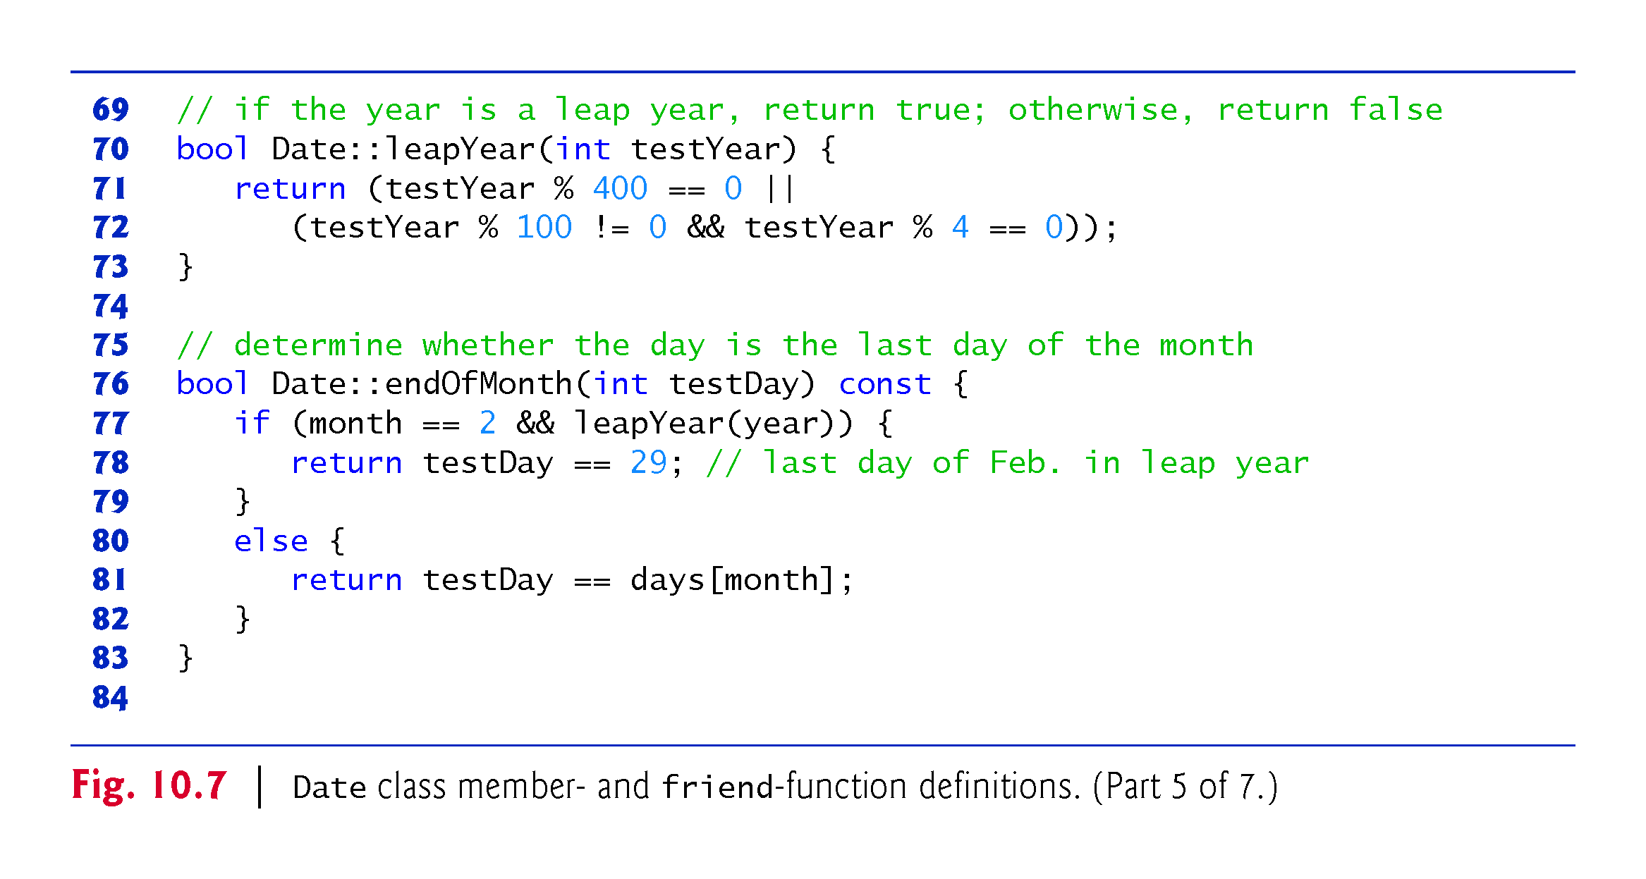

Slide 28
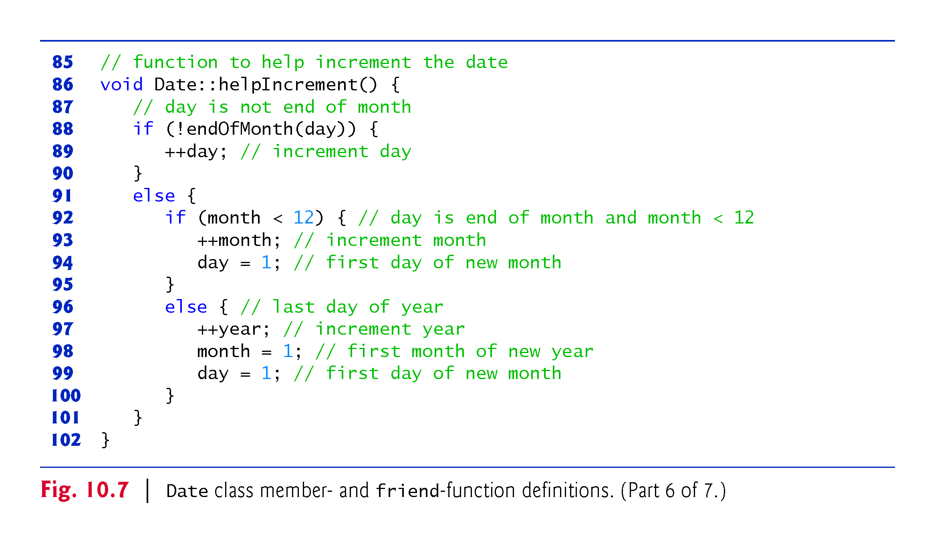

Slide 29
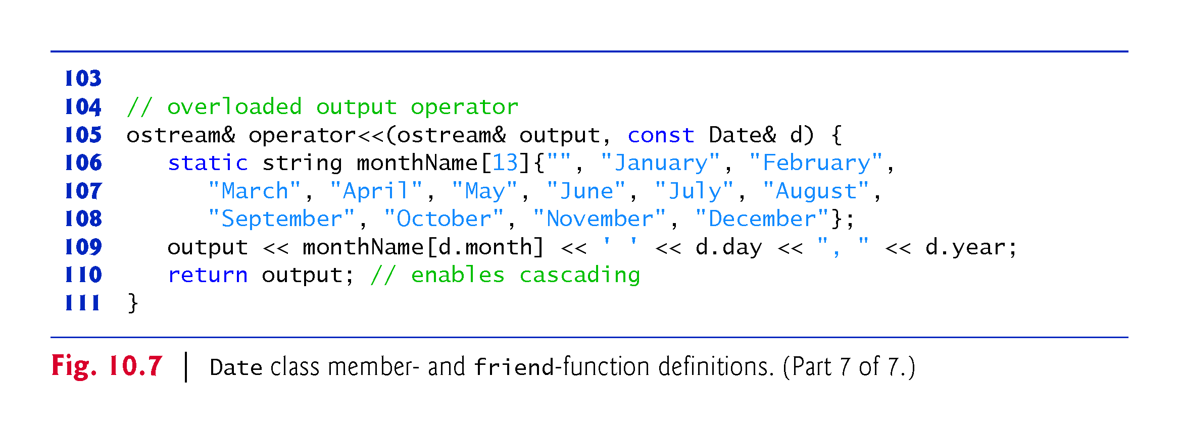

Slide 30
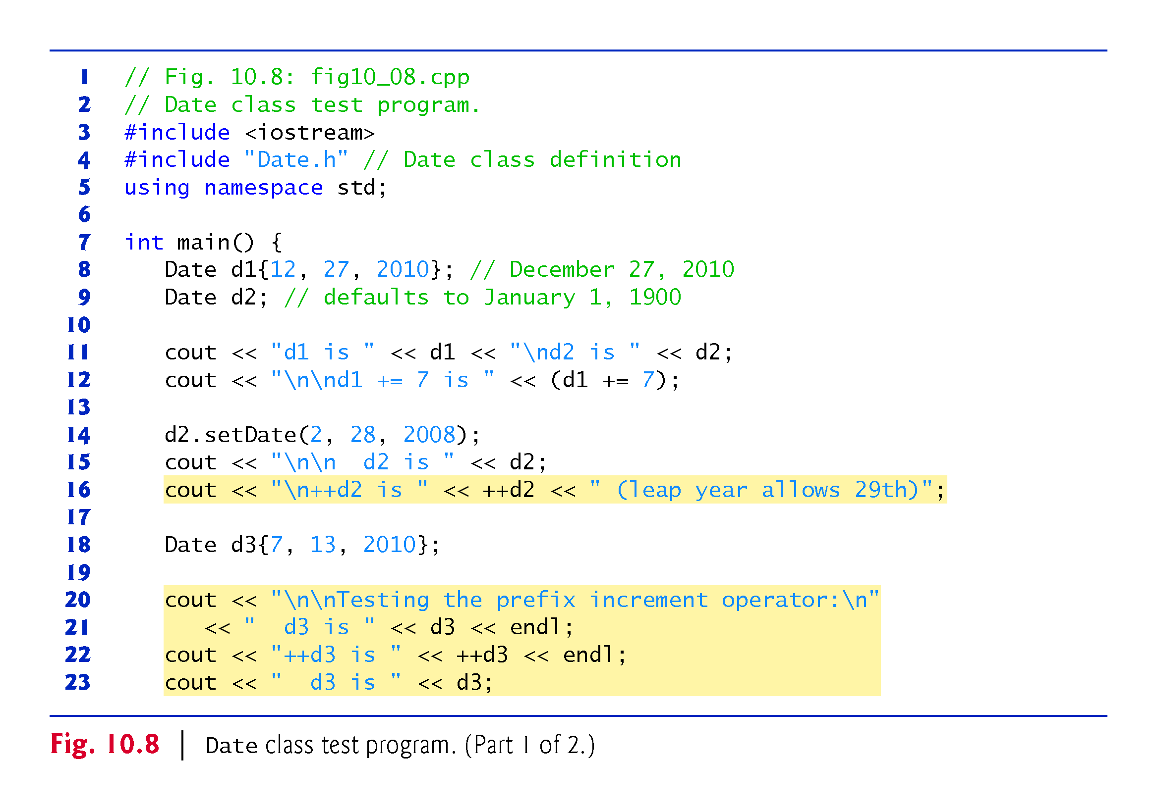

Slide 31
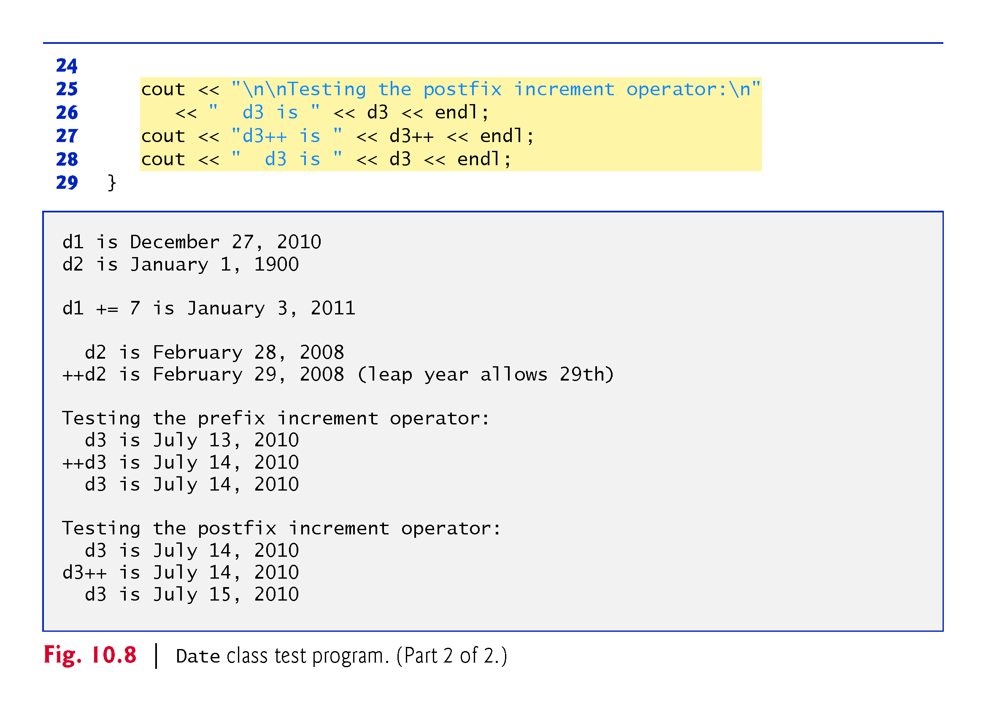

Slide 32
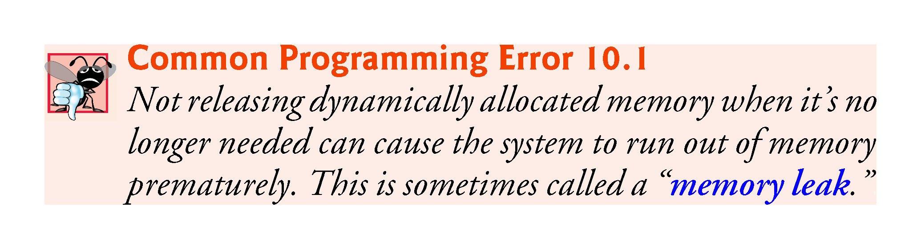

Slide 33
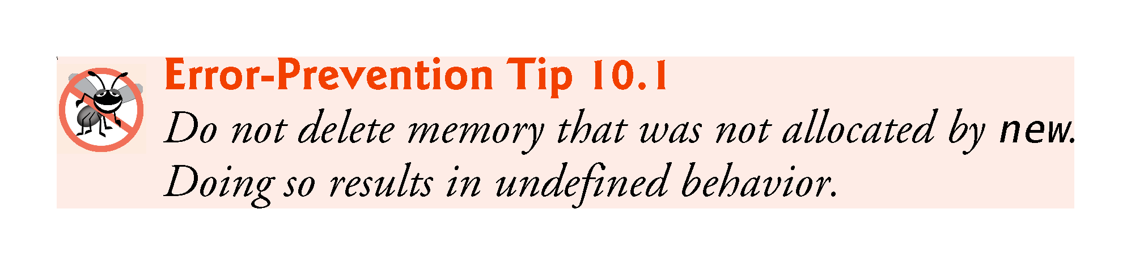

Slide 34
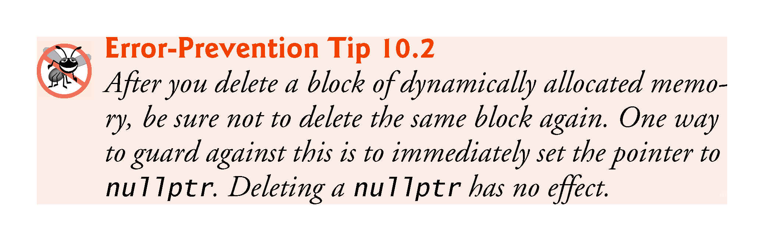

Slide 35
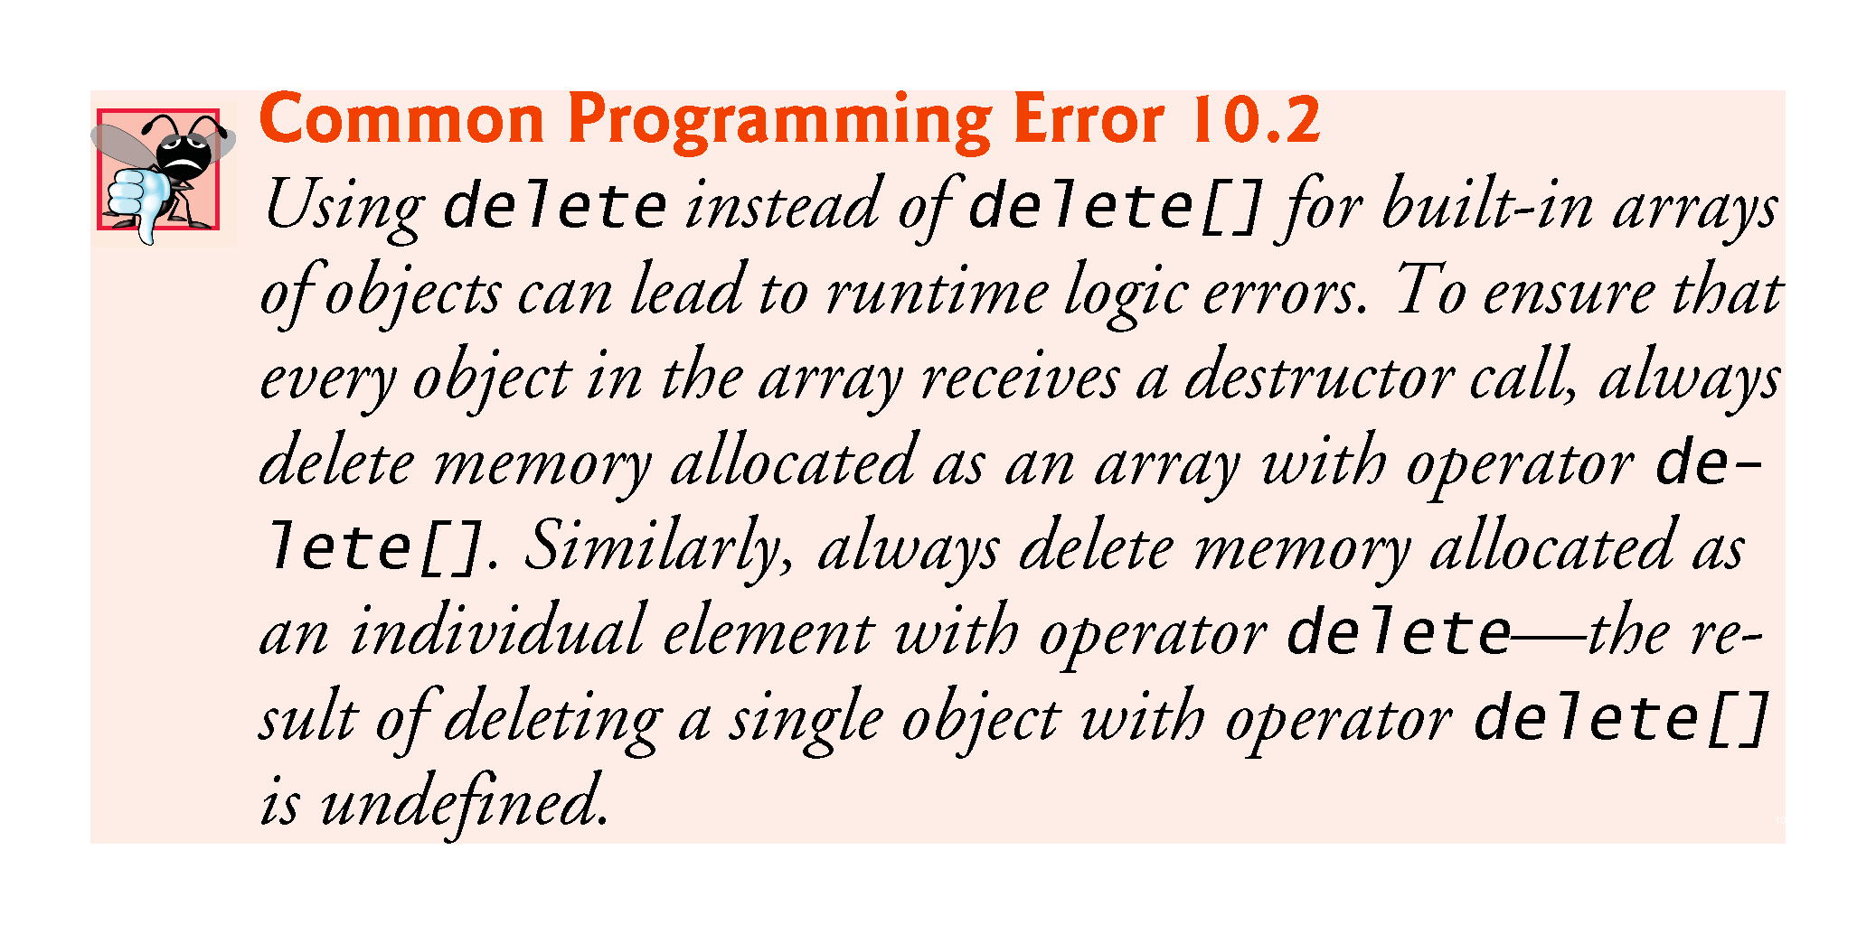

Slide 36
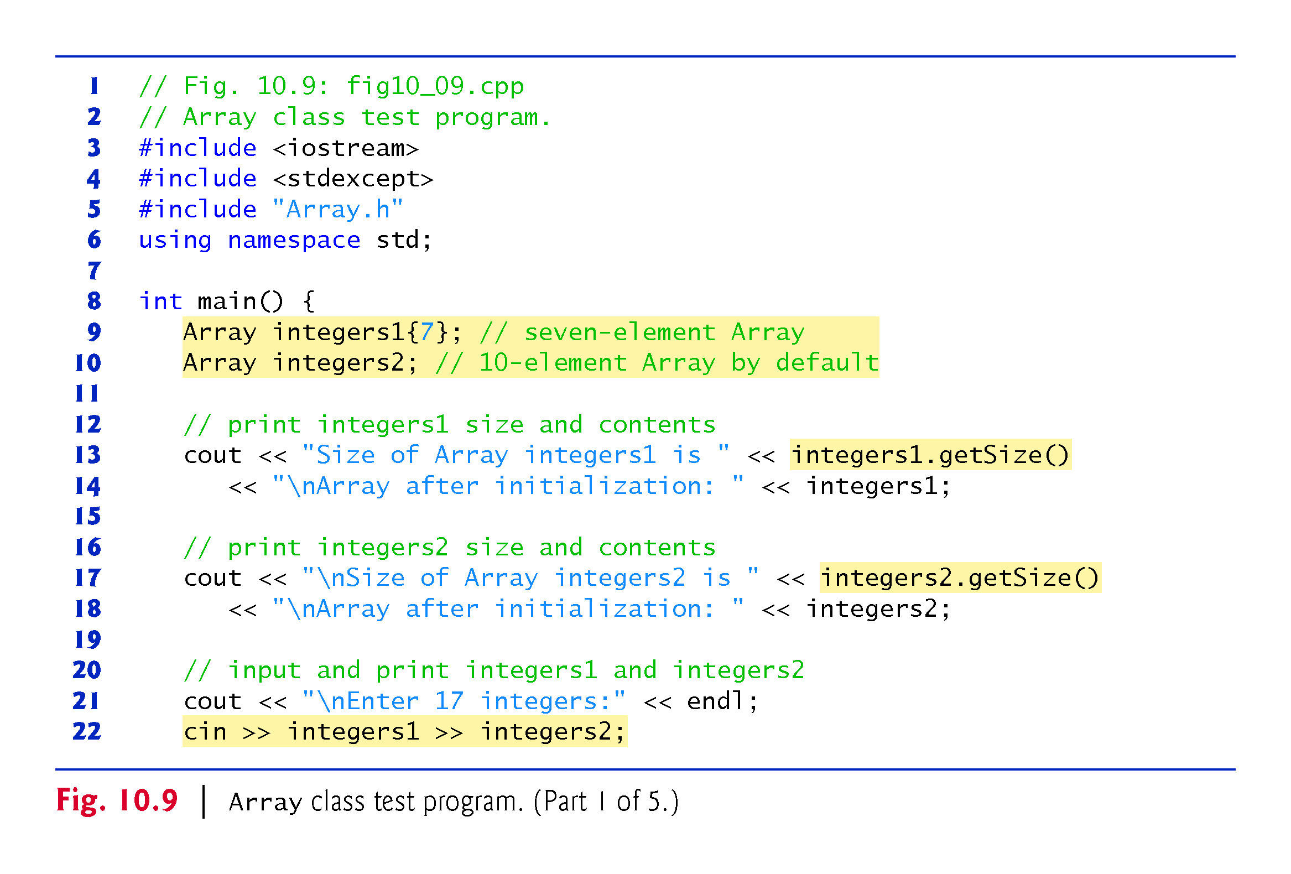
Notes:
Ob: It’s a 10 element array due to the default constructor – not in this slide. Rather than braces use brackets for compatibility with VC++ 2012

Slide 37
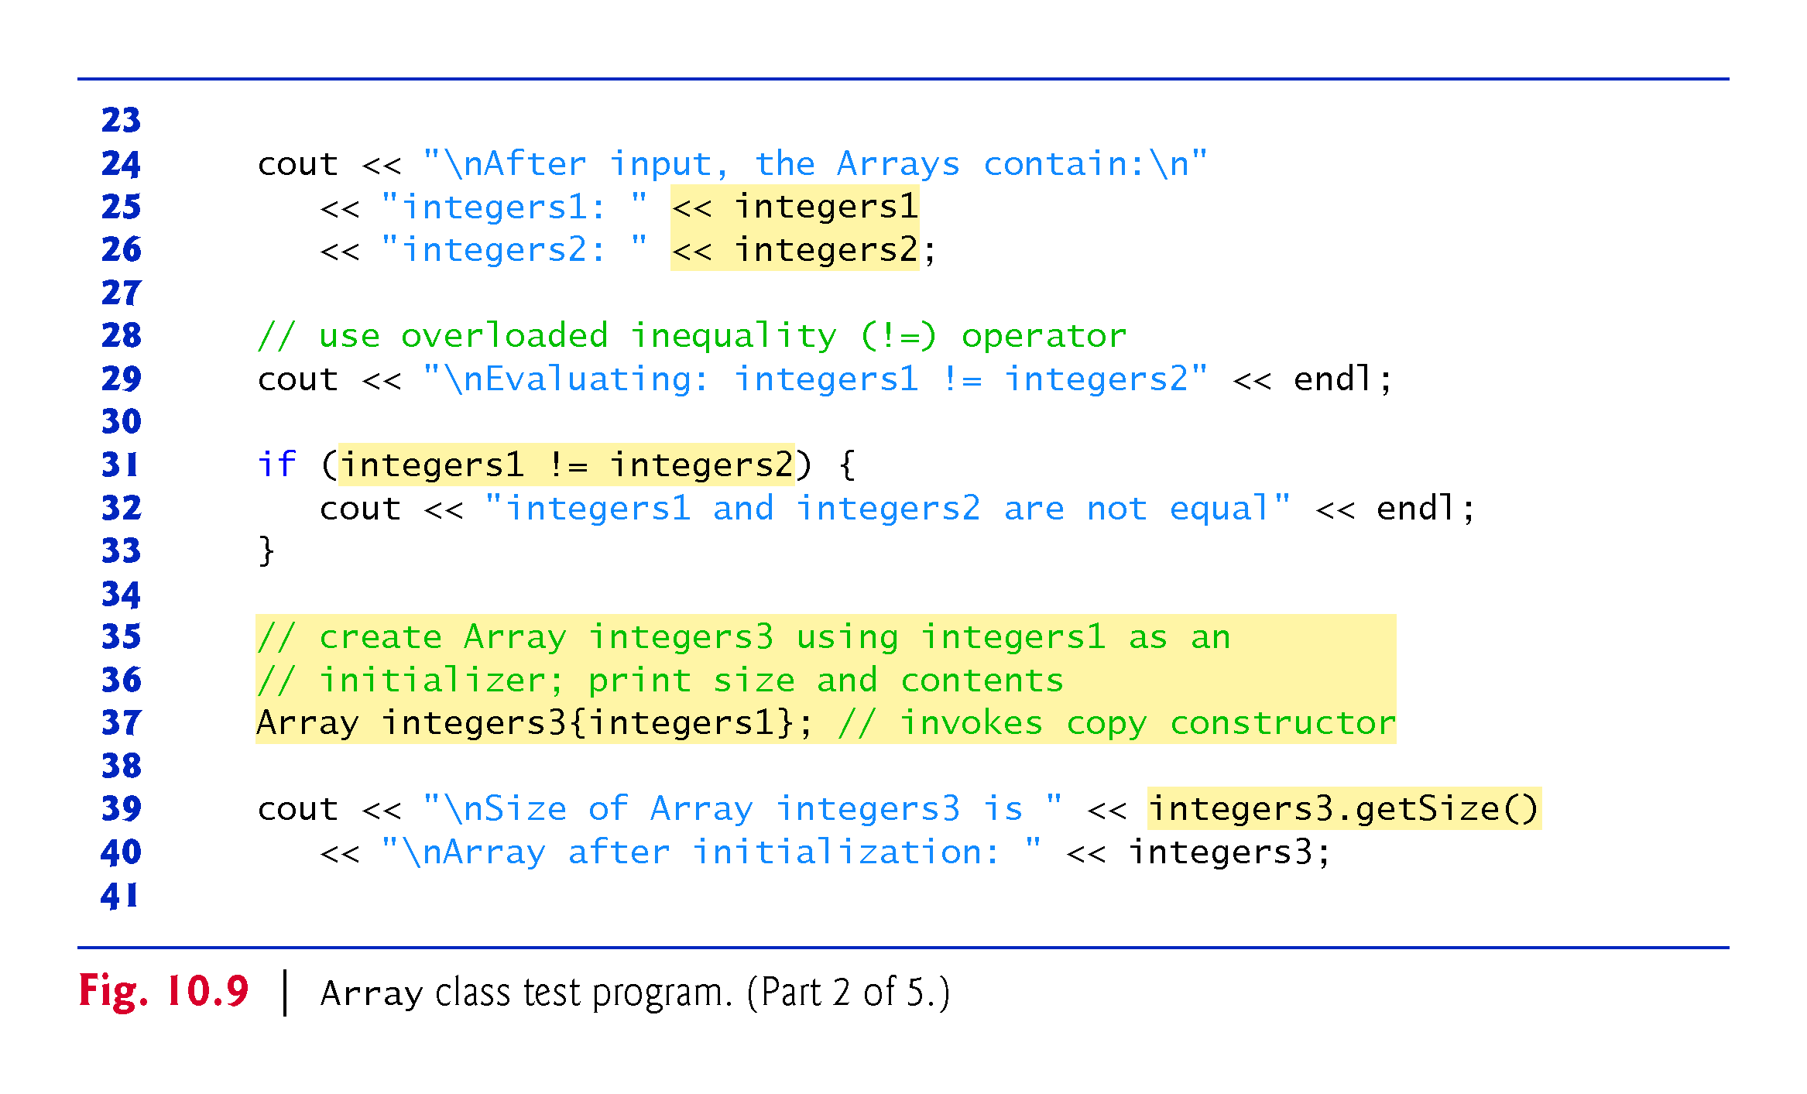

Slide 38
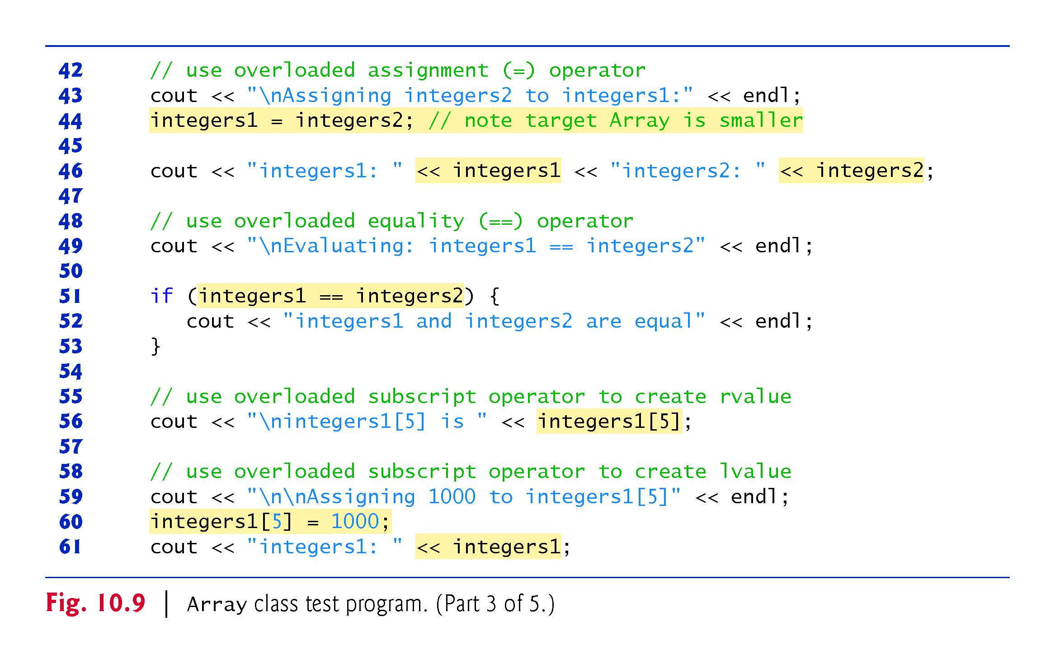

Slide 39
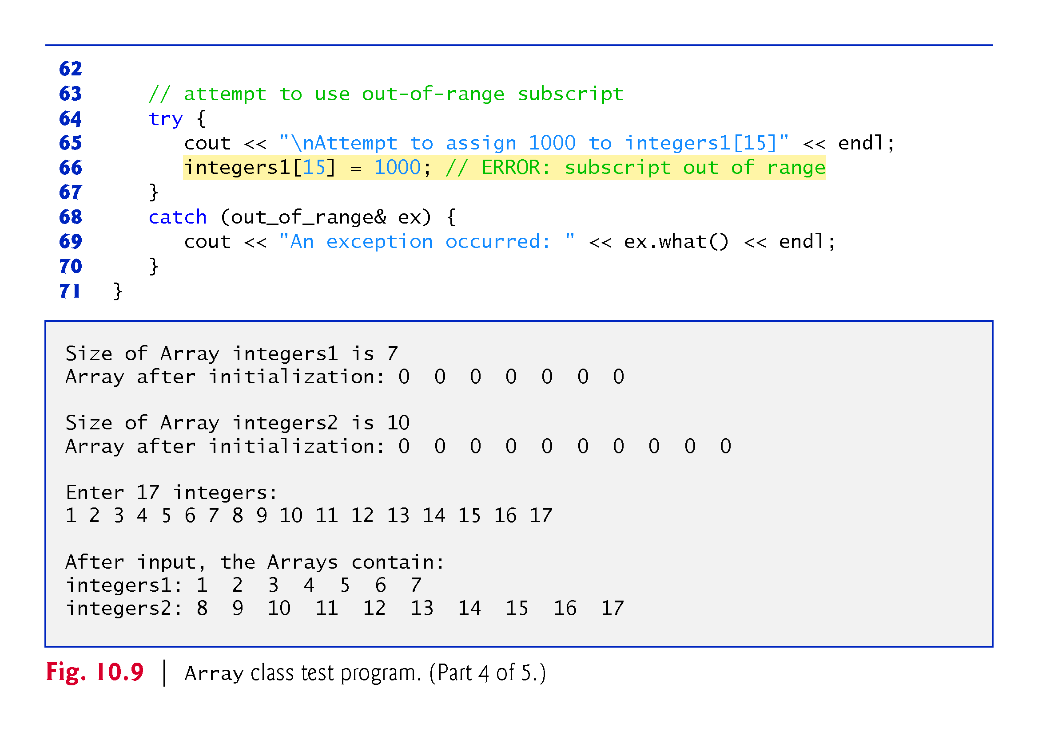

Slide 40
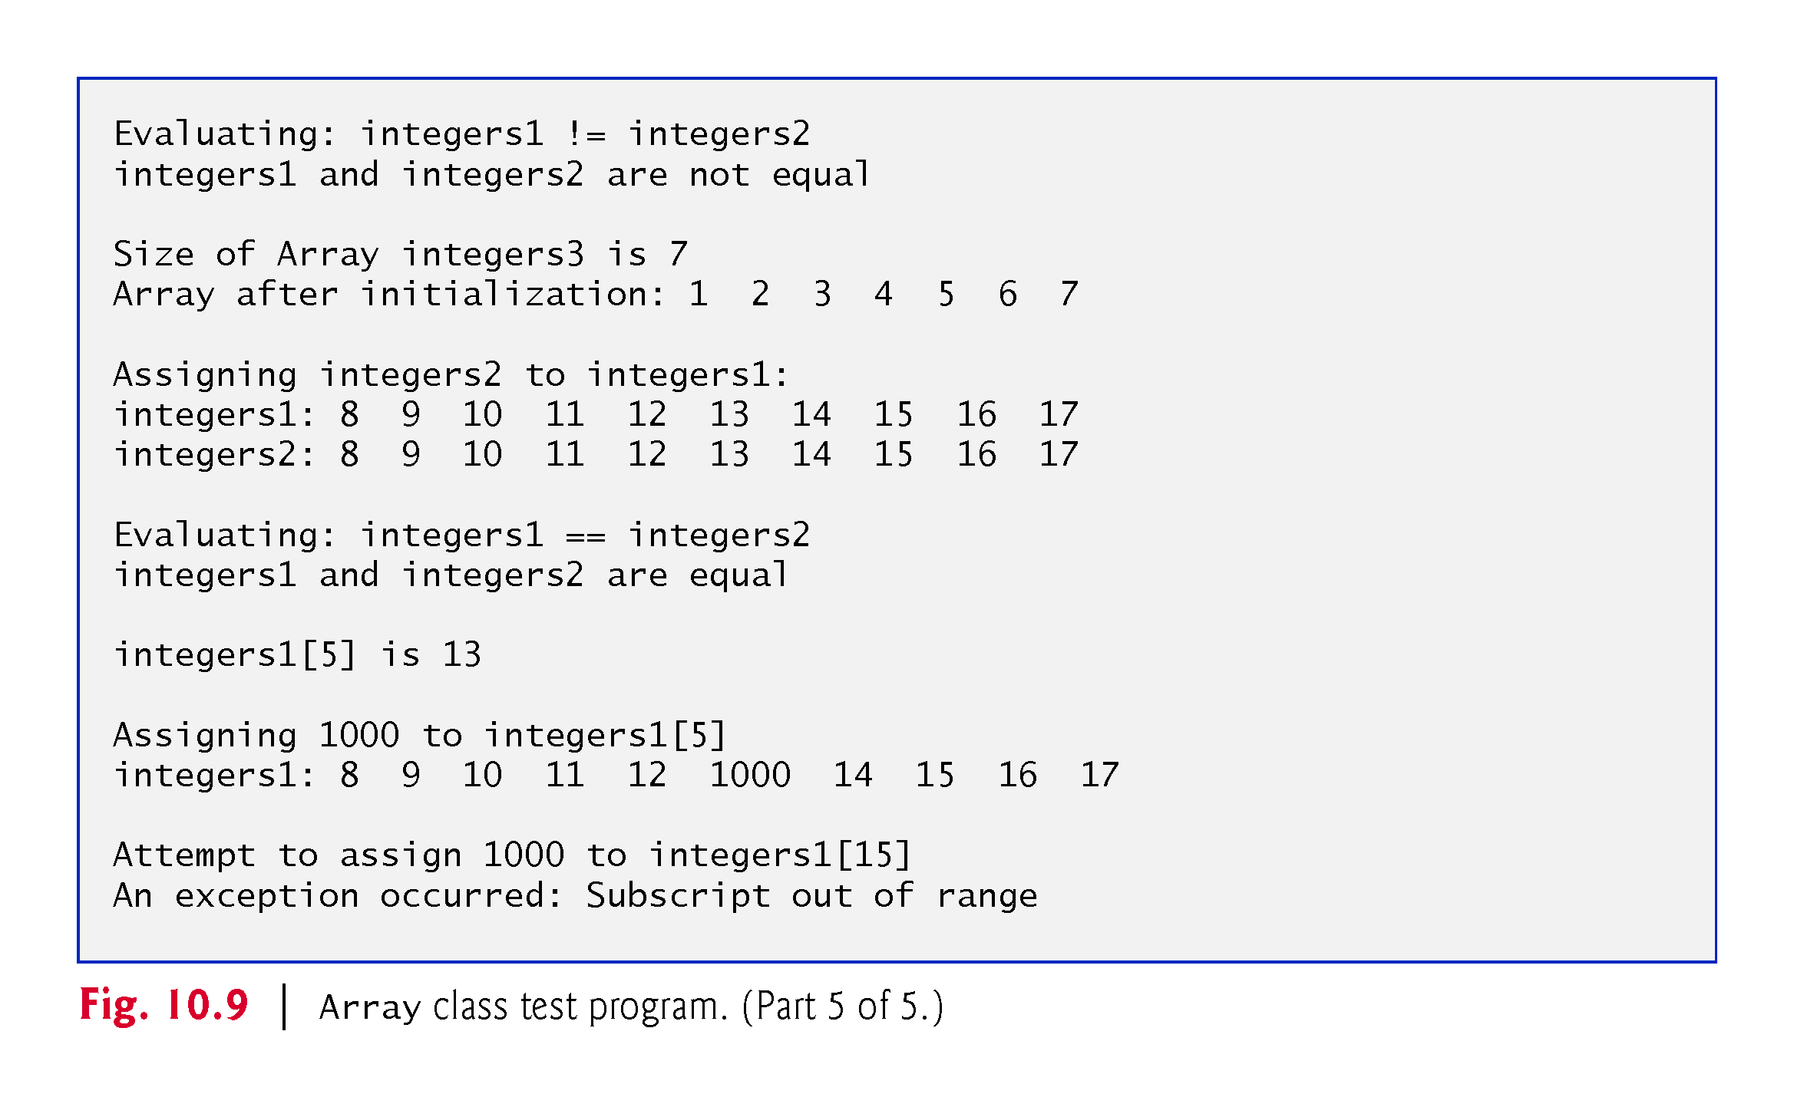

Slide 41
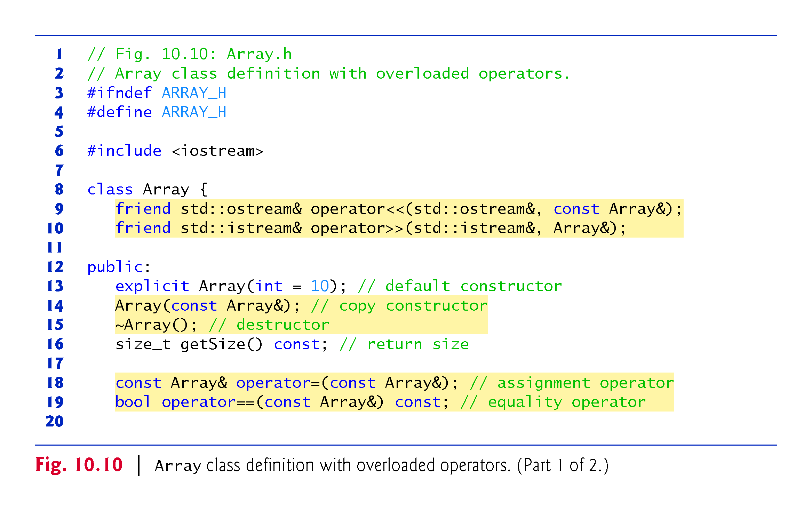

Slide 42
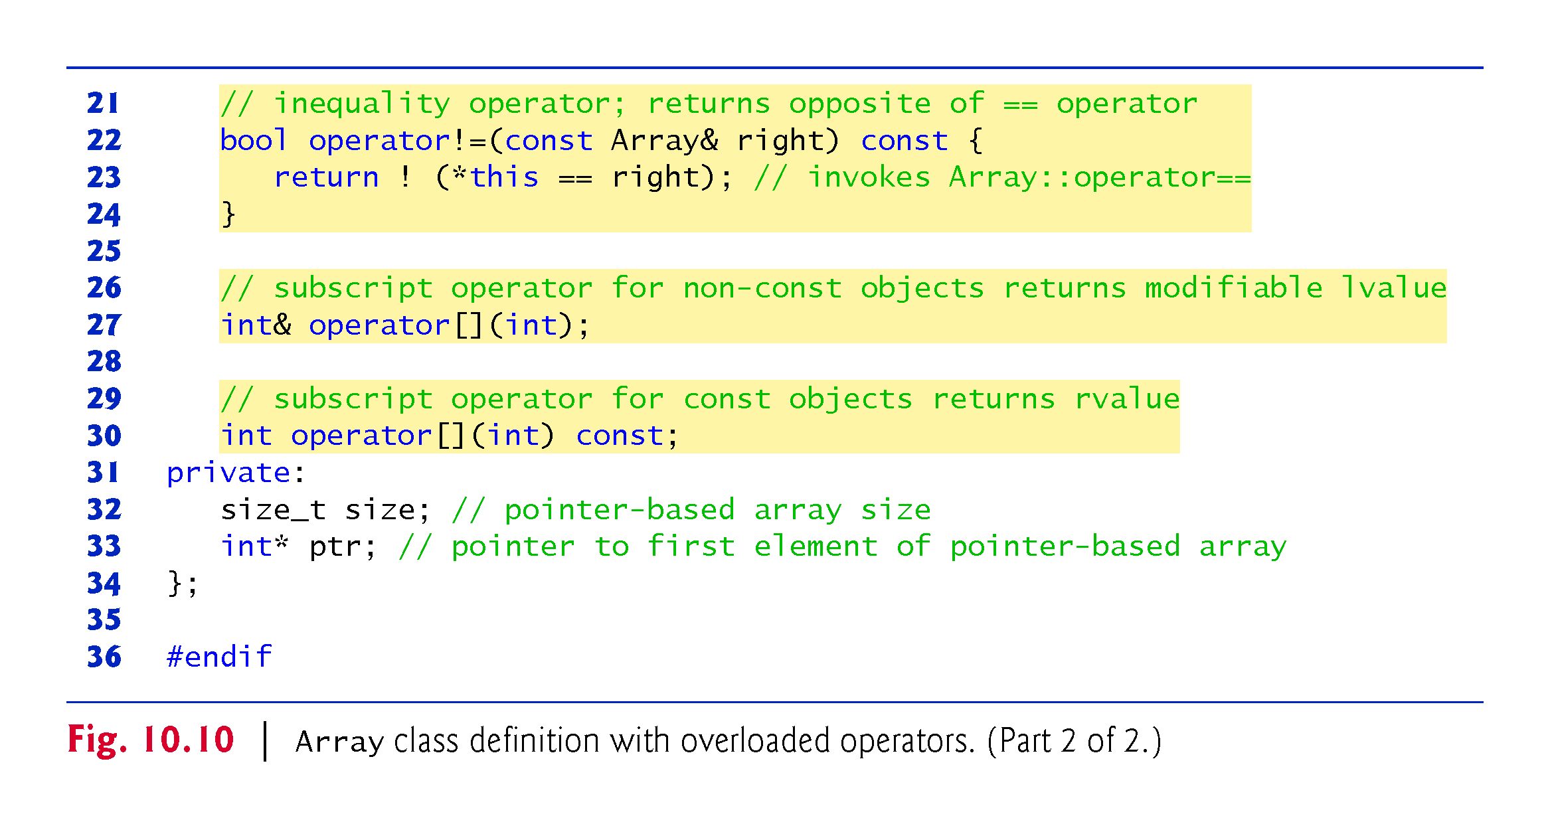

Slide 43
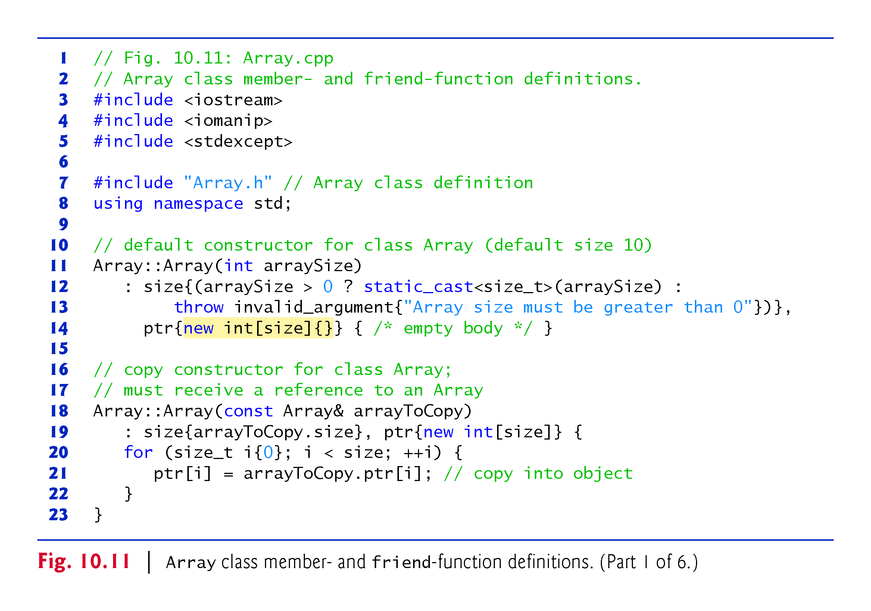

Slide 44
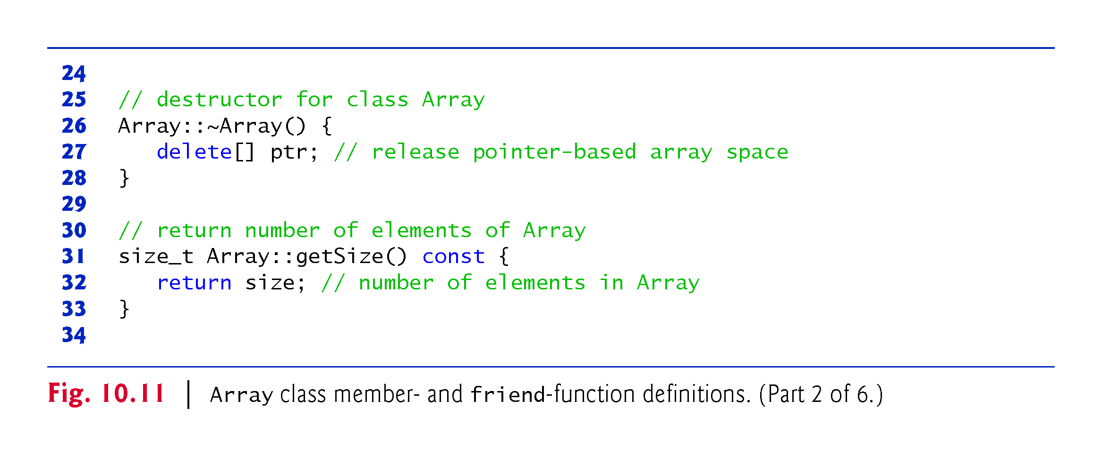

Slide 45
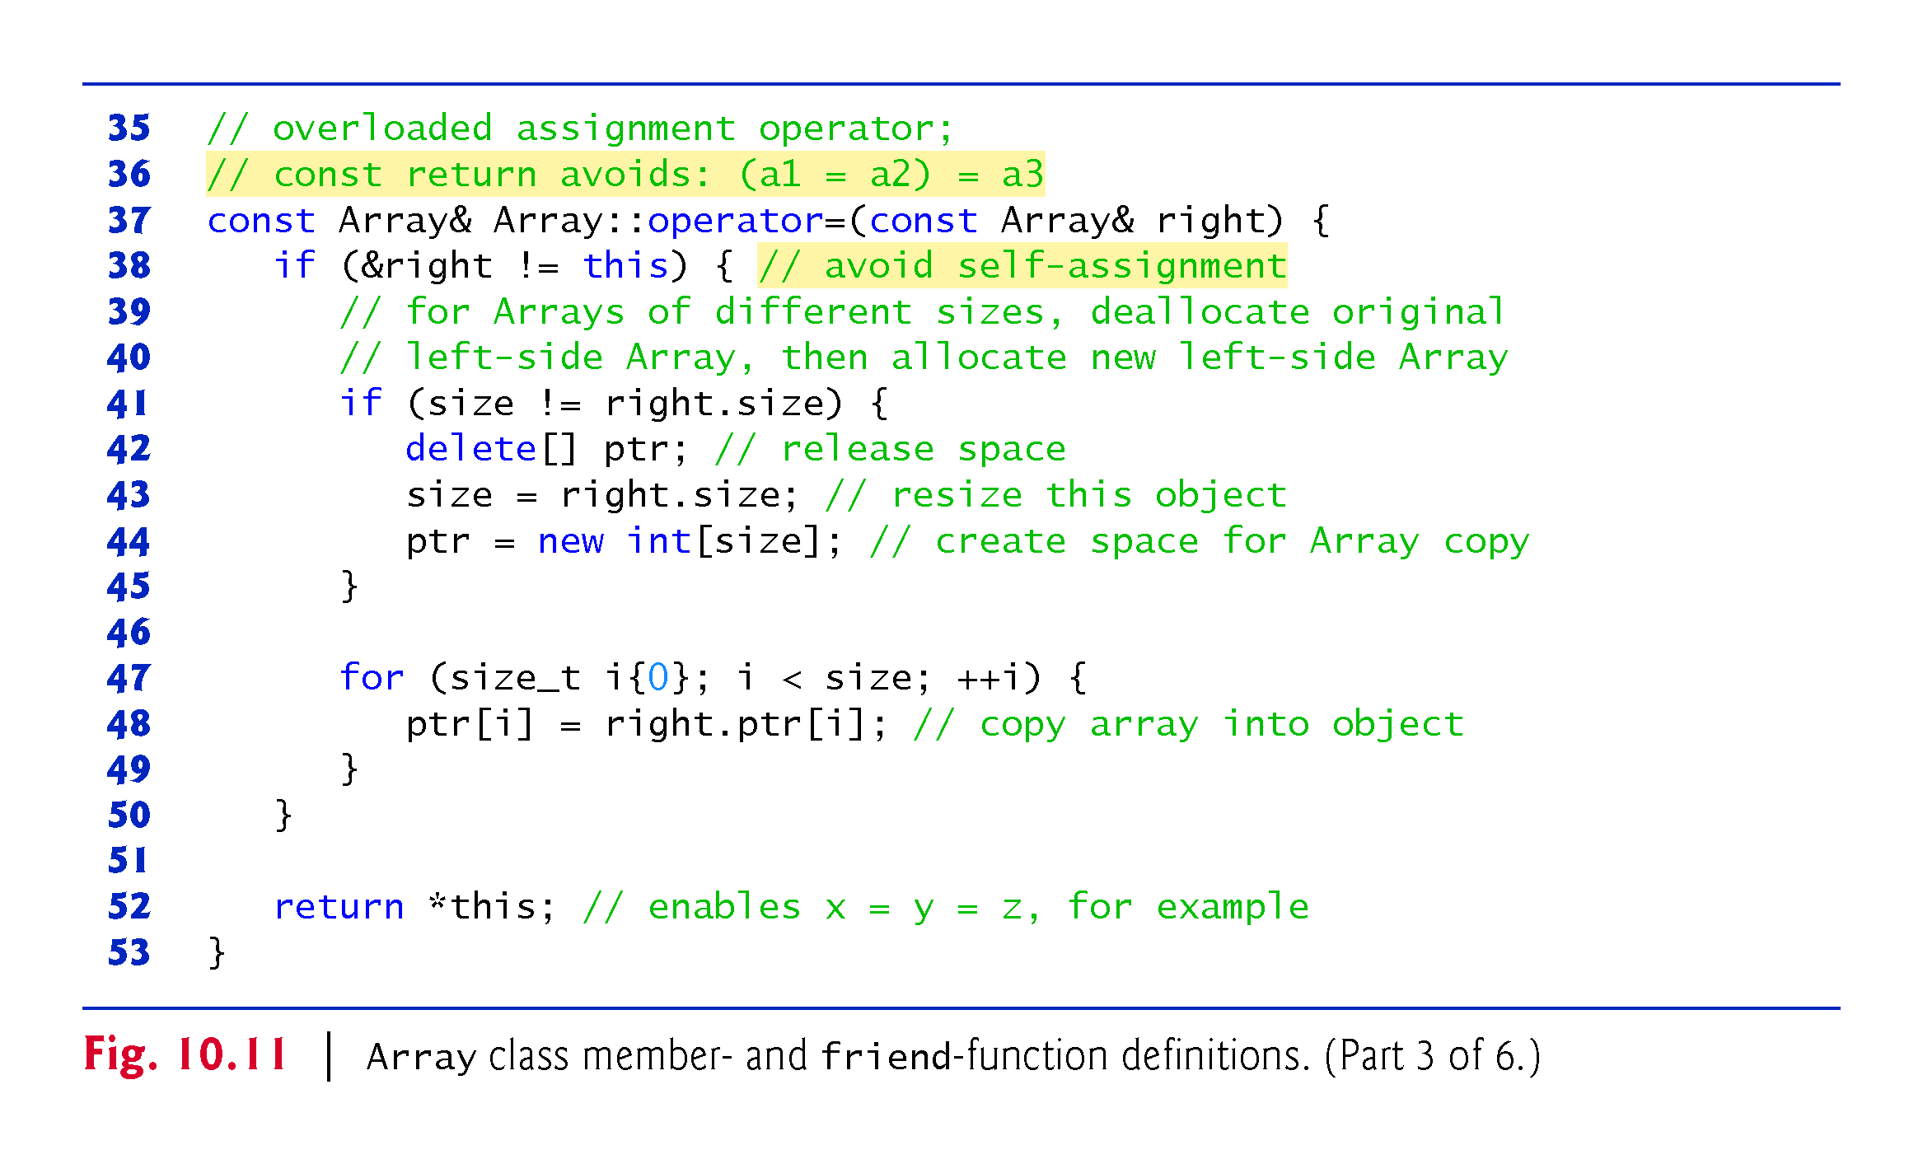

Slide 46
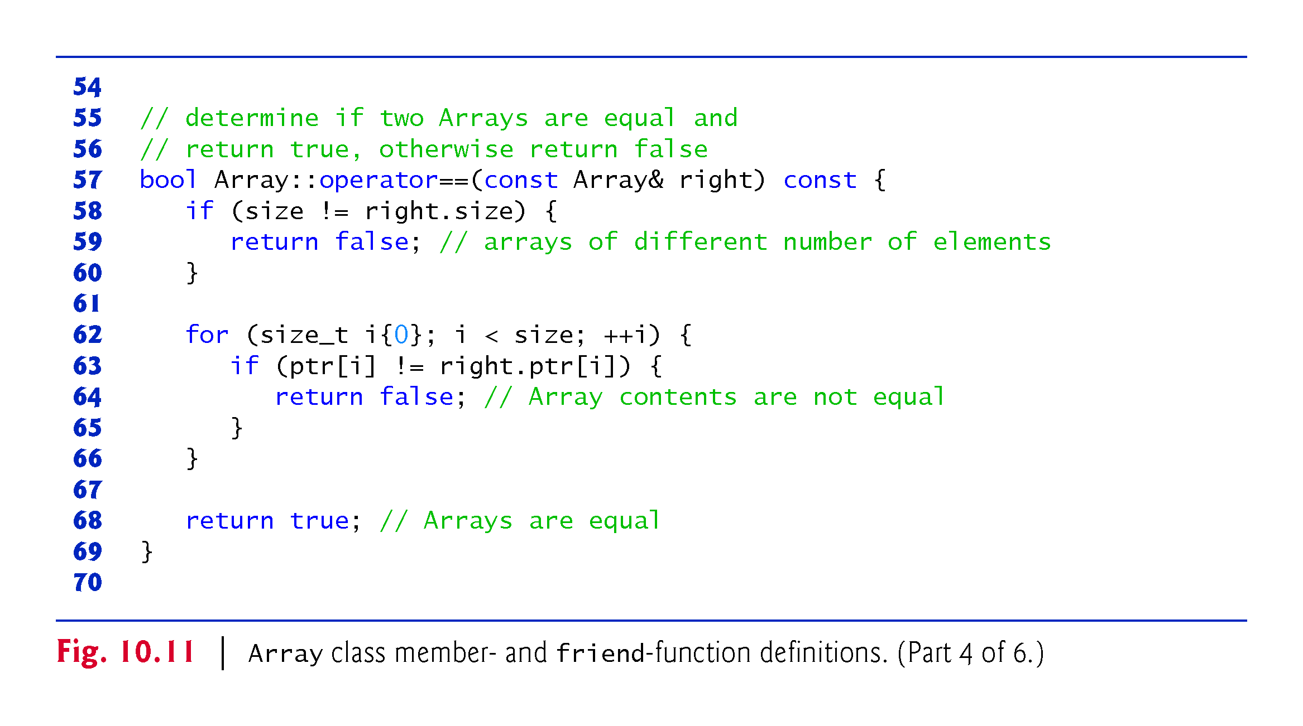

Slide 47
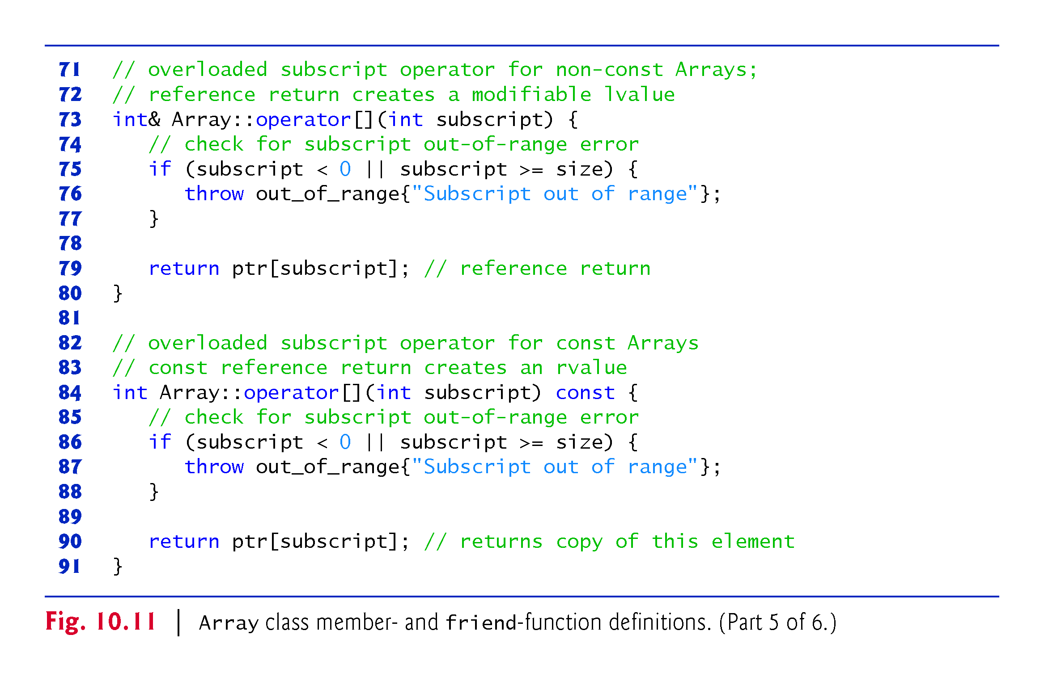

Slide 48
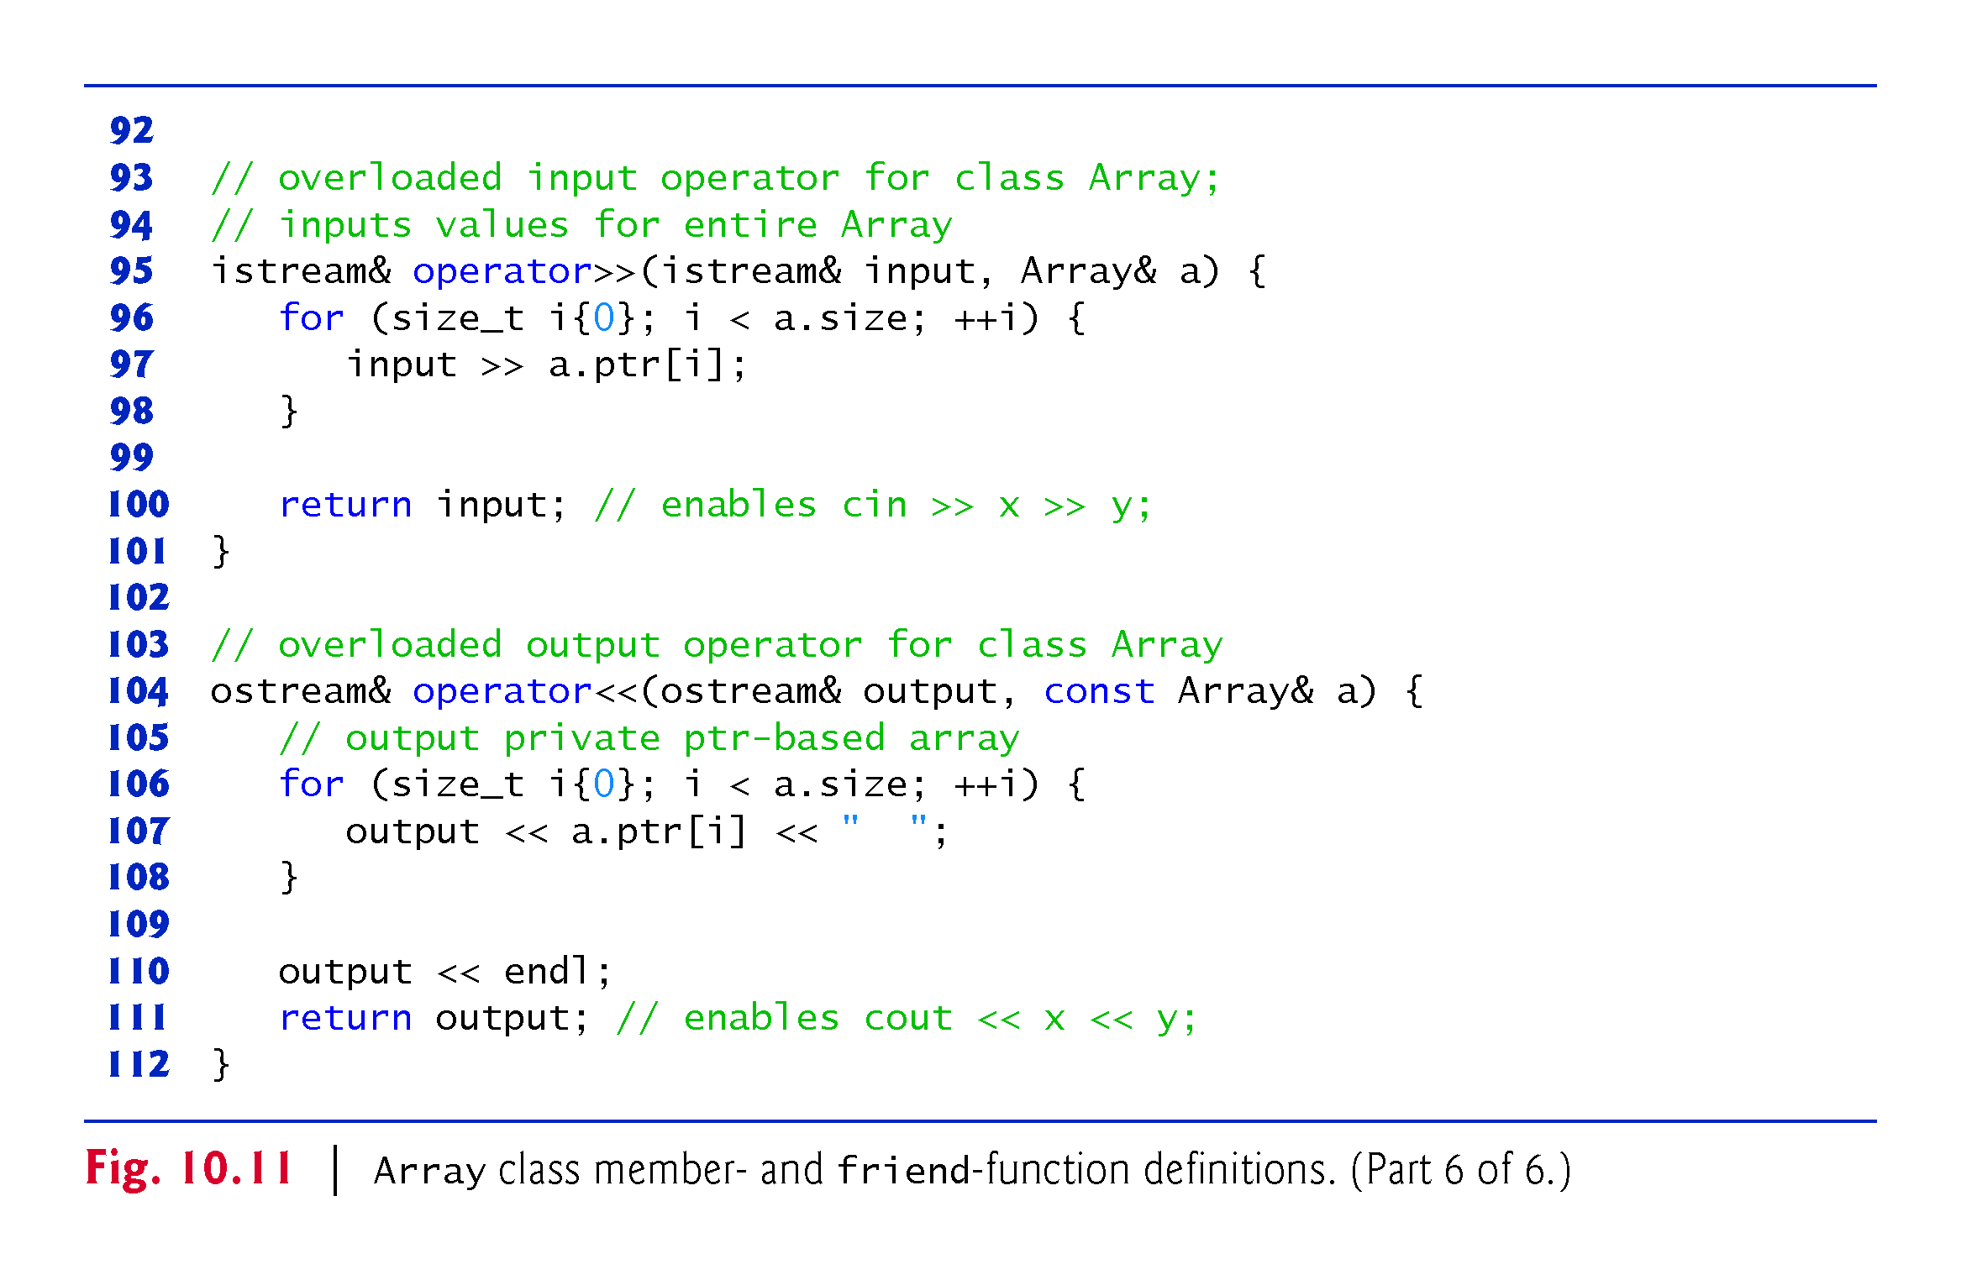

Slide 49
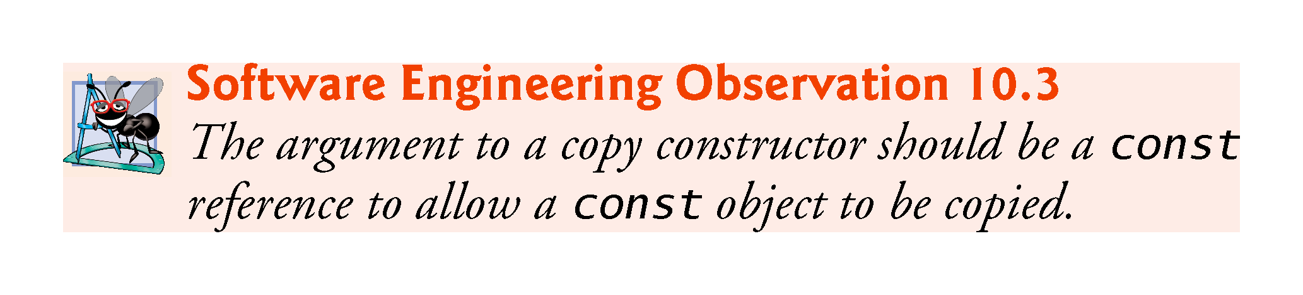

Slide 50
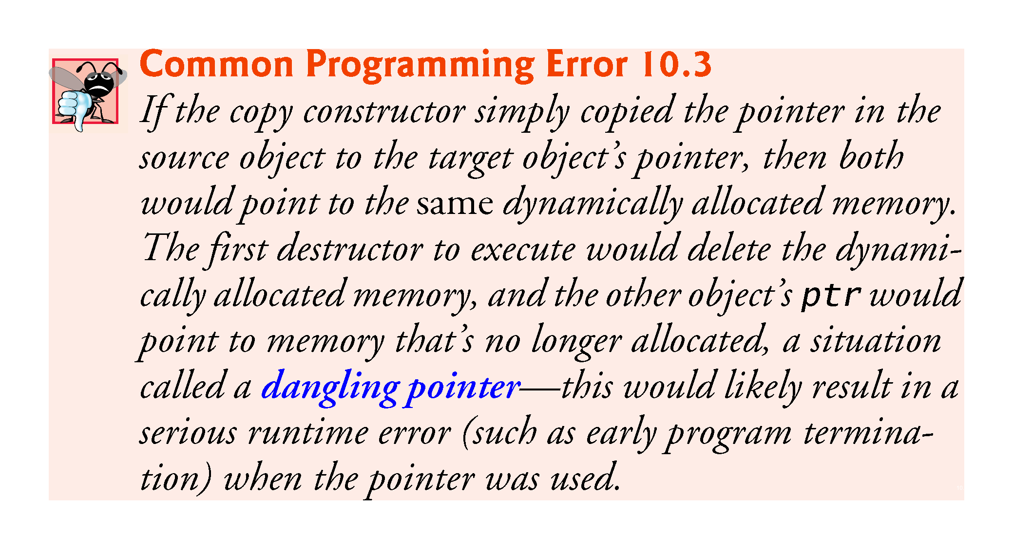

Slide 51
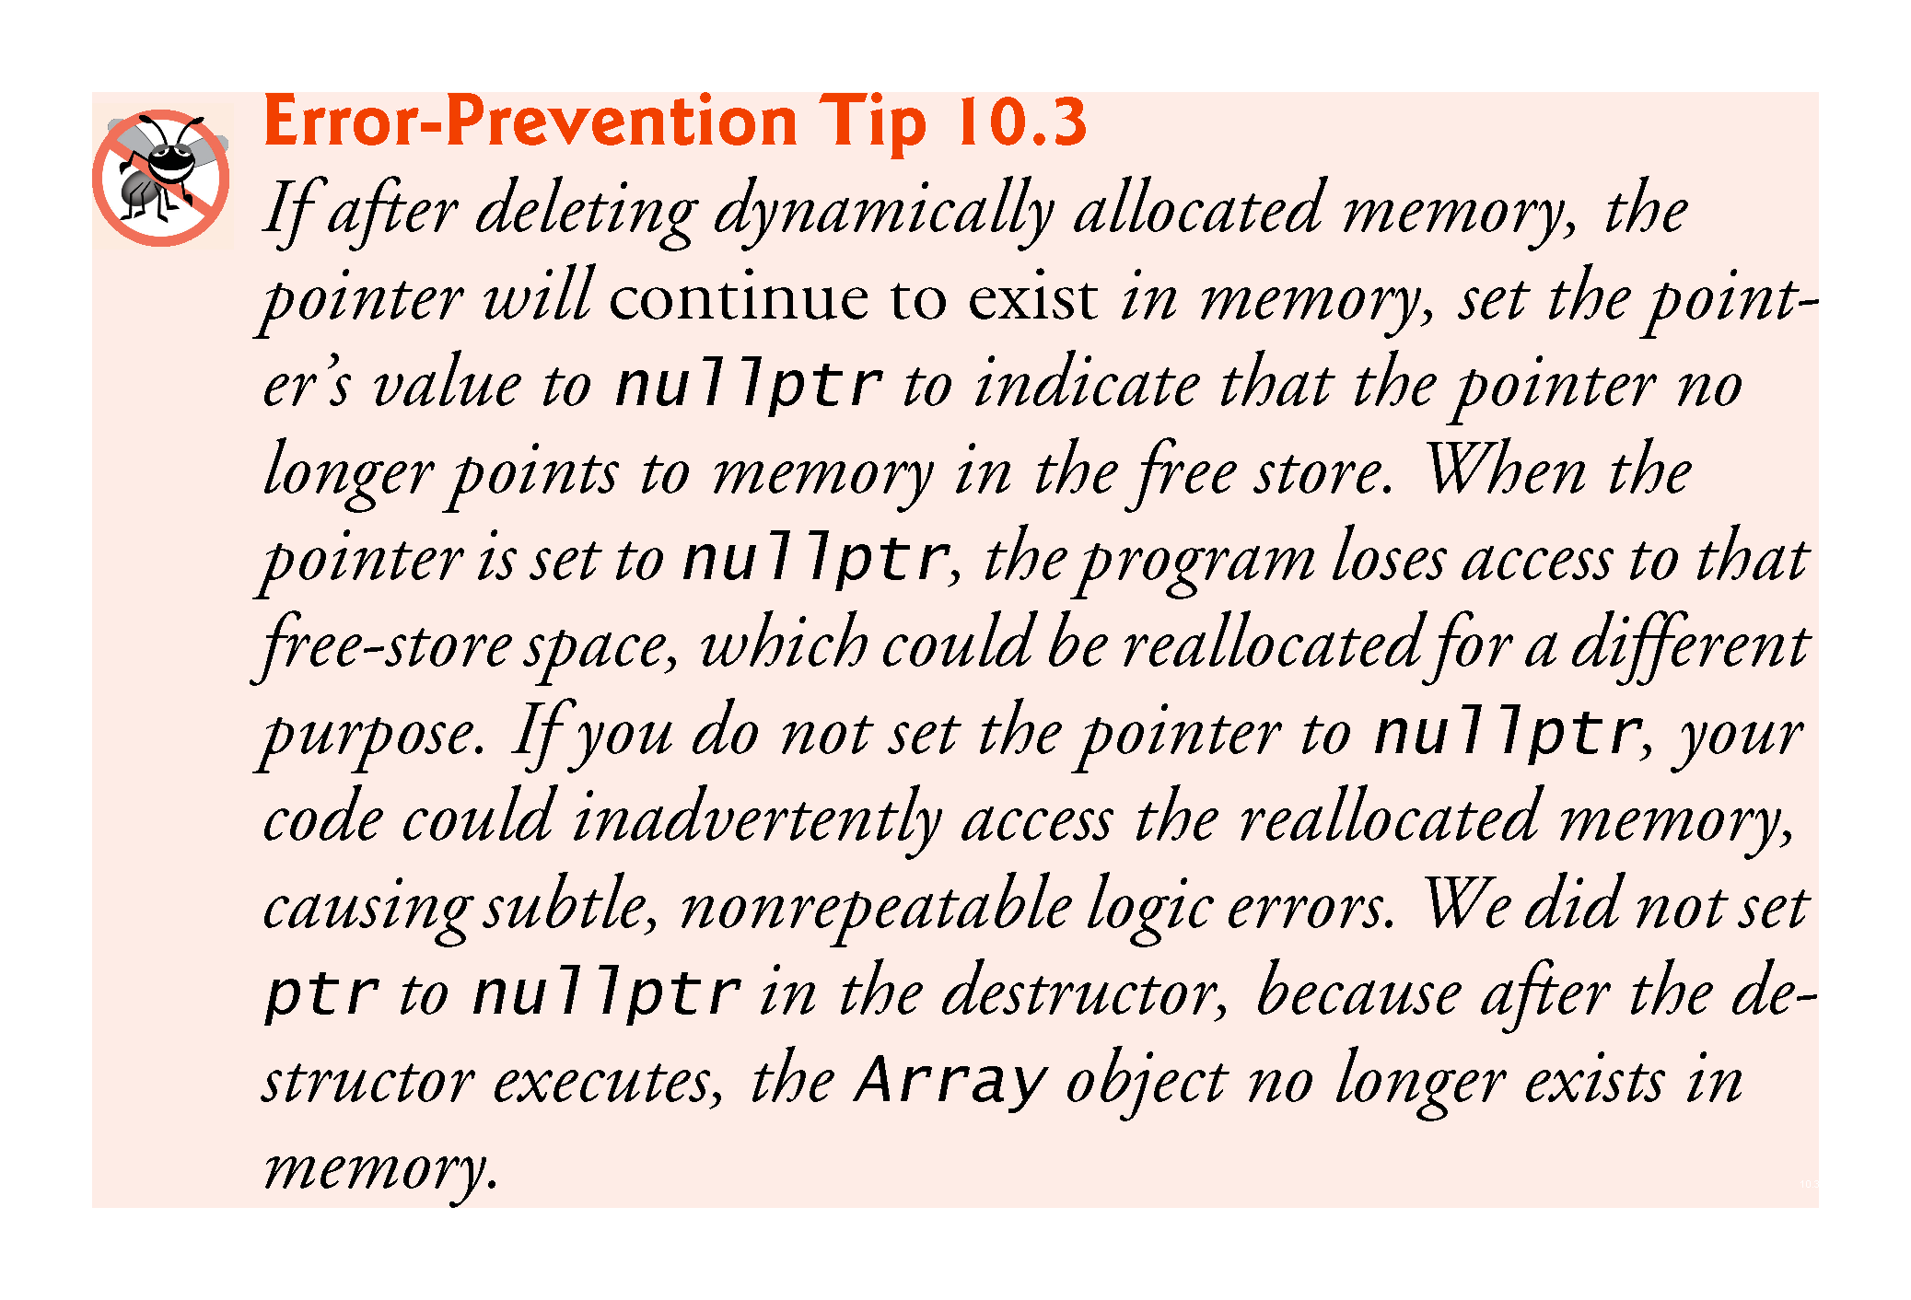

Slide 52


Slide 53


Slide 54


Slide 55


Slide 56


Slide 57


Slide 58


Slide 59

Notes:
Ob: There will be an error in line 12 because the prototype in line 7 is for const Array&. Problem solved in line 13

