Slide 1
Object-Oriented Programming: Polymorphism
Based on Chapter 12 of C++ How to Program, 10/e

Slide 2
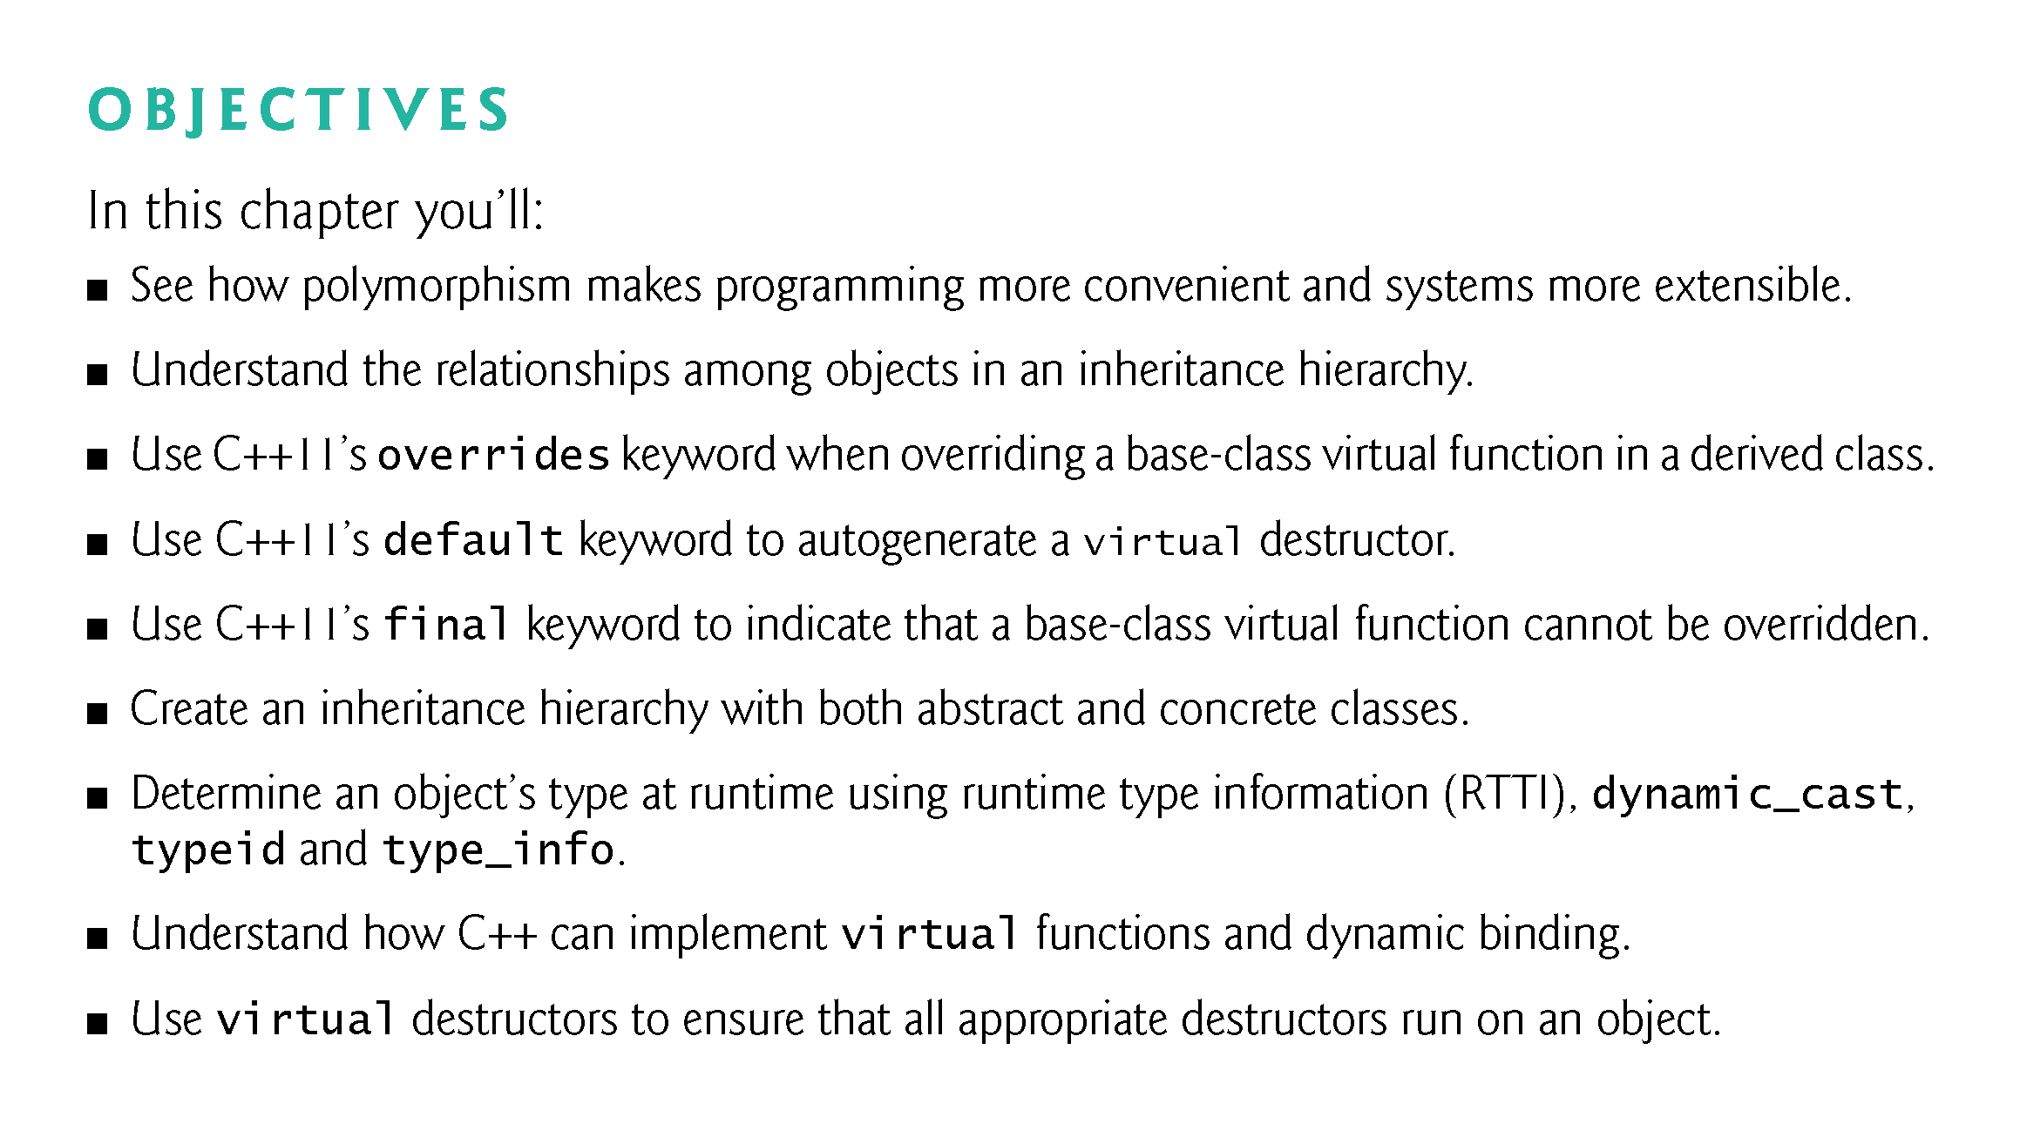

Slide 3
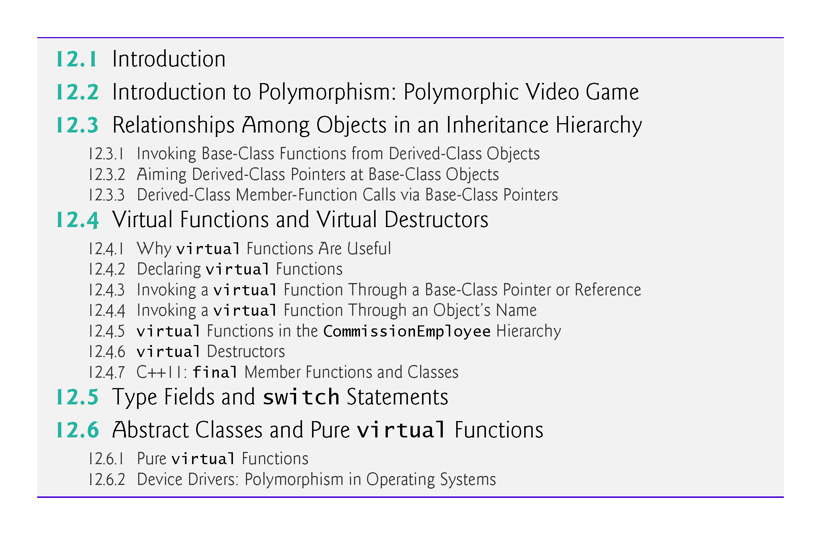

Slide 4
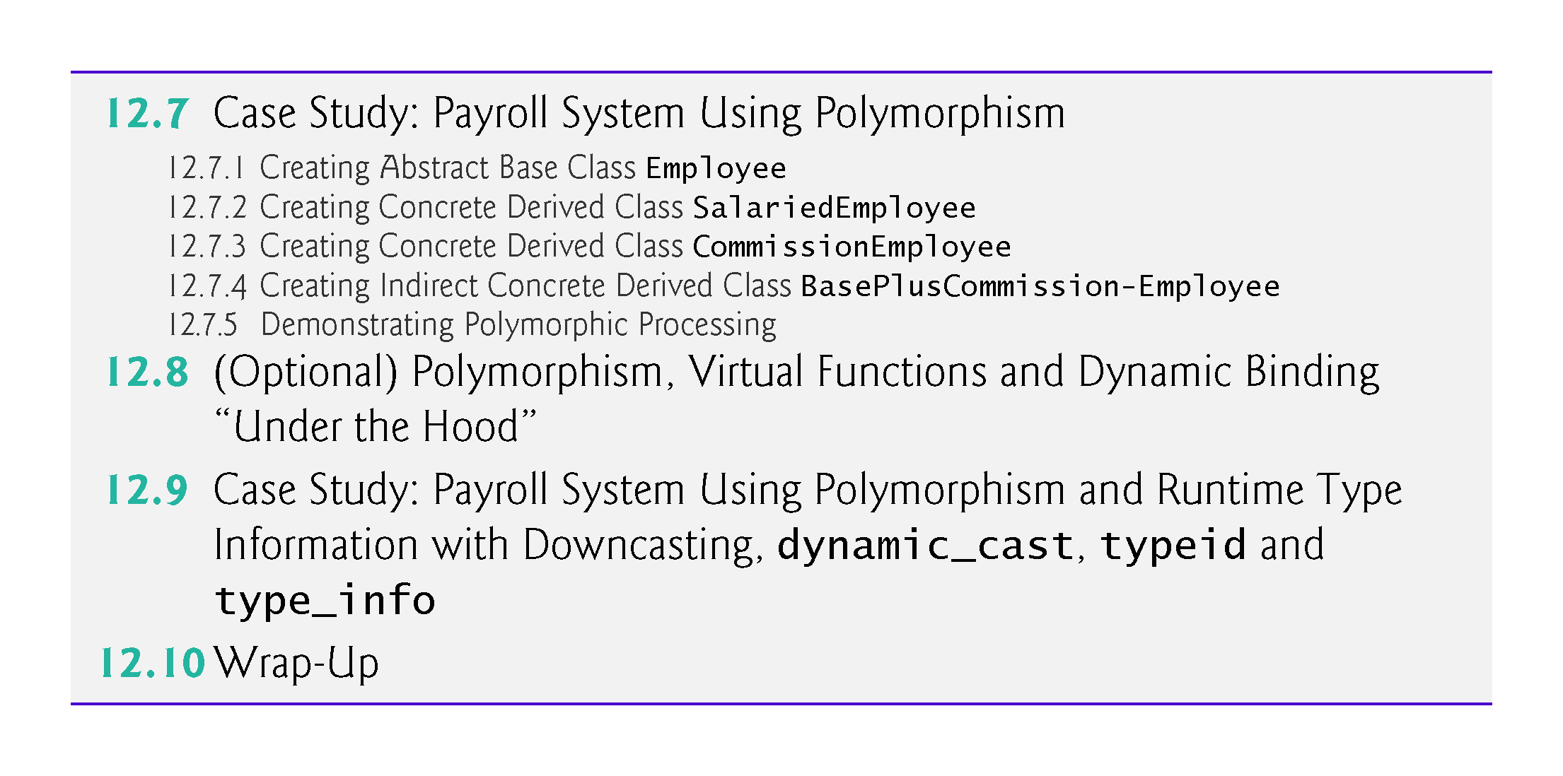

Slide 5
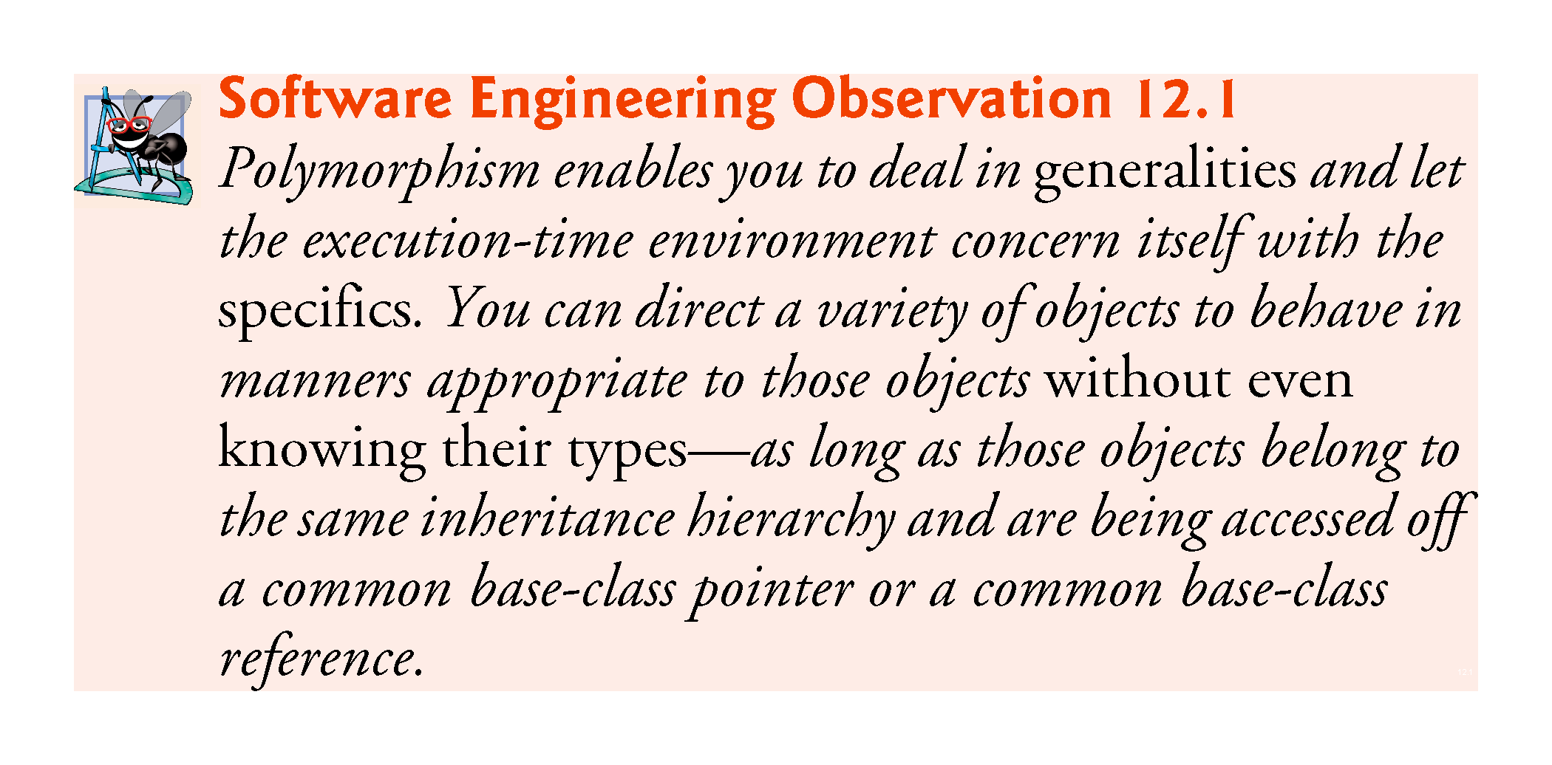

Slide 6
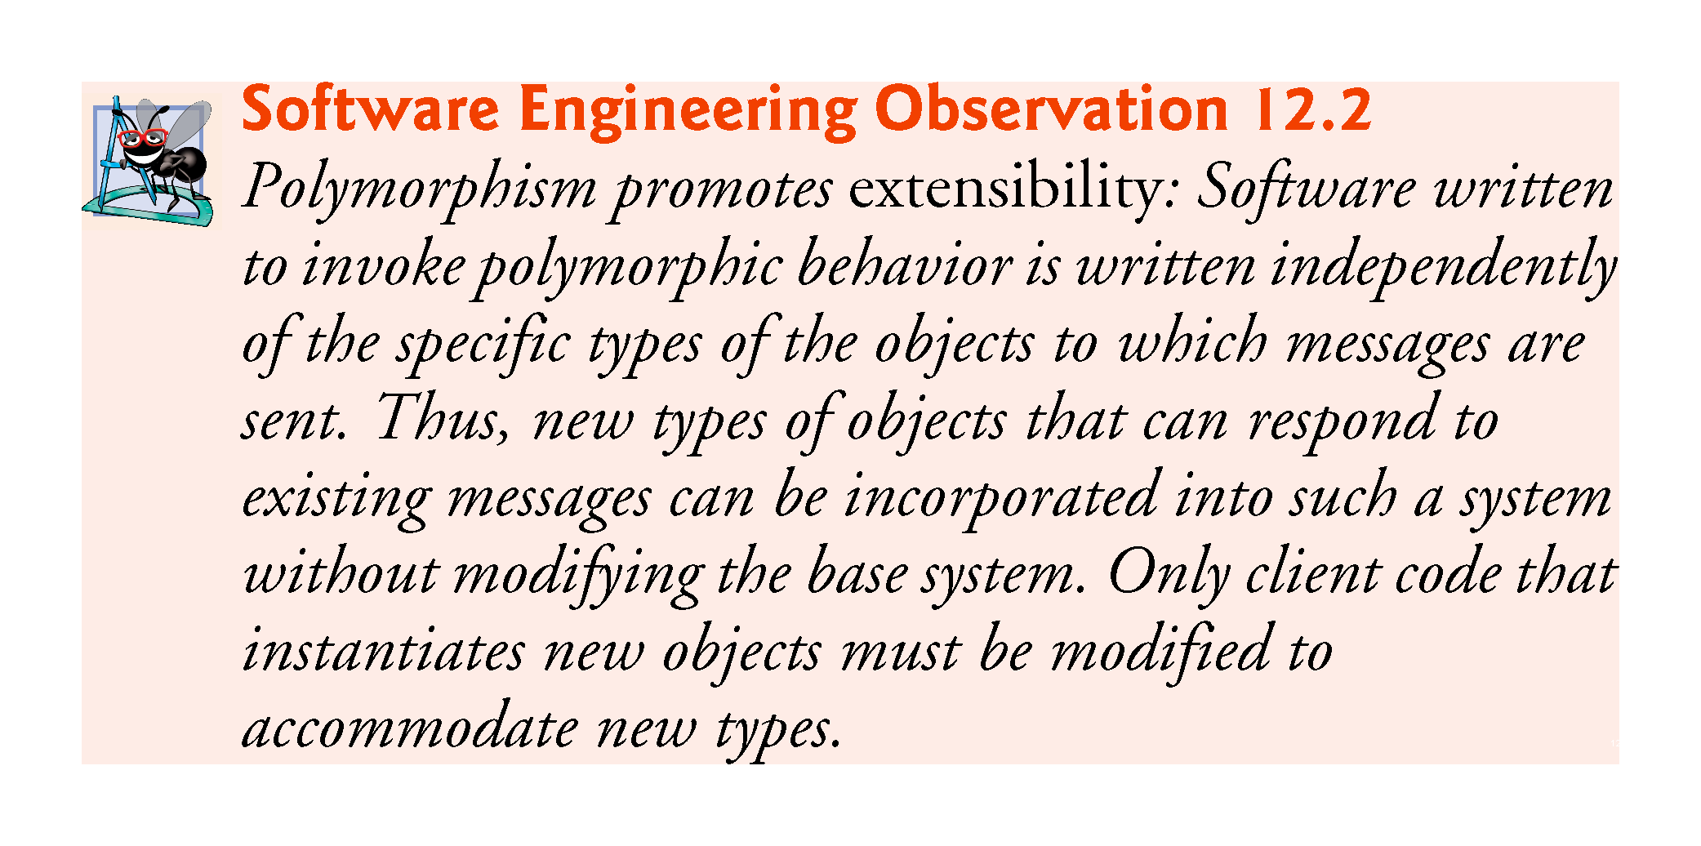

Slide 7
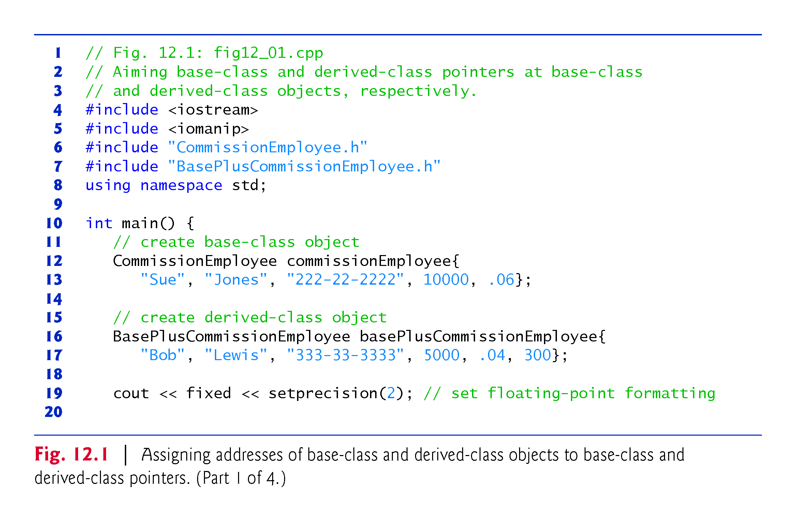

Slide 8
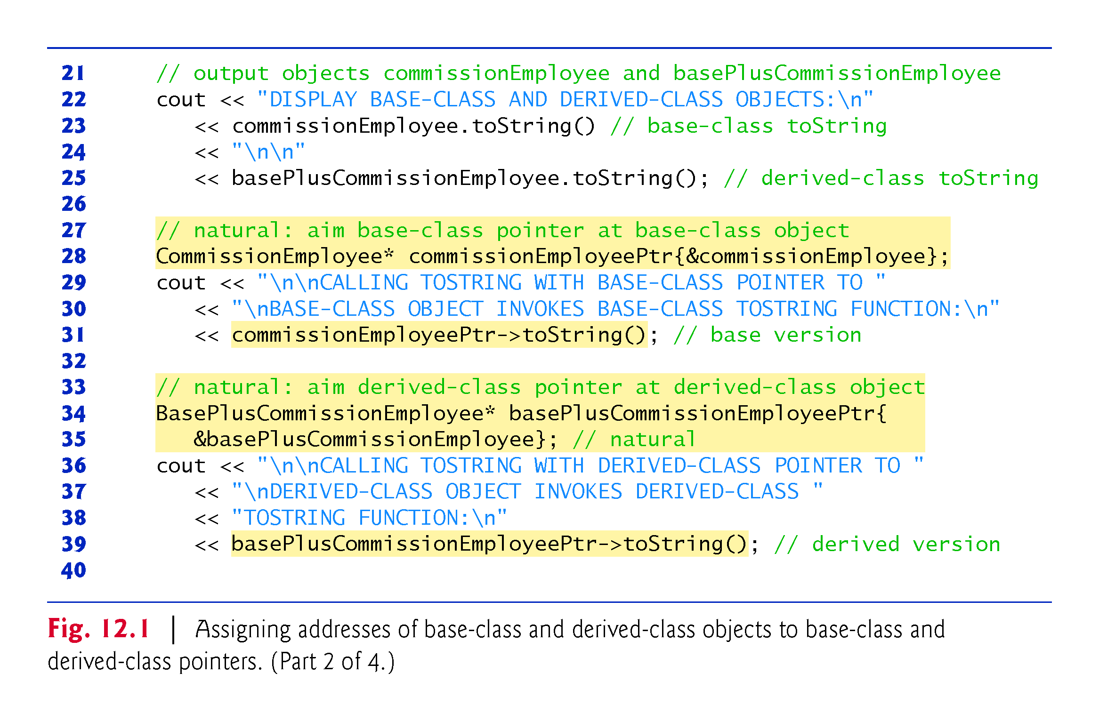

Slide 9
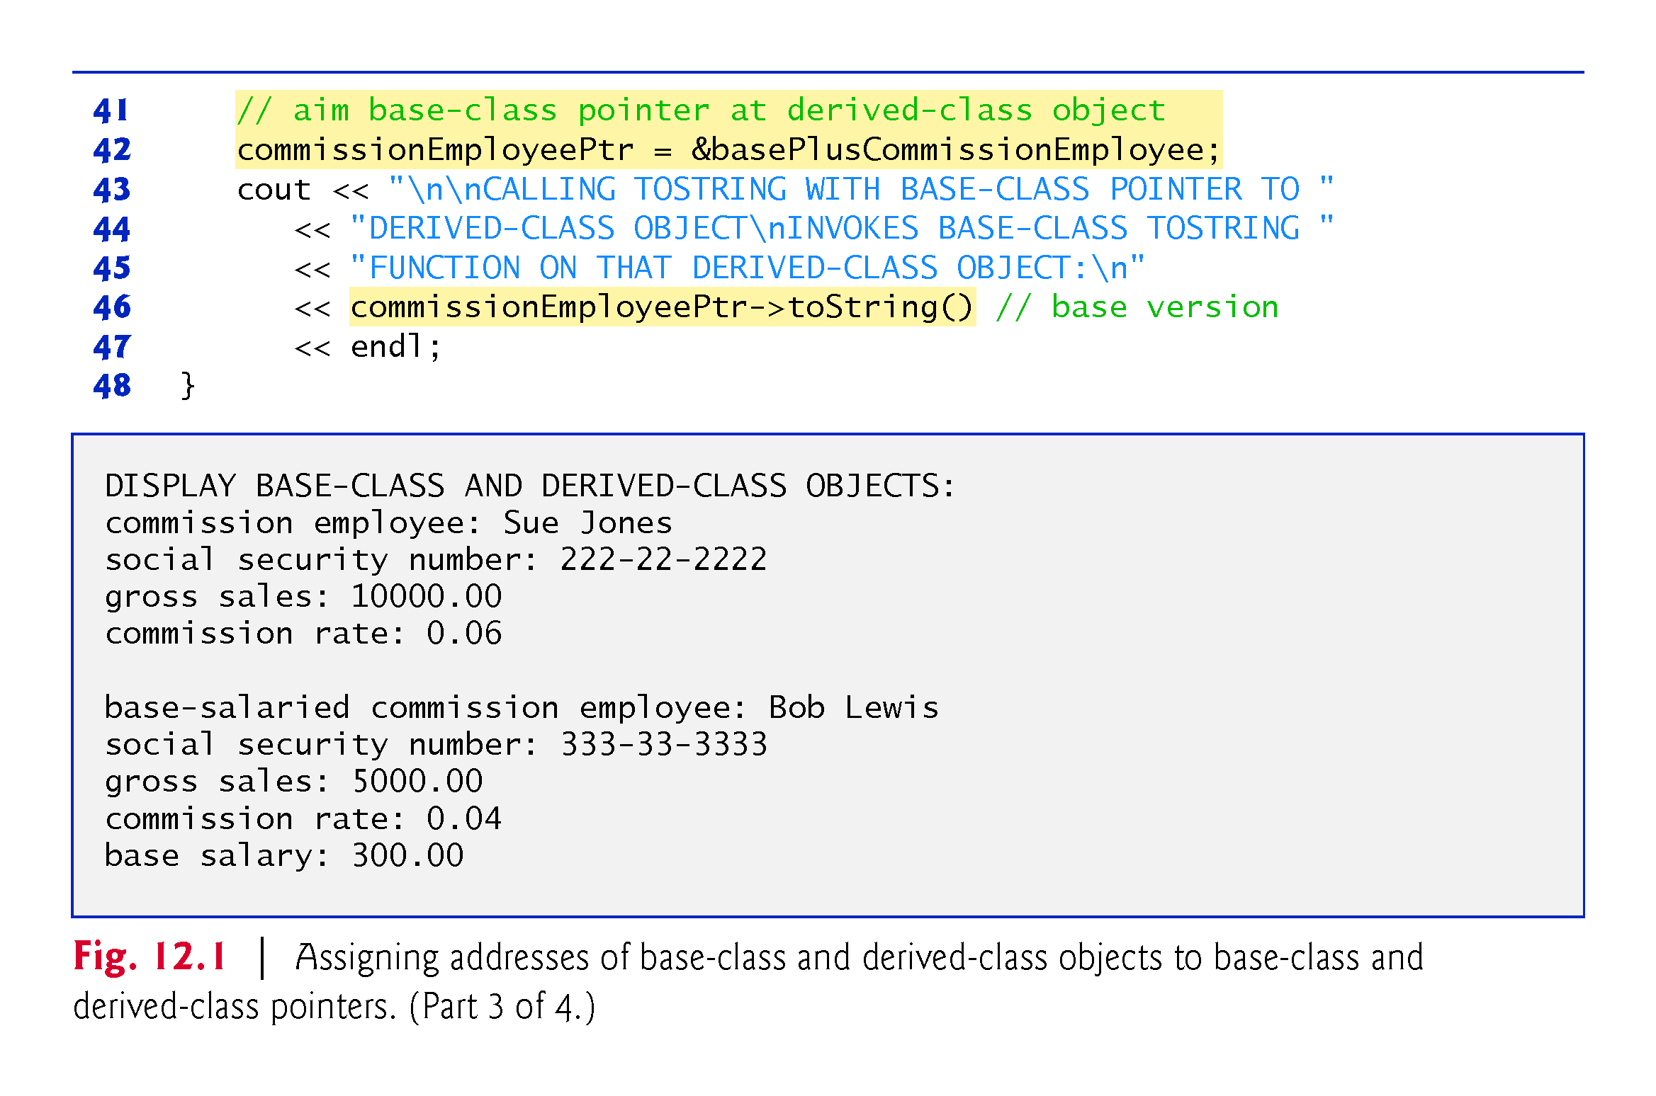

Slide 10
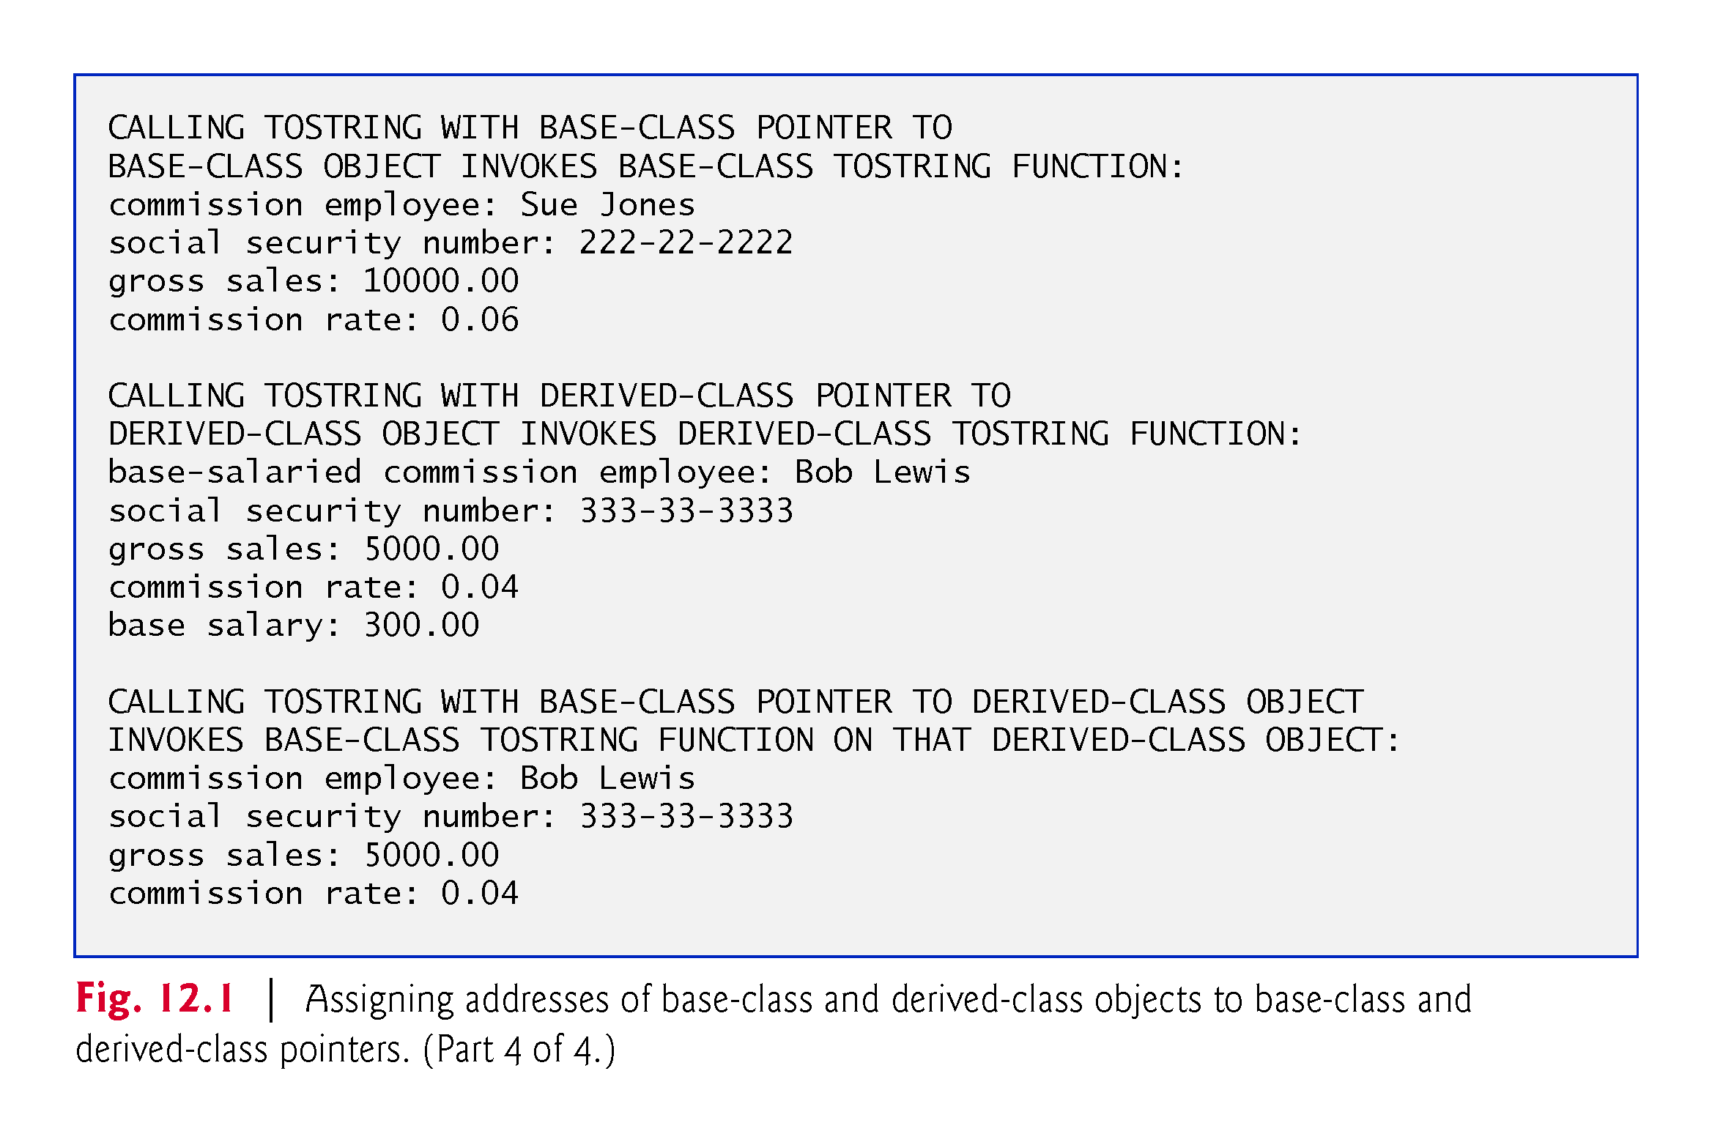
Notes:
Ob: The difference is that in the last invocation there is no base salary (base class object function invocation)

Slide 11
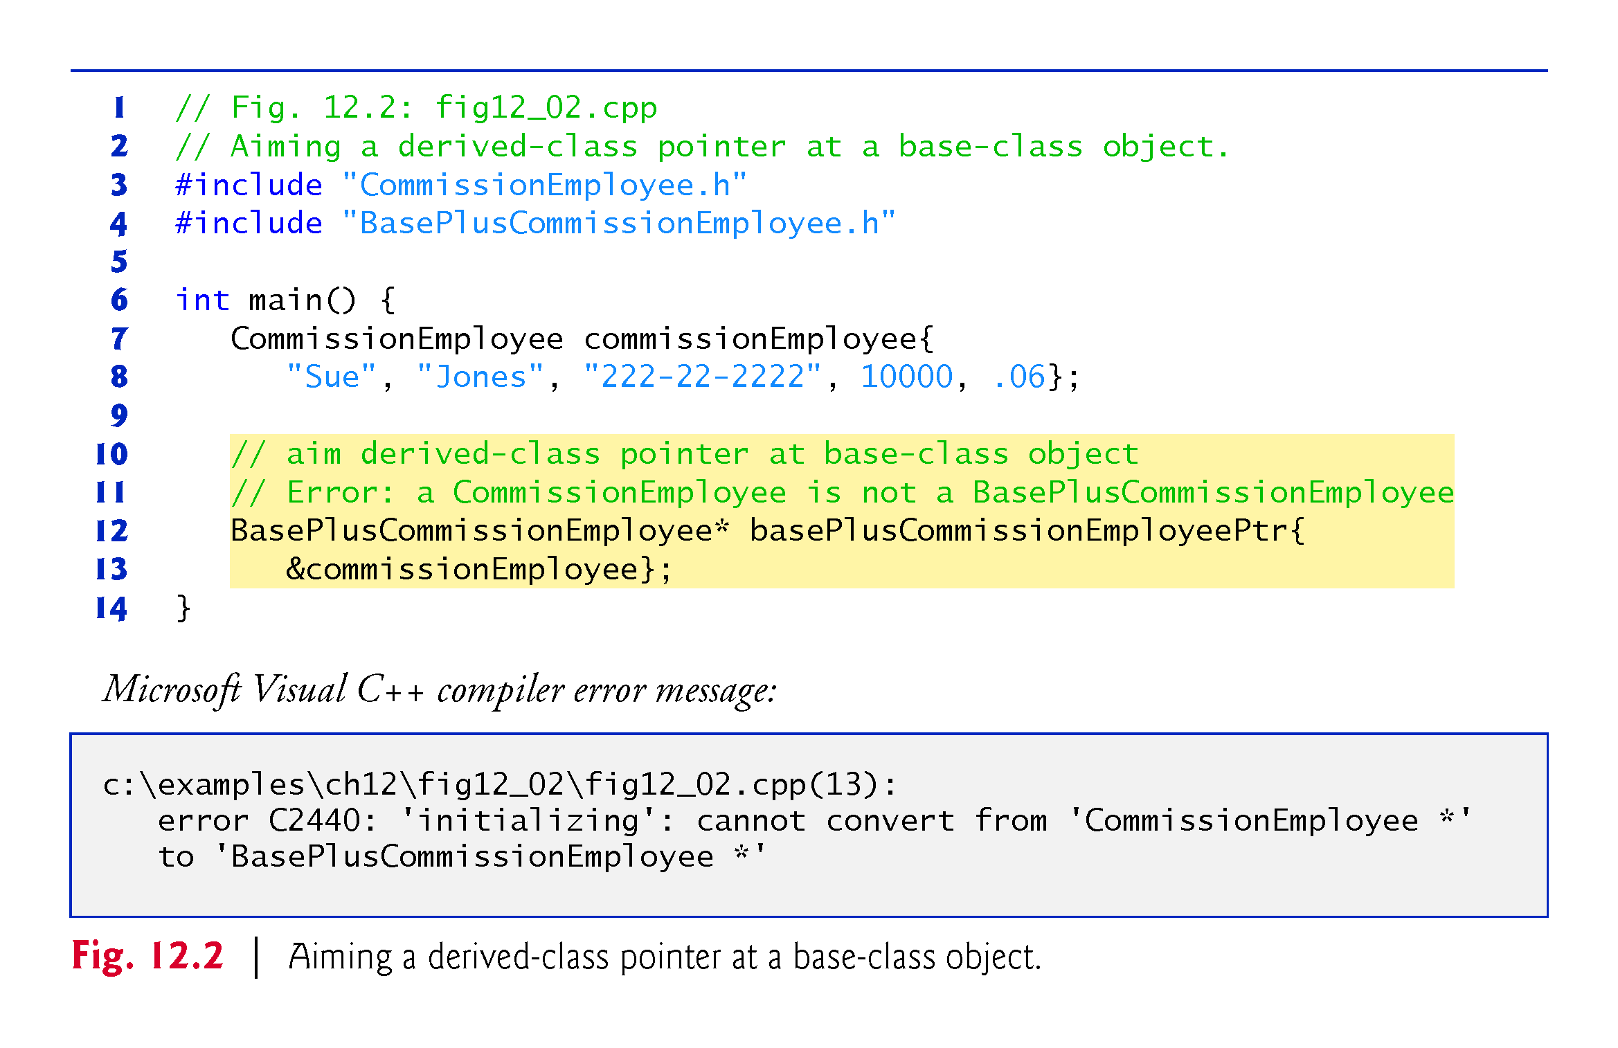
Notes:
Ob: Only the other way is allowed – base class object pointer to hold the address of a derived class object

Slide 12
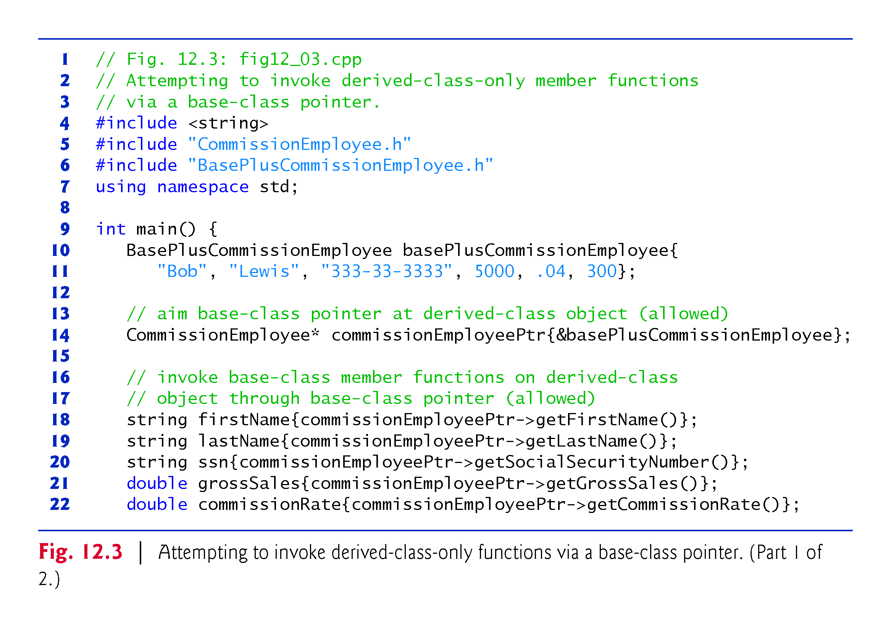

Slide 13
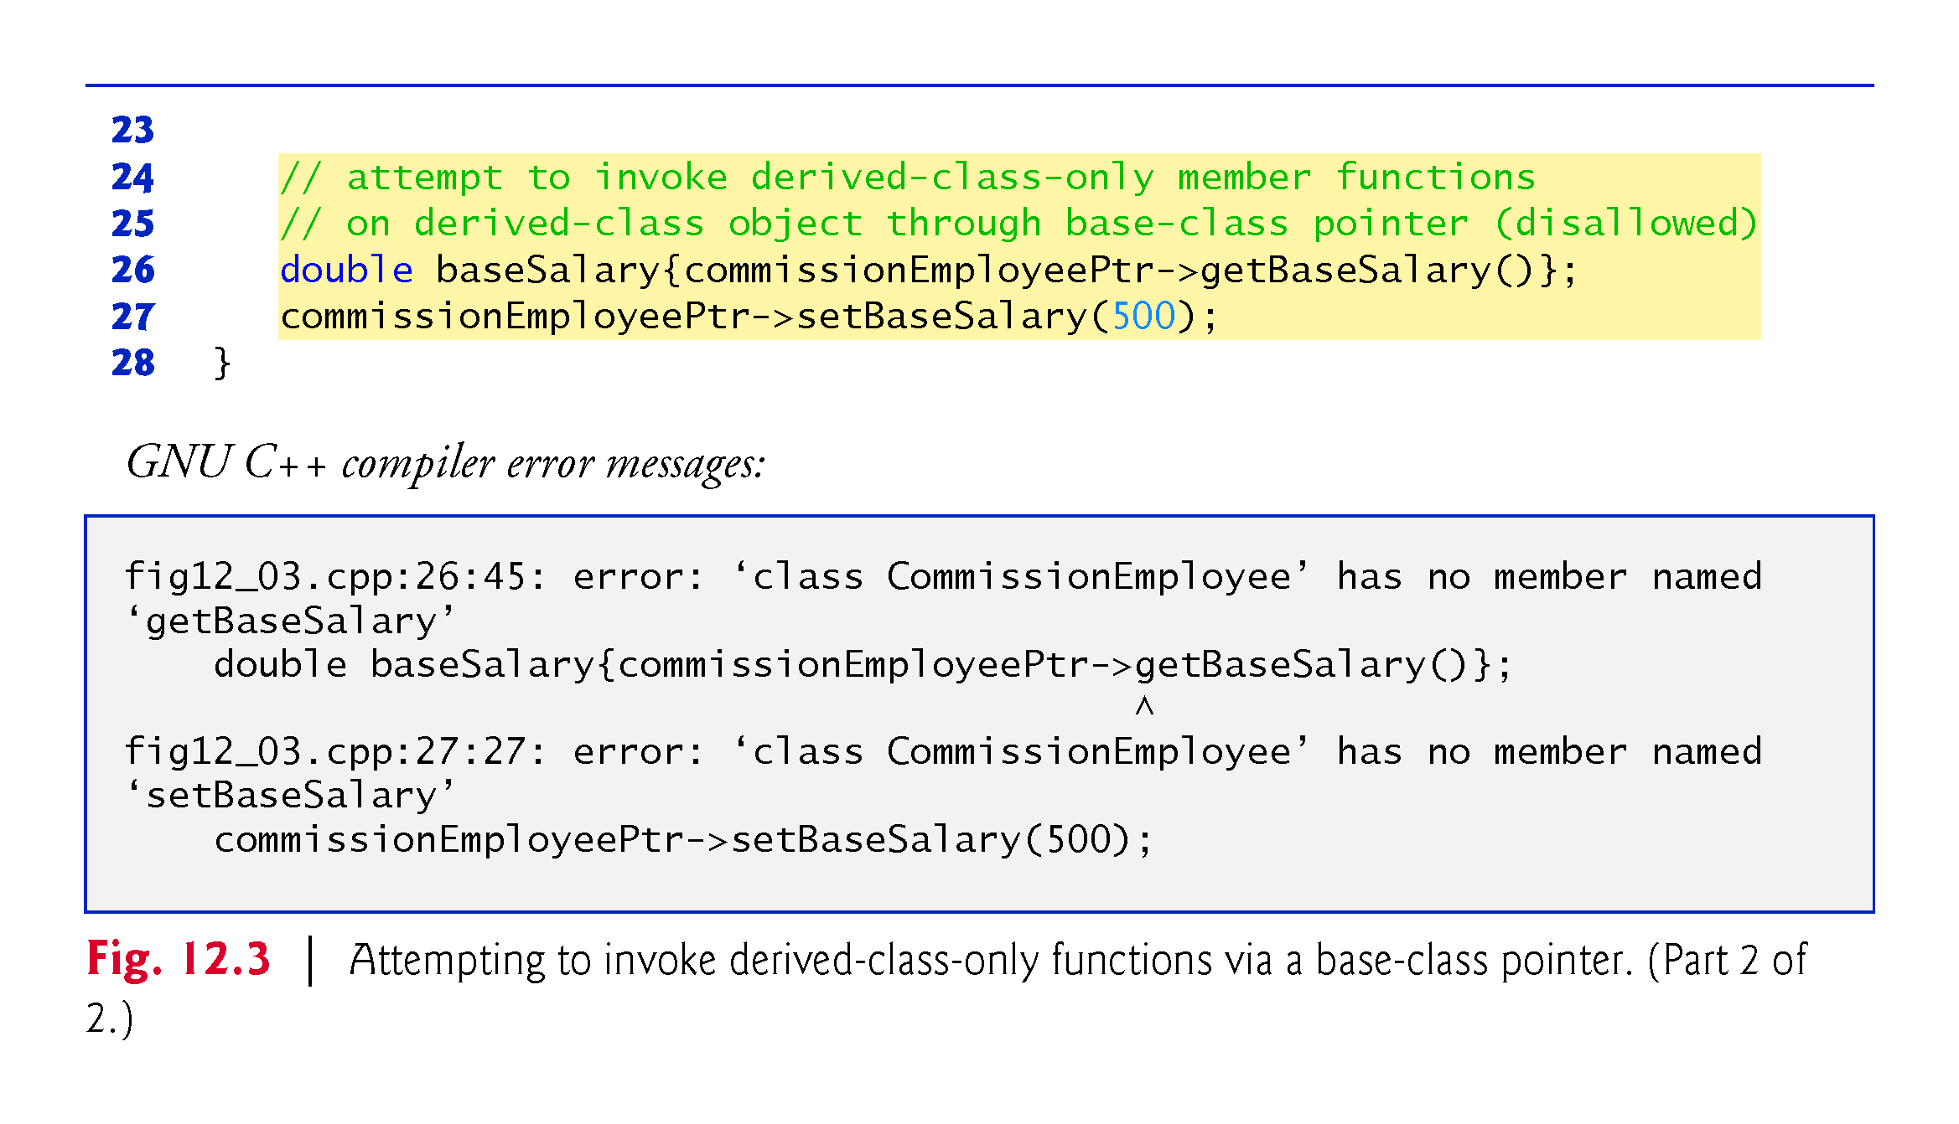
Notes:
Ob: getBaseSalary and setBaseSalary functions of the derived class only. Access to these is not allowed through a base class pointer – despite this pointer holding the address of a derived class object

Slide 14
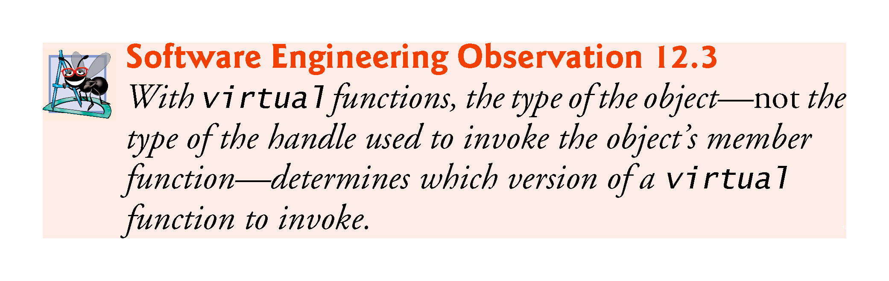

Slide 15
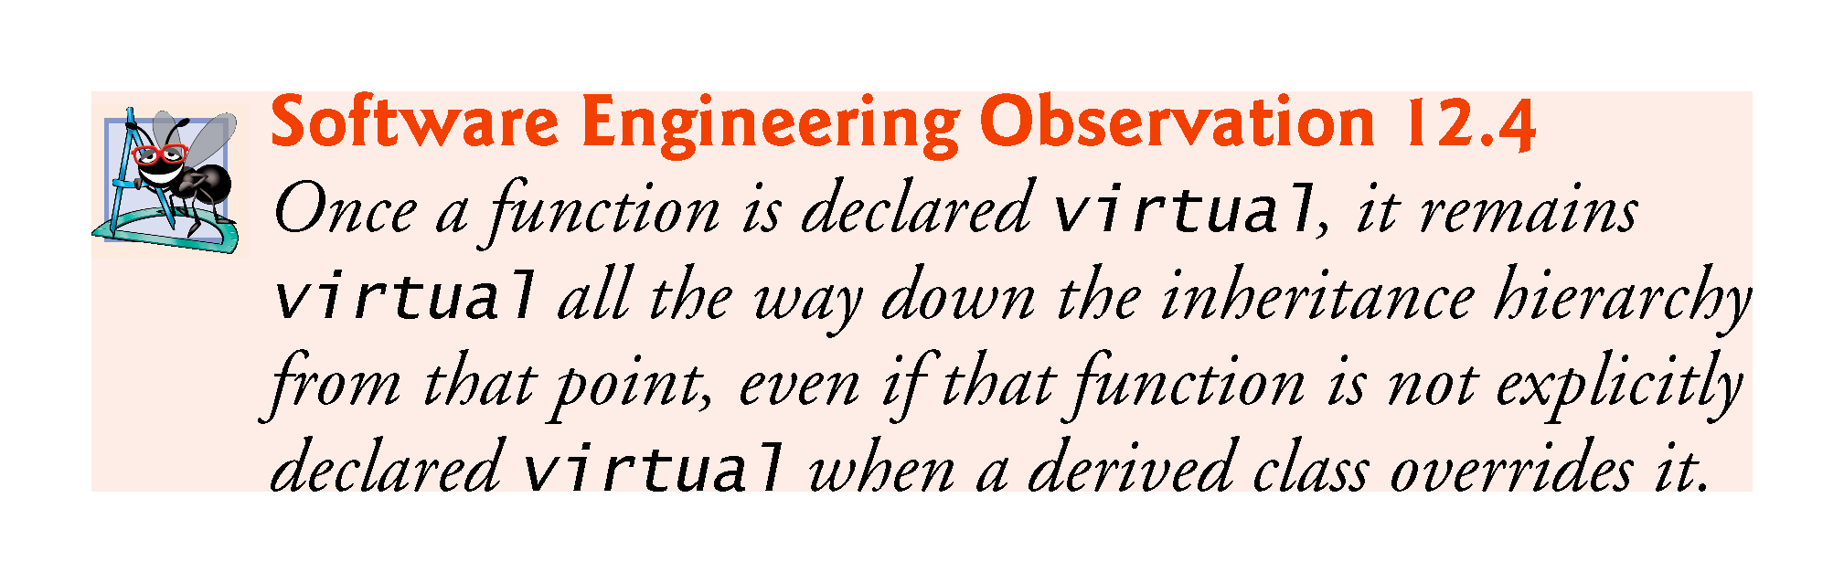

Slide 16
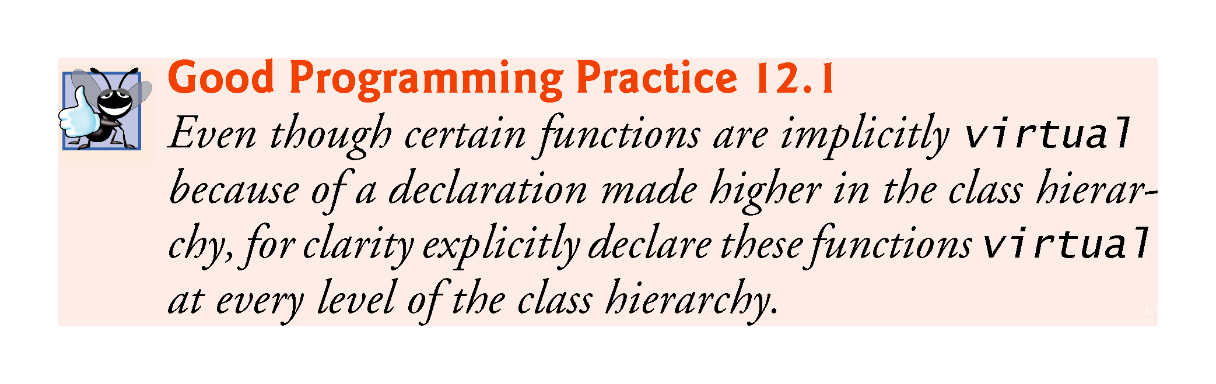

Slide 17
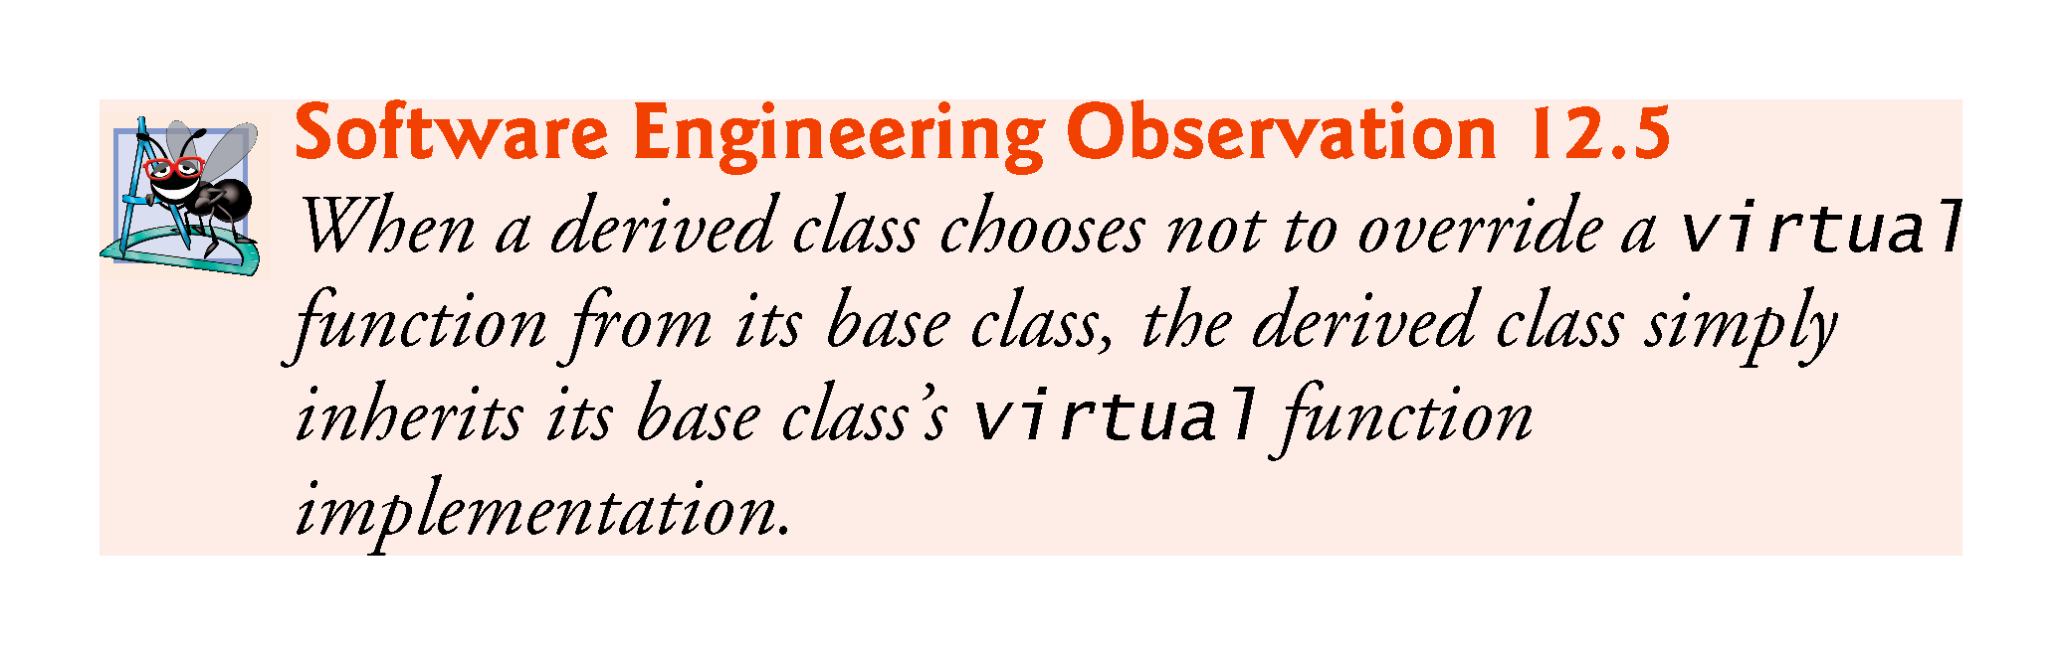

Slide 18
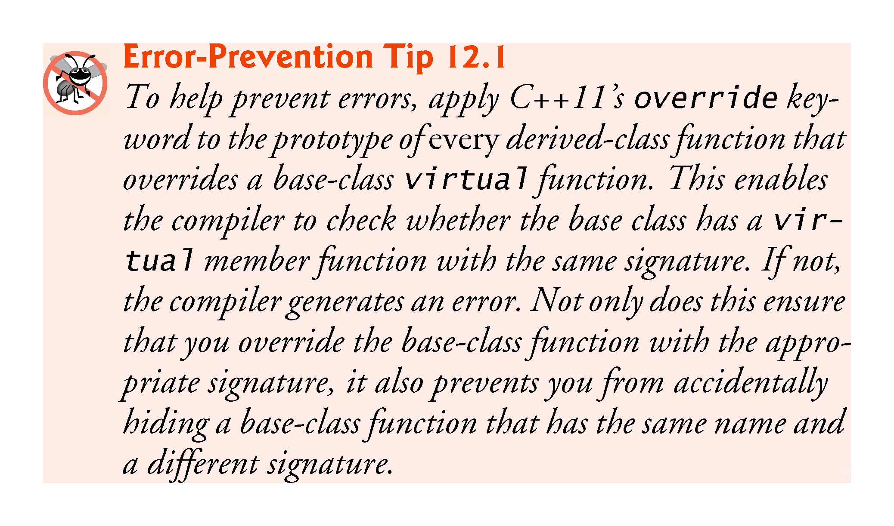

Slide 19
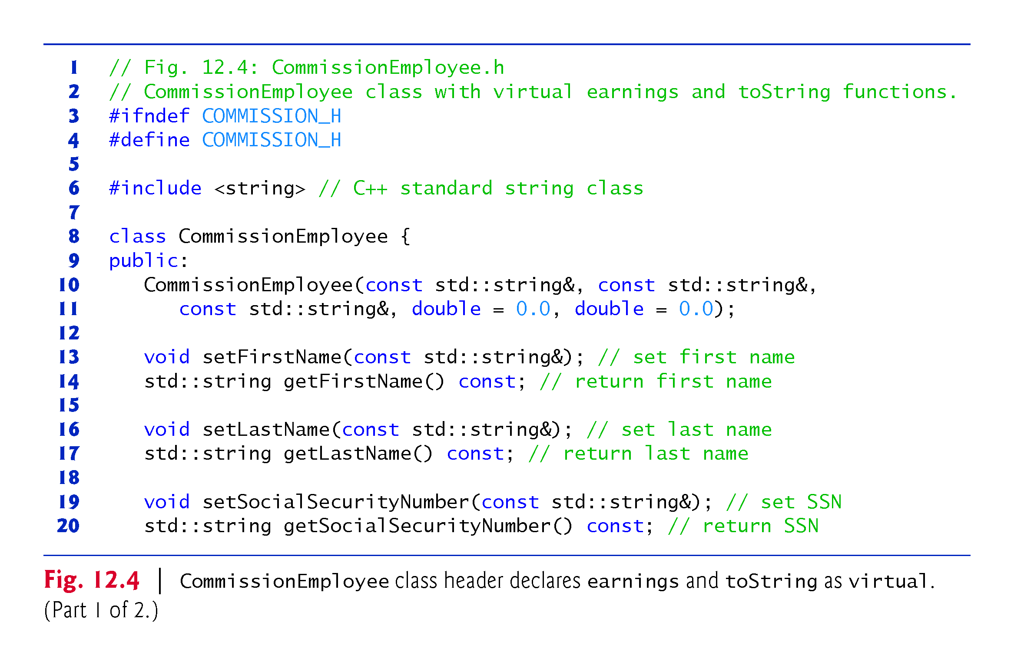

Slide 20
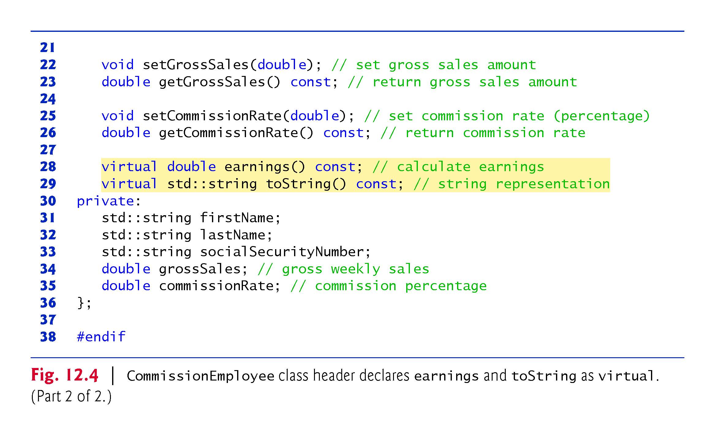

Slide 21
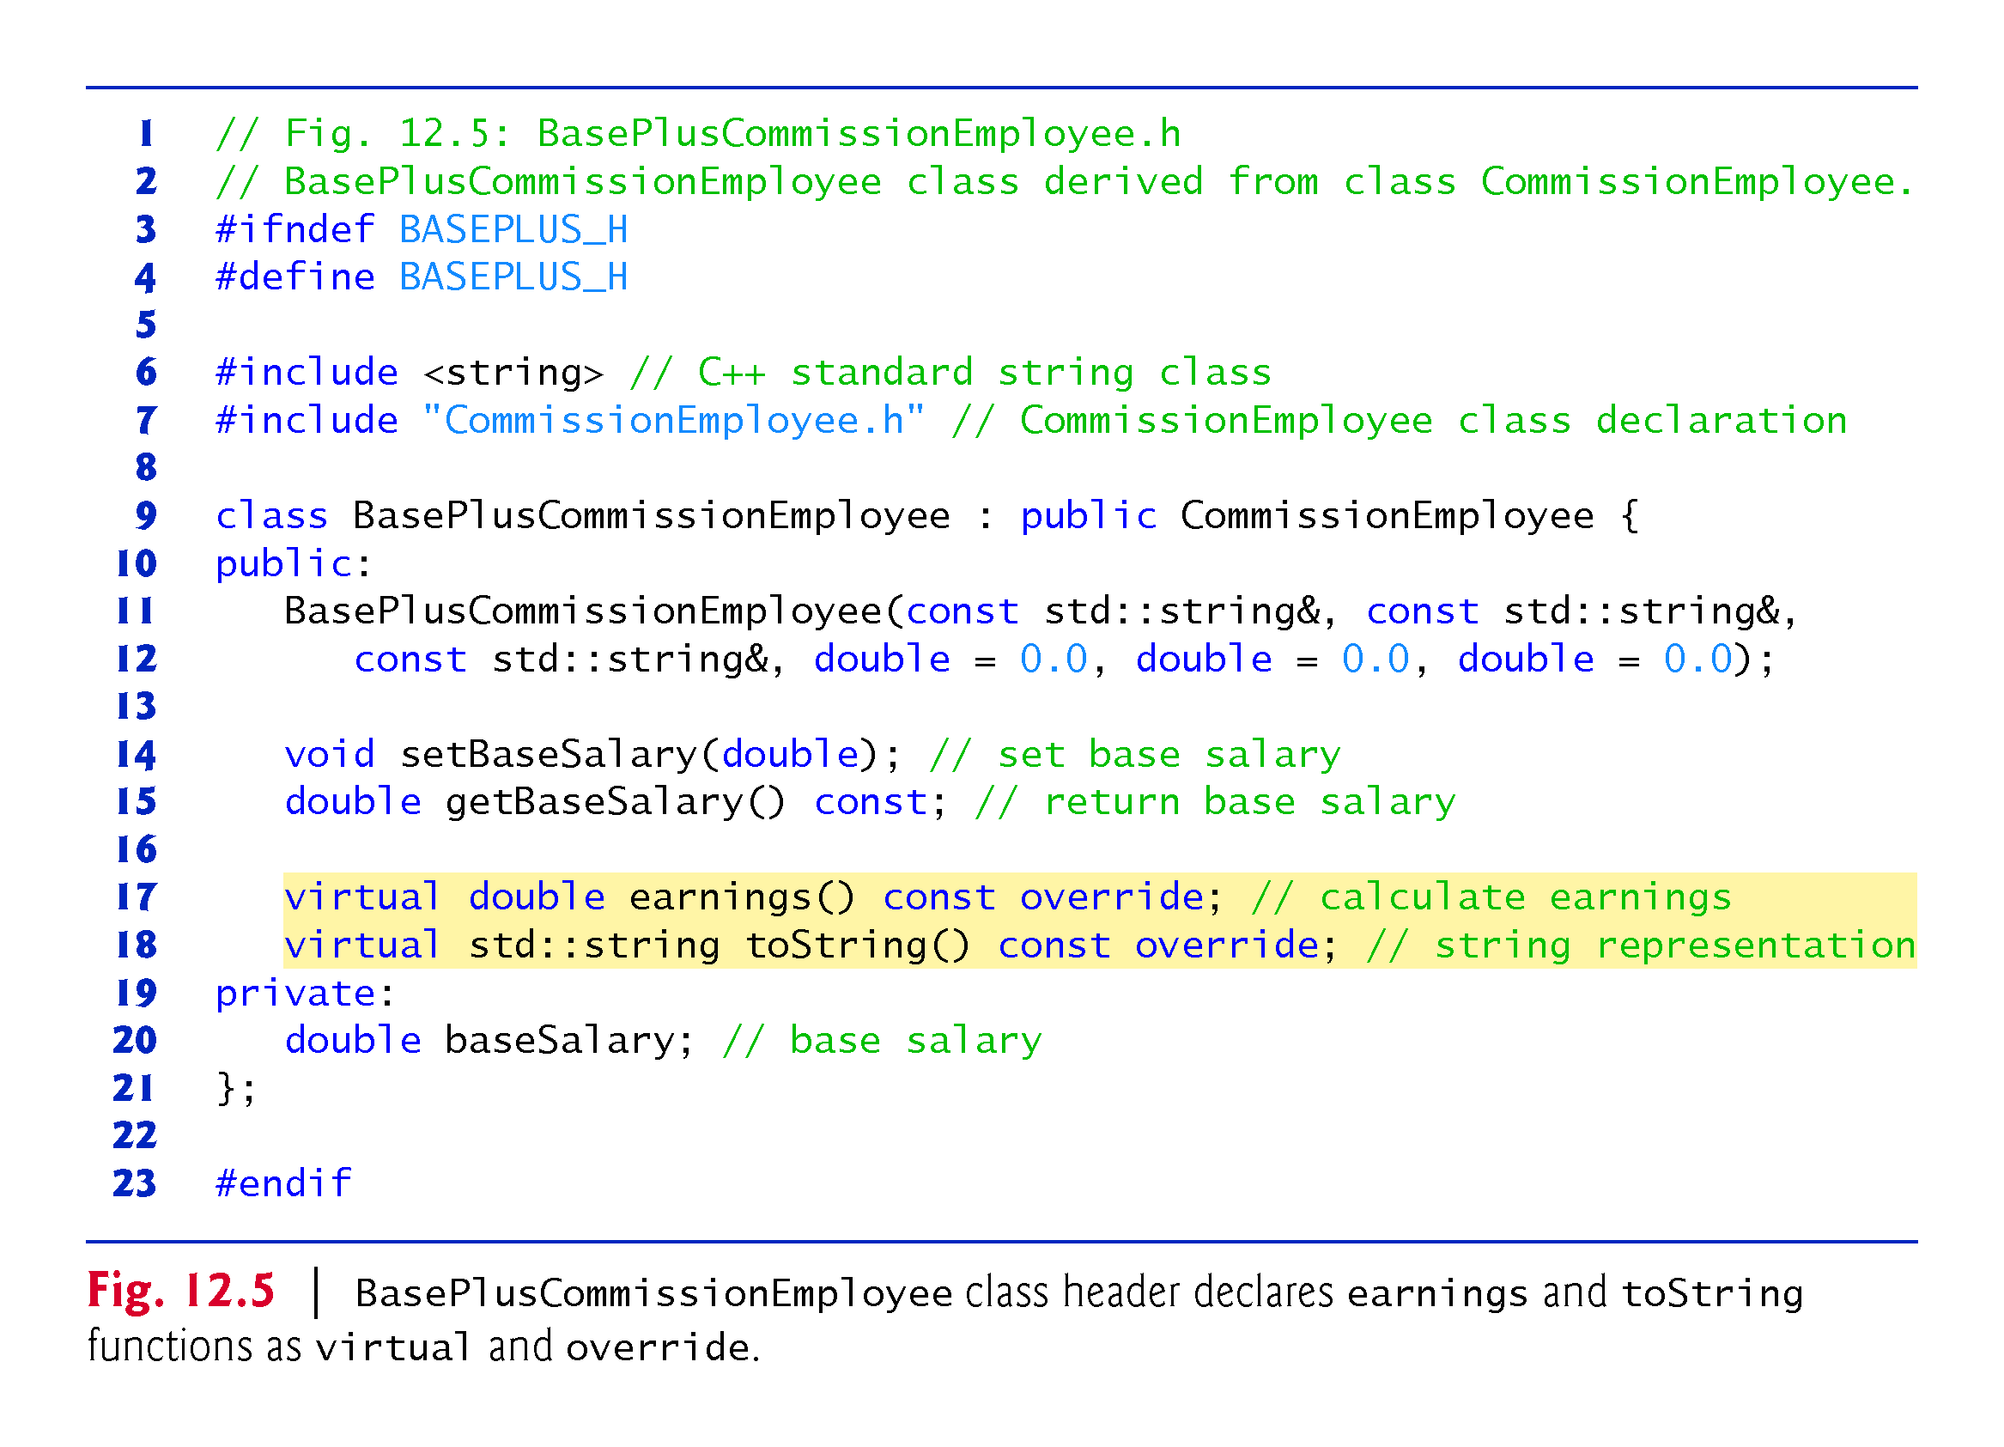
Notes:
Ob: Derived class only has the specialisation functions and data members. All other functions and data members reside in base class.

Slide 22
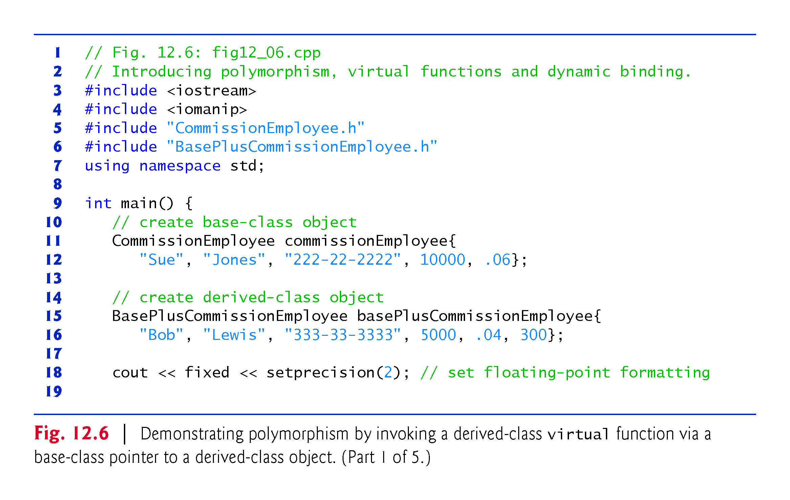

Slide 23
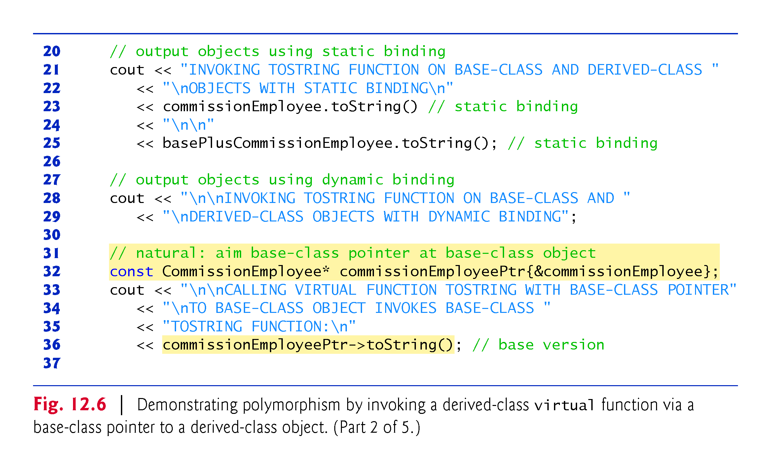
Notes:
Ob: Note that toString function was declared virtual in inheriting class but its virtual characterization is pushed down to the base class hierarchy.

Slide 24
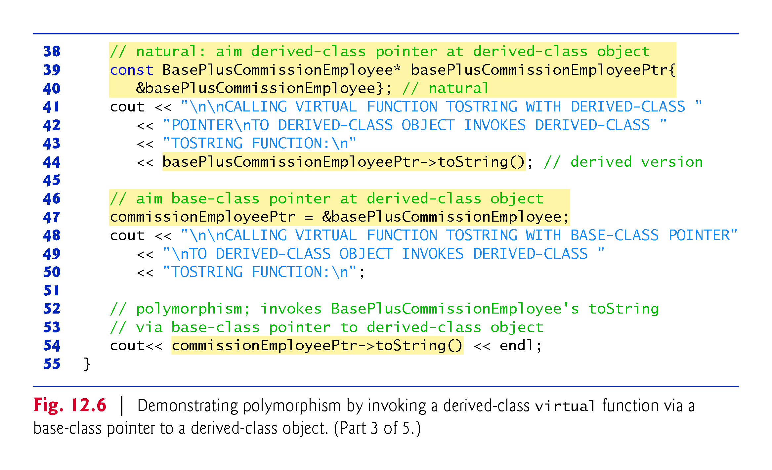

Slide 25
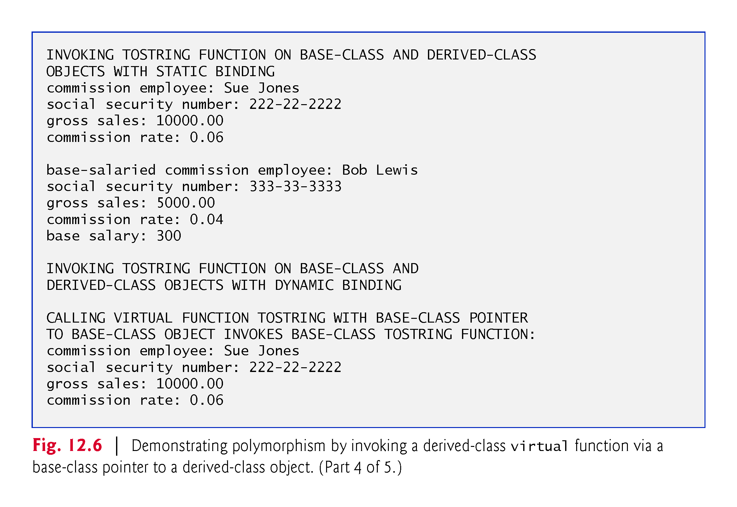

Slide 26
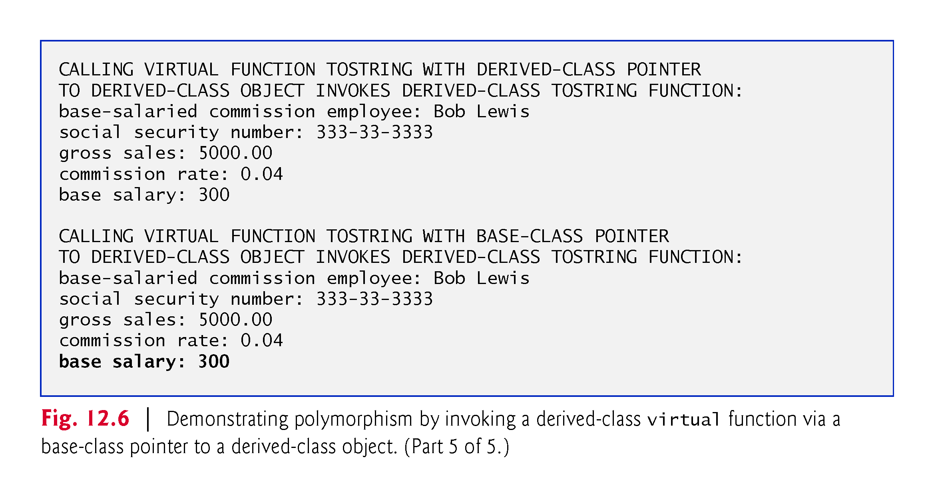

Slide 27
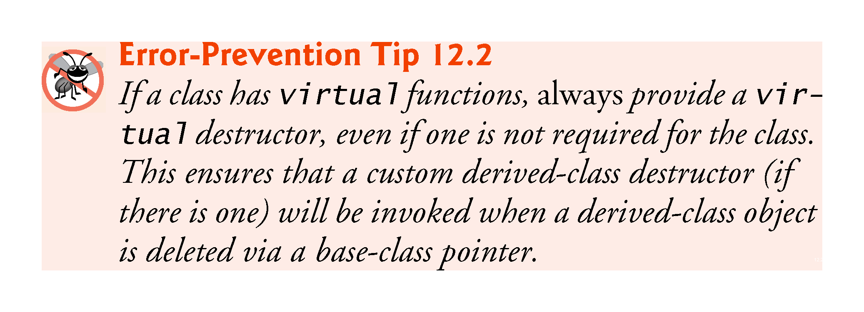

Slide 28


Slide 29
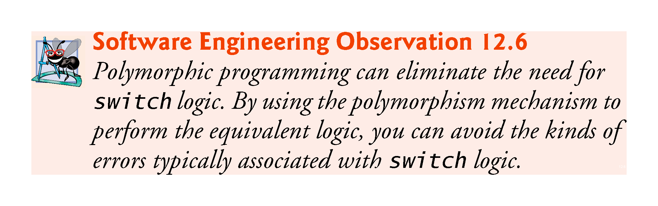
Notes:
Ob: Expand on this

Slide 30
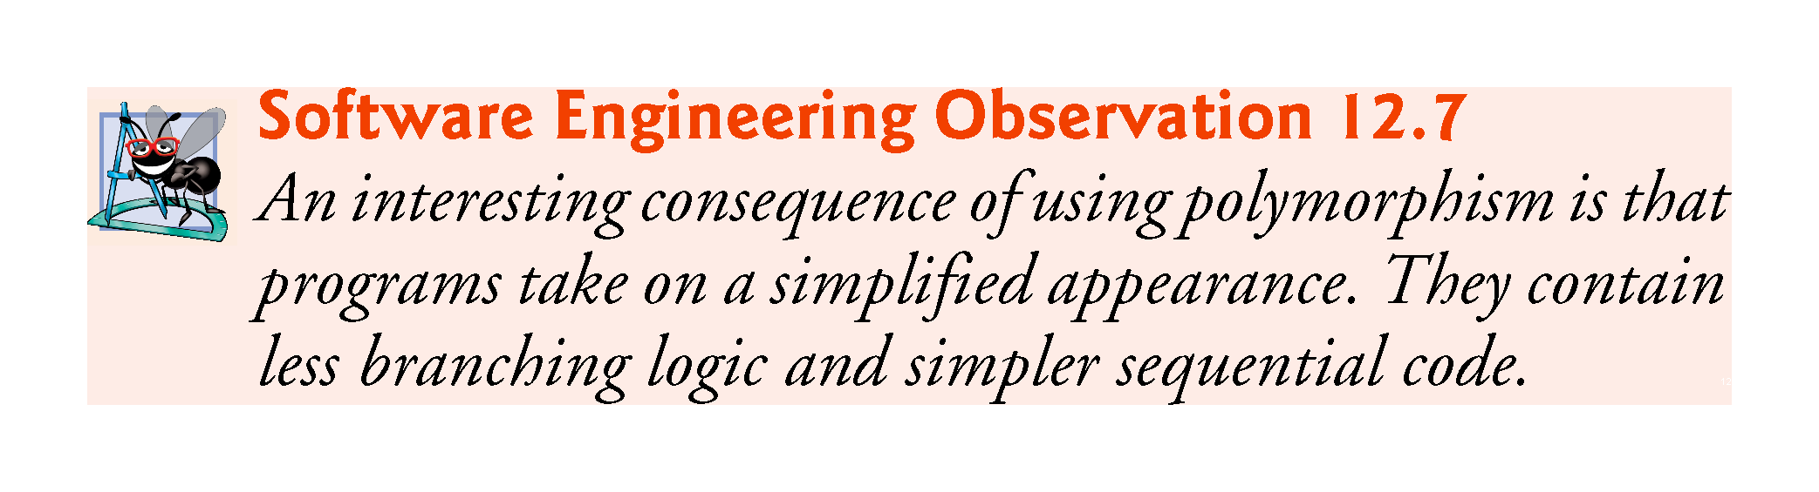

Slide 31
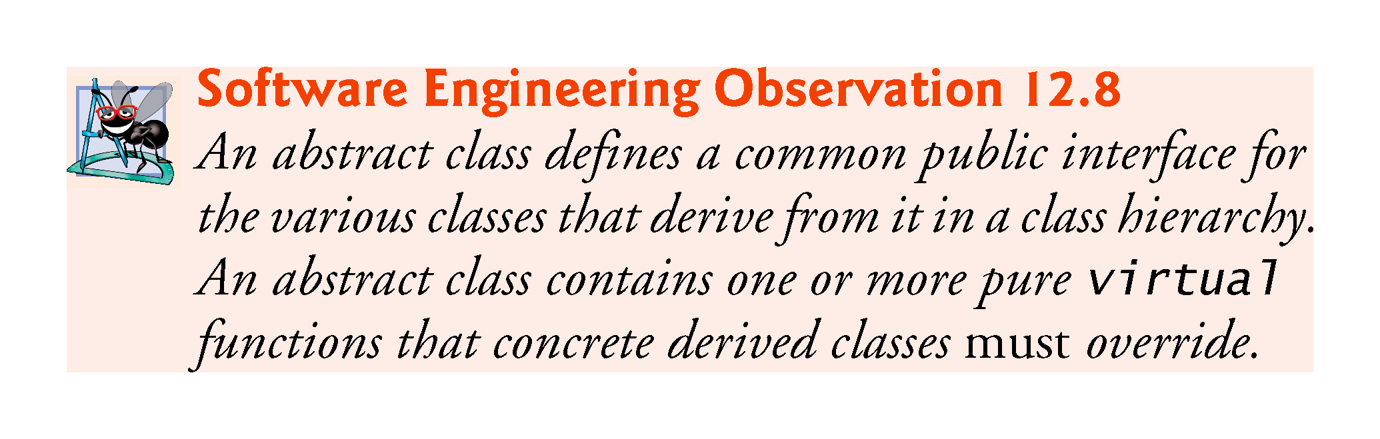

Slide 32
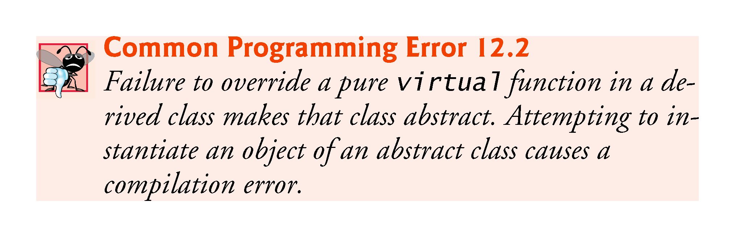
Notes:
Ob: show an example with figure 12.7 - 3 slides down

Slide 33
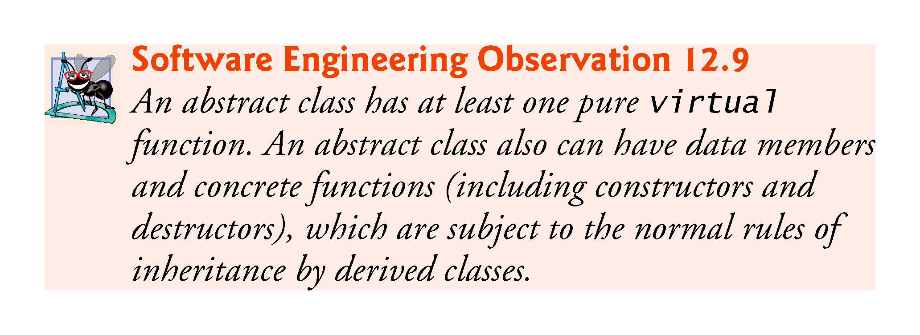

Slide 34
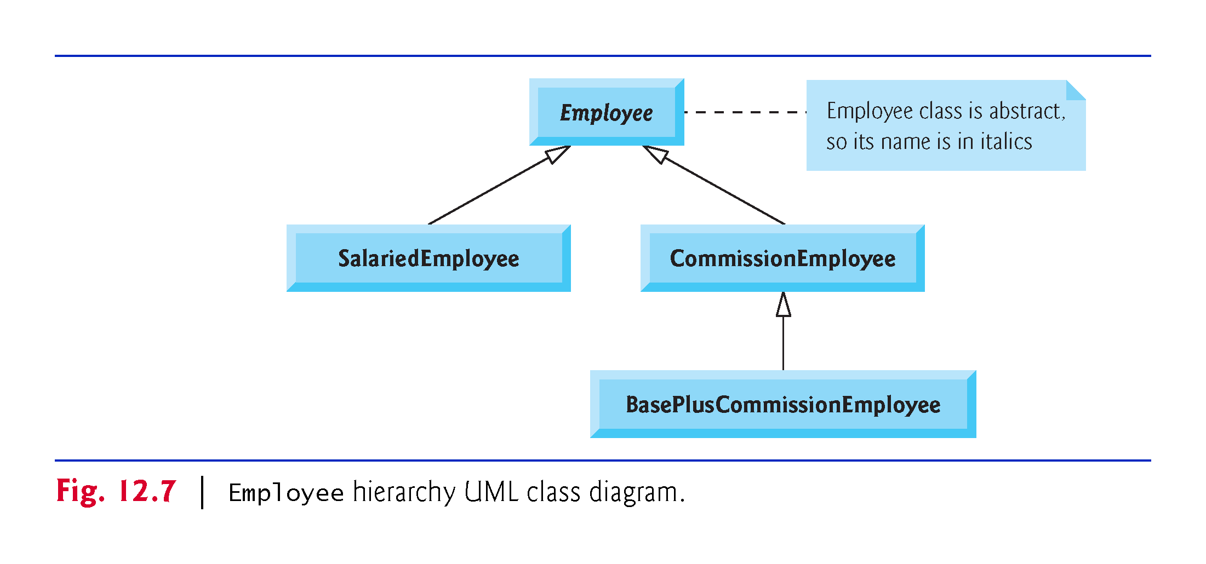

Slide 35
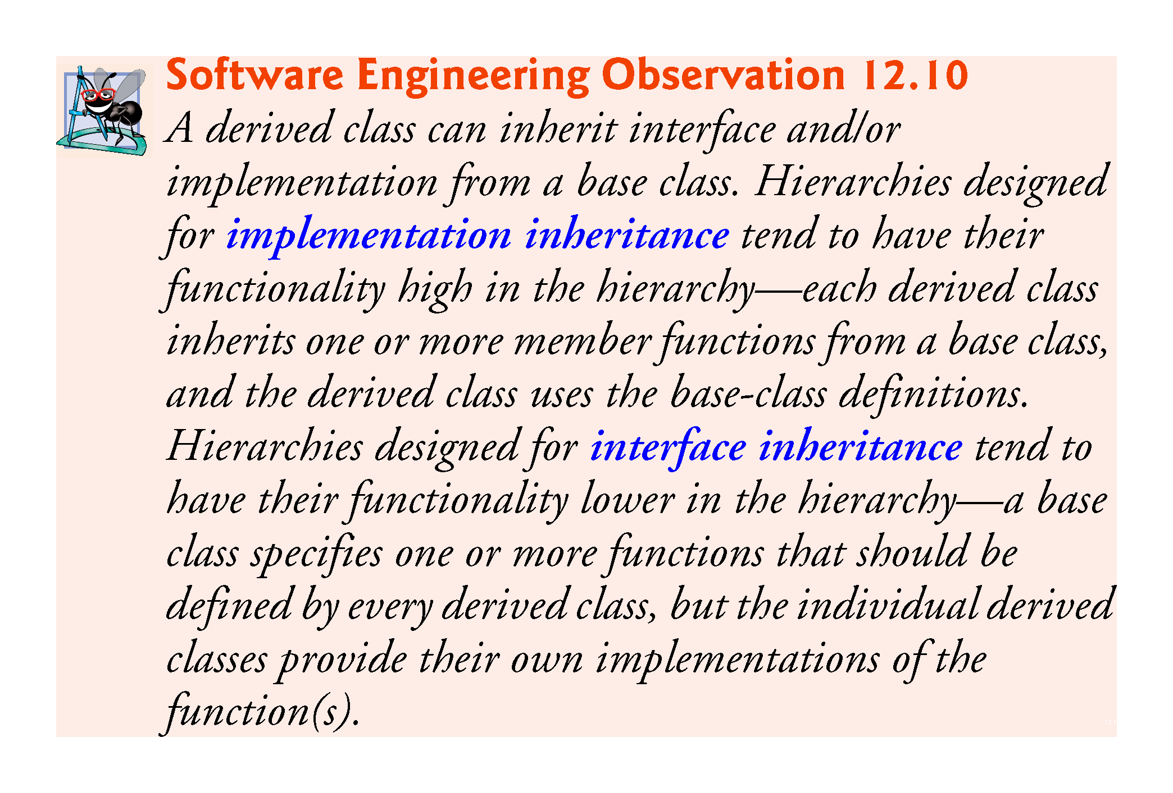

Slide 36
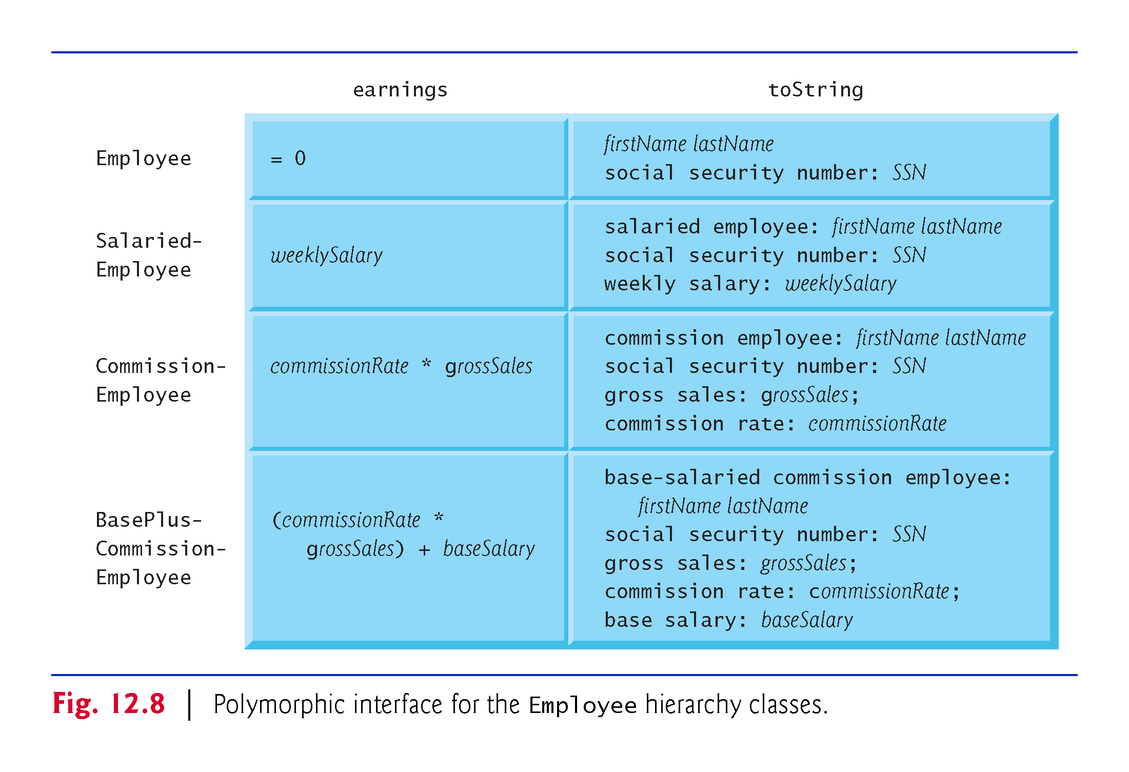
Notes:
Ob: From general to specific

Slide 37
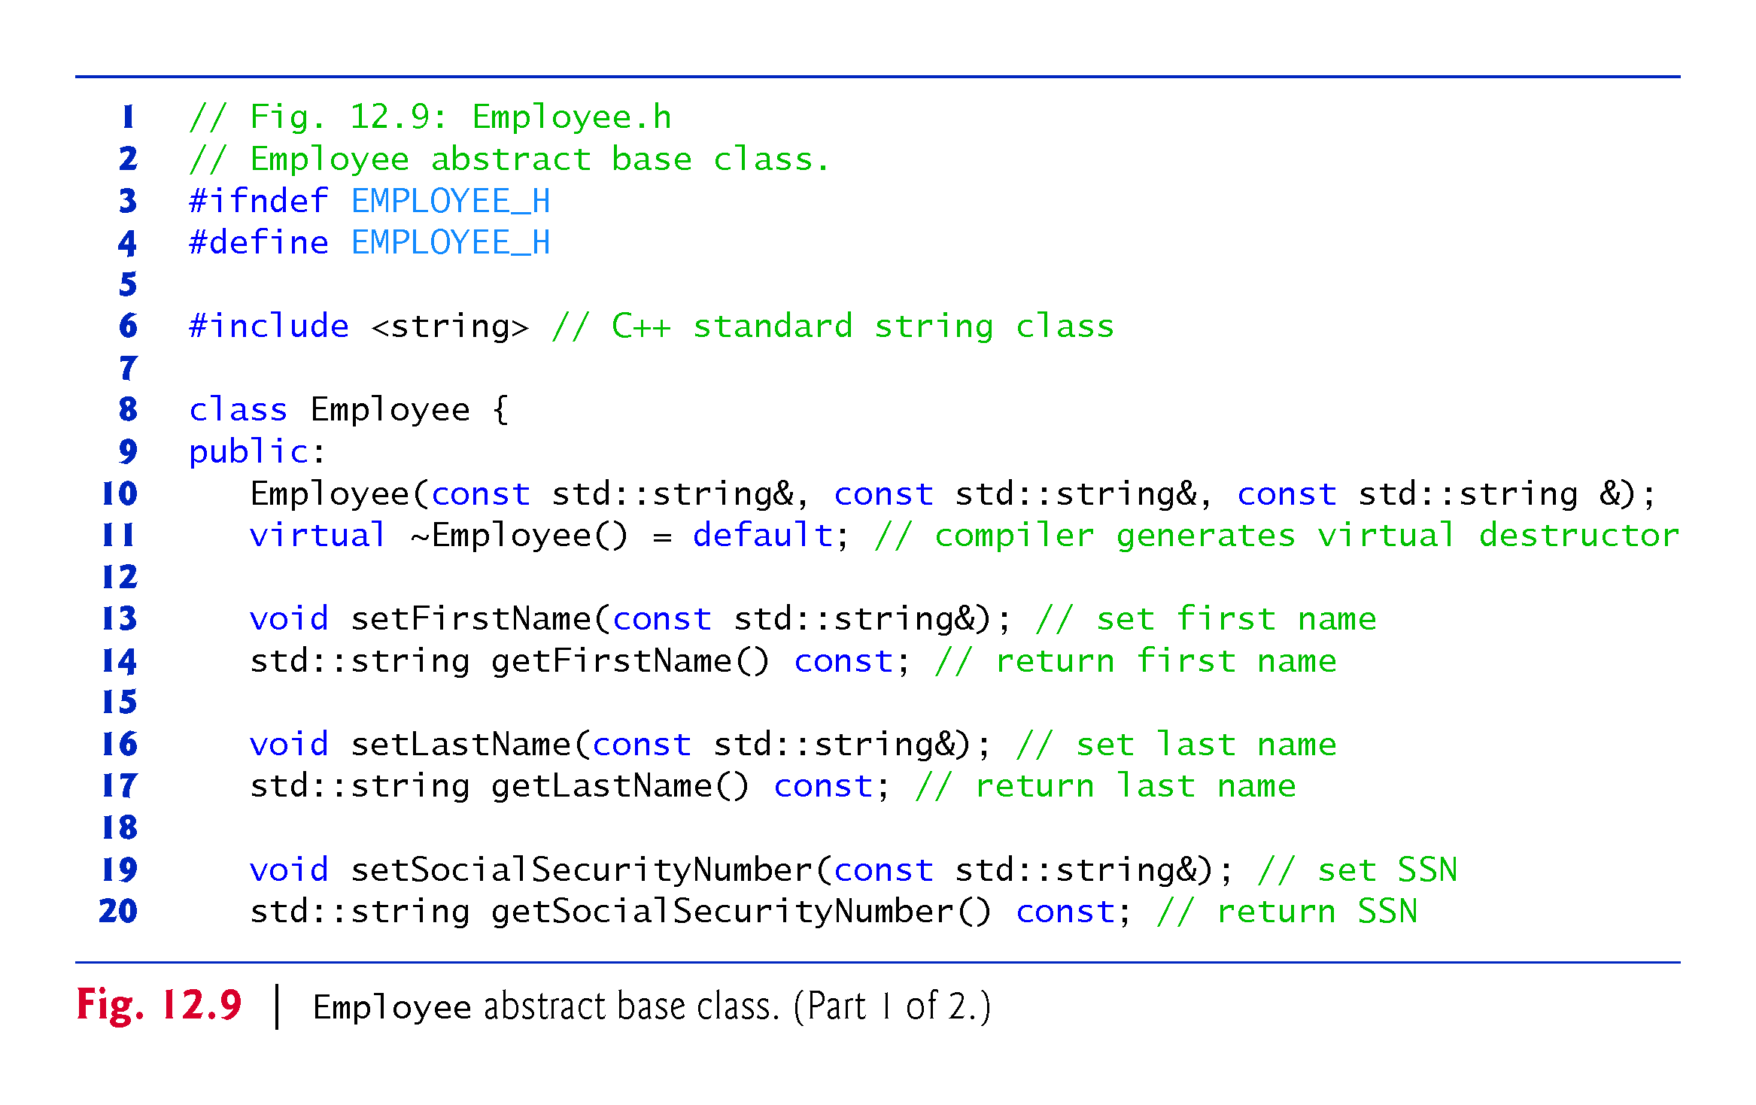

Slide 38
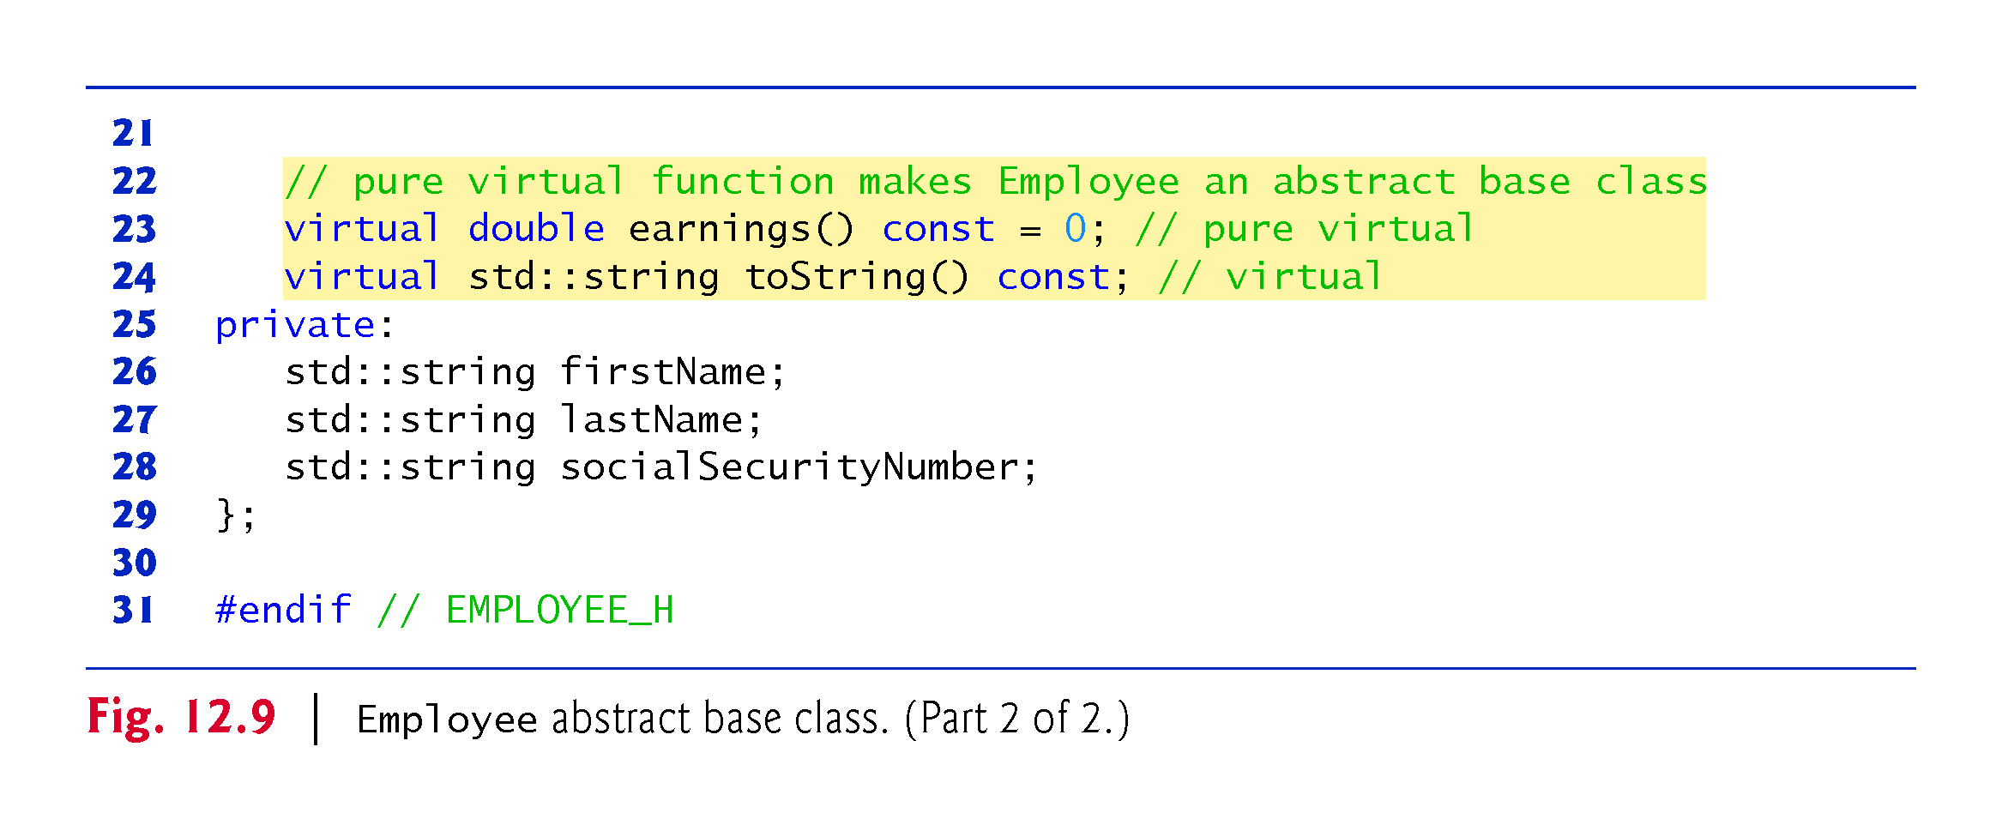

Slide 39
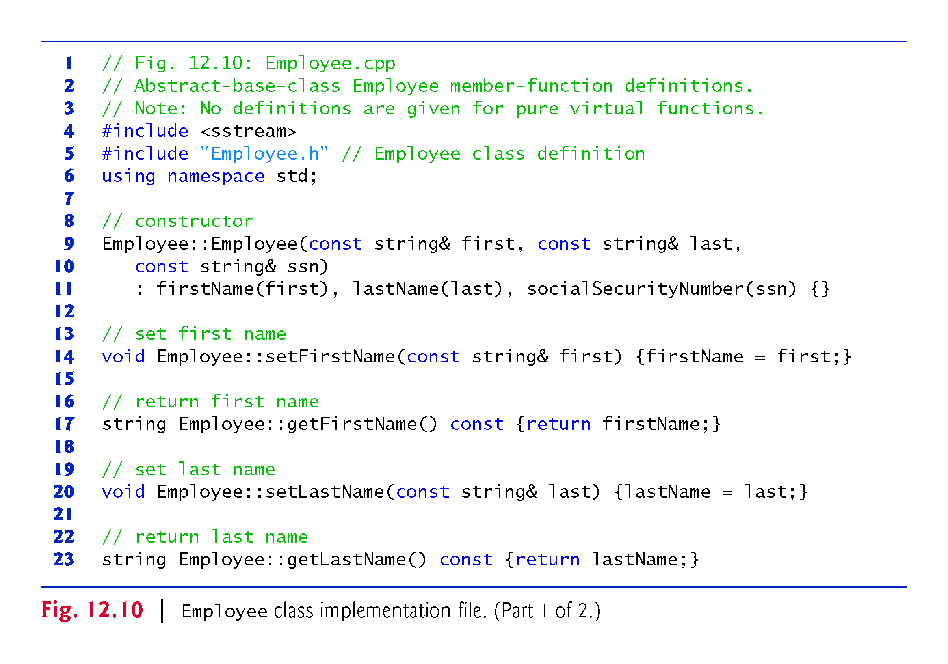

Slide 40
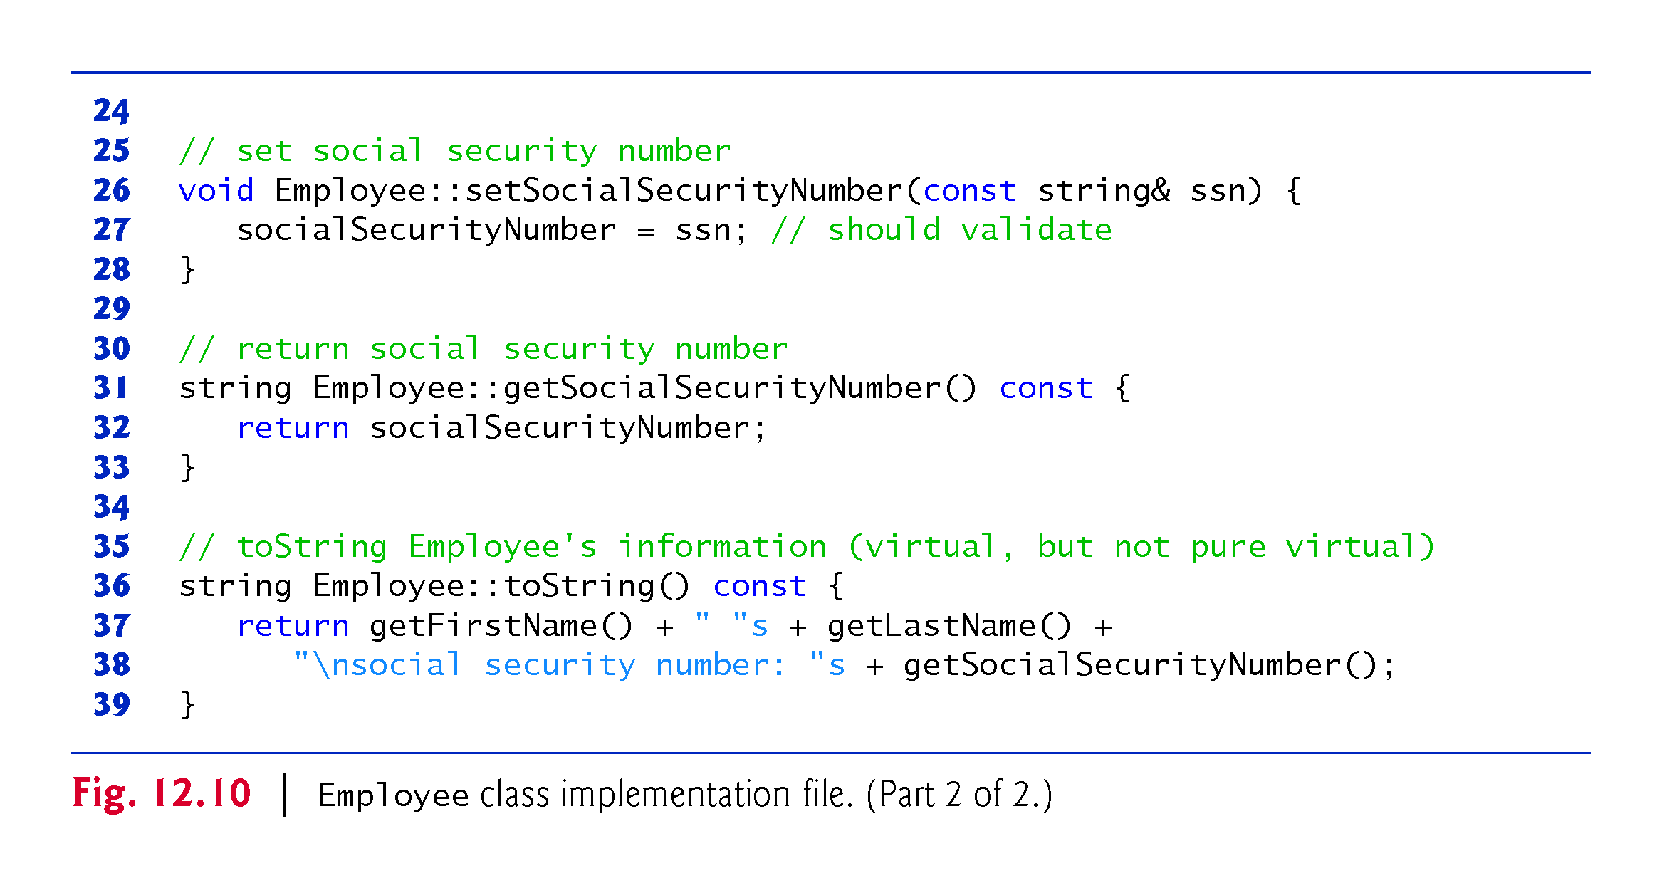
Notes:
Ob: NO IMPLEMENTATION OF EARNING FUNCTION –THAT’S WHY PURE VIRTUAL

Slide 41
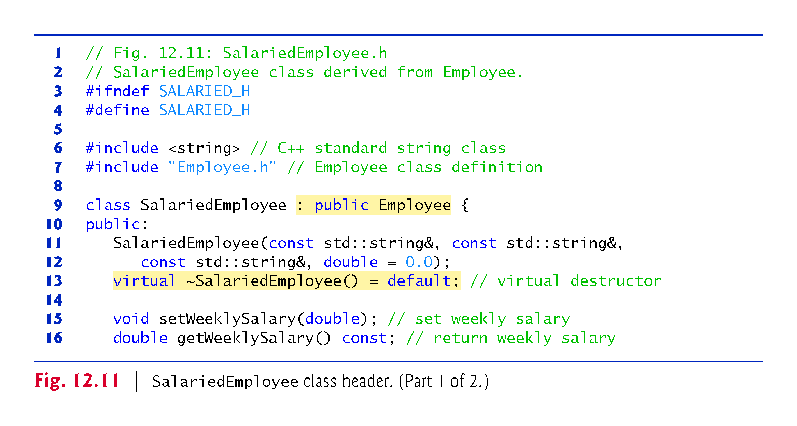

Slide 42
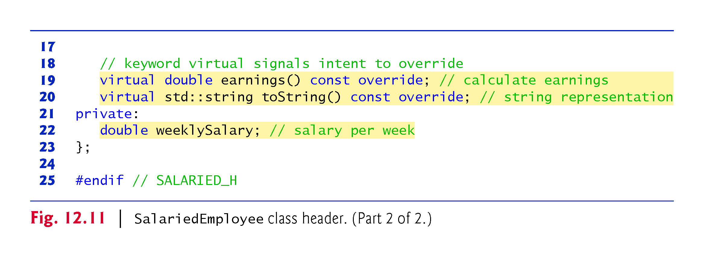

Slide 43
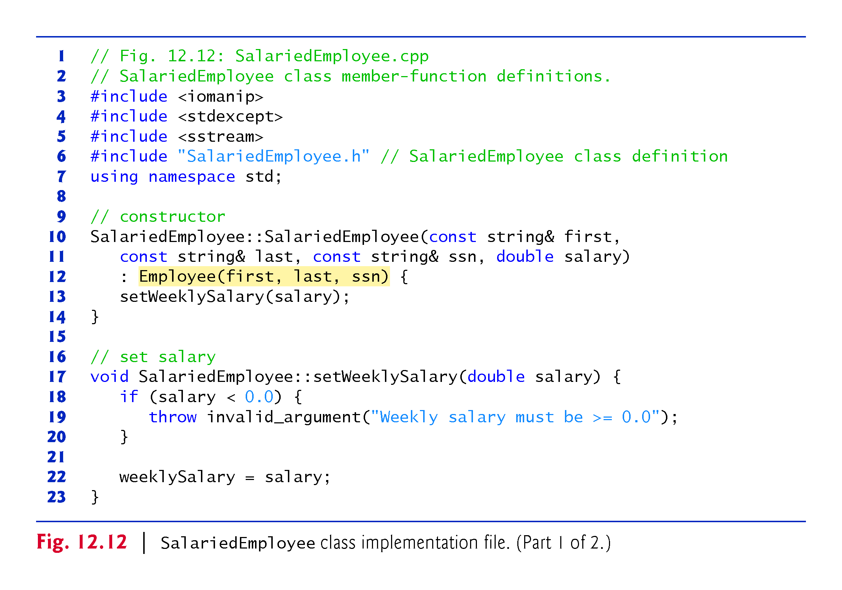

Slide 44
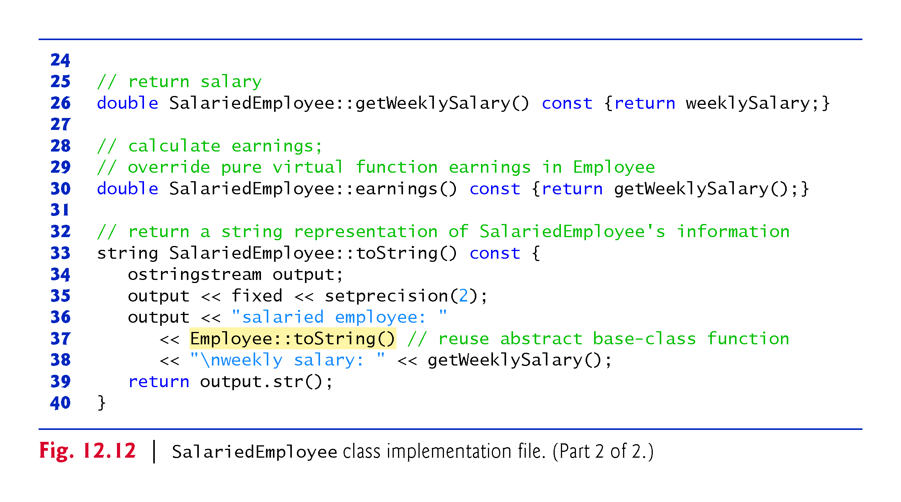

Slide 45
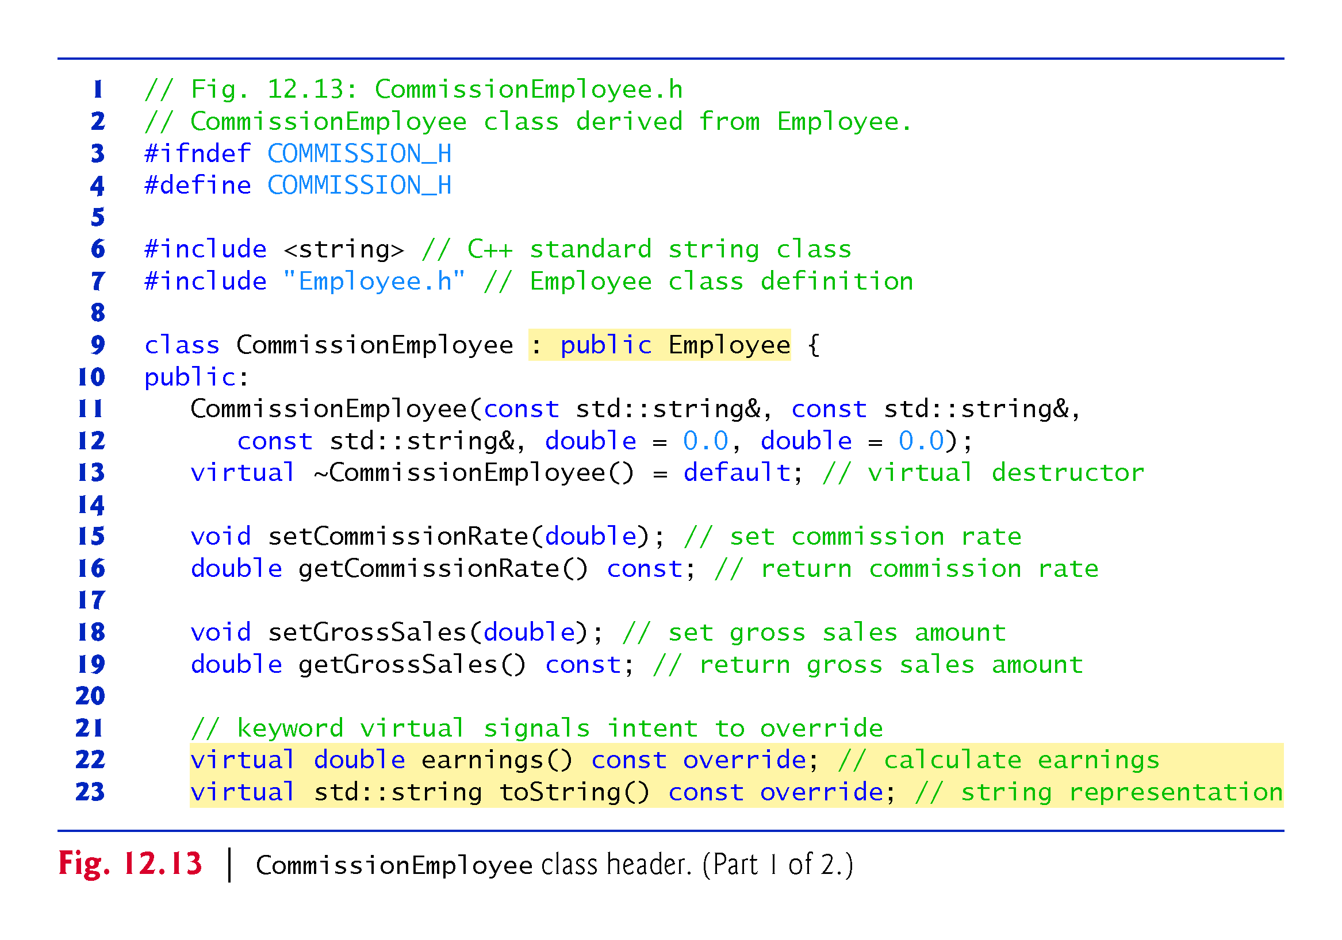

Slide 46
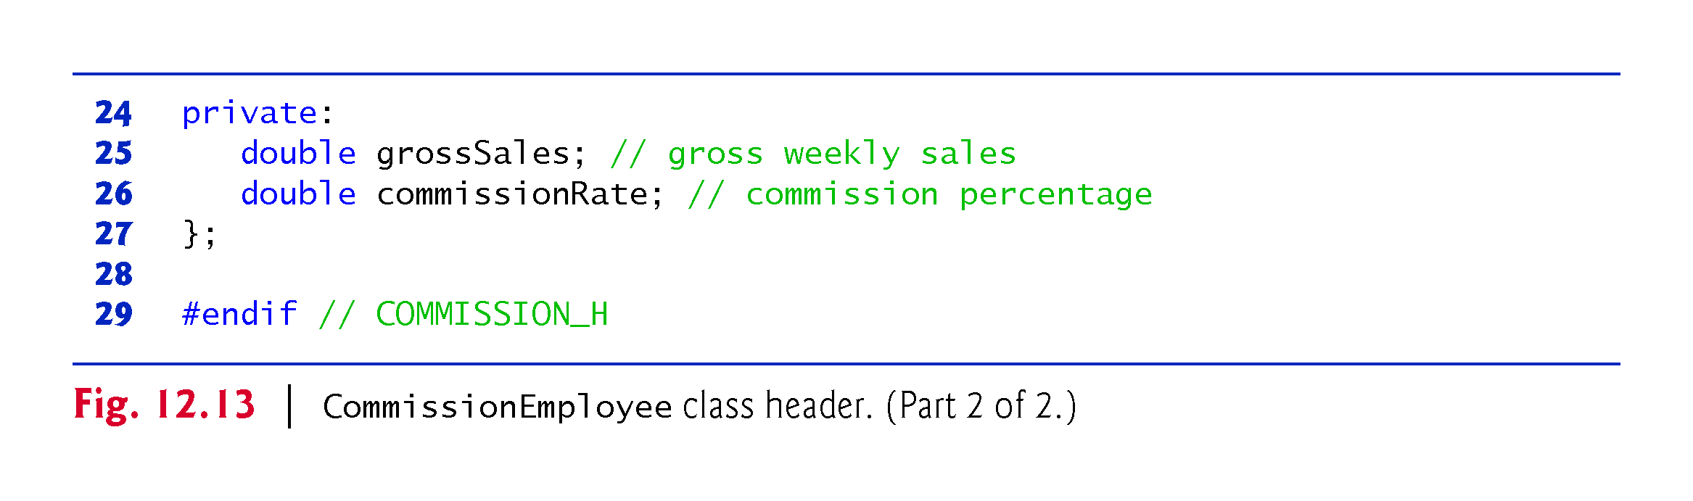

Slide 47
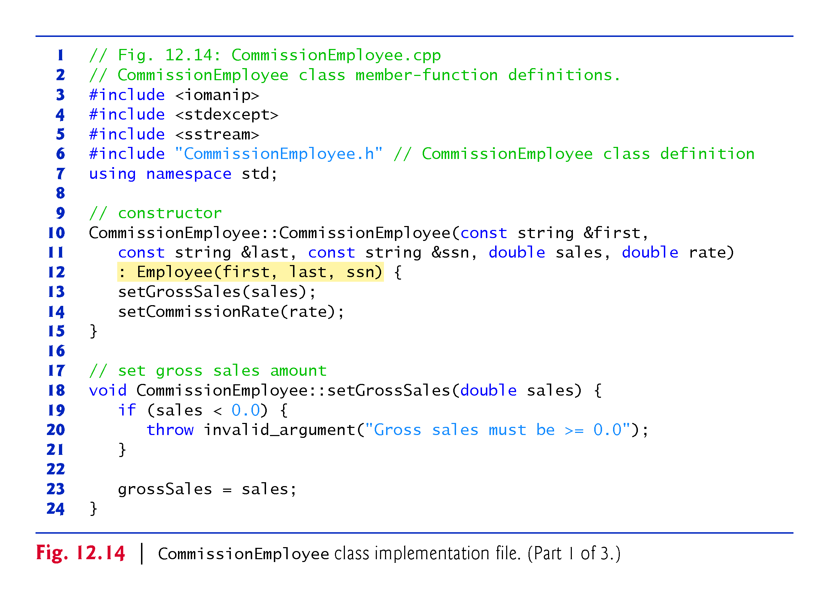

Slide 48
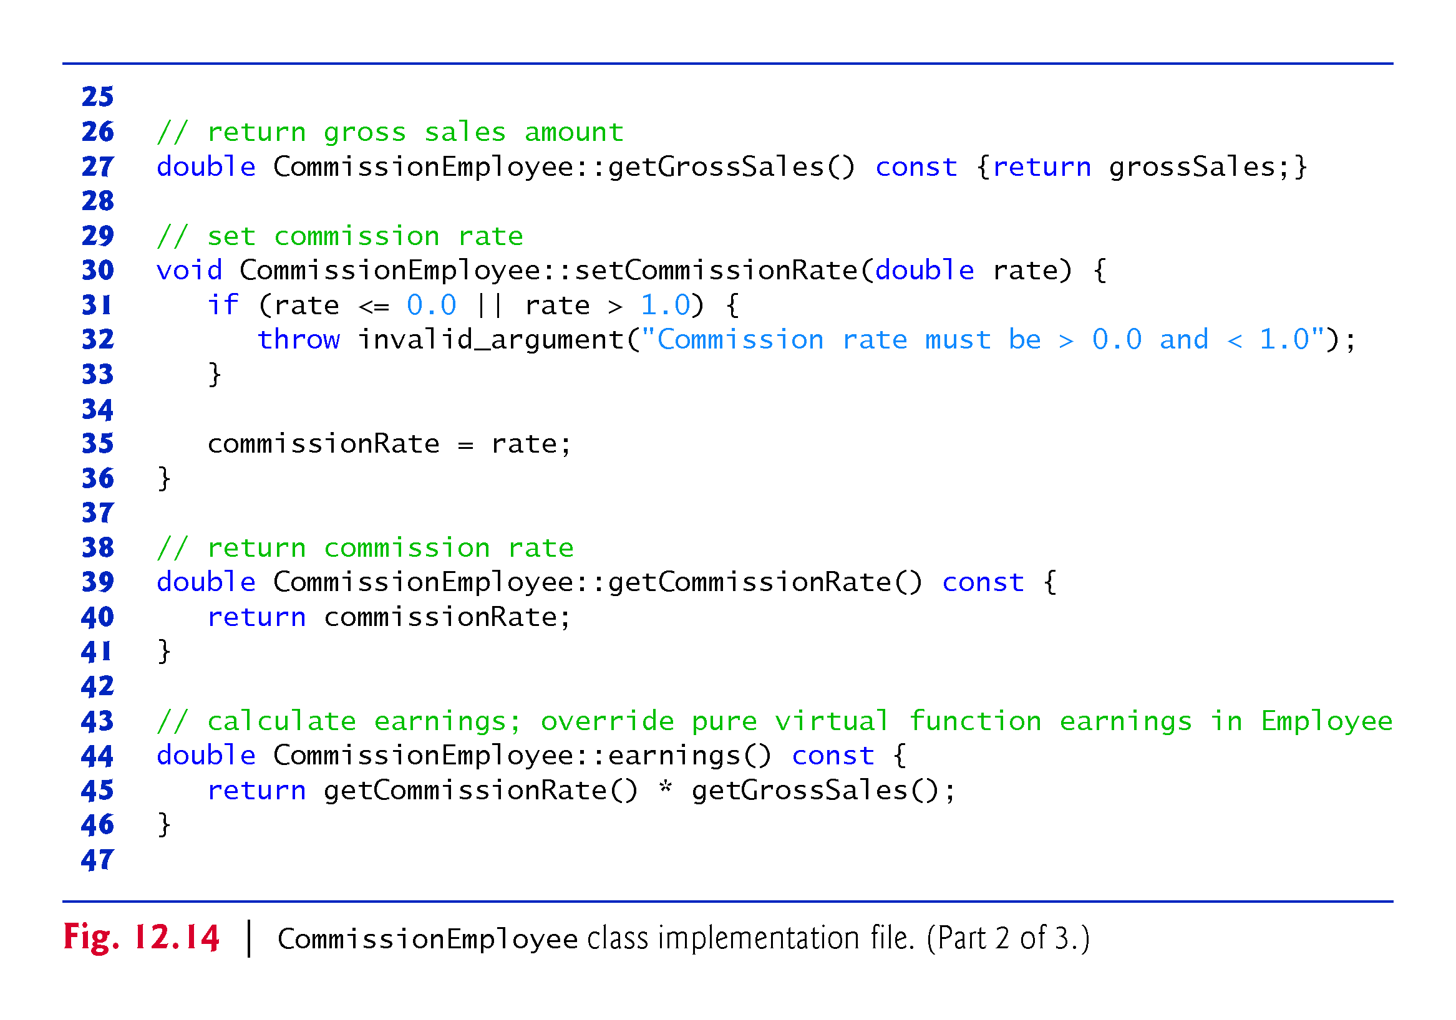

Slide 49
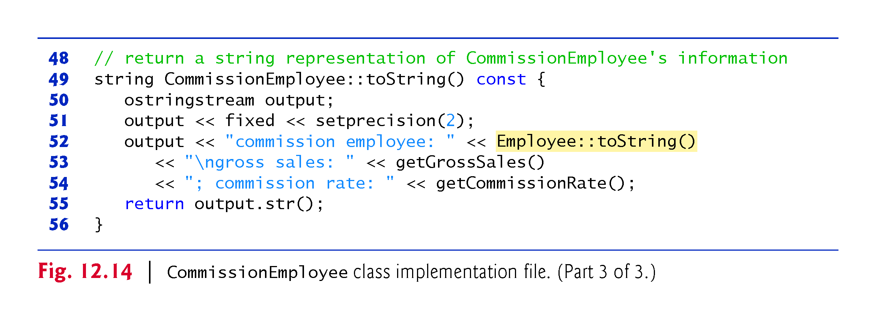

Slide 50
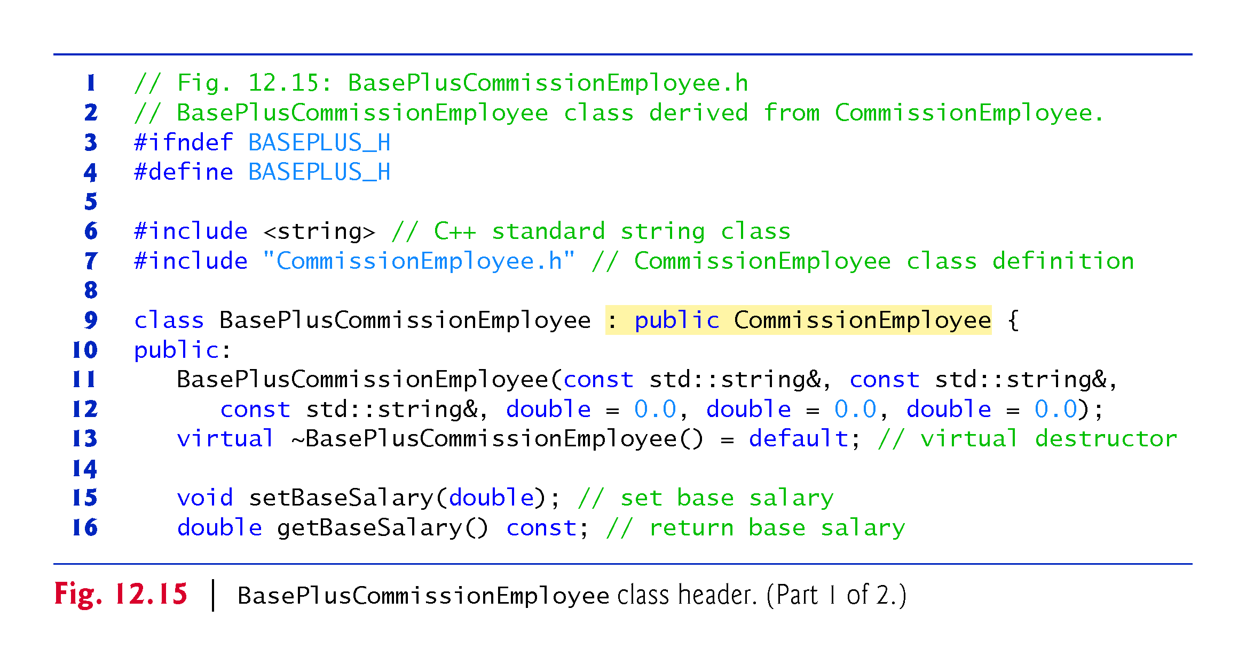

Slide 51
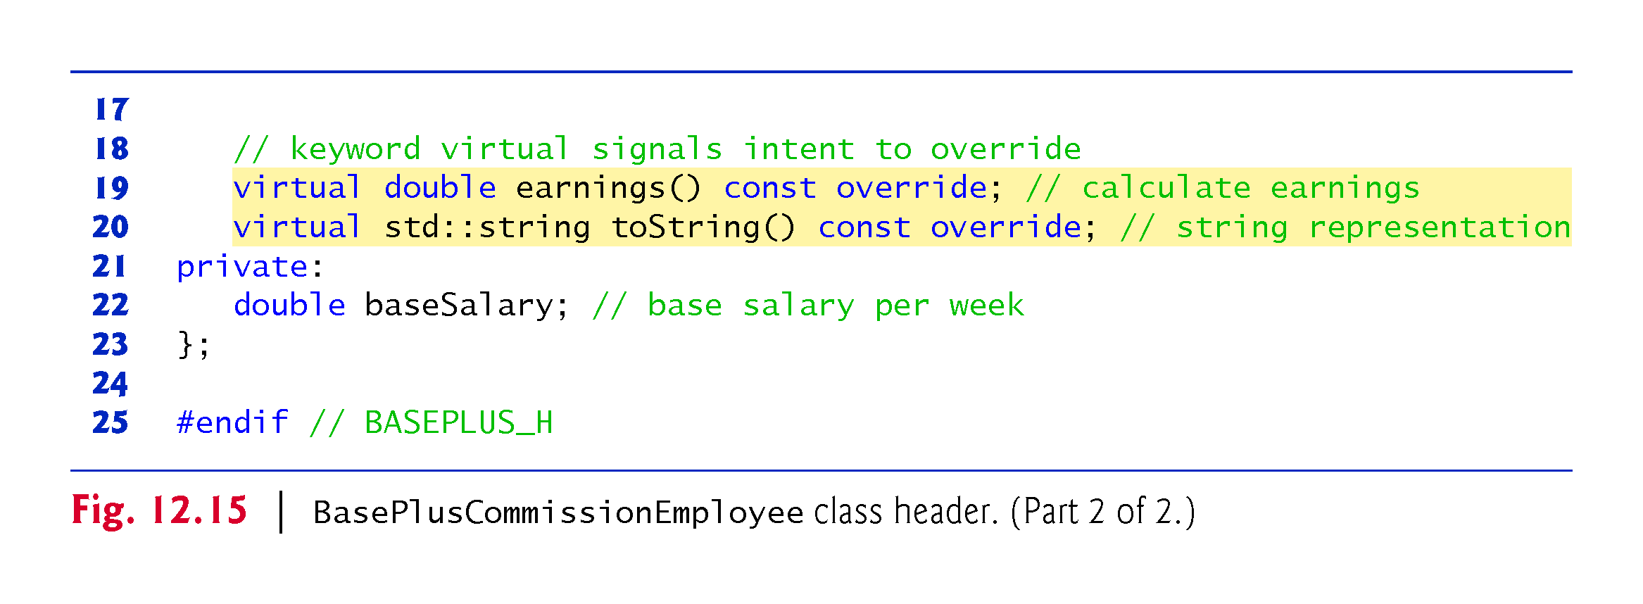

Slide 52
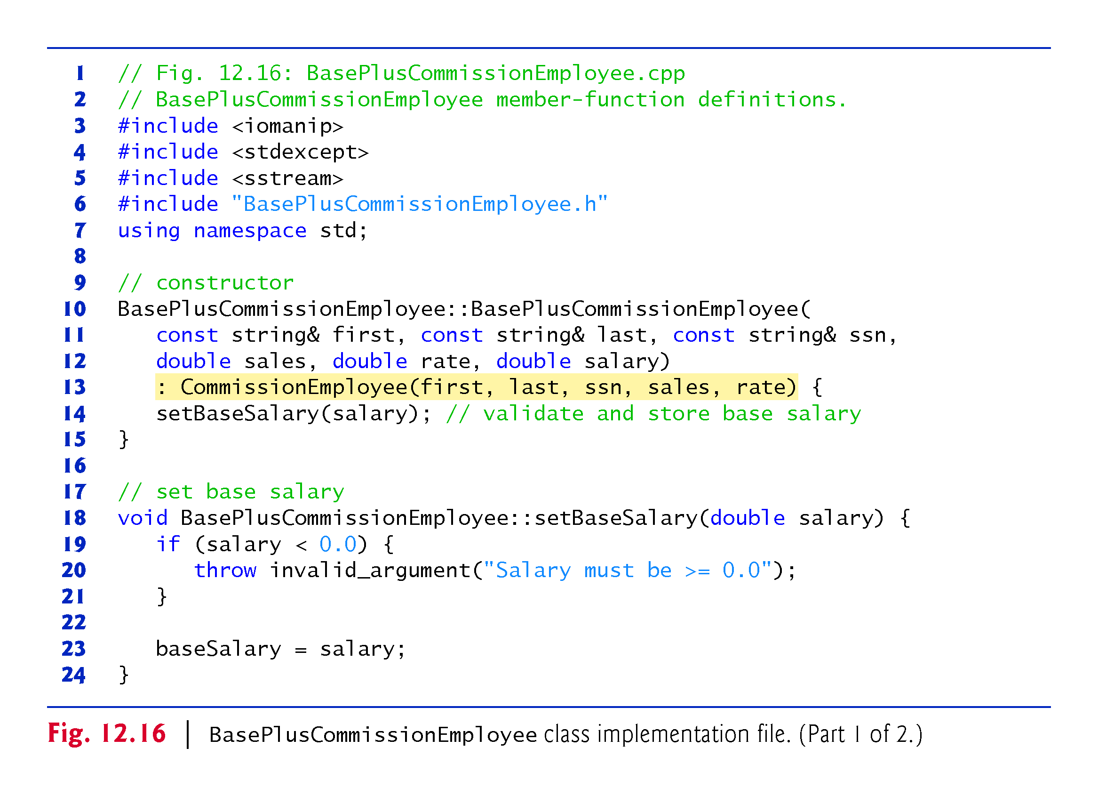

Slide 53


Slide 54


Slide 55


Slide 56


Slide 57


Slide 58


Slide 59


Slide 60


Slide 61


Slide 62


Slide 63


Slide 64


Slide 65

Notes:
Ob: GetBaseSalary() and SetBaseSalary() are both functions of the BasePlusCommissionEmployeeObject. Attempts to access them through the employeeptr is a syntax error. Earnings is a PURE virtual function in the base class, so the derived class earnings function is called – dynamic binding through pointers. Talk about the IS-A relationship in combination with base and derived class pointers

Slide 66

Notes:
Ob: To use typeid, the program needs to include header <typeinfo>

Slide 67

Notes:
Ob: Formula for base salaried commission employee – grosssales*commissionrate + increased base salary

Slide 68


