Slide 1
Stream Input/Output
Based on Chapter 13 of C++ How to Program, 10/e

Slide 2
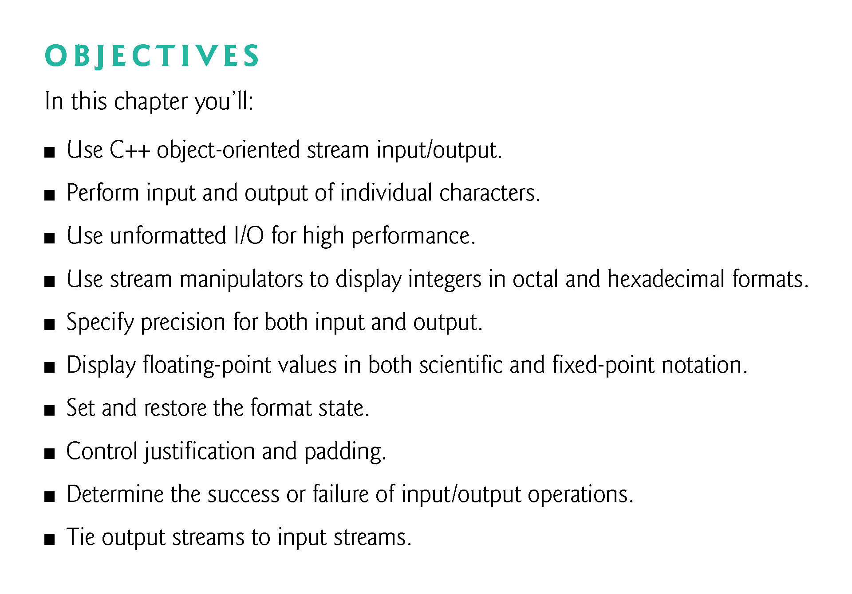

Slide 3
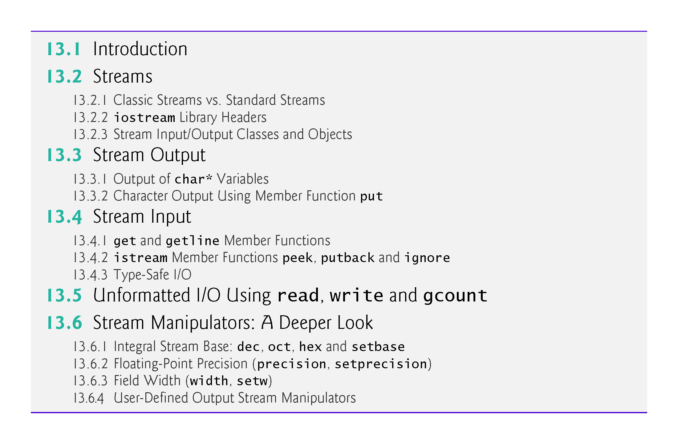

Slide 4
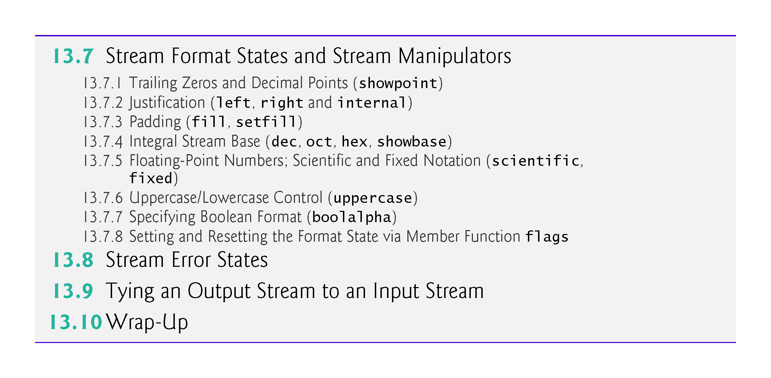

Slide 5
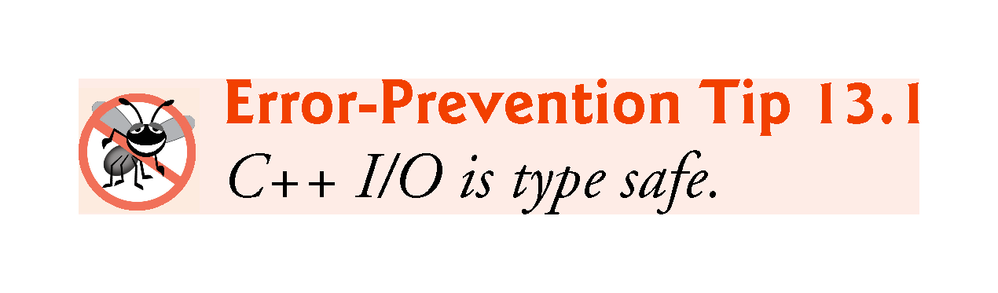

Slide 6
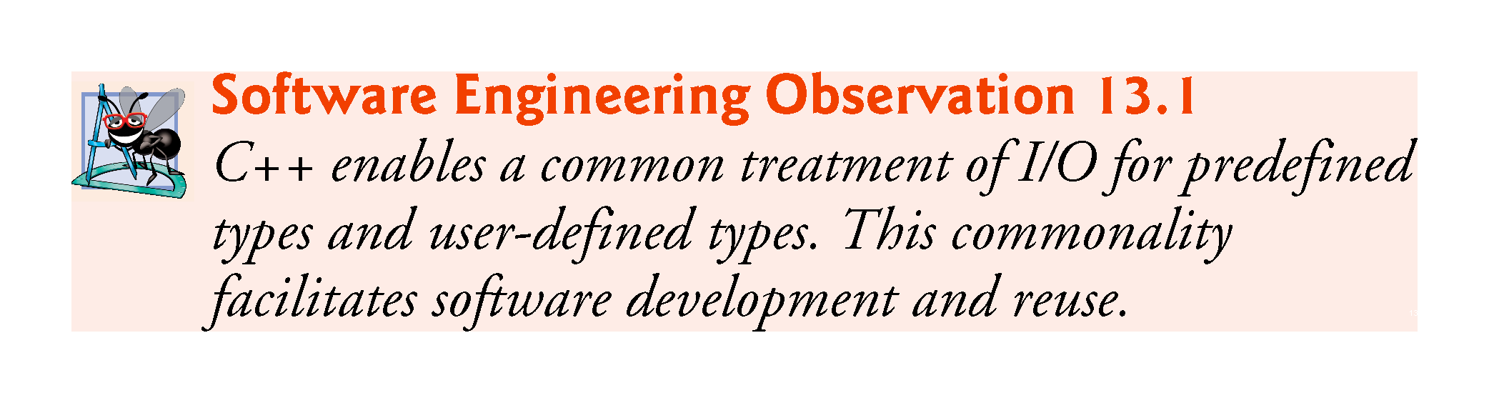

Slide 7
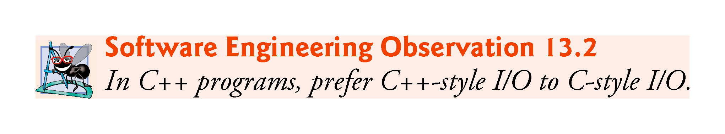

Slide 8
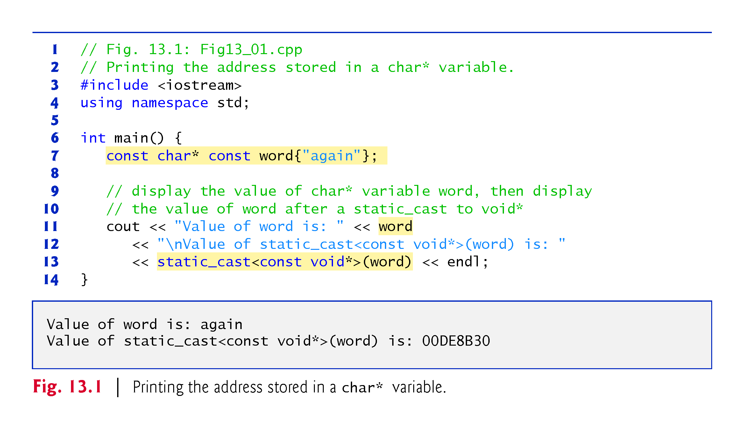
Notes:
Ob: The address printed is implementation dependent

Slide 9
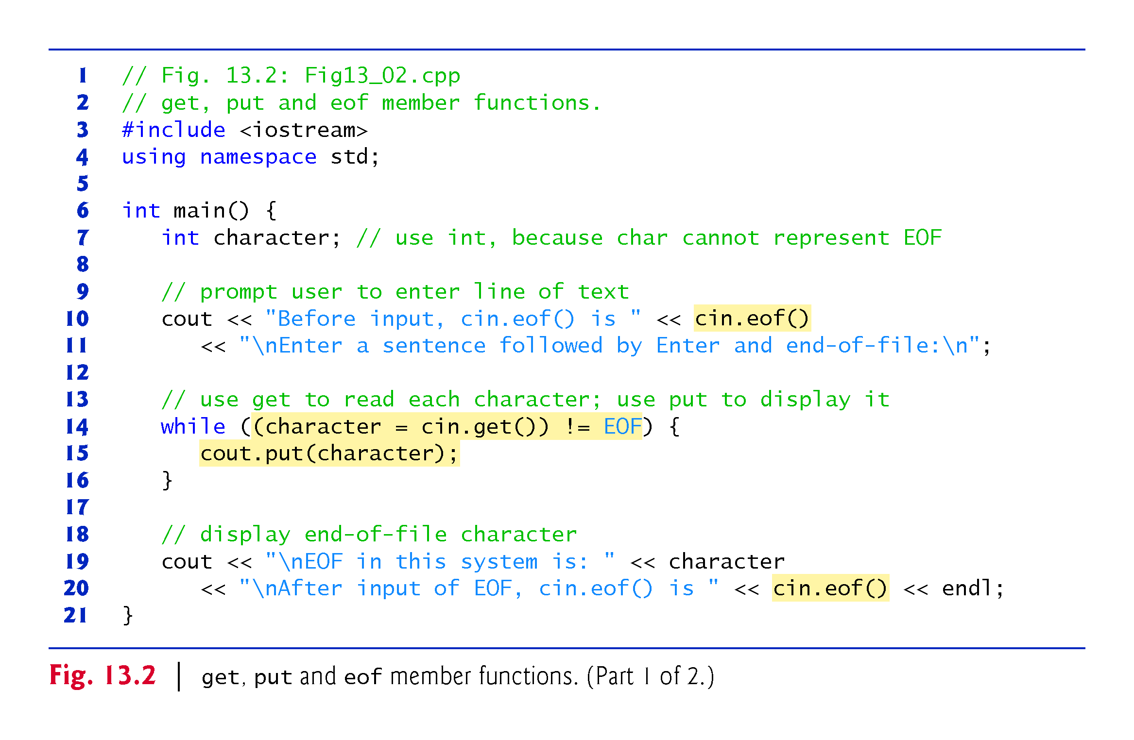
Notes:
Ob: get and put functions accept white space characters. Character has to be an integer in order to test against EOF. We do not use characters since in many platforms chars are non-negative values and EOF is typically -1.

Slide 10
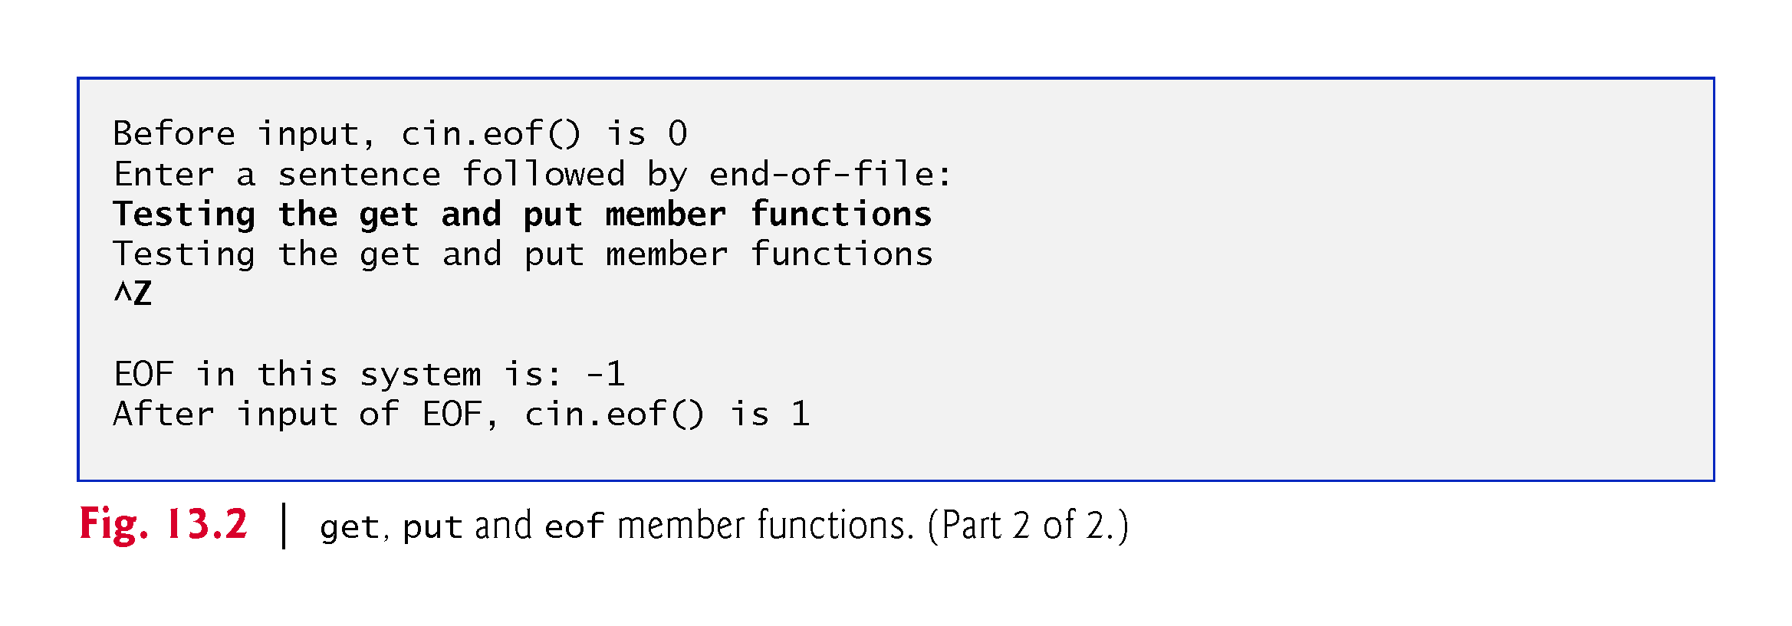

Slide 11
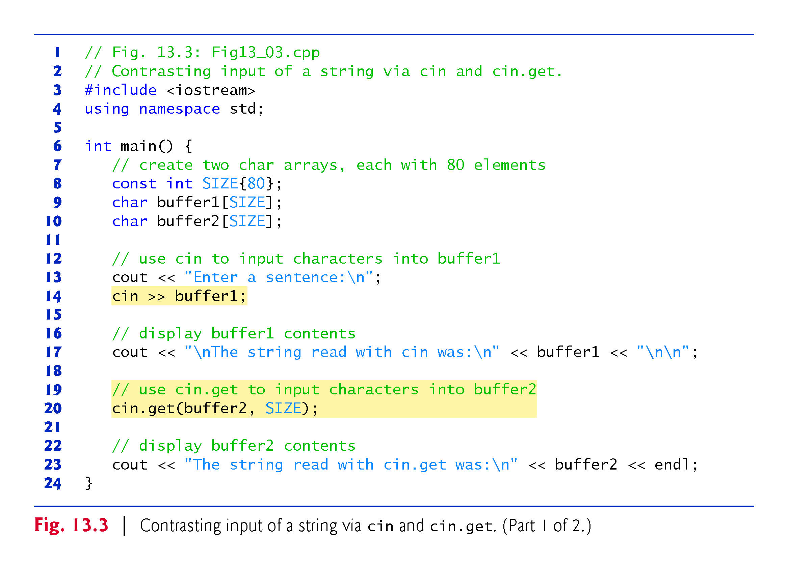
Notes:
Ob: cin reads (extracts from input stream) until whitespace is encountered. Cin.get() has arguments a char array and its size – it reads the rest of the input string. Since \n is still in the input stream (not the buffer2 array) , use cin.ignore() to clear the input stream.

Slide 12
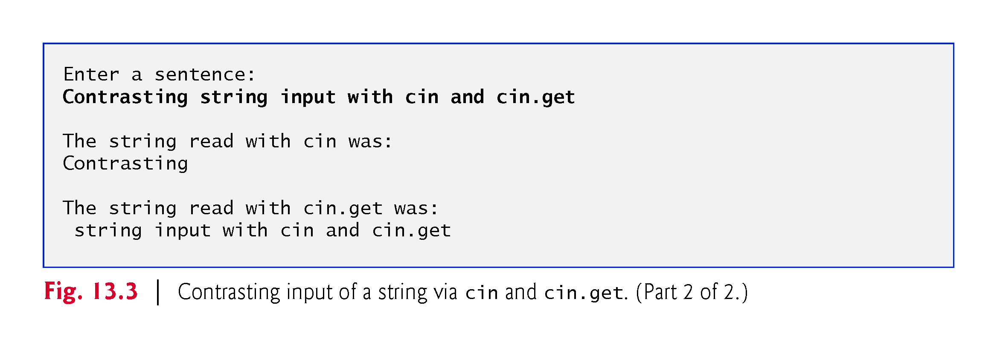

Slide 13
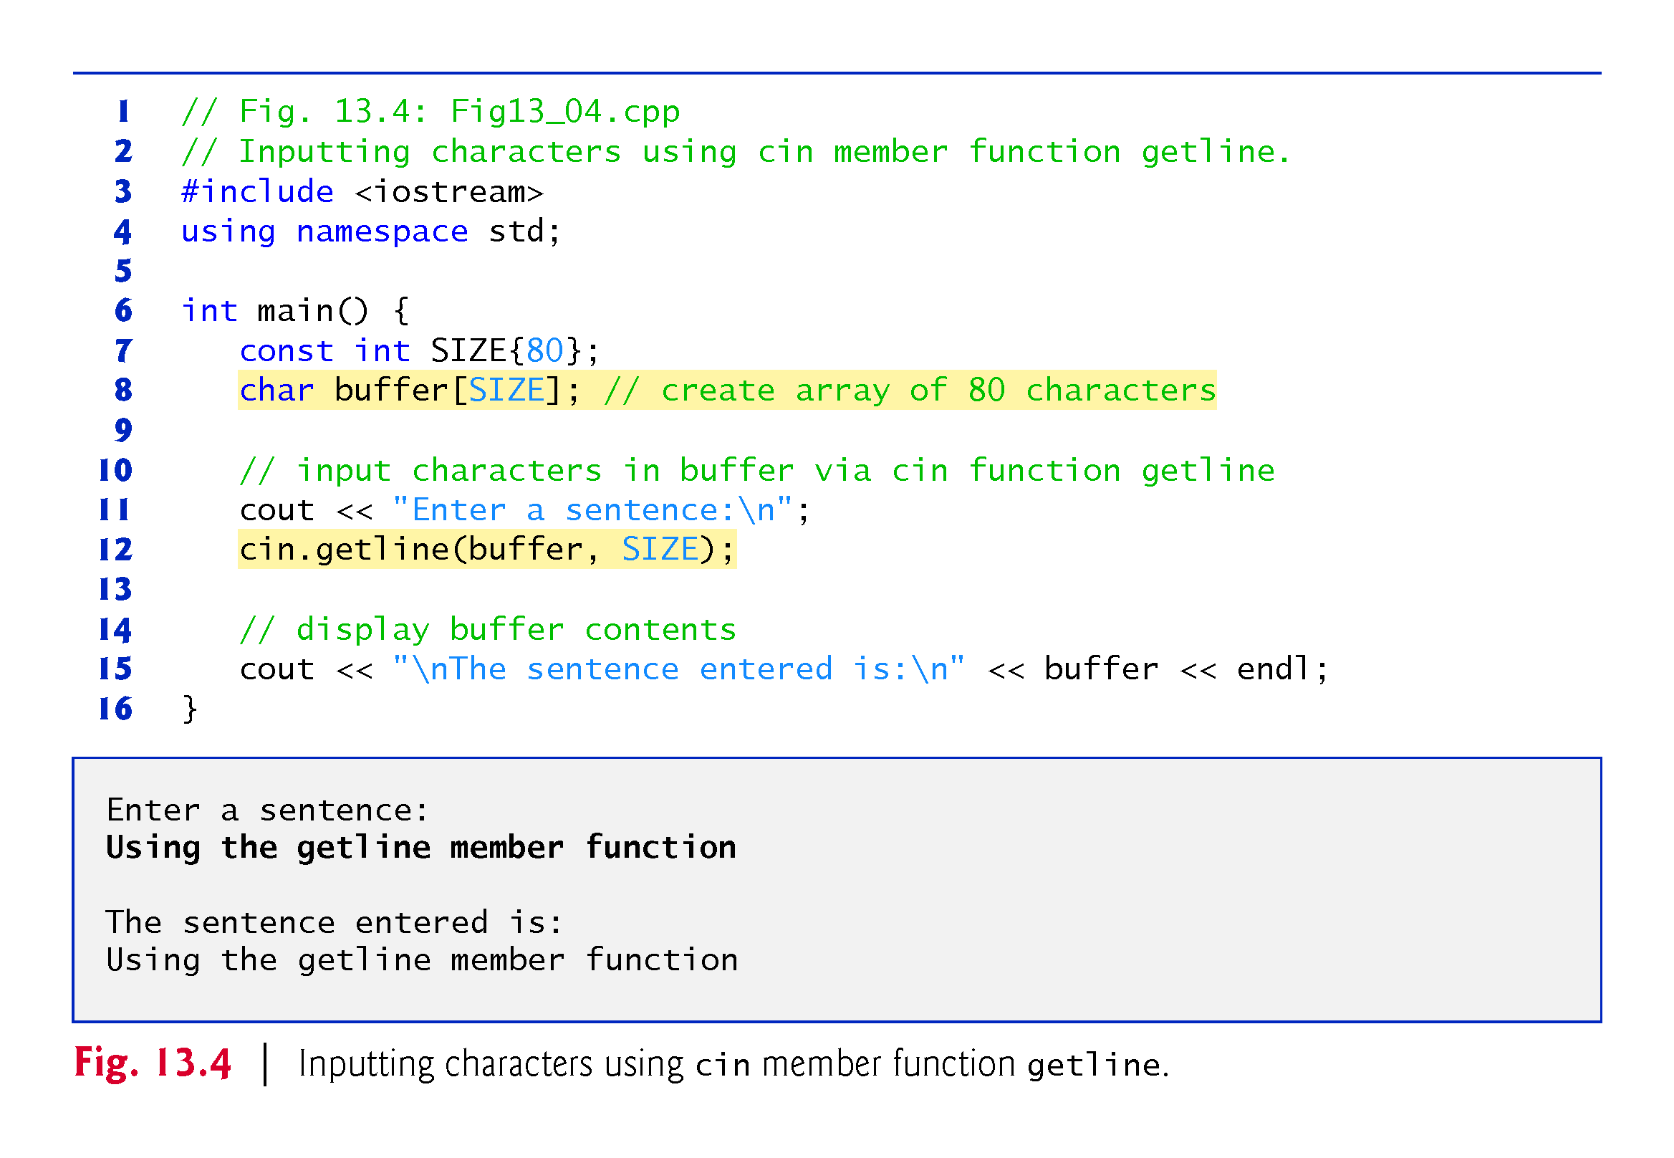
Notes:
Ob: getline removes \n from input stream. \n not stored in buffer array. Compare this to cin.get(buffer2, size);

Slide 14
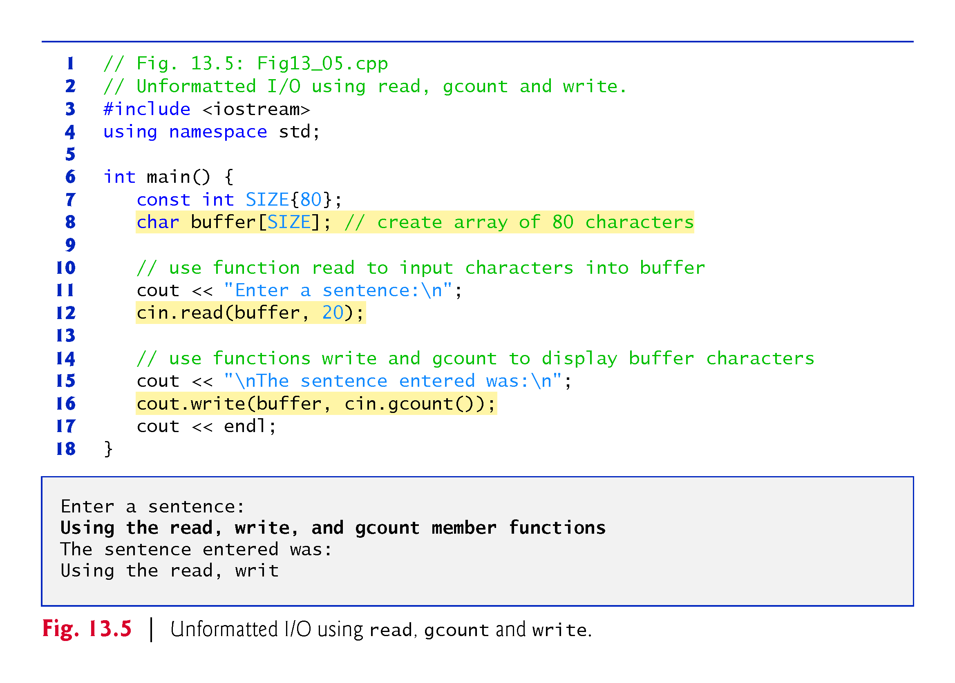
Notes:
Ob: cin.gcount() determines the number of characters to write from the buffer.

Slide 15
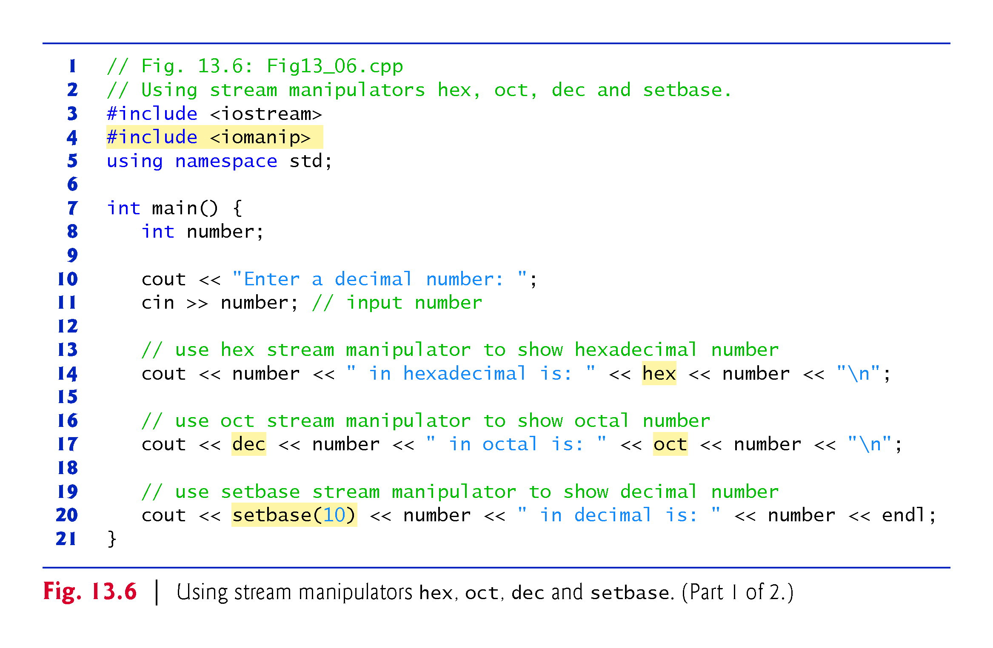
Notes:
Ob: setbase function defined in <iomanip> system header file and can set number bases to 10,8,16 etc. If set base was not used to revert back to base 10, the next cout of a number would still be in base 8.

Slide 16
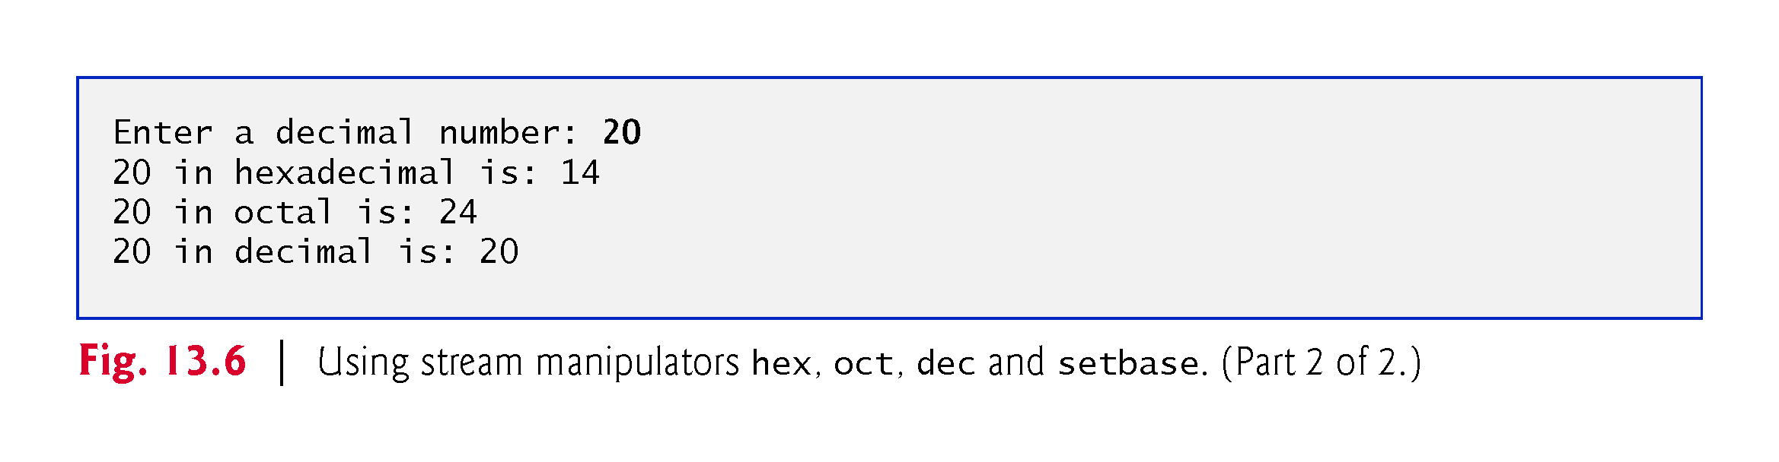

Slide 17
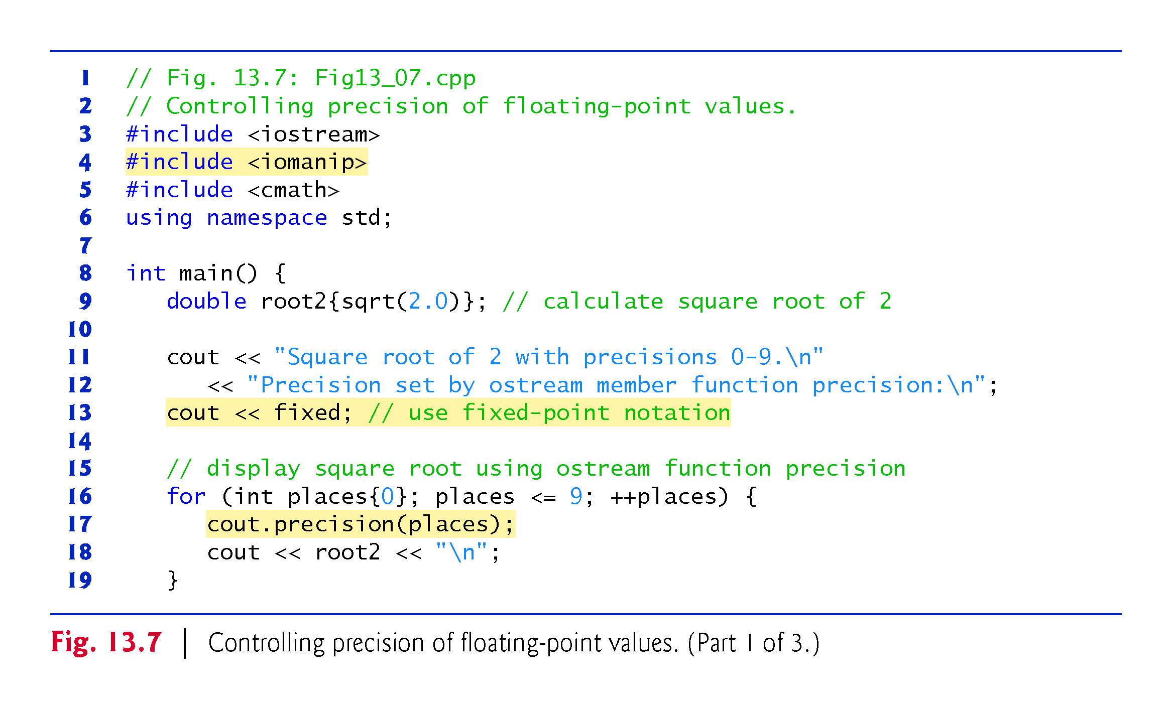
Notes:
Ob: cout.precision(places) defined in <iostream>. Cout.precision with no arguments restores the default precision settings.

Slide 18
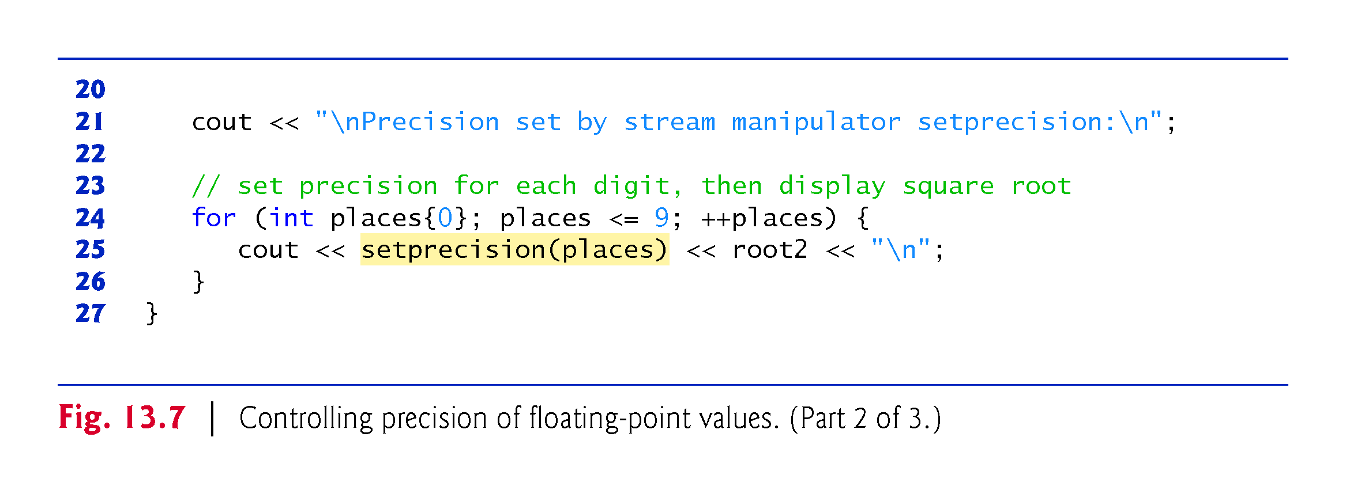
Notes:
Ob: setprecision(places) defined in <iomanip>

Slide 19
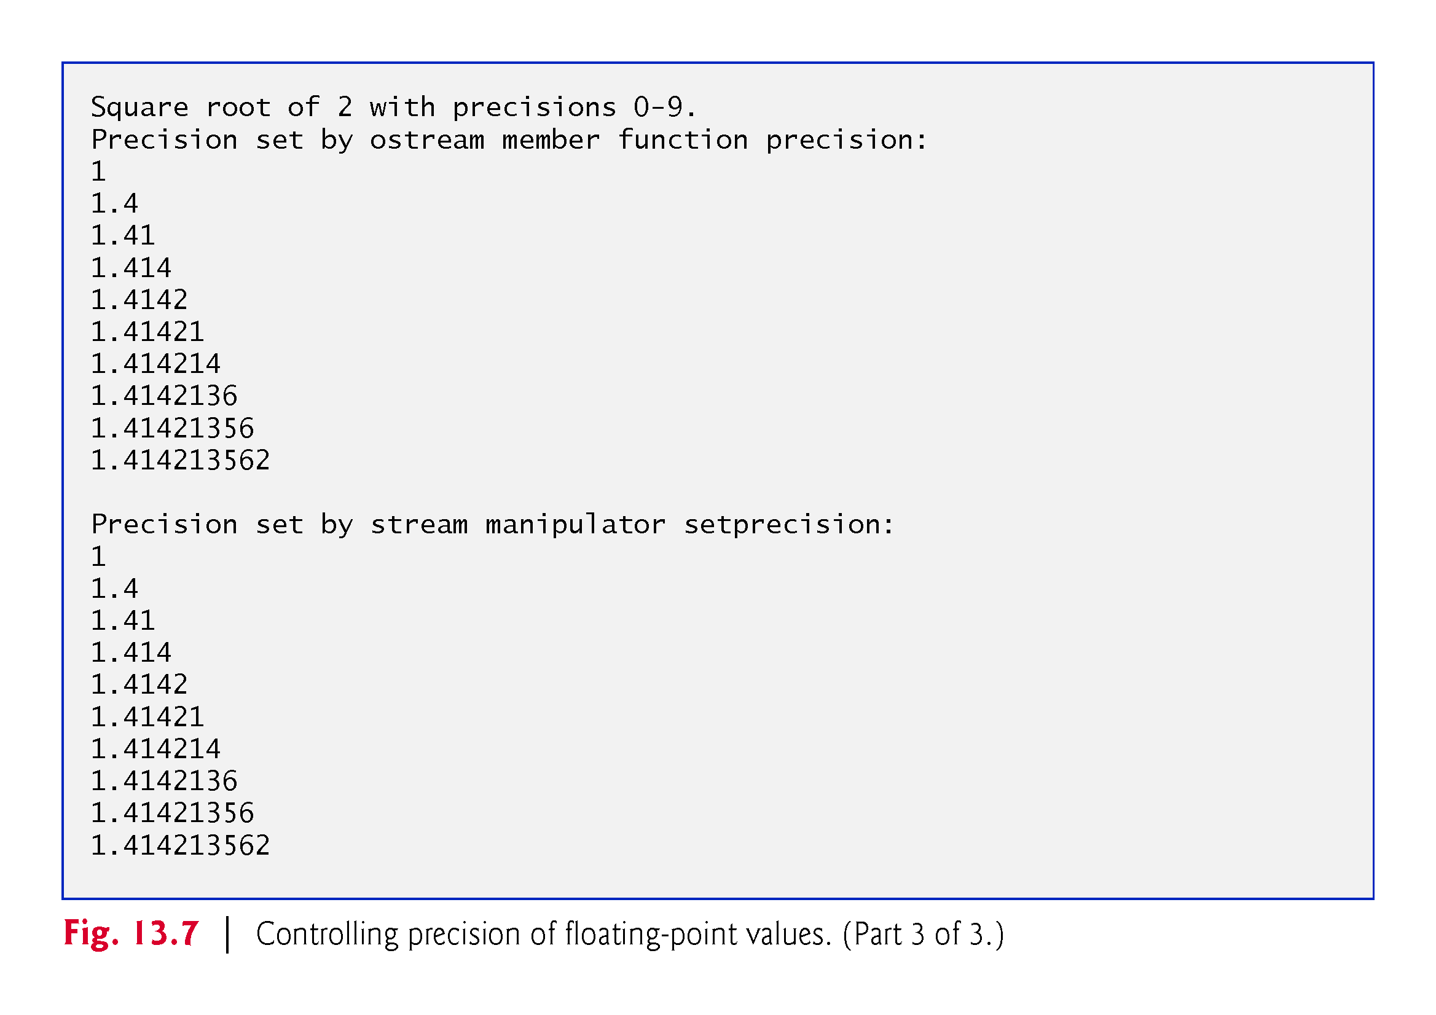

Slide 20
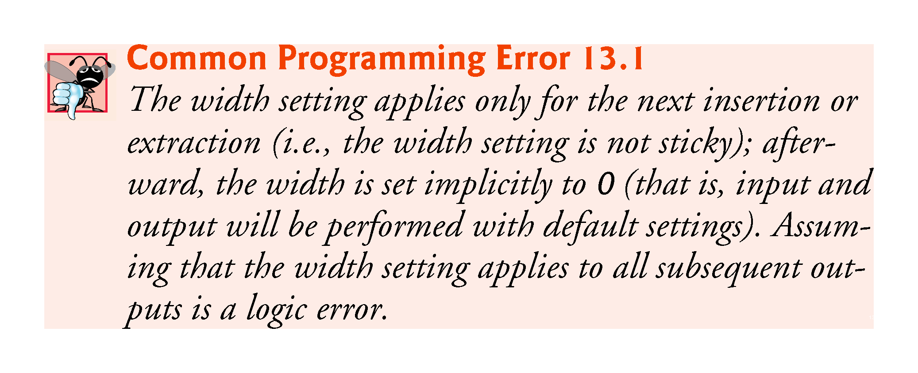
Notes:
Ob: important for width setting – that’s why we need to continuously setwidth(X)

Slide 21
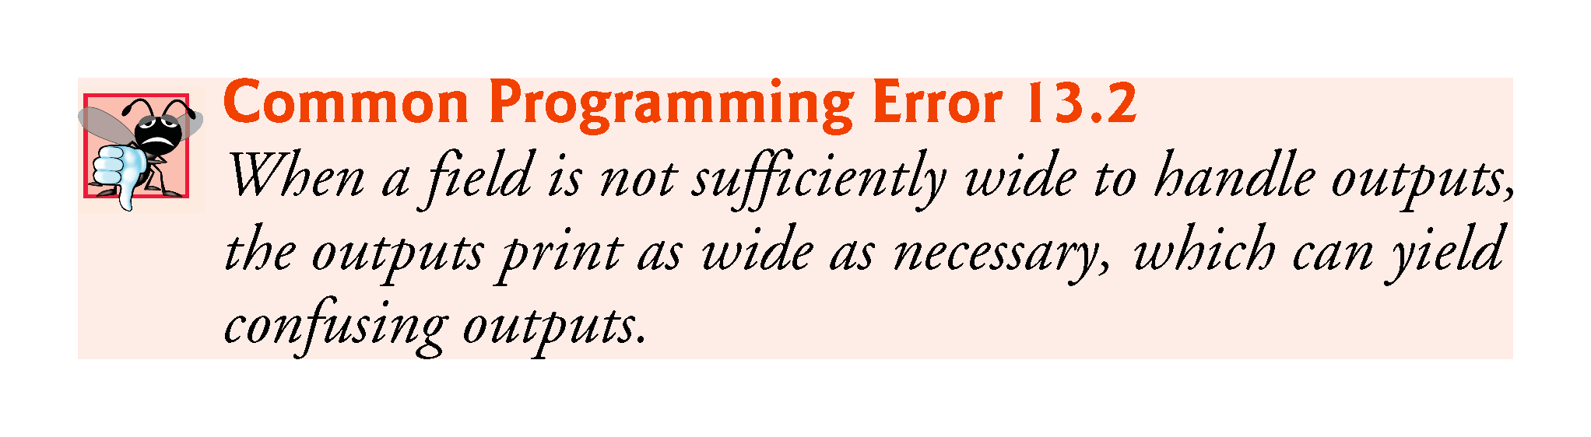

Slide 22
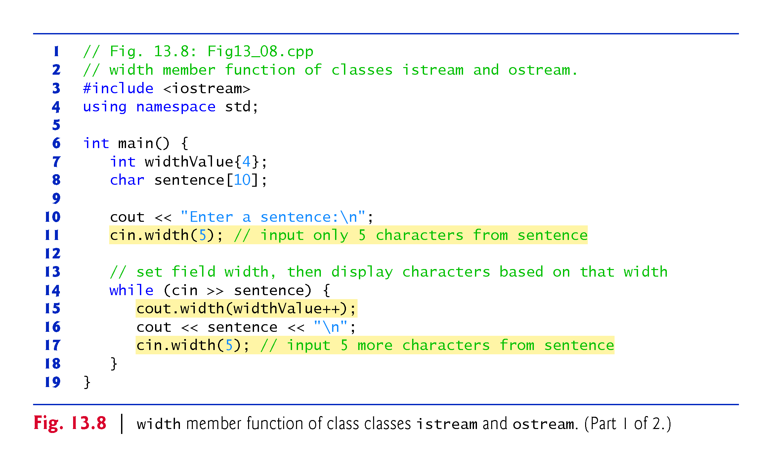

Slide 23
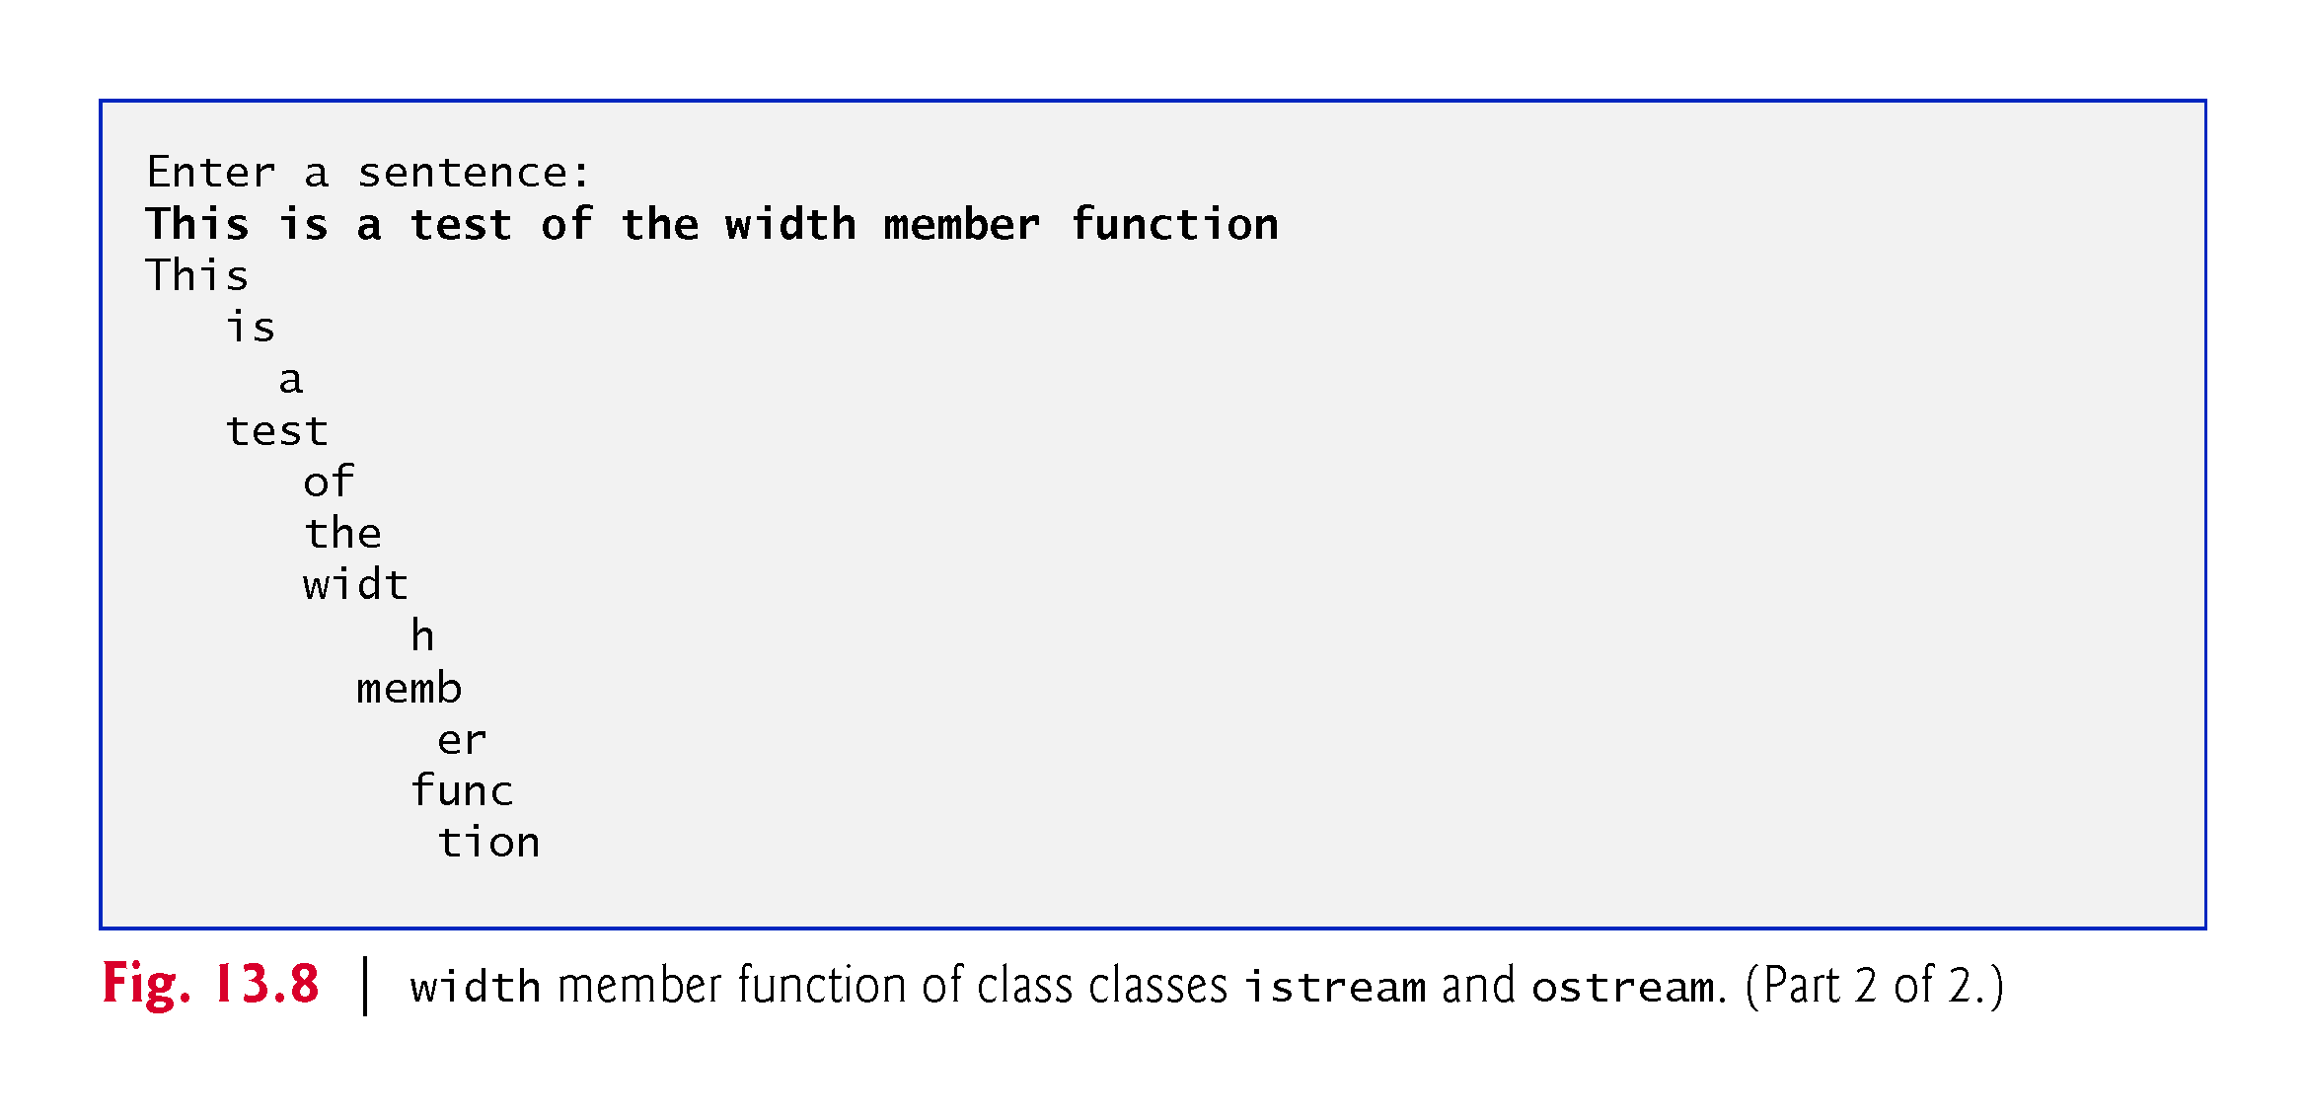
Notes:
Ob: width is always incrementing by 1 and prints from inwards towards width. Cin.get(5) always reads the next 5 characters from input.

Slide 24
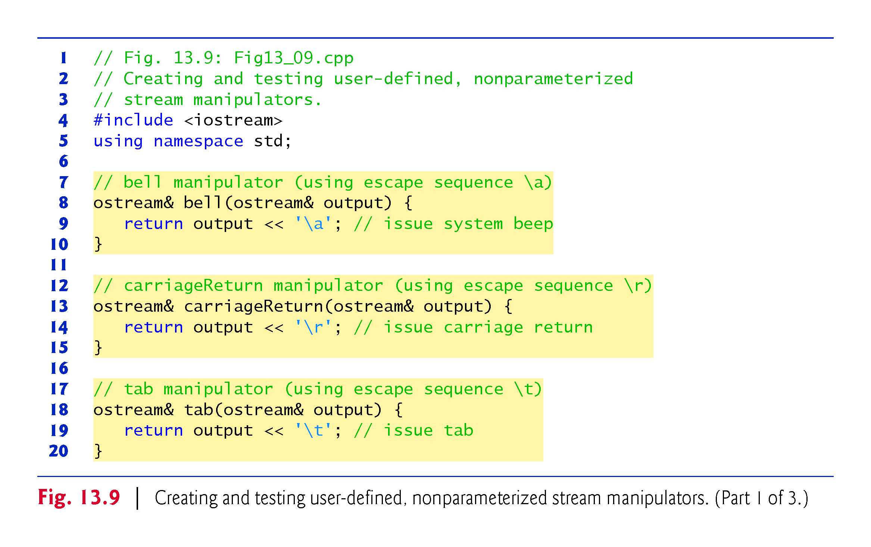

Slide 25
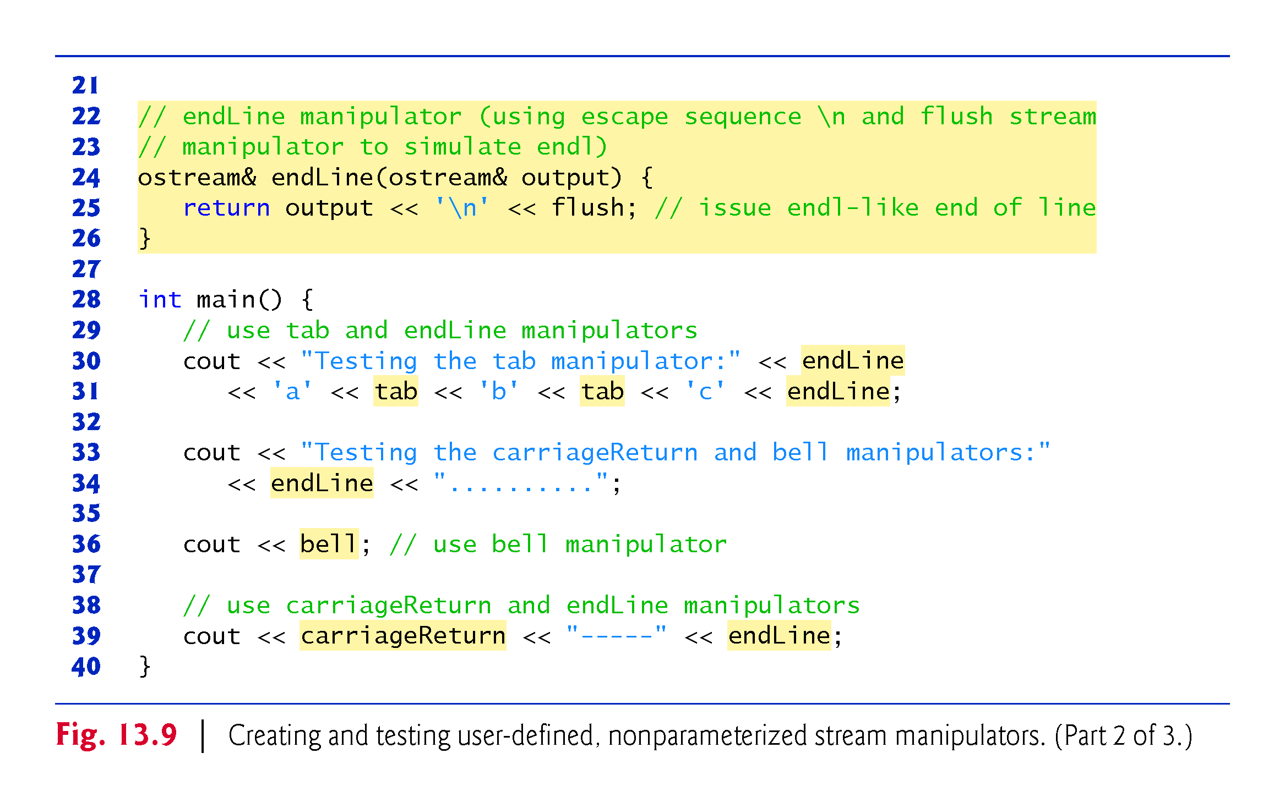

Slide 26
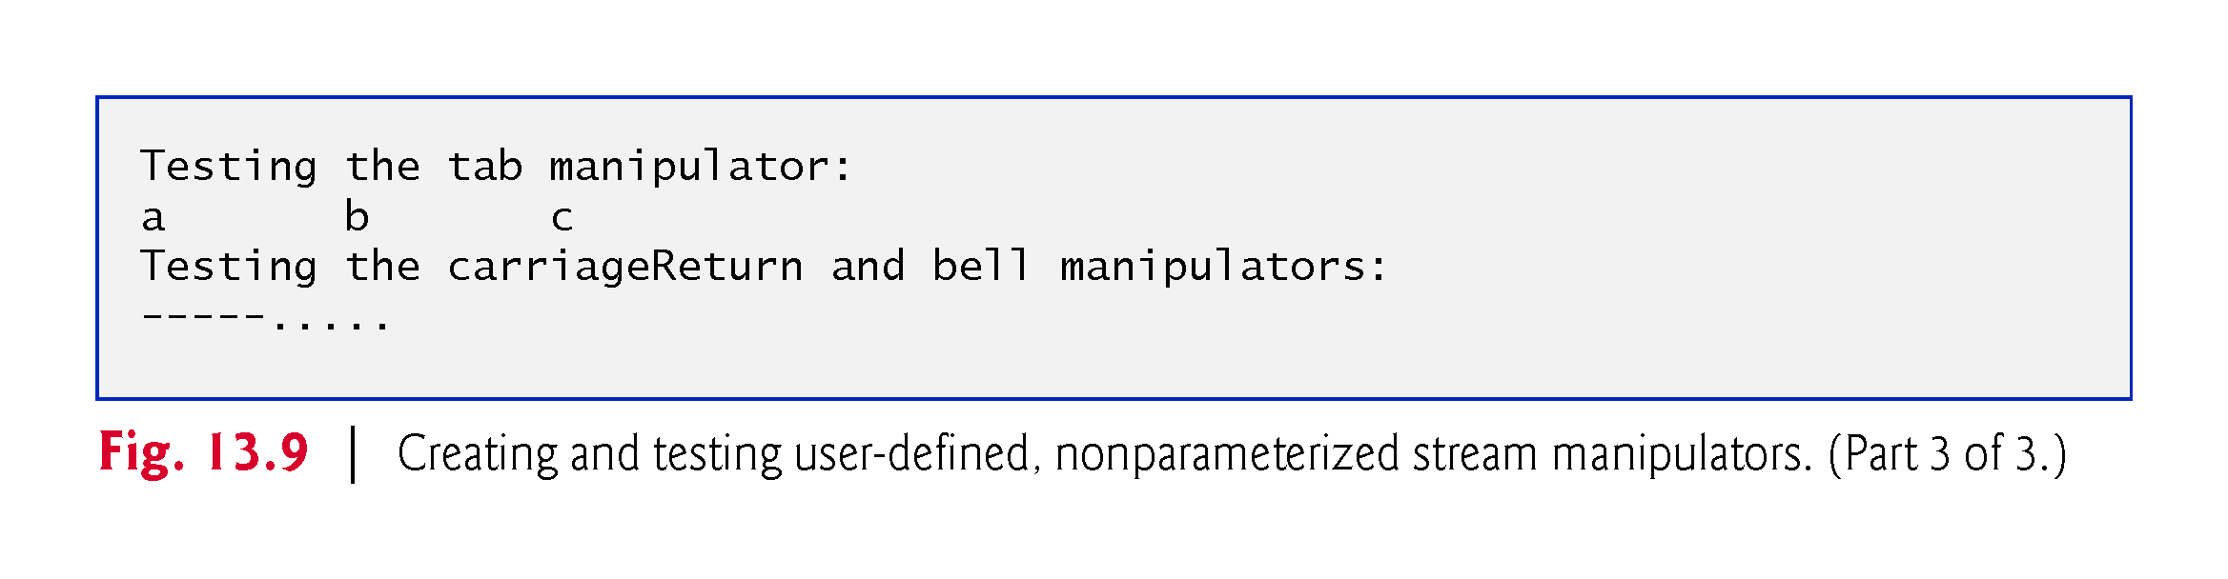

Slide 27
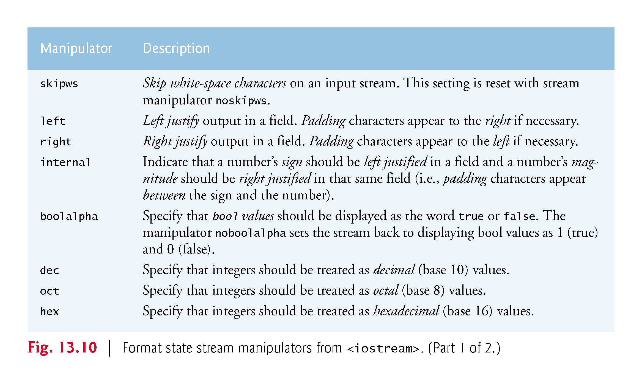

Slide 28
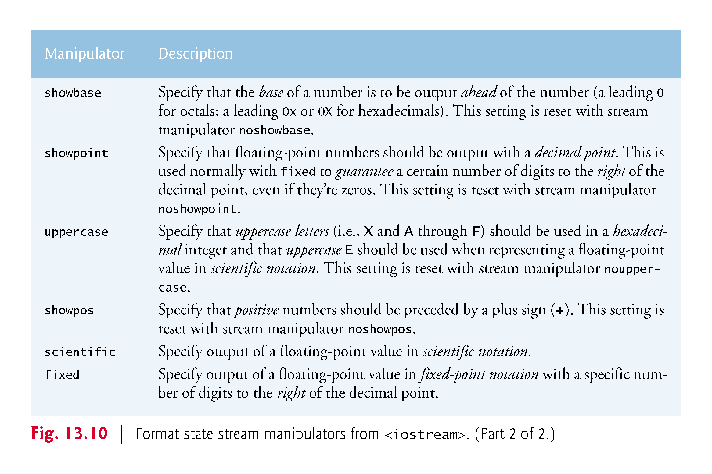

Slide 29
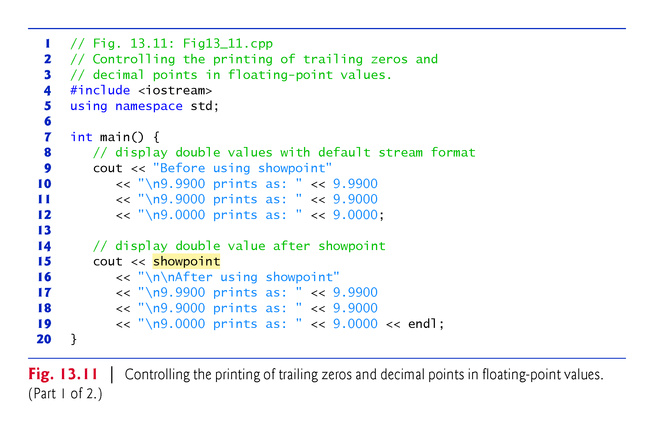

Slide 30
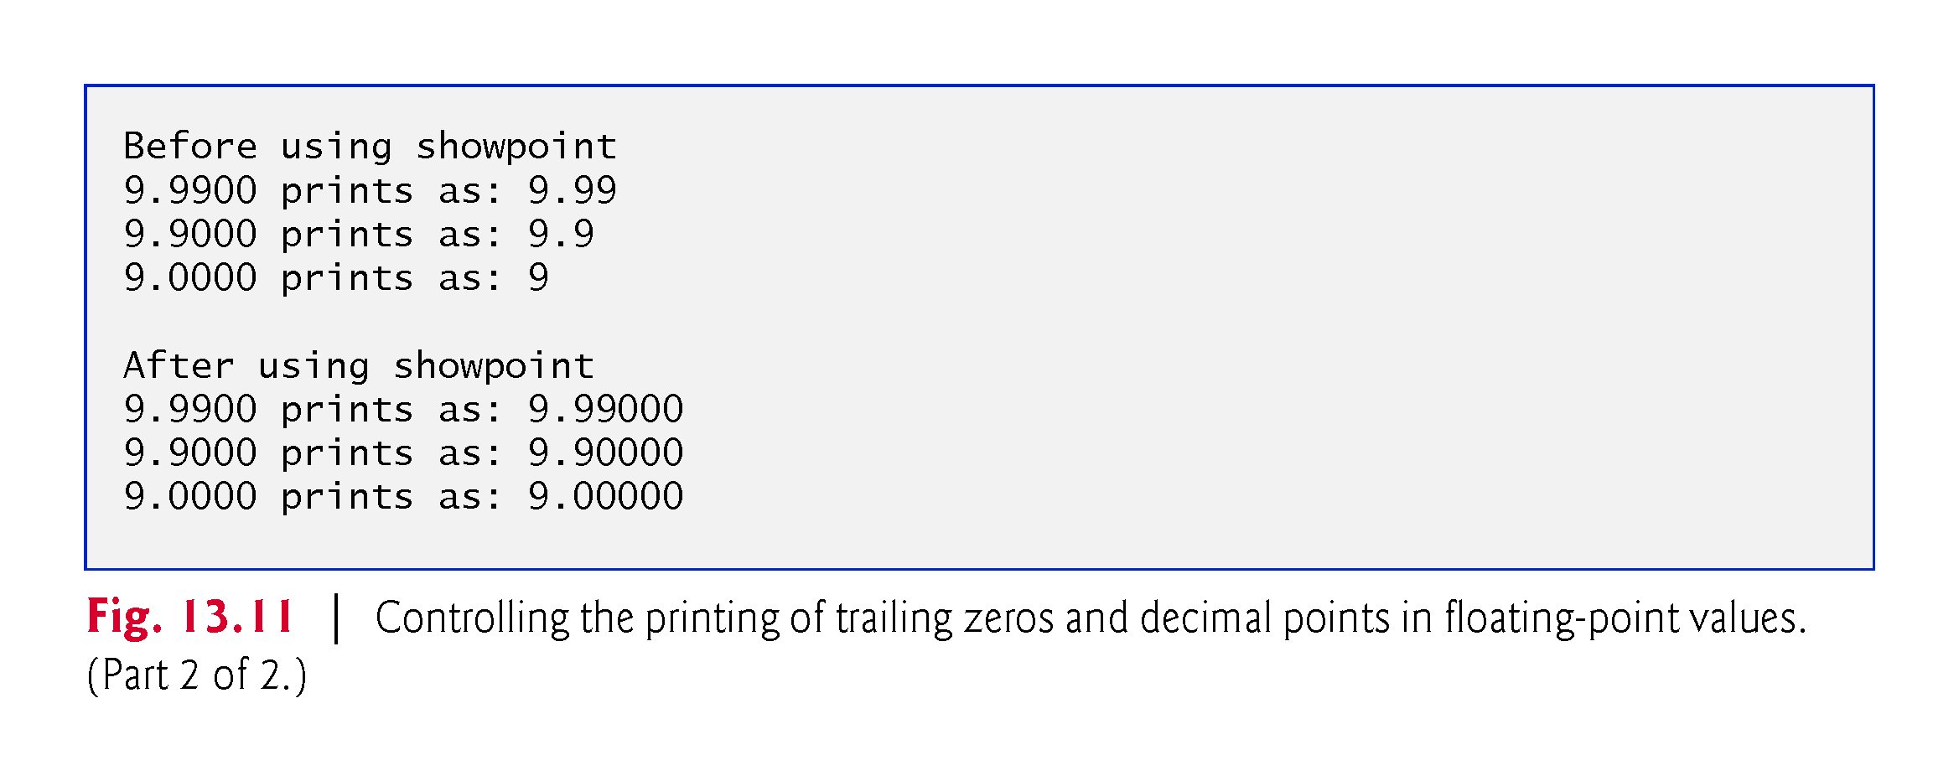

Slide 31
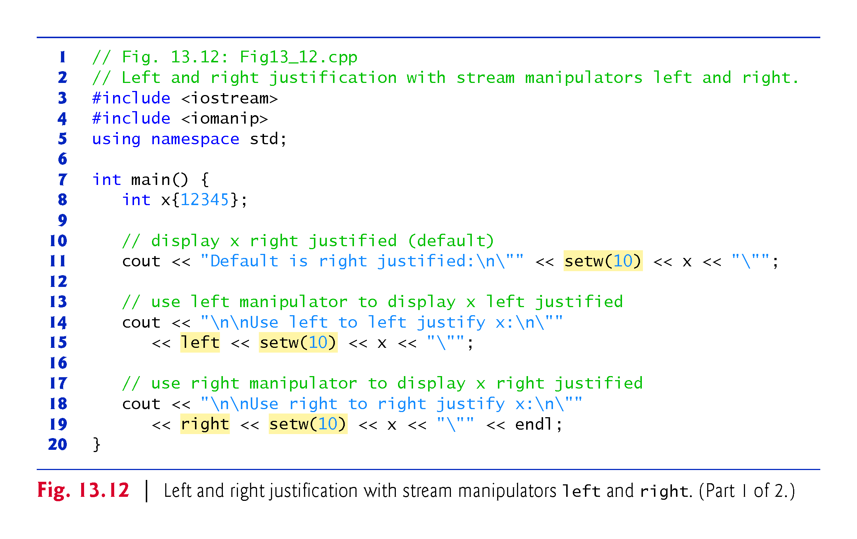

Slide 32
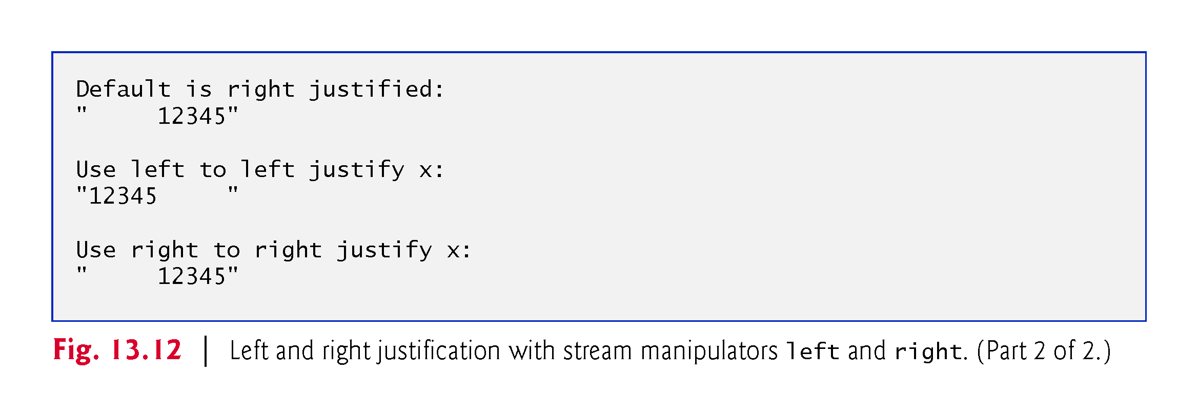

Slide 33
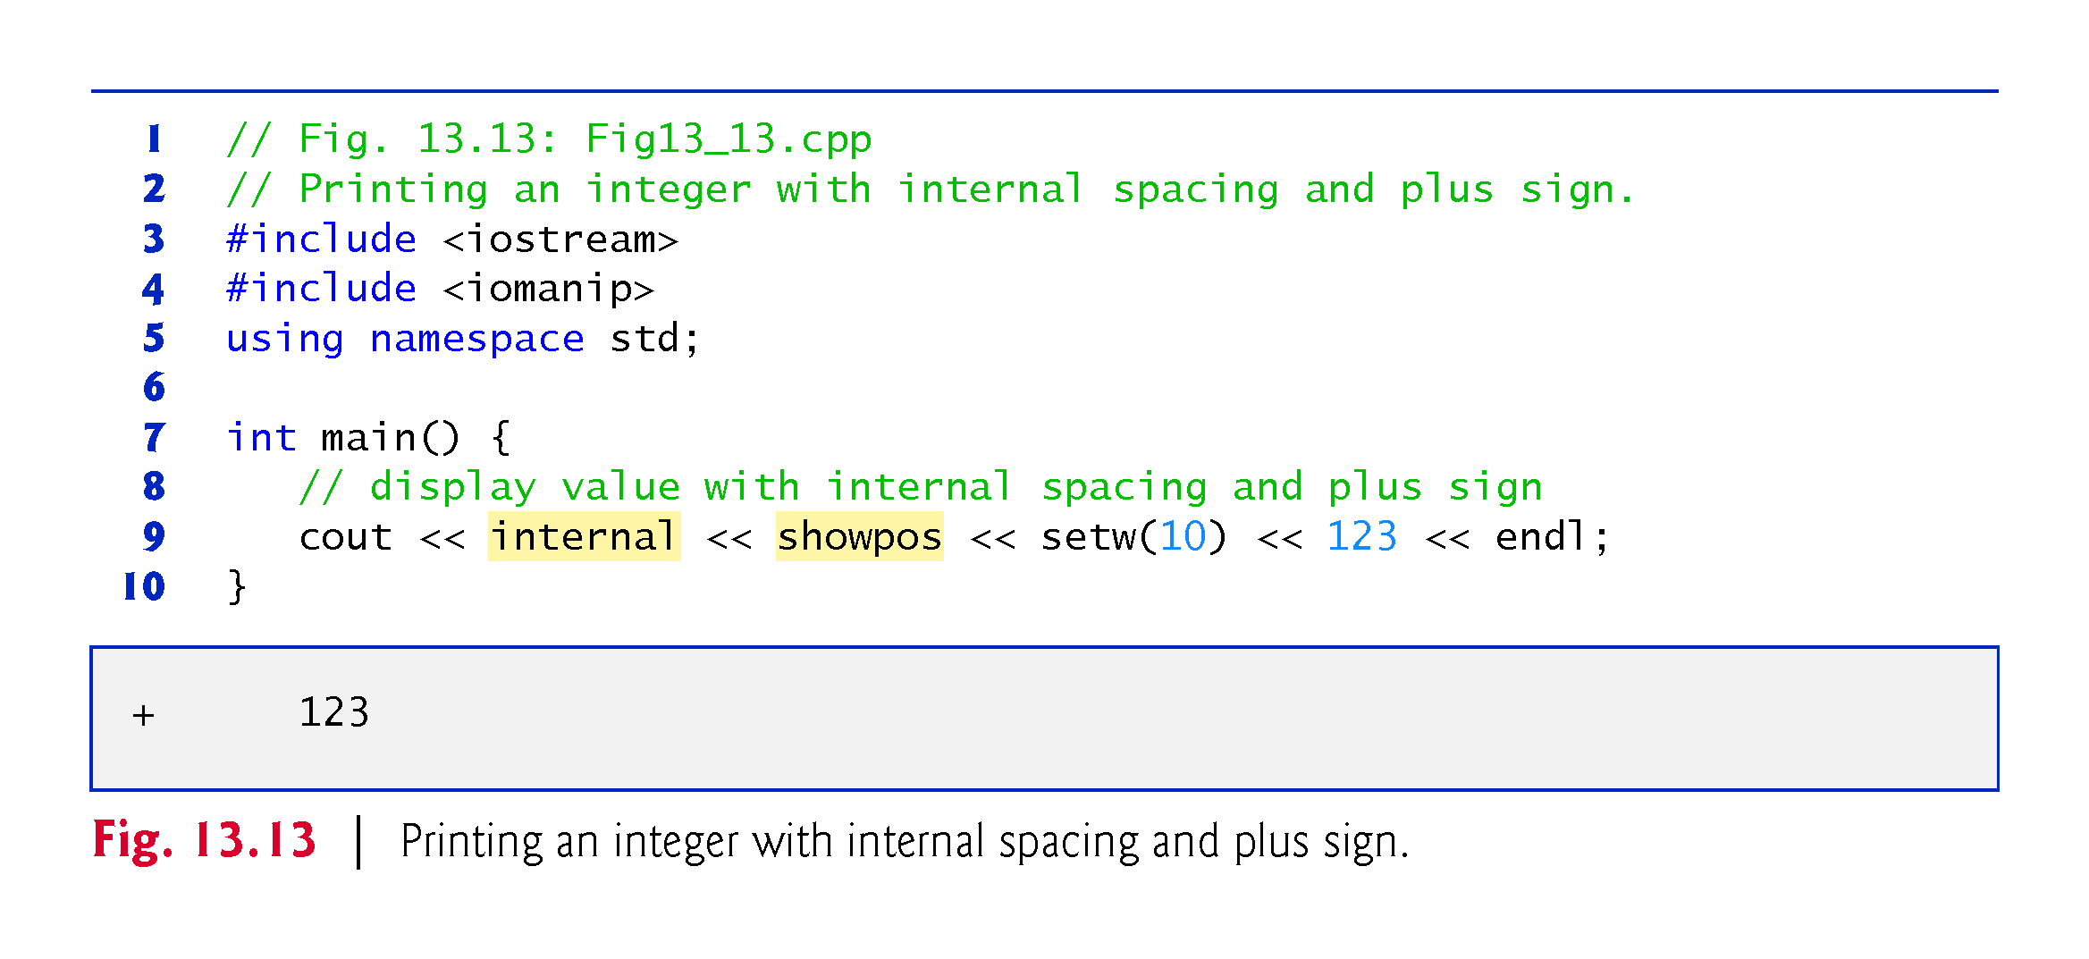

Slide 34
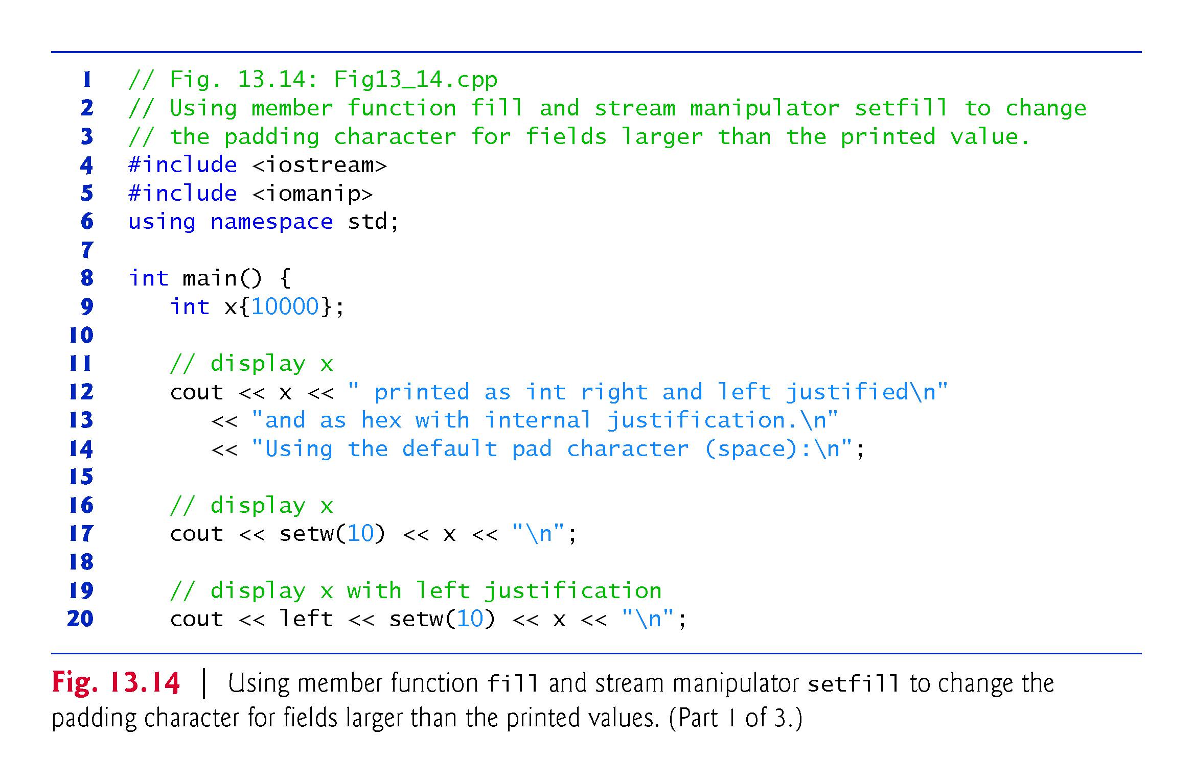

Slide 35
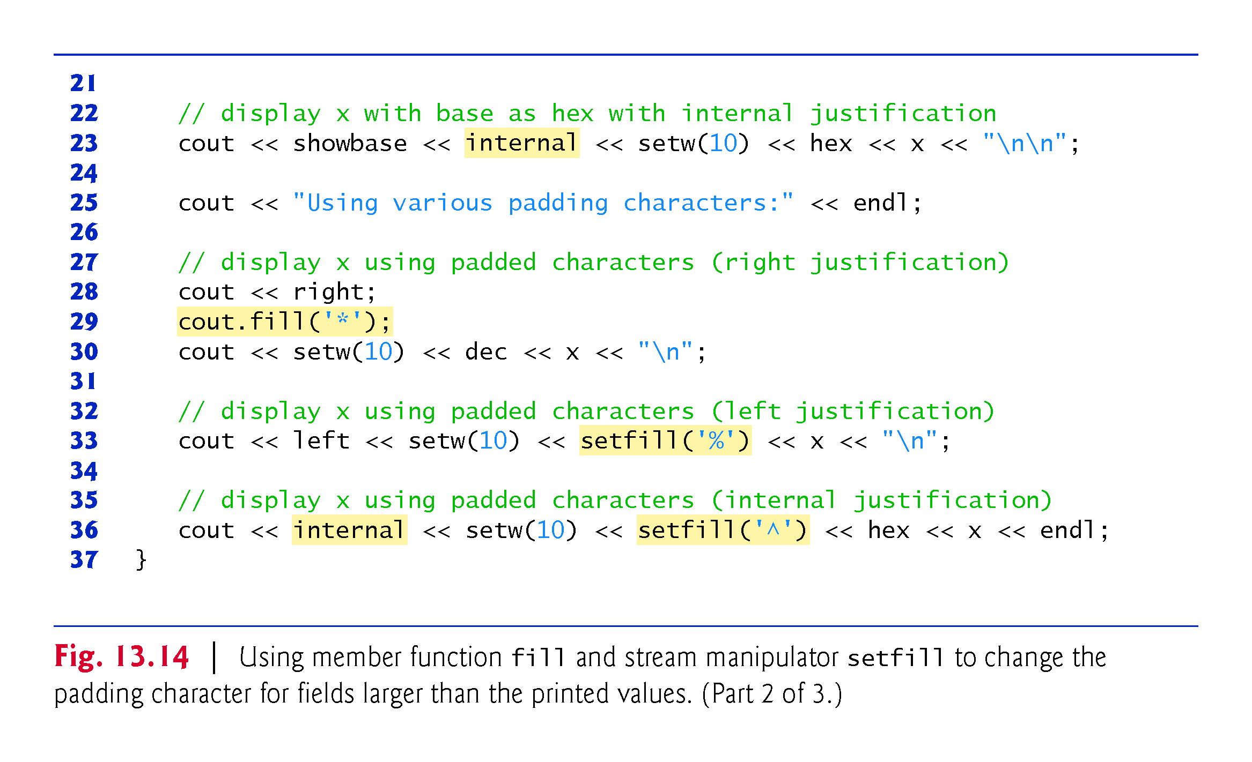
Notes:
Ob: showbase will output hexadecimal baes (left justified here) as 0x or 0X depending on if uppercase stream manipulator has been set or not. The value of the variable x will be right justified in the field.

Slide 36
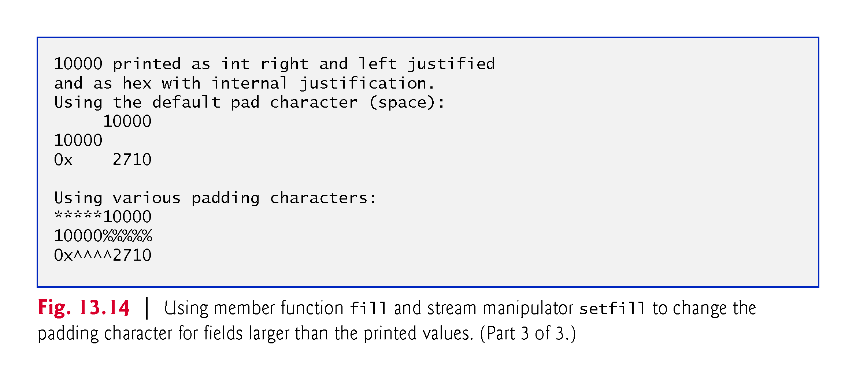

Slide 37
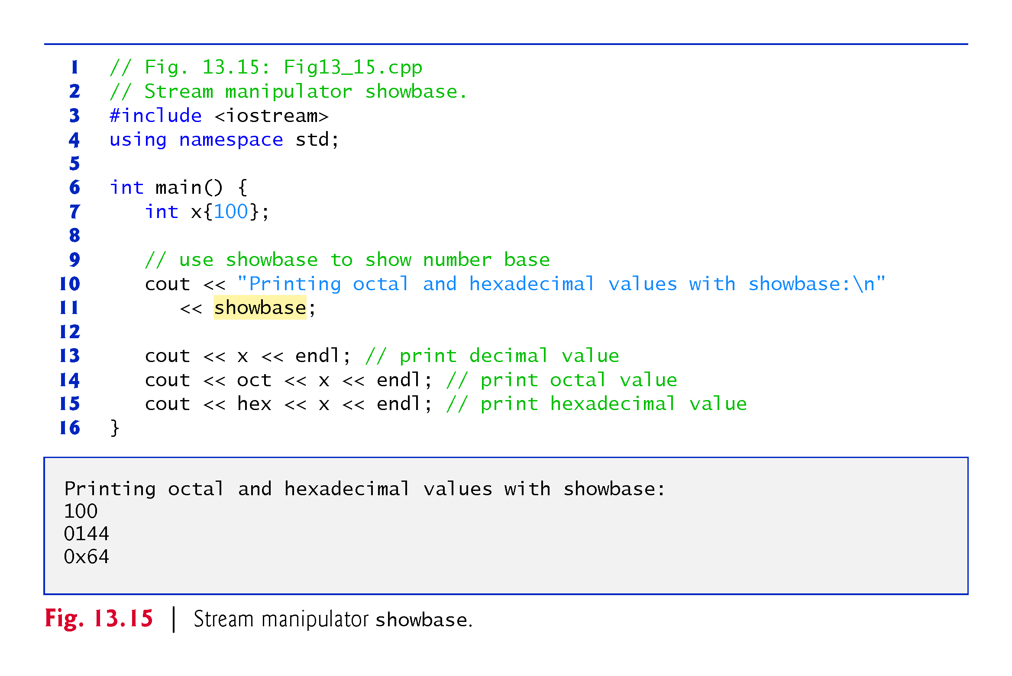
Notes:
Ob: Octal has a leading zero, hex has a leading 0x or 0X depending on if uppercase stream manipulator has been set.

Slide 38
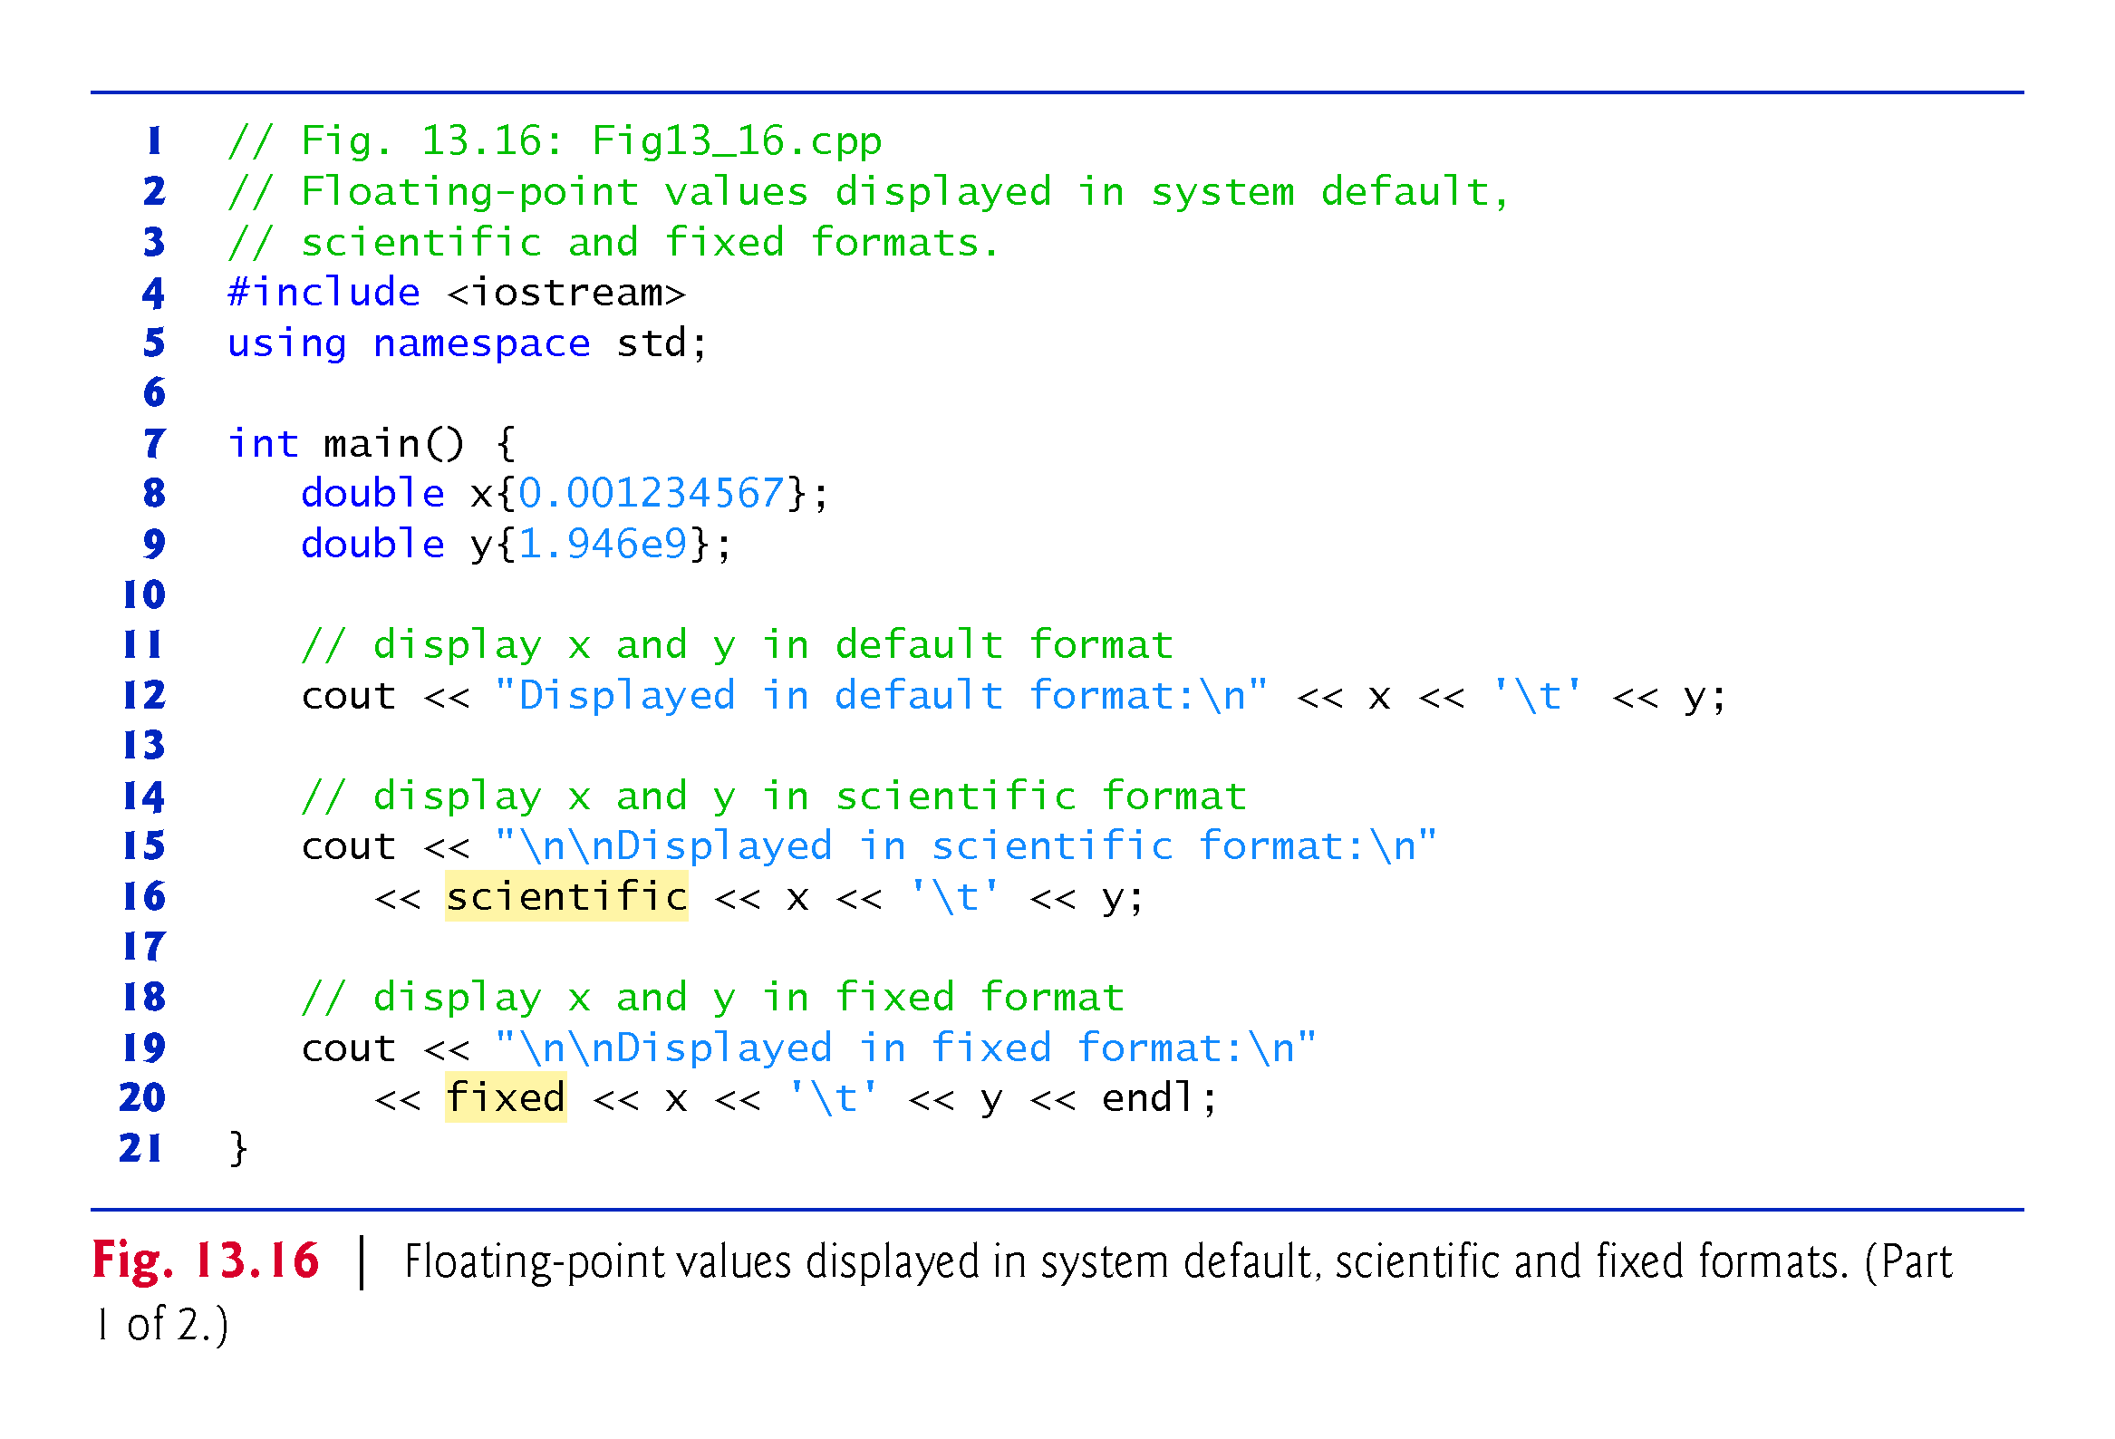

Slide 39
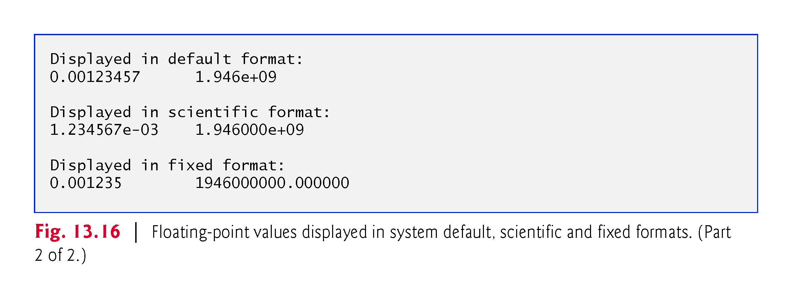
Notes:
Ob: in fixed stream manipulators, the number of decimal digits is specified by the set precision stream manipulator. In the last output there is an error. It should have been 0.001234

Slide 40
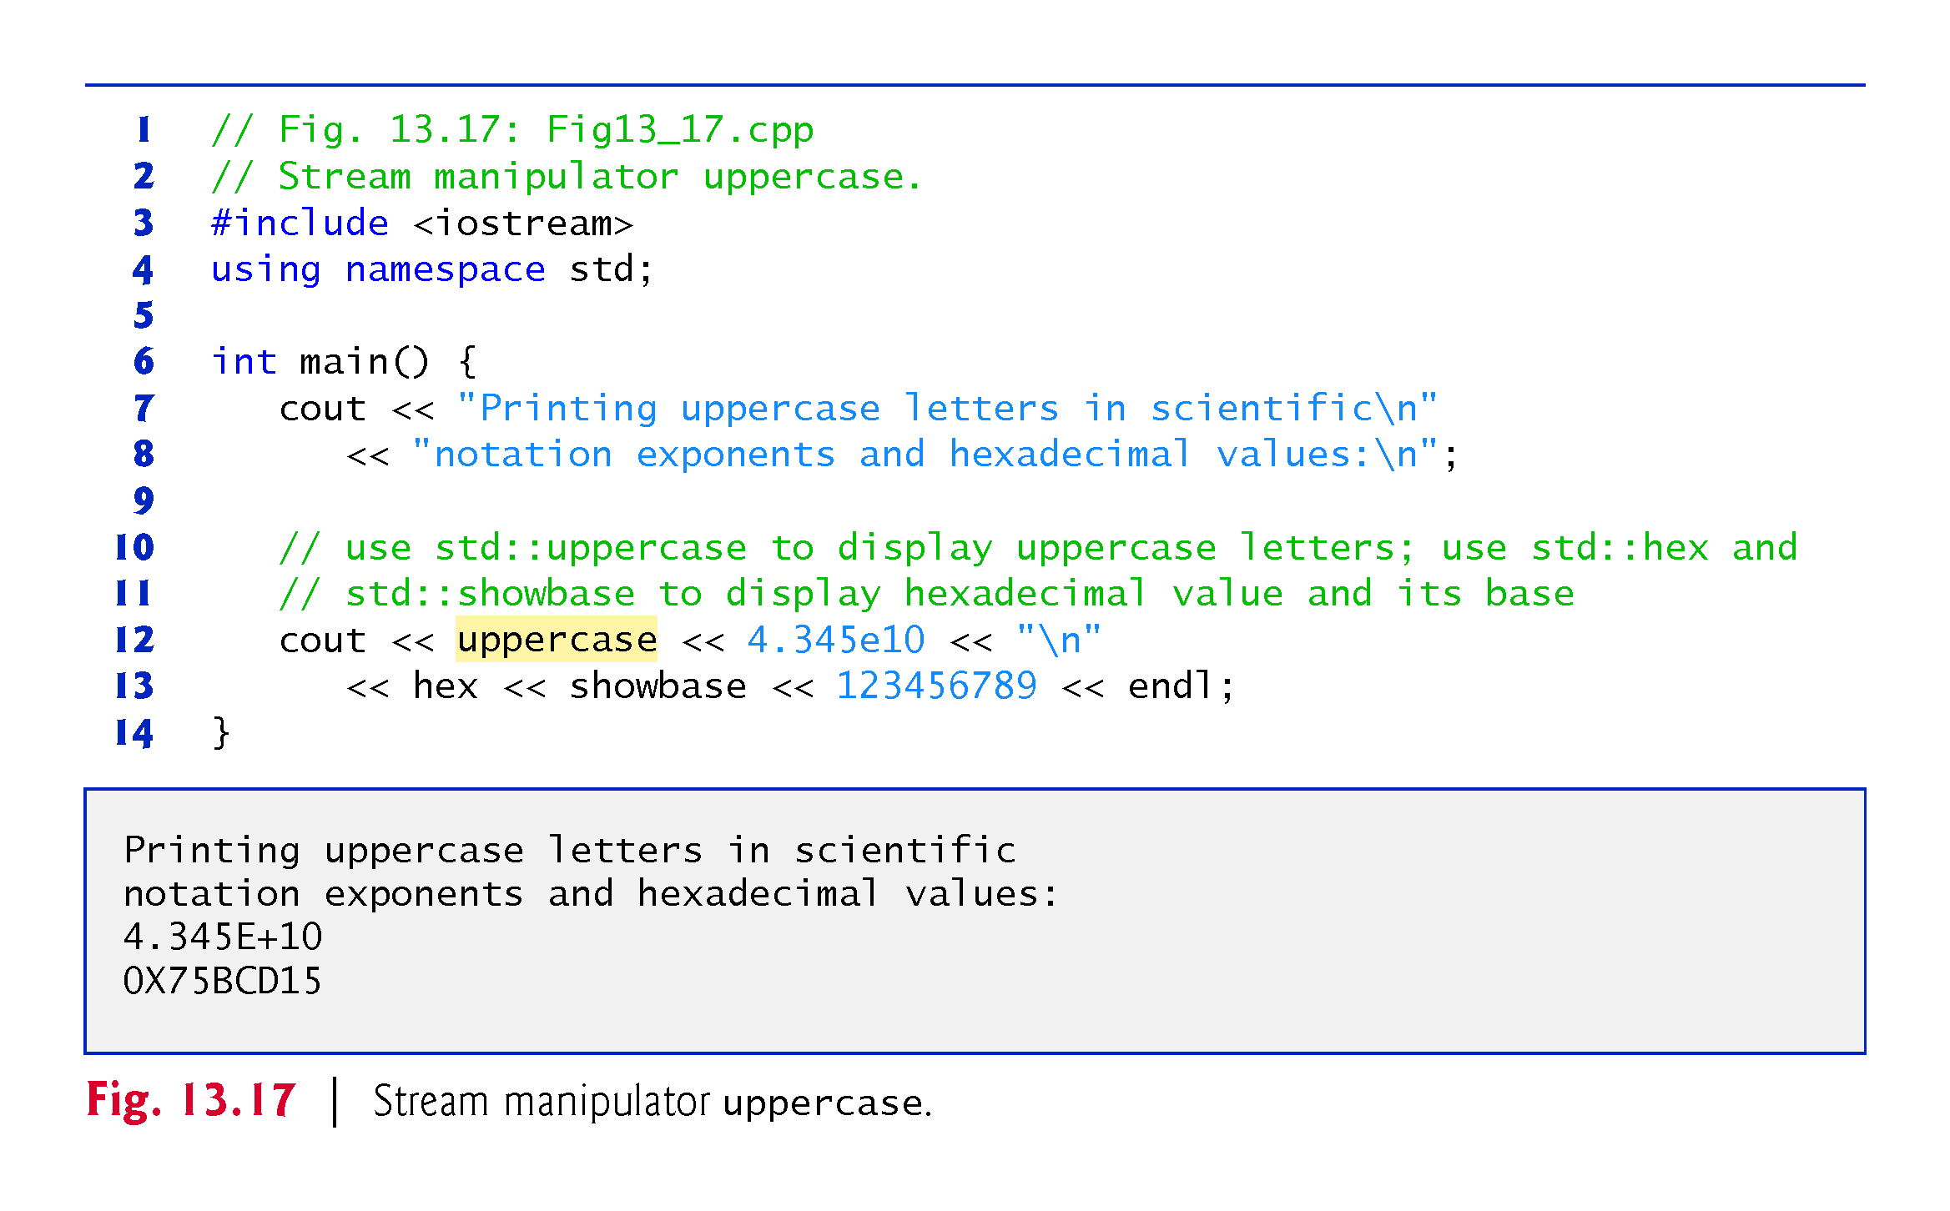

Slide 41
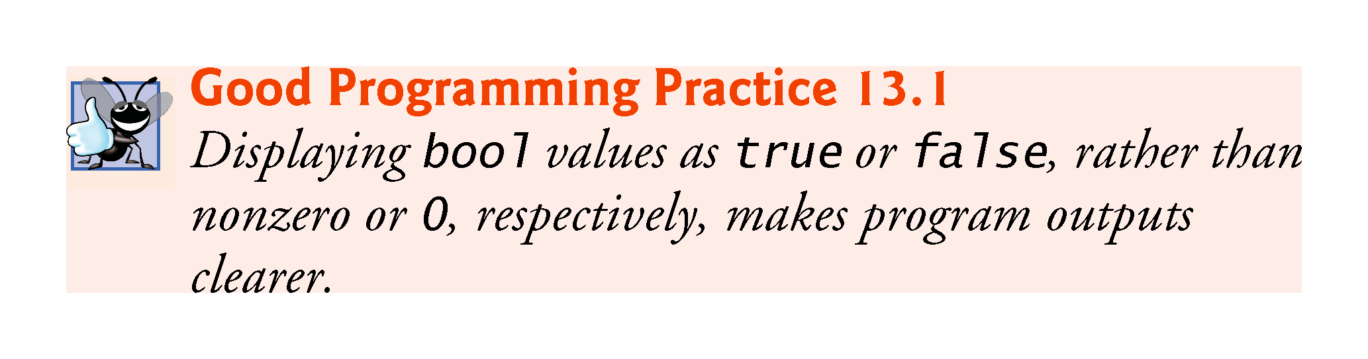

Slide 42
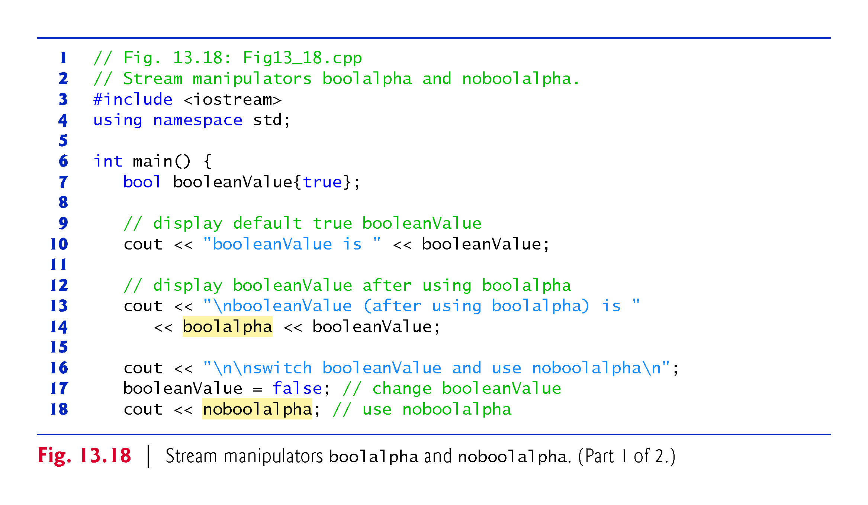

Slide 43
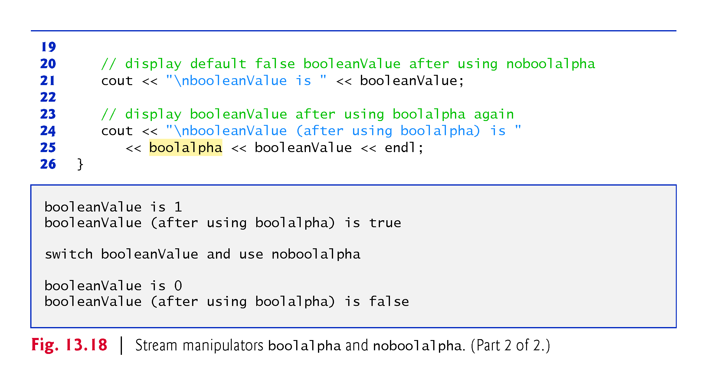

Slide 44
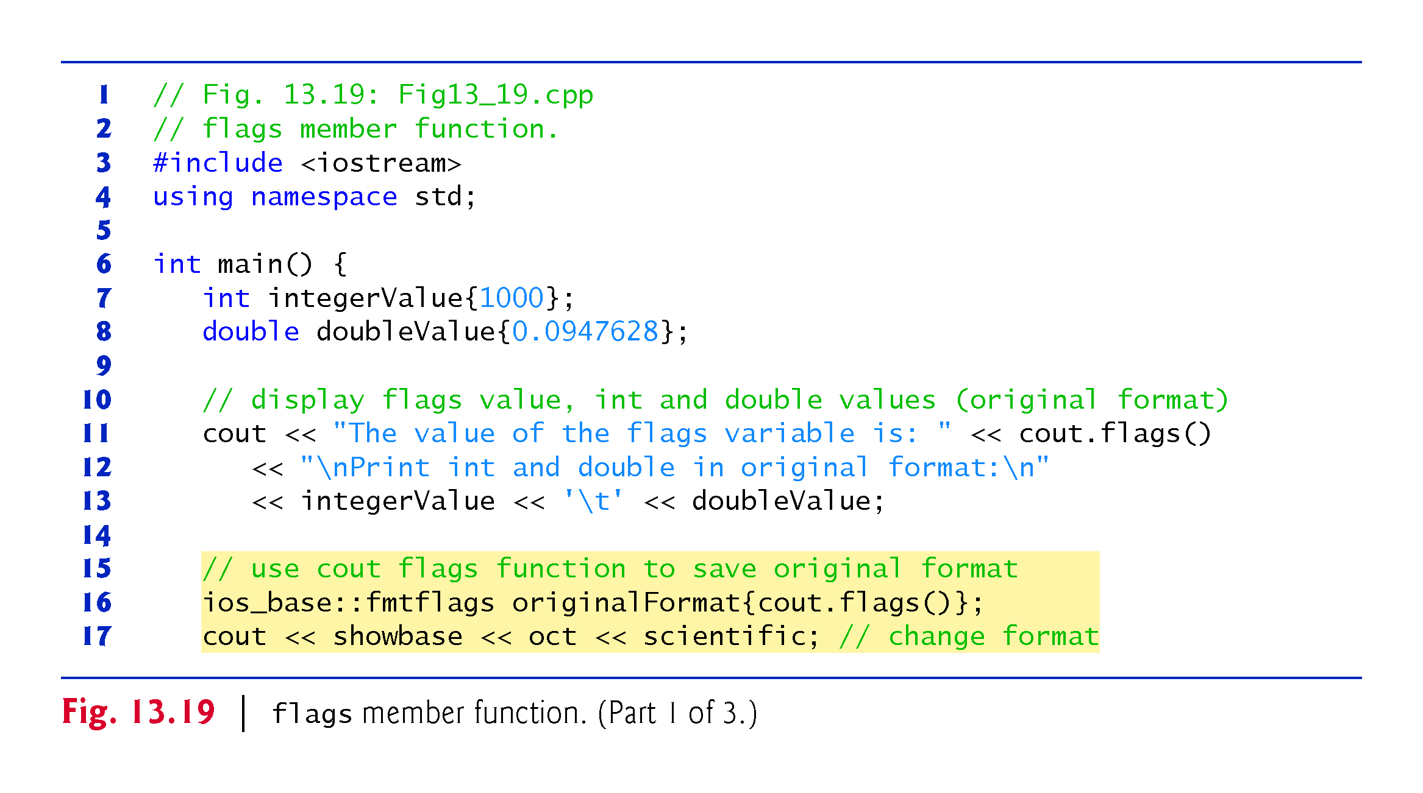
Notes:
Ob: oct base will be for the integer number, scientific base will be for the double number

Slide 45
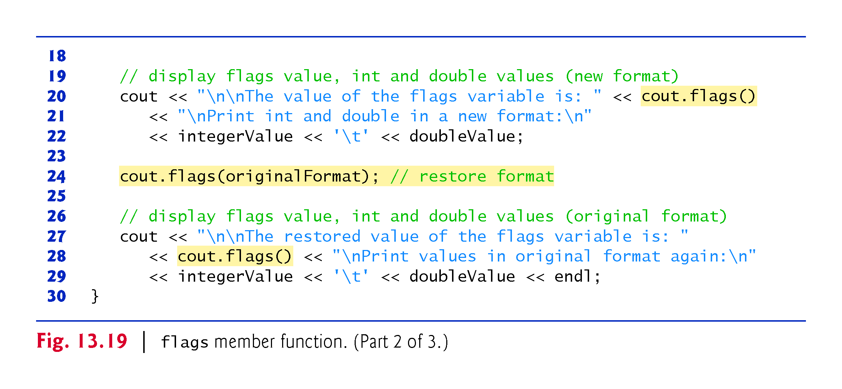

Slide 46
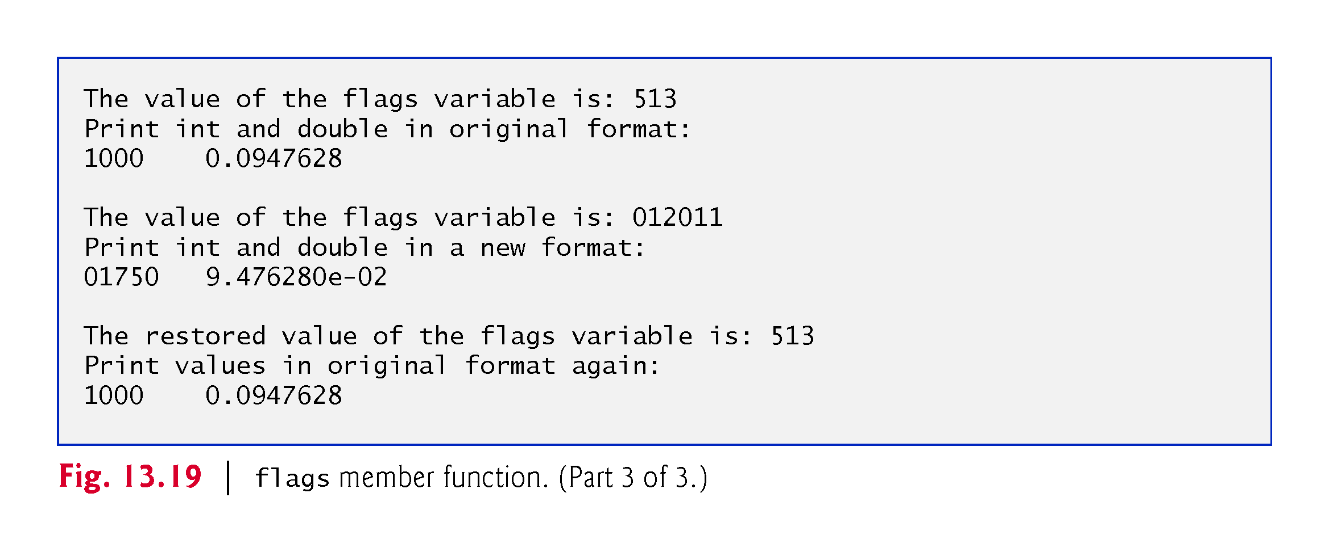

Slide 47
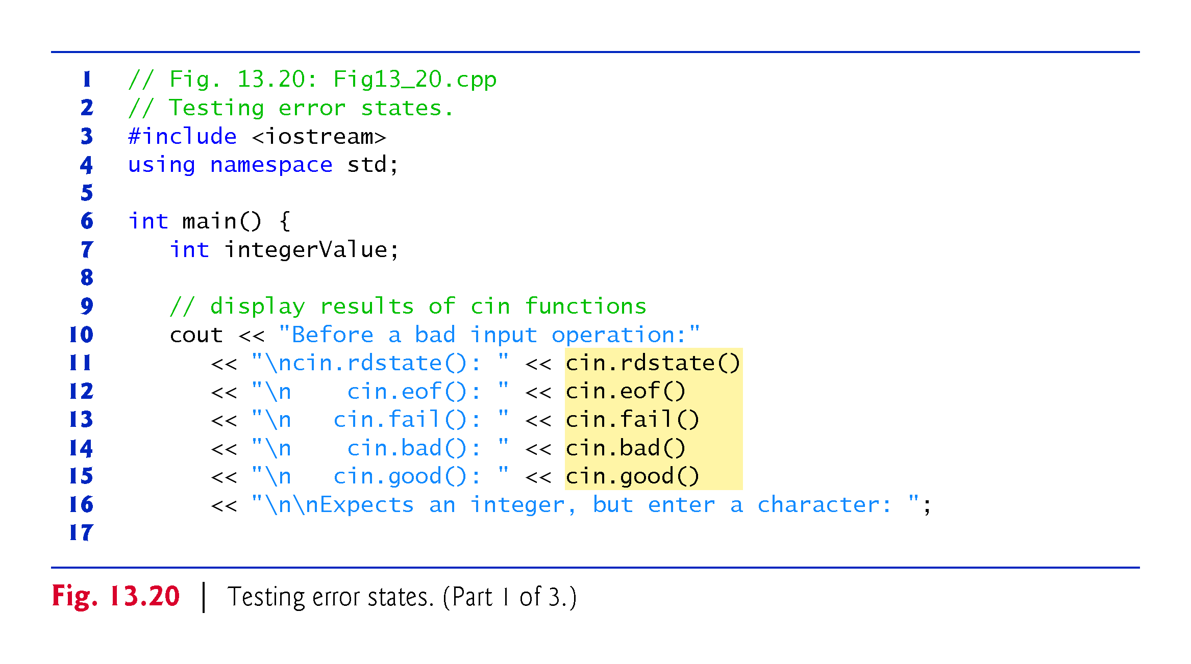

Slide 48
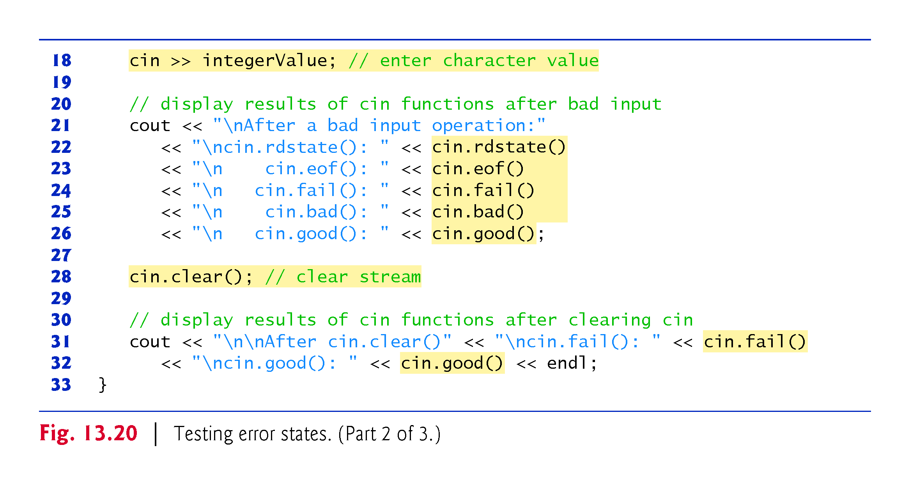
Notes:
Ob: fail is for input of a different data type – e.g string instead of integer, bad() if for disk read failures and loss of data. Rdstate() returns the overall error state of the system [how many of eof(), fail() and bad() have returned zeros – false). Good() returns 1 if all the eof(),bad(),fail() return zero – false.

Slide 49
