Slide 1
File Processing
Based on Chapter 14 of C++ How to Program, 10/e

Slide 2
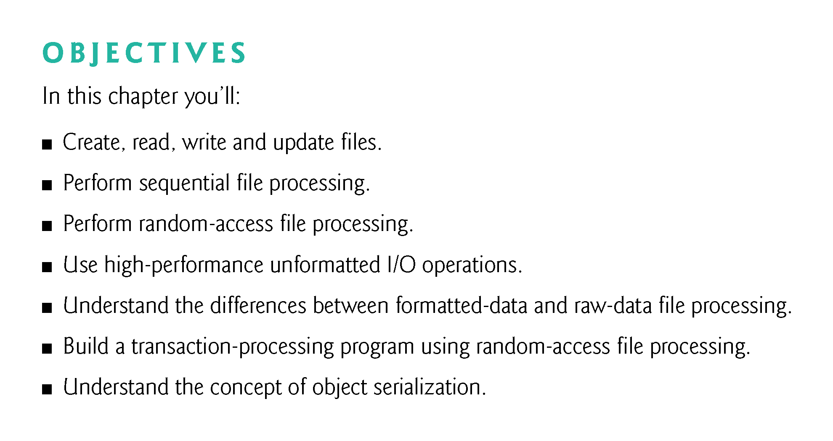

Slide 3
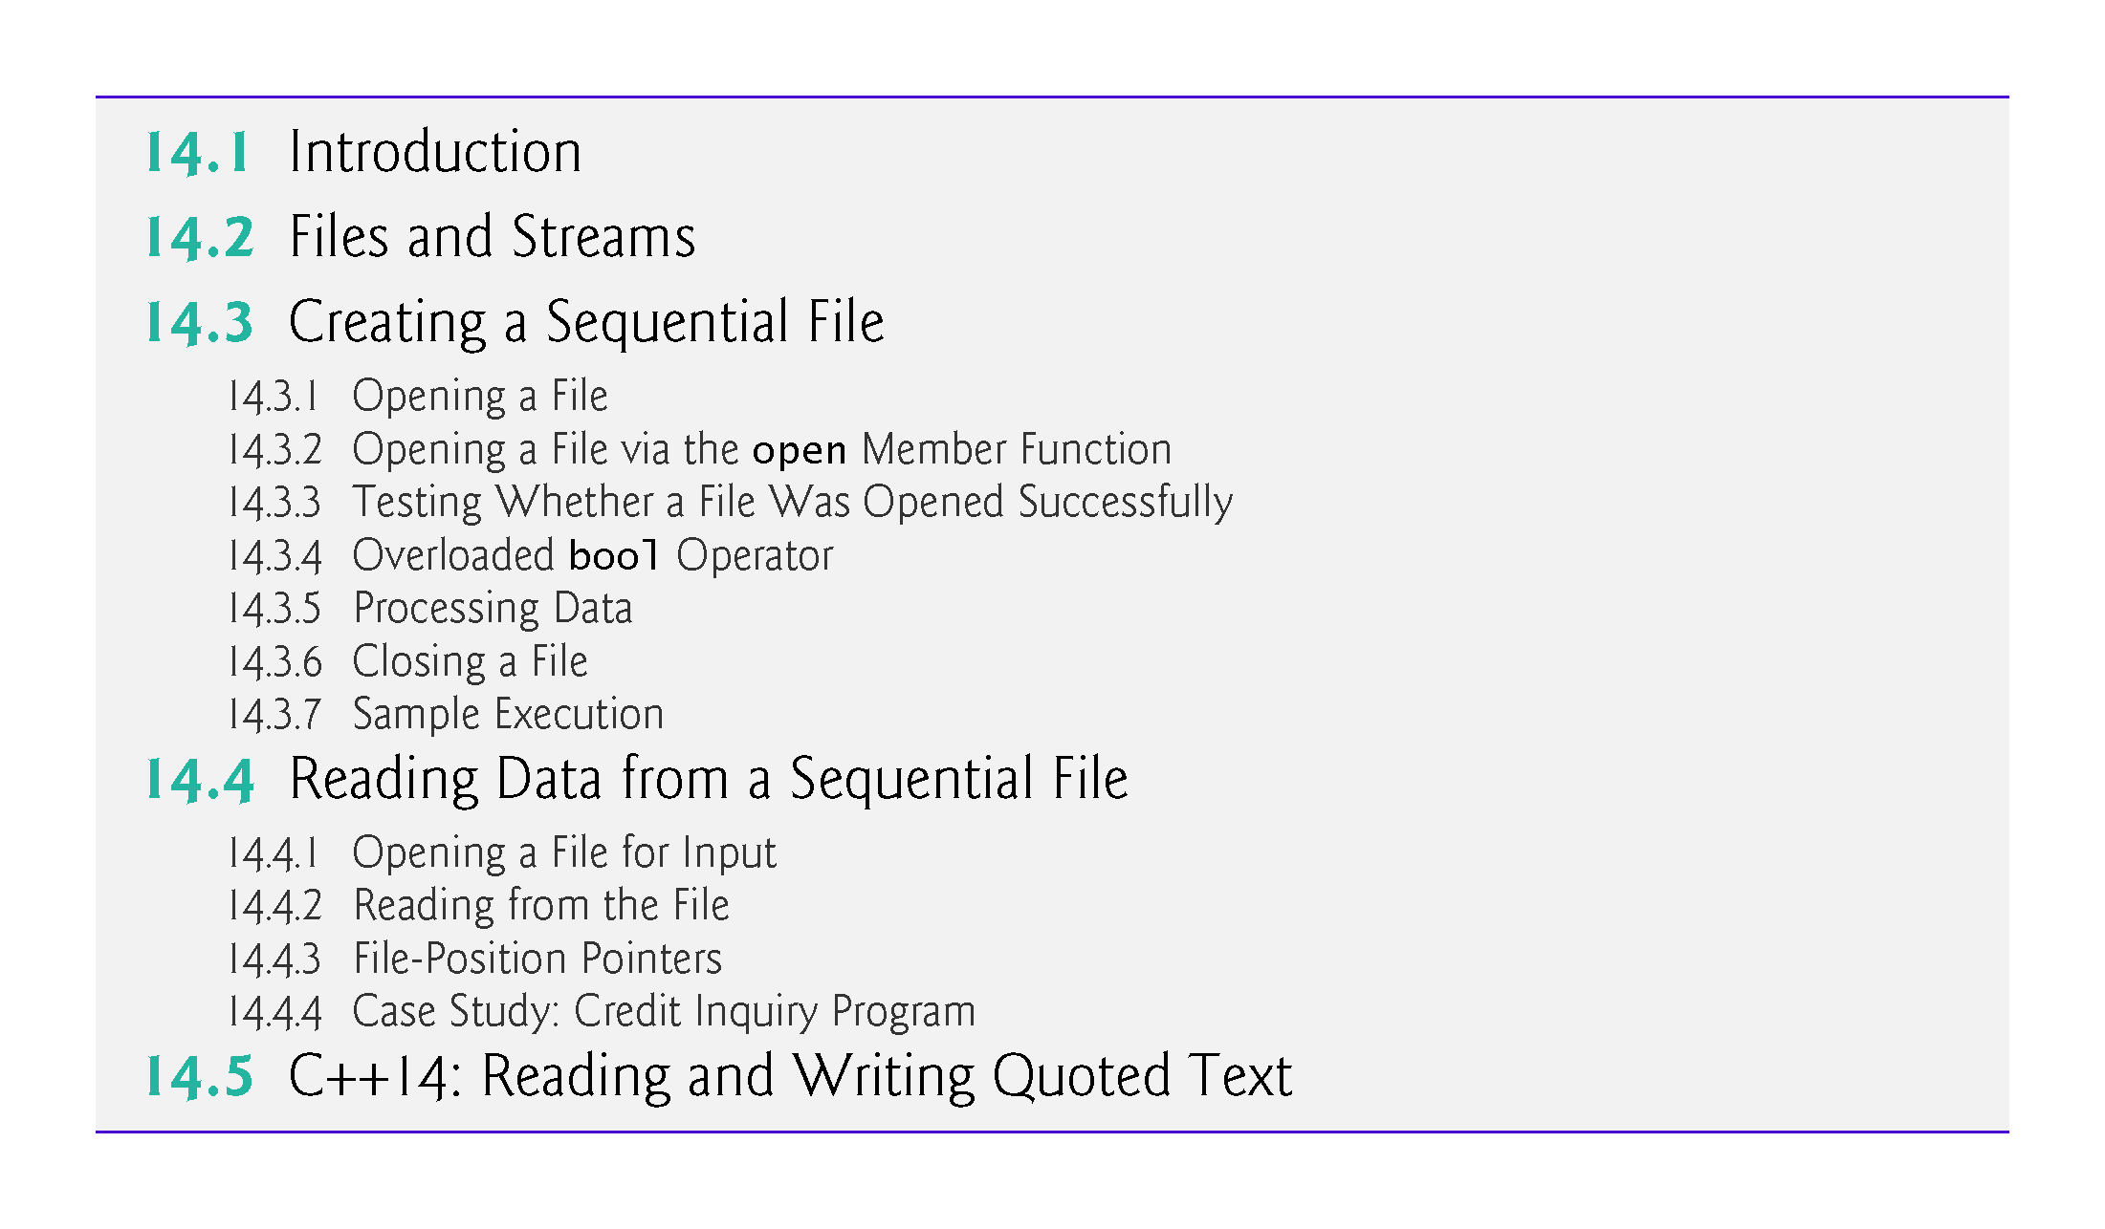

Slide 4
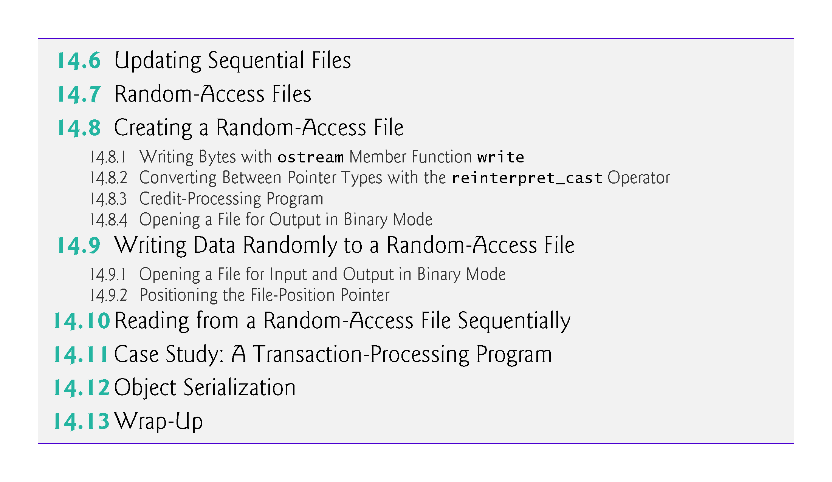

Slide 5
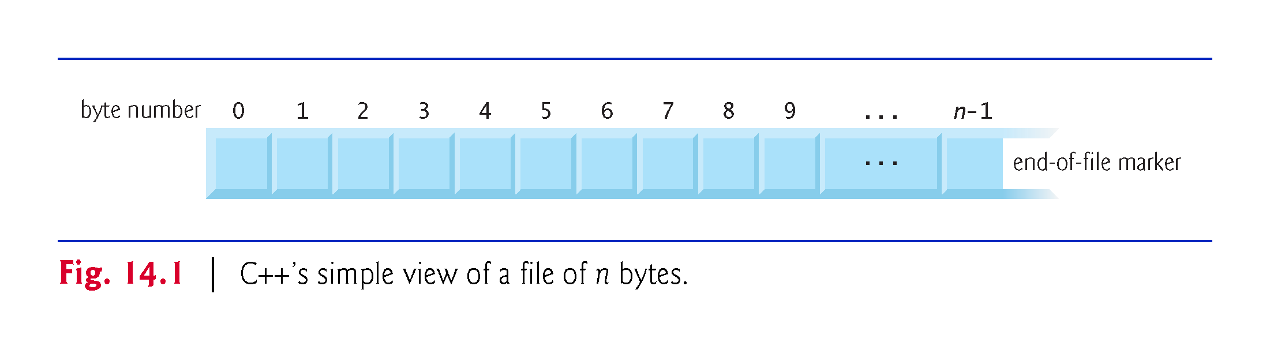

Slide 6
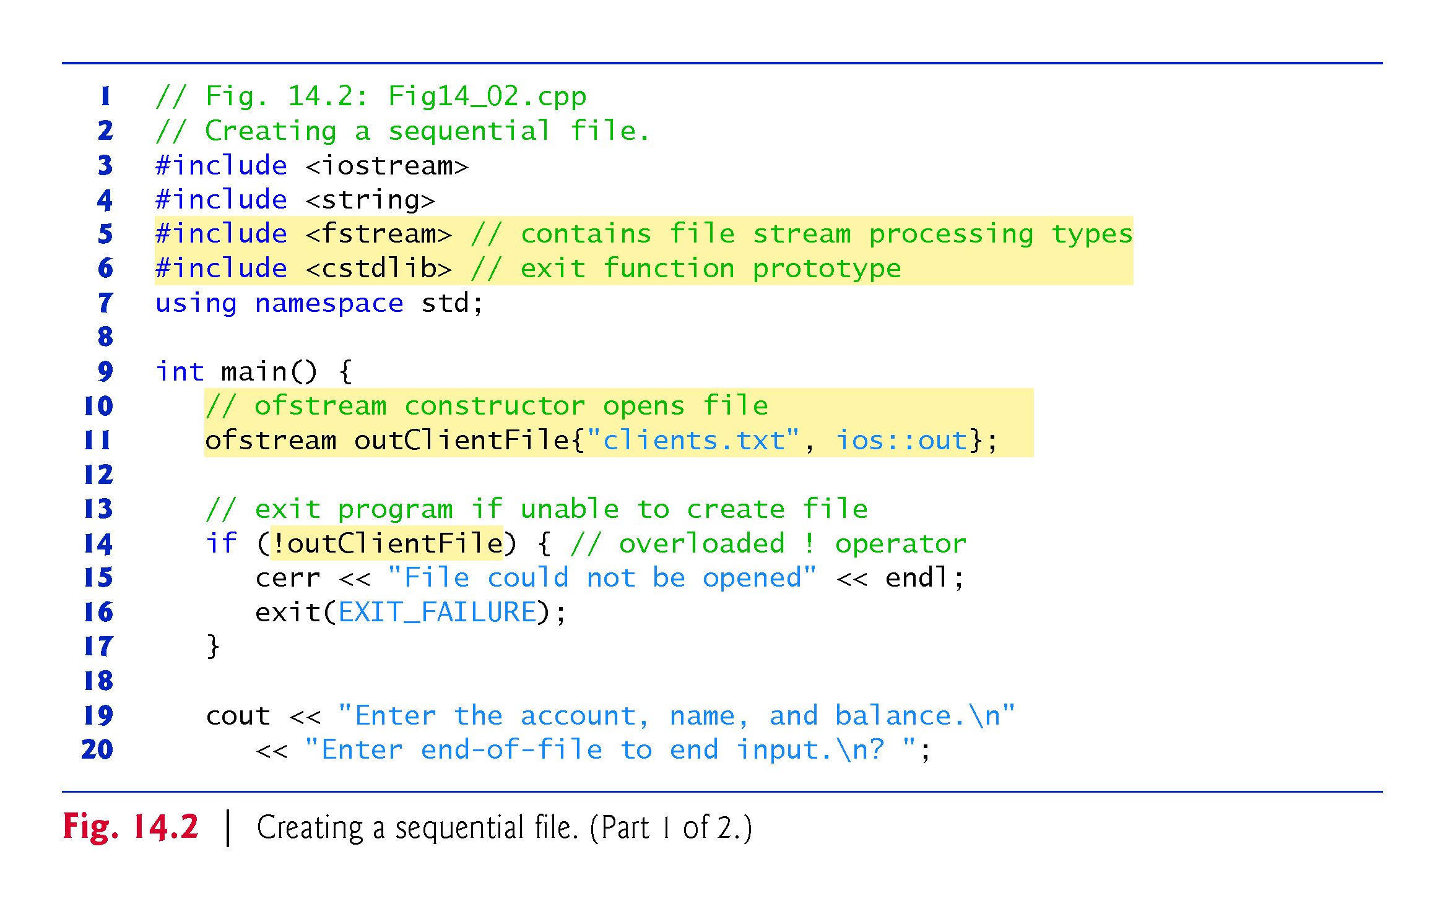
Notes:
Ob: ios::out file mode to output data to a file. Ios::app to append contents to a file. File will be opened in the current directory of the program. Existing files opened with ios::out have their contents discarded. If such files do not exist, they are created. Other available modes are
Ios::ate – open the file for output and move to the end of the file.
Ios::in – open the file for input
Ios::trunc – discard the contents of the file
Ios:binary – open the file for binary io – nontextual io

Slide 7
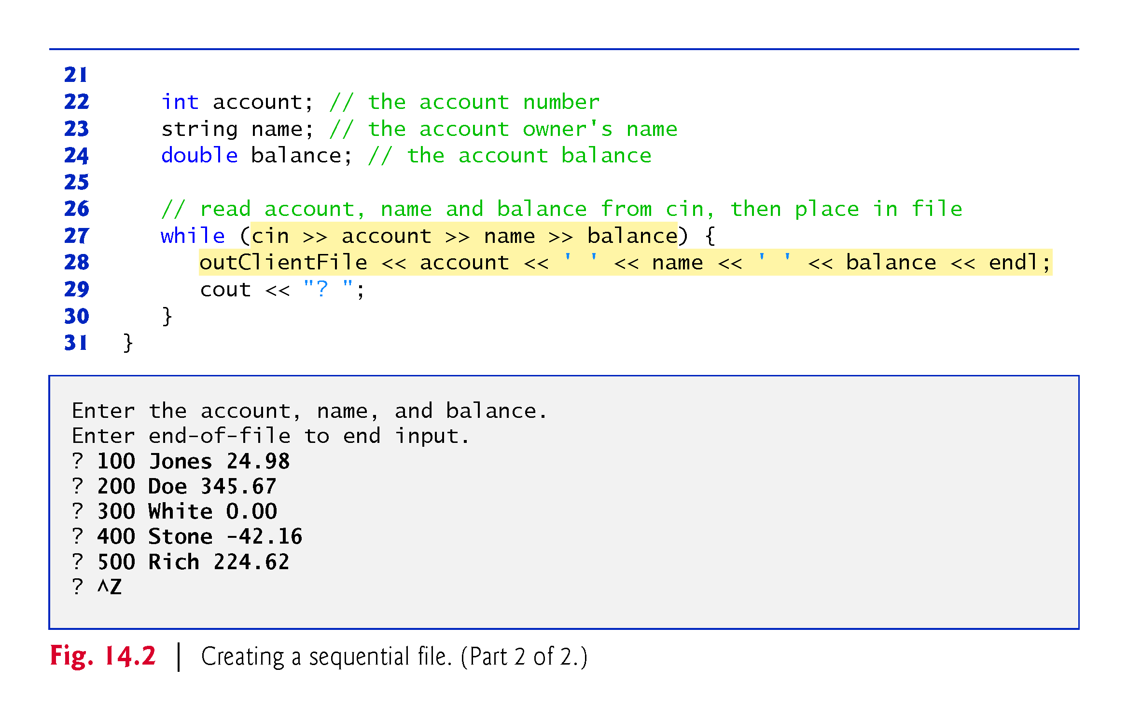

Slide 8
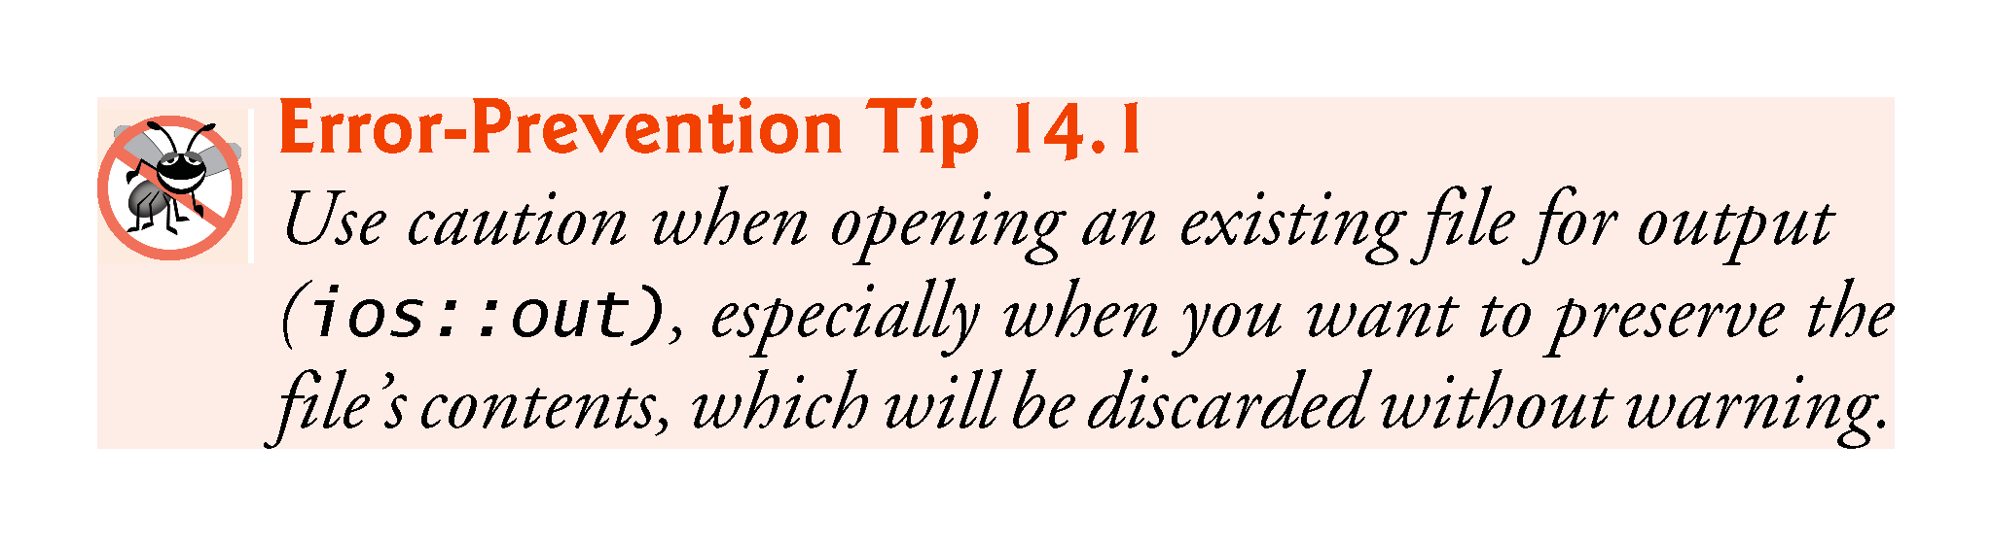

Slide 9
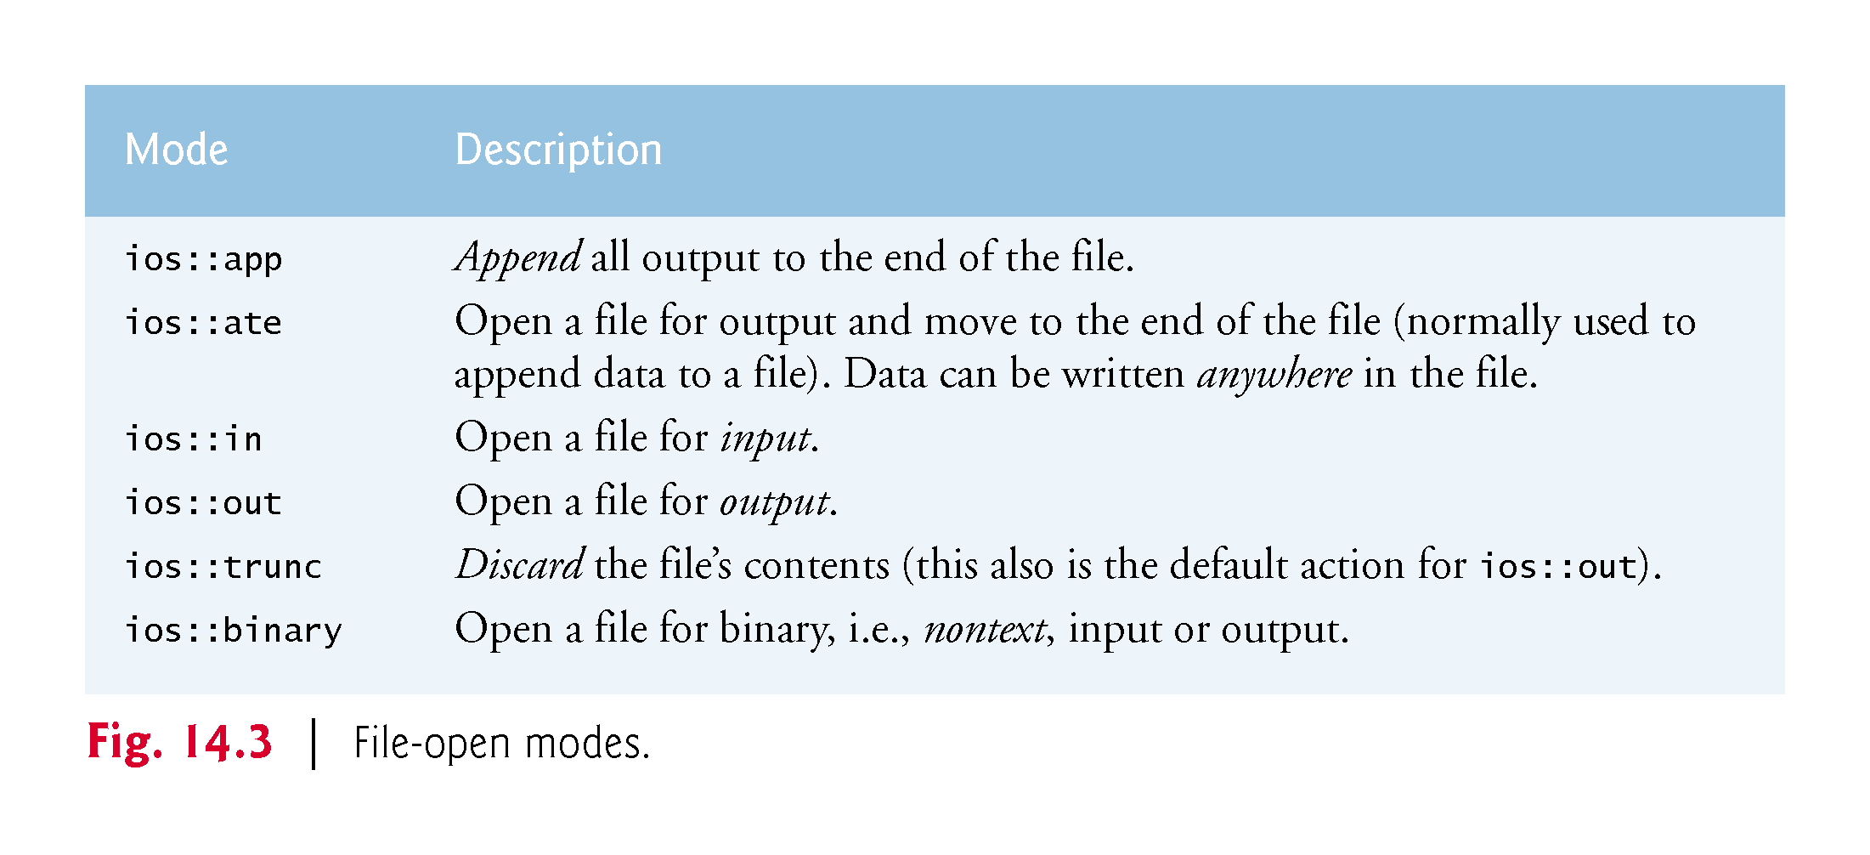

Slide 10
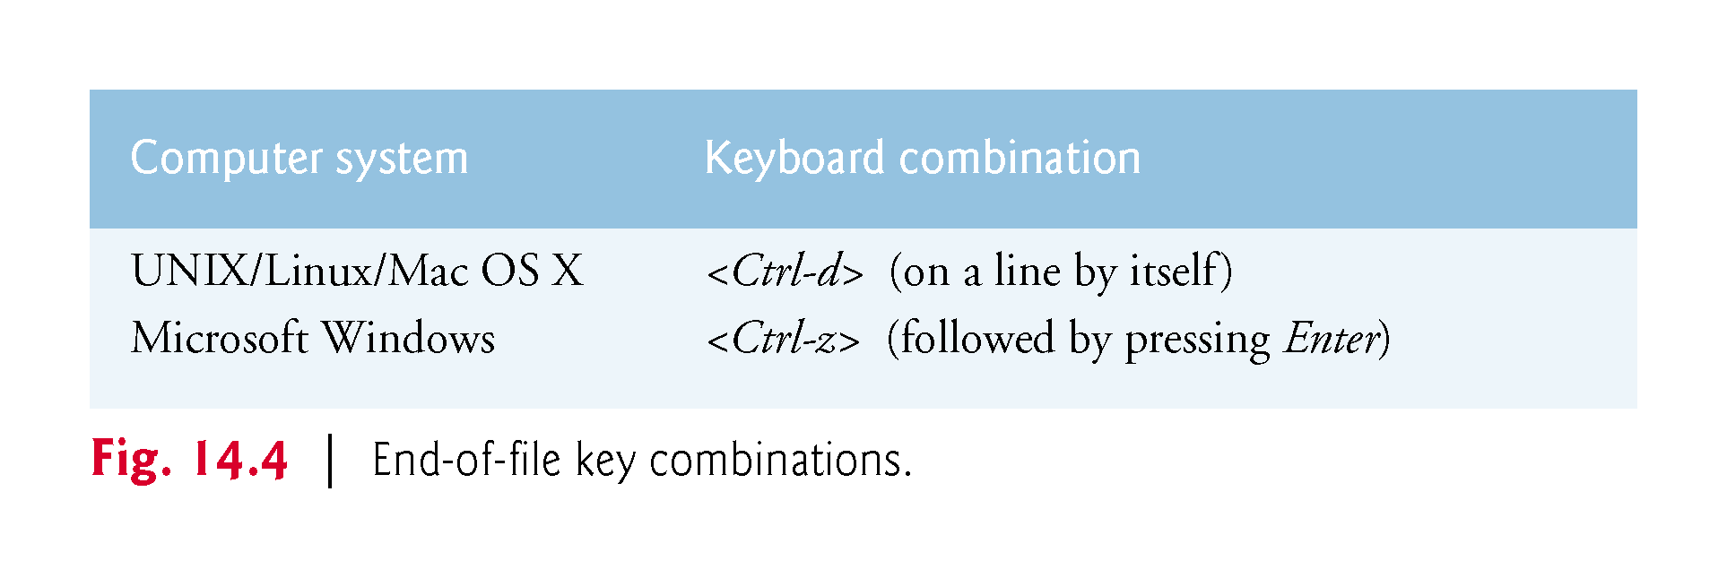

Slide 11


Slide 12
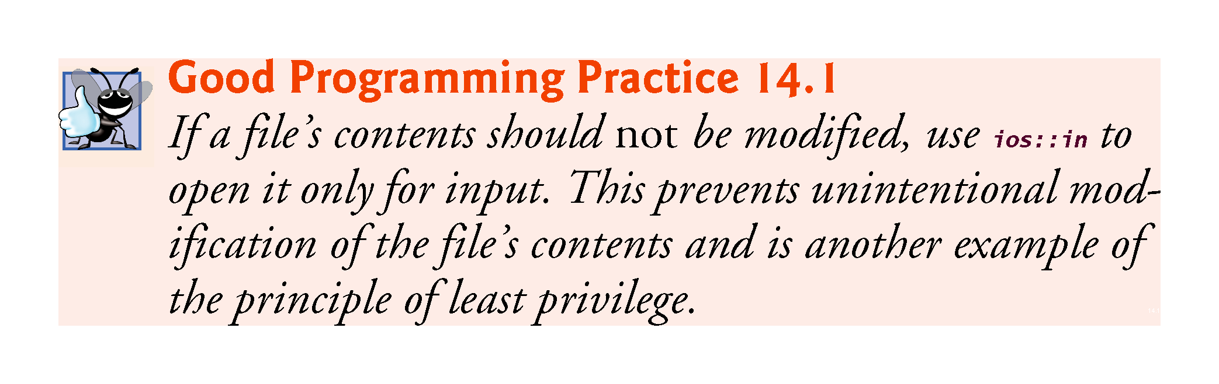

Slide 13
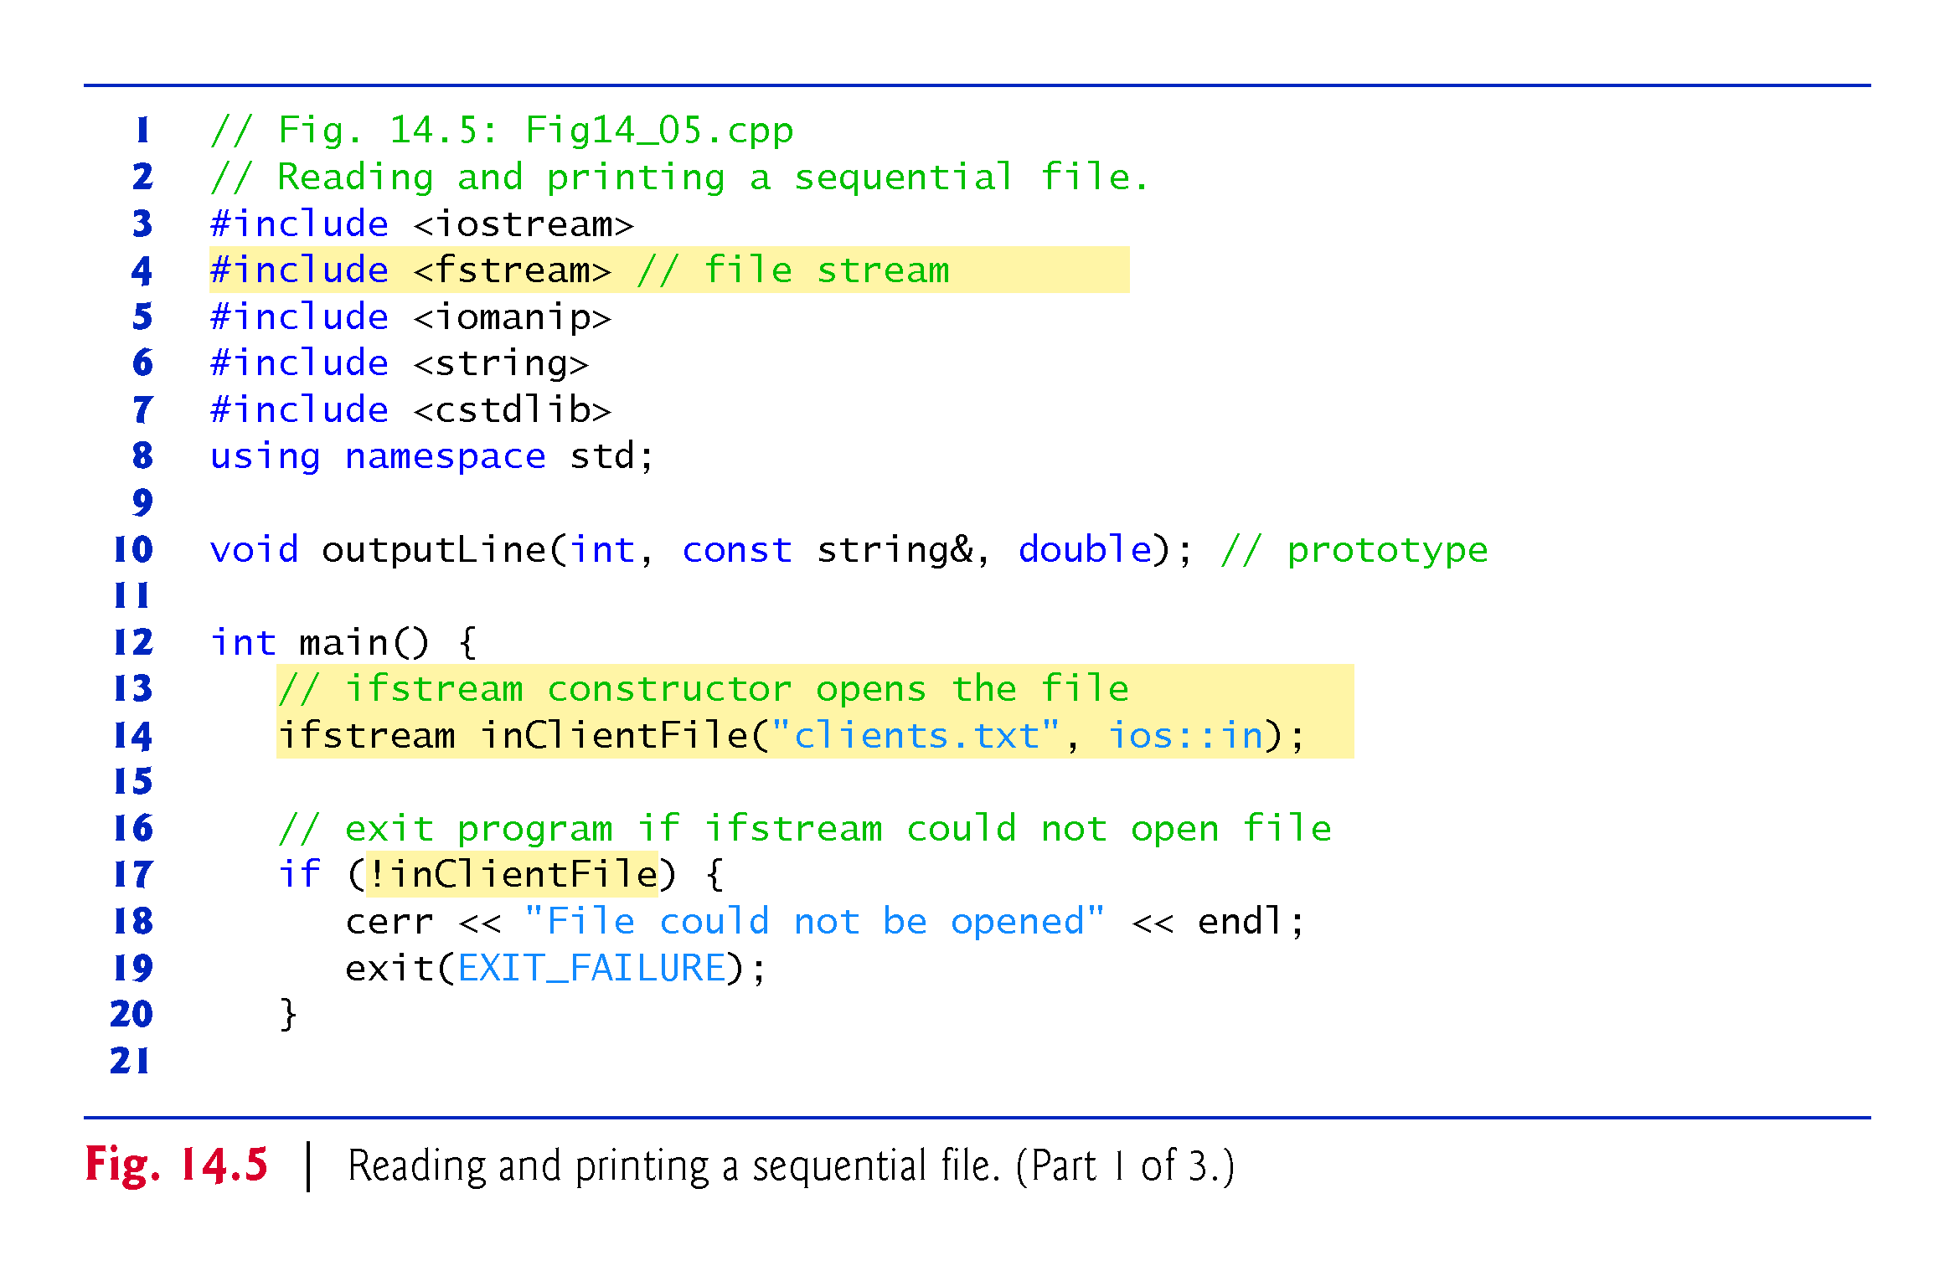

Slide 14
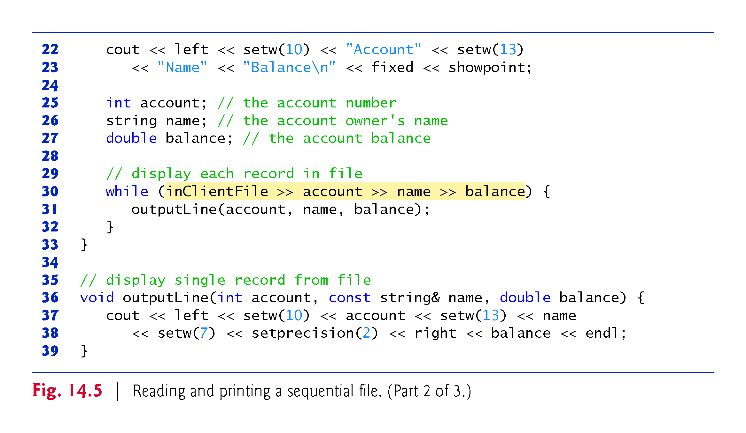

Slide 15
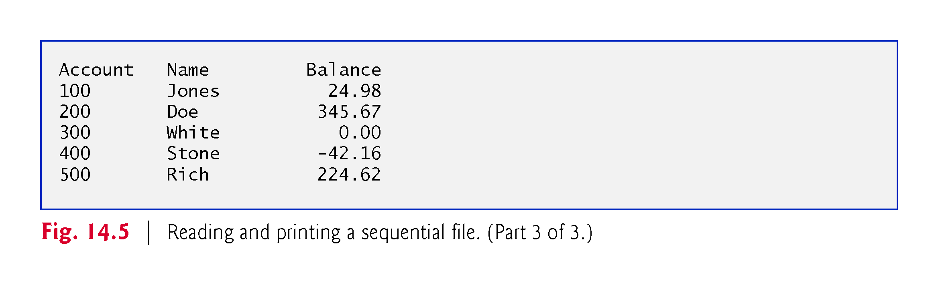
Notes:
Ob: some useful ios::seekg and ios::seekp flags. Seekg is associated with the file input poiner, seekp with the output file pointer. Seek directions – ios::beg is beginning of file, ios::cur is current position in the file, ios::end is the end of file. So fileObject.seekg(n), positions the file pointer at the nth byte of the fileObject assuming ios;:beg has been set. fileObject.seek(n, ios::curr) positions the file pointer n bytes from the current byte location in the file, fileObject.seekg(n,ios::end) positions the file pointer n bytes from the end of the file, fileObjectseekg(0, ios::end) positions file pointer at the end of the file. Similar operations can be performed via the seekp flags. The positions of get and put pointers can be found by using tellg and tellp functions.

Slide 16
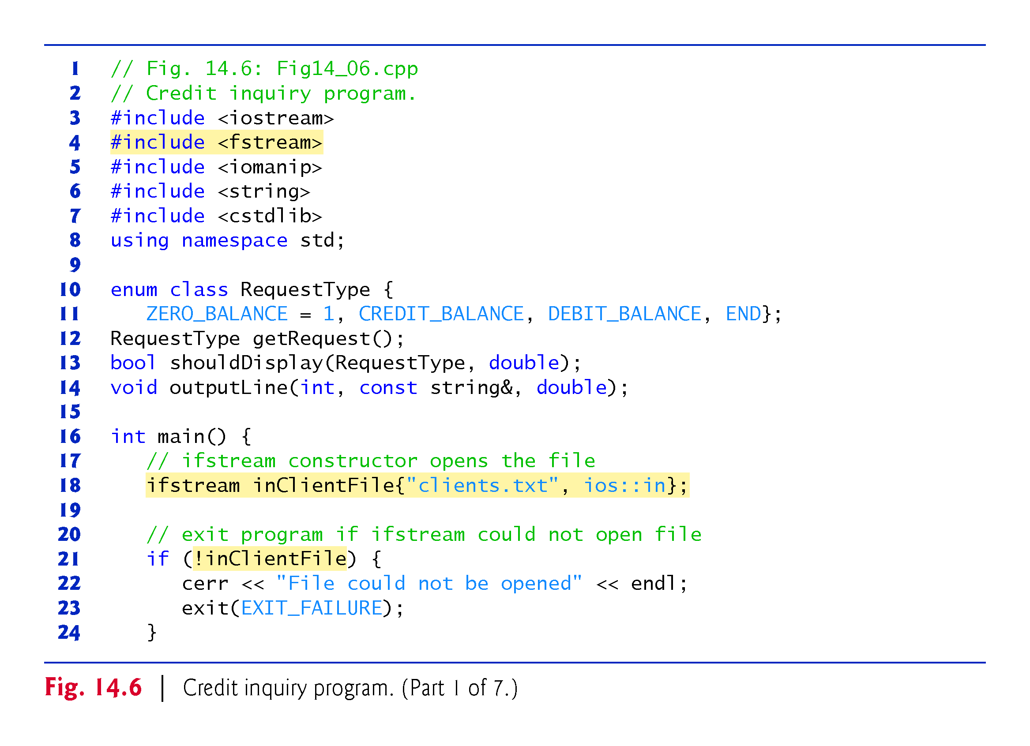

Slide 17
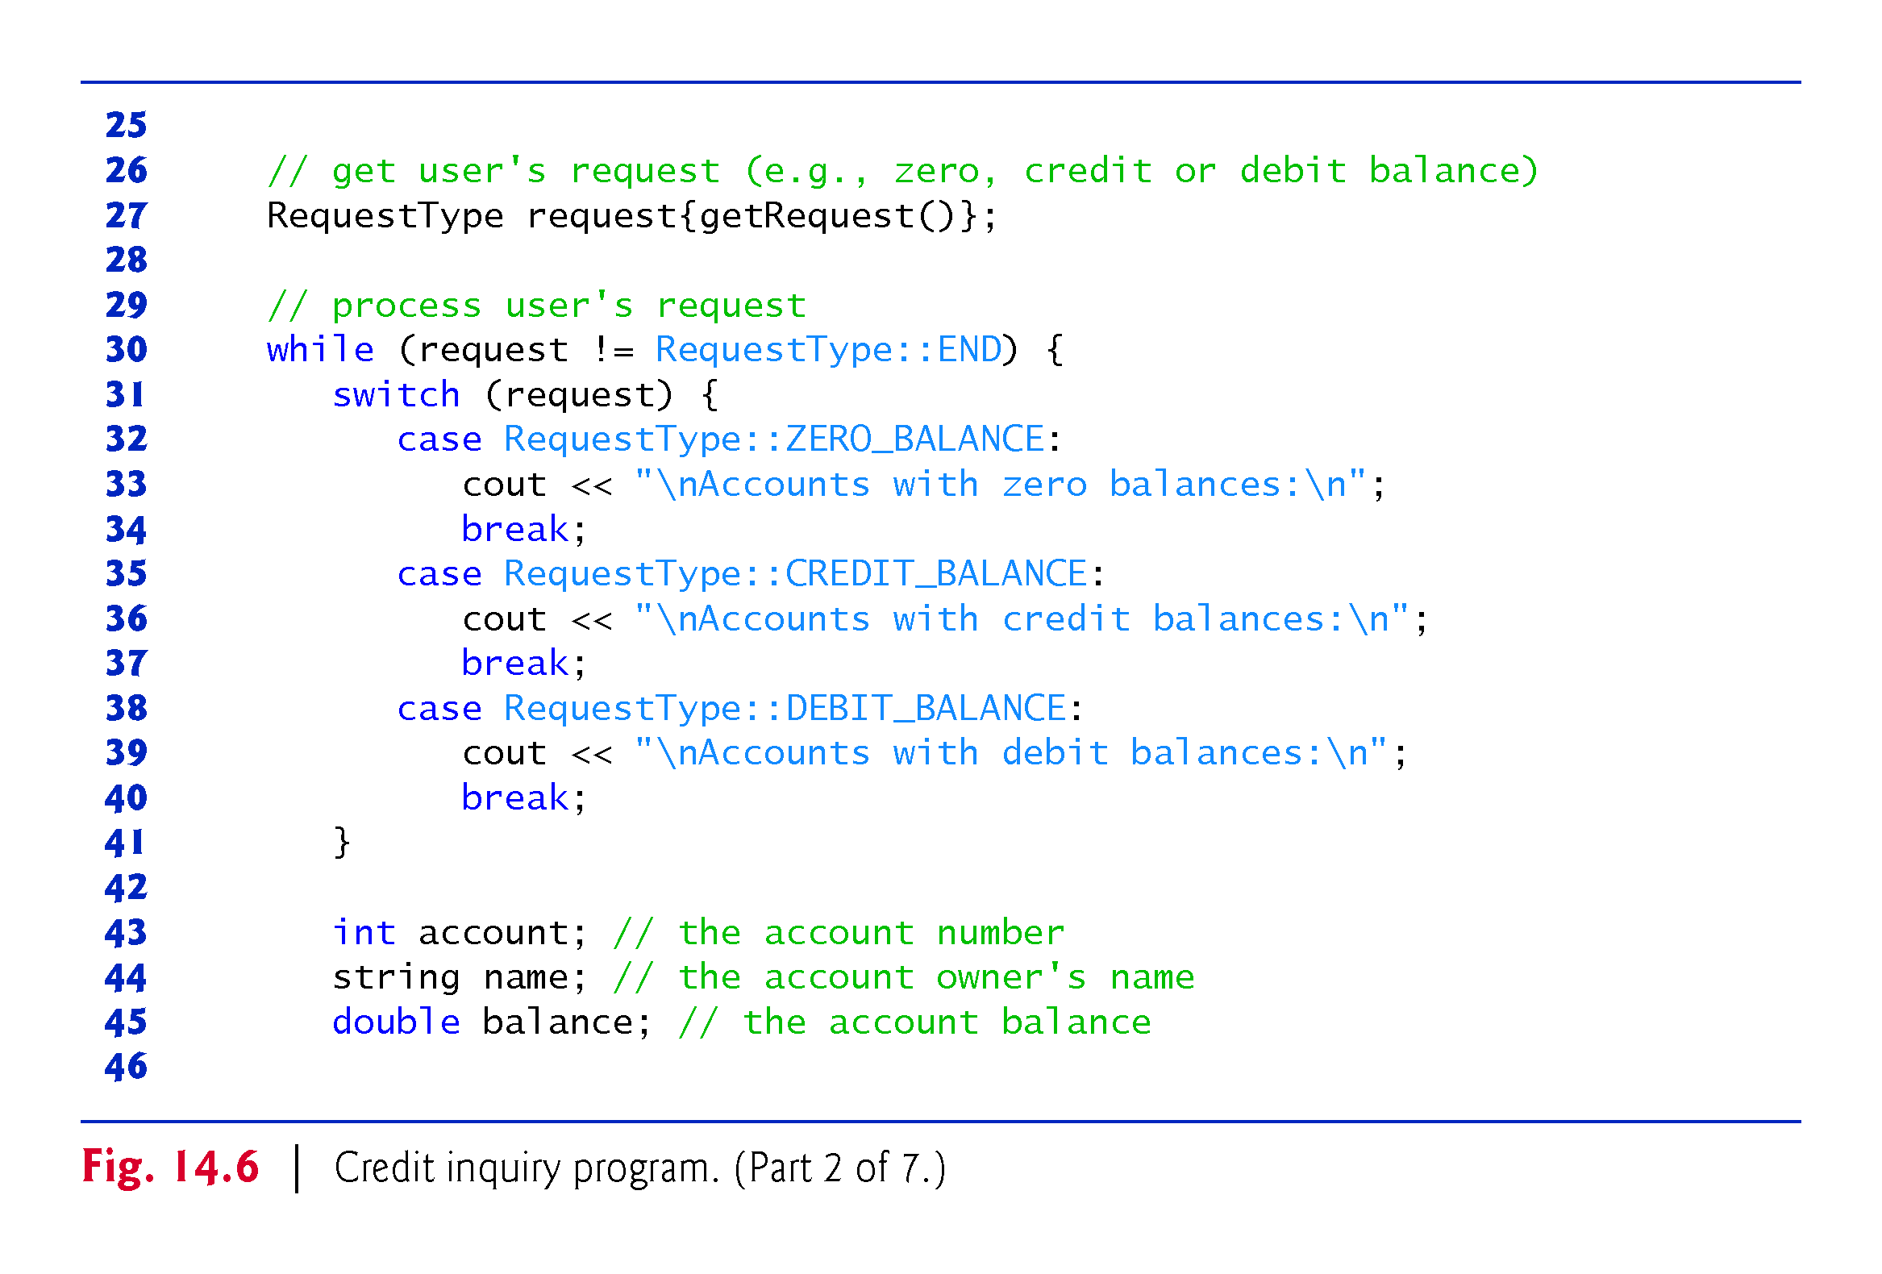

Slide 18
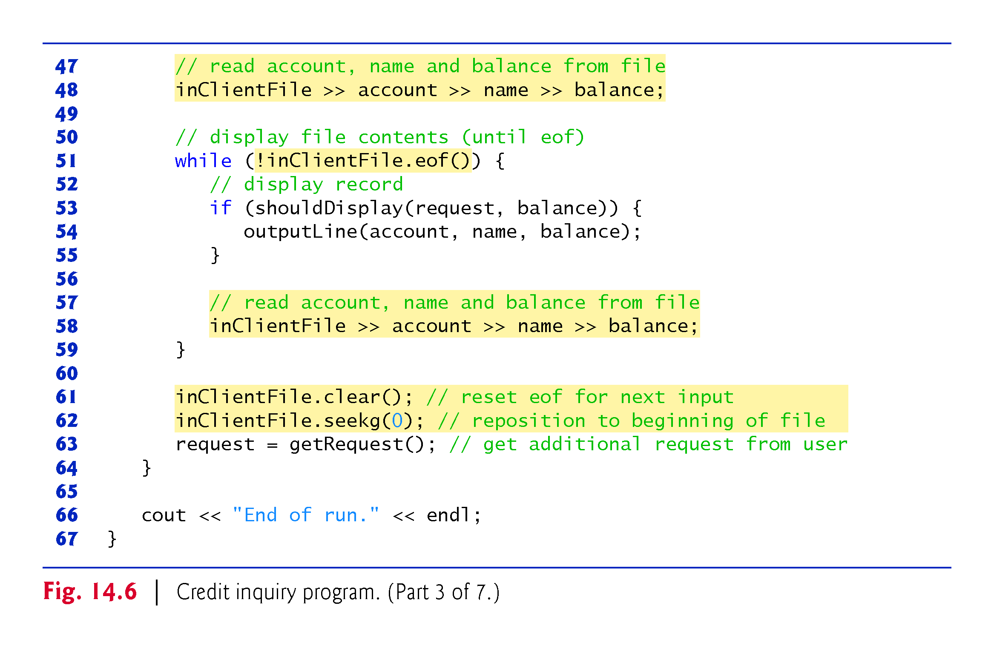

Slide 19
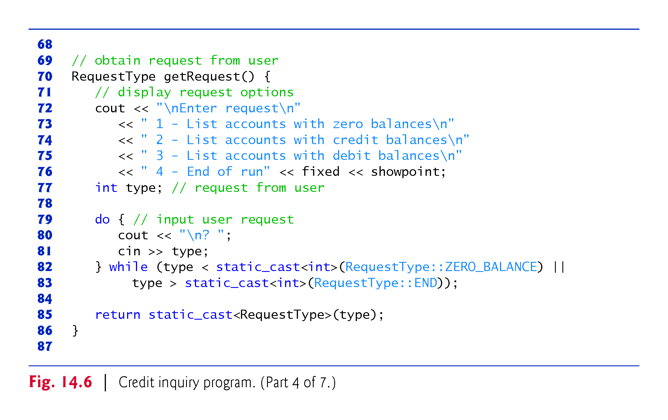

Slide 20
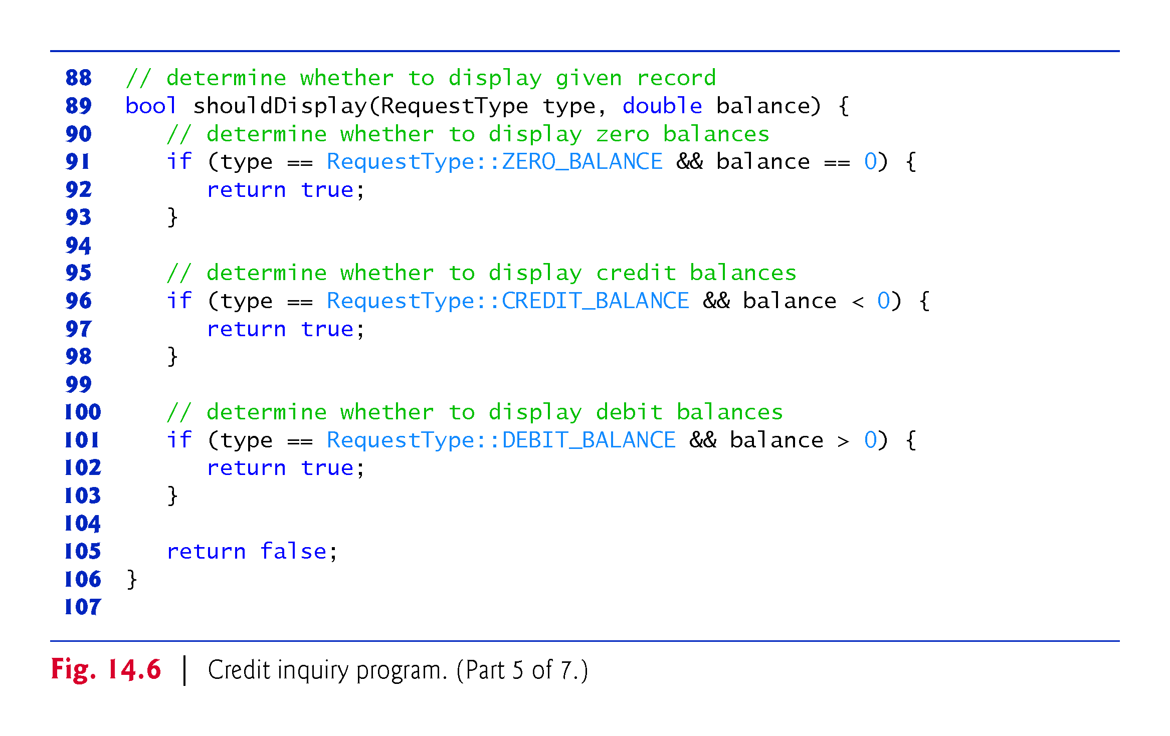

Slide 21
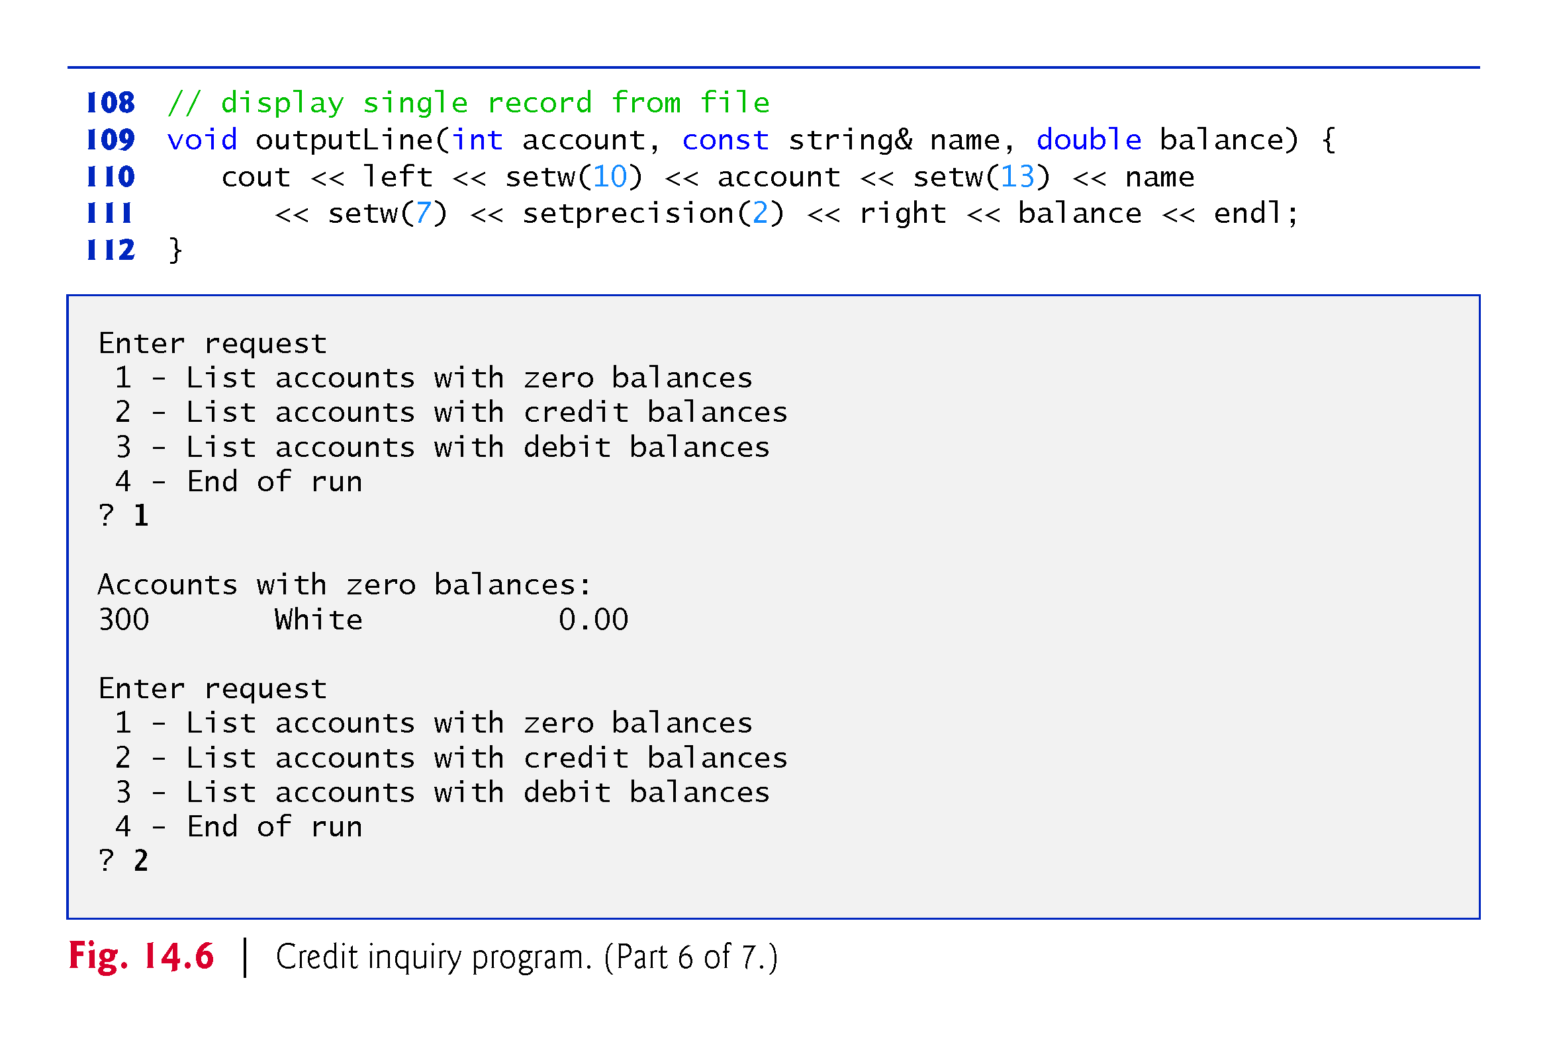

Slide 22
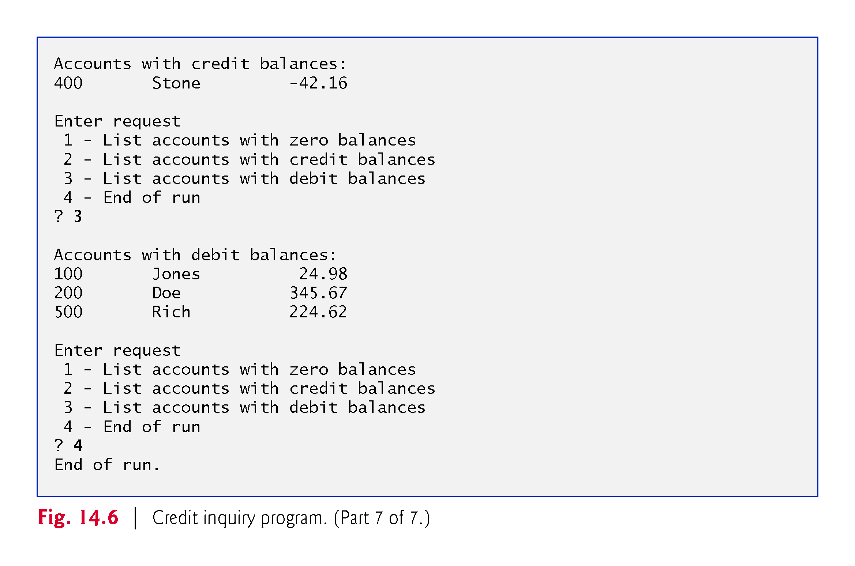
Notes:
Ob: To read or write text such as “John Smith” in the variable name from a file, you need to use the stream manipulator quoted(name). Quoted manipulator is in <iomanip>.

Slide 23
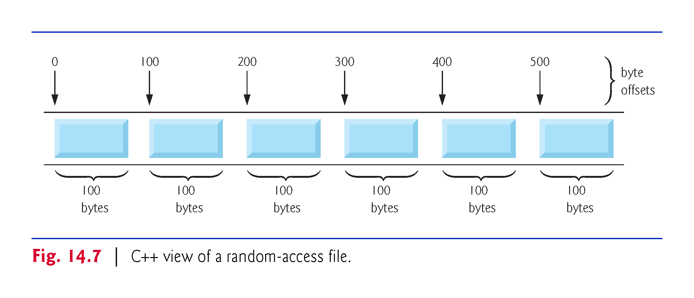
Notes:
Ob: outFile.write(reinterpret_cast<const char*>(&number), size of(number))

Slide 24
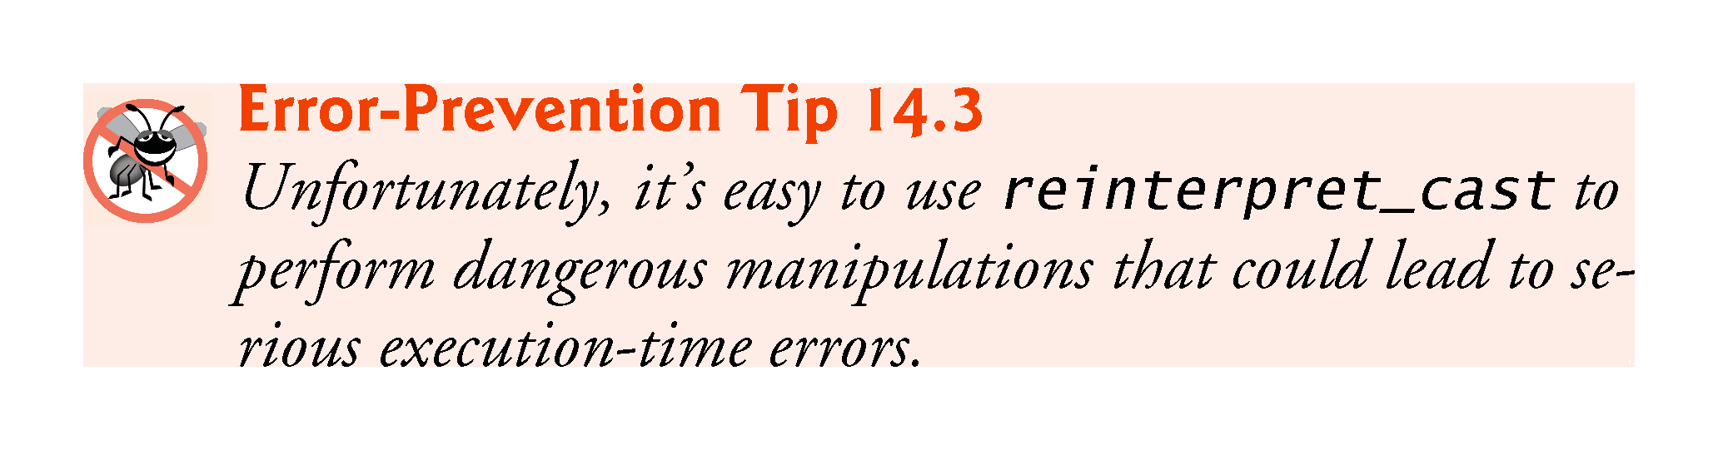

Slide 25
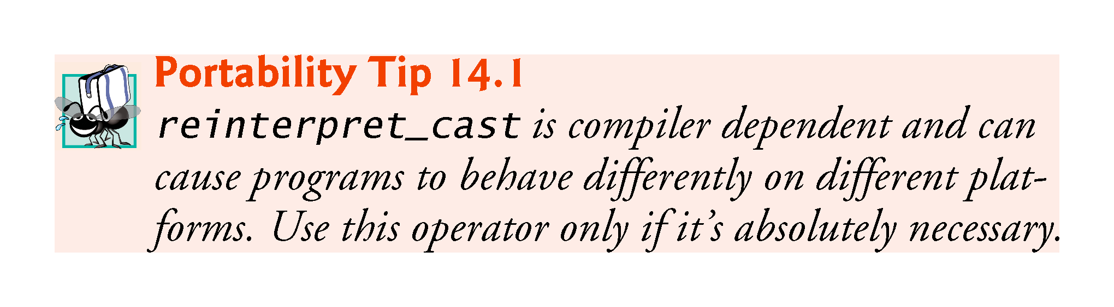

Slide 26
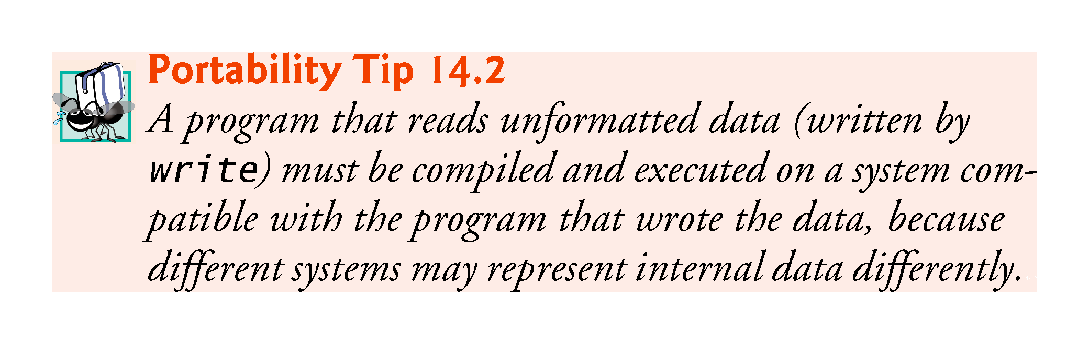

Slide 27
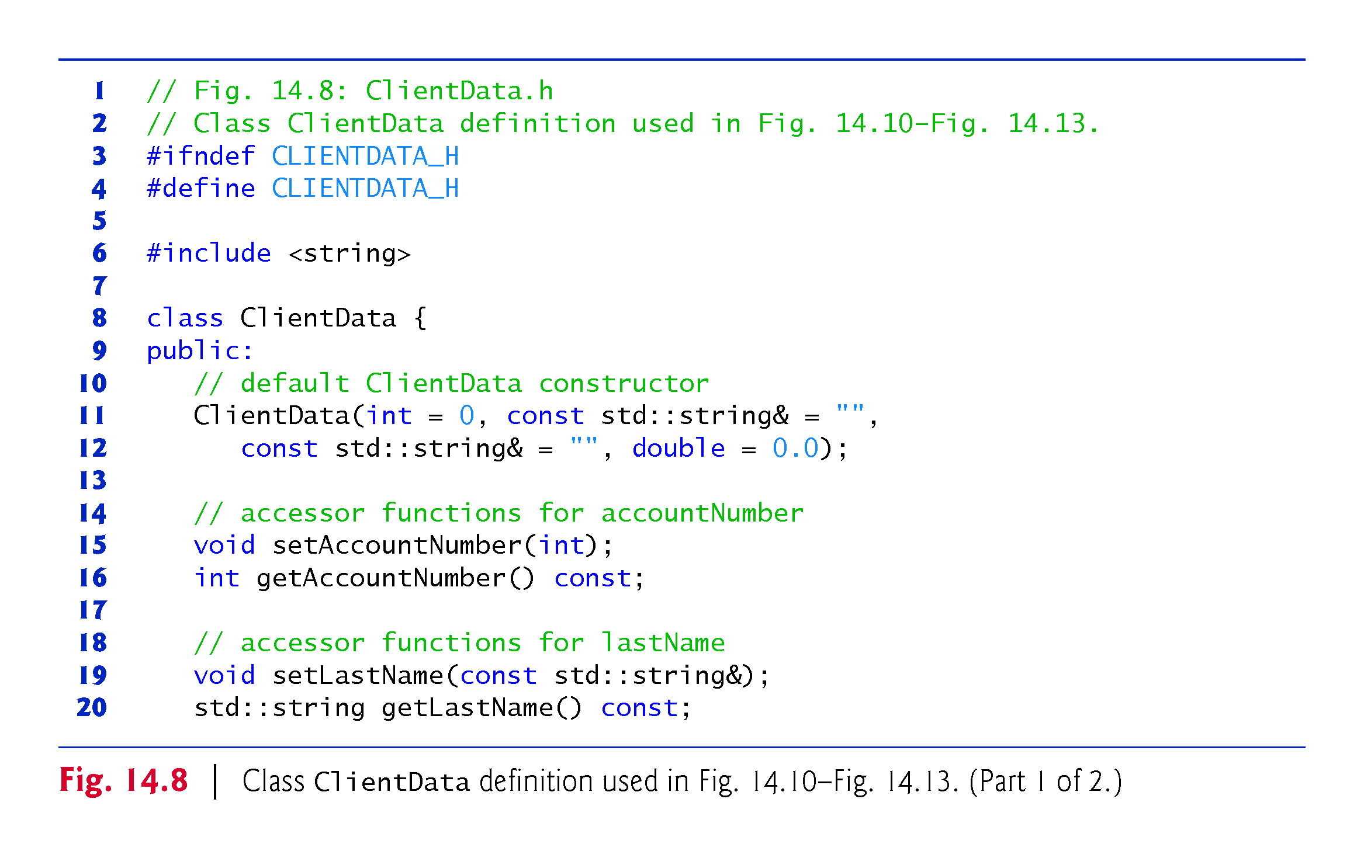

Slide 28
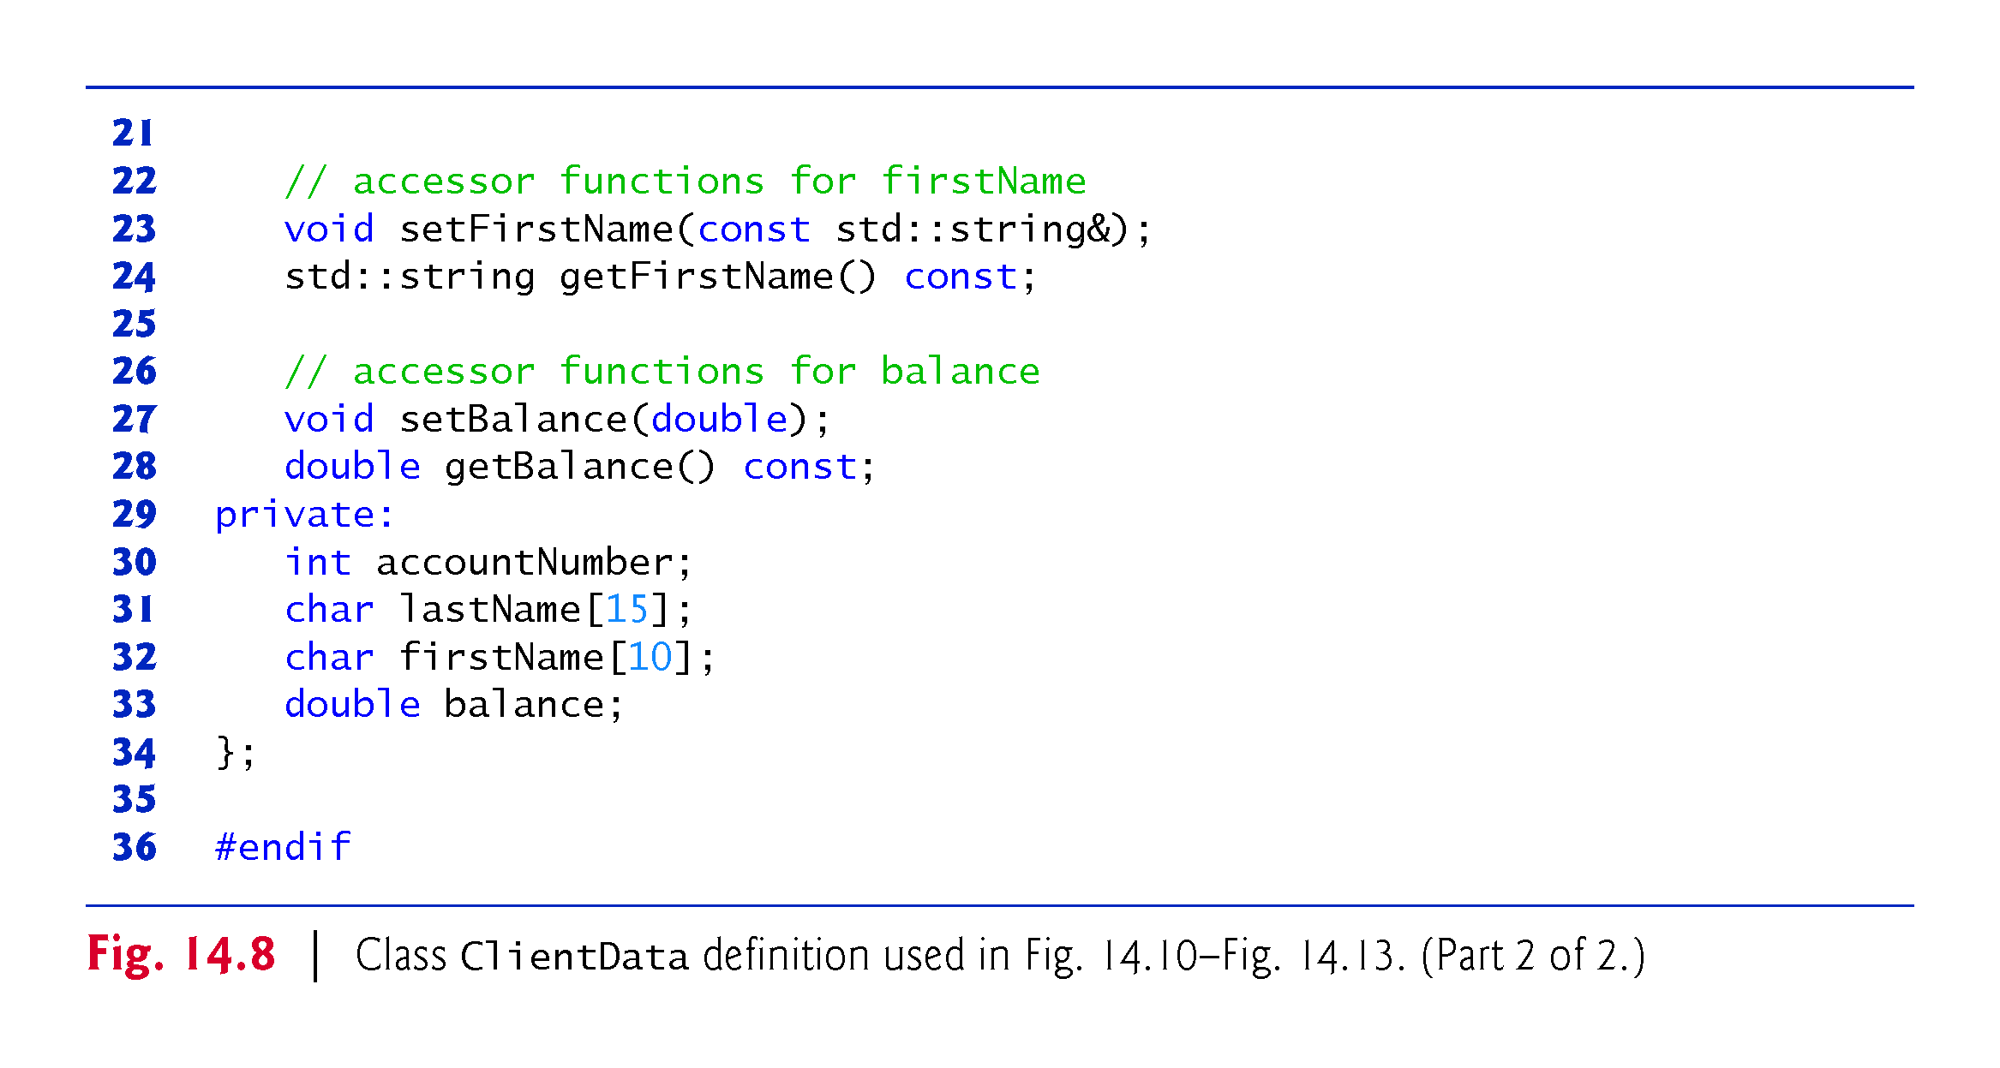

Slide 29
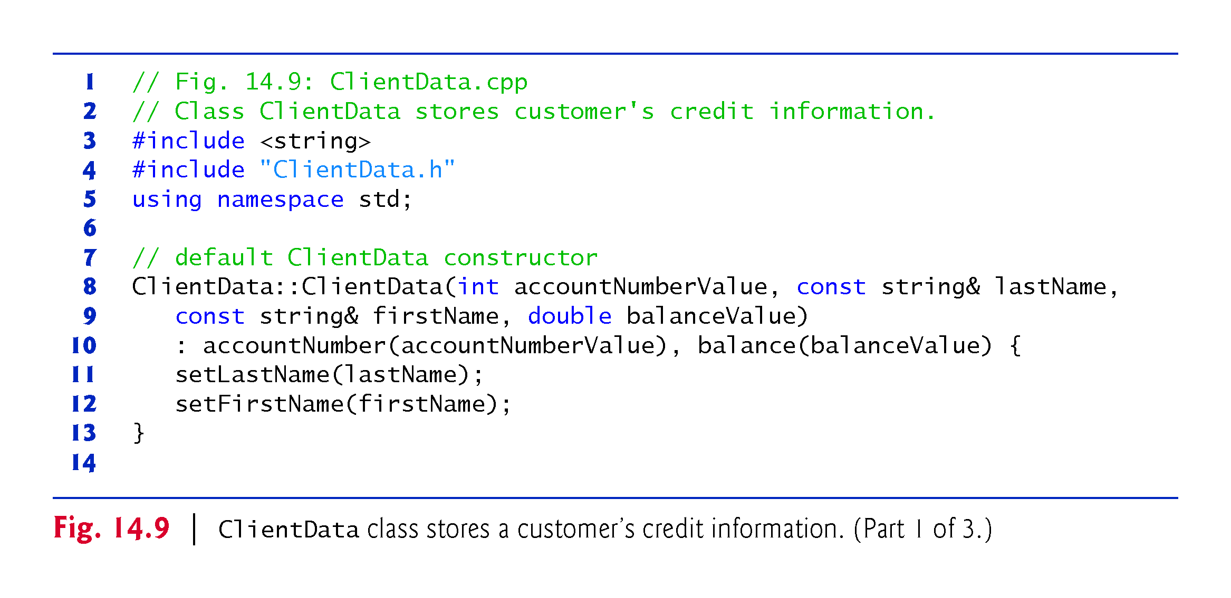

Slide 30
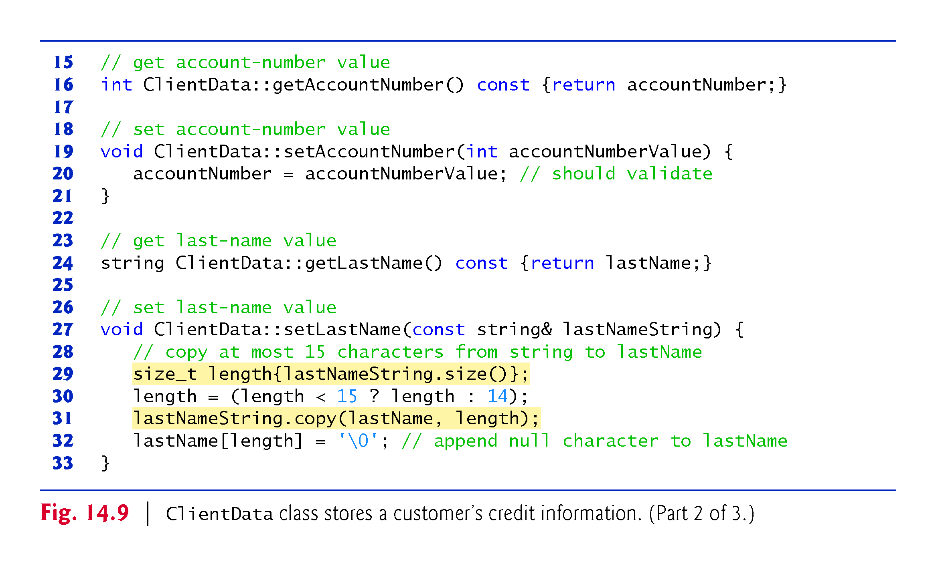
Notes:
Ob: The length is 15 characters from the private data member in slide 28

Slide 31
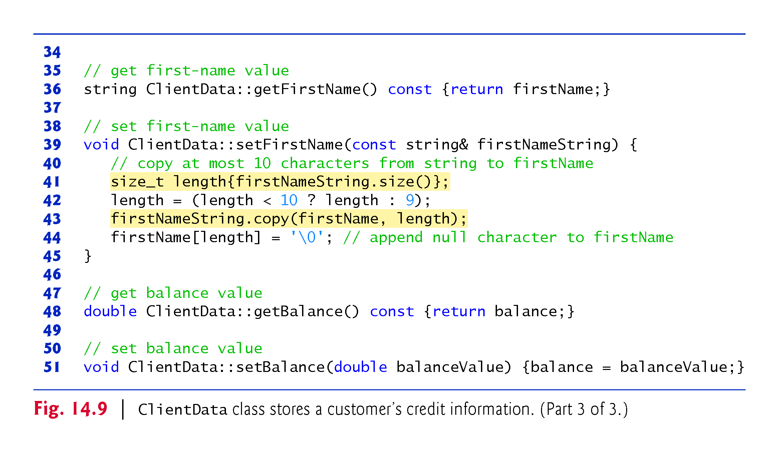
Notes:
Ob: As before look at slide 28

Slide 32
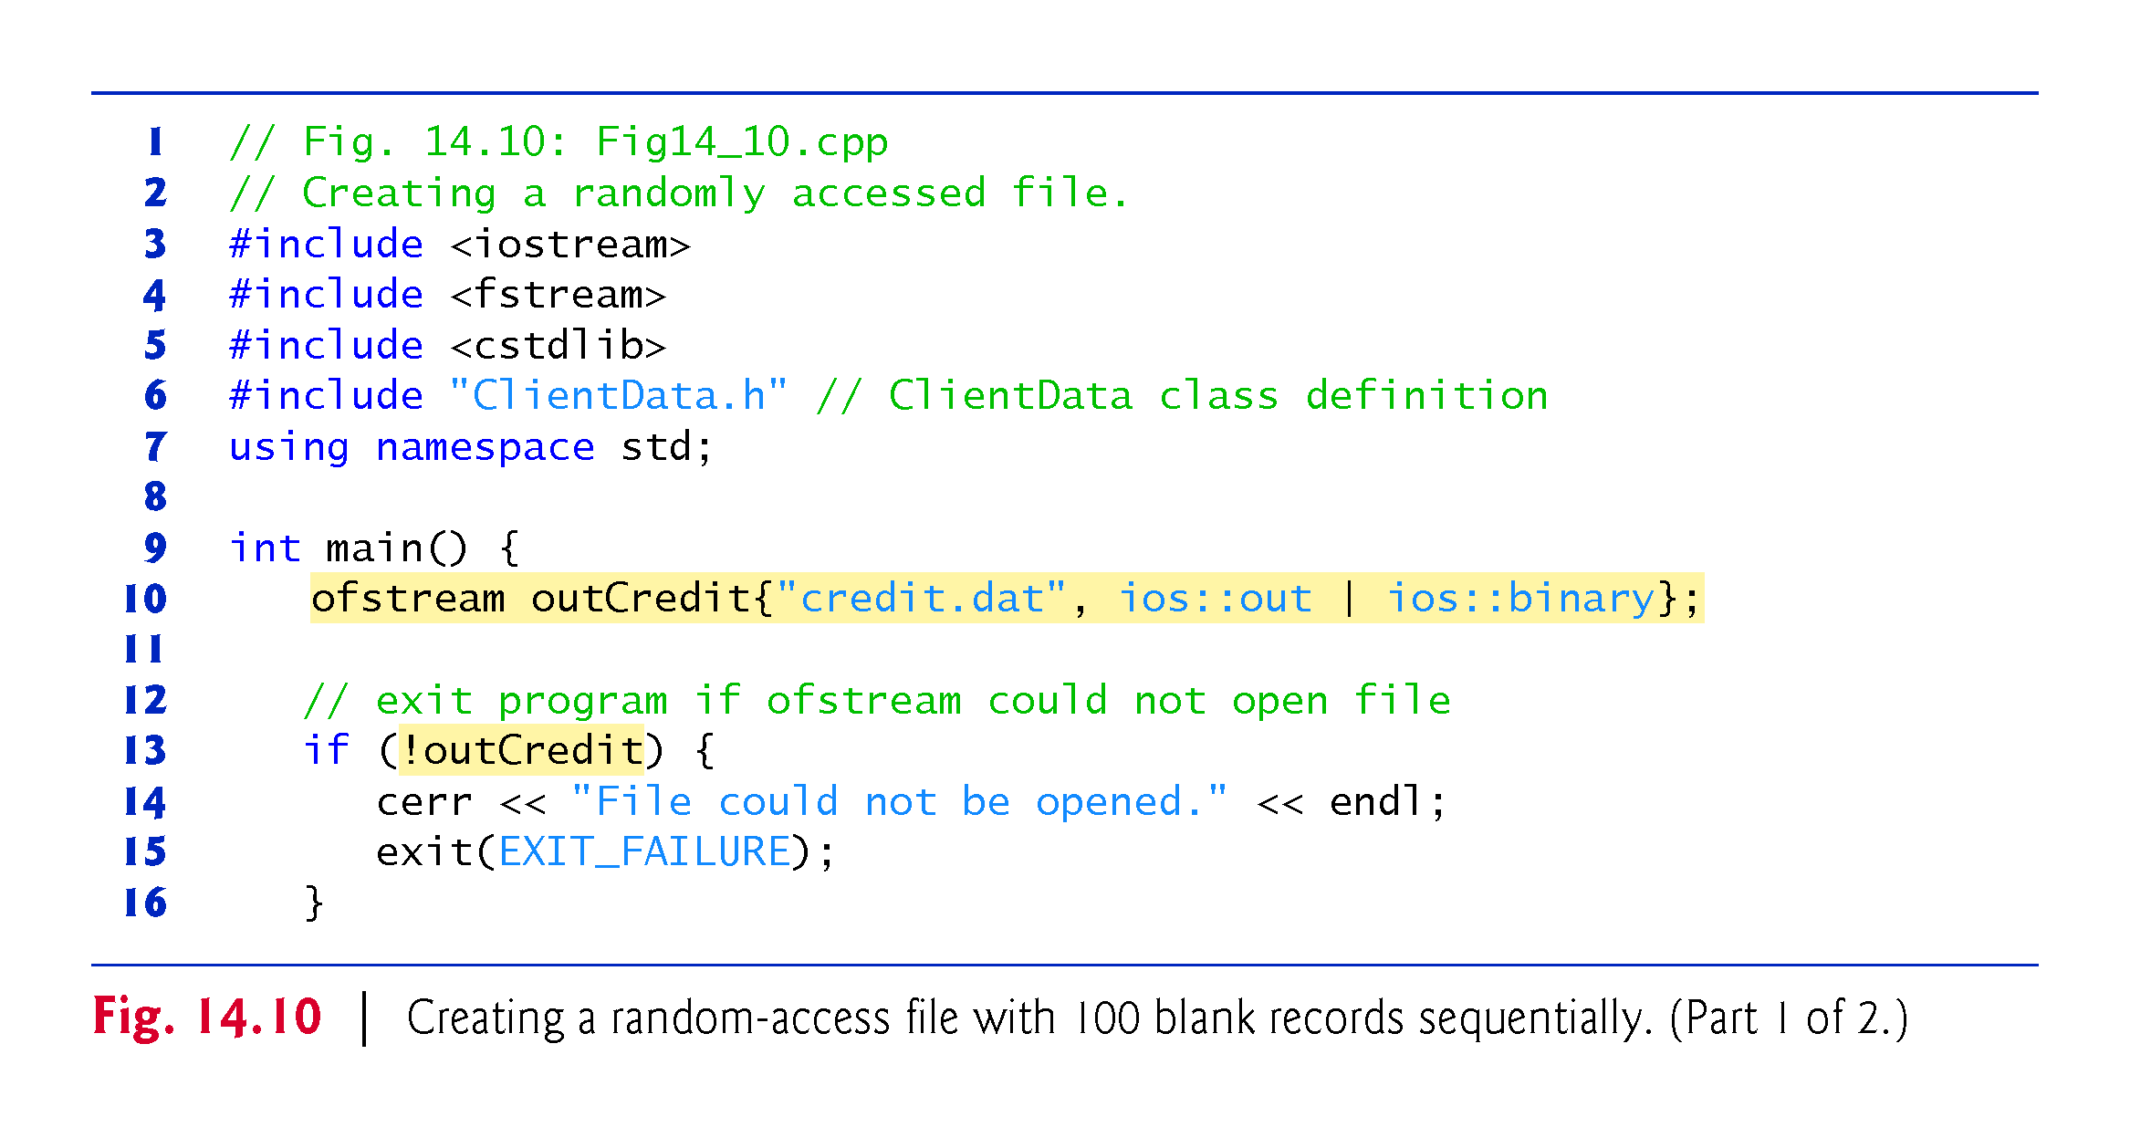
Notes:
Ob: The exit function is defined in <cstdlib>

Slide 33
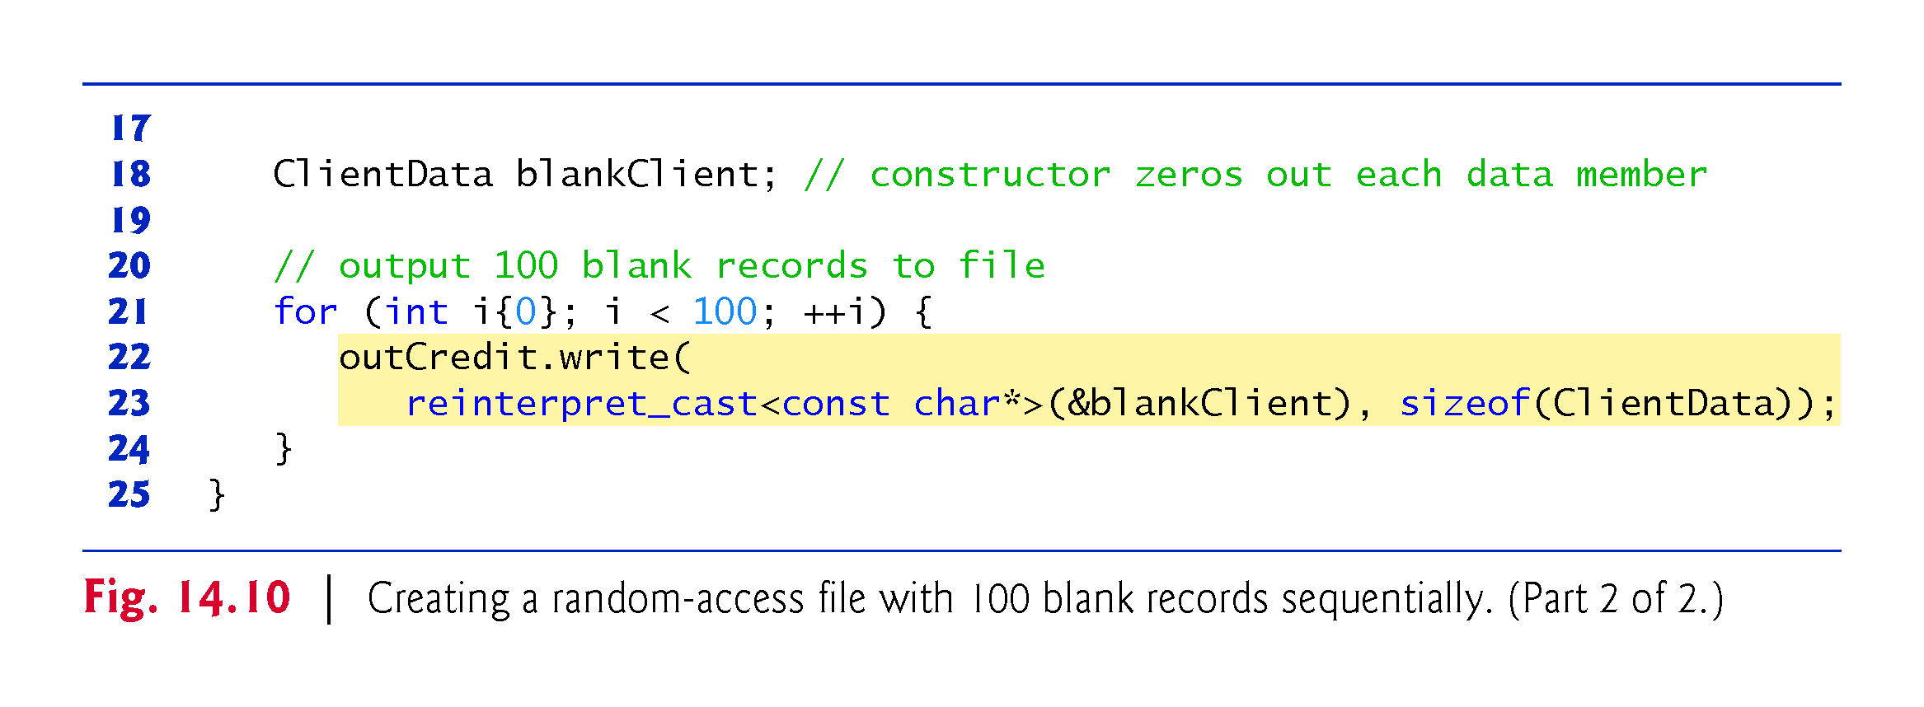

Slide 34
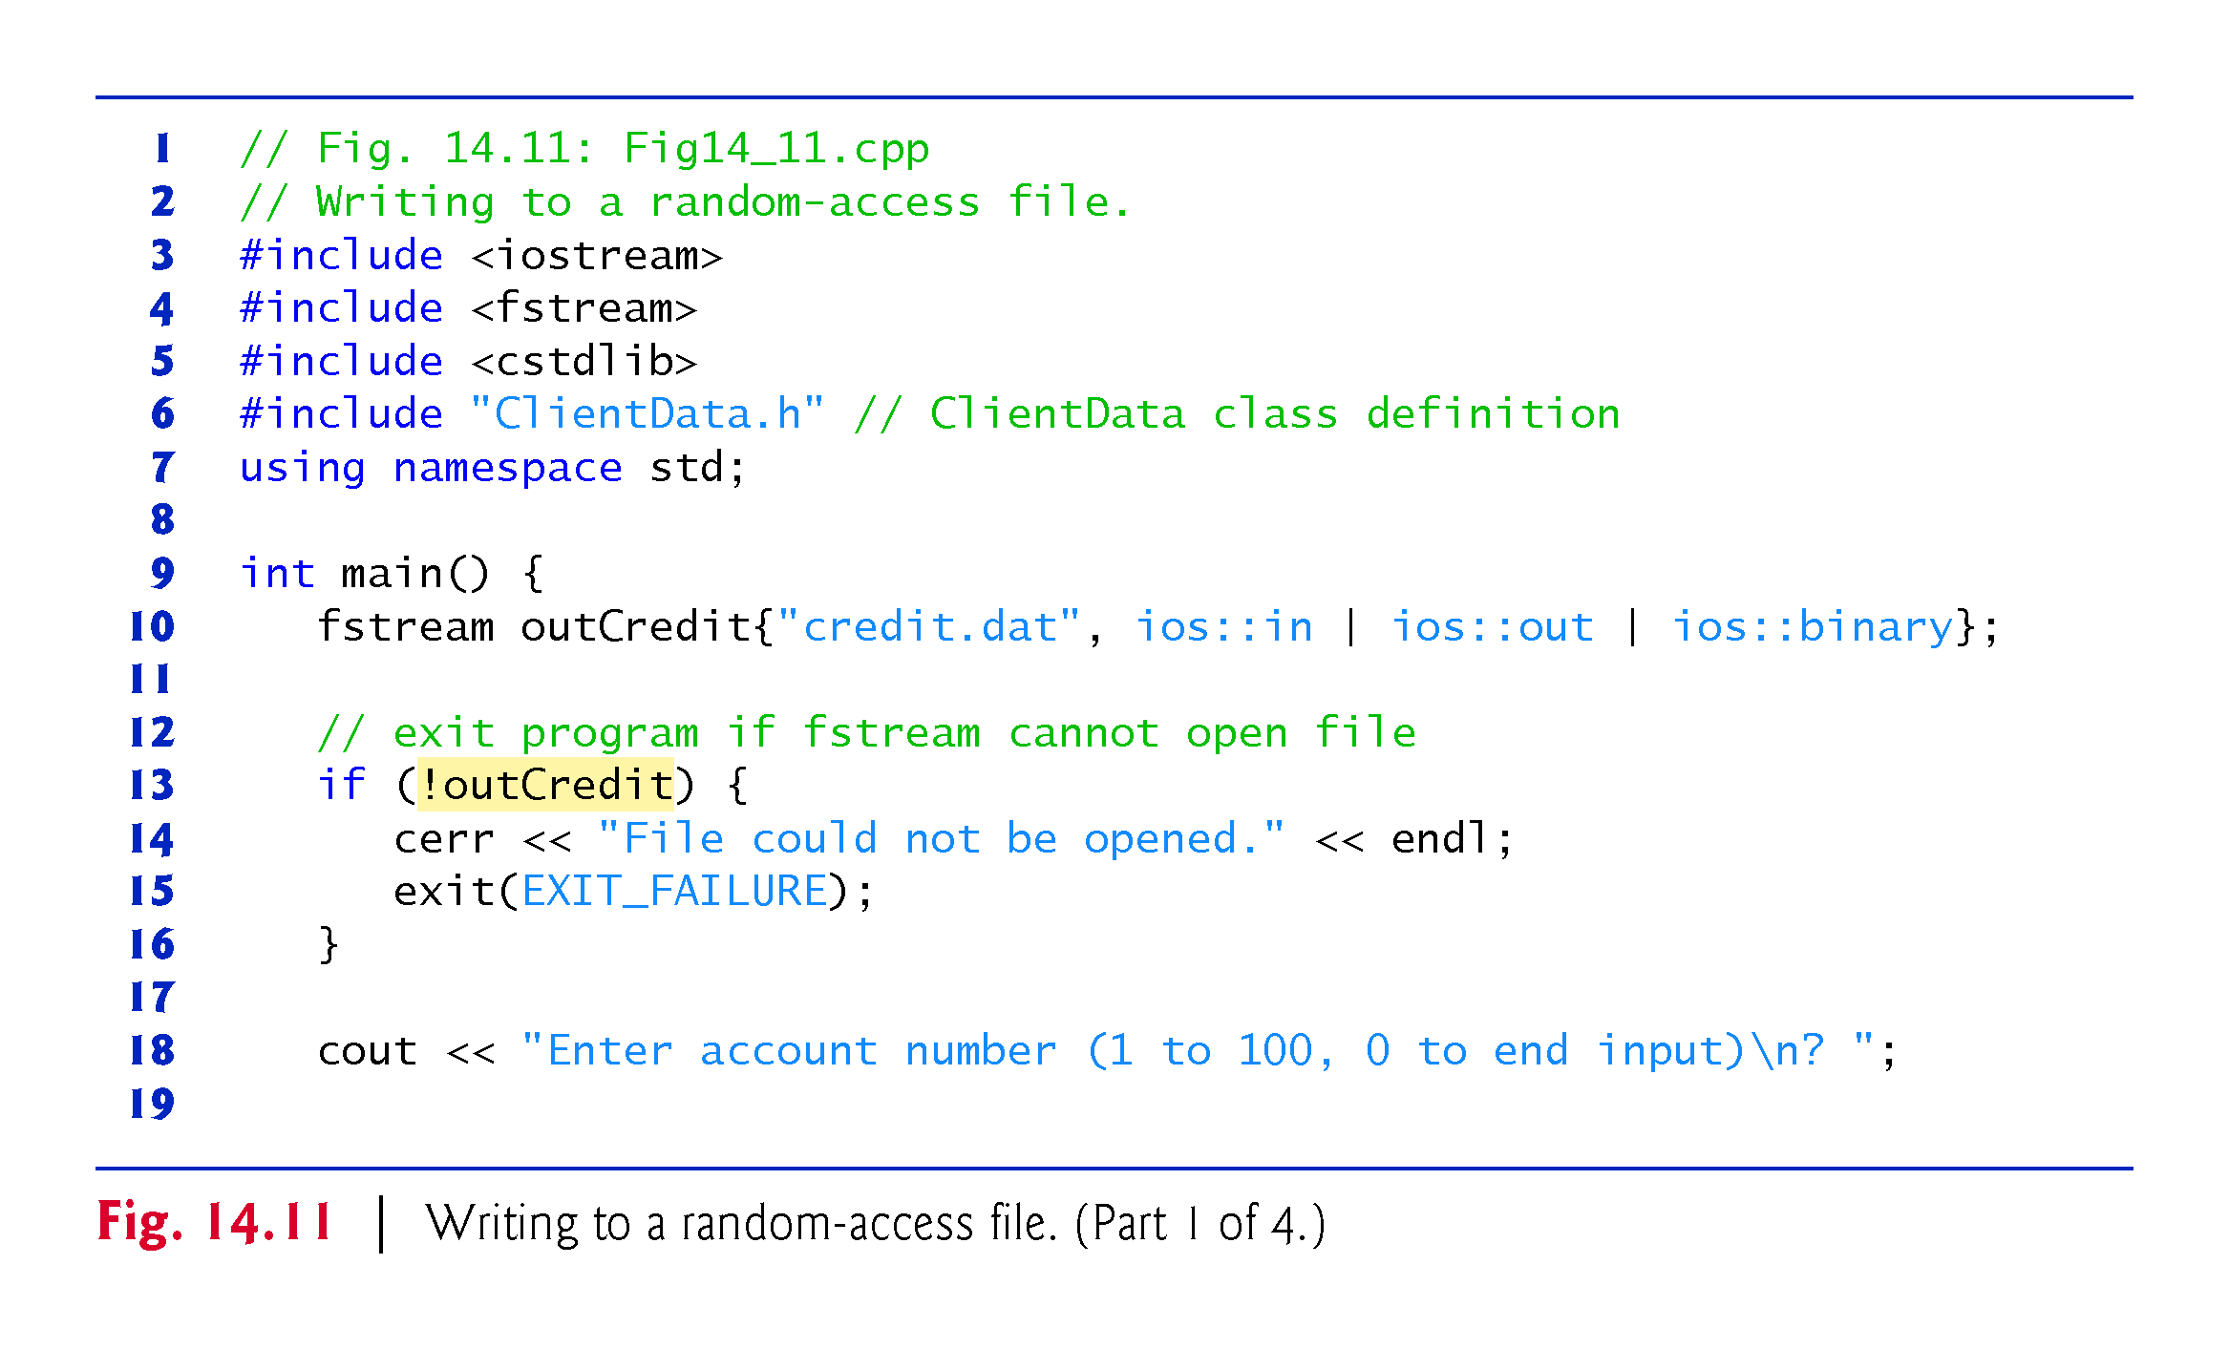

Slide 35
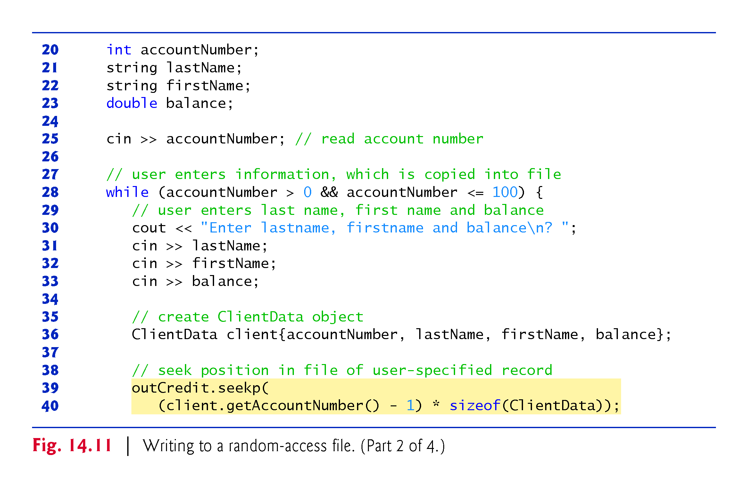

Slide 36
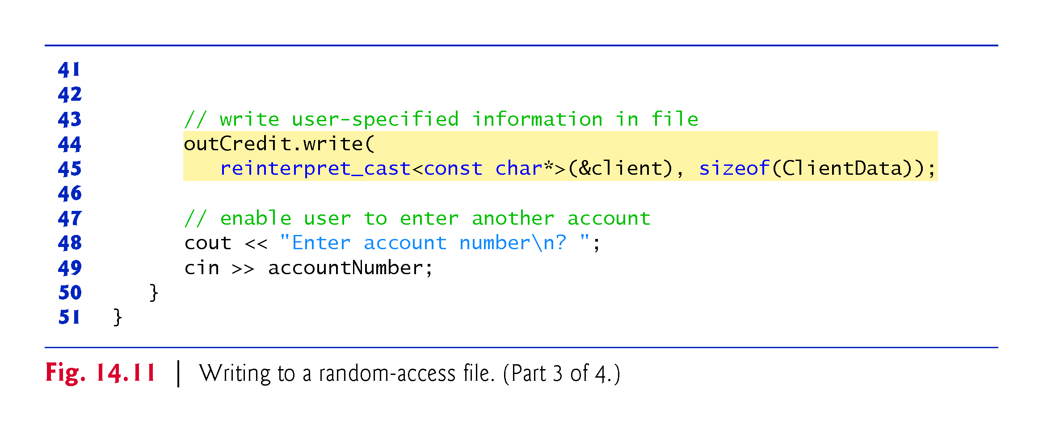
Notes:
Ob: The program outputs one record at a time using the write function of object fstream

Slide 37
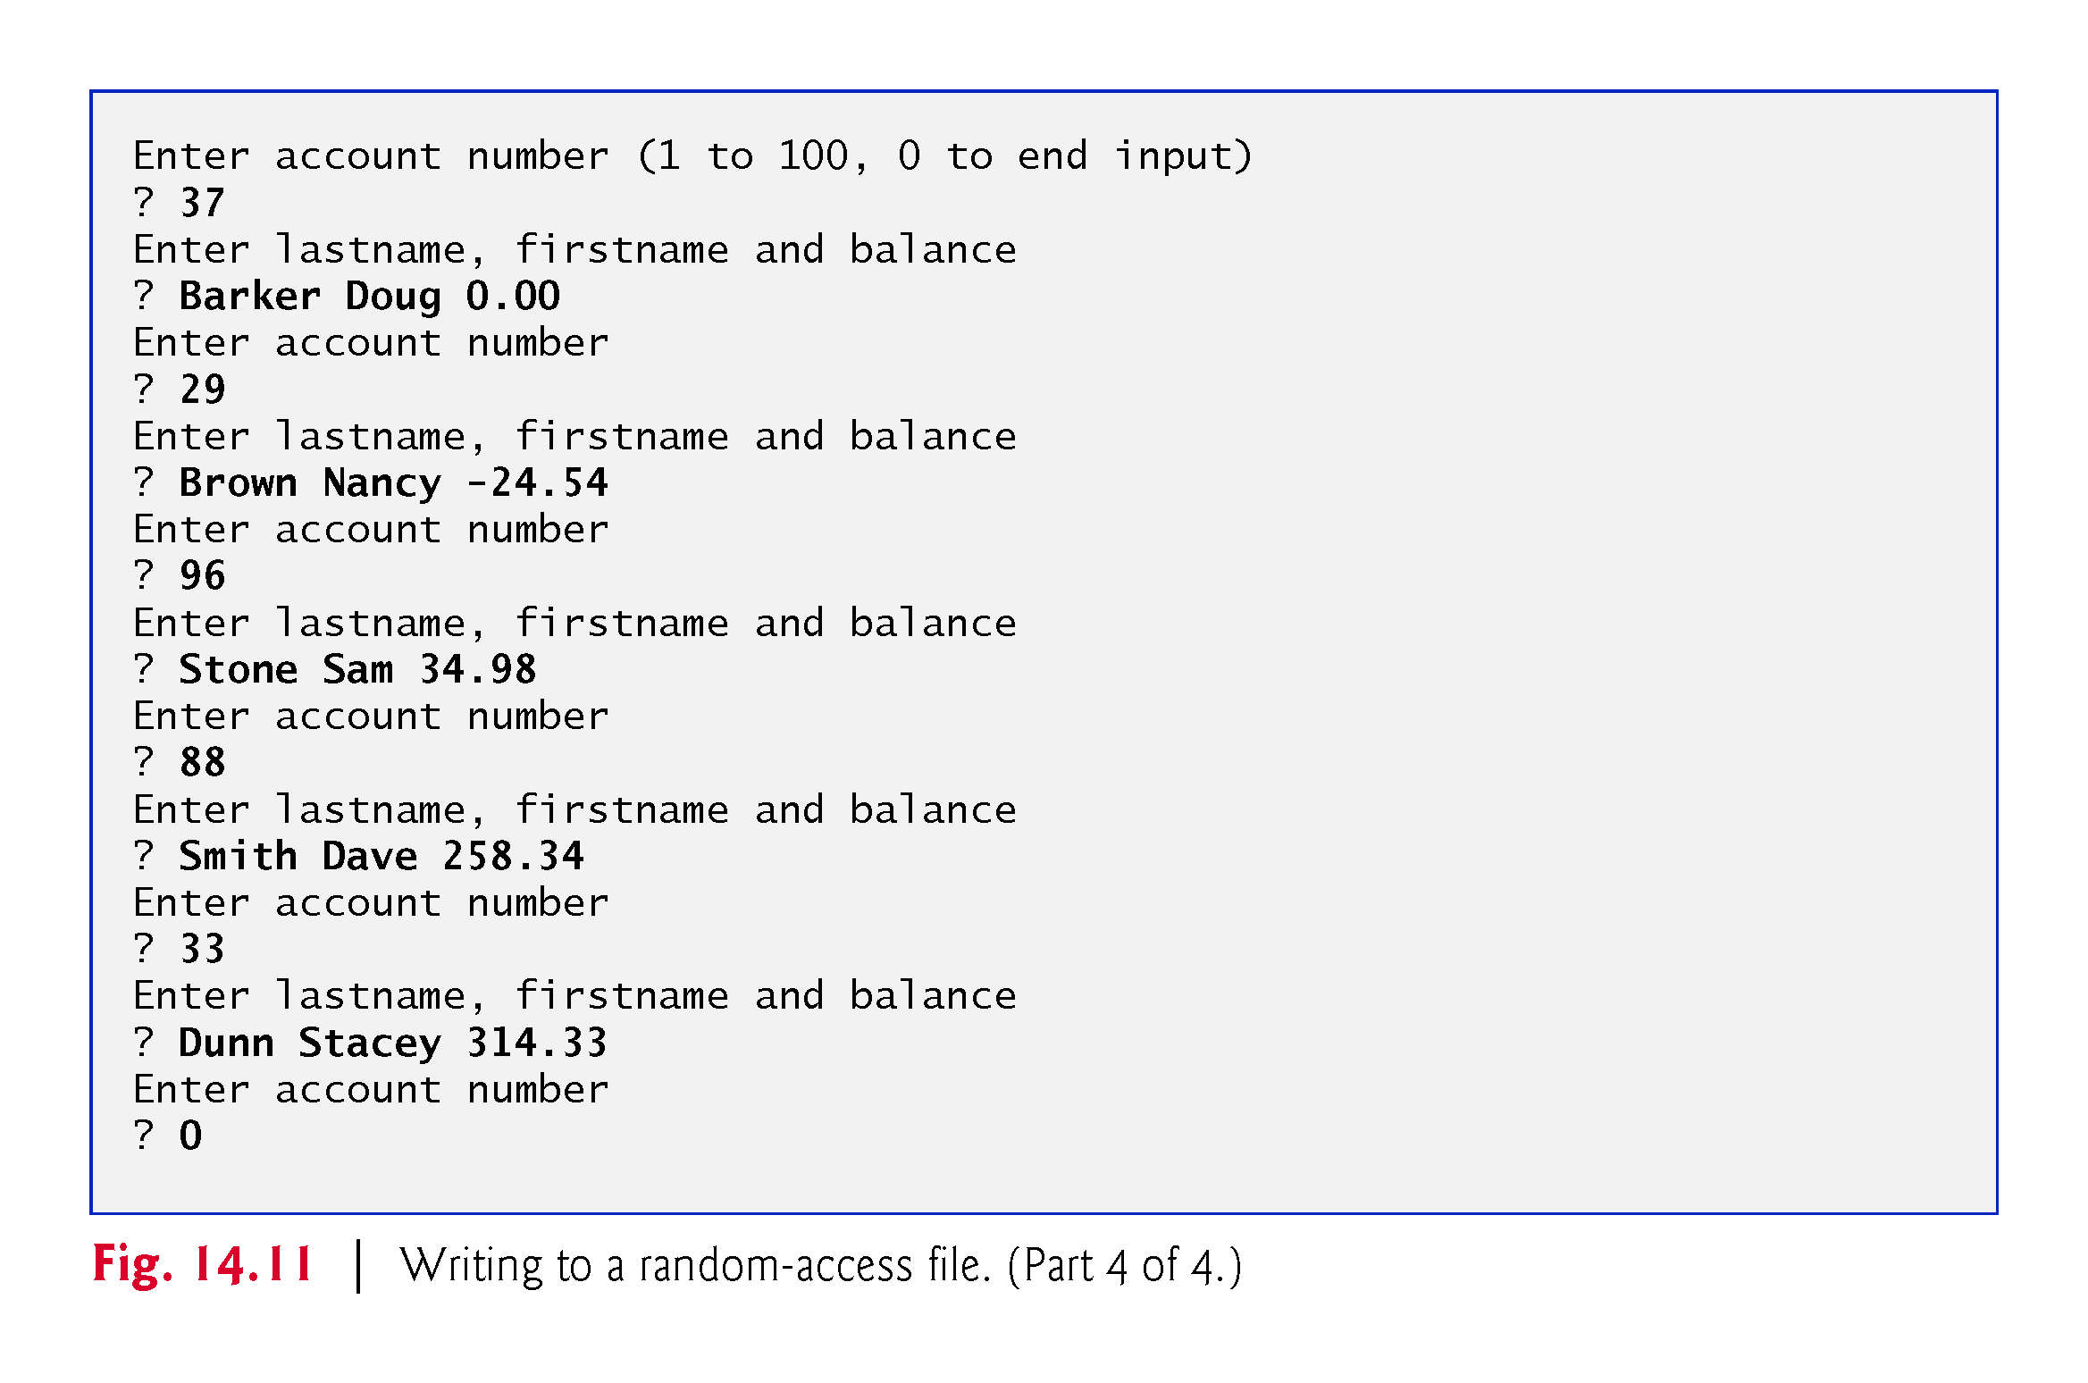

Slide 38
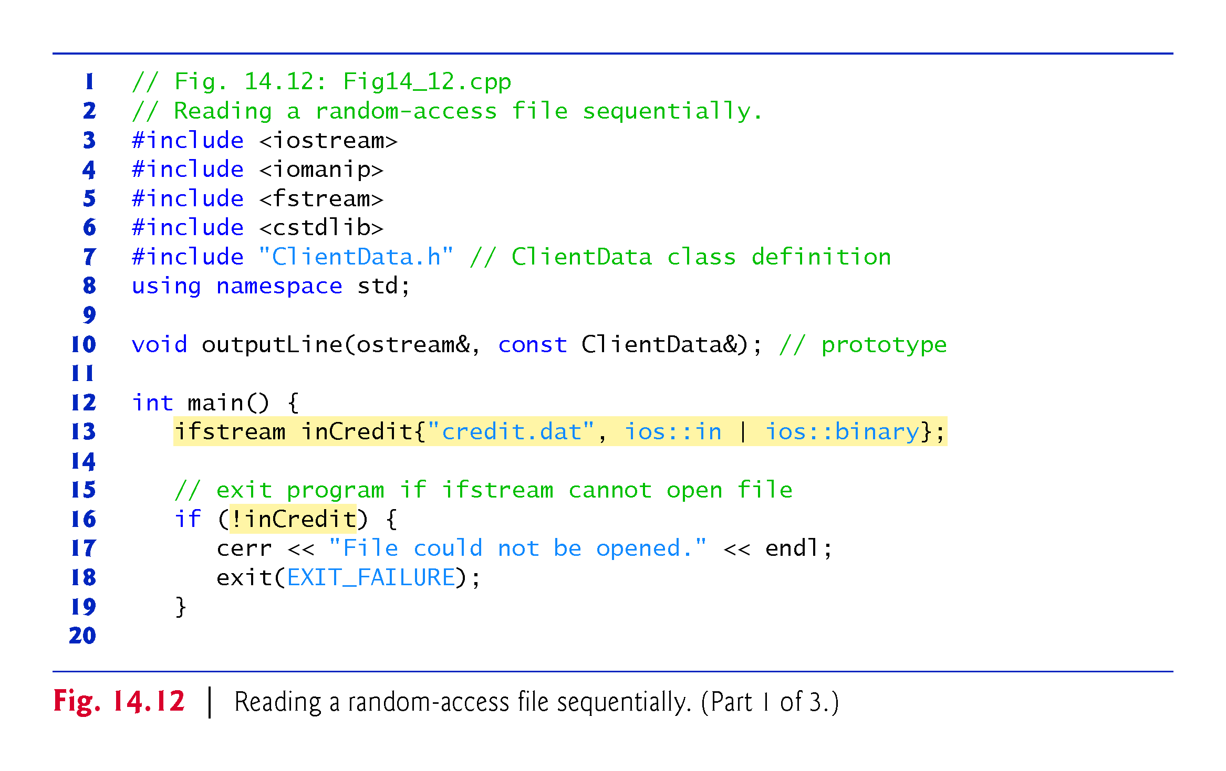

Slide 39
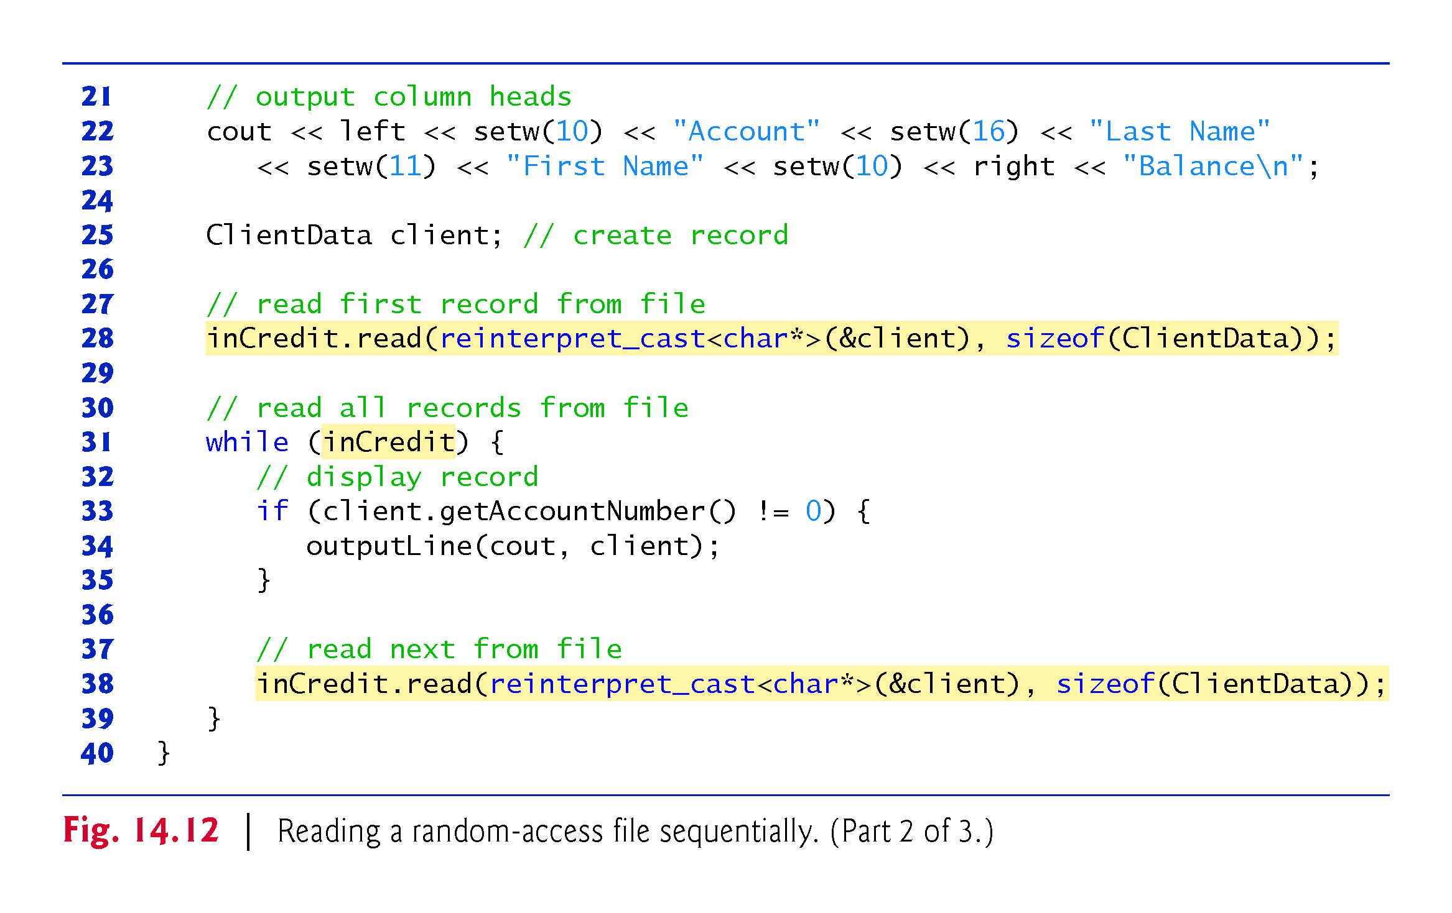
Notes:
Ob: The read function from the inCredit ifstream object

Slide 40
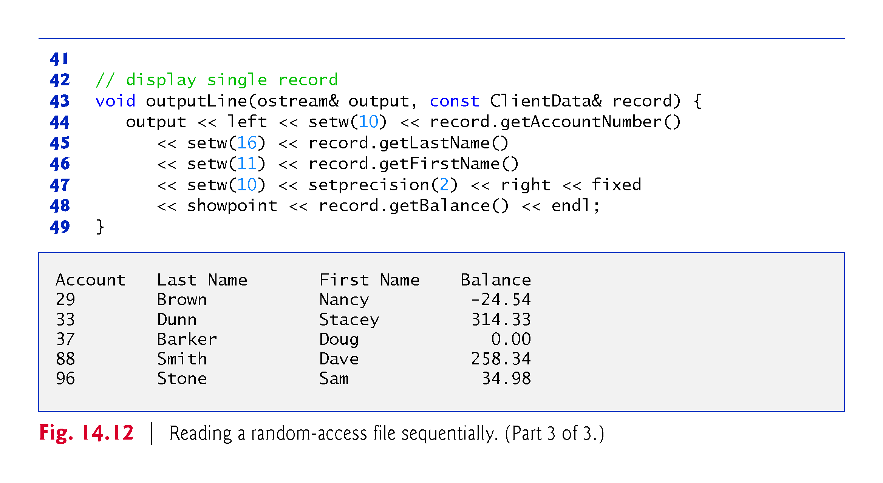

Slide 41
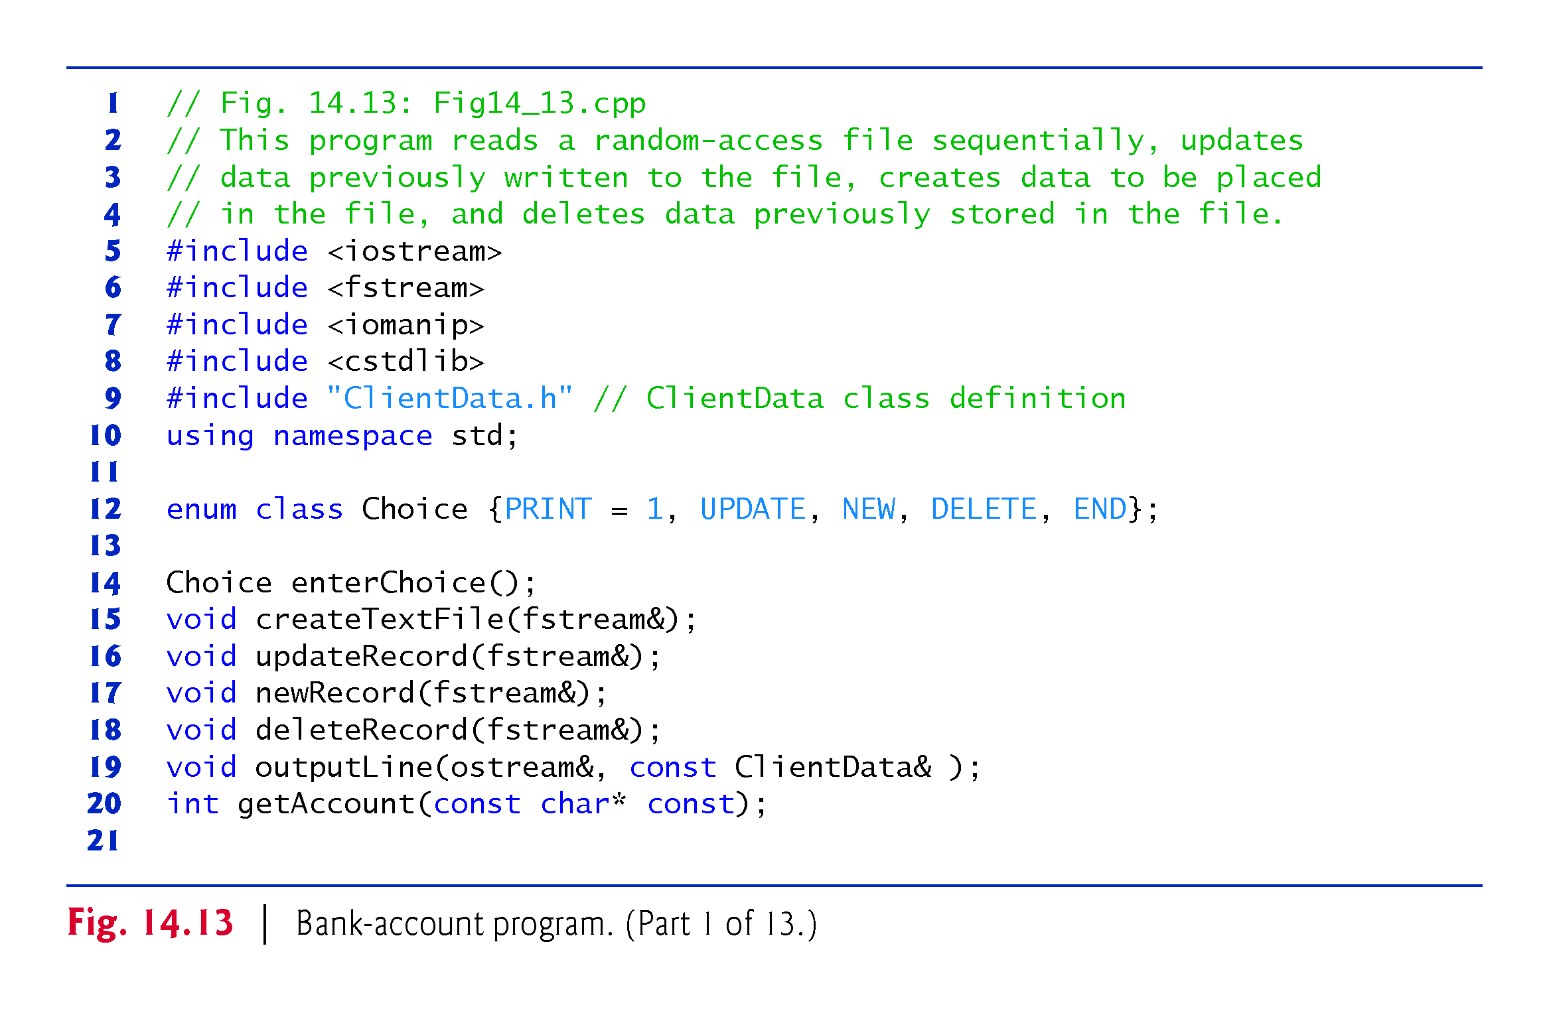
Notes:
Ob: getAccount is a different function to getAccountNumber – Its argument list accepts a string

Slide 42
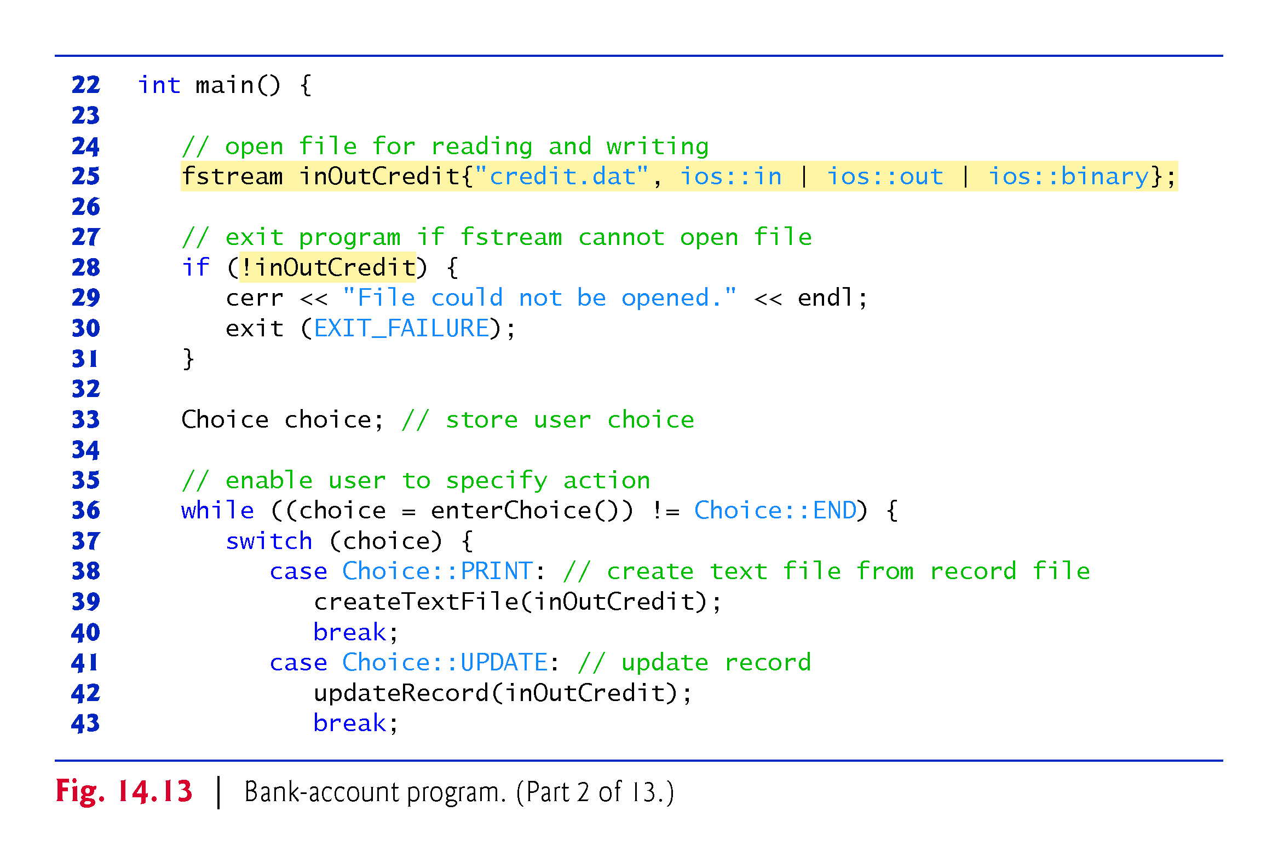

Slide 43
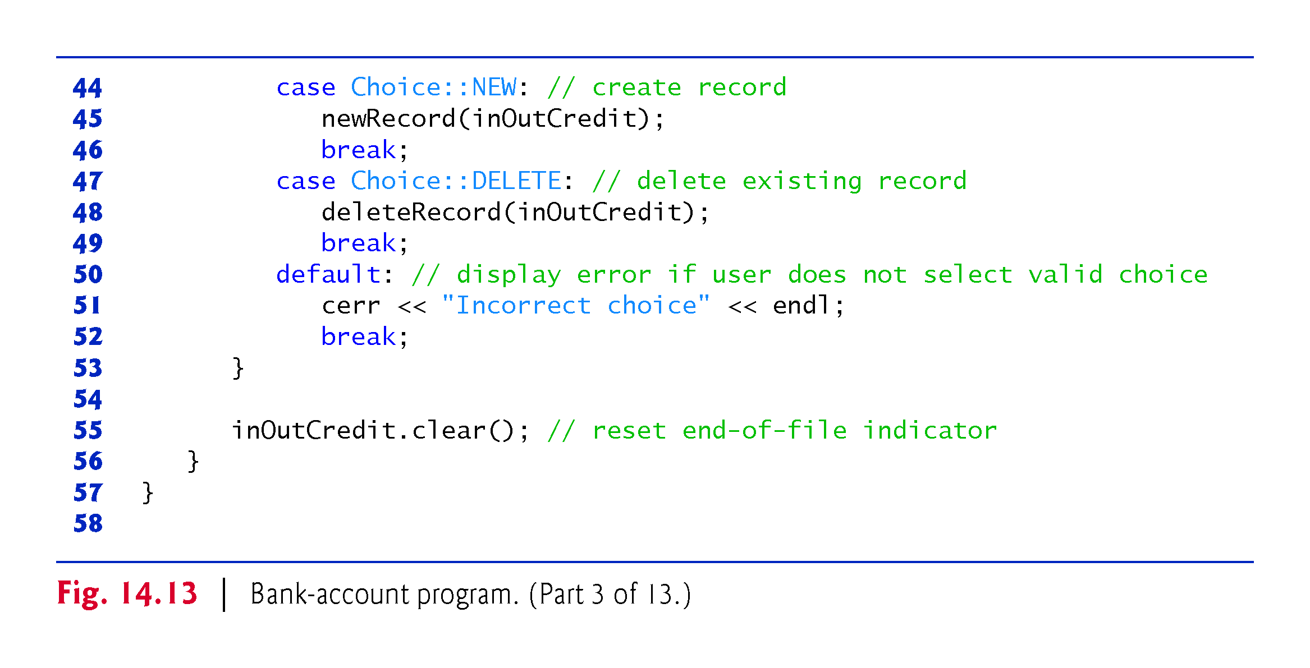
Notes:
Ob: Note what the clear function does. LOOK AT THE BOOK

Slide 44
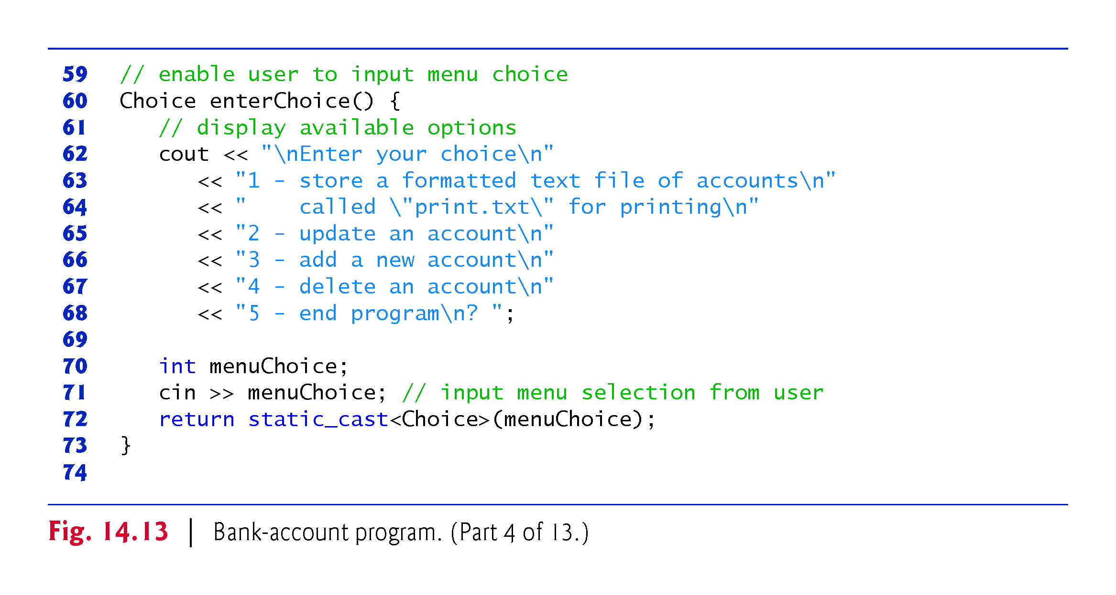

Slide 45
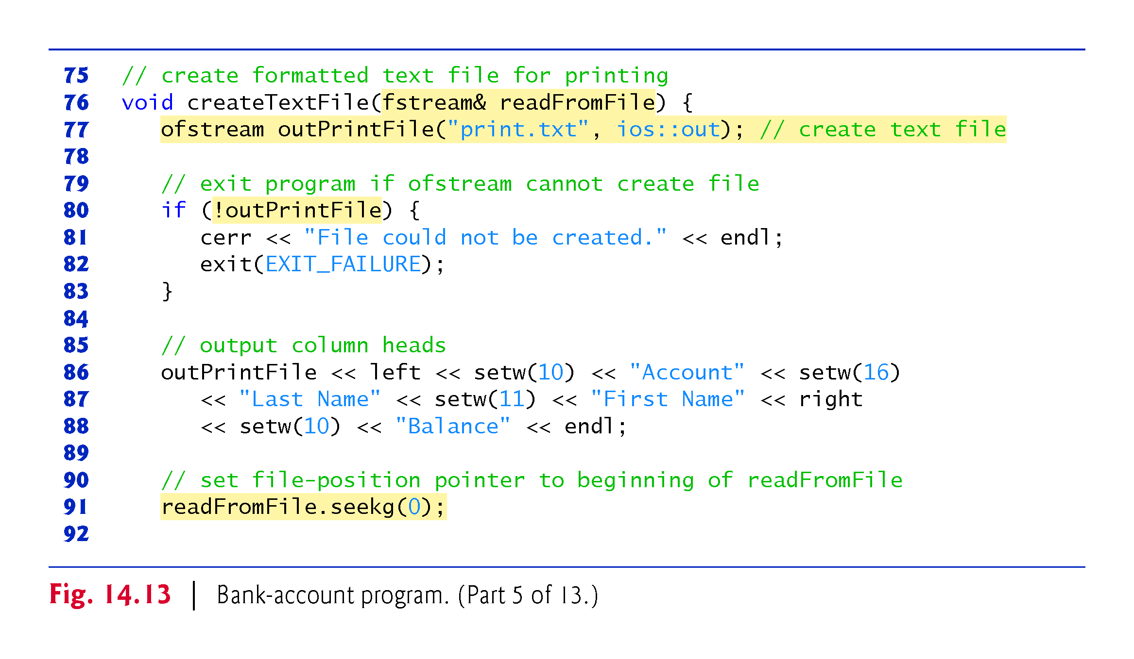

Slide 46
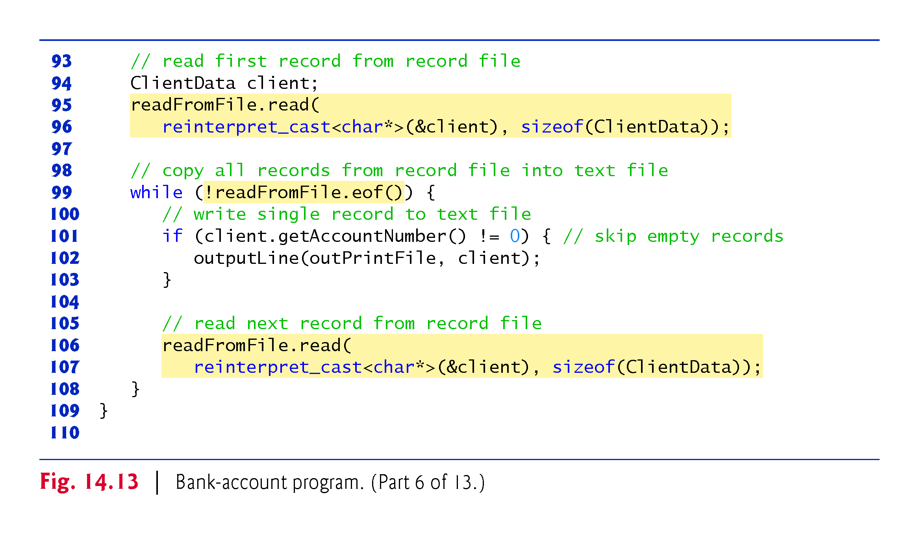

Slide 47
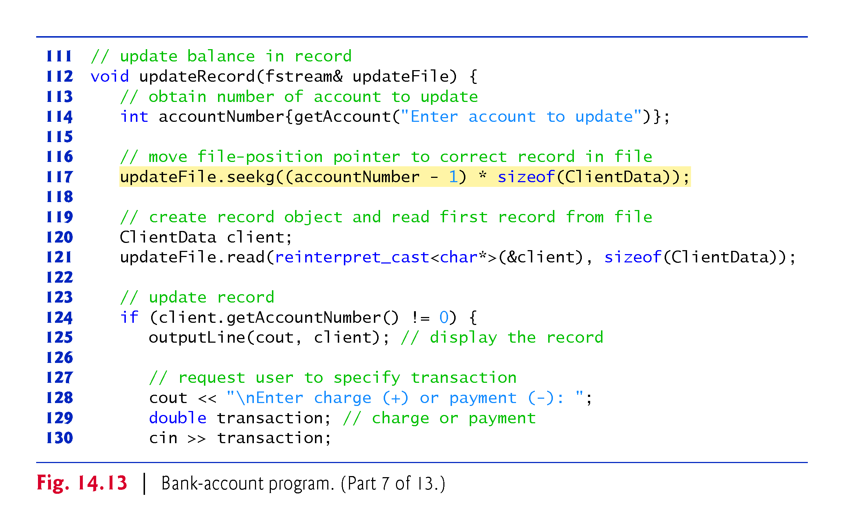

Slide 48
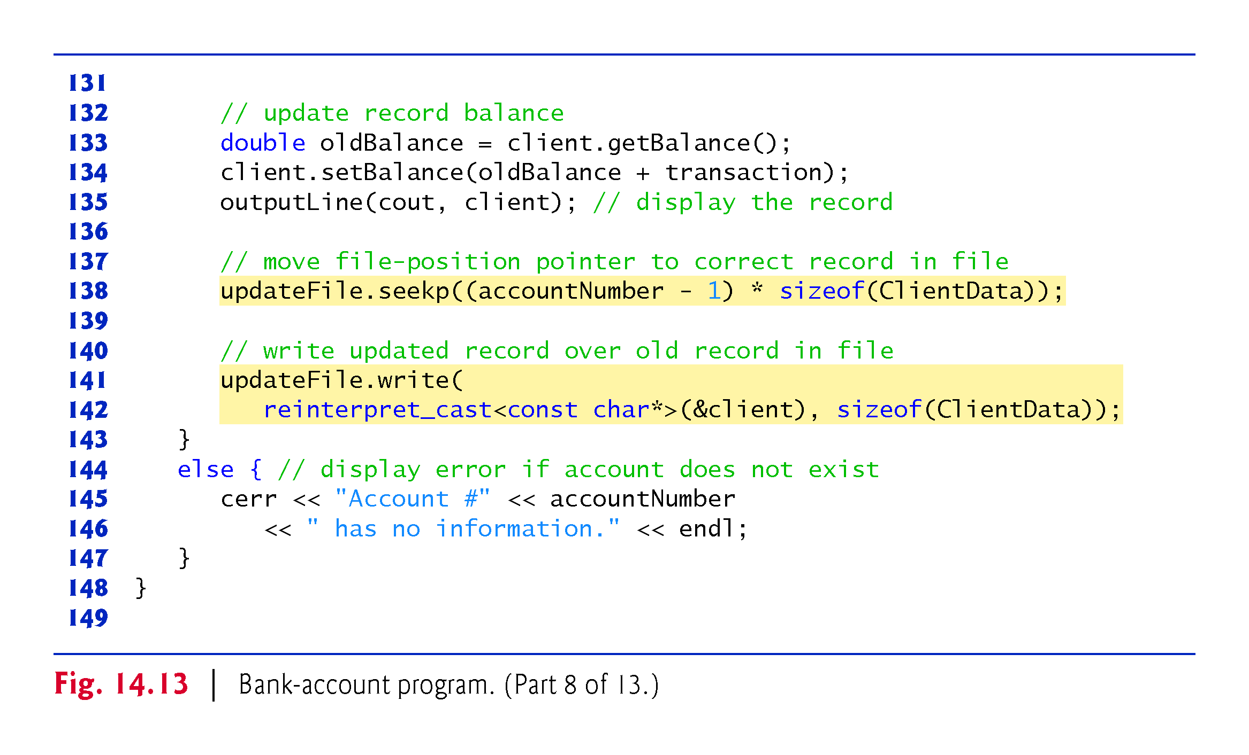

Slide 49
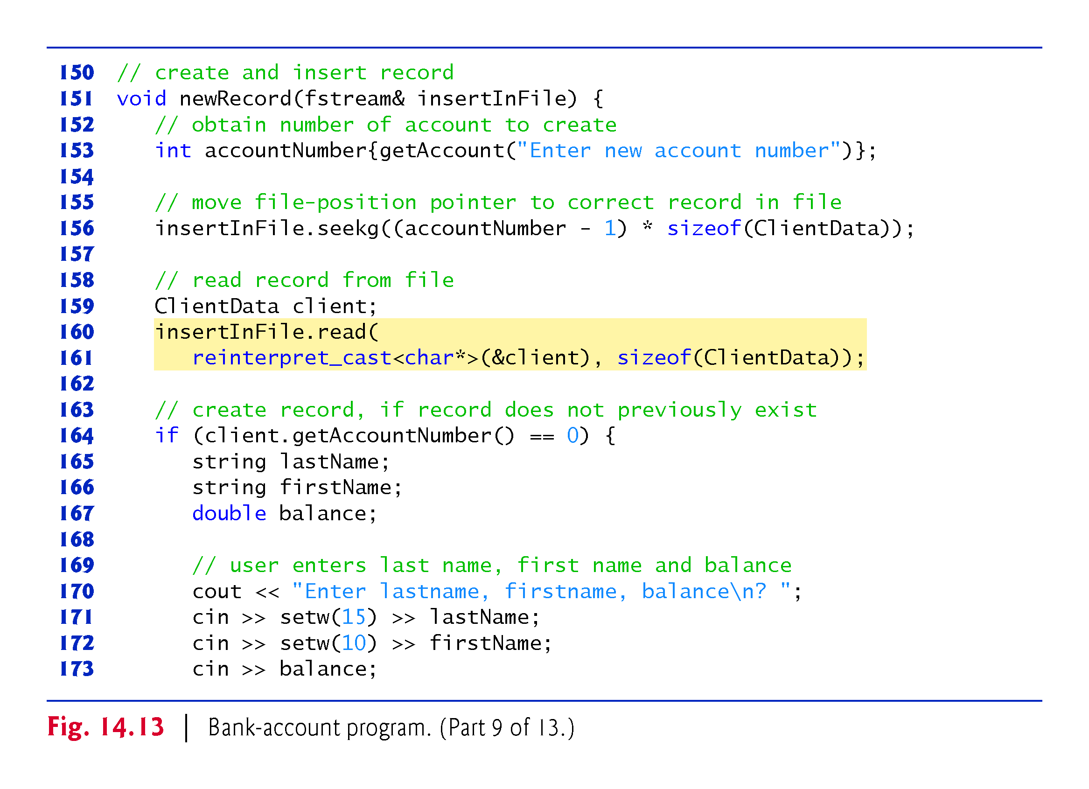

Slide 50
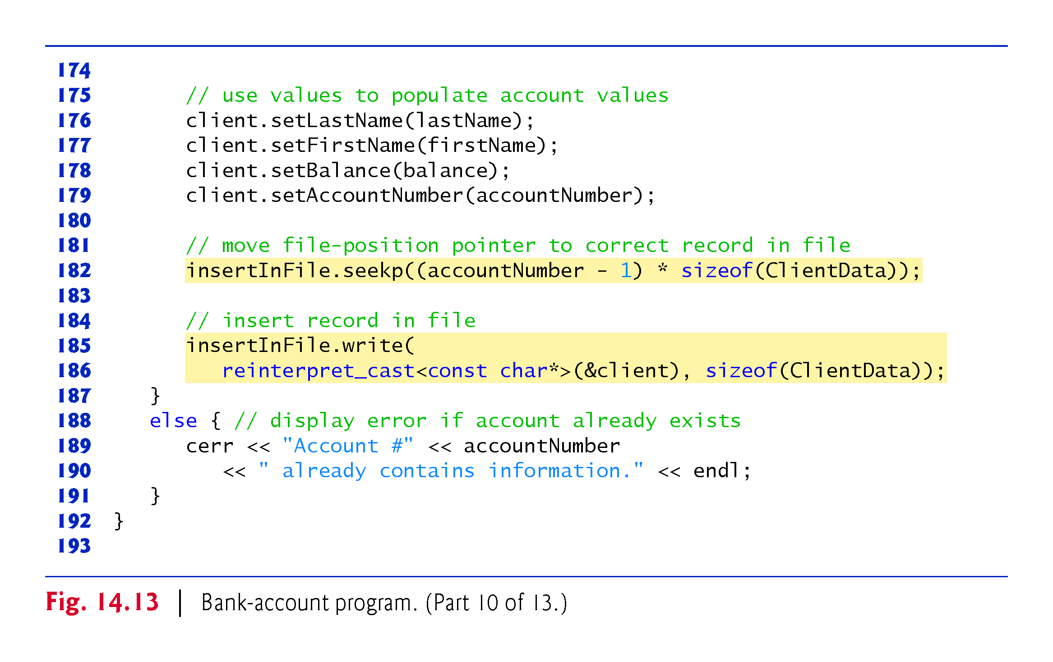

Slide 51
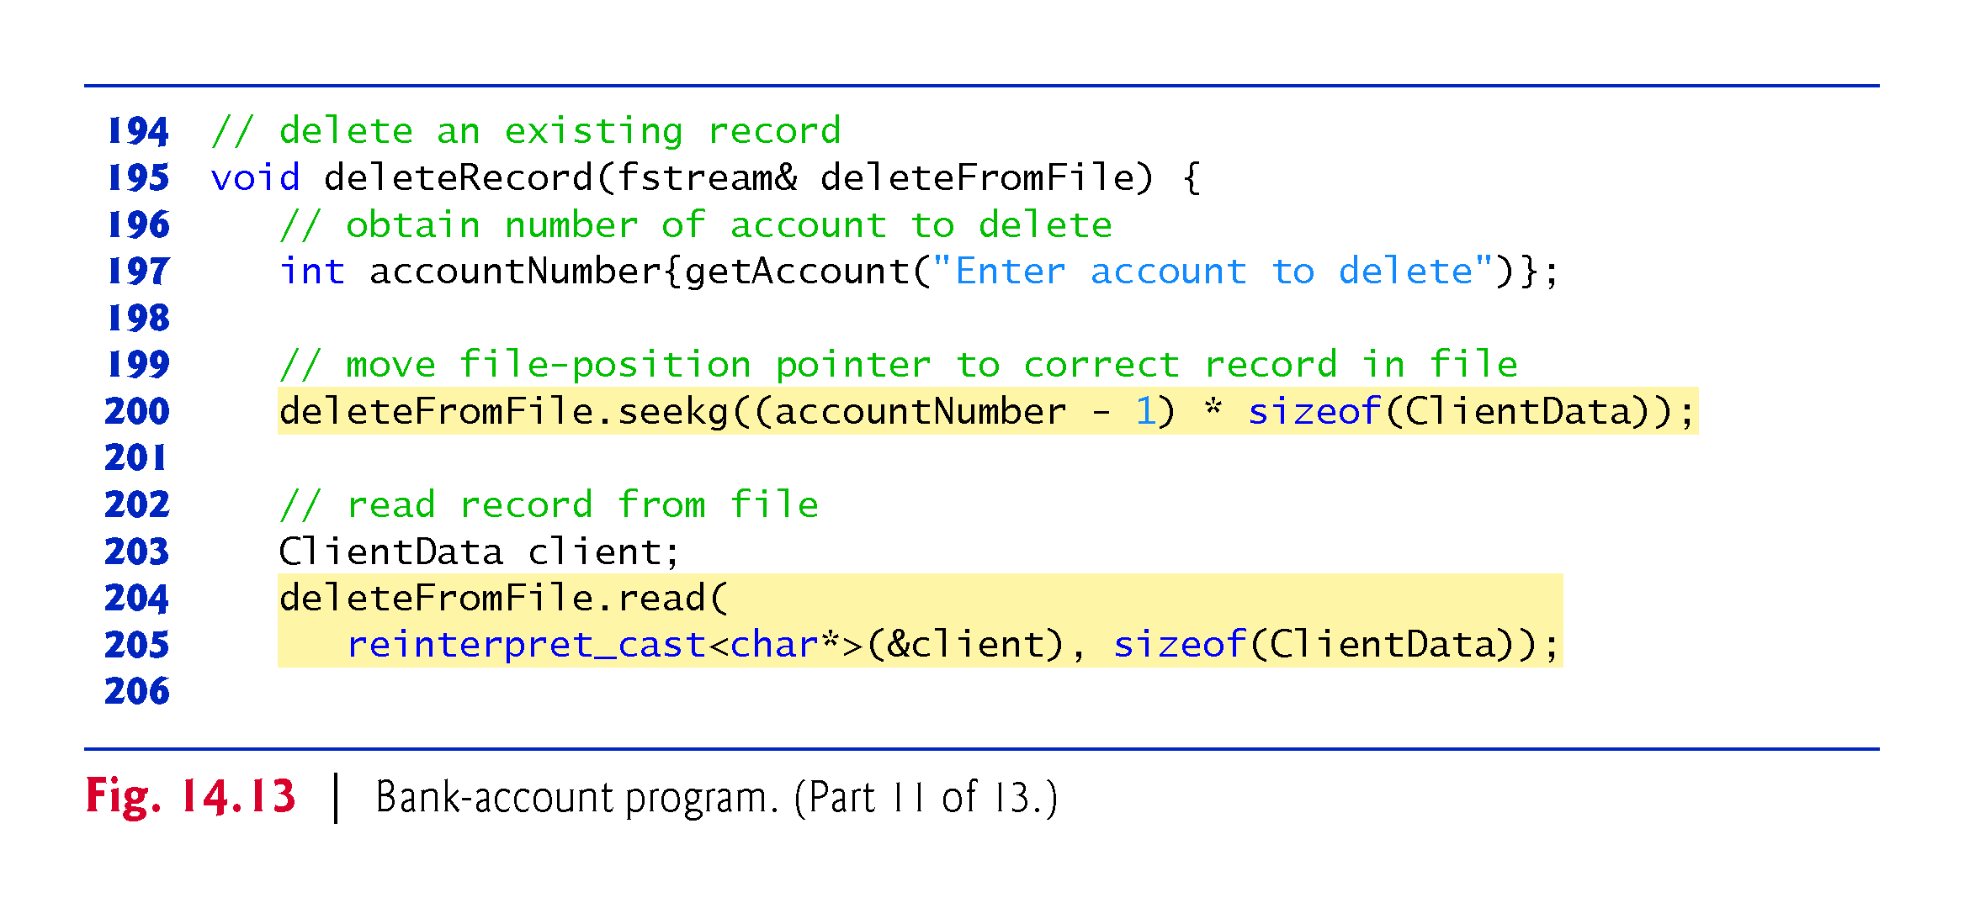

Slide 52
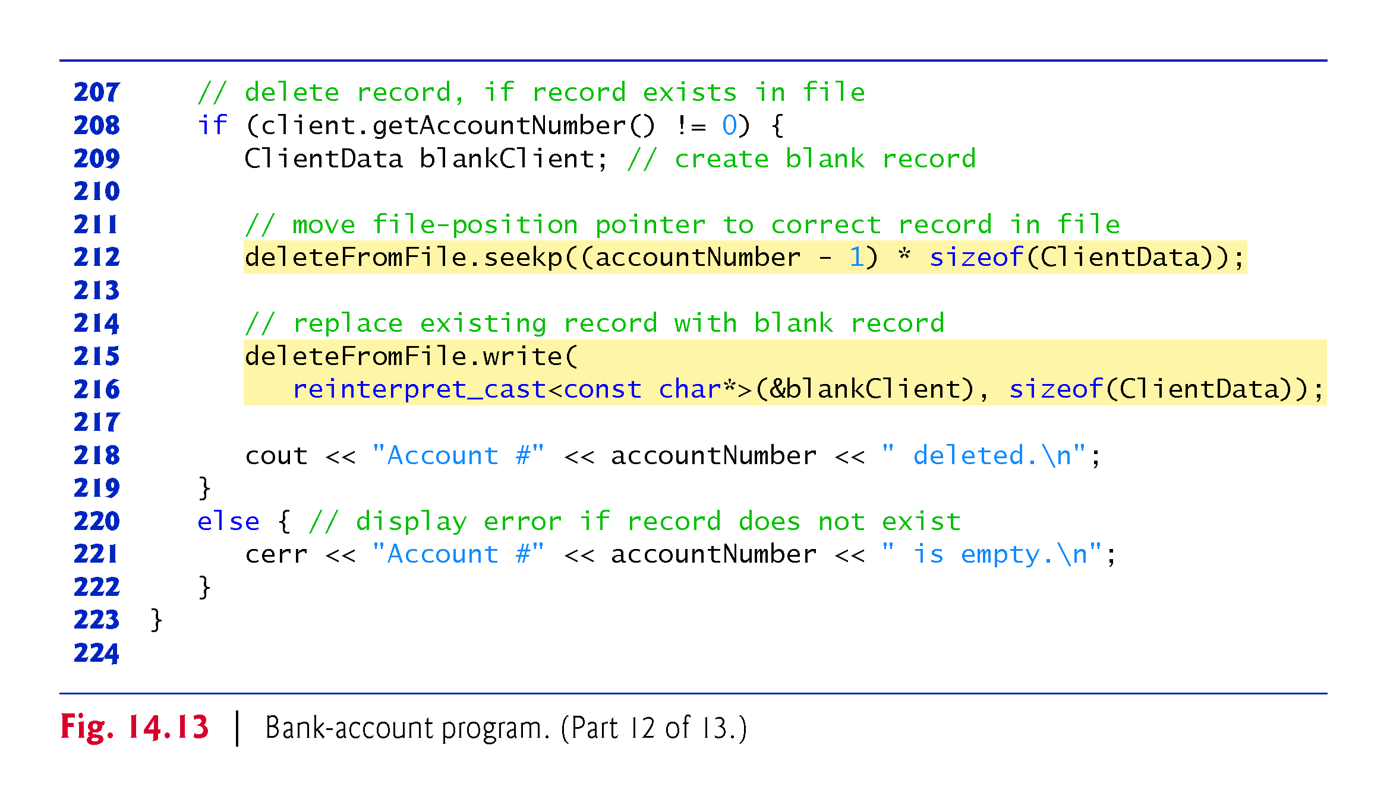
Notes:
Ob: Check if deleteFromFile.seekp function is strictly needed. Can you read and write in place?

Slide 53


Slide 54


