Slide 1
Standard Library Containers and Iterators
Based on Chapter 15 of C++ How to Program, 10/e

Slide 2
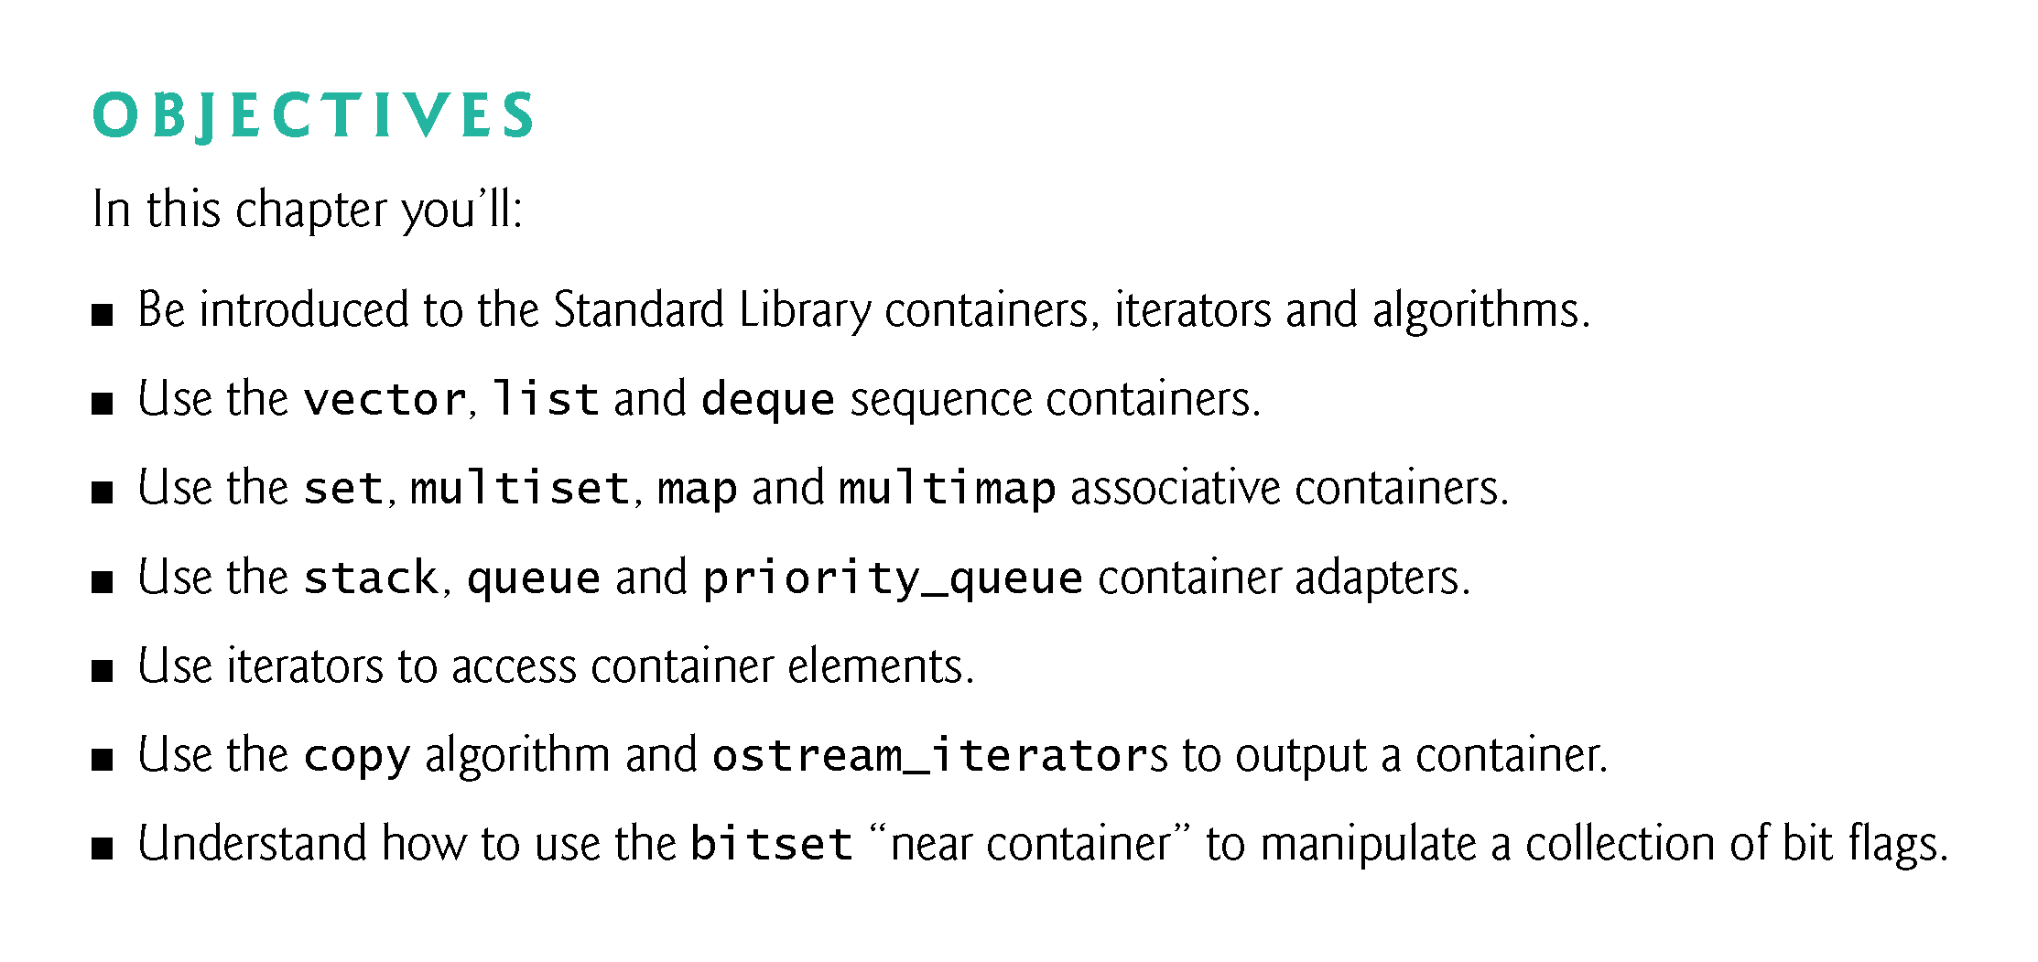

Slide 3
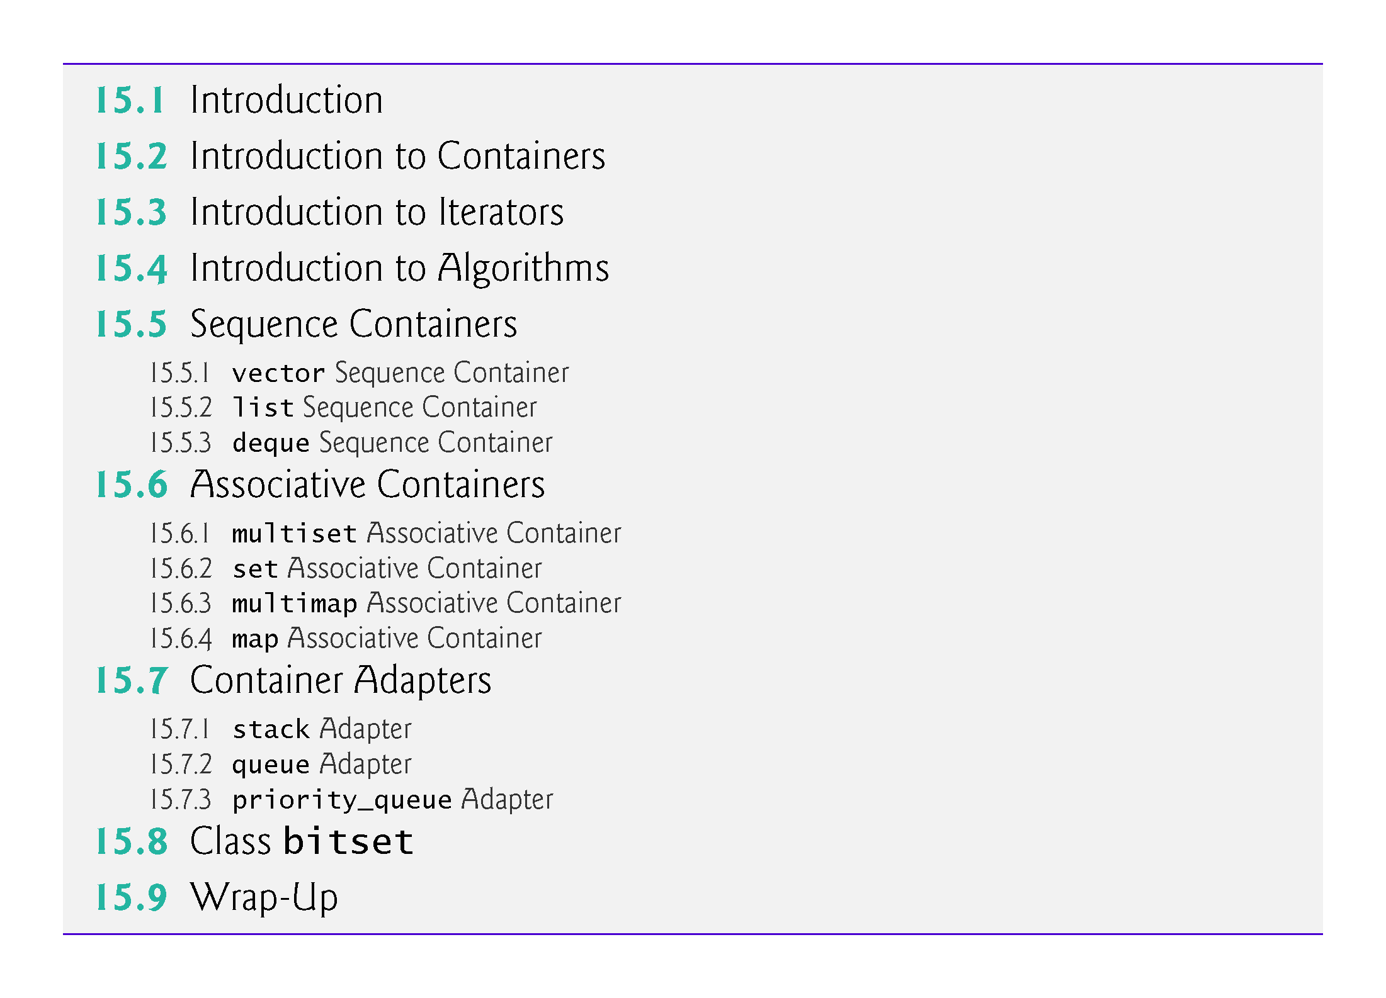

Slide 4
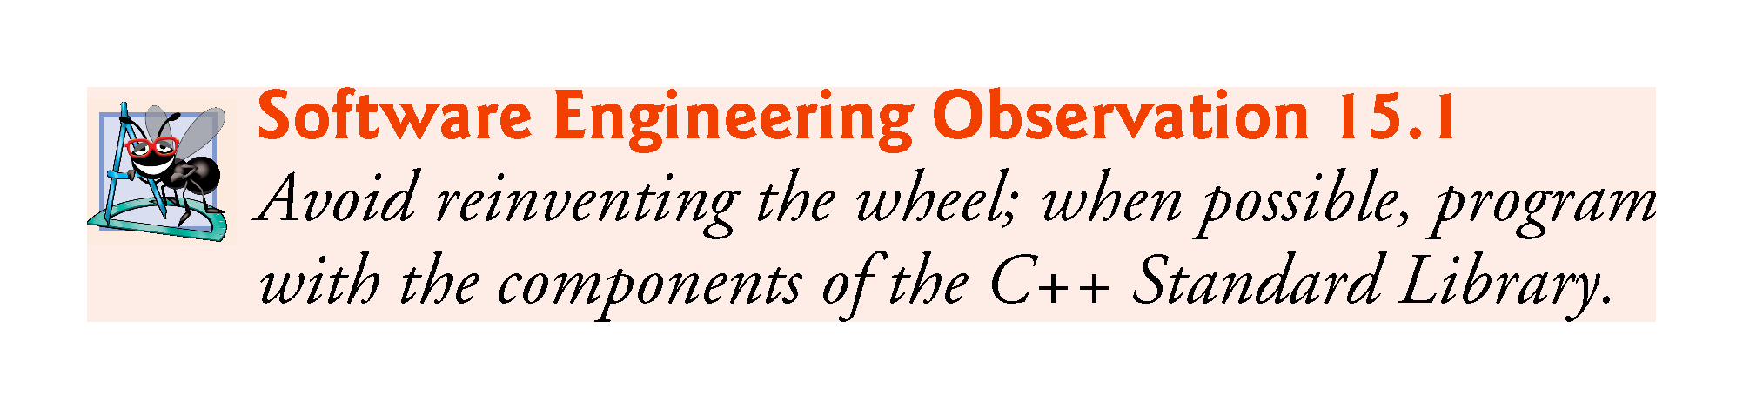

Slide 5
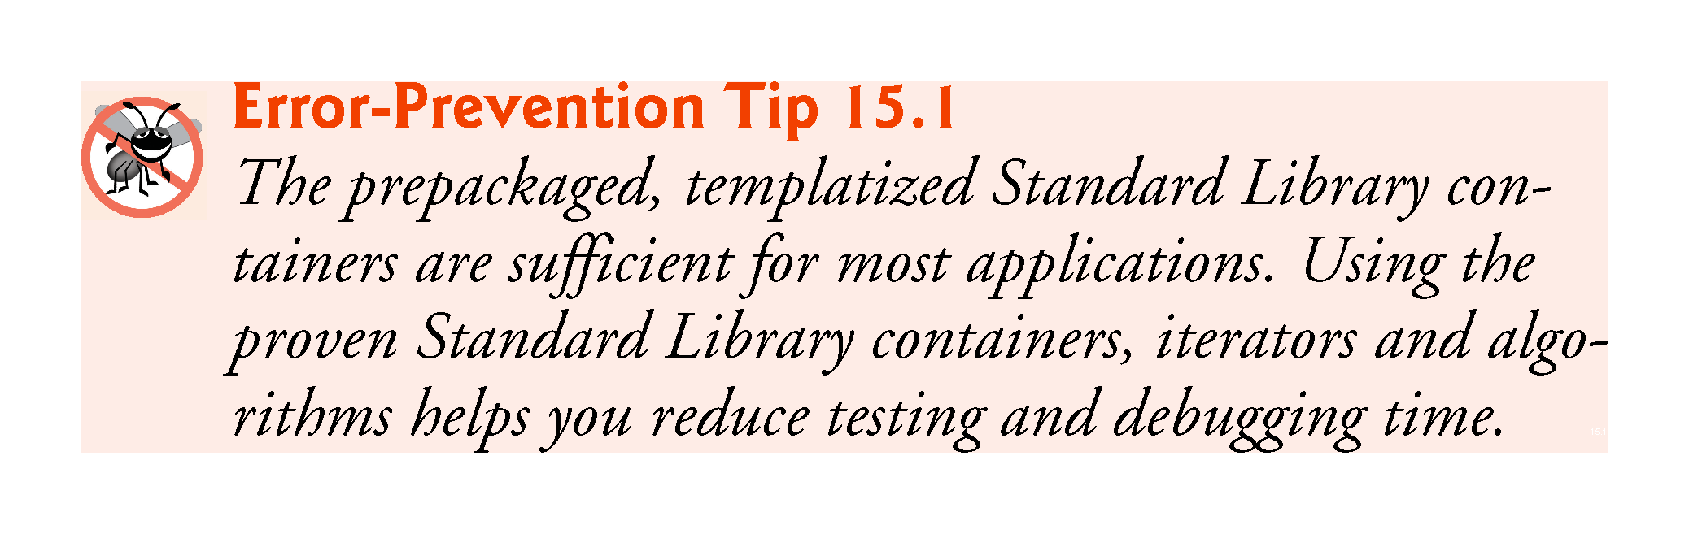

Slide 6


Slide 7
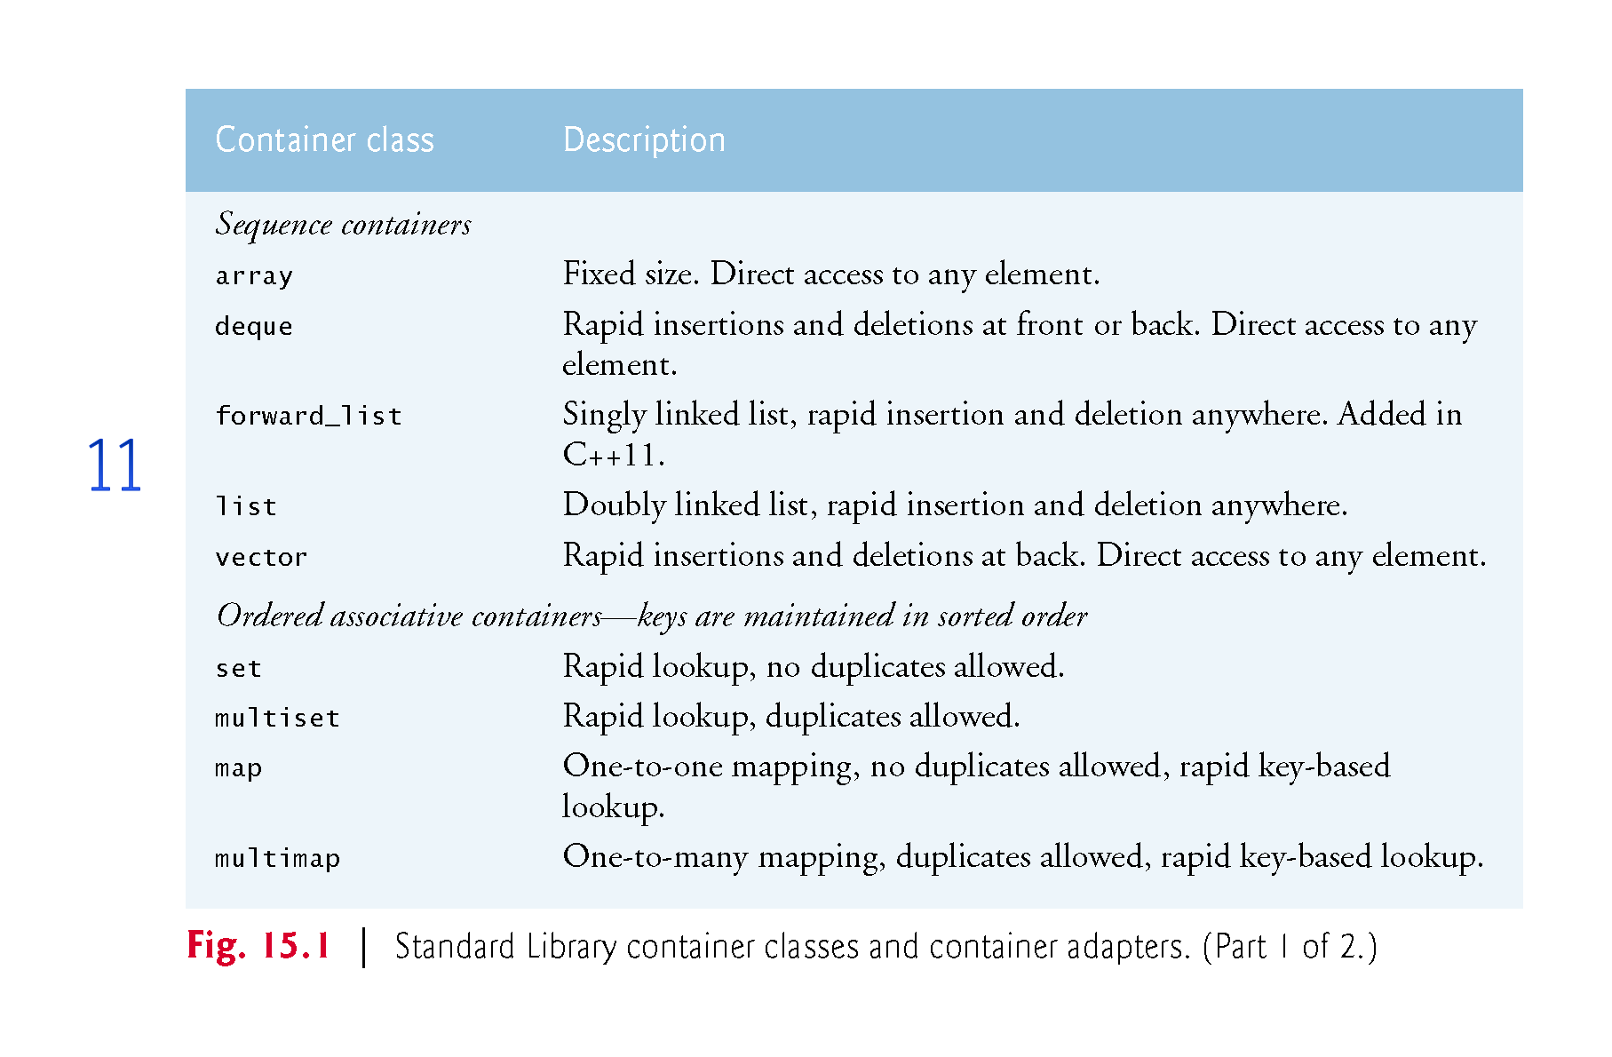

Slide 8
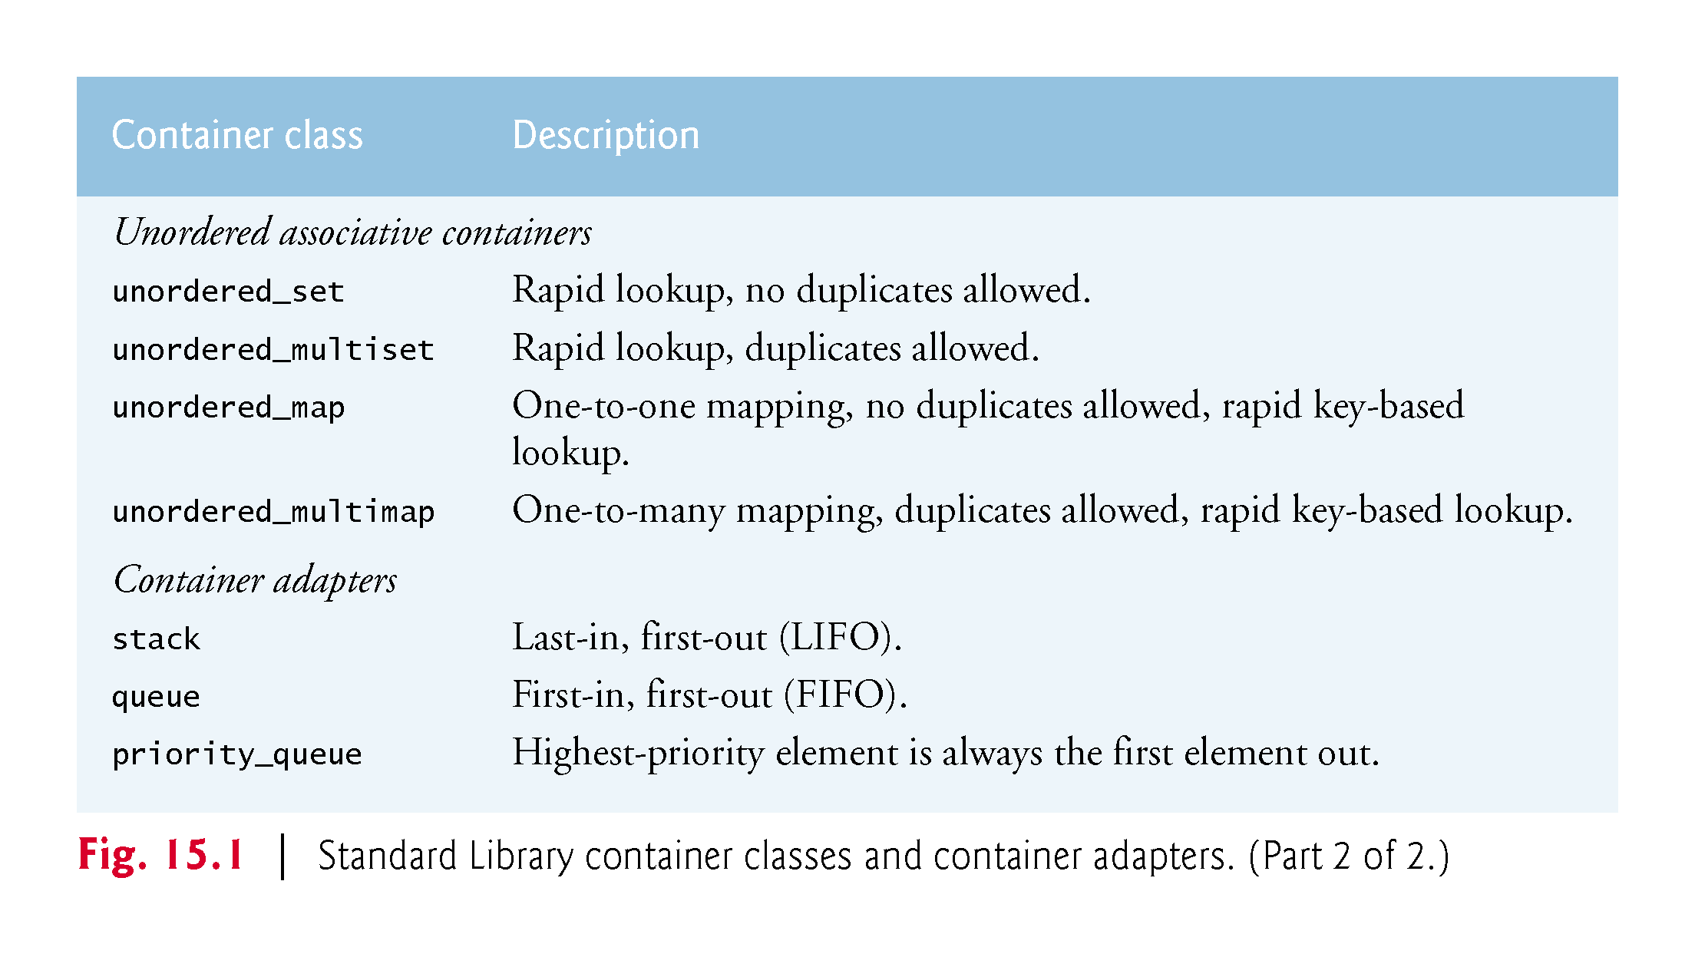

Slide 9
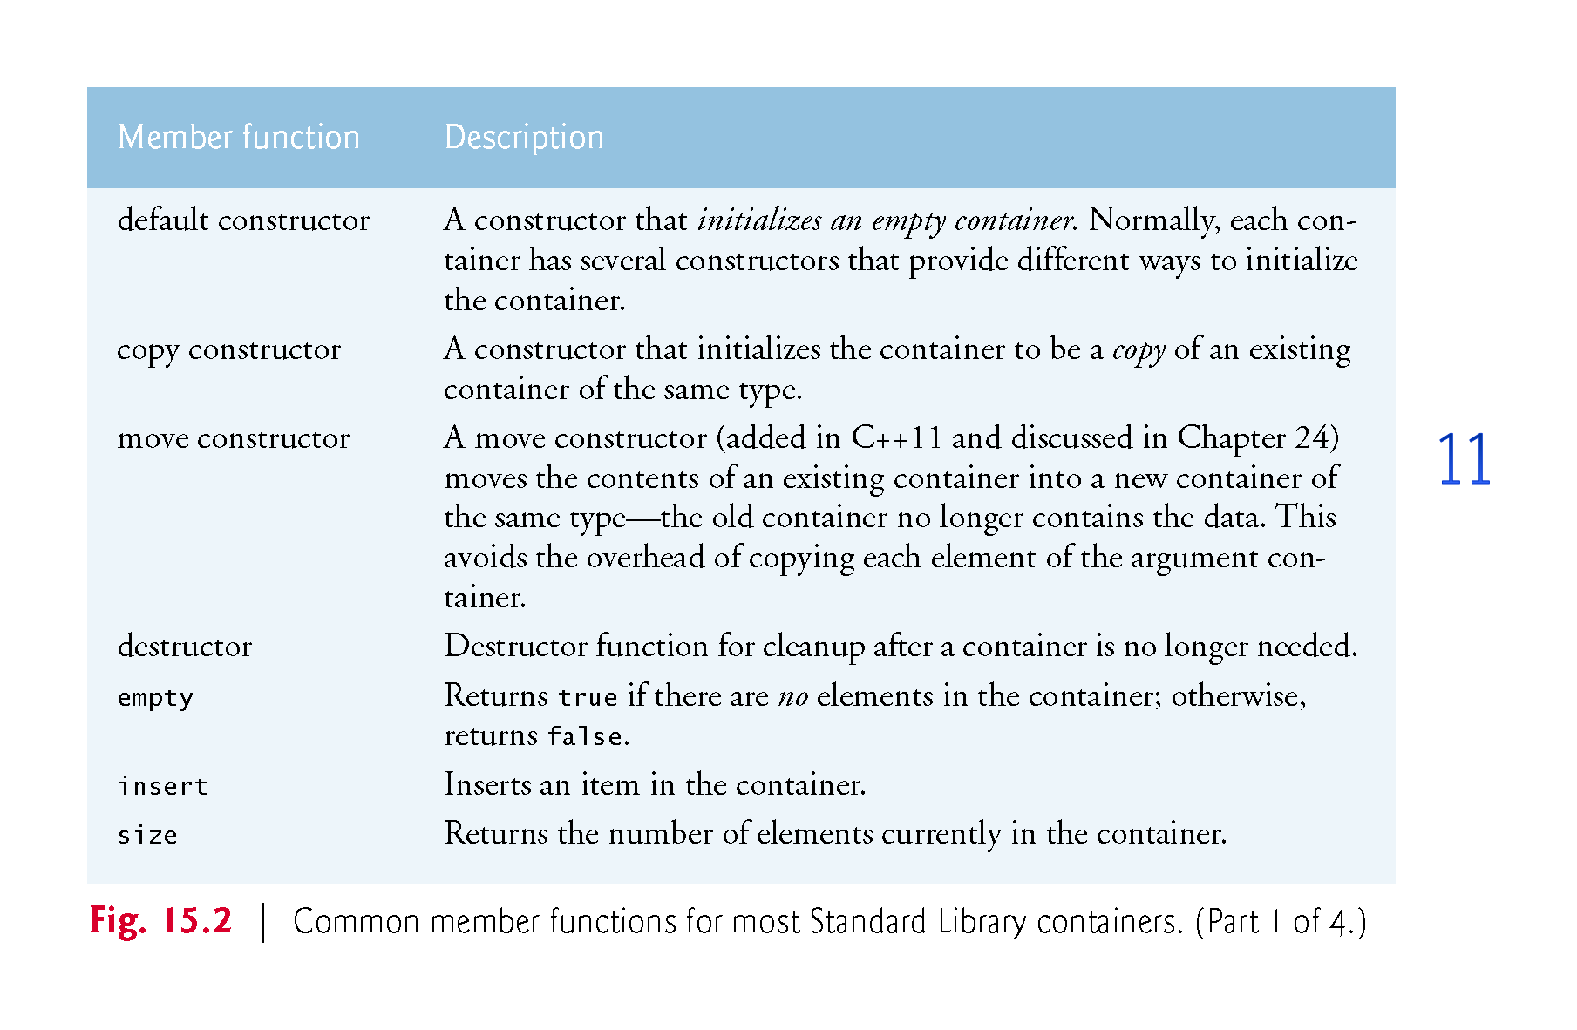

Slide 10
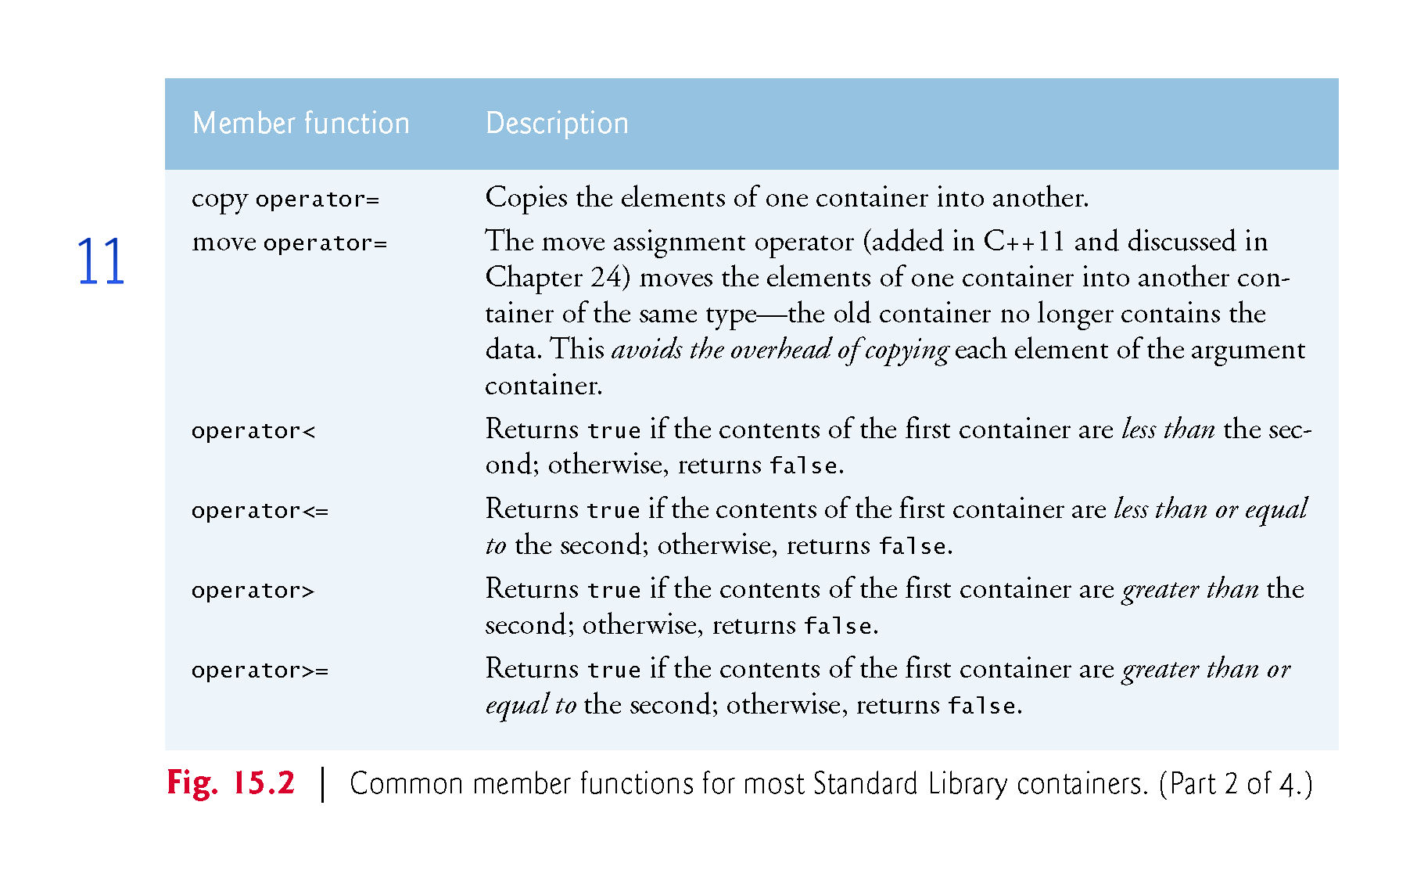

Slide 11
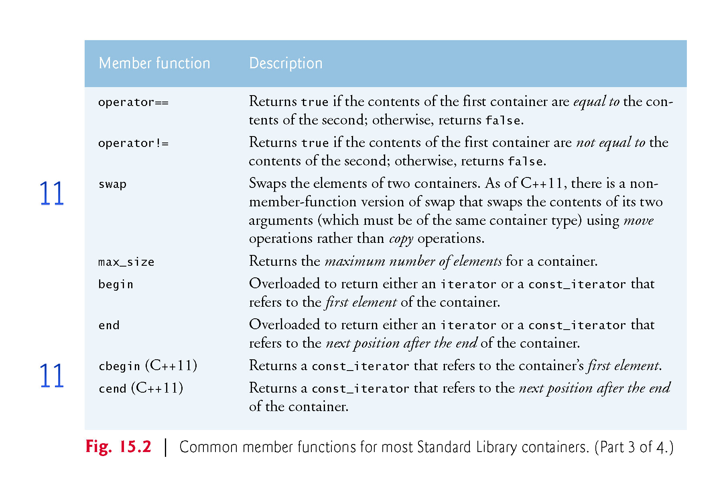

Slide 12
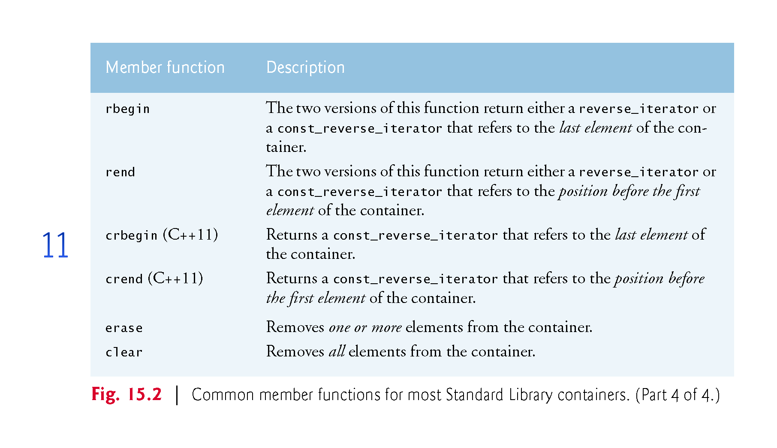
Notes:
Ob: rbegin and rend are earlier versions of crbegin and crend

Slide 13
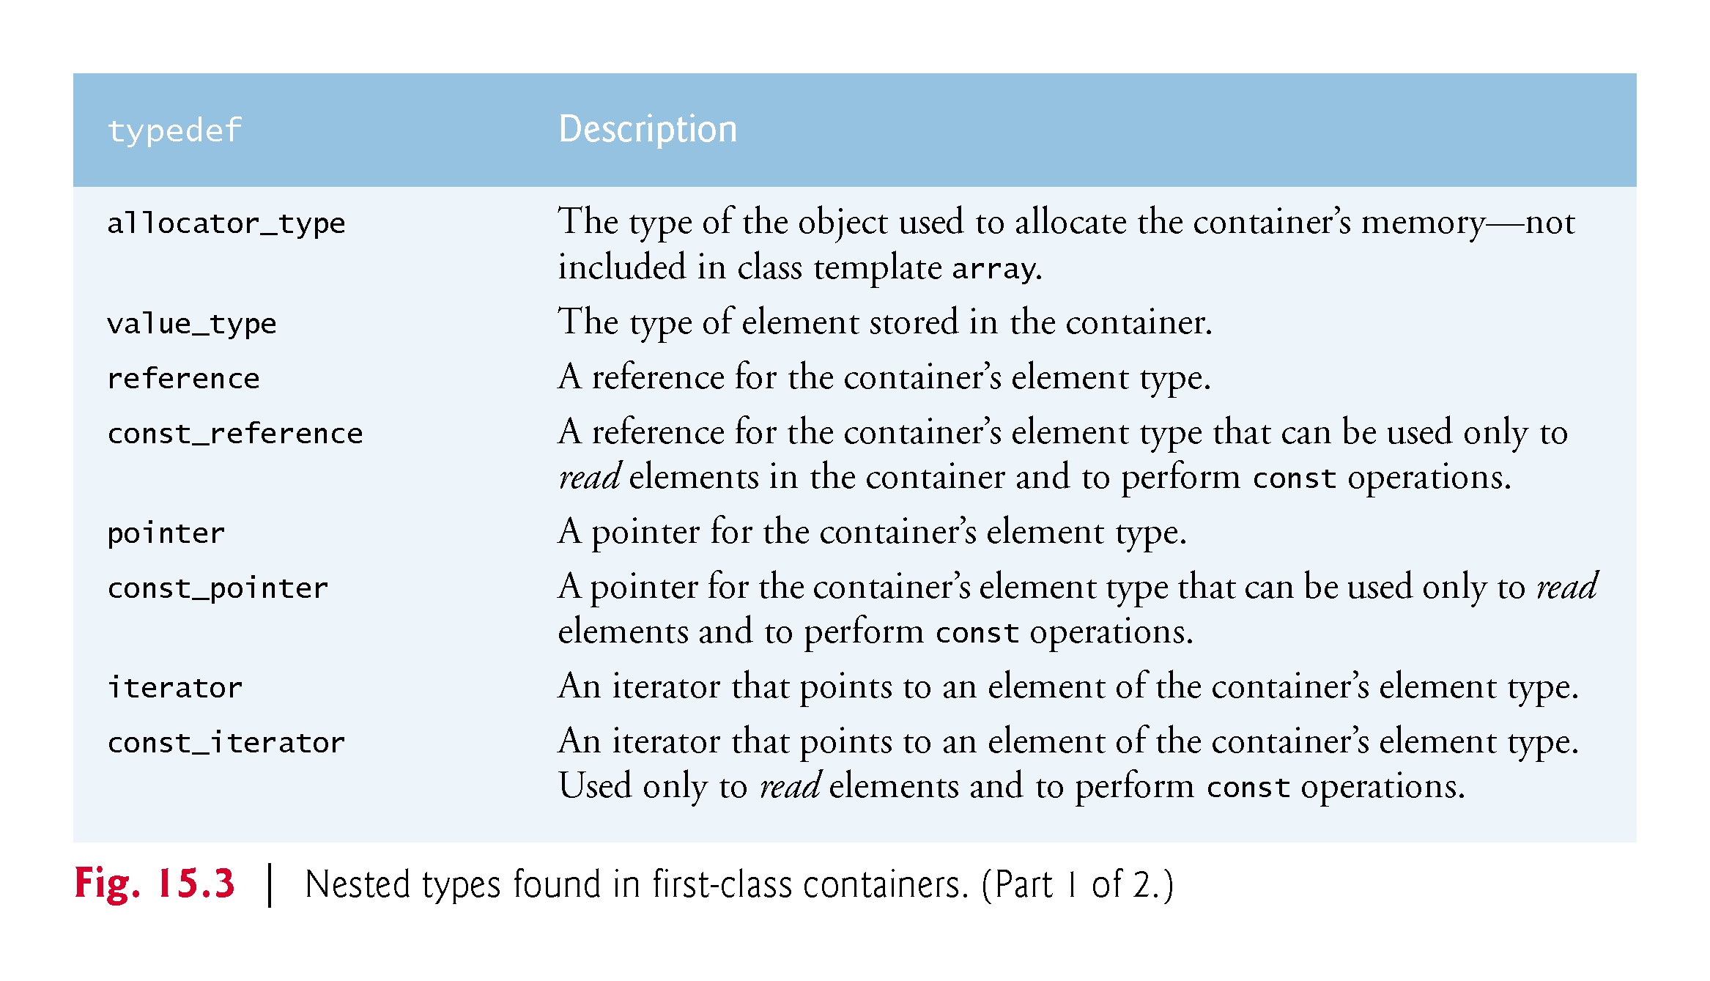
Notes:
Ob: const_reference const operations are the set of getter functions in a class. It’s the same for const_pointer and const_iterators and const_reverse_iterators

Slide 14
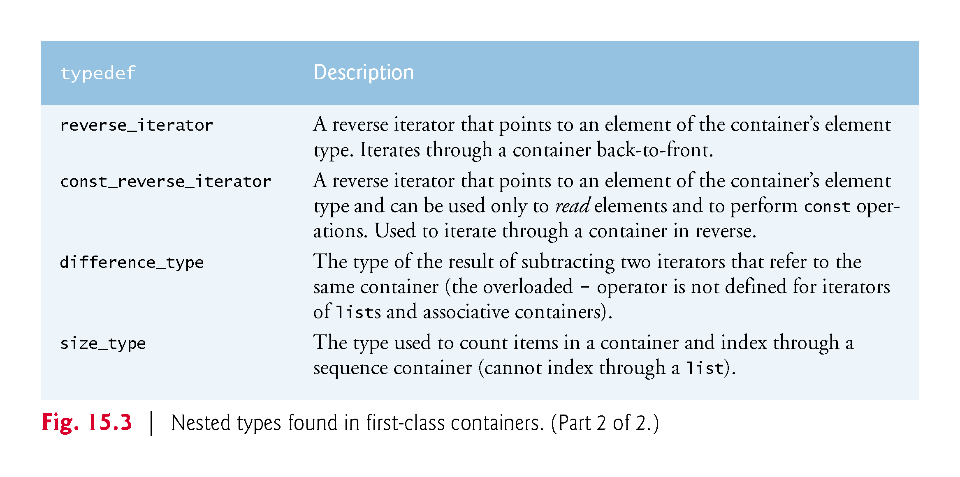

Slide 15
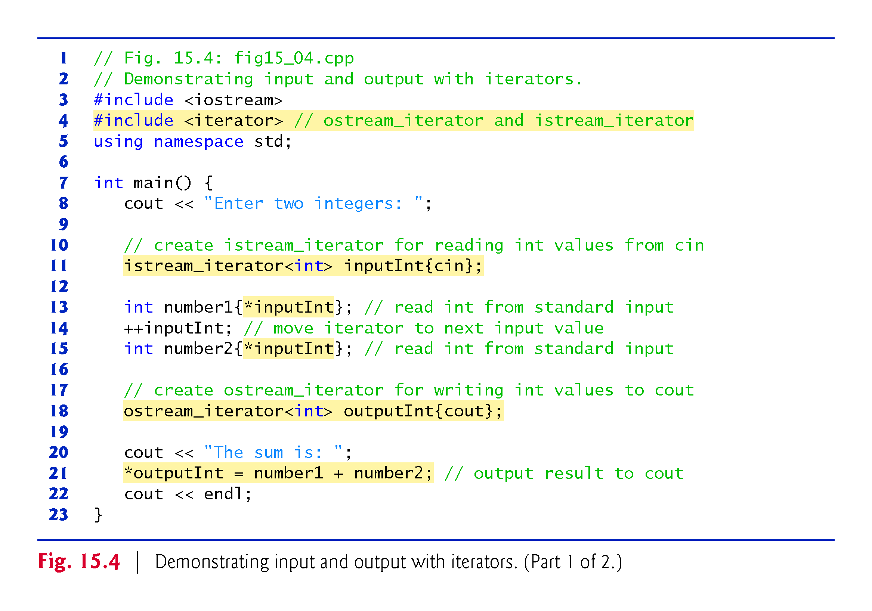

Slide 16
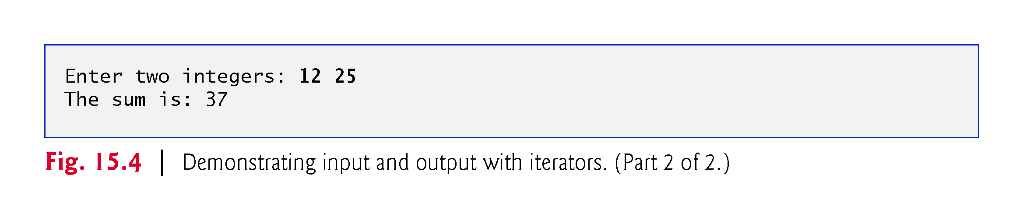

Slide 17
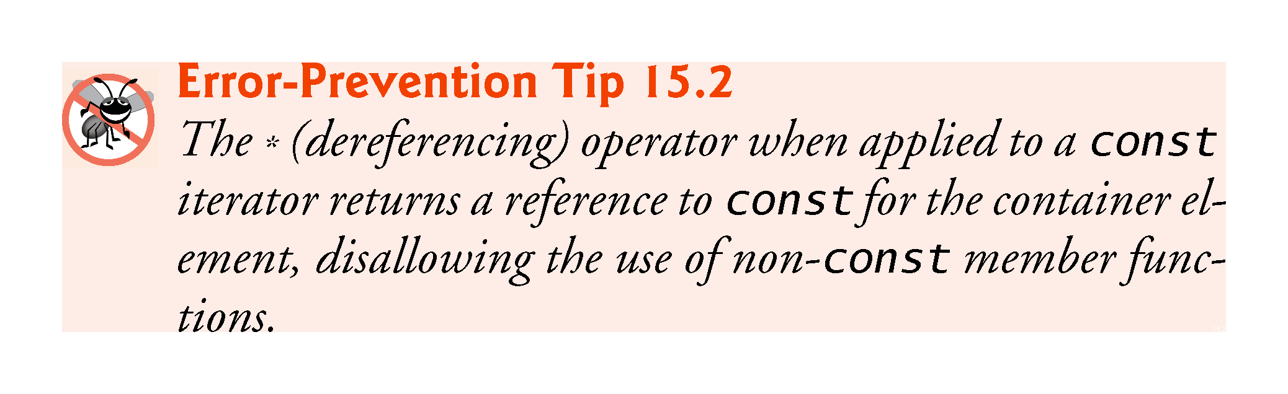

Slide 18
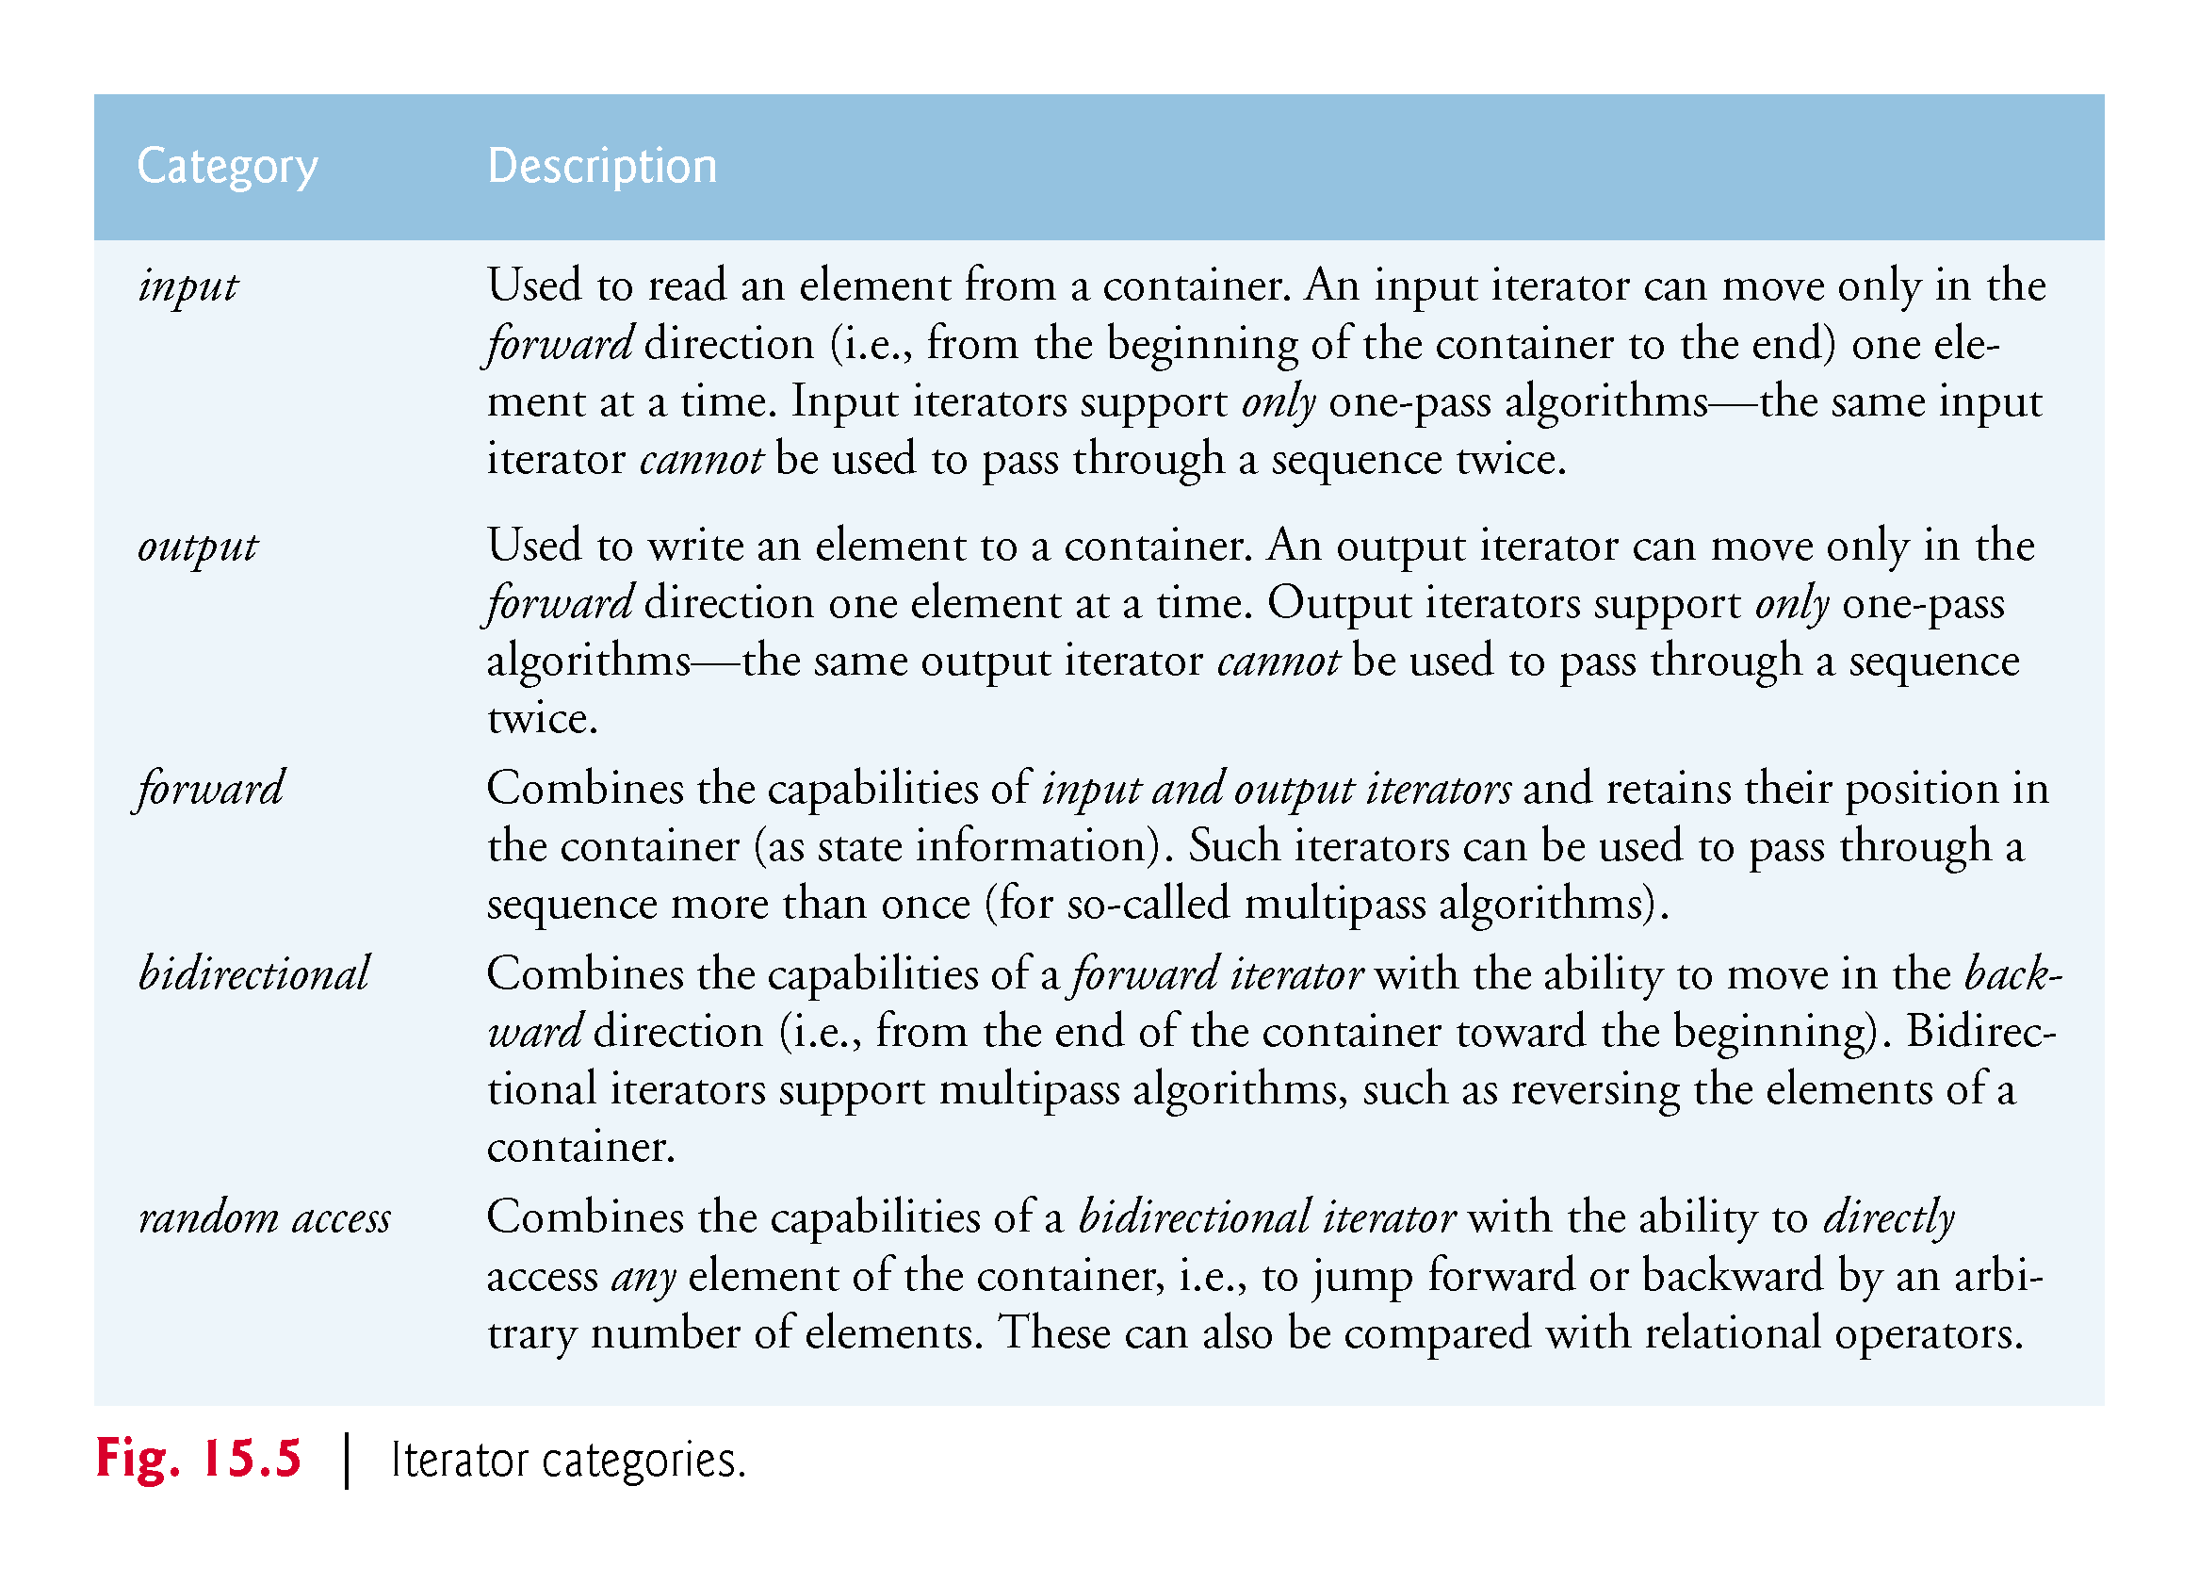

Slide 19
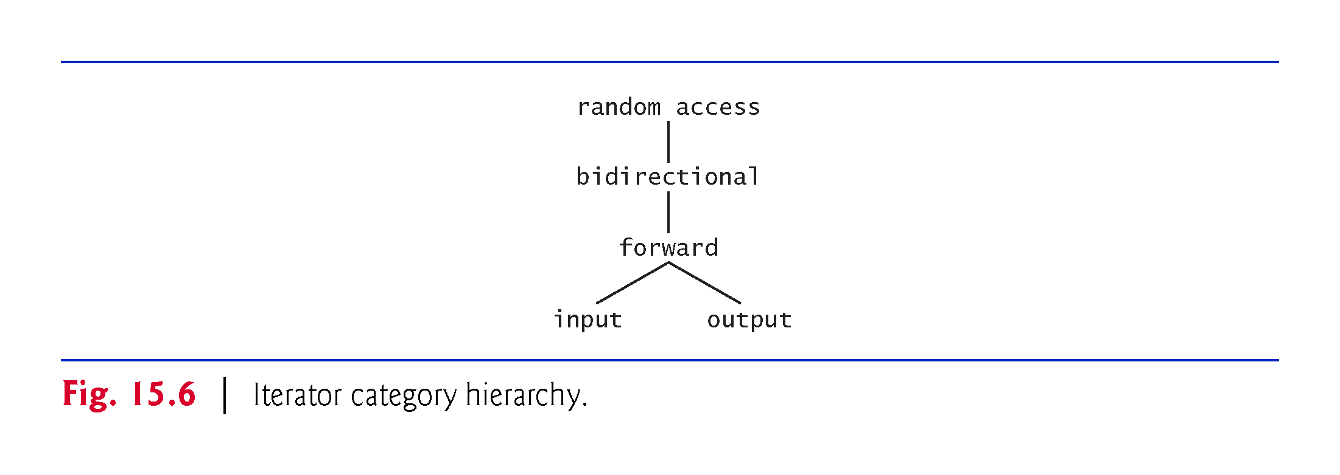

Slide 20
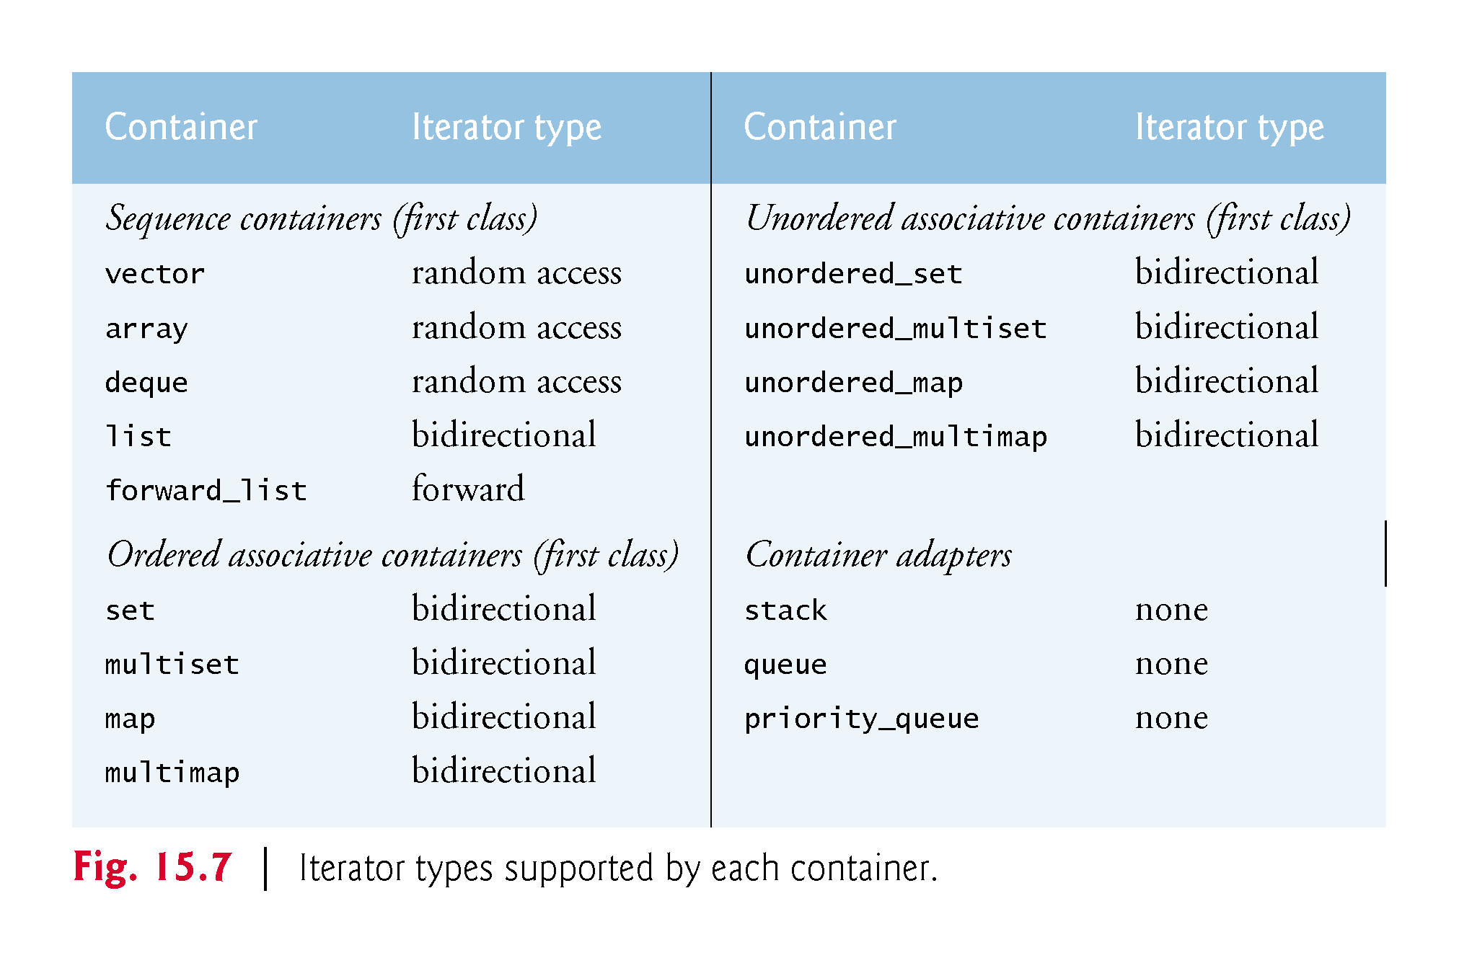

Slide 21
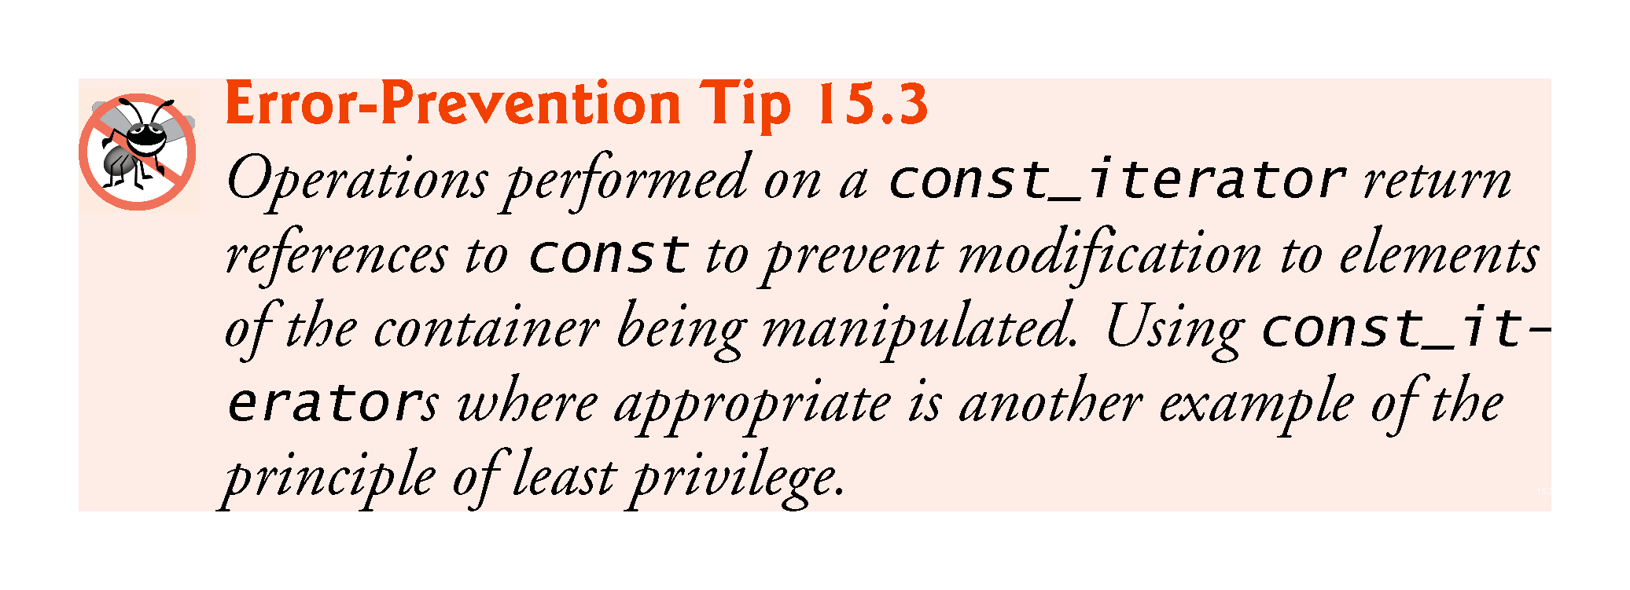

Slide 22
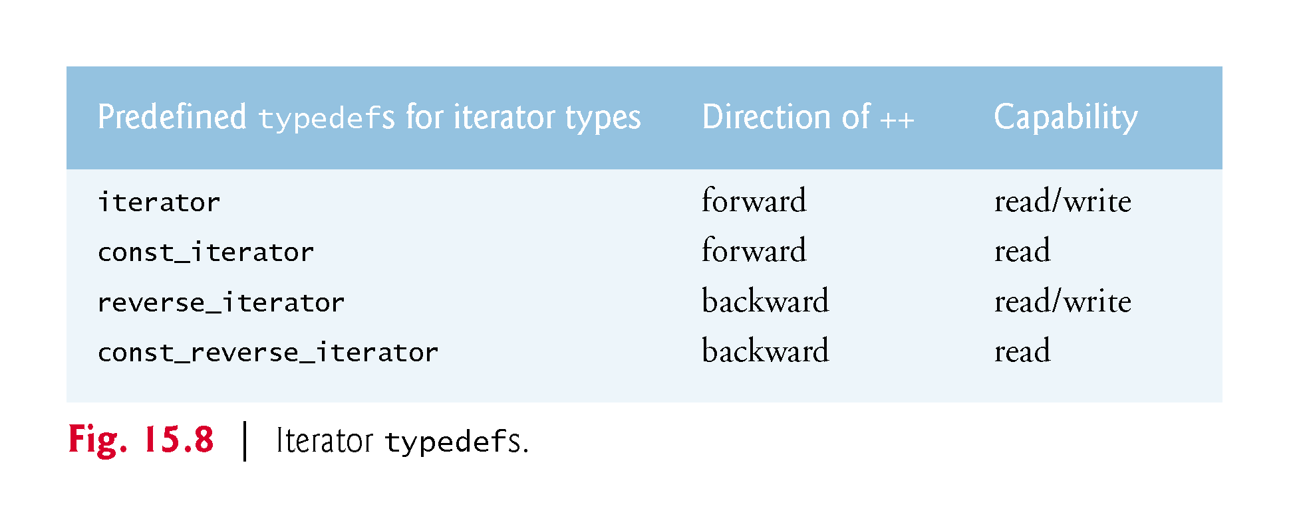

Slide 23
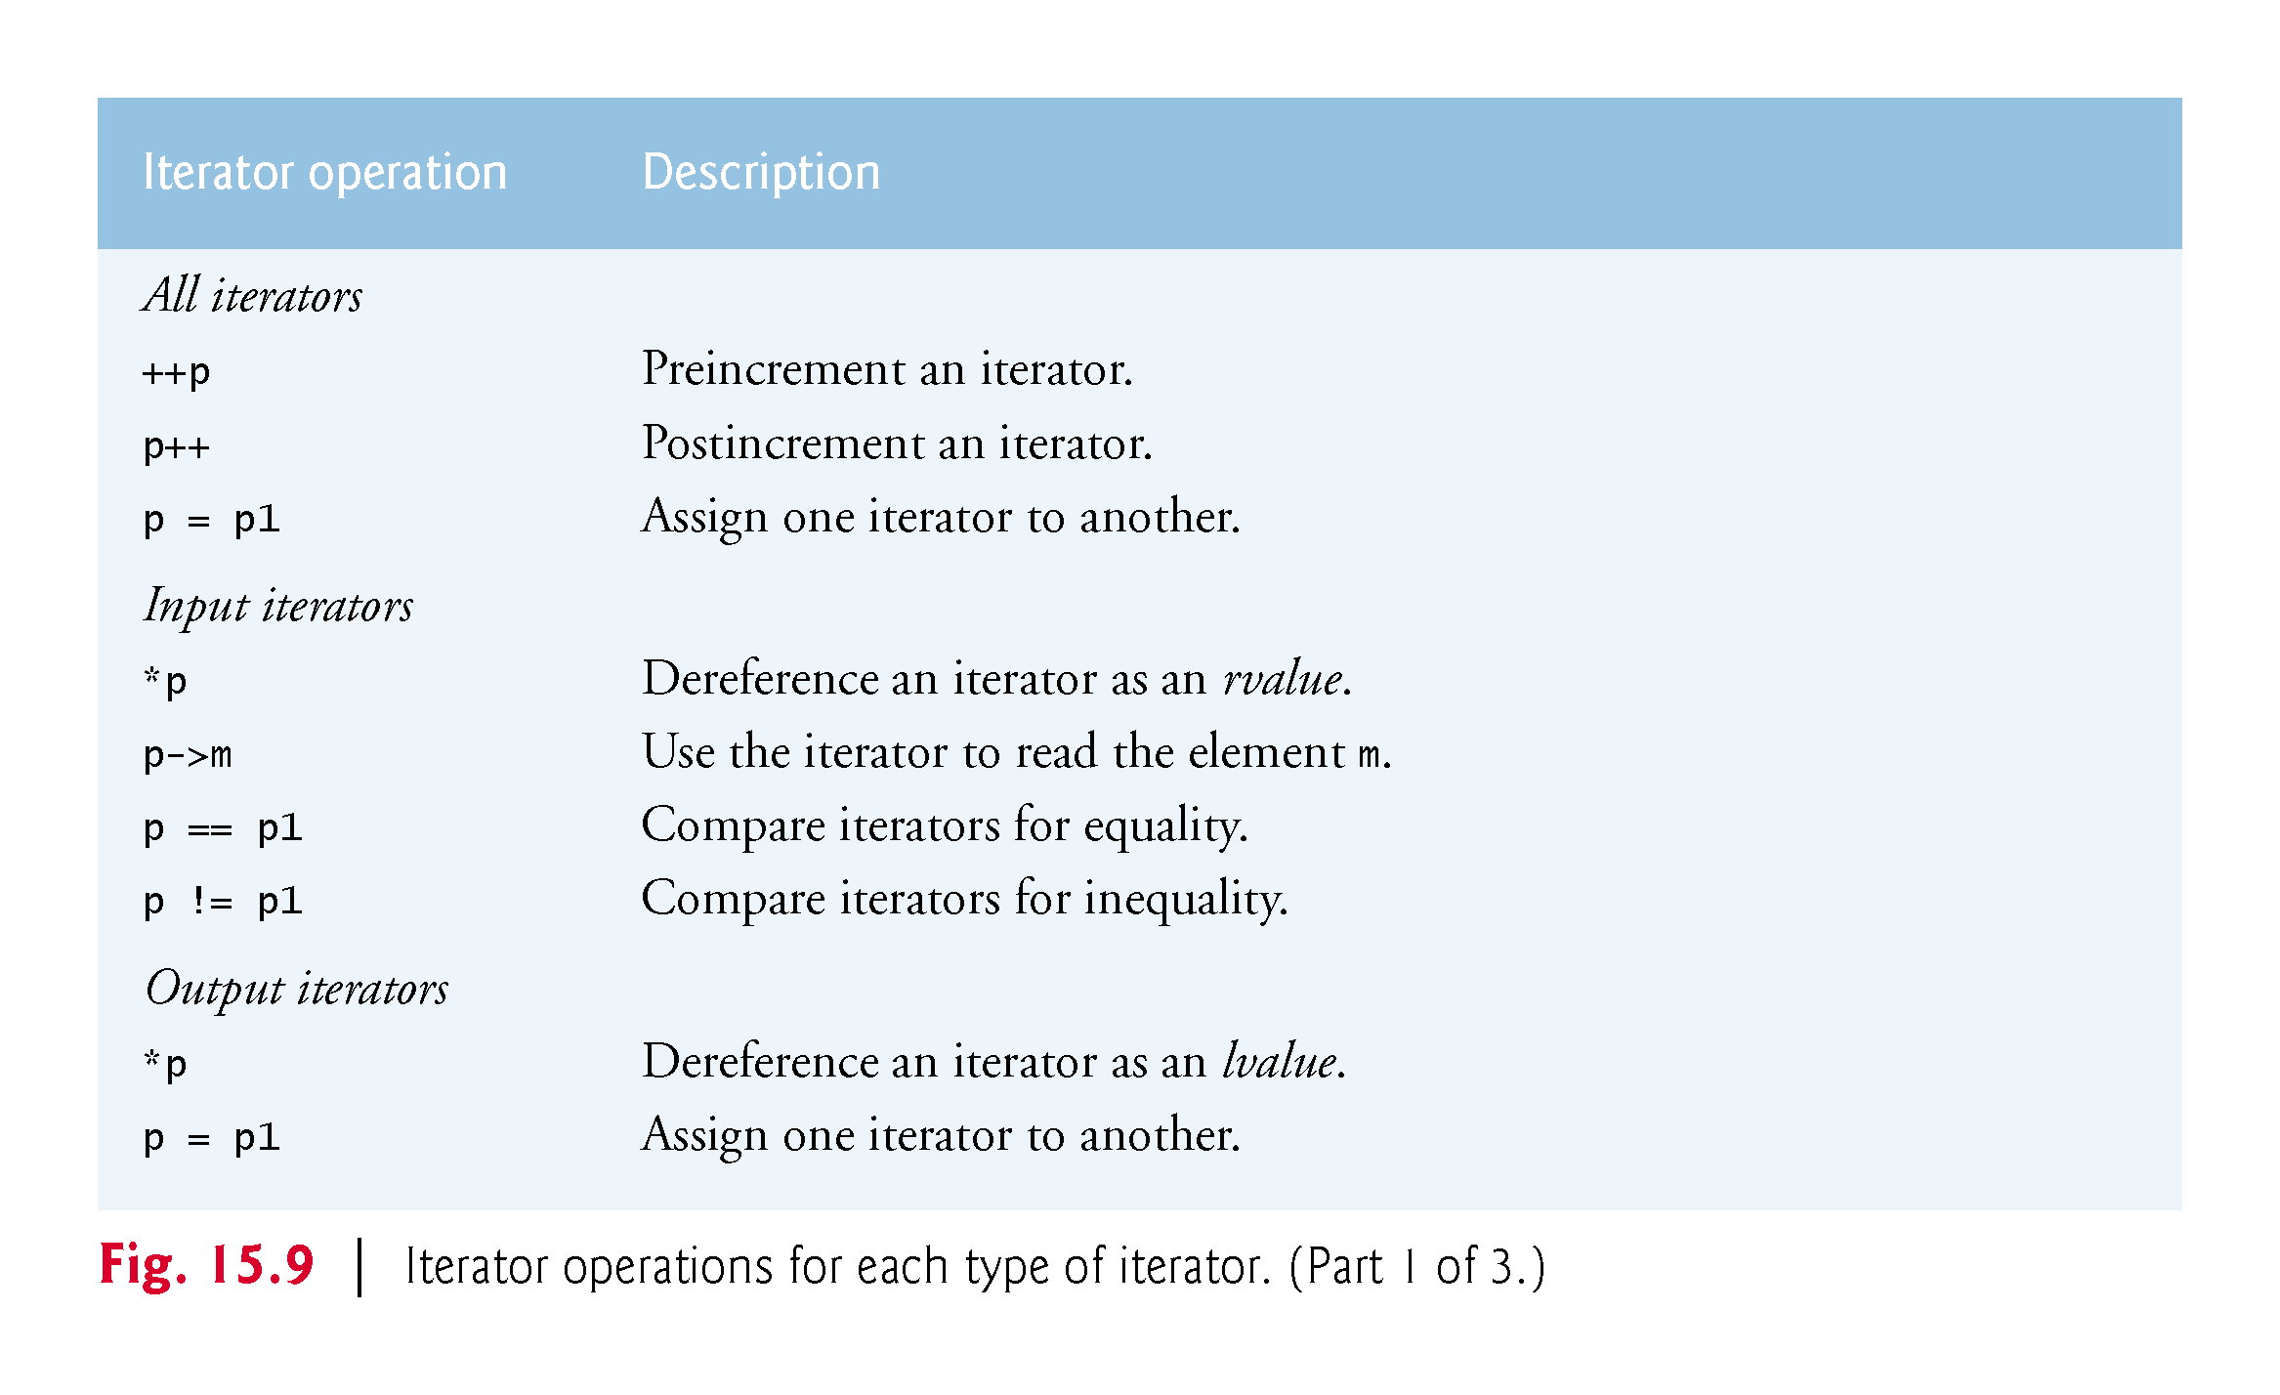

Slide 24
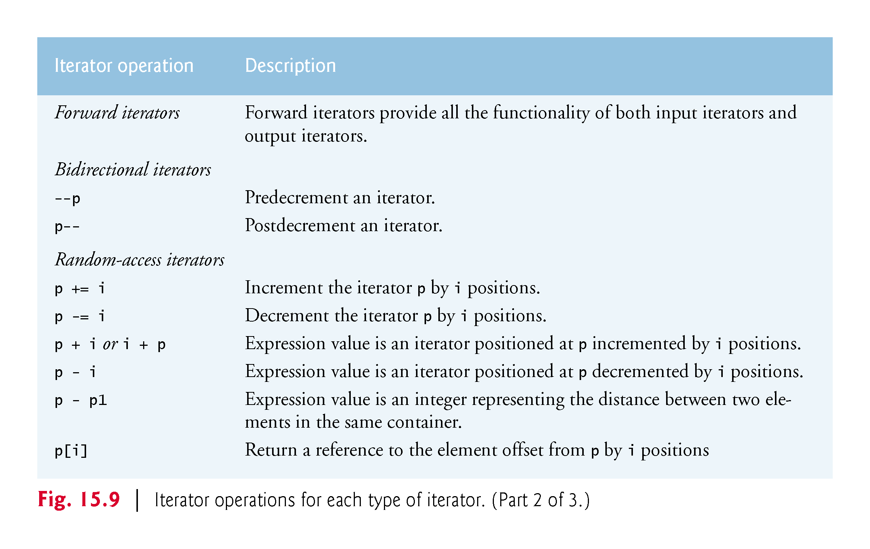

Slide 25
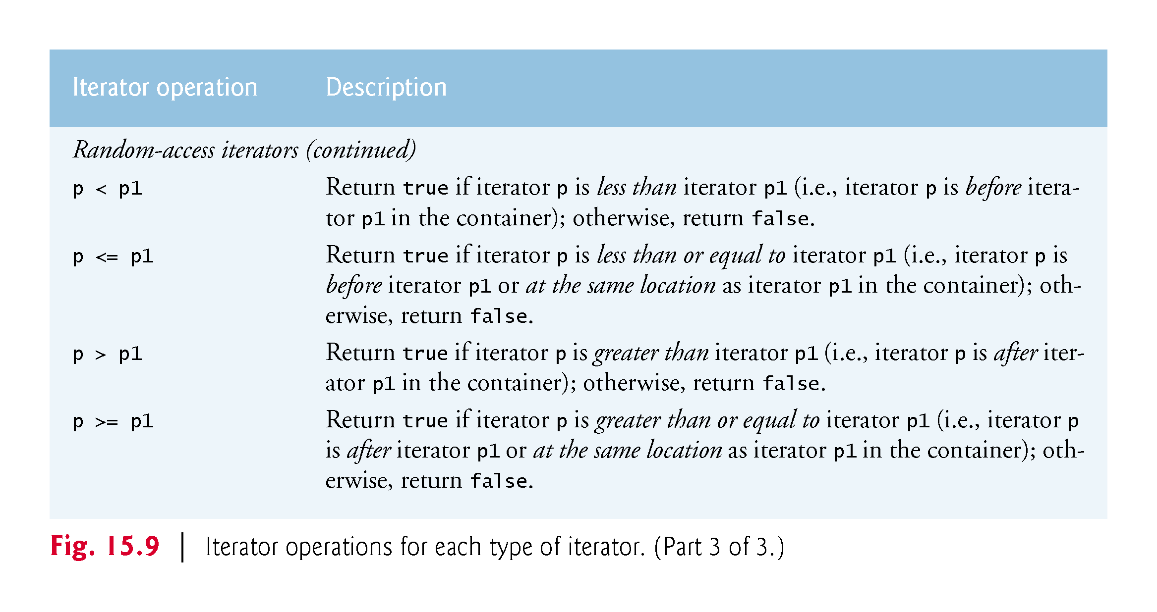

Slide 26
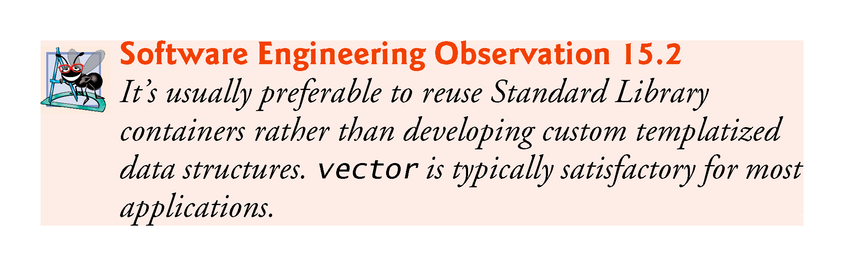

Slide 27
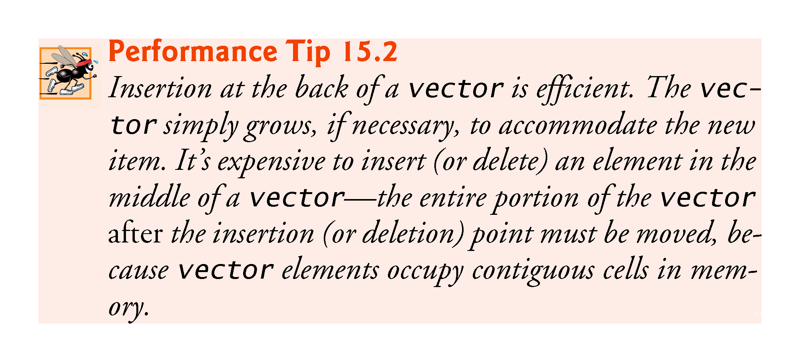

Slide 28
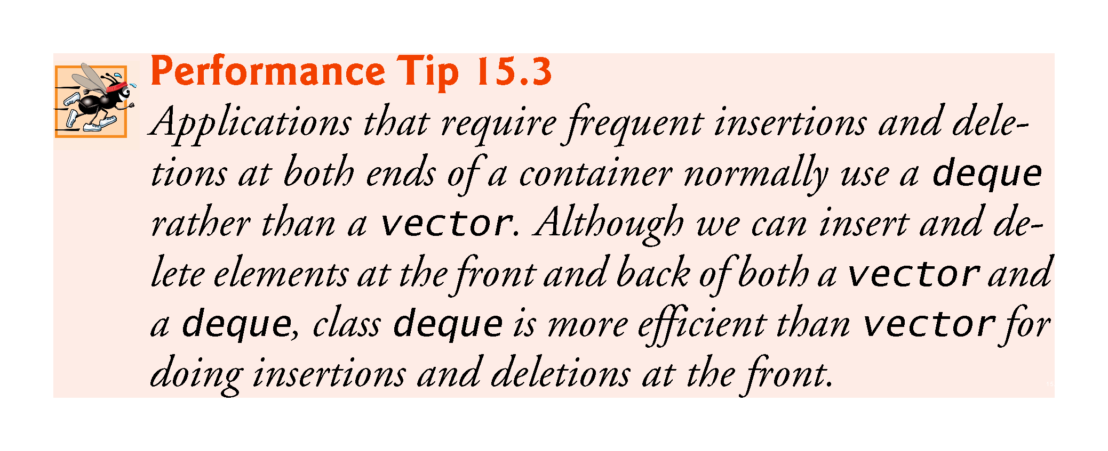

Slide 29
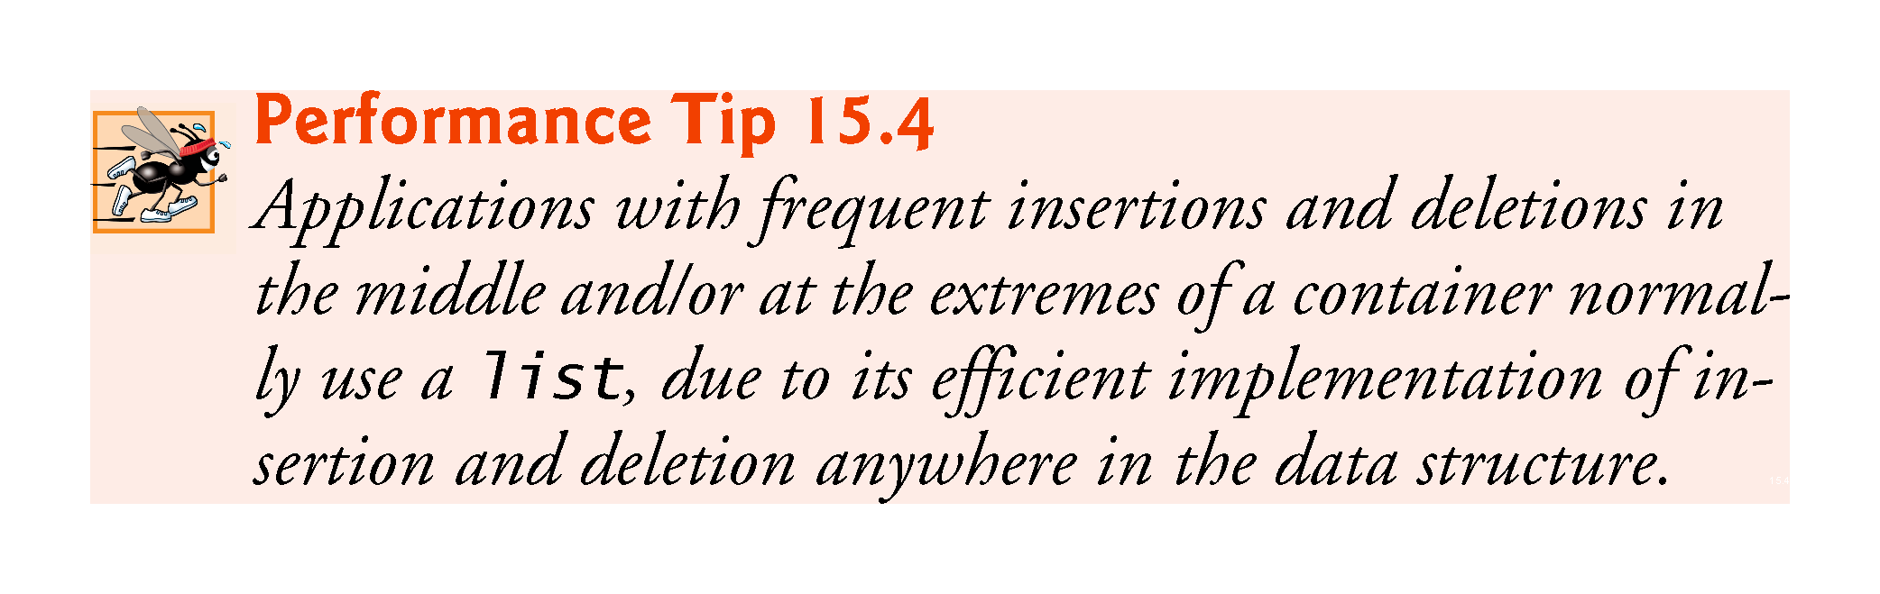

Slide 30


Slide 31
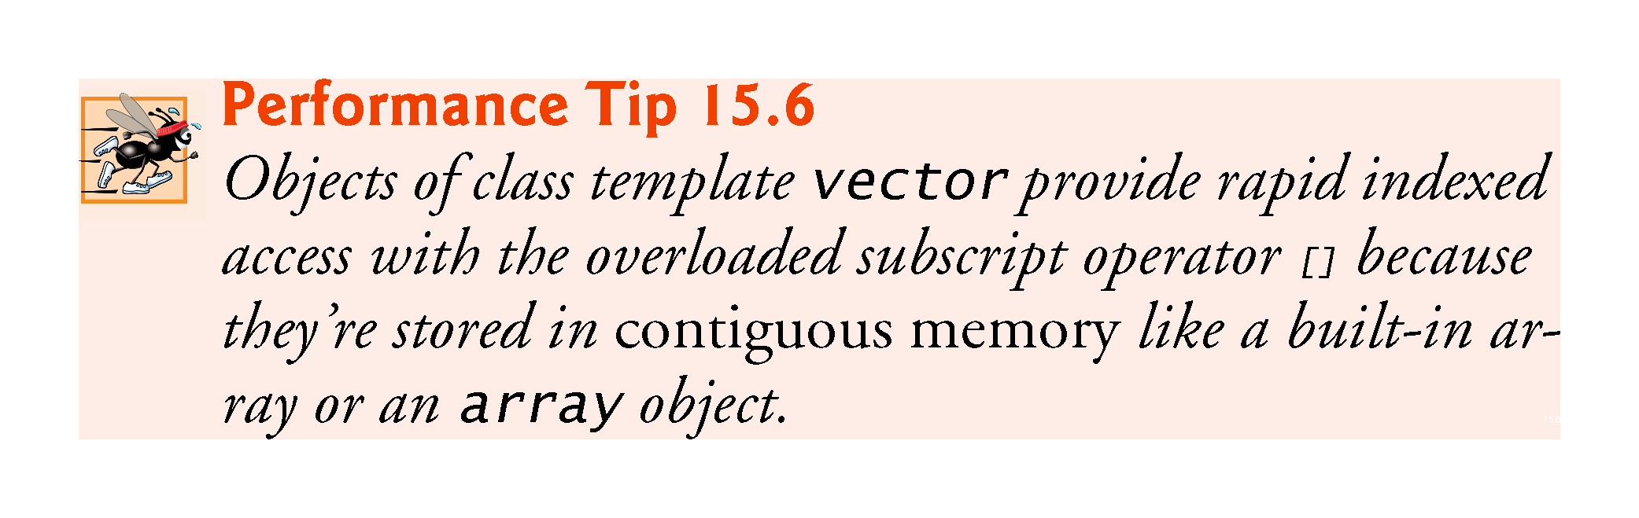

Slide 32
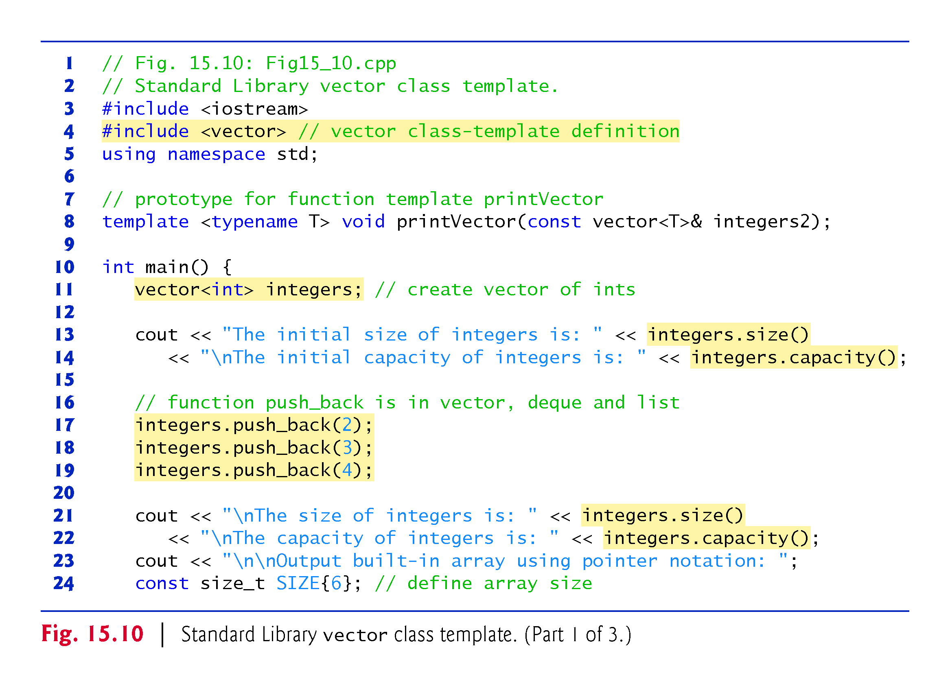
Notes:
Ob: size returns the number of elements currently stored in a container. Capacity returns the maximum number of elements that can be stored (i.e max-size) before the container needs to dynamically resize itself.

Slide 33
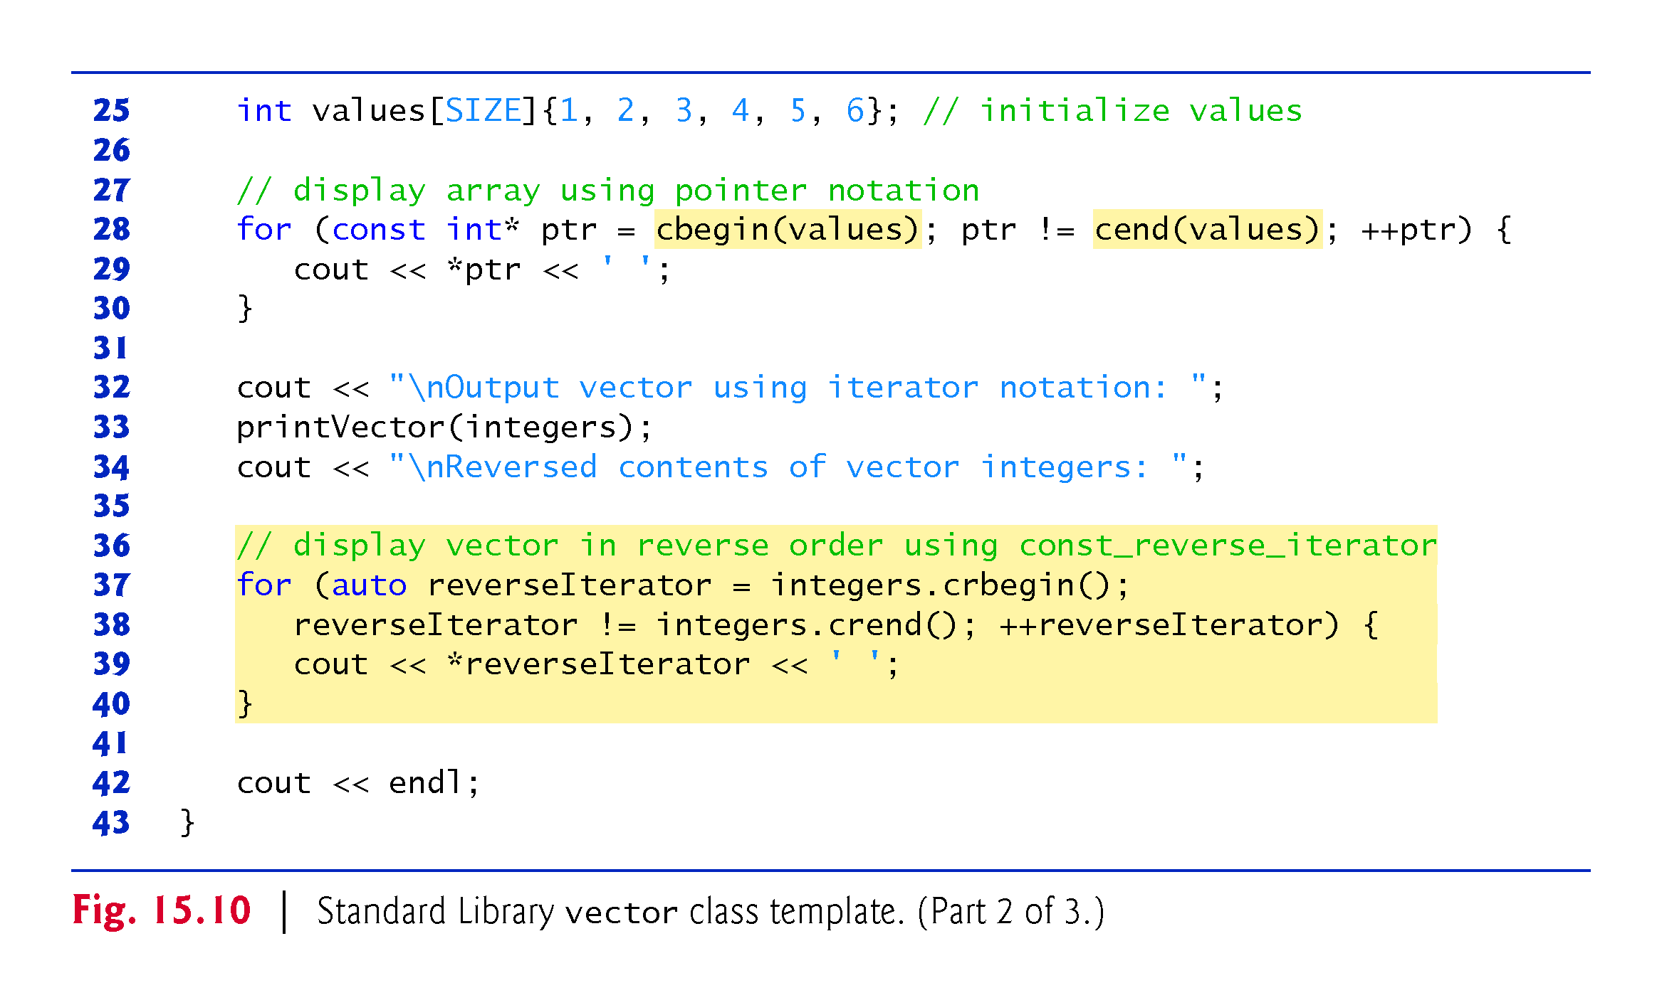
Notes:
Ob: Note that these operations are applied in 2 arrays – values and integers

Slide 34
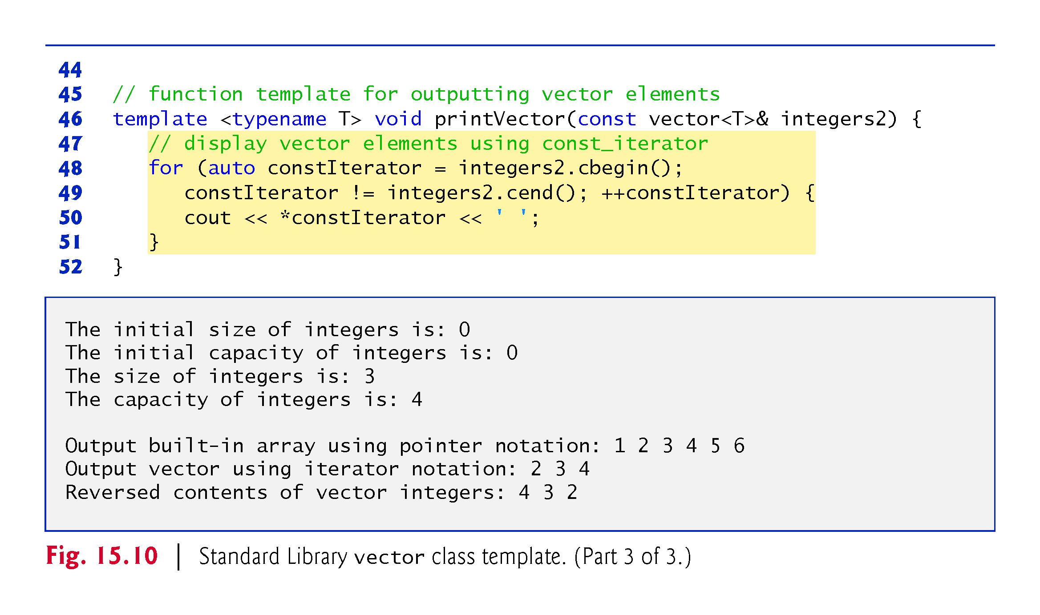

Slide 35
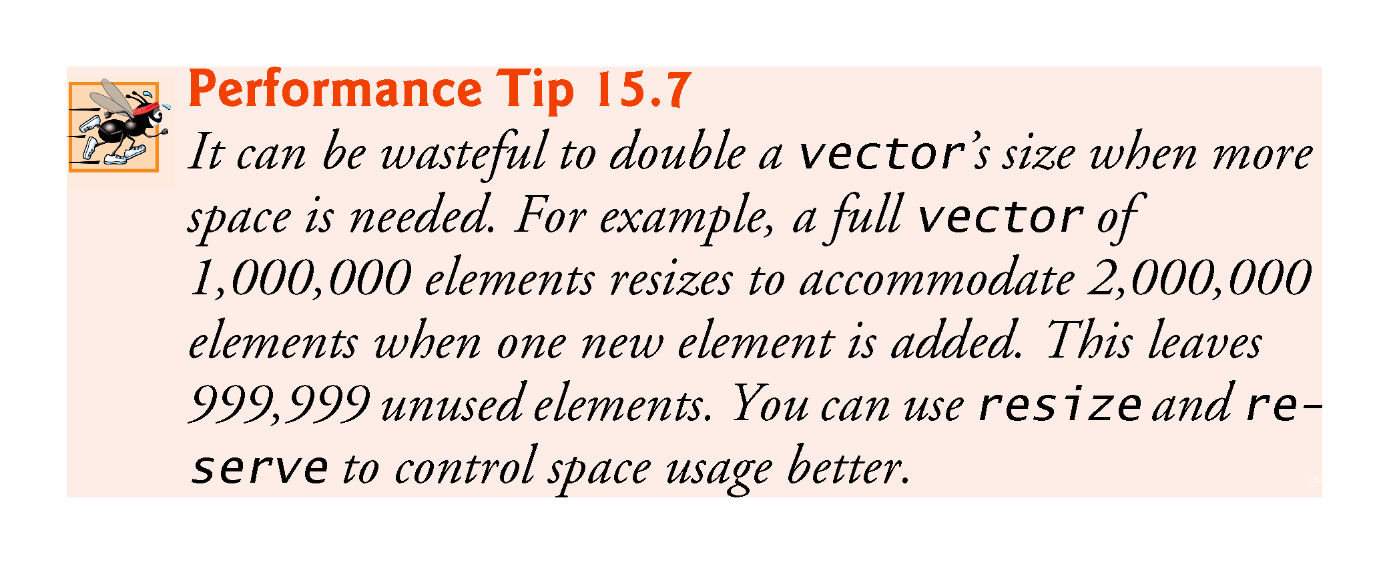

Slide 36
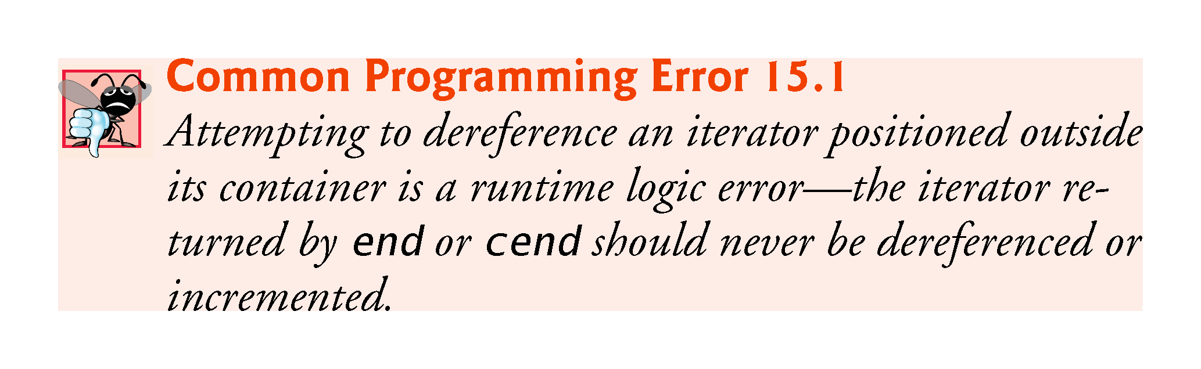

Slide 37
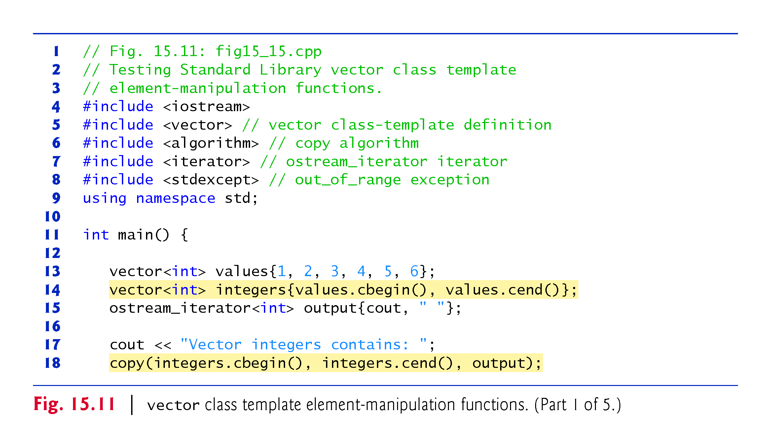
Notes:
Ob: values.begin(),values.end() initialize array integers with the contents of the values array. Copy is a function that reads from the input container (in this case the array integers) through iterator functions cbegin() and cend(). Elements are copied to the location specified by the output iterator – output.

Slide 38
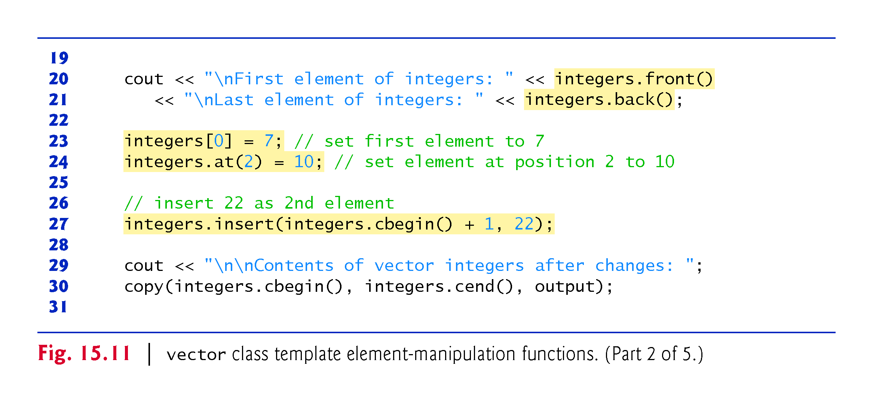
Notes:
Ob: difference between front() and begin().front() returns a reference to the first element of the container, begin() returns a random access iterator pointing to the first element inj the container. Back() returns a reference to the last element in the container, end() returns a random access iterator pointing to the location after the last element in the container.
Ob: watch what is happening with the insertions.

Slide 39
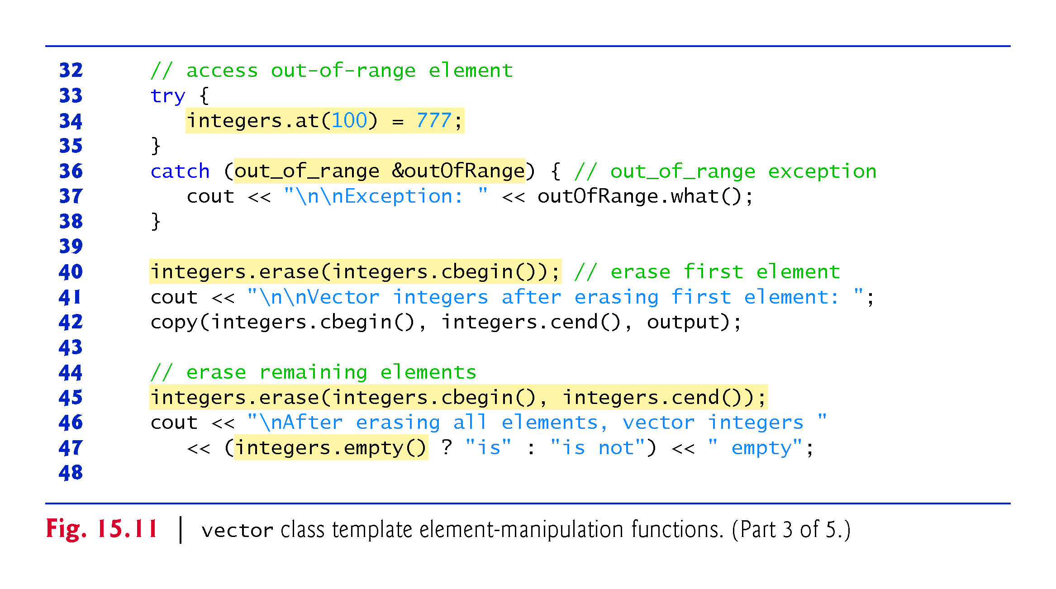

Slide 40
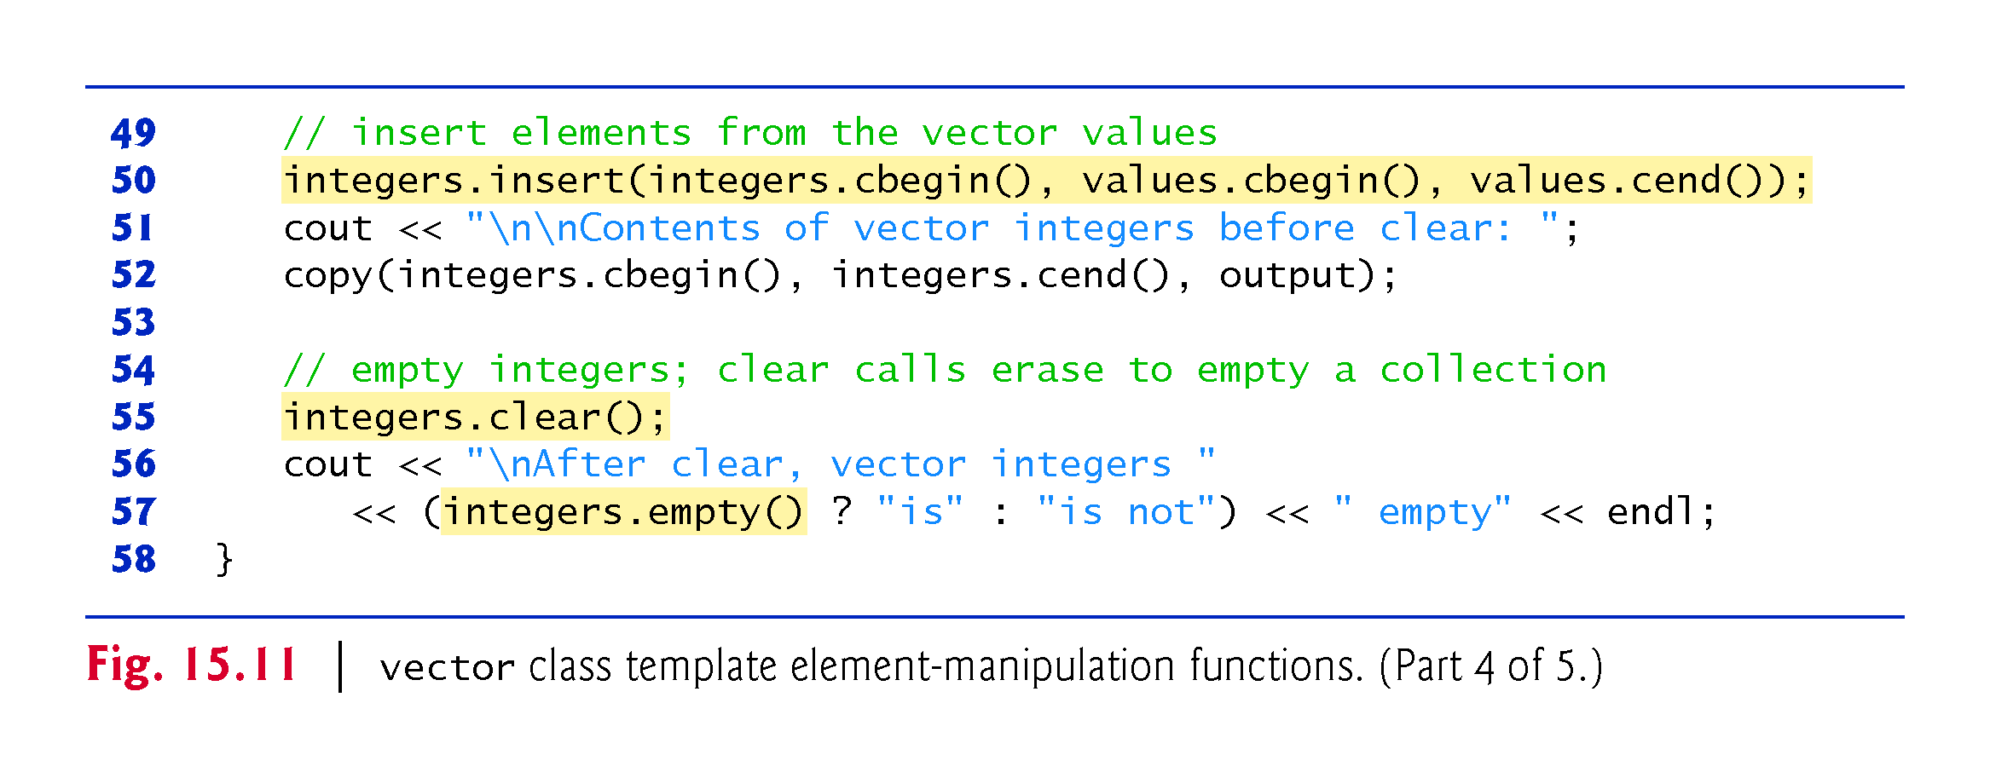
Notes:
Ob: clear does not necessarily return the vector’s memory to the system

Slide 41
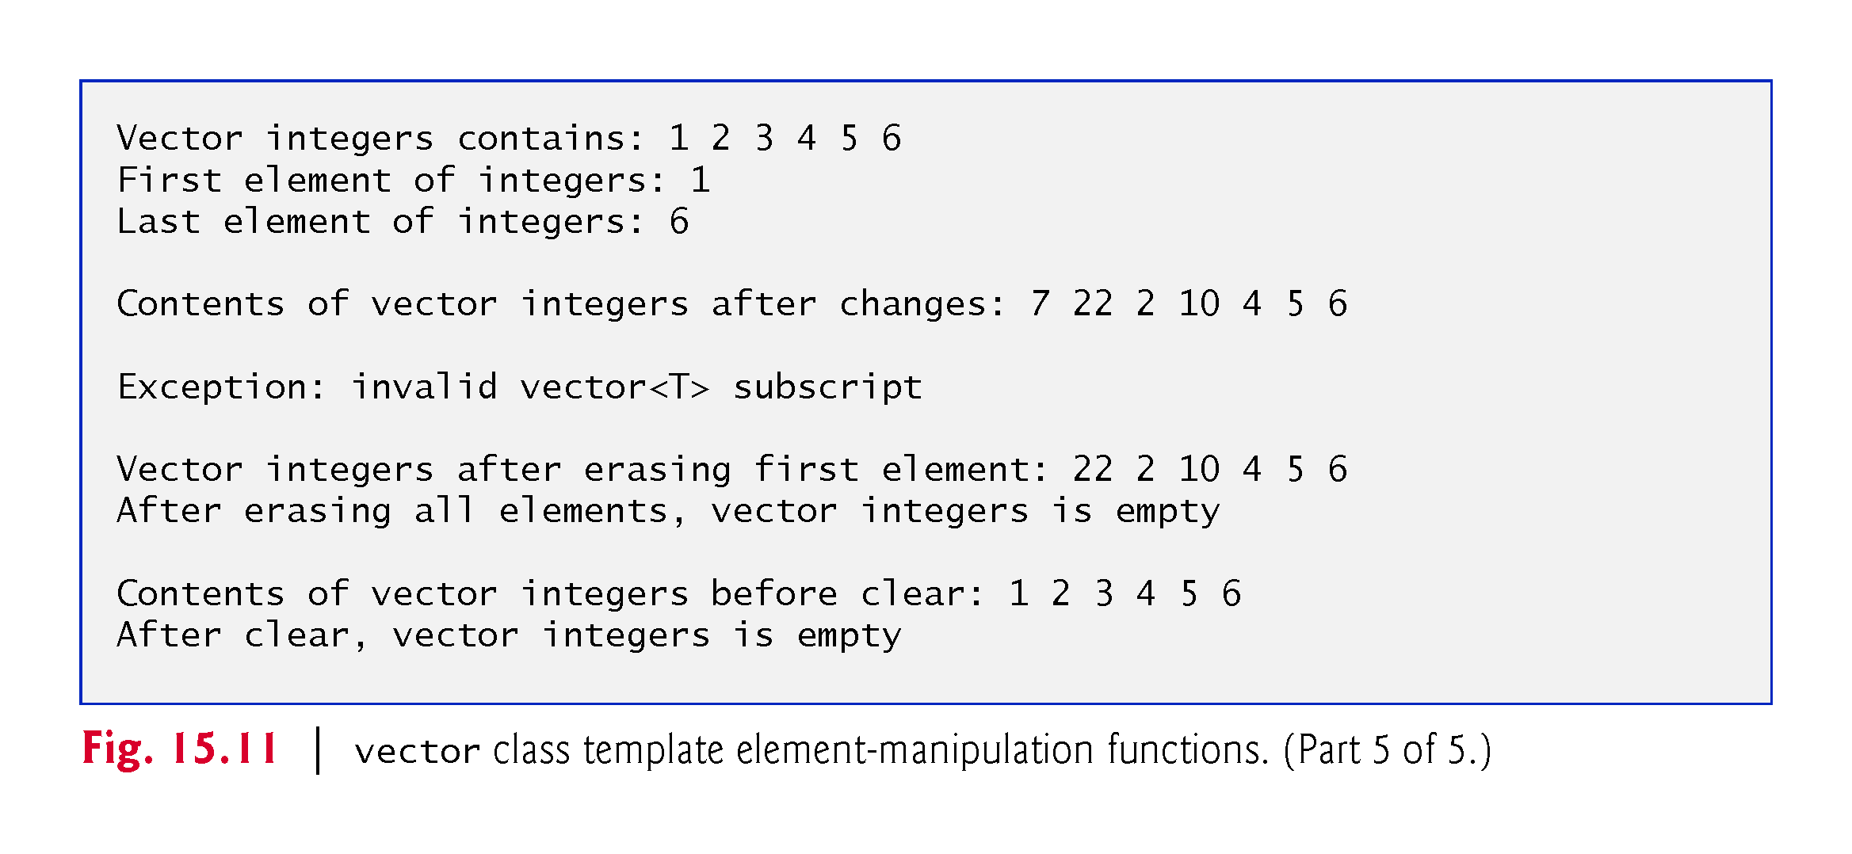

Slide 42


Slide 43
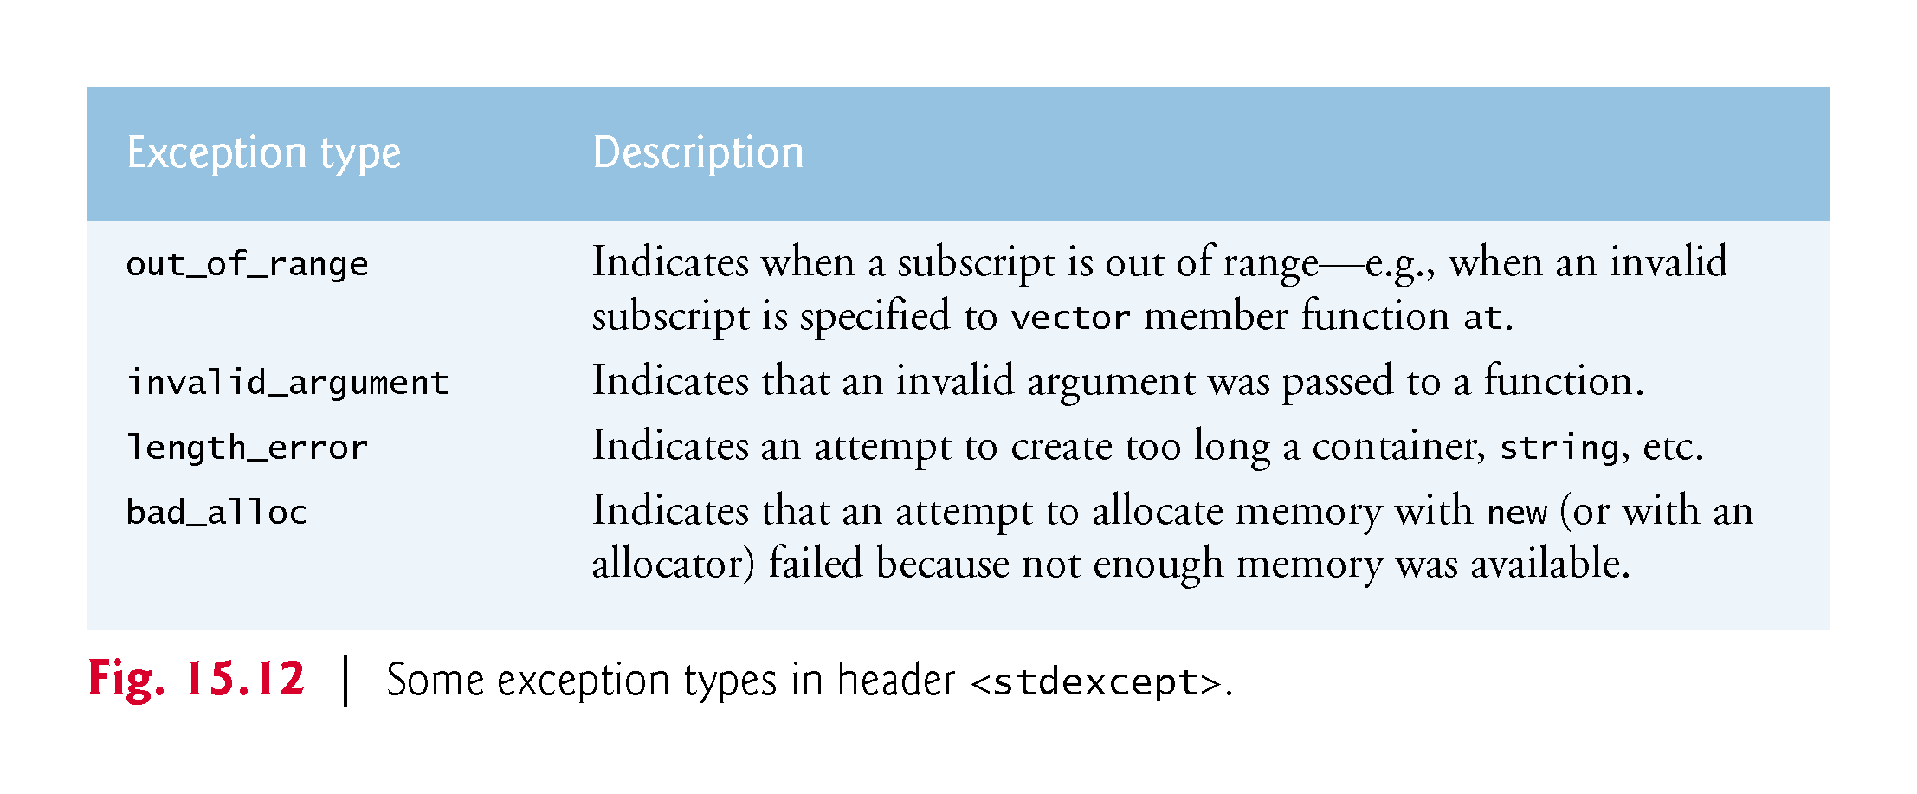

Slide 44
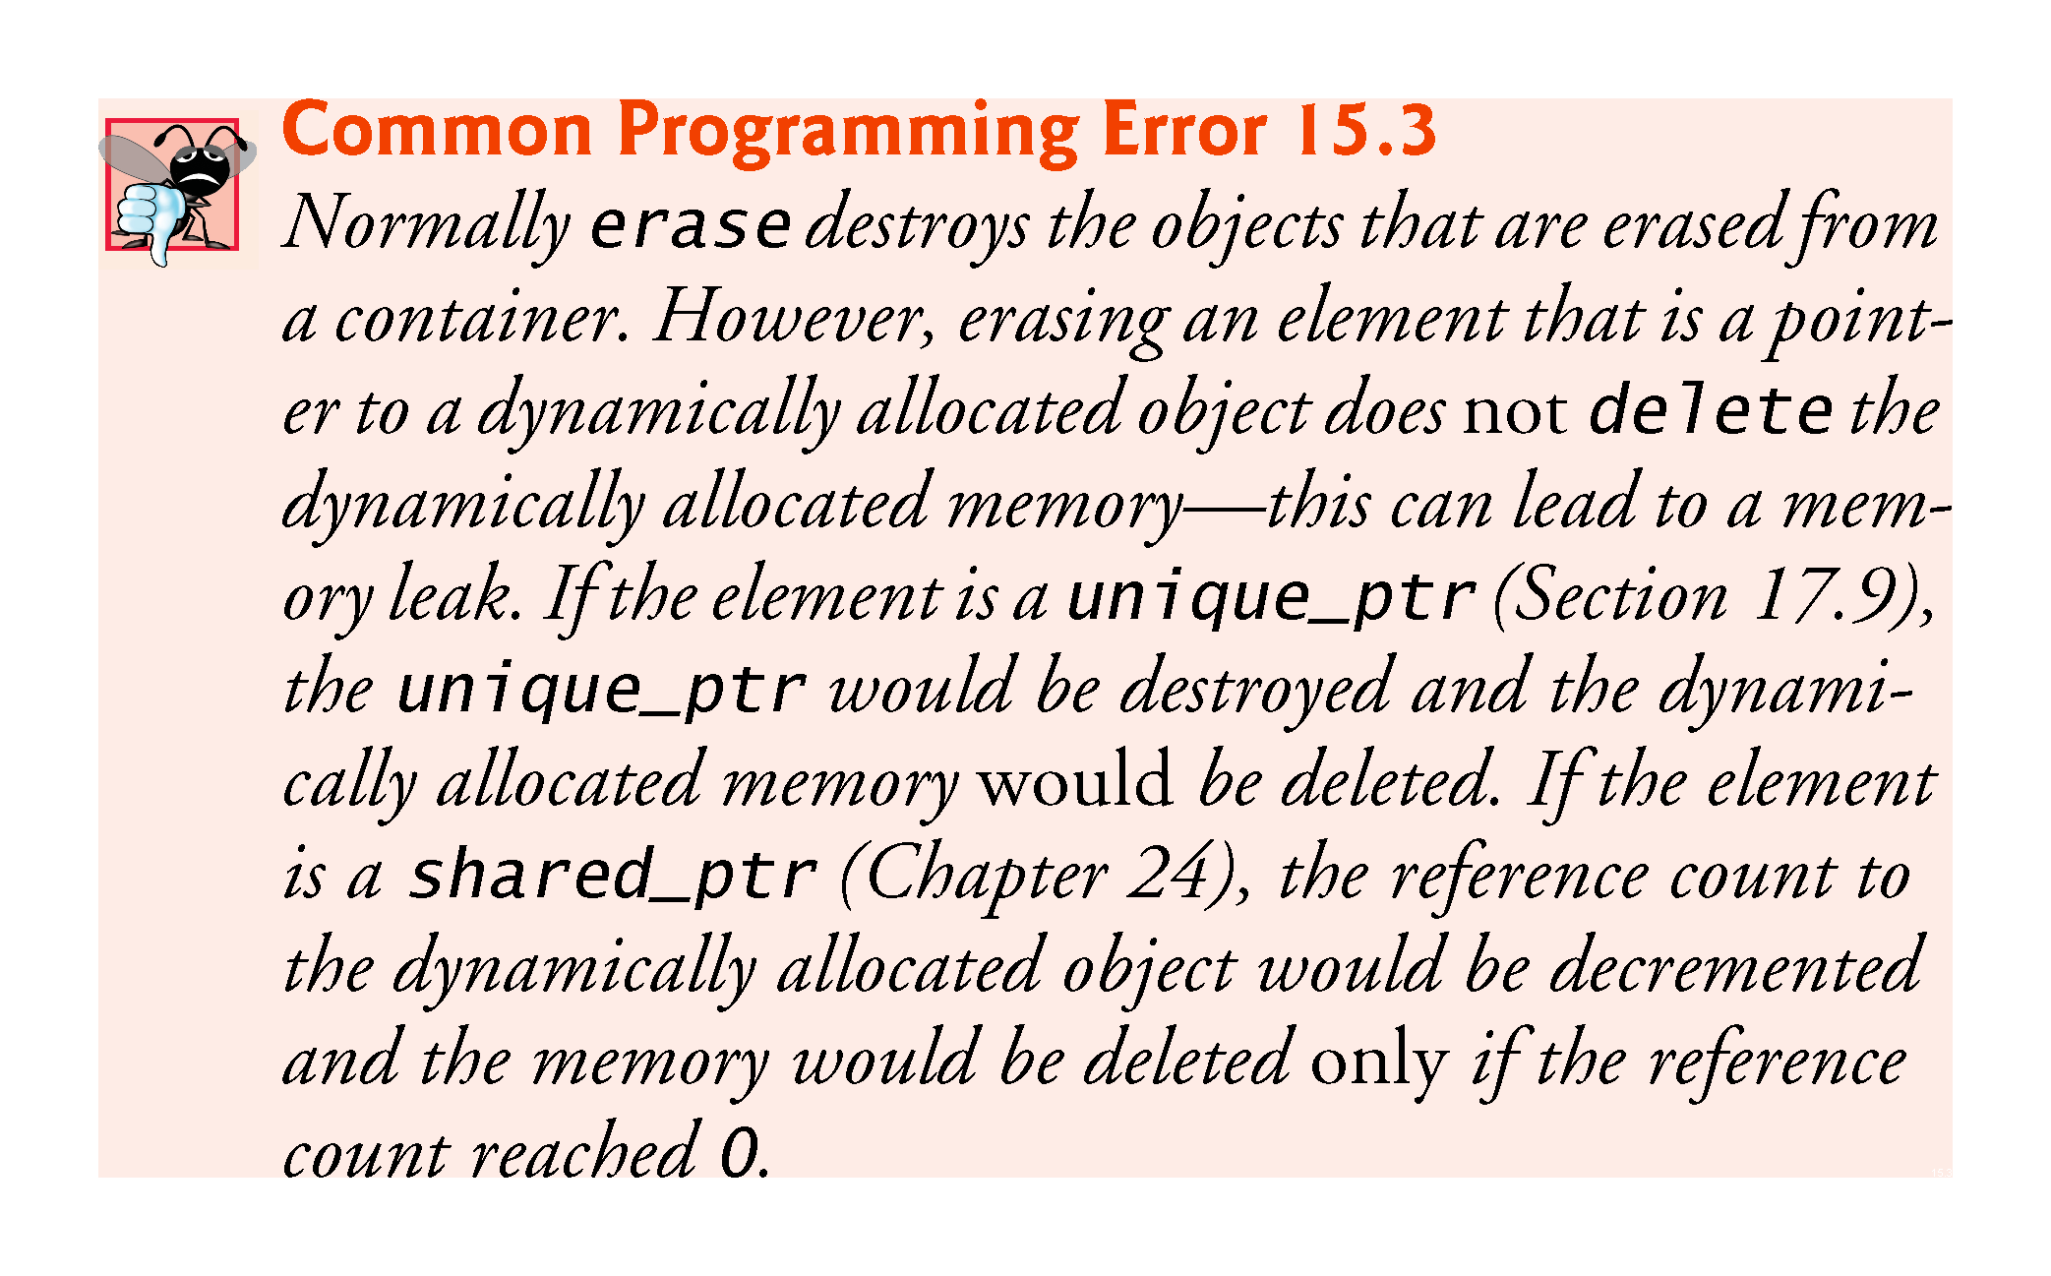

Slide 45
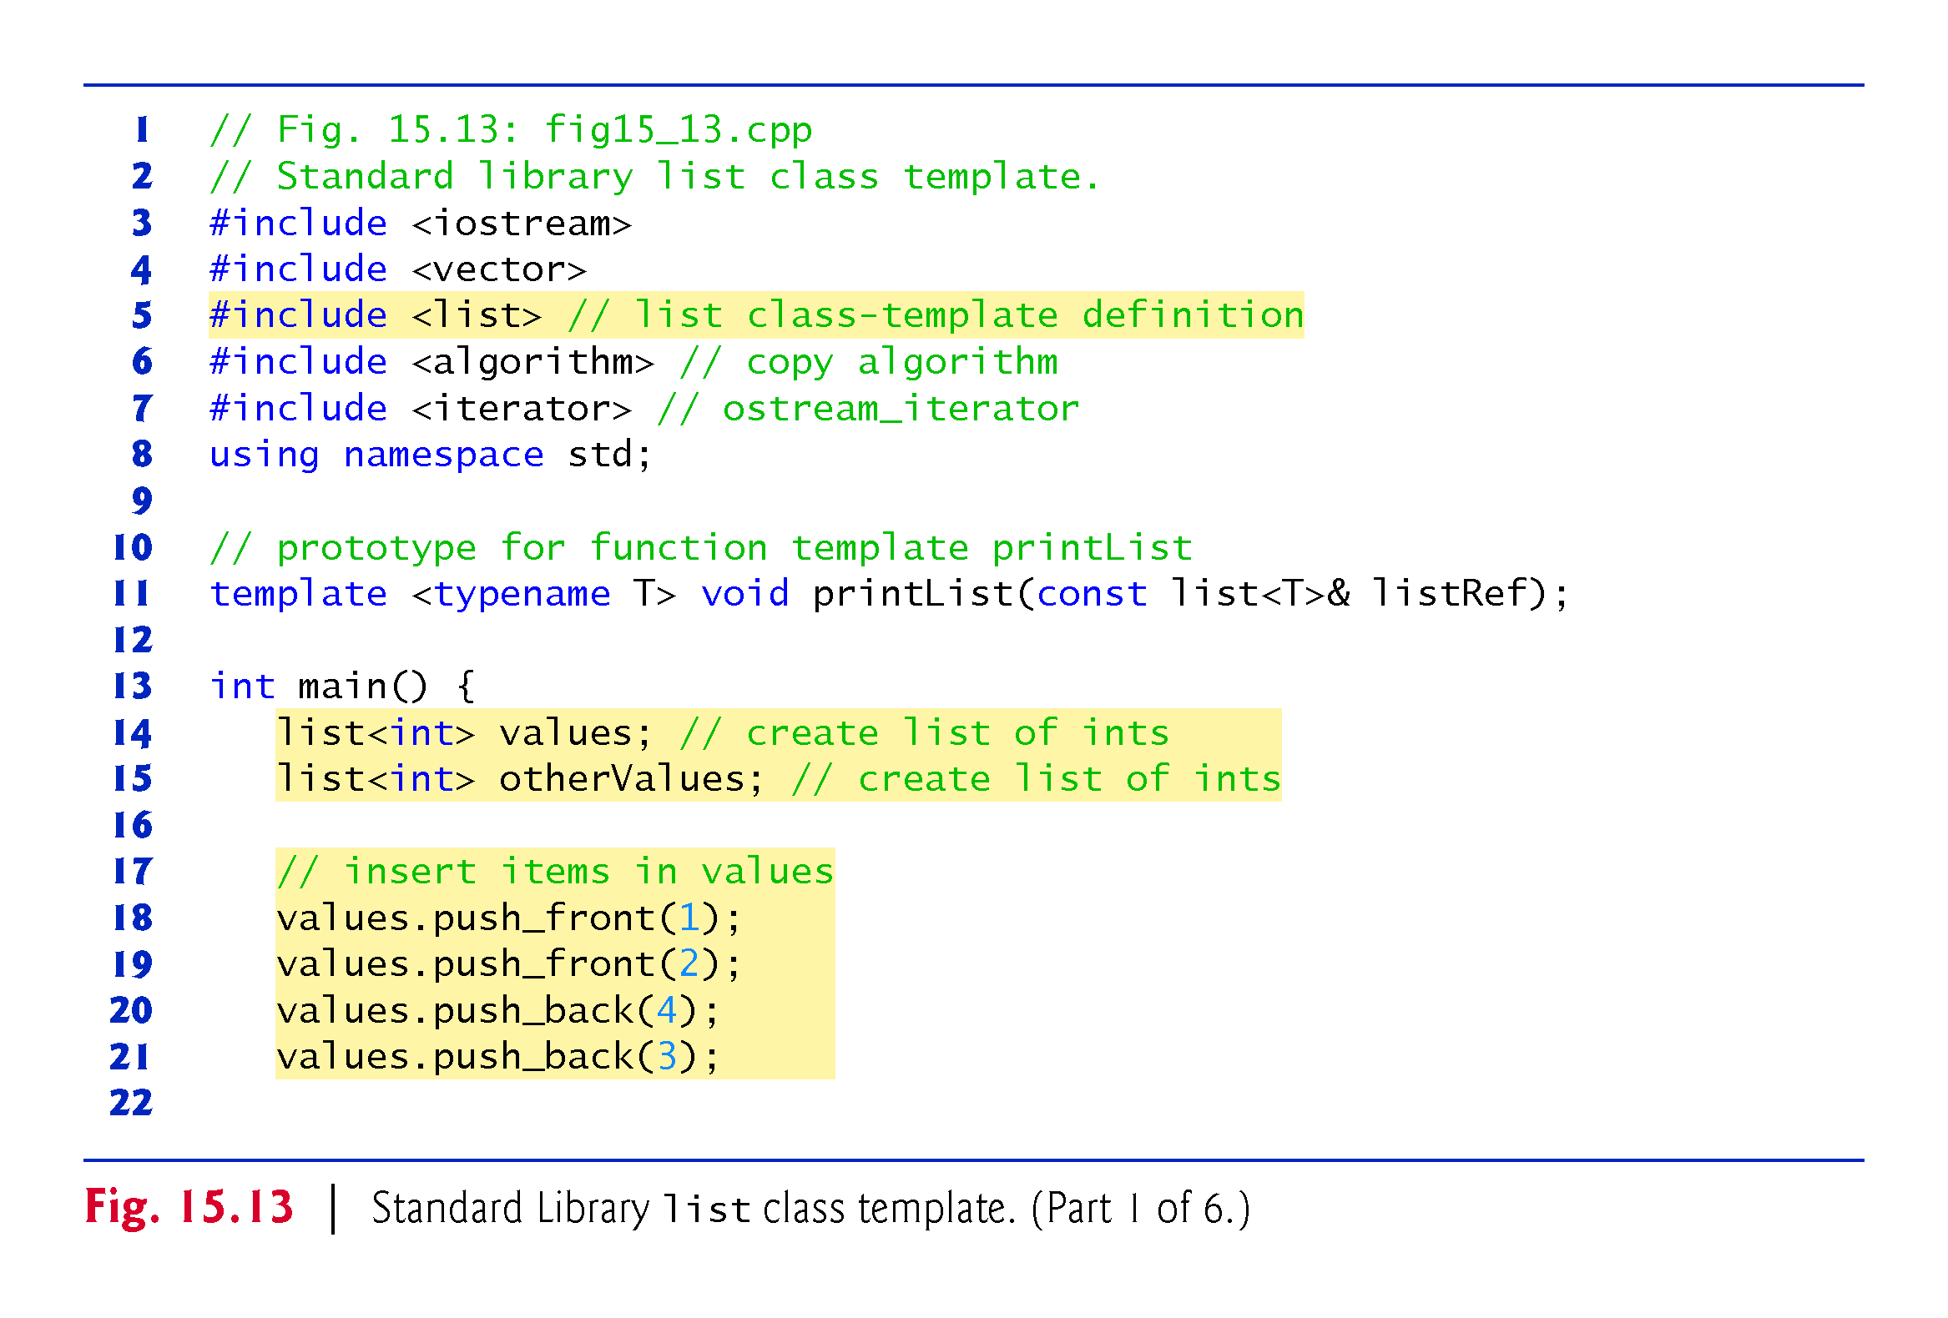

Slide 46
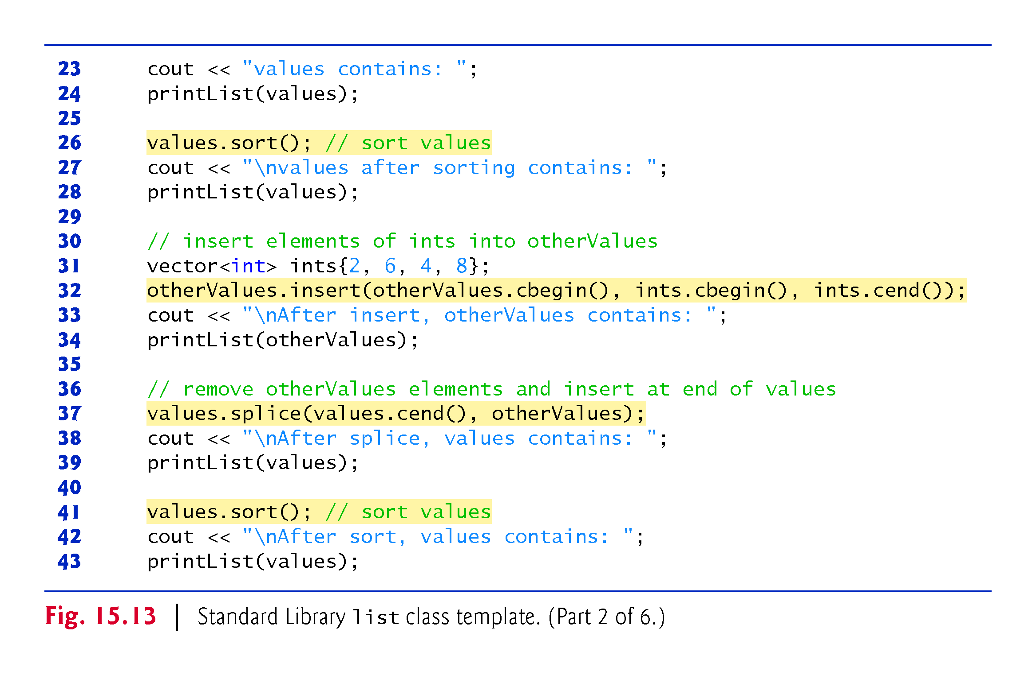

Slide 47
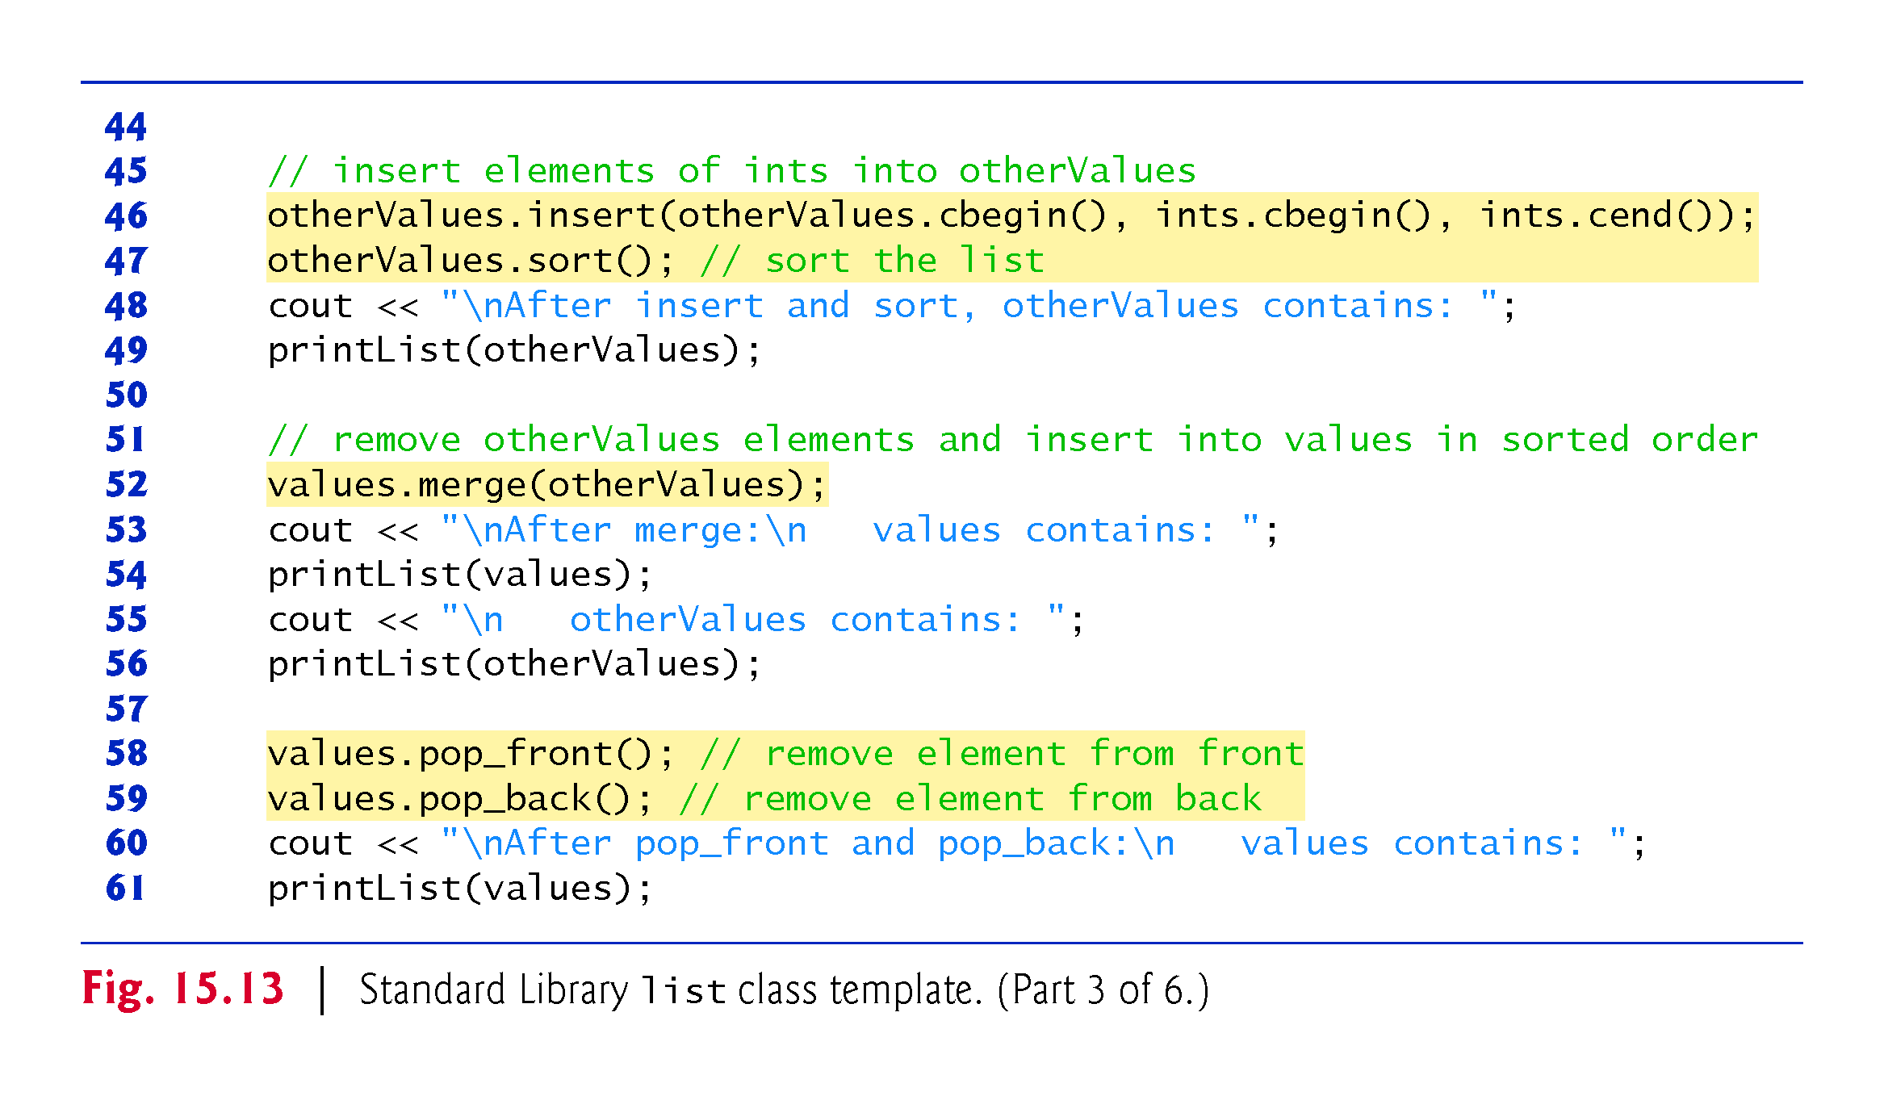

Slide 48
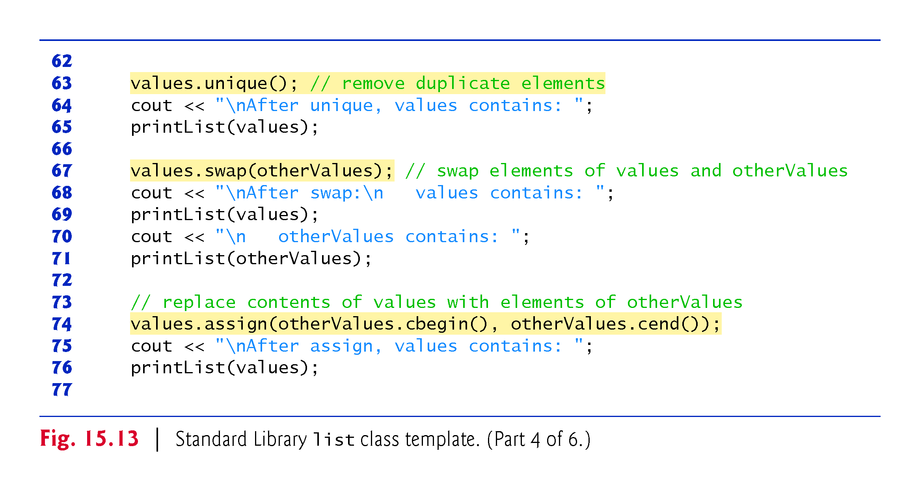

Slide 49
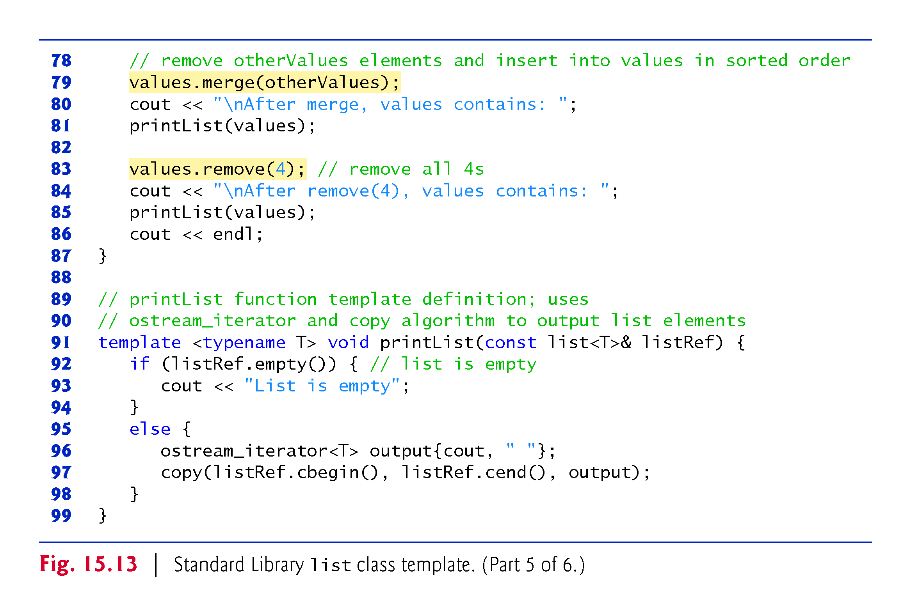

Slide 50
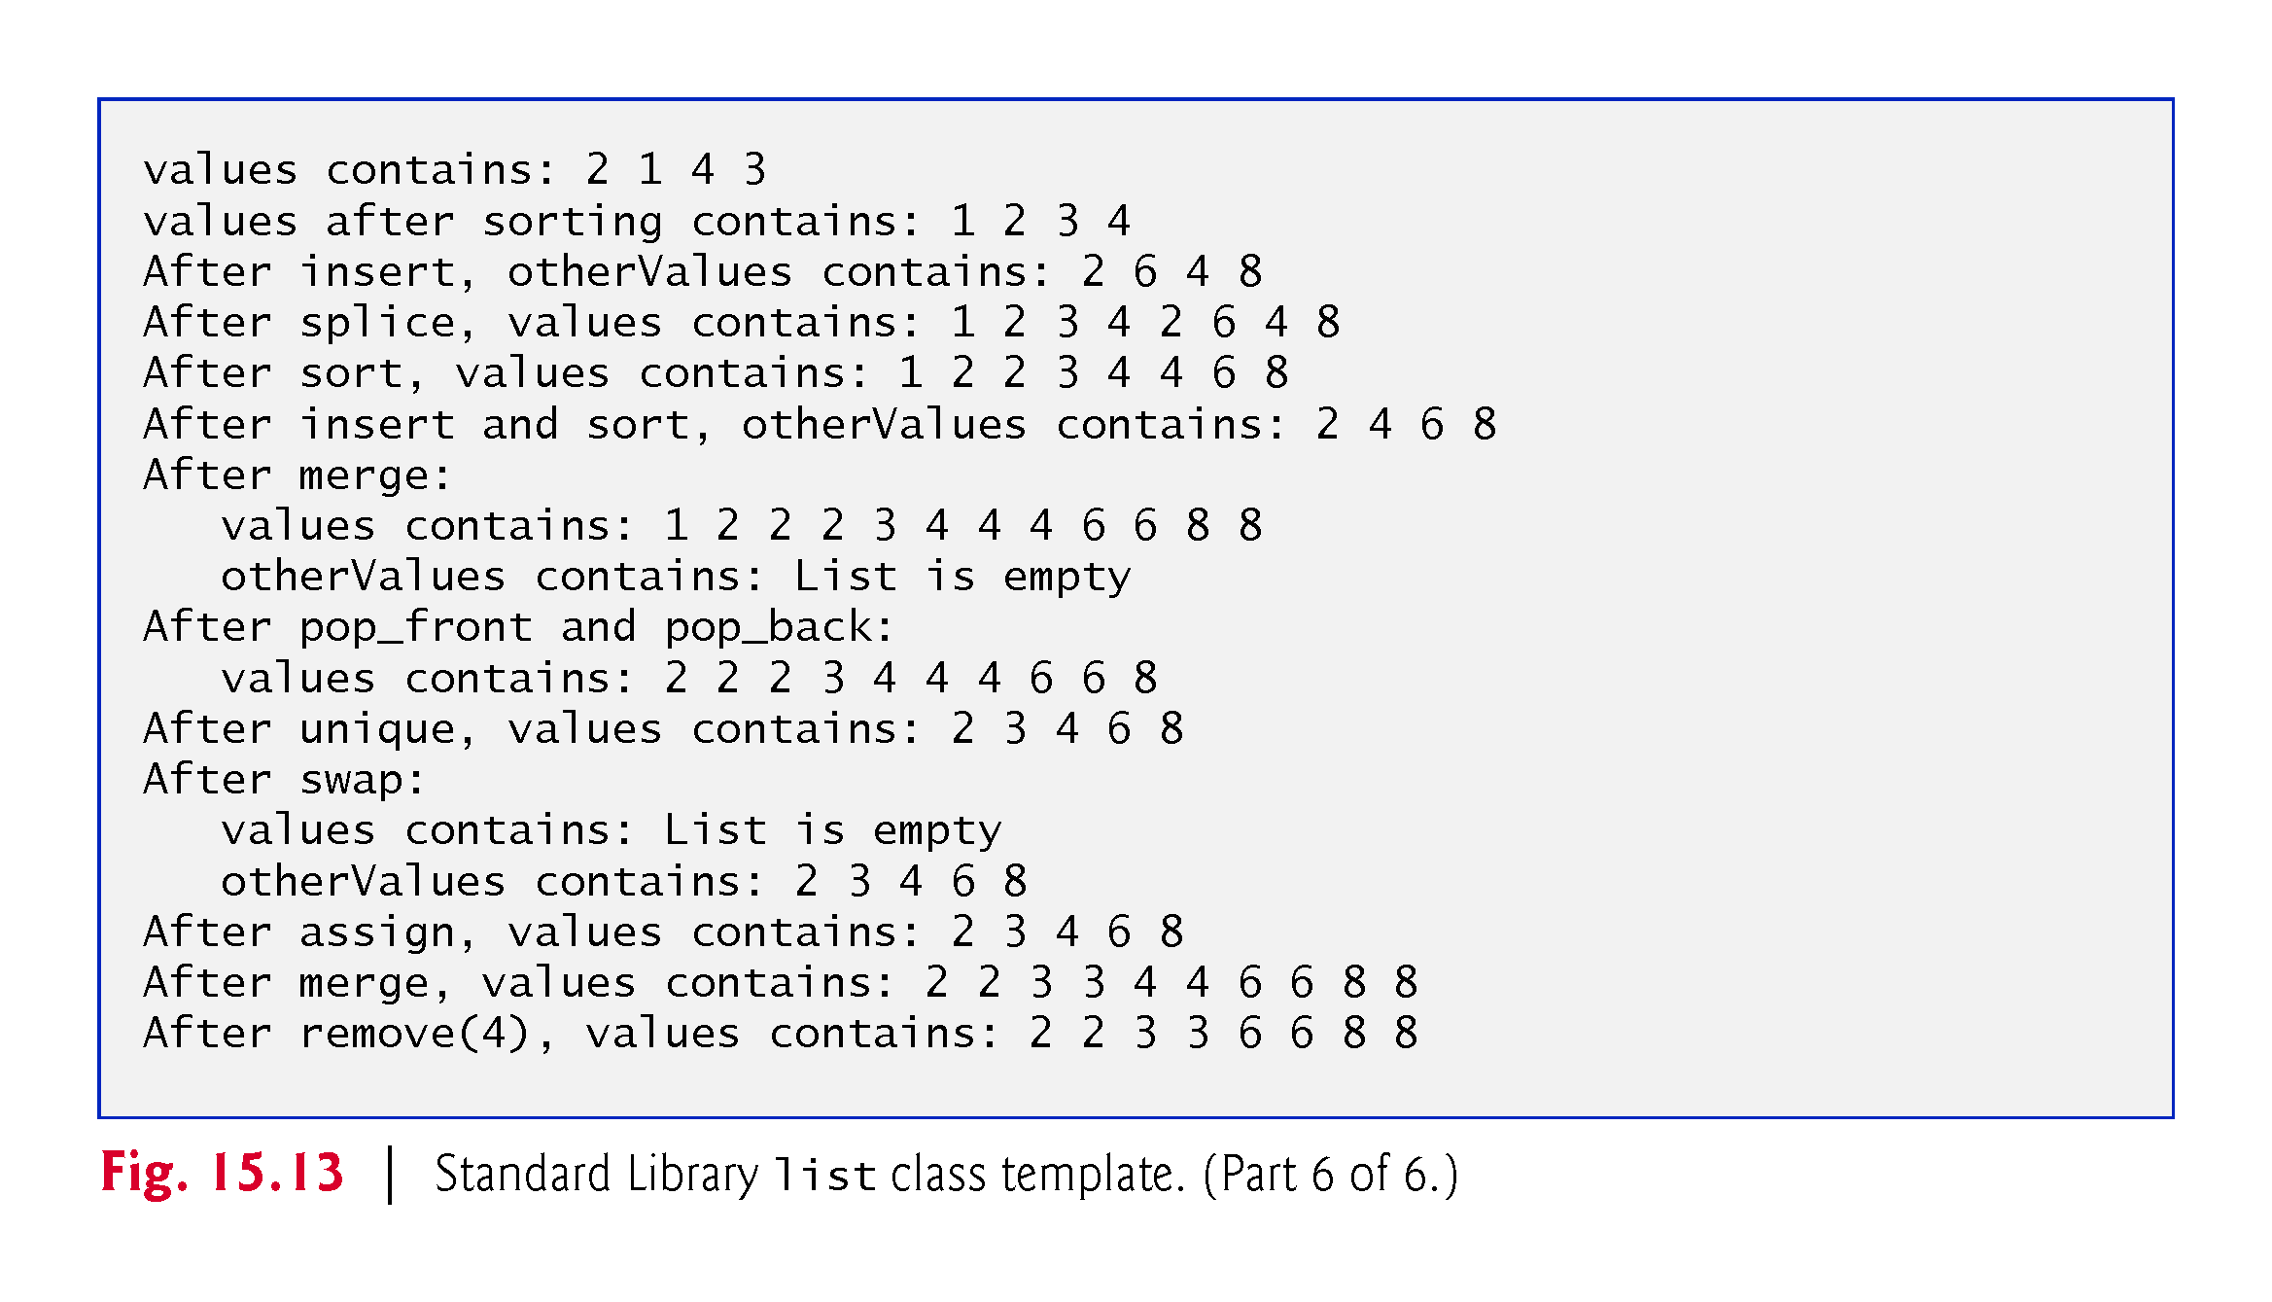

Slide 51
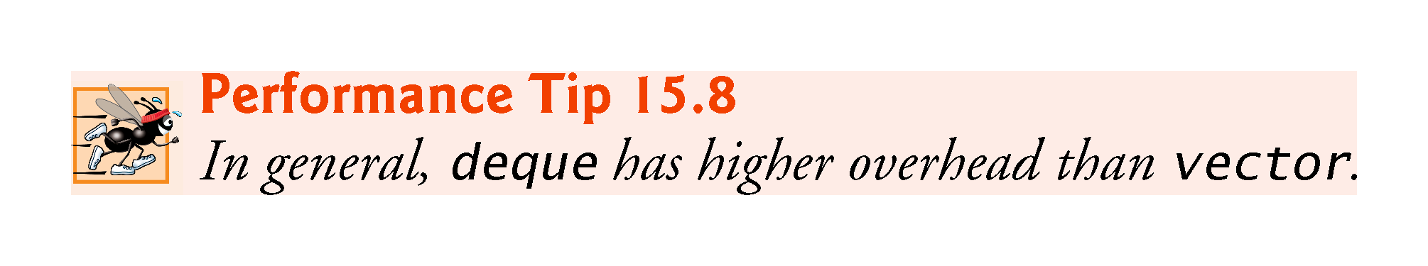

Slide 52
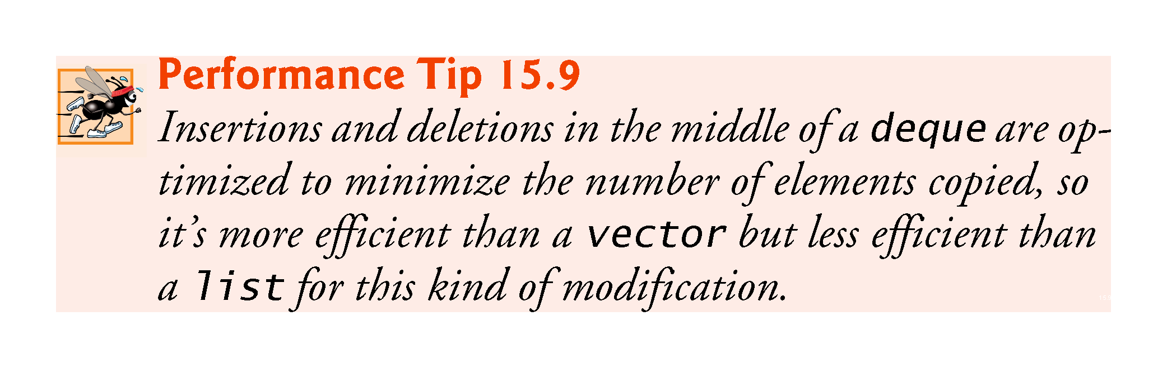

Slide 53
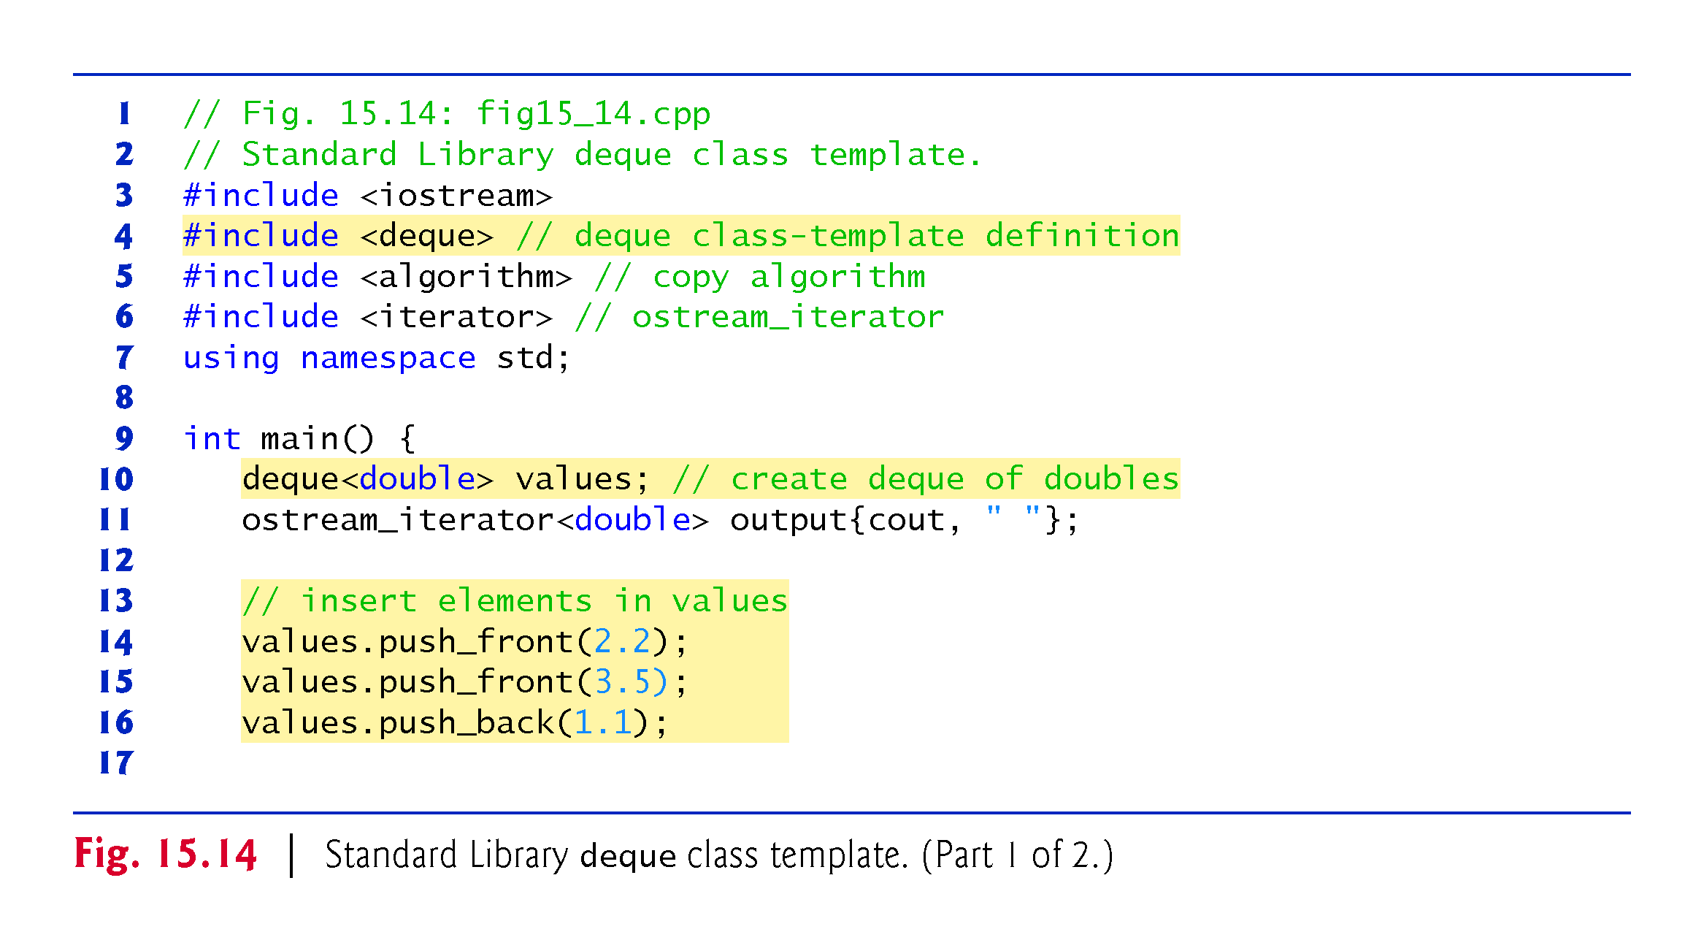

Slide 54
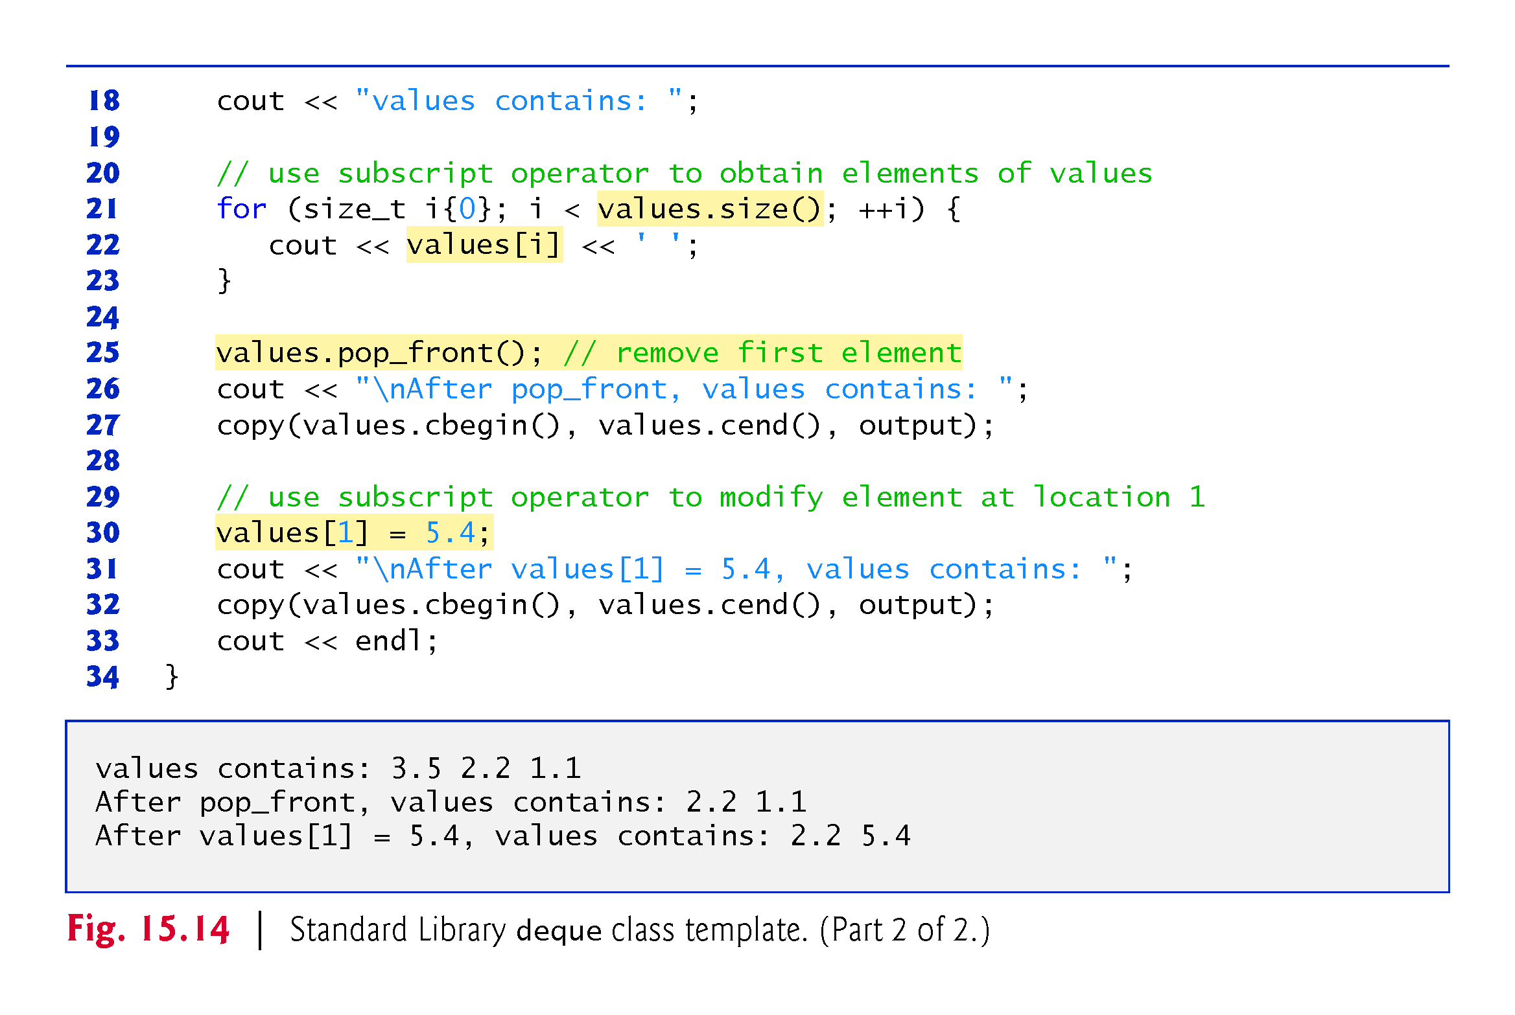

Slide 55


Slide 56

Notes:
Less<int> is a comparator function

Slide 57


Slide 58

Notes:
Ob: lower_bound(22) returns an iterator that points to the earliest occurrence of the value 22 in the multiset. Upper_bound(22) returns an iterator that points to the element after the last occurrence of the value 22 in the multiset.

Slide 59

Notes:
Ob: After insertion, set elements are sorted due to the function less<int>

Slide 60

Notes:
Ob: The constructor takes all elements of set a and inserts then in the set called doubleSet. The container set has only unique values – no duplicates, while vector a can have duplicates

Slide 61


Slide 62


Slide 63


Slide 64

Notes:
Ob: multimap is created where the type of the key is int, the values associated with keys are type double and the less than relation is between keys. Duplicate keys are allowed in the multimap container – one to many relationship.

Slide 65


Slide 66

Notes:
Ob: The multimap contains ALL the inserted elements

Slide 67

Notes:
Ob: The map container has no duplicates

Slide 68


Slide 69


Slide 70


Slide 71


Slide 72


Slide 73


Slide 74


Slide 75

Notes:
Ob: The underlying data structure is the vector container for the priority queue adapter

Slide 76


