Slide 1
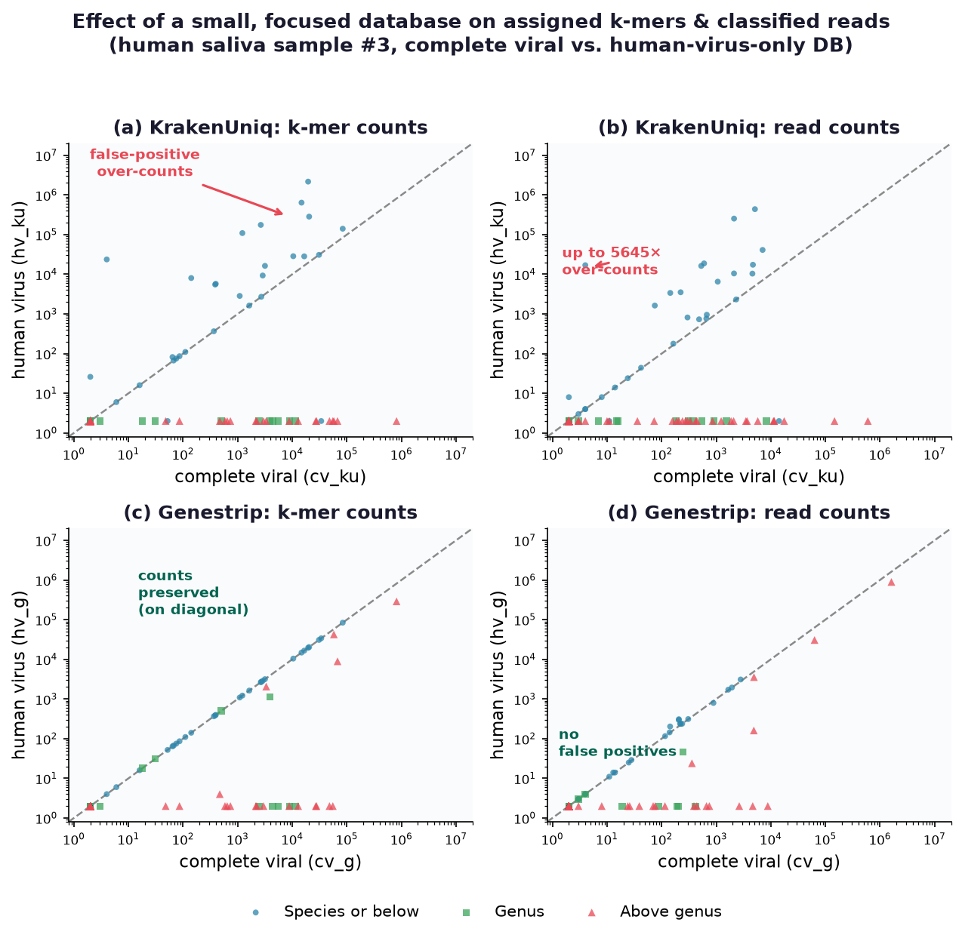
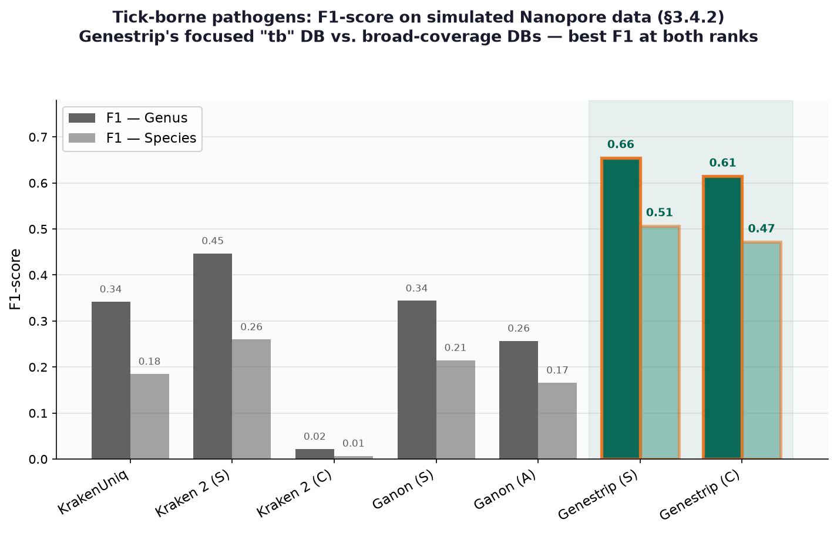
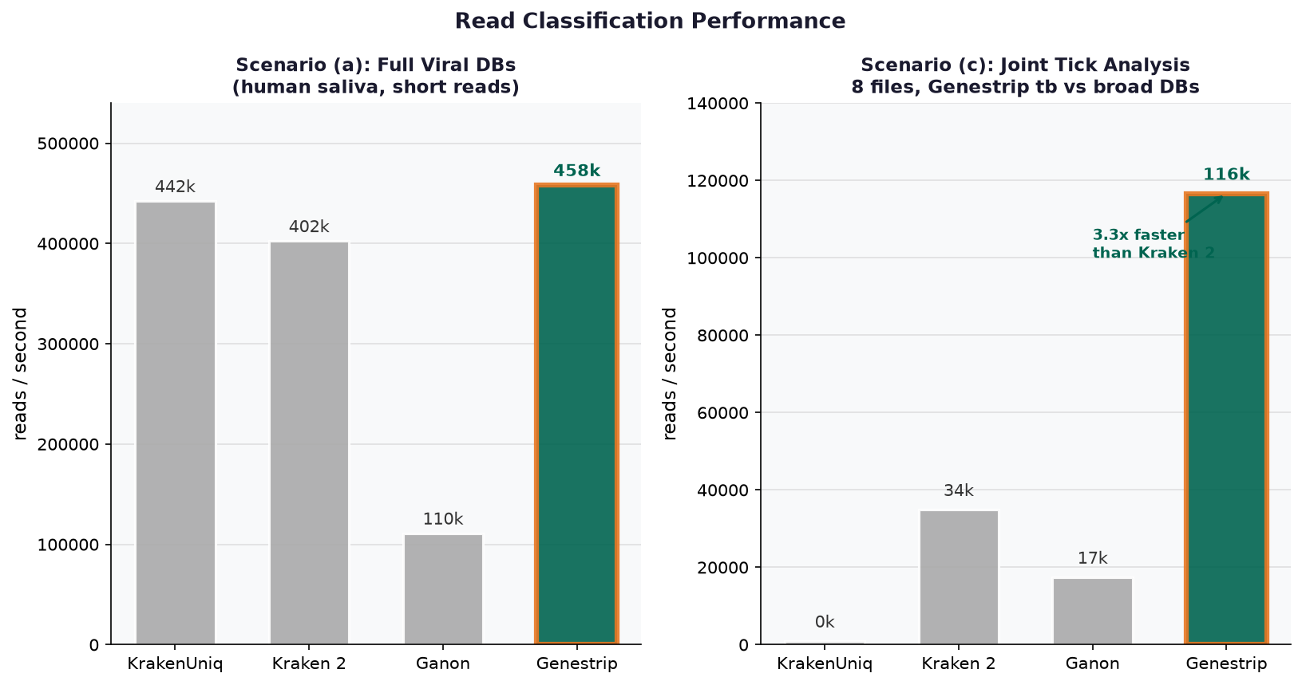
Genestrip: Exact and Efficient Read Classification for Selected Groups of Organisms
Published at BMC Bioinformatics, 2026 • doi: 10.1186/s12859-026-06512-1
Daniel Pfeifer¹, Markus Graf¹, Clas Rurik² ¹ Heilbronn University of Applied Sciences ² codeclap, Denmark
k-mer-based metagenomic analysis is essential for pathogen detection, tick surveillance, and environmental monitoring. Existing tools face a fundamental trade-off:
KrakenUniq: High precision via uncompressed k-mers → needs 2.5 TB RAM for full bacterial DB (2018); RefSeq prokaryotic genomes grew 5.8× since then → memory demands are unsustainable
Kraken 2 / Ganon: Reduce memory via k-mer compression → false positives → unsuitable for medical diagnostics
Current small databases: without special measures, focused small databases suffer from many false positives due to evolutionary k-mer sharing
Key Question:
Can we create small, focused databases that deliver high precision AND high recall — without k-mer compression?
Yes — via two-phase database generation:
1) Entry phase: store all k-mers (k = 31) from the genomes of the selected organisms of interest.
2) Update phase: check every stored k-mer against the genomes of ALL other organisms in the same RefSeq category. If it also occurs elsewhere, reassign its taxon to the lowest common ancestor (LCA).
→ Unspecific k-mers are pushed up the taxonomy, so a small focused database produces NO false positives — even though most genomes are never stored.
Key idea: the LCA update considers ALL genomes from the RefSeq (from one category) – even if the genome is NOT included in the k-mer database.
Because the database stays small, k-mer compression becomes unnecessary — eliminating compression-induced false positives entirely.
Java • goal-oriented build (Make-like) • Bloom filters • multi-threaded • command-line & API • Linux / Windows / macOS
Background & Problem
The Genestrip Approach
Method Overview & Key Comparisons
Genestrip: Two-Phase Database Generation
Phase 1: Entry
Phase 2: Update
Genomes of selected organisms of interest
ALL genomes in the RefSeq category (thousands)
Borr.
Rick.
Ehrl.
Anap.
k-mers stored with the
species taxon ID
taxon updated to the
lowest common ancestor (LCA)
Result: Small, Focused k-mer Database
✓
✓
✓
✓
No k-mer
compression
No false
positives
Runs on a
regular PC
High precision
& recall
Two-Phase Database Generation (entry + LCA update)
Small-DB effect on assigned k-mers & classified reads
(KrakenUniq over-counts; Genestrip stays exact)
Example: Tick-borne pathogens — F1-score on simulated Nanopore data
Classification Quality
Runtime Performance
Effect of small focused databases
Switching from the complete viral DB to a human-virus-only DB on real-world human saliva data:
KrakenUniq: massive false-positive over-counts — up to 5645× more reads assigned to a taxon (14 k-mer + 15 read taxa over-counted)
Genestrip: counts stay on the diagonal — identical to the complete DB (max. 1.5× deviation, 0 over-counted k-mer taxa)
Genestrip's LCA update phase considers non-human viral genomes → no false positives despite the 98× smaller (32 MB) database
Tick-borne pathogens on simulated Nanopore data
Highest error case (83–88 % of read k-mers unassignable) — differences are most pronounced here:
Genestrip (S) leads on F1 at both ranks: genus 0.66 vs. 0.45 (Kraken 2), species 0.51 vs. 0.26
Competing tools reach high precision but collapse on recall (KrakenUniq genus recall 0.23, species 0.13)
Genestrip (S) recall: genus 0.57, species 0.44 — driven by tb's deep genomic coverage + loss-less k-mer storing
All 6 example DBs were generated on a regular PC using ≤ 32 GB RAM
Fig. 4: Read classification speed (viral & tick scenarios)
Conclusions
Get Genestrip
github.com/pfeiferd/genestrip
Releases: v2.5
• Apache 2.0 License subject to Commons Clause
• Java (JRE 11+)
• Linux | Windows | macOS
• Command-line & API usage
• Extensive automated tests
Example databases:
human_virus | tick-borne | protozoa
vineyard | parasites | ...
Key Finding | Impact
Two-phase DB generation (entry + LCA update phase) considers ALL RefSeq genomes | Small, focused databases without false positives
Human virus DB: 32 MB vs 3.1 GB complete viral DB (98× smaller) | Same precision & recall on real-world data
Tick-borne DB (3.7 GB): 27,303 reads/s at 6 GB RAM vs. KrakenUniq: 946 reads/s at 121 GB RAM | 29× faster, 20× less memory for same task
Database generation on regular PC: 5 min – 8 hrs using ≤ 32 GB RAM | No specialized hardware needed
k-mer compression eliminated for focused DBs | Zero false positives from compression artifacts
github.com/pfeiferd/genestrip • BMC Bioinformatics 2026 • DOI: 10.1186/s12859-026-06512-1 • Java • Contact: daniel.pfeifer@hs-heilbronn.de

