Slide 1












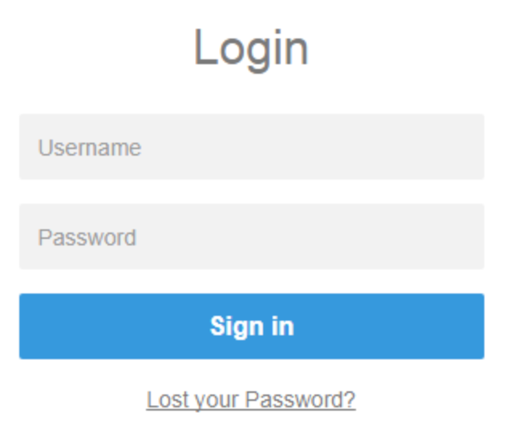
Private Static Content Hosting: AWS System Architecture
AWS Cloud
origin: /api/* -> api.example.com
downstream
service
Request Flow
user visits private-app.company.com
route 53 DNS routes to CloudFront distribution
root (/) origin is protected by signed cookies and CF error page does a 302 redirect to /login
/login triggers lambda@edge. it sees there is no Authorization header or cookies and redirects to Cognito IdP URL
cognito is configured to federate to IdP, and redirects to IAM IdP URL (https://myidp.com/idp/...)
User logs in with IdP email and password
IdP POSTs SAML2 auth grant to Cognito. Cognito verifies with IdP. If successful creates JWT and POSTs back to root (/login).
/login triggers lambda@edge. Extracts JWT. Verifies against Cognito JWKS endpoints. If successful, creates signed cookies via CloudFront key pair stored in AWS Secrets Manager. Returns cookies in header along with 302 redirect to root (/)
Client browser gets the response, sets cookies, and then follows redirect and issues request to root (/), which contains the signed cookies
CloudFront receives request to root (/), which is protected, extracts and verifies cookies, then passes request along to S3.
S3 responds with static asset
Static asset passed along to CloudFront, then to end user browser.
1
2
API Gateway
TLS Cert
3
4
12
origin: /, /login, /private/*
origin
access identity
10
8
11
User
Lambda@Edge
JWT Token
private assets
Route 53
(DNS)
CloudFront
9
Secrets Manager
(CloudFront Key Pair)
5
7
origin
access identity
signed
cookies
origin: /public/*
public assets
Cognito
SAML2 or
OIDC federation
https://myidp.com/
6
Federated SSO

