Slide 1
Microgrid Dispatch Optimization
Classical vs. Quantum Approach
Status Report
QC Praktikum
May 2026
Notes:
Introduction. This deck presents the current project status: what has been implemented, what results we have, why we are exploring the quantum approach, and what the next steps are. Backup slides contain the detailed numbers.

Slide 2
The Problem
When does the battery charge? When do we feed back to the grid? When do we buy power?
30
Microgrid in New Mexico
days
Components: utility grid, photovoltaic, battery (BESS), load
Objectives: minimize energy cost · minimize demand charge · maximize resiliency revenue
Challenges: Time-of-Use tariff (×8 price spread) · a single demand peak determines the monthly bill · PV and load forecasts are uncertain
simulated billing period
2,880
15-min slots
dispatch decisions per month
$14,802
USD/month
optimized electricity cost (baseline)
Microgrid Dispatch — 2/12
Notes:
Microgrid near Albuquerque, New Mexico. Four components, each 15-minute slot is its own dispatch decision — 2,880 decisions per month in total. Three main difficulties: ToU tariff makes timing critical, demand charge is set by a single peak, and the forecasts for PV and load are uncertain.

Slide 3
Our Approach: Two Solvers, One Problem
Same data, same problem, two solver families — a fair comparison of quality and runtime
Data Pipeline
all_data.csv · 30 days · 15 min
Classical MILP Solver
Quantum Solver
Gurobi (gurobipy)
Branch-and-Bound
QUBO formulation
D-Wave Quantum Annealing
Comparison
Approximation Ratio · Runtime
Microgrid Dispatch — 3/12
Notes:
Both solvers consume the same input file and produce the same output format. On the classical side we use Gurobi with a MILP formulation. On the quantum side we use a QUBO formulation solved by D-Wave Quantum Annealing. The comparison runs solver-agnostically on identical schedule CSVs.

Slide 4
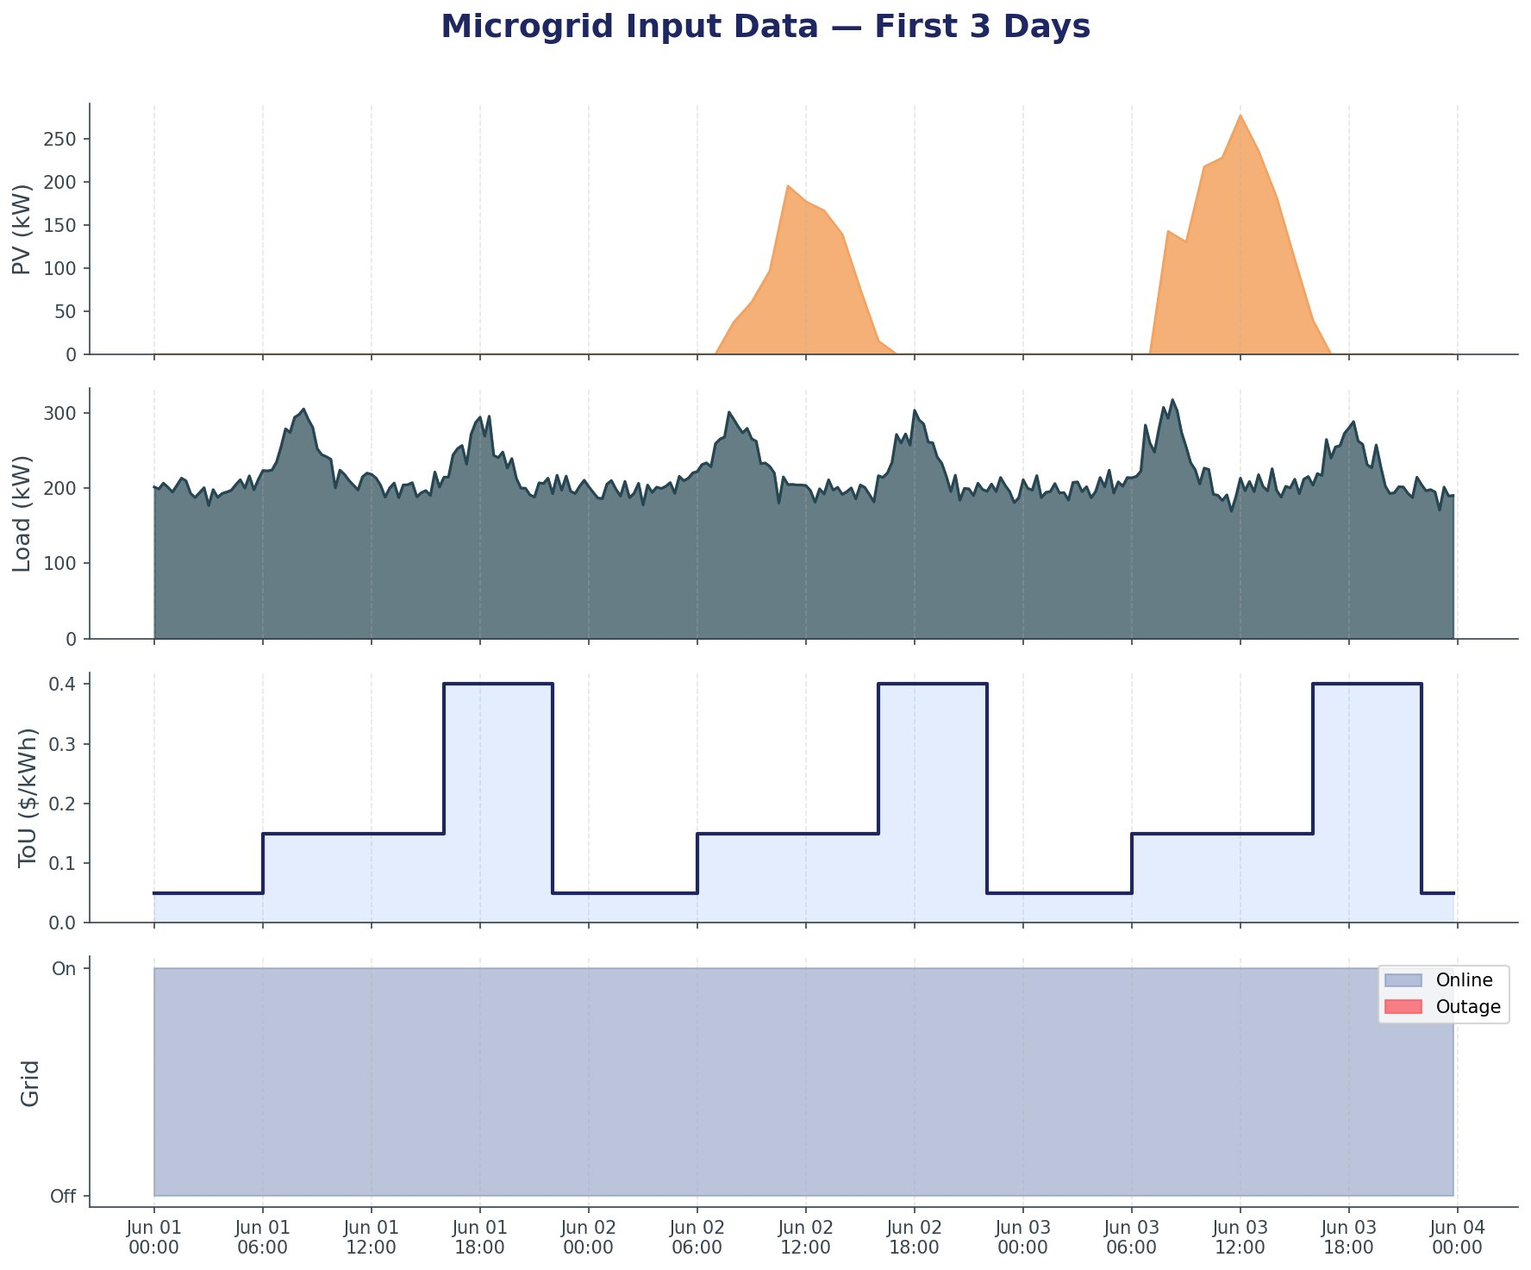
Step 1: Data Foundation
Synthetic 30-day dataset at 15-min resolution — PV, load, tariff and grid availability
Four Inputs
PV Generation via pvlib + PVGIS TMY, 500 kWp
Load Commercial profile with morning + evening peaks
ToU Tariff 3 tiers: $0.05 · $0.15 · $0.40 / kWh
Grid Availability Bernoulli outages, p ≈ 0.5 %
Microgrid Dispatch — 4/12
Notes:
Data pipeline is complete and validated. The PV model is physics-based using pvlib with TMY weather data for Albuquerque. Load and ToU tariff are synthetic but realistically parameterized. Outage slots are needed for the resiliency calculation. All solvers read the same CSV file.

Slide 5
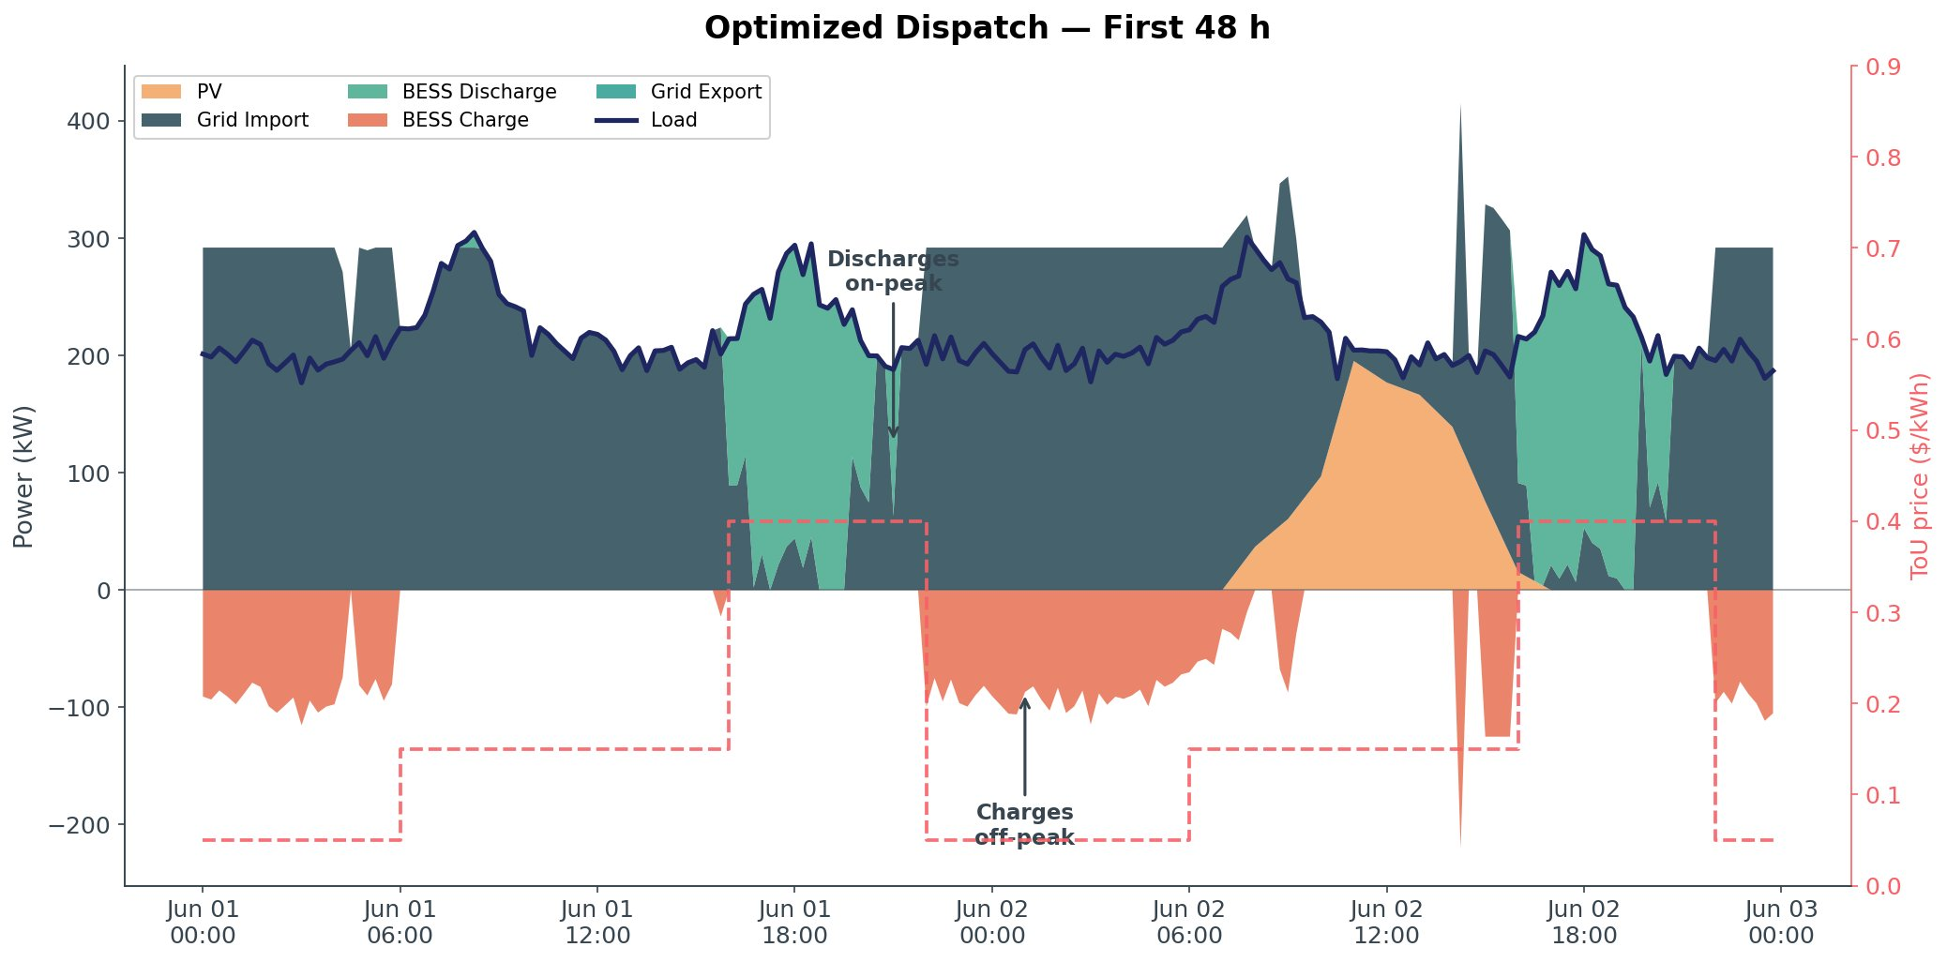
Step 2: Classical Solver — Deterministic
Gurobi finds the optimal charge/discharge strategy in 2 seconds
What the Solver Finds
Battery charges during off-peak tariff (nights, $0.05)
Battery discharges during on-peak tariff (18:00–22:00, $0.40)
= classical ToU arbitrage, visually validated.
Horizon
T = 2,880 slots (30 days)
Runtime
2.2 s
MIP Gap
≈ 0 %
Total Cost
$14,802
Microgrid Dispatch — 5/12
Notes:
The classical solver handles the deterministic case trivially: 30 days in 2.2 seconds at optimality, gap effectively 0. The chart shows 48 hours of the dispatch plan. You can clearly see: battery charges at night (orange areas), discharges in the evening (green) when electricity is 8× more expensive. This is the behavior we expect — sanity check passed.

Slide 6
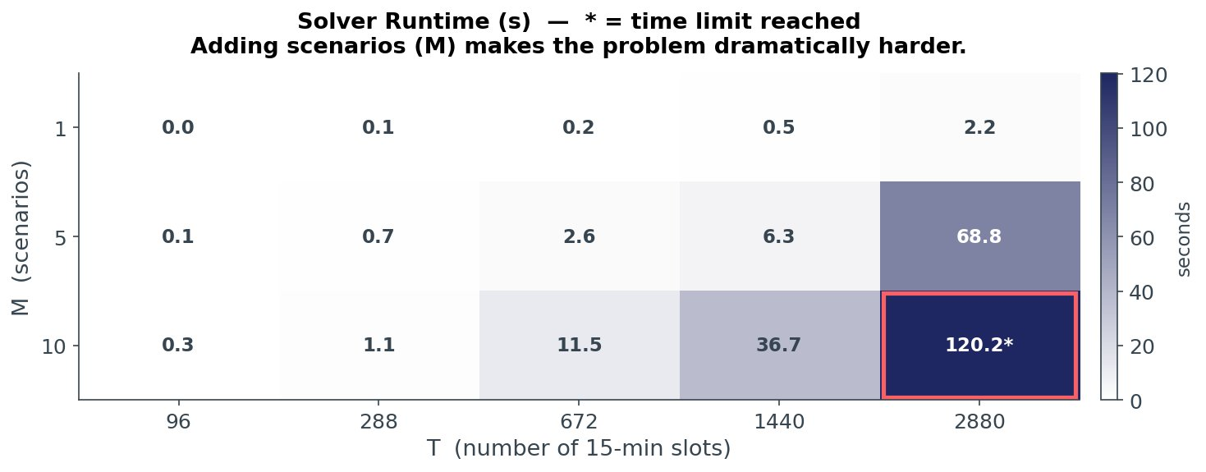
Step 3: Realistic Uncertainty
Two-Stage Stochastic Programming — optimize across multiple PV/load scenarios simultaneously
What's Happening?
What We Observe
AR(1) noise on PV (±15 %) and load (±5 %)
Solver must find ONE demand-charge peak that fits ALL scenarios
Variable count grows with M × T
M=1 trivial: 30 days in 2.2 s
M=5 gets serious: 70 s, still optimal
M=10 hits the time limit (red cell)
Real MILP hardness reached — no shortcuts left
Microgrid Dispatch — 6/12
Notes:
The key observation of the presentation. In the deterministic case the problem is too easy for an interesting comparison. As soon as we add uncertainty — as is the case in practice — the search space grows dramatically. At M=10 and T=2880, Gurobi no longer completes within the 2-minute limit without proving optimality. This is exactly the regime where quantum approaches become potentially relevant.

Slide 7
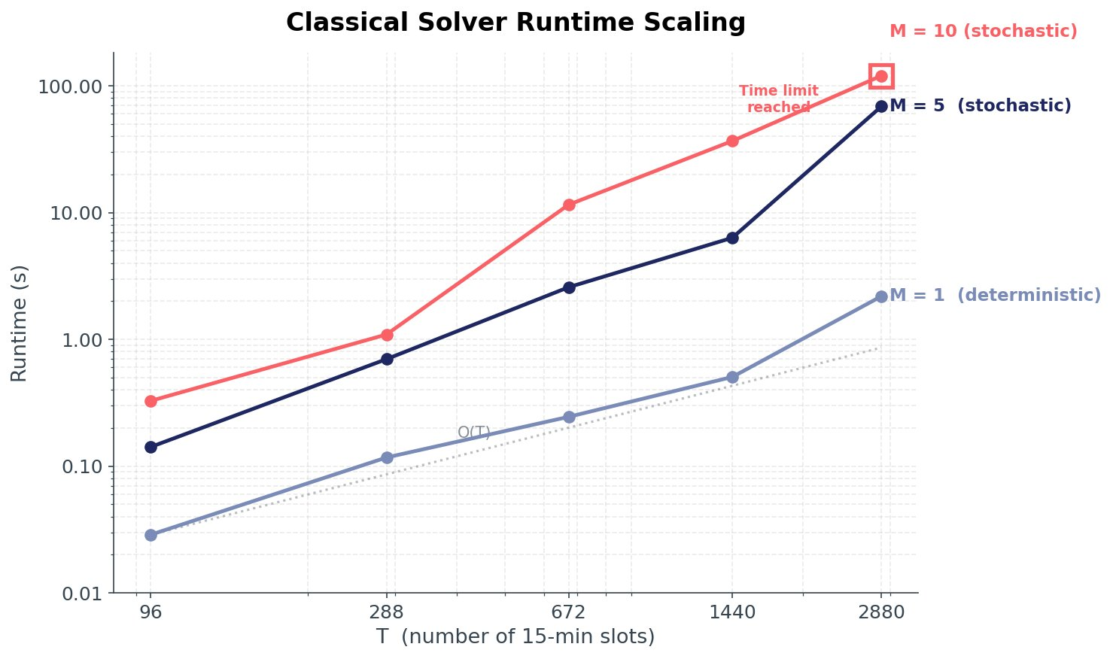
Scaling Behavior
Classical solver scales exponentially with the number of scenarios — this motivates the quantum approach
Det. (M=1): linear, no problem · Stochastic (M=5/10): super-linear, time limit reached
Microgrid Dispatch — 7/12
Notes:
Log-log plot. Three curves: M=1 (deterministic) essentially follows an O(T) line. M=5 is noticeably steeper. M=10 reaches the time limit at the right edge. The difference in slopes is the key point — each additional scenario doesn't just add work additively, it adds work multiplicatively. This is the lever where quantum annealing could show structural advantages.

Slide 8
Why Quantum Computing?
Different scaling on combinatorial problems — framed honestly
→
∿
↗
Classical Search
Quantum Annealing
What This Gains Us
Branch-and-Bound
Energy Landscape
Scaling Advantage
Algorithm examines schedules one at a time. Pruning via bounds. Worst case exponential.
All possible schedules exist simultaneously in superposition. The system evolves into the state of lowest energy = lowest cost.
On combinatorial problems with many local optima — like dispatch under uncertainty — annealing can find competitive solutions with different scaling behavior.
⚠ Today's quantum hardware is small and noisy. We are investigating where this approach is already competitive.
Microgrid Dispatch — 8/12
Notes:
Most important explainer slide for non-quantum specialists. Three simple pictures: classical searches path by path, quantum models the entire solution landscape as an energy surface and the system rolls into the lowest valley. The metaphor is simplified but not wrong. The disclaimer at the bottom is important: we are not promising a speedup today, we are investigating the scaling behavior.

Slide 9
Planned Quantum Backend: D-Wave
Purpose-built hardware for QUBO problems — directly applicable to our problem size
D-Wave Quantum Annealing
Why Annealing for This Problem
Advantage 2 system, accessed via Leap cloud platform
Our QUBO encoding maps naturally to annealing hardware
Stochastic dispatch has many local optima — annealing escapes them by design
Problem size (~500 qubits for reduced horizon) fits comfortably on current hardware
Up to ~5,000 qubits — fits our problem size directly
Returns 1,000+ candidate solutions in seconds
Hybrid sampler combines classical CPU and QPU
Native QUBO interface — no algorithmic translation required
Mature stack with established tooling (dimod, Ocean SDK)
Both solvers consume the same QUBO problem definition. Reference baseline = Gurobi solution.
Microgrid Dispatch — 9/12
Notes:
We focus on D-Wave for the quantum backend. Reasons: D-Wave is purpose-built for QUBO problems, our problem size fits the hardware, and the tooling is mature. QAOA on gate-model quantum computers could be a future extension, but is not part of the current scope.

Slide 10
Roadmap
What's done, what's next, what we need from you
✓ Completed
→ Next Steps
? Open Questions
Data pipeline + scenario generator
Classical MILP solver, deterministic
Stochastic extension (Two-Stage)
Scaling sweep across (T, M)
Comparison instance defined: T=2,880, M=5
QUBO formulation of the dispatch problem
D-Wave runs on the canonical instance
Approximation ratio + scaling comparison
Final report + live demo
Realistic export tariff for grid feed-in?
Calibration data for forecast noise levels?
Resiliency revenue: is $0.10/min representative?
Comparison instance size for the quantum track?
Microgrid Dispatch — 10/12
Notes:
Left column: what's running. Middle column: what comes next — primarily the QUBO reformulation and the first D-Wave runs. Right column: open questions where we need input from the partner. Particularly relevant: the export tariff, because the current model assumes free export and exports aggressively as a result.

Slide 11
Summary
01
Classical Solver Works
MILP via Gurobi, all One-Pager requirements covered. Deterministic 30 days in 2 s, gap 0 %.
02
Stochastic Hardness Achieved
Two-Stage Programming couples the scenarios genuinely — at M=10, T=2880 the time limit is no longer sufficient.
03
Quantum Track Prepared
Canonical comparison instance T=2,880, M=5 with gap 0 % established — reference baseline for D-Wave.
04
Where It Gets Interesting
Precisely in the stochastic hardness regime we investigate whether quantum approaches show different scaling.
Notes:
Four key takeaways. Classical works, stochastic makes it interesting, quantum comparison baseline is ready, and the punch line comes from the stochastic hardness regime. After this, Q&A — for detail questions, flip to the backup slides.

Slide 12
Backup
Detailed numbers and implementation notes
Notes:
Divider slide. Only show beyond this point if detail questions come up.

Slide 13
Backup: Full Scaling Table
Solver performance across all (T, M) combinations
M / T | 96 (1d) | 288 (3d) | 672 (7d) | 1440 (15d) | 2880 (30d)
M=1 (deterministic) | 0.03 s | 0.12 s | 0.24 s | 0.51 s | 2.19 s
M=5 (stochastic) | 0.14 s | 0.70 s | 2.58 s | 6.33 s | 68.8 s
M=10 (stochastic) | 0.33 s | 1.09 s | 11.5 s | 36.7 s | 120 s (TL)
TL = Time Limit (120 s) reached without proof of optimality, MIP gap 0.02 %
Microgrid Dispatch — B1/12
Notes:
Full view of the runtime heatmap. At the largest instance (T=2880, M=10) the 2-minute time limit is reached — the MIP gap is already very small at 0.02 %, but Gurobi was unable to prove optimality.

Slide 14
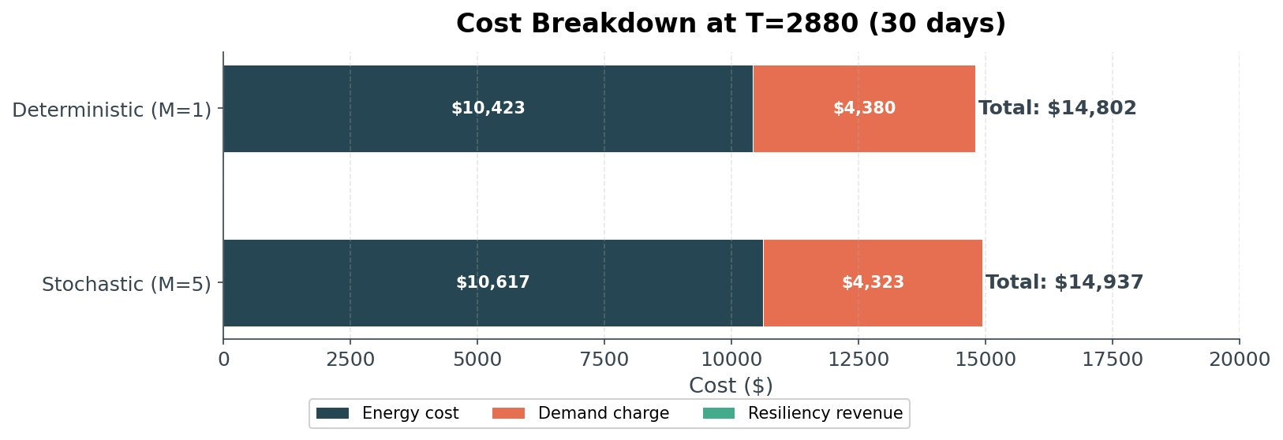
Backup: Cost Breakdown
Deterministic vs. Stochastic at T=2,880, M=5
Mode | Energy Cost | Demand Charge | Resiliency Rev. | Total Cost
Deterministic (M=1) | $10,423 | $4,380 | $1.50 | $14,802
Stochastic (M=5) | $10,617 | $4,323 | $0.00 | $14,937
Δ (Information Cost) | +$194 | −$57 | −$1.50 | +$135
Microgrid Dispatch — B2/12
Notes:
The stochastic solution costs $135 more — the price for the solver not knowing the realization of the random variables in advance. Demand charge is actually slightly lower in the stochastic case, while energy cost is higher. Resiliency revenue is marginal in both cases — that's a discussion point.

Slide 15
Backup: Implementation Highlights
Key technical choices in the classical solver
Three-Tier SoC Power Limits
Charge - Discharge XOR
Battery power limits depend on State-of-Charge: 50 % at 0–10 % SoC, 100 % at 10–90 % SoC, 50 % at 90–100 % SoC. Models battery protection at extremes (per One-Pager spec).
Binary on/off variables enforce mutual exclusion: battery cannot charge and discharge simultaneously. Added as a hardness lever after the initial deterministic baseline solved too easily.
Grid Import - Export XOR
Two-Stage Stochastic Coupling
Same XOR pattern for grid I/O. Prevents the solver from gaming ToU arbitrage by simultaneous buy/sell. Also matches the structure required by the QUBO formulation.
Demand-charge peak is a first-stage variable shared across all scenarios; all dispatch variables are second-stage. This coupling is what makes the stochastic version genuinely hard.
Microgrid Dispatch — B3/12
Notes:
Four core technical choices in the classical solver, in the order they were added: SoC-dependent power limits come from the One-Pager and were in from the start. XOR constraints on charge/discharge and import/export were added as a first hardness lever — they tighten the formulation and align with the QUBO structure. The two-stage stochastic coupling is the actual hardness driver.

