Slide 1

Apparels
Preston P. Fernandes 181039
Bruno J. Colas 181014
Joston H. Fernandes 181038
Yash N. Gupta 181050
Date of presentation: 4th Sept 2021
Under the guidance of: Ms.Vandana Patil
St. Francis Institute of Technology
Department of Information Technology

Slide 2

Content
Introduction
Review of Literature
Research Gaps Identified
Problem Definition & Objectives
Proposed Solution
Scope of Project
System Description
Architecture Design
Sequence Diagram
Hardware & Software Requirements
User Interface Design
Conclusion
Future Scope
Literature Cited

Slide 3
Introduction
Clothing industry is one of the most affected sectors of business during the lockdown period and thus it is very important to make sure that all possible efforts are made to make sure the business flourishes through online means.
In this project we aim to develop an online clothing store which will be a subscription based platform in order to establish the presence of small scale local clothing stores in the global market which can help them to promote their business and thus increase sales.
Having an online business platform can increase the growth in business by 15%-50%. As stated by Stanford University 75% of the customers will make a judgement on the business’s credibility based solely on their website.

Slide 4
Review of Literature
[1] E-COMMERCE APPLICATION USING WEB FRAMEWORK TECHNOLOGY AND MACHINE LEARNING
Description
In this paper, adaptivity and recommendation methods have been explored and implemented for an e-commerce web application of an online e-shop system. The approach used to create such adaptivity methods is described through the analysis of initial requirements, models and designs of the planned solution, and the final implementation of the chosen method using the Web2py Python Model-View-Controller (MVC) framework
Disadvantages
The recommendations in this specific system were inaccurate. This system used weighted slope one algorithm which was not enough for products categorization according to user requirement and required a content-based recommender and compared to other collaborative filtering recommendation algorithms, both Improved Slope One and Weighted Slope One were outperformed
Future Scope
This system can be improved by implementation of latest frameworks, Drupal can be used in collaboration with React.js to provide further improved interactions through personalization for a user.

Slide 5
Review of Literature
[2] DEVELOPMENT AND IMPLEMENTATION OF E-COMMERCE SYSTEM
Description
This system is implemented using PHP, jQuery, MYSQL, CSS and HTML5.This system follows the concept of 3 tier architecture where the client side is responsible for designing User Interface, application server side for processing the user request, and the database tier for storing of data. The sole task of a Web Server is to accept incoming http requests and to return the requested resource in an http response. The system was analyzed, design using UML tools, then implemented using PHP, jQuery, MYSQL, CSS and HTML 5 on local host server (XAMPP).
Disadvantages
No information about how payments are handled was not provided in this paper. This system does not have provision for adding items categorically.
Future Scope
Further security measures need to be added to secure user information. Payment gateway or api can be included.

Slide 6
Review of Literature
[3] IMPLEMENTATION OF E-COMMERCE BASED ON CLOUD COMPUTING USING ASP.NET TECHNOLOGY
Description
This system was built using ASP.NET which provides improved execution, scalability and security. This Web app was designed using VB.NET, C# as frameworks. ASP.NET utilizes ADO.NET to interact with the database.
MYSQL as back-end language. ASP.NET utilizes ADO.NET to interact with the database as it gives in-memory caching that takes out the need to contact the database server as often as possible and it can without much of a stretch send and keep up an ASP.NET application.
Disadvantages
The website should provide more functionality, such as looking at a particular client’s profile, stores that must be reordered and capacity to view the contents of users. Credit Card for shopping and approval is not done. The system is not designed for multi-clients
Future Scope
Shopping Cart/ Wishlist functionality can be implemented in future. The third party proprietary software can be used for validation.

Slide 7
Review of Literature
[4] A TRUST-BASED COLLABORATIVE FILTERING ALGORITHM FOR E-COMMERCE RECOMMENDATION
Description
In this paper a recommender system is build as an improvement on slope one algorithm .The slope one algorithm does not have not high prediction accuracy .The slope one algorithm does not perform well when dealing with personalized recommendation task that concerns the relationship among users. The improvised slope one algorithm based on the fusion of trusted data and user similarity comprises of three procedures: selecting trusted data, calculating similarity between users, adding this similarity to the weight factor of the improved slope one algorithm and getting the final recommendation.
Disadvantages
No disadvantages mentioned
Future Scope
Other methods can be applied to recommendation system such as semi-supervised feature analysis.

Slide 8
Review of Literature
[5] Security Flows in OAuth 2.0 Framework: A Case Study
Description
OAuth framework employs an authorization server for issuing security tokens to different users who request access to protected resources. The authentication schema has four entities (1) the client,the application used by the user for acquiring access to the protected data (2) the the resource owner ( relying party), the end user or a host acting on her behalf with the ability to requestaccess to protected resources; (3) the authorization server, that is the issuer ofaccess tokens and assures the authenticity of the owner; and (4) theresource server, the host of the restricted data and consumer of the accesstokens. The OAuth framework heavily relies on the concept of bearer tokens.The two bearer tokens (1)the Access Token, that represents the credentials required toaccess protected resources which defines scope and duration of the access in the authorization grant and the(2) Refresh Token, that are used to obtain new access tokens when the old ones expires.
Disadvantages
Vulnerable to attacks like cross site request forgery ,session wrapping attack etc .
Future scope
Attacks like cross site request forgery could be fixed by using hash function to make state value not guessable .solution to session wrapping is to use single state values.

Slide 9
Review of Literature
Ref no. | Title | Methodology | Disadvantages
[1] | E-commerce Application Using Web Framework Technology And Machine Learning | In this paper, adaptivity and recommendation methods have been explored and implemented The final implementation of the chosen method is done using the Web2py Python Model-View-Controller (MVC) framework. | The weighted slope one algorithm used was not enough for products categorization according to user requirement and required a content-based recommender and compared to other collaborative filtering recommendation algorithms, both were outperformed

Slide 10
Review of Literature
Ref no. | Title | Methodology | Disadvantages
[2] | Development And Implementation Of E-Commerce System | This system follows the concept of 3 tier architecture where the client side is responsible for designing User Interface application server , and the database tier for storing of data. The system was analyzed, designed using UML tools and web techniques. | Implementation of payments gateway was not maintained. This system does not have provision for adding items categorically.

Slide 11
Review of Literature
Ref no. | Title | Methodology | Disadvantages
[3] | Implementation Of E-commerce Based On Cloud Computing Using ASP.Net Technology | This system was built using ASP.NET which provides improve scalability, execution and security. ASP.NET utilizes ADO.NET to interact with the database. | The website should provide more functionality, such as looking at a particular client’s profile, stores that must be reordered and capacity to view the contents of users. The system is not designed for multi-clients

Slide 12
Review of Literature
Ref no. | Title | Methodology | Disadvantages
[4] | A Trust based collaborative filtering algorithm for E-Commerce recommendation | In this paper a recommender system is build as an improvement on slope one algorithm. The improvised slope one algorithm comprises of three procedures: selecting trusted data, calculating similarity, adding this similarity to the weight factor of the improved slope one algorithm and getting the final recommendation. | The data used for algorithm should be valid enough to get accurate result.

Slide 13
Review of Literature
Ref no. | Title | Methodology | Disadvantages
[5] | Security Flows In OAuth 2.0 Framework: A Case Study | The authentication schema has four entities client, the application used by the user for acquiring access to the protected data, the resource owner , the end user or a host acting on her behalf with the ability to request access to protected resources; the authorization server, that is the issuer of access tokens and assures the authenticity of the owner; and the resource server, the host of the restricted data and consumer of the access tokens. | Vulnerable to attacks like cross site request forgery, session wrapping attack

Slide 14
Research Gaps Identified
System’s efficiency can be further improved using frameworks like React.js or Angular.js as it allows reusability of code.
Online payments using third party proprietary software/API can be added.
Products can be categorically filtered and presented for good user experience.
The customers must be able to add their reviews and feedback on a purchased product.
The security of user login credentials can be improved using Google OAuth API.
The app must have multi user facility by using user authentication
Recommendation Engine can be improved
Hash functions can be used to safeguard from cross-site forgery

Slide 15
Problem Definition & Objectives
To design a scalable online webapp which can handle functionalities such as logging in, checkout, surfing through products with filters, handling customer reviews ,adding products to cart and proceeding with online payment and provide an affordable alternative to traditional E-Commerce platforms by keeping customer and seller satisfaction as the primary mission.
Problem definition can be satisfied with the help of following objectives
Incorporating payments API by which user can complete the transaction online itself.
Developing a fast and responsive User Interface which ensures responsiveness and reusability of code.
Using hash functions and other cryptography methods for securing the details of users.
Hosting the website on a scalable platform.
Developing a subscription based E-Commerce platform where the seller only has to pay for the amount of products he/she wishes to host.

Slide 16
Proposed Solution
In this project we aim to develop a system which can have high efficiency using React.js (frontend library) as it allows reusability of code.
We will also incorporate Online payments option using stripe API for buying products.
The products will be categorically filtered and the users can leave their feedback based on the purchased product.
Security related to User details such as login credentials, payment (credit-card) information will be highly secured using Google OAuth API and google firebase.
We aim to develop a scalable restful API which can handle backend interactions smoothly.

Slide 17
Scope of Project
Due to corona virus people tend to avoid crowded places as shopping via traditional means while visting a store is not safe.
Startup can have a platform for selling their products without the requirement of a physical store.
We aim to develop a Full-Stack E-commerce website which handles every aspect right from surfing through products to payments and delivery.
Since this website is a subscription based model the seller only has to pay for the amount of products he wishes to host.

Slide 18
Description about Subscription Based Model
Sellers registers himself on the platform and after agreeing to the terms and conditions the subscription plans page is showed.
The seller choses from the available subscription plans which will be as follows Silver Plan, Gold Plan, Platinum Plan and Diamond Plan.
Each of the above mentioned plan will allow the seller to host predefined number of products.
After choosing a suitable plan the seller will have to fill a form which will ask for certain details regarding return policy after which the seller can proceed to pay for the chosen package.
After successful payment the plan will be activated and the seller can add products he wishes to host.
An option will also be provided that all the above steps will be done by the website executive for the seller.

Slide 19
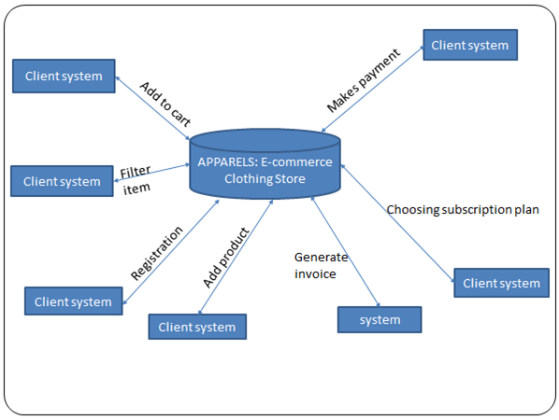
Architecture Design

Slide 20
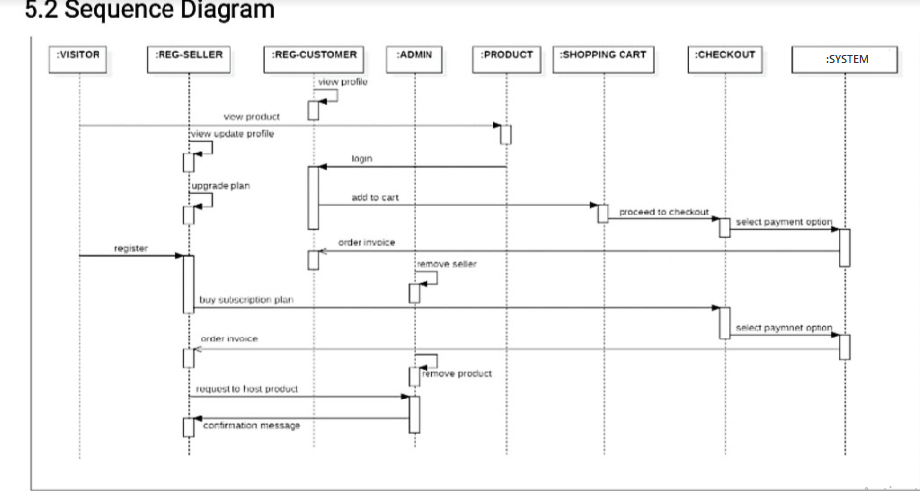
Sequence Diagram

Slide 21
Hardware & Software Requirements
Software
Hardware
1. | Operating System | Windows 10
2. | Text Editor | Atom/Visual Studio/Notepad++
3. | Web Browser | Google Chrome
4. | Open source run-time environment | Node.js
1. | RAM | 8gb
2 | Intel processor | I3 10th gen
3. | CPU | Octa core
4. | Internet connection | 1 mbps or higher

Slide 22
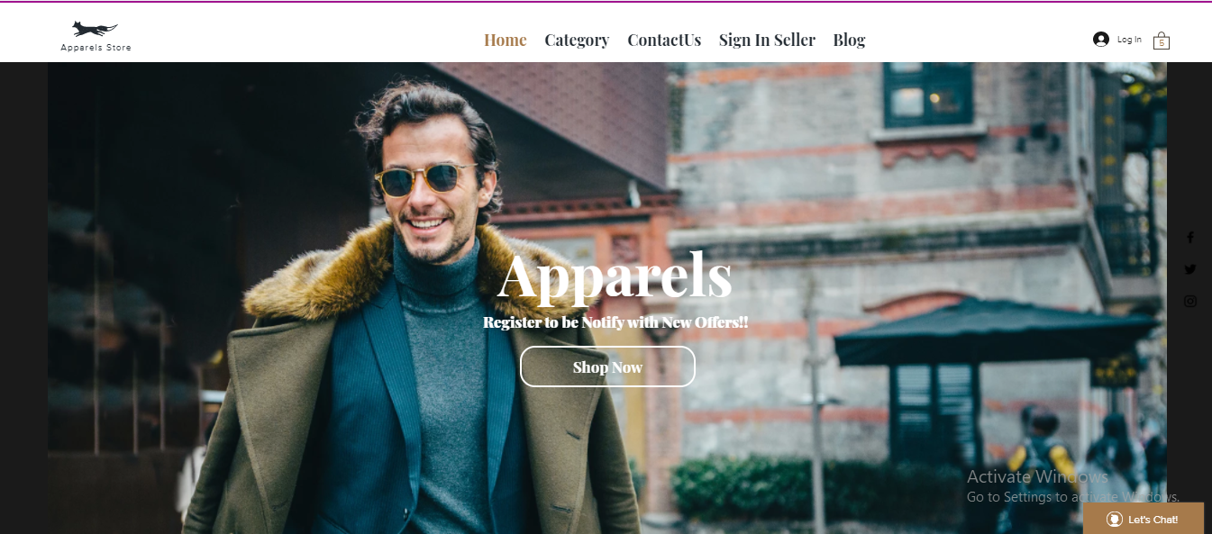
User Interface Design
fig1: Home Page

Slide 23
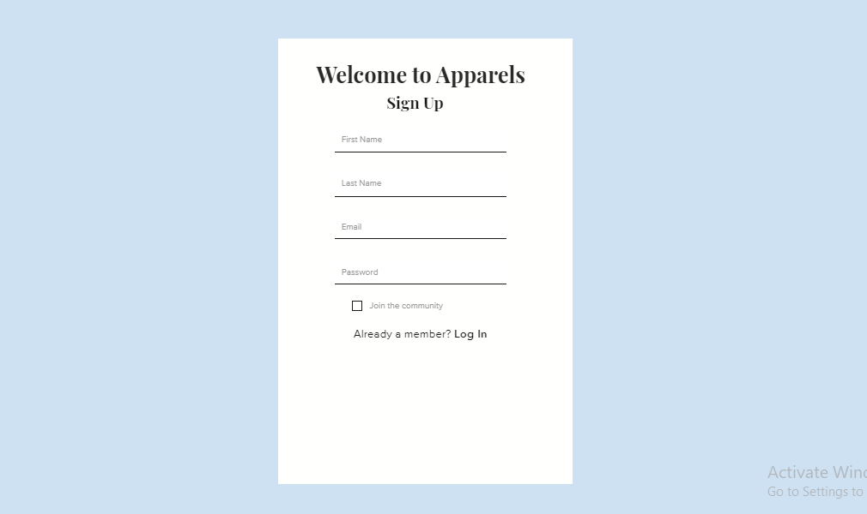
User Interface Design
fig 2: Visitor SignUp Page

Slide 24
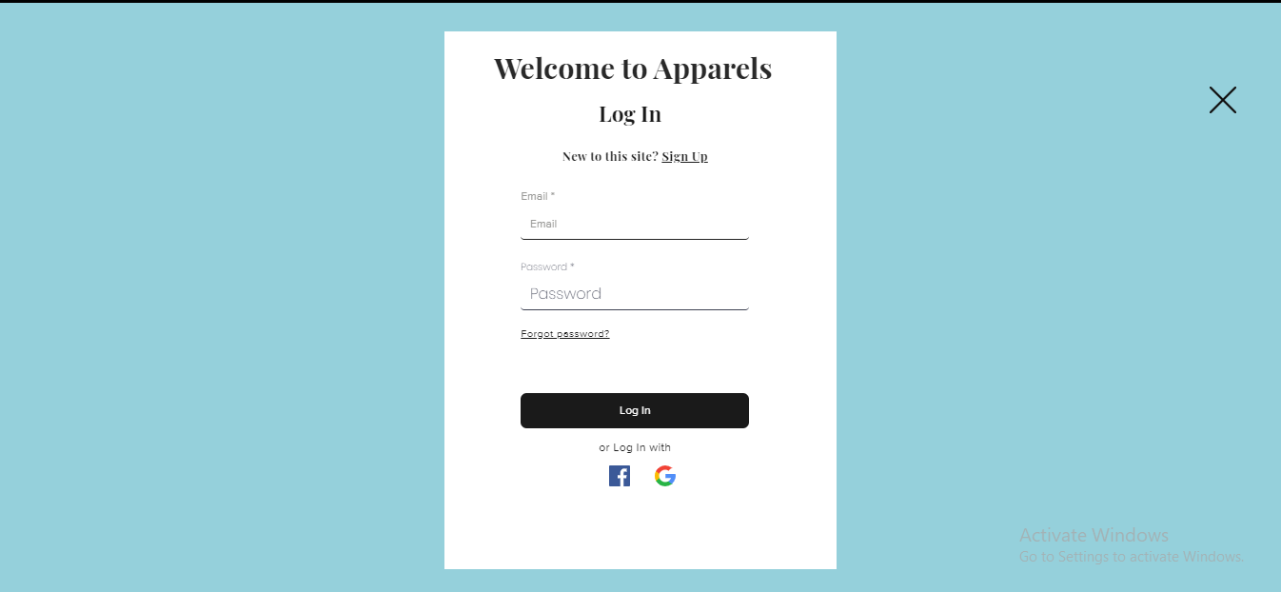
User Interface Design
fig 3: Customer Login Page

Slide 25
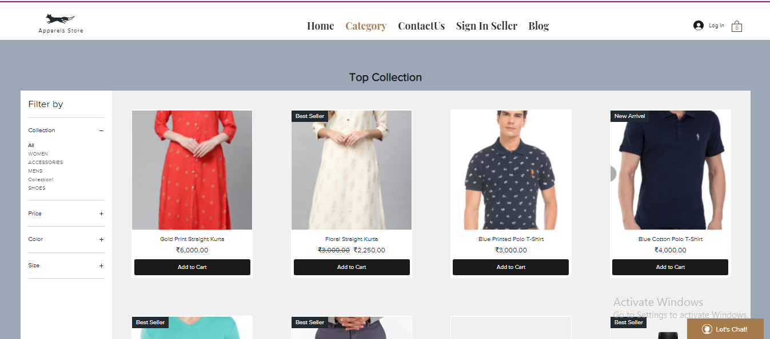
User Interface Design
fig 4: Products Collection Page

Slide 26
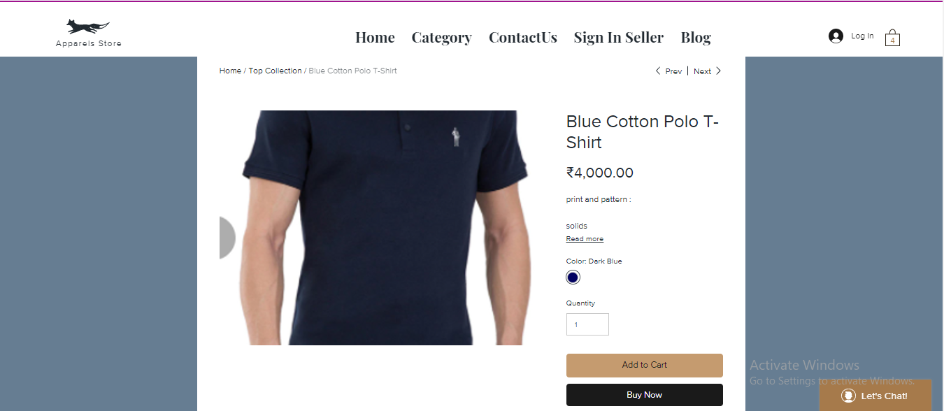
User Interface Design
fig 5: Product Details Page

Slide 27
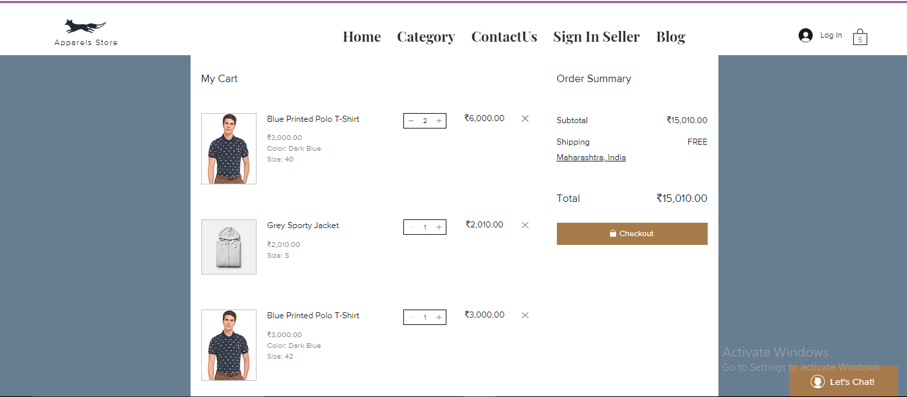
User Interface Design
fig 6: Cart Page

Slide 28
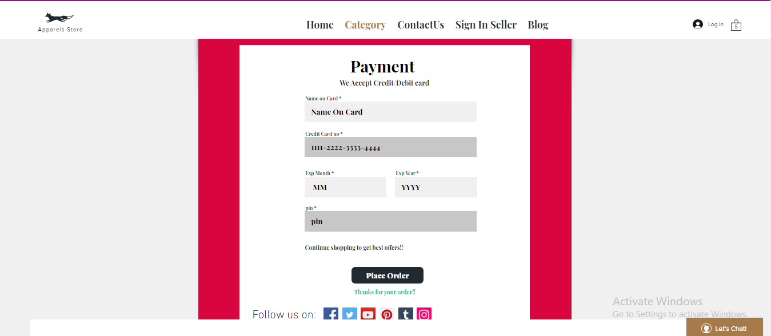
User Interface Design
fig 7: Payment Page

Slide 29
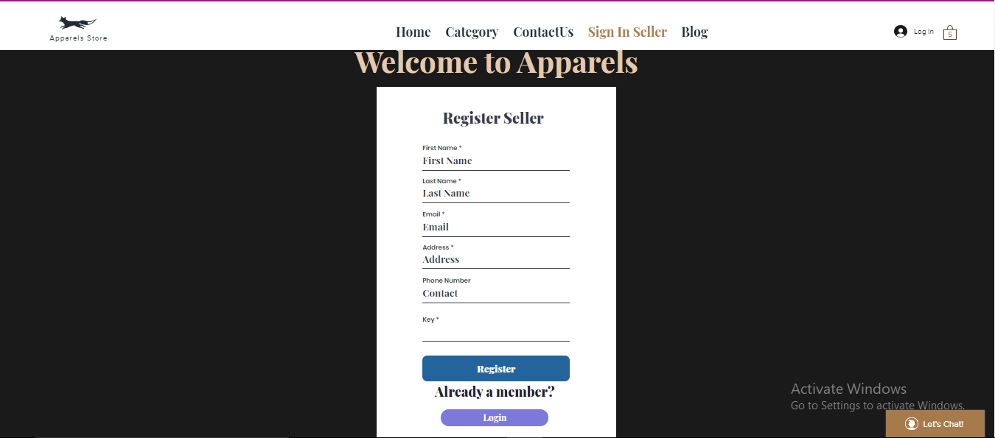
User Interface Design
fig 8: Seller SignUp Page

Slide 30
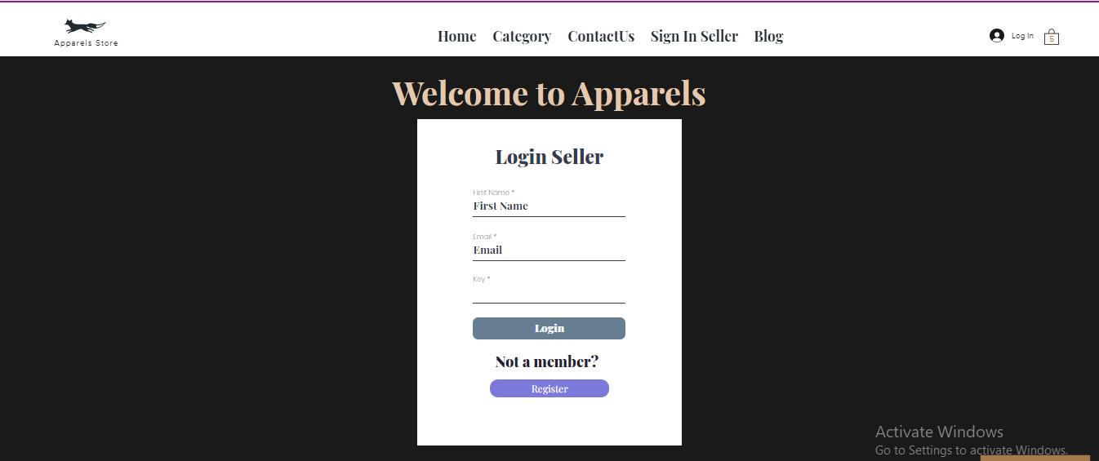
User Interface Design
fig 9: Seller Login Page

Slide 31
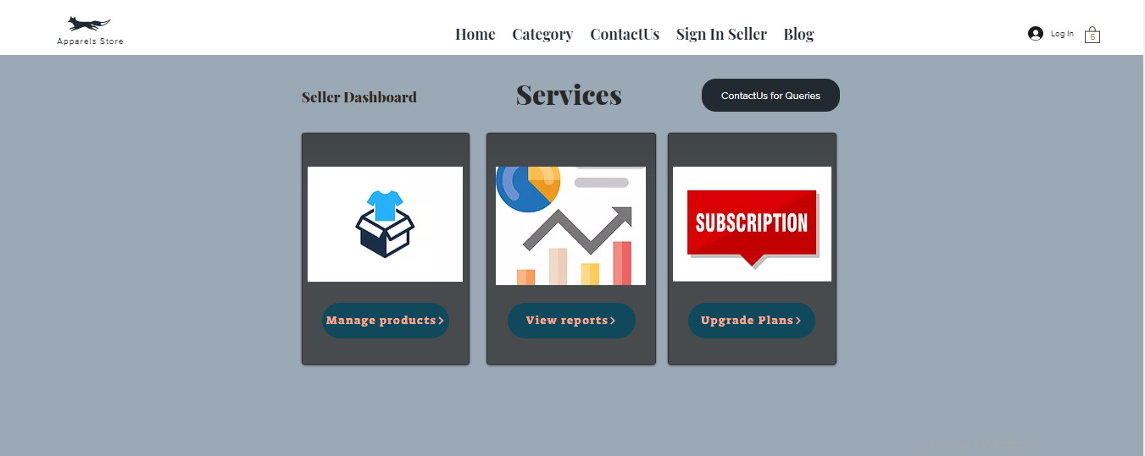
User Interface Design
fig 10: Seller Dashboard Page

Slide 32
Future Scope
Targeted advertising can be implemented using ML algorithms.
Affiliate with Courier / Delivery companies to support delivery services.
The spectrum of the products can be widened to include all categories of products.

Slide 33
Conclusion
Through our project we aim to provide an efficient and affordable way to establish one’s clothing business online
Also by using modern development stack handling interactions and relations between users and server becomes extremely convenient.
Using technology like Google firebase/mongodb atlas ensures the security of all data related to consumers personal details and payment details.
This project can provide flexibility to sellers particularly to revamp their business and make up for the losses incurred during the pandemic

Slide 34
References
[1] G.Issac,H.Hamzeh,S.Meacham,A.Stefanidis,” An Adaptive E-Commerce Application Using Web Framework Technology and Machine Learning”,in Conf. BCS Software Quality Management (SQM),Dorset BH12 5BB,UK,pp.101-112,Mar 2018.
[2] M.Lawan,” Development and Implementation of E-Commerce System”, International Journal of Advanced Research in Computer Science ,vol.9,no.1,pp.900-906,Mar 2018.
[3] S.Oluwaseun,A.Odeh,E.Joshua,” Implementation of E-Commerce based on Cloud Computing using ASP.NET Technology”, International Journal of Advanced Science and Applied Management,vol.2,no.7,pp.61-76, Jul 2016.
[4] L.Jiang,Y.Cheng,L.Yang,J.Li,”A Trust-Based Collaborative Filtering Algorithm for E-Commerce Recommendation”, 𝘑𝘰𝘶𝘳𝘯𝘢𝘭 𝘰𝘧 𝘈𝘮𝘣𝘪𝘦𝘯𝘵 𝘐𝘯𝘵𝘦𝘭𝘭𝘪𝘨𝘦𝘯𝘤𝘦 𝘢𝘯𝘥 𝘏𝘶𝘮𝘢𝘯𝘪𝘻𝘦𝘥 𝘊𝘰𝘮𝘱𝘶𝘵𝘪𝘯𝘨,vol.9,no.1,pp.3023–3034,Aug 2019.
[5] M.Argyriou,N.Dragoni,A.Spognardi,”Security Flows in OAuth 2.0 Framework: A Case Study”,in Conf. International Conference on Computer Safety, Reliability, and Security,pp.396-406,Sep 2017.

Slide 35
Questions??
Thank You!

