Slide 1
Mecklenburg County
Enterprise Application Logging
October 18, 2018

Slide 2
Document Purpose
This presentation covers Mecklenburg County ITS’s approach to Enterprise Application Logging.
The scope of the Enterprise Application Logging initiative
The objectives of Enterprise Application Logging
Cost associated to processing and storing logging data
Current state of Application Logging
Future state of Enterprise Application Logging
A gap analysis of Enterprise Application Logging
An impact assessment of this initiative.

Slide 3
Scope
Project Name: Enterprise Application Logging
Scope: To create a Enterprise Application Logging solution that will consolidate all the various application logging data to a centralized location to help rapidly identify application issues and prevent possible data loss.
Milestones:
POC to consume logging messages using a Logic App utilizing Table Storage connector. (complete)
POC to consume logging messages using a Function App and Table Storage assemblies.(complete)
POC Enterprise Application Logging for DataSync (Windows Service, Web Job and Web API). (in progress)
Integrate Logging to applications currently in development. (TBD)

Slide 4
Objectives
The solution must be:
Unobtrusive to applications utilizing it.
Cost effective
Efficient
Able to streamline support effort for distributed integrations.
At the application level, be as simple to implement as possible.

Slide 5
Compliance
Enterprise Application Logging initiative complies with approved architecture principles currently being implemented across several county cloud based initiatives.
Adjusting Data Retention policy for Enterprise Application Logging may be required to adhere to county compliance standards. (see gap analysis)

Slide 6
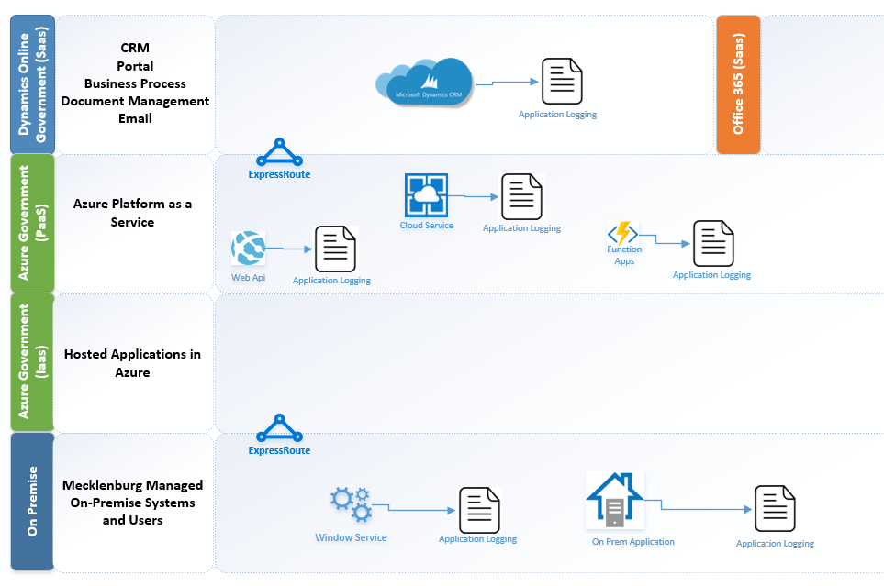
Application Logging, Current State

Slide 7
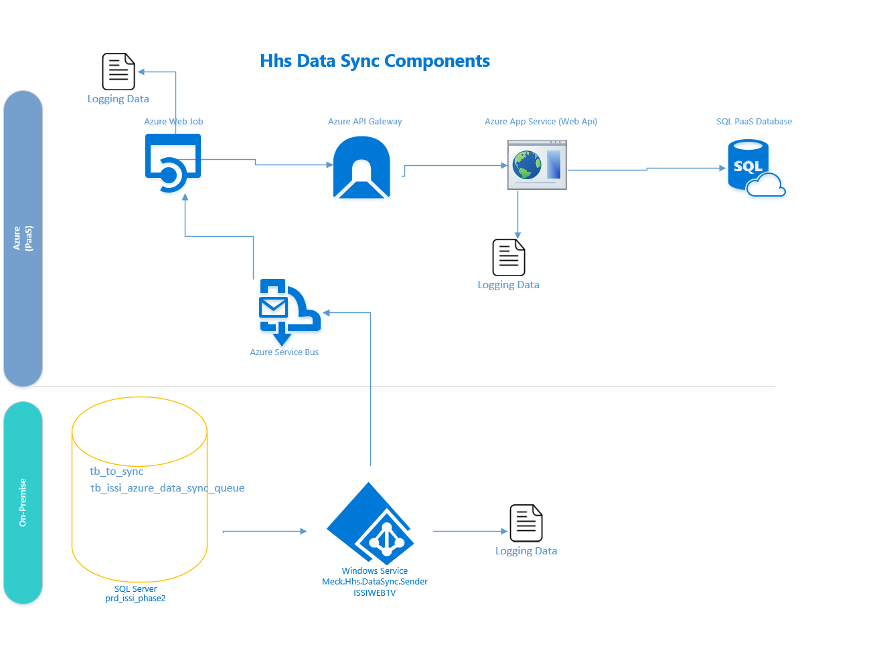
Current Logging structure for HHS Data Sync

Slide 8
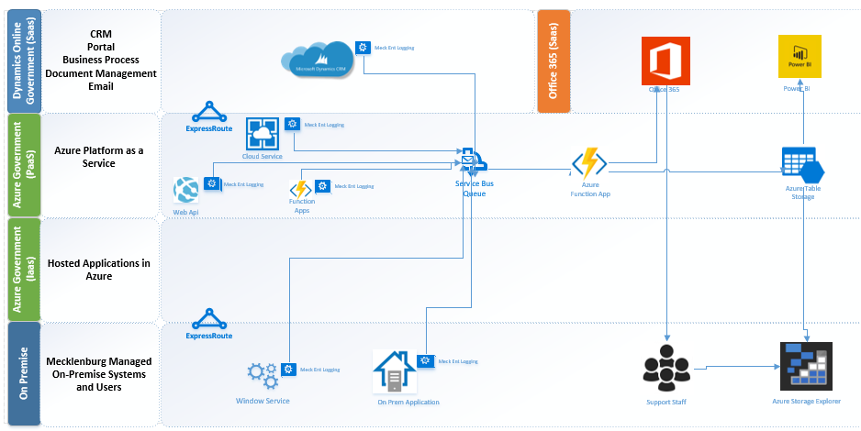
Enterprise Application Logging, Future State

Slide 9
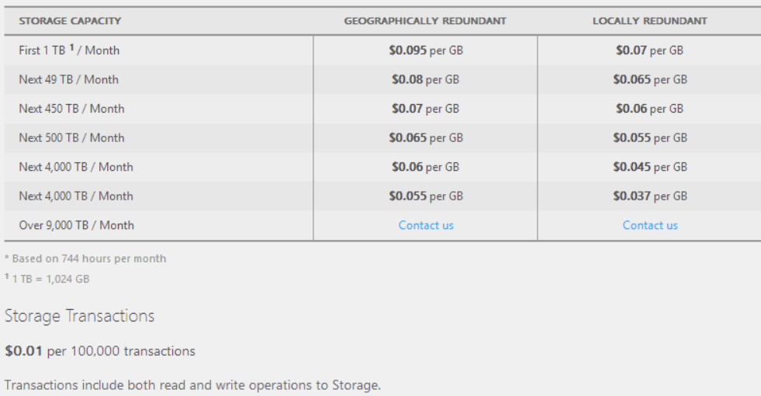
Azure Storage Table Costs
Storage: 50 GB (est.)/ month = $3.50
Transactions (3 million in and out): $.60
$4.10 per month

Slide 10
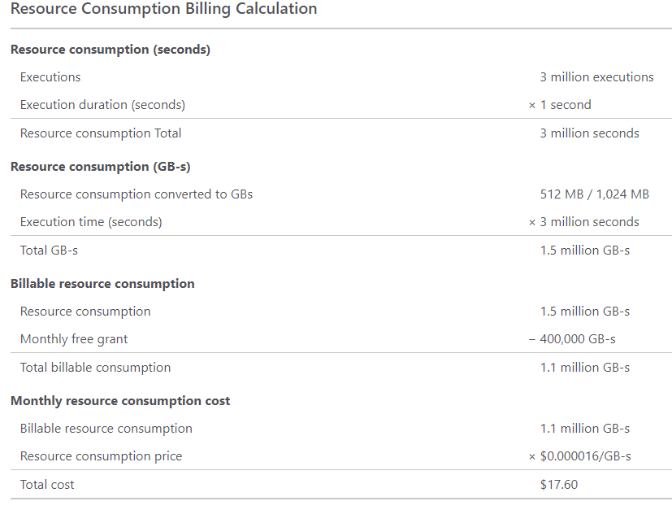
Azure Function App Cost (part 1)
Function App Resource Consumption at 3 million transactions:
$17.60/month

Slide 11
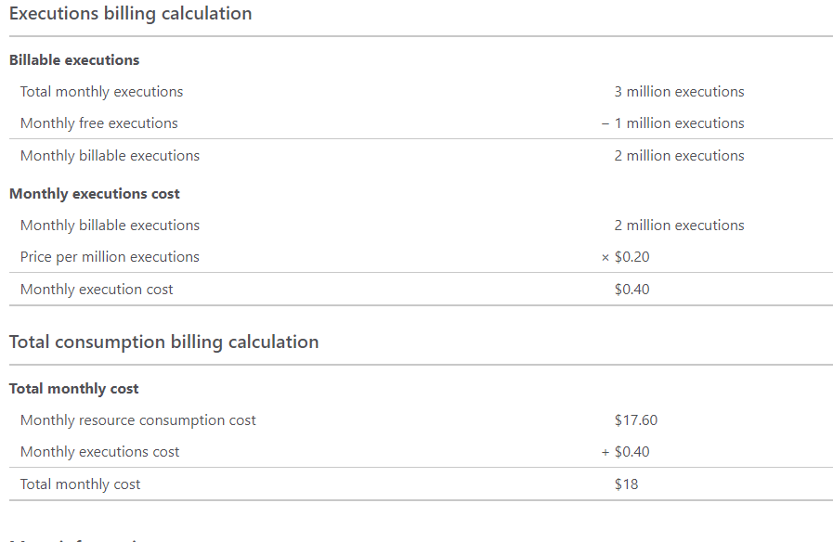
Azure Function App Cost (part 2)
Function App Executions at 3 million transactions:
$0.40/month
Function App total at 3 million transactions:
$18.00/month

Slide 12
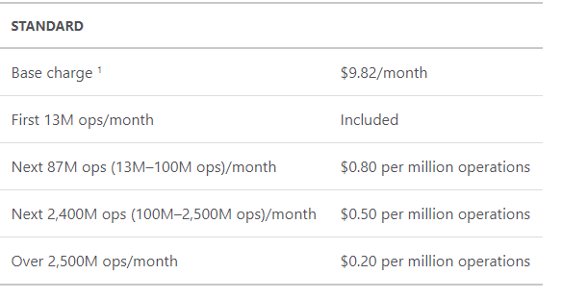
Azure Service Bus Cost
Service Bus Fixed cost for up to 13 million operations (shared namespace):
$9.82/month

Slide 13
Enterprise Application Logging: Total Cost
Total Cost monthly cost at a rate of 3 million logging messages per month.
$4.10 (Azure Storage)
$18.00 (Function App)
$9.82 (Service Bus)
$31.82/month

Slide 14
Gap Analysis
Retention Policy: Since some of the logging methods accept [encrypted] application data, we may have some data retention considerations. As of today, the plan is to only keep one month of logging data. If need be, this can be prolonged based on county policies
Enterprise Application Logging is used to augment the support effort for distributed cloud based integrations. Its not true Log Analytics. Its meant to work in conjunction with other azure products (Application Insights, Log Analytics and Azure Monitor) that can give us full-stack visibility and analysis. This a broader discussion that will take place in the future.

Slide 15
Impact Assessment
New Development: Impacts to new development is minimal. Implementation requires a simple reference to the logging assembly, a few config file entries (azure key vault candidate) and as little as one line of code for exception logging at the base level. Other logging types require a line of code to fire a logging event.
Existing Applications: Would require a code changes and a deployment (quarterly release). As with new development, a simple reference to the logging assembly, a few config file entries (azure key vault candidate) and as little as one line of code for exception logging at the base level.
Applications impacted: Logging POC is slated for the HHS DataSync solution. If this proves successful, we will implement for Day Sheets, Taf and Online Reporting in the HHS/PS domain.

