Slide 1
Anaka : Efficient Prediction of Time-Based Events using Parallel Computing Architecture.
Team : Ankit Sirmorya, Preethu Thomas, Shantanu Kande, Sumeet Pande

Slide 2

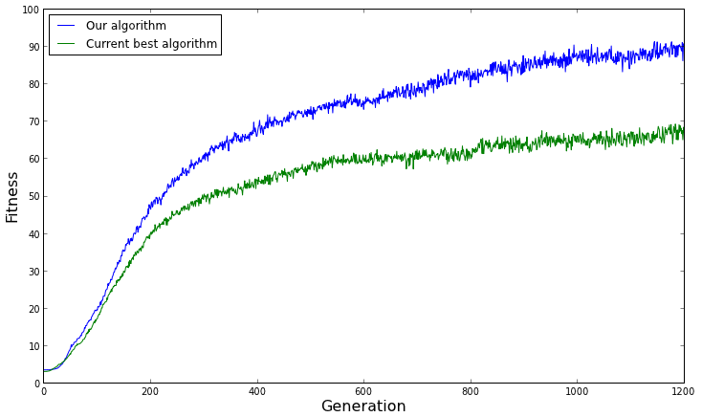
Project Objectives
Primary objective of the project is fast and efficient prediction of time based events by making use of parallel computing paradigm.
A hybrid model based on Genetic Algorithm(GA) and Fuzzy Time Series(FTS) is being proposed to be implemented on time bound data set.
GA+FTS to be used for the purpose of distributed processing of time bound data set using MapReduce on Hadoop framework.

Slide 3
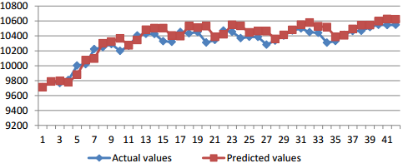
Used Cases
GA+FTS have been used to solve prediction problem in various fields. Implemented to reduce root mean square error and improve accuracy. Examples: Stock Market prediction Model. Enrollment Forecasting. Temperature Prediction Models. Tourism Demand Model. | Fig: Comparison of the predicted and expected value of Dow Jones Index (Year 2009)

Slide 4
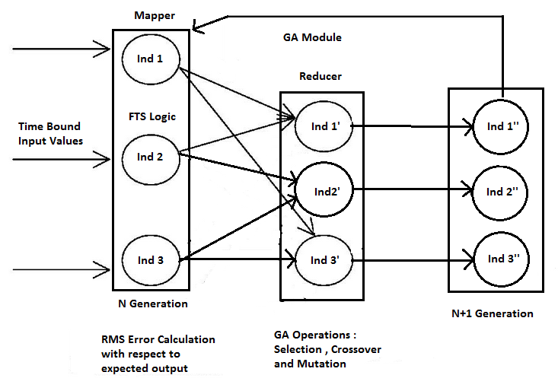
Architecture Overview

Slide 5
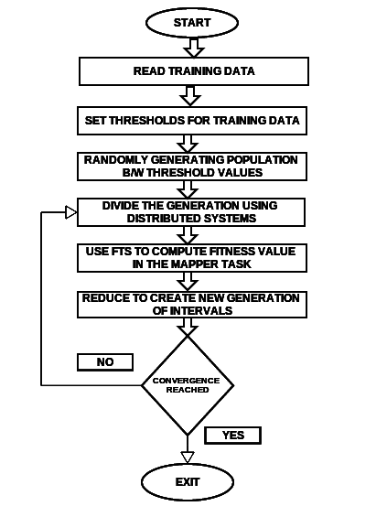
Flowchart Implementation
Creation of first generation of Individuals from the time bound data set.
Dividing this data in distributed manner so as to implement the data in MapReduce framework.
Mapper Function -> Apply FTS to calculate fitness of each individual.
Reducer Function -> Perform selection , crossover and mutation (GA operators) thereby creating an a new generation.

Slide 6

Related Work & Possibilities to Consider
Successful Implementation of GA-FTS prediction model but in a sequential manner.
Similar to GA, there are other evolutionary algorithms which have been developed on a parallel computational model
Use of advanced parallel computational framework such as Apache Giraph, YARN and so forth
Experimenting with the threshold parameters for GA and FTS to increase the fitness value
Analyzing the adaptability of GA operations to MapReduce paradigm
Dynamically retrieving data

