Slide 1

Wiktionary Mobile
Patrick Hayes
@pfjhayes
Notes:
Introduce self
- Patrick Hayes,
- Volunteer on the Wiktionary Mobile project
What the talk is about
- Wiktionary Mobile, the mobile app for Wiktionary
- How it was made
- Next steps for the project

Slide 2
The Project
Develop an official mobile Wiktionary app
Foundations set by Wikipedia mobile app
Design for extensibility
Notes:
- Wiktionary app for mobile platforms
- Follow in footsteps of Wikipedia
- Extend to Wikiquote, Wikibooks, etc.

Slide 3
The Volunteer Effort
Undergraduate Capstone Open Source Projects (http://ucosp.ca)
Get Canadian undergraduate students involved in open source projects
Contribute to open source for course credit
Notes:
- Canadian universities volunteer students
-

Slide 4




The Team
Tony Cheng
University of Toronto, Computer Science
Shea Clare
University of British Columbia, Computer Science
@sheaclare
Patrick Hayes
University of Waterloo, Computer Science
@pfjhayes
Dale Lemieux
University of Waterloo, Computer Science
@dalelemieux

Slide 5
Development
Built with PhoneGap
HTML5, CSS, JavaScript
Compatible with iOS, Android, BlackBerry, Windows Phone
Notes:
Explain PhoneGap
- Open source technology to build apps for multiple platforms
- From a single codebase
- Live version
Features up next

Slide 6
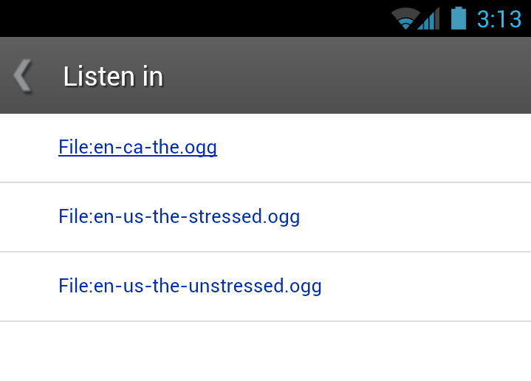
Listen In...
Listen to word pronunciations

Slide 7
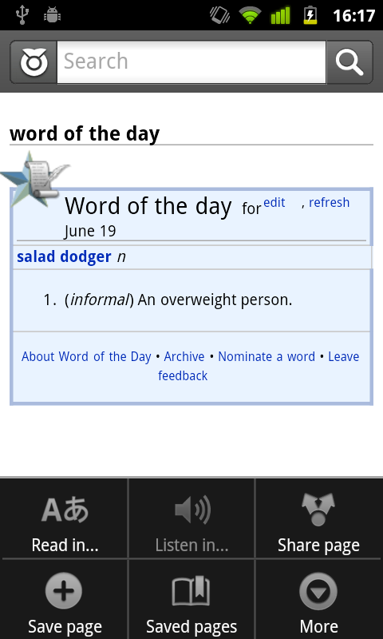
Word of the Day

Slide 8
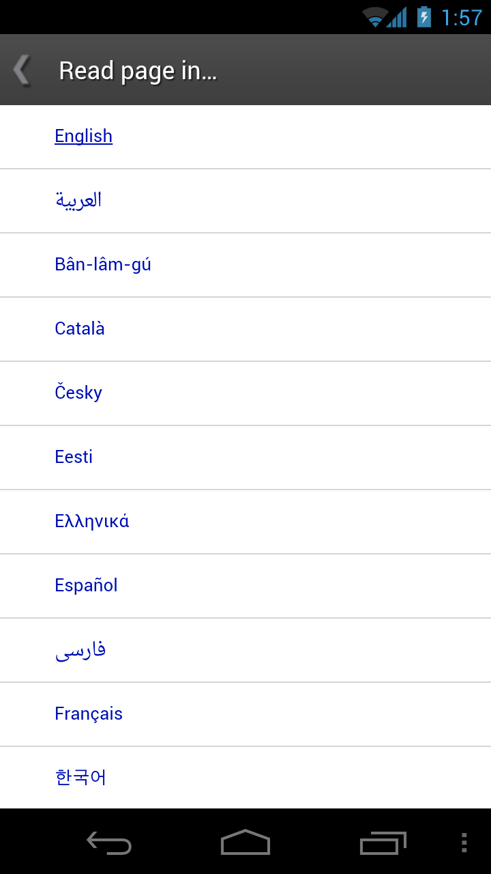
250+ Languages
Access pages in over 250 languages
App has been localized to over 30 languages
Notes:
TranslateWiki

Slide 9
Volunteer
http://github.com/wikimedia
#wikimedia-mobile on IRC
Developers, contributors, beta testers
Notes:
- Your contributions appear immediately

Slide 10
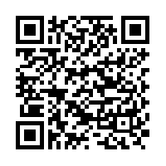
Available Now
Android: http://tiny.cc/wiktionary
iOS: Coming soon...

