Slide 1

Wiktionary Mobile
Patrick Hayes
@pfjhayes

Slide 2
The Project
Develop an official mobile Wiktionary app
Foundations set by Wikipedia mobile app
Design for extensibility

Slide 3
The Volunteer Effort
Undergraduate Capstone Open Source Projects (http://ucosp.ca)
Get Canadian undergraduate students involved in open source projects
Contribute to open source for course credit

Slide 4




The Team
Tony Cheng
University of Toronto, Computer Science
Shea Clare
University of British Columbia, Computer Science
@sheaclare
Patrick Hayes
University of Waterloo, Computer Science
@pfjhayes
Dale Lemieux
University of Waterloo, Computer Science
@dalelemieux

Slide 5
Development
Built with PhoneGap
HTML5, CSS, JavaScript
Compatible with iOS, Android, BlackBerry, Windows Phone

Slide 6
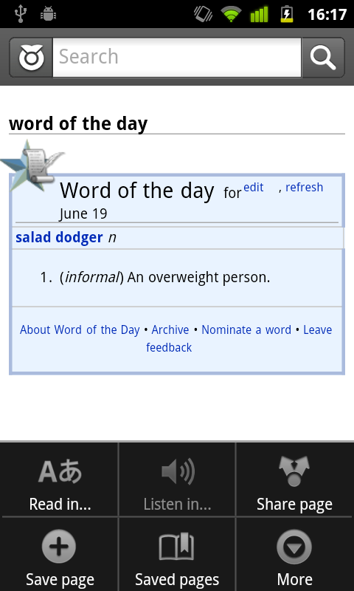
Word of the Day

Slide 7
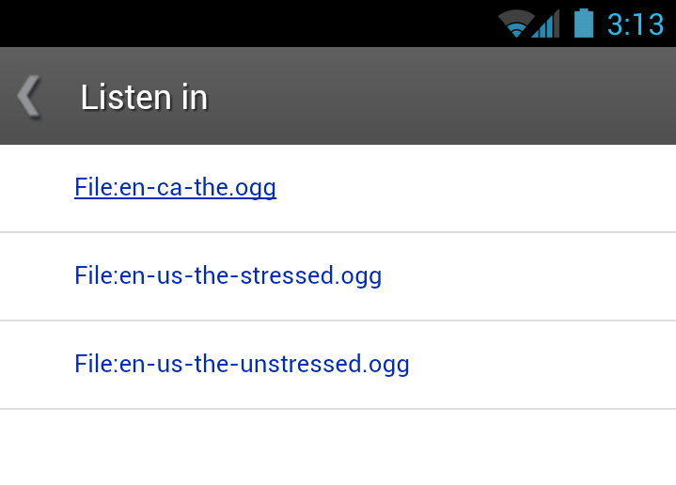
Listen In...
Listen to word pronunciations

Slide 8
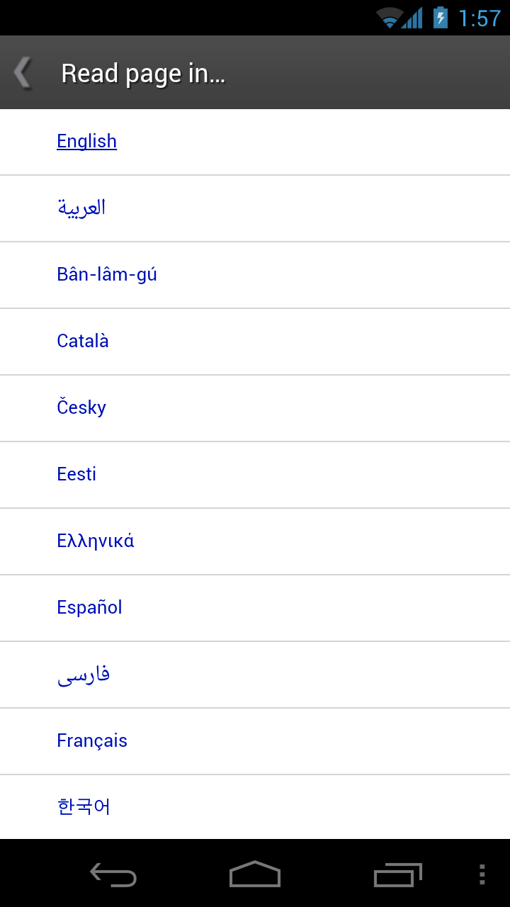
250+ Languages
Access pages in over 250 languages
App has been localized to over 30 languages

Slide 9
Volunteer
http://github.com/wikimedia
Developers, contributors, beta testers
Notes:
talk about feature freeze

Slide 10
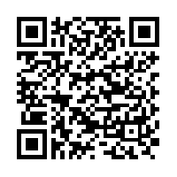
Available Now
Android: http://tiny.cc/wiktionary
iOS: Coming soon...

