Slide 1
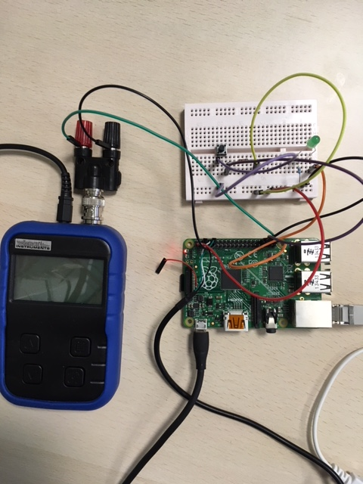
auto/manuel mode switch
led simulation
Easy Pulse sensor simulator
(signal generator)

