Slide 1
Alu Polymorphism Detection
Petko Fiziev, Bioinformatics IDP

Slide 2
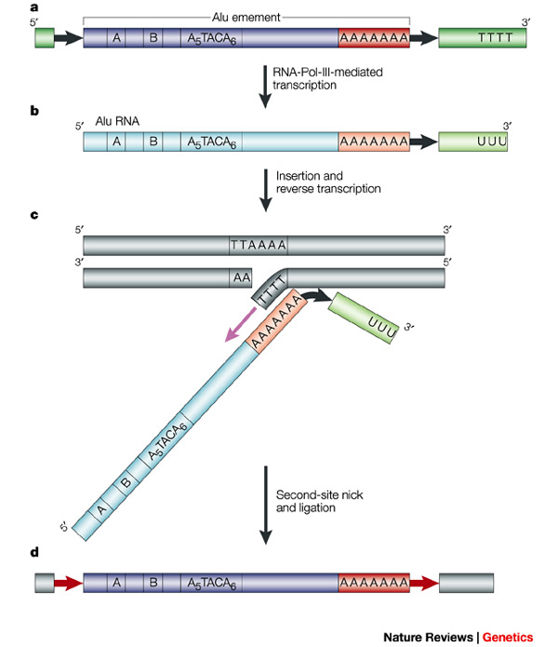
What are Alu repeats?
Source: Batzer et al. 2002

Slide 3
Why do we care about Alus?
insertional mutations
gene conversion
recombination
alterations in gene expression,
pseudogenization
structural variation
formation of segmental duplications
genetic marker for diseases
track down human evolution

Slide 4
Project goals
Given:
  a reference genome + Alu annotation
  a set of short reads from a subject genome
  DB of known Alu sequences
Detect Alu insertions and deletions
Diploid human genome
SNPs and small indels
No other large structural variations
Sequencing errors

Slide 5
The idea (insertions)
Reference Genome
Alu
Subject Genome

Slide 6
The idea (deletions)
Reference Genome
Alu
Subject Genome

Slide 7
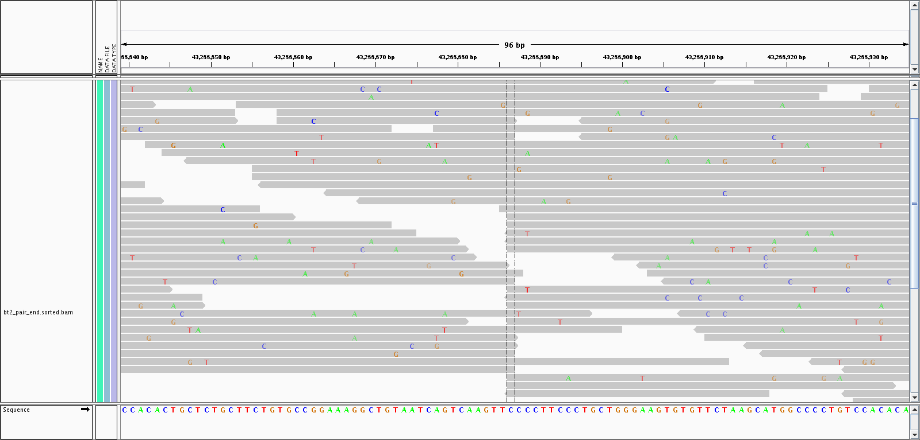
How real heterozygous insertions look like

Slide 8
The algorithm
Map all reads to the reference (MAPQ > 10)
Map all reads to a DB with Alu sequences to tag Alu reads
Detect potential inserts
  Sliding window of 30 bp
    Are there any Alu reads in the window?
    Count how many reads start at each position
    Count how many reads end at each position
    Are those counts high enough somewhere in the window?

Slide 9
The algorithm (part 2)
Detect potential deletions
  Scan all known Alus in the reference genome
  What is the overall coverage within the Alu?
  How many reads end at the beginning of a known Alu?
  How many reads start at the end of a known Alu?

Slide 10
How much is high enough?
N – genome size, M – # reads
H – # reads that start at a certain position
T – # reads that end at a certain position
H and T ~ Poisson(λ),
C – some constant
K = 4 or K = 5 was enough for my testing data

Slide 11
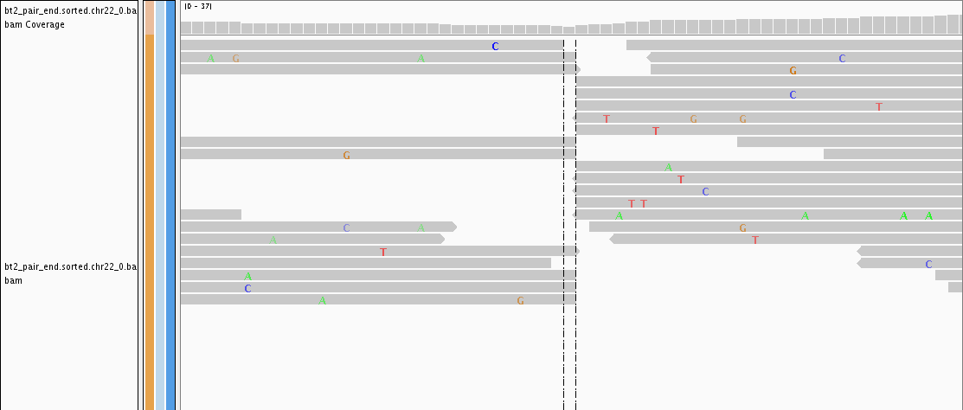
Is it homozygous or heterozygous?
Calculate the ratio of spanning reads to all reads
Insertion is on both chromosomes if the ratio is 0

Slide 12
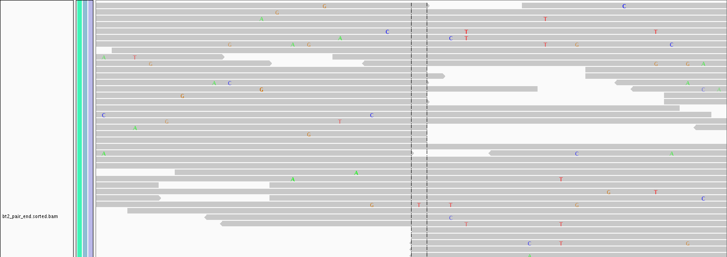
Is it homozygous or heterozygous?
Insertion is only on one of the chromosome copies if the ratio is equal to what you expect divided by 2. Estimate it!

Slide 13
Test data (insertions)
Human chromosome 22 (50 Mbp, 23361 Alu instances from 37 families)
Generate 2 chromosome copies:
  Add a SNP every 1,000 bp
  Add an indel every 10,000 bp
  Insert 1,000 Alus per chromosome copy in random positions and orientation
  New Alus cannot be inserted into each other, but can land inside existing Alu sequences.
  Mutate the new Alus in 5% of their bases (a higher mutation rate actually helps)

Slide 14
Test data (short reads)
100 bp pair-end reads
  Fragment lengths: 150 bp to 500 bp, uniform
  Average overall error rate ~ Normal (mean = 5%, var = 0.01%)
  Lower error rate at the beginning, increases gradually towards the end of the reads
  Generate fastq with quality scores
Generate 30x, 20x and 10x total coverage

Slide 15
Results (insertions)
Total inserted Alus: 2000
Running time < 1 hour
Total Coverage (both chromosomes) | 30x (K=5) | 30x (K=4) | 20x (K=4) | 10x (K=3)
True Positives | 1761 (88%) | 1847 (92%) | 1515 (75%) | 817 (40%)
False Positives | 2 (FDR: 0.1%) | 155 (FDR: 7%) | 15 (FDR: 1%) | 29 (FDR: 3.43%)
False Negatives | 239 (11%) | 148 (7%) | 470 (23%) | 1174(58.70%)

Slide 16
Test data (deletions)
Human chromosome 22 (50 Mbp, 23361 native Alu instances from 37 families + 1000 artificially inserted Alus)
Generate 2 chromosome copies:
  Add a SNP every 1,000 bp
  Add an indel every 10,000 bp
  Delete randomly 500 Alus per chromosome copy from the set of artificial Alus
Generate 30x total coverage (15x per chromosome)

Slide 17
Results (deletions)
Accuracy:
  Total deleted Alus: 1000, Alus tested: 24361
  True positives: 850 (85%)
  False positives: 142 (FDR: 14%)
  False negatives: 150
Running time ~ 1 hour

Slide 18
Improvements and ideas
Improve detection of insertions within existing Alus
  Use RepeatMasker annotation
  Use insert size deviations
Improve detection resolution
Pool data from multiple individuals for higher coverage.
  Population specific Alus (European, Asian, African etc)

Slide 19
References
Alu repeats and human genomic diversity. Batzer et al., Nature Genetics, 2002
Alu repeat discovery and characterization within human genomes. Hormozdiari et al. Genome Research, 2011
PAIR: polymorphic Alu insertion recognition. Sveinbjörnsson et al., Bioinformatics 2012

Slide 20
Thank you!

