Slide 1
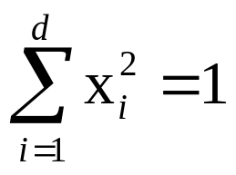
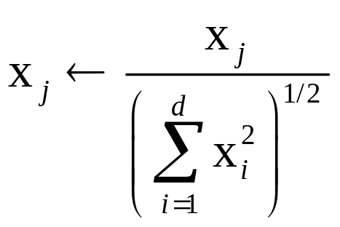
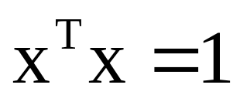
Normalization
归一化
Patterns are normalized (or scaled) to have unit length, or
This is done by replacing each feature value by
Effect of normalization

Slide 2
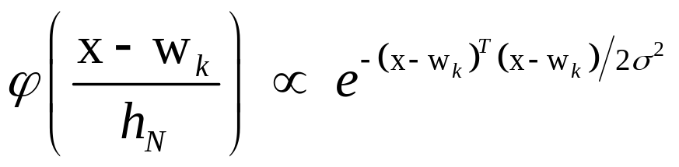
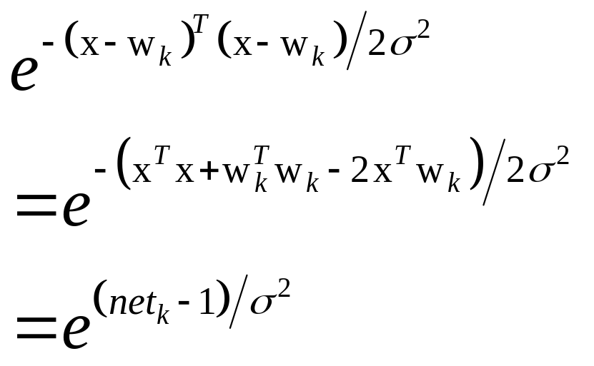
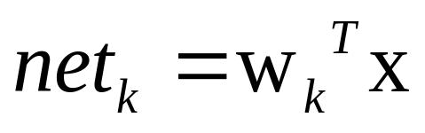
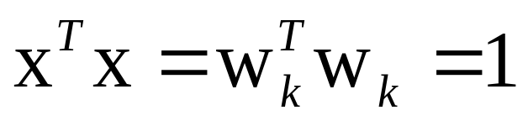
Activation Function 激活函数
Desired Gaussian
Contribution of a sample at x
Here we let weights correspond
to feature values of sample
样本对x的贡献，在这里，我们让权重对应样本的特征值
Simplified form due to normalization1

Slide 3
y
n维信息损失至(n-1)维信息
x
o

Slide 4
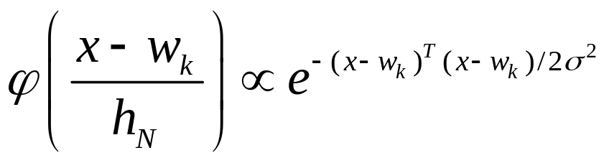
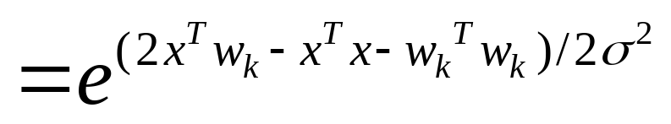
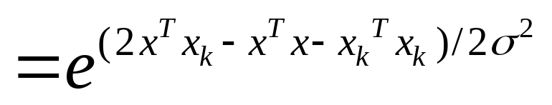
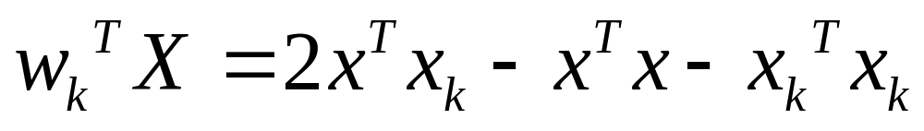
Activation Function 激活函数

Slide 5




Probabilistic Neural Networks
.
.
.
Category
units
Input unit
d+2×n个连接
Patterns units
n个连接
.
.
.
_{x1i}
W₁₁
p₁
a₁₁
ω₁
.
_{x2i}
p₂
ω₂
.
.
.
.
.
.
.
.
a_{n1}
.
W_{d2}
.
.
_{xdi}
a_{2c}
₋₁
W_{dn}
p_{n}
ωc_{c}
Modifiable weights (trained)

Slide 6
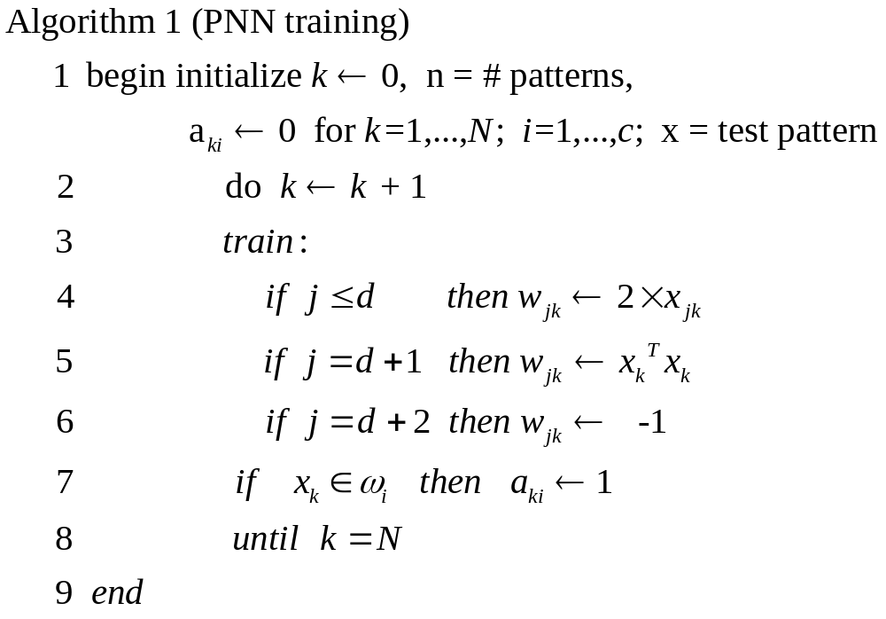
PNN training

Slide 7

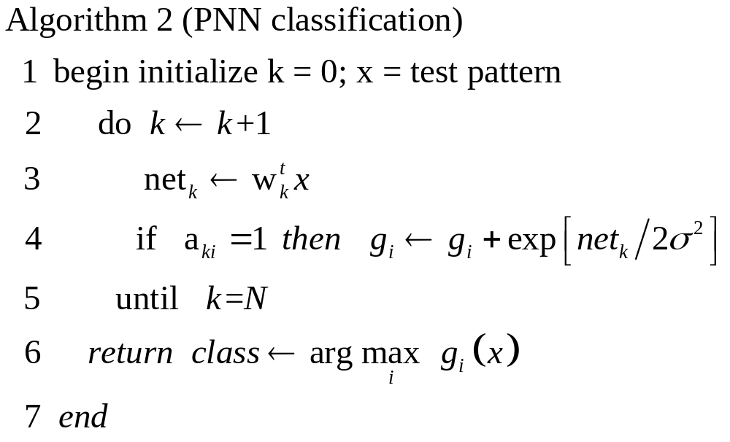
PNN classication 用PNN分类

Slide 8
Experimental result 实验结果
Data1:二维正态分布 mean = [0,0]; SIGMA = [1 0;0 1]; num = 7000;
Data2:二维正态分布 mean = [200,0]; SIGMA = [1 0;0 1]; num = 7000;
待测样本均值 | [0,0] | [50,0] | [100,0] | [150,0] | [200,0]
归一化 正确率 | 50.48% | 0% | 50.56% | 100% | 100%
本方法 正确率 | 100% | 100% | 100% | 100% | 100%
测试样本集均为5000个点，同matlab自带pnn对比得到正确率

