Slide 1
Analysis Tools
Eight Mylyn Releases (Temporal Analysis)
R Packages Used
TNET
iGraph
Statnet

Slide 2
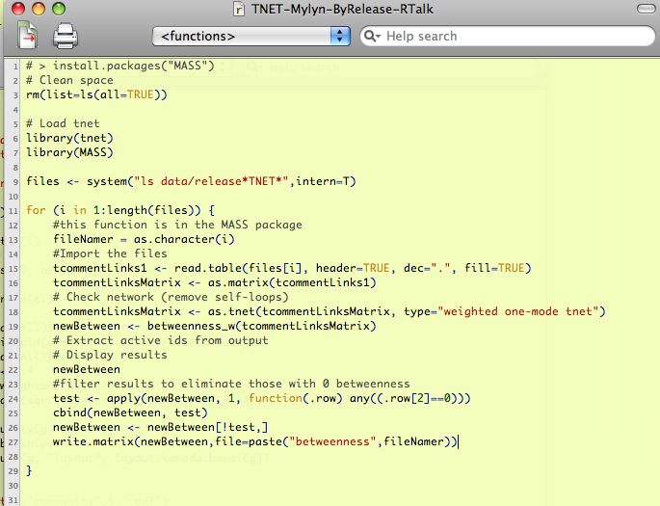
Weighted Network: TNET
Notes:
TNET is a package I would turn you on to if you need to consider weighted network measures. The data structure is a little different than STATNET or iGraph. When you are working with small world data that is relatively closed, the weights of the connection become very important to the analysis.

Slide 3
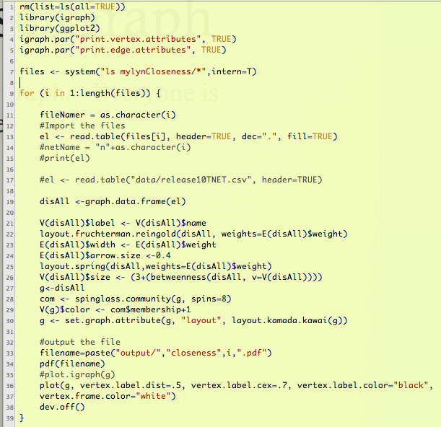
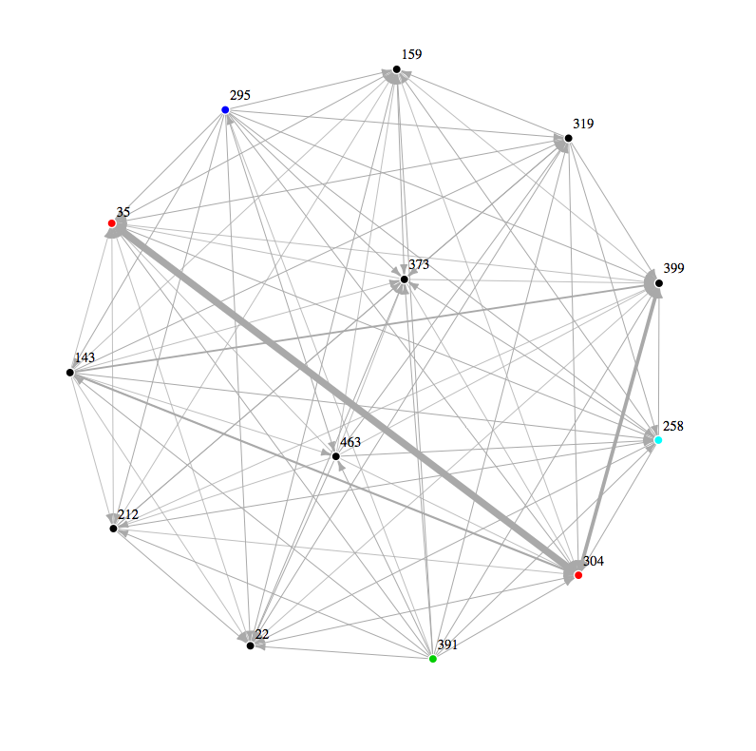
The Dense Graph (Work)
Developers create a dense graph. Not a complete graph, but dense.
Work

Slide 4
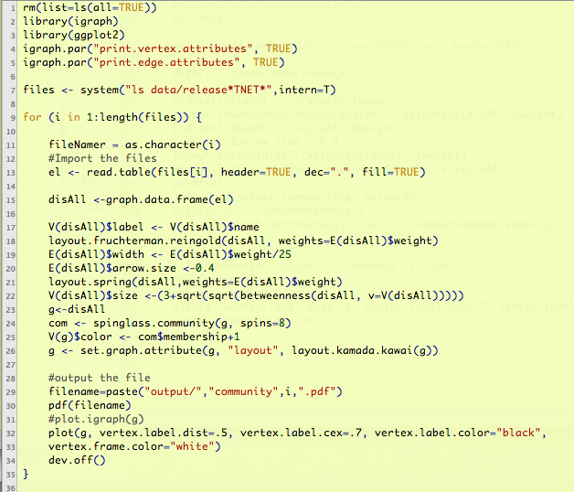
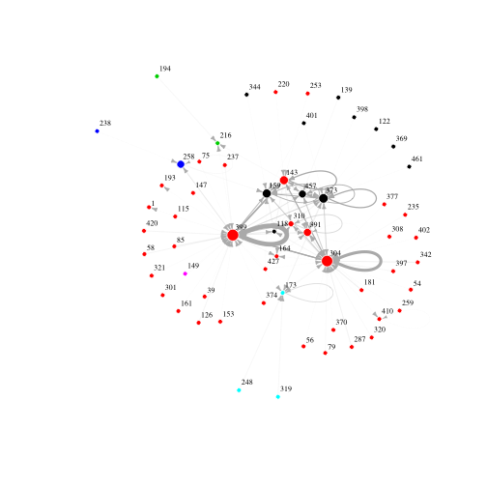
A Sparser Graph (Talk)
Commenter's create a sparse graph
Talk

Slide 5
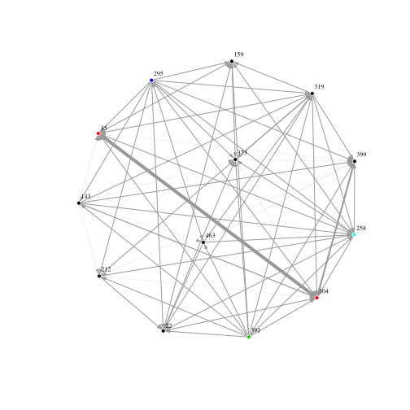
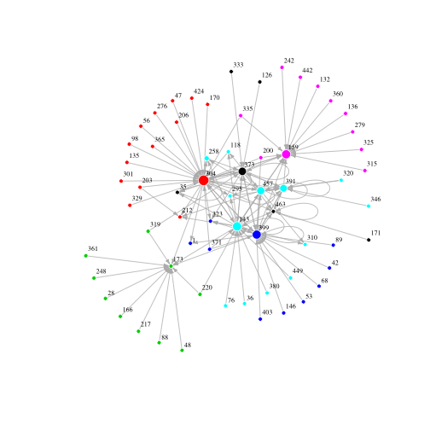
Release One (2.0) Analysis
Release 1
Discussion
Code
Talk
Work
iGraph

Slide 6
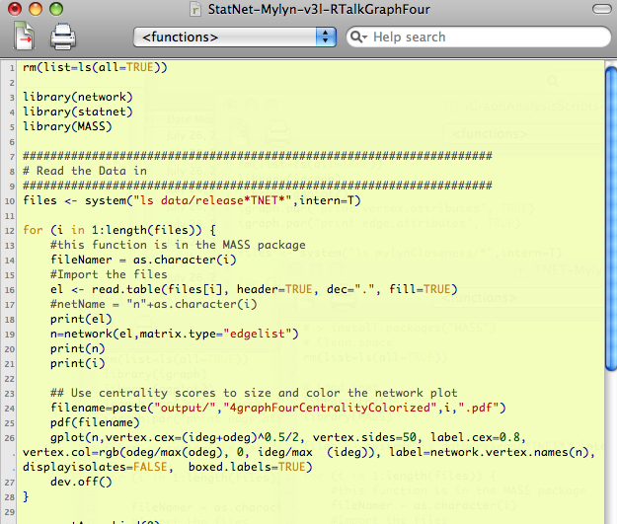
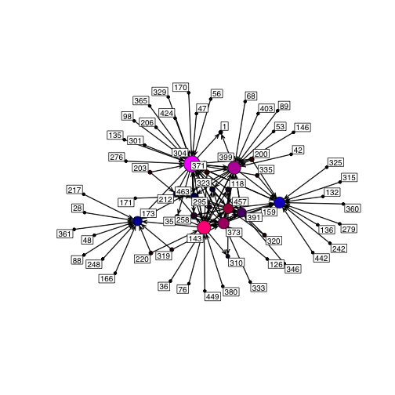
STATNET for Discussion
StatNet
Red = Bug Commenter
Blue = Bug Opener
Release 1
Talk
StatNET

Slide 7
Release One
Work & Talk

Slide 8
Release 1 (2.0) iGraph & Statnet
Talk
Red = Bug Commenter
Blue = Bug Opener
Clusters
Release 1
StatNET
In Degree &
Out Degree
iGraph

Slide 9
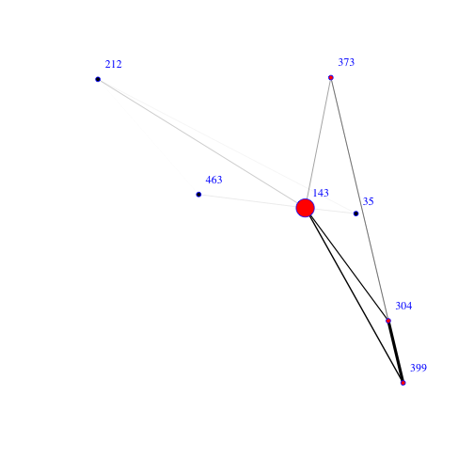
Release One (2.0): Filtered
Code
Discussion
Talk
Release 1
Work
Google Summer Coder
304, 373, 399 & 143 form
The Strongest Connections
In both networks
Red = Bug Commenter
Blue = Bug Opener
Notes:
Here we have filtered the developer code for the strongest connections.

Slide 10
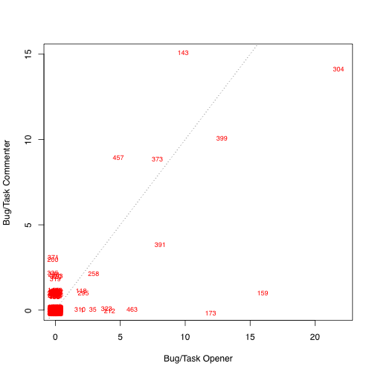
Release One (2.0): Filtered
Code
Work
Discussion
Talk
Release 1
457, 391 & 159 –
Comment & Open
Google Summer Coder
304, 373, 399 & 143 form
The Strongest Connections
In both networks
Red = Bug Commenter
Blue = Bug Opener
Notes:
Here we have filtered the developer code for the strongest connections.

Slide 11
Compare Over Time
First & Last Release

Slide 12
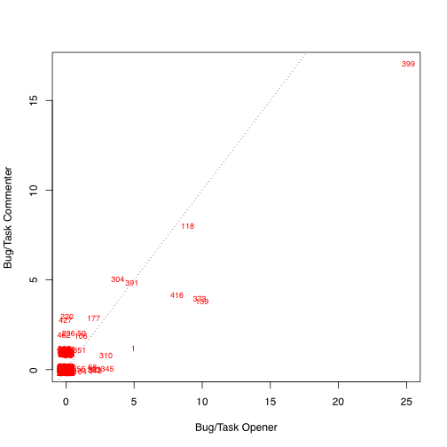
Release 1 (2.0) Compared to Release 8 (3.3)
Release 1
Talk
Release 8
304, 399, 143, 159, 173, 373
399, 118, 304, 159, 391, 416
StatNET & ordinary plotting

Slide 13
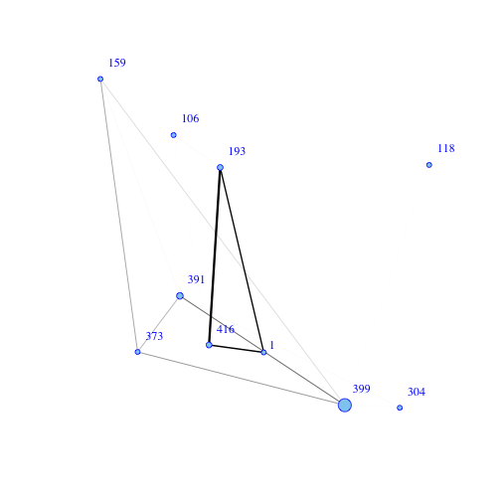
Release 1 (2.0) Compared to Release 8 (3.3)
Work
Release 1
143 & 304 disengaged
Or missing entirely
Release 8
304, 373, 399 & 143
Two disconnected
Graphs in release 8
iGraph

Slide 14
Release Eight
Work & Talk

Slide 15
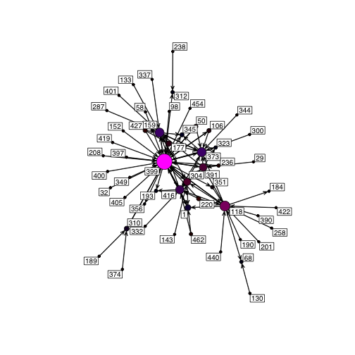
Release 8 (3.3): Filtered
Discussion
Code
Release 8
Talk
Nobody is
“Just Blue”
Work
Red = Bug Commenter
Blue = Bug Opener
Notes:
304 & 399 are the story
Statnet is centrality.
89, 276 & 301 are commenters who do not write code.

Slide 16
Release 8 (3.3): Filtered
Release 8
Discussion
Code
Talk
Work
Notice 416 in Talk & Second Coder Graph
Red = Bug Commenter
Blue = Bug Opener
Notes:
416 is part of the disconnected graph, and has two other folks connected to it. That person also shows up in the discussion graph.

Slide 17
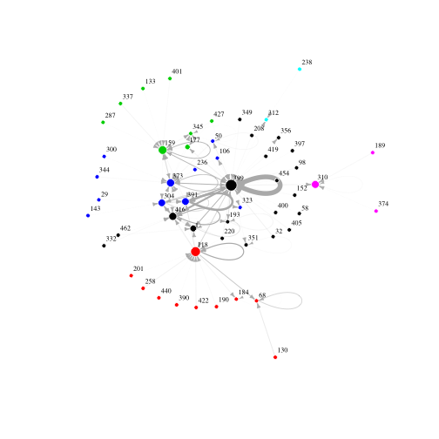
Release 8 (3.3) iGraph & Statnet
399, 118 & 159 are significant, But play with different clusters of Other people.
Release 8
Talk
Red = Bug Commenter
Blue = Bug Opener
Clusters
StatNET
In Degree &
Out Degree
Blue
Cluster
iGraph

Slide 18
Releases One → Eight
High Level Views Over Time

Slide 19
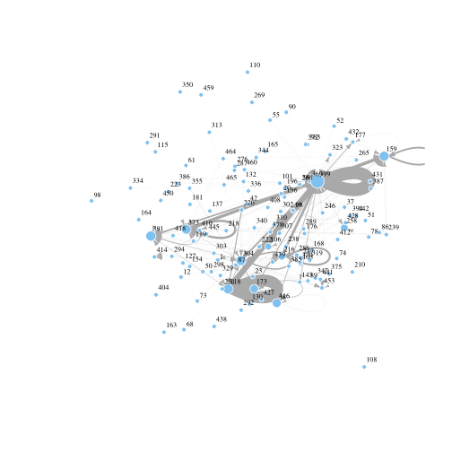
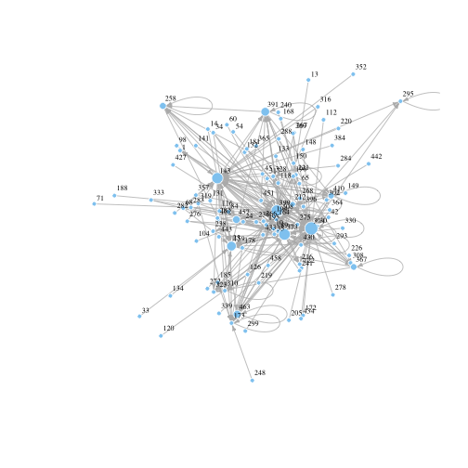
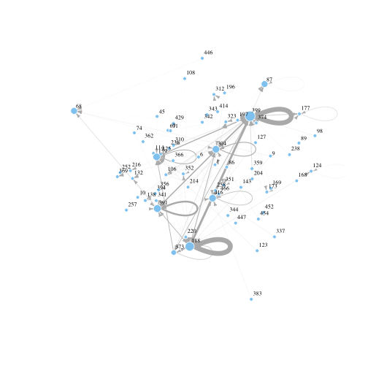
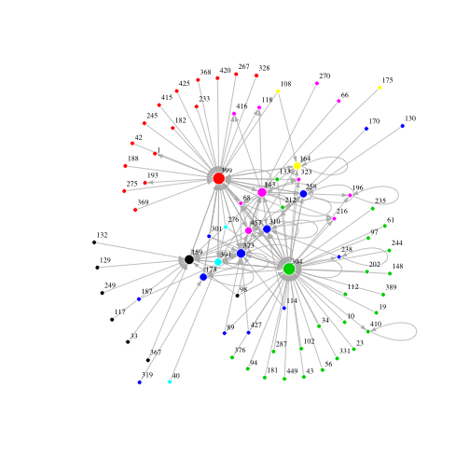
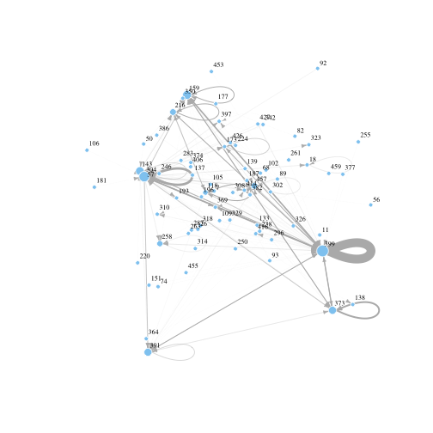
Discussion, Releases 1 – 8
Where there is no color,
There are multiple, incomplete
Graphs.
Notes:
When the graph is connected in a community of this size, it may indicate some level of cohesiveness that does not exist when the graph is incomplete. We know that major changes took place during the periods leading up to 3.3, and it is interesting to us that the final release we studied shows a complete discussion graph once again. It suggests that a new, larger community with several clusters has emerged. And the structure is different than it was the last time.

Slide 20
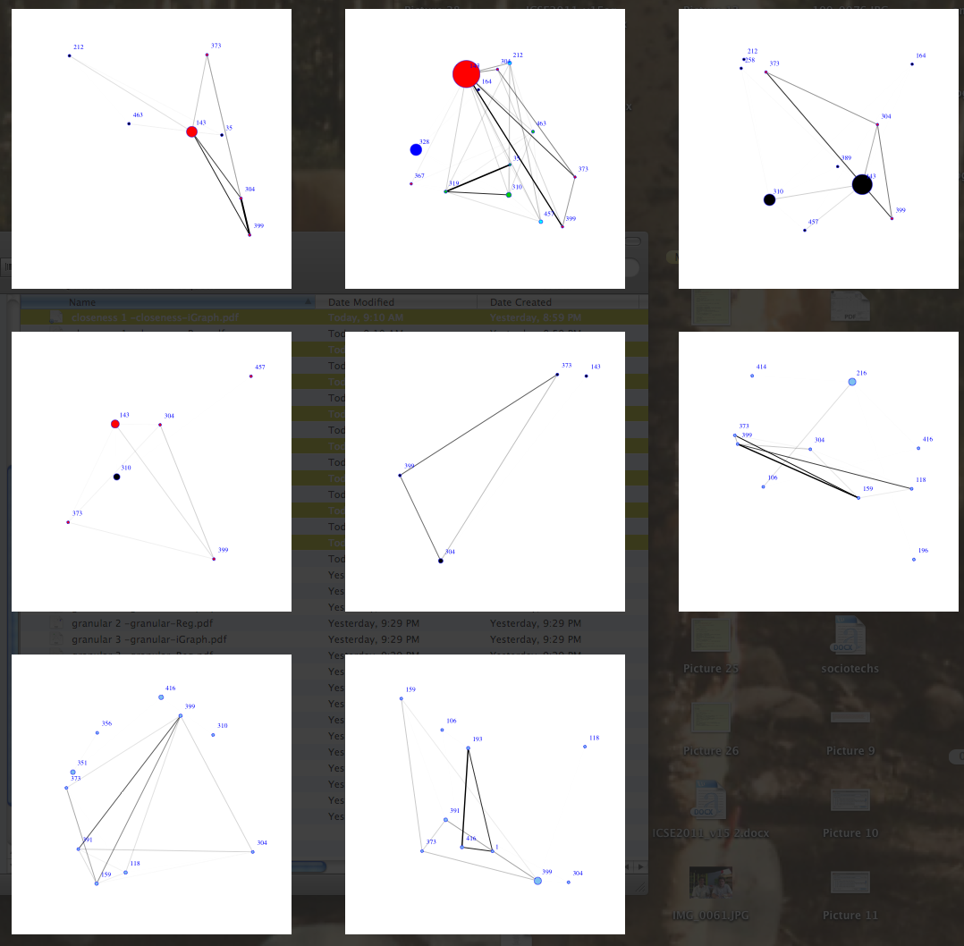
Code, Releases 1 – 8
One Possible explanation:
A few central
People who slowly but
Observably begin to engage
Other contributors in
An open source software
Development project.
Structure evolves
Key Groups Evolve
iGraph

Slide 21
Next Step: The Story

Slide 22
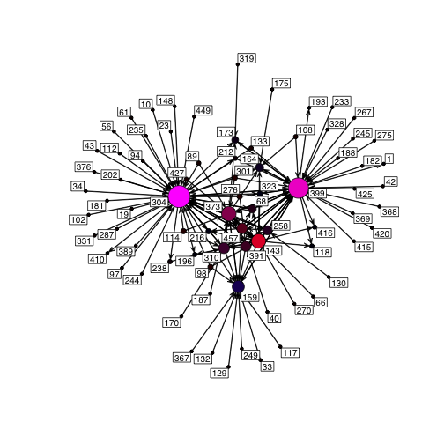
The People
373
304
399
159
143
Our next step is piecing together a narrative about the groups that emerged on this project, and describing each of the individuals. This is all open data. When we finish this part, we will publish one or more papers. For now, Let’s look at the cool “R Stuff”

