Slide 1

Group Informatics: Design, Research and Blended Data Methodologies
Sean P. Goggins, Ph.D
&

Slide 2

Data
Analysis
Methods
Computation
Theory
Finding Connections – Animals? People? Snowmobiles? Overwhelmed.
The beach is different than the frozen tundra – But they both have footprints!
A rescue patrol has different needs than a tourist
What is our theory for *guessing* whose steps to follow?
Notes:
Knowing where others have been is of tremendous value in some situations. If you are dropped in the Wilderness of Alaska, following footsteps could save your life. I started my research trying to understand how small groups come together and work when there is little evidence other than discussion that they are even together. As I studied these groups, I came to recognize four dimensions of their interactions and their behavior that are distinct from small groups that exist in the face to face world:
Finding implicit connection is difficult, because most systems do not log and report implicit connections; by which I mean acts of reading or sharing the same artifacts, etc.
Identification with the group is powerfully influenced by the participants, but also by other experiences we have had in different kinds of technologically mediated groups. We all learn what to expect from each other in face to face social settings and adapt. In the online world, these adaptations are different in each technical system; and each individual has an array of technical systems they become familiar with …. That shape their expectations and perceptions of each new system.
Github
Sourceforge
Most research is domain bound. I can read studies of online learning. I can read studies of distributed software organizations. Few studies cover more than one context and almost as few researchers systematically examine multiple contexts – The idea of thinking about technologically mediated groups in a domain and system agnostic way is little explored. This problem takes on two distinct forms in two fields I participate in
CSCW – A lot of research on a small set of massive social computing systems
CSCL – A lot of research focused on small, microstudies of systems that are not widely distributed or used at all. I call these the “artisan cheeses”. Most learning design is built around systems that are the artisan cheeses – made in limited quantities, facing obstacles to scalability
The connection between activities that are logged in these systems and existing theories are not executed systematically across studies even within a domain; again, making comparisons and innovation more difficult.

Slide 3


Prominent, Contemporary Example: MOOCs
Learning Technologies We use
Technologies We Use Every Day
How do we get from A to B?
Pain
Fun

Slide 4


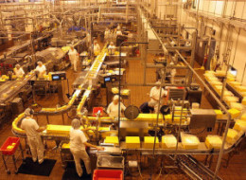


State of Learning Technology Design
Learning Technologies We Use
The Technologies We Design And Research
Massive
Unfriendly
Artisan Cheeses
They do not scale

Slide 5
A Pragmatic Path
Signal and Noise
Group Informatics
Questions
Theory
Probability
Construct
& question
Specific
Design based Research
Traces & Design
Notes:
From a design perspective, "big social data" is a way to frame how we make sense of the rich electronic trace data (logs) that are left behind in various learning environments; and then to use those logs to provide useful feedback to people about the learning that is taking place. Partly this is a social theory of learning framing, which is what my 2009 dissertation examines. In the four years since that once in a lifetime (for me) project, the scope of my inquiry has expanded to fields of software engineering, social media, computational linguistics, "big data" and virtual organizations. Furthermore, I have taken up projects focused on workplace learning and rural outsourcing firms that train their own workers. Why? Simply put, there is not enough signal solely in the study of how people learn in traditional, school focused contexts to identify the design ideas that are likely to push learning technology design forward to a breakthrough.
There are also institutional obstacles to the application of data science to learning that arise from learning technologies that are already in place. In one widely rejected article I wrote with Jonathan Foster, and which we each abandoned for different reasons, I argue that a fundamental issue in the slow market innovation of novel learning technologies centers on infrastructure. Not the first level technical infrastructure, or the second level process and interaction focused infrastructure, but infrastructuring around resource allocation within educational institutions. To date, we experience specific difficulties in trying new things at an institutional level because the human and capital costs to change are prohibitive. It takes time to turn a big boat, even at sea.
Given the institutional limitations, and my own ambitions for advancing learning technology through the systematic study of how people interact, form groups and build institutions in a virtual world, I have spent a number of years examining contexts outside formal learning environments. The work that is published and in progress brings a novel and I think important perspective to learning technology design. A perspective born of the deep study of how people learn in informal contexts; how non-learning focused virtual organizations function; and how people use social media to argue, share information and build connection in ways that we frankly do not yet understand.
I think one key, as it relates to "Big Social Data", is that if you want to understand learning and make learning technology better, you have to study how people learn. And that's mostly not in school. If you want to build better learning technology, you have to study technology people use and how they use it. And that's mostly not Blackboard or systems like it. IMHO.
----- Meeting Notes (1/21/13 19:25) -----
When you use the work example, point out the failures of the education system being studies not having impact in workplace or out of school environments…
Relevance to stay engaged is important … CSCL@Work feeds back into my fundamental approach that suggests that to discover learning where it is occuring…

Slide 6

Learning Technology Design
Design
Research
“If you build it, they will come” – Kevin Costner’s character in Field of Dreams
“Supposing is good, and finding out is better” – Mark Twain
Infrastructure
Resources appear, too, as shared visions of the possible and acceptable dreams of the innovative, as techniques, knowledge, know-how, and the institutions for learning these things. Infrastructure in these terms is a dense interwoven fabric that is, at the same time, dynamic, thoroughly ecological, even fragile. —Bucciarelli, 1994, p. 131

Slide 7
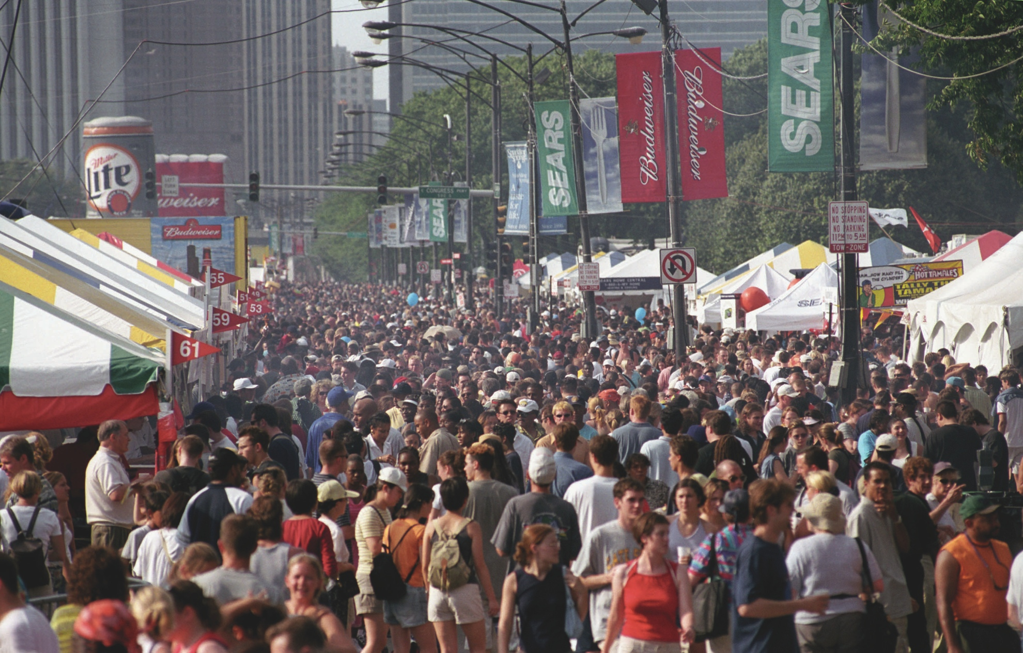
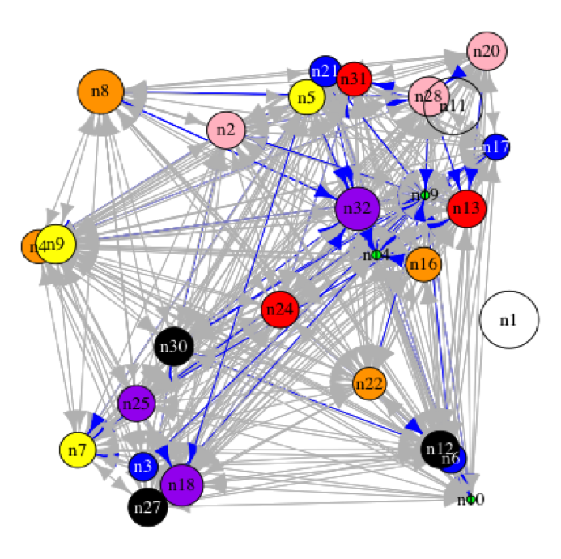
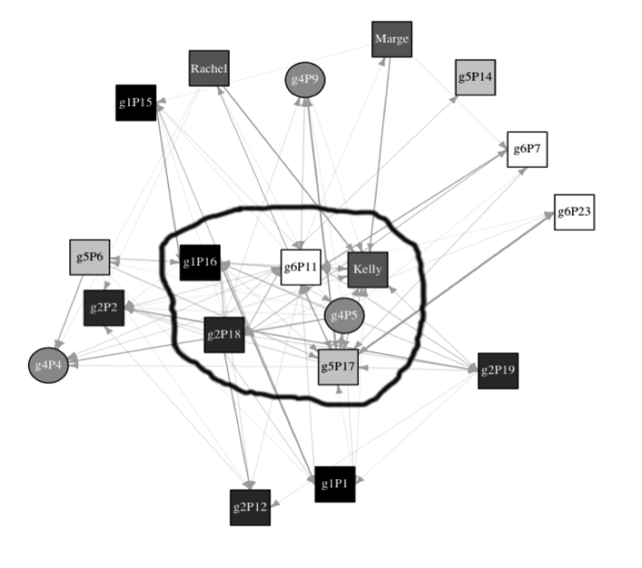
Leadership
Coordination
Knowledge Construction
Information Diffusion
Discourse
Negotiation
Knowledge Transfer

Slide 8
The Group Informatics Path
Inductive Research
Qualitative
Quasi-Experimental
Abductive
Phenomenological
Design Experiments
Ethnographic
Increasing Generalizability
Drawing Inference from Electronic Trace Data (Logs)
Notes:
----- Meeting Notes (2/8/13 16:21) -----
WE don't start with computation…

Slide 9
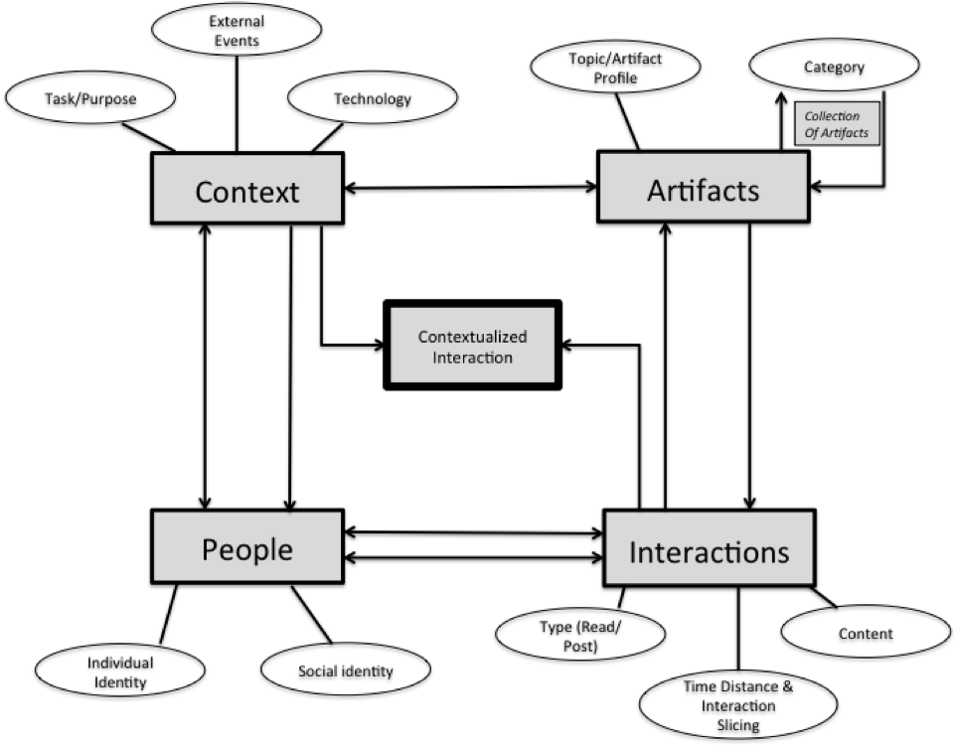
Group Informatics Ontology

Slide 10
General Group Informatics Methodological Approach
Discussion Post
Open Coding
Connect to Theory
Time proximity
Topical proximity
Classification
Read
Response
Axial Coding
Aggregation of Posts by Topic, time or other
Weighted Network Analysis of Interactions
Notes:
This slide would benefit from a key.
Also get rid of white on black.
----- Meeting Notes (1/21/13 19:25) -----
This slide is hard to read. Fix that.

Slide 11
Studies Across Contexts
Big Social Data
Key Constructs: Discourse, Coordination, information diffusion

Slide 12
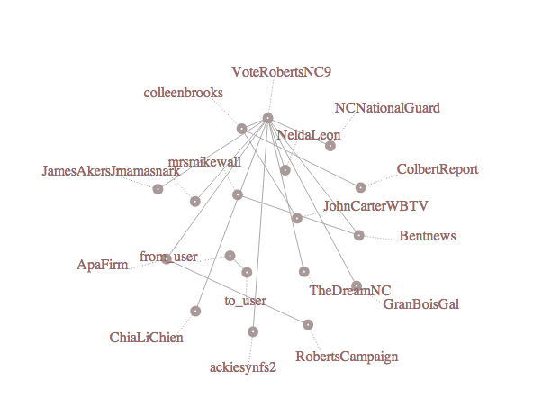
Live, Topical Twitter Networks

Slide 13
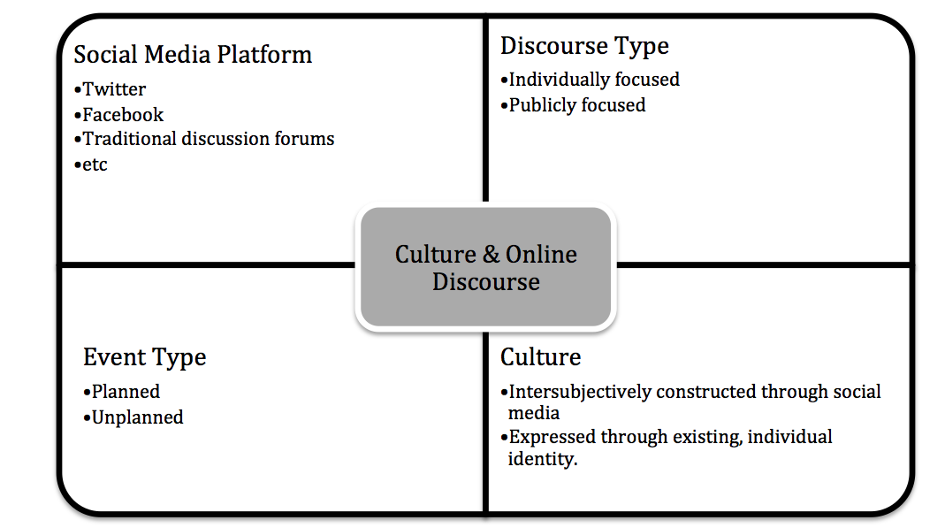
Big Social Data: Framing the Problem
Challenges
Studies Across Contexts
Applying Lessons in Learning
Examining Log Data

Slide 14
To Sum Up Big Social Data: Probabilistic Thinking to Instrument Learning and Information Behavior
Theory
Hypothesis
Data
Skepticism about your findings

Slide 15
Big Social Data in Design
Learning Technologies We use
Technologies We Use Every Day
My Approach
Building Measures and Indicators: Research Collaboration Technology in Learning Intensive Disciplines … where people are using that technology … so that we understand what works.
How do we get from A to B?
A
Pain
Fun
B

Slide 16
Social Network Analysis
GOAL: Begin a discussion of Big Social Data
Activities
Talks looking at Big Social Data; but also Rich and long social data
Collection
Analysis / Summarization
Specifics:
Data Collection
Network Analytic Techniques
Twitter Collection and Analysis
Inciting Discussion of Methods and Opening the Creation of an iSchools Big Social Data Community Through the Github Repository – Don’t just be committed – Be a committer!

Slide 17
This slide accidentally left blank

