Slide 1

PFOND Project: Technical Overview
May 1, 2012

Slide 2
Outline
Resources available for building your PFOND site
RSS Feeds
SEO (Search Engine Optimization)

Slide 3
Quick Reminder
Getting Started (http://pfond.cmmt.ubc.ca/welcome-to-the-pfond-project/)
Editor Manual (http://pfond.cmmt.ubc.ca/wiki/pfond-editor-manual/)
Piazza (http://piazza.com/)
Email
Troubleshooting: pseidkarbasi@gmail.com
PFOND: pfond@cmmt.ubc.ca

Slide 4

RSS Feeds
Originally: RDF Site Summary
Rich Site Summary
Really Simple Syndication
RSS allows the distribution of regularly changing web content (such as news, blog posts or other general website updates) across multiple platforms.
desktop, mobile, website
“Facebook Newsfeed for websites”
On PFOND: we use RSS to pull relevant information from PubMed and Google Alerts, to be placed in the news section of PFOND sites

Slide 5
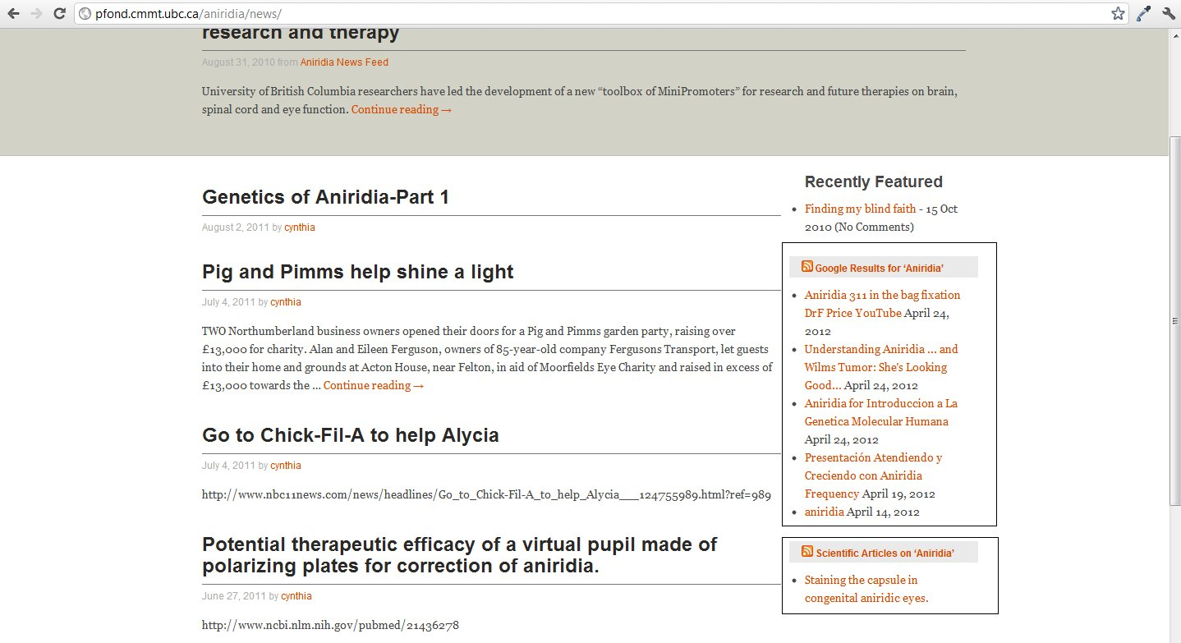

Slide 6
Setting Up RSS Feed for PubMed
Navigate to http://www.ncbi.nlm.nih.gov/pubmed/
Refine your search if necessary, so that the results are appropriate for your PFOND site
Video tutorial posted:
http://pfond.cmmt.ubc.ca/wiki/pfond-editor-manual/useful-resources/
Click on RSS icon below search bar
Select “Create RSS”

Slide 7
Setting Up RSS Feed for PubMed
Copy the URL of the new page.
From the Admin Panel, go to Appearance > Widgets.
On the right hand side, find the item labeled “RSS: Scientific Articles on ‘Template’” and click the small arrow to its right.
Paste the URL
Click “Save”

Slide 8
Setting Up RSS Feed For Google Alerts
Navigate to http://www.google.com/alerts
Sign in with any Google account.
Enter relevant search term(s).
Make sure the following options are selected:
Type: “Everything”
How often: “As-it-happens”
Volume: “All results”
Deliver to: “Feed”

Slide 9
Setting Up RSS Feed For Google Alerts
Click “Create Alert”. You should be redirected to a list of all Alerts you have created with this Google account.
Click the orange RSS icon for the alert you have created.
Copy the URL of the new page.
From the Admin Panel, go to Appearance > Widgets.

Slide 10
Setting Up RSS Feed For Google Alerts
On the right hand side, find the item labeled “RSS: Google Results on ‘Template’” and click the small arrow to its right.
Paste the URL you copied into the text box labeled “Enter the RSS feed URL here”.
Customize the feed title as desired.
Click “Save”

Slide 11
Search Engine Optimization (SEO)
Can have great content but still rank poorly
Few Factors:
Inbound links (backlinks)
Outbound links

Slide 12
Search Engine Optimization (SEO)
Inbound links (backlinks)
Partner with other sites
Outbound links
<a rel="nofollow" href="http://google.com/">Google</a> Google
<a href="http://google.com/">Google</a> Google
Wikipedia:
nofollow is a value that can be assigned to the rel attribute of an HTML element to instruct some search engines that a hyperlink should not influence the link target's ranking in the search engine's index.

Slide 13
Search Engine Optimization
Freshness of Content
Unique Content?
Age

