Slide 2
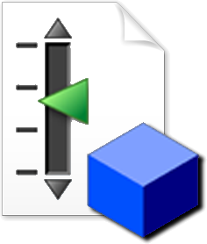
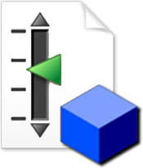

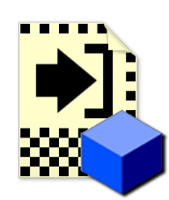






Control Class
Load
Reference
Load State Data
DVR
Event
Handler
Constructor
Properties
Methods
Close Control
State Data Class
Constructor
Accessors
Close

Slide 3




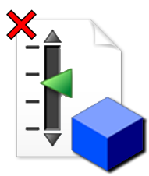
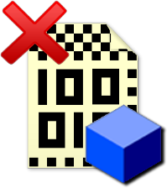
Control Class
State Data
Constructor
Constructor
Load Reference
Load State Data
Initialize
Event Handler
Properties
Accessors
Methods
Close Control
Close – Kill DVR Reference

Slide 4
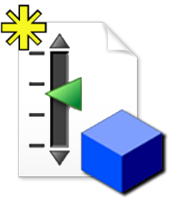
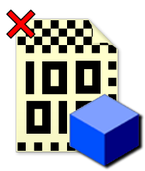
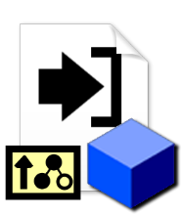
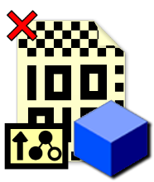
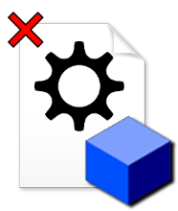
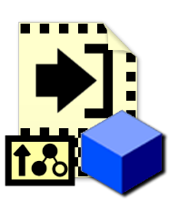
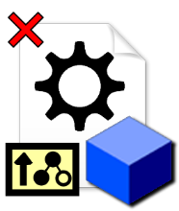




QControl Class
Constructor
Properties
Deconstructor
Load Reference
Methods
Close State Data
Call Parent Method
Call Parent Method
Load State Data
Close Control
Call Parent Method
Call Parent Method
Initialize
Close Event Handler
Call Parent Method
Launch Event Handler
Event Handler

