Slide 1
Statistical, real-time classification of IP traffic in Linux operating system
Paweł Foremski
Advisor: dr inż. Arkadiusz Biernacki

Slide 2
Agenda
Short reminder
Program architecture
Technical summary and results
Remaining work

Slide 3
Reminder -
IP traffic classification

Slide 4
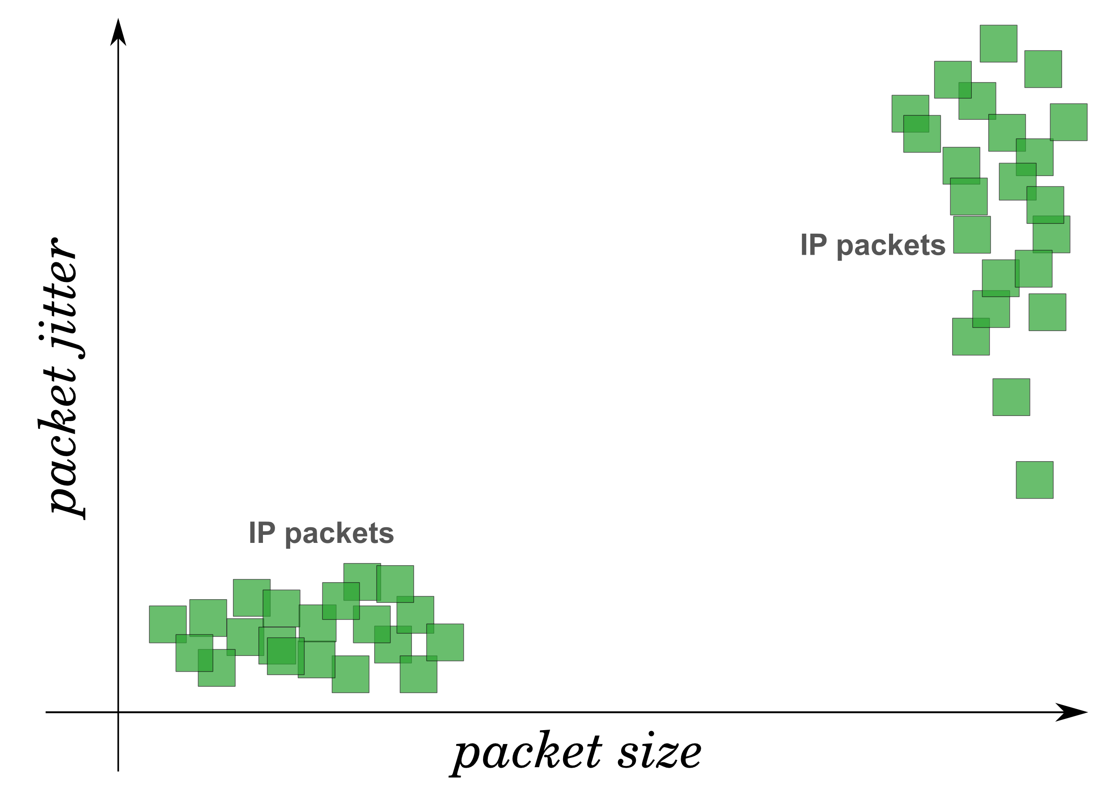

Slide 5
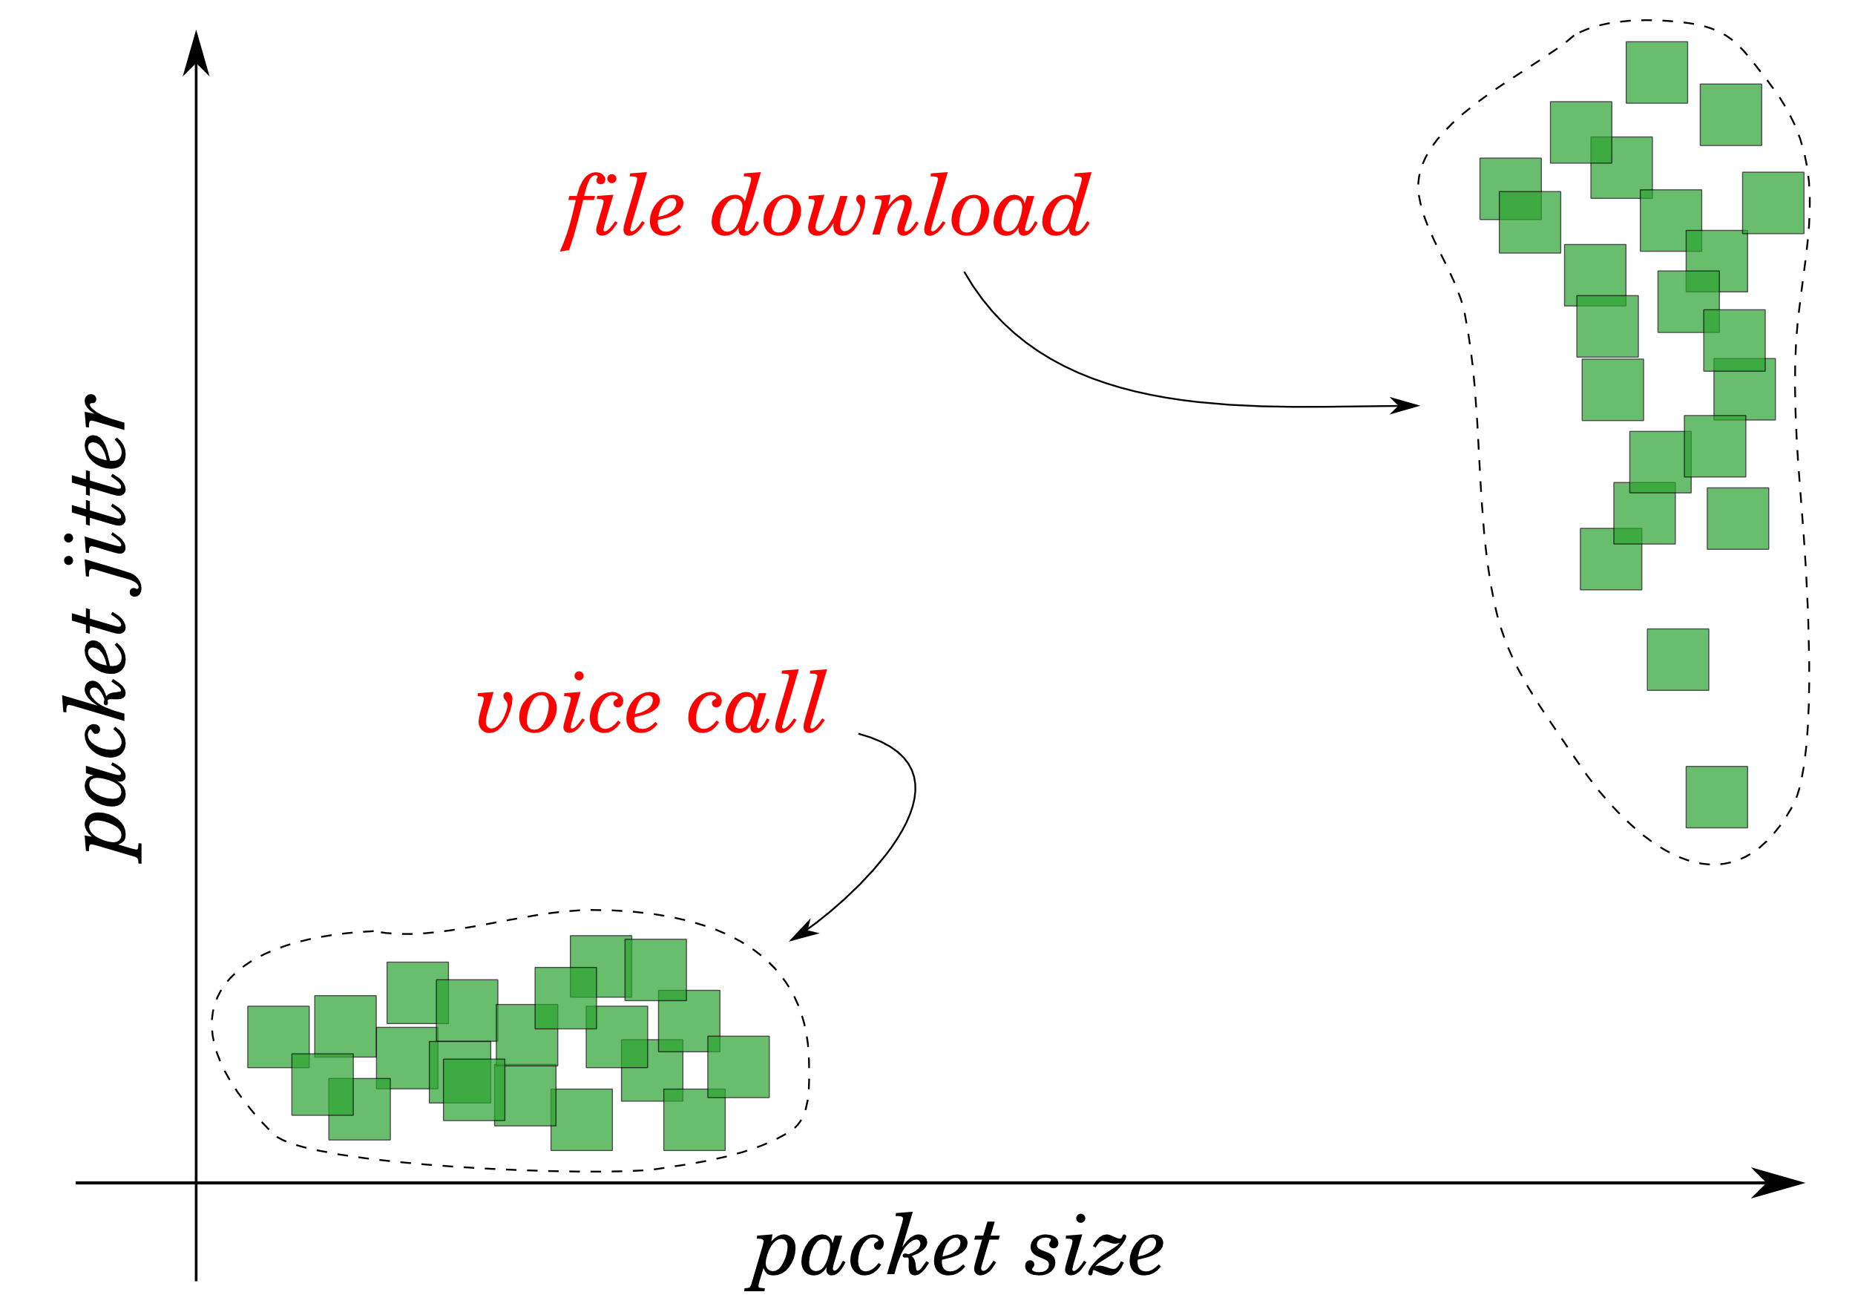

Slide 6
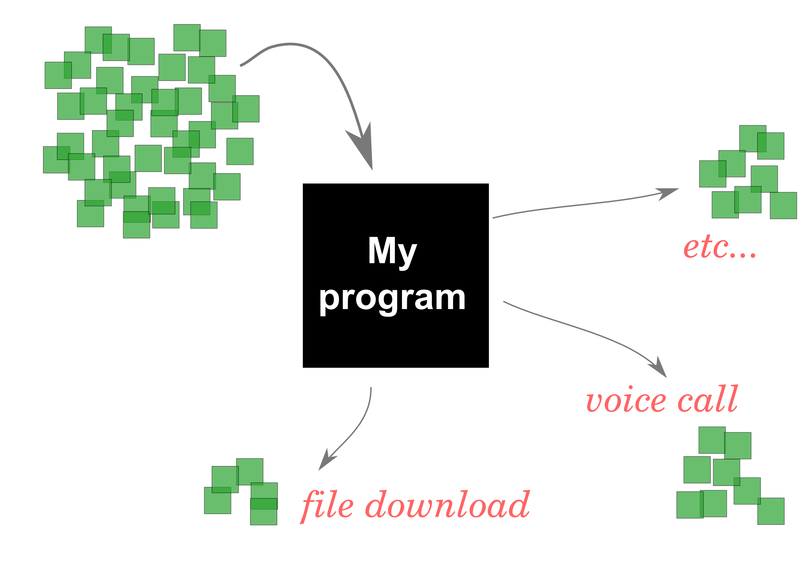

Slide 7
Program architecture

Slide 8
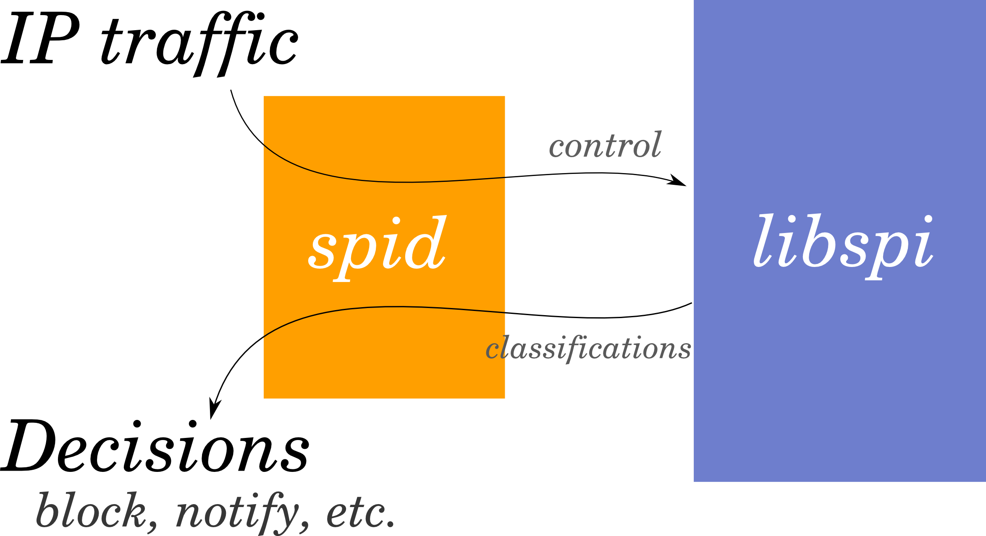

Slide 9
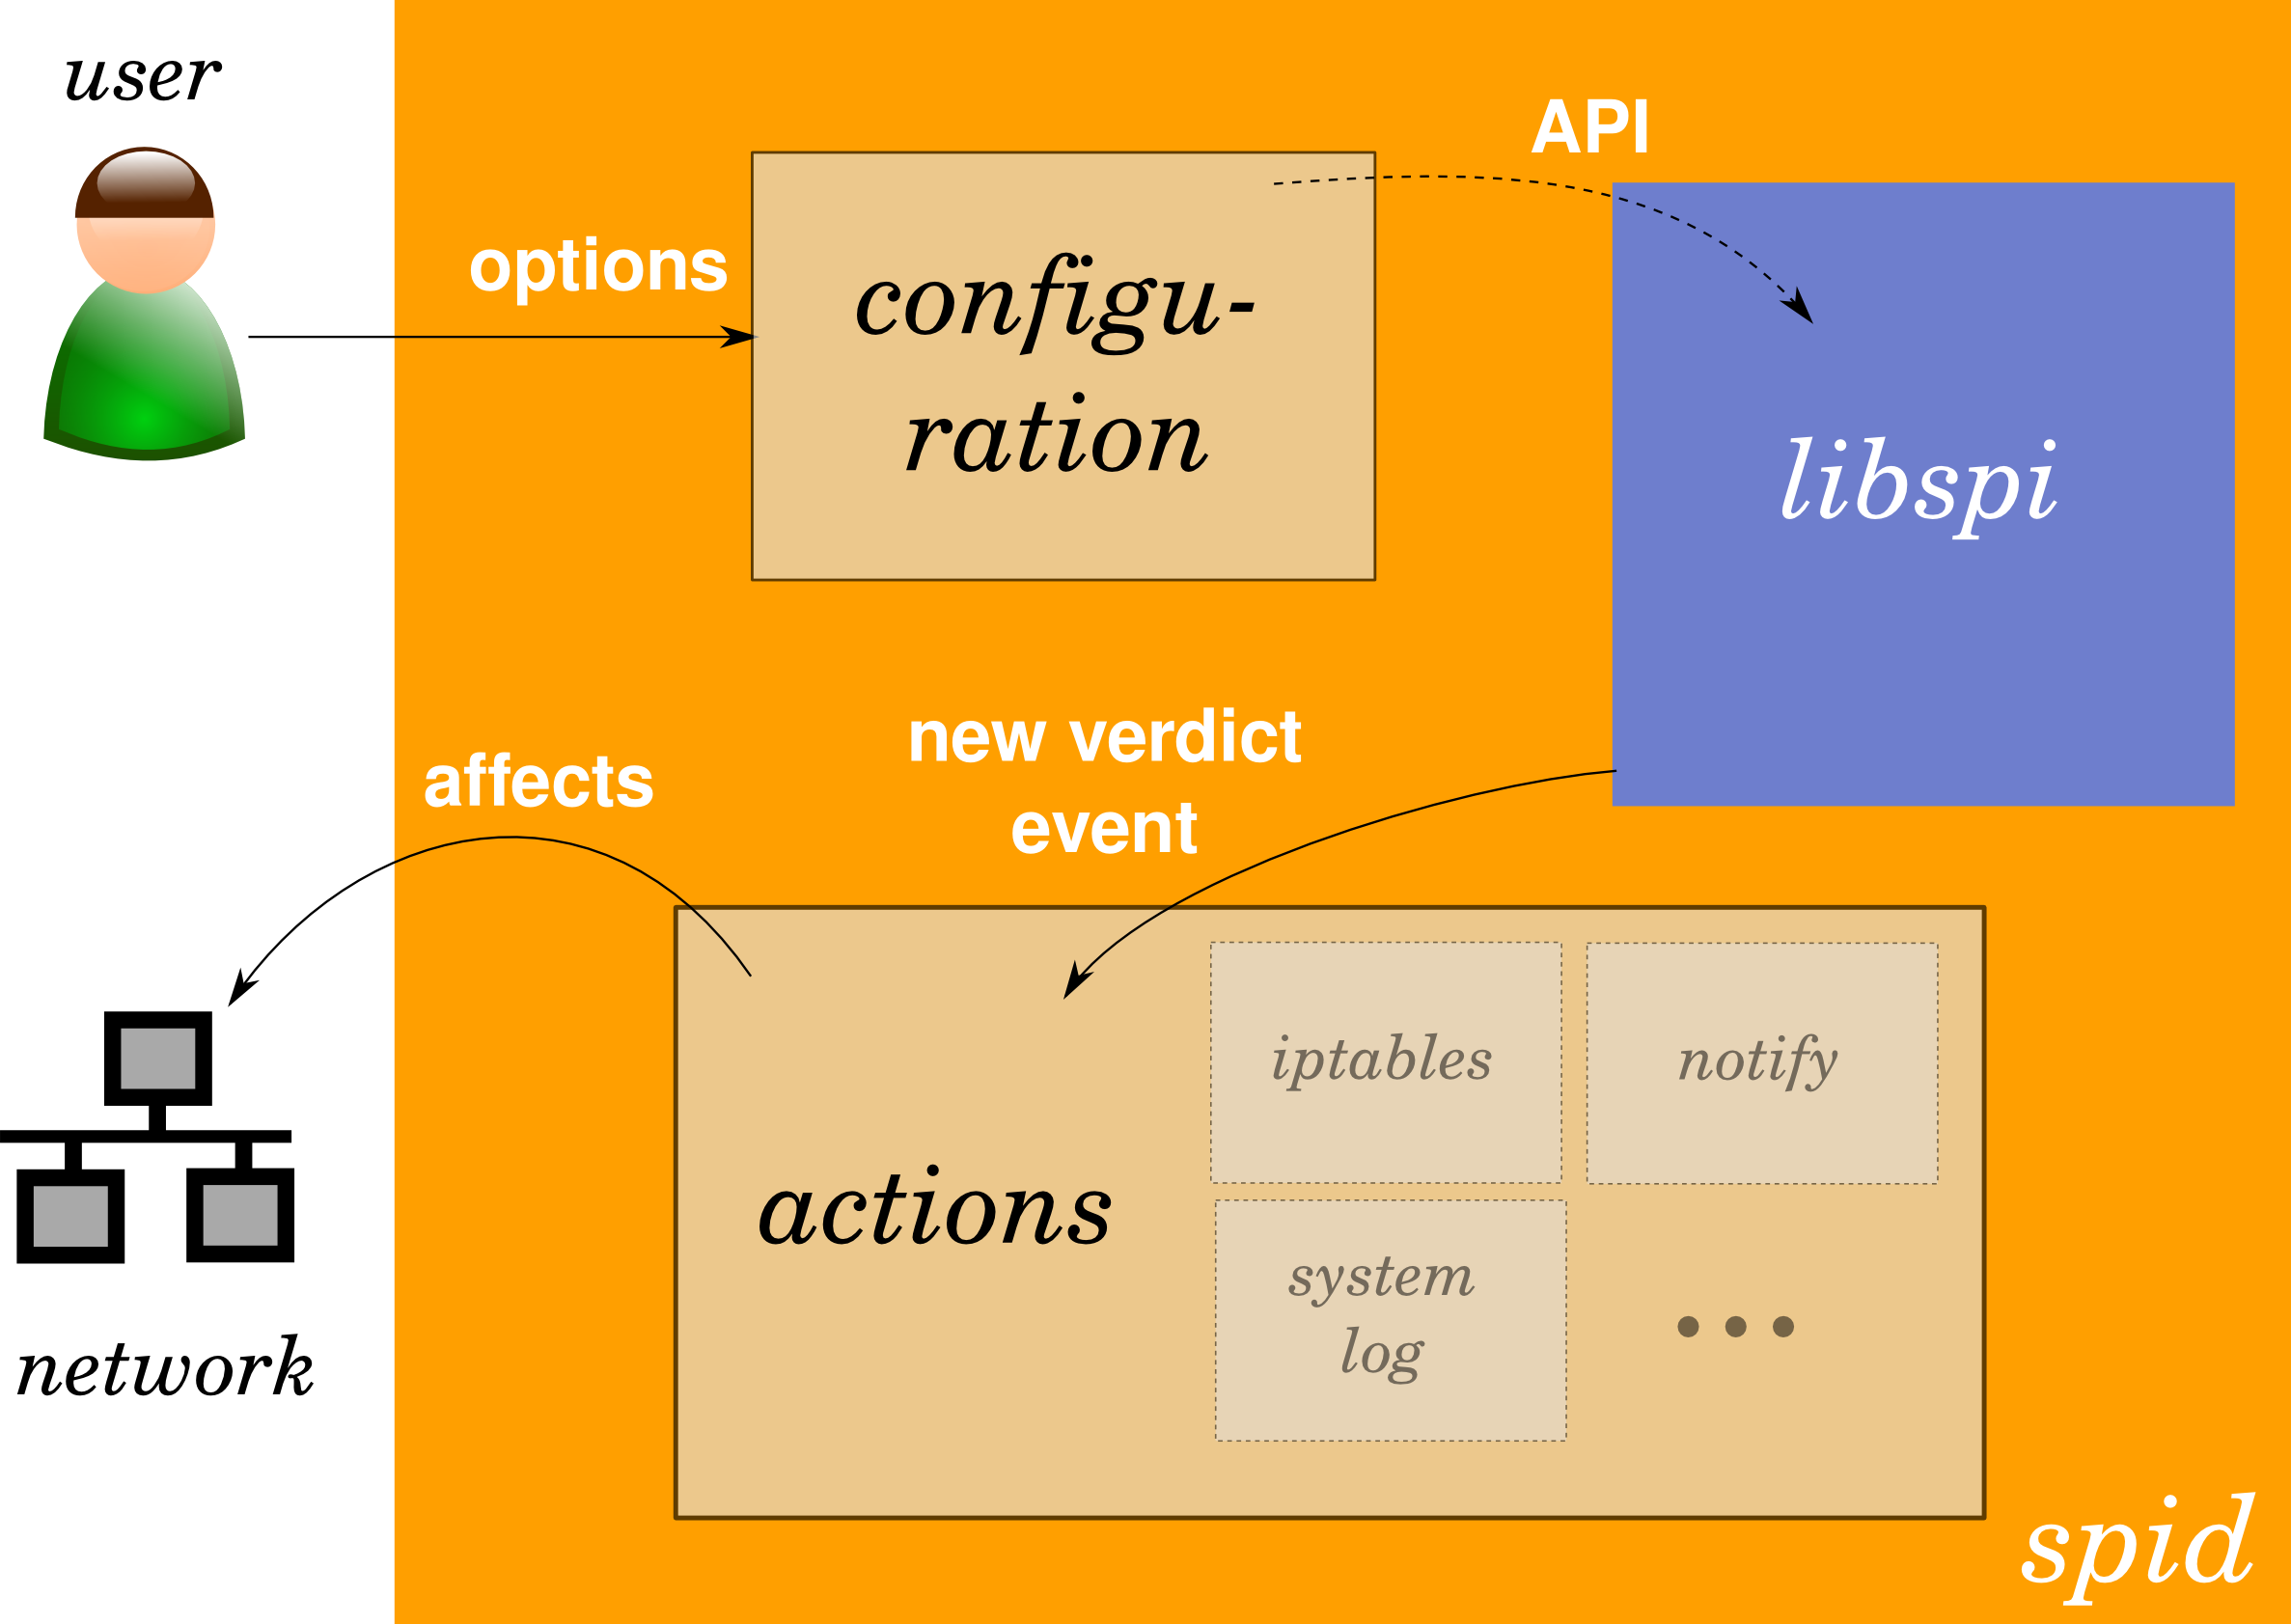

Slide 10
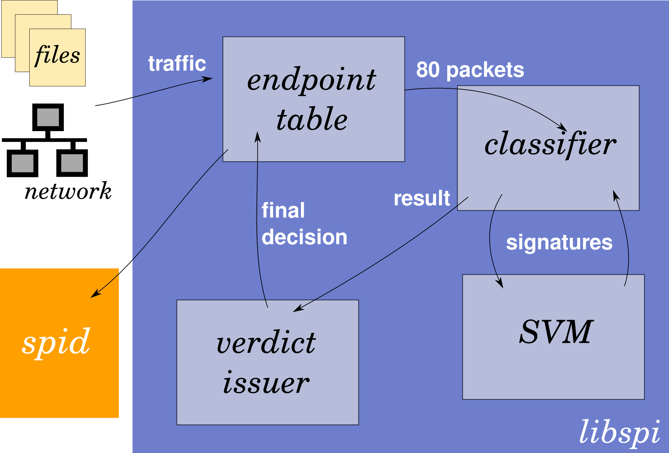

Slide 12
Technical summary
and results

Slide 13
Technical summary
C language, 2000 lines of code
Single-threaded, event-driven
Modular
  libsvm, liblinear

Slide 14
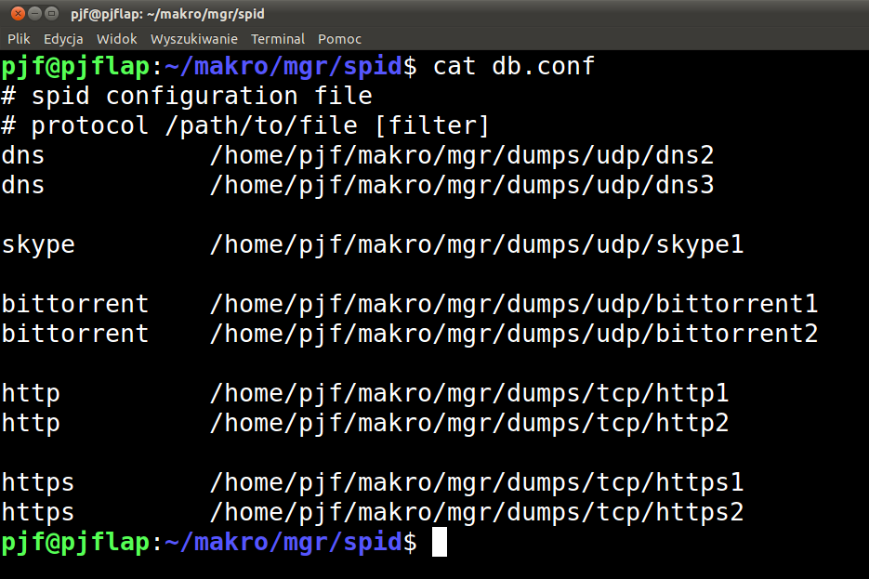
Configuration file

Slide 15
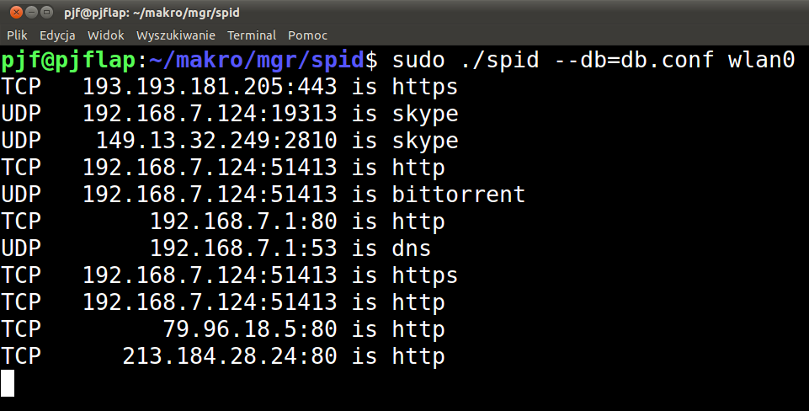
Exemplary output

Slide 16
Results
Learns ~100 000 packets / second
Properly recognizes 5 protocols: HTTP, HTTPS, DNS, BitTorrent, Skype
Event-driven control very fair

Slide 17
Remaining work

Slide 18
Remaining work
SVM module
Network actions
System performance evaluation
Linux netfilter integration
The Thesis ;-)

Slide 19
Thank you.
Questions?

