Slide 1
Statistical, real-time classification of IP traffic in Linux operating system
Paweł Foremski
Advisor: dr inż. Arkadiusz Biernacki

Slide 2
Agenda
Introduction
System description
Implementation
Evaluation
Summary

Slide 3
Introduction

Slide 4
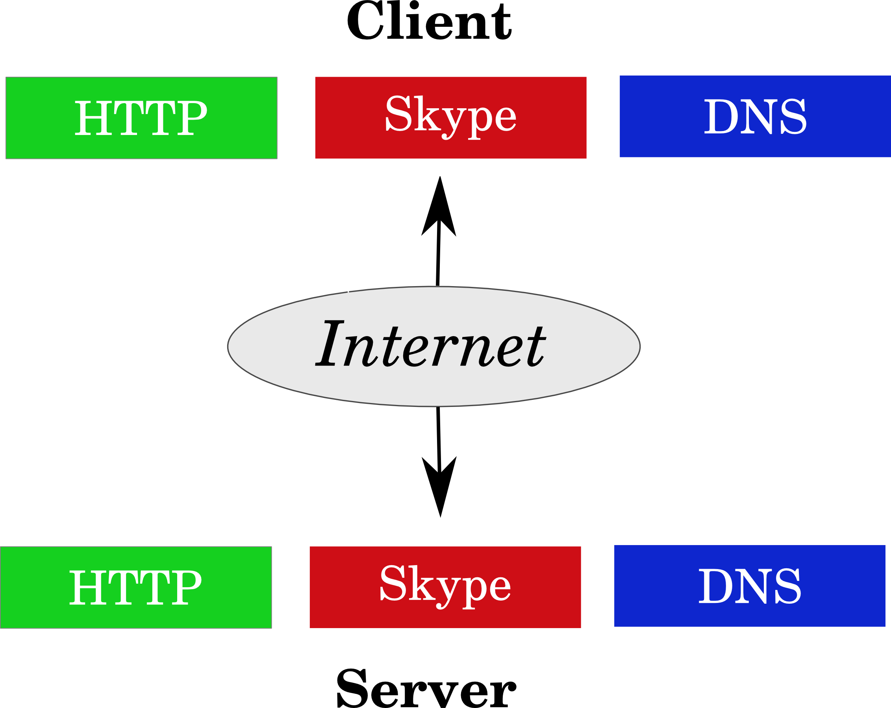

Slide 5


Slide 6
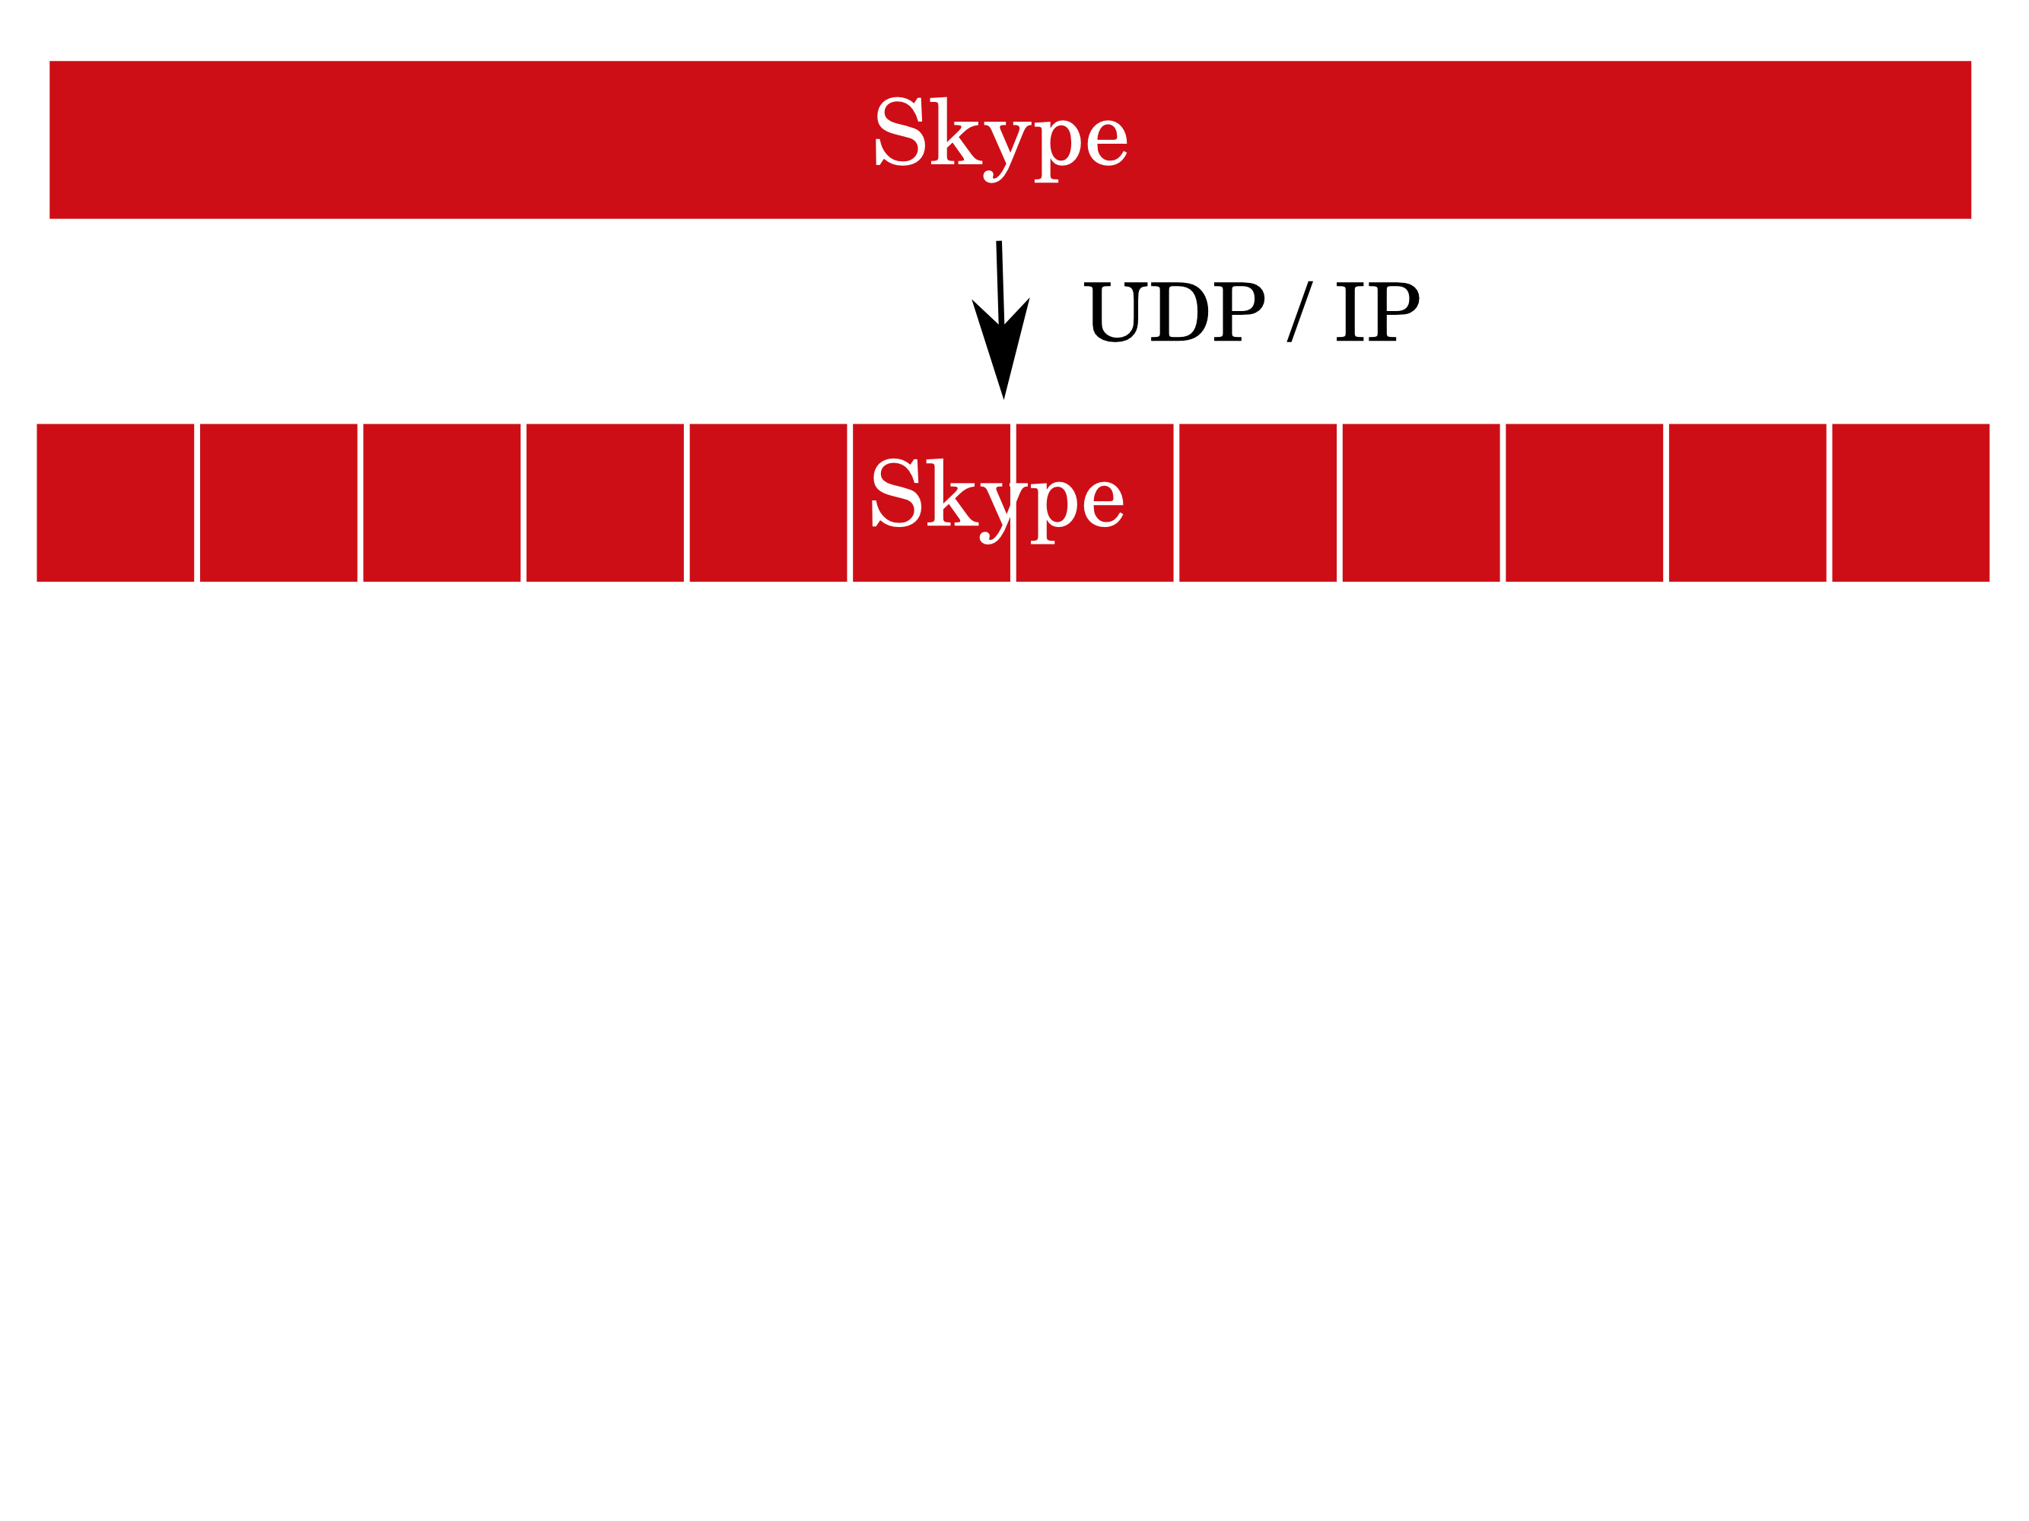

Slide 7
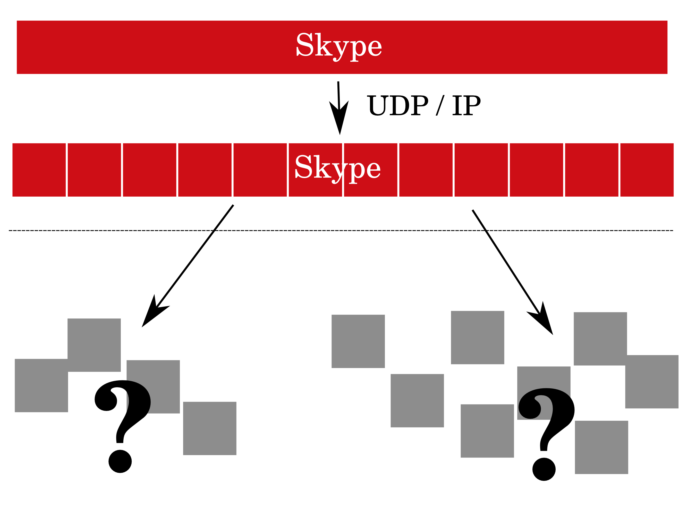

Slide 8
The problem
Given a set of IP packets, what is the identity of the application that generated them?

Slide 9
Solutions
Port number
Pattern matching
Statistical approaches
  Feature vectors
  Classification algorithm

Slide 10
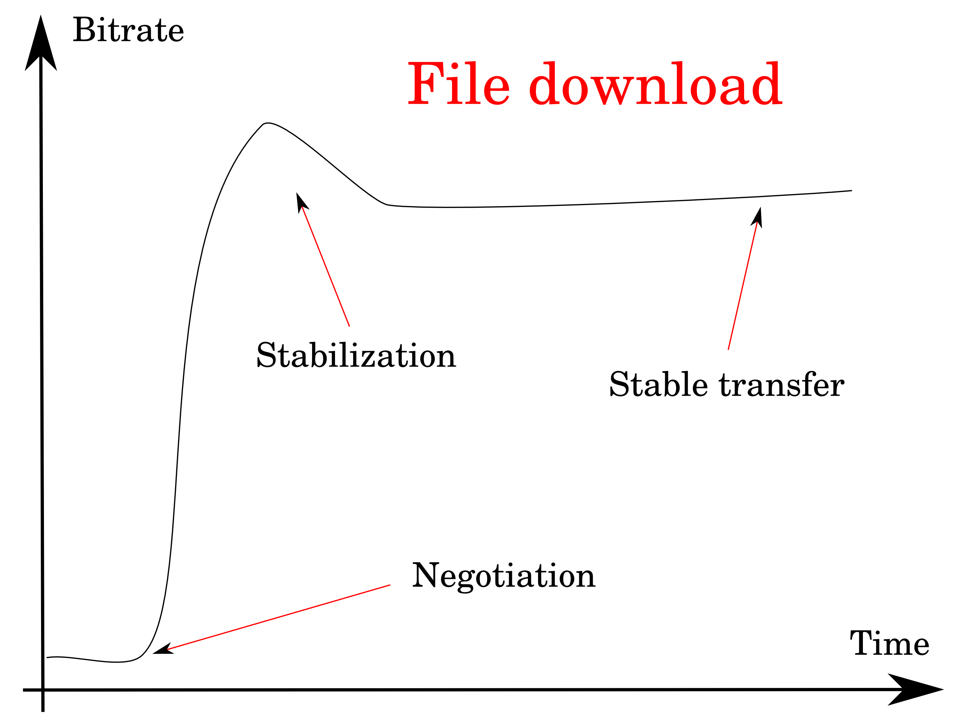

Slide 11
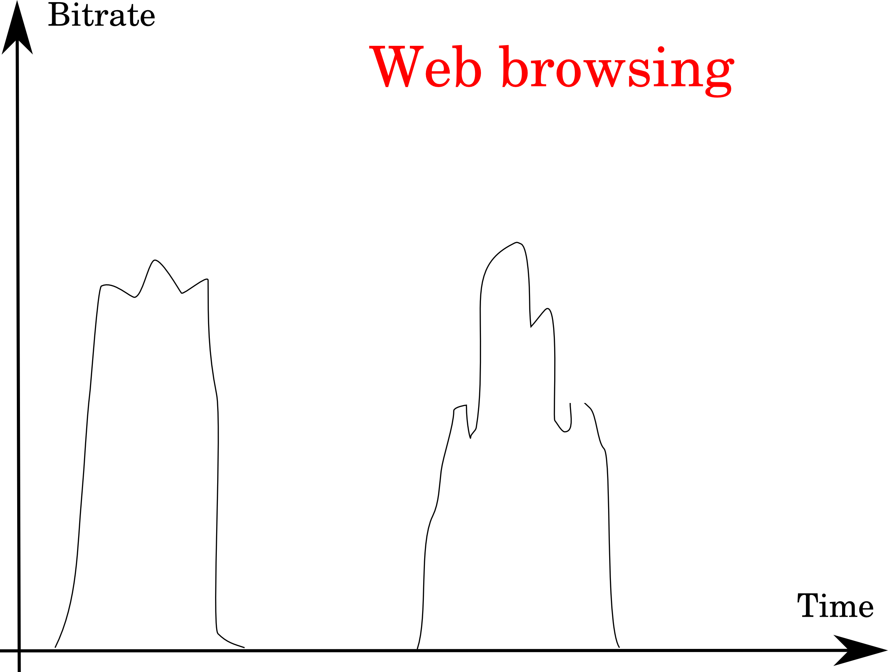

Slide 12
Thesis goals
Implement the KISS algorithm
TCP and UDP
Real-time and off-line
C language and Linux

Slide 13
System description

Slide 14
The KISS algorithm
KISS: Chi-Square Signatures
80 packets = a window
Distribution of payload header values for fixed p
Feature vector – distances – a signature

Slide 15
KISS operation modes
Training
  Traffic samples of applications
  SVM model generation
Classification
  Network traffic
  SVM classification

Slide 16
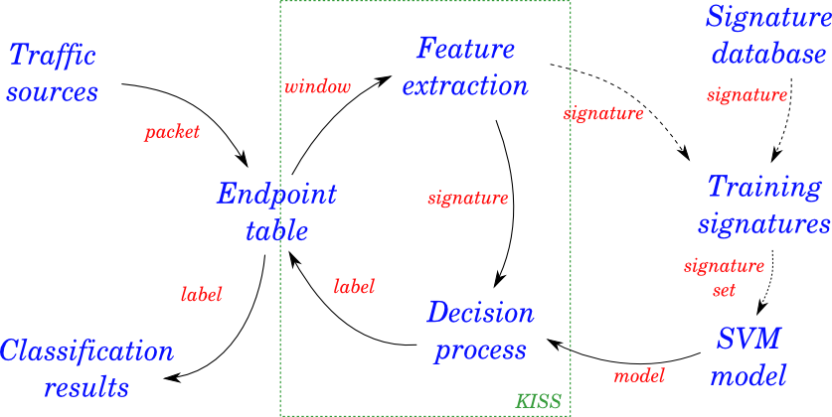
System architecture

Slide 17
Thesis modifications
Signature extensions
Decision reconciliation algorithm
Unknown protocol detection

Slide 18

Performance metrics

Slide 19
Implementation

Slide 20
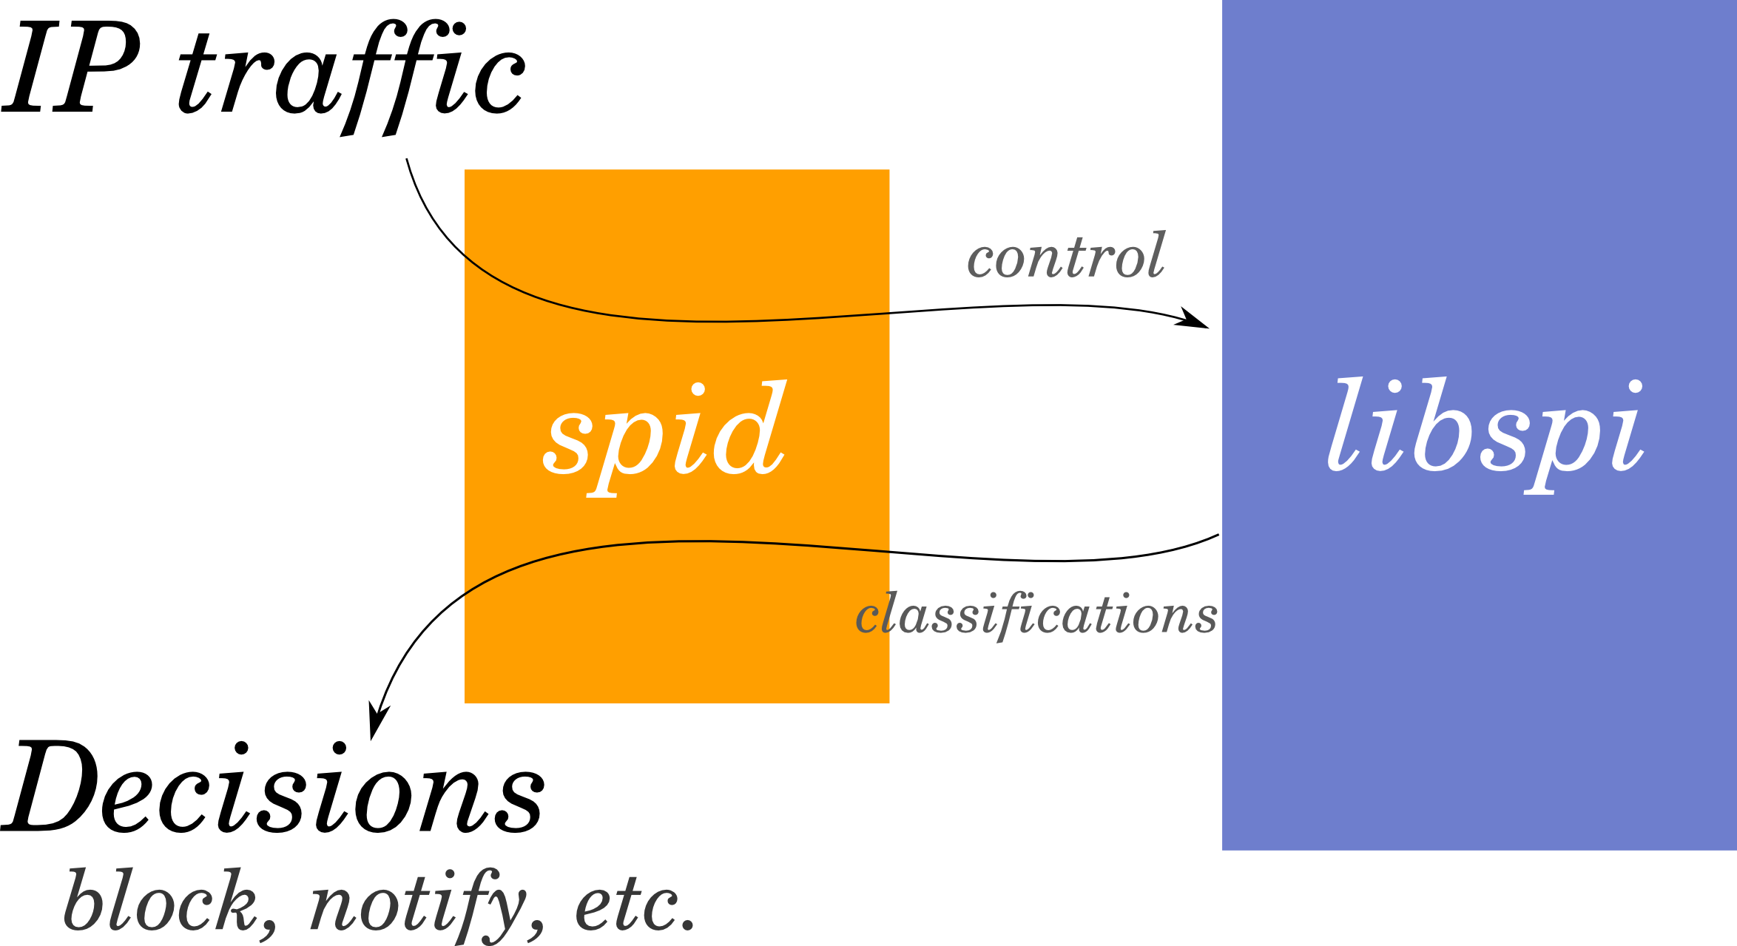

Slide 21
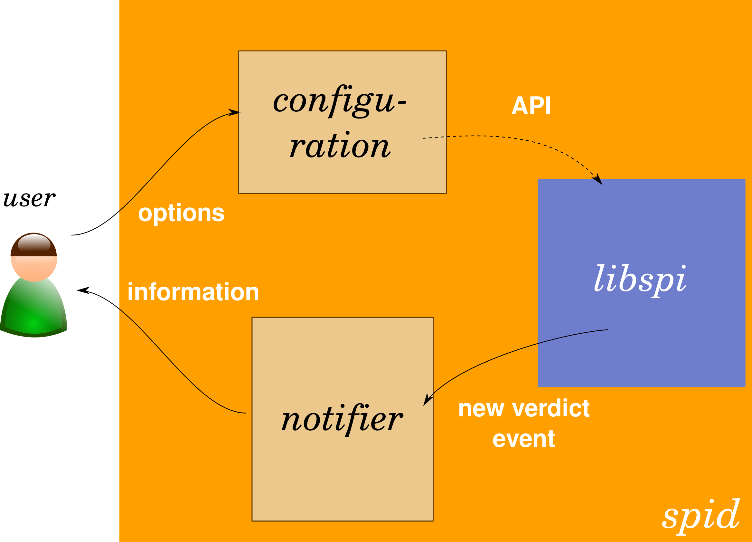

Slide 22
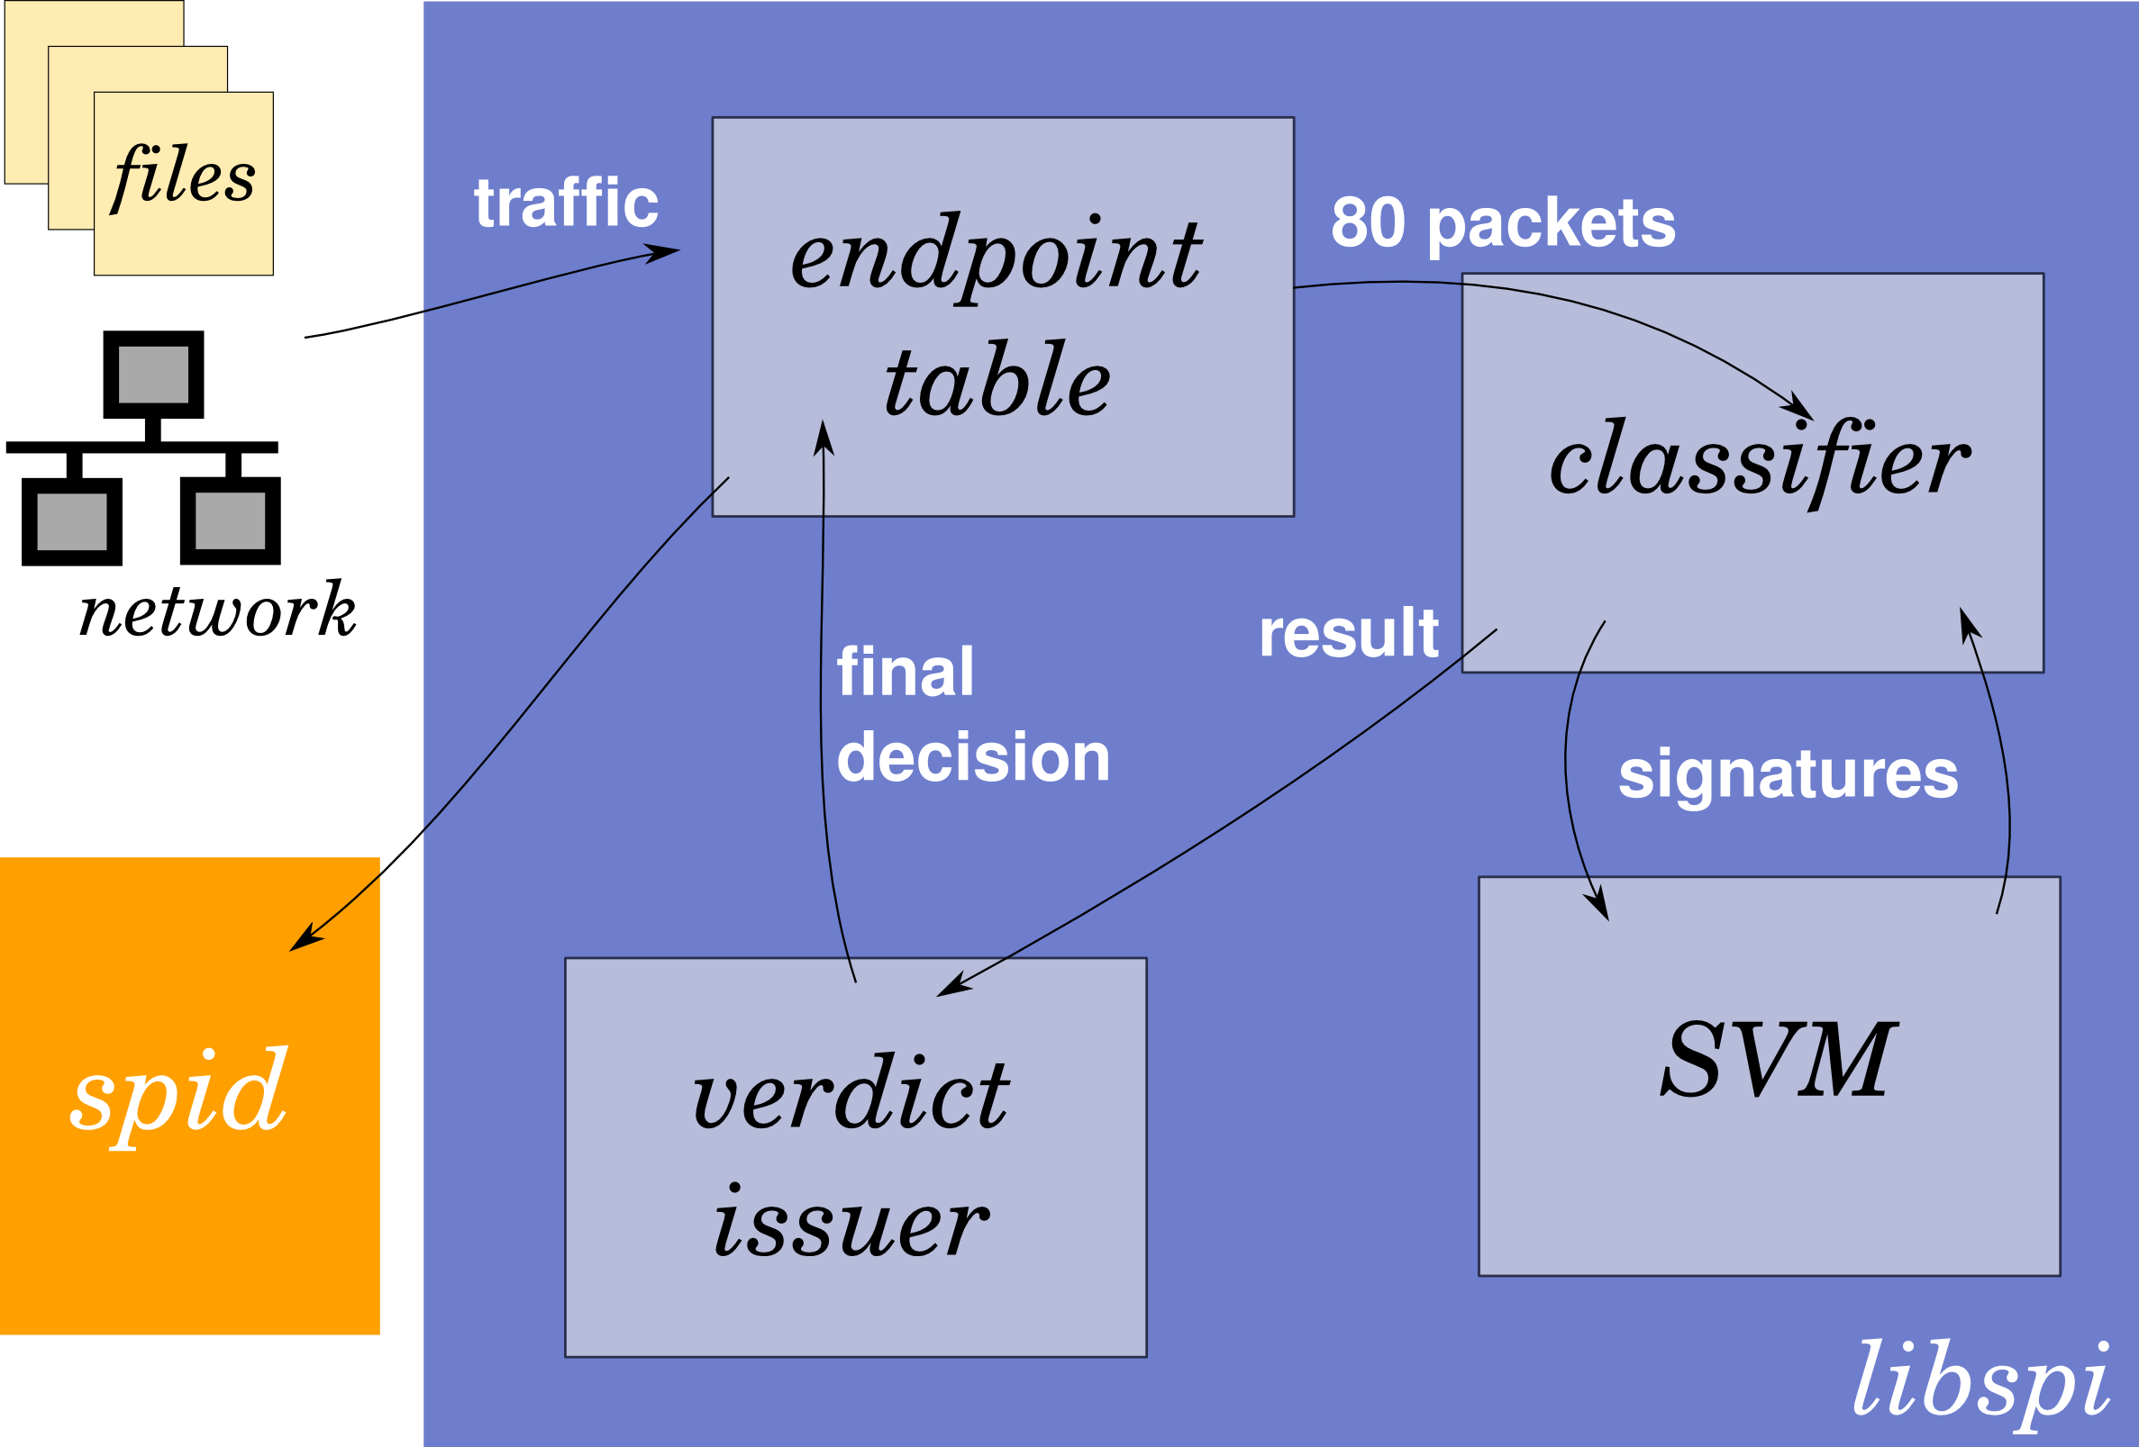

Slide 24
Evaluation

Slide 25
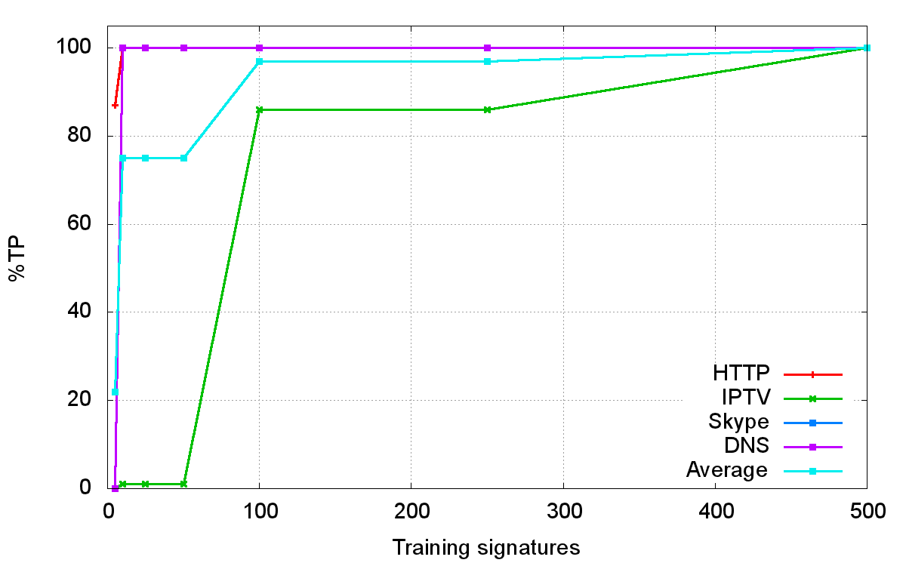
Test 1: training set size

Slide 26
Test 2: overall performance

Slide 27
Test 3: unknown protocols

Slide 28
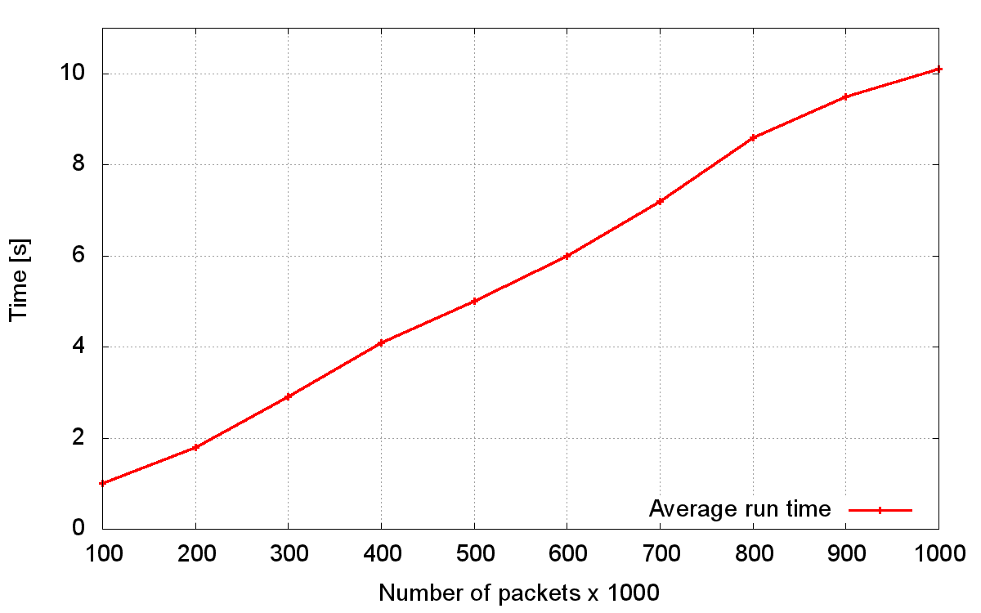
Test 4: processing speed

Slide 29
Summary

Slide 30
Conclusions
System fulfills the thesis goals
Fast and flexible implementation
Average %TP=97.87 and %FP=0
100 000 pps and over 130 Mbps
Improved the KISS algorithm
Recognizes encrypted protocols

Slide 31
Summary
Statistical packet inspection is applicable in practice
Space for research: scope and comparability
Several applications
  Firewall, IDS, network monitoring

Slide 32
Thank you.
Questions?

