Slide 1
Statistical, real-time classification of IP traffic in Linux operating system
Paweł Foremski
Advisor: dr inż. Arkadiusz Biernacki

Slide 2
Agenda
IP traffic classification
Statistical approach
The KISS algorithm
My work

Slide 3
IP traffic classification

Slide 4
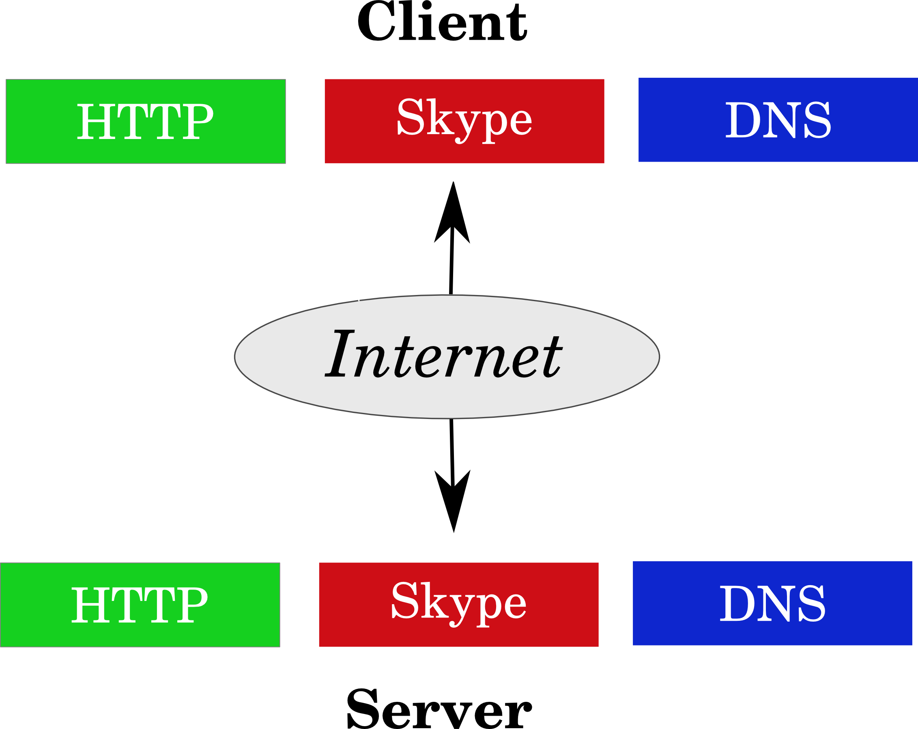

Slide 5


Slide 6
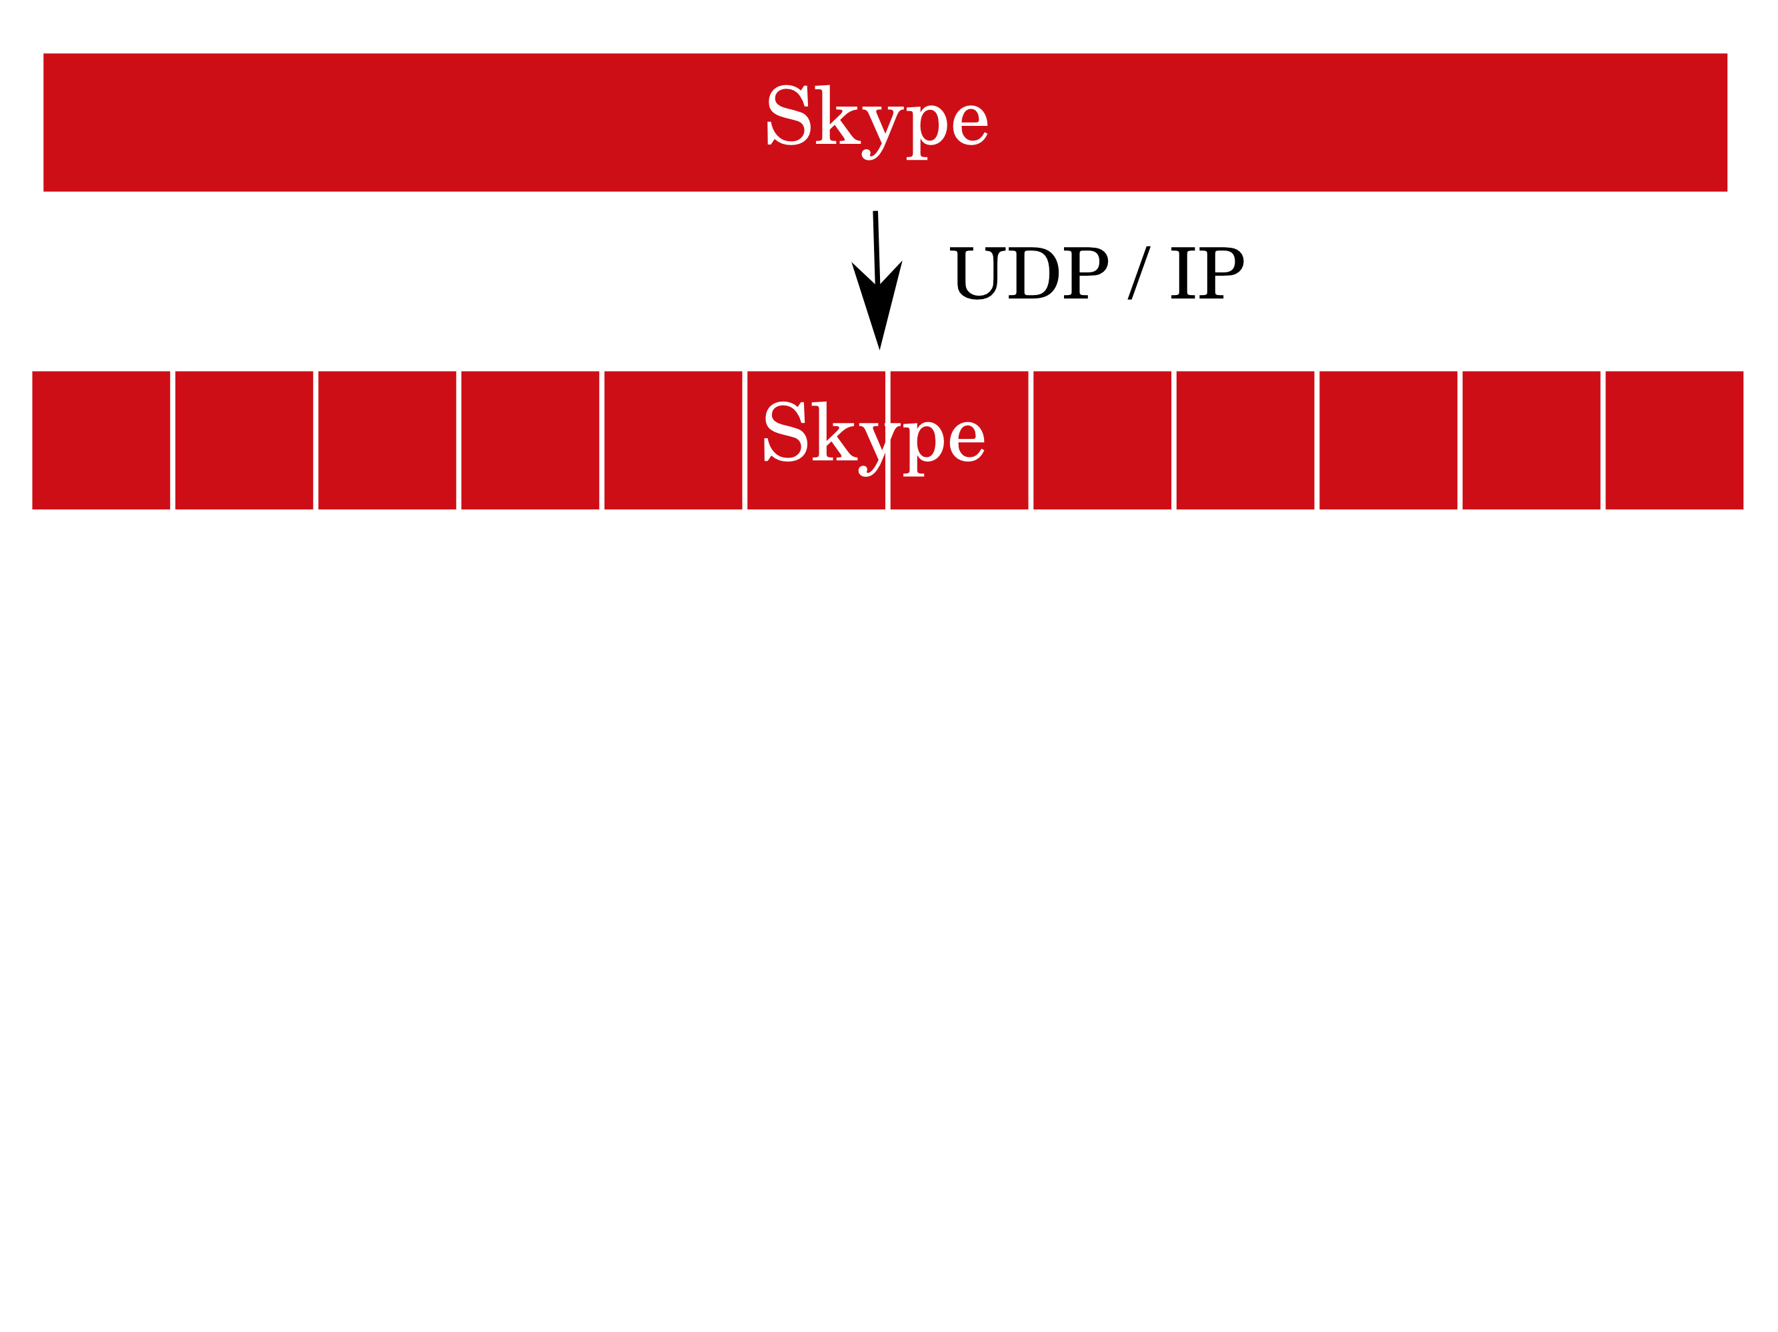

Slide 7
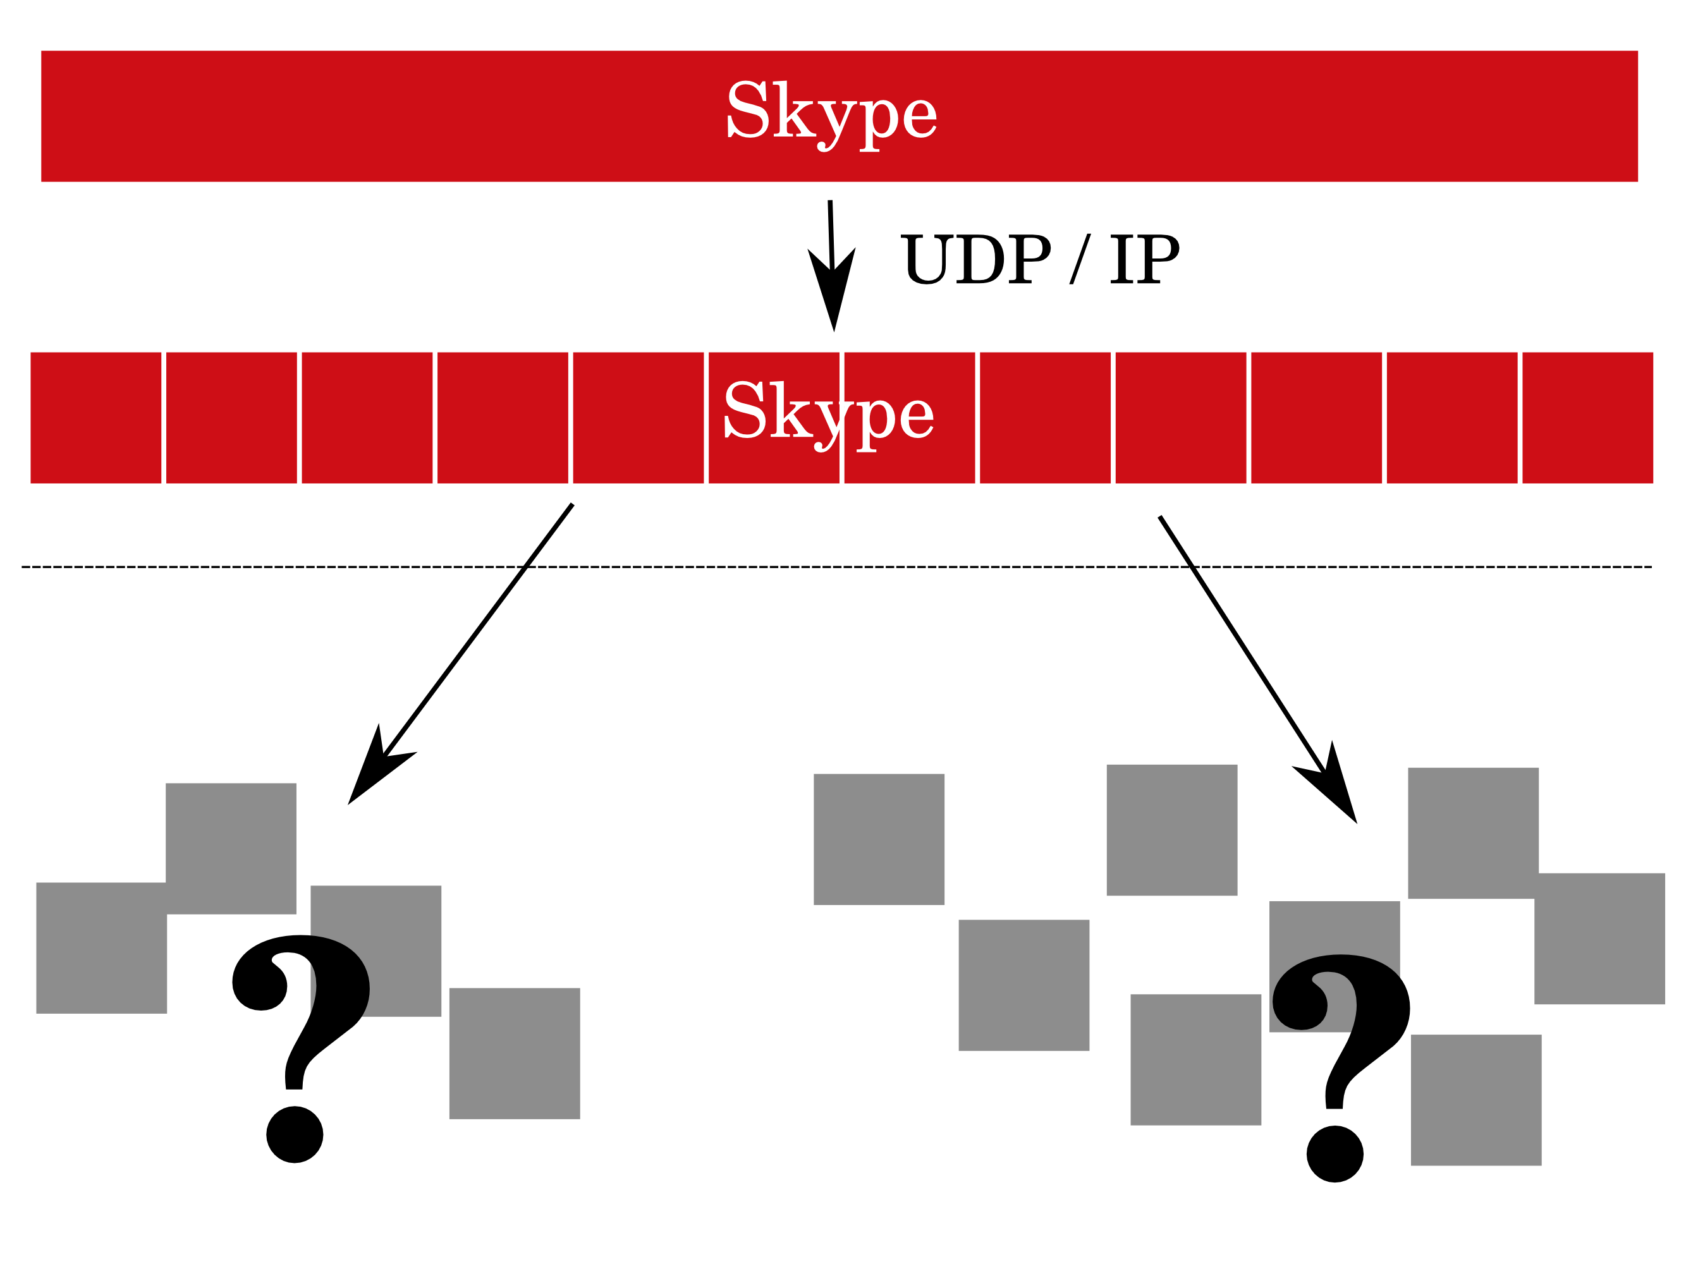

Slide 8
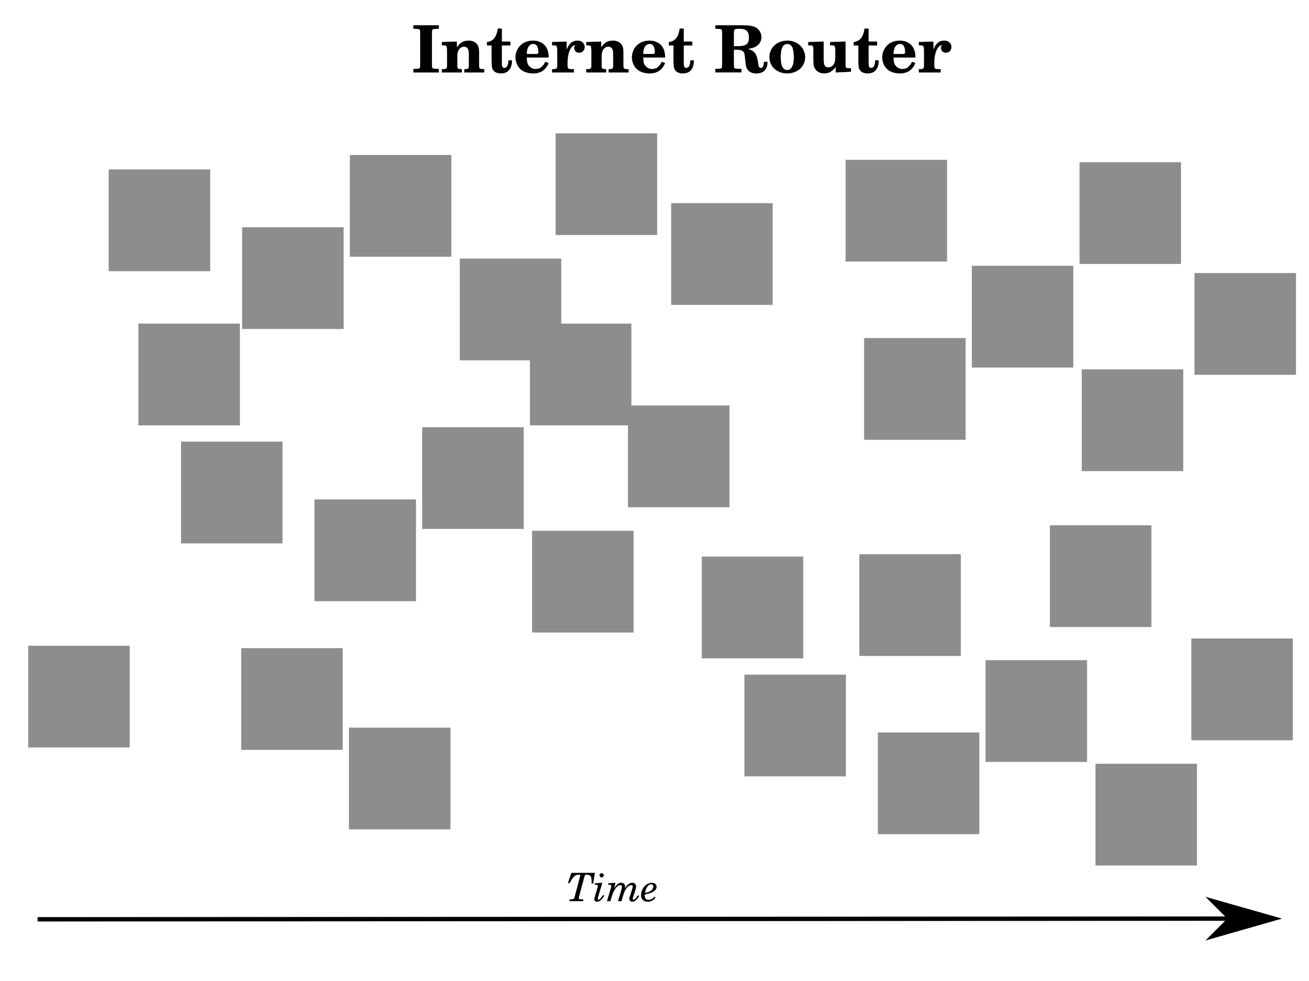

Slide 9
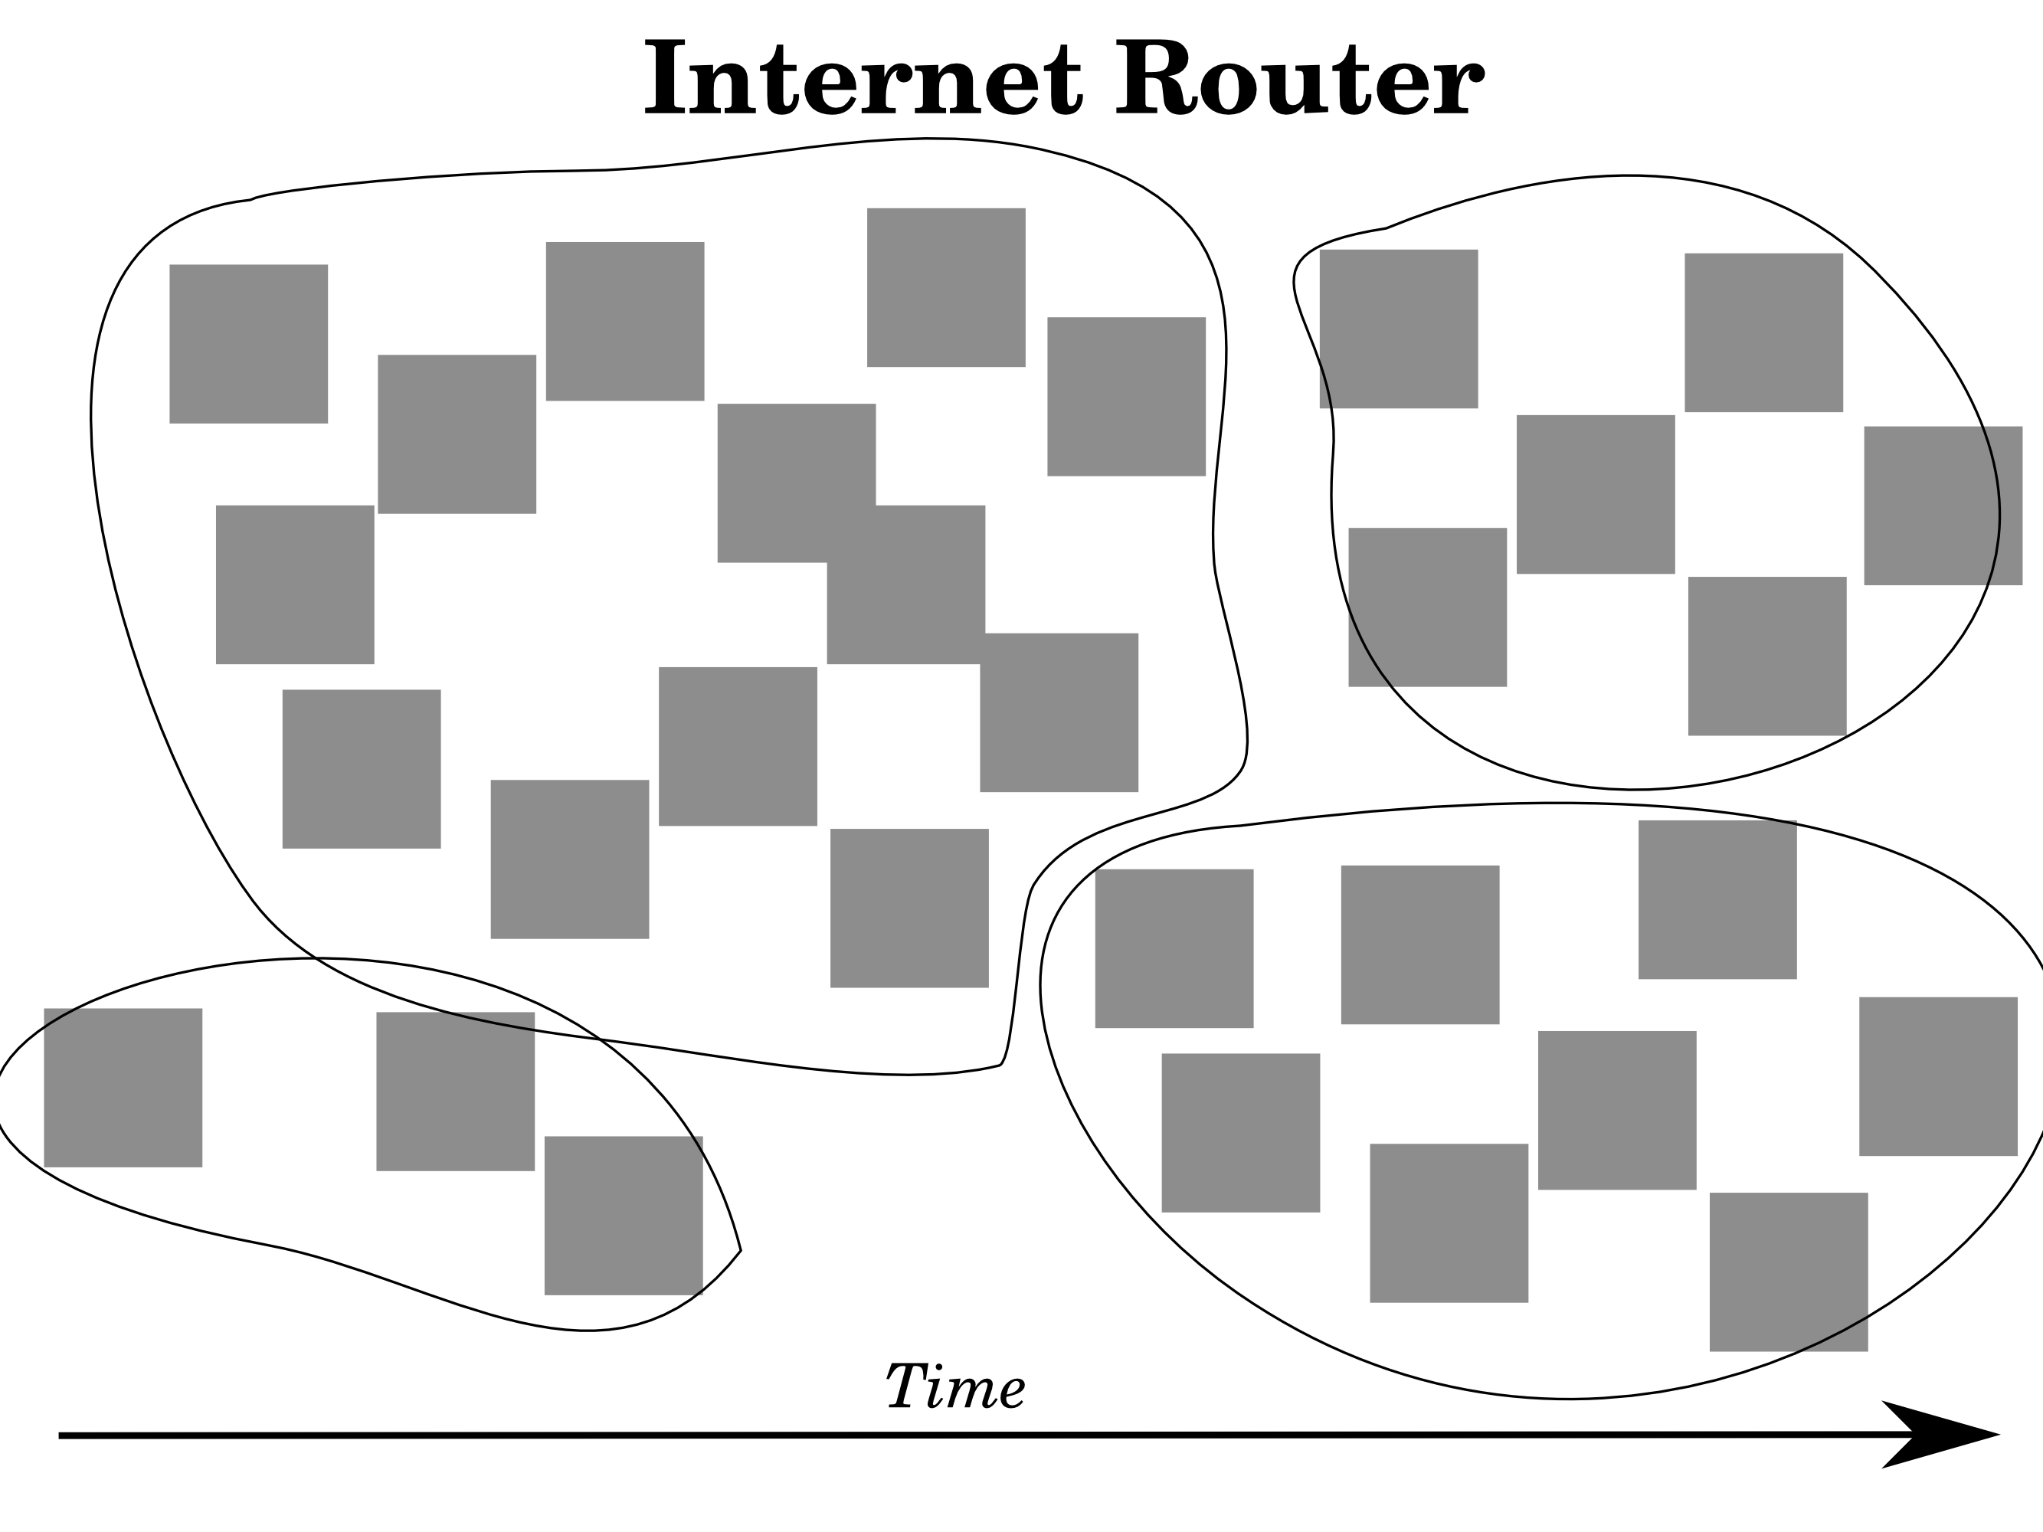

Slide 10
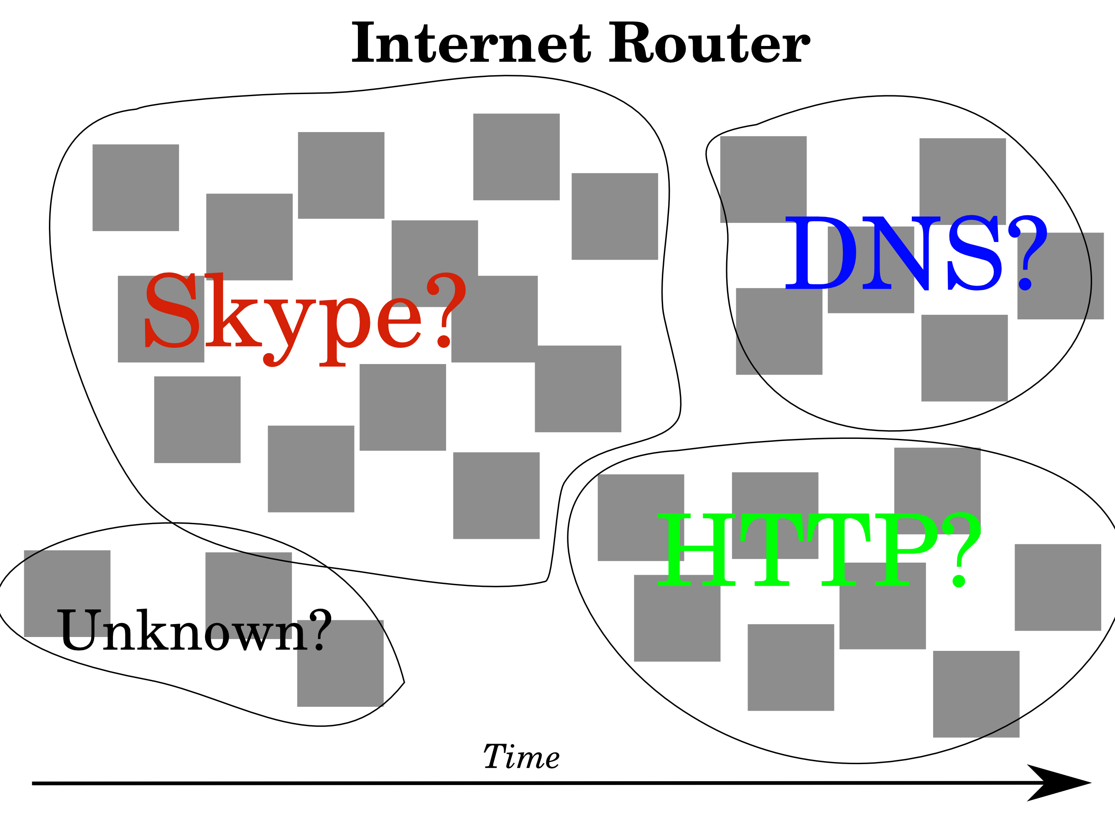

Slide 11
Statistical approach

Slide 12
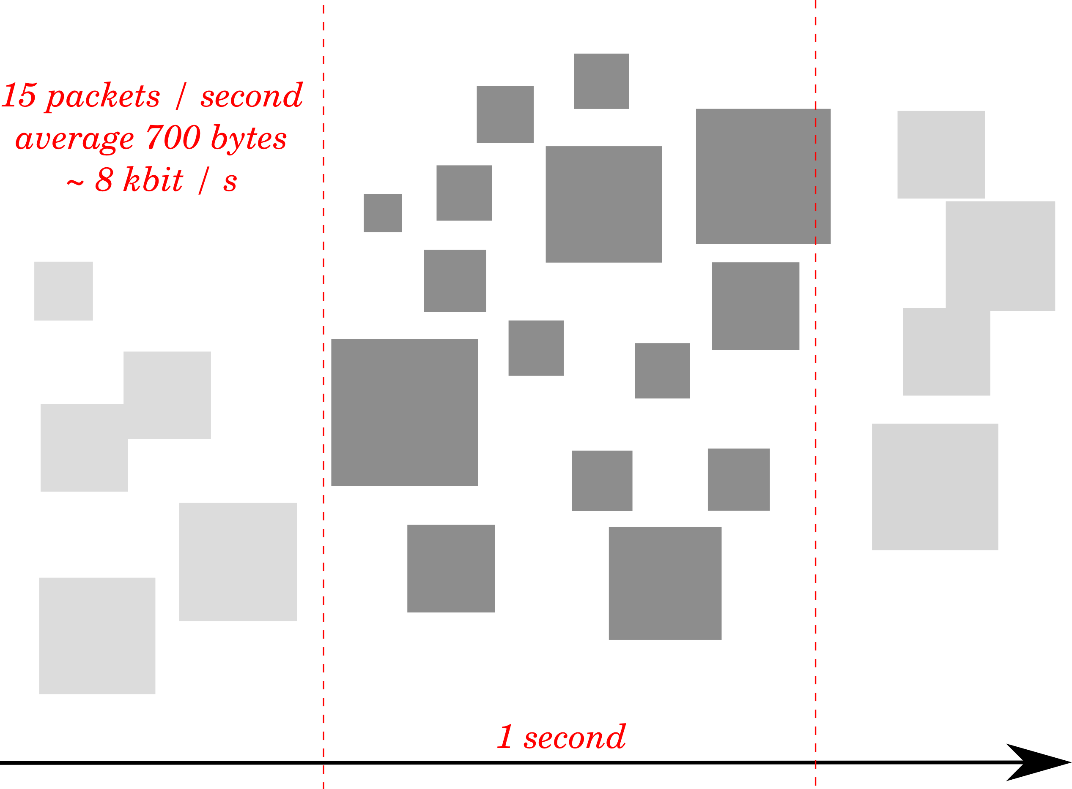

Slide 13
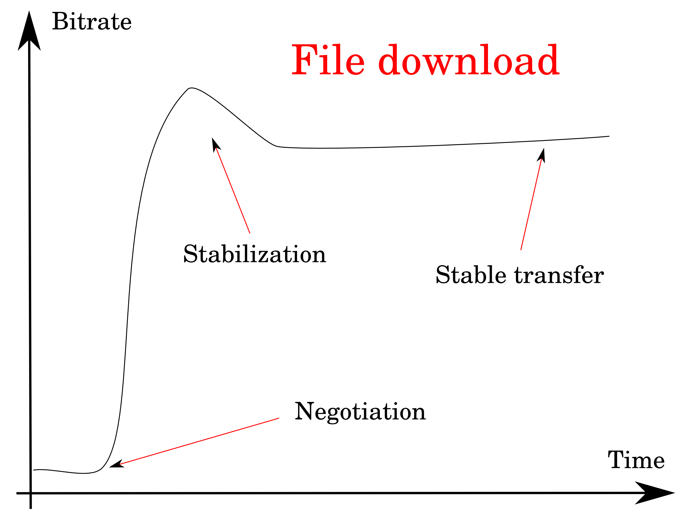

Slide 14
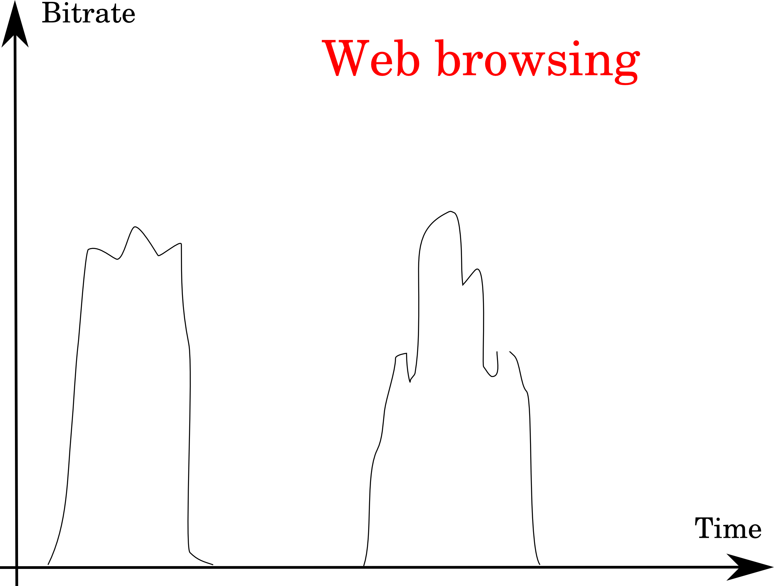

Slide 15
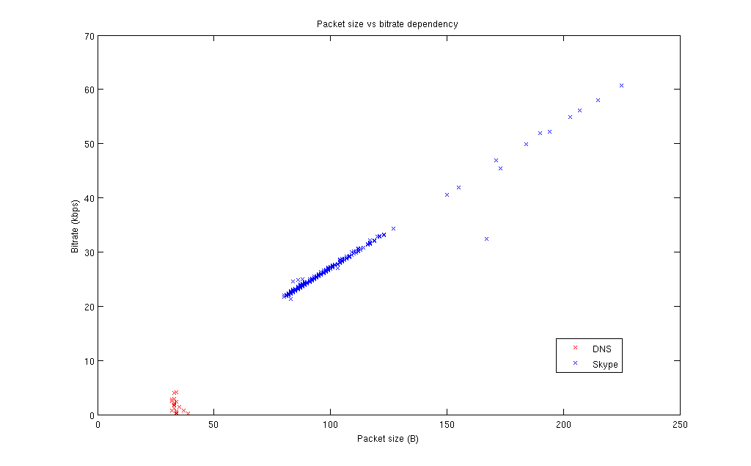

Slide 16
Existing statistical approaches
Flow-level analysis
    Language detection in Skype
Behavioral (e.g. P2P)
Packet-level inspection

Slide 17
The KISS algorithm

Slide 18
KISS algorithm
KISS: Chi-Square Signatures
Idea: each UDP packet must have an additional application-level header
    Counters
    Constants
    Random numbers

Slide 19
KISS algorithm
First 12 bytes as protocol header
Measure randomness on each byte position
Result: feature vector – protocol signature
Similar to goodness of fit test for Pearson's χ² distribution

Slide 20
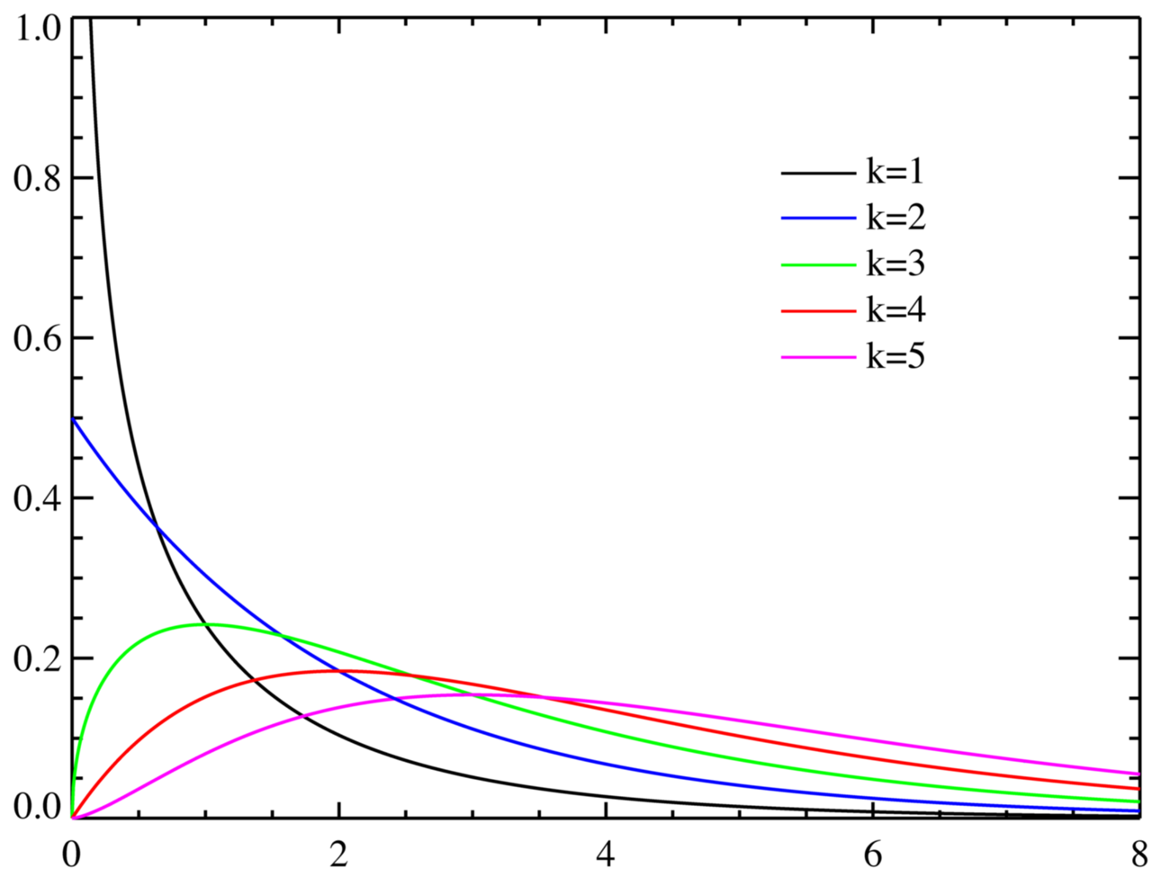
χ² of one byte position
Sum of differences

Slide 21
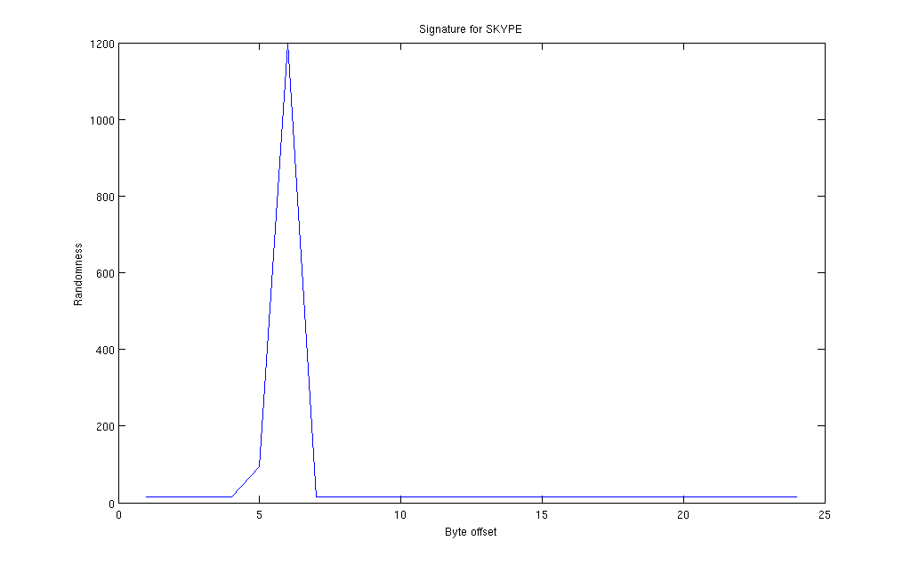
Example: Skype
Position in
feature vector

Slide 22
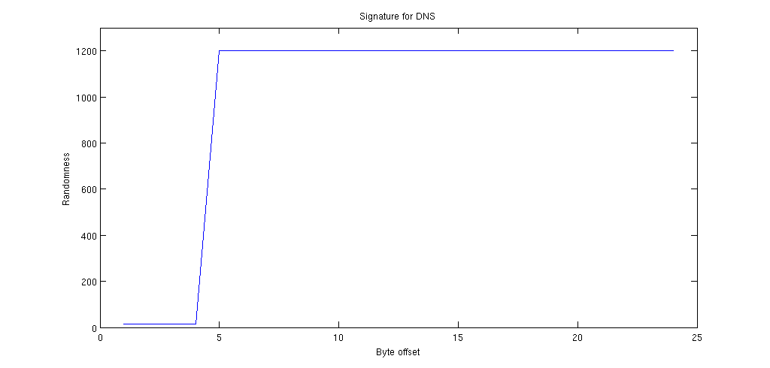
Example: DNS

Slide 23
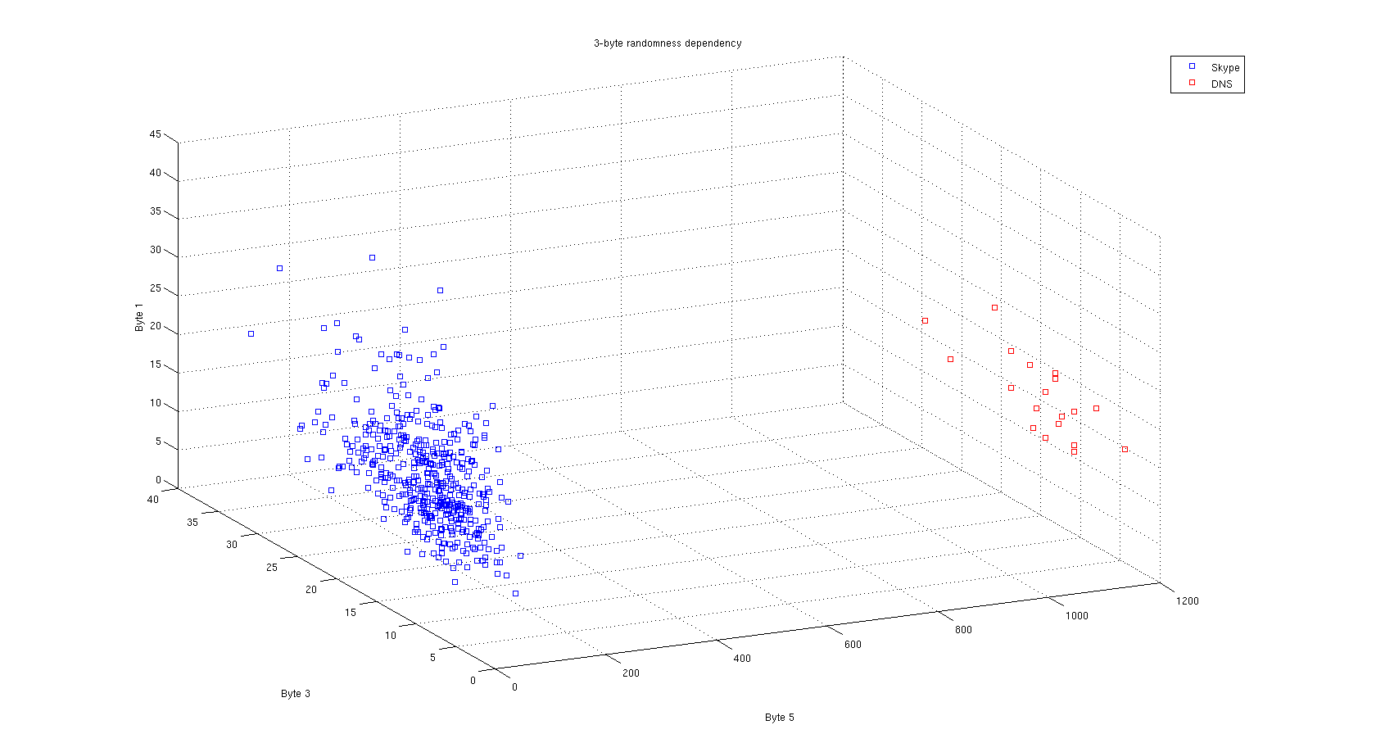
Cross-byte dependency

Slide 24
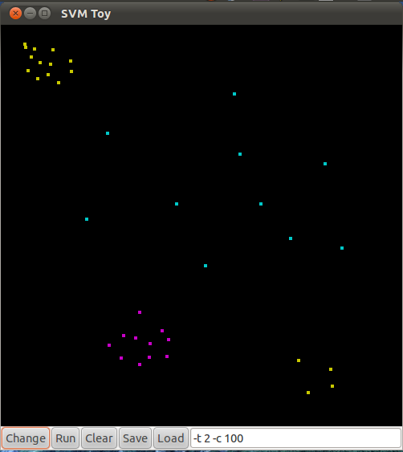
Support Vector Machines

Slide 25
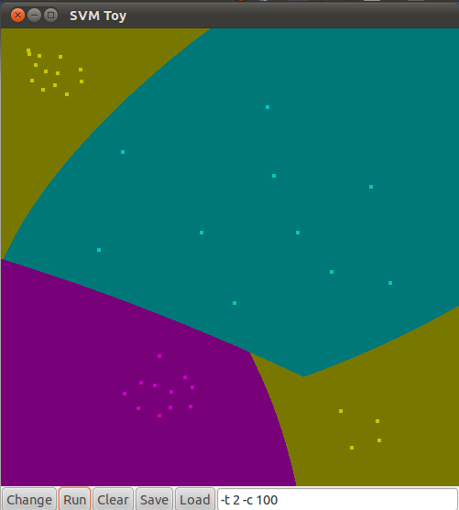
Support Vector Machines

Slide 26
My work

Slide 27
MATLAB prototype
~1k lines of source code
Packet sniffer
Grouping in flows
Computation of KISS signatures
    Flow-level additions
Preliminary SVM classification
    libsvm

Slide 28
Current objectives
Representative traffic samples
Evaluation of flow-level extensions in feature vector
Tuning of SVM classification

Slide 29
Target
Implementation in C
Real-time
Work as live packet sniffer
Work as Linux firewall
    netfilter NFQUEUE target

Slide 30
Questions?
Statistical, real-time classification of IP traffic in Linux operating system
Paweł Foremski
Advisor: dr inż. Arkadiusz Biernacki

