Slide 1
Unit 2
CPU Pipeline

Slide 2
Pipelined Y86 Implementation
Unit outline
  Motivation and basic concepts
  Initial Implementation
  Hazards
  Types of hazards
  Dealing with hazards by stalling
  Data hazards: forwarding to avoid stalling
  Control hazards: branch prediction
  Indirect jumps
  Performance analysis

Slide 3
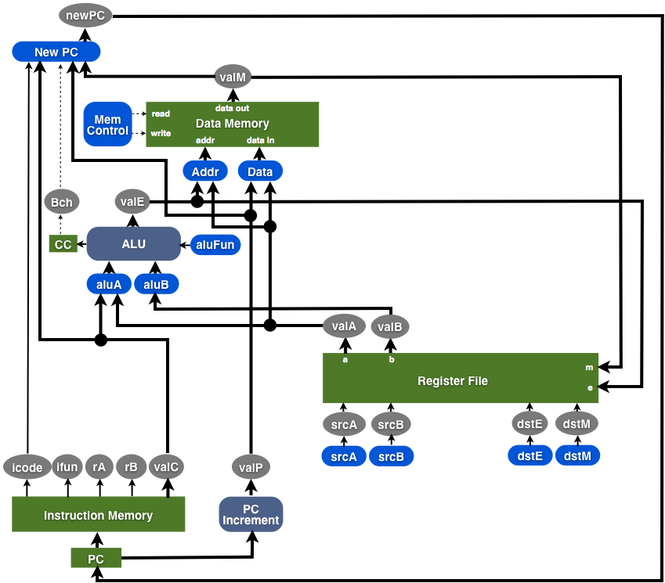
Design so Far
f.prPC
register file
F
D
E
M
W
CC
main memory

Slide 4
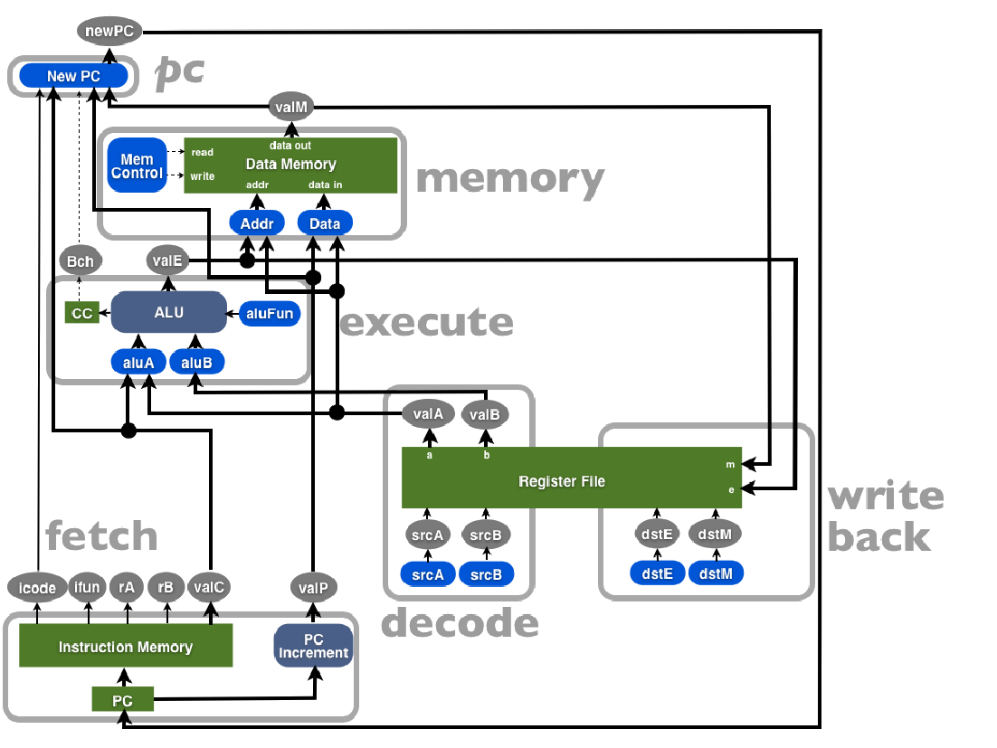

Slide 5
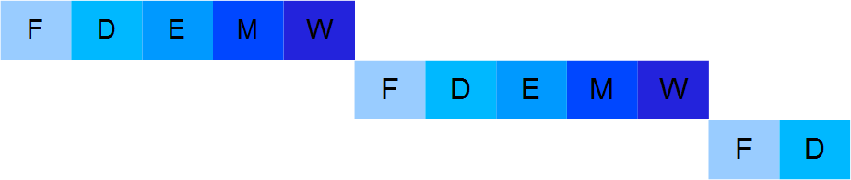
Motivation and basic concepts
How instruction execution proceeds:
Sequential Y86 implementation
Instr 1:
Instr 2:
Instr 3:

Slide 6
Human Pipeline

Slide 7
Motivation and basic concepts
Pipeline computation
  Divide the execution into modules (fetch, decode, ...)
  Modules are ordered along the flow of computation.
  One module's output is the input of the next module.
Turn each module into a pipeline stage.
  Add pipeline registers before every stage except the 1st.
  These store the inputs for that stage.
  Stages execute in parallel working on different instructions.
As we will see later this introduces new problems.

Slide 8
Sequencing a 3-Stage Pipeline
Clock
OP1
B
C
OP2
A
B
OP3
A
120
240
360
Time
●


❍

Time = 239
●
Time = 300
100 ps
20 ps
100 ps
20 ps
100 ps
20 ps
100 ps
20 ps
100 ps
20 ps
100 ps
20 ps
Comb.
logic
A
R
e
g
Comb.
logic
B
R
e
g
Comb.
logic
C
R
e
g
Comb.
logic
A
R
e
g
Comb.
logic
B
R
e
g
Comb.
logic
C
R
e
g

Time = 241
Clock
❍
Time = 359
Clock
100 ps
20 ps
100 ps
20 ps
100 ps
20 ps
100 ps
20 ps
100 ps
20 ps
100 ps
20 ps
Comb.
logic
A
R
e
g
Comb.
logic
B
R
e
g
Comb.
logic
C
R
e
g
Comb.
logic
A
R
e
g
Comb.
logic
B
R
e
g
Comb.
logic
C
R
e
g
Clock
Clock

Slide 9
Sequencing a 3-Stage Pipeline

Time = 239
100 ps
20 ps
100 ps
20 ps
100 ps
20 ps
Comb.
logic
A
R
e
g
Comb.
logic
B
R
e
g
Comb.
logic
C
R
e
g

Time = 241
Clock
100 ps
20 ps
100 ps
20 ps
100 ps
20 ps
Comb.
logic
A
R
e
g
Comb.
logic
B
R
e
g
Comb.
logic
C
R
e
g
Clock

Slide 10
Sequencing a 3-Stage Pipeline
●
Time = 300
100 ps
20 ps
100 ps
20 ps
100 ps
20 ps
Comb.
logic
A
R
e
g
Comb.
logic
B
R
e
g
Comb.
logic
C
R
e
g
❍
Time = 359
Clock
100 ps
20 ps
100 ps
20 ps
100 ps
20 ps
Comb.
logic
A
R
e
g
Comb.
logic
B
R
e
g
Comb.
logic
C
R
e
g
Clock

Slide 11
Pipeline Stages
How many stages should a pipeline have?
If it has too few stages...
  We are not exploiting the parallelism present in the program.
If it has too many...
  There is high overhead and complexity.
  The program may not have enough parallelism to use them well.

Slide 12
Examples
MIPS processor (1985): first RISC processor, 5 stages.
Sparc, PowerPC processors: 9 pipeline stages.
Intel Pentium IV (late models): ____________
Intel Core i7 processor: _______________
Notes:
Answers 31 and 14

Slide 13
Latency & Throughput
How do we measure processor efficiency?
Latency:
  How long it takes to execute one instruction from start to finish.
Throughput:
  The number of instructions we can execute per unit of time.
  This is the only meaningful measure for pipelined CPUs.

Slide 14
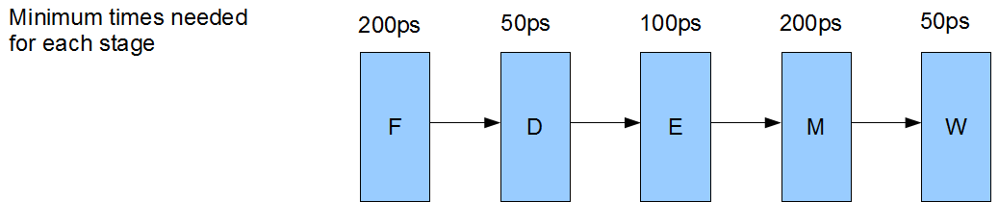
Latency & Throughput
Sequential Implementation
Latency
Throughput

Slide 15




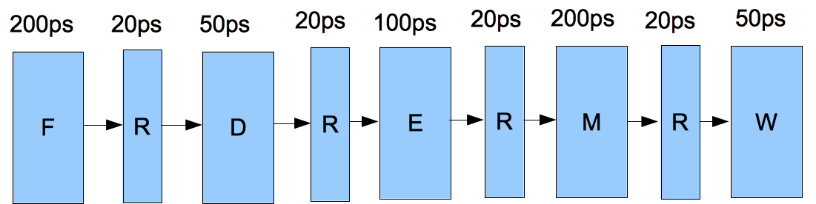




Measuring Performance
Pipeline Stages
Pipeline Overhead
Throughput
  the rate at which instructions leave the pipeline
  what is it here? 1/220 PS → 4.54GIP
  in general? 1/Clock Rate
Latency
  total time it takes an instruction to be processed by entire pipeline
  what is it here? 5x220=1100
  in general? CLOCK x #ofStages

Slide 16
Pipelined Y86 Implementation
Unit outline
  Motivation and basic concepts
  Initial Implementation
  Hazards
  Types of hazards
  Dealing with hazards by stalling
  Data hazards: forwarding to avoid stalling
  Control hazards: branch prediction
  Indirect jumps
  Performance analysis

Slide 17
Pipelined Computation
divide execution into modules along flow of computation
  classic RISC pipeline has five modules
  modules arranged in order along computation flow
  all inputs to a module must be computed by an earlier module in flow
turn modules into pipeline stages
  add pipeline registers between each stage
  registers store inputs for that stage
  each stage executes in parallel working on a different instruction
observe that
  a stage has less gate-propagation delay than overall circuit
  what determines clock rate? Max time form the stages
  new instruction retrieved by FETCH on each cycle

Slide 18
The RISC Pipeline
How many stages?
  enough to achieve sufficient parallelism
  must have enough parallelism in the program
  not too much to add undo overhead or complexity
What are they?
  divide instructions into stages that instruction completes in order
  e.g.: do A, then B, then C, then D, then D and then instruction is done
  then we can execute the stages in parallel on different instructions
lets look at rmmovl rA, D(rB), for example
  what are the parts?
  what order do they need to execute?

Slide 19
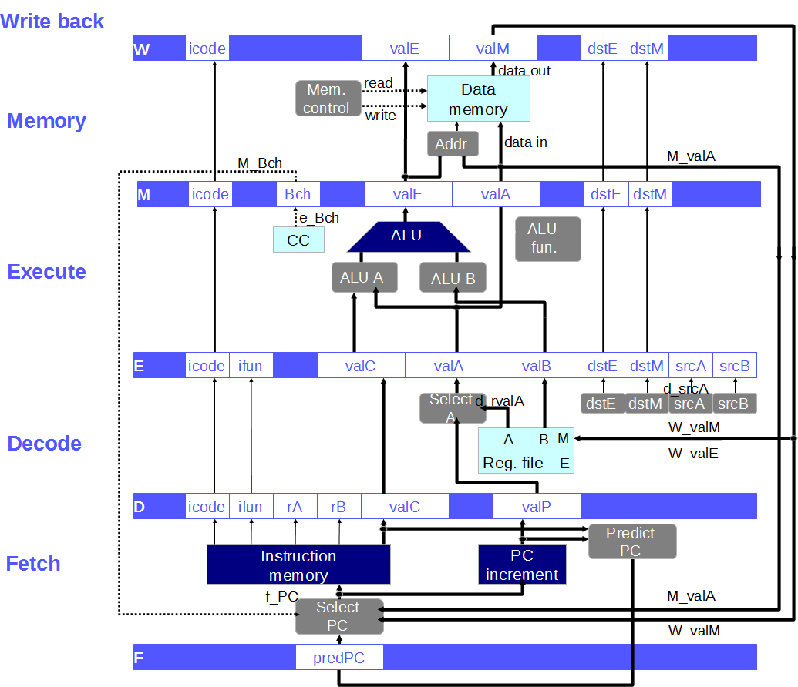

Slide 20
Data Flow Through Processor Stages
F
D
➤
E
M
W
f.prPC
d.iCd | ➤
d.iFn | ➤
d.rA
d.rB
d.valC | ➤
d.valP
e.iCd | ➤
e.iFn
e.valC | ➤
e.srcA
e.srcB
e.dstE | ➤
e.dstM | ➤
e.valA | ➤
e.valB
m.iCd | ➤
m.valC | ➤
m.dstE | ➤
m.dstM | ➤
m.valA
m.valE | ➤
m.bch | ➤
w.iCd
w.valC
w.dstE
w.dstM
m.valE
w.bch
w.valM
irmovl $1, %eax
irmovl $2, %ecx
irmovl $3, %edx
irmovl $4, %ebx
irmovl $5, %esi
main memory
register file
Notes:
Red arrows indicate the new register values. The registers are the ones that are inputs to the stage they are under, or more precisely the inputs. The balck arrows are registers that get forwarded to the next stage.

Slide 21
An Example Problem
What will each pipeline register contain when the last instruction in this sequence is entering the Fetch stage?
.pos 0x100
irmovl $1, %eax
irmovl $2, %ecx
irmovl $3, %edx
irmovl $4, %ebx
irmovl $5, %esi

Slide 22
An Example Problem (2)
What will each pipeline register contain when the last instruction in this sequence is entering the Fetch stage?
.pos 0x100
irmovl $1, %eax 30 f0 01 00 00 00
irmovl $2, %ecx 30 f1 02 00 00 00
irmovl $3, %edx 30 f2 03 00 00 00
irmovl $4, %ebx 30 f3 04 00 00 00
irmovl $5, %esi 30 f6 05 00 00 00

Slide 23
Data Flow Through Processor Stages
F
D
➤
E
M
W
f.prPC
d.iCd
d.iFn
d.rA
d.rB
d.valC
d.valP
e.iCd
e.iFn
e.valC
e.srcA
e.srcB
e.dstE
e.dstM
e.valA
e.valB
m.iCd
m.valC
m.dstE
m.dstM
m.valA
m.valE
m.bch
w.iCd
w.valC
w.dstE
w.dstM
m.valE
w.bch
w.valM
Notes:
Red arrows indicate the new register values. The registers are the ones that are inputs to the stage they are under, or more precisely the inputs. The balck arrows are registers that get forwarded to the next stage.

Slide 24
Terminology
an instruction is in flight when
  is currently being executed by the pipeline
an instruction is retired when
  when it exits the pipeline; i.e., it completes
on upcoming slides ...
  exploiting and expressing parallelism
  instruction-level parallelism
  instruction dependencies
  thread-level parallelism
  sequential consistency
  pipeline hazard, stall and bubble

Slide 25
Ordering Instruction Execution
What we think now
  program determines order of instruction execution
What about the pipeline presents a problem?
  are pipelined instructions still executed in order?
  think about the register file ...
  what about conditional jumps ...
What really determines instruction execution order?

Slide 26
Pipeline Considerations
At what stage will %eax be updated?
Consider this code:
irmovl $5, %eax
addl %eax, %edx
At what stage is irmovl in when addl needs %eax?
Problem!!!!!
At what stage is %eax extracted from the register file?

Slide 27
Instruction-Level Parallelism
Pipeline requires some parallelism
  multiple in-flight instructions
  run partly at the same time
  may even run out-of-order
The program must have the same output as if instructions were executed sequentially.
Notes:
give examples of each

Slide 28
Dependencies Constrain Parallelism
A dependency means that the execution of 2 more instructions has to proceed in strict time order to be able to produce the same output as if one instruction were completely executed before the next instruction is started.
If no dependency, execution order doesn’t matter
Compilers try to expose as much instruction-level parallelism as they can by separating dependent instructions and grouping them with others on which they don’t depend

Slide 29
Compilers & Instruction Parallelism
Compilers can reorder instructions to expose as much instruction-level parallelism as possible.
However they can not know every detail of the processor's pipeline (e.g. later Pentium IV's had more stages than earlier ones).
So the pipeline must handle all dependencies correctly

Slide 30
Dependencies
Example: how can we rewrite the following code
addl %eax, %ebx
iaddl $5, %ebx
addl %edx, %ecx
iaddl $9, %ecx
addl %esi, %edi
iaddl $3, %edi
to expose more parallelism?

Slide 31
Data Dependencies
if A and B are instructions, then A ≺ B means instruction B depends on instruction A.
  Causal: A ≺ B if B reads a value written by A.
  Output: A ≺ B if B writes to a location written by A.
  Alias (anti): A ≺ B if B writes to a location read by A.
Read “<“ as must happen before

Slide 32
Control Dependencies
Whether a branch is taken or not taken (jmp, jxx, call, ret).
When an instruction writes to instruction memory (self-modifying code).

Slide 33
Types of Data Dependency
(a) no dependency (c) causal dependency
(b) output dependency (d) anti dependency
1.
a = 1;
b = 2;
a = 1;
a = 2;
a = 1;
b = a;
b = a;
a = 1;
2.
3.
4.

Slide 34
Exercise Classify Examples
No dependency 3) anti-dependency
2) Casual dependency 4) output dependency
(a) irmovl $1, %eax rrmovl %ecx, %eax | (c) rrmovl %eax, %ecx irmovl $1, %eax
(b) irmovl $1, %eax rrmovl %eax, %ecx | (d) irmovl $1, %eax Irmovl $2, %ecx
Notes:
A: output dependency
B: causal dependency
C: anti-dependency
D: no dependency

Slide 35
Expressing and Exploiting Parallelism
What does this mean?
expressing: its how the programmer tells the system that two pieces of code can execute in parallel
exploiting: is the system actually executing two pieces of code in parallel
How do you express parallelism in Java?
Is this mechanism useful for expressing ILP?

Slide 36
Exploiting Instruction-Level Parallelism
The problem with instruction-level parallelism is:
Programming languages like C, C++ and Java are based on the sequential consistency model:
  The effect of executing the program must be the same as if instructions were executed one by one in the order they are written.
Programmers write code without thinking about parallelism
Example:
Can be rewritten as:
But compilers must find this on their own.
Notes:
Write out some code like
a = b + c;
d = a + 1;
e = f + g;
Which things can execute in parallel

Slide 37
Pipelined Y86 Implementation
Unit outline
Motivation and basic concepts
Initial implementation
Hazards
  Types of hazards
  Dealing with hazards by stalling
  Data hazards: using data forwarding to avoid stalling
  Control hazards: branch prediction
  Indirect jumps
Performance analysis.

Slide 38
What is the problem here?
irmovl $1, %eax
F
D
E
M
W
addl %eax, %ebx
F
D
E
M
W
F
D
E
M
W
addl %eax, %ecx
F
D
E
M
W
addl %eax, %edx
addl %eax, %esi
F
D
E
M
W
time

Slide 39
Hazard Definition
A pipeline hazard exists when the “normal” progression of instructions through the pipeline would violate a data or control dependency.
What can we do?
  Nothing?
Therefore:
One possible solution is:

Slide 40
Pipeline Hazard
definition
  a pipeline hazard exists when the processor’s execution would violate a data or control dependency
what might we do
  can’t do nothing
  execution might produce erroneous results
  must detect
  we could stall
defns
  pipeline stall: holding an instruction in a pipeline stage for an extra cycle, always produces a bubble in the subsequent stage in the next cycle
  pipeline bubble: when a pipeline stage is forced to do nothing in order to avoid a hazard.
irmovl $1, %eax
F
D
E
M
W
addl %eax, %ebx
F
D
E
M
W
addl %eax, %ecx
F
D
E
M
W
addl %eax, %edx
F
D
E
M
W
time
F
D
E
M
W

Slide 41
Stalling
defns
  pipeline stall: hold an instruction in a pipeline stage for an extra cycle
  always produces a bubble in the subsequent stage in the next cycle
  pipeline bubble: when a pipeline stage is forced to do nothing in order to avoid a hazard. (result of a previous stall)

Slide 42
Doing Something Better than Stalling
Is important
  every stall creates a pipeline bubble
  every bubble results in a cycle in when processor can’t retire an instruction
  retiring a bubble is of no value to program execution
  computing program performance/throughput on pipelined processor?
What are the consequences of bubbles on throughput?
Ideas
  data dependencies
  control dependencies

Slide 43
Bubble
The term pipeline bubble denotes a pipeline stage that is forced to do nothing to avoid a hazard, due to a stall in a previous stage.

Slide 44
Example

Slide 45
Anti and Output Dependencies
These are fairly easy
  they aren’t real dependencies
  instead they are dependencies on a register name (or memory address)
Register renaming
  solution to both anti and output dependencies
  processor has a bunch of extra registers laying around
  if it sees an anti or output dependency, it changes register names to eliminate it
  output is special case where first instruction’s output can be ignored
example
Only needed if instructions executed out of order by CPU
irmovl $1, %eax
addl %eax, %ebx
irmovl $2, %eax
addl %eax, %ecx

Slide 46
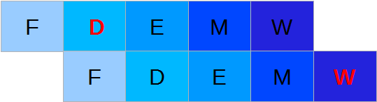
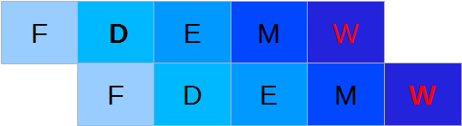
Types of Hazards
For our pipelined Y86 implementation:
Anti-dependency:
addl %eax, %edx
irmovl $1, %eax
Output dependency:
addl %eax, %edx
irmovl $1, %edx
So the solution is:

Slide 47
Y86 Pipeline Hazards
data hazards: only issue is
  causal hazards on register file, why?
  what not
  memory or condition codes?
control hazards
  conditional jump
  Return
  why not unconditional jump or call?
Notes:
Conditional jumps: check branch taken or not in Execute, but need it in Fetch.
Return: get value in Memory stage, needed in Fetch
No problem for call or unconditional jumps: have the value at the end of Fetch, needed the next Fetch (more things happen later, but they don't affect the PC)

Slide 48
Pipe–: Resolving Hazards by Stalling
data hazards
  reading registers in decode that are written by instructions currently in execute, memory or write-back stages
  stall instruction in decode until writer is retired
  how many stall cycles? ______
Notes:
Stall until the

Slide 49
Control Hazards
Conditional jump
  stall fetch until jump exits execute
  how many stall cycles? ______
Return
  stall fetch until return exits memory
  how many stall cycles? ______

Slide 50
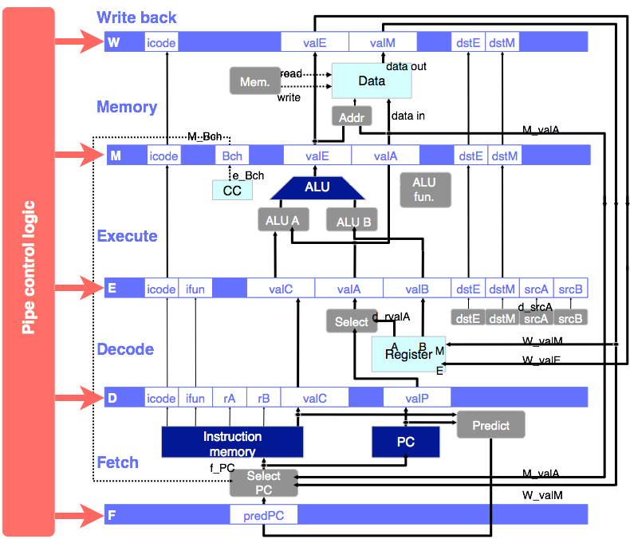
Pipeline Control Unit
Notes:
signal relabling - prefix - uppercase in in memory, lowercase is just computed
select A: replaces memory-stage “data”, selecting the value to write to memory earlier to reduce amount of pipeline state carried out of D

Slide 51
Pipeline Control Unit
The pipeline-control module
  is a hardware component (circuit) separate from the 5 stages
  examines values across every stage
  decides whether stage should stall or bubble

Slide 52
Dealing with hazards
Each stage register has a control input that determines what happens when the clock ticks:
  Normal: register's new value is the input value.
  Stall: register's new value is the same as its current value.
  Bubble: register's new value is the same as for nop.

Slide 53
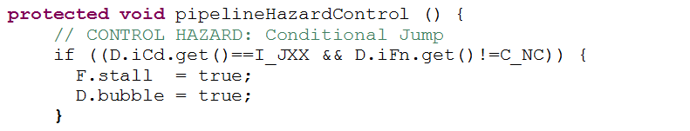
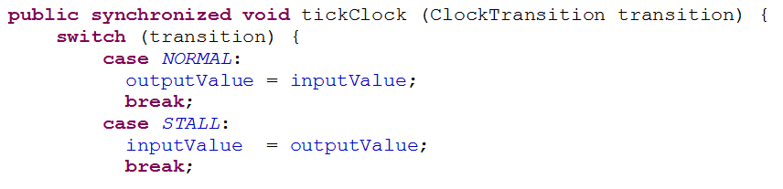
In the Simulator
stage.stall/stage.bubble determine the control input for the stage registers:
In file Register.java:

Slide 54
Pipelined Y86 Implementation
Unit outline
Motivation and basic concepts
Initial implementation
Hazards
  Types of hazards
  Dealing with hazards by stalling
  Data hazards: using data forwarding to avoid stalling
  Control hazards: branch prediction
  Indirect jumps
Performance analysis.

Slide 55
Dealing with Causal Dependencies
may have to stall
  an instruction can’t read a value that the processor doesn’t know yet
but in most cases
  processor has computed value, it just hasn’t written it to the register file yet
so data forwarding will resolve hazard (in these cases)
  is mechanism that forwards values from later pipeline stages to earlier ones
  so that an instruction can read value before it is written back to register file
Notes:
Talk about end / beginning issue. What is wrong with forwarding from end of one stage to the beginning of another? Even end to end may slow the clock a little (if FROM is the longest stage).

Slide 56
Data Forwarding
In y86, at the end of what stage is output known by CPU?
  irmovl, addl, subl, andl, xorl, pushl, popl (esp), call (esp), ret (esp)
  mrmovl, popl (target reg)
in y86, at the end of what stage is register value needed?
Notes:
Execute Stage
Memory Stage
Decode Stage

Slide 57
Pipe (with forwarding)
Write back
W_valE
W
icode
valE
valM
dstE
dstM
W_valM
Mem.
control
read
data out
m_valM
Data
memory
to
  D
from
  W new value to register file
  M new value read from memory
  E new value from ALU
by
  sending value and name
  from all three stages
  back to forwarding logic
  in decode stage
Memory
write
Addr
data in
M_Bch
M_valE
M_valA
M
icode
Bch
e_Bch
valE
valA
dstE
dstM
CC
ALU
ALU
fun.
e_valE
ALU
A
ALU
B
Execute
E
icode
ifun
valC
valA
valB
dstE
dstM
srcA
srcB
d_srcA
dstE
dstM
d_srcB
srcA
srcB
Sel+Fwd
A
Fwd
B
Decode
A
B
M
W_valM
Register
file
W_valE
E
D
icode
ifun
rA
rB
valC
valP
Predict
PC
Instruction
memory
PC
increment
Fetch
f_PC
M_valA
Select
PC
W_valM
F
predPC

