Slide 1
Blockchain Identity Management System
Old Dominion University (ODU) – Virginia Modeling Analysis Simulation Center (VMASC)

Slide 2
Types of Blockchain Research at ODU
Real - Real
Real Blockchain System with Interacting Environment
Real – Simulated
Real Blockchain System Interacting with Simulated Environment
Simulated – Simulated
Simulated Blockchain System Interacting with Simulated Environment

Slide 3
Real - Real
What are real use cases that we can test today?
What are the limitations?
Is the real blockchain able to perform good enough?

Slide 4
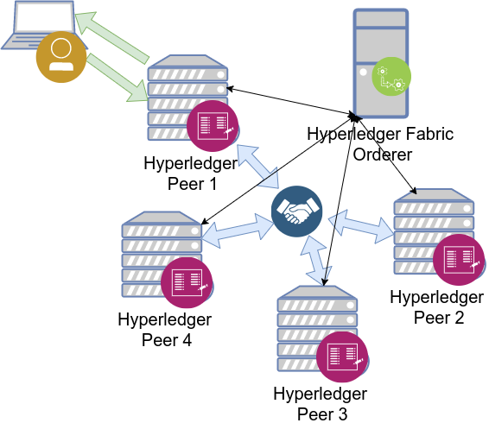
Real Blockchain System (Hyperledger Fabric)
Permissioned based distributed ledger
Blockchain based consensus
Kafka
Practical Byzantine Faulat Tolerance
Participating nodes host the distributed ledger
Orderer handles the broadcasting and implements the consensus algorithm

Slide 5
Device Identity Management Use Case
Distributed ledger that is less centralized than current solutions to privately store networked device identities
More resistant to attacks
Performance possibilities (ledger is mostly queried)
Does not rely on a single party to manage, providing better trust among alliances or consortium's

Slide 6
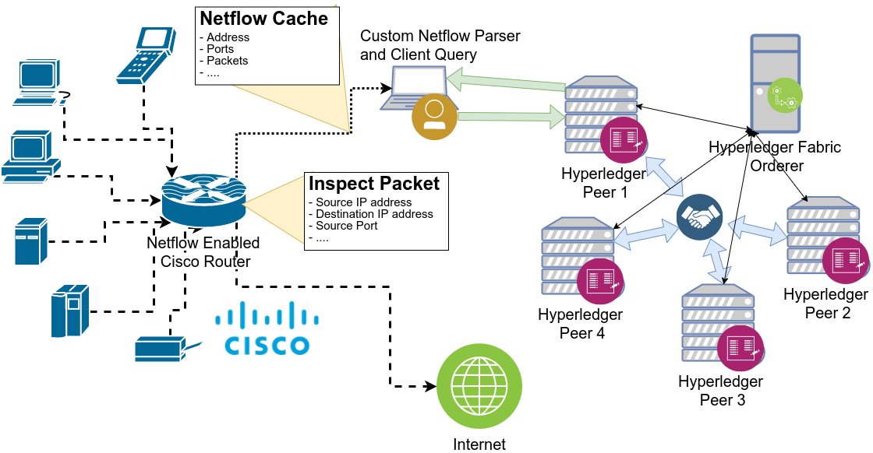
IOT Device Identity Management Architecture

Slide 7
Real - Simulated
Real enviornments to apply blockchain systems can be expensive to set up or impractical to have access to.
Integrating real blockchain systems with simulated environments allow for rapid deployment and test of various environments
What use cases are most appropriate and benefit the most from blockchain systems?

Slide 8
Integrating Blockchain with Simulation
Integrate real blockchain systems with existing simulation environments to explore their effectiveness
Blockchain focuses on maintaining states of simulated entities or system that simulated entities utilize
Communication needs to be handled based on the time frame of the simulation
Real blockchain system is continuous
Simulation is by nature more likely discrete
Possibility that the simulation will take longer to run
Utilize simulation package application programming interface (API)

Slide 9
Integrating Blockchain with Simulation
Integrate real blockchain systems with existing simulation environments to explore their effectiveness
Blockchain focuses on maintaining states of simulated entities or system that simulated entities utilize
Communication needs to be handled based on the time frame of the simulation
Real blockchain system is continuous
Simulation is by nature more likely discrete
Possibility that the simulation will take longer to run
Utilize simulation package application programming interface (API)

Slide 10
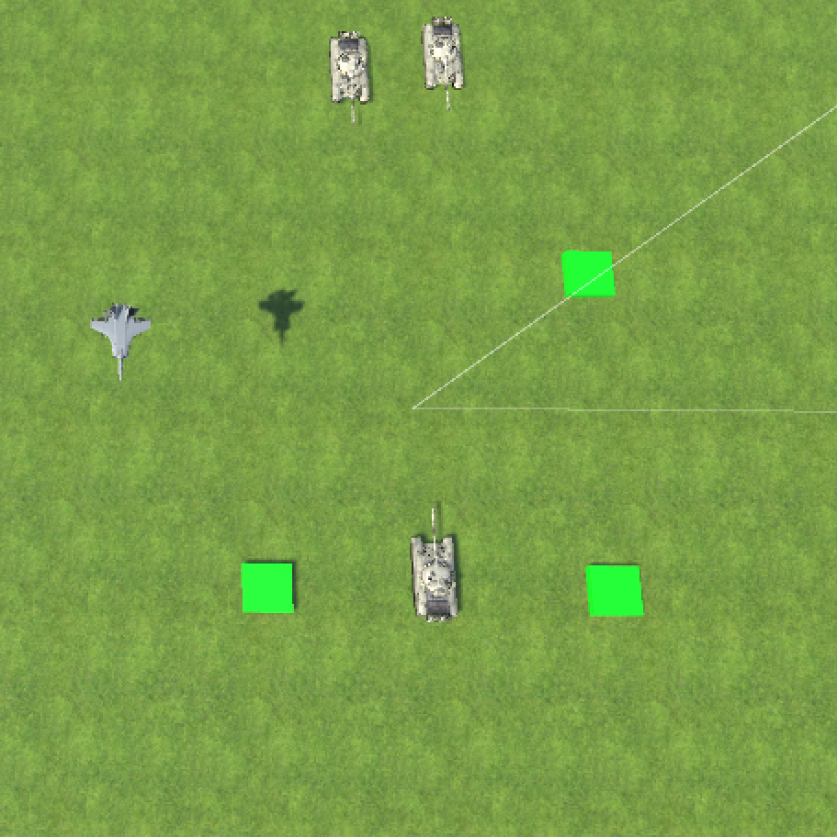
Airspace Identity Management
3d Simulated environment of a battlefield
A sensor observes entities within a range of friendly tank (center bottom)
Entities identified on the blockchain system show up as friendly on sensor (green)
Unidentified entities show up as unknown on sensor (red)
Three structures indicate blockchain participating nodes
Green indicates online
Yellow indicates offline

Slide 11
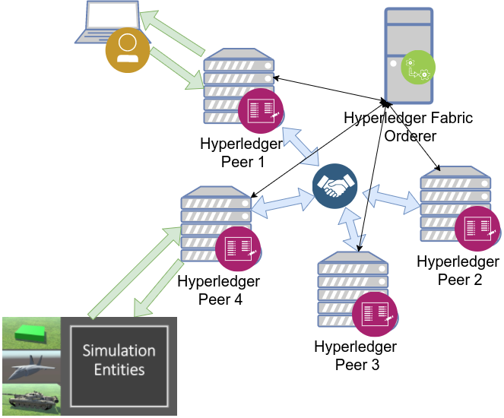
Unity Game Engine Simulation Prototype

Slide 12
Simulated - Simulated
Distributed systems can be costly systems to run
Systems made up of large number of computing nodes
Especially if we are to explore the systems scaled up
Allows for rapid testing of different blockchain systems and different use case environments
Simulation can be built to run fast (discrete event) allowing for a better exploration of system

Slide 13
Simulation of Blockchain Systems
Key aspects to model of blockchain systems in simulation
Consensus algorithm
Network connectivity
Messaging
First need to gather data
Gathered data needs to be modeled
Network needs to be modeled
Participating nodes need to be modeled (based on data)
Total system simulation needs to be calibrated
Total system simulation needs to be verified and validated

Slide 14
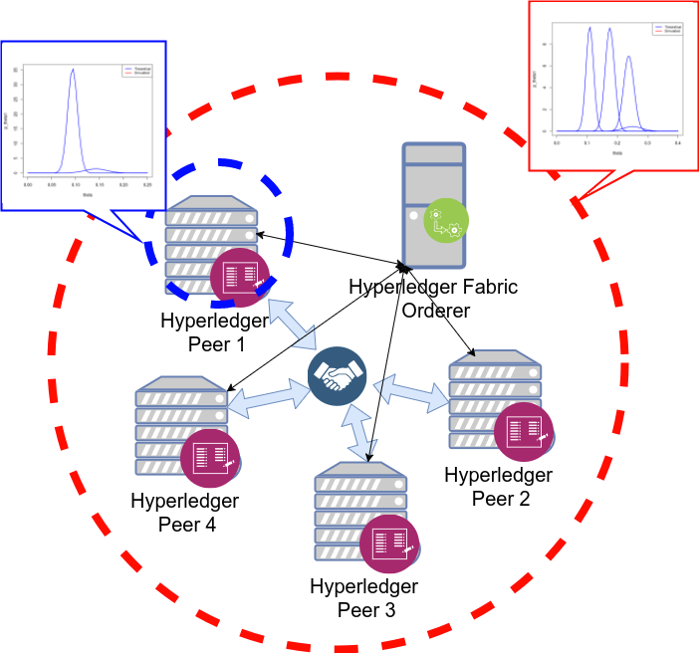
Architecture: Real Blockchain Data
Red Borders indicate data collected of entire system
Recorded as time for the entire system to find consensus
Important for verification, and validation of final model and simulation
Blue Borders indicate data collected of individual participating peer nodes
Recorded as the time for the individual peer to compute its portion of the consensus
Also recorded is the number of networked messages the peer must receive
Important for calibration of the consensus system for Network Simulator Nodes

Slide 15
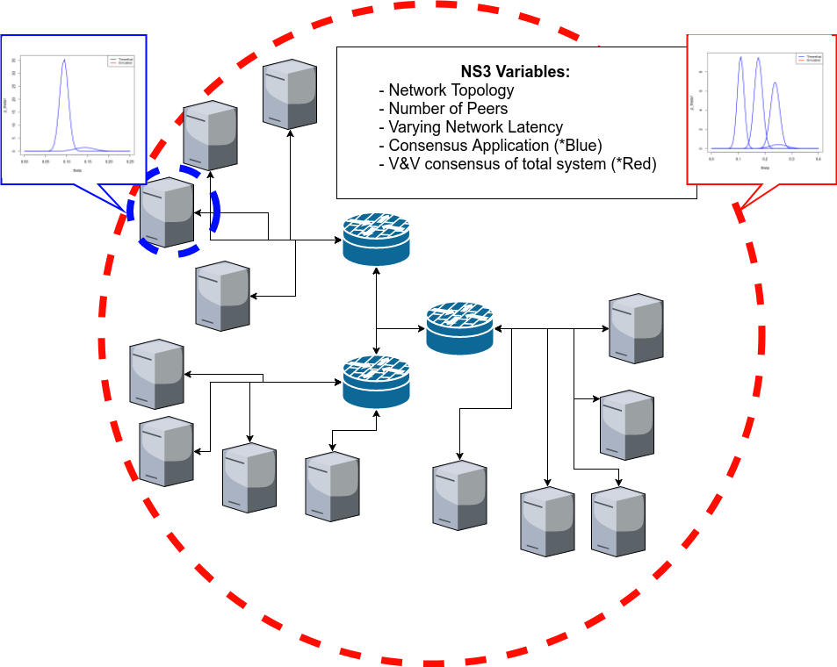
Architecture: NS3 Blockchain Simulation
Network Simulator 3
Can run many simulations fast (even for large scale)
Already models common network protocols that are used by blockchain systems
Handles realistic network delays and even disconnects based on environment variables
Allows for custom applications to be built on simulated nodes (consensus protocol)

Slide 16
NS3 Blockchain Simulation
Currently runs with proof of work consensus
Main output is block propagation delay
Secondary is transactions per second
Modifying it to work with other consensus algorithms
Solo consensus
Proof of Stake
Practical Byzantine Fault Tolerance (PBFT) and networked voting algorithms
Avalanche and probabilistic deriving algorithms
Gervais, Arthur, et al. "On the security and performance of proof of work blockchains." Proceedings of the 2016 ACM SIGSAC Conference on Computer and Communications Security. ACM, 2016.

