Slide 2
Have you ever had this issue?...
Notes:
Play a few snippets with hard to understand/ambiguous lyrics

Slide 3
Don’t be this guy…
Notes:
Insert video of someone singing totally off/misheard lyrics

Slide 4
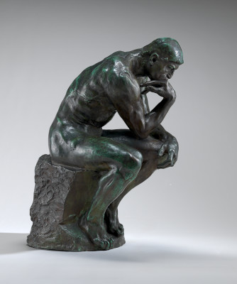

Maybe…
Notes:
“You are the philosophical type”….
“you prefer to examine the artistry from all angles”…

Slide 5

Or Maybe…
Notes:
Have image appear as animation

Slide 6
The answer is here….

Slide 7
Notes:
YouPhonics logo/design

Slide 8
Features
On Demand Video and Lyrics!
More fully experience the artist’s creativity
Develop and bring forth you inner star Power?...
YES!
Notes:
Consider making into separate slides to utilize animation/transitions
Consider including a funny picture

Slide 9
Technology
YouTube Data API v3
MusixMatch API
JavaScript Client Library
Notes:
YouTube Data API allows you to retrieve “resources” and incorporate functions normally associated with the YouTube website into your web application
MusixMatch API allows you to retrieve lyrics (among other data) associated with your favorite songs
JavaScript Client library provides authentication and supports the functioning of the YouTube API
We will then demonstrate the app…
This will segway into each person discussing their component/topic

Slide 10
Next steps/future development
Notes:
Provide an overview of some of the next steps to build/improve the app
Provide further talking points for brief individual discussion (potentially if time permits)
Firebase can be used to authenticate users which is a requirement if others or a non local host is utilized
A commerical account on musixmatch gives access to full lyrics for a song
More sophisticated keyword searching parameters could be used such as the “Freebase Topic” method or consider using an API that is more specialized to music/performance videos

