Slide 1

A VoxPop Worldwide Company
Winter 2012
L. Joshua Eikov, CEO
VoxPop Worldwide, Inc.

Slide 2




Summary
Entrepreneurial artists have more opportunities than ever to make it without the backing of a label and so many more ways to make money than in the past. The advent of the Internet has produced new sites and services that allow artists to get discovered, fund, produce, and market a CD, online and off; they can find their fans, set up a tour, sell merchandise and license their work. Consumers can find all types of music online and compare their tastes with others. They can stream for free, sample indefinitely, and communicate with other fans and artists.
Tranzistor Radio is a holding of VoxPop Worldwide Inc. (OTC: VOXI)
VoxPop is a public digital media holding company that is amassing a portfolio of products and services used to enhance brands and create selling opportunities for their customers using music and multimedia.
Our customers are corporations and their brands looking for new media enhancement, artists and musicians looking for exposure and digital asset managers looking for new opportunities.
Our solutions include the Tranzistor Radio Network, VoxBox branded internet radio, TagMango, KoolStart and MediaPal.

Slide 3
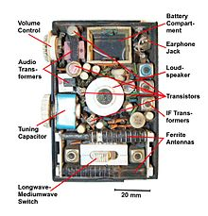

Tranzistor Radio: What is old is new again.
Creating A Simple Solution for Music and Digital Media Distribution
We have come a long way since 1954 with the development of computers, cell phones and now smartphones. Technology has advanced and along with it the various models for delivering news, entertainment and branding information. The amount of choice is staggering- but in all of this tremendous innovation the independent artist, the mass creative forces have relied on DIY (Do-it-yourself) models that have failed them and the consumer has been cheated.
Circa
1954
Circa
2012
Until now- Tranzistor Radio proposes a fusion
of old and new that exposes artists to new fans
and provides the possibility of increased sales
through online and mobile promotion.
Background | Market | Competition | Business Model | Financials | Exit Strategy

Slide 4
Market Data and Trends
Growing popularity of internet radio ensures high profit potential.
240.4 Million People Ages 14+*
29% Stream Online Audio^{t}
(Estimated Projections)
69.7 Million
Potential Listeners
664% Growth Potential
Source: Mintel, Tranzistor
Percent Online Radio Listeners of United States, Age 14+
$ 36 Subscription Fee
x 69.7M Potential Subscribers
71%
45.4%
29%
55.6%
$ 2.51 Billion Potential Market
2007
2012
*Source: CIA World Fact Book – July 2007
Background | Market | Competition | Business Model | Financials | Exit Strategy

Slide 5
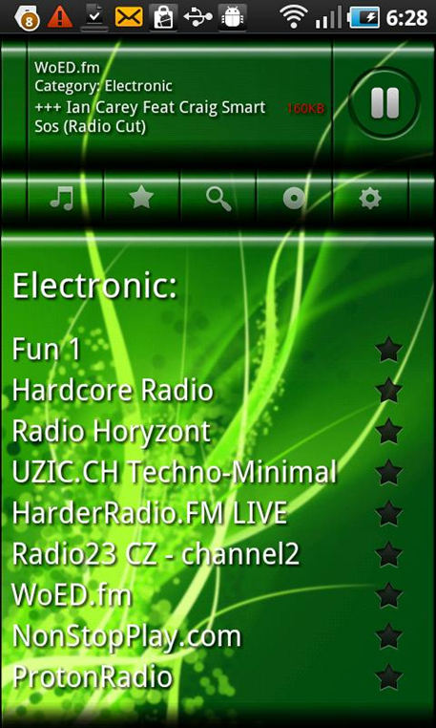
Features
Numerous features promise maximum user satisfaction.
Tranzistor PLAYER / RECORDER & MEDIA SERVER
Listen to Tranzistor stations.
Many SKINS included.
Bluetooth enabled on Livio™ Radio
Both Freemium and Subscription models.
Displays ARTIST, SONG and BITRATE
MEDIASERVER: Share MP3,MP4 and JPG Files within same WiFi.
Records everything in advance. If Record is active at the end of a session, the entire session is saved .
Multi-tab application with tabs for news, ecommerce and search.
Version 1.0
Background | Market | Competition | Business Model | Financials | Exit Strategy

Slide 6
Management & Investors
Experienced management team leads to Tranzistor’s success.
Phil Quartararo
Executive Chairman
  CEO, Warner Music
  CEO, Virgin Music
  EVP, EMI North America
L. Joshua Eikov
CEO
  4x Tech Entrepreneur
  CEO, Faceted Information Systems
  CEO, Digital Consumer Network
Jim O’Mahony
CMO
  CEO, Saatchi & Saatchi (Ex America)
  CEO, Lion Nathan
  Founder, fixit
Martha Snider
CBDO
  CEO, CeeLite Technologies Inc.
  Executive Operations, Comcast-Spectracor
  Policy Advisor for Arts and Culture, State of Pennsylvania
Kyle Siptroth
CTO
  Associate, Booze-Allen Hamilton
  Consultant, US Defense Department
  Director, Northrup Grumman
  Manager, Intersil
Background | Market | Competition | Business Model | Financials | Exit Strategy

Slide 7

Competitive Positioning
Tranzistor’s industry offers the most cost-attractive and convenient way to listen to music.
Streaming Radio Stations
Digital Audio Downloads
CDs
Cost
Free or low cost
subscription option
Free or
subscription option
Charge per song purchased
Full CD purchase
Quality of Service
Hand built, programmed radio. Ability to buy music, merch, tix and get background info on artists in one application.
Some customized music, select providers will link to similar artists
Songs on demand, search may provide similar artists
Provides only purchased music
Loyalty (Fan Base)
Customers will return to hear programming and indie music unavailable on other services as well as loyalty program points.
Inconsistent because users float between preset radio stations
Easy to purchase music from any provider
Dependent on loyalty to artist
Difficulty in replicating programming and music curation.
Small product differentiation
Several sites available (i.e. Amazon, iTunes, Napster)
Copyright, easily open to infringement
Duplicability
Poor
Good
Background | Market | Competition | Business Model | Financials | Exit Strategy

Slide 8



Competitor Analysis
Tranzistor beats its strongest competitors across all industries.
Type
Advantages
Disadvantages
Individual song analysis
Free to use online
User friendly interface
Portable option
Limited usage of “Next
Track” option
No song search capability
Personalized Radio
Complex user interface
Recommendations requires
software download
Radio based on genre
Widespread use
Social networking
User Radio
Preset stations only
Subscription fee
Stations don’t play desired
music
Streaming Radio
Brand-name recognition
Portable
Cost per individual song
Many alternatives
Only accessible for credit
card holders
Digital Downloads
Portable
Song search capability
Background | Market | Competition | Business Model | Financials | Exit Strategy

Slide 9
User Acquisition
Expansion opportunities: Offer more products to more people in more places.
Current Method
Viral Growth
Word of mouth
Personalized emails
Blogs, Facebook
Partnerships
Amazon, iTunes
Mobile Services
Sonos, other devices
Search Marketing
Go after music lovers
Cater ads to market
Expansion Plans
Direct Advertising
Music forums
Distribution Partners
Lead generation/Affinity
Groups
Fan clubs, concerts,
Ticket distributors
Go International
Obtain cross-border
licenses
Expand service to include
international music
Set up stations abroad
New Products
Tranzistor independent of
computers
Distribute on other networks
Continue to expand database
Background | Market | Competition | Business Model | Financials | Exit Strategy

Slide 10

Business Model
Multiple revenue streams guarantee continuously increasing earnings.
User Methods
Partnering Platforms
Ad Partners
Annual subscriptions to Tranzistor
Mobile devices
Home entertainment systems
Car radios
Advertisements on Tranzistor
Subscription revenue
Advertising revenue
Expansion Outlook
Increased subscription revenue + High scalability = High profit potential
Background | Market | Competition | Business Model | Financials | Exit Strategy

Slide 11
Exit Strategy
Acquirers attracted by Tranzistor’s loyal user base and a high expected ROI.
Broadcasting Companies
Media Players
Online Radio Stations
Incorporates Tranzistor’s loyal listener community into specific broadcasting networks.
Allows users to easily discover new music and download directly into media players, producing increased profits.
Transforms impersonalized radio service into one that caters to specific user preferences, expanding user base.
Potential Acquirers
Clear Channel
Cumulus Broadcasting
Citadel Broadcasting
Apple iTunes
Amazon MP3
Napster
MSN Radio
AOL Radio
Yahoo! Music
S-1 Offering
  Goal: Expand existing market base and revenue model in order to obtain financial and strategic position as excellent investment opportunity for public market investors.
Background | Market | Competition | Business Model | Financials | Exit Strategy
Notes:
-

Slide 12
Risks and Precautions
Risks
Precautions
New competitors
Develop name recognition through unique product offering; competitors unlikely to offer better product
Lack of user interest
Develop user community through social networks and forums; emphasize mobile applications
Existing competitors adding similar features
Technology patents not secured; effect of Tranzistor’s music-analysis difficult to duplicate digitally
Decreasing user base
Current user base is strong and growing quickly; integrate other advertising mediums

Slide 13
External Factors
Increase in Online Trend
People continue to consume music online (more inline than offline) due to fast lifestyles and culture.
CD players increasingly seen as bulky and inefficient in comparison to online music.
Decrease in CD Purchases
Increase in Music Downloads
People prefer instant access and ease of getting music virtually.
Increase in
Use of Online Radio
Music trend to digital – plays into Tranzistor’s business model.
Increase in Popularity and Use of Tranzistor

Slide 14
Market Trend Calculations
29% of US Population 14+ uses Streaming Audio†
÷
75.7% of US Population 14+ uses the Internet † †
39% of Internet users use Streaming Audio
 | %
I listen to streaming music content | 29
I pay to download songs from stores such as iTunes | 18
I download songs for free from sites such as myspace | 13
I subscribe to an Internet monthly music service | 6
Base: 24,438 adults
† : Source: Mintel
† †: Source: Mintel, CIA World Factbook

Slide 15
Special Thanks and Sources
Rob Miller, VP of Content and Radio Operations, VoxPop Worldwide, Inc.
Martha McGeary Snider, Chief Business Development Officer, VoxPop Worldwide Inc.
International Telecommunications Union/World Bank/Trade
Sources/Euromonitor International
Mike Zappert, 3i
US Census
www.ciaworldfactbook.gov
www.mintel.com
www.secinfo.com
www.sirius.com
www.xmradio.com
Rosa and Bella

