Slide 1

MS OPD
Farmasi Pesakit Luar, Hospital Segamat
Muhammad Redzuan bin Zulkifli (RPh 14205)

Slide 2
Pengenalan
Sistem ini dipasang di Farmasi Pesakit Luar
Purata jumlah pesakit 400-800 sehari (pesakit klinik dan discaj)
Pada waktu puncak boleh mencecah 120 pesakit sejam
Pemberian nombor secara manual (buku tiket, 4 atau 5 digit)
1 salinan diserah kepada pesakit, 1 lagi dikepil bersama preskripsi
Preskripsi tersebut akan melalui proses saringan, transkrib, filling, labelling, checking dan akhir sekali dispensing.
Nombor akan dipanggil semasa proses dispensing
Nombor tersebut juga digunakan sebagai patient identifier (bersama nama penuh, no ic/tarikh lahir, dan lain-lain)

Slide 3
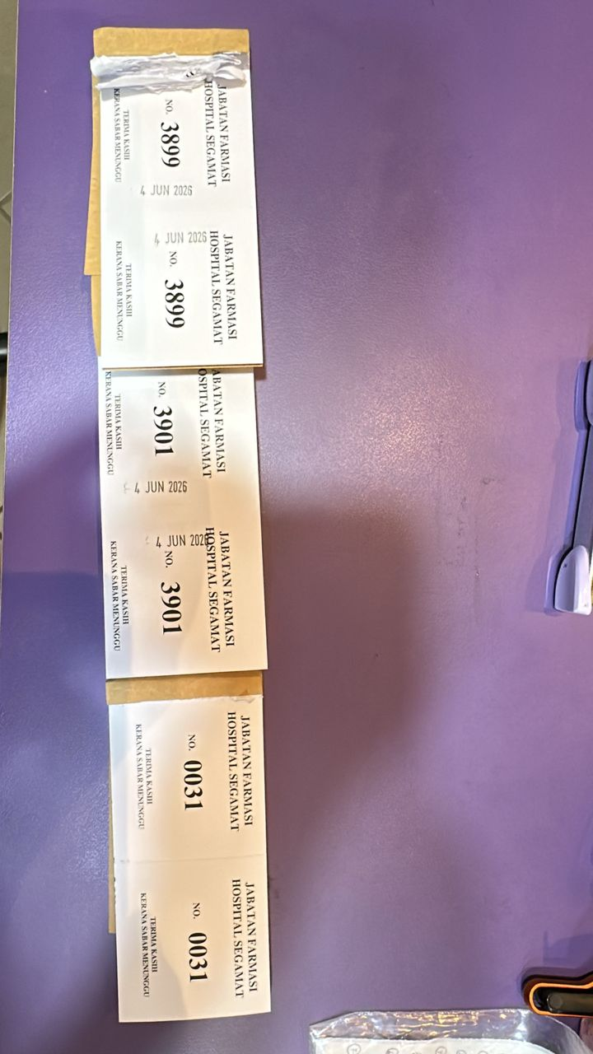
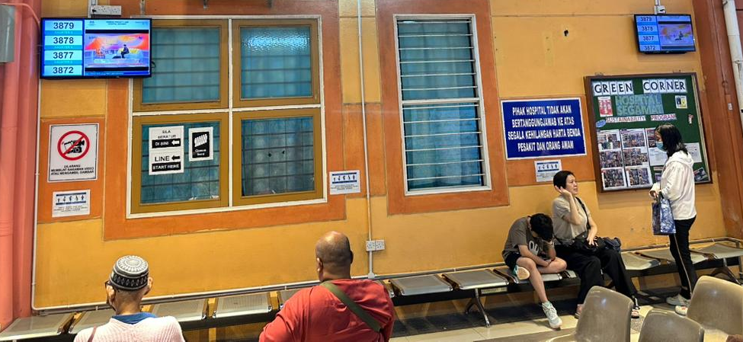
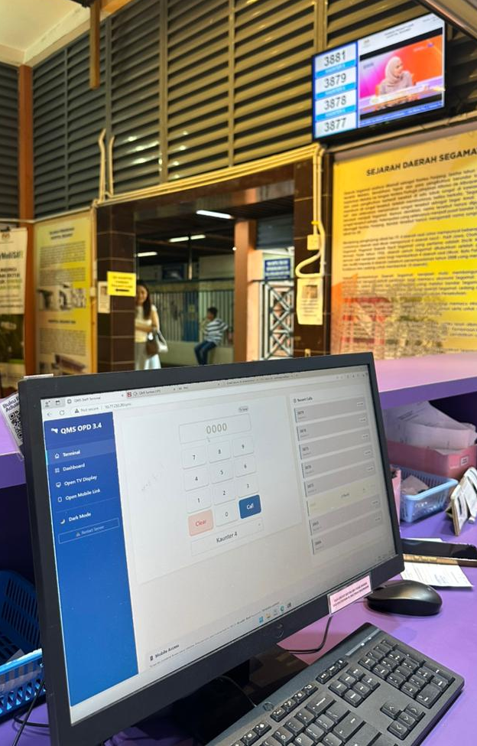
FARMASI PESAKIT LUAR
Kaunter Nombor
Farmasi
Pesakit Beratur
Ruang Menunggu
Kaunter Dispens

Slide 4
FARMASI PESAKIT LUAR
Kaunter Nombor
Farmasi
1 - Pesakit dapatkan nombor panggilan
2 - Proses preskripsi
3 - Dispensing - panggil nombor menggunakan terminal - nombor akan dipapar dalam display / mobile-link
4 - Pesakit datang ambil ubat, Jika pesakit tiada - ketepikan/simpan bakul ubat
5 - Jika pesakit datang bertanya status nombor, staff akan semak dalam sistem
5.5 - Pesakit juga boleh semak sendiri menggunakan QR code Mobile-Link yang (akan) disediakan
Pesakit Beratur
Ruang Menunggu
Kaunter Dispens

Slide 5
Software Architecture
Mobile-Link
Google Firebase
Internet
Intranet
Intranet
Websocket
Websocket
CSV file
(Temporary Database)
Terminal
Dashboard
Display
Backend Server
(Python, Flask, Socket.IO, eventlet)
Staff Farmasi
Pesakit

Slide 6
Setup 1 – Host di Local Server ICT
LAN
LAN
HDMI
Intranet Network
PC
Desktop
TV
WIFI
Access Point
hsgmt20
Pesakit
Mobile
Kaunter Farmasi
Bilik Server ICT
Ruang Menunggu

Slide 7
Setup 2 – Host di PC Kaunter Farmasi
HDMI
LAN
Intranet Network
Desktop*
TV
*perlu ada 2 display output
WIFI
Access Point
Pesakit
Mobile
Kaunter Farmasi
Ruang Menunggu

Slide 8
System Requirements (Server)
Hardware | Minimum | Recommended
CPU | Dual-core 1.6 GHz | Quad-core 2.0 GHz+
RAM | 2 GB | 4 GB
Storage | 500 MB free (OS + app) | 2 GB+ (for media video files)
Network | Wired LAN (100 Mbps) | Gigabit LAN
Display Output | 1 port (if not using as client) | 2 ports (if used as terminal+display)
Software | Version | Notes
OS | Windows 7-11 / any linux distro | Linux will have slightly different setup procedure
Python | 3.8 or later | 3.11+ recommended
pip | Latest | Installed with Python
git | Latest | Required for auto-update feature
Chrome/Browser | Latest | Required for terminal & tv display

Slide 9
4 Modul Utama
Terminal
Display
Dashboard
Mobile-Link
Staff Farmasi
Pesakit

Slide 10
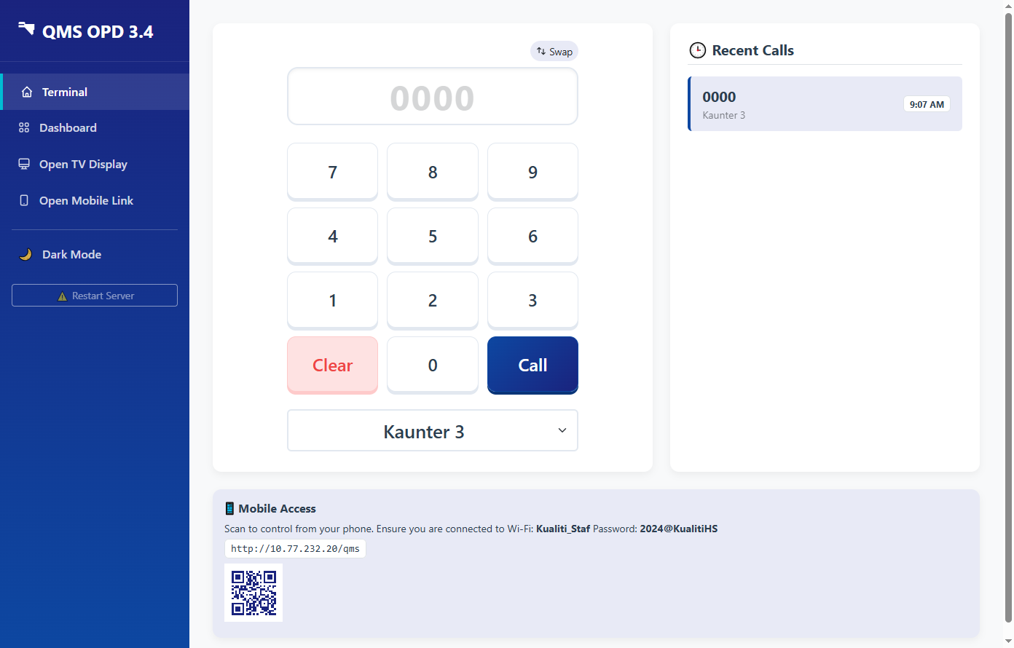
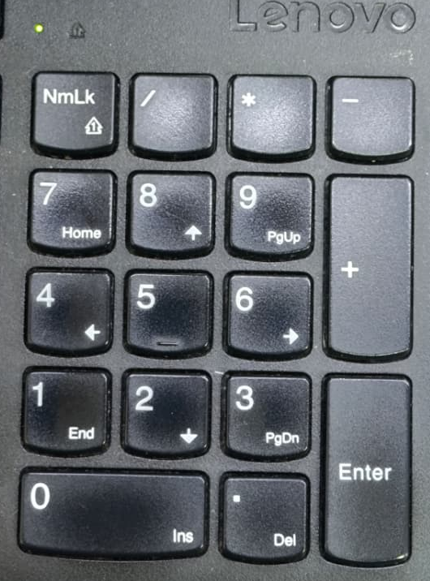
Features :
Quick Counter Change (press [+], number)
Swappable Keypad Layout
Key Event Listener enabled (can type anywhere without clicking on the input box)
QMS TERMINAL
(Desktop View)

Slide 11
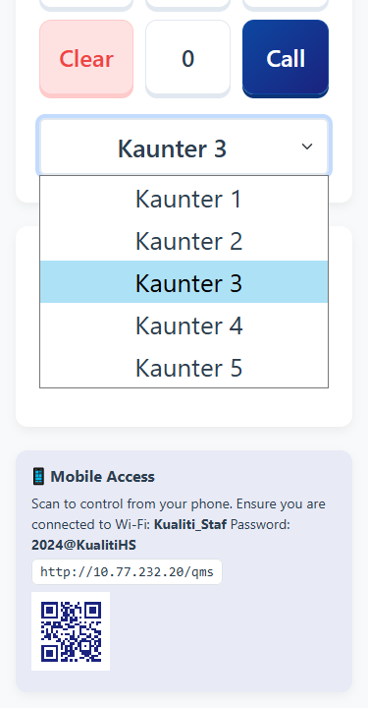
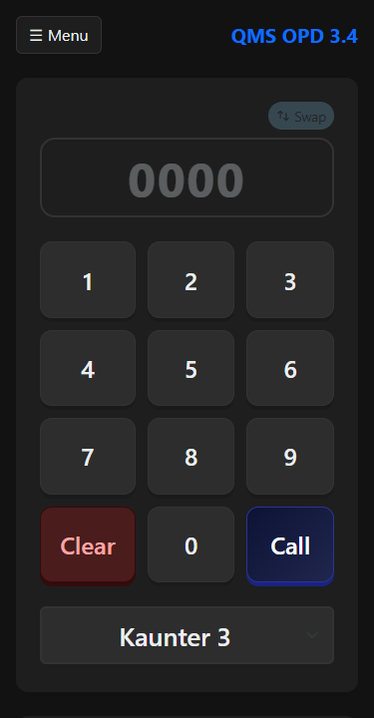
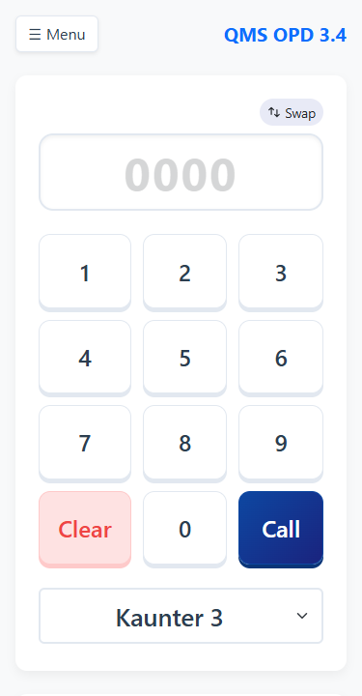
QMS TERMINAL
(Mobile Display)
Features :
Responsive Design (Auto resize on mobile device) Wakelock Build-in (Device will not go to sleep when active)
Dark Mode available (to save power for oled device)

Slide 12
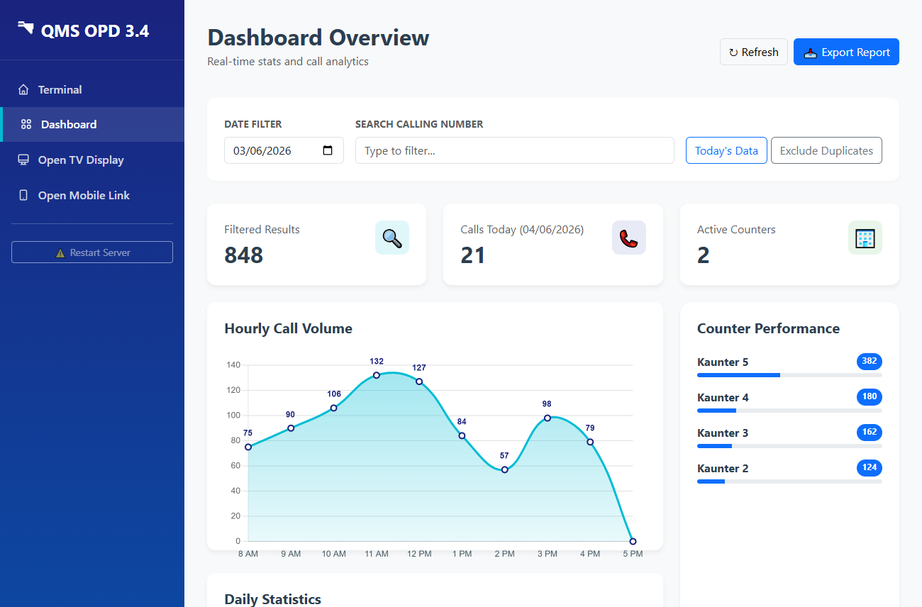
Export function
Search for called number
View Past Data
(up to 1 month)
DASHBOARD VIEW
(For Counter Staff)
View call volume per hour

Slide 13
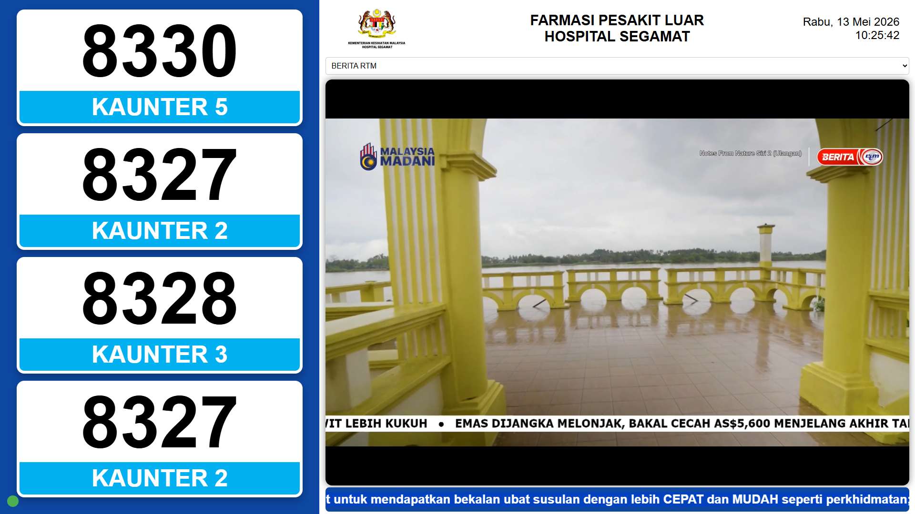
TV DISPLAY
(Ruang Menunggu)
Paparan sama seperti SeQue

Slide 14
TV DISPLAY
(Ruang Menunggu)
Semasa Waktu Puncak :
120 panggilan dalam tempoh 60 minit
1 panggilan setiap 30 saat
Display hanya paparkan 4 nombor pada satu masa
secara purata 1 nombor dipaparkan selama 2 minit sahaja

Slide 15
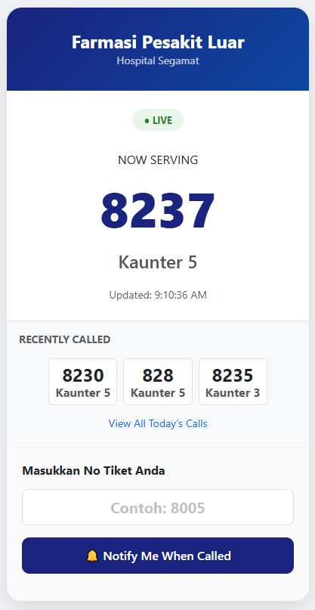
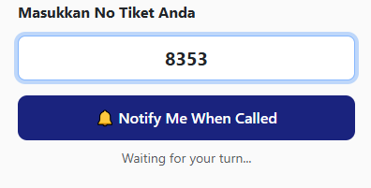
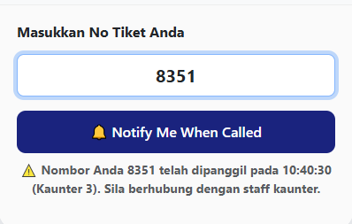
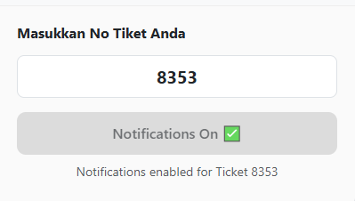

1. No Panggilan Belum Dipanggil
3. No Panggilan telah lepas
MOBILE-LINK
2. Daftar untuk Notification
(For Patient)
Features :
Pesakit boleh semak status nombor panggilan.
Jika belum dipanggil, pesakit boleh klik button utk mendapatkan notification
Jika nombor telah dipanggil, sistem akan maklumkan masa dan kaunter panggilan
Boleh diakses dari mana-mana (internet)

Slide 16
Additional Helper Script
(For Windows PC connected to Display TV in Extended Mode Only)
<batch file>
START "" "C:\Program Files\Google\Chrome\Application\chrome.exe" ^
--user-data-dir="C:\ChromeKiosk" ^
--kiosk ^
--window-position=1920,0 ^
--autoplay-policy=no-user-gesture-required ^
--no-first-run ^
--disable-infobars ^
--disable-session-crashed-bubble ^
"http://<your local ip>:5000/display?kiosk=true"
Save this as bat file and set to run in Task Scheduler - trigger start at logon
This script assumes extended display is on right side after 1920x1080 monitor.
This script will automatically load the queue display page on connected tv on every startup

Slide 17
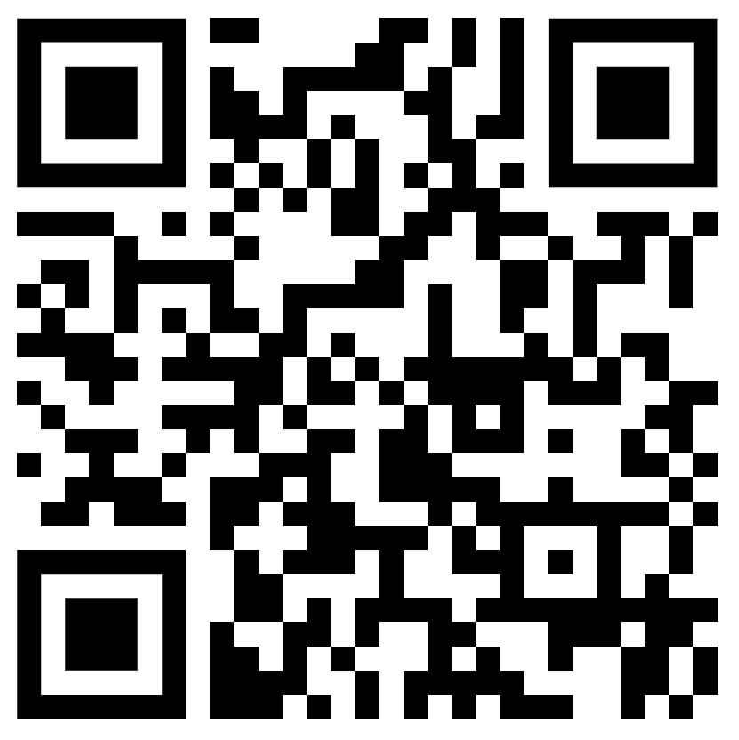
Live Demo {QMS Server}
(Served from a test server)
QMS Terminal
http://backuphs.duckdns.org/qms
QMS Display
http://backuphs.duckdns.org/qms/display

Slide 18
Terima Kasih

