Slide 1

MS OPD
Farmasi Pesakit Luar, Hospital Segamat
Muhammad Redzuan bin Zulkifli (RPh 14205)

Slide 2
System Architecture
Mobile-Link
Google Firebase API
Websocket
Websocket
Terminal
Dashboard
Display
Backend Server
(Python, Flask, Socket.IO, eventlet)

Slide 3
Setup 1 – Host di Local Server ICT
LAN
LAN
HDMI
Intranet Network
PC
Desktop
TV
WIFI
Access Point
Local Server
Pesakit
Mobile
Kaunter Farmasi
Bilik Server ICT
Ruang Menunggu

Slide 4
Setup 2 – Host di PC Kaunter Farmasi
HDMI
LAN
Intranet Network
Desktop*
TV
*perlu ada 2 display output
WIFI
Access Point
Pesakit
Mobile
Kaunter Farmasi
Ruang Menunggu

Slide 5
System Requirements
Hardware | Minimum | Recommended
CPU | Dual-core 1.6 GHz | Quad-core 2.0 GHz+
RAM | 2 GB | 4 GB
Storage | 500 MB free (OS + app) | 2 GB+ (for media video files)
Network | Wired LAN (100 Mbps) | Gigabit LAN
Display Output | 1 port (if served on another server) | 2 hdmi ports (terminal + display)
Software | Version | Notes
OS | Windows 7-11 / any linux distro | Linux will have slightly different setup process
Python | 3.8 or later | 3.11+ recommended
pip | Latest | Installed with Python
git | Latest | Required for auto-update feature
Chrome/Browser | Latest | Required for terminal & tv display

Slide 6
Main Modules
Terminal
Dashboard
TV Display
Mobile-Link

Slide 7
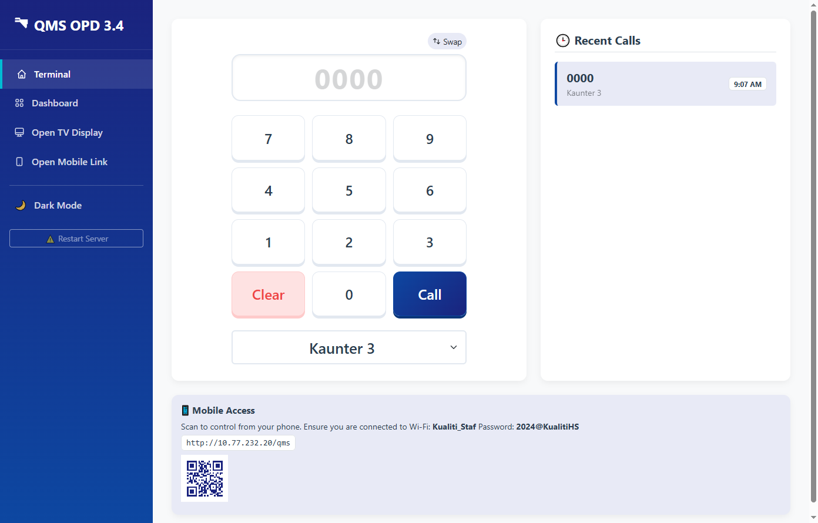
Features :
Quick Counter Change (press [+], counter number)
Swappable Keypad Layout
Key Event Listener enabled (can type anywhere without clicking on the input box)
QMS TERMINAL
(Desktop View)

Slide 8
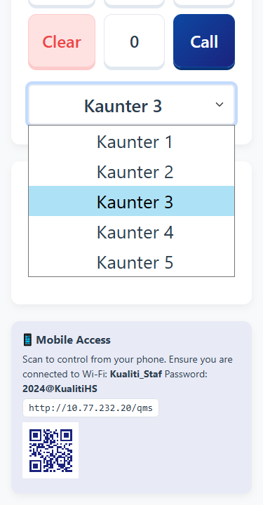
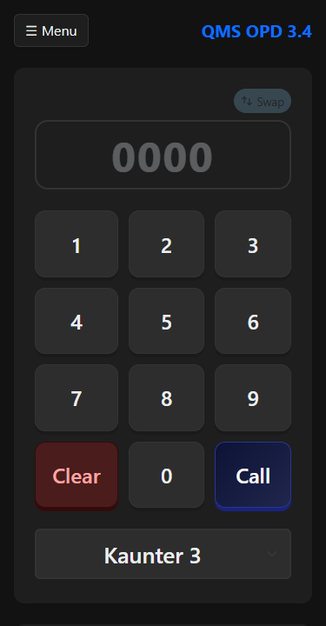
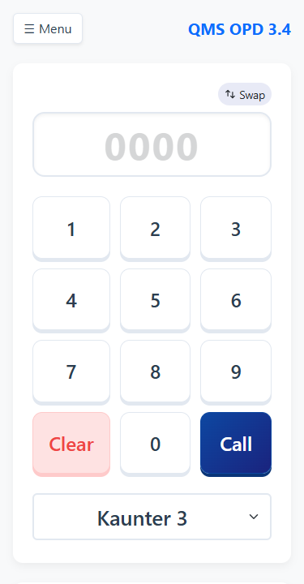
QMS TERMINAL
(Mobile Display)
Features :
Responsive Design (Auto resize on mobile device) Wakelock Build-in (Device will not go to sleep when active)
Dark Mode available (to save power for oled device)

Slide 9
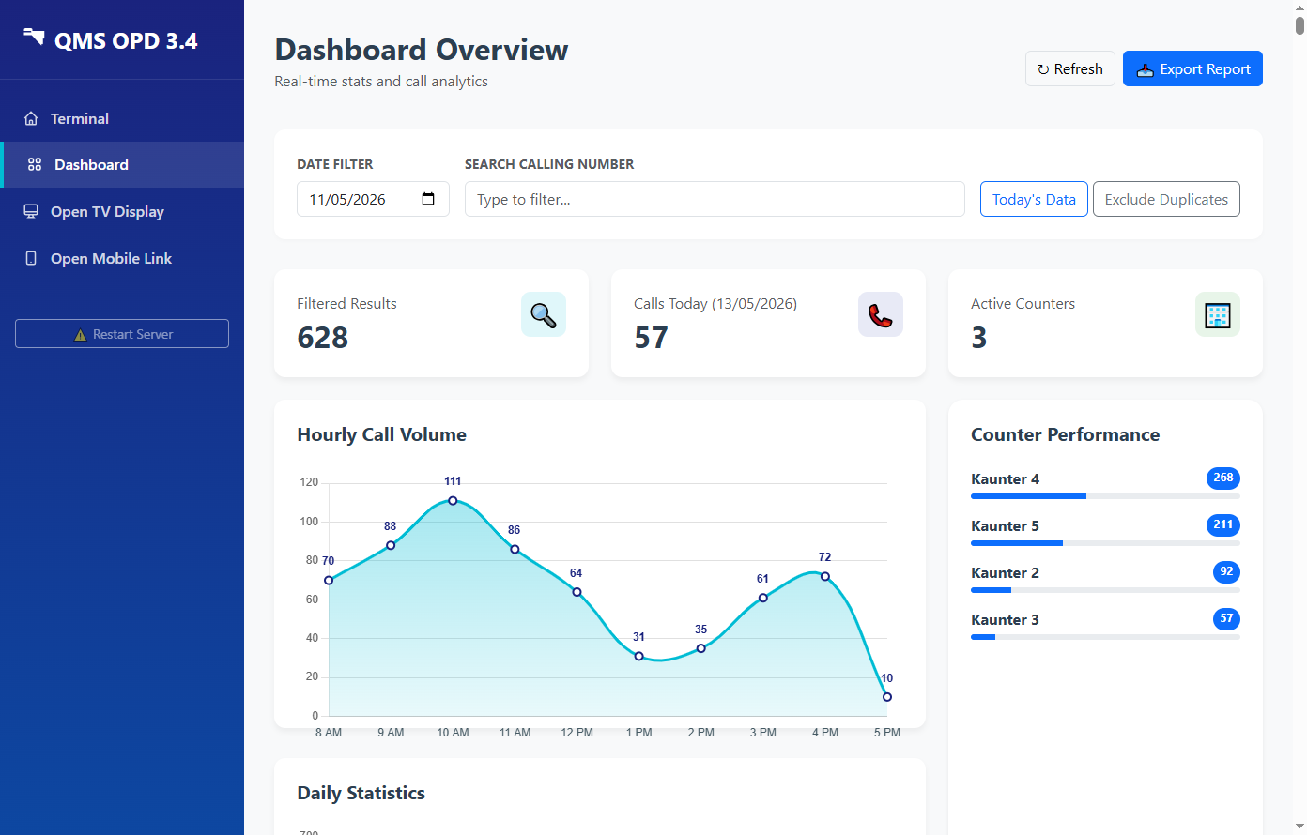
Search for called number
DASHBOARD VIEW
(For Counter Staff)
View call volume per hour

Slide 10
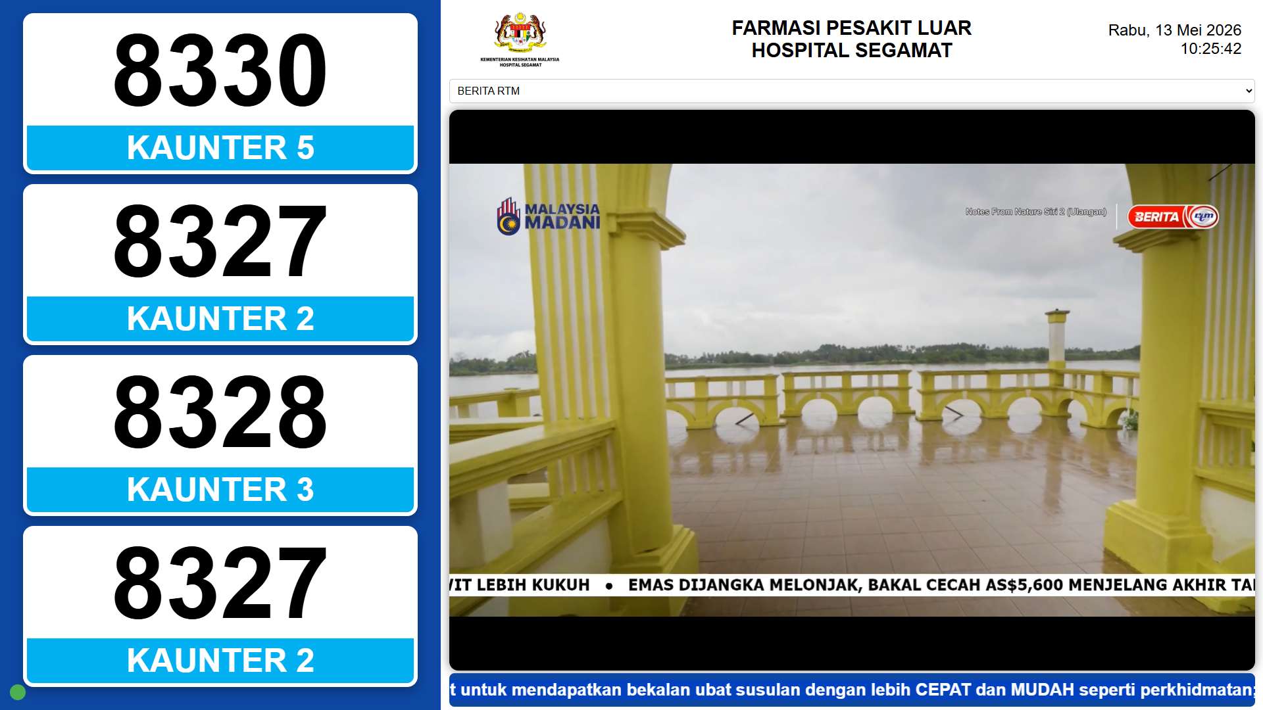
TV DISPLAY
(Ruang Menunggu)

Slide 11
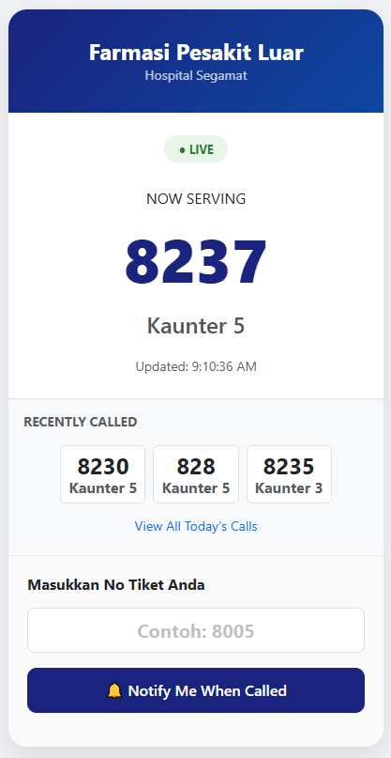
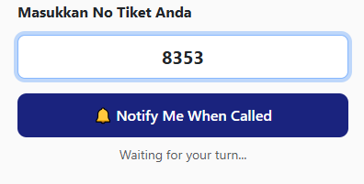
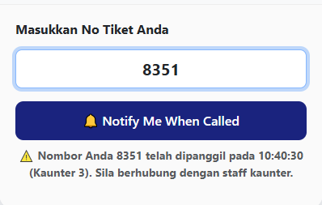
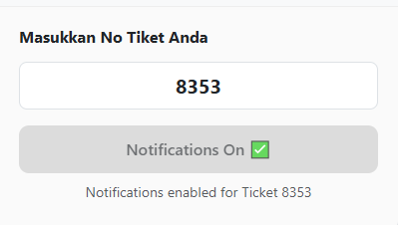
1. No Panggilan Belum Dipanggil
3. No Panggilan telah lepas
2. Daftar untuk Notification
MOBILE LINK
(For Patient)
Features :
Pesakit boleh semak status nombor panggilan.
Jika belum dipanggil, pesakit boleh klik utk mendapatkan notification
Jika telah dipanggil, sistem akan maklumkan masa dan kaunter panggilan
Boleh diakses dari mana-mana

Slide 12
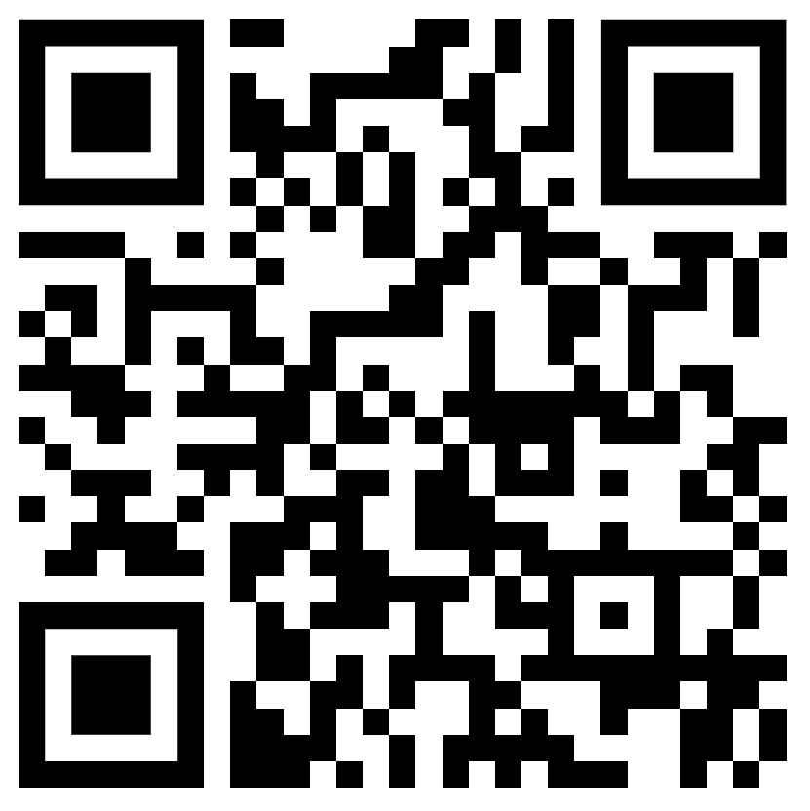
Live Demo {QMS Server}
(Served from a test server)
QMS Terminal
http://backuphs.duckdns.org/qms
QMS Display
http://backuphs.duckdns.org/qms/display

Slide 13
Additional Helper Script
(For Windows PC connected to Display TV in Extended Mode Only)
<batch file>
START "" "C:\Program Files\Google\Chrome\Application\chrome.exe" ^
--user-data-dir="C:\ChromeKiosk" ^
--kiosk ^
--window-position=1920,0 ^
--autoplay-policy=no-user-gesture-required ^
--no-first-run ^
--disable-infobars ^
--disable-session-crashed-bubble ^
"http://<your local ip>:5000/display?kiosk=true"
Save this as bat file and set to run in Task Scheduler - trigger start at logon
This script assumes extended display is on right side after 1920x1080 monitor.
This script will automatically load the queue display page on connected tv on every startup

