Slide 1
how to choose
a road bicycle
Peter Froud
Notes:
Presentation is about how to use engineer-style thinking to approach a real-world problem, in this case how to choose a bicycle.

Slide 2
origins
Notes:
I started this project in May 2015, when I had the idea and wanted to see what it looked like.

Slide 3
problem
Notes:
We’ll look at the problem,...

Slide 4
problem
deconstruction
Notes:
...how I broke it down,...

Slide 5
problem
deconstruction
visualization
Notes:
...how I visualized

Slide 6
problem
deconstruction
visualization
discussion

Slide 7
problem
deconstruction
visualization
discussion

Slide 10


Slide 11


Slide 12


Slide 14
CAAD8
CAAD12
SuperSix EVO
SuperSix EVO Hi-Mod
Synapse
Synapse Carbon

Slide 15
CAAD8
CAAD12
SuperSix EVO
SuperSix EVO Hi-Mod
Synapse
Synapse Carbon
105
Claris
Sora
Tiagra

Slide 16
CAAD8
CAAD12
SuperSix EVO
SuperSix EVO Hi-Mod
Synapse
Synapse Carbon
105
Disc 105
Disc Ultegra
Disc Ultegra Di2
Tiagra
Ultegra 3
Ultegra 4
Hi-MOD Disc Black Inc.
Hi-MOD Disc Red
Hi-MOD Disc Ultegra
Hi-MOD Dura Ace

Slide 18
Defy
Defy Disc
Defy Advanced
Defy Advanced Pro
Defy Advanced SL
TCR Advanced
TCR Advanced Pro
TCR Advanced SL
Propel Advanced
Propel Advanced Pro
Propel Advanced SL

Slide 19
Allez
Amira
Diverge
Dolce
Roubaix
Ruby
Tarmac
Venge

Slide 20
Sprint X2 Specialized Edition
Sprint X1 Specialized Edition
DSW Sprint X1 Expert
DSW Sprint X1 Comp
DSW SL Expert
DSW SL Comp
DSW Elite
E5 Sport
E5
Allez
Amira
Diverge
Dolce
Roubaix
Ruby
Tarmac
Venge

Slide 21
Emonda
Emonda ALR
Madone
1 Series
Domane

Slide 22
S 4
S 5
S 6
SL 5
SL 6
SL 8
SL 8 RED
SLR 10
SLR 6
SLR 8
SLR 9
Emonda
Emonda ALR
Madone
1 Series
Domane

Slide 25
190

Slide 27
insight

Slide 28
problem
deconstruction
visualization
discussion

Slide 29
problem
deconstruction
visualization
discussion

Slide 31
value

Slide 32
price
value
performance

Slide 33
price
value
performance

Slide 34
price
value
performance

Slide 35
price
value
material
performance
components

Slide 36
price
value
material
performance
components

Slide 37
carbon fiber

Slide 38
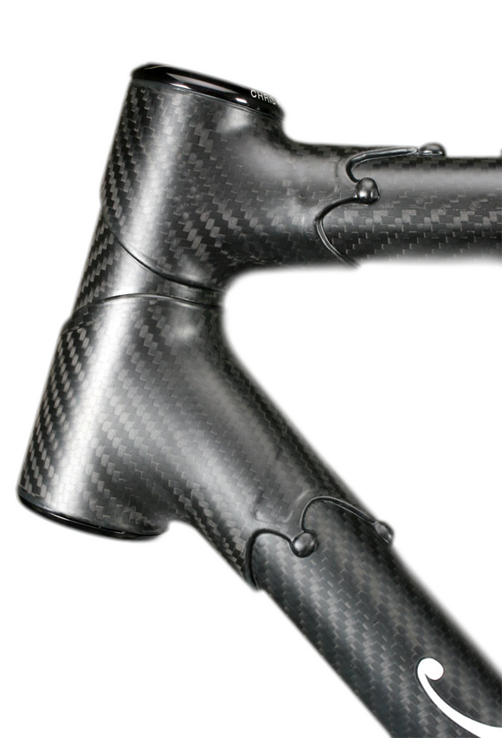

Slide 39


Slide 40
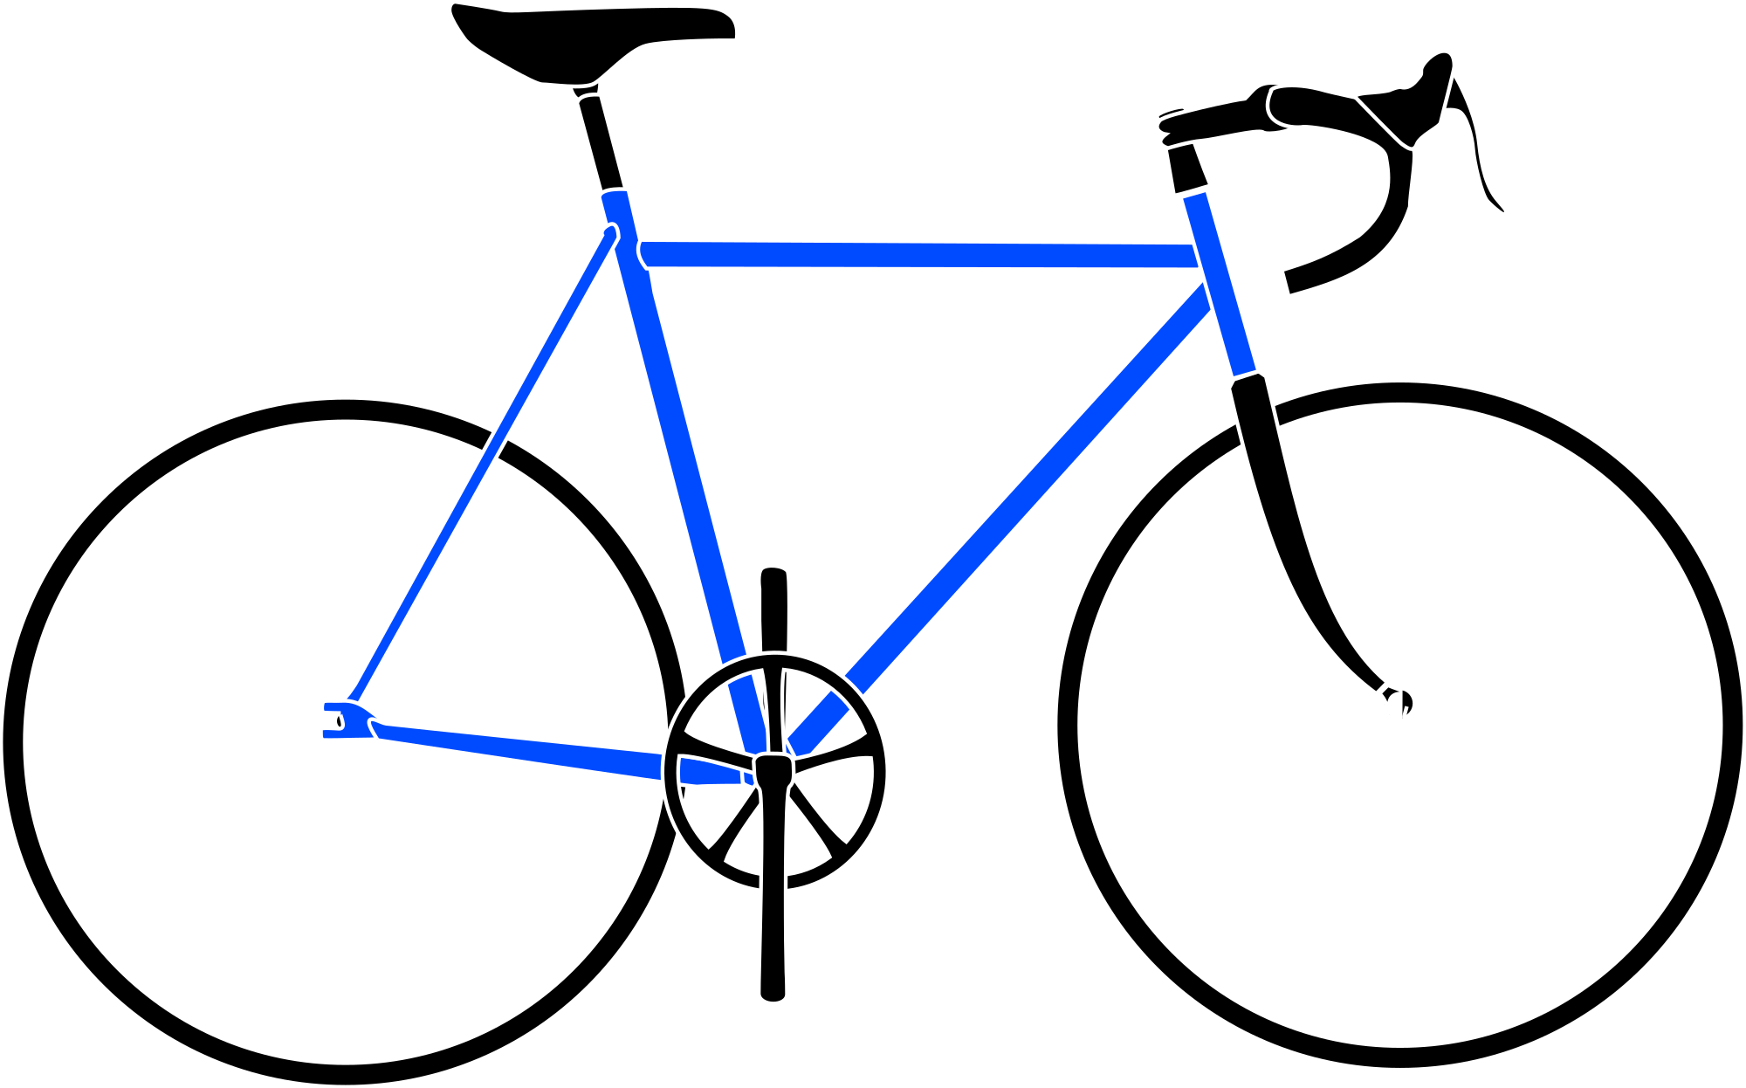
frame

Slide 41

fork

Slide 42
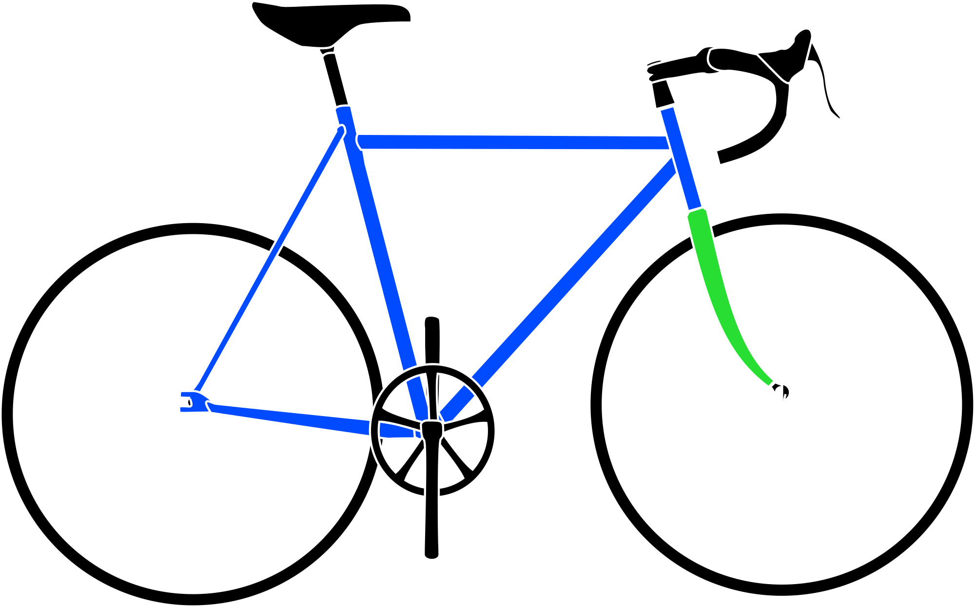
frame
fork

Slide 43
price
value
material
performance
components

Slide 44
price
all
fork
none
value
material
performance
components

Slide 45
price
value
material
performance
components

Slide 46
price
value
material
performance
components

Slide 47
groupset

Slide 48
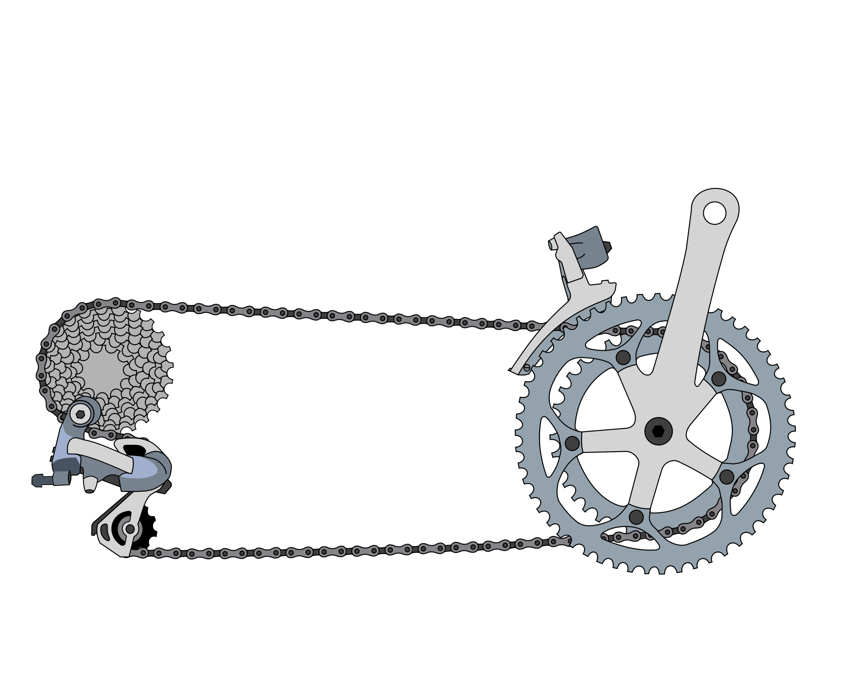

Slide 49


Slide 50
race
enthusiast
entry-level

Slide 51
race
enthusiast
entry-level
Dura-Ace Di2
Dura-Ace
Ultegra Di2
Ultegra
105
Tiagra
Sora
Claris

Slide 52
price
value
material
performance
components

Slide 53
price
Dura-Ace Di2
Dura-Ace
Ultegra Di2
Ultegra
105
Tiagra
Sora
Claris
value
material
performance
components

Slide 54
price
value
performance

Slide 55
value

Slide 56
problem
deconstruction
visualization
discussion

Slide 57
problem
deconstruction
visualization
discussion

Slide 58
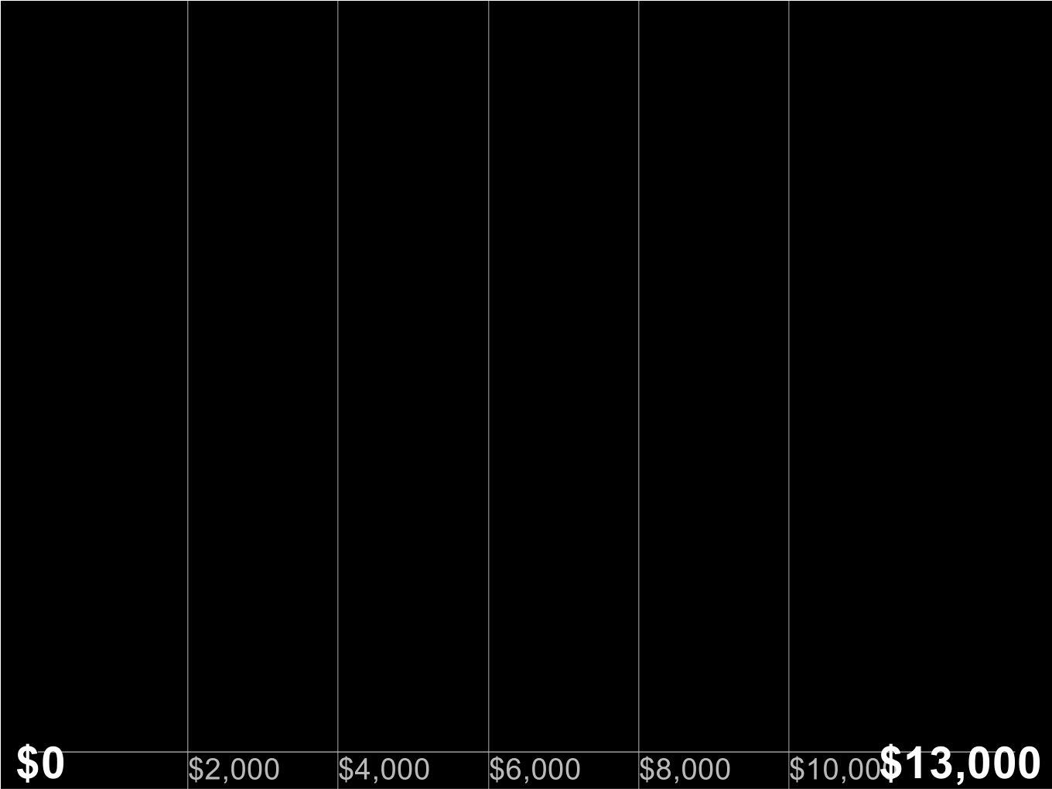

Slide 59
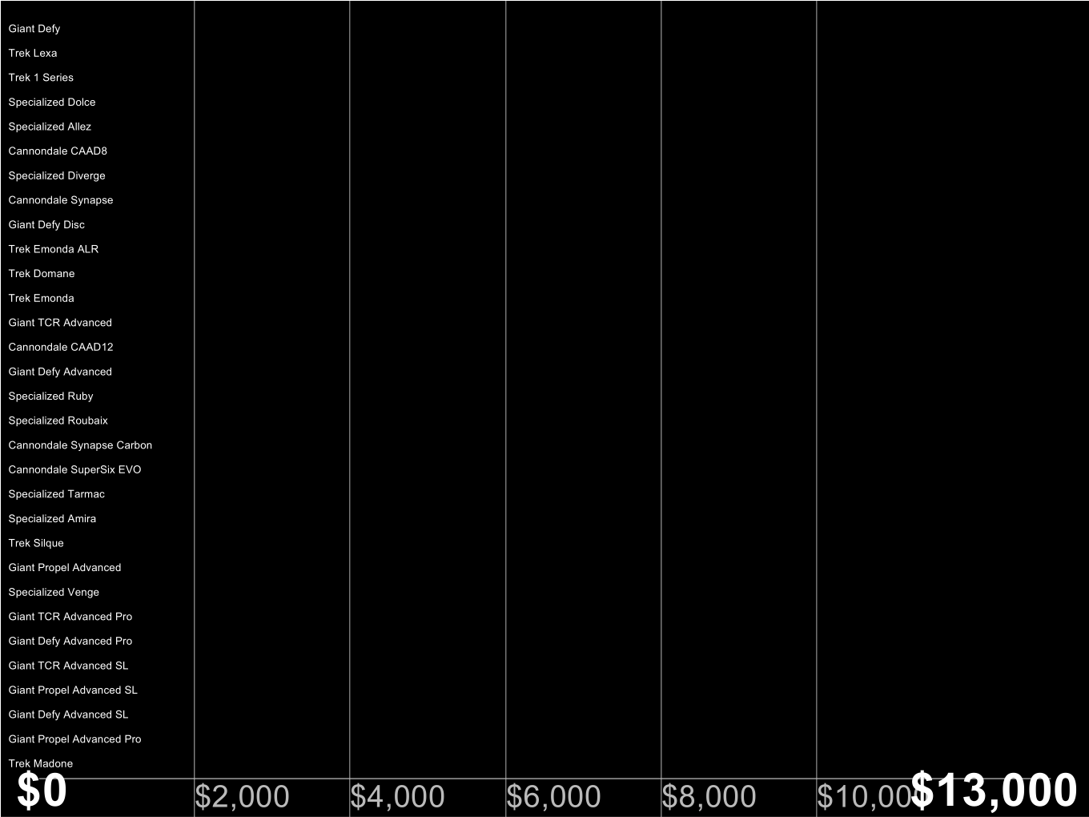

Slide 60
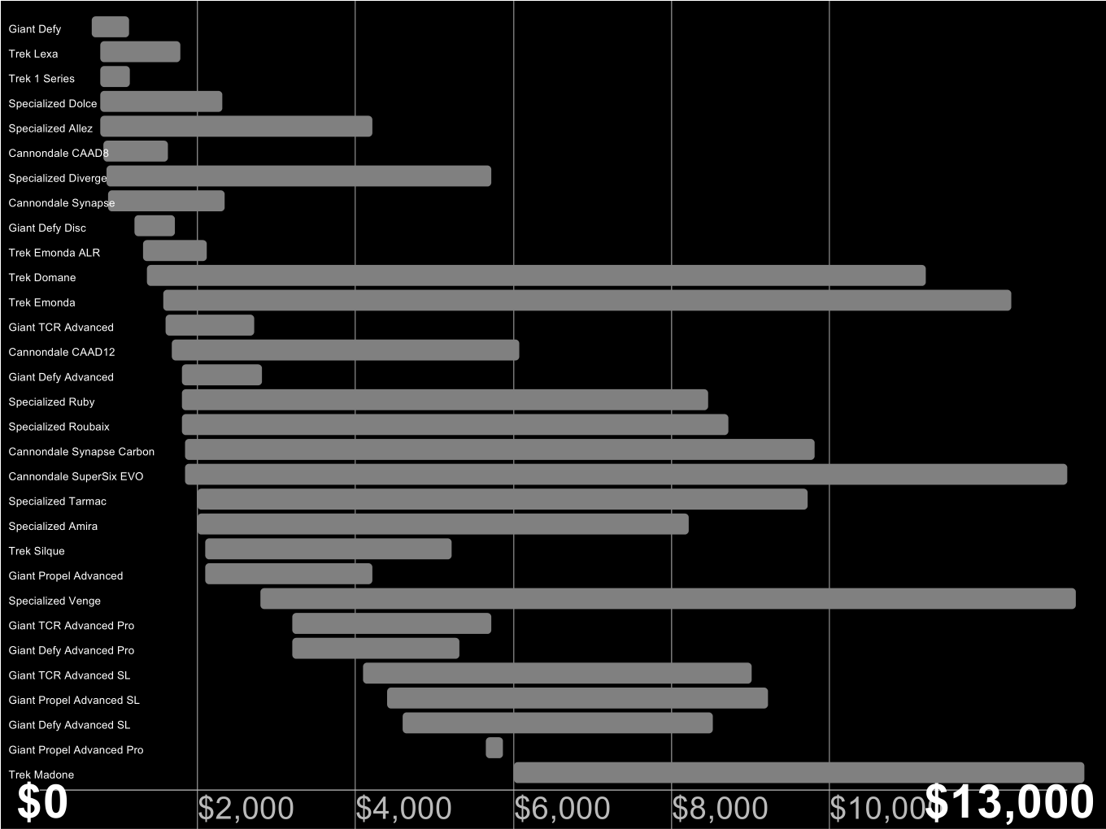

Slide 61
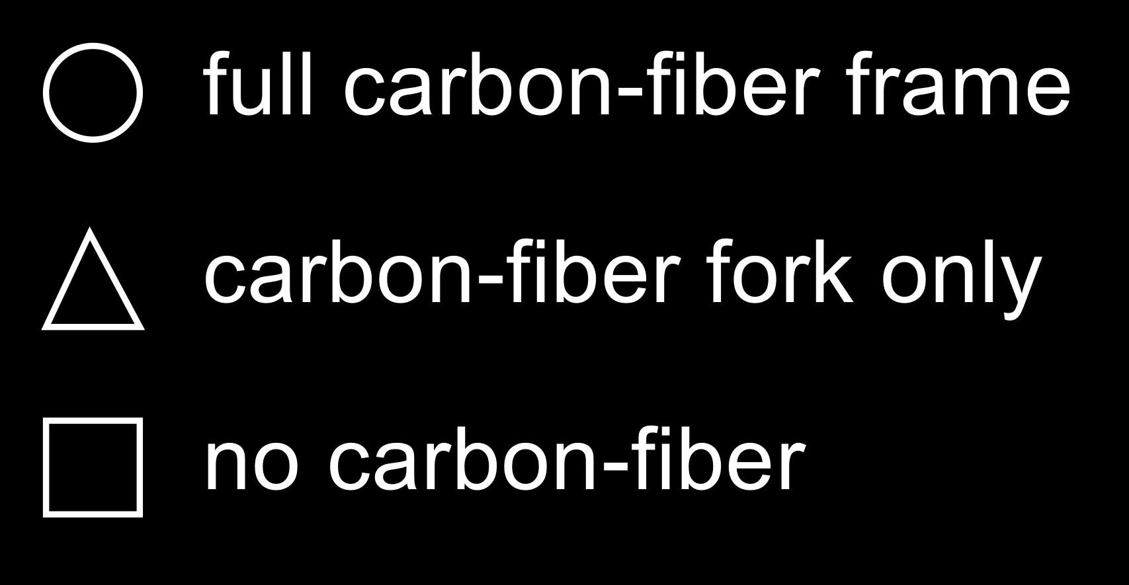

Slide 62
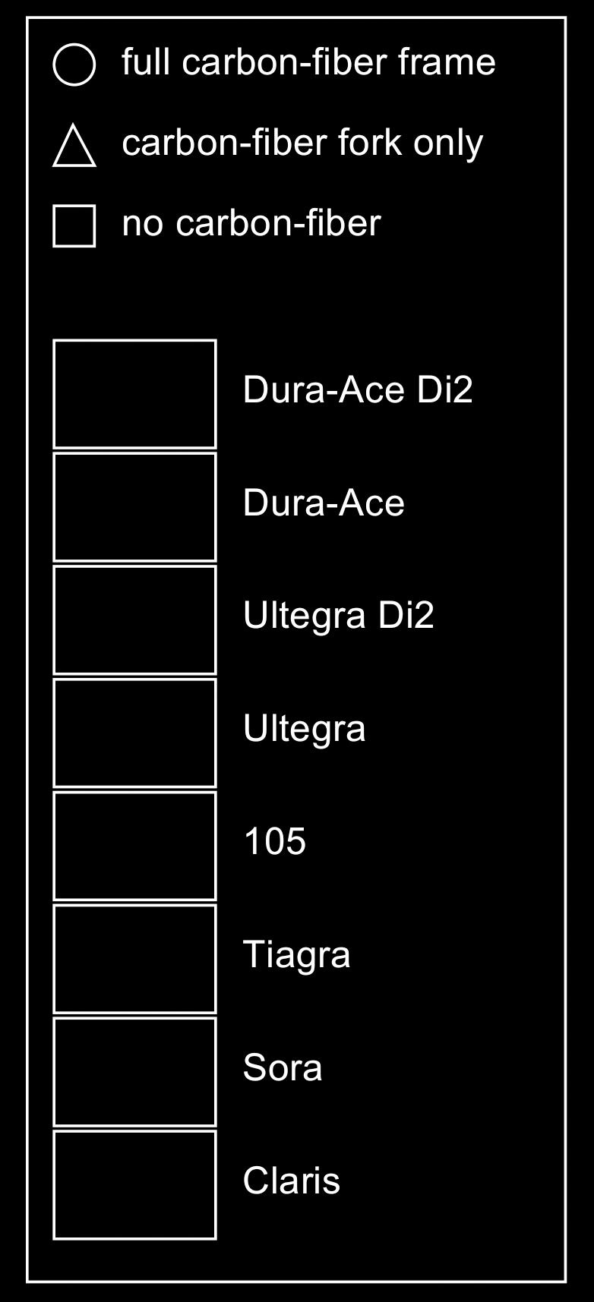

Slide 63
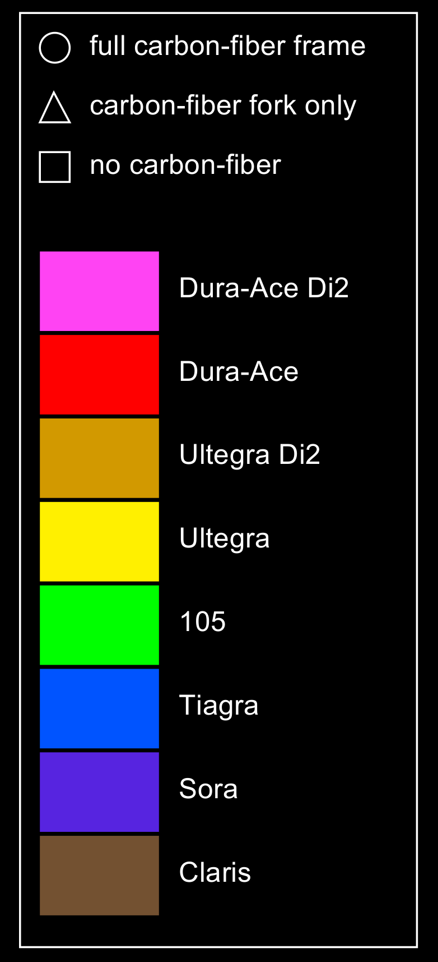

Slide 64
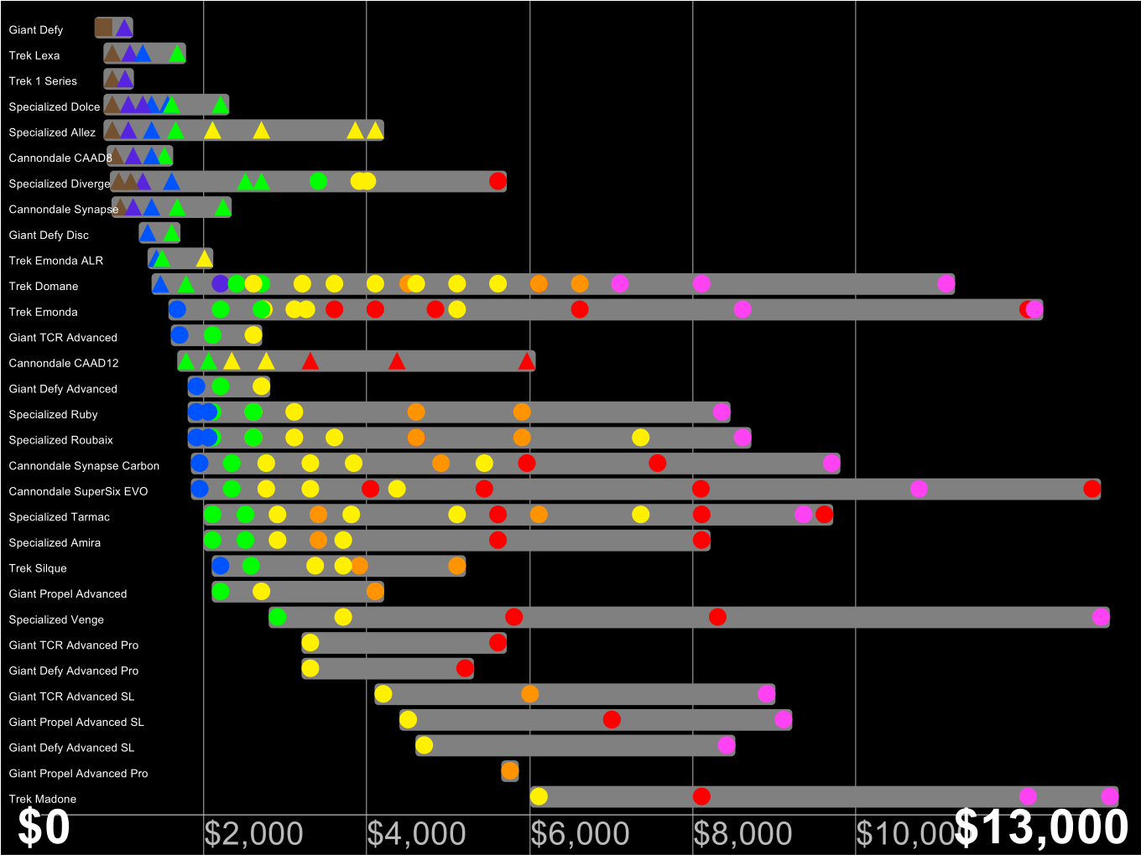

Slide 65
problem
deconstruction
visualization
discussion

Slide 66
problem
deconstruction
visualization
discussion

Slide 69
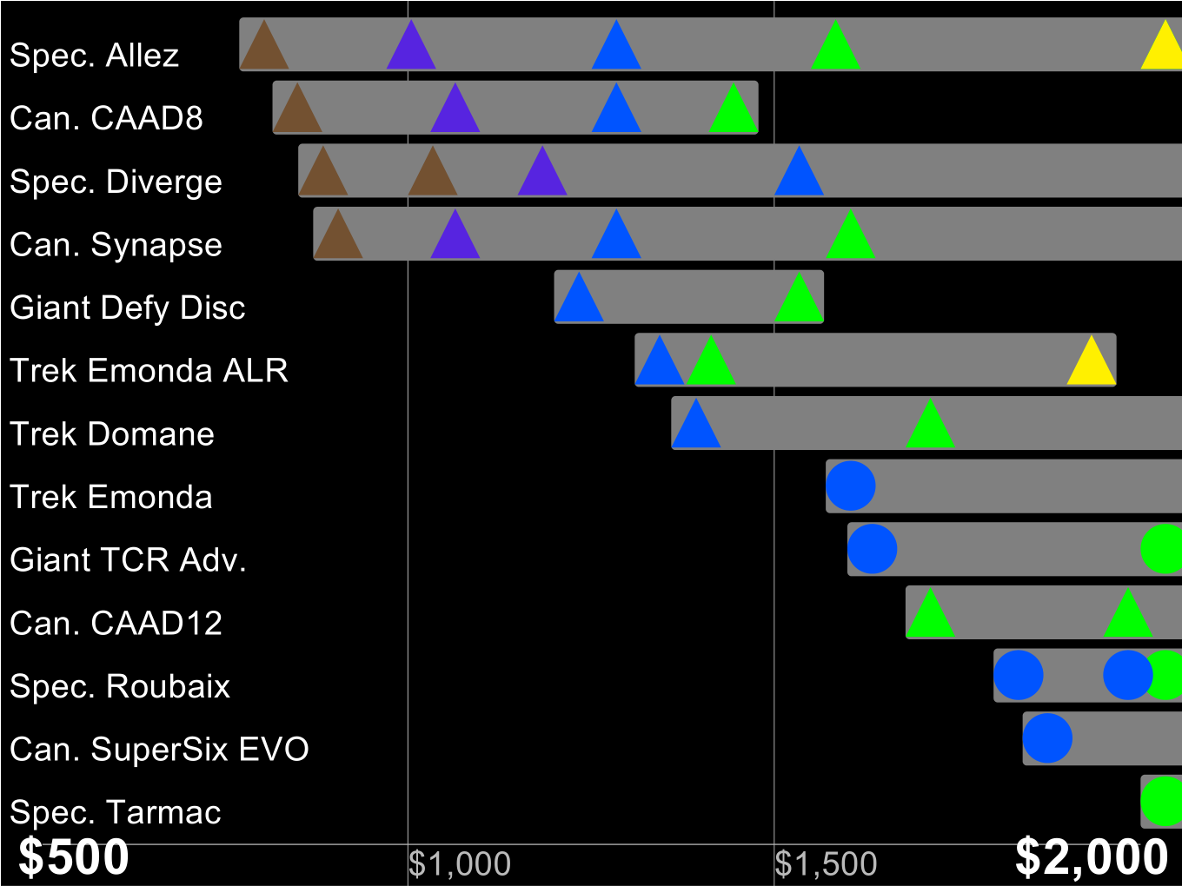

Slide 70
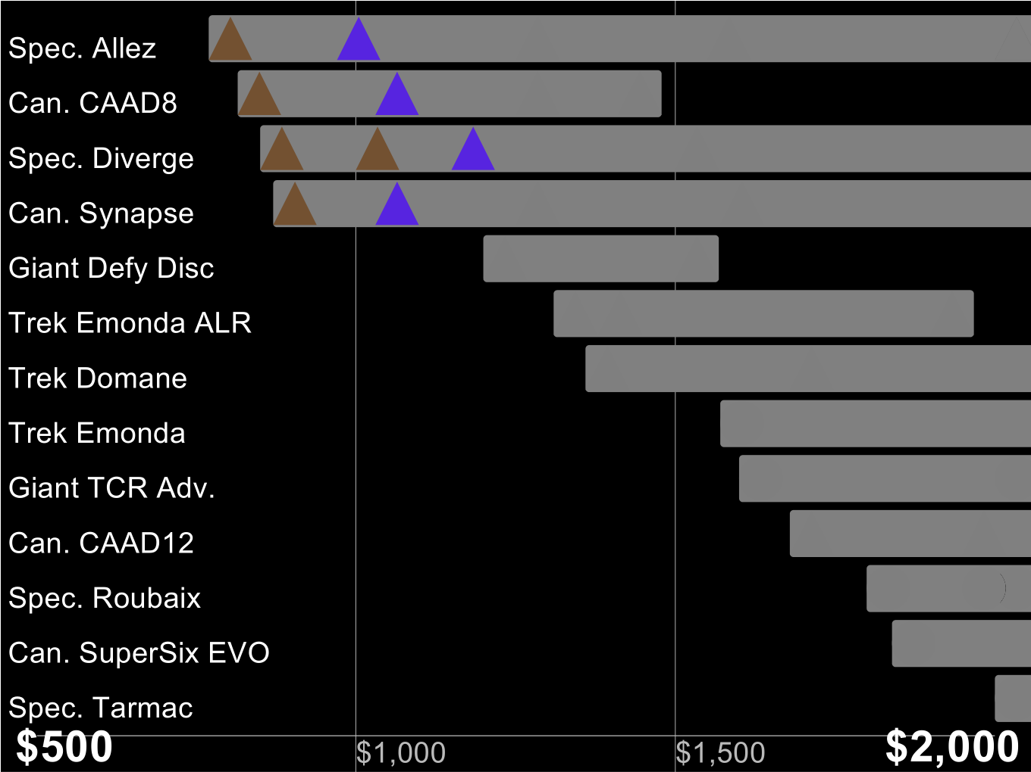

Slide 72
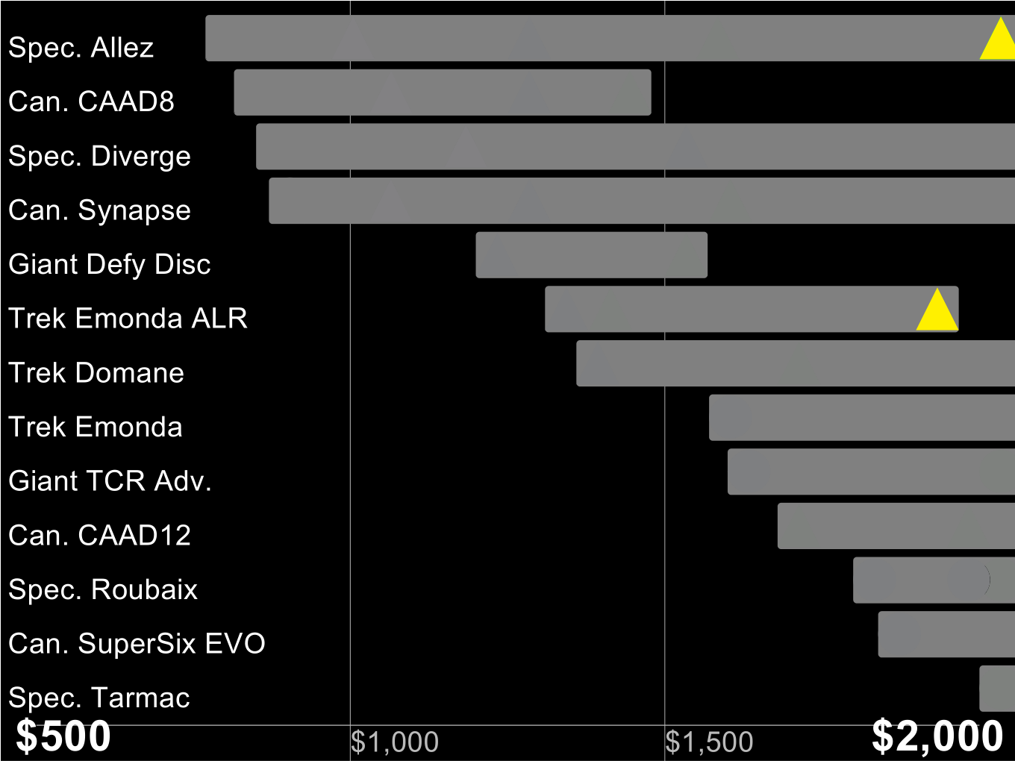

Slide 74
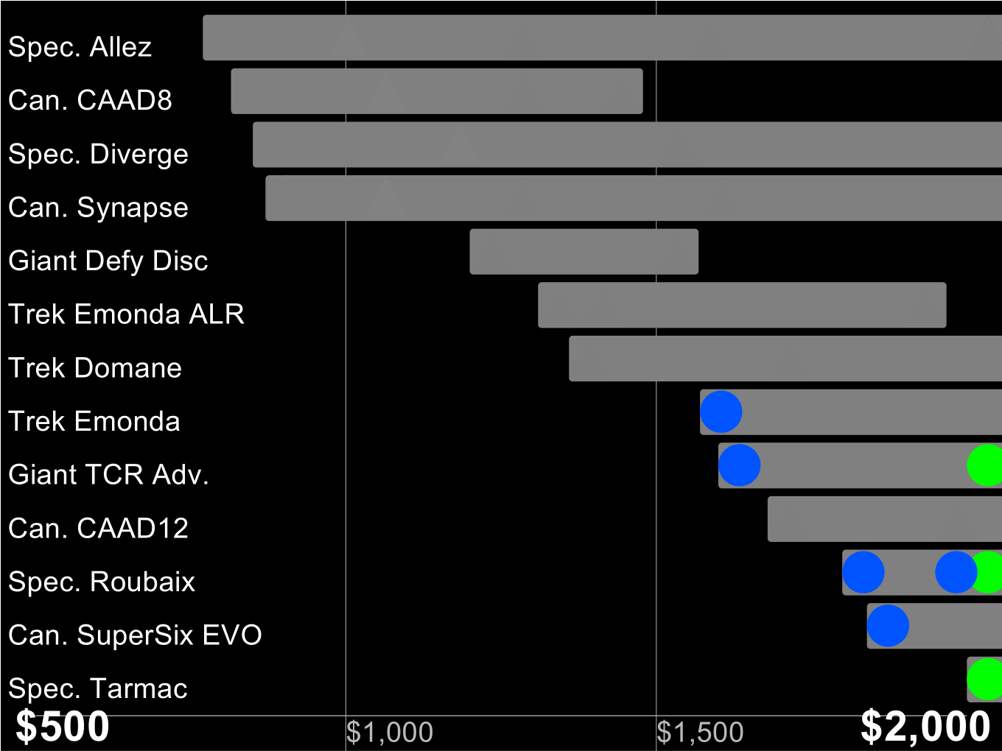

Slide 76
insight?

Slide 77
no

Slide 78
thank you!
http://froud.xyz

