Slide 1
CQE-UAF

Slide 2
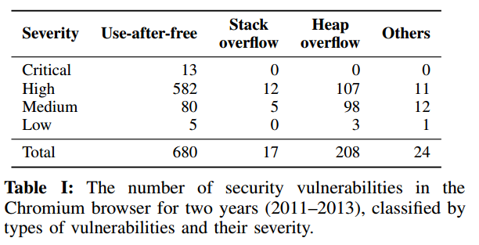
Motivation

Slide 3
Related Work
Dynamic analysis (most papers and defense papers)
Pointer invalidation
Pointer dereference checking
Secure memory allocators
Taint tracking
Static analysis (exploring)
Static analysis and Dynamic analysis (exploring)
Source code or Binary only

Slide 4
Attack Point
FreeSentry
DangNull
DangSan
CETS
Allocation
Propagation
Free
New Allocation
Use
DieHard
Dieharder
Cling
AddressSantizier

Slide 5
Pointer invalidation
Keep track of pointers to each object and invalidate them once an object is freed.
FreeSentry: Protecting Against Use-After-Free Vulnerabilities Due to Dangling Pointers (NDSS 15)
Can track all pointers, but cannot support multithreaded programs
source code requirement （compile time)
Source code transformation and insert runtime code to track pointers and invalidate when free
25% (CPU Bench, Apache and OpenssH)
Preventing Use-after-free with Dangling Pointers Nullification (NDSS 15)
Automatically trace the point-to relations between pointers and memory objects
Only in the heap, stack-located pointers are unlikely to be exploitable (short lifetime)
source code requirement, overhead 80% (SPEC CPU), range information, lock
DangSan: Scalable Use-after-free Detection (EuroSys 17)
Track all pointers, support multithreaded programs, and focus on concurrency efficiently.
source code requirement
22% (CPU Bench)

Slide 6
Page Permission
Change the free page permission to avoid dangling pointer
Efficiently Detecting All Dangling Pointer Uses in Production Servers (DSN 06)
source code
create shadow page which occure the whole page
change the page permission of shadow page

Slide 7
Problem
DangNull/FreeSentry do not work correctly with encrypted pointers (e.g., PointGuard [20]) or with typecasting from non-pointer types. CETS has false positives when casting from a non-pointer to pointer, as it will initialize the key and lock address to invalid values. Additionally, DangNull does not allow pointer arithmetic on freed pointers. For example, suppose we allocate a string p on the heap, search for a character, then free the string:
char* p = strdup("Oscar"); // Memory from malloc
char* q = strchr(p, ’a’); // Find the first ’a’
free(p);
Computing the index of “a” (q - p == 3) fails with DangNull, since p and q were nullified. It does work with FreeSentry, since FreeSentry only changes the top bits, and with Oscar.

Slide 8
Pointer dereference checking
Perform checking when pointers are dereferenced rather than invalidating them when they are deallocated.
CETS: Compiler-enforced temporal safety for C (ISMM 10)
Attach a label to each allocation and perform a check when dereferenced.
each allocation (key + lock location), deallocation ( NULL for lock location)
Cover the case that pointers are temporarily converted into integers.
Higher run-time overhead (48% CPU Bench)
Source code requirement

Slide 9
Secure memory allocators
Prevent allocated objects from ending up at the same address as previously freed objects.
DieHard: Probabilistic memory safety for unsafe language (PLDI 06)
binary only
DieHarder: Securing the heap (CCS 10)
binary only
Cling: A memory allocator to mitigate dangling pointers (Usenix Sec 10)
Source code
It only allows address space reuse for freed objects among objects of the same type.
No stack
AddressSanitizer: A fast address sanity checker (Usenix ATC 12)
Allow the attacker to force the reuse of a freed memory region
Source code requirement

Slide 10
Taint Tracking
Track the pointer value from its allocation site onward not depending on the variable type.
Undangle: Early Detection of Dangling Pointers in Use-After-Free and Double-Free Vulnerabilities (ISSTA 12)
It can report all the dangling pointers that point to a particular memory location at a given set in time and allows a user to specify a window when to report these findings
Avoid the loss of metadata when pointers are copied in a type-unsafe way
Binary code no source code
Combine Undangle with fuzzing tool
find two dangling pointer bugs in windows libraries

Slide 11
Static Analysis
Staticly detecting use after free on binary code(JICV 14)
binary only
potential UAF patterns: allocation, free, used (dangling pointer)
Abstract memory representation: heap (base, size) and stack (EBP, offset)
Value set analysis
assume no particular loop iteration
small programs
Uncovering Use-After-Free Conditions In Compiled Code (ARES 15)
binary only (potential 127/652 windows binaries)
C++ object with virtual function
data flow analysis: available object definition analysis
compute four sets for each basic block GEN[B], KILL[B], AVAILIN[B], and AVAILOUT[B]
the virtual address of constructor and deleted object
rely on RECALL’s ClassTracker to identify C++ object creation and deletion with high reliability

Slide 12
Static Analysis
Detecting Bugs Using Decompilation and Data Flow Analysis
represent x86 to an IR

Slide 13
Combine Static and Dynamic Analysis
Finding the needle in the heap: combining static analysis and dynamic symbolic execution to trigger use-after-free (SSPREW 16)
binary only
GUEB guided dynamic symbolic execution
Poster: UAFChecker: Scalable Static Detection of Use-After-Free Vulnerabilities (CCS 14)
Source code
unroll each loop only once
no depending on executing a loop for several times.
finite-state machine: precise alias analysis (MustAlias and MayAlias)
Inter-procedure analysis: function inlining not good for large program
Symbolic execution: free point to use point
Taint: directly taint untrust pointer

Slide 14
Static Analysis
LiSTT: An Investigation into Unsound-incomplete Yet Practical Result Yielding Static Taintflow Analysis
Alias analysis of executable code
Pointer Analysis
pointer analysis
Slicing Machine Code
https://github.com/unsw-corg/SVF
Data dependence analysis of assembly code
Alias Analysis for Assembly
Data flow analysis: DepGraph
Pointer analysis work and ugly source code

Slide 15
Potential related work
Statically-Directed Dynamic Automated Test Generation

Slide 16
Why Static Analysis
Static analysis provides more complete results than dynamic analysis by allowing to explore the whole set of program executions.
false negatives
Program slicing
CFG contruction
Data-flow analysis
pointer analysis: return from library or system call, pointer copying and arithmetic

Slide 17
The difficulty for static analysis
How to manage the loop in programs
most assume that loops have no great influence on UAF
The way of representing memory (IR)
precise points-to and reachability analyses across all possible inter-procedure paths
pointer copy and pointer arithmetic
pointers are temporarily converted into integers

Slide 18
Locating Pointers
Locations
stack
data
heap
type:
non-pointer types
range:
pointer range
null the top bit problem

Slide 19
The difficulty for Fuzzing
Loop
No crash
a dangling pointer itself may be not erroneous behavior

Slide 20
About new idea: Deferred Free
Deferred Free
https://infocon.org/cons/SyScan/SyScan%202015%20Singapore/SyScan%202015%20Singapore%20presentations/SyScan15%20Yuki%20Chen%20-%20The%20Birth%20of%20a%20Complete%20IE11%20Exploit%20Under%20the%20New%20Exploit%20Mitigations.pdf
http://blogs.bromium.com/wp-content/uploads/2015/01/demott_uaf_migitation_and_bypass2.pdf
http://www.freebuf.com/articles/system/93598.html
https://researchcenter.paloaltonetworks.com/2014/07/beginning-end-use-free-exploitation/

Slide 21
MemGC
https://github.com/zenhumany/hitcon2015
https://blogs.technet.microsoft.com/srd/2016
https://www.blackhat.com/docs/us-15/materials/us-15-Yason-Understanding-The-Attack-Surface-And-Attack-Resilience-Of-Project-Spartans-New-EdgeHTML-Rendering-Engine.pdf
https://github.com/zenhumany/blackhat_asia_2017/blob/master/BYPASS%20ALL%20MODERN%20MITIGATIONS%20OF%20MICROSOFT%20EDGE.pdf
https://github.com/BuddhaLabs/PacketStorm-Exploits/tree/master/1612-exploits
http://blog.skylined.nl/20160316001.html
https://conference.hitb.org/hitbsecconf2017ams/materials/D1T2%20-%20Linan%20Hao%20and%20Long%20Liu%20-%20The%20Secret%20of%20ChakraCore.pdf
https://sanwen8.cn/p/6193Zkh.html

Slide 22
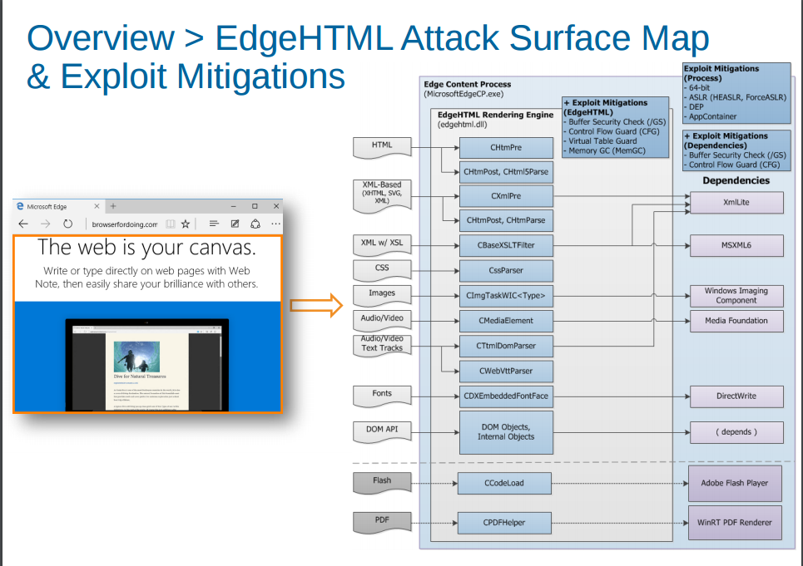

Slide 23
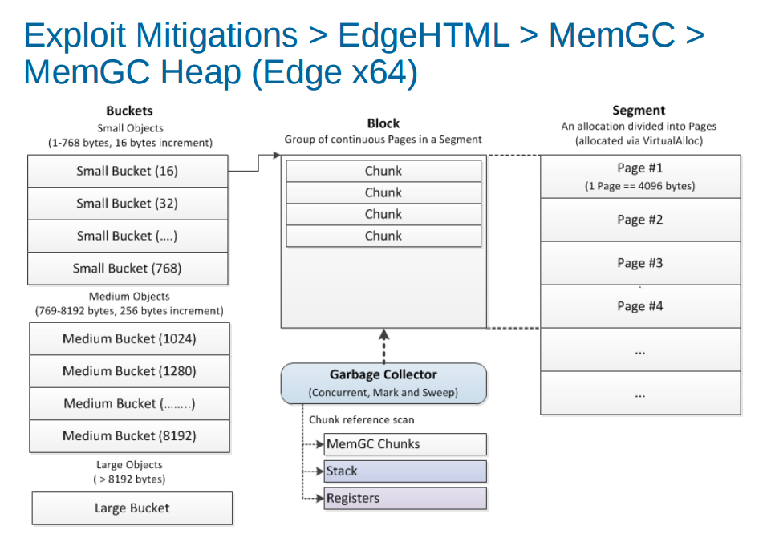

Slide 24
Disadvantage
If we were able to make the size of the current heap block in this structure larger than the threshold of 0x186A0 bytes and trigger CMemoryProtector::ProtectedFree, it is still possible to force a true freeing action and occupy the freed object with other data
From a researchers’ point of view, deferred free created a few problems, one of the major ones being that the page heap feature may not work correctly. Page heap is a useful feature for debugging. When page heap is turned on, the system allows only one object in one memory page. Once this object is freed the whole page is marked as invalid. So the next time IE tries to access a freed object an invalid address exception would be raised. This mechanism is extremely helpful when researchers are trying to find use-after-free bugs.
Exploit

Slide 25
How to bypass Deferred free
Avoid reference to the object on the stack
Avoid early free, choose proper timing to free
transfer reference to heap not keep in the stack
pointer encryption problem

Slide 26
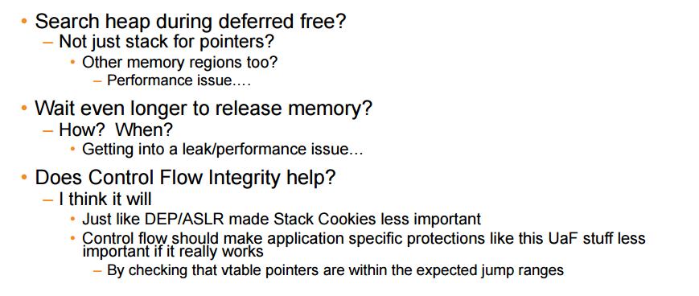

Slide 27
9 UAF Samples
CROMU_00035 : CROMU_00035
KPRCA_00054 : KPRCA_00054
NRFIN_00024 : NRFIN_00024
KPRCA_00011:KPRCA_00011
NRFIN_00023:NRFIN_00023
CROMU_00025:CROMU_00025
CROMU_00044: CROMU_00044
KPRCA_00100: KPRCA_00100
NRFIN_00054: NRFIN_00054

Slide 28
Fuzz result for UAF
BINARY NAME | VULNERABILITIES | UNIQUE CRASHES | DRILLER INVOKED | TIME TO FIND 1ST CRASH | PATHS FOUND | BITMAP COVERAGE | PATHS IMPORTED | DRILLER SYNCED | Size of largest crashing input | No of seeds | Size of dict file | No of POV
CROMU_00025 | 2 | 1 | NO | 29 MINUTES | 189 | 1.31% | 0 | No | 920 bytes | 898 | 6.9kB | 2
CROMU_00035 | 2 | 28 | No | 2 hours 9 minutes | 551 | 0.97% | 37 | No | 304bytes | 5 | 11.8kB | 2
CROMU_00044 | 1 | 15 | NO | 6 MINUTES | 419 | 0.92% | 124 | No | 252 bytes | 7 | 7.4kB | 1
KPRCA_00011 | 2 | 1 | NO | 8 minutes | 105 | 0.34% | 58 | No | 172 bytes | 1000 | 14.5kB | 1
KPRCA_00054 | 1 | 3 | No | 19 Minutes | 475 | 1.42% | 163 | No | 631bytes | 999 | 7.7kB | 1
NRFIN_00023 | 6 | 6 | No | 3 minutes | 42 | 0.16% | 3 | No | 91bytes | 1 | 2.8kB | 5
NRFIN_00024 | 4 | 1 | No | 25 Min | 91 | 0.25% | 3 | No | 250bytes | 998 | 3.1kB | 3
NRFIN_00054 | 6
KPRCA_00100 | 2

Slide 29
Whether fuzz detect UAF and Scores for each team
BINARY NAME | VULNERABILITIES | UNIQUE CRASHES | UAF | Shellphish | ForAllSecure | CodeJitsu | TECHx | TrailofBits | Disekt | CSDS | FuzzBOMB | DeepRed
CROMU_00025 | 2 | 1 | No | 0 | 3.5 | 1.0 | 0.95 | 0.18 | 0.31 | 1.27 | 0 | 0.04
CROMU_00035 | 2 | 28 |  | 1.68 | 0.85 | 0.55 | 0.3 | 0.15 | 0 | 0 | 0
CROMU_00044 | 1 | 15 | Yes | 0 | 4.0 | 1.04 | 0 | 0 | 1.75 |  | 0
KPRCA_00011 | 2 | 1 | No | 0 | 0 | 0 | 0 | 0 | 0 | 0.54 | 0 | 2.0
KPRCA_00054 | 1 | 3 | Yes | 3.55 | 4.0 | 0 | 0 | 0 | 3.05 | 0.66 | 0
NRFIN_00023 | 6 | 6 | No | 0 | 2.8 | 0 | 0 | 0 | 2.2 | 0 | 2.01 | 0
NRFIN_00024 | 4 | 1 | Yes | 0 | 2.33 | 1.99 | 0 | 0.61 | 0.19 | 1.65 | 0 | 0.11
NRFIN_00054 | 6
KPRCA_00100 | 2

Slide 30
CROMU_00025:CROMU_00025 (2:1)
case 6: if ( pixel > 61 ) { deallocate( tid->image, tid->image_length +1); /// Bug #ifdef PATCHED tid->image = NULL; tid->image_length = 0; #endif return tid->image_length; } if ( index > tid->image_length + 1 || index < 0) { deallocate( tid->image, tid->image_length +1); tid->image = NULL; tid->image_length = 0; return tid->image_length; } tid->image[index] = six[pixel]; break;
The second bug is in the TBIR image type. It is a failure to clear certain values after a parsing error and buffer deallocation. This ultimately results in a use after free situation.
deallocate() -> munmap()
LOOP related
The munmap() system call deletes the mappings for the specified address range, and causes further references to addresses within the range to generate invalid memory references. The region is also automatically unmapped when the process is terminated. On the other hand, closing the file descriptor does not unmap the region.

Slide 31
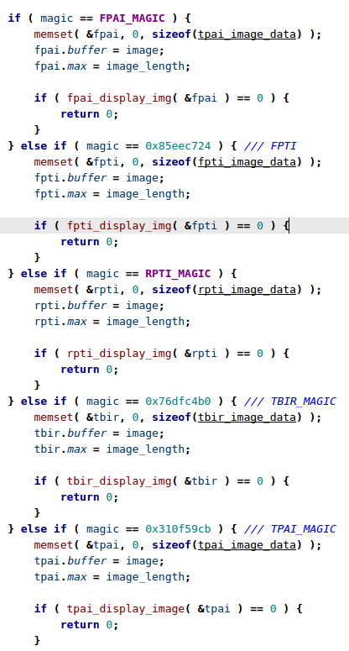
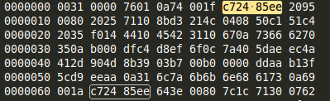
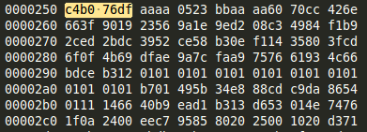
Continue..

Slide 32
CROMU_00035 : CROMU_00035 (2:28)
pPerms delete_perms(pNode node,pPerms temp){//returns next perm or null if no next if (temp == NULL){ return NULL; } pPerms retval = temp->next; if (temp->prev != NULL){ temp->prev->next = temp->next; } #ifdef PATCHED if (temp->prev == NULL) {//first perm in list node->perms = temp->next; } #endif if (temp->next != NULL){ temp->next->prev = temp->prev; #ifndef PATCHED if (temp->prev ==NULL){ node->perms = temp->next; } #endif } free(temp); return retval; }
deleting the only permission on a file results in a use after free, due to failing to update the perm link in Node_s

Slide 33
CROMU_00044: CROMU_00044 (1:15)
bool CUserEntry::DeleteMessage( CUserMessage *pCur ) { if ( !pCur ) return (false); #if PATCHED if ( m_pLastUnreadMessage == pCur ) m_pLastUnreadMessage = (CUserMessage *)m_oMessageQueue.GetPrev( pCur ); m_oMessageQueue.DeleteItem( pCur ); #else // BUG:: Update the last unread message if we need to m_oMessageQueue.DeleteItem( pCur ); #endif return (true); }
There is one vulnerability in this service. It is due to the method in which unread messages are tracked per user. An unread message pointer points to the last unread message in the linked list of user messages. When a message is deleted by a user (but not read -- as this will clear the unread message pointer) and that message that is chosen to be deleted is the one the unread message is pointing to the unread message pointer will now point to deleted data. Hence a use after free event can occur. When a user then goes to read a message the program will attempt to display the oldest unread message (which points to deleted data) and a use after free will occur.
m_pLastUnreadMessage
non crash can incur UAF

Slide 34
KPRCA_00011:KPRCA_00011 (2:1)
node = movie_find_by_id(movies_full, movie_id); movie_t *movie = node->movie; #if PATCHED if (movie_delete(&movies_full, movie_id) != 0 || movie_delete(&movies_rented, movie_id) != 0) #else if (movie_delete(&movies_full, movie_id) != 0) #endif printf("[ERROR] Failed to remove.\n"); else { g_num_movies--; free_movie(movie); printf("Successfully removed the movie!\n"); }
The second bug is a UAF bug with the movie lists, where the rental list holds a stale pointer to the free'd movie entry.
Specifically, in main.c:445, when the movie is removed (in admin menu), it is removed only from the full list, not the rented list. Then, by allocating memory of size equivalent of the movie object, it is possible to control the contents of the stale movie pointer, which has a function pointer in it. By setting the function pointer, EIP control is possible.
Found Buffer Overflow
not found

Slide 35
KPRCA_00054 : KPRCA_00054 (1:3)
for (i = 0; i < files->length(); ++i) { File *file = files->get(i); if (strcmp(file->GetName(), name) == 0) { if (file->GetType() == File::FT_REG) { #if PATCHED int j; for (j = 0; j < MAX_NUM_OPENED_FILES; ++j) { if (file == openedFiles[j]) { CloseFile(j); break; } } #endif files->remove(file); delete file; numFiles--; return 0; }
When deleting a file, the file object pointer is not removed from the list that keeps track of currently opened files.
This yields a dangling pointer when a file is deleted while it's opened.
By allocating similar-sized buffer by writing into another file, it is possible to take over the memory for the dangling pointer -- allowing Use-After-Free condition.
Arbitrary code execution can be achieved by triggering a virtual function in the file object after carefully setting up the payload.

Slide 36
NRFIN_00023:NRFIN_00023 (6:6)
static void remove_stock(struct stock_state *state, struct stock *stock) { stock_list_t *bucket = NULL; // Type confusion #ifdef PATCHED if (stock->obj_type != STOCK) return; #endif bucket = get_bucket(state, stock->name); // Use after free #ifdef PATCHED state->stock_freed = 1; LIST_REMOVE(&state->stocks_list, global_list, stock); #endif LIST_REMOVE(bucket, bucket_list, stock); pool_free(&state->stock_pool, stock); }
The system uses heap allocated variables after freeing them. The implemented fix ensures that all references to heap-allocated chunks are removed prior to freeing a chunk. See src/stock.c:88-92. Patching requires ensuring that all aliases of a heap-allocated chunk are removed when the chunk is freed, in order to ensure that dangling pointers aren't left into the freed chunk.

Slide 37
NRFIN_00024 : NRFIN_00024 (4:1)
void delete_session(uint32_t sid) { /* * Our vulnerable function. If unpatched, we leave a dangling pointer in head. */ lms_sess_t *cur = head; lms_msg_list_t *list, *listnext = NULL; lms_sess_t *last = NULL; while (cur) { if (cur->sid == sid) { #ifdef PATCHED if (cur == head) head = cur->next; #endif //remove from list if (last) last->next = cur->next; //free all our messages and the list listnext = cur->head; while ((list = listnext)) { listnext = list->next; free(list->msg->data); free(list->msg); free(list); } //free the session free(cur->received); free(cur); outstanding--; return; } #ifdef PATCHED last = cur; #endif cur = cur->next; } }
Two seperate dangling pointer vulnerabilities exists in the delete_session function, leading to a use after free situation in later packet processing. By adding two or more sessions, causing the first to complete, then forcing an appropriately sized allocation to occupy the same memory, it is possible trigger this condition and cause a segfault.

Slide 38
Combine Static analysis and Dynamic analysis
Static analysis
Collect the potential paths which may generate UAF
how to use data structure knowledge?
Dynamic analysis
Generate inputs to reach dangling pointer for potential UAF
Combine modified heap allocation functions and dangling pointers to generate the attacks.
how to use data structure knowledge?

Slide 39
New Detection
Combine static and dynamic analysis
CFG/DFG
Large stripped binary code
Reachability
from the free point to use point (satisfied)
between free point and use point, it may include hundreds or thousand line instruction, it is not possible to use CFG/DFG to compute one path
fuzz
concolic symbolic execution
backward force function-level / instruction-level execution
how to find all possible paths for UAF
FUZZ/CONCOLIC

Slide 40
Browser
Firefox Explore
https://www.exploit-db.com/exploits/41042/
Edge explore
https://blog.quarkslab.com/exploiting-ms16-145-ms-edge-typedarraysort-use-after-free-cve-2016-7288.html

Slide 41
LLVM alias analysis
$clang++ -emit-llvm -S uaf.cpp -o uaf.ll
$opt -globalsmodref-aa -basicaa -scev-aa -print-alias-sets uaf.ll
opt -basicaa -aa-eval -print-all-alias-modref-info < hello.bc
opt -basicaa -print-alias-sets -disable-output hello.bc
Like all AliasAnalysis interfaces, the alias method requires that either the two pointer values be defined within the same function, or at least one of the values is a constant.
http://phrack.org/issues/64/8.html
IR: https://github.com/google/binnavi/wiki/Replacing-IDA-as-Disassembler-Frontend

Slide 42
Delay Free
Delay Free
stack
register
heap
value-based analysis
scanning the memory to figure out the pointer or memory address
word or double word
avoid pointer similar integer or float point value
How to know the data type information for each location
https://github.com/trolldbois/python-haystack-reverse
How to use binary static analysis to improve the delay free

