Slide 1
ReViver: Trace-Free Memory Data Structure Forensics via Past Inference and Future Speculations
Presented by Pengfei Sun

Slide 2

Motivation

Slide 3
Motivation
Memory data structure reverse engineering
Memory forensics
Semantic information to higher level concepts
Vulnerability discovery
Buffer overflow
Malware analysis
Malware signature

Slide 4
Previous Work
Without execution trace
Source code
SigGraph (NDSS’11)
Stripped binary code
Laika (OSDI’08) (limited to aggregates structures)
Execution trace
Stripped binary code
Rewards (NDSS’10), TIE (NDSS’11) and Howard (NDSS’11)

Slide 5
Goal
Live memory
No execution trace
Stripped binary code
Trace-free reverse engineering of live memory data structure layout

Slide 6





1. Idea
2. Design
3. Evaluation
4. Conclusion

Slide 7

ReViver
service_library {
const char *
void *
struct service_library *
}
...
09406ca0 0000 0000 0021 0000 6004 0940 6d00 0940
09406cb0 0000 0000 efef efef fefe fefe 0018 0000
...
09407570 acfc b76f 0e7f af6f efef efef fefe fefe
09407580 0014 0000 0039 0000 0000 0000 0004 0000
...
known_function {
const char *
void *
}
Part of memory snapshot
2. Design
3. Evaluation 4. Conclusion
1. Idea

Slide 8
Past: statistical information
Present: static memory analysis
Future: speculative forensics
2. Design
3. Evaluation 4. Conclusion
1. Idea

Slide 9
Present: Static Memory Analysis
...
09406ca0 0000 0000 0021 0000 6004 0940 6d00 0940
09406cb0 0000 0000 efef efef fefe fefe 0018 0000
...
09407570 acfc b76f 0e7f af6f efef efef fefe fefe
09407580 0014 0000 0039 0000 0000 0000 0004 0000
...
Memory initial layout
Suspension point
Part of memory snapshot
2. Design
3. Evaluation 4. Conclusion
1. Idea

Slide 10
Present: Static Memory Analysis
Trace-free reverse engineering
No need for execution tracing
Memory allocation function hooking (1.8% runtime overhead)
Landmarks (efef efef fefe fefe )
Superset of possible types for each memory region
String, pointer-to-pointers, data structure, str-zeros
Pointer address: 0x09406ca8
...
09406ca0 0000 0000 0021 0000 6004 0940 6d00 0940
09406cb0 0000 0000 efef efef fefe fefe 0018 0000
...
09407570 acfc b76f 0e7f af6f efef efef fefe fefe
09407580 0014 0000 0039 0000 0000 0000 0004 0000
...
Part of memory snapshot
Landmarks
Size is 0x18
stru_0x9406ca8 {
pointer-str
pointer-stru
zero
}
2. Design
3. Evaluation 4. Conclusion
1. Idea

Slide 11
Present: Static Memory Analysis
Pruning candidate data structures
Memory-resident data structures
Application binary executable
Library
Search memory allocation call sites based on call graph
Reduce the data structures search space (815 to 69 candidates)
Dump-database structure matching
Allocated with the same API function
Data structure size should not be larger than the allocation memory region
2. Design
3. Evaluation 4. Conclusion
1. Idea

Slide 12
Symbolic Execution
Make variables (inputs) symbolic
Collect path constraints during execution
Solve path constraints by SMT solver → concrete values (test cases)
T
a > b
F
int main(int ac, char* av[]) {
int a = atoi(av[1]); //symbolic
int b = atoi(av[2]}; //symbolic
int c = atoi(av[3]}; //symbolic
if(a > b)
a = a – b;
if(b < 1) {
if(c != a)
c = a – b;
}
b = 1;
return 0;
}
a = a - b
b < 1
T
F
b < 1
c != a
b = 1
T
F
T
F
a <= b & b >=1
c != a
b = 1
c = a - b
b = 1
T
F
a > b & b >=1
c = a - b
b = 1
b = 1
a <= b & b < 1 & c = a
b = 1
a > b & b < 1 & c = a -b
a <= b & b < 1 & c != a
a > b & b < 1 & c != a -b
Path Constraint
2. Design
3. Evaluation 4. Conclusion
1. Idea

Slide 13
Past: Statistical Information
entry
Collecting statistical information
Completed symbolic execution
Best-effort partial symbolic execution
Relevant execution paths
Partial and directed
Suspend
2. Design
3. Evaluation 4. Conclusion
1. Idea

Slide 14
Future: Speculative Forensics
Suspend
Backward taint analysis
Exit
Type-revealing instructions
2. Design
3. Evaluation 4. Conclusion
1. Idea

Slide 15
Future: Speculative Forensics
Revive execution
Checkpoint
DMTCP (process migration)
Symbolic execution
LibraryInject
Load override library functions (parameters was marked as symbolic input)
2. Design
3. Evaluation 4. Conclusion
1. Idea

Slide 16
Case Study: CoreUtils Groups
...
09406ca0 0000 0000 0021 0000 6004 0940 6d00 0940
09406cb0 0000 0000 efef efef fefe fefe 0018 0000
...
09407570 acfc b76f 0e7f af6f efef efef fefe fefe
09407580 0014 0000 0039 0000 0000 0000 0004 0000
09407590 0018 0000 001b 0000 001e 0000 002e 0000
094075a0 006d 0000 007c 0000 03e8 0000 efef efef
094075b0 fefe fefe 0030 0000 0000 0000 ea49 0001
094075c0 0000 0000 0000 0000 0000 0000 0000 0000
094075d0 0000 0000 0000 0000 0000 0000 0000 0000
094075e0 0000 0000 0000 0000 0000 0000 0000 0000
094075f0 0000 0000 a980 b76e ffff ffff 0041 0000
09407600 0000 0000 0000 0000 7658 0940 ffff ffff
09407610 ffff ffff 0000 0000 7664 0940 0000 0000
09407620 0000 0000 ffff ffff ffff ffff 0000 0000
09407630 0000 0000 0000 0000 0000 0000 0000 0000
09407640 0000 0000 0000 0000 0000 0000 0000 0000
09407650 0000 0000 9a20 b76e 0000 0000 ffff ffff
09407660 0000 0000 0000 0000 0000 0000 0000 0000
09407670 0000 0000 0000 0000 0000 0000 0000 0000
09407680 0000 0000 0000 0000 0000 0000 0000 0000
09407690 0000 0000 0000 0000 0000 0000 0000 0000
094076a0 0000 0000 0000 0000 0000 0000 0000 0000
094076b0 0000 0000 0000 0000 0000 0000 0000 0000
094076c0 0000 0000 0000 0000 0000 0000 0000 0000
094076d0 0000 0000 0000 0000 0000 0000 0000 0000
094076e0 0000 0000 98a0 b76e efef efef fefe fefe
This case study will show how ReViver use the hybrid solution to get memory data structure layout.
2. Design
3. Evaluation 4. Conclusion
1. Idea

Slide 17
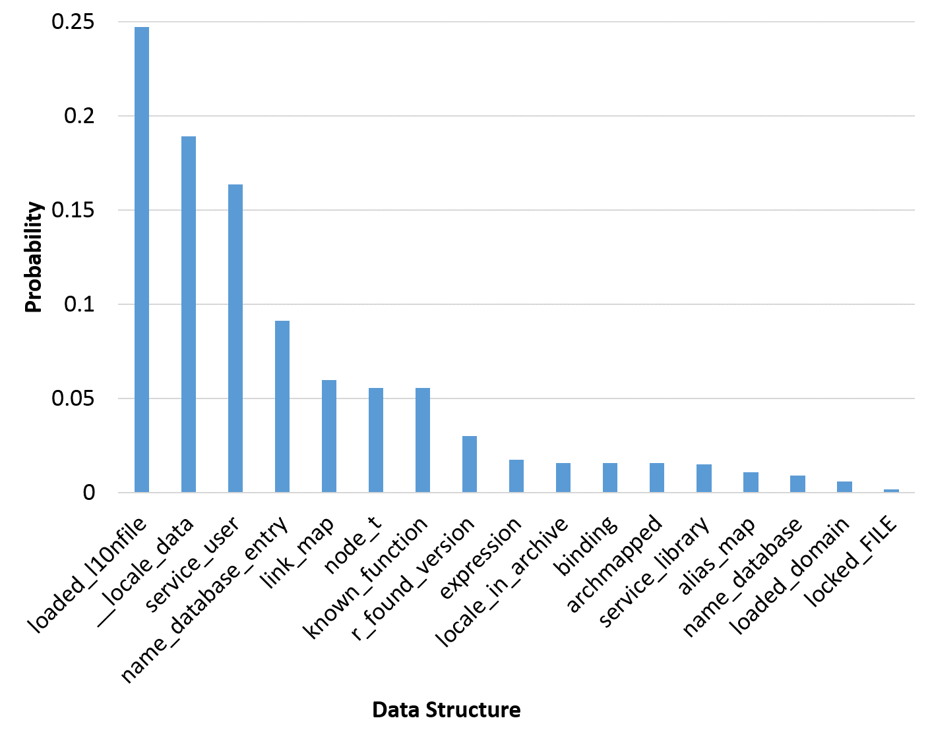
Case Study: CoreUtils Groups
...
09406ca0 0000 0000 0021 0000 6004 0940 6d00 0940
09406cb0 0000 0000 efef efef fefe fefe 0018 0000
...
Memory Address/Structure Name (size) | 0x9406CA8 | Service_library (12 bytes) | Libname_list (12 bytes)
First field | Pointer-str | const char* | const char*
Second field | Pointer-stru | void* | struct libname_list*
Third field | Zero | struct service_library* | int
2. Design
3. Evaluation 4. Conclusion
1. Idea

Slide 18
Case Study: CoreUtils Groups
...
09406ca0 0000 0000 0021 0000 6004 0940 6d00 0940
09406cb0 0000 0000 efef efef fefe fefe 0018 0000
...
09407570 acfc b76f 0e7f af6f efef efef fefe fefe
09407580 0014 0000 0039 0000 0000 0000 0004 0000
09407590 0018 0000 001b 0000 001e 0000 002e 0000
094075a0 006d 0000 007c 0000 03e8 0000 efef efef
094075b0 fefe fefe 0030 0000 0000 0000 ea49 0001
094075c0 0000 0000 0000 0000 0000 0000 0000 0000
094075d0 0000 0000 0000 0000 0000 0000 0000 0000
094075e0 0000 0000 0000 0000 0000 0000 0000 0000
094075f0 0000 0000 a980 b76e ffff ffff 0041 0000
09407600 0000 0000 0000 0000 7658 0940 ffff ffff
09407610 ffff ffff 0000 0000 7664 0940 0000 0000
09407620 0000 0000 ffff ffff ffff ffff 0000 0000
09407630 0000 0000 0000 0000 0000 0000 0000 0000
09407640 0000 0000 0000 0000 0000 0000 0000 0000
09407650 0000 0000 9a20 b76e 0000 0000 ffff ffff
09407660 0000 0000 0000 0000 0000 0000 0000 0000
09407670 0000 0000 0000 0000 0000 0000 0000 0000
09407680 0000 0000 0000 0000 0000 0000 0000 0000
09407690 0000 0000 0000 0000 0000 0000 0000 0000
094076a0 0000 0000 0000 0000 0000 0000 0000 0000
094076b0 0000 0000 0000 0000 0000 0000 0000 0000
094076c0 0000 0000 0000 0000 0000 0000 0000 0000
094076d0 0000 0000 0000 0000 0000 0000 0000 0000
094076e0 0000 0000 98a0 b76e efef efef fefe fefe
exit: malloc
ret: 0x094075c0
enter: fgetpos(0x094075c0, 0xbfdcbbb4)
definition: fgetpos(_IO_FILE *, fpost_t *)
_IO_FILE
2. Design
3. Evaluation 4. Conclusion
1. Idea

Slide 19
Case Study: CoreUtils Groups
...
09406ca0 0000 0000 0021 0000 6004 0940 6d00 0940
09406cb0 0000 0000 efef efef fefe fefe 0018 0000
...
09407570 acfc b76f 0e7f af6f efef efef fefe fefe
09407580 0014 0000 0039 0000 0000 0000 0004 0000
09407590 0018 0000 001b 0000 001e 0000 002e 0000
094075a0 006d 0000 007c 0000 03e8 0000 efef efef
094075b0 fefe fefe 0030 0000 0000 0000 ea49 0001
094075c0 0000 0000 0000 0000 0000 0000 0000 0000
094075d0 0000 0000 0000 0000 0000 0000 0000 0000
094075e0 0000 0000 0000 0000 0000 0000 0000 0000
094075f0 0000 0000 a980 b76e ffff ffff 0041 0000
09407600 0000 0000 0000 0000 7658 0940 ffff ffff
09407610 ffff ffff 0000 0000 7664 0940 0000 0000
09407620 0000 0000 ffff ffff ffff ffff 0000 0000
09407630 0000 0000 0000 0000 0000 0000 0000 0000
09407640 0000 0000 0000 0000 0000 0000 0000 0000
09407650 0000 0000 9a20 b76e 0000 0000 ffff ffff
09407660 0000 0000 0000 0000 0000 0000 0000 0000
09407670 0000 0000 0000 0000 0000 0000 0000 0000
09407680 0000 0000 0000 0000 0000 0000 0000 0000
09407690 0000 0000 0000 0000 0000 0000 0000 0000
094076a0 0000 0000 0000 0000 0000 0000 0000 0000
094076b0 0000 0000 0000 0000 0000 0000 0000 0000
094076c0 0000 0000 0000 0000 0000 0000 0000 0000
094076d0 0000 0000 0000 0000 0000 0000 0000 0000
094076e0 0000 0000 98a0 b76e efef efef fefe fefe
Name | Size
0x94075C0 | 0x160
_IO_FILE | 0x94
locked_FILE | 0x160
Probability:
P(locked_FILE) > P(_IO_FILE)
2. Design
3. Evaluation 4. Conclusion
1. Idea

Slide 20
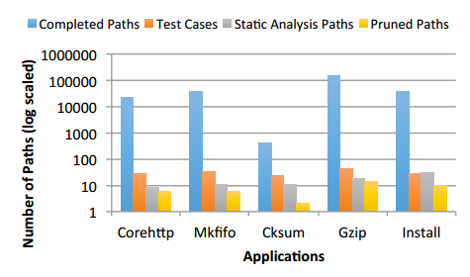
Performance Speedup Through ReViver’s Directed Symbolic Execution
Search Space Reduction 75.8%
2. Design
3. Evaluation 4. Conclusion
1. Idea

Slide 21
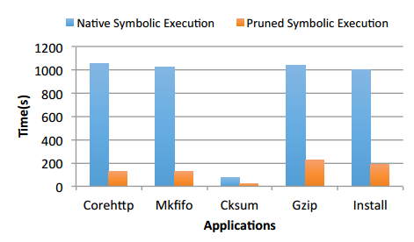
Performance Speedup Through ReViver’s Directed Symbolic Execution
Time Requirement Reduction 83.6%
2. Design
3. Evaluation 4. Conclusion
1. Idea

Slide 22
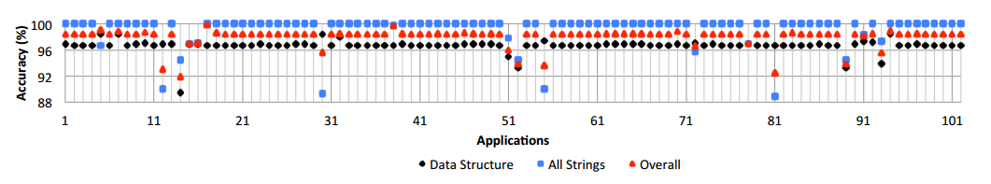
Accuracy
ReViver’s overall accuracy is 98.1%
2. Design
3. Evaluation 4. Conclusion
1. Idea

Slide 23
Application (orzhttpd)
typedef struct {
time_t now; f039 574e
socklen_t salen; 0010 0000
unsigned int proc_num; 0001 0000
char sysname[SYS_NMLN]; 694c 756e +
const char *configfile; a870 bfb3
CONFIG_t config;
typedef struct {
uint16_t port; 0050 0000
const char *user; 0118 0837
const char *host; 0138 0837
const char *basedir; 0158 0837
const char *vhostbase; 01b0 0837
const char *errmsgpath; 0208 0837
const char *indexfile; 0260 0837
const char *userdir; 0280 0837
const char *accesslog; 02a0 0837
const char *errorlog; 0308 0837
const char *passfile; 0000 0000
unsigned int options; 0036 0000
} CONFIG_t
HTTP_STATE_t (*write)(CONN_t *); ace8 0804
void (*log)(LOG_TYPE_t, const char *); af04 0804
FILE *access_log; 2158 0837
FILE *error_log; 22c8 0837
} SERVER_t;
How can a semantic memory dump data structure layout provided by ReViver assist with detecting a non-control data attack?
08352000 0000 0000 00a9 0000 f039 574e 0010 0000
08352010 0001 0000 694c 756e 0078 0000 0000 0000
08352020 0000 0000 0000 0000 0000 0000 0000 0000
08352030 0000 0000 0000 0000 0000 0000 0000 0000
08352040 0000 0000 0000 0000 0000 0000 0000 0000
08352050 0000 0000 0000 0000 a870 bfb3 0050 0000
08352060 0118 0837 0138 0837 0158 0837 01b0 0837
08352070 0208 0837 0260 0837 0280 0837 02a0 0837
08352080 0308 0837 0000 0000 0036 0000 ace8 0804
08352090 af04 0804 2158 0837 22c8 0837 efef efef
083520a0 fefe fefe 00a0 0000 0000 0000 c409 0001
...
Part of memory snapshot of orzhttpd
2. Design
3. Evaluation 4. Conclusion
1. Idea

Slide 24
Application (orzhttpd)
08370110 0000 0000 0021 0000 7777 2d77 6164 6174
08370120 ef00 efef feef fefe 15fe 0000 0000 0000
08370130 0000 0000 0021 0000 726f 2e7a 7962 6873
08370140 6e65 6e2e 7465 ef00 efef feef fefe 1bfe
08370150 0000 0000 0059 0000 0100 0000 2f65 6f64
08370160 2f70 6c66 776f 7473 7469 6863 612d 7474
08370170 6361 736b 6f2f 7a72 7468 7074 2f64 726f
08370180 687a 7474 6470 722d 6165 2d64 6e6f 796c
08370190 772f 7777 642f 7461 0061 efef efef fefe
083701a0 fefe 004e 0000 0000 0000 0000 0059 0000
083701b0 682f 6d6f 2f65 6f64 2f70 6c66 776f 7473
083701c0 7469 6863 612d 7474 6361 736b 6f2f 7a72
083701d0 7468 7074 2f64 726f 687a 7474 6470 722d
Part of memory snapshot of orzhttpd
The original root directory is “/home/orzhttpd/orzhttpd-read-only/www/data”
2. Design
3. Evaluation 4. Conclusion
1. Idea

Slide 25
Limitation
Memory modification attacks
Landmarks
Limited to memory allocation functions
E.g., malloc, calloc and realloc
Symbolic execution state explosion
Complex path conditions
2. Design
3. Evaluation 4. Conclusion
1. Idea

Slide 26
Conclusion
ReViver, a hybrid memory data structure reverse engineering solution without the need for execution traces before the memory capture point
Average accuracy is 98.1 %
Only 1.8% runtime performance overhead
2. Design
3. Evaluation 4. Conclusion
1. Idea

Slide 27
Future Work
Semantic memory attack to change the power system critical parameters for optimal power flow algorithm
Transmission line ratings (capacities) in powerworld
ROP attack to inject the payload
Lightweight memory pattern matching to locate the sensitive power system parameters
Semantic Reversing of CPS Control Algorithm
Build the mapping between the function implementation and the algorithm expression
3. Evaluation 4. Conclusion

Slide 28
Publication
Compromising Security of Economic Dispatch in Power System Operations, Submitted to The 47th IEEE/IFIP International Conference on Dependable Systems and Networks (DSN), 2017.
Trace-Free Memory Data Structure Forensics via Past Inference and Future Speculations, Annual Computer Security Applications Conference (ACSAC), 2016.
Power Grid Safety Control via Fine-Grained Multi-Persona Programmable Logic Controllers, IEEE International Conference on Smart Grid Communications (SmartGridComm), 2016.
Cyber-Air-Gapped Detection of Controller Attacks through Physical Interdependencies, IEEE International Conference on Smart Grid Communications (SmartGridComm), 2016.
Post-Intrusion Memory Forensics Analysis, Poster Session, The 37th IEEE Symposium on Security and Privacy (S&P), San Jose, CA, USA, May 23-25, 2016.
PLCloud: Comprehensive Power Grid PLC Security Monitoring with Zero Safety Disruption, IEEE International Conference on Smart Grid Communications (SmartGridComm), Miami, USA, Nov. 2-5, 2015.
Thank You
Questions?
Email: pengfei.sun@rutgers.edu

