Slide 1
GitHub Essentials
By Gourab Sahu

Slide 2


Why use GitHub?
Version Control
Software Backup / Sharing data

Slide 3
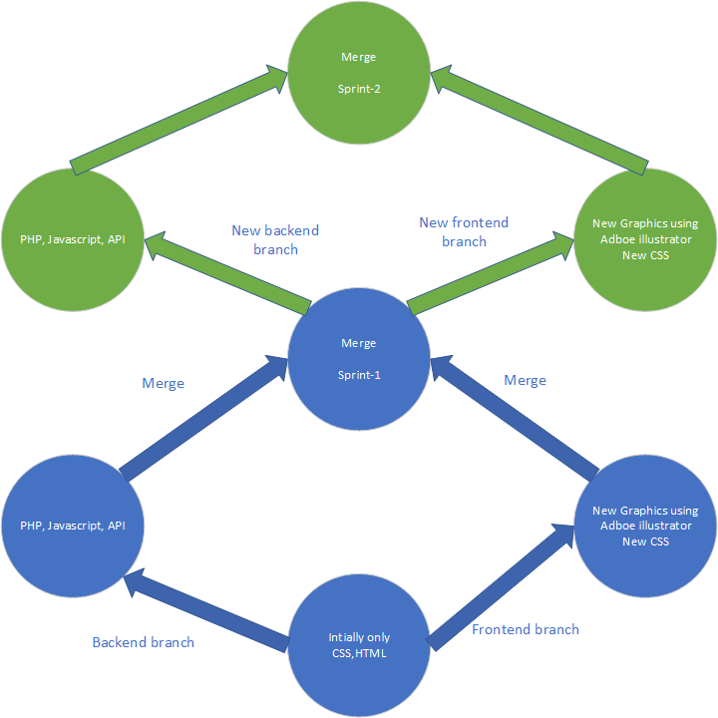
A small example of version control in web development.

Slide 4
Important Git commands in 4 categories
Installation
Saving Changes
Collaboration
Branches

Slide 5

Installation
git init
Initializes a normal directory as a git directory.
git clone
First runs the git init command internally and then downloads a copy from remote repo to local direcotry.
git config
To setup configuration at local or global level.

Slide 6

Saving Changes
git add
Adds files into staging area.
git commit
If the staged changes are satifactory then this command commits the new changes into the project history.
git stash / git stash pop
Not sure about the current changes/ Unfinished work.
git ignore
Log files or System variables or Security information should not be tracked.

Slide 7

Collaboration
git remote
Every repo has 1 compulsory remote repo called origin.
git fetch
Gives a temporary head to check changes in the remote repo. Safer than git pull.
git pull
= git fetch + git merge
git push
Pushes locally committed changes to the remote repository.

Slide 8

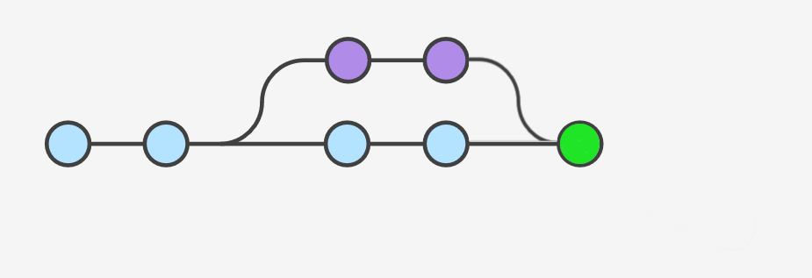
Branches
git branch
To view/create existing/new branches.
git checkout
To navigate between the branches.
git merge
Combines code from one branch
into another.

Slide 9
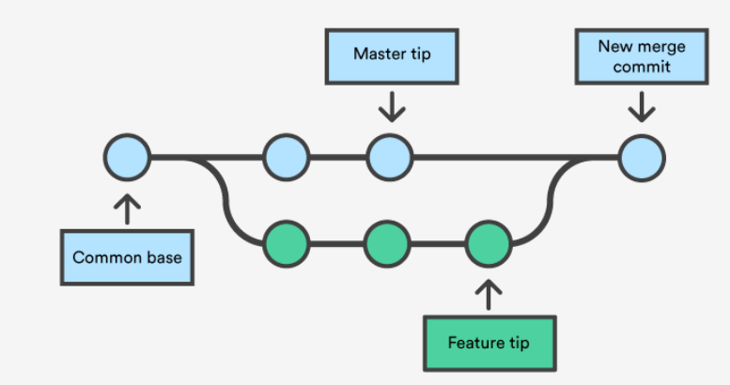
How to resolve merge conflicts?
Conflict can happen in following two cases:
During untracked changes
Both branches have conflicting
changes

Slide 10
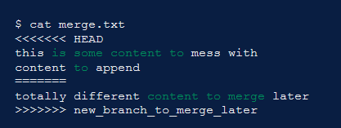
How to resolve merge conflicts?
Conflicts can be resolved by opening the disputed files and keeping the changes asked by descrptive git texts such as follows:
After making necessary changes git add and git commit can be used to finally merge the file.

Slide 11


How to resolve merge conflicts?
Conflicts in a disputed file can be resolved using any plain text editor.
However it is recommended to use specialized tools such as TortoiseGit or VSCode if conflicts need to be resolved in multiple files.

Slide 12
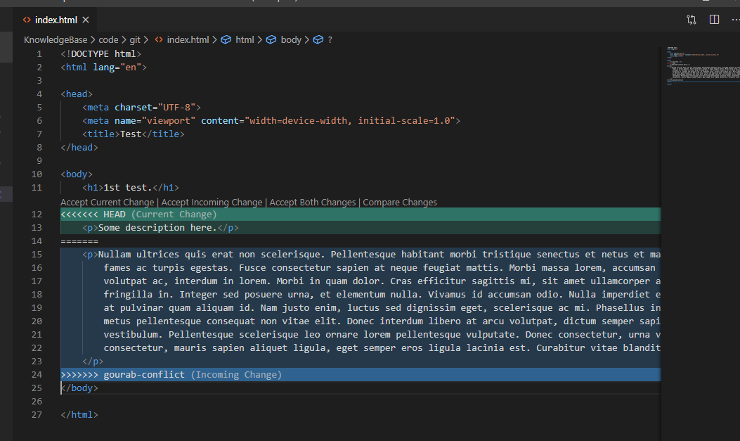
How to resolve merge conflicts?
Visual studio interface for conflict resolution. It also provides a visual in the right side with colored lines to reach them faster.

Slide 13
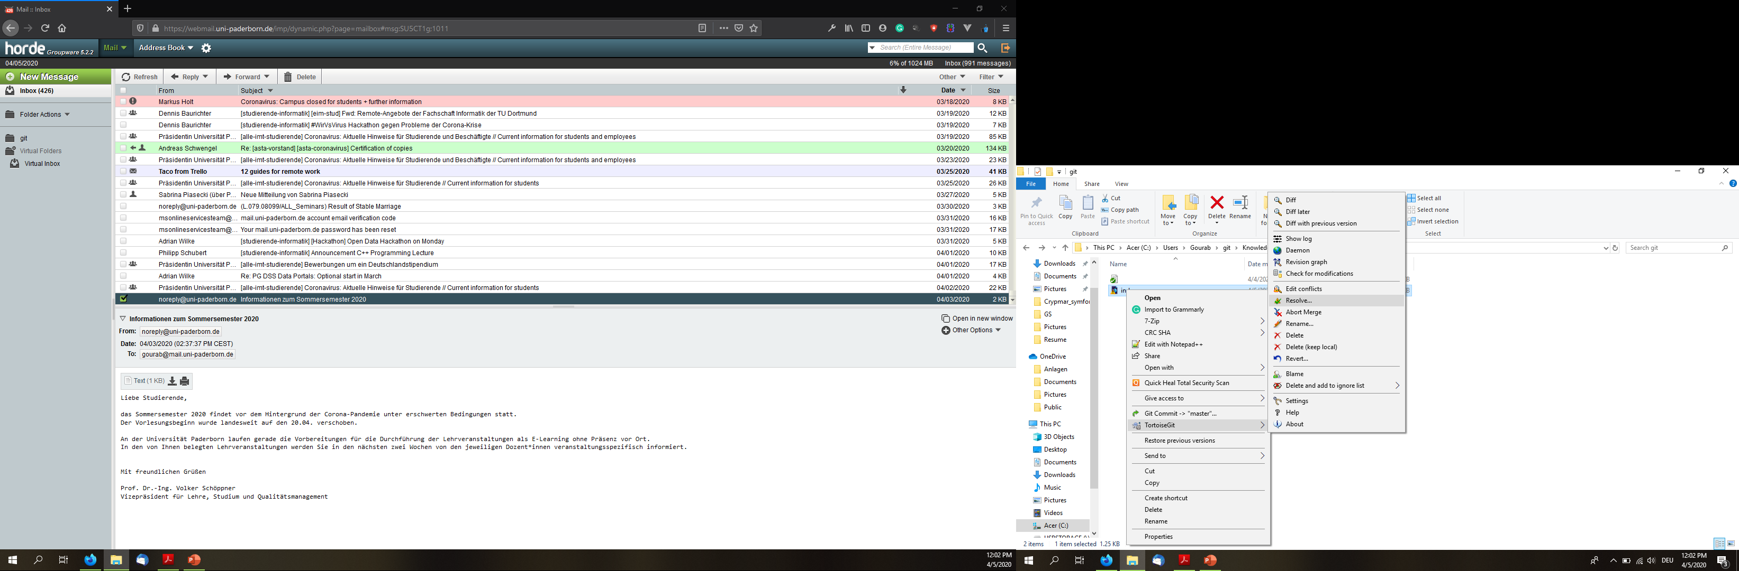
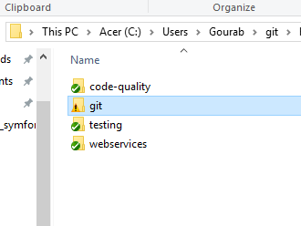
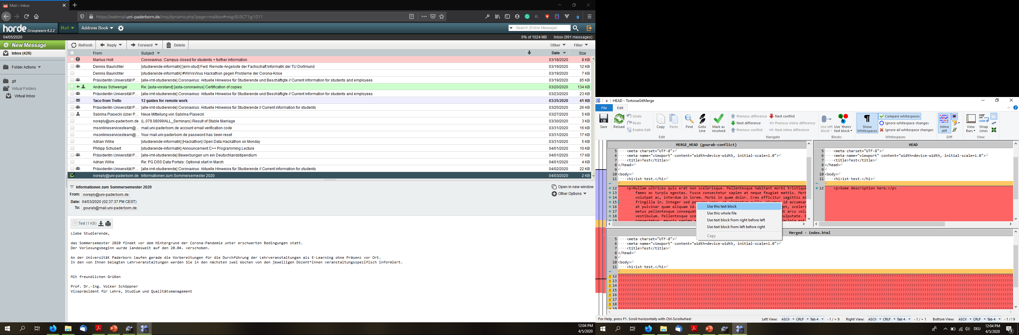
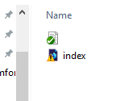
How to resolve merge conflicts?
TortoiseGit conflict notification.
TortoiseGit conflict resolution Interface
TortoiseGit user-menu.

Slide 14
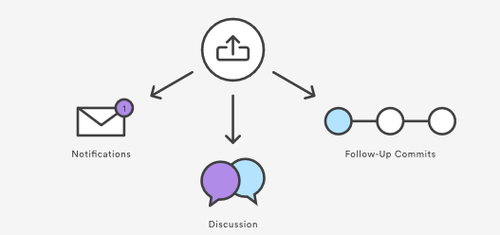
Difference between pull request and git merge?
git merge is just a command to merge a feature branch into working/master branch.
Pull request is a notification from a developer to another developer to merge a feature branch.
Pull request also provides a platform for discusssion and code review by other team members.
git pull request

Slide 15
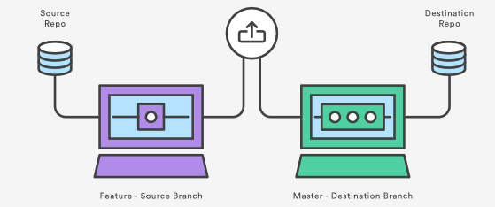
How pull request works?
1. A team-member creates a new branch in the same repo or in a forked repo.
2. The team-member adds new feature in the branch and makes a pull-request.
3. All team-members review new feature and provide comments.
4. Once approved, the git-master merges the requested branch into master branch.

Slide 16

.gitignore
Inside a git folder a file can be tracked, untracked or ignored.
Following category of files should not be tracked by git:
Javascript dependencies such as node_modules.
System generated files such as .DS_Store, Thumbs.db or .log files.
Security files with password or secret key.
To ignore any file following 2 steps can be used:
Make a file called .gitignore and put the name of the file to be ignored into it.
Or Use "git rm –cached file_to_ignore “ command.

Slide 17
References
Atlassian. “Learn Git- Git Tutorials, Workflows and Commands: Atlassian Git Tutorial.” Atlassian, www.atlassian.com/git.
“Reference.” Git, git-scm.com/docs.

