Slide 1
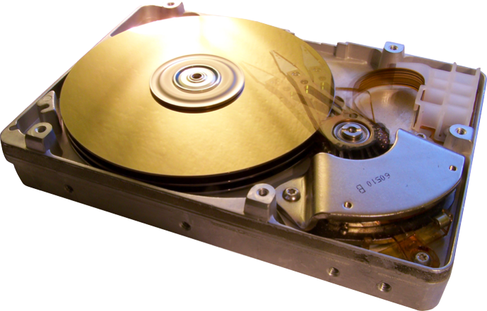
Intellidrive
Improving Disk Drive Read Access with Machine Learning Algorithms

Slide 2

Introduction
Motivation:
  Hard drive speed often a bottleneck. CPU speeds increasing faster than hard drive speeds
  Random access reads are significantly slower than sequential access reads
Goal
  Improve read performance in situations where random access reads are performed and the reads have a predictable pattern
Use machine learning algorithm to:
  Reorganize blocks to reduce random reads
  Determine groups of blocks to precache together

Slide 3
Design
Intellidrive operates at the block layer between the file system and the physical disk
Optimizations:
    Block reorganization
    Precaching
Periodically logs drive access information
Block mapping and precache groups optimized using a genetic algorithm
Notes:
The Intellidrive system operates at the block layer between the file system and the physical disk. Block I/O requests are made by the file system to Intellidrive which stores and retrieves blocks on the physical disk.
The Intellidrive system performs two primary optimizations:
One of these optimizations is block reorganization. Block reorganization allows blocks that are likely to be accessed together to be stored sequentially on the disk. Blocks are reorganized by creating a mapping between the logical block numbers used by the file system and the physical block numbers used to physically store blocks on the disk.
The other optimization performed by Intellidrive is precaching. Because blocks are organized such that blocks that are likely to be accessed together are stored physically near each other on the disk blocks that are near blocks that were recently read are likely to be read if they are precached. The Intellidrive system also groups blocks that are likely to be read together. Precaching stops when a group boundary is encountered
In the Intellidrive system optimizations are performed based on drive access patterns. In order to accomplish this the system periodically logs drive access information to the disk. This information consists of the logical block numbers for each block read and write request coupled with a timestamp indicating the time when the request was made.
These access logs are used by a genetic algorithm to periodically optimize the block mapping and precache groups.

Slide 4
Genetic Algorithm
Representation:
      Organisms represented by block map and precache groups
Selection:
      Fitness based on expected efficiency in executing the requests specified in the access logs
Reproduction:
      Block groups selected at random from each parent
      Blocks selected from one parent are not included in groups selected from the other parent
      Small groups are combined and large groups are split
Notes:
In the genetic algorithm each organism is represented by a block map and a set of precache groups.
Each generation organisms are selected for mating based on a measure of their expected efficiency in executing the requests specified in the access logs.
Organisms are mated to produce new organisms by choosing block groups at random from each parent. In order to ensure that a valid child organism is formed, blocks selected from one parent are not included in groups selected from the other parent. So that the precache groups do not tend to become too large or too small groups smaller than a certain threshold are combined and groups larger a threshold are split.

Slide 5
Implementation
First Attempts:
  Linux Block Device Driver
  Java Algorithm
  Java iSCSI target
Final Implementations:
  Driver: C Code compiled with Windows Driver Kit (WDK)
  Algorithm: C++
    Galib
  Drive Loader: C++ Code compiled with WDK

Slide 6
Implementation
Usage:
  Install the driver on Windows machine
  Use our Drive Loader to mount drive (as a new drive, ie: ‘G:\’)
  Use drive as normal
  After drive is idle for a while or upon restart, drive is unmounted and algorithm is run on it which regenerates a mapping file that is read in upon mounting of the drive

Slide 7
Experiments
Disk drive performance
    ~11.0 MB/s sequential read (4K requests)
    ~0.15 MB/s random read (4K requests)
Access pattern profiling and visualization
    Eclipse startup (37MB read, 41% random, 59% sequential)
    Firefox startup (14MB read, 21% random, 79% sequential)

Slide 8
Results
Fitness of population in genetic algorithm not improving
Possible causes
    Mating function is overly randomizing offspring
    Fitness function not sufficiently discriminative
Currently investigating
    Other mating implementations
    Including distance between random reads in fitness measure
    Other machine learning algorithms

Slide 9
Related Work
Adaptive Block Rearrangement Under UNIX:
  Reduced disk access times due to efficient block rearrangement
  No prior knowledge of encountered data is needed
Loge: a self-organizing disk controller:
  Use of a device driver to improve I/O, use of indirection
  Focused on write performance (placing data in convenient location)
The Logical Disk: A New Approach to Improving File Systems:
  Logical block numbers (indirection mapping)
Multiple Prefetch Adaptive Disk Caching:
  Prefetching adapts based on prior data accesses (improves over sequential prefetching)

Slide 10
References
AKYUREK, S. , and SALEM, K. Adaptive Block Rearrangement Under UNIX. Proceedings of USENIX Summer 1993 Technical Conference (June 1993).
ENGLISH, R. M., and STEPANOV, A. A. Loge: a self-organizing disk controller. Proceedings of USENIX Winter 1992 Technical Conference (January 1992).
BUCY, J OHN S., SCHINDLER, J., S. W. S. G. R. G. , and CONTRIBUTORS. The DiskSim Simulation Environment Version 4.0 Reference Manual. Parallel Data Laboratory, Carnegie Mellon University (May 2008).
GRIMSRUD, K. S., J . K. A. , and NELSON, B. E. Multiple Prefetch Adaptive Disk Caching. IEEE Transactions on Knowledge and Data Engineering (February 1993).
MITCHELL, T. M. Machine Learning. McGraw-Hill, March 1997.
RAMAKRISHNA KAREDLA, J . S. L. , and WHERRY, B. G. Caching Strategies to Improve Disk System Performance. IEEE Computer (March 1994).
WALL, M. GAlib: A C++ Library of Genetic Algorithm Components. MIT (August 1996).
WIEBREN DE JONGE , M. F. K. , AND HSI E H, W. C. The Logical Disk: A New Approach to Improving File System. Proceedings of the Fourteenth ACM Symposium on Operating Systems Principles (May 1993).

