Slide 1
ReconcileBot
Execution

Slide 2
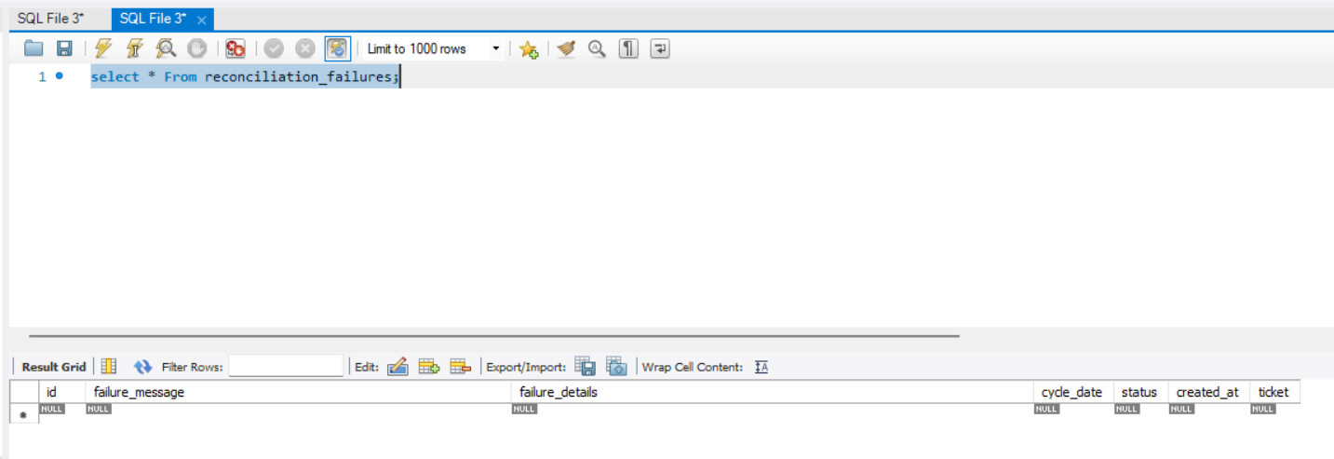
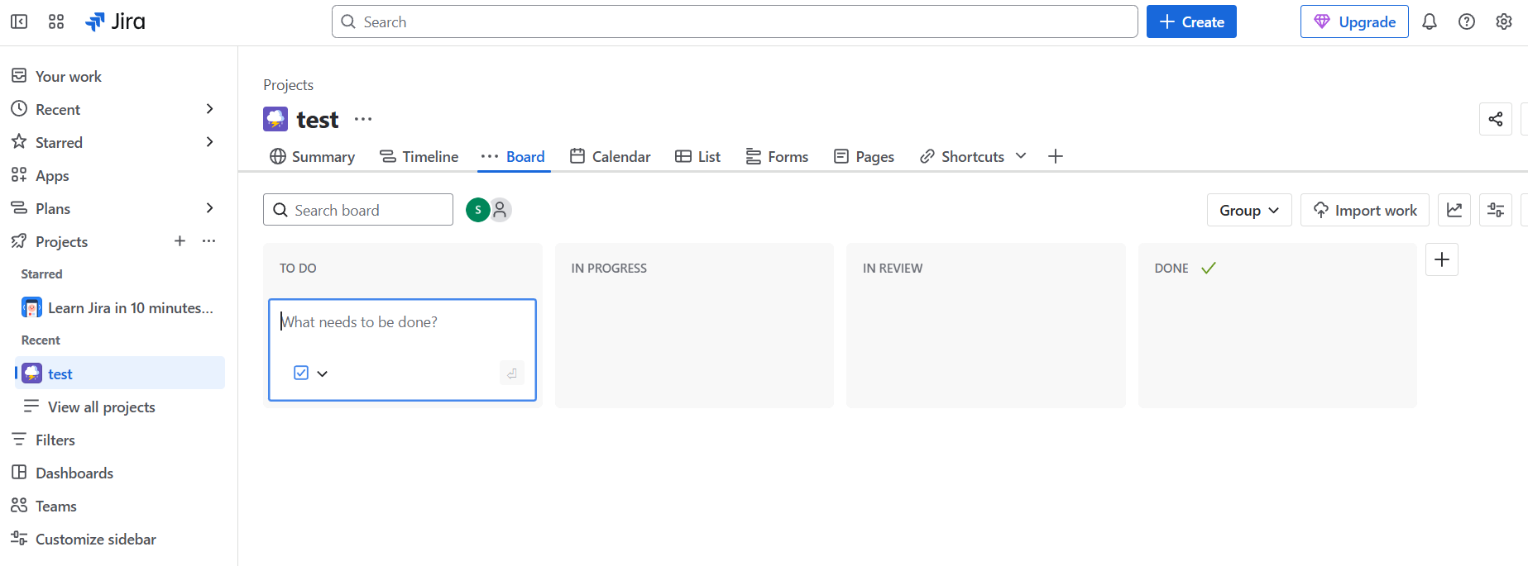
Before Job execution

Slide 3
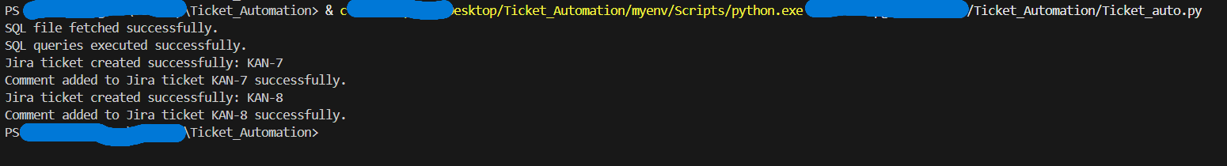
Job execution Logs

Slide 4
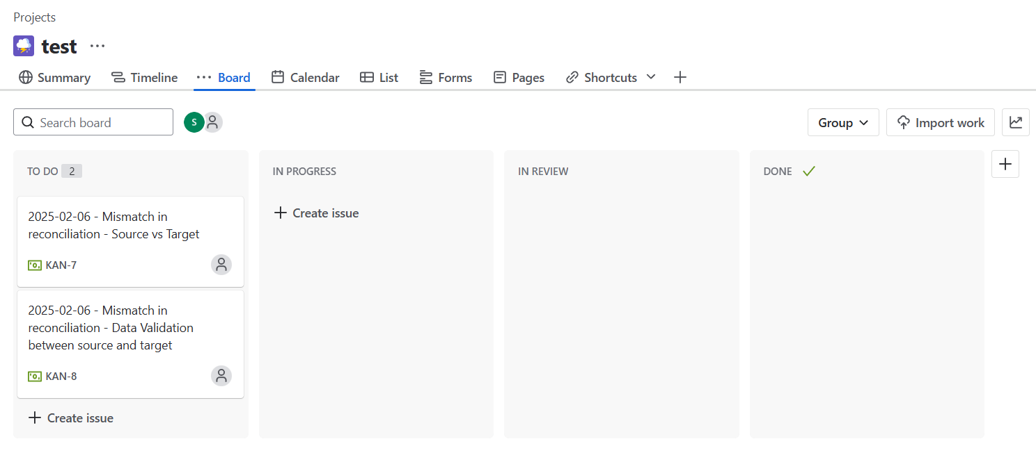
After Job execution

Slide 5
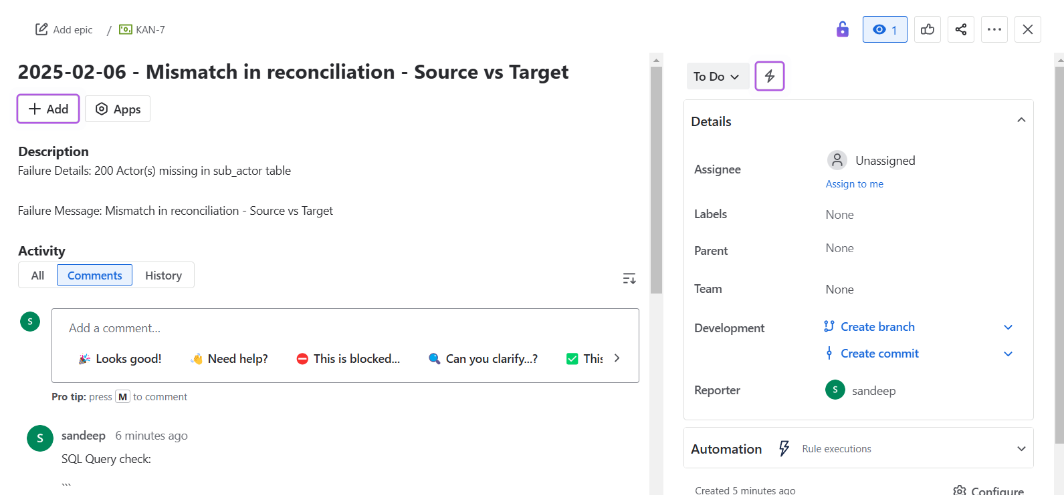
Contd..

Slide 6
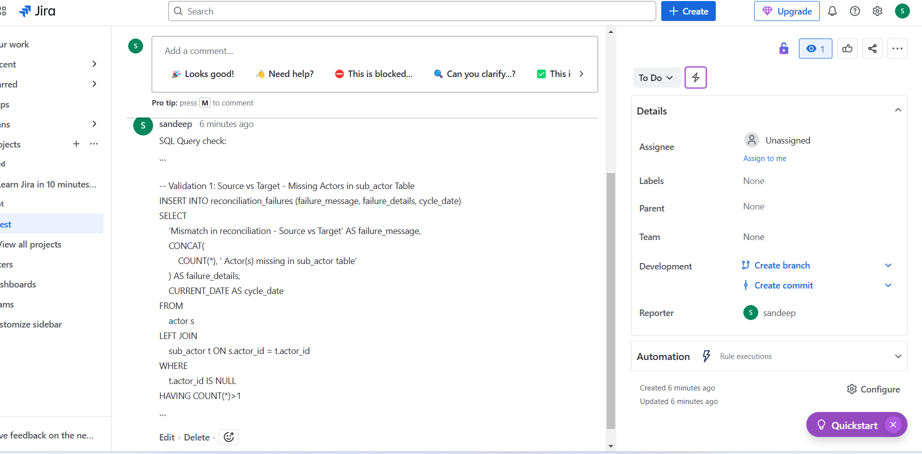
Contd..

Slide 7
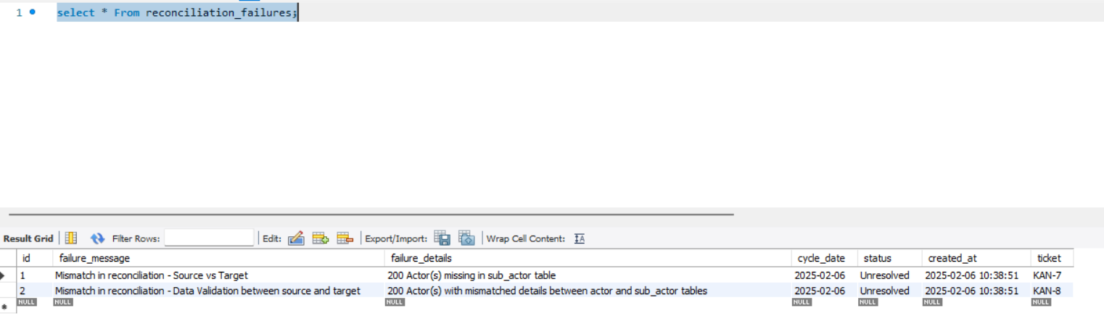
Contd..

Slide 8
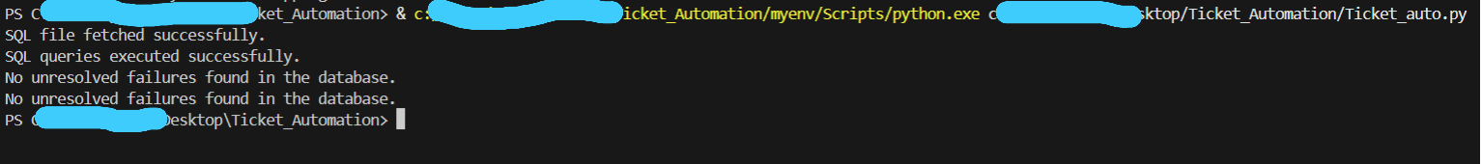
Job Failure & Re-execution Logs

Slide 9
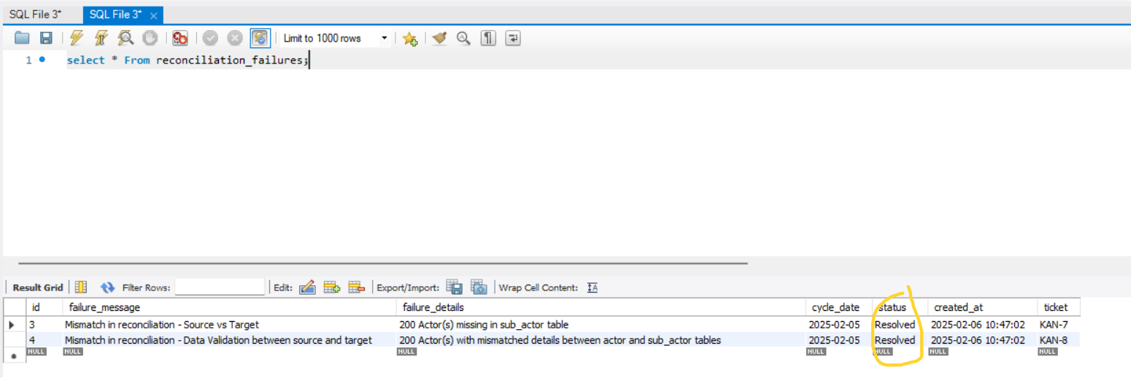
Post ticket resolution & Job logs

Slide 10
THE END

