Slide 1

Virginia Tech Parking
By Patrick Gatewood
Tara Helms
Varun Kumar
Gabrielle Wilber
Notes:
Patrick

Slide 2
Focus
A further examination of how overcrowding and university expansion affect the parking situation at Virginia Tech.
Notes:
Patrick

Slide 3
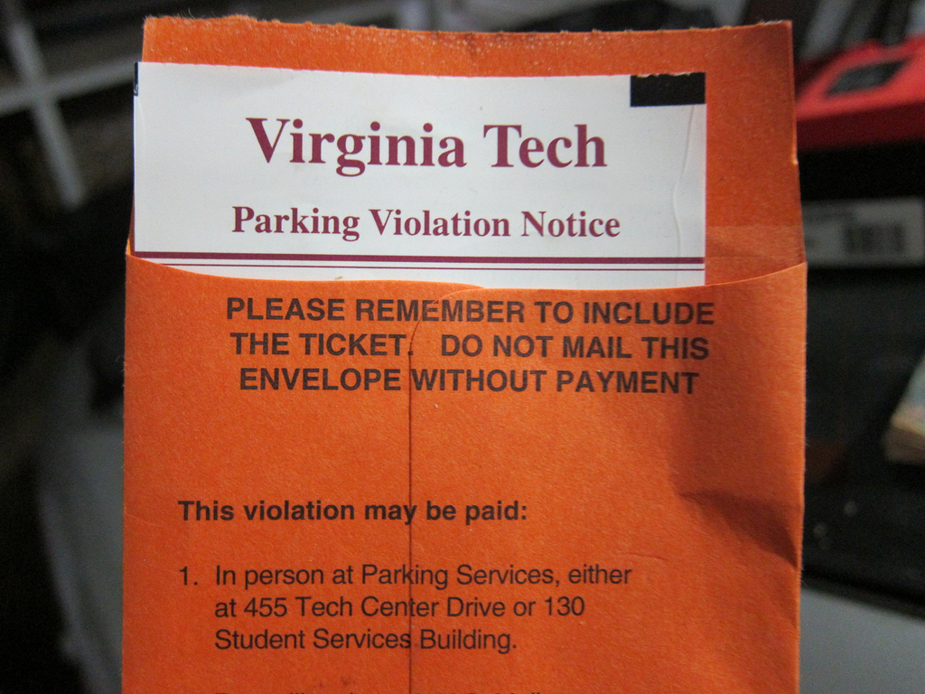
Outline
Background
Current parking system
Research
Survey
Interview
Recommendations
https://www.flickr.com/photos/mager/4669369187
Notes:
Patrick
Survey recorded 178 responses
Interviewed Director of Parking and Transportation

Slide 4
Current Parking System
3 types of parking permits: Faculty/Staff, Commuter/Graduate, and Resident spots.
Commuters have access to 9 parking lots.
The average commuter takes 5 to 20 minutes to find a parking spot daily.
There are over 1,500 commuter spots left vacant every day.
Parking is free after 5:00 pm.
Notes:
Patrick

Slide 5
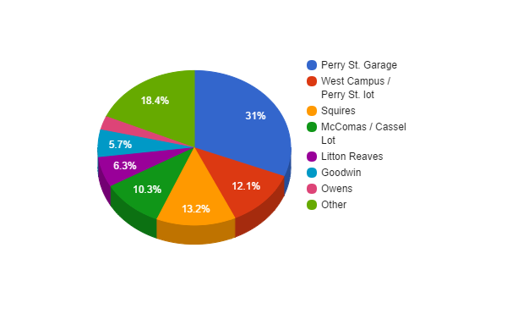
Primary Research: Survey
178 responses
Seven Questions - key points
How long it takes to find a spot
What time the commuter parks
Where they park
How long does it take to walk from your parking spot to classes
Notes:
Varun

Slide 6
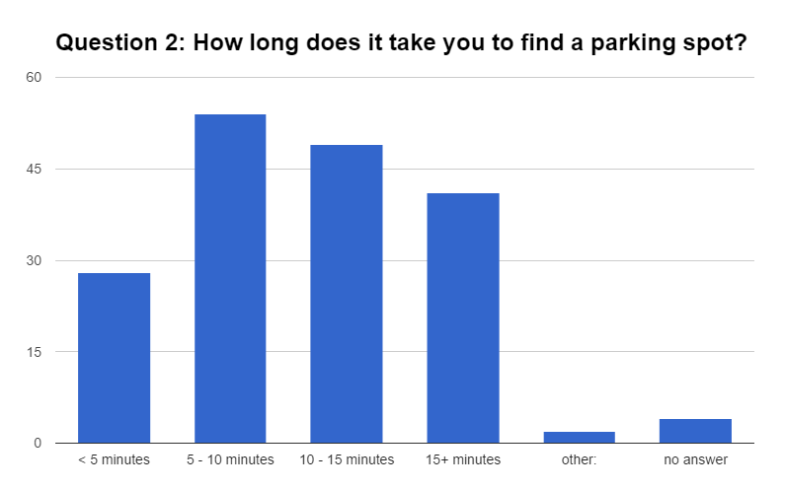
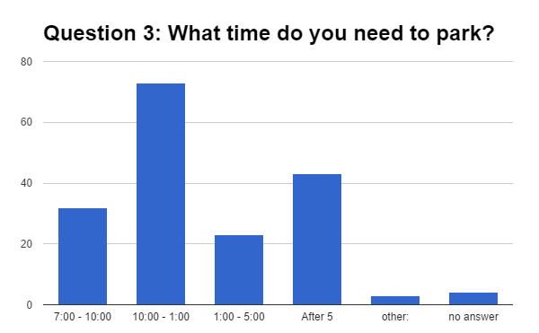
Primary Research: Survey Results
Main Correlation:
51% of responders take 10-15 or greater than 15 minutes to find a parking spot
54% try to park between 10am-5pm
Notes:
Varun

Slide 7
Interview with Jeri A. Baker - Director of Parking and Transportation
Current unfair policies
Visitor Parking
Personal Recommendations
Tier Parking
Funding
Parking Services is a self-funded entity
Other thoughts
Who’s to blame?
Educating VT students
Possible changes/Change in Progress
Multi-Modal Transit Facility
Notes:
Gabby

Slide 8
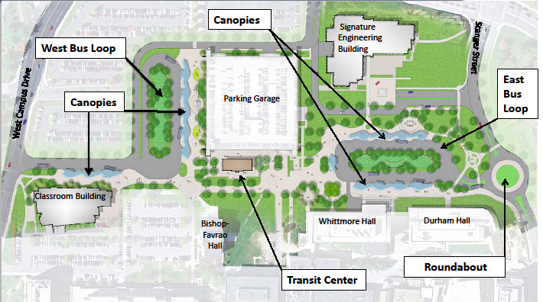
Secondary Research: Planned Expansion
Multi-Modal Transit Facility:
12,000 sq. ft.
Replace sections of the Derring parking lot
Remove the majority of Perry Street
Will reduce number of parking spots, but encourage commuters to take alternative transportation
https://vtnews.vt.edu/articles/2014/09/091914-vpa-multimodal.html
Notes:
Gabby
(after slide) Since this is a long-term project, our recommendations will focus more on reducing the impact of this facility on parking and making the lives of drivers easier today
The MMTF is fully funded through the town and university through federal grants.

Slide 9
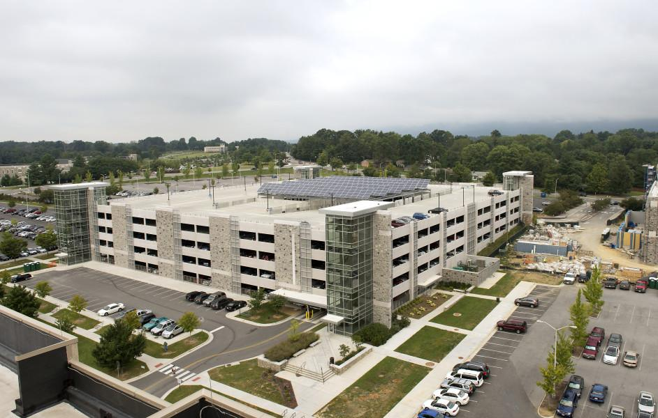
Recommendation: Tier Parking
Little to no implementation cost
Each lot will have its own specific pass
No longer just a general C/G pass
Each pass will have a different cost
In demand lots will have a higher price
Limits parking lot options
Will ensure a spot in assigned lot
Will reduce stress during MMTF construction
http://www.wileywilson.com/project/photovoltaic-parking-garage/
Notes:
Tara:

Slide 10
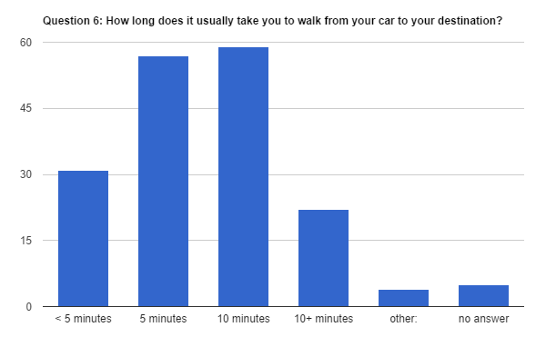
Recommendation: Tier Parking
Tiered parking would not change the amount of time it takes commuters to get to class
Less stress
Notes:
Varun

Slide 11

Conclusion
Short Term Solution
Tier Parking
Long Term Solution
Multi-Modal Transit Facility
https://twitter.com/vtparking
Notes:
Tara: these solutions will reduce the stress on campus parking and while the MMTF is being constructed

Slide 12
Any Questions?
Notes:
Tara

