Slide 1
Kubernetes Container Orchestration with AKS

Slide 2
Content
Why orchestration is needed?
What is kubernetes?
Kubernetes architecture
Kubernetes objects
Azure Kubernetes Service (AKS)
Demo
Useful resources to learn

Slide 3
Why orchestration is needed?

Slide 4
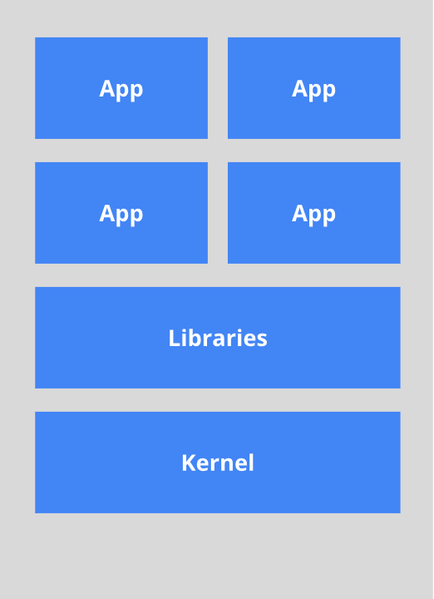
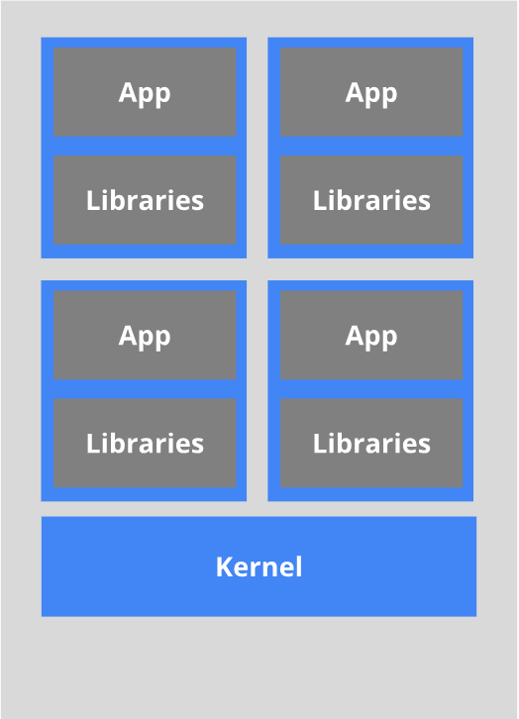
Apps running (old way)
Apps running (nowadays)
Heavyweight, non-portable
Relies on OS
Small and fast, portable
Uses OS-level virtualization

Slide 5
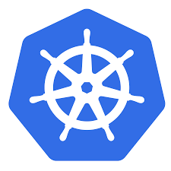
What is Kubernetes?
Portable, extensible open source container platform
Open source (Apache 2.0)
Born in Google in 2014
Written in Go/Golang
Can be found with shorten name K8s
Kubernetes means “Helmsman” – person who steers a ship
Notes:
Kubernetes is a portable, extensible open-source platform for managing containerized workloads and services, that facilitates both declarative configuration and automation. It has a large, rapidly growing ecosystem. Kubernetes services, support, and tools are widely available.
Kubernetes provides a container-centric management environment. It orchestrates computing, networking, and storage infrastructure on behalf of user workloads. This provides much of the simplicity of Platform as a Service (PaaS) with the flexibility of Infrastructure as a Service (IaaS), and enables portability across infrastructure providers

Slide 6
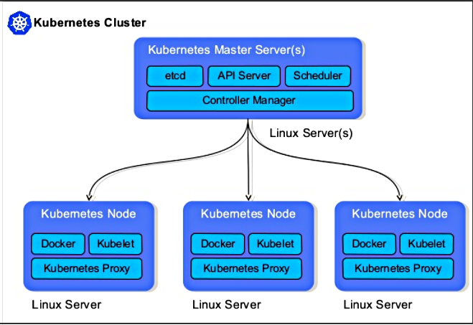
Kubernetes architecture

Slide 7
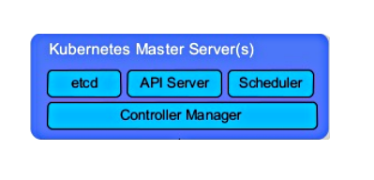
Master component
kube-apiserver
etcd
kube-scheduler
kube-controller-manager
Notes:
kube-apiserver
------------------
Component on the master that exposes the Kubernetes API. It is the front-end for the Kubernetes control plane.
It is designed to scale horizontally – that is, it scales by deploying more instances
etcd
----------------
Consistent and highly-available key value store used as Kubernetes’ backing store for all cluster data.
Always have a backup plan for etcd’s data for your Kubernetes cluster.
kube-scheduler
---------------------
Component on the master that watches newly created pods that have no node assigned, and selects a node for them to run on.
Factors taken into account for scheduling decisions include individual and collective resource requirements, hardware/software/policy constraints, affinity and anti-affinity specifications, data locality, inter-workload interference and deadlines
kube-controller-manager
-------------------------------
Component on the master that runs controllers.
Logically, each controller is a separate process, but to reduce complexity, they are all compiled into a single binary and run in a single process.
These controllers include:
Node Controller: Responsible for noticing and responding when nodes go down.
Replication Controller: Responsible for maintaining the correct number of pods for every replication controller object in the system.
Endpoints Controller: Populates the Endpoints object (that is, joins Services & Pods).
Service Account & Token Controllers: Create default accounts and API access tokens for new namespaces

Slide 8
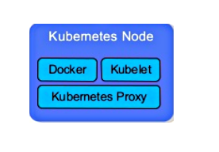
Node component
kubelet
kube-proxy
Container runtime
Notes:
Kubelet
-----------
An agent that runs on each node in the cluster. It makes sure that containers are running in a pod.
The kubelet takes a set of PodSpecs that are provided through various mechanisms and ensures that the containers described in those PodSpecs are running and healthy. The kubelet doesn’t manage containers which were not created by Kubernetes.
KubeProxy
-------------
kube-proxy enables the Kubernetes service abstraction by maintaining network rules on the host and performing connection forwarding
Container Runtime
------------------------
The container runtime is the software that is responsible for running containers. Kubernetes supports several runtimes: Docker, containerd, cri-o, rktlet and any implementation of the Kubernetes CRI (Container Runtime Interface)

Slide 9
Kubernetes objects
Persistent entities in the Kubernetes system
Described using an object spec in yaml/json format
Main objects:
Pods
ReplicaSets
Deployments
Services
Other objects: DaemonSets, Jobs, Ingress, Networks, volumes, secrets etc.

Slide 10
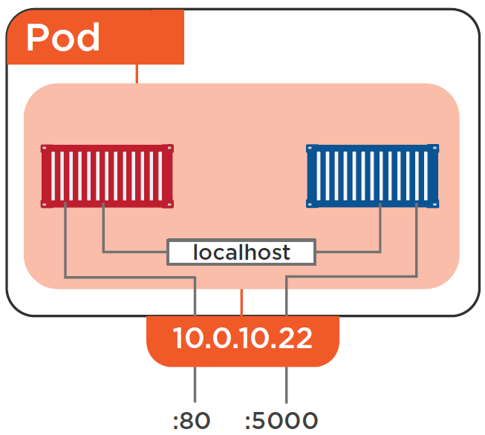
Pods
Group of one or more containers that share storage/network
Atomic unit of scheduling
Pod lifecycle:
Pending (born)
In Progress (live)
Succeed/fail (die)

Slide 11
DEMO!

Slide 12
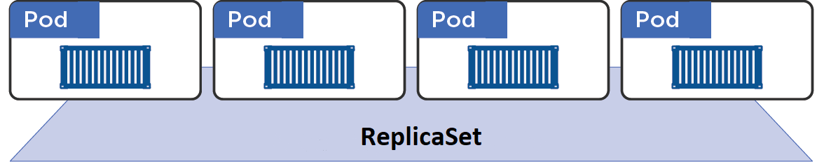
ReplicaSets
Maintains stable set of replica Pods running at any time
Defining number of replicas running (desired state)
Identifies pods using selectors

Slide 13
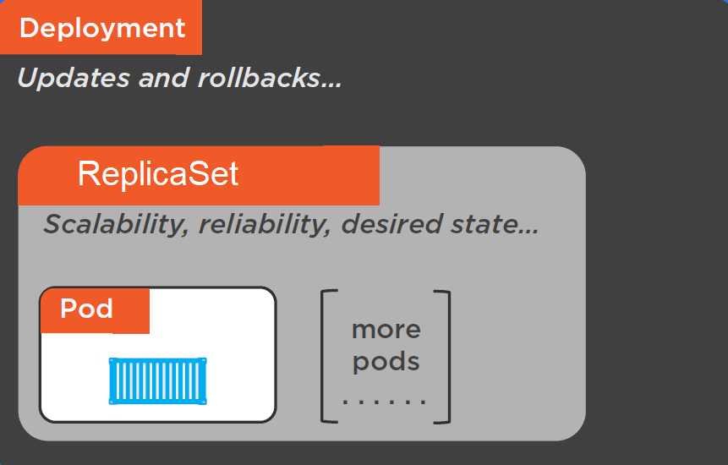
Deployments
Declarative updates for Pods and ReplicaSets
Creates updates and rollbacks
Ability to scale and pause
Rollback to any revision
Most commonly used

Slide 14
DEMO!

Slide 15
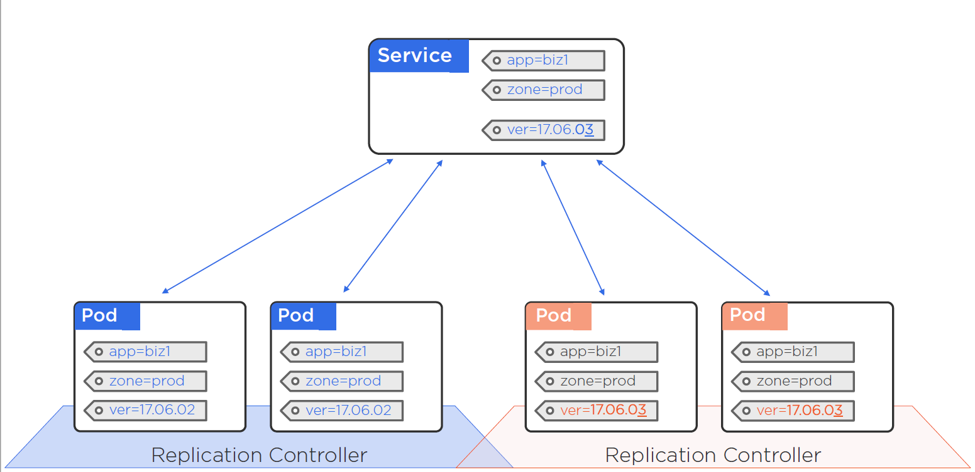
Services
Abstraction that defines logical set of pods
Pod is targeted by label selector
Use load balancing alghorithms: round-robin (rr), least connection (lc), destination hashing (dh), source harshing (sh), shortest expected delay (sed), never queue (nq)
Types: ClusterIp, NodePort, LoadBalancer, External Name
Notes:
Types:
----------
ClusterIP: Exposes the service on a cluster-internal IP. Choosing this value makes the service only reachable from within the cluster. This is the default ServiceType.
NodePort: Exposes the service on each Node’s IP at a static port (the NodePort). A ClusterIP service, to which the NodePort service will route, is automatically created. You’ll be able to contact the NodePort service, from outside the cluster, by requesting <NodeIP>:<NodePort>.
LoadBalancer: Exposes the service externally using a cloud provider’s load balancer. NodePort and ClusterIP services, to which the external load balancer will route, are automatically created.
ExternalName: Maps the service to the contents of the externalName field (e.g. foo.bar.example.com), by returning a CNAME record with its value. No proxying of any kind is set up. This requires version 1.7 or higher of kube-dns

Slide 16
DEMO!

Slide 17
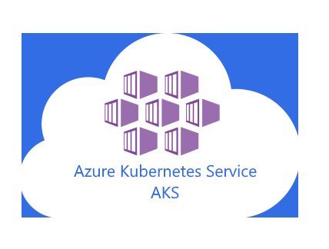


Azure Kubernetes Service (AKS)
Fully managed container orchestration service
Deployment and management with ease
Scale and run application easy
Works with open source tools such as Helm and Draft
Helm is package manager for Kubernetes (easily define, install, and upgrade complex applications)
Draft – Simplifies development and deployment by executing few commands (draft create, draft up)
Set up CI/CD pipelines in few clicks

Slide 18
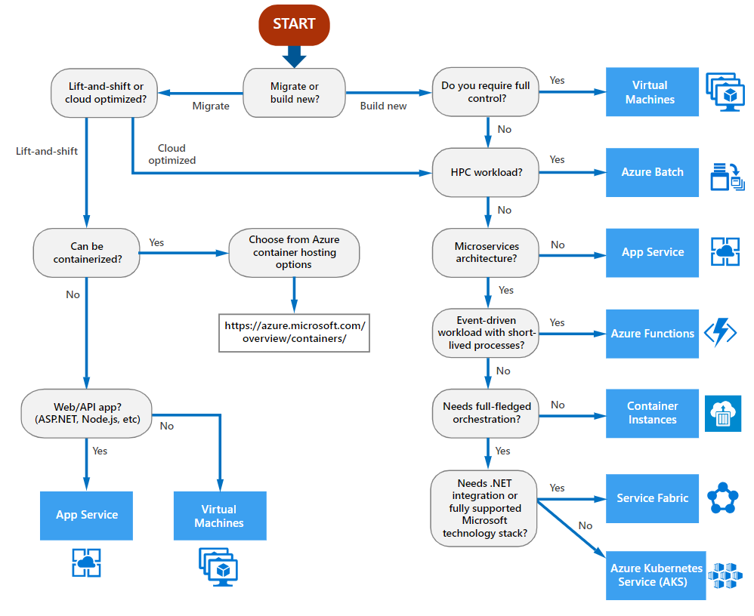
When to choose AKS?

Slide 19
Why orchestration is needed?

Slide 20
DEMO!

Slide 21

Questions?

Slide 22
Useful Resources to Learn
Kubernetes.io (https://kubernetes.io)
Hands on learning (https://instruqt.com/public/topics/getting-started-with-Kubernetes)
Hands on lab (https://github.com/Microsoft/MCW-Containers-and-DevOps)
Books:
Kubernetes: Up and Running (https://www.oreilly.com/library/view/kubernetes-up-and/9781491935668/)
Managing Kubernetes (https://www.oreilly.com/library/view/managing-kubernetes/9781492033905/)

Slide 23
Thanks!
Presentation materials link: https://github.com/pg992/k8s-presentation-demos

