Slide 1

Social Networks and Social Media

Slide 2












Social Media: Many-to-Many
Social Media
Social Networking
Blogs
Microblogging
Wiki
Forum
Content
Sharing
Notes:
Firstly, let us see what is social networks and social media
There are various of social media: like social network , blogs, wiki, forums content sharing. Most of them are an open platform so users can connect with each other, generate content. These web 2.0 applications gained a lot of online traffic recently. They provide rich information about online users, also new tasks and challenges.

Slide 3
Various forms of Social Media
Blog: Wordpress, blogspot, LiveJournal
Forum: Yahoo! Answers, Epinions
Media Sharing: Flickr, YouTube, Scribd
Microblogging: Twitter, FourSquare
Social Networking: Facebook, LinkedIn, Orkut
Social Bookmarking: Del.icio.us, Diigo
Wikis: Wikipedia, scholarpedia, AskDrWiki
Notes:
There are many famous social media systems.
For example,
Blog …
Forum …
Media Sharing …
Microblogging …
Social Networking …
Social BookMarking …
Wikis …

Slide 4

Characteristics of Social Media
“Consumers” become “Producers”
Rich User Interaction
User-Generated Contents
Collaborative environment
Collective Wisdom
Long Tail
Broadcast Media
Filter, then Publish
Social Media
Publish, then Filter
Notes:
The characteristics of Social Media, which make it different with traditional media includes:
The consumers become producers, each individual not only attends the system, but also contributes to the system.
There are rich user interaction in the Social Media. For example, you can share your real time status in the microblog system. And your friends can follow your status.
There are many user-generated contents in Social Media. For example, in facebook, there are a lot of photos and articles written by users.
The Social Media is a collaborative environment and collective wisdom.
The last one is the social media has long tail. It can make benefits from small communities.
These characteristics makes the Social Media different with the traditional media. For example, the Boradcast Media is to firstly filter the content, then publish. While, Social Media is to firstly publish information, then do filter.

Slide 5
Top 20 Websites at USA
1 | Google.com | 11 | Blogger.com
2 | Facebook.com | 12 | msn.com
3 | Yahoo.com | 13 | Myspace.com
4 | YouTube.com | 14 | Go.com
5 | Amazon.com | 15 | Bing.com
6 | Wikipedia.org | 16 | AOL.com
7 | Craigslist.org | 17 | LinkedIn.com
8 | Twitter.com | 18 | CNN.com
9 | Ebay.com | 19 | Espn.go.com
10 | Live.com | 20 | Wordpress.com
40% of websites are social media sites
Notes:
This table contains the top 20 websites in USA based on the Alex Report as of August 3, 2010.
We can see the search engines such as google, msn, bing are includes in it. We can see the explosion of search engine industry in the past 10 years.
Of course, the traditional news websites such as CNN is still an important media.
Most of others are social media. We can expect the explosion of social media industry in the future ten years

Slide 6
What is Social Network and Social Media
Social Network
The networks formed by individuals
Social Media
social network + media
media = content of twitter, tag, videos, photos ....
Notes:
Simply see, social network is the network formed by individuals.
Social Media can be considered as a super concept of social network. It is the combination of social network and media. Media may be the content of twitter, tag, videos, photos etc.
We can see the social network is the core part of social media, which makes it different with other media.
So, in this course, we will first discuss the data mining and data management topics on social networks. Then I will introduce some works on Social Media

Slide 7
Statistical Properties of Social Networks
Notes:
Today, let us study the first important category of social network study “The statistical Properties of Social Networks”
This is a natural research direction for any new media. When a new media appears, the first thing people want to know is how the data looks like, what are the properties of the data.

Slide 8
Why do statistics
To understand the networks
Understand their topology and measure their properties
Study their evolution and dynamics
Create realistic models
Create algorithms that make use of the network structure
Notes:
So,people must do statistics to understand the networks. People want to study
What are the topology and properties of the networks.
How the networks evaluate and what are the dynamic characteristics
How to create realistic models for the social networks
How to create algorithms that make use of the network structure.

Slide 9
Interesting Questions: demonstration
Some interesting questions
What do social networks look like, on a large scale?
How do networks behave over time?
How do the non-giant weakly connected components behave over time?
What distributions and patterns do weighted graphs maintain?
Notes:
To answer these problems, some interesting questions may includes:
“What do social networks look like, on a large scale?”
How do networks behave over time?
How do the non-giant weakly connected components behave over time?
What distributions and patterns do weighted graphs maintain?

Slide 10
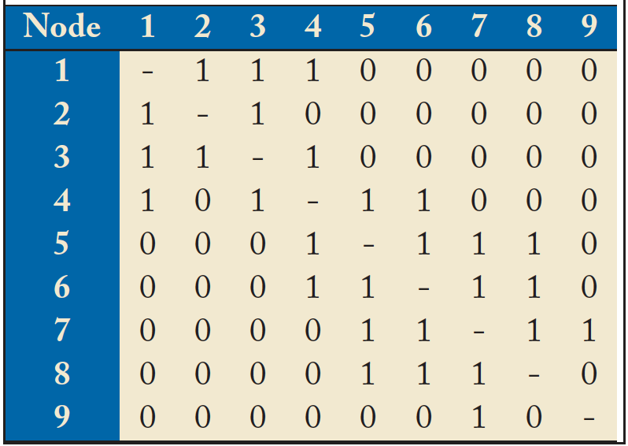
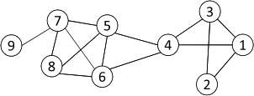
Networks and Representation
Social Network: A social structure made of nodes (individuals or organizations) and edges that connect nodes in various relationships like friendship, kinship etc.
Graph Representation
Matrix Representation
Notes:
Before we go into details, let us briefly review the basic concept of a social network.
A social network is “A social structure made of nodes (individuals or organizations) and edges that connect nodes in various relationships like friendship, kinship etc.”
If you have take the computer science core course “data structure” before, you may remember there are two basic representation method for a graph. The first is graph representation like this. We can use the adjacency list or a matrix to represent it.

Slide 11
Basic Concepts
A: the adjacency matrix
V: the set of nodes
E: the set of edges
v_{i}: a node v_{i}
e(v_{i}, v_{j}): an edge between node v_{i} and v_{j}
N_{i}: the neighborhood of node v_{i}
d_{i}: the degree of node v_{i}
geodesic: a shortest path between two nodes
geodesic distance
Notes:
The basic concepts related with a graph includes:
*****

Slide 12
Statistical Properties
Static analysis
Static snapshots of graphs
Dynamic analysis
A series of snapshots of graphs
Notes:
The statistical properties includes two parts, the static analysis and dynamic analysis.
The static analysis is to study the static snapshots of graphs
While the dynamic analysis is to study a series of snapshots of graphs

Slide 13
Some famous properties
‘Small-world’ phenomenon
An Experiment by Milgram (1967)
Asked randomly chosen “starters” to forward a letter to the target
Name, address, and some personal information were provided for the target person
The participants could only forward a letter to a single person that he/she knew on a first name basis
Goal: To advance the letter to the target as quickly as possible
Notes:
The first property has been observed is the famous “small-world” phenomenon. This phenomenon has been mentioned in numerous papers. Maybe any people who do research on social network related topics in the first three days reading. The experiment is conducted by Milgram at 1967
The basis procedure of this experiment is: in a network,
They asked randomly chosen “starters” to forward a letter to the target
Name, address, and some personal information were provided for the target person
The participants could only forward a letter to a single person that he/she knew on a first name basis
The goal is to advance the letter to the target as quickly as possible

Slide 14
The Milgram Experiment (Wikipedia)
Detailed procedure
Milgram typically chose individuals in the U.S. cities of Omaha, Nebraska and Wichita, Kansas to be the starting points and Boston, Massachusetts to be the end point of a chain of correspondence
because they were thought to represent a great distance in the United States, both socially and geographically.
Information packets were initially sent to "randomly" selected individuals in Omaha or Wichita. They included letters, which detailed the study's purpose, and basic information about a target contact person in Boston.
It additionally contained a roster on which they could write their own name, as well as business reply cards that were pre-addressed to Harvard.
Notes:
Let see the details of the experiment

Slide 15
The Milgram Experiment (cont.)
Upon receiving the invitation to participate, the recipient was asked whether he or she personally knew the contact person described in the letter.
If so, the person was to forward the letter directly to that person. For the purposes of this study, knowing someone "personally" was defined as knowing them on a first-name basis.
In the more likely case that the person did not personally know the target, then the person was to think of a friend or relative they know personally that is more likely to know the target.
A postcard was also mailed to the researchers at Harvard so that they could track the chain's progression toward the target.

Slide 16
The Milgram Experiment
When and if the package eventually reached the contact person in Boston, the researchers could examine the roster to count the number of times it had been forwarded from person to person.
Additionally, for packages that never reached the destination, the incoming postcards helped identify the break point in the chain.

Slide 17
Result of the Experiment
However, a significant problem was that often people refused to pass the letter forward, and thus the chain never reached its destination.
In one case, 232 of the 296 letters never reached the destination.[3]
However, 64 of the letters eventually did reach the target contact.
Among these chains, the average path length fell around 5.5 or six.

Slide 18
Some famous properties con’t
‘Small-world’ phenomenon
Property
Any two people can be connected within 6 hops
Verified on a planetary-scale IM network of 180 million users (Leskovec and Horvitz 2008)
The average path length is 6.6
six degrees of separation
Notes:
The conclusion is the “small-world”phenomenon
The“small-world”property shows that the world is much smaller than we imagine before. In a social network, can two people can be connected within 6 hops. That means, you can reach any people in the world, of course, the people in the social network, in 6 steps. So some papers also call this phenomenon the “six degrees of separation” property.
This property is Verified on a planetary-scale IM network of 180 million users (Leskovec and Horvitz 2008)
The average path length is 6.6

Slide 19
Some famous properties con’t
‘Power-law’ degree distributions
Degree distributions
frequency
f_{k} = fraction of nodes with degree k
= probability of a randomly
selected node to have degree k
f_{k}
k
degree

Slide 20
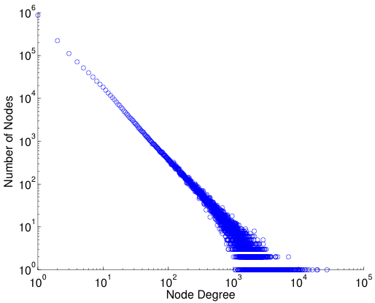
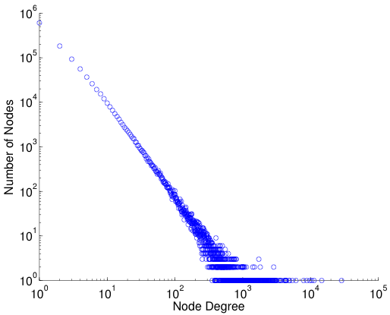
log-log plot
Power law distribution becomes a straight line if plot in a log-log scale
Friendship Network in Flickr
Friendship Network in YouTube

Slide 21

Some famous properties con’t
‘Power-law’ degree distributions
The degree distributions of most real-life networks follow a power law
frequency
f_{k}
k
degree
Notes:
The second famous one is called the “Power-law” degree distribution in social networks.
This properties provides a base of a lot of following research works.
The degree distributions of most real-life networks follow a power law distribution. That is, if we draw the degree frequency table, the y axis represent the number of nodes that has the corresponding degree in the networks. We will get a curve like this represented by the function. This means only a few nodes have very large degree. Most nodes in a graph has small degrees.
You can imagine a microblog networks. There are some famous guy that many many people following them. Thus these nodes have large degrees. But the numerous normal users only followed by their friends, so most nodes degrees are small

Slide 22
Some other properties
Triangle Power Law
Notes:
Besides the degree, some following works studied the distribution of other connection features.
For example, the number of triangles.
They follow the triangle power law distribution. When a < 0

Slide 23
Some other properties
Eigenvalue Power Law
The 20 or so largest eigenvalues of the adjacency matrix are power law distributed
This is consequence of the “Degree Power Law”
Notes:
Some works find that the eigenvalue of the adjacency matrix also follows the power law distribution. The 20 or so largest eigenvalues of the adjacency matrix are power law distributed. Actually, they find this phenomenon is consequence of the “Degree Power Law”

Slide 24
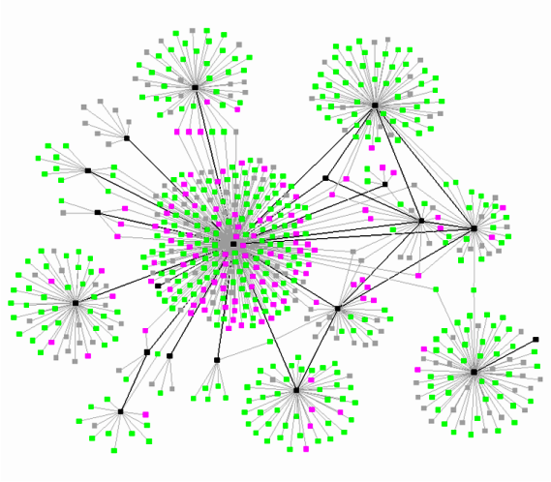
Some other properties
Community Structure
Social networks are modular
i.e nodes form communities
Notes:
Another important property observed is that the social networks exhibit community structure, which means social networks are modular, nodes form communities. This brings lot of opportunities for other applications such as the advertisement or the production recommendation.

Slide 25
Statistical Properties
Static analysis
Static snapshots of graphs
Dynamic analysis
A series of snapshots of graphs
Notes:
Besides the static analysis, since networks are evaluating over time, another important statistical work is to do the dynamic analysis, which is based on a series of snapshots of grpahs.

Slide 26
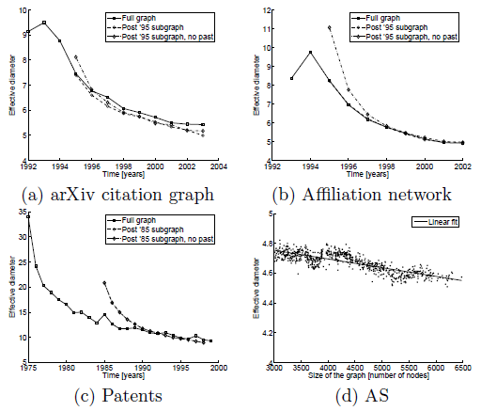
Properties
Shrinking Diameter
Notes:
Let use see part of the observed phenomenon.
The first one is called the “Shrinking Diameter”. Which is, the diameter of the graph is decreased over time. In other words, the network is shrinking. The connection of people is becoming tighter and tighter.

Slide 27
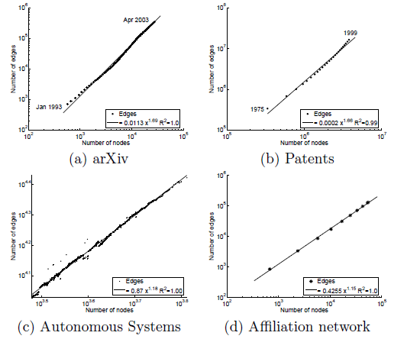
Properties con’t
Densification Power Law (DPL)
E(t): the number of edges
N(t): the number of nodes
Notes:
The second phenomenon that can be observed is that the densification of graph follows the power law distribution
For example, E(t) is the number of edges, N(t) is the number of nodes, they have the following relationship.
This is consistent with the “Shrinking diameter” phenomenon. The increasing rate of edge is exponential to the increasing rate of node.

Slide 28
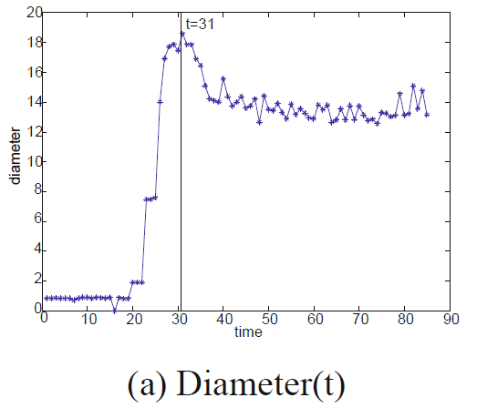
Properties con’t
Diameter-plot and Gelling point
Graph forming
Establishment period
Stable period
Notes:
They other phenomenon is that the network’s forming exibit two clear separate period.
The Establishment period and the Stable period. There’s a gelling point such that after that, the network becomes stable.

Slide 29
Properties con’t
Constant/Oscillating Connected Components (CC)
Largest: constant
Second/Third: oscillation
Notes:
The other property is called constant/oscillating connected components. The Largest component is normally remain to be the largest one, while the second and third ones are oscillating.
The reason is that the new coming nodes will randomly connect to the second/third and tend to connect to the giant CC.
So the giant CC tends to remain unchanged.

Slide 30
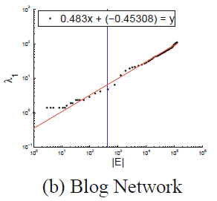
Properties con’t
Principal eigenvalue over time
E(t): the number of edges
: the largest eigenvalue
Notes:
Another work studied the change of principal eigenvalue of the adjacent matrix over time.
Like E(t) be the number of edges. Lamda(t) be the largest eigenvalue.
Then have this power relationship where alfa is less than or equal t o0.5.

Slide 31
Conclusion
Usefulness of the statistical properties
Understanding human behaviors
Anomalous graphs/subgraphs detection
Identifying authorities and search algorithms
Prepare resources based on the prediction
…
Notes:
We simply introduced come properties observed. There are many other works observed many other properties.
One thing we should emphasize here is that the properties may not be universal. Some works study information exchange network, some works study communication networks, they may get different properties.
Studying the evolution of social networks, especially after the popular use of smart phones is still a hot research topic now.
After getting the statistical properties, people use them to do a lot of extension works ,for example,
Understanding human behaviors
Anomalous graphs/subgraphs detection
Identifying authorities and search algorithms
Prepare resources based on the predciton

Slide 32
Statistical Properties of Social Networks
Notes:
Today, let us study the first important category of social network study “The statistical Properties of Social Networks”
This is a natural research direction for any new media. When a new media appears, the first thing people want to know is how the data looks like, what are the properties of the data.

Slide 33
Why do statistics
To understand the networks
Understand their topology and measure their properties
Study their evolution and dynamics
Create realistic models
Create algorithms that make use of the network structure
Notes:
So,people must do statistics to understand the networks. People want to study
What are the topology and properties of the networks.
How the networks evaluate and what are the dynamic characteristics
How to create realistic models for the social networks
How to create algorithms that make use of the network structure.

Slide 34
Interesting Questions: demonstration
Some interesting questions
What do social networks look like, on a large scale?
How do networks behave over time?
How do the non-giant weakly connected components behave over time?
What distributions and patterns do weighted graphs maintain?
Notes:
To answer these problems, some interesting questions may includes:
“What do social networks look like, on a large scale?”
How do networks behave over time?
How do the non-giant weakly connected components behave over time?
What distributions and patterns do weighted graphs maintain?

Slide 35
Networks and Representation
Social Network: A social structure made of nodes (individuals or organizations) and edges that connect nodes in various relationships like friendship, kinship etc.
Graph Representation
Matrix Representation
Notes:
Before we go into details, let us briefly review the basic concept of a social network.
A social network is “A social structure made of nodes (individuals or organizations) and edges that connect nodes in various relationships like friendship, kinship etc.”
If you have take the computer science core course “data structure” before, you may remember there are two basic representation method for a graph. The first is graph representation like this. We can use the adjacency list or a matrix to represent it.

Slide 36
Basic Concepts
A: the adjacency matrix
V: the set of nodes
E: the set of edges
v_{i}: a node v_{i}
e(v_{i}, v_{j}): an edge between node v_{i} and v_{j}
N_{i}: the neighborhood of node v_{i}
d_{i}: the degree of node v_{i}
geodesic: a shortest path between two nodes
geodesic distance
Notes:
The basic concepts related with a graph includes:
*****

Slide 37
Statistical Properties
Static analysis
Static snapshots of graphs
Dynamic analysis
A series of snapshots of graphs
Notes:
The statistical properties includes two parts, the static analysis and dynamic analysis.
The static analysis is to study the static snapshots of graphs
While the dynamic analysis is to study a series of snapshots of graphs

Slide 38
Some famous properties
‘Small-world’ phenomenon
An Experiment by Milgram (1967)
Asked randomly chosen “starters” to forward a letter to the target
Name, address, and some personal information were provided for the target person
The participants could only forward a letter to a single person that he/she knew on a first name basis
Goal: To advance the letter to the target as quickly as possible
Notes:
The first property has been observed is the famous “small-world” phenomenon. This phenomenon has been mentioned in numerous papers. Maybe any people who do research on social network related topics in the first three days reading. The experiment is conducted by Milgram at 1967
The basis procedure of this experiment is: in a network,
They asked randomly chosen “starters” to forward a letter to the target
Name, address, and some personal information were provided for the target person
The participants could only forward a letter to a single person that he/she knew on a first name basis
The goal is to advance the letter to the target as quickly as possible

Slide 39
The Milgram Experiment (Wikipedia)
Detailed procedure
Milgram typically chose individuals in the U.S. cities of Omaha, Nebraska and Wichita, Kansas to be the starting points and Boston, Massachusetts to be the end point of a chain of correspondence
because they were thought to represent a great distance in the United States, both socially and geographically.
Information packets were initially sent to "randomly" selected individuals in Omaha or Wichita. They included letters, which detailed the study's purpose, and basic information about a target contact person in Boston.
It additionally contained a roster on which they could write their own name, as well as business reply cards that were pre-addressed to Harvard.
Notes:
Let see the details of the experiment

Slide 40
The Milgram Experiment (cont.)
Upon receiving the invitation to participate, the recipient was asked whether he or she personally knew the contact person described in the letter.
If so, the person was to forward the letter directly to that person. For the purposes of this study, knowing someone "personally" was defined as knowing them on a first-name basis.
In the more likely case that the person did not personally know the target, then the person was to think of a friend or relative they know personally that is more likely to know the target.
A postcard was also mailed to the researchers at Harvard so that they could track the chain's progression toward the target.

Slide 41
The Milgram Experiment
When and if the package eventually reached the contact person in Boston, the researchers could examine the roster to count the number of times it had been forwarded from person to person.
Additionally, for packages that never reached the destination, the incoming postcards helped identify the break point in the chain.

Slide 42
Result of the Experiment
However, a significant problem was that often people refused to pass the letter forward, and thus the chain never reached its destination.
In one case, 232 of the 296 letters never reached the destination.[3]
However, 64 of the letters eventually did reach the target contact.
Among these chains, the average path length fell around 5.5 or six.

Slide 43
Some famous properties con’t
‘Small-world’ phenomenon
Property
Any two people can be connected within 6 hops
Verified on a planetary-scale IM network of 180 million users (Leskovec and Horvitz 2008)
The average path length is 6.6
six degrees of separation
Notes:
The conclusion is the “small-world”phenomenon
The“small-world”property shows that the world is much smaller than we imagine before. In a social network, can two people can be connected within 6 hops. That means, you can reach any people in the world, of course, the people in the social network, in 6 steps. So some papers also call this phenomenon the “six degrees of separation” property.
This property is Verified on a planetary-scale IM network of 180 million users (Leskovec and Horvitz 2008)
The average path length is 6.6

Slide 44
Some famous properties con’t
‘Power-law’ degree distributions
Degree distributions
frequency
f_{k} = fraction of nodes with degree k
= probability of a randomly
selected node to have degree k
f_{k}
k
degree

Slide 45
log-log plot
Power law distribution becomes a straight line if plot in a log-log scale
Friendship Network in Flickr
Friendship Network in YouTube

Slide 46
Some famous properties con’t
‘Power-law’ degree distributions
The degree distributions of most real-life networks follow a power law
frequency
f_{k}
k
degree
Notes:
The second famous one is called the “Power-law” degree distribution in social networks.
This properties provides a base of a lot of following research works.
The degree distributions of most real-life networks follow a power law distribution. That is, if we draw the degree frequency table, the y axis represent the number of nodes that has the corresponding degree in the networks. We will get a curve like this represented by the function. This means only a few nodes have very large degree. Most nodes in a graph has small degrees.
You can imagine a microblog networks. There are some famous guy that many many people following them. Thus these nodes have large degrees. But the numerous normal users only followed by their friends, so most nodes degrees are small

Slide 47
Some other properties
Triangle Power Law
Notes:
Besides the degree, some following works studied the distribution of other connection features.
For example, the number of triangles.
They follow the triangle power law distribution. When a < 0

Slide 48
Some other properties
Eigenvalue Power Law
The 20 or so largest eigenvalues of the adjacency matrix are power law distributed
This is consequence of the “Degree Power Law”
Notes:
Some works find that the eigenvalue of the adjacency matrix also follows the power law distribution. The 20 or so largest eigenvalues of the adjacency matrix are power law distributed. Actually, they find this phenomenon is consequence of the “Degree Power Law”

Slide 49
Some other properties
Community Structure
Social networks are modular
i.e nodes form communities
Notes:
Another important property observed is that the social networks exhibit community structure, which means social networks are modular, nodes form communities. This brings lot of opportunities for other applications such as the advertisement or the production recommendation.

Slide 50
Statistical Properties
Static analysis
Static snapshots of graphs
Dynamic analysis
A series of snapshots of graphs
Notes:
Besides the static analysis, since networks are evaluating over time, another important statistical work is to do the dynamic analysis, which is based on a series of snapshots of grpahs.

Slide 51
Properties
Shrinking Diameter
Notes:
Let use see part of the observed phenomenon.
The first one is called the “Shrinking Diameter”. Which is, the diameter of the graph is decreased over time. In other words, the network is shrinking. The connection of people is becoming tighter and tighter.

Slide 52
Properties con’t
Densification Power Law (DPL)
E(t): the number of edges
N(t): the number of nodes
Notes:
The second phenomenon that can be observed is that the densification of graph follows the power law distribution
For example, E(t) is the number of edges, N(t) is the number of nodes, they have the following relationship.
This is consistent with the “Shrinking diameter” phenomenon. The increasing rate of edge is exponential to the increasing rate of node.

Slide 53
Properties con’t
Diameter-plot and Gelling point
Graph forming
Establishment period
Stable period
Notes:
They other phenomenon is that the network’s forming exibit two clear separate period.
The Establishment period and the Stable period. There’s a gelling point such that after that, the network becomes stable.

Slide 54
Properties con’t
Constant/Oscillating Connected Components (CC)
Largest: constant
Second/Third: oscillation
Notes:
The other property is called constant/oscillating connected components. The Largest component is normally remain to be the largest one, while the second and third ones are oscillating.
The reason is that the new coming nodes will randomly connect to the second/third and tend to connect to the giant CC.
So the giant CC tends to remain unchanged.

Slide 55
Properties con’t
Principal eigenvalue over time
E(t): the number of edges
: the largest eigenvalue
Notes:
Another work studied the change of principal eigenvalue of the adjacent matrix over time.
Like E(t) be the number of edges. Lamda(t) be the largest eigenvalue.
Then have this power relationship where alfa is less than or equal t o0.5.

Slide 56
Conclusion
Usefulness of the statistical properties
Understanding human behaviors
Anomalous graphs/subgraphs detection
Identifying authorities and search algorithms
Prepare resources based on the prediction
…
Notes:
We simply introduced come properties observed. There are many other works observed many other properties.
One thing we should emphasize here is that the properties may not be universal. Some works study information exchange network, some works study communication networks, they may get different properties.
Studying the evolution of social networks, especially after the popular use of smart phones is still a hot research topic now.
After getting the statistical properties, people use them to do a lot of extension works ,for example,
Understanding human behaviors
Anomalous graphs/subgraphs detection
Identifying authorities and search algorithms
Prepare resources based on the predciton

Slide 57
Community Discovery in Social Networks
Notes:
We have showed that the social network exhibits the community structure. Thus, the community Discovery is a very import topic in social networks.
Today, let us briefly review the techniques for this.

Slide 58
What is community
Notes:
Social networks exhibits community structure.

Slide 59
What is community
A community is a group of nodes with greater ties internally than to the rest of the network
Strictest: clique
Notes:
A community is a group of nodes with greater ties internally than to the rest of the network.
For example, the subgraphs in the red cycles can be regarded as communities.
The strictest definition of community is the clique. The people who form a clique is a community.

Slide 60
Why community exists?
Why communities in social media?
Human beings are social
Easy-to-use social media allows people to extend their social life in unprecedented ways
Difficult to meet friends in the physical world, but much easier to find friend online with similar interests
Interactions between nodes can help determine communities
Notes:
Why there are communities in a social network?
The most intuitionistic reason is that human beings are social
Easy-to-use social media allows people to extend their social life in unprecedented ways.
Difficult to meet friends in the physical world, but much easier to find friend online with similar interests.
Interactions between nodes can help determine communities

Slide 61
Why do community discovery
Why?
Understand and underpin social structure and its evolution
Study the social behavior of human/animals
Set proxy caches
Detect link farms
Do personalized recommendation
Enable efficient message routing and posting in mobile ad-hoc networks
Enable efficient customer feedback
…
Notes:
Why should we do community discovery? There are a lot of applications need the communities in the social network.
Understand and underpin social structure and its evolution
Study the social behavior of human/animals
Set proxy caches
Detect link farms
Do personalized recommendation
Enable efficient message routing and posting in mobile ad-hoc networks
Enable efficient customer feedback
[1] Note: animals: behavior of dolphins in “The emergent properties of a dolphin social network”
[2] Set proxy caches: a grouping of web clients who have similar interests and are geographically near each other may enable them to be served by a dedicated proxy server.

Slide 62
Discovering Algorithms
Outline
Overview
Quality Estimation
Some Algorithms
Notes:
Next, let us briefly review the community discovering algorithms.
This is the outline, we firstly overview the algorithms. Then introduce how estimate the quality of the discovered communities. Finally, we’ll study some algorithms.

Slide 63
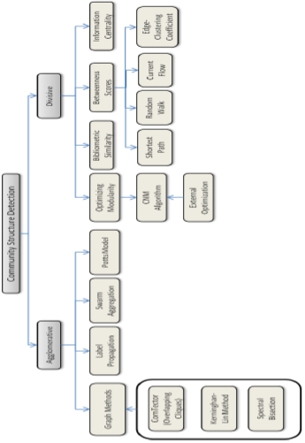
Overview
Notes:
The algorithms can be divided into two categories. The agglomerative and divisive. Simply say, agglomerative is bottom-up algorithms and divisive is top-down algorithms.
Agglomerative is to treat each node as a community and make the communities bigger and bigger by merging.
Divisive is to treat all nodes as a single community and separate it to smaller communities.

Slide 64
Quality Estimation
How to measure the discovering results?
Normalized Cut
Conductance
Kernighan-Lin (KL) objective
Notes:
After getting communities, we must estimate how good is the discovering.
People have defined many metrics for it.
For example, the normalized cut estimate how good a cut between any two communities S and neg S by this formula. The numerator is the number of edges between these to community. The denominator is the sum of node degrees in each community.
The other metric is called Conductance, which uses the number of edges cross two communities to divide the minimal one of the some of node degrees in each community.
Another famous one is called Kernighan-Lin (KL) objective, which is used to discover the communities with the same size.

Slide 65

Quality Estimation: Modularity
Q(division) = #(internal edges) - E(#(internal edges) in a
RANDOM graph with same node degrees)
Trivial division: all vertices in one group ==> Q(trivial division) = 0
…
m is the number of edges in the network
Optimizing any of these objectives is NP-Hard
Notes:
There are also more complex meric. For example,
****
Note that optimizing any of these objectives is NP-Hard

Slide 66
Discovering Algorithms
Outline
Overview
Quality Estimation
Some Algorithms
Notes:
Next, let us see some algorithms.

Slide 67
The Kernighan-Lin (KL) algorithm
P₁
P₂
-2
0
v₁
v₇
+2
+1
v₂
v₆
-2
v₃
-1
+1
v₈
+1
v₄
v₅
CUT=5
IF V₂ MOVES GAIN=2 and TOT_GAIN=2
0
-2
v₁
v₇
v₂
-1
v₆
-2
v₃
-3
+1
v₈
+1
v₄
v₅
CUT=3
IF V₅ MOVES GAIN=1 and TOT_GAIN=3
Notes:
The kernighan-Lin (KL) algorithm is a famous top down algorithm.
It first randomly cut a community into two communities. Then, we can compute a gain value of each node. The gain value represent how much benefit we can get if move this node into the other community. So the gain is the number of cross community edges minus the number of inner community edges. For example, V2 has three cross community edges and 1 inner community edge. So moving V2 to P2 can reduce 2 edges in the cut. So V2’s gain is 2.
Next step, we select the nodes with largest gain and move it. After V2 is moved, we should updated the gain values. Of course, only the gains of nodes that connect V2 should be recomputed.
We repeate the process

Slide 68
The Kernighan-Lin (KL) algorithm con’t
0
-2
v₁
v₇
v₂
-1
v₆
v₅
-2
v₃
-3
v₈
v₄
-1
CUT=2
IF V1 MOVES GAIN=0 and TOT_GAIN=3
Notes:
Until no benefit can be get.

Slide 69
The Kernighan-Lin (KL) algorithm con’t
Back
Notes:
We do this cut for each community. This is a global view of the algorithm. It is clear that this is a recursive process. Finally, a group of small communities can be computed.

Slide 70
Edge Betweenness Method
The strength of a tie can be measured by edge betweenness
Edge betweenness: the number of shortest paths that pass along with the edge
The edge with higher betweenness tends to be the bridge between two communities.
The edge betweenness of e(1, 2) is 4 (=6/2 + 1), as all the shortest paths from 2 to {4, 5, 6, 7, 8, 9} have to either pass e(1, 2) or e(2, 3), and e(1,2) is the shortest path between 1 and 2
70
Notes:
The other method is called the Edge Betweenness Method
The strength of a tie can be measured by edge betweenness, which is the number of shortest paths that pass along with the edge. For example The edge betweenness of e(1, 2) is 4 (=6/2 + 1), as all the shortest paths from 2 to {4, 5, 6, 7, 8, 9} have to either pass e(1, 2) or e(2, 3), and e(1,2) is the shortest path between 1 and 2
Nodes 4-9 have two paths to reach Node2: e(1,2) and e(2,3), hence, 6/2 = 3, Node 3 can reach Node 2 directly, and Node 1 reaches Node 2 via e(1,2). Hence, edge betweenness of e(1,2) is 4.
We can see that the edge with higher betweenness tends to be the bridge between two communities
70

Slide 71
Edge Betweenness Method
Basic idea
Calculate betweenness score for all edges
Find the edge with the highest score and remove it from the network
Recalculate betweenness for all remaining edges
Repeat from step 2
Notes:
The basic idea of edge betweenness method is
Calculate betweenness score for all edges
Find the edge with the highest score and remove it from the network
Recalculate betweenness for all remaining edges
Repeat from step 2

Slide 72
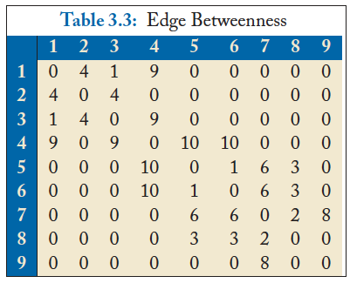
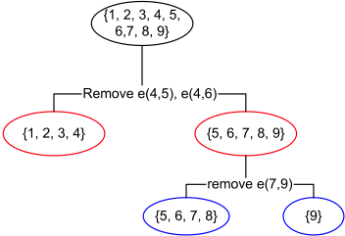
Edge Betweenness Method con’t
Initial betweenness value
After remove e(4,5), the betweenness of e(4, 6) becomes 20, which is the largest;
After remove e(4,6), the edge e(7,9) has the largest betweenness value 4, and should be removed.
Idea: progressively removing edges with the highest betweenness
72
Notes:
Let use see an example here. The initial betweenness value of edges are computed in this table.
We can see the largest one in it is 10 on e(4,5)
After removing e(4,5), the betweenness of e(4,6) becomes 20, which is the largest. We continue to remove e(4,6) After remove e(4,6), the edge e(7,9) has the largest betweenness value 4, and should be removed.
The working process is shown in the left tree. Finally, we get three communities, {1,2,3,4}, {5,6,7,8} and {9}

Slide 73

Modularity Matrix
Q = ∑(Aij - ki*kj/M | i,j in the same group)
73
Modularity matrix:
Modularity maximization can be reformulated as
Optimal solution: top eigenvectors of the modularity matrix
Apply k-means to S as a post-processing step to obtain community partition
Notes:
The other method is called Modularity Matrix method.
The modularity matrix of a graph can be computed from the adjacent matrix. In order to get the best effect with the modularity distance Q.
Modularity maximization can be reformulated as ****
Optimal solution is top eigenvectors of the modularity matrix.
Then, the k-means can be applied to S as a post-processing step to obtain community partition

Slide 74
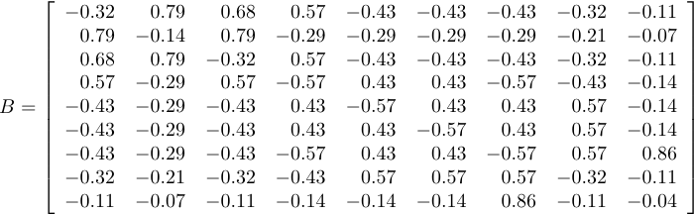
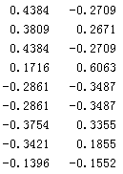
Modularity Maximization Example
Two Communities:
{1, 2, 3, 4} and {5, 6, 7, 8, 9}
k-means
Modularity Matrix
74

Slide 75



Spectral Clustering
graph Laplacian for ratio cut
normalized graph Laplacian
A diagonal matrix of degrees
75
Both ratio cut and normalized cut can be reformulated as
Where
Spectral relaxation:
Optimal solution: top eigenvectors with the smallest eigenvalues
Notes:
The other method is called the spectral clustering
Both ratio cut and normalized cut can be reformulated as **** (Tr(A): the trace of matrix A.)
Spectral relaxation of it is *****
Optimal solution is the top eigenvectors with the smallest eigenvalues

Slide 76
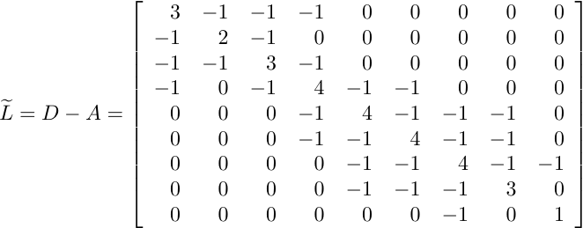
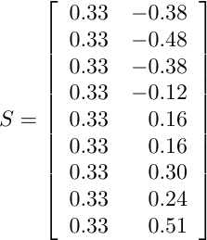
Spectral Clustering Example
Two communities:
{1, 2, 3, 4} and {5, 6, 7, 8, 9}
The 1st eigenvector means all nodes belong to the same cluster, no use
k-means
Centered matrix
76
Notes:
We first compute the Trace of the adjacent matrix
Then we can get a new matrix, and compute its eigenvalues
The 1st eigenvector is discarded. We do k-means on the smallest eigenvalues.
We can get two communities {1,2,3,4} and {5,6,7,8,9}
76

Slide 77
Multi-level Graph Partitioning
Logic flow
Produce a smaller graph that is similar to the original graph
A partitioning of the coarsest graph is performed.
the partitioning of the coarser graph is projected back to the original graph. The partition is further refined.
Notes:
Another algorithm is called Multi-Level Graph Partitioning
The basic idea is
Produce a smaller graph that is similar to the original graph
A partitioning of the coarsest graph is performed.
the partitioning of the coarser graph is projected back to the original graph. The partition is further refined.

Slide 78
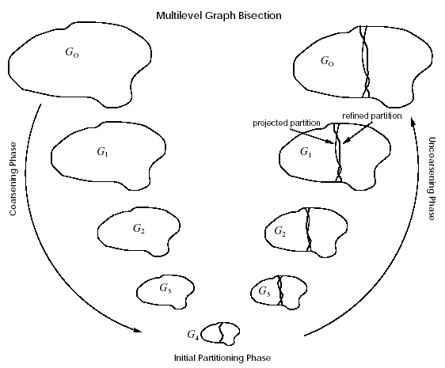
Multi-level Graph Partitioning
3 Phases
Coarsen
Partition
Uncoarsen
Notes:
This is a demo graph of this algorithms:
There are three steps: coarsen, partition and uncoase. We get a smaller graph, partition it and uncoase to the original graph.

Slide 79
Coarsening Phase
A coarser graph can be obtained by collapsing adjacent vertices
Matching, Maximal Matching
Different Ways to Coarsen
Random Matching (RM)
Heavy Edge Matching (HEM)
Light Edge Matching (LEM)
Heavy Clique Matching (HCM)
Notes:
A coarser graph can be obtained by collapsing adjacent vertices.
There are different ways to coarsen. Such as
Random Matching (RM)
Heavy Edge Matching (HEM)
Light Edge Matching (LEM)
Heavy Clique Matching (HCM)

Slide 80
Other methods
Markov Clustering
Ratio Cut & Normalized Cut
Local Graph Clustering
Flow-Based Post-Processing method
Shingling method
…
Notes:
There are also many other methods to discover the communities.
Such as
Markov Clustering
Ratio Cut & Normalized Cut
Local Graph Clustering
Flow-Based Post-Processing method
Shingling method
…
If you are interesting, you can reading the book for more details.

Slide 81
Other works
Community Discovery in Dynamic Networks
How should community discovery algorithms be modified to dynamic networks?
How do communities get formed?
How persistent and stable are communities and their members?
How do they evolve over time?
Community discovery in Heterogeneous Networks
Coupling Content Relationship Information for Community Discovery

Slide 82
Issues
Issues
Scalable Algorithms
Visualization of Communities and their Evolution
Incorporating Domain Knowledge
Ranking and Summarization in Community
Notes:
There are still many open problems for the community discovering
The first one is how to design scalable algorithms, since the social networks are becoming extremely large now.
The second one are visualization of communities and their evolution
The third one is how to incorporate Domain Knowledge to do the community mining
Also, how to do ranking and summarization in community is another interesting problem.

Slide 83
Reference
Chapter 3, Community Detection and Mining in Social Media. Lei Tang and Huan Liu, Morgan & Claypool, September, 2010.
http://www.google.com/url?sa=t&rct=j&q=&esrc=s&source=web&cd=1&ved=0CFYQFjAA&url=http%3A%2F%2Fdelab.csd.auth.gr%2Fcourses%2Fc_mmdb%2Fmmdb-2011-2012-metis.ppt&ei=SEIjUJa8OKm0iQf0vYGIBg&usg=AFQjCNEP5NPt_GFIpnTQXye8l3Fzc8EHAg

Slide 84
Link Prediction in Social Networks
Notes:
Today, let’s briefly review

Slide 85
Outline
Link Prediction Problems
Social Network
Recommender system
Algorithms of Link Prediction
Supervised Methods
Collaborative Filtering
Recommender System and The Netflixprize
References

Slide 86
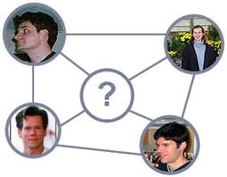
Link Prediction Problems
Link Prediction is the task to predict the missing links in graphs.
Applications
Social Network
Recommender systems

Slide 87
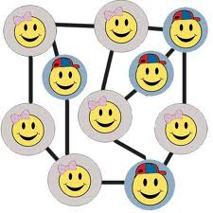
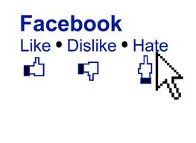
Links in Social Networks
A social network is a social structure of people, linked(directly or indirectly) to each other through a common relation or interest
Links in Social network
Like, dislike
Friends, classmates, etc.
Notes:
87

Slide 88
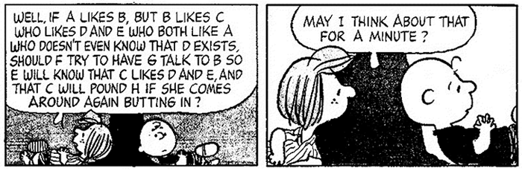
Link Prediction in Social Networks
Given a social network with an incomplete set of social links between a complete set of users, predict the unobserved social links
Given a social network at time t predict the social link between actors at time t+1
(Source: Freeman, 2000)

Slide 89




Link Prediction in Recommender Systems
Recommender Systems

Slide 90
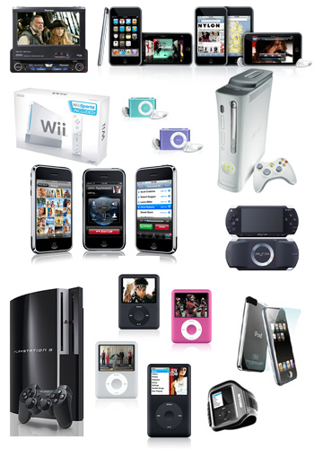

Link Prediction in Recommender Systems
Users and items form a bipartite-graph
Predict links between users and items

Slide 91
Predicting Link Existence
Predicting whether a link exists between two items
web: predict whether there will be a link between two pages
cite: predicting whether a paper will cite another paper
epi: predicting who a patient’s contacts are
Predicting whether a link exists between items and users

Slide 92
Everyday Examples of Link Prediction/Collaborative Filtering...
Search engine
Shopping
Reading
Social
....
Common insight: personal tastes are correlated:
If Alice and Bob both like X and Alice likes Y then Bob is more likely to like Y
especially (perhaps) if Bob knows Alice

Slide 93
Example: Linked Bibliographic Data
P₁
P₁
P₁
P₃
P₃
P₃
P₂
P₂
I₁
P₂
I₁
Objects:
A₁
A₁
Papers
Papers
P₄
Links:
P₄
Authors
P₄
Authors
Citation
Citation
Institutions
Institutions
Co-Citation
Co-Citation
Author-of
Author-of
Attributes:
Author-affiliation
Author-affiliation

Slide 94

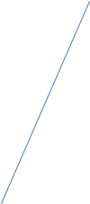
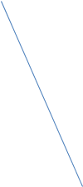






















Example: linked movie dataset
collection
favorites
friend
similar
User
rate
1-5
Movie
genre
age, location, joined(t)
list
comment
rate
1-3
review
comment
actor, director, writer

Slide 95

How to do link prediction?
How can you do recommendation based on this item?

Slide 96
Link Prediction using supervised learning methods
P₁
P₃
Feature Extractor
P₂
[1, 2, 0, …, 1] +1
[0, 0, 1, …, 1] -1
…
Supervised Learning

Slide 97
Supervised Learning Methods [Liben-Nowell and Kleinberg, 2003]
Link prediction as a means to gauge the usefulness of a model
Proximity Features: Common Neighbors, Katz, Jaccard, etc
No single predictor consistently outperforms the others

Slide 98
supervised learning methods [Hasan et al, 2006]
Citation Network (BIOBASE, DBLP)
Use machine learning algorithms to predict future co-authorship (decision tree, k-NN, multilayer perceptron, SVM, RBF network)
Identify a group of features that are most helpful in prediction
Best Predictor Features: Keyword Match count, Sum of neighbors, Sum of Papers, Shortest Distance

Slide 99
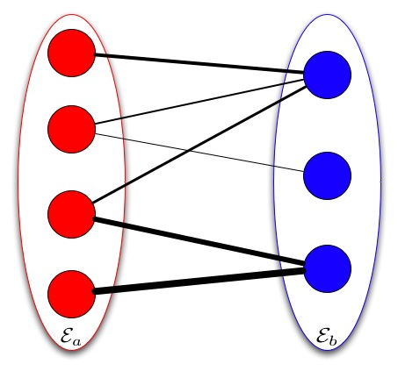
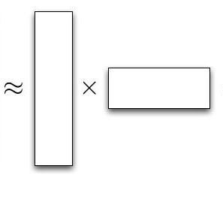
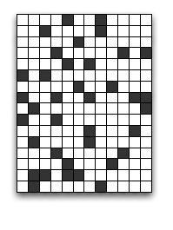
Link Prediction using Collaborative Filtering
Find the background model that can generate the link data

Slide 100
Link Prediction using Collaborative Filtering
 | Item 1 | Item 2 | Item 3 | Item 4 | Item 5
User 1 | 8 | 1 | ? | 2 | 7
User 2 | 2 | ? | 5 | 7 | 5
User 3 | 5 | 4 | 7 | 4 | 7
User 4 | 7 | 1 | 7 | 3 | 8
User 5 | 1 | 7 | 4 | 6 | ?
User 6 | 8 | 3 | 8 | 3 | 7

Slide 101
Challenges in Link Prediction
Data!!!
Cold Start Problem
Sparsity Problem

Slide 102
Link Prediction using Collaborative Filtering
Memory-based Approach
User-base approach [Twitter]
item-base approach [Amazon & Youtube]
Model-based Approach
Latent Factor Model [Google News]
Hybrid Approach

Slide 103
Memory-based Approach
Few modeling assumptions
Few tuning parameters to learn
Easy to explain to users
Dear Amazon.com Customer, We've noticed that customers who have purchased or rated How Does the Show Go On: An Introduction to the Theater by Thomas Schumacher have also purchased Princess Protection Program #1: A Royal Makeover (Disney Early Readers).

Slide 104

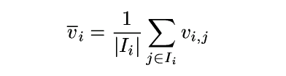
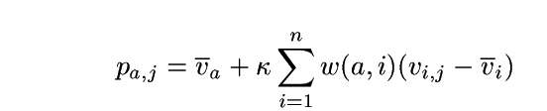
Algorithms: User-Based Algorithms (Breese et al, UAI98)
v_{i,j}= vote of user i on item j
I_{i} = items for which user i has voted
Mean vote for i is
Predicted vote for “active user” a is weighted sum
normalizer
weights of n similar users

Slide 105
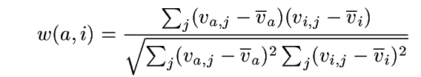
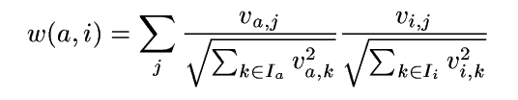
Algorithms: User-Based Algorithms (Breese et al, UAI98)
K-nearest neighbor
Pearson correlation coefficient (Resnick ’94, Grouplens):
Cosine distance (from IR)

Slide 106
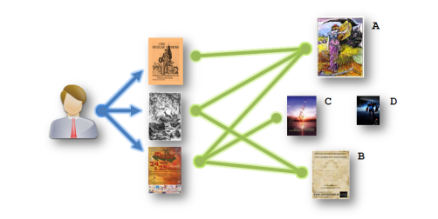
Algorithm: Amazon’s Method
Item-based Approach
Similar with user-based approach but is on the item side

Slide 107
Item-based CF Example: infer (user 1, item 3)
 | Item 1 | Item 2 | Item 3 | Item 4 | Item 5
User 1 | 8 | 1 | ? | 2 | 7
User 2 | 2 | ? | 5 | 7 | 5
User 3 | 5 | 4 | 7 | 4 | 7
User 4 | 7 | 1 | 7 | 3 | 8
User 5 | 1 | 7 | 4 | 6 | ?
User 6 | 8 | 3 | 8 | 3 | 7

Slide 108
How to Calculate Similarity (Item 3 and Item 5)?
 | Item 1 | Item 2 | Item 3 | Item 4 | Item 5
User 1 | 8 | 1 | ? | 2 | 7
User 2 | 2 | ? | 5 | 7 | 5
User 3 | 5 | 4 | 7 | 4 | 7
User 4 | 7 | 1 | 7 | 3 | 8
User 5 | 1 | 7 | 4 | 6 | ?
User 6 | 8 | 3 | 8 | 3 | 7

Slide 109
Similarity between Items
Item 3 | Item 4 | Item 5
? | 2 | 7
5 | 7 | 5
7 | 4 | 7
7 | 3 | 8
4 | 6 | ?
8 | 3 | 7
How similar are items 3 and 5?
How to calculate their similarity?
Notes:
Each row in the table are the ratings one user on the items
109

Slide 110
Similarity between items
Item 3 | Item 5
? | 7
5 | 5
7 | 7
7 | 8
4 | ?
8 | 7
Only consider users who have rated
both items
For each user: Calculate difference in ratings for the
two items
Take the average of this difference over
the users
Can also use Pearson Correlation Coefficients as in user-based approaches
sim(item 3, item 5) = cosine( (5, 7, 7), (5, 7, 8) )
= (5*5 + 7*7 + 7*8)/(sqrt(5²+7²+7²)* sqrt(5²+7²+8²))
Notes:
Each row in the table are the ratings one user on the items
110

Slide 111
Prediction: Calculating ranking r(user1,item3)
Item 2
8
1
Item 1
Item 3
Item 5
7
Where α is a normalization factor, which is
1/[the sum of all sim(item_{i},item₃)].
Item 4
2
Notes:
Showing five items, Item 3 is the one we need to know for User 1. Distances to Item 3 indicate similarity. Numbers in yellow boxes give ratings for User 1 for other items.
Blue area shows nearest neighbours, items that are most similar to Item 3 based on past ratings by other users.
111

Slide 112

Netflixprize

Slide 113
“We’re quite curious, really. To the tune of one million dollars.” – Netflix Prize rules
Goal to improve on Netflix’s existing movie recommendation technology
Contest began October 2, 2006
Prize
Based on reduction in root mean squared error (RMSE) on test data
$1,000,000 grand prize for 10% drop
Or, $50,000 progress for best result each year

Slide 114
Data Details
Training data
100 million ratings (from 1 to 5 stars)
6 years (2000-2005)
480,000 users
17,770 “movies”
Test data
Last few ratings of each user
Split as shown on next slide
Notes:
Although I use the term “movies” throughout this talk, it refers to DVDs of all types besides made-for-theater movies, including seasons of popular TV series such as Seinfeld, children’s videos, concerts, etc.

Slide 115
Data about the Movies
Count | Avg rating | Most Loved Movies
137812 | 4.593 | The Shawshank Redemption
133597 | 4.545 | Lord of the Rings: The Return of the King
180883 | 4.306 | The Green Mile
150676 | 4.460 | Lord of the Rings: The Two Towers
139050 | 4.415 | Finding Nemo
117456 | 4.504 | Raiders of the Lost Ark
Most Rated Movies
Miss Congeniality
Independence Day
The Patriot
The Day After Tomorrow
Pretty Woman
Pirates of the Caribbean
Highest Variance
The Royal Tenenbaums
Lost In Translation
Pearl Harbor
Miss Congeniality
Napolean Dynamite
Fahrenheit 9/11

Slide 116
Major Challenges
Size of data
Places premium on efficient algorithms
Stretched memory limits of standard PCs
99% of data are missing
Eliminates many standard prediction methods
Certainly not missing at random
Training and test data differ systematically
Test ratings are later
Test cases are spread uniformly across users
116

Slide 117
Major Challenges (cont.)
Countless factors may affect ratings
Genre, movie/TV series/other
Style of action, dialogue, plot, music et al.
Director, actors
Rater’s mood
Large imbalance in training data
Number of ratings per user or movie varies by several orders of magnitude
Information to estimate individual parameters varies widely
117
Notes:
The two challenges on this slide are central to the whole endeavor as they clearly conflict with each other.
Number 4 points us towards building very big models.
Number 5 tells us that it will be easy to over fit—at least for some users and some movies.

Slide 118
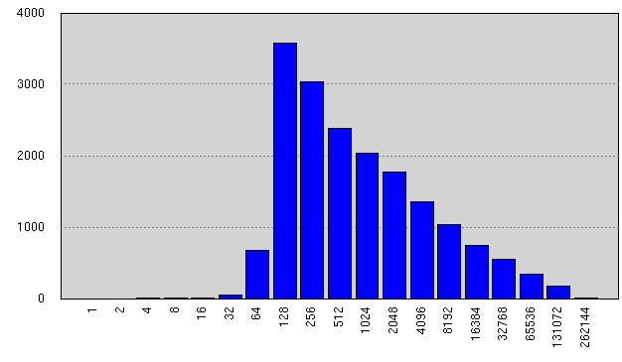
Ratings per Movie in Training Data
Avg #ratings/movie: 5627
Notes:
Although some movies were rated tens of thousands of times, most were rated fewer than 1,000 times and many were rated fewer than 200 times.
We are obviously limited in what we can learn about those movies.

Slide 119
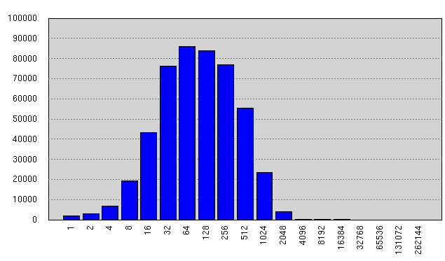
Ratings per User in Training Data
Avg #ratings/user: 208
Notes:
The problem is worse for users.
While the mean number of ratings per user is 208, about 15 percent of users rated fewer than 25 movies in the training data.
And those users contribute almost 15 percent of the test data.

Slide 120
The Fundamental Challenge
How can we estimate as much signal as possible where there are sufficient data, without over fitting where data are scarce?

Slide 121
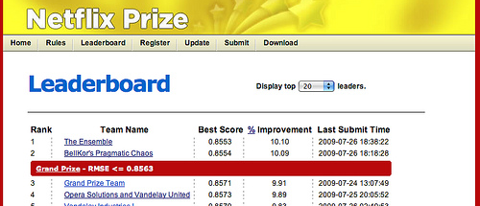
Test Set Results
The Ensemble: 0.856714
BellKor’s Pragmatic Theory: 0.856704
Both scores round to 0.8567
Tie breaker is submission date/time
121

Slide 122
Lessons from Netflixprize
Lesson #1: Data >> Models
Lesson #2: The Power of Regularized SVD Fit by Gradient Descent
Lesson #3: The Wisdom of Crowds (of Models)

Slide 123
References
Koren, Yehuda. “Factorization meets the neighborhood: a multifaceted collaborative filtering model.” In Proceeding of the 14th ACM SIGKDD international conference on Knowledge discovery and data mining, 426–434. ACM, 2008. http://portal.acm.org/citation.cfm?id=1401890.1401944
Koren, Yehuda. “Collaborative filtering with temporal dynamics.” Proceedings of the 15th ACM SIGKDD international conference on Knowledge discovery and data mining - KDD ’09 (2009): 447. http://portal.acm.org/citation.cfm?doid=1557019.1557072.
Das, A.S., M. Datar, A. Garg, and S. Rajaram. “Google news personalization: scalable online collaborative filtering.” In Proceedings of the 16th international conference on World Wide Web, 271–280. ACM New York, NY, USA, 2007. http://portal.acm.org/citation.cfm?id=1242610.
Linden, G., B. Smith, and J. York. “Amazon.com recommendations: item-to-item collaborative filtering.” IEEE Internet Computing 7, no. 1 (January 2003): 76-80. http://ieeexplore.ieee.org/lpdocs/epic03/wrapper.htm?arnumber=1167344.
Davidson, James, Benjamin Liebald, and Taylor Van Vleet. “The YouTube Video Recommendation System.” Design (2010): 293-296.

